Slide 1
GSI IPMs

Slide 2
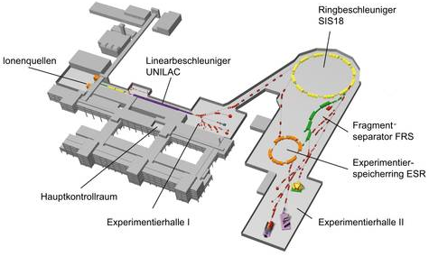
IPMs @ GSI

Slide 3
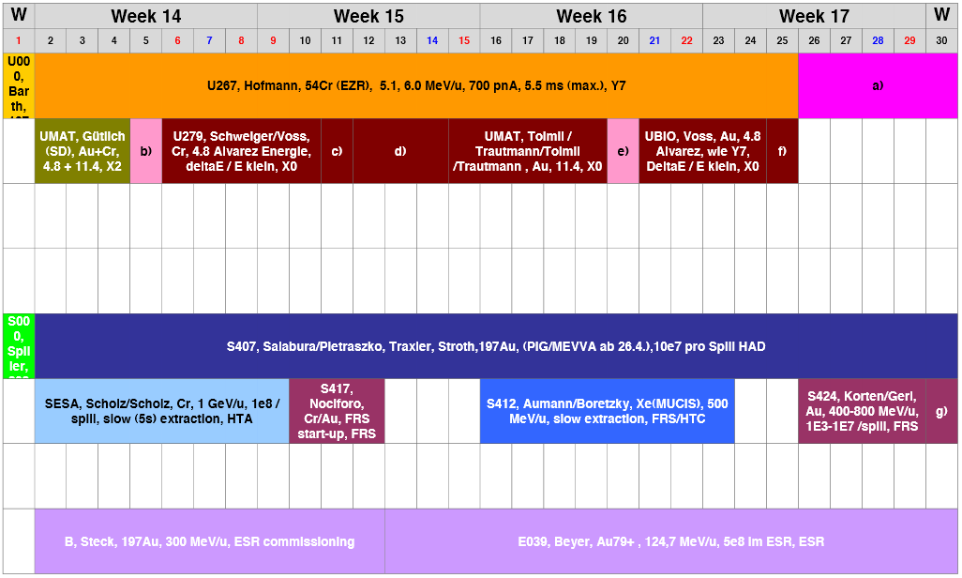
SIS18 Operation
SIS18 Operation:
different sorts of ions from different sources alternately in the SIS18 accelerated
different beam intensities
different consumers / experimenters
requests for intensity / focusing changes
SIS18 operation example:
Au 200 AMeV
Cr 1 AGeV
Xe 500 AMeV
Au 400-800 AMeV

Slide 4
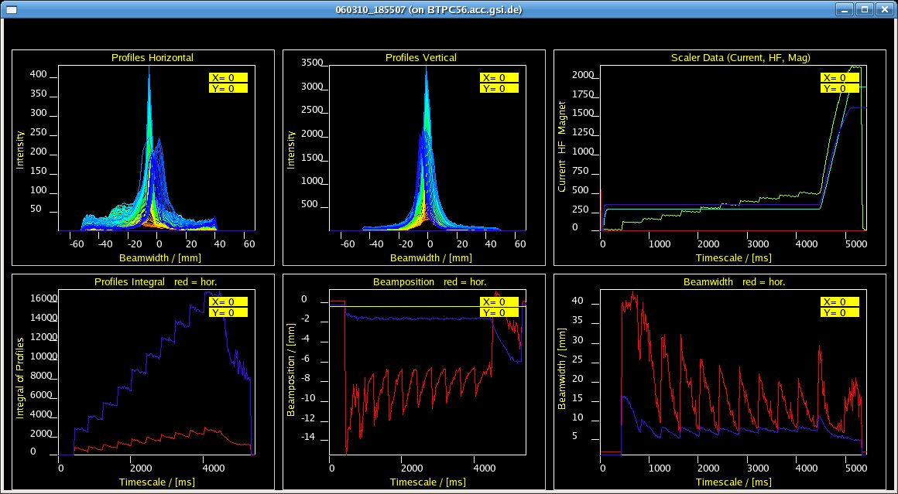
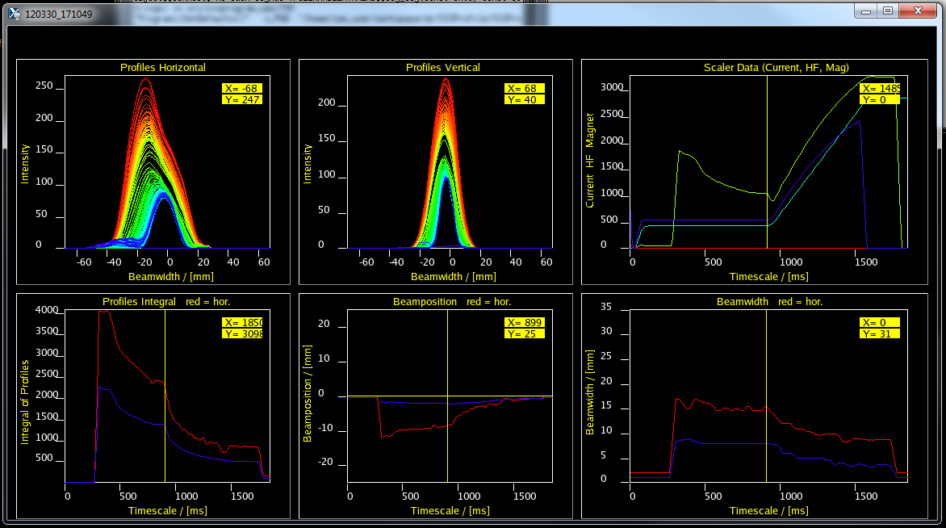
IPM Use
IPM Use:
Operators:
set up different ion sorts
check beam width by time
cooling optimization
injection optimization
Machine Experimentators /
PhD Students:
accelerator physics
varying beam intensities
tune changes
resonance crossings
emittance exchanges
beam excitations
cooling effects

Slide 5
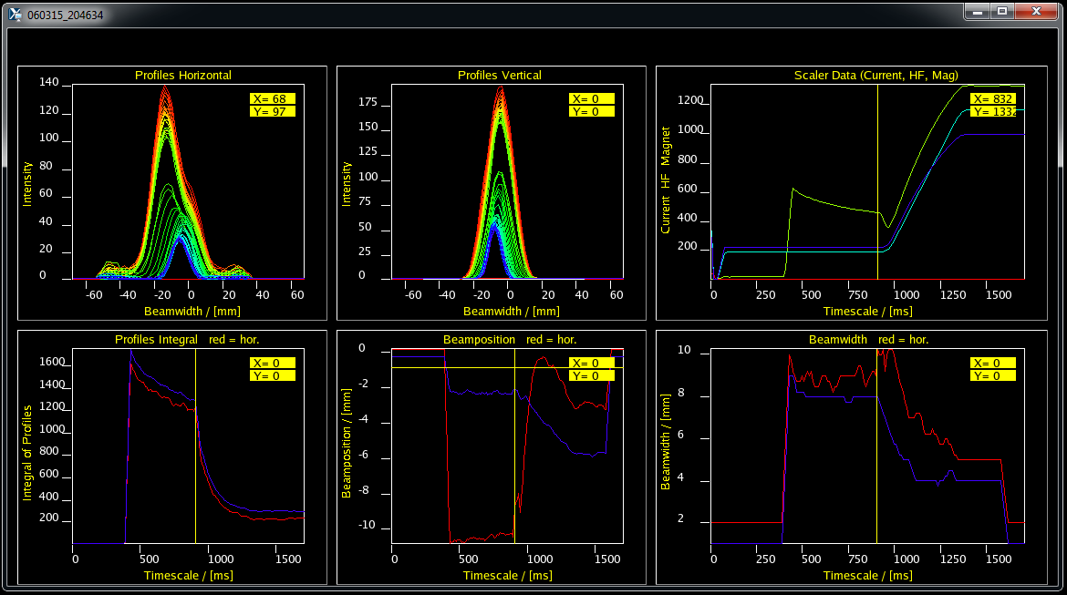
IPM @ SIS18 / Wire Array
Beam Profiles:
7.8x10⁹ Ar18+ ions
350 AMeV
1.7 s cycle
beam pos changes at accel start

Slide 6
IPM @ SIS18 / Wire Array
Beam Profiles:
1.5x10⁹ U73+ ions
2 s cycle
300 AMeV
excitations for tune meas.
losses at accel start

Slide 7
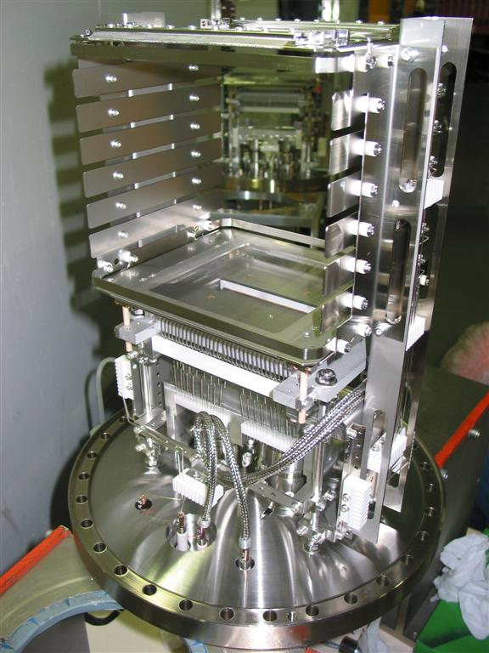
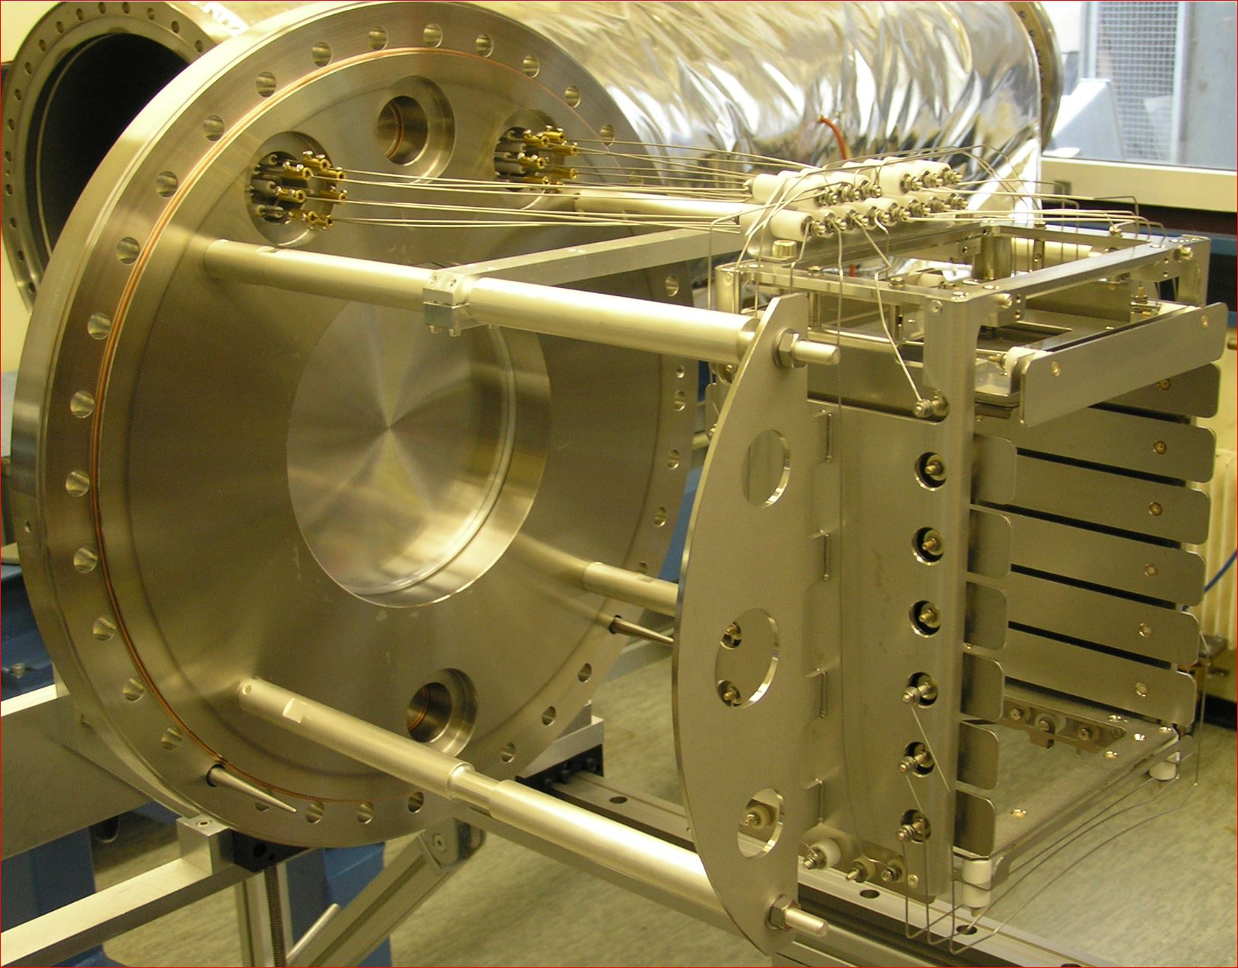
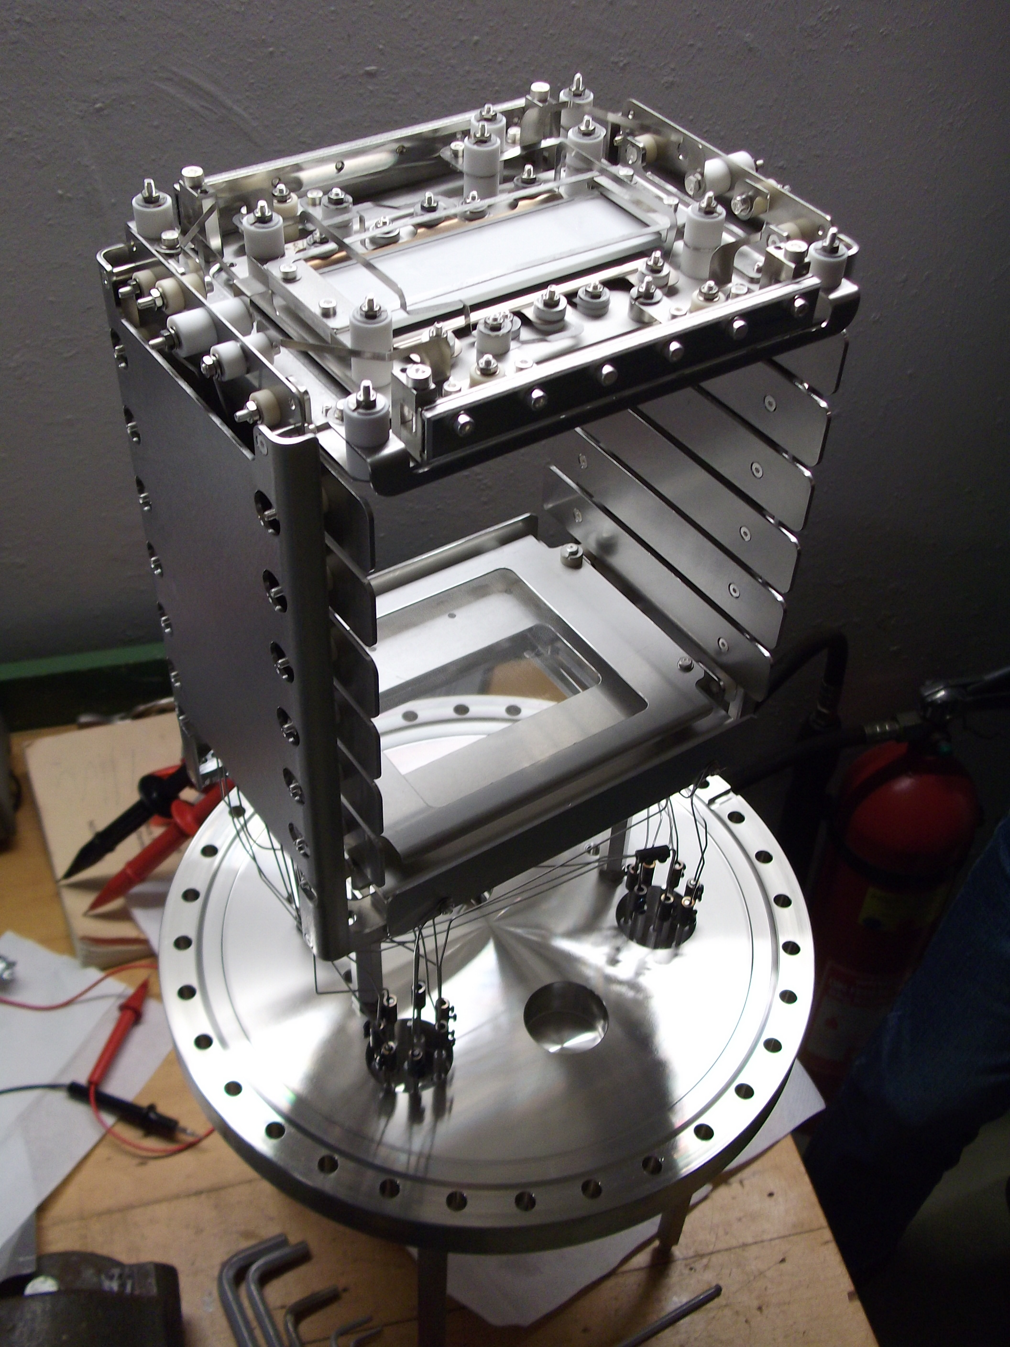
IPMs @ GSI
SIS18
ESR
SIS18 : wire readout 0.6 / 2.1mm, 100 profiles/s, integration time 0.5/5ms, COF300
SIS18 : phosphor screen P47 100ns, camera readout, 100 profiles/s, COF400
ESR : phosphor screen P47 100ns, camera readout, 100 profiles/s, CF250

Slide 8
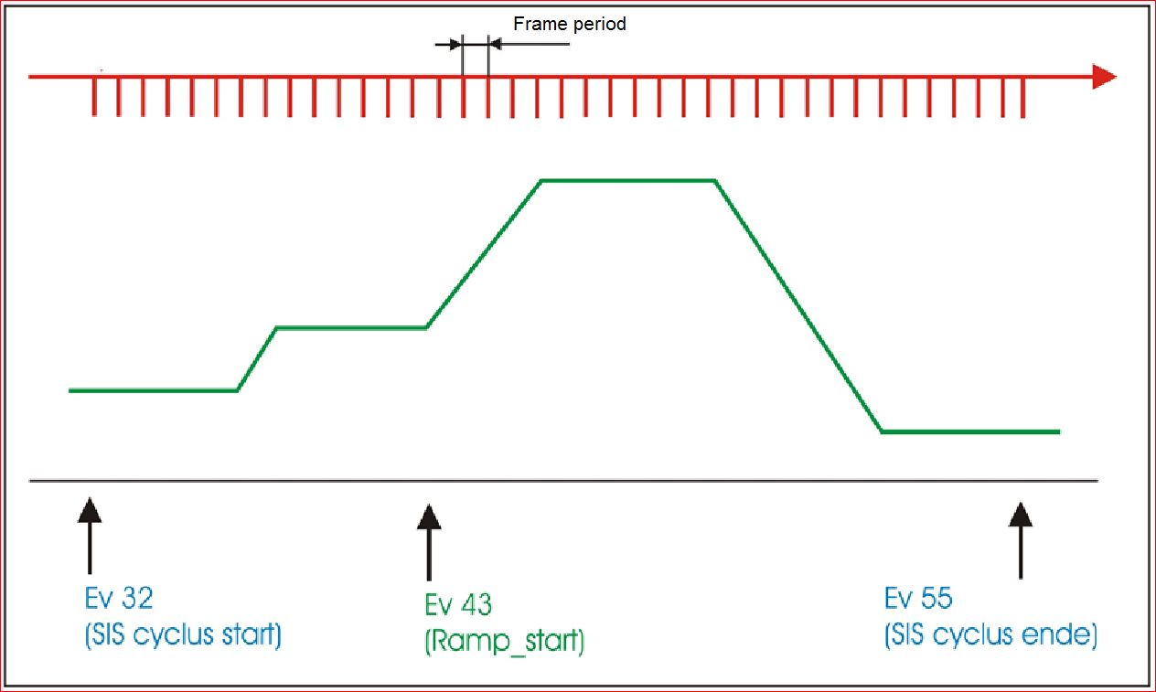
SIS18 vs ESR
SIS18 - Synchrotron (beam production):
~ s injection – cooling – acceleration
– extraction
Measurement fully event controlled from
meas_start to meas_stop.
ESR - Storage ring :
~ min injection – storage – several re-injections (manually requested)
Measurement manually controlled.
Data are saved to different files for horizontal and vertical.

Slide 9
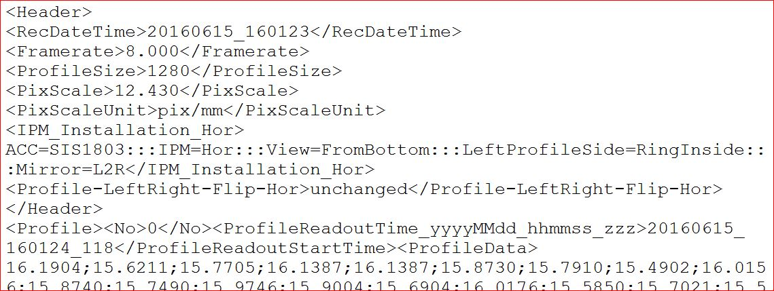
IPM Data Storage
Data stored as
ascii in a network
folder.
Data file header
Data part,
start of profile
End of profile

Slide 10
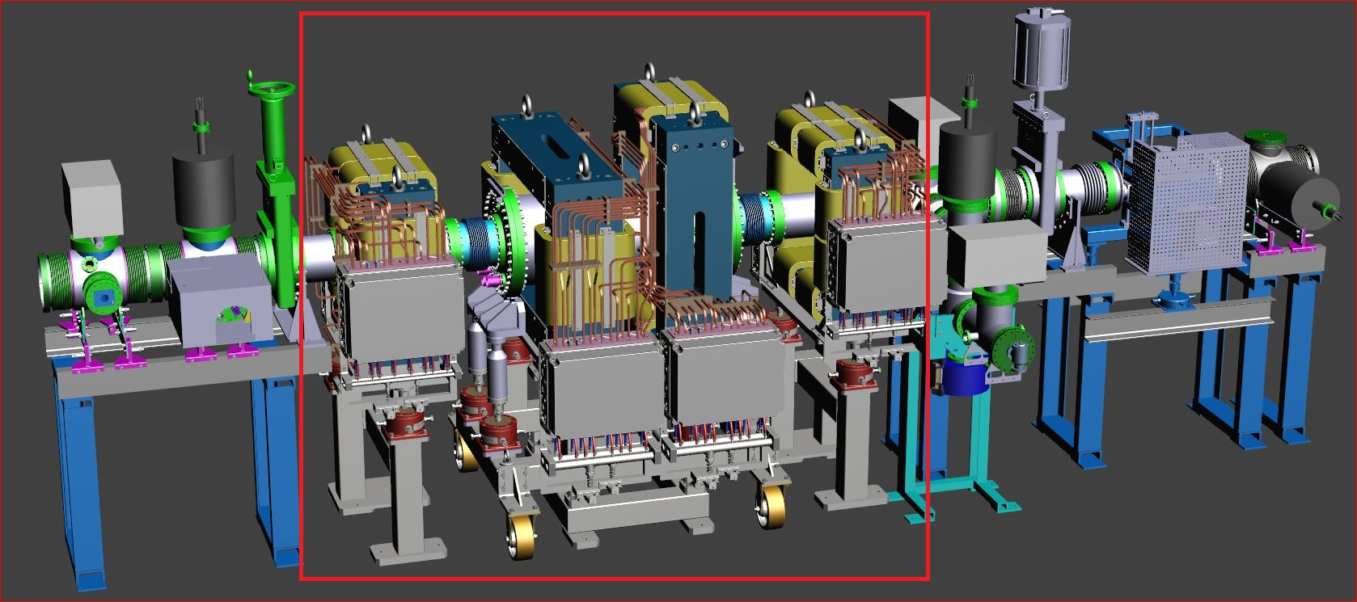
SIS18 – SIS100 IPM
IPM design for the heavy ion synchrotron SIS18.
SIS18 :
216 m circumference / 18 Tm / 10⁻¹¹ mbar / vacuum bakeout / 200mm aperture / IPM length 2.5m.
2 diagnostic magnets, 2 corrector magnets with 4 coils, detection of electrons and ions

Slide 11
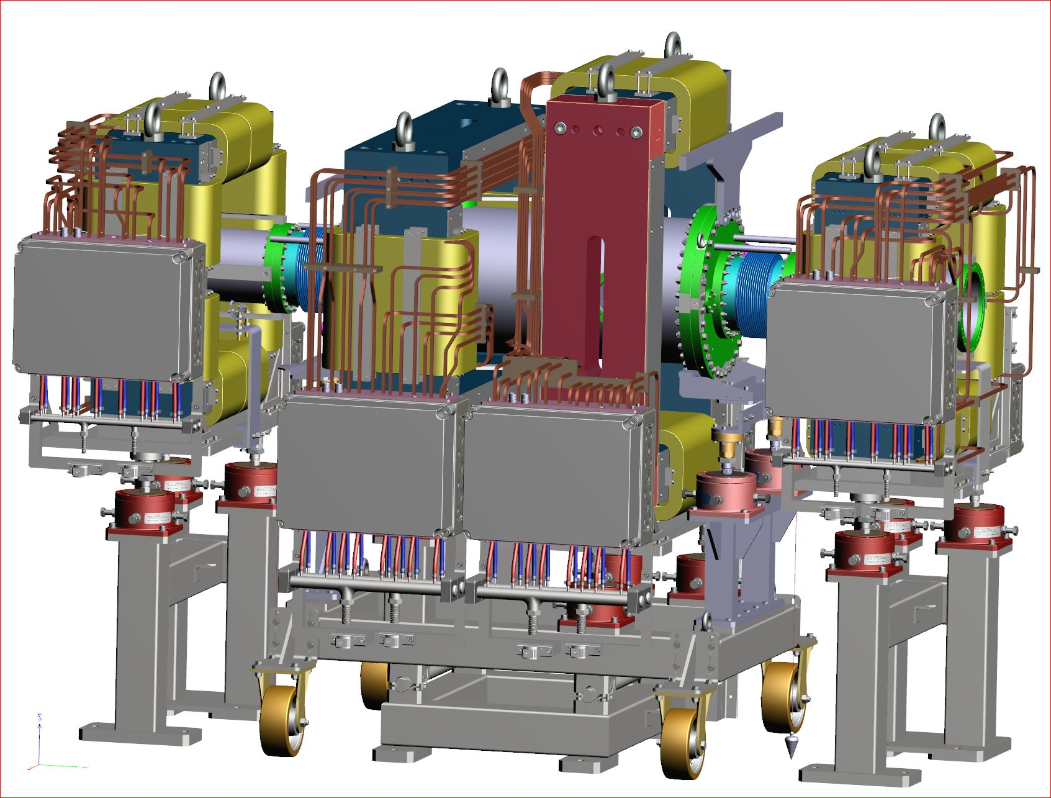
IPM Window Frame Magnet
diagnostics with slit in yoke for camera and uv lamp
UV 115nm / 120nm
diagnostic section moveable transverse to beam line
self-repositioning
IPM insertion in beam
direction, avoid tangential flange – keep magnet aperture small
field compensation in
short beam pipes
diagnostic : 1.34 to
corrector : 0.79 to
connection boxes split up

Slide 12
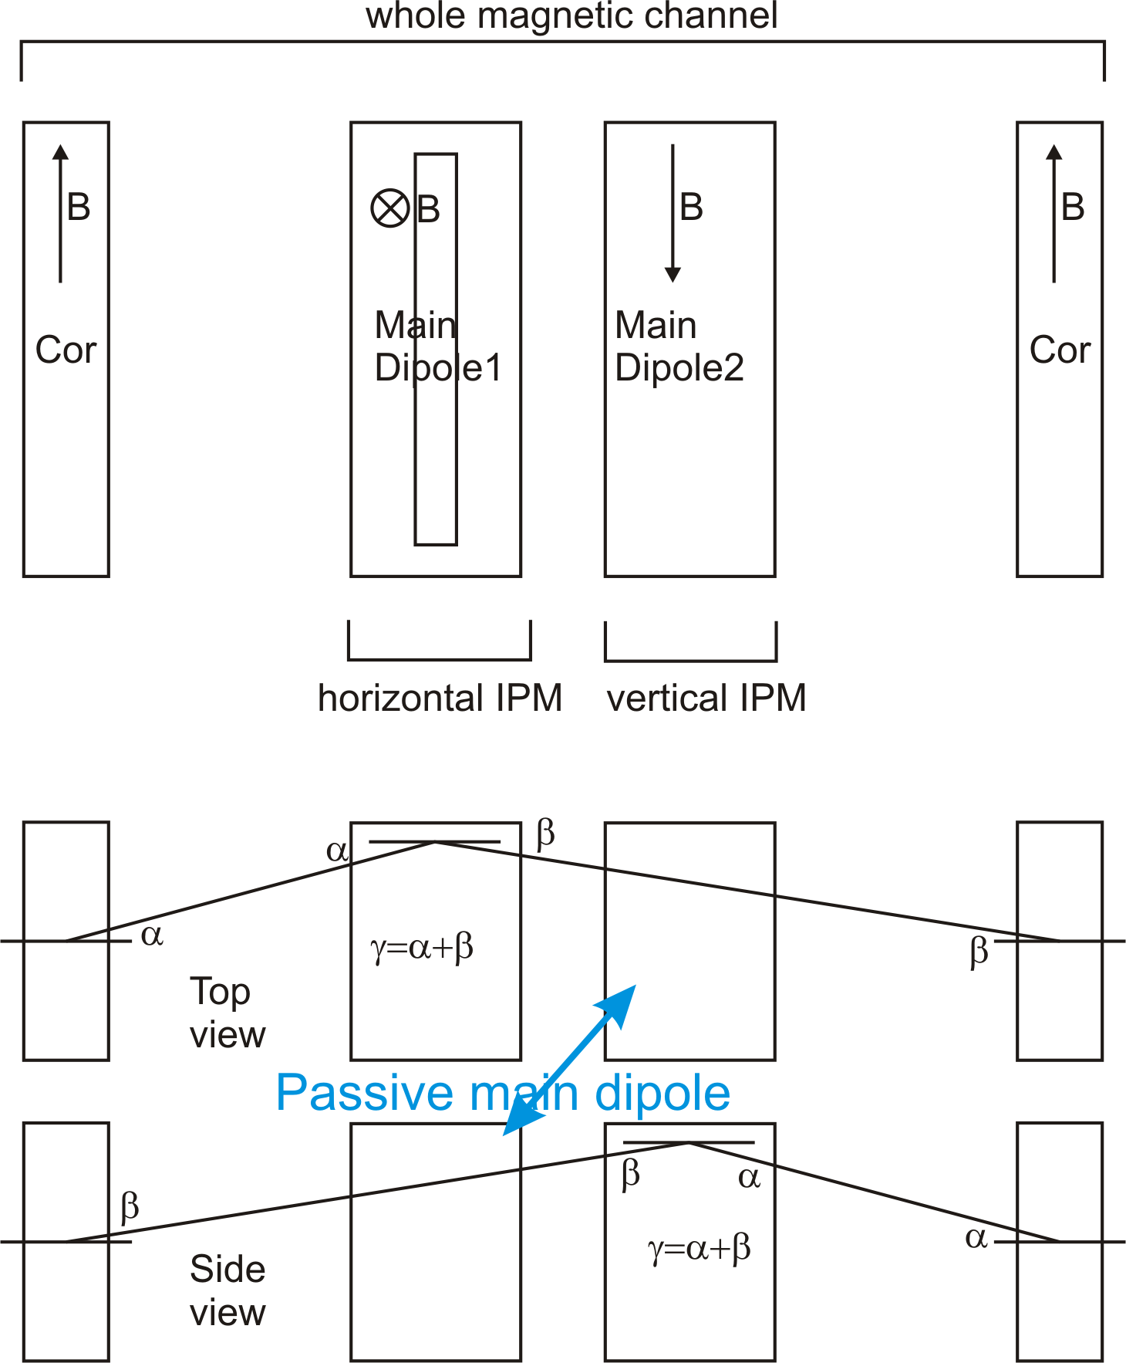
IPM Magnet
Diagnostic magnets are used alternating.
Correctors used always.
Slit in yoke manipulates mainly z-comp.
of magnetic field.
Correctors act in two planes.
The correctors are equal but turned by 90 degree around beam axis.

Slide 13
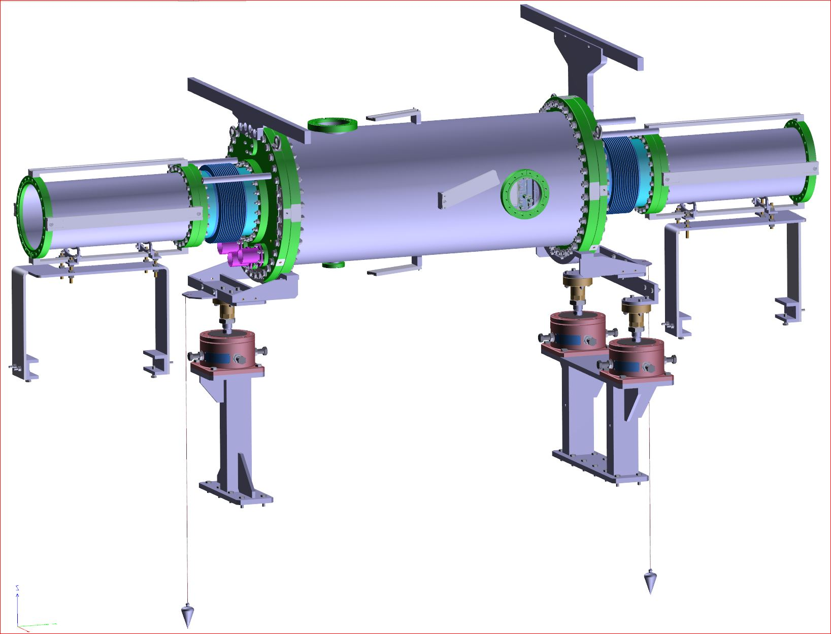
IPM Vacuum Chamber
Main vacuum chamber length 1m /
inner diameter 0.4 m.
Main flanges are COF400
bellows CF200 /
length 250
beam pipes CF200 /
length 500
holders for Hall probes
adjustment feet for tension and compression
high voltage feedthroughs 2x CF40 with 8x 20kV each
support fixed on the moveable magnet support

Slide 14
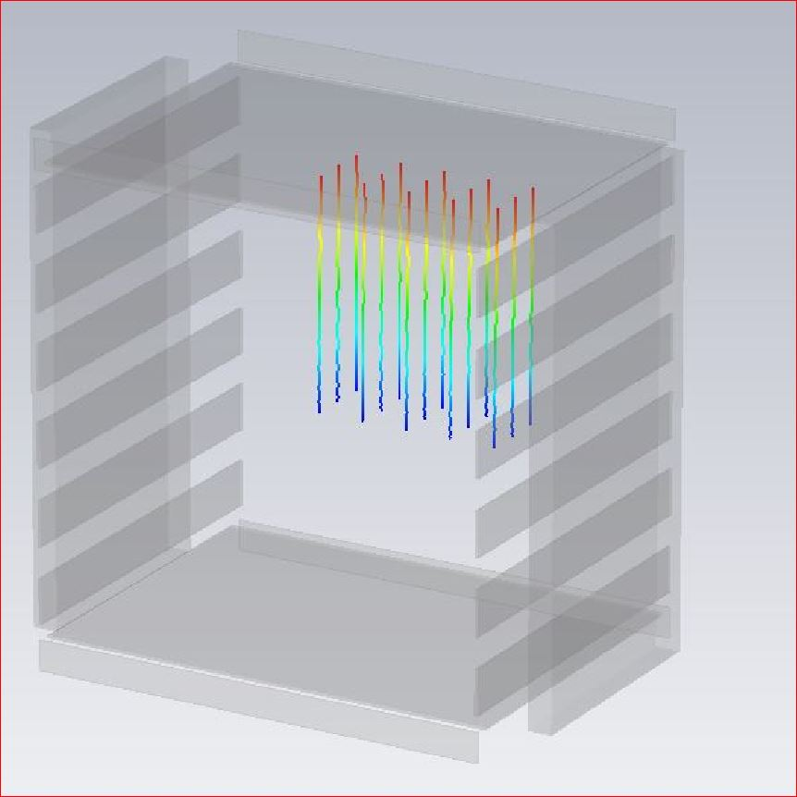
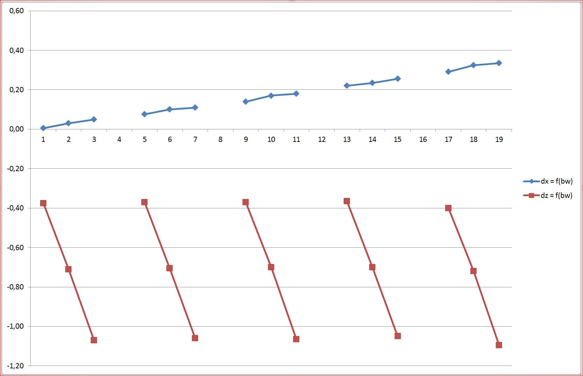
IPM Magnet Benachmark
Particle tracking simulations with CST show a maximum beam width spread of 0.2mm for a beam with 30mm radius.
The magnetic field was designed with Opera.
15 Particles starting at:
x = 0, 15, 30, 45 and 60 mm
z = 0, 11, 22 mm
x0 x15 x30 x45 x60
z 22
z 11
z 0

Slide 15
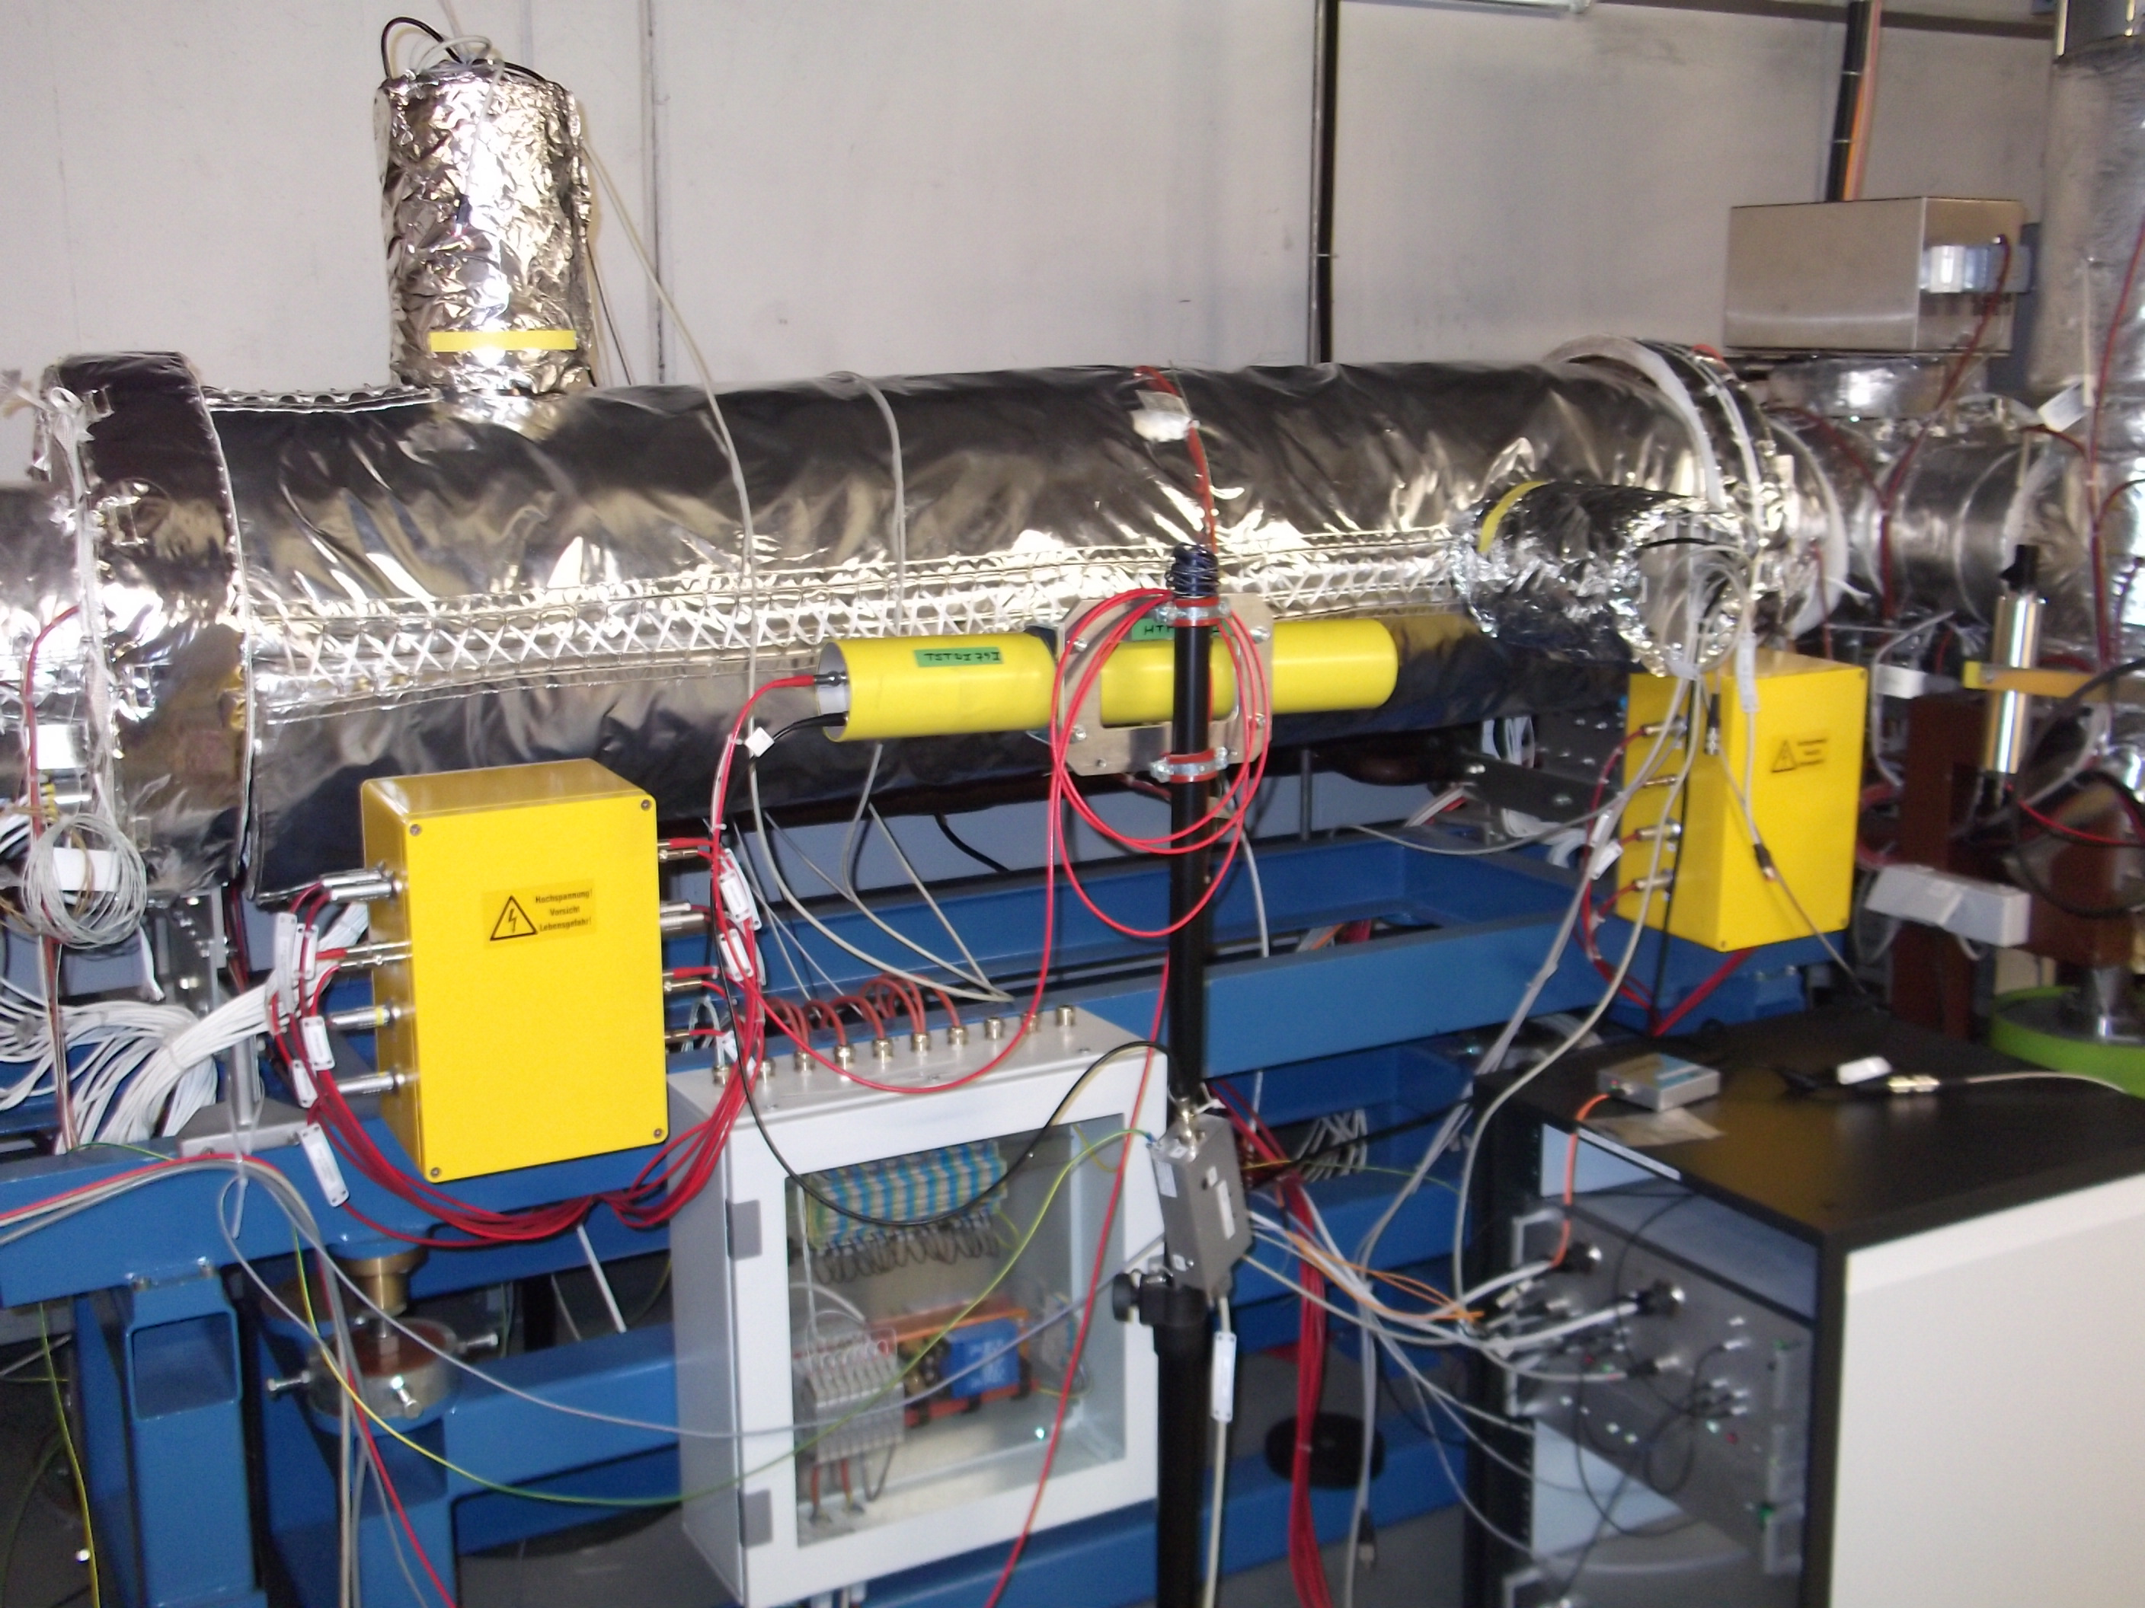
IPM SIS18 installation w/o magnet
IPM w/o magnet in operation in the SIS18.
FESA software under development.
Vacuum chamber equipped with heat jackets for vacuum bakeout.
Camera holders are covered by aluminium foil.
High voltage adapter boxes.

Slide 16
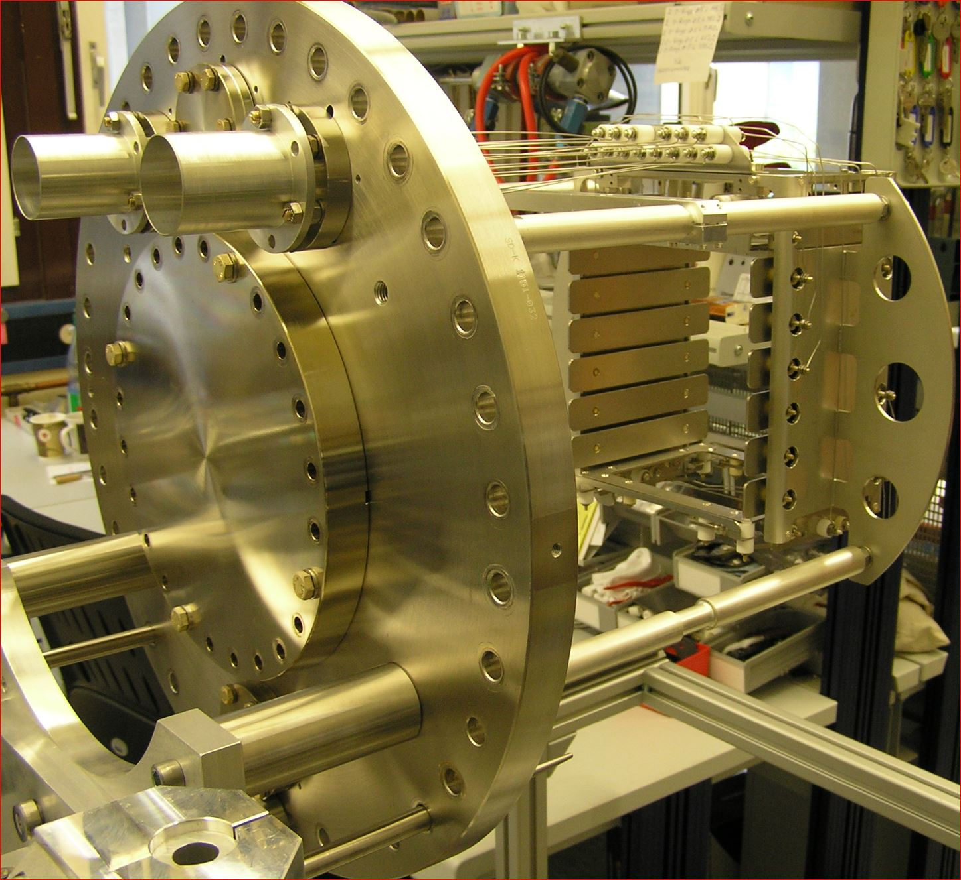
IPM SIS18
IPM e-field box mounted on COF400 main flange.
Aperture is 180mm x 180mm.
MCP size : 100 x 48 mm,
not shown will be installed in the tunnel last

Slide 17
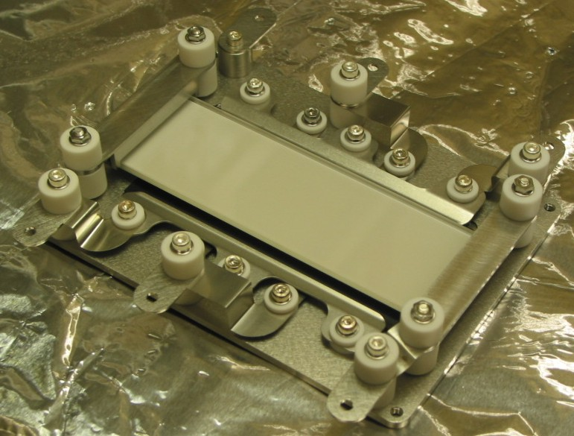
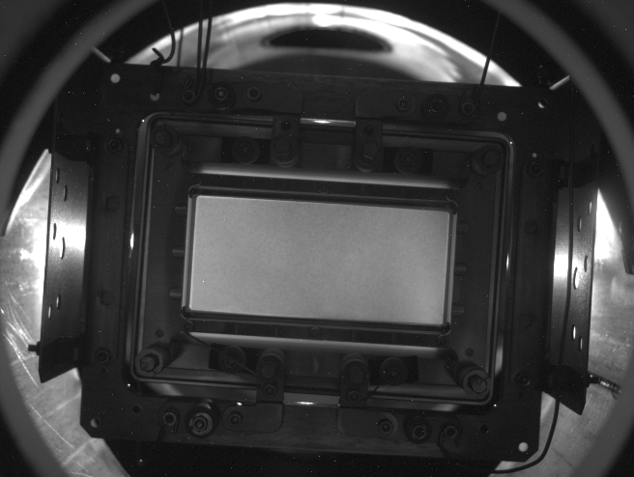
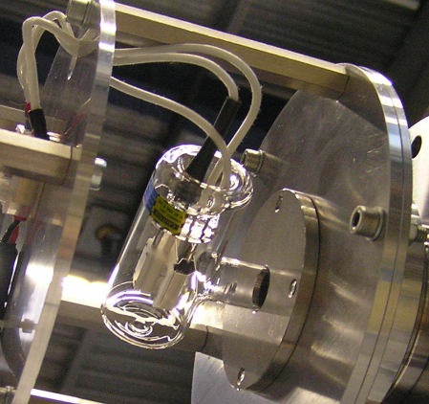
IPM
MCP – PH – Assembly
MCP – Ph shape ideal rectangular,
large width ~ 100 mm
length 40 mm
P47, 100ns decay time
MCPs few MOhms
UV light signal for MCP calibration
L2D2 lamp, 115nm

Slide 18
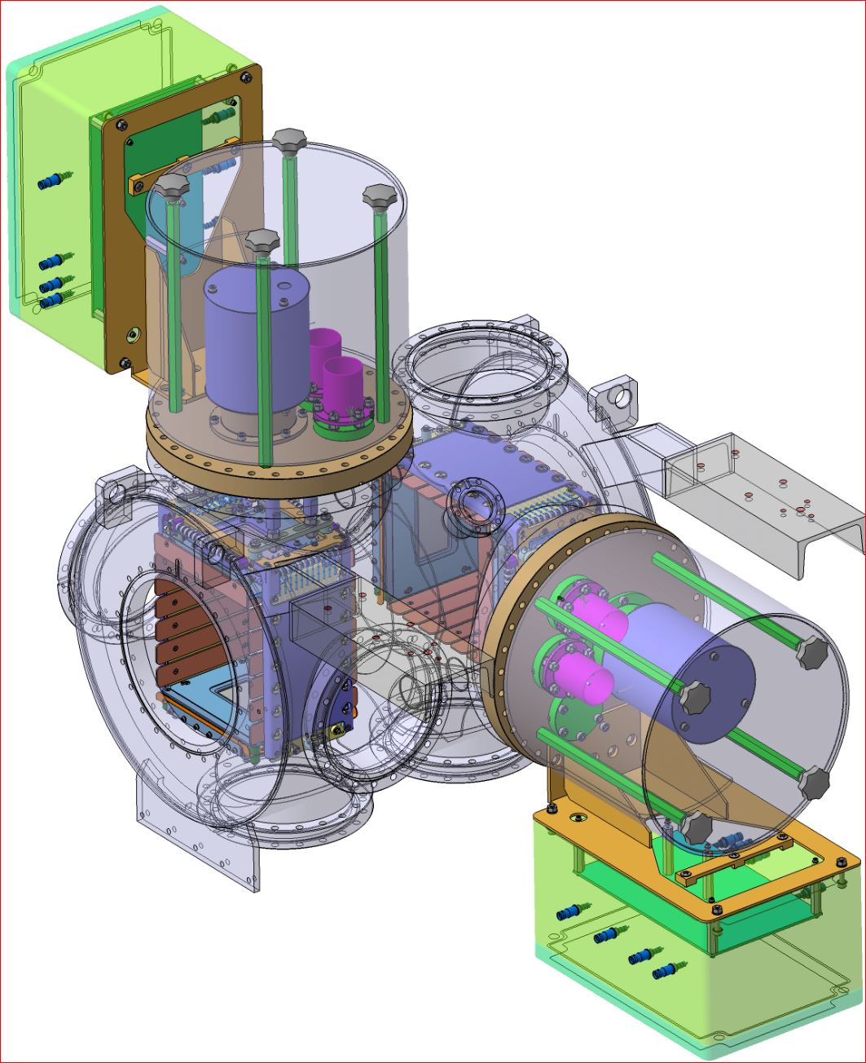
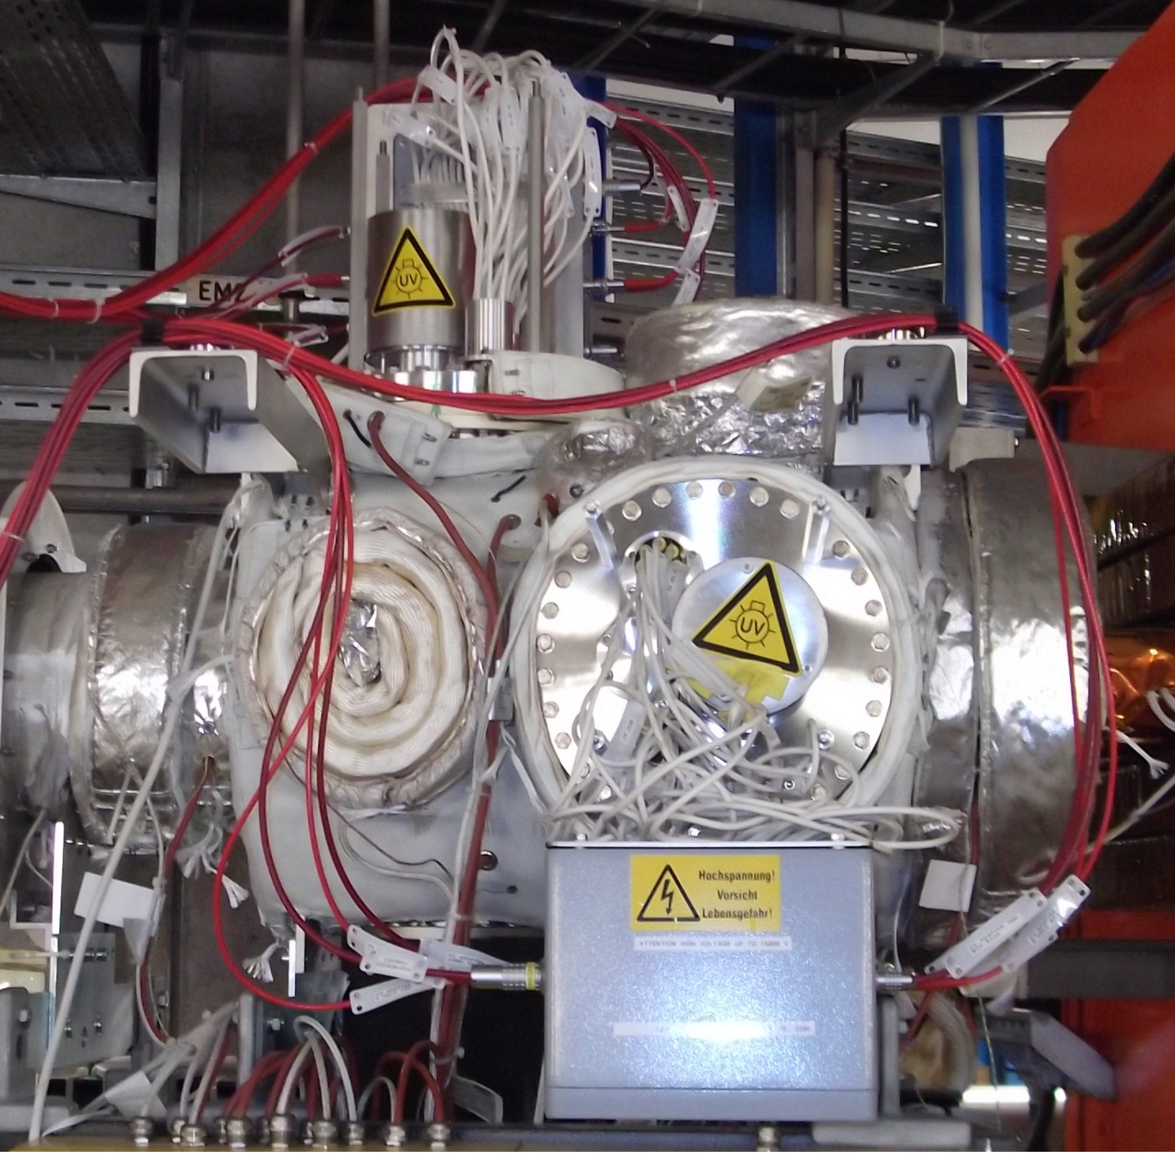
ESR IPM
Compact system
Aperture 180 x 180 mm²
Overall length : 0.6 m
Main flange : CF250, with high voltage feedthroughs, UV lamp
Readout by camera through CF100 viewport
MCP size : 100 x 48 mm²
E-field 55 kV/m
ESR 108 m, 10Tm, bakeable, 10⁻¹¹ mbar

Slide 19
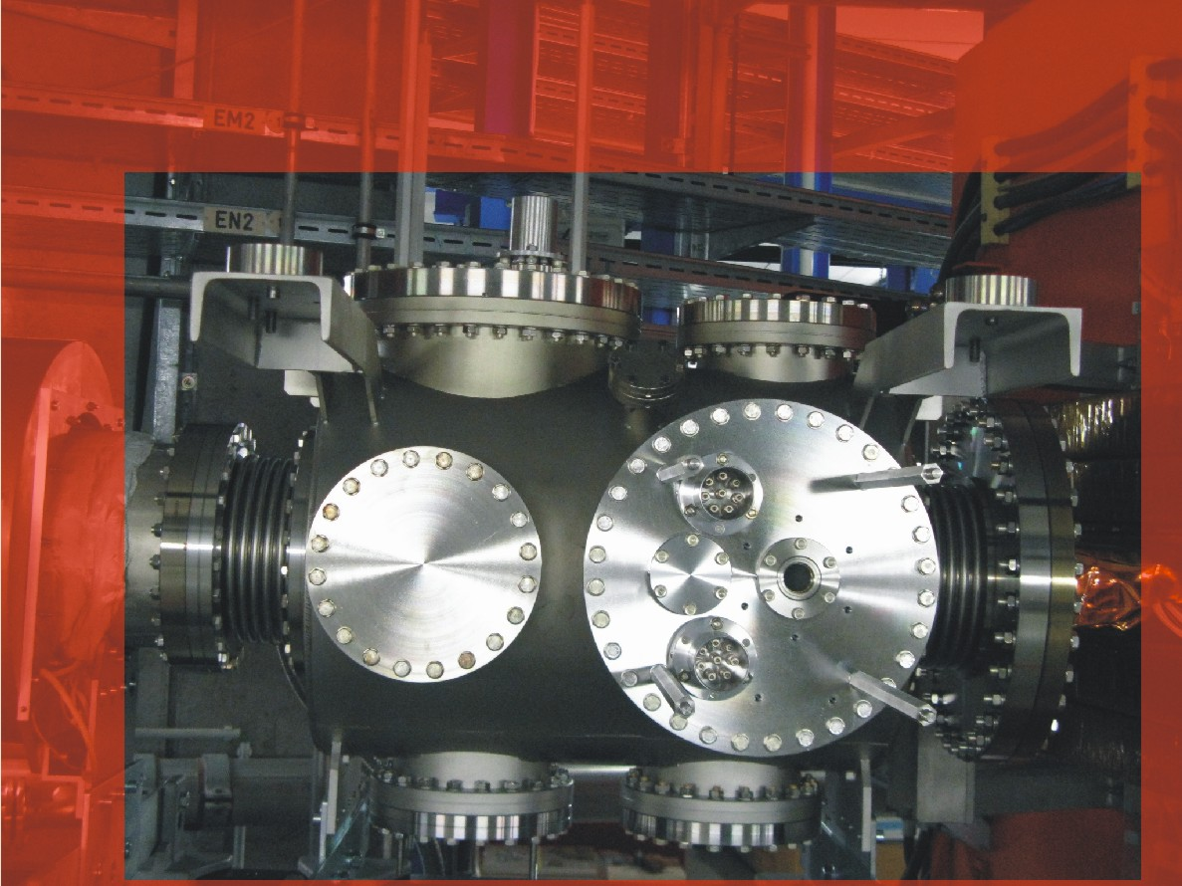
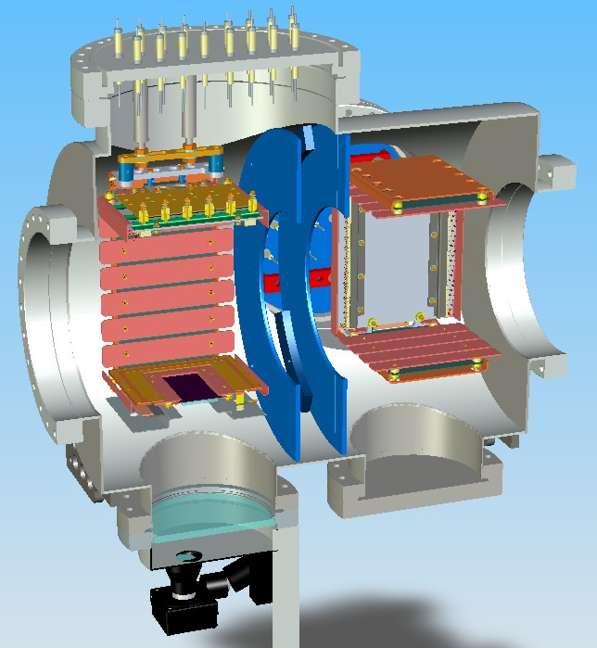
ESR IPM
Hor IPM
Ver IPM
8x 20kV
CF35 viewport for uv light

Slide 20
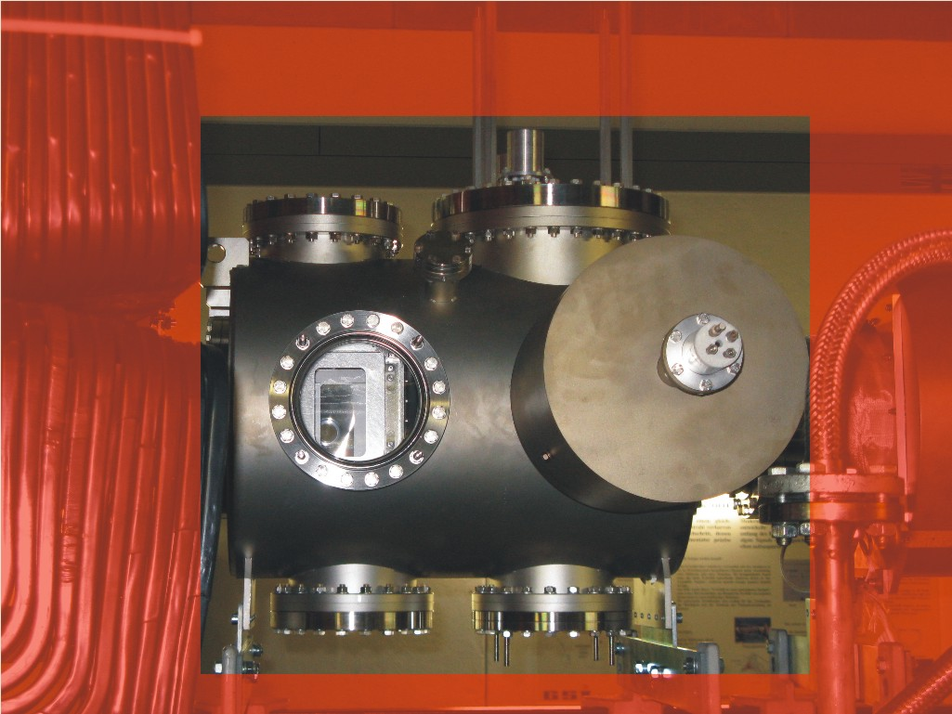
ESR IPM - Backside
Viewport CF150 vertical IPM
Viewport for horizontal IPM

Slide 21
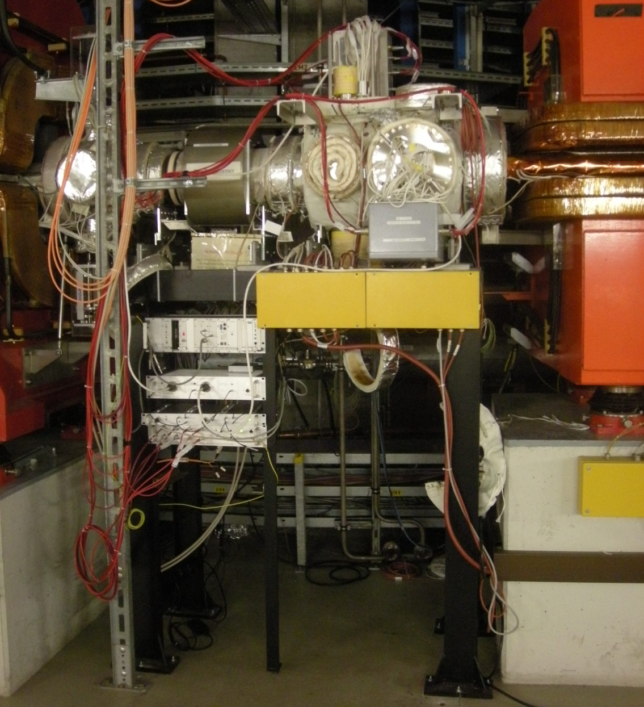
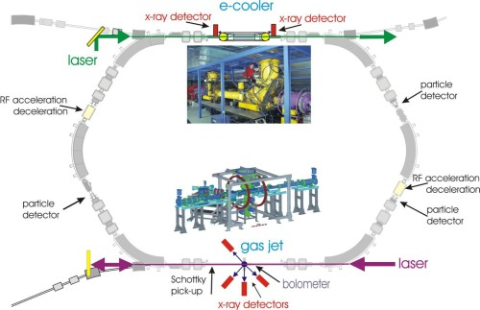
ESR IPM Location
- IPM location
- Current transformer
- Crates & Control
ESR ->
Experimental Storage Ring
Circumference 108,36 m
Magnetic rigidity 10 Tm
Vakuum mbar 10⁻¹⁰ - 10⁻¹¹

Slide 22
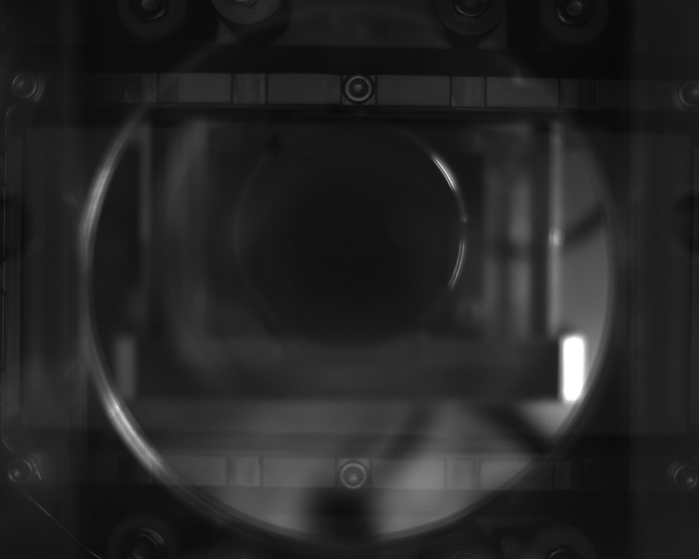
IPM Camera readout
Camera observes the phosphor screen.
MCP width : 100 mm,
CCD size : 1280 pix.
Scaling factor : 12.8 pix/mm
Marks on phospor holder give a hint of the viewed size – 5 - 10 mm.
Drag n drop an area of interest on the GUI with known width in mm.
Software knows pix.

Slide 23
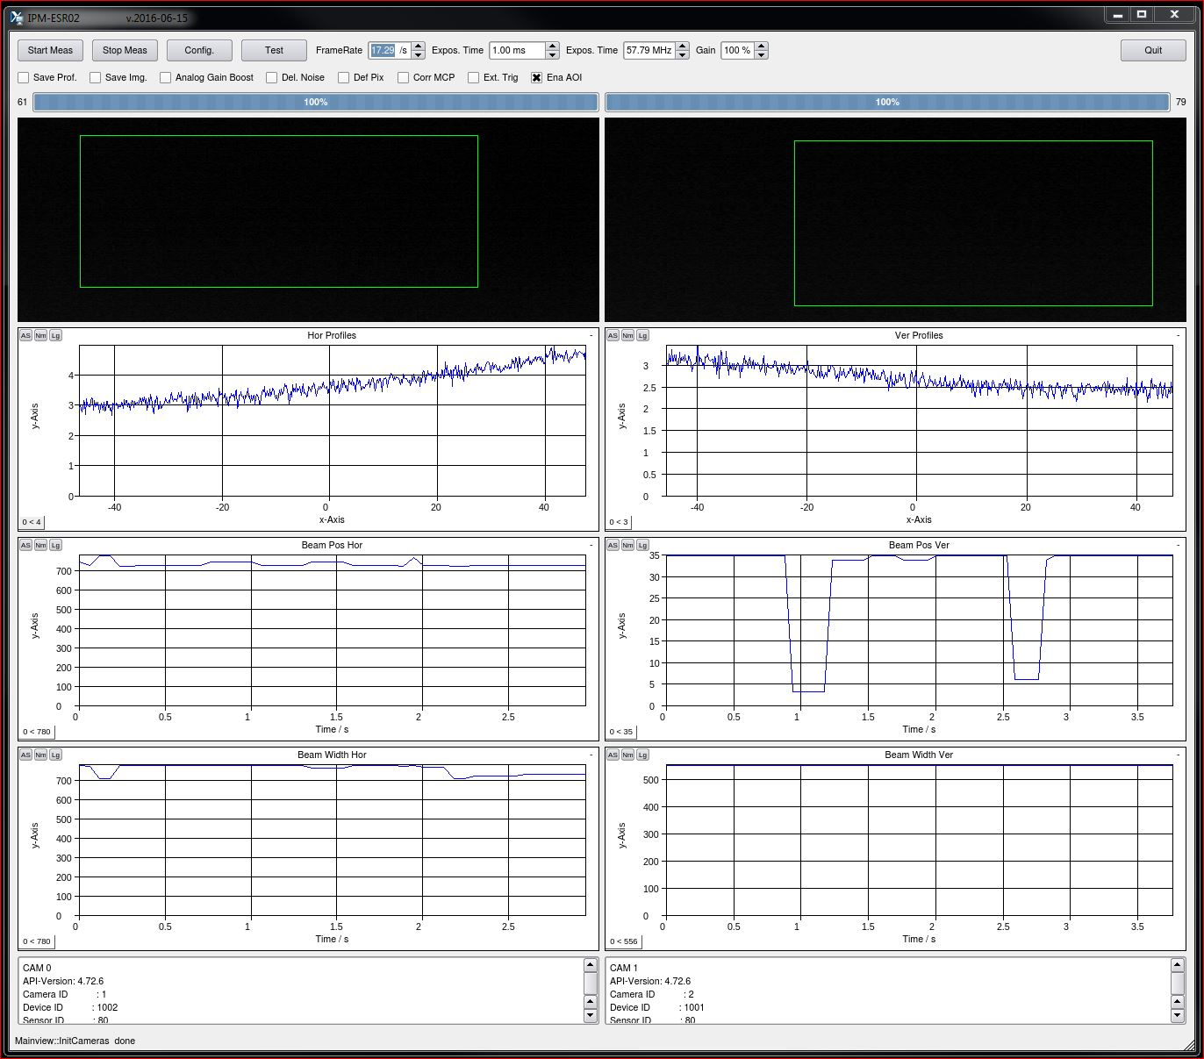
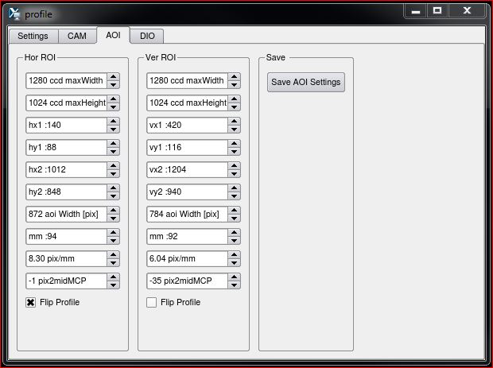
IPM Profile Software with Qt
Image of hor and ver camera.
Beam profiles, beam position and beam width.
Set an area of interest AOI by drag and drop.
Type the known size of the AOI.
Scale factor calculated / saved w data.
Flip profile function if cam is mounted against beam direction.
Save prof / Save img / ...

Slide 24
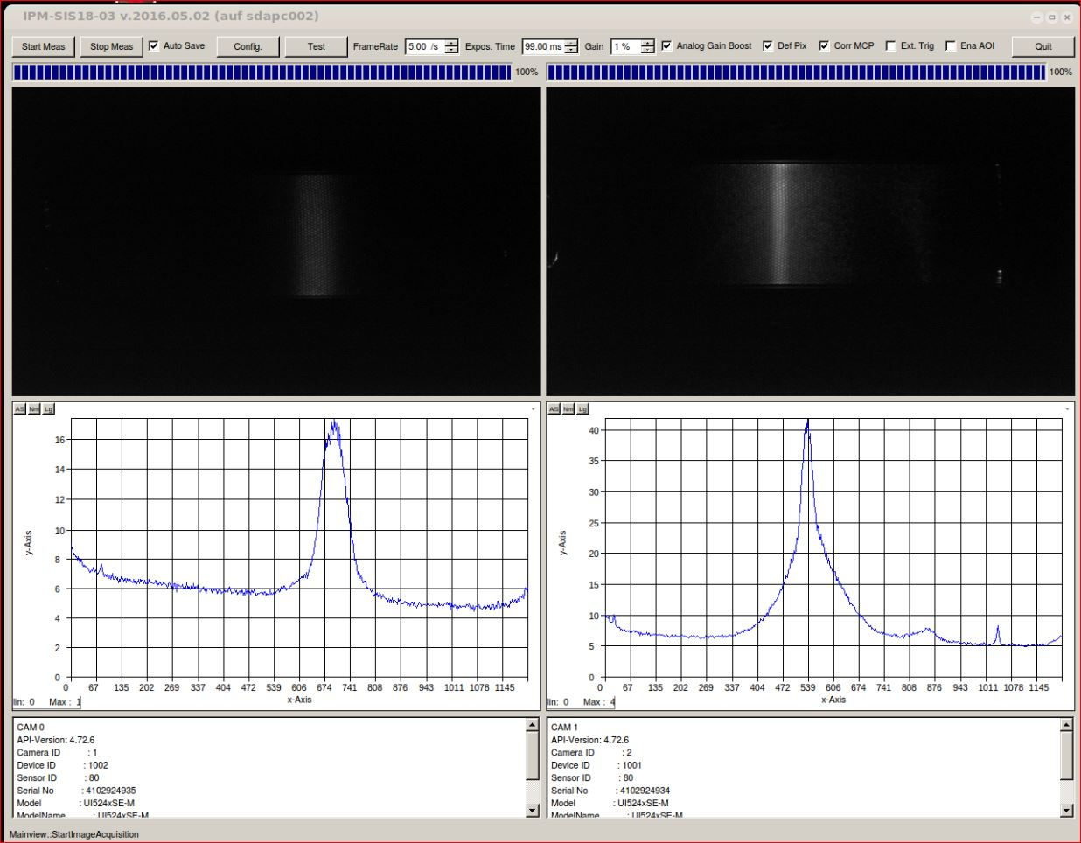
IPM SIS18 Beam Profiles
238 U 4+
300 MeV/u
13 mA
Images of beam and profiles.
Left side horizontal profile.
Right (ver) profile shows shoulders and peak on right hand side due to high MCP voltage and MCP defects.

Slide 25
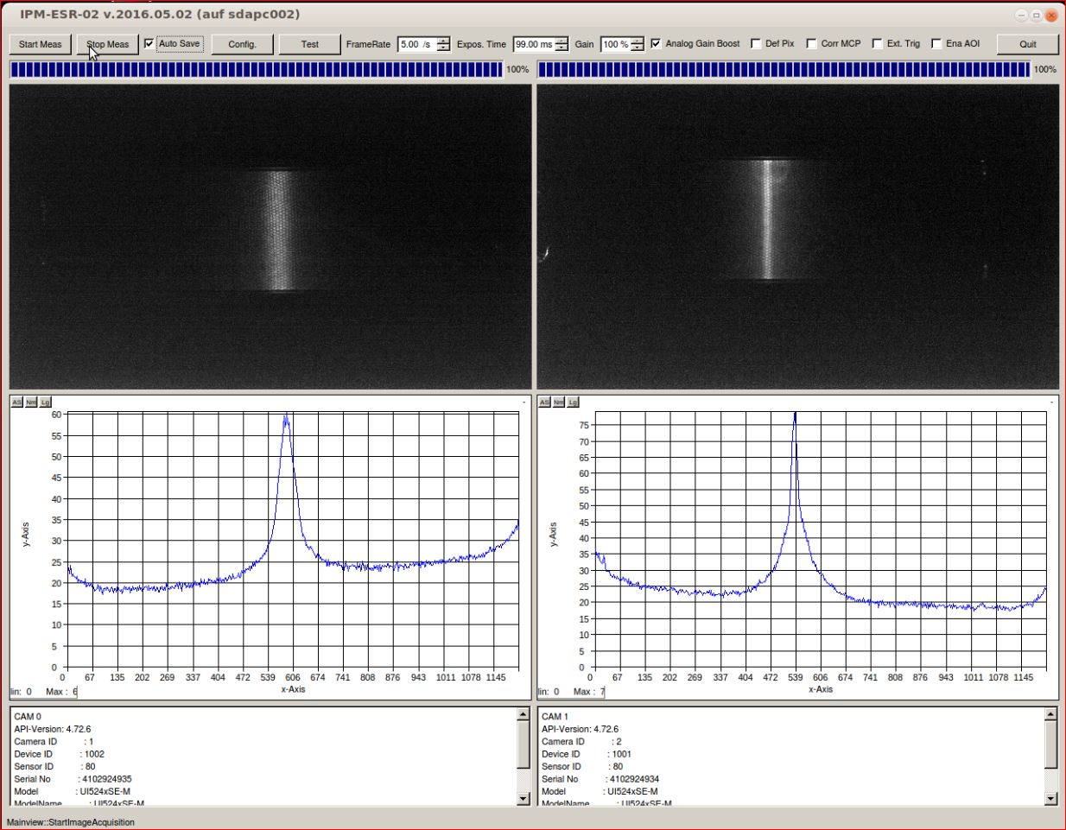
IPM SIS18 Beam Profiles
238 U 4+
300 MeV/u
13 mA
Images of beam and profiles.
Left side horizontal profile.
Right (ver) image shows a light halo and shoulders.

Slide 26
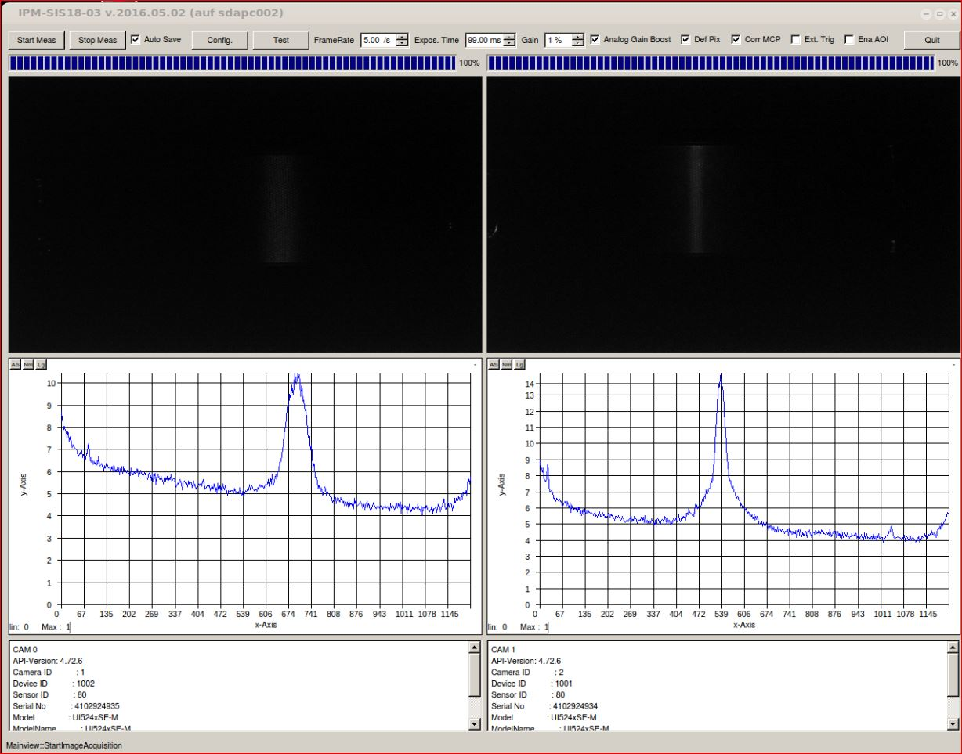
IPM SIS18 Beam Profiles
238 U 4+
300 MeV/u
13 mA
Images of beam and profiles.
Left side horizontal profile.
Beam image hardly visible.

Slide 27
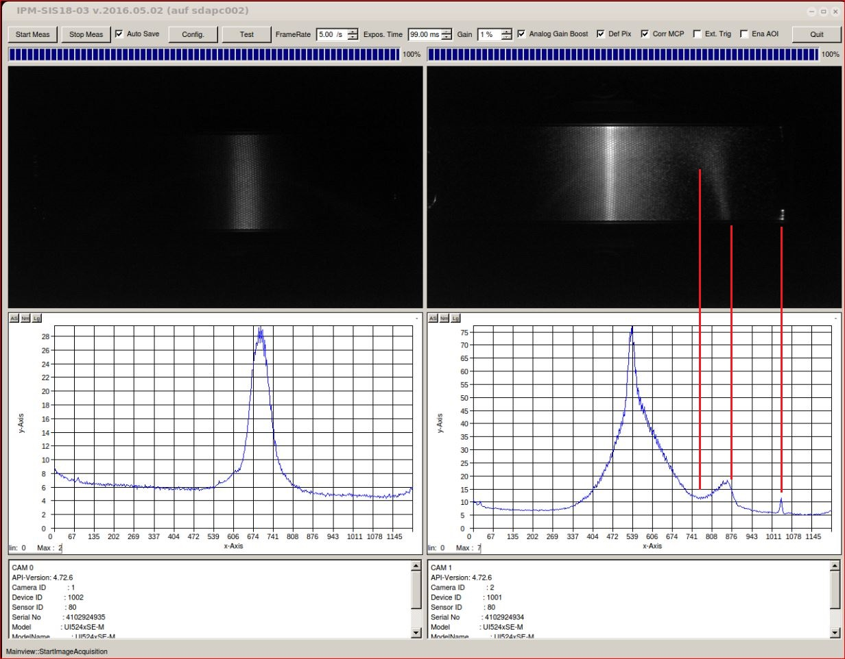
IPM SIS18 Beam Profiles
238 U 4+
300 MeV/u
13 mA
Images of beam and profiles.
Right side vertical.
MCP voltage overdriven.
Signal shadows beam signal induced.

Slide 28
Thank you

