Slide 1
Operational experience of the AGS eIPMs
Chuyu Liu
IPM workshop 2017, Darmstadt, Germany

Slide 2
Outline
History of the AGS IPM
Overview of the AGS eIPM
Operation of the AGS eIPM
Summary

Slide 3
History of the AGS IPM
AGS IPM was collecting electrons, however the profiles had a large halo. It was converted to collect ions.
Electron IPMs have been developed at BNL in a program that began in 1996. During the 2012 shutdown the prototype from 2007 was refurbished and installed into the AGS as the D5/horizontal eIPM. In 2013, a similar eIPM was installed at AGS D15 location for vertical measurements.

Slide 4
Overview of the AGS eIPM

Slide 5
Introduction of eIPM
An eIPM sweeps electrons produced by beam ionization of background gas to a micro-channel plate (MCP) on the side of the beam pipe.
The electrons (which carry the transverse distribution of the beam) is then amplified linearly by MCP with proper bias voltage.
The projection of the MCP output is then grouped in 64 channels. Each of the group of 8 channels is amplified by an amplifier board. Then the signal is digitized.
Controlled leaks were installed on both eIPMs to provide a statistically usable number of signal electrons to image the proton bunch turn-by-turn at injection. The leaked gas is CO2.
The expected advantage of eIPM compared with ion IPM are: more precision (0.5mm/channel vs 1.27mm/channel), less space charge effect and turn-by-turn measurement ability.

Slide 6
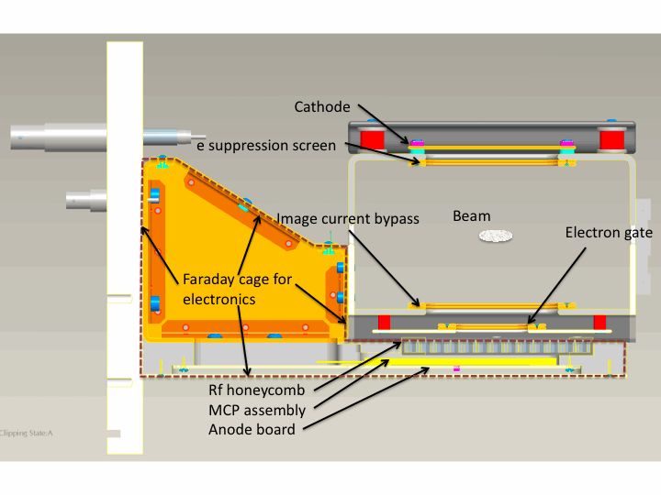
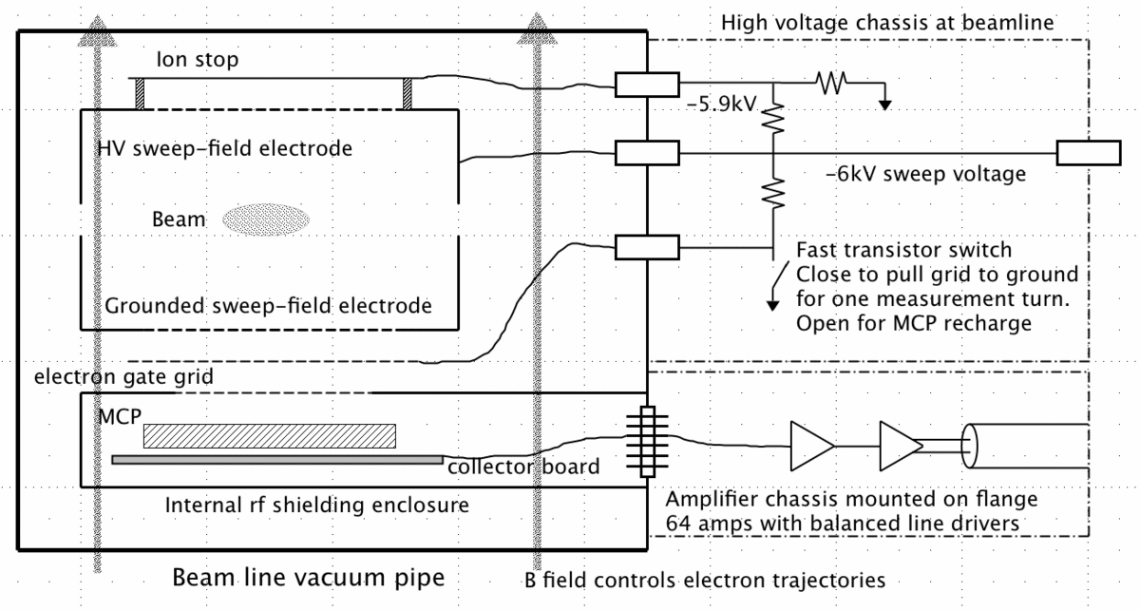
eIPM diagram

Slide 7
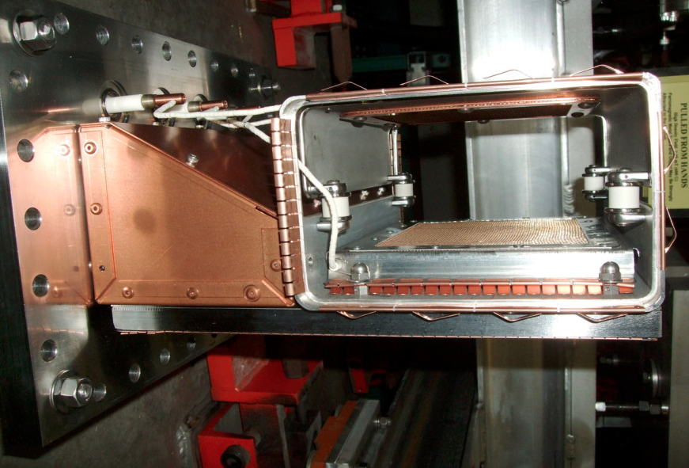
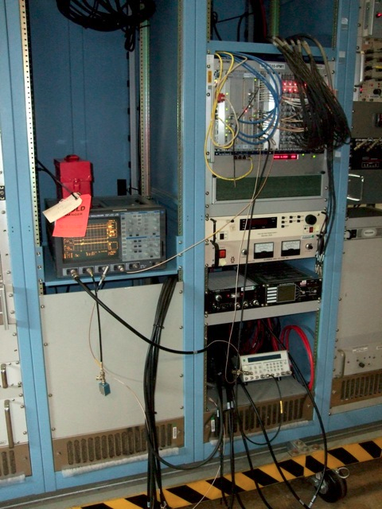
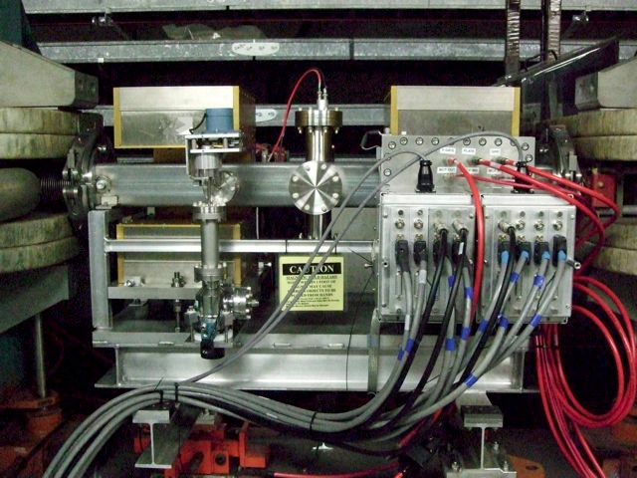
Hardwares

Slide 8
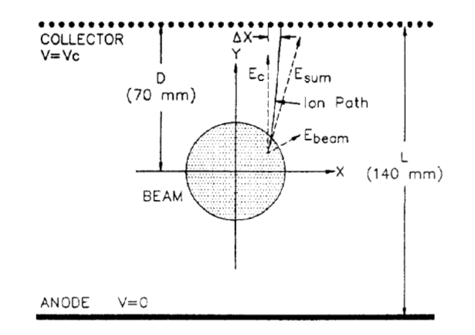
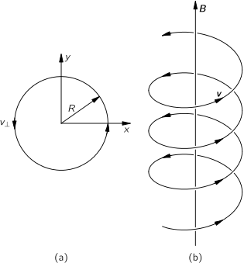
Space charge effect
Permanent magnets were installed at eIPMs to contain the sidewalk of electrons therefore the space charge effect.
The eIPM detector is placed in a dipole magnet with a field of 1.4kG (the deflection angle is ~2mrad at injection). The magnetic field constrains the signal electron to trajectories perpendicular to the collection plane. A second identical magnet is mounted with opposite field direction in the D5 gap to correct the steering deflection to the beam.

Slide 9
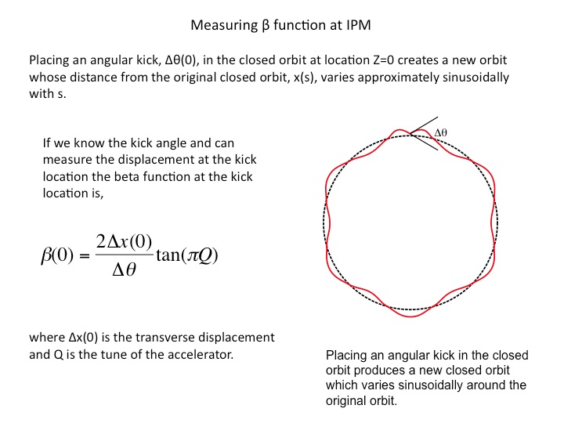
Beta function measurement
Back windings for dipole corrector at each eIPM was installed to deflect beam orbit to measure beta functions at the eIPMs.

Slide 10
Operation of the AGS eIPM

Slide 11
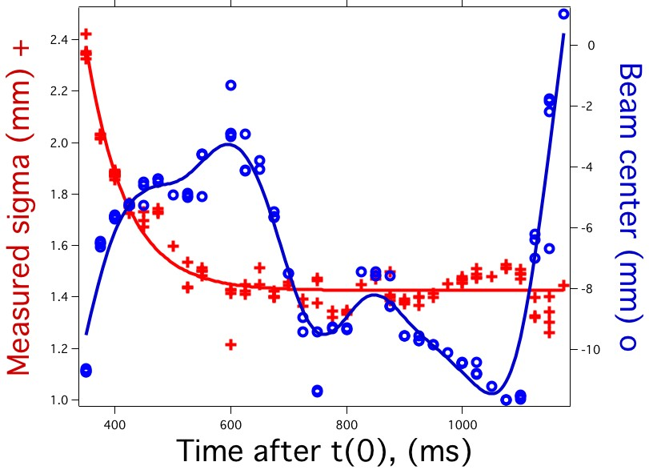
Orbit stability
During the cycle the beam moves around horizontally over a range up to 6cm. Since the IPM measurement aperture is 3.4cm, the beam is out of this aperture much of the time. The operators were able to center the beam at injection.

Slide 12
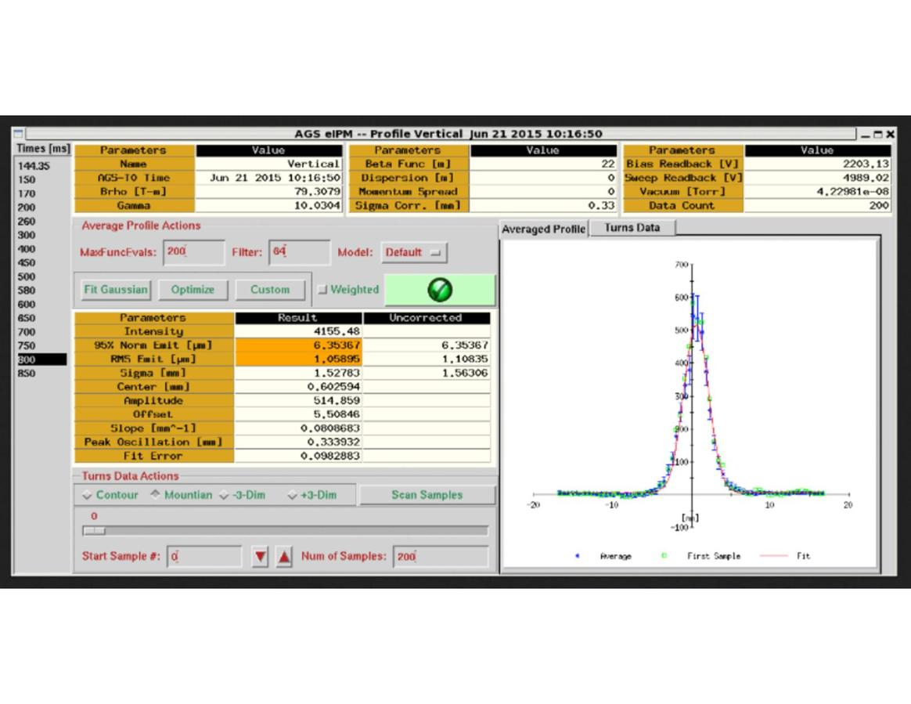
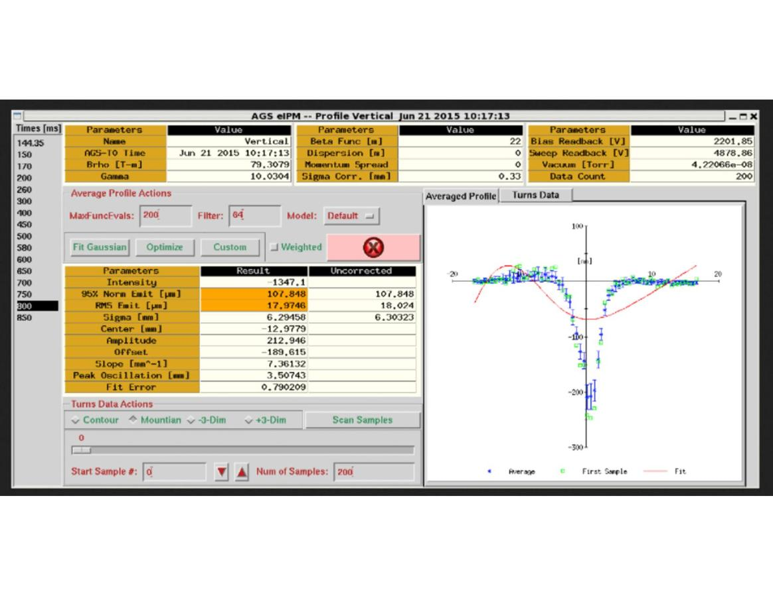
AC coupled amplifier
When the digitizers were triggered on the beam pulse we got good profiles. When we moved the trigger point we got 'inverted profiles' from the undershoot.
With many bunches in the AGS, the 'inverted' and 'non-inverted' profiles cancel each other. For that reason we have removed the output transformers for the start of Run 16.

Slide 13
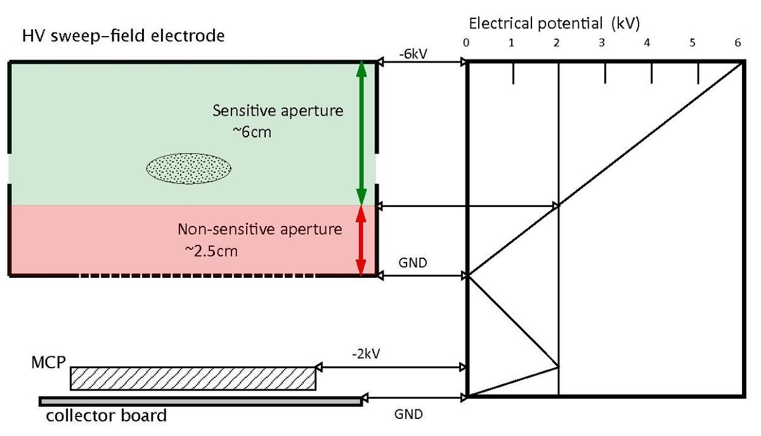
Dead zone
The dead zone is about 1/3 fo the beam aperture next to the MCP. Free electrons created in this zone will not pick up enough energy from the sweep field to enter the MCP channels.
We rotated the detector head by 180° moving the dead zone to the inside of the ring.

Slide 14
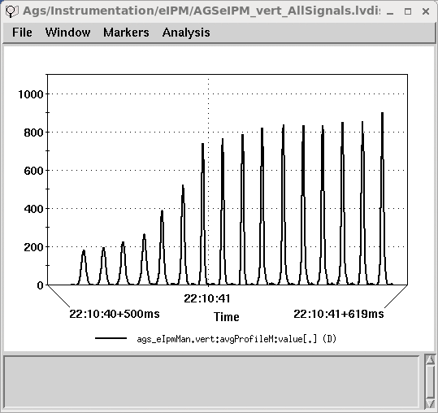
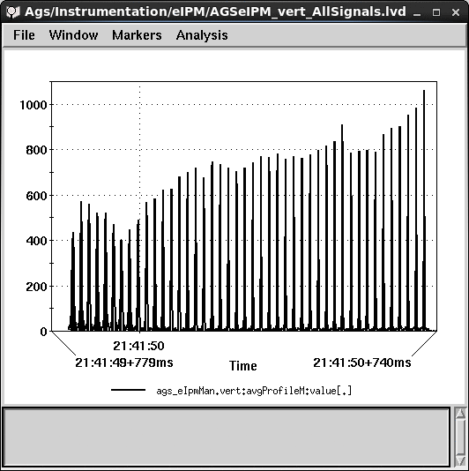
Bias voltage control on ramp
In the AGS we want to make several profile measurements during a single machine cycle. As the beam is accelerated, the profile width decreases and the amplitude increases.
We would like the amplitudes of the measured profiles to remain about the same during the machine cycle. To to this we are adding the capability to program a MCP voltage ramp during the machine cycle.
w/o voltage ramp
w voltage ramp

Slide 15
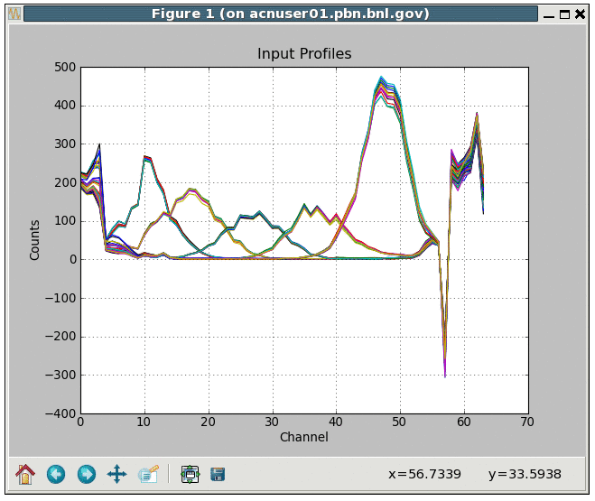
Reducing MCP damage
During beam position scans at the eIPMs, we observed profiles with lower amplitudes in the center of the MCP, which indicated gain depletion due to excessive exposure to the beam.
In 2017 we have added a time out feature which turns off data acquisition after a preset number of machine cycles.

Slide 16
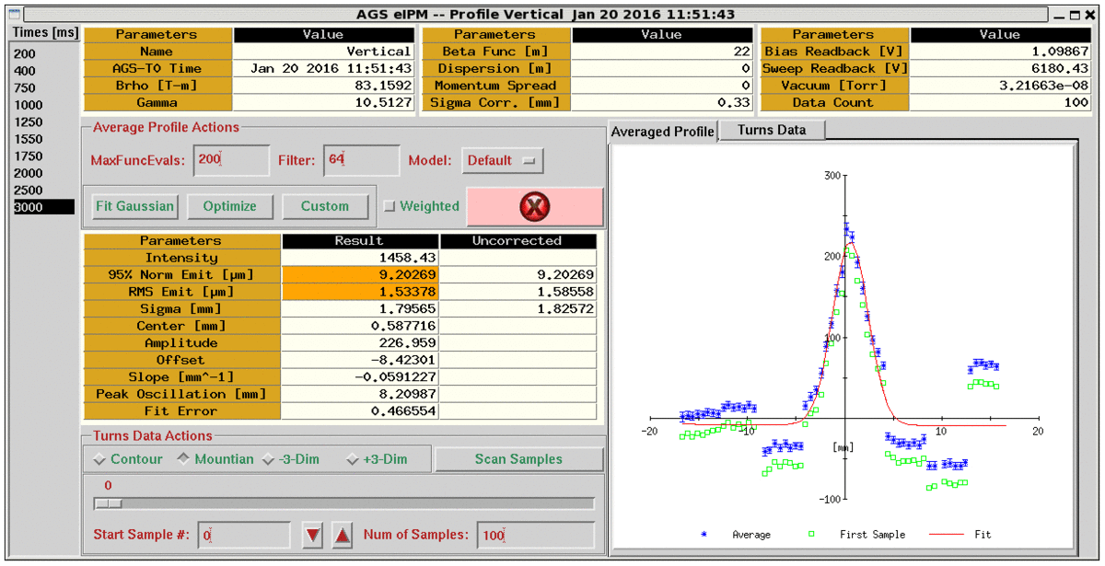
DC offsets
DC offsets was subtracted by background which is taken for each measurement.

Slide 17
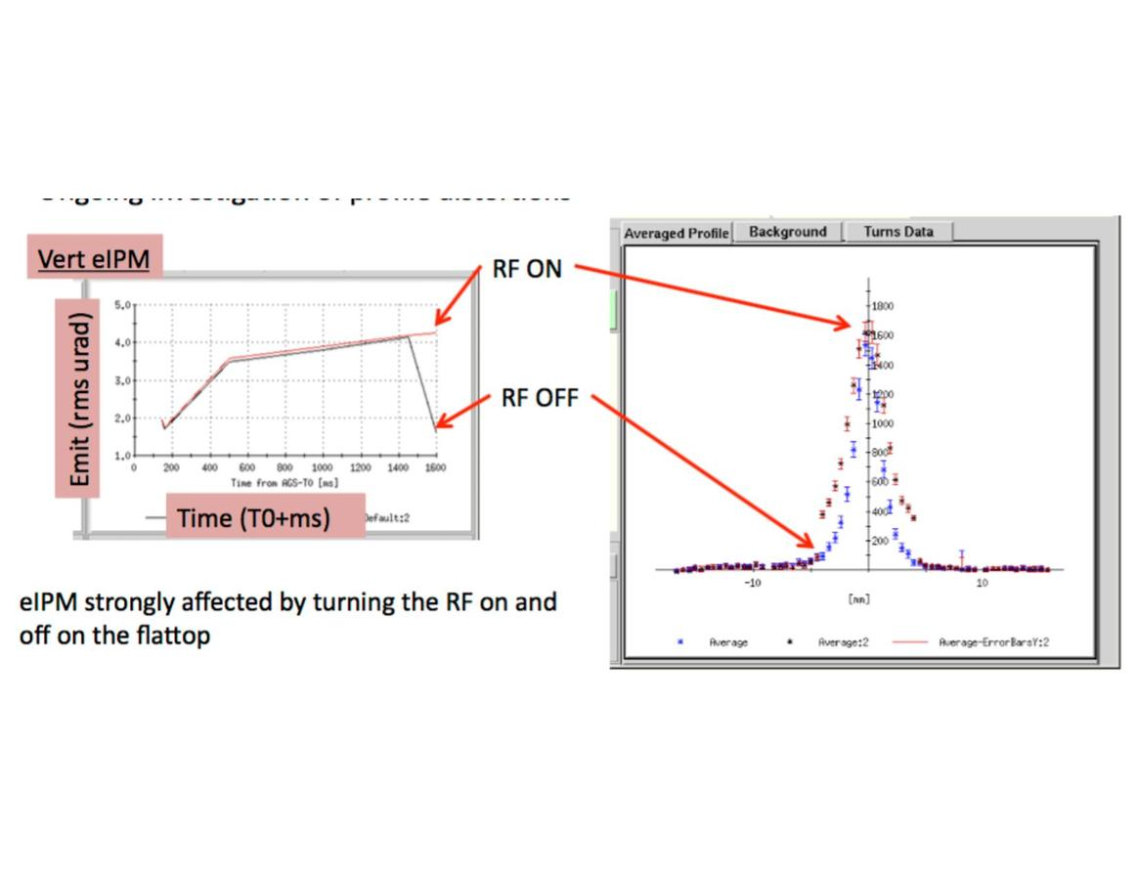
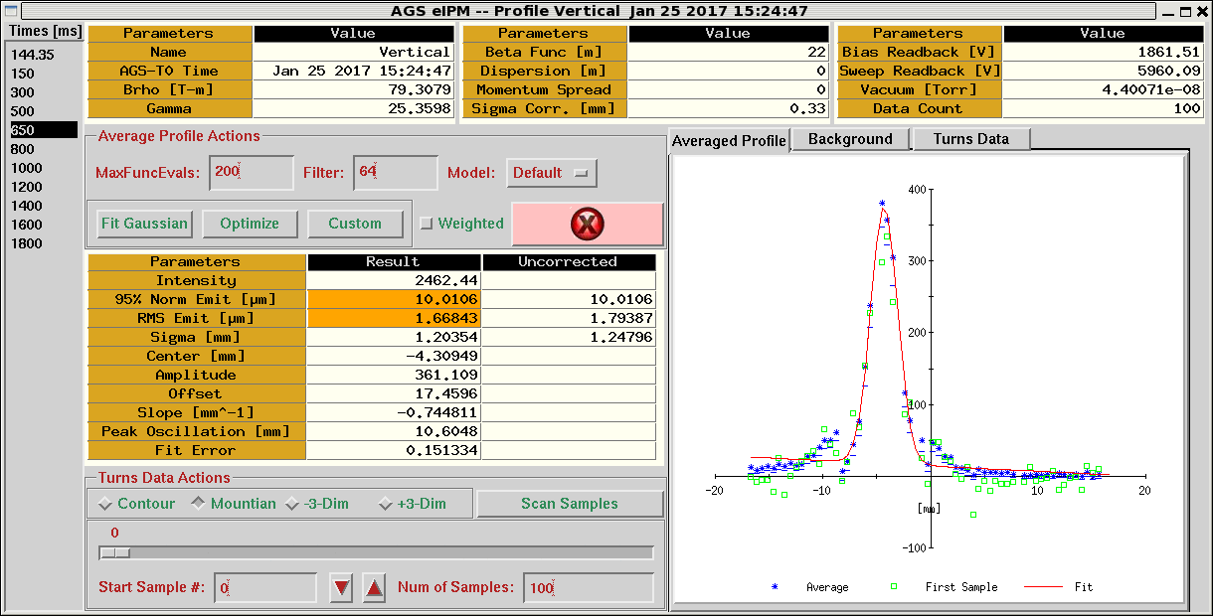
Timing problem
We observed discontinuity of beam profile between groups of 8 channels.

Slide 18
Studies on timing problem
It was long believed as a RF interference problem.
Beam studies showed no interference from local RF station. The beam was debunched first, the problem disappeared. Then it was rebunched (not completely), the problem didn't come back.
The problem stays with low bias voltage.
The test signal was installed for the horizontal eIPM. No interference from beam RF was observed.
The timing issue theory was proposed based on the test signal behavior.
It was confirmed by timing scan of the test pulse that there is timing difference of ~20 ns between channels.
It was confirmed by measuring the output from amplifier channels with scope.
The problem was mostly solved by moving the sample timing to a place less sensitive to the timing variation.

Slide 19
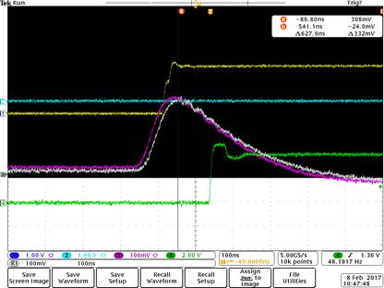
Confirmation of timing problem
Output from #1 (white) and #8 (pink) amplifier channel
Timing scan with test signal

Slide 20
Improvements
Horizontal orbit was out of the range (3.4cm) covered by the MCP in the early part of the ramp. The closed orbit was adjusted.
AC coupled amplifier produced inverted profiles. The profiles cancel out with multiple bunches in AGS.
The vertical IPM was rotated by 180 degree so that the beam stay out of the dead zone.
MCP gain was configured so that the amplitudes of profiles measured on the ramp are more or less the same.
A time out feature was added which turns off data acquisition after a preset number of machine cycles.
To calibrate the gains of MCP channels, the beam is scanned across the MCP range with either local bump or harmonics.
DC offsets was subtracted by background which is taken for each measurement.
The discontinuity of the profile was believed to be RF related was found to be a timing problem. The problem was solved mostly by fine tuning the timing.

Slide 21
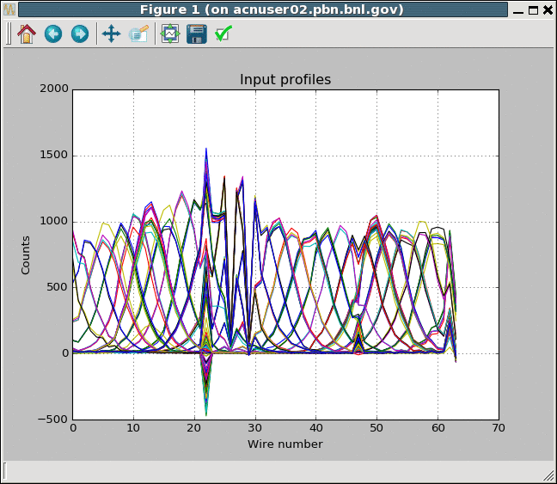
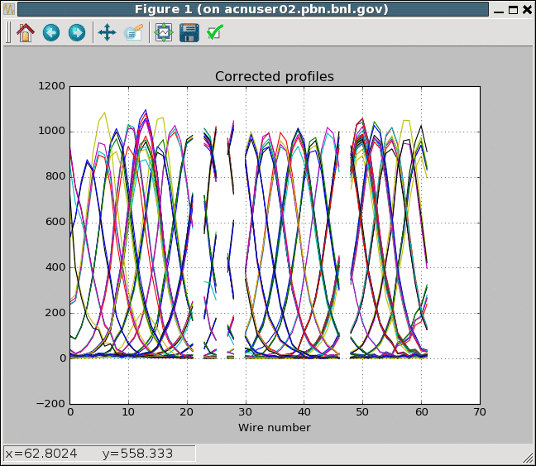
Gain calibration
There are gain variation due to wear-out of MCP. In general, the gain depletion is more severe in the center of the MCP.
The beam was scanned across the MCP with orbit bump. The profiles were fitted to Gaussian function by varying the gain of each channel.
Profiles before gain correction
Profiles after gain correction

Slide 22
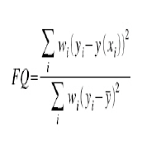
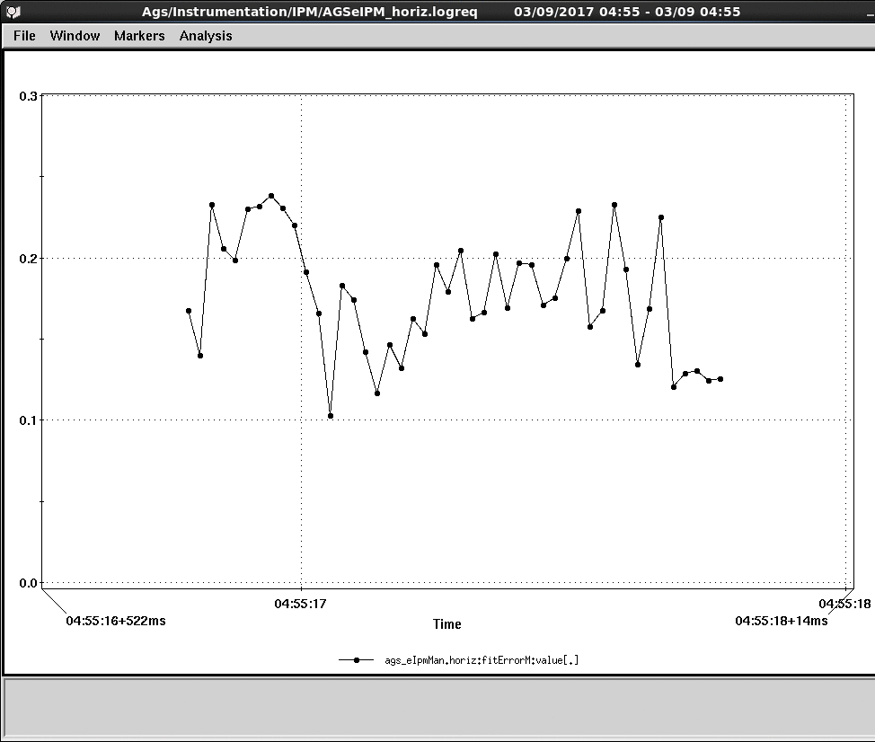
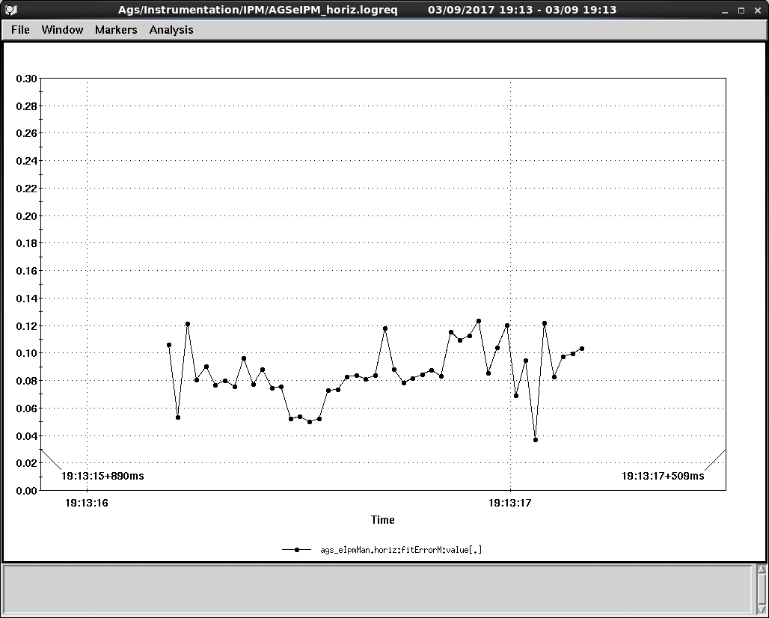
Fit quality with gain calibration
Fit quality is defined as , 0 means perfect fit, 1 means there is no correlation.
Fit quality before gain correction
Fit quality after gain correction

Slide 23
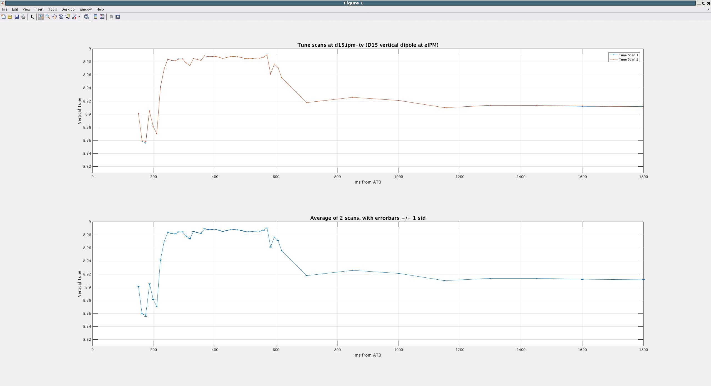
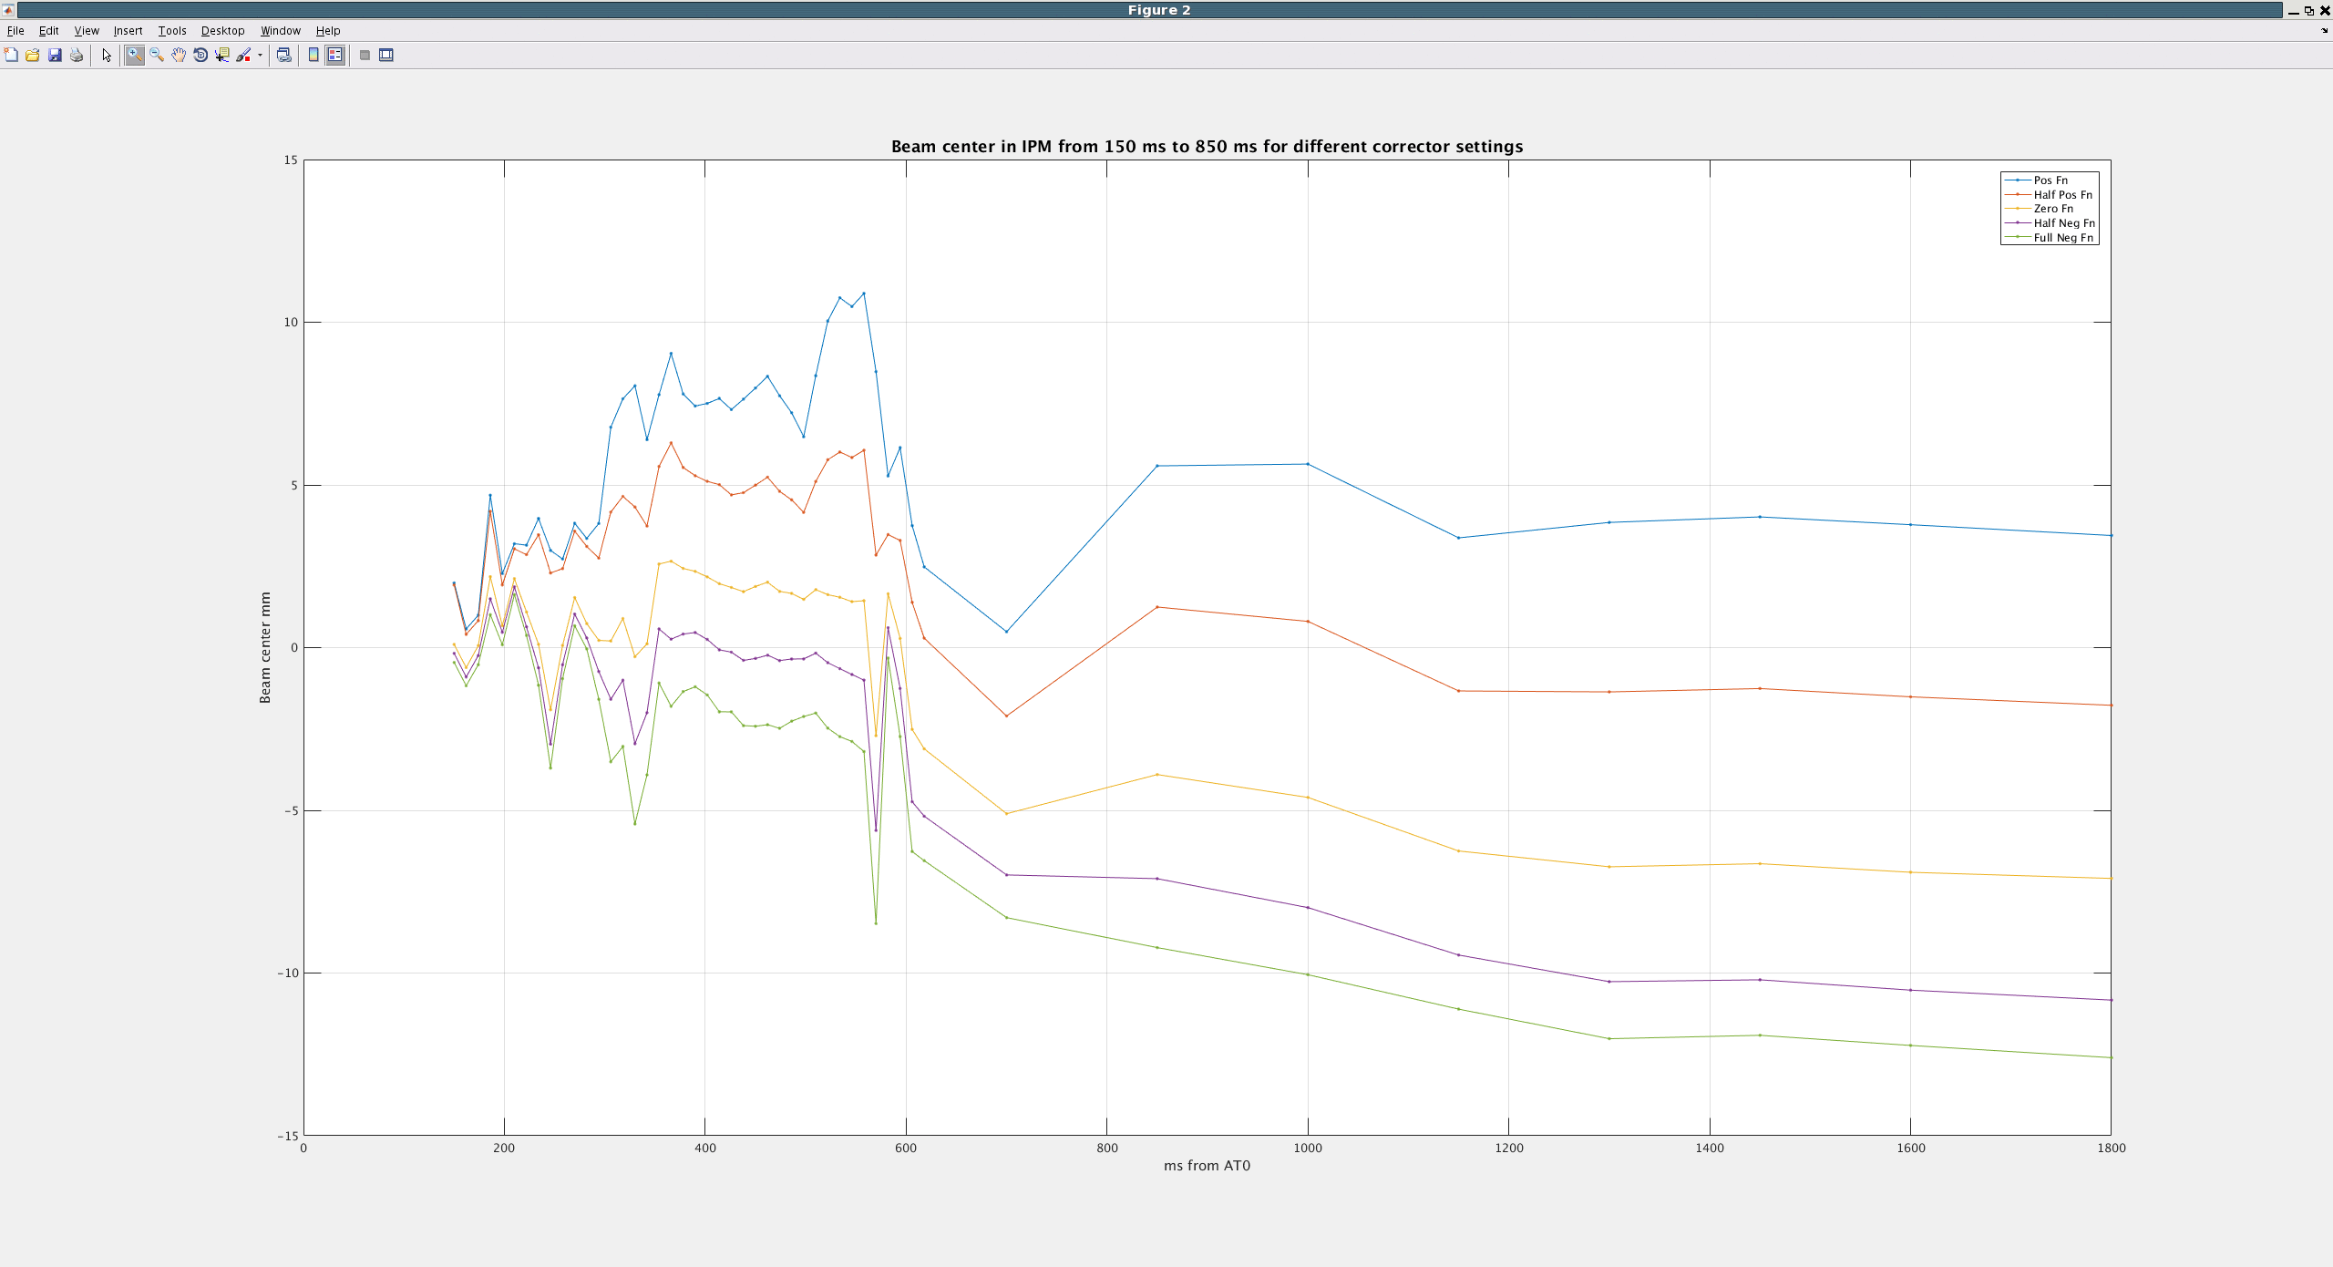
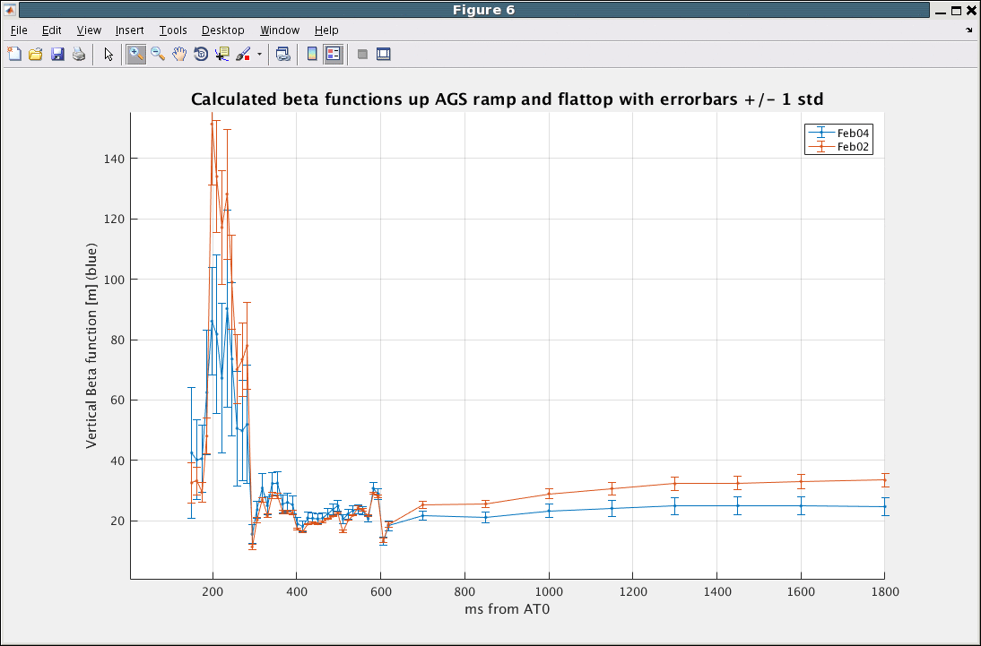
Beta function measurements results
One concern was the centroid orbit stability during the measurements.

Slide 24
RHIC Beta function measurements for IPMs
In RHIC, we kicked one bunch every 4s using tune meter kicker for an optics (also beta at IPMs) measurement. We also correct optics and measure it again, then use measured betas for IPMs emittance calculation.
One needs kicker, enough turn-by-turn BPMs for measurements, and tunable quadrupoles for corrections of optics.
We only kicked one/two out of 110 bunches. The process is quasi-nondestructive even the beam loss of the bunches was not negligible.
A single corrector scheme for measuring beta function at the IPM was done for the RHIC IPMs as well. The results are not as good as the global optics measurement scheme.
C. Liu et al., “First demonstration of optics measurement and correction during acceleration with beta-squeeze in a high energy collider”, in Nucl. Instr. Meth. A, vol. 816, 2016.

Slide 25
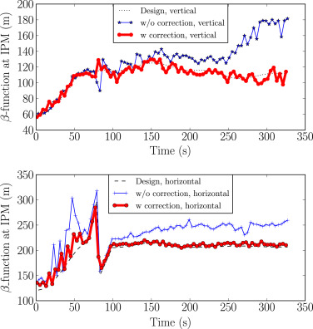
The model and measured β-functions on the ramp at the ionization profile monitors in the Yellow ring with and without ramp optics corrections.

Slide 26
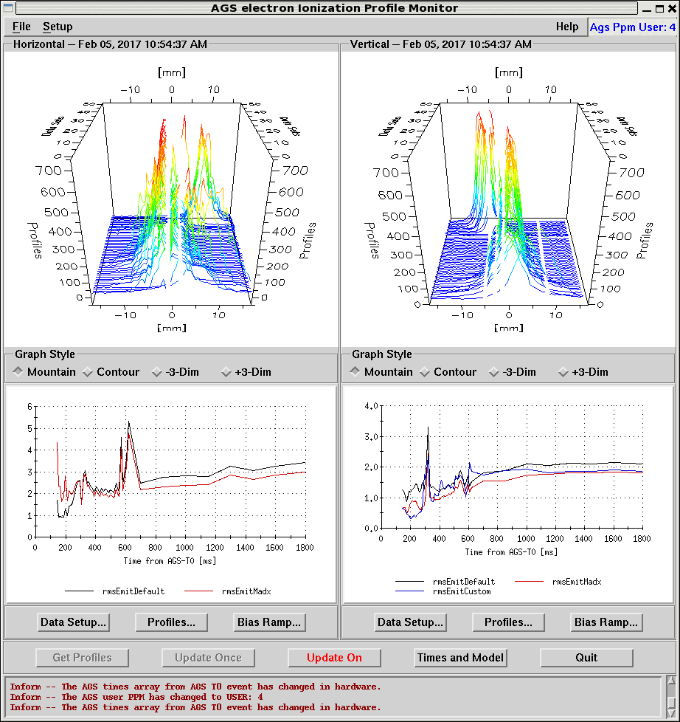
Impact of measured beta functions

Slide 27
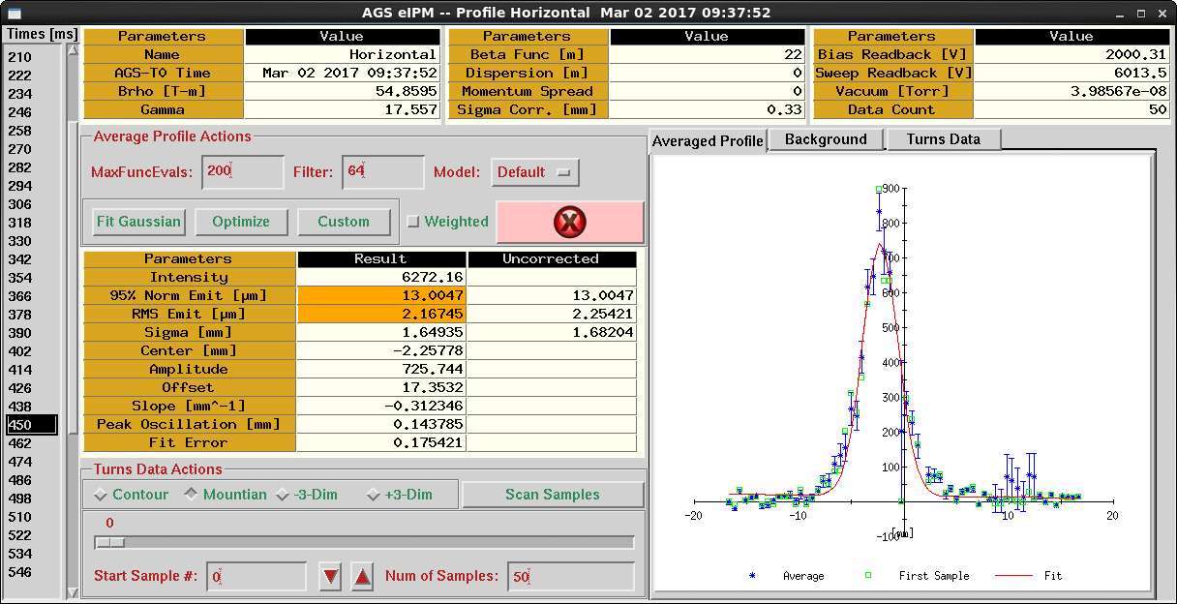
Noise channels
There are corrosion issues on the IC pins which are worse on the bottom channels due to humidity.
It helps reducing the noisy sometimes when reseating the digitizer boards.

Slide 28
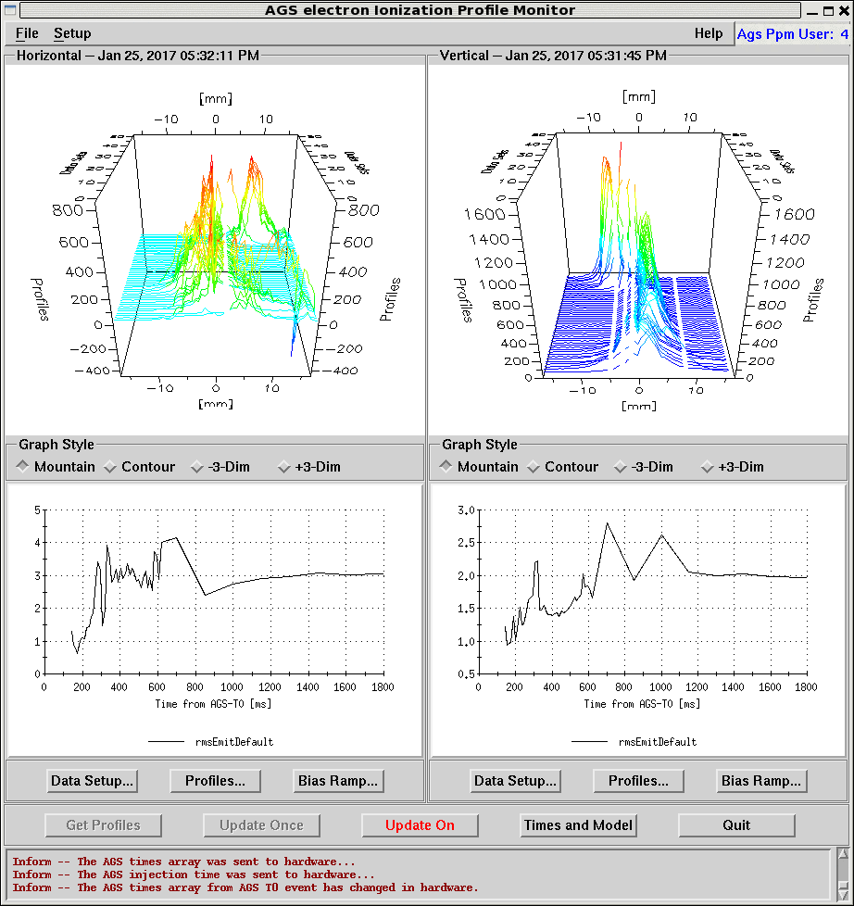
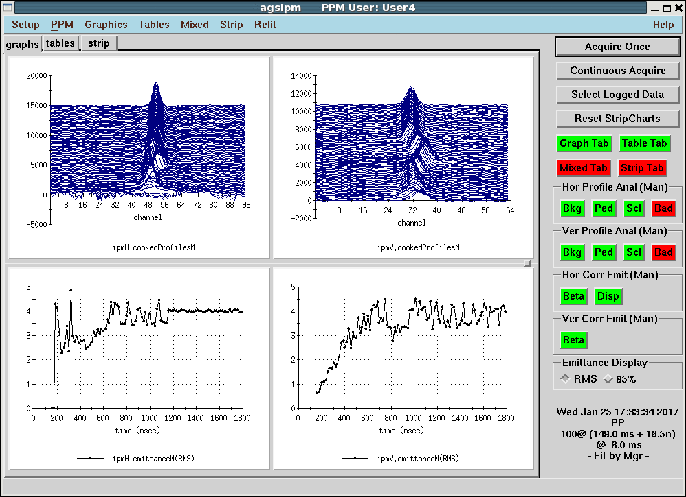
eIPM vs IPM, RF on
The beam emittances reported by eIPMs were smaller than those reported by IPMs.

Slide 29
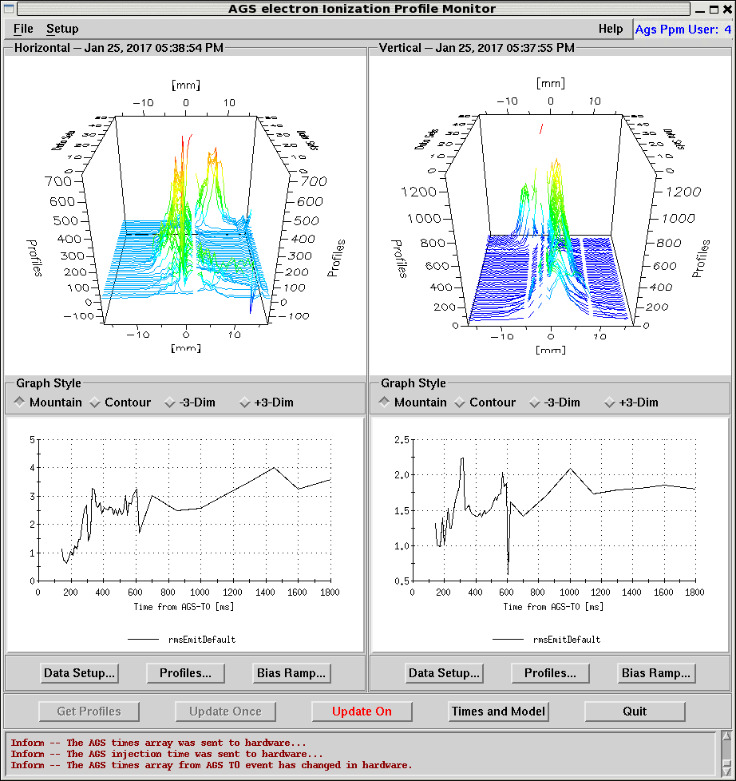
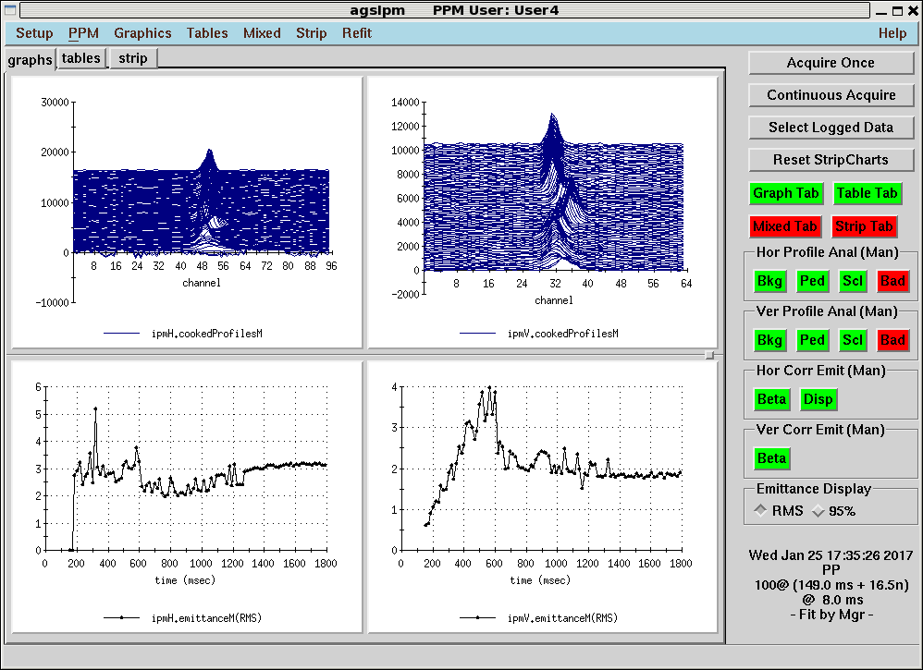
eIPM vs IPM, RF off
When RF was turned off ~600 ms during the cycle, the emittances reported by eIPMs did not drop like the ones reported by IPMs.

Slide 30
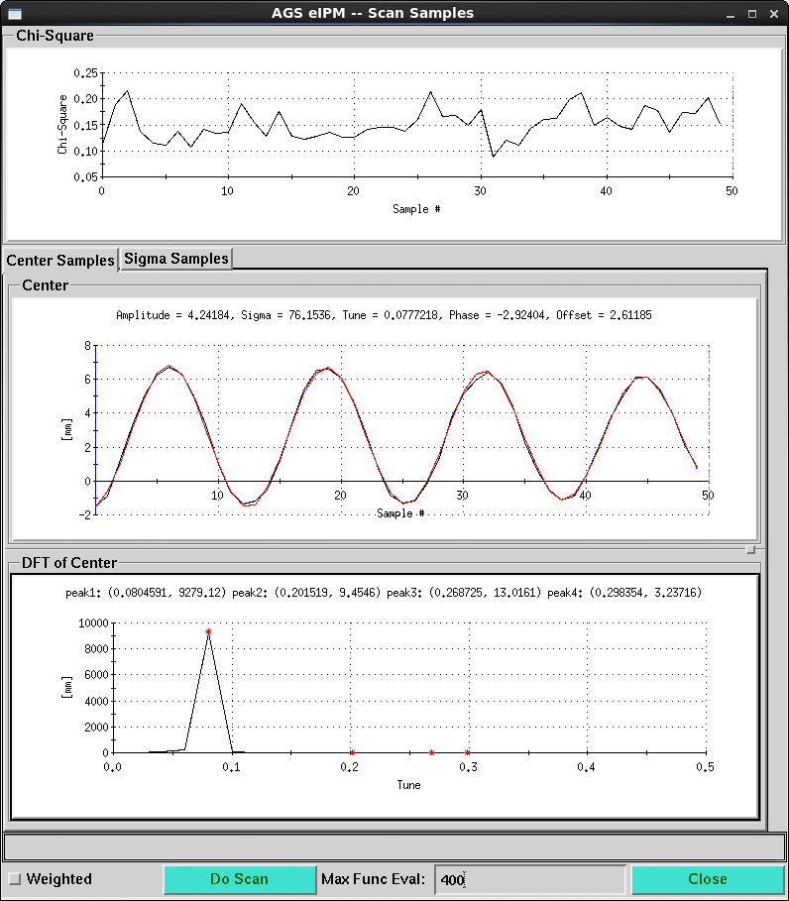
Injection oscillation

Slide 31
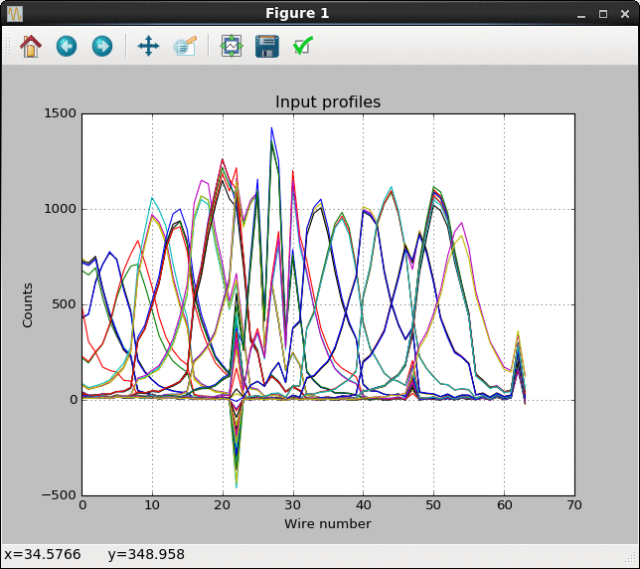
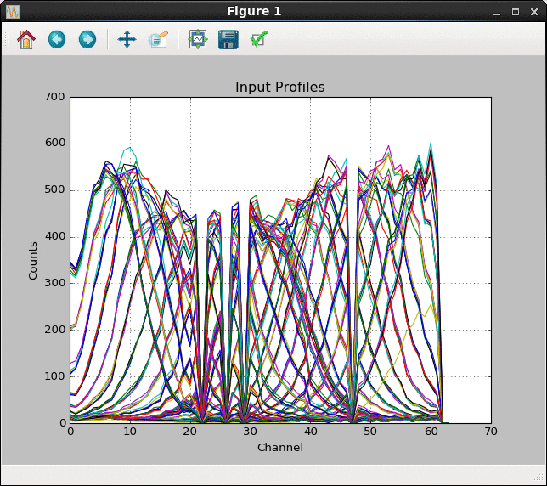
MCP lifetime
Gain depletion
Scan on Jan. 5th.
Scan on May 10th.

Slide 32
Other features
The spin polarization measurement takes 15-20 AGS cycles. The eIPMs are configured to take emittance measurement for 5 of these AGS cycles.
It takes 110 AGS cycles to fill one of the RHIC rings. The eIPMs are configured to take emittance measurement for 20 of these AGS cycles.
There are 49 times during the AGS cycle at which emittance measurements are taken.

Slide 33
Summary
The installation of AGS eIPMs started in 2013. It started to provide regular emittance reporting in 2017 for the polarized proton program.
It requires gain calibration every ~4 months due to gain depletion in the center region of the MCP.
It is crucial to measure the beta functions for a better understanding of the emittance evolution during the AGS cycle.
It has been used in many beam studies.

Slide 34
Acknowledgement
Thanks to Roger Connelly for the intensive knowledge transfer.
Thanks to Craig Dawson and Steve Jao working on hardware and test signal.
Thanks to Steve Tepikian working on software.
Thanks to Vincent Schoefer working on gain correction and diagnosis.
Thanks to Caitlin Harper working on beta function measurements.
Thanks to Ian Blackler working on automating data taking.
Thanks to Michiko Minty, Haixin Huang and Kevin Brown for support.

