Slide 1

Preliminary Study on IPM for CADS Injector I
Jun He
IHEP
ARIES IPM workshop
22th May,2017,GSI

Slide 2
Outline
1
Introduction
2
The IPM for C-ADS injector
3
IPM history in China
4
Summary

Slide 3
1. Introduction China Accelerator Drive Subcritical system
Finished
Goal: 1.5 GeV, 10mA, CW
IMP
Difference of injector :f and cavity type
Under construction
Main Linac
IHEP
12 β=0.21 cavities in Cryomodule3,4
14 β=0.12 spoke cavities in Cryomodule1,2
2 injectors have been finished, getting a 2mA, 10 MeV, CW beam. The main linac is under construction in Lanzhou. The facility will locate in Huizhou near the Hongkong in the end.

Slide 4
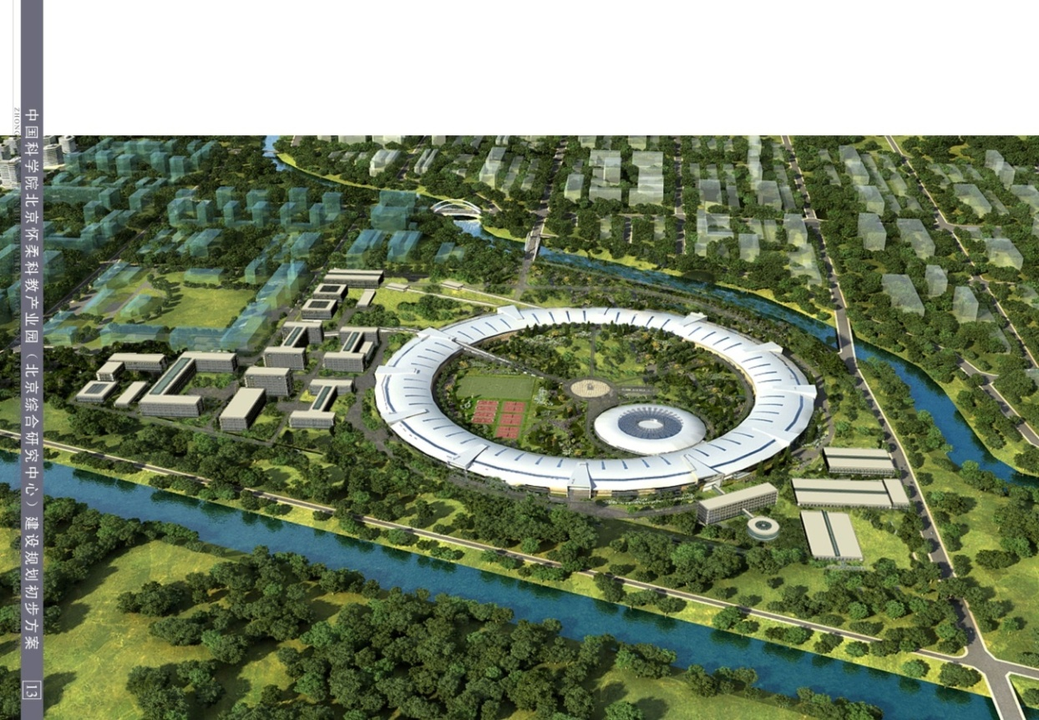
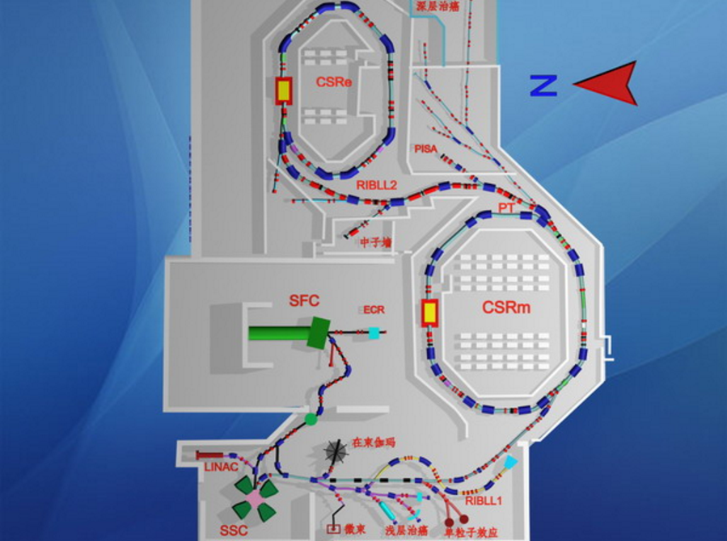
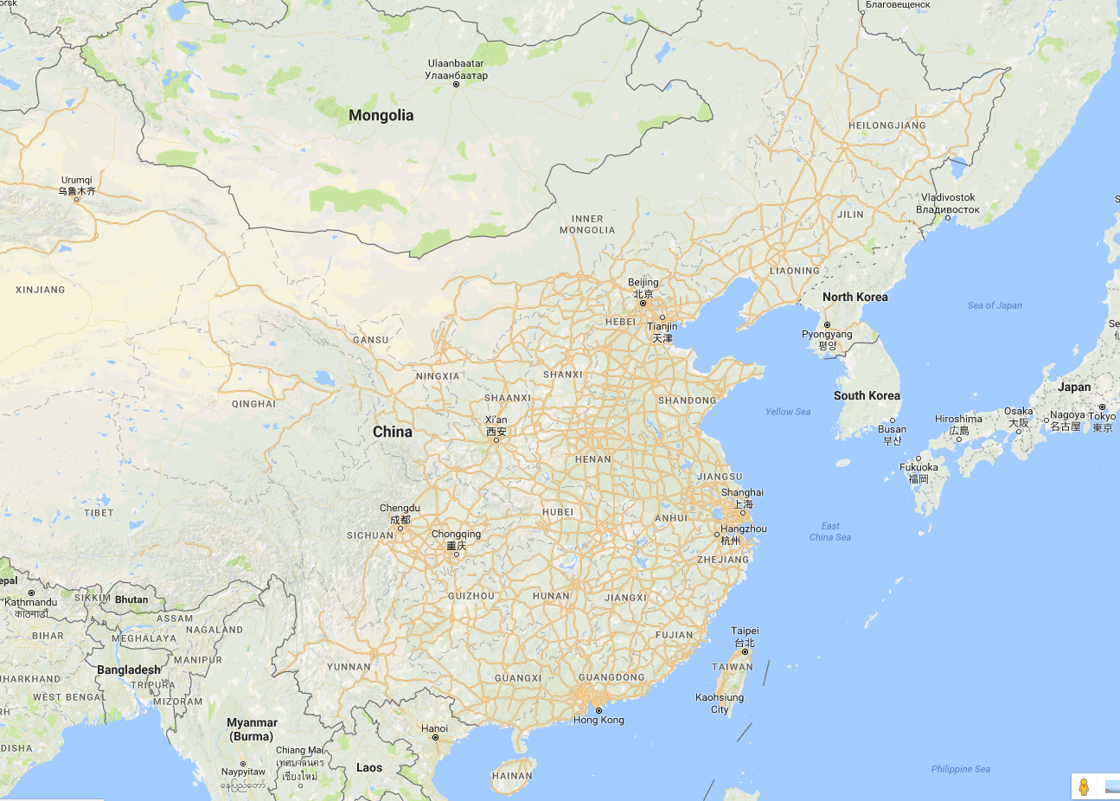
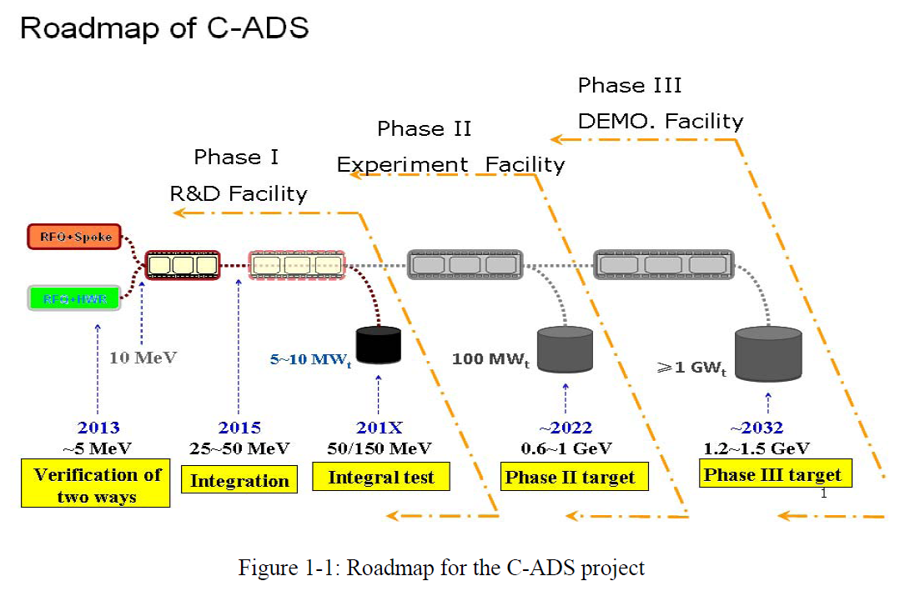
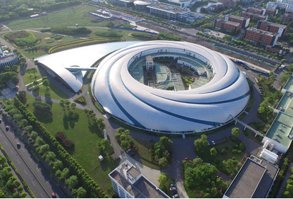
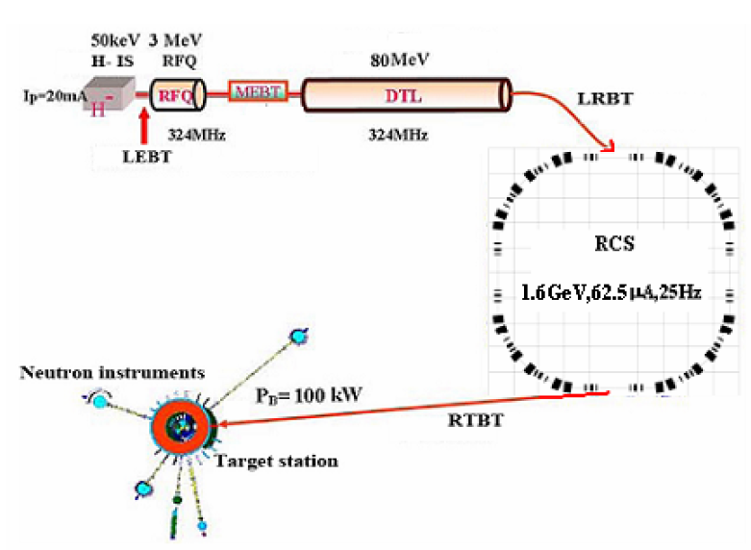
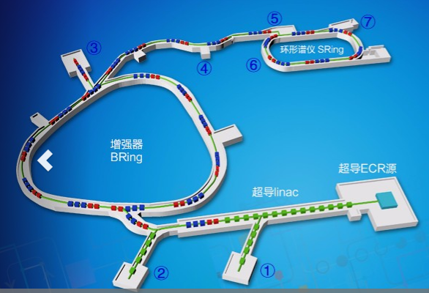
Both ADS and HIAF(High intensity heavy-ion Accelerator Facility）will locate in Huizhou
HIAF will be built in Huizhou with proved fund of $ 0.2 billion. The center of the ion machine research will shift to the south of China.
IMP@HIRFL
IHEP@BEPC& HEPS
ADS
~1000 km
SINAP@SSRF
~1000 km
~2000 km
IMP@HIAF
IHEP@CSNS
~100km

Slide 5
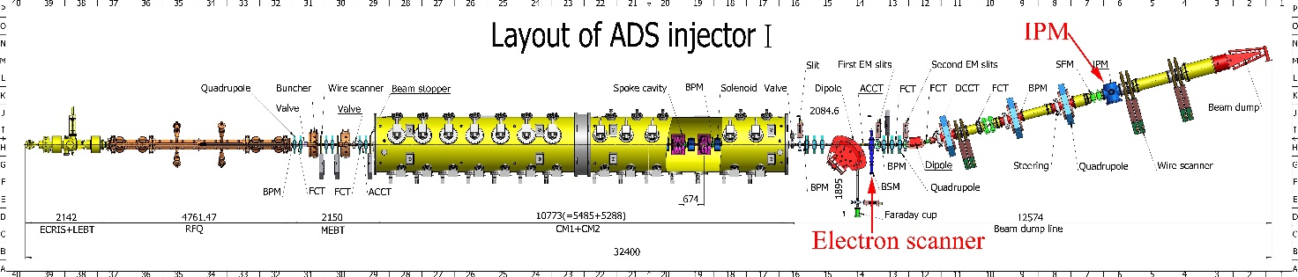
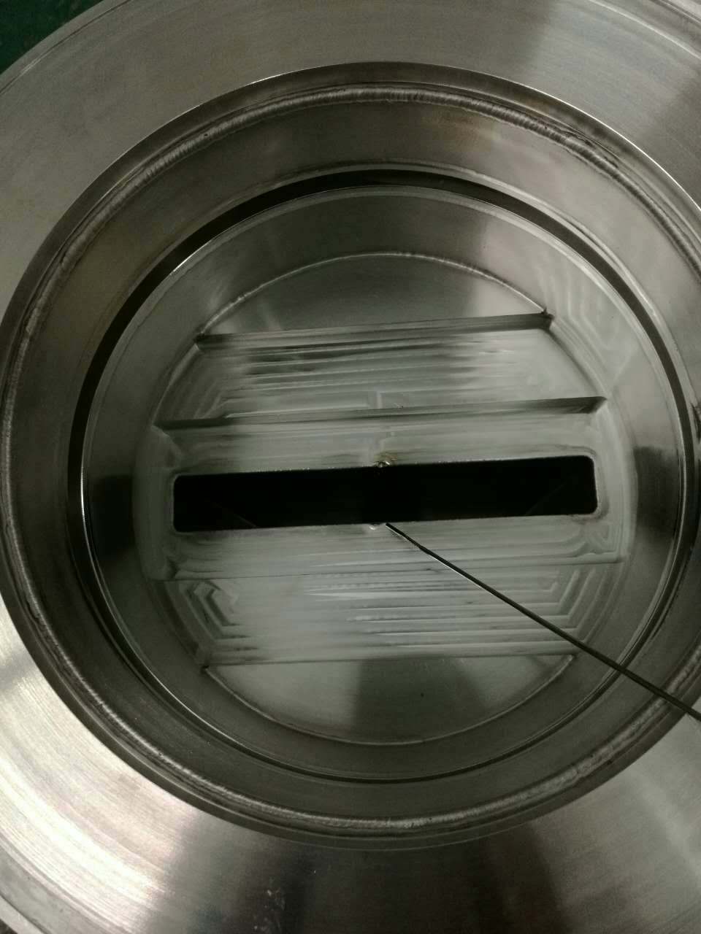
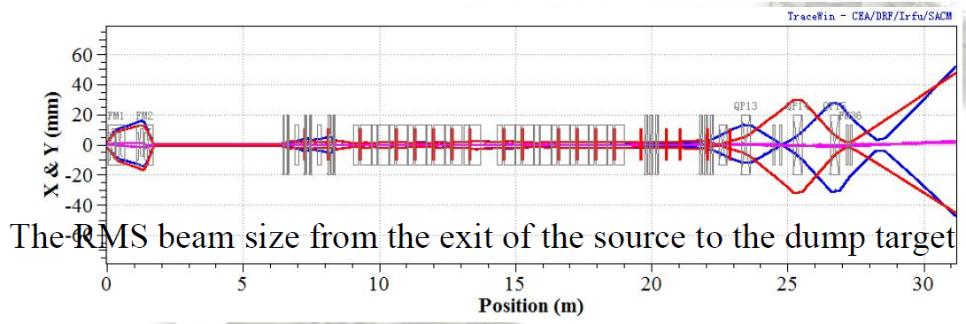
Minimal-invasive profile measurements on Injector-I
The layout of ADS injector I and the location of the IPM
According to the physics design, a flat beam at the IPM
A SFM system is used for homogenize the beam
Blue~X Red~Y
IPM
15×4 mm
Cross section of SFM

Slide 6
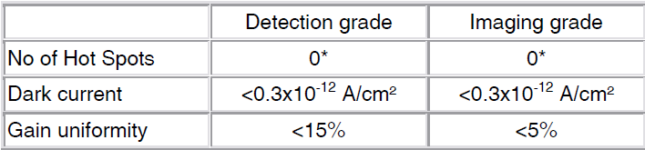
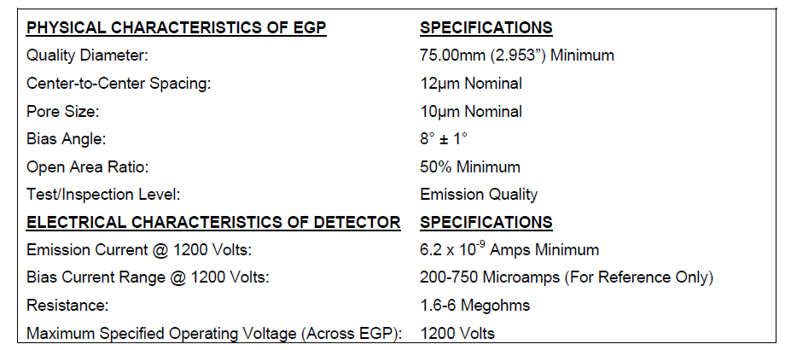
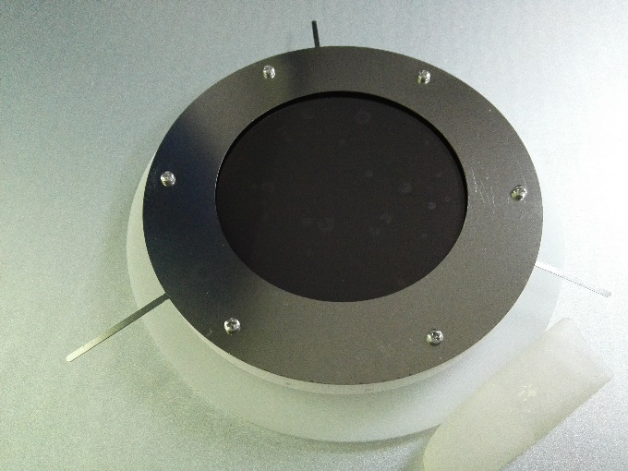
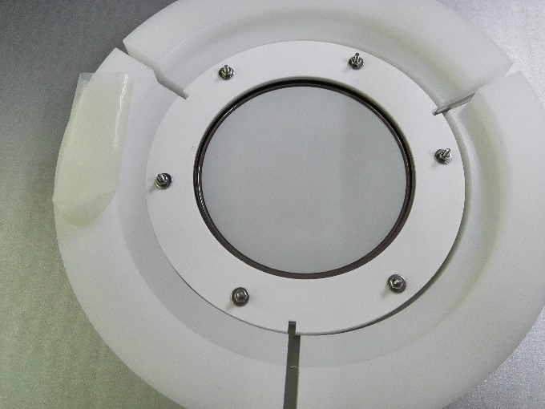
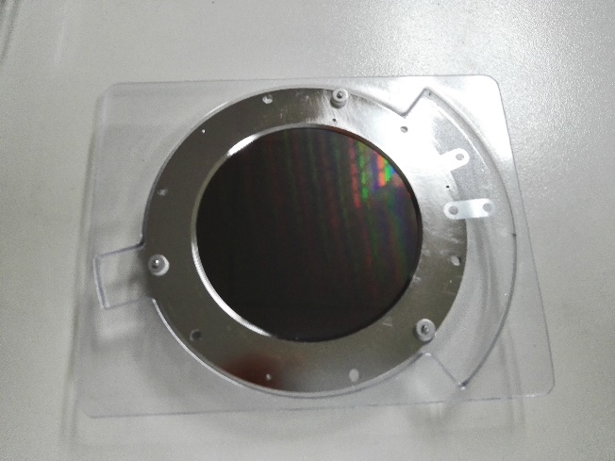
Design parameters
Design parameters(unit) | Value
Electric field (kV/cm) | 1
Distance of two plates (mm) | 80
Size of MCP (mm) | Φ75
Size of EGA (mm) | Φ70
Detector | P43 Screen+CCD
Work mode | ions
TECTRA MCP-90-D-R-A
PHOTONIS EGA
Parameter of the MCP and EGA
Input side view of MCP
Output side view of MCP
PHOTONIS EGA
2 stage with Gain:10⁶

Slide 7
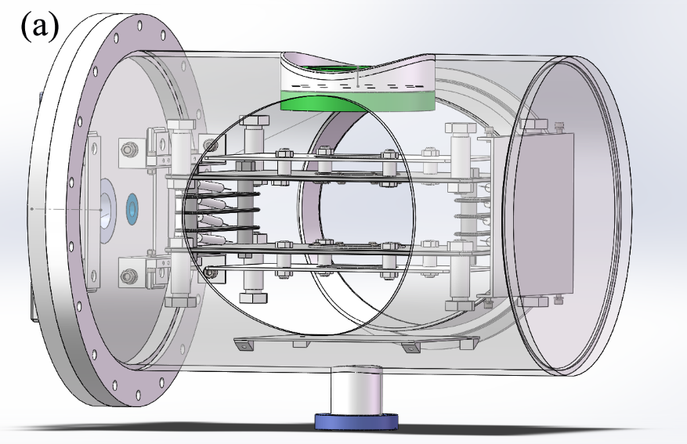
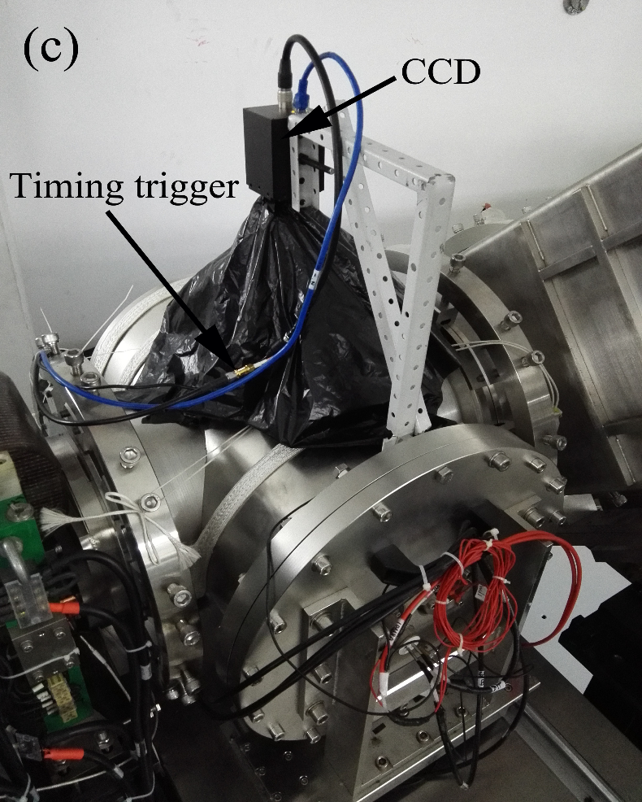
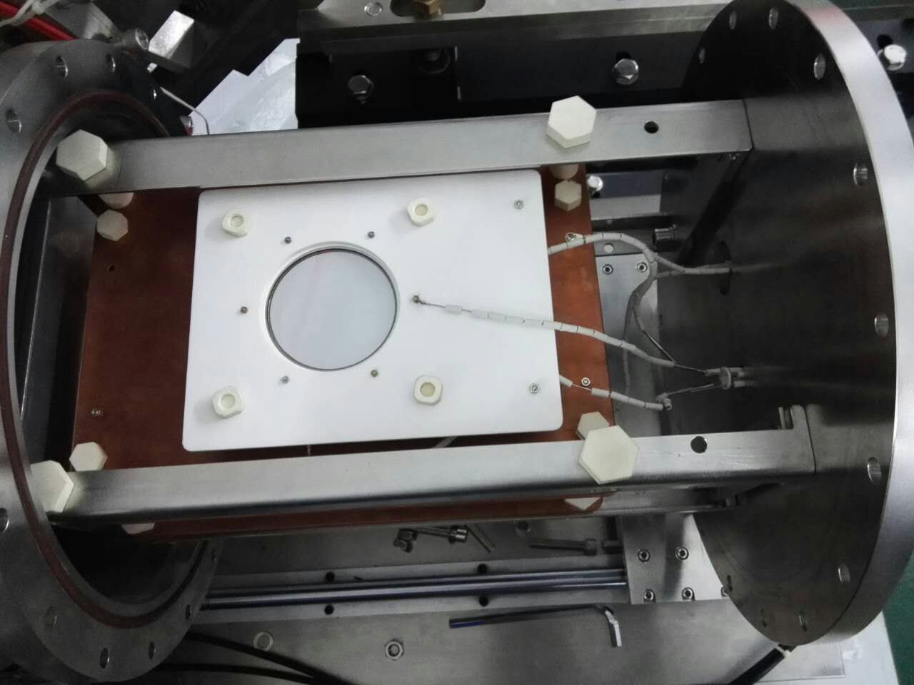
IPM for CADS
2 big：320×200×3 mm
6 small：180 ×30×3mm
cover
(b)
The Ionization profile monitor system.(a) mechanical design(b) inside structure (c) outside structure of the IPM.

Slide 8
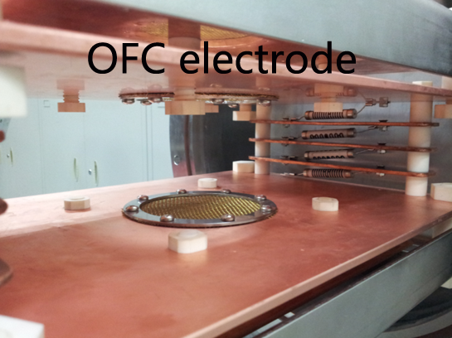
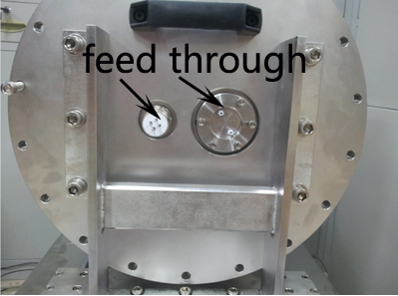
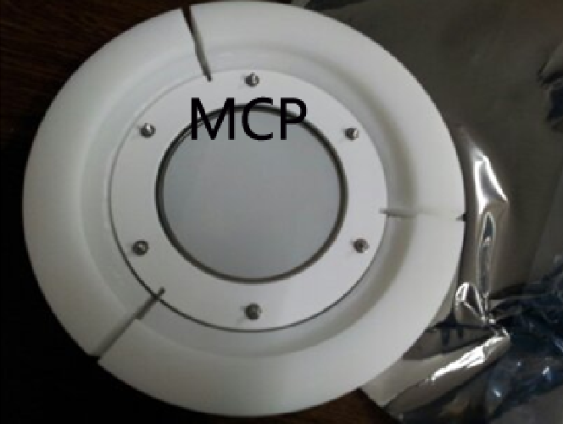
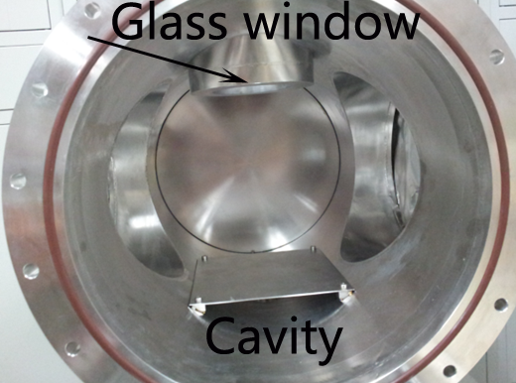
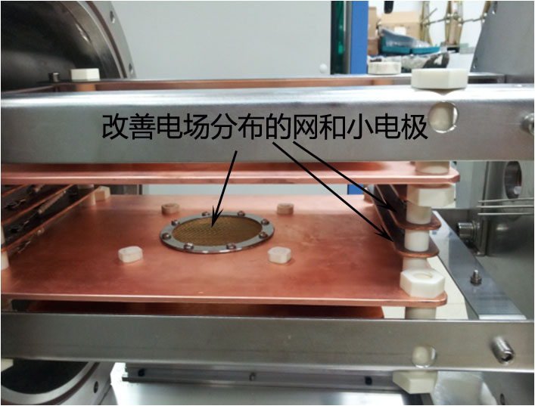
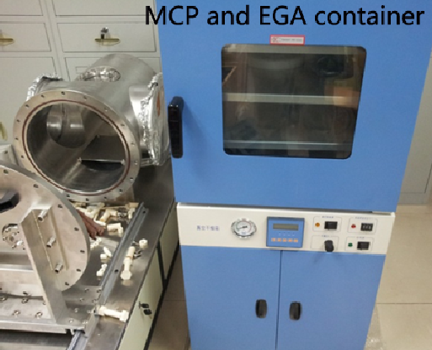
IPM system components
A net made by copper wire
Photos of IPM components.

Slide 9
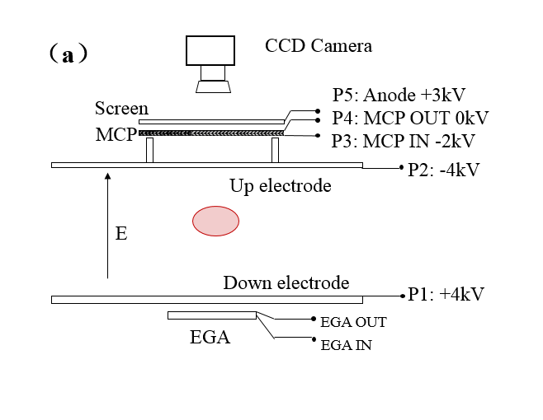
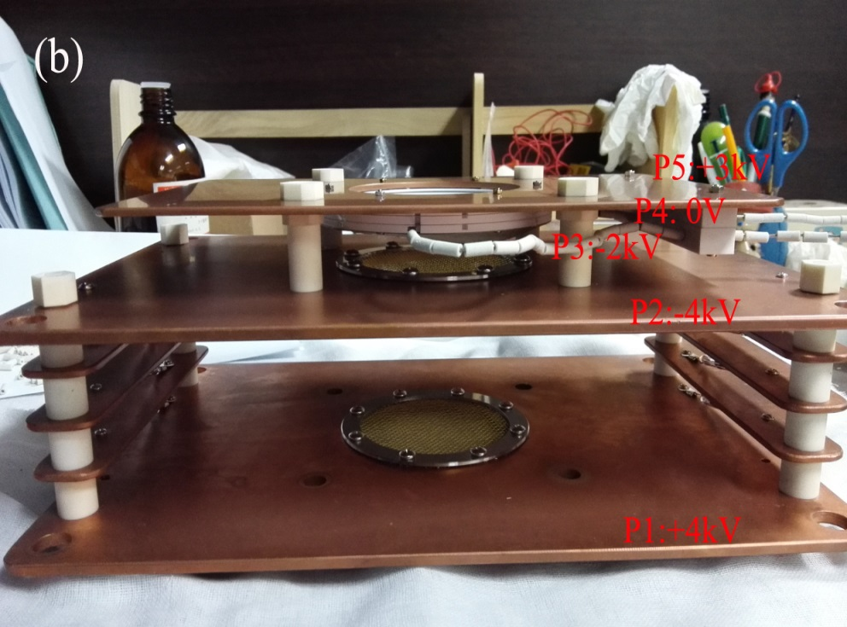
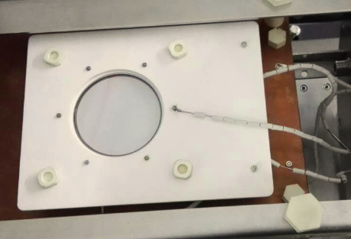
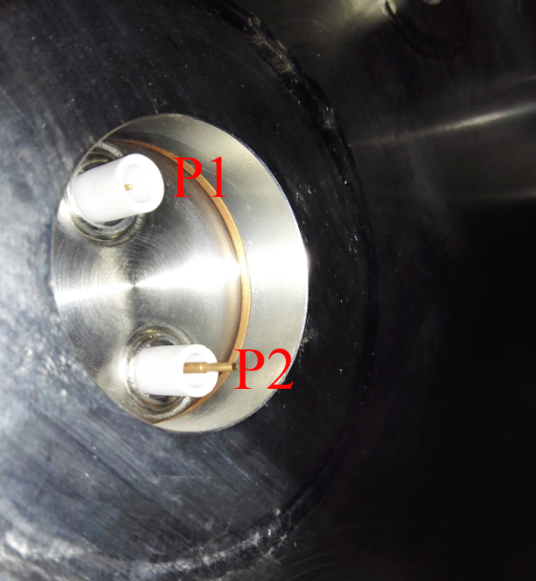
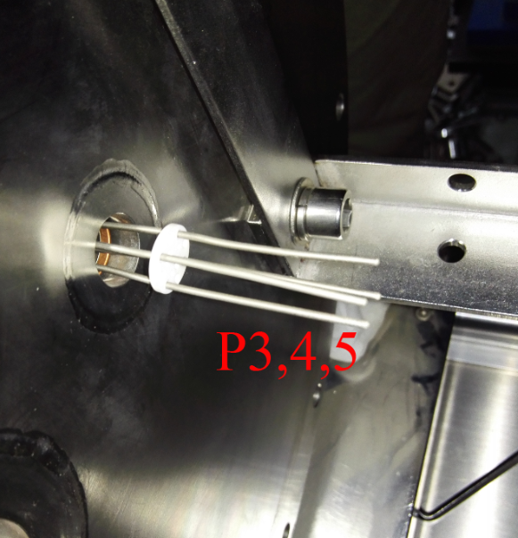
IPM system potential distribution
Instead of by ceramics
(a)Potential distribution MAP of IPM (b) picture of Oxygen-free copper electrodes and MCP.
10kV and 3 kV feed through
The left free pin is keep for EGA, which is not installed right now.

Slide 10
IPM test: beam parameters
10 MeV, 2mA, 10⁻⁵ Pa, l=30mm, ω=20eV,
N_{D}=7.72 × 10⁶ pps, E_{space}max=100V/m
The signals is very strong for CW beam but the space charge effect is small.
P43: 2.3eV(550nm): transfer efficiency: 0.05photons/ev/electron
CCD Resolution: 1360×1024, pixel Size: 5.3×5.3 μm
Digital data: 10 bits
Optical system resolution: ~100 μm/pixel

Slide 11
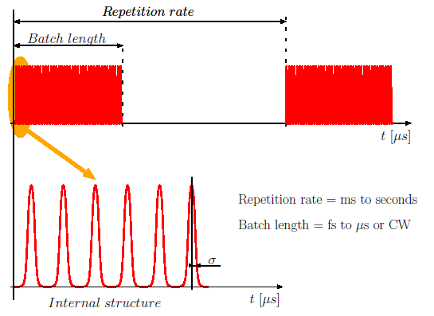
External trigger~ synchronize exposure
Trigger signal
Exposure time
EVG/EVR
DG645
CCD trigger
The scheme of the timing system
The repetition rate: 1or 2 Hz. f=325 MHz
Delay of the cable：~ 1μs
Exposure time：100μs ~1s （several μs after the rising edge of the trigger）
Nominal after time of the P43: 90%~10% 1ms 10%~1% 1.6 ms

Slide 12
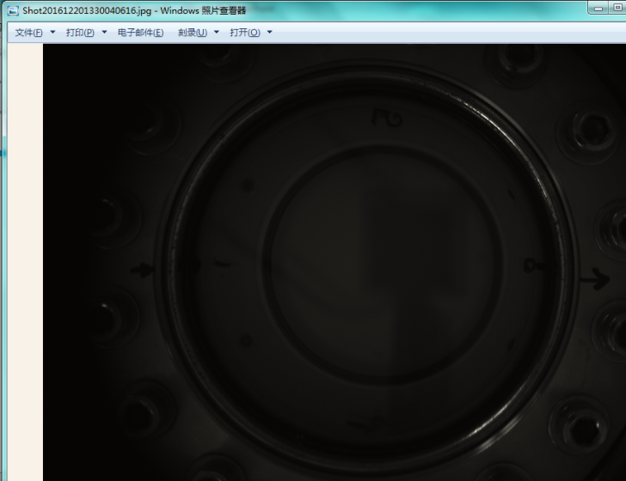
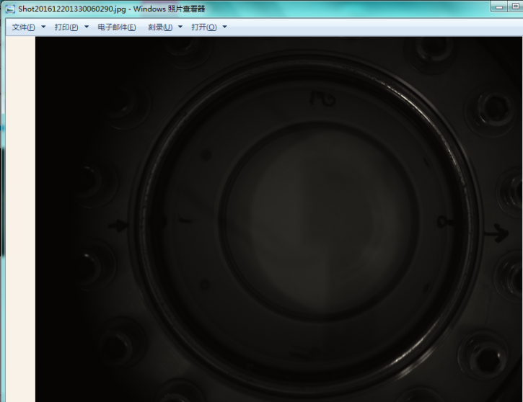
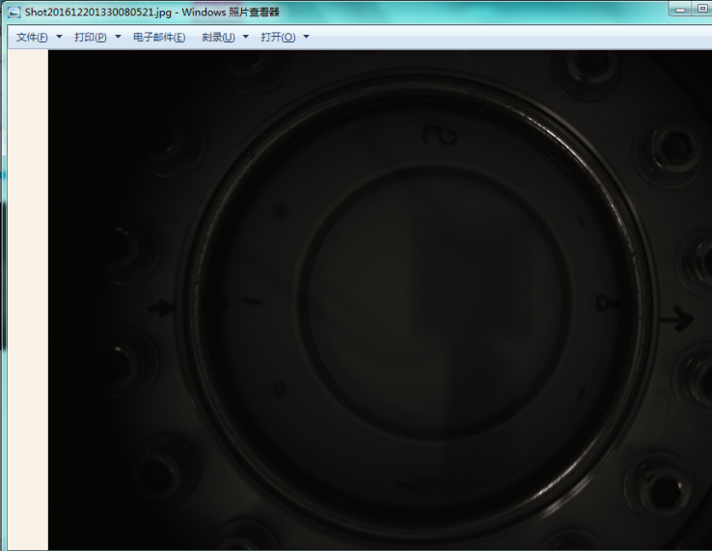
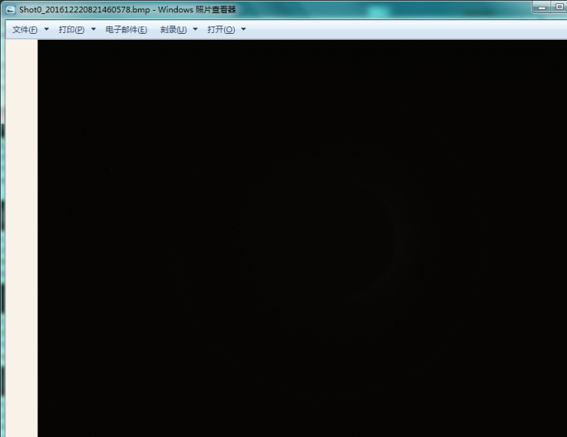
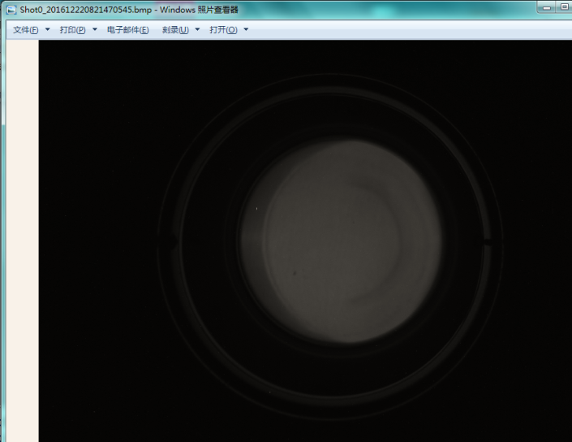
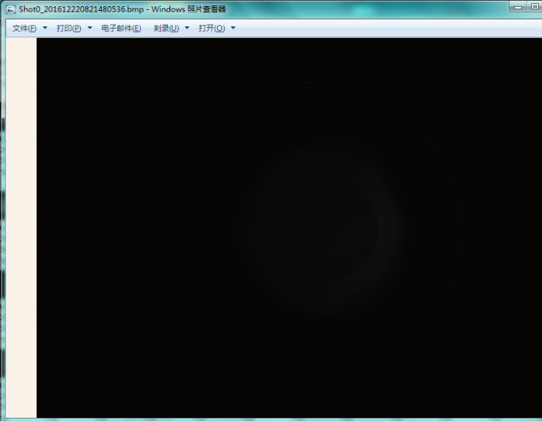
IPM test results
Beam direction
(a1)
(a2)
(a3)
ΔT=1s
ΔT=1s
Shadow of the CCD and cables
(a) before (b) after adding a cover
(1)without (2)with(3) without a beam @ time interval: 1 second
(b1)
(b2)
(b3)
ΔT=1s
ΔT=1s
Notes:
2016.12.20 13:30:04@13:30:06@13:30:08
2016.12.22 08:21:46@08:21:47@08:21:48

Slide 13
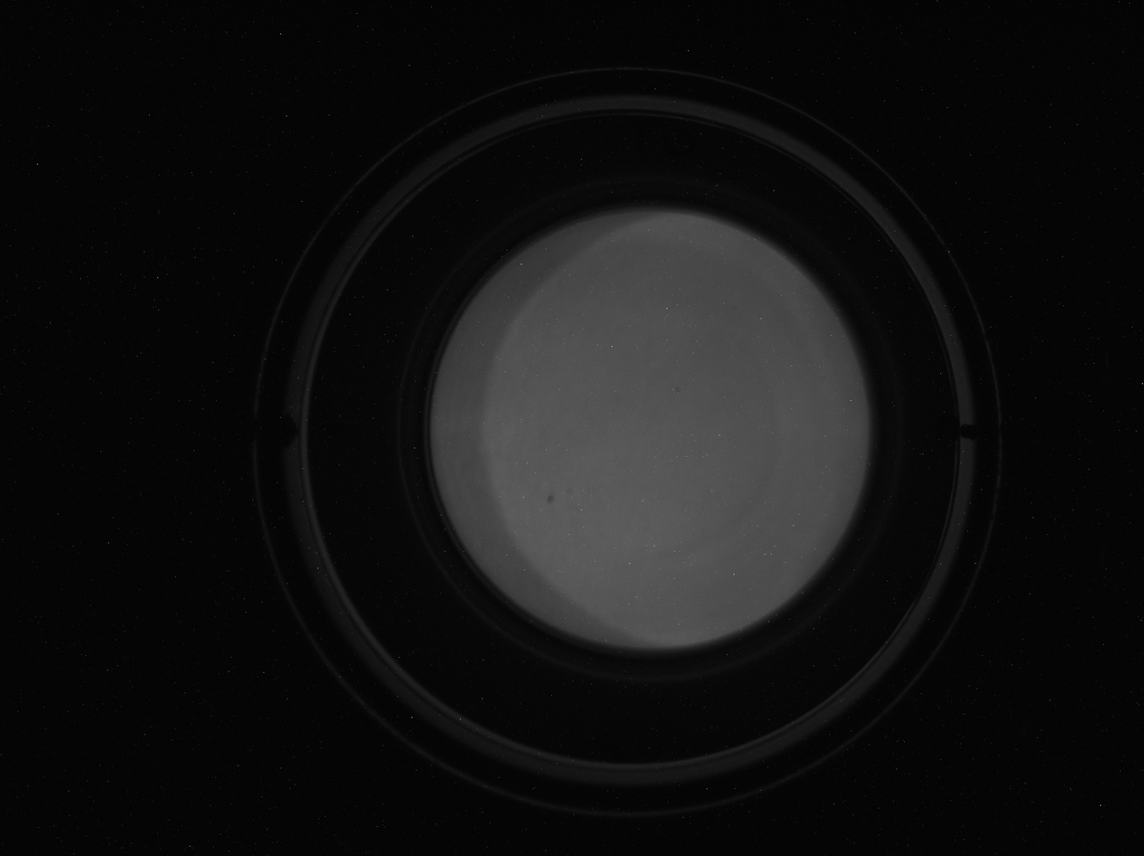
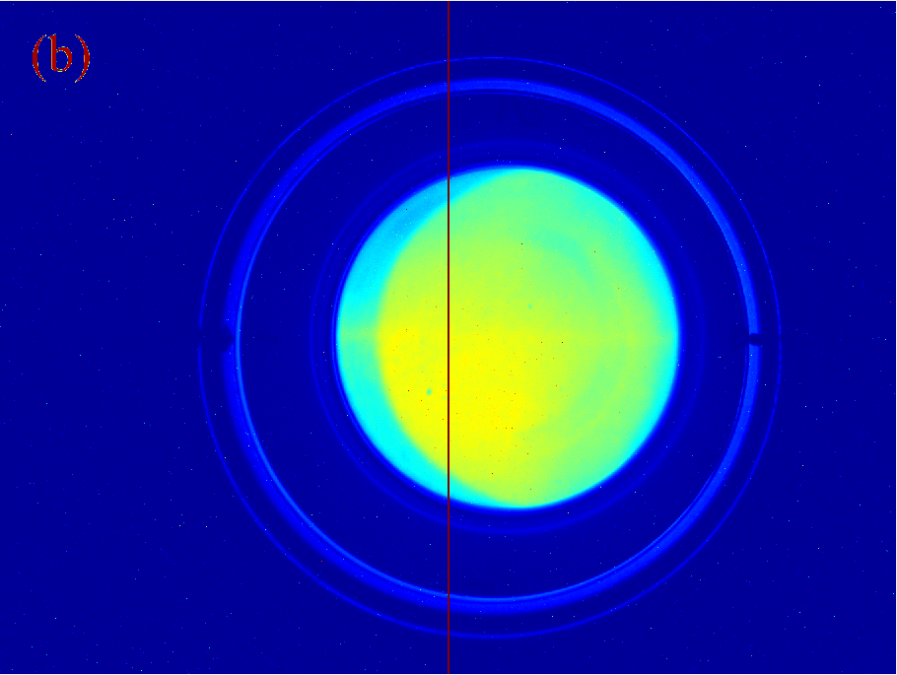
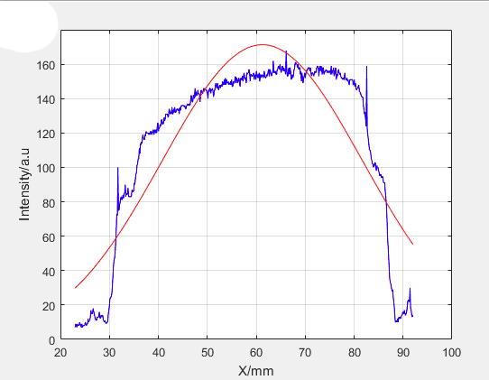
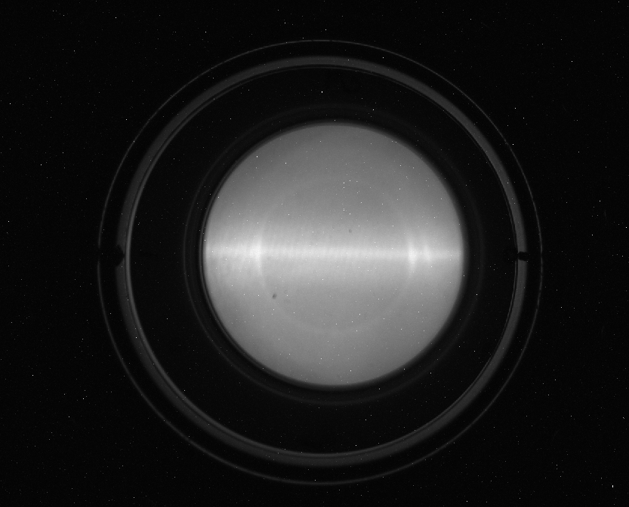
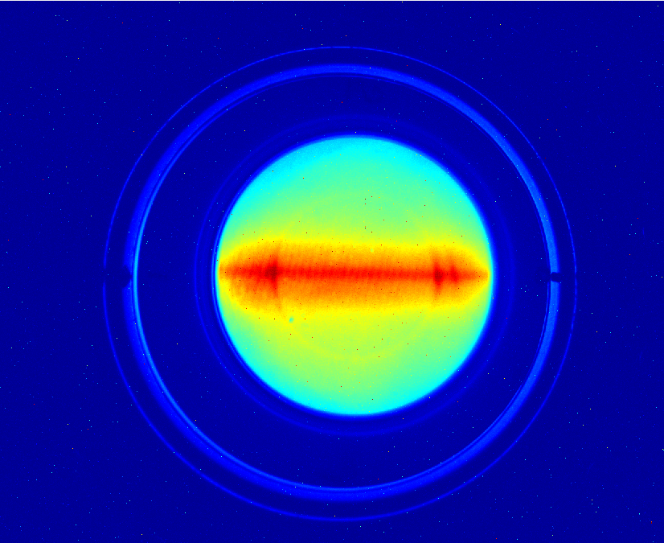
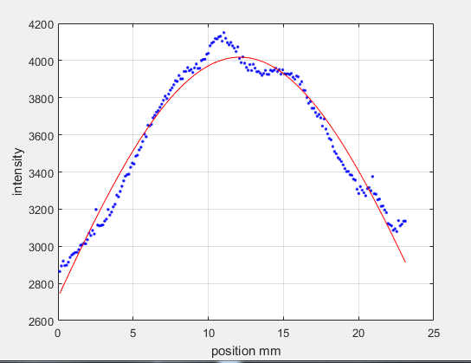
IPM test results~~ a very noisy signal
pseudo-color
Design value ~15mm
(b)
(b)
(b)
Integral line/area
RMS=28.10±0.90 mm
（c）
pseudo-color
（c）
（c）
（c）
Only few pictures show a gaussian-like distribution
RMS=13.72±0.28 mm
(b)Low duty factor measurement results (c) high duty factor results 10%

Slide 14
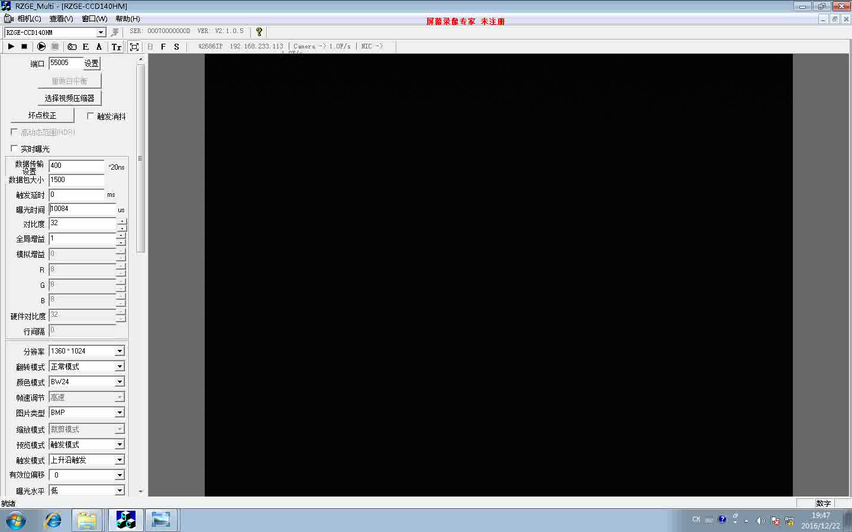
On-line test of IPM
The commissioning strategy is increase the duty factor from 1‰ to 1.
The intensity changing is caused by the duty factor and exposure time.
Beam direction
Measurement direction
exposure time
100ms
10ms
50ms
30ms
Notes:
There is not special time for IPM test. All the results is took during the CW commissioning. The trajectory of the commissioning is changing the length of the macro pulse. From 50 us, 200 us,1 ms ,10 ms, cw. The repetition frequency is 1Hz. Pressure is about 1x10-5 pa.
The video is the results of the IPM when the linac is CW commissioning. The exposure time is 10 ms 30ms 100ms.

Slide 15
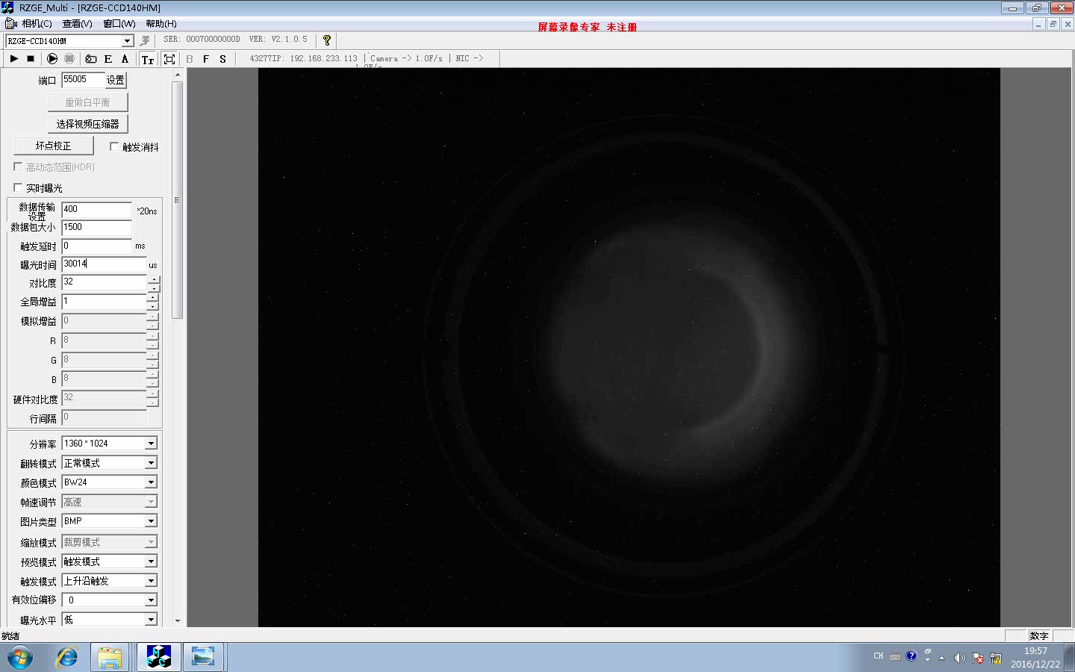
On-line test of IPM
Only a high duty factor can get a beam-like distribution
Exposure time is fixed to 30ms
30 ms

Slide 16
Result analysis~~possible reasons, plan in future
Too close to the dump induce a noisy background
The beam size is bigger than the size of the MCP,(Beam halo induced a very broad distribution)
Device problem
Dynamic range of the CCD is not big enough???
To change the setting of corrector or Q
To use wire scanner to find out the size of the beam.

Slide 17



IPM development history in China
Institute/Machine | Maker | Characteristic | State
IMP/Transfers line | Xiaoyan Zhao | Ion /Electronic | Retired(beam test)
IMP/CSRm&Linac | Hongming Xie | Ion/Optic | Commissioned
IHEP/CSNS-RCS | Yaofeng Zhang | Electron/electronic | Retired(without test)
IHEP/CADS-Injector I | Jun He | Ion/Optic | Debugging
There is only one IPM system can work normally at IMP in China. There is no strip anode readout IPM which can get the TBT profile.
Both IMP and IHEP are trying to develop the minimal invasive profile monitors, both injectors need to increase stability.

Slide 18
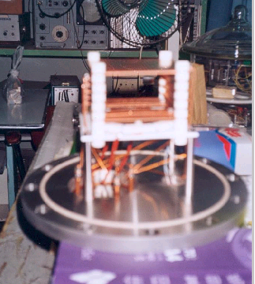
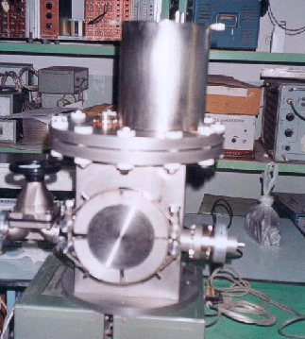
IPM development in China
IMP~Zhao ion detection/ anode plate
CSNS_RCS IPM design parameters
Parameters | Value
E(V/m) | 10⁵
Distance Of electrode(cm) | 24
Electrode potential | 0,-24kV
Gap of magnet(mm) | 302
Size of MCP(mm) | 81X31
Size of the anode(mm) | 1.25,1.25
B(T) | 0.1
Signal of each anode | 10nA ~70uA
Signal dynamic range | 10⁴
Both two IPMs retired
Photos of the IPM made by Zhao
IHEP~Zhang e+ detection/anode plate finished the design but without beam testing

Slide 19
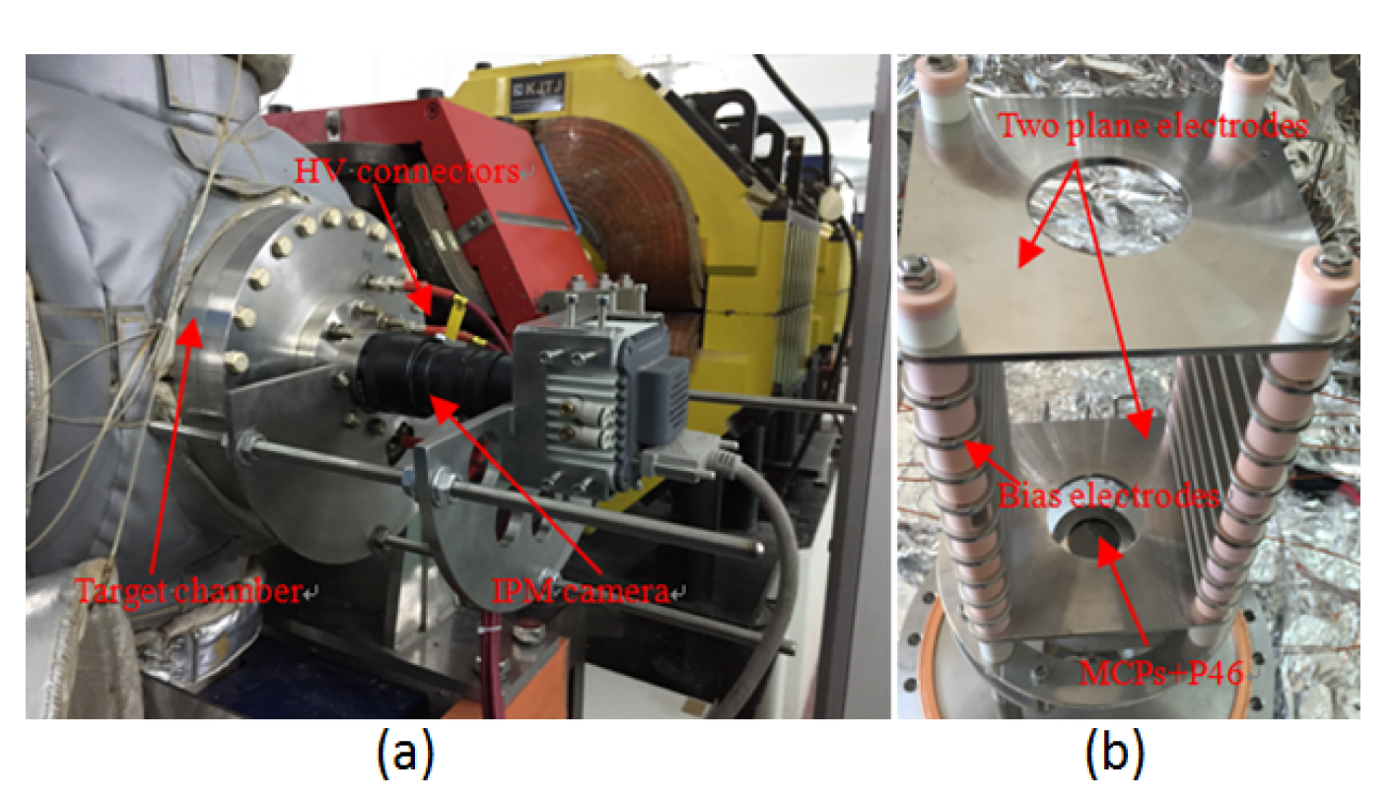
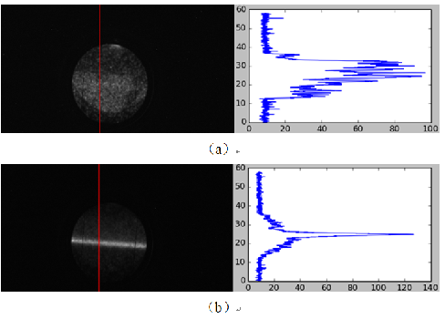
IPM development in China@IMP~Xie/ions detection
(a) appearance of IPM mounted on CSRm (b) structure inside target chamber.
HIRFL-CSRm results: Ar¹⁵⁺ 6.89 MeV/u, 30μA. (a) before (b)after electron cooling.
The results match the wire scanner with a 10% uncertainty (1.75/1.92mm) in linac test.

Slide 20
Summary
1. IPM system in IHEP is still in debugging. We will try to do further test when there is a beam.
To make sure whether the center signal is the beam.
Try to decrease the noise the wider is the beam?
2. IPM system in IMP has been proved to work well.
YES
NO
YES
NO
MCP arrays
To build a new one

Slide 21
Acknowledgements
Thanks to all colleagues, experts in KEK and GSI for valuable discussion!
Special thanks to Peter Forck for helpful advice and invitation to the workshop.
Thanks for your attentions!

Slide 22
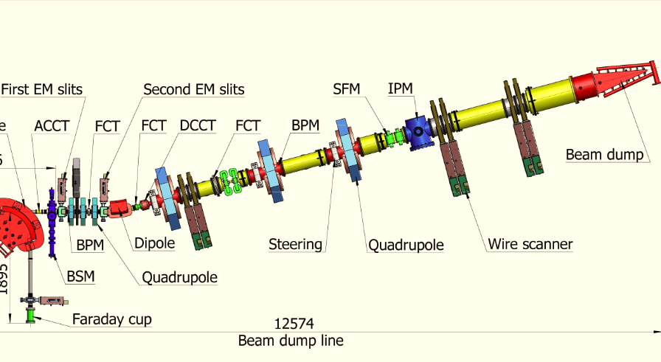
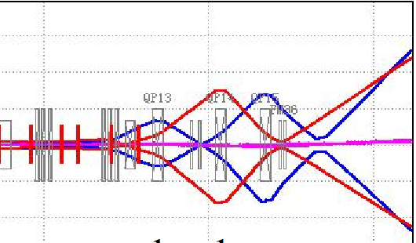
Spares

Slide 23


Spares
0.5kV/cm,170mm
120 × 120 × 3
@120 × 20 × 3mm

Slide 24


