Slide 1
Welcome to the Workshop on
Simulation, Design and Operation of Ionization Profile Monitors
GSI, Darmstadt, May 22nd to 24th, 2017

Slide 2
European Network ARIES and ADA
ARIES:
Accelerator Research and Innovation for European Science and Society
Project related to R&D in accelerator science, lead by M. Vretenar CERN
Funded by European Union with 10 M€ from 2017 to 2021
Covers all major parts of accelerator physics and technology
Successor of EuCARD² → EuCARD → CARE as started in 2004
ARIES - ADA:
Advanced Diagnostics at Accelerators
Network Activity concerning actual topics, 200 k€ total budget
→ Organization of workshops & exchange of personnel on several weeks basis
Tasks: ➢ Task 1: Management of ADA → Peter Forck GSI
Task 2: BD at hadron LINACs → Peter Forck GSI
Task 3: BD at hadron synchrotrons → Rhodri Jones CERN
Task 4: BD at 3rd gen. light sources → Fancis Perez ALBA-CELLS
Task 5: BD at 4th gen. light sources → Kay Wittenburg DESY
Successor of CARE-HHH-ABI (2004 to 2008)

Slide 3
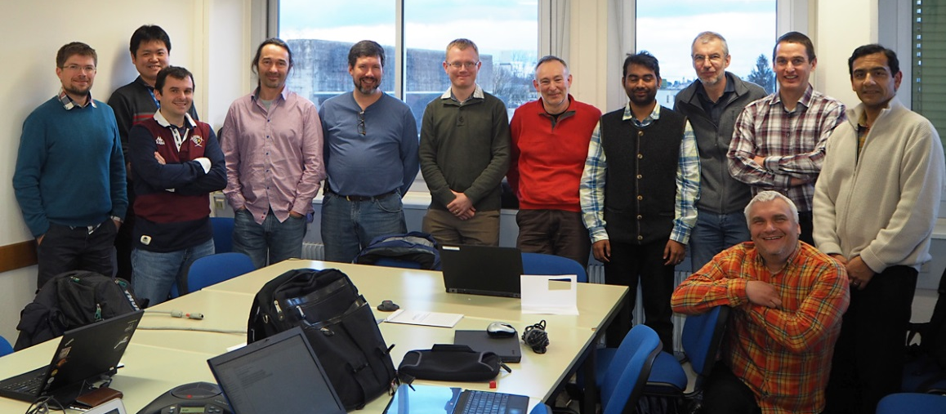
Workshop Overview
Organization of sessions:
Goal of the workshop: Meeting of all world-leading experts i.e. you !
summary on IPM technology and operation, discussion on simulation codes
Monday morning: Technical realization of IPMs
Monday afternoon: Operational usage
Tuesday morning: Simulation codes concerning space charge broadening
Tuesday afternoon: GSI guided tour, GSI related talk, novel idea for data analysis
Wednesday morning: Hands-on demo of ‘Virtual IPM’, discussion of hardware
The simulation session
is partly a follow-up of a
workshop at CERN, March 2016
dedicated to code development

Slide 4
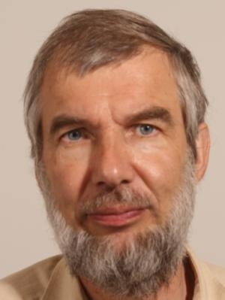
Workshop in memorial to Bernd Dehning
Bernd Dehning passed away on
14 January 2017 after a cancer attack.
Born on 3 May 1957 in Germany
At CERN since October 1987
Section leader for beam loss monitors, profile measurement etc.
Valuable contribution to many fields & supervisor of many students
⇒ an excellent scientist & a good friend

Slide 5
Practical Details
Organization:
Workshop venue: KBW Lecture Hall, Wednesday-morning: + neighboring room
Included in fee: Lunch on Mo&Tu at GSI canteen, dinner Mo&Tu at ‘Weißer Schan’
hotel cost at ‘Weißer Schwan’ or GSI guest house (→ don’t pay, we will do it...)
Lunch: Self-service for full menu (soup, main dish, desert) incl. one soft-drink
→ tell at the cashier that you participate in ‘IPM2017 workshop’, tables are reserved
Workshop photo on Tuesday 12:20
Guided tour on Tuesday: Meeting point at KBW i.e. here
Scientific program:
Please up-load your contribution to the INDICO site
Workshop atmosphere: Please ask question and contribute to the discussion
→ discussion might have priority with respect to schedule!
→ Let’s get started ...

