Slide 1
Precision Experiments over
12 Decades from 4 MeV/u to sub meV
Precision experiments at low and high energies with stored and cooled ions
  Atomic properties
  Nuclear properties
  Storage, Cooling
  Why HCI
Facilities and Experiments at GSI-FAIR
  SHIPTRAP
  HITRAP
  CRYRING@ESR
Notes:
Warum HCI, warum Speichern
(QED, nucl. Phys.
Atomic properties
Nuclear properties
Zwei folien mit listen ohne! Bilder aber mit Prezision
Storage, Cooling – nur prinzip – tabelle-Matrix

Slide 2
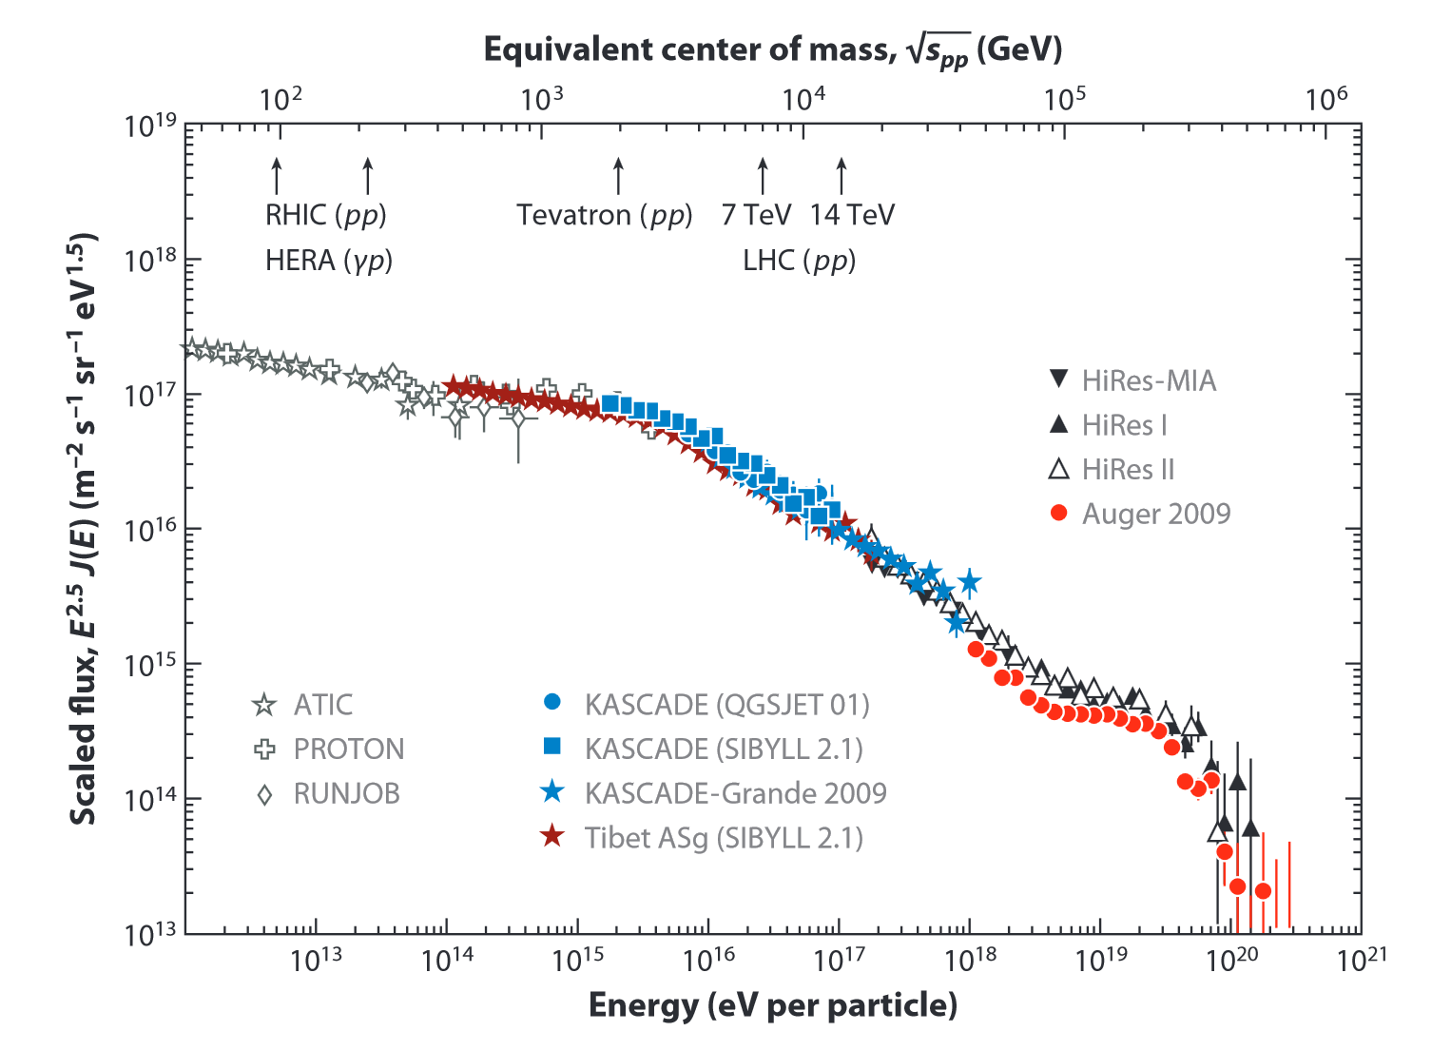

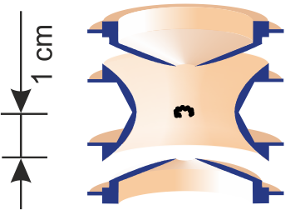
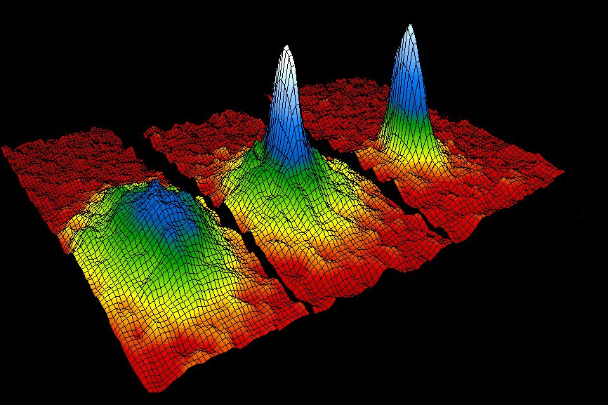
Energy Scale of Particles on Earth
R. Engel, D. Heck and T. Pierog, Annu. Rev. Nucl. Part. Sci. 61, 2011, p. 467
Cosmic Rays
Penning Trap
Bose-Einstein Condensate
Department of Physics, University of Colorado at Boulder
50
200
400
nanoKelvin
Notes:
GZK - Greisen–Zatsepin–Kuzmin limit

Slide 3

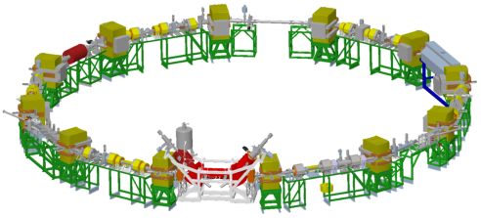
Ion Storage at GSI
ESR
400 MeV/u
400 MeV/u
UNILAC
SIS
Stripper
FRS
ESR
CRYRING
SHIPTRAP
4 K
HITRAP
4 MeV/u
4 MeV/u … 100 keV/u
SHIPTRAP
CRYRING
10 MeV/u
HITRAP
Notes:
1e-11 eV (1e-7K) = BEC, Obere Energie Cosmics 1e20

Slide 4
Atomic Properties, Other fields
Precision tests of modern theory in strong fields
  Electron binding energies
    Lamb shift (QED test)
  g-factor of bound electrons
    QED test, m_{e}, α
Collision spectroscopy with electrons, atoms, and molecules
Atomic processes, reaction dynamics, and lifetimes
Surface modifications using HCI
Hollow atoms and trampoline effect

Slide 5
Nuclear Properties
Atomic Mass
Nuclear Lifetime
Nuclear Charge Radius
Reaction cross sections and channels
Exotic nuclear decay modes
We need to control
– location
– observation time
– energy

Slide 6
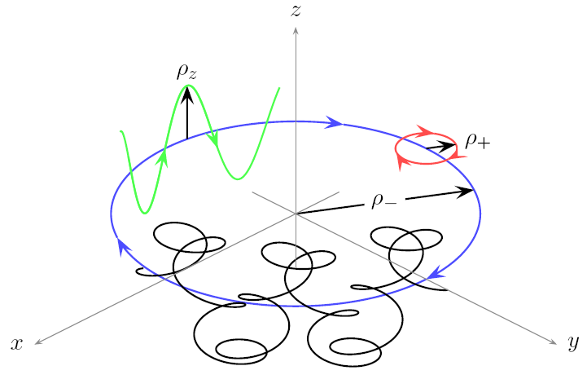
Storage
to control
– location
– observation time
– energy
+ B
+ E
ions
ions
Small circle(s) - Traps
Large “circle(s)” - Rings
axial motion
axial motion
ν_{z}
cyclotron motion
ν₊
ν₋
magnetron motion
trajectory
d < mm
d ~ m

Slide 7
Control the Energy – Cooling
Method | Storage Rings | Traps
Stochastic Cooling | routinely | demonstrated
Electron cooling | routinely | experimental for HCI, routinely with positrons
Laser cooling | experimental | routinely
Sympathetic cooling | - | routinely
Buffer gas cooling | - | routinely for singly-charged ions
Resistive cooling | - | routinely for single ions, experimental for clouds
Evaporative cooling | - | routinely

Slide 8
Electron Cooling - Principle
Produce cold electrons
Put ions in a bath of cold electrons
Separate ions and electrons
Replenish (re-cool) the electrons
ions
electrons
electrons
ions
Storage Ring
Penning Trap

Slide 9
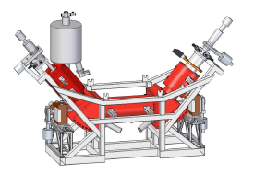
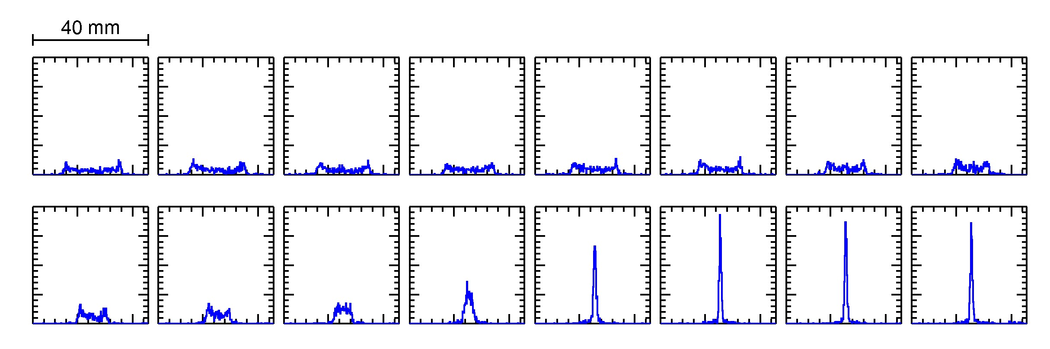
Electron Cooling in Storage Rings
Let many electrons and some ions move along at about the same speed.
via Coulomb collisions, ions transfer energy to electrons
electrons are replaced continuously
1 m
Beam profile while cooling at CRYRING
0s
1s
Notes:
Field in cooling reagion about 0.3 mT, at the gun up to 4 T
Electron energy a few kV
Electron current up 110 mA (cathode diameter 4 mm) / design was 3 A.

Slide 10
Electron Cooling – Schottky Signal
Ordered state –
Crystalline Beam
Beam stored at CRYRING

Slide 11
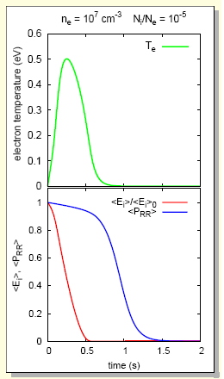
Electron Cooling in Traps
Store electrons and ions in about the same volume (nested traps)
via Coulomb collisions, ions transfer energy to electrons
electrons are rapidly cooled again by synchrotron radiation to 4.2 K
Approximations for shown calculations:
instantaneous conversion E_{ion} → T_{e}
no ion-ion collision
isotropic e⁻ distribution
Recombination?
G. Zwicknagel, in „Non-neutral Plasma Physics VI“, eds. M. Drewsen, U. Uggerhoj, H. Knudsen, AIP Conference Proceedings, 862, 281 (2006)

Slide 12
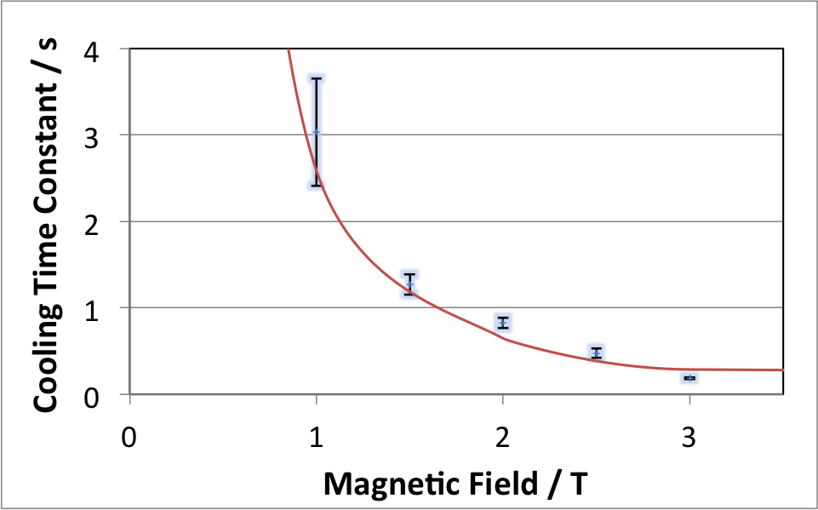
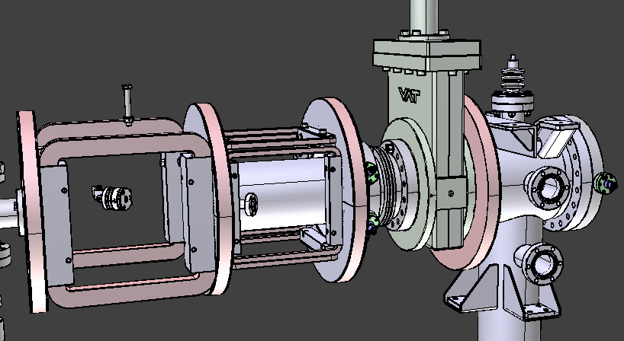
Storage and Cooling of Electrons
Measured in the HITRAP cooler Penning trap
theoretical 1/B²
(synchrotron radiation)
Masterthesis B. Maas
Photo cathode
electron source
Air coils, ca. 10A
10⁹ e⁻ per bunch to trap
Notes:
Add slide on Buffer gas cooling with ISOLTRAP or SHIPTRAP on it?

Slide 13
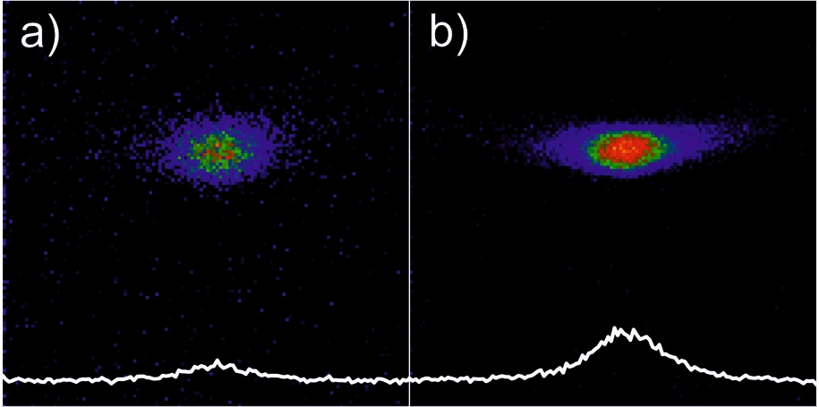
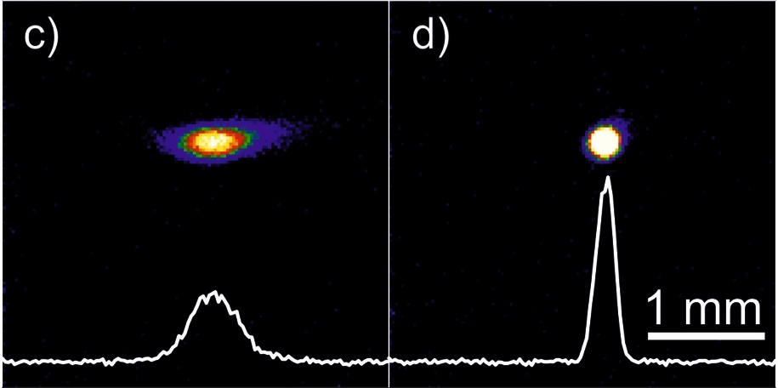
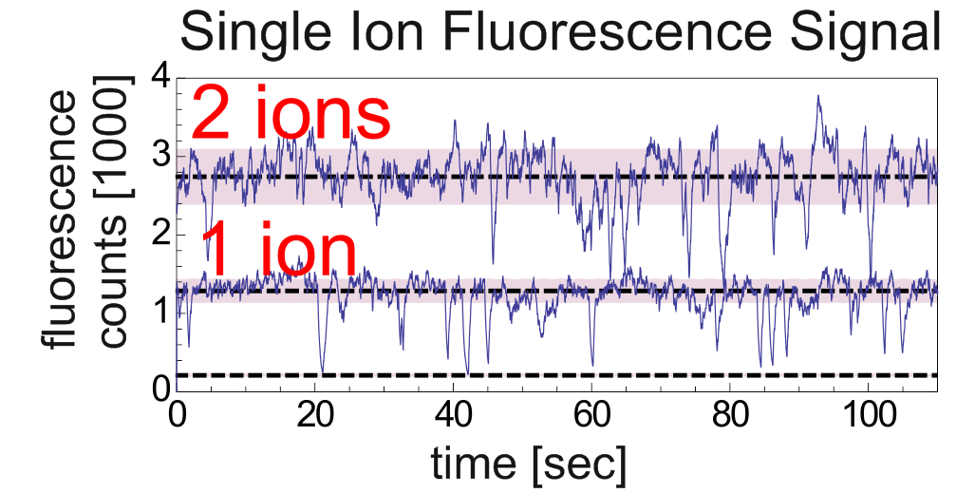
Laser Cooling in SpecTrap
W. Nörtershäuser et al.
optical detection of several thousand Mg⁺ ions
storage times of cooled Mg⁺ cloud several hours
time
... and single ion resolution
Notes:
Als Beispiel fuer Kuehltechnik nehmen

Slide 14
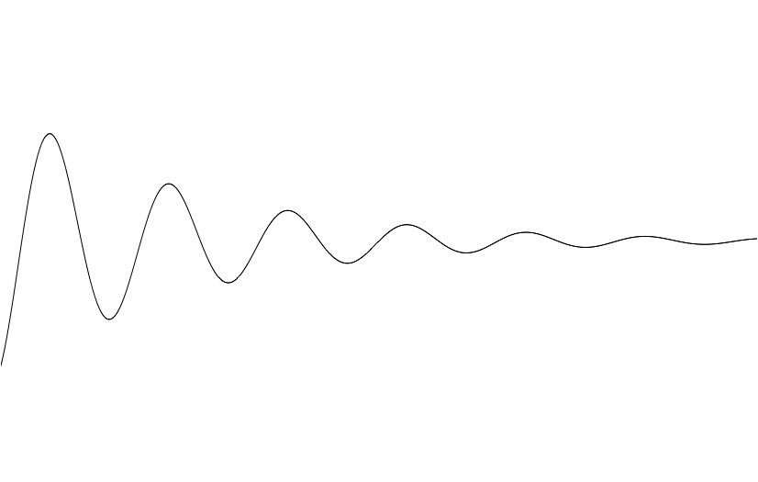
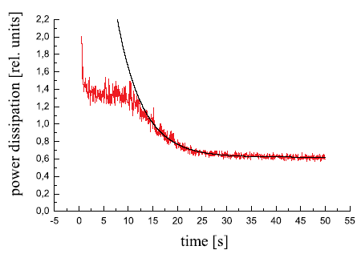
Resistive Cooling - Principle
4 K
U(t), z(t)
R
t
H. Häffner et al., Eur. Phys. J. D 22, 163 (2003)
ions
Ion cloud (30 ¹²C⁵⁺)
0 V
- V
0 V
Understood for single ion
Unclear for ion clouds

Slide 15
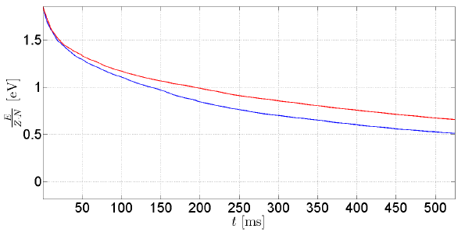
Resistive Cooling – Simulations
1024 U⁹²⁺ ions, scaled resistance, running ~20d on TESLA (GPU)
With ion-ion interaction
J. Steinmann PhD
Without ion-ion interaction

Slide 16
Why Highly-Charged Ions?
Simplest atomic system = Hydrogen
  (1 proton + 1 electron)
  Easy to calculate, very precise measurements (1s2s – 10⁻¹⁵)
Very close in simplicity = “Hydrogen like” Heavy Ion
  (1 nucleus + 1 electron)
  Precise calculations available
  Dominated by QED effects, but includes nuclear effects
Heavy highly charged ion
  Large Z = large electric field not accessible elsewhere
Nuclear cross section vs. Atomic cross section
  To suppress atomic reactions – remove all electrons

Slide 17
Production of Highly-Charged Ions
Bombarding with electrons
Stripping at relativistic energy
Electrons
@ keV
Ions @ eV/q
Ions @ MeV/u
Ions @ MeV/u
Cu foil
Simple, small
T_{ion} ~ eV/q
fast, efficient
up to 10⁶ bare Uranium

Slide 18
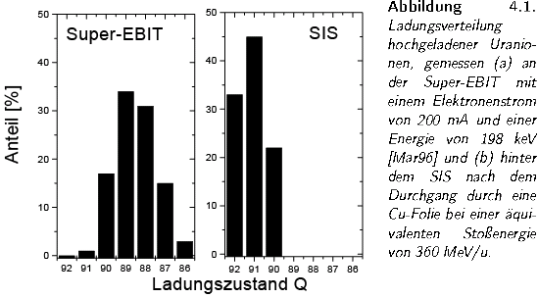
Production of HCI: Uranium
E_{electron} = 198 keV
E_{U26+} = 360 MeV/u
10⁶ ions
Abundance (%)
Marrs et al. PRL 72(1994)4082
8 ions
Charge State
Notes:
Charge distribution highly charged ions Super Ebit Marrs 1996 (probably the LNLL Report) SIS at 360 MeV/u, Super EBIT 200 mA and 198 keV

Slide 19
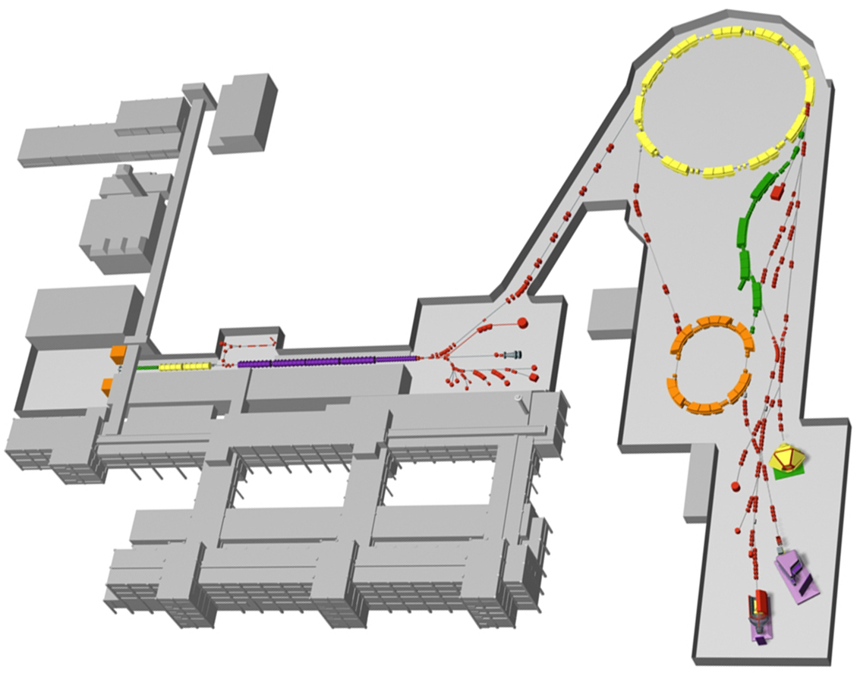
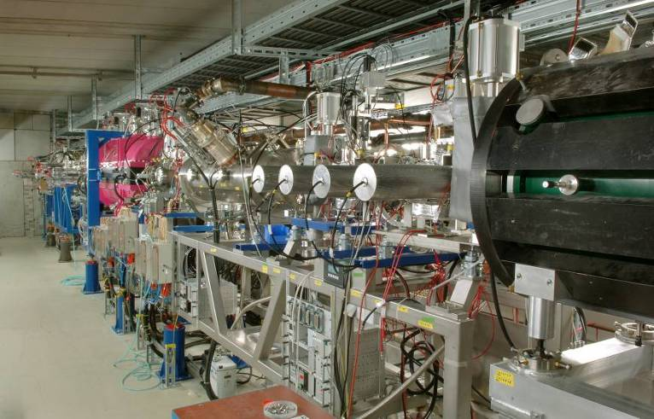
GSI
HITRAP @
SIS
GeV/u
FRS
few MeV/u
ESR
UNILAC
4 MeV/u

Slide 20
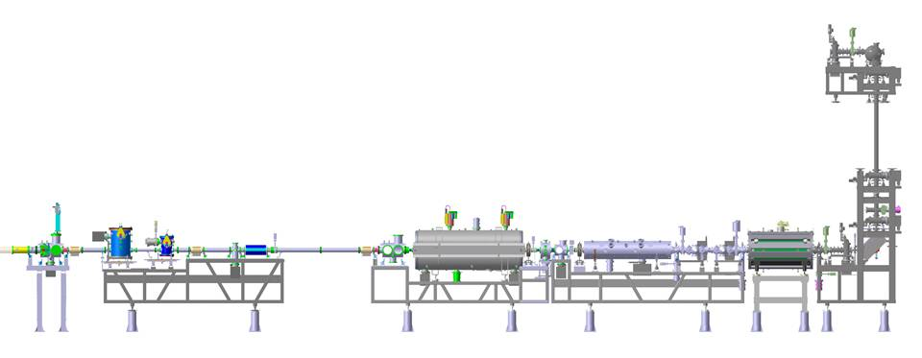
HITRAP
A/q < 3 (U⁹²⁺ ...)
10⁵ ions/pulse @ keV/q ... meV/q (Δ < 0.3 meV)
4 MeV/u
500 keV/u
6 keV/u
ESR
Buncher
IH
RFQ
Trap
400 MeV/u
Experiments
10 … 60 s
few μs
~ 10 s
Deceleration
Cooling
Bunching
Capture
Cooling
Electrons
Resistively
Deceleration
10 m

Slide 21
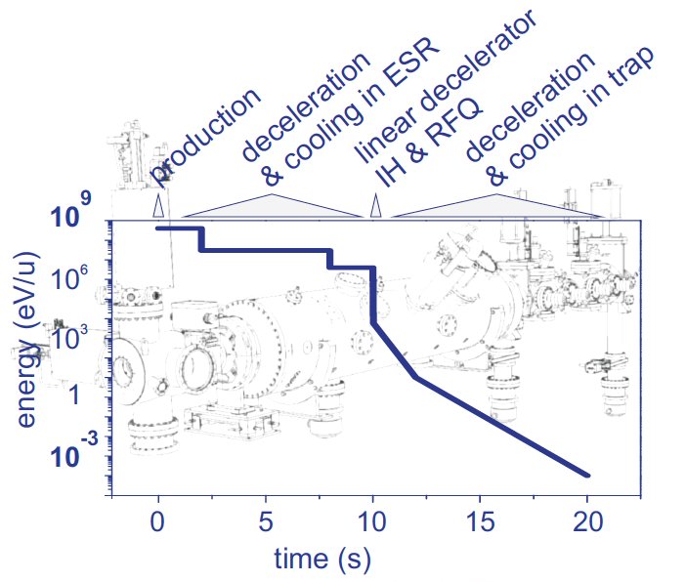
Deceleration at the ESR and HITRAP
Notes:
Unter Cooling in der Einfuehrung?

Slide 22
One Shot Energy Analyzer

Slide 23
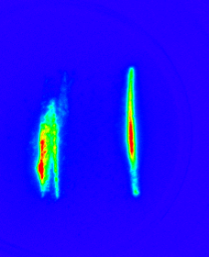
Decelerated Ions after the IH
~0.5 MeV/u
~4 MeV/u
~ E^{0.5}
Notes:
Decelerators onlz realized unitl now at CERN AD and HITRAP,
Blockshaltbild mit einzelnen Schritten durchgehen

Slide 24
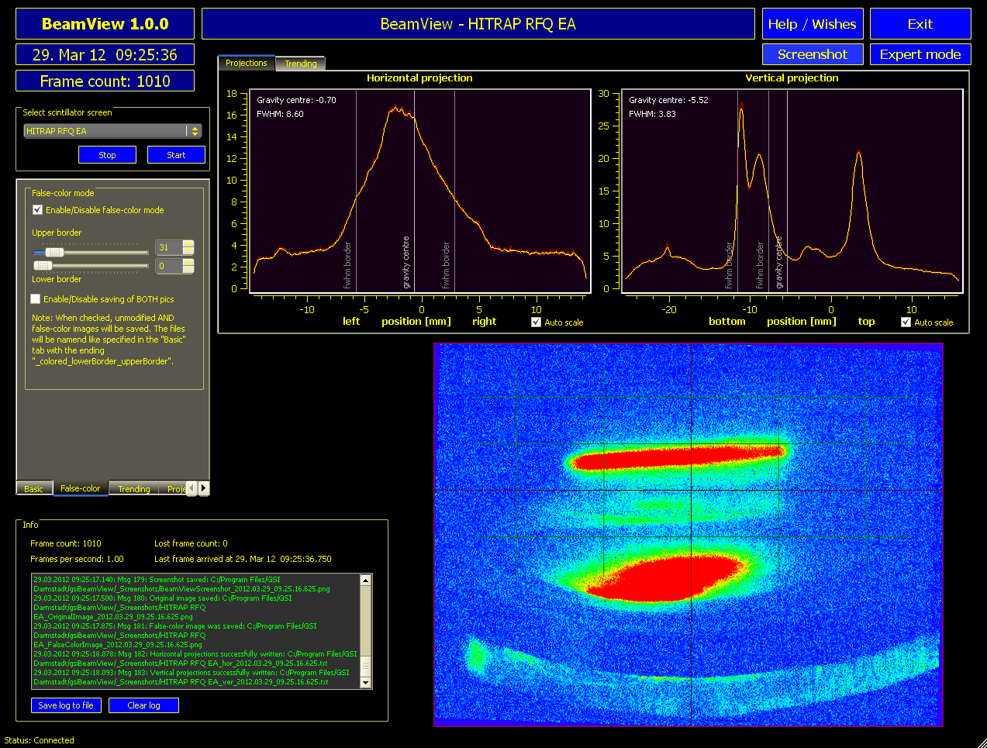
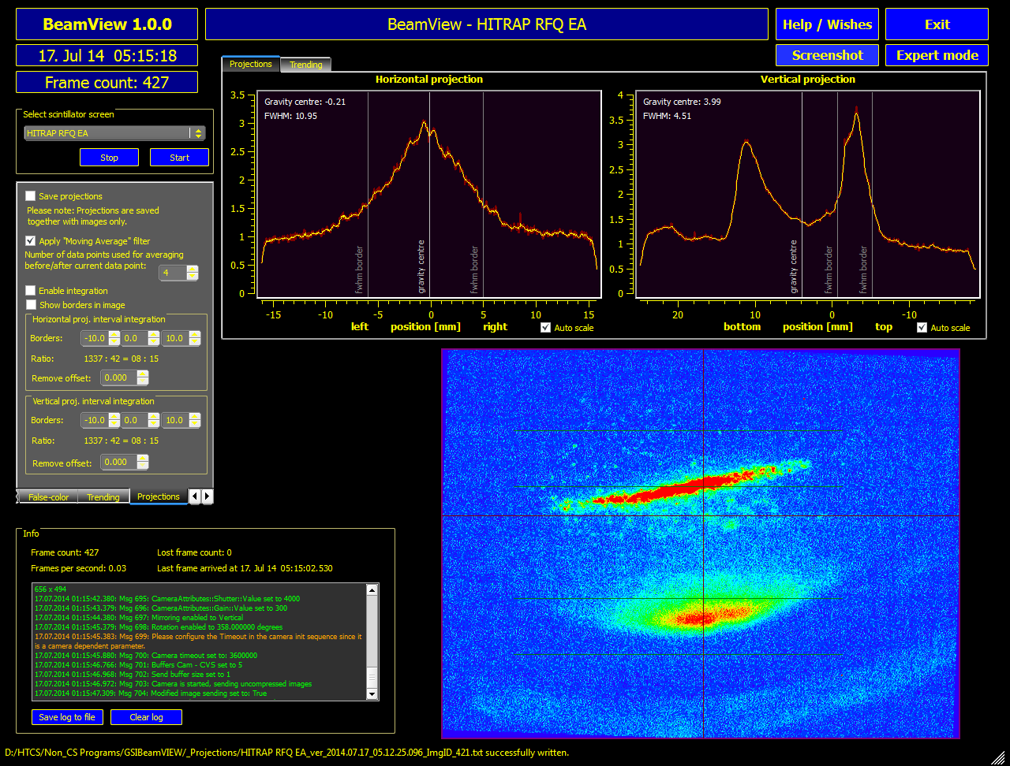
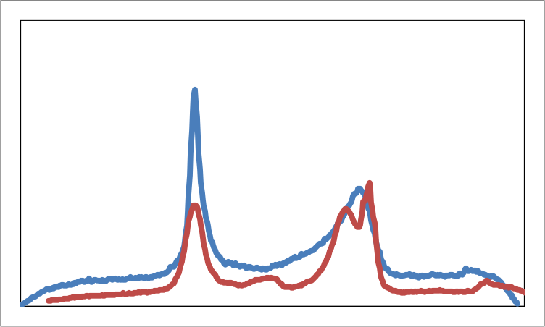
On-Line Results with redesigned RFQ
result of the experiments in 2014
Signal in Heidelberg
On-line signal at GSI
~ 6 keV/u
primary beam
Notes:
Vereinfachen?

Slide 25
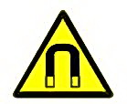
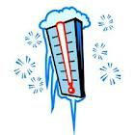
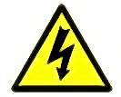
The HITRAP Cooler Penning Trap
10⁵ U⁺⁹²
10⁹ e⁻
UHV
6T
4K
20 kV
10⁻¹³ mbar
Notes:
Zum Kuehlen als Beispiel

Slide 26
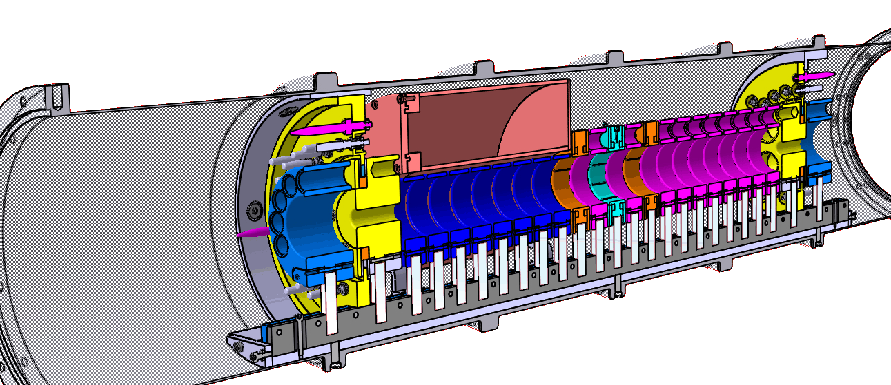
Design Overview - Cooler Trap
plug connection
differential pumping barriers
cold (4K) magnet
bore tube
electronics
8 fold split central electrode
sapphire stands

Slide 27
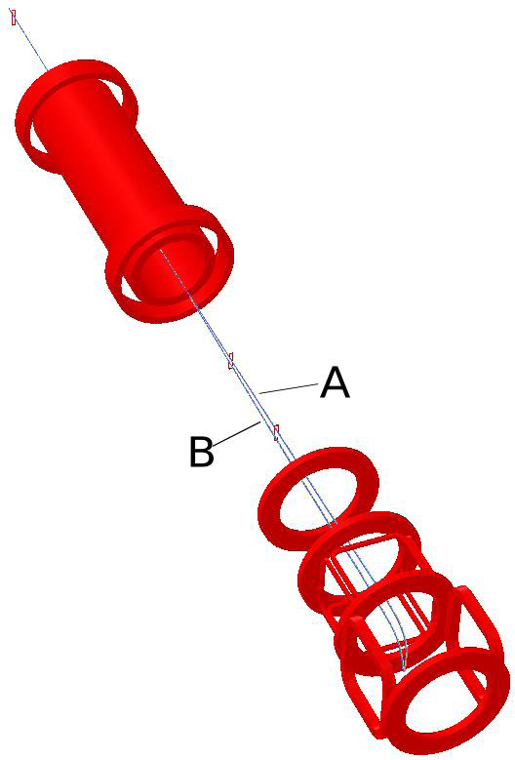
Storage and Cooling of Electrons
Masterthesis B. Maas
theoretical 1/B²
Electron source
UHV Flashlamp + GaAs Surface
Acceleration voltage 60 V
Pulse length 400 ns
Peak current 0.5 mA
>10⁹ electrons in a bunch

Slide 28
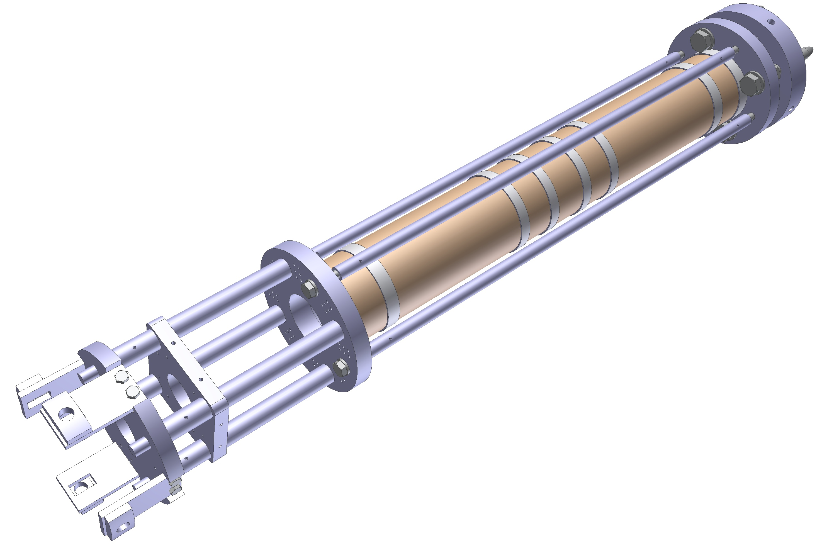
Redesign of Cooler Penning Trap
less electrodes,
less feedtroughs,
less connections
= fewer faults (but a bit less flexible)
Notes:
Skala, lieber in der Hinterhand haben, ungeschickte Aussage.

Slide 29
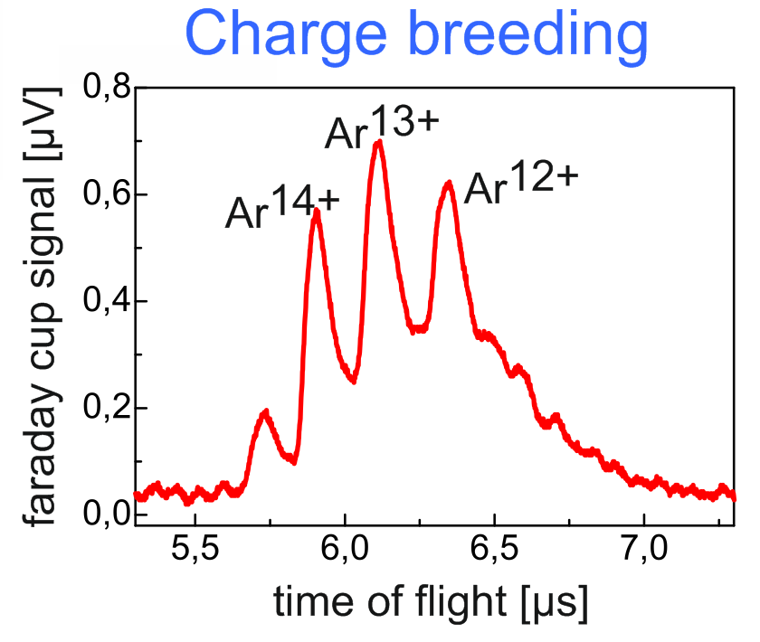
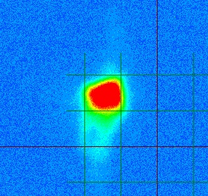
An EBIT to produce light HCI
beam after 10 m
Characteristics of the HITRAP exp. LEB
beam energy | 2-10 keV/q
beam size | ~ 5 mm
transport efficiency | up to 95%
charge states | up to ~ 44+
ion species (DREEBIT) | Ar, Xe, Kr, O, C, K, Ca, ...
Notes:
An Anfang als Beispiel zur Erzeugung HCIs. Inklusive SEBIT

Slide 30
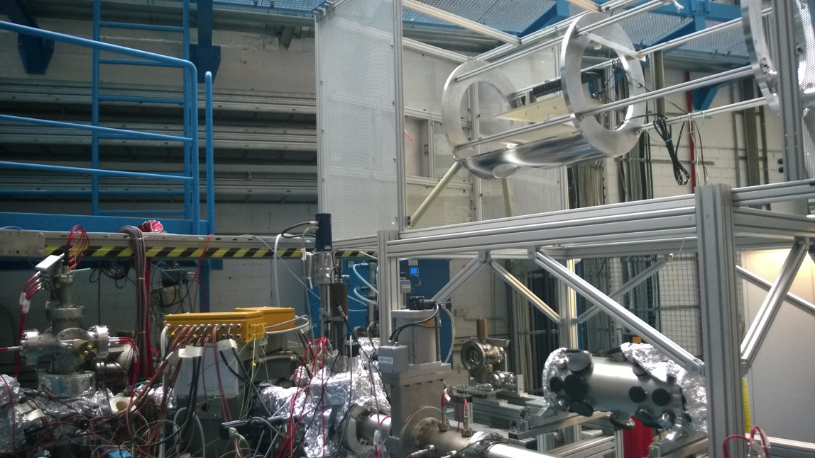
Preparing for S-EBIT
S. Trotsenko
Loan from Helmholtzinstitute Jena (HIJ), Originally from Stockholm Univ. (R. Schuch et al.)
Max. electron energy 260 keV (Design Goal)
Electron current density 4 kA/cm²
Ion capacity – 10⁸ charges

Slide 31
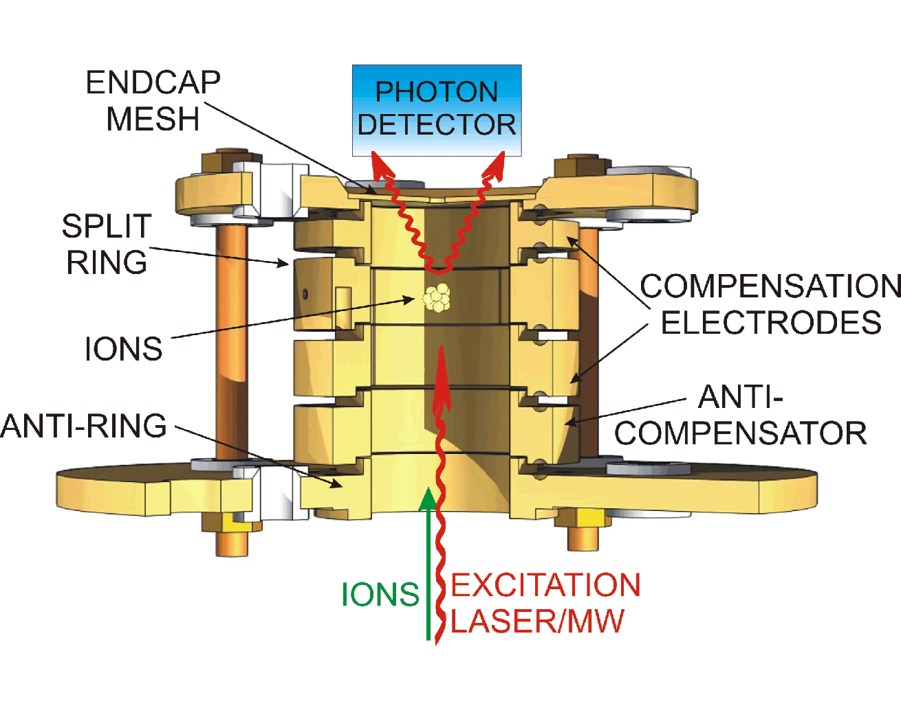
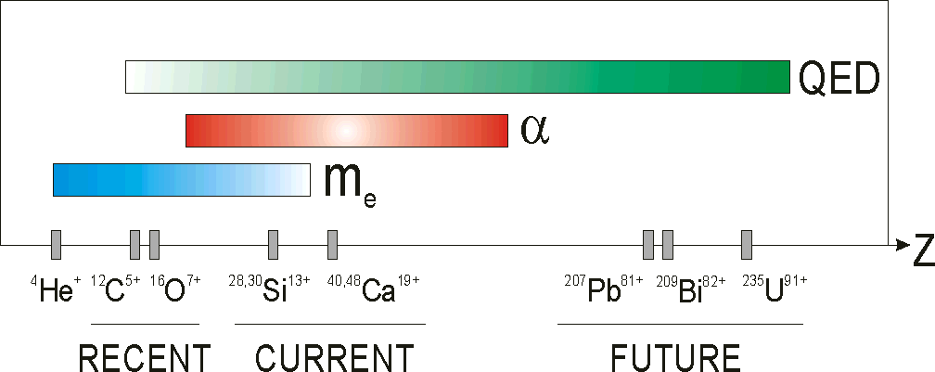
g-Factor of the bound Electron
g_{bound}/g_{free} ≈ 1 - (Zα)²/3 + α(Zα)²/4π + ....
Dirac theory
bound-state QED
W. Quint et al.

Slide 32
Contributions to g-factor
Relative CONTRIBUTION
D. Glazov et al.
NUCLEAR CHARGE Z

Slide 33
g-Factor of the bound Electron
W. Quint et al.
Larmor precession
frequency of the
bound electron:
Ion cyclotron frequency:
B
→ 'experimental
g-factor'
→ comparison with theory
our
measurement
external input parameter

Slide 34
Determination of fine-structure constant α, and
test of bound-state QED by g-factor measurements
⇒
Bound-state QED and nuclear effects:
g-Factor measurements in a series of elements up to U⁹¹⁺
  - medium-Z → fine-structure constant α
  - high-Z → test of QED
g-Factor measurements in different charge states,
e.g. Li-like and H-like ions, up to U⁸⁹⁺ and U⁹¹⁺
Disentanglement of QED and nuclear effects
(Shabaev, Glazov, Yerokhin, Jentschura, et al.)
for HFS Spectroscopy of Li and H-like Bi see M. Lochmann et al. PRA90(2014)30501
Notes:
Weglassen? Oder Keitel nachsehen!

Slide 35
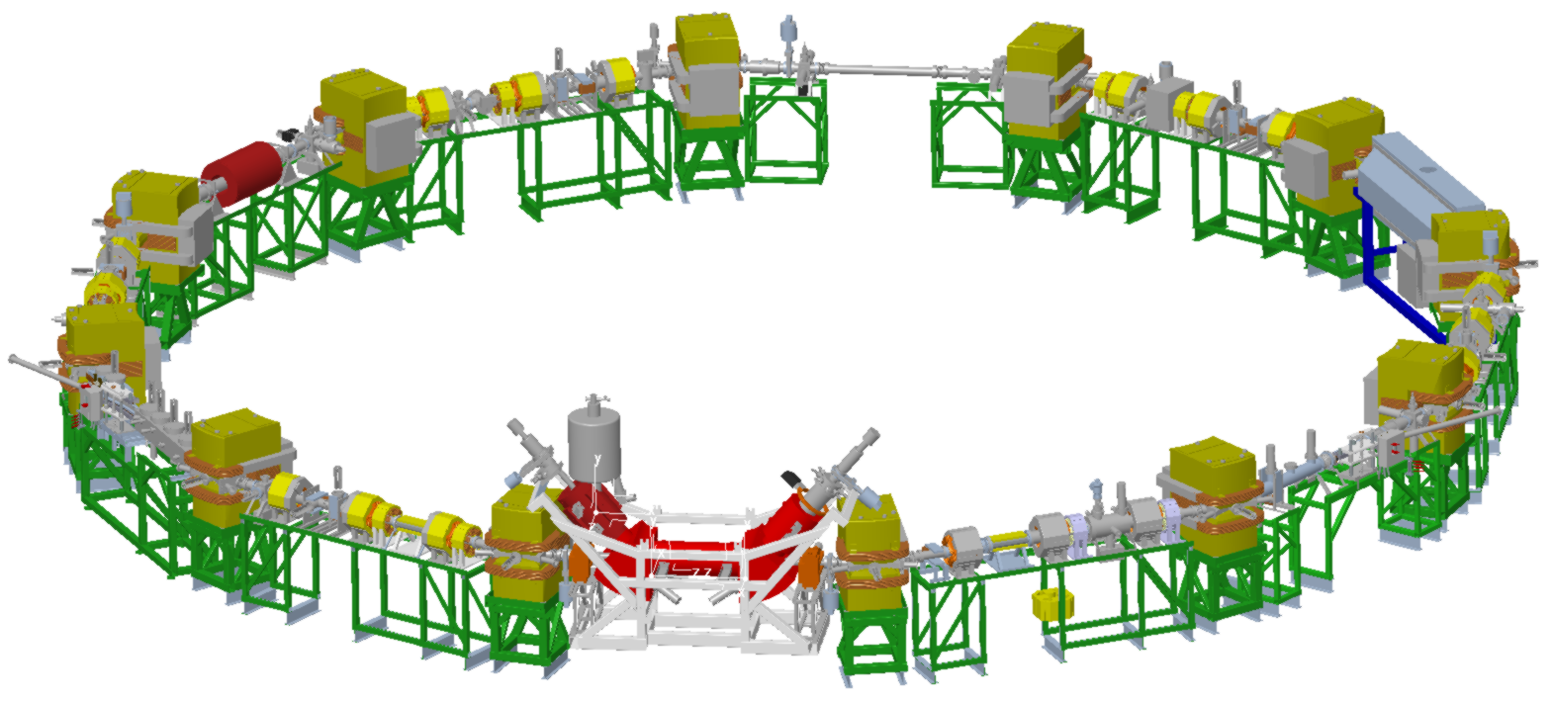
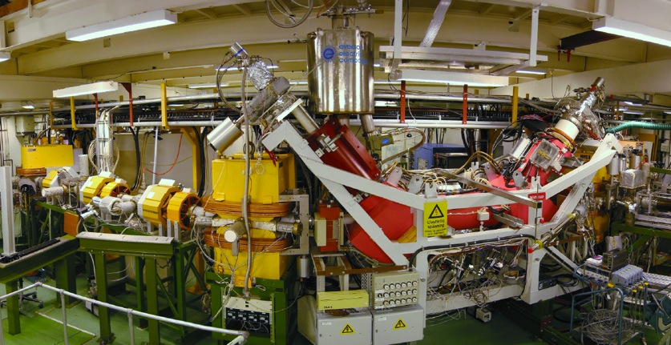
GSI
SIS
400 MeV/u
CRYRING @ ESR
FRS
11 MeV/u
ESR
UNILAC
4 MeV/u

Slide 36
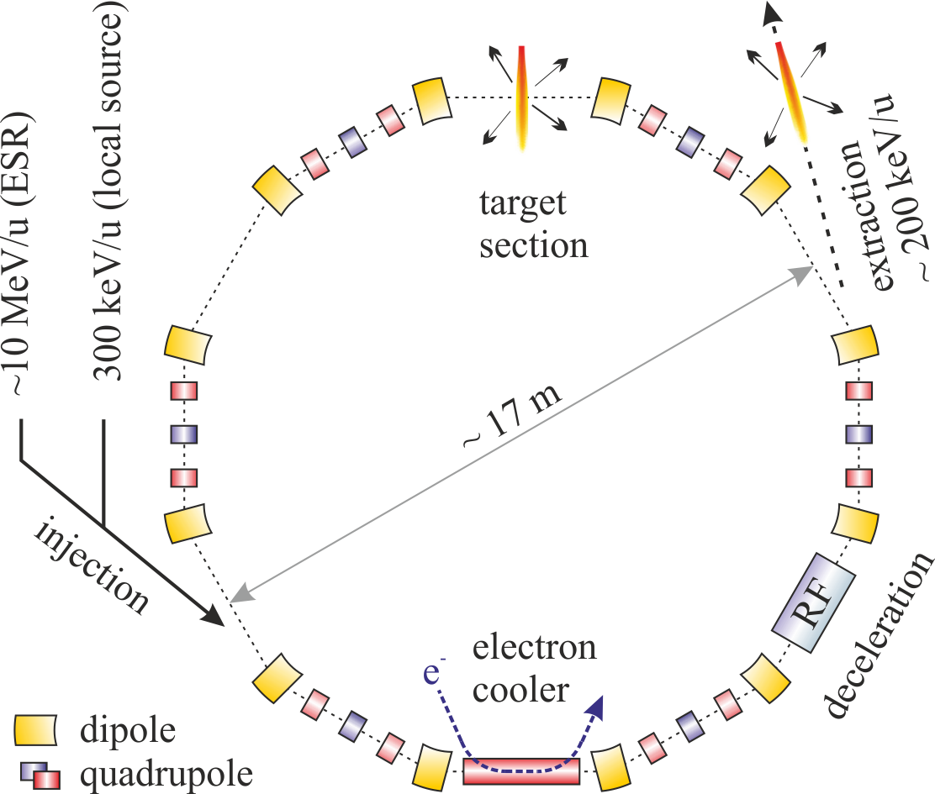
CRYRING@ESR

Slide 37
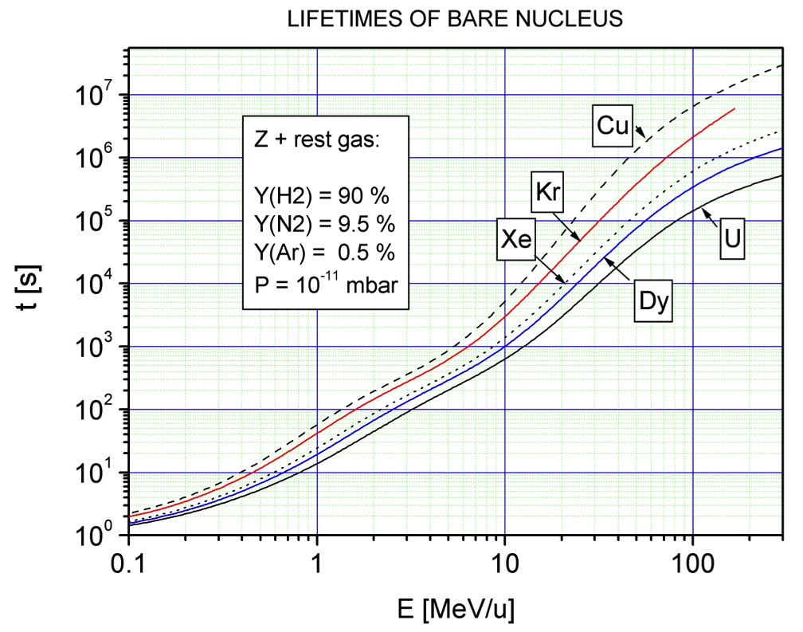
Vacuum & Beam Life Time
Ion pumps
  ~ 10
Cryopumps
NEG pumps
  ~ 100
15 min
V. Shevelko, priv. comm.
3 s
0.3
15

Slide 38
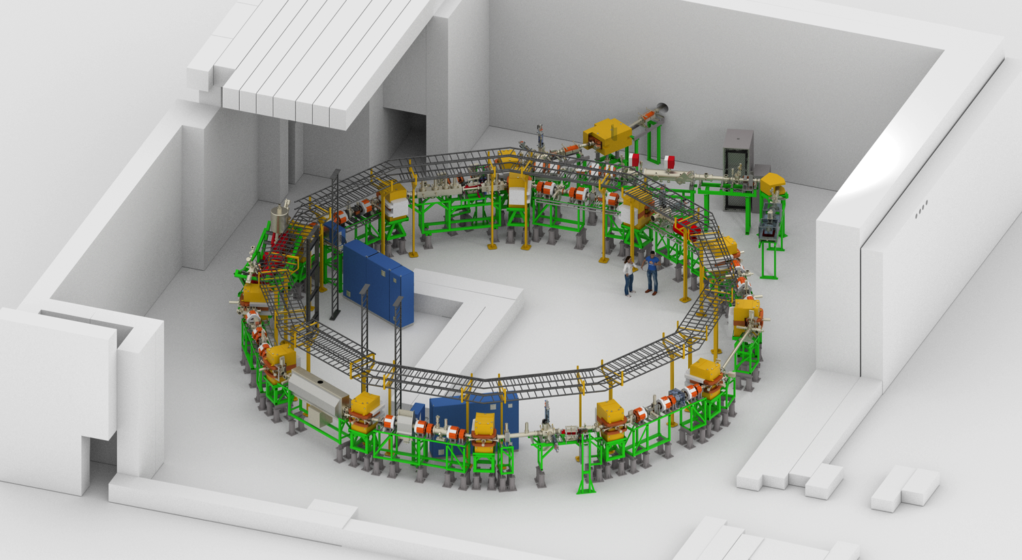
CRYRING@ESR in new Cave

Slide 39
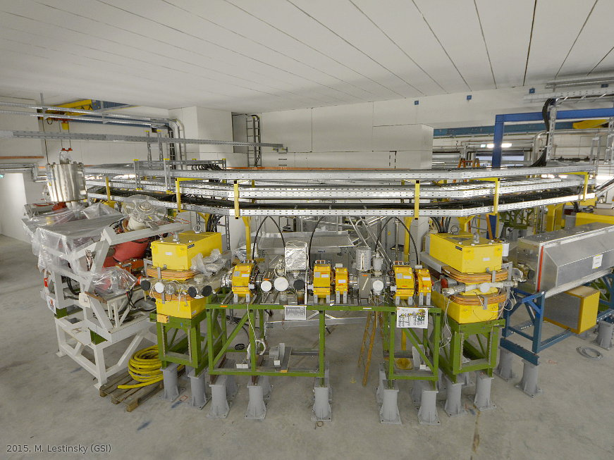

Slide 40
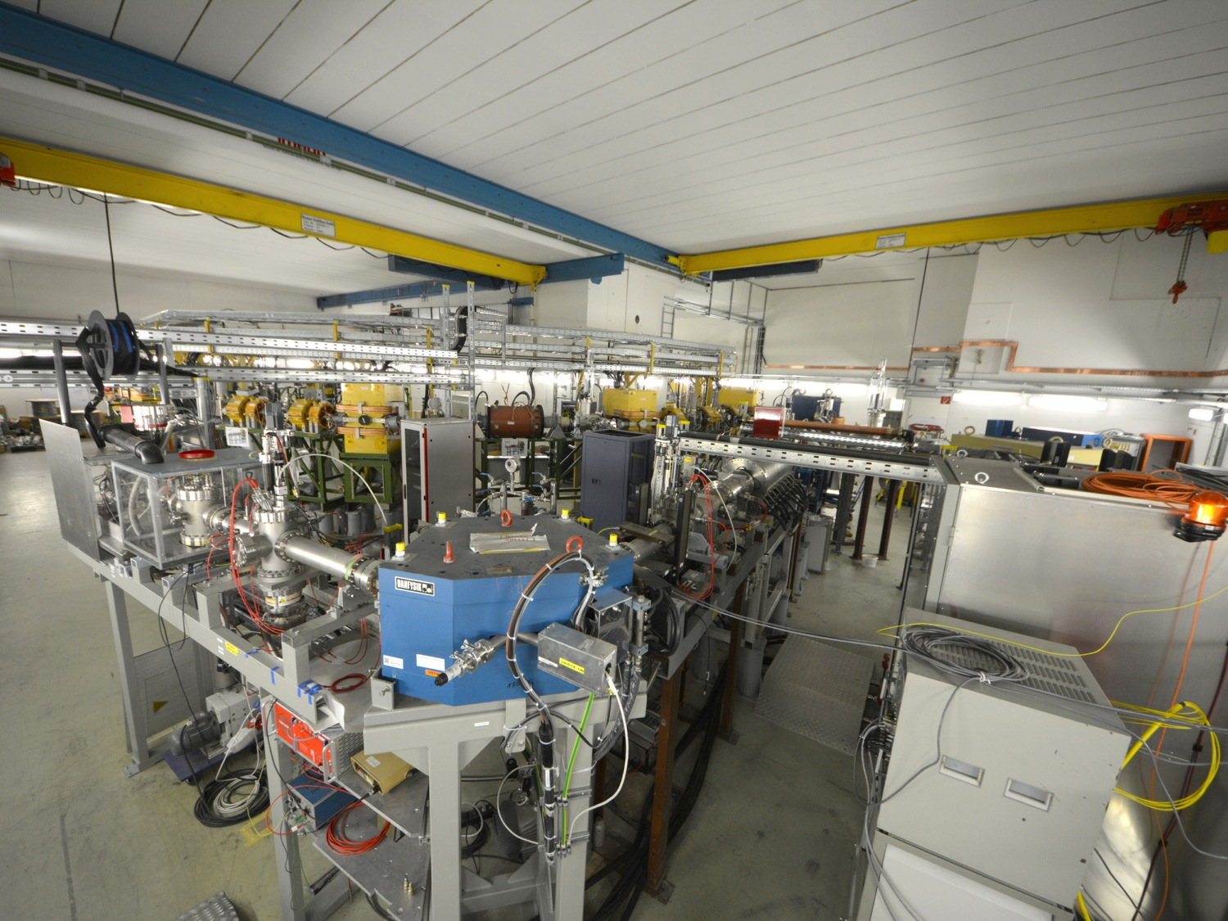

Slide 41
Timeline CRYRING@ESR
We are here
Idea, Study Group Report
Restart of SIS/ESR
2012
2013
2014
2015
2016
2017
2018
Nov 7
Transport
to GSI
Dec 20
First ions from source
commissioning
Reconstruction Cave B
First ions @ 300 keV/u
New Cave Topping Out
Infrastructure, Setup, cables etc.
Transport test with ESR beam
First ions stored in ring
UHV, bake out, e-Cooler
Installation
and Test of 1st
Experiments

Slide 42

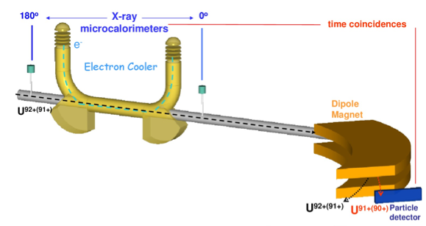

Strong Field QED in Helium-like Ions
Measurement of X-rays emitted during
K-shell radiative recombination employing
X-ray microcalorimeters
Accurate measurements of binding energies of K-electron in
H- and He-like ions (<1 eV) highest sensitivity to high-order QED corrections
42

Slide 43
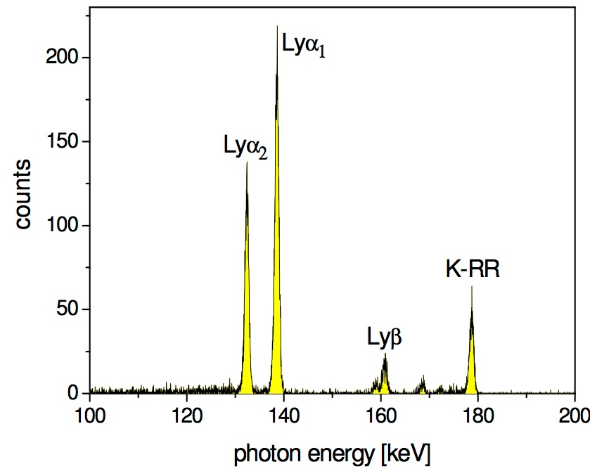

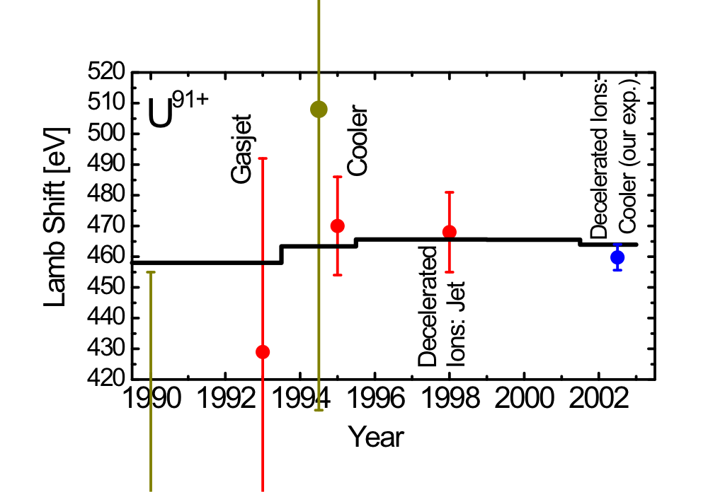

1s Lambshift in H-like Uranium
2p_{3/2}
2s_{1/2}
Lyα₁ (E1)
Most accurate test of bound state QED for a one-electron HCI
2p_{1/2}
M1
Lyα₂ (E1)
1s_{1/2}
1s Lamb shift
1s-Lamb Shift:
Experiment: 459.8 eV ± 4.6 eV
Theory: 463.95 eV
At CRYRING: lower kinetic energy -> smaller doppler broadening -> higher accuracy
Theory
A. Gumberidze
PRL 94, 223001
(2005)
Research Highlights
Nature 435, 858-859
(16 June 2005)
Notes:
Lieber HFS Wismut nehmen.

Slide 44
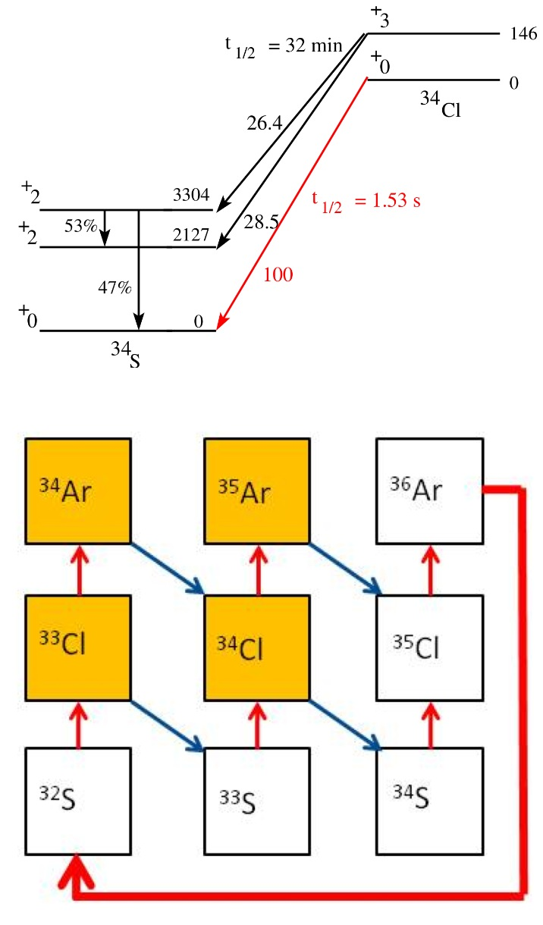
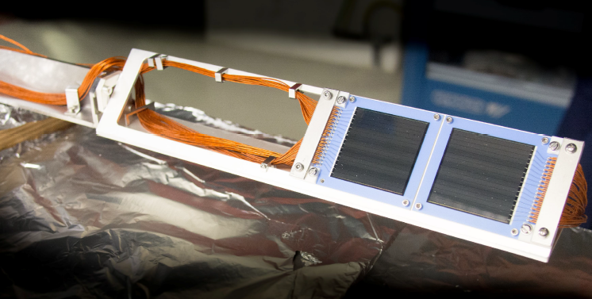
DSSD to be used in CRYRING
Nuclear Reaction Rates
(p,γ) reactions in novae for γ-ray astronomy
M. Lestinsky et al. “Physics Book: CRYRING@ESR”
Proof of principle:
⁹⁶Ru(p,γ)⁹⁷Rh
Mei et al. PRC92 (2015)35803
Critical rate for abundance of
γ-rays
Notes:
With dwarfs of One type develop into novae, want to measure 33Cl p, gamma 34 Argon
Referenz zum Test im ESR Rh cross sections

Slide 45
Slow, Heavy, Highly Charged Ions @ GSI/FAIR
Precision Measurements over 12 Decades
400 MeV/u
400 MeV/u
UNILAC
SIS
Stripper
FRS
ESR
Slow, heavy, highly charged Ions … mostly stored but always well controlled
Energy range between 10 MeV/nucleon to sub eV/Ion
10⁵ to 10⁷ heavy, highly charged ions like U⁹¹⁺
Low energy antiprotons in the future
4 K
HITRAP
4 MeV/u
S-EBIT
4 MeV/u … 100 keV/u
CRYRING
10 MeV/u

Slide 46
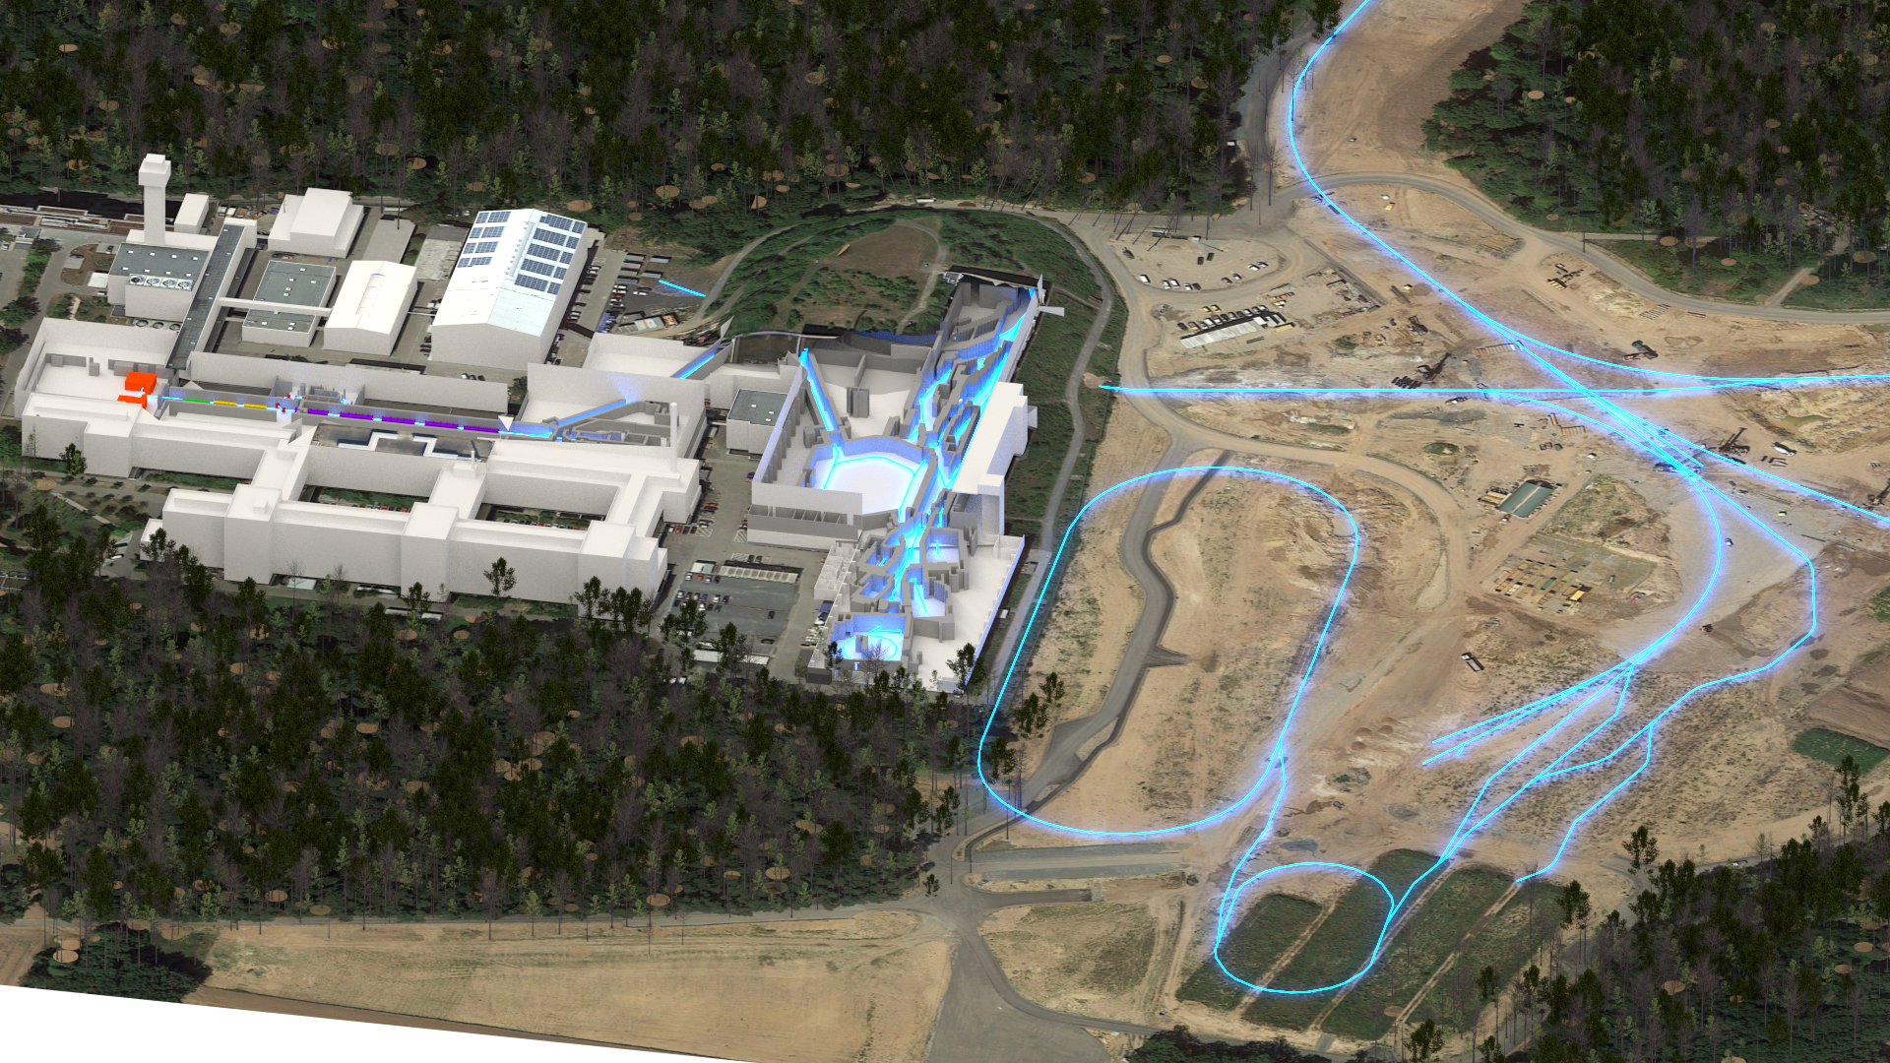

The GSI/FAIR Site
Ionsources
Fragment-
separator
HITRAP
SIS18
SIS100
CBM
HESR,
PANDA
UNILAC
Super-FRS,
Antiproton
target
ESR
SHIPTRAP
CRYRING
Collector-Ring

Slide 47
The HITRAP decelerator facility
g-factor of bound electron in HCI
Precise hyperfine structure splitting in heavy, highly charged ions (Bi, …)
Z. Andelkovic, W. Barth, D. Beck, T. Beier, M. Block, A. Bräuning-Demian, H. Brand, K. Brantjes, E. Bodewits, G. Clemente, L. Dahl, C. Dimopoulou, S. Eliseev, S. Fedotova, P. Forck, F. Herfurth, R. Hoekstra, M. Kaiser, O. Kester, H.-J. Kluge, S. Koszudowski, N. Kotovskiy, C. Kozhuharov, C. Krantz, S. Litvinov, M. Maier, F. Nolden, W. Nörtershäuser, F. Peldzinski, J. Pfister, W. Quint, U. Ratzinger, A. Sauer, A. Schempp, M. Shaaban, A. Sokolov, M. Steck, J. Steinmann, K. Stiebing, Th. Stöhlker, W. Vinzenz, M. Vogel, H. Vormann, G. Vorobjev, D. Winters, A. Wolf, ..
Univ. Frankfurt, Univ. Mainz, MPI-K Heidelberg, KVI Groningen

Slide 48
CRYRING@ESR
Most precise Lamb shift in HCI
Nuclear reaction cross sections in Gamov Window
N. Bauer, A. Bräuning-Demian, R. Bär, H. Danared, C. Dimopoulou, O. Dolinskyy, W. Enders, M. Engström, S. Fedotova, B. Franzke, M. Frey, W. Geithner, O. Gorda, F. Herfurth, L. Heyl, P. Hülsmann, A. Källberg, Th. Köhler, N. Kotovskiy, M. Lestinsky, S. Litvinov, Y. Litvinov, J. Mohr, I. Pschorn, A. Reiter, G. Riefert, J. Roßbach, A. Simonsson, T. Sieber, J. Sjöholm, M. Steck, Th. Stöhlker, G. Vorobjev, N. Winckler, ...
Stockholm University, KVI Groningen, HI Jena, Krakow University

