Slide 2
Ionisation Profile Monitor Proposal for ELENA
IPM17 workshop, GSI
22/05/2015
Pierre Grandemange
CERN BE/BI/EA

Slide 3
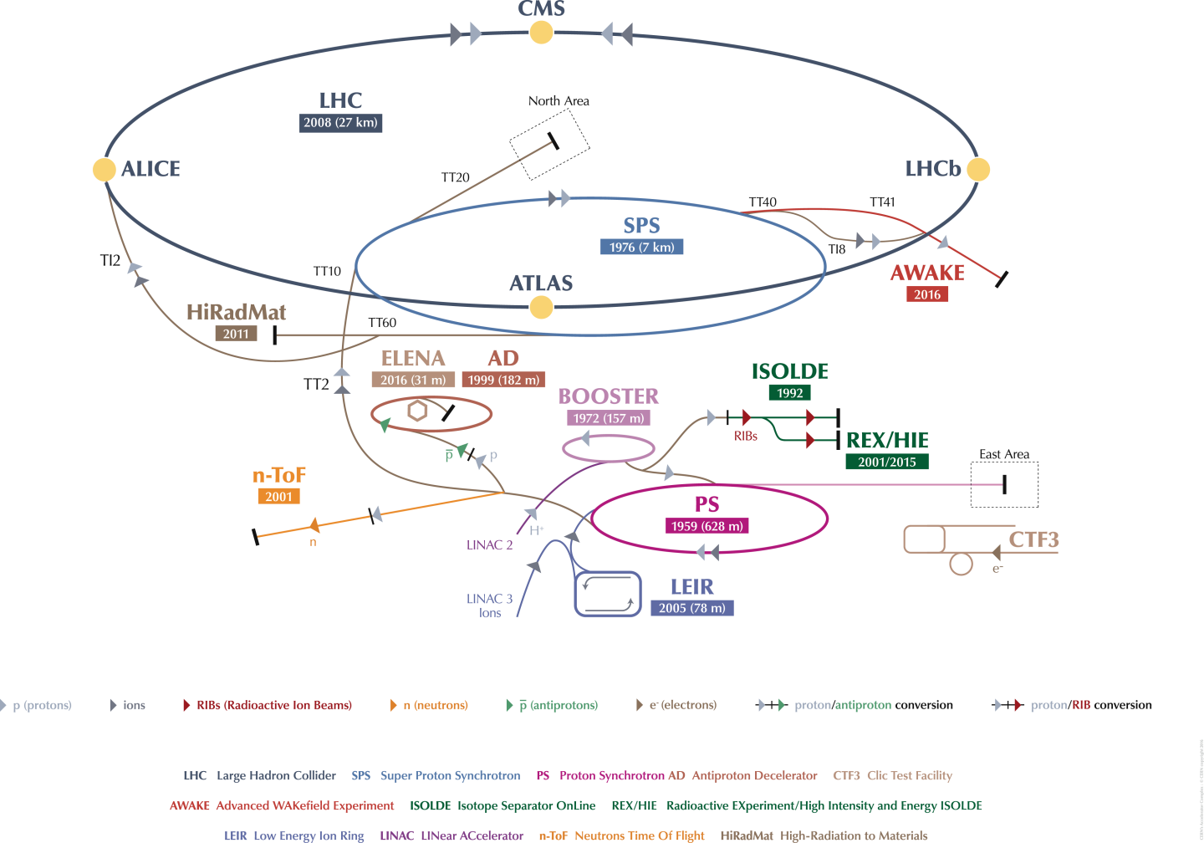

Slide 4
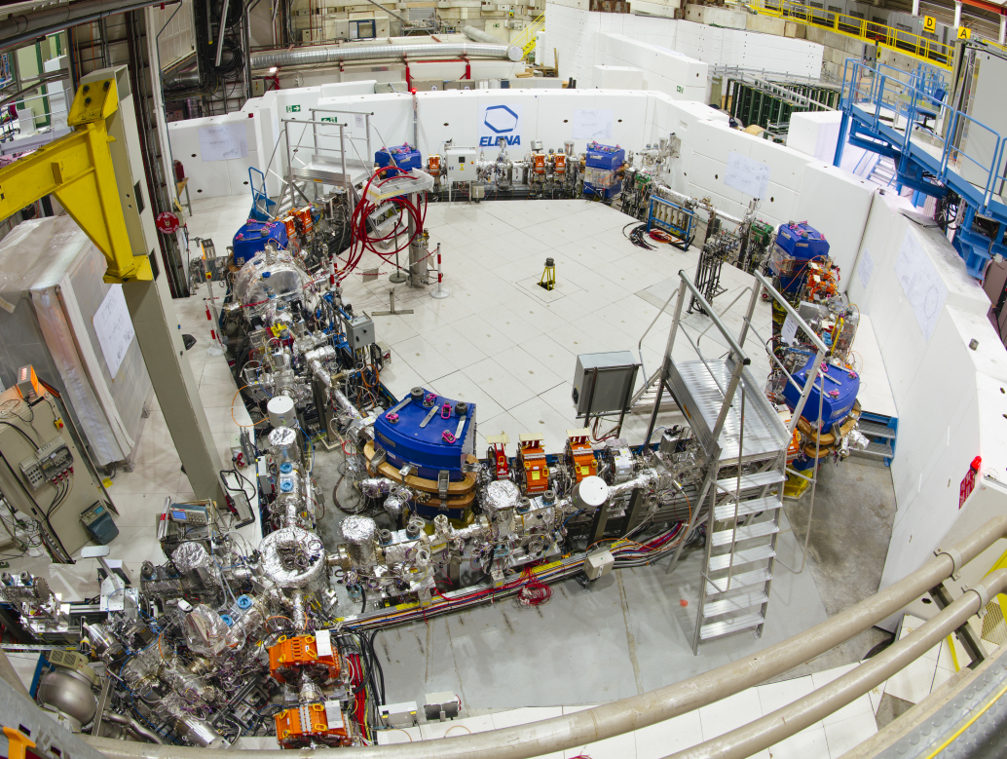

Extra Low Energy Antiproton
5.3MeV to 100keV
2.e7 pbar
4.e-12 mbar
Why an IPM?!!!

Slide 5
Why an IPM for ELENA ?
  A scraper is already foreseen to monitor the beam profile : destructive detector
  The IPM is non/semi destructive
  Acquisition during a complete machine cycle
  Especially useful to characterise the electron cooling efficiency

Slide 6
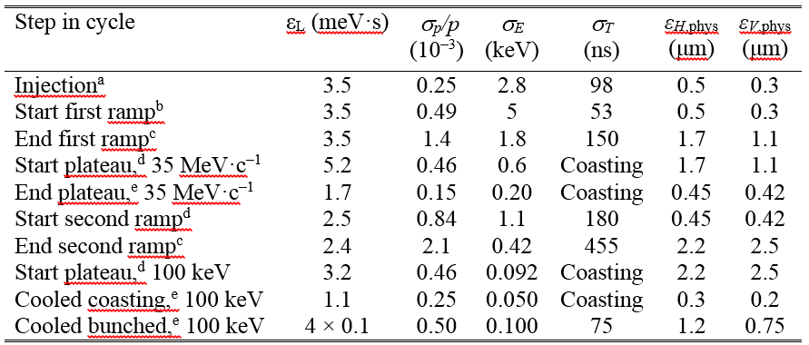
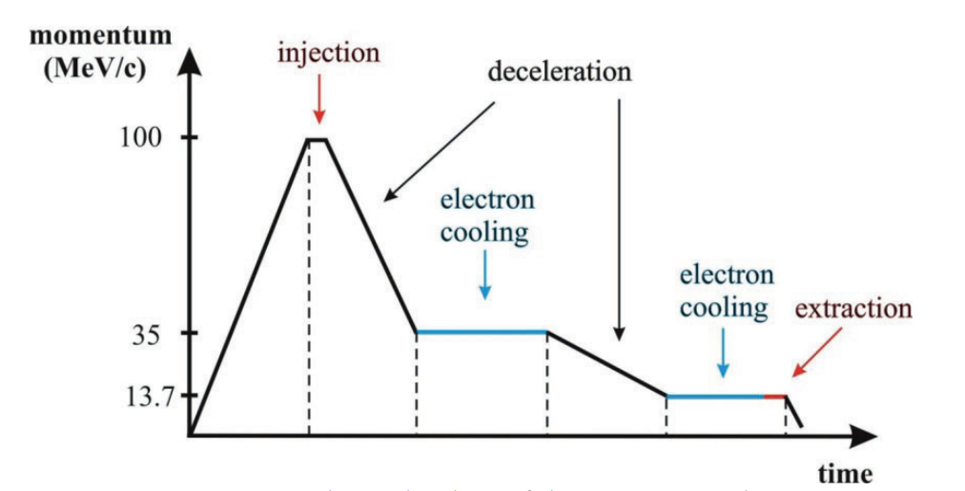
ELENA cycle
ELENA parameter list
ELENA design report

Slide 7




IPM principle
MCP
Read Out
Top electrode
V-
Residual gas
+
+
+
+
-
+
-
-
-
-
+
+
+
-
-
-
$$\vec{E}$$
Beam
V+
$$\vec{x}$$
Bottom electrode
BIPM principle drawing
$$\vec{y}$$
$$\vec{z}$$

Slide 8
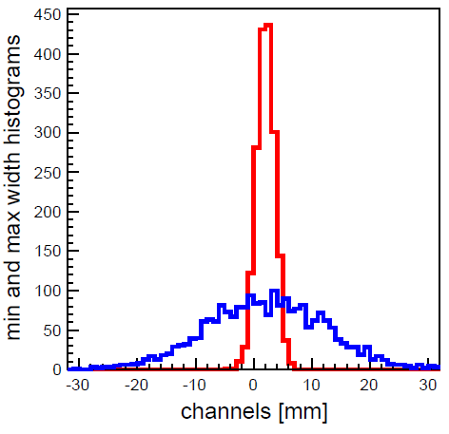
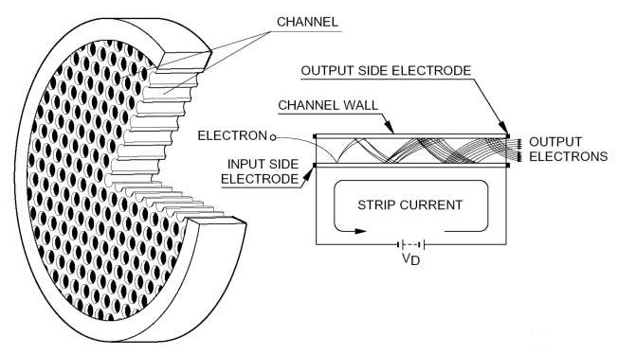



IPM principle
MCP
Read Out
$$\vec{x}$$
BIPM principle drawing
$$\vec{z}$$
$$\vec{y}$$

Slide 9
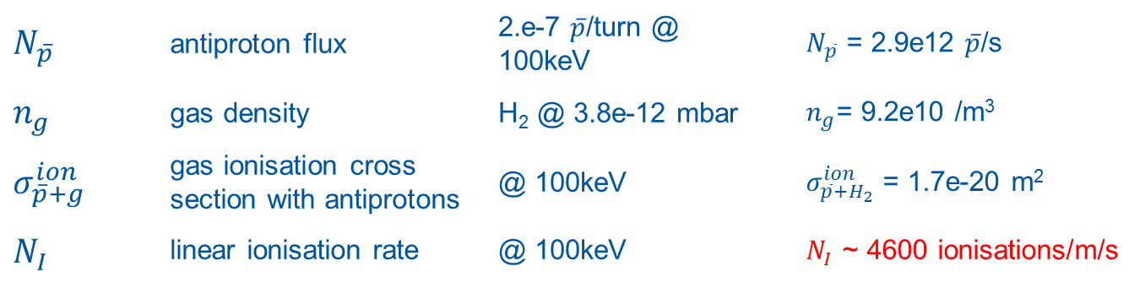
Ionisation rate
$$N_{I}[m^{−1}s^{−1}]=N_{\overline{p}}\left[s^{−1}\right]×n_{g}\left[m^{−3}\right]×σ_{\overline{p}+g}^{ion}\left(E\right)\left[m^{2}\right]$$
$$N_{\overline{p}}$$ | antiproton flux | 2.e-7 $\overline{p}$/turn @ 100keV | $N_{\overline{p}}$ = 2.9e12 $\overline{p}$/s
$$n_{g}$$ | gas density | H₂ @ 3.8e-12 mbar | $n_{g}$= 9.2e10 /m³
$$σ_{\overline{p}+g}^{ion}$$ | gas ionisation cross section with antiprotons | @ 100keV | $σ_{\overline{p}+H_{2}}^{ion}$ = 1.7e-20 m²
$$N_{I}$$ | linear ionisation rate | @ 100keV | $N_{I}$ ~ 4600 ionisations/m/s
4.6 ions /1cm/100ms

Slide 10
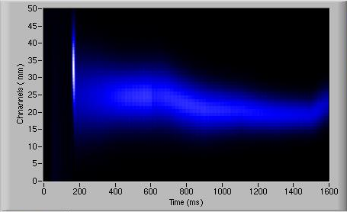
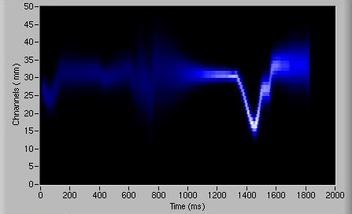
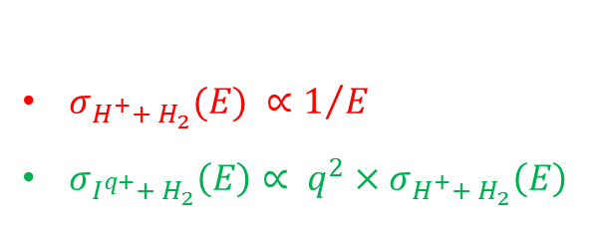
Ionisation rate
Beam | Intensity [A] | Kinetic energy [MeV] | Gas pressure [mbar] | Ionisation rate [/m/s]
ELENA extraction | 4.6e-7 | 100 keV | 3.8e-12 | 4600
AD extraction | 1.1e-6 | 5.3 MeV | 1.e-11 | 1300
LEIR Ar¹¹⁺ | 1.6e-4 | 4.2 MeV/u | 5.e-12 | 1.3e6
LEIR Pb⁵⁴⁺ | 7.8e-4 | 4.2 MeV/u | 5.e-12 | 3.e7
Increase detection length
Increase acquisition time
Inject gas :
  Increase local pressure
  Increase ionisation probability
  Decrease antiproton lifetime
$σ_{H^{+}+ H_{2}}(E) ∝1/E$
$σ_{I^{q+}+ H_{2}}\left(E\right)∝ q^{2}×σ_{H^{+}+ H_{2}}\left(E\right)$
AD – 01/12/2014
Gas injection – 8.5e-9mbar
Alexandre Frassier
BE/BI/EA
LEIR – 11/11/2014
Alexandre Frassier
BE/BI/EA

Slide 11
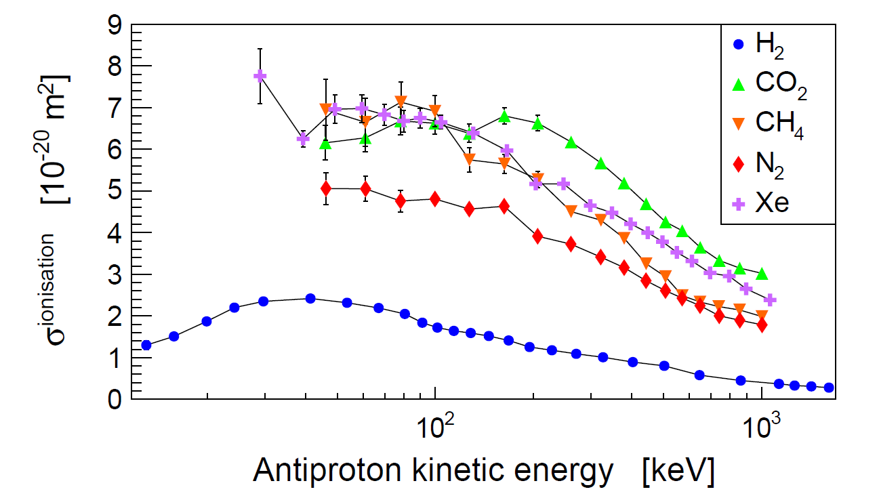
Gas injection ?
J. Phys. B: At Mol Opt. Phys. 44 (2011) 122001 (CERN PS194, ASACUSA)

Slide 12
Ionisation in ELENA
No gas injected

Slide 13
Ionisation in ELENA
CO2 @ 1.0e-11 mbar
9% average pressure rise

Slide 14
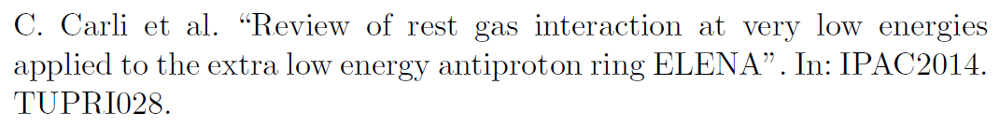
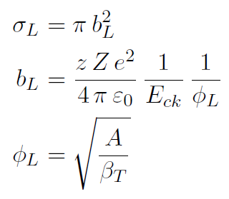
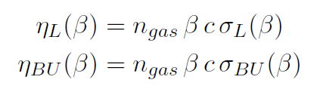
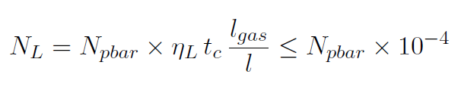
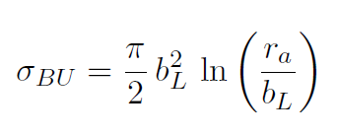
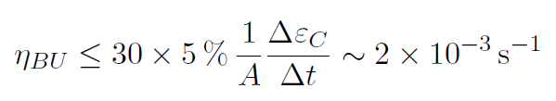
blow up and large angle scattering

Slide 15
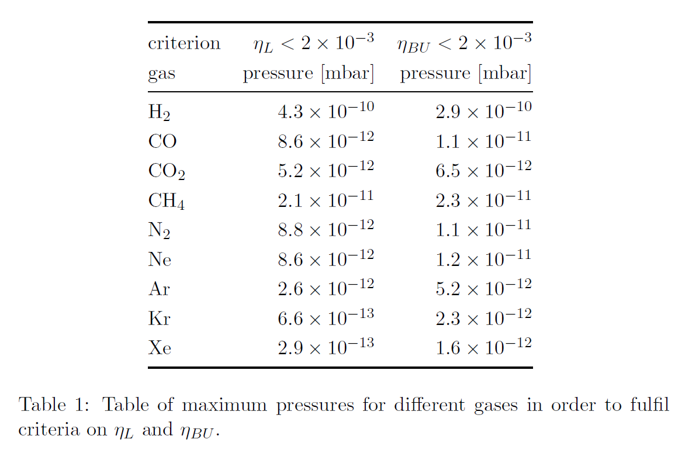

Slide 16
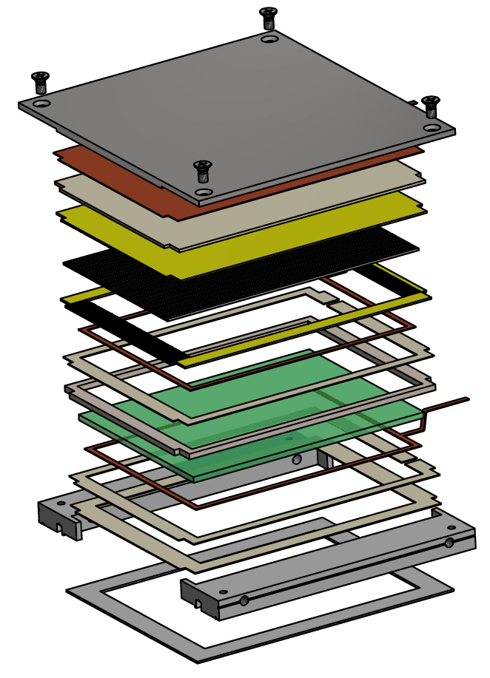
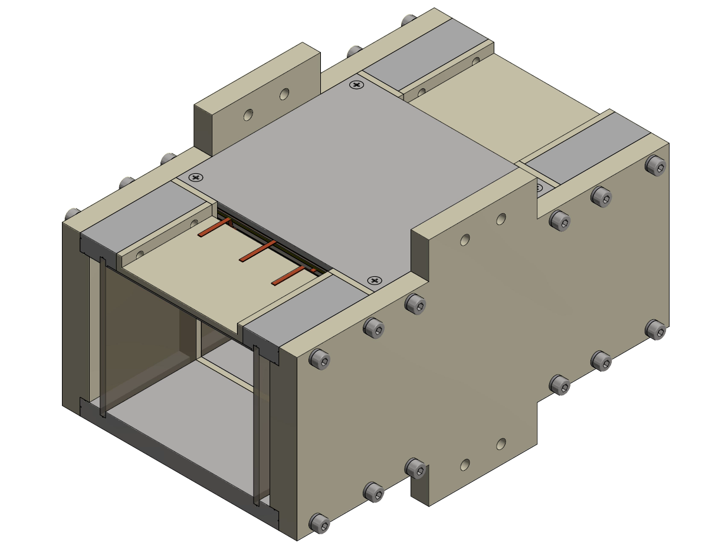
BIPM detector
Wilfried Devauchelle, 2015
Read-out
tubes
MCP
Top
electrode
External dimensions: 206 x 140 x 128 mm
Beam aperture: 82 x 70 mm

Slide 17
BIPM detector
Triple Z stack matched MCP
  Gain > 2.e8
  Long detection length : 84 mm
High vacuum compatible materials
  inox, alumina (AL2O3) and copper… and kapton…
  … what about vespel?!
Resistive glass
  Improve electric field quality in the bulk
Orbit correction electrodes
NEW

Slide 18
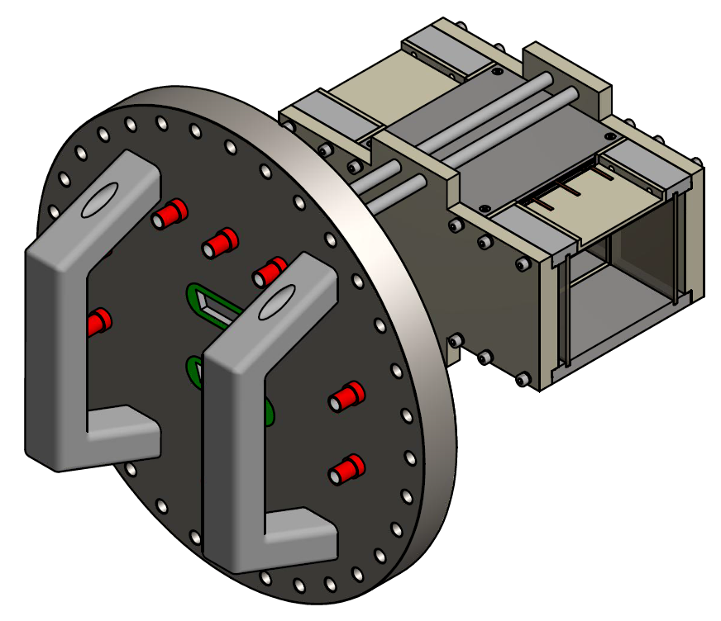
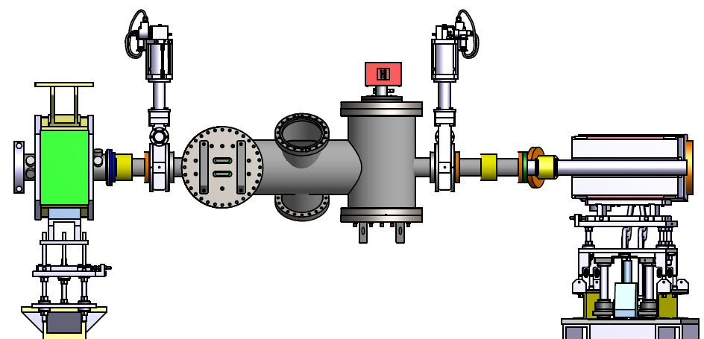
Integration in ELENA
Bellow
Gas injection
Bellow
Horizontal BIPM +
NEXTorr D 1000-10
Vertical BIPM +
NEXTorr D 1000-10
Turbo-molecular
pump

Slide 19
Acquisition chain
1 VME crate
2 * VIPM cards
  DDC 264 integrator
2*4 channels positive HV power supply
2*4 channels negative HV power supply
VME crate
CERN technical
network
ELENA
timing
BIPM V
BIPM H

Slide 20
Cost estimates
BIPM | mechanics | 15 kCHF | 65 kCHF
 | MCPs | 30 kCHF
 | Resistive glasses | 20 kCHF
Vacuum chamber | Main tank | 16 kCHF | 31 kCHF
 | BIPM flanges | <10 kCHF
 | Support | <5 kCHF
Vacuum | Gas injection, valves, pumping | 50 kCHF | 50 kCHF
Acquisition | VME + CPU | 2kCHF | 23 kCHF
 | HV power supplies | 8 kCHF
 | VIPM cards | 3 kCHF
 | Cables | <10 kCHF
Total |  |  | 169 kCHF

Slide 21
Conclusion
An IPM is a non destructive profile detector
Efficient to monitor beam cooling efficiency
Preliminary study promising
  Complete transport simulation still to be done
Detector design and ECR ready

Slide 23
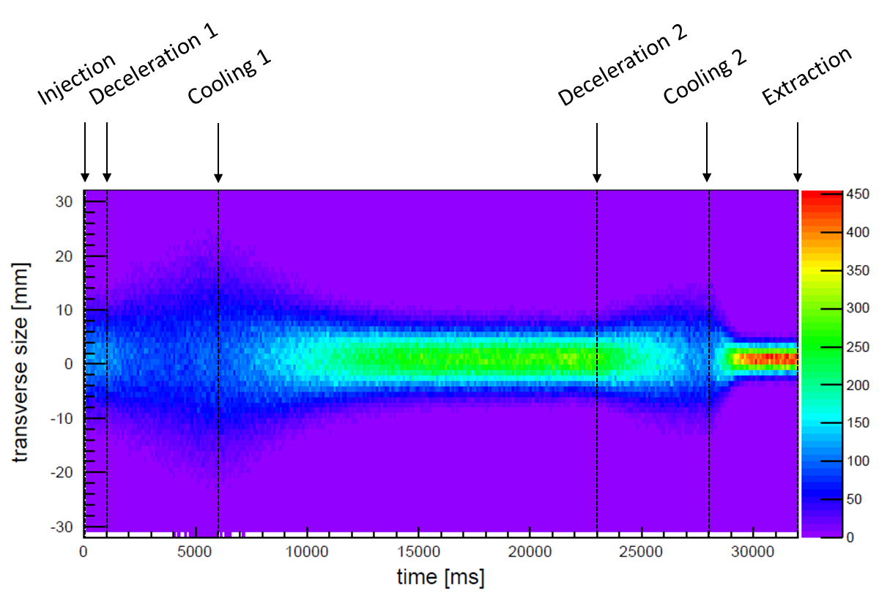

Ionisation in ELENA

Slide 24
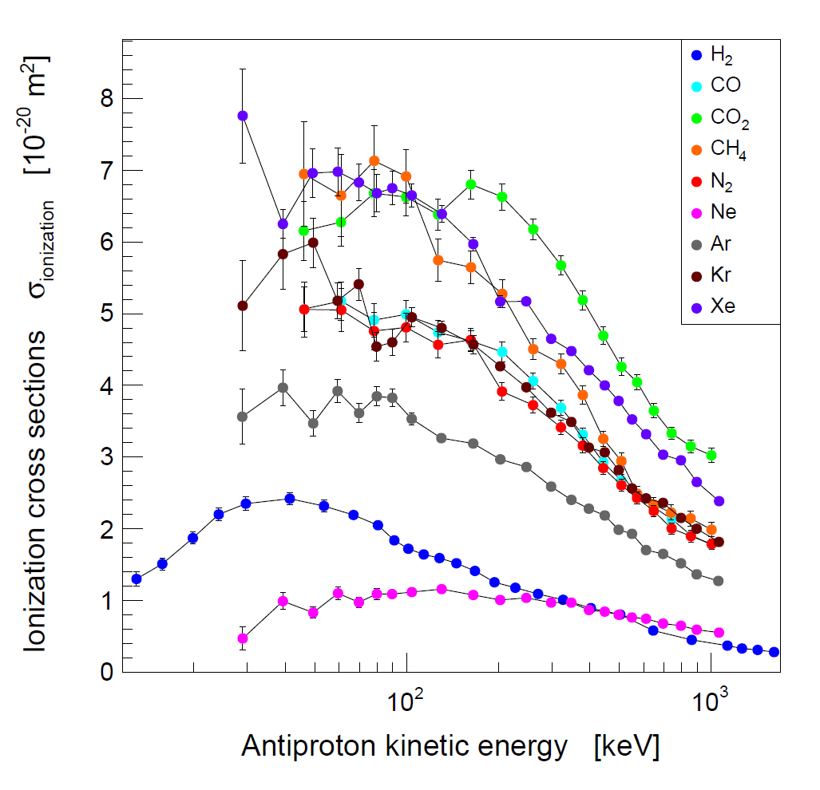
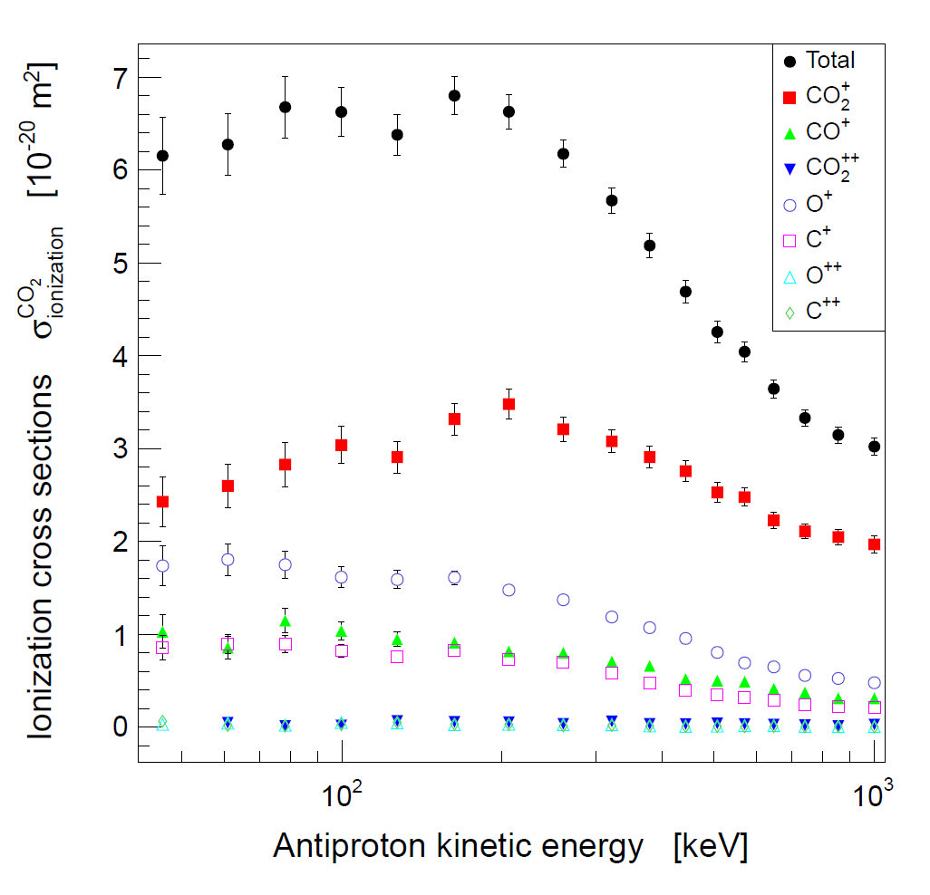
Gas injection ?

Slide 25
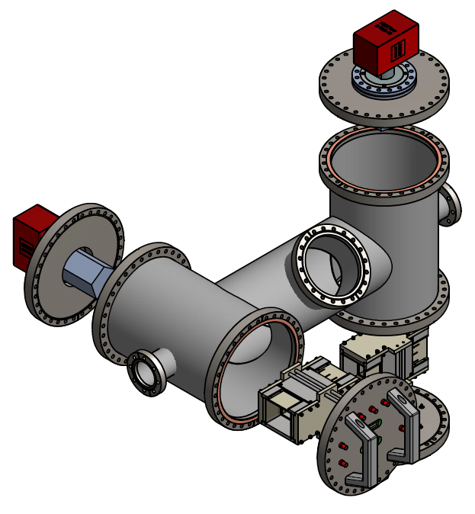
BIPM vacuum chamber

Slide 26
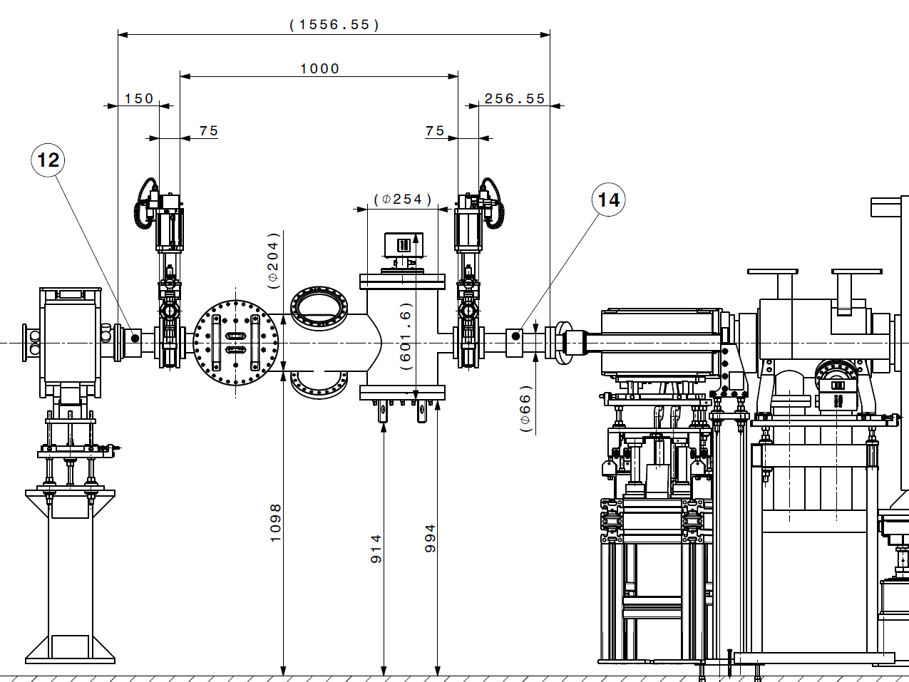
Integration in ELENA

Slide 27
Schedule

Slide 28
Schedule : detector

Slide 29
Schedule

Slide 30
Schedule

Slide 31
Schedule

Slide 32
Schedule

Slide 33
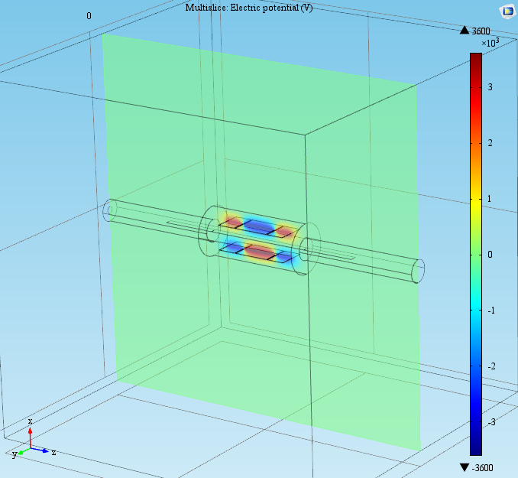
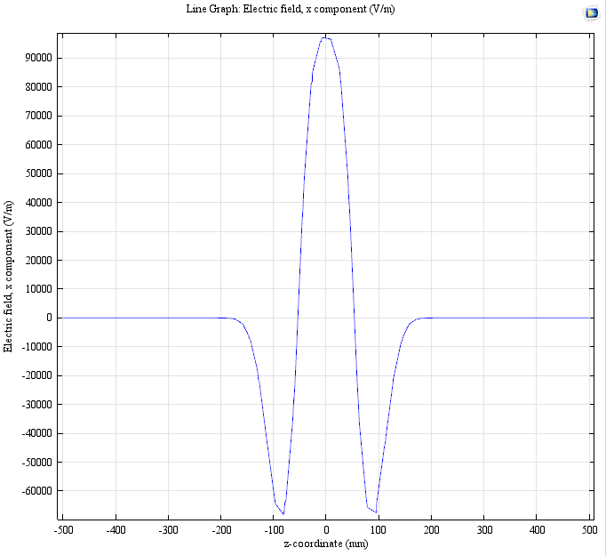
Beam transport
Gerard Tranquille, 2015

Slide 34
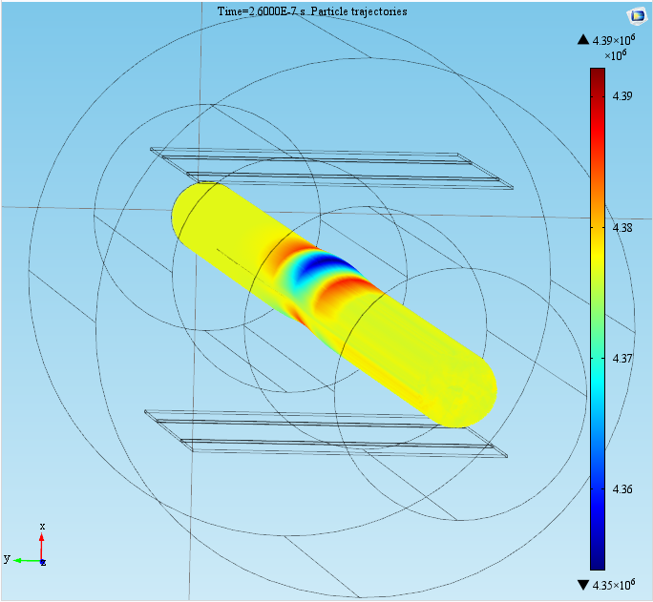
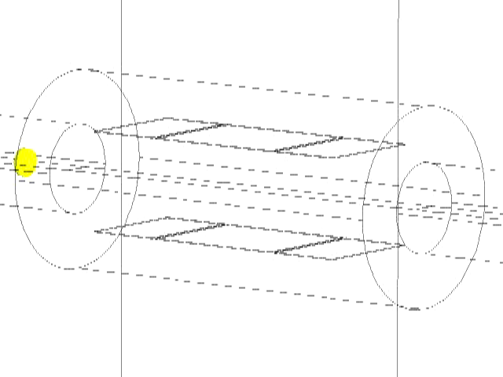
Beam transport
Gerard Tranquille, 2015

Slide 35
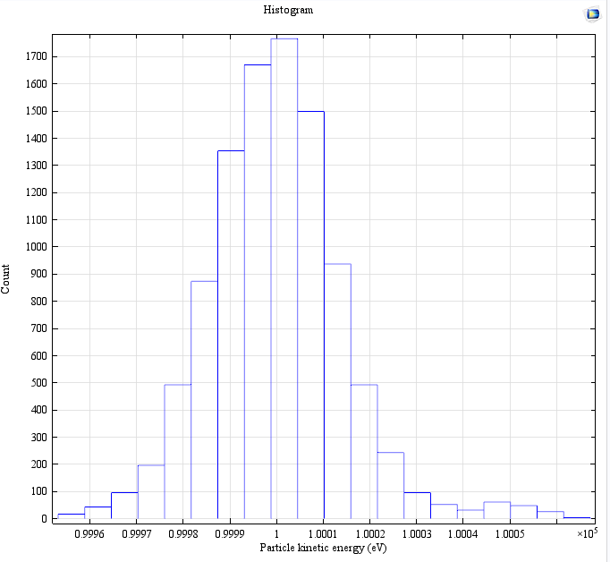
Beam transport
Gerard Tranquille, 2015

