Slide 1
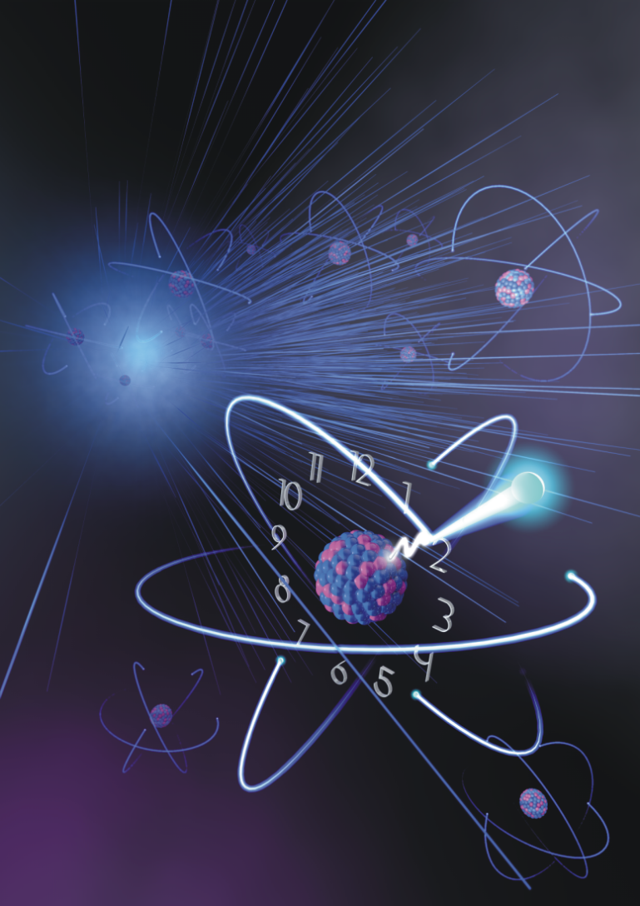
Direct Detection of the Elusive ²²⁹Thorium Isomer: Milestone towards a Nuclear Clock
P.G. Thirolf, LMU München
Clock basics
229mTh properties and prospects
Experimental approach & setup
Isomer decay study results
Verification studies
Summary & Perspectives
1

Slide 2
Functional Principle of Clocks
periodic event
(oscillation)
counting device
examples:
- rotation of earth, moon phases
- pendulum, spring
- quartz crystal
- atomic transitions
- nuclear transitions ?
examples:
- sun dial
- mechanical clocks
- ‘digital’ clocks
- microwave, laser
rising frequency
2

Slide 3
Clock Accuracies
Mechanical clocks
accuracy: 1s /day
world record (NIST): 1s / year
Quartz clocks
accuracy: 1s / month
world record: 10-12
Atomic clocks
accuracy: 10-14
world record: 10-18
nuclear clocks ??
229mTh
3

Slide 4
Clock properties
continuous operation:
- feedback on resonance
- optimum energy transfer at specific excitation frequency f
Quality factor Q:
best clock:
- highest oscillation frequency (f large)
- as precise as possible (Δf small)
Energy transfer
f excitation frequency
microwave atomic clocks: Q ~ 1010
‘optical’ atomic clocks: Q ~ 1014
nuclear clock: Q > 1015 ??
4

Slide 5
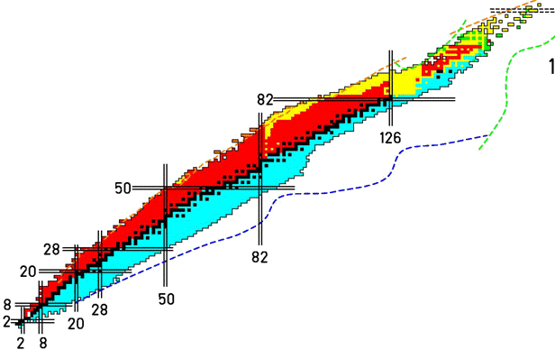
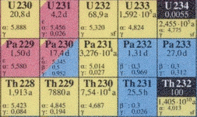
What makes ^{229m}Th so unique ?
since 40 years nuclear physicists seemed to chase a phantom:
presumed low-lying isomer in 229Th:
- 1976 (Kroger, Reich): < 100 eV
1990 (Reich, Helmer): -1 ± 4 eV
1994 (Reich, Helmer): 3.5 ± 1 eV
2005 (Guimaraes-Filho, Helene): 5.5 ± 1 eV
2007 (Beck et al.): 7.6 ± 0.5 eV
(expected/assumed) properties of 229mTh:
energy: 7.8(5) eV (indirect evidence)
wavelength: 159(10) nm
radiative τ ≈ 104 s
ΔE/E ≈ 10-20
Δν ~ 10-4 Hz
B.R. Beck et al., LLNL-PROC-415170 (2009)
5

Slide 6
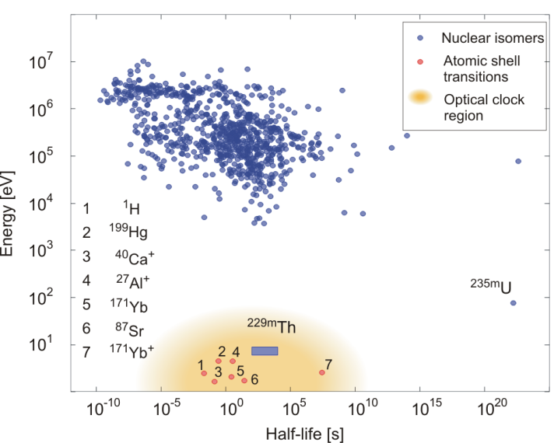
^{229m}Th: Nuclear Clock ?
lowest excitation energy of all ca. 176000 presently known excited nuclear states
insensitivity of 229mTh nuclear transition frequency to external perturbations
→ small nuclear moments
→ largely immune to systematic frequency shifts:
→ ultra-precise nuclear frequency standard ?
6
Notes:
Longest-lived nuclear isomer: 180mTa (> 10^15 years, never seen to decay)

Slide 7
^{229m}Th and time dependence of fundamental constants
Theories unifying gravity with other interactions suggest temporal and spatial
variations of the fundamental “constants” in an expanding universe
Uzan, Rev. Mod. Phys. 75, 403 (2003)
- near degeneracy of 229,229mTh results from cancellation between large
contributions from Coulomb energy (~109 eV)
dependencies on fundamental constants
→ any variation would be enhanced in the transition frequency
temporal variation in transition energy may provide enhanced
sensitivity by (102 – 105) for fine structure constant α/α
and strong interaction parameter (m_{q}/Λ_{QCD})
.
- Flambaum, PRL 97 (2006) - Hayes, Friar, PL B 650 (2007)
He, Ren, NP A 806 (2008) - Berengut, Flambaum et al., PRL 102 (2009)
Litvinova, Feldmeier et al., PRC 79 (2009) - Flambaum et al., Europhys. Lett. 85 (2009)
Flambaum, Wiringa, PRC 79 (2009) - Flambaum, Porsev, PRA 80 (2010)
Rellergert et al, PRL 104 (2010)
current (theor.) limit of potential time variation:
Fujii et al., NP B573, 377 (2000)
7
Notes:
Theories unifying gravity with other interactions suggest temporal and spatial variations of the fundamental “constants” in an expanding universe
(see, e.g., review: J.-P. Uzan, Rev. Mod. Phys. 75 , 403 (2003).
The fundamental constants may be slightly different near massive bodies .
There are some hints for the variation of different fundamental constants in quasar absorption spectra and big bang nucleosynthesis data.
However, a majority of publications report limits on the variations of the fundamental constants.
Dirac initiated the consideration of time-varying constants:
expressed, in his ‘‘Large Numbers hypothesis,’’ the opinion that very large (or small) dimensionless universal constants cannot be pure
mathematical numbers and must not occur in the basic laws of physics. He suggested, on the basis of this numerological principle, that these large
numbers should rather be considered as variable parameters characterizing the state of the universe.
→ Dirac noticed that alpha_G mu/alpha_EM, representing the relative magnitude of electrostatic and gravitational forces between a proton and an
electron, was of thesame order as H_0e^2/m_ec^2 = delta alpha_EM /mu, representing the age of the universe in atomic time, so that the
five previous numbers can be ‘‘harmonized’’ if one assumes that alpha_G and delta vary with time and scale as the inverse of the cosmic time.
- grand unified theories (GUT), higher-dimensional theories (Kaluza-Klein and string theories)
a number of cosmological models taking these variations into account.
The development of high-energy physics theories such as multidimensional and string theories provides new motivations to consider the time variation of the fundamental constants. The observation of the variability of these constants constitutes one of the very few hopes to test directly the existence of extra dimensions and to test these high-energy physics models.
- Modern theories of high-energy physics offer new arguments to reconsider the variation of the fundamental constants
Constraints from: geological studies → alpha decay, beta decay, spontaneous fission
atomic spectra
cosmological constraints: CMB, nucleosynthesis → give no tight constraints
equivalence principle
- Experimental limit: Sortais et al., 2001) → (8.4+/- 13.8) x 10^-15 2sigma 24 months method: Atomic clock

Slide 8
Sensitivity to variations of α
sensitivity of 229mTh transition frequency ω to temporal variation of α= e2/hc:
system | K | λ [nm]
Sr | 0.06 | 699
Yb⁺ E2 | 0.91 | 436
Yb⁺ E3 | -6 | 467
Hg+ | -2.9 | 281.5
Al⁺ | 0.01 | 267
Ir¹⁷⁺ T1 | -20.6 | ca. 267
Ir¹⁷⁺ T2 | 32.2 | ca. 470
Cf^{16+*} T1 | 75 | ca. 520
Cf^{16+*} T2 | -46 | ca. 653
Th* (nuclear) | 8000 | ca. 160
ΔV_{C}: difference in Coulomb energy between 229Th, 229mTh
(proton polarization by modified neutron distribution)
enhancement factor:
example:
for ΔV_{C} = 100 keV, δα/α = 10-16
→ δω = 10-11 eV (= 2.4.103 Hz)
104 larger than limits on shifts in
atomic transitions
problem: - Coulomb energy cannot be directly measured
- V_{C} needs to be calculated in nuclear models
- insufficient accuracy in present nuclear models
(e.g. Hartree-Fock, Hartree-Fock-Bogoliubov:
-300 keV < ΔV_{C} (229Th) < 400 keV → - 4.104 < K < + 4.104 )
Schmidt & Crespo,
Phys. Jour. Oct. 2016
8
Notes:
Sensitivity factor K: relative shift of transition frequency as a function of alpha (→ Crespo)
DeMille et al 2004, 2008: – enhancement in Cs2: cancellation between electron excitation and vibration energies
Flambaum 2006: Cancellations between rotational and hyperfine intervals
Δω/ω0 = Κ Δα/α , Enhancement K = 10² -10³
Flambaum, Kozlov 2007: Cancellations between fine structure and vibrations
Δω/ω0 = Κ(Δα/α −1/4 Δμ/μ)
Enhancement K = 10⁴ -10⁵
Table: from atomic structure calculations (T1, T2: different optical transitions)

Slide 9
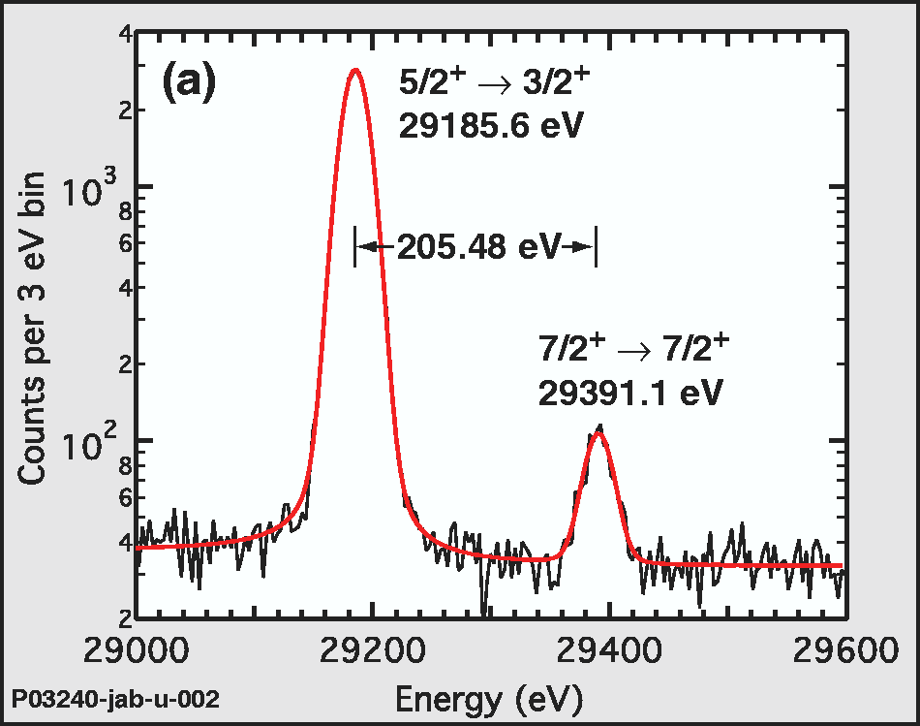
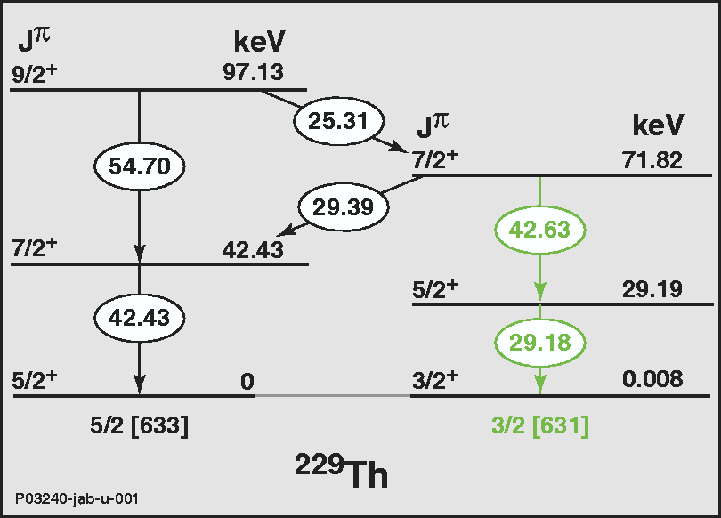
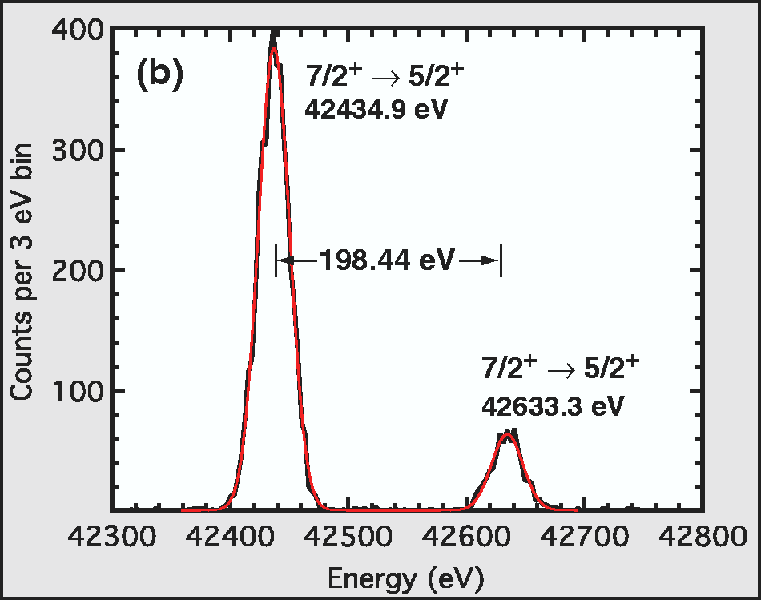
Indirect Evidence for ^{229m}Th
data from X-ray micro-calorimeter
E* (229mTh) = ΔE₂₉ - ΔE₄₂
E* (229mTh) = (7.8 ± 0.5) eV
B.R. Beck et al., PRL 98 (2007) 142501
LLNL-PROC-415170 (2009)
from energy difference of high-energy transitions → low isomer excitation energy
9

Slide 10
Experimental Approach @ LMU
concept:
populate the isomeric state via 2% decay branch in the α decay of 233U
spatially decouple 229(m)Th recoils from the 233U source
detect the subsequently occurring isomeric decay
triodic
extraction
electrode
Buffer gas
stopping cell
Laval
nozzle
aperture
electrode
detection
system
229(m)Th2+,3+
233U
source
RF + DC
funnel
RF quadrupole
ion guide
Quadrupole
mass separator
UV detection
MCP
CCD
40 mbar (He)
10-2 mbar
10-6 mbar
→ 4 vacuum chambers , 3 differential pump sections, overall length ~ 2 m
10

Slide 11
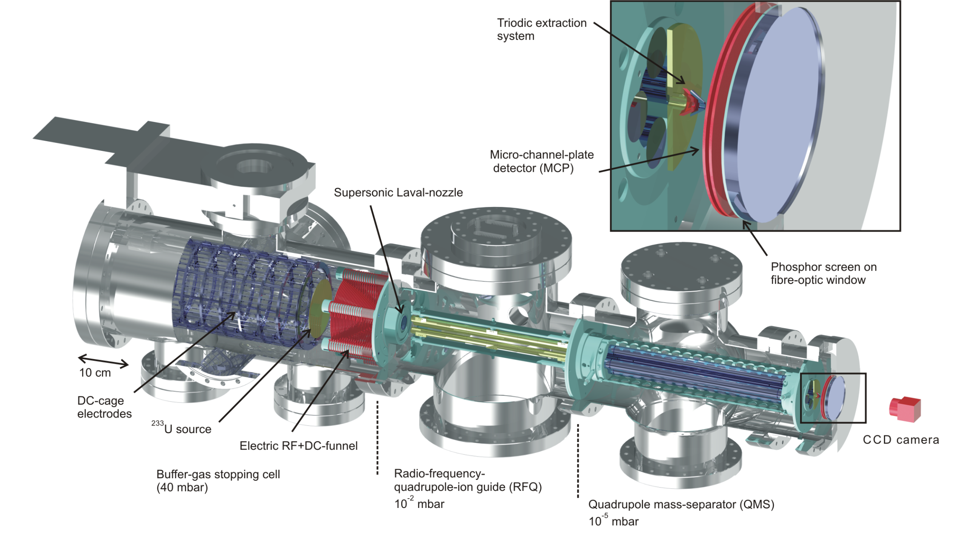
Experimental Setup
strictly UHV compatible, bakeable (180o)
typical: 2.8.10-10 mbar
operated at 40 mbar He 6.0
catalytically purified (< ppb)
220 V_{pp}, 850 kHz
4 V/cm
m/Δm~ 150
200 V_{pp}, 880 kHz
0.1 V/cm
Th2+: 925 kHz, 901.5 V_{pp}, 75.23 V
11
Th3+: 925 kHz, 600.5 V_{pp}, 50.15 V

Slide 12
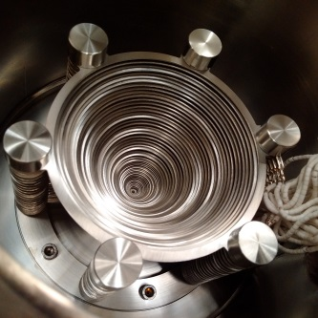
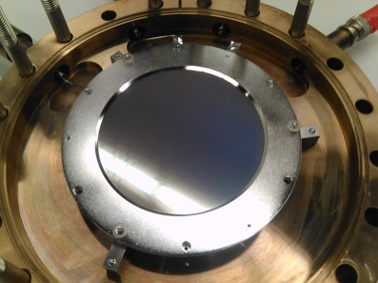
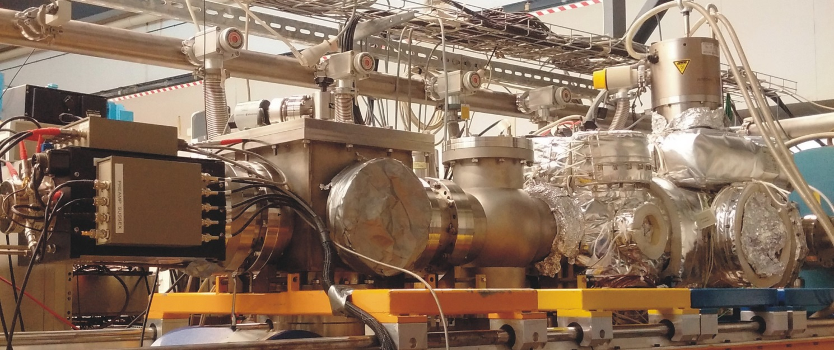
Experimental Setup
located at Maier-Leibnitz Laboratory, Garching:
12

Slide 13
²³³U ion sources
population of 229mTh via 2% α decay branch of 233U
2 different 233U sources were used:
source 1:
- 200 kBq 233UF₄ evaporated onto 20 mm ø steel plate
- no radio-chemical purification before evaporation
- 232U contamination ≤ 10-6
- eff. 229(m)Th recoil activity: ca. 4000/s
source 2: (IRC Uni Mainz)
- 290 kBq electro-deposited onto 90 mm ø wafer
- radio-chemical purification before evaporation
- 232U contamination ≤ 10-6
- eff. 229(m)Th recoil activity: ca. 55000/s
13

Slide 14
Ion Extraction from Buffer Gas Cell
mass scan of extracted ion species: efficient 229(m)Th3+ extraction
element | 1⁺ [%] | 2⁺ [%] | 3⁺ [%]
Th | 0.37(7) | 5.5(11) | 10(2)
Fr | 21.0(42) | 16.0(32) | ≤ 1.5.10⁻³
Rn | 5.8(12) | 9.3(19) | 0.053(11)
At | 8.6(17) | 13.0(26) | 0.033(7)
Po | 7.3(15) | 8.1(16) | ≤ 0.0021
Bi | 4.3(9) | 21.0(42) | 0.083(16)
Pb | 2.2(4) | 11.0(22) | ≤ 0.012
element | 1⁺ [eV] | 2⁺ [eV] | 3⁺ [eV]
U | 6.1 | 11.6 | 19.8
Th | 6.3 | 11.9 | 18.3
Ra | 5.3 | 10.1 | 31.0
Fr | 4.1 | 22.4 | 33.5
Rn | 10.7 | 21.4 | 29.4
At | 9.3 | 17.9 | 26.6
Po | 8.4 | 19.3 | 27.3
Bi | 7.3 | 16.7 | 25.6
q=1
233U+
q=2
229Th2+
233U2+
229Th3+
q=3
229Th+
233U3+
L. v.d. Wense, B. Seiferle, M. Laatiaoui, PT, EPJ A51, 29 (2015)
I(He+) = 24.6 eV
14

Slide 15
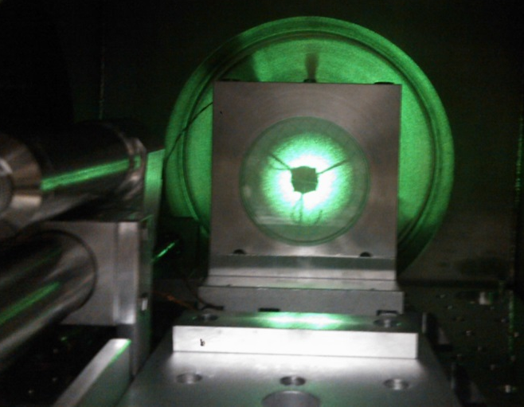
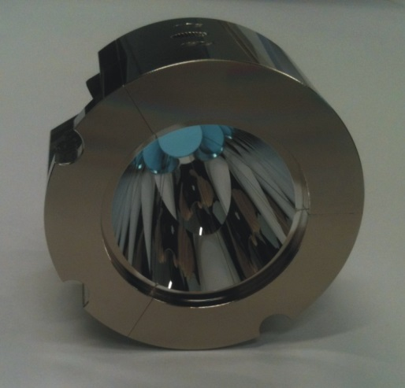
Isomer Decay: Search for VUV Fluorescence
UV optical setup designed, built and commissioned (aligned):
→ 2 annular, parabolic mirrors (MgF₂ coated, from Fraunhofer IOF, Jena)
mirror 1
mirror 2
from triode
MCP
50 μm ø collection
micro electrode
mirror 1:
mirror 2:
B. Seiferle, L. v.d. Wense, M. Laatiaoui, PT, EPJ D70, 58 (2016)
15

Slide 16
VUV Optics Setup
efficiency:
2% 16% 65% 80% 40% 42% 49% 76% 10% 1.3.10-5
L. v.d. Wense, PT, D. Kalb, M. Laatiaoui, Journal of Instrumentation 8, P03005 (2013)
signal-to-noise ratio:
²³³U source 2
eff. ²²⁹Th recoil activity | 55000 / s
detectable VUV photons | 0.72 / s
count rate/area | 81.82 / mm²s
dark count rate | 0.01 / mm²s
signal/noise ratio | 8182:1
VUV fluorescence ?
ion collection on micro-electrode:
no fluorescence signal was observed
→ radiative decay branch too weak ?
→ search for dominant IC decay branch
→ measure conversion electrons
16

Slide 17
Isomer Detection Process
triodic
extraction
electrode
Buffer gas
stopping cell
Laval
nozzle
aperture
electrode
detection
system
229(m)Th2+,3+
233U
source
RF + DC
funnel
RF quadrupole
ion guide
Quadrupole
mass separator
UV detection
MCP
CCD
17

Slide 18
Isomer Detection Process
triodic
extraction
electrode
Buffer gas
stopping cell
Laval
nozzle
aperture
electrode
detection
system
229(m)Th2+,3+
233U
source
RF + DC
funnel
RF quadrupole
ion guide
Quadrupole
mass separator
MCP
CCD
→ accumulate 229(m)Th ions directly onto MCP surface
17

Slide 19
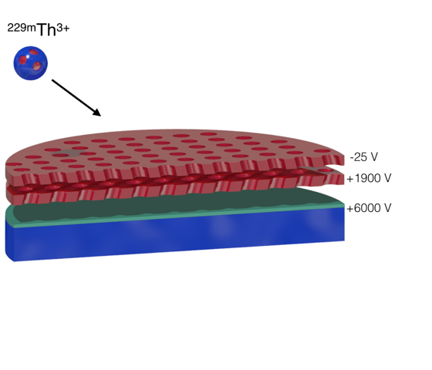
Isomer Detection Process
extracted 229(m)Th3+ ions: impinging directly onto MCP surface behind triode exit
18

Slide 20
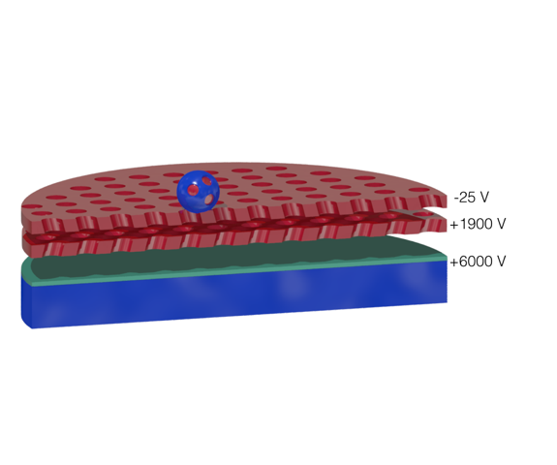
Isomer Detection Process
extracted 229(m)Th3+ ions: ‘soft landing’ on MCP surface
18

Slide 21
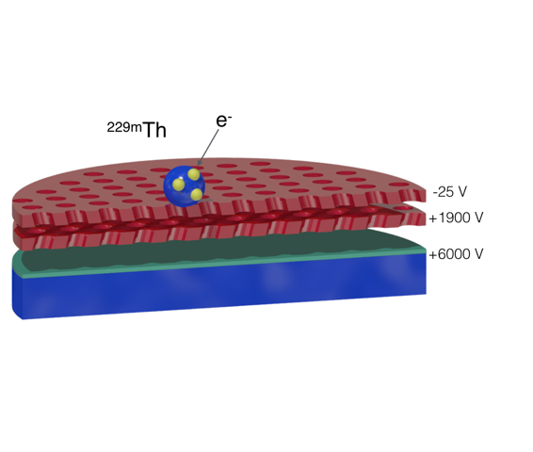
Isomer Detection Process
electron capture on MCP surface: neutralization of Th ions
18

Slide 22
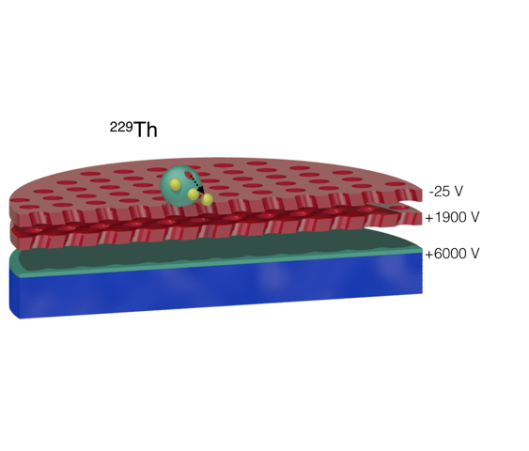
Isomer Detection Process
isomer decay by Internal Conversion: electron emission
internal conversion (IC) energetically allowed for neutral thorium:
I(Th+, 6.31 eV) < E*(229mTh, 7.8 eV)
isomer lifetime expected to be reduced by ca. 109 (from ~104 s → ~ 10 μs)
Th ions: IC is energetically forbidden, radiative decay branch may dominate
18

Slide 23
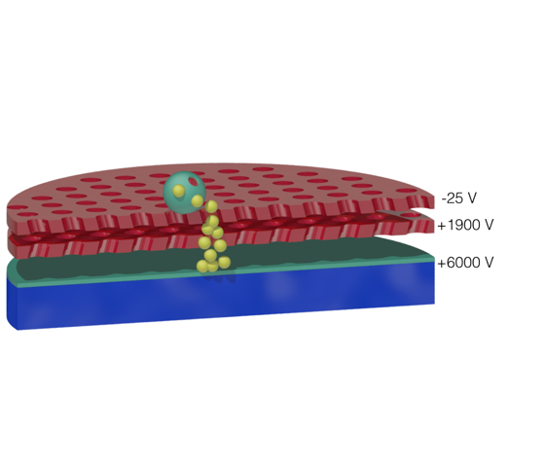
Isomer Detection Process
amplification of IC electron: electron cascade generated,
accelerated towards phosphor screen
internal conversion (IC) energetically allowed for neutral thorium:
I(Th+, 6.31 eV) < E*(229mTh, 7.8 eV)
isomer lifetime expected to be reduced by ca. 109 (from ~104 s → ~ 10 μs)
Th ions: IC is energetically forbidden, radiative decay branch may dominate
18

Slide 24
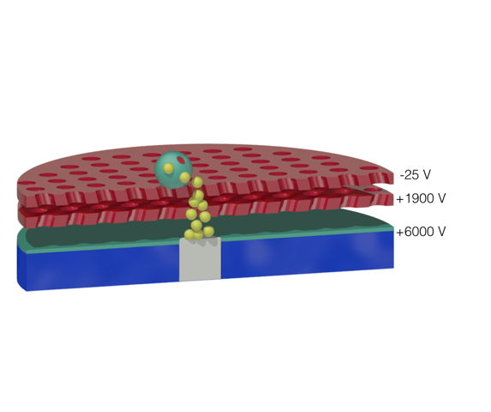
Isomer Detection Process
electrons hit phosphor screen: visible light imaged by CCD camera
internal conversion (IC) energetically allowed for neutral thorium:
I(Th+, 6.31 eV) < E*(229mTh, 7.8 eV)
isomer lifetime expected to be reduced by ca. 109 (from ~104 s → ~ 10 μs)
Th ions: IC is energetically forbidden, radiative decay branch may dominate
18

Slide 25
Direct Signal of IC Decay from ^{229m}Th
L. v.d. Wense, PT et al., Nature 533, 47-53 (2016)
Th3+
U3+
Th2+
U2+
clear signal from Th3+, Th2+
no signal from U3+, U2+
19

Slide 26
Verification Measurements
Background-corrected isomeric decay signals:
U_{MCP}= -25 V
→ isomeric decay
U_{MCP}= -900 V
→ ionic impact
during extraction of 229Th2+
229Th2+
233U2+
during extraction of 233U2+
235U2+
- ionic impact signal decreases with U_{MCP}
- 233U2+ signal drops to zero
- 229Th2+ signal remains, cutoff at E_{kin}=0
(rise: IC electrons back-attracted to
MCP surface by repelling triode)
- comparable mass peak amplitudes for
229Th2+, 233U2+ ion impact signals
- for U_{MCP}= -25 V 233U2+ signal vanishes
- 229Th2+ signal remains
20

Slide 27
Potential Background Contributions
A) Background due to kinetic energy or charge state of impinging ions
B) Background signals from setup components
(source, gas stopping cell, extraction system, QMS , MCP system)
C) Signals from thorium atomic shell
(e.g. long-lived excited states, chemical reactions on MCP surface)
Signals from short-lived
daughter nuclides or
non- 229Th isomers
could all be excluded,
mostly by several ways
21

Slide 28
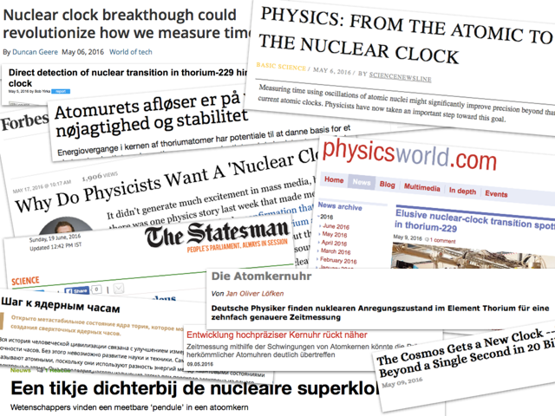
Lively Echo to Publication
15

Slide 29
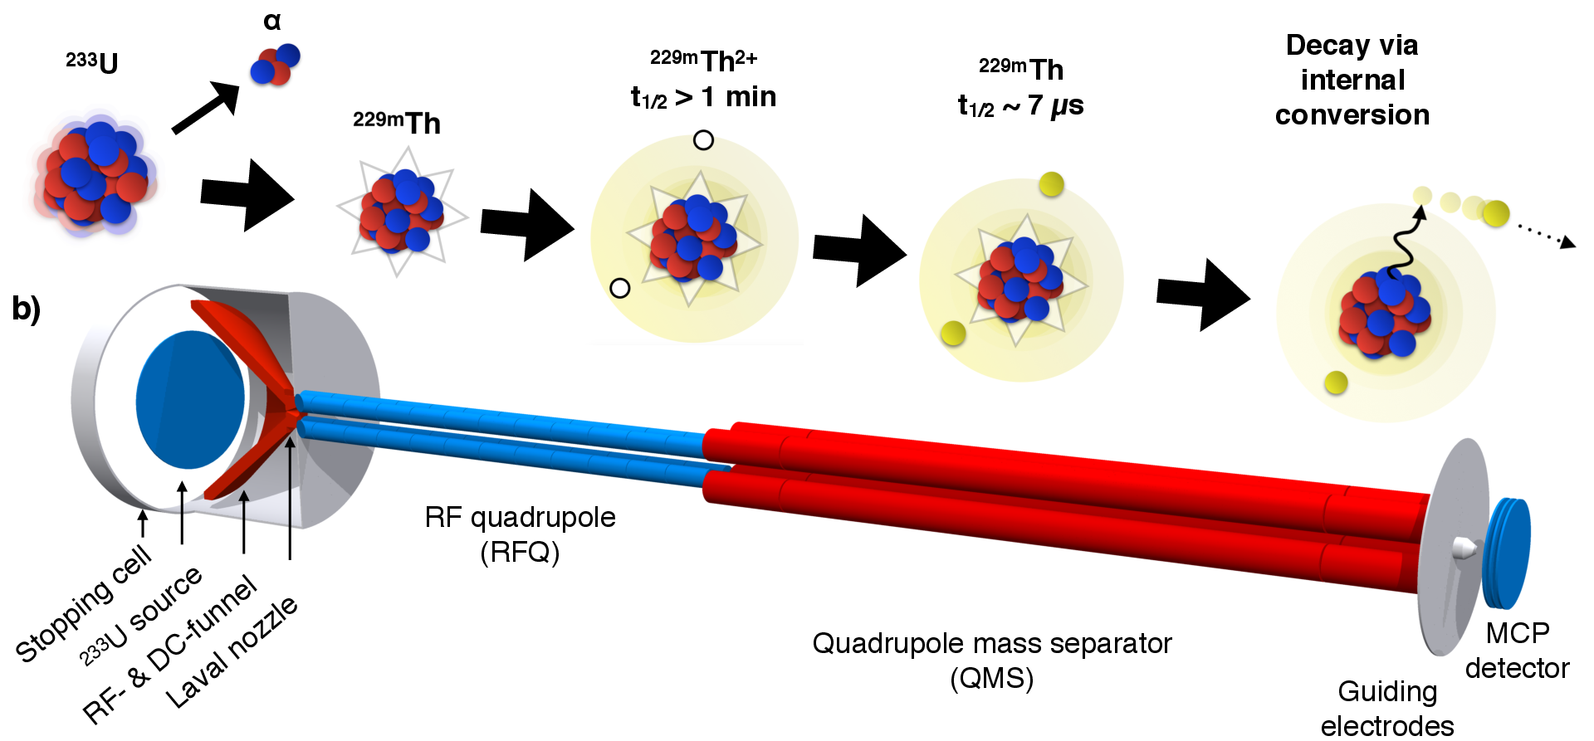
Next steps: Halflife determination
- charged 229mTh2+: t_{1/2} > 1 min (limited by RFQ storage time)
- neutral 229mTh: pulsed extraction from RFQ
229mTh2+
t_{1/2} > 1 min.
229mTh
t_{1/2} : ?
expected conversion coefficient: ca. 109
provides constraint for strength of photonic decay branch
(if IC cannot be suppressed, e.g. by suitable lattice implantation)
22
B. Seiferle et al., to be published
Notes:
Electron/gamma decay rate ratio

Slide 30
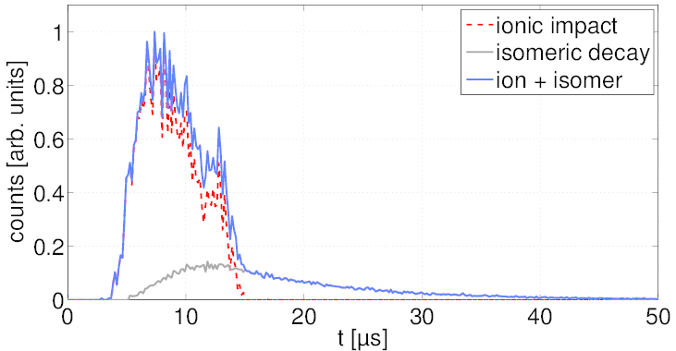
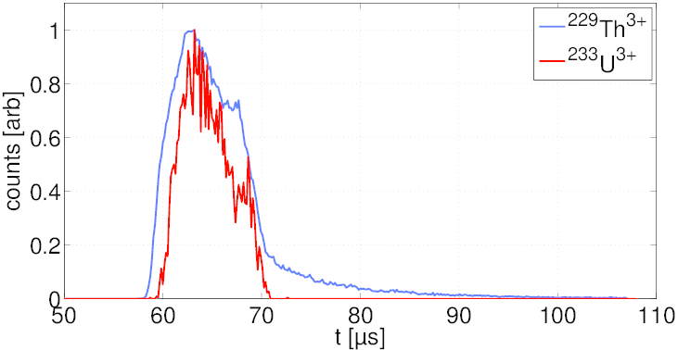
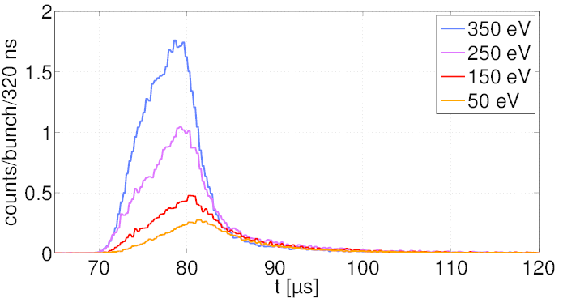
Halflife: Neutral ^{229m}Th
simulation:
measurement:
U_{MCP}= -70V
assumed: t_{1/2} = 7 μs
MCP signal of 229(m)Th2+ ion bunches
with different kinetic energies:
bunch width: ca. 10 μs
600- 800 229(m)Th2+,3+ ions/bunch
ionic impact
isomeric decay
23
B. Seiferle et al., to be published
Notes:
Simulations: - t1/2 = 7 microseconds assumed
- electron detection efficiency assumed to be 25x the one for ions

Slide 31
Halflife: Neutral ^{229m}Th
extracted: Th2+
extracted Th3+
based on expected charged isomeric half-life of a few 103 s:
confirms expected conversion coefficient of ca. 109
→ photonic decay branch ??
24

Slide 32
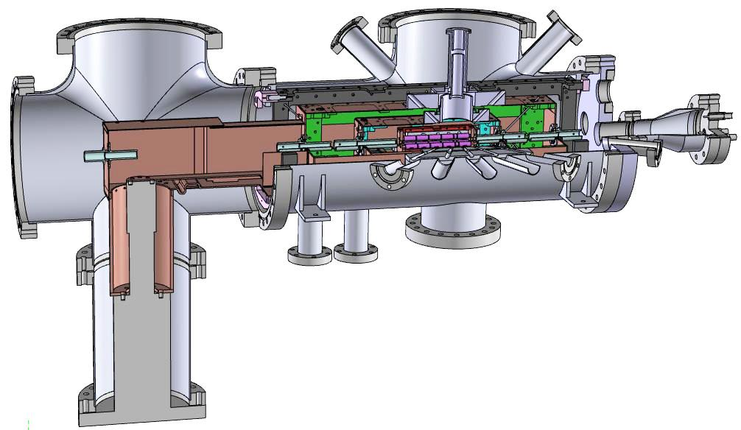
Halflife: Charged ^{229m}Th
- 229mThq+: longer ion storage time needed (→ UHV)
→ cryogenic linear Paul trap:
- in operation at MPI-K (HD): CryPTEx → operating at 4 K (p(H₂) ~ 10-15 mbar)
→ ion storage time ≤ 30 h
→ laser access ports
M. Schwarz et al.,
Rev. Sci. Instr. 83, 083115 (2012)
prerequisite for laser manipulation
of 229mTh3+
thanks to: MPIK (J. Crespo et al.), PTB (P. Schmidt)
25

Slide 33
“Holy Grail”: Excitation Energy
our present constraint: 6.31 eV < E(229mTh) < 18.3 eV
Magnetic bottle spectrometer: large acceptance needed (~ 4π)
10000 229Th ions extracted/sec. → 200 e-/s
electron
detector
retarding
electrodes
guiding
solenoid
inhom.
B field
permanent
magnet
Y. Yamakita et al., Rev. Sci. Instr. 71, 3042 (2000)
26
Notes:
bottom part of this schematics is specific to the application targeted in [46], namely Penning ionization electron spectroscopy, where a beam of metastable rare-gas atoms is crossed with a continuous supersonic sample beam in the source region of the analyzer.
Ca. 1000x more efficient than hemispherical electron analyzers with 180-degree deflection geometry and small entrance aperture
The kinetic electron energy is analyzed by scanning the retarding field in a flight tube of the analyzer in the presence of a weak magnetic field.
Energy resolution: Delta E/E < B_f/B_i (exit/entrance values of inhomogeneous magnetic field)

Slide 34
Excitation Energy
229mTh2+,3+ neutralization with subsequent IC:
- metallic catcher electrode
- but: how to control/avoid surface effects (work function) ?
→ contact-free neutralization: charge-transfer cell
finally expected:
ΔE < 50 meV
M.G. Helander et al., Applied Surface Science 256, 2602 (2010)
27

Slide 35
Laser diagnostics of isomer excitation
use closed 2-level system in electron shell:
ω₁
ω₂
ω₁
229mTh
229Th(g.s.)
after nuclear transition (via ω₂):
→ change of nuclear moments, spin
change of hyperfine splitting,
total angular momenta
ω₁ out of resonance (~GHz)
→ drop in resonance fluorescence
α: nuclear, β: electronic
double resonance method
Dehmelt’s ‘electron shelving’
Peik, Tamm, Eur. Phys. Lett. 61 (2003) 181
28

Slide 36
²²⁹Th³⁺: suitable level scheme
simple structure: alkali-like (Rn core + single valence electron)
6p6 7s 2S_{1/2}
6p6 6d 2D_{5/2}
717 nm
(metastable, ~1s)
984 nm
6p6 6d 2D_{3/2}
~GHz
690 nm
1087 nm
6p6 5f 2F_{7/2}
6p6 5f 2F_{5/2}
closed 3-level Λ system and closed 2-level system available
for laser cooling and fluorescence detection
constant resonance fluorescence scattering with closed optical transition
- after nuclear excitation: out of resonance
→ spectroscopy of laser-cooled 229Th3+ (e.g. in linear Paul trap)
29

Slide 37
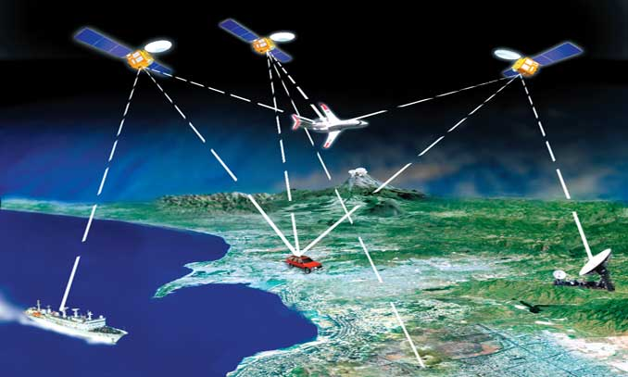
Why better clocks at all ?
every time that clock precision has improved, new and
frequently unexpected applications have emerged
example: GPS navigation
present technology:
- ‘thermal’ microwave atomic clocks
(Rb, Cs)
- GPS, GLONASS: active
- Galileo, Beidou, IRNSS:
under construction
GPS satellites
GPS
receiver
→ positioning precision: 1-10 m
goal: positioning to cm – mm
- autonomous driving
- freight-/ component tracking
- …..
requirements:
- better clocks (10-16 – 10-18)
- robust, small, low power consumption …
30
Notes:
Not clock limited on short timescales, but advantage via superb longterm drift stability:
Longer resynchronization intervals
→ improved system integrity: enabling autonomous operation within given acceptable
position ranging errors for time scales of days or weeks, instead of hours.
applications which can benefit from improved system integrity include precision airplane approaches at airports
- onboard deep space missions to aid in navigation and timekeeping.

Slide 38
Further potential applications
(networks of) ultra-precise clocks could be used
to search for dark matter
Derevianko & Pospelov,
Nature Physics 10, 933–936 (2014)
topological dark matter:
clumped to point-like monopoles,
1D strings, 2D ‘domain walls’
networks of clocks can be used as 3D gravity sensors
→ Ludlow, Boyd, Ye, Peik, Schmidt, Rev. Mod. Phys. 87, 637–701 (2015)
Δf: clock frequency difference
ΔU: gravitational potential difference
- best present clocks: detect gravitational shifts of ± 2 cm
- “relativistic geodesy” or “chronometric leveling”:
→ allows long-distance potential difference measurements
precise, fast measurements of nuclear clock network:
e.g. monitor volcanic magma chambers, tectonic plate movements
31
Notes:
Dark matter search:

Slide 39
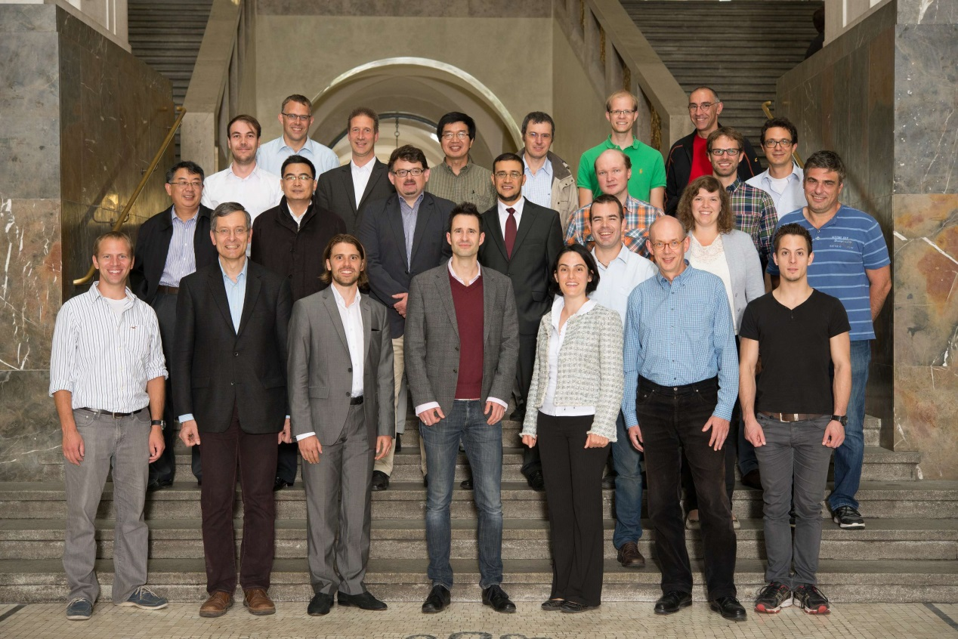
The nuClock Consortium
FET-OPEN project within EU Horizon 2020:
→ experiment, theory, industrial R&D
TU Wien (T. Schumm et al., Coord.)
Univ. Jyväskylä (I. Moore et al.)
Univ. Heidelberg (C. Enss et al.)
MPI-K, HD (A. Pálffy et al.)
PTB Braunschweig (E. Peik et al.)
MPQ Garching (T. Udem et al.)
TOPTICA Photonics AG, Munich
LMU Munich (PT et al.)
associated:
- Okayama Univ., Japan (SPRING8)
- Metrology Light Source (MLS), Berlin-Adlershof
- U Mainz/ HIM (C. Düllmann et al.)
http://www.nuclock.eu/
- Kerstin Ergenzinger (Berlin): artist, via FEAT (future emerging art and technology)
32

Slide 40
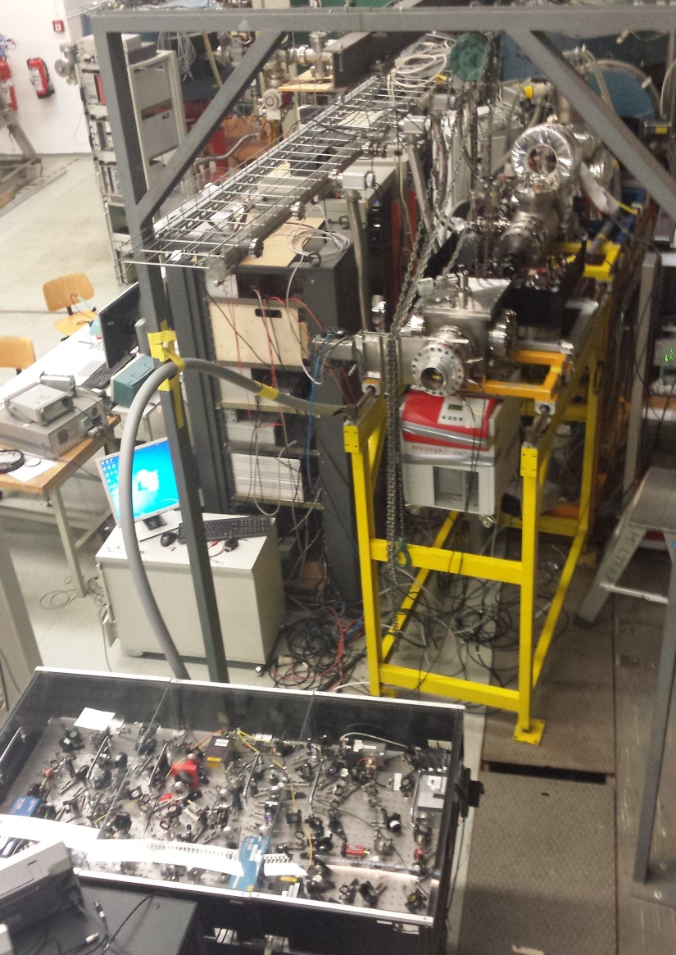
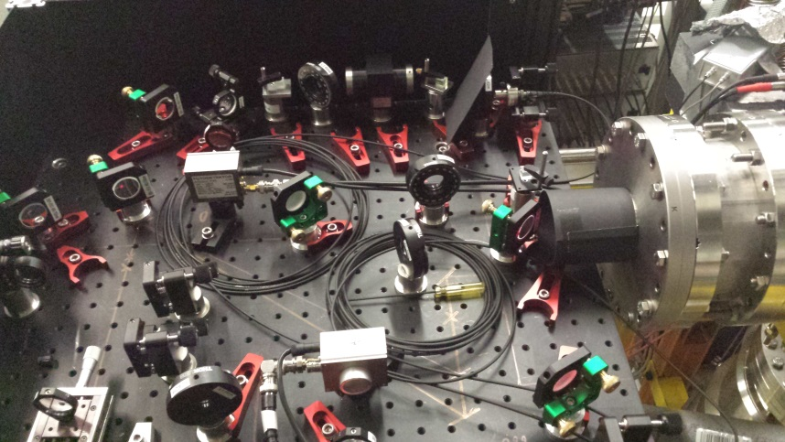
Collaboration with PTB Braunschweig
E. Peik, M. Okhapkin et al.: targeting hyperfine structure of 229mTh1+,2+
collinear laser spectroscopy:
- laser interaction with 229Th ions
extracted from QMS
- measurement campaign started
33

Slide 41
Summary
successful experimental approach based on spatial decoupling of population and deexcitation via buffer-gas stopping cell
efficient extraction of pure 229(m)Th2,3+ ions achieved
VUV optical detection system was designed and commissioned
radiative decay channel in neutral 229mTh drastically reduced (in favor of IC)
IC decay channel provided first direct (and unambiguous) identification of
isomeric ground-state transition in 229mTh
constraints of 229mTh properties: 6.3 eV ≤ E* ≤ 18.3 eV
τ > 60 s
next steps: determination of halflife for neutral 229Th
towards determination of isomeric excitation energy
(magnetic bottle spectrometer )
started: setup of cryogenic Paul trap
→ to achieve longer storage times for halflife measurement in charged 229mTh
→ prerequisite also for laser manipulation of 229mTh3+
34

Slide 42
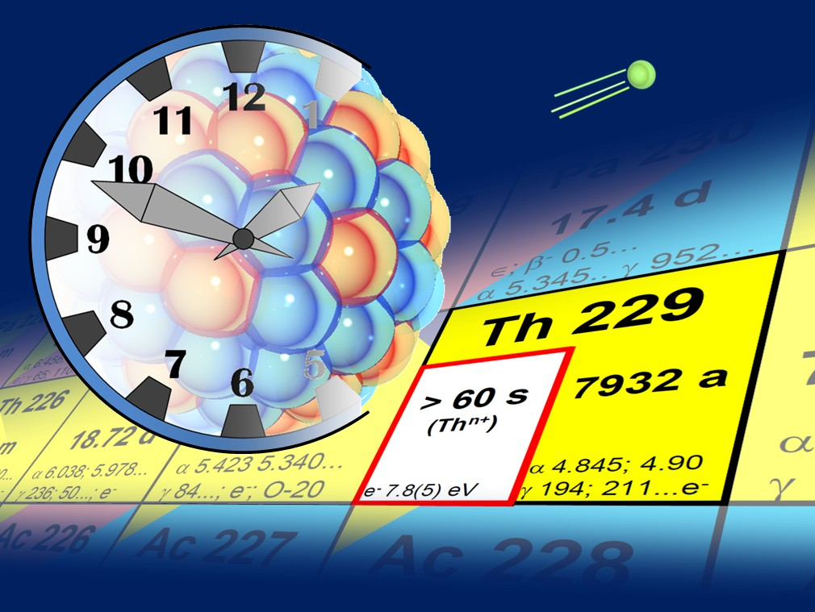
we made a big step towards the ultimate goal of a Nuclear Clock ….
but many more are yet to come ….
35

Slide 43
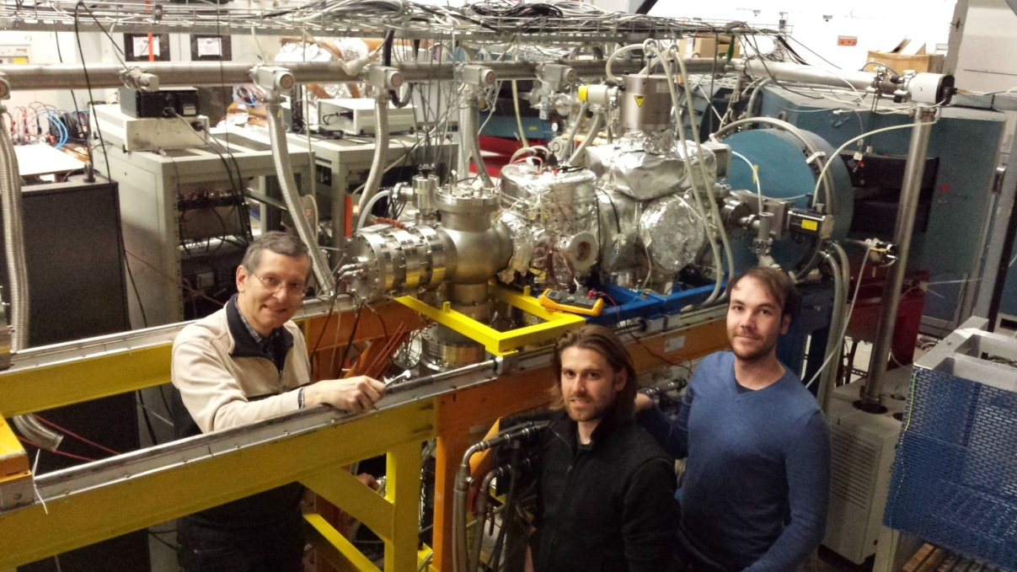
Thanks to ….
LMU Munich: L. v.d. Wense, B. Seiferle, J.B. Neumayr, H.-J. Maier, H.-F. Wirth,
D. Habs
GSI Helmholtzzentrum f. Schwerionenforschung, Darmstadt & Helmholtz-Institut Mainz:
M. Laatiaoui
Helmholtz-Institut Mainz & Johannes Gutenberg-Universität Mainz:
C. Mokry, J. Runke, K. Eberhardt, C.E. Düllmann, N.G. Trautmann
Thank you for your attention !
36

