Slide 1
Plasma physics at FAIR
V. Bagnoud for the plasma physics collaboration

Slide 2
FAIR is a very attractive driver for plasma physics
Summary
Plasma physics is pertinent to some outstanding planetary science questions but also it is a field that can be studied at FAIR on its own.
Compared to other drivers, FAIR offers many unique advantages: quasi-equilibrium and mesoscopic scales.
FAIR-generated plasma require power diagnostics.
pump-probe setups are standard in plasma physics
laser-generated sources of particles (ions, electrons) used to generate tertiary sources (neutrons, X-rays) offer the most promising solution for direct measurement of plasma parameters

Slide 3
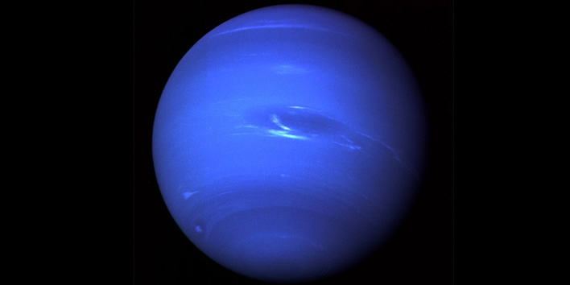
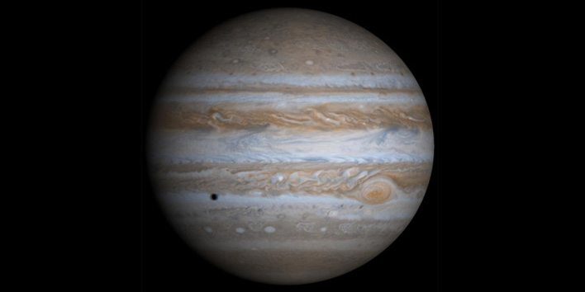
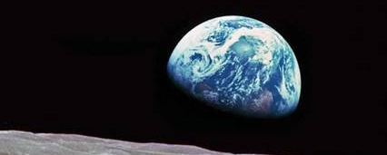
Current questions in planetary science are relevant to plasma physics
Are there diamond layers in Uranus and Neptune? – Ross et al., Nature 292 435 (1981)
Does high density metallic state of water contribute to sustaining magnetic field in Uranus and Neptune? (Stevenson et al., Rep. Prog. Phys. 46, 555, 1983)
What is equation of state of H across range of conditions for Jupiter, how does it separate from He? (Nepelman et al., Astrophys. J 683 1217, 2008)
What is exact melting curve for Fe? (Anzellini et al., Science 340, 2013)

Slide 4
Dense plasmas are strongly correlated many particle quantum systems
A great challenge for theory:
Strong coupling: E_{pot} > kB_{T}
Collisions (conductivity, heat transport)
Partial ionization
Continuum lowering
Exotic states, complex properties:
Equation of state, melting + phase transitions, transport properties, metallization,...
Transport properties (heat, radiation), equilibration,...., non-equilibrium states
Interaction of ions and photons with plasma
Atomic & nuclear physics in dense plasmas

Slide 5
Plasma are found in many flavors
Plasma coupling parameter:
$$Γ=\frac{E_{Coulomb}}{k_{B}T}$$
When Γ >1, plasma difficult to describe
10⁵
Ideal Plasma
1 Mbar
10⁴
MCF
ICF
1 kbar
sun core
10³
Solid state density
10²
temperature [eV]
Lightning
10¹
Γ = 1
Jupiter core
10⁰
sun surface
10⁻¹
non-ideal plasma
10⁻²
10¹²
10¹⁴
10¹⁶
10¹⁸
10²⁰
10²²
10²⁴
10²⁶
density [ion/cm³]

Slide 6
FAIR offers a unique alternative to other driver techniques
5
10
1 Gbar
HED
4
ICF
10
Laser plasma
1 Mbar
sun core
3
10
2
10
temperature [eV]
FAIR
WDM
1
Γ = 1
10
Jupiter core
0
10
isochoric
earth-like cores
Solid state density
-1
compression
10
DAC
-2
10
20
21
22
23
24
25
26
10
10
10
10
10
10
10
3
density [ion/cm
]

Slide 7
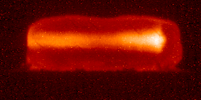
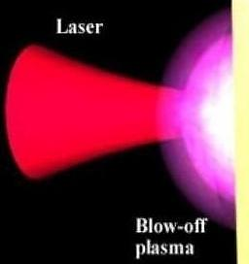
FAIR-driven plasma have also other advantages
Intense, energetic beams of
heavy ions (GSI & FAIR)
High-brilliance XUV photon sources (XFEL & DESY)
65 mm
Ne¹⁰⁺ 300 MeV/u; Kr crystal
large sample volume (mm³)
uniform physical conditions
any target material
long time scales (50 ns)
small sample volume (100 μm³)
high gradients
low-Z target material
short time scales (100 fs)
Advantages of FAIR-generated plasma:
large samples
local thermodynamical equilibrium
uniform samples

Slide 8
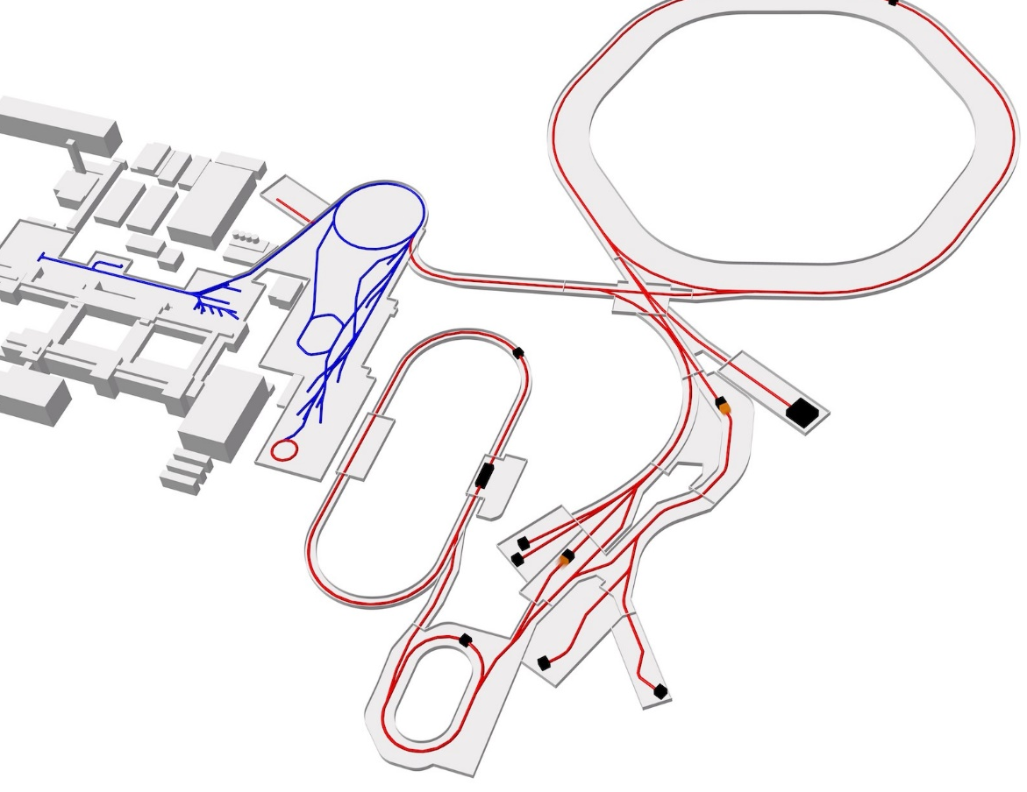
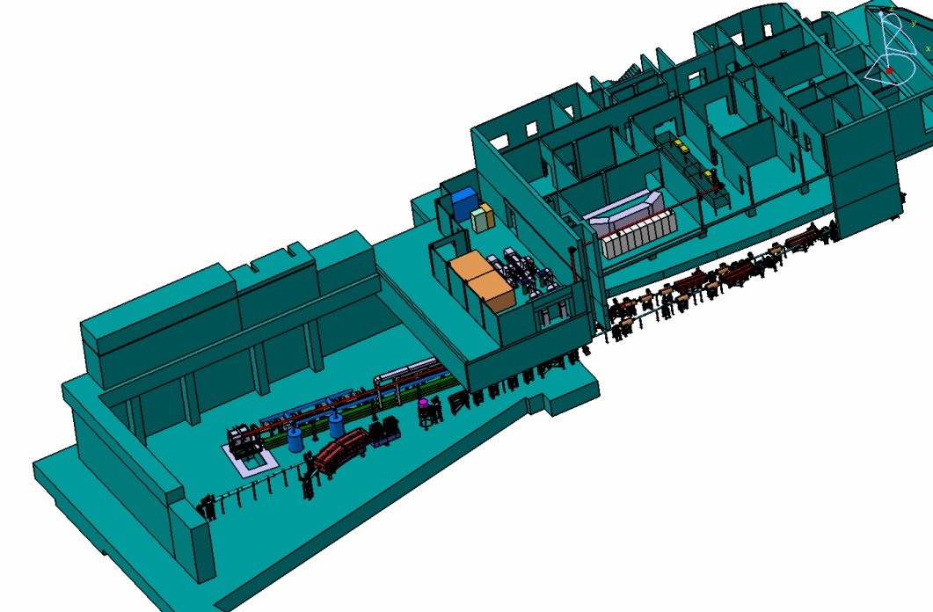
The APPA Cave
At APPA-cave:
protons (10 GeV): 2 x 10¹³ p/bunch
U²⁸⁺ (2 GeV/u): 5 × 10¹¹ ions/bunch
Bunched operation: ≈100ns
SIS100
PHELIX
SIS18
Z6
HHT
APPA
Cave
HESR
several target stations
flexible detector settings
flexible beam shaping
external drivers (HE-laser, pulsed power, gas gun, ...)

Slide 9
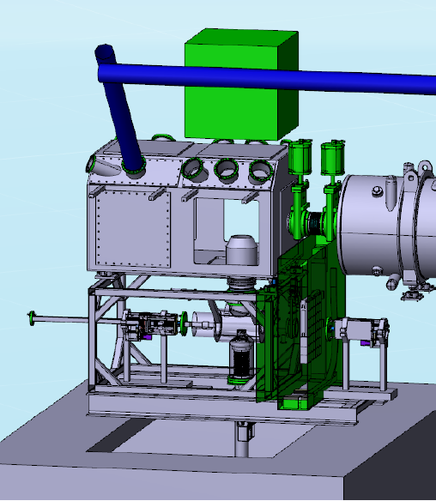
Specificities of the FAIR experiments
Complicated experiment conditions
Large amount of debris per shots and repetition rates require robust diagnostics
large activation (in-target ion stopping) limit the repetition rate
Fully remote target positioning and exchange
Enhanced diagnostic setups
Backlighting is necessary (not in the starting phase)
High-energy backlighter mandatory because of the large volumes
“safety” distance between optics and target
Target station in the APPA Cave
A high-energy laser is the most versatile and efficient diagnostic driver

Slide 10
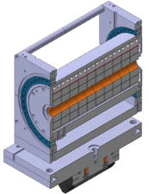
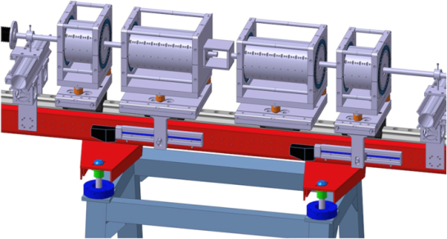
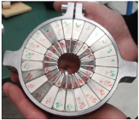
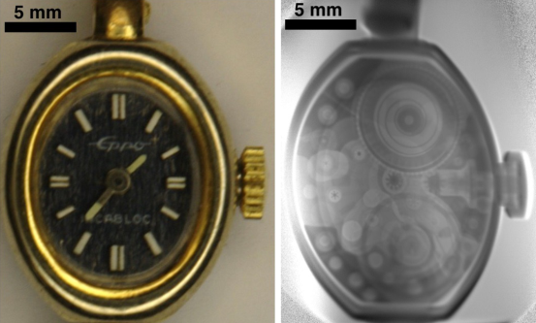
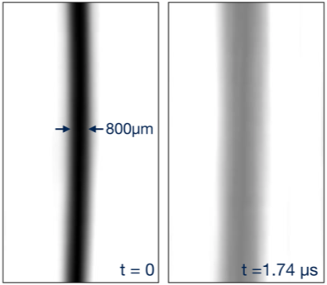
FAIR as a proton microscope
Proton-beams from FAIR will enable unprecedented capabilities
High-magnification: 10 μm spatial resolution
High field-of-view: several cm
Intense proton pulses → high density contrast even for short (10ns) exposure
Recent successful demonstration of Prior prototype (SIS18@HHT)
High resolution static images with 30μm spatial resolution
Framing mode for dynamical events
(Underwater electrical wire explosion)
Cu
W
static
dynamic
(20ns frame)
PRIOR should be used with external drivers (pump-probe)

Slide 11
Pump probe experiments
?
Plasma physics relies on measuring plasma parameters
surface diagnostics are adapted to a limited numbers of configuration
ρ, T, P
Pyrometry allows surface temperature measurement that are:
time-resolved
spatially resolved
VISAR measurements offer information on shocks and indirectly on pressures
quasi one-dimensional geometry required
Volumetric measurements are mandatory with FAIR targets

Slide 12
Diagnostics based on laser-accelerated particles
Proton imaging can be applied exploiting the unique properties of such beams (sub ns resolution etc...)
Advanced schemes are even more promising
laser driven neutron sources
proton beam transport
PW laser
Protons > 50 Mev
neutrons
thin target
Be converter

Slide 13
Laser-driven proton and neutron sources as diagnostics
hot plasma
foil
5 – 50 μm
fast electrons
large field
$$\vec{E}$$
laser
electron
sheath
I >10¹⁸ W/cm²
field ionization
& acceleration
directed plasma expansion
GSI belongs to the leading laboratories when it comes to laser-driven particle acceleration. Highlights are:
record-high proton energies and numbers obtained at PHELIX¹
host-lab for the LIGHT² (Laser Ion Generation Handling and Transport) experiment
Proton source performance (cut-off energy)
at various facilities
80
long pulse lasers (>100 fs)
short pulse lasers (< 100 fs)
Wagner (GSI - 2015)
60
Gaillard (2011)
maximum proton energy [MeV]
Snavely (2000)
40
Robson (2007)
20
0
0,01
0,1
1
10
1 - F. Wagner et al. PRL 116, 205002 (2016)
2 - S. Budold et al. Scientific reports 5 (2015)
Laser on-target intensity [10²⁰W/cm²]

Slide 14
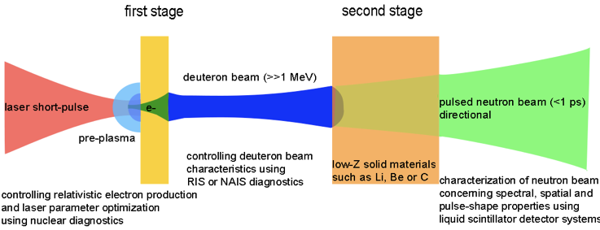
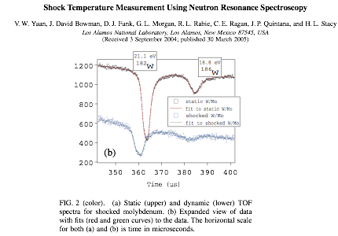
A direct application of proton/deuteron sources¹ is the temperature measurement of WDM states
Laser–driven deuterons produce large neutron numbers when a moderator is employed
Laser-driven neutrons are produced in sufficient numbers
first conclusive proof-of-principle experiments on neutron resonance spectroscopy
Single shot neutron based temperature measurements of shocked material has been shown at LANSCE
1 - M. Roth et al. PRL 110, 044802 (2013)

Slide 15
X-ray based diagnostics will play an important role
Many diagnostic techniques employ bright x-ray sources:
baklighting with K-α or Bremsstrahlung radiation,
XANES, X-ray scattering
Recent laser developments allow for a step-wise creation of powerful x-rays
generation of directed electrons beams
electrons radiate x-rays (coherent or incoherent)
source can be located meters from probe
PW laser
Incoherent X-rays (10 – 100 keV)
Betatron or table top FEL
electrons
coherent X-rays (10 – 100 keV)
gas jet
foil or wire target

Slide 16
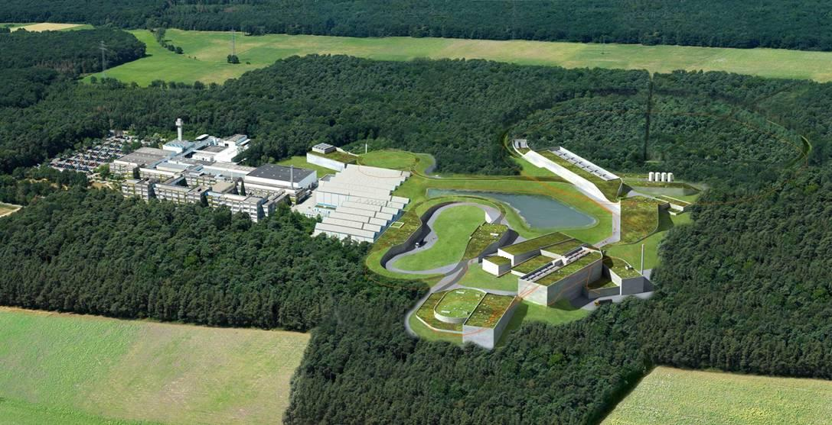
The Helmholtz Beamline at FAIR
Helmholtz-Beamline
Scope:
Building a kilojoule high-repetition-rate laser
Use:
Advanced diagnostics for HED targets at the high-energy cave (backlighting with X-rays, ions, neutrons, electrons)
Relativistic laser-ion interactions in the nearby HESR hall

Slide 17
Technical requirements for a laser at FAIR
Laser parameters | value
Laser energy - short pulse | 1 kJ
Laser Energy - long pulse (2ω) | 10 kJ
Pulse duration | 150 fs
Temporal contrast | 10⁻¹⁴
power | 7 PW
Repetition rate | 1 Hz
Proton energies | 200 MeV
An evolution of the existing architecture (PHELIX) in order to foster on existing expertise and minimize risks
2 Beam-lines with flexible characteristics (short and long pulses, high-temporal contrast)
Moderate to high repetition rate (> 500 shots per day)

Slide 18
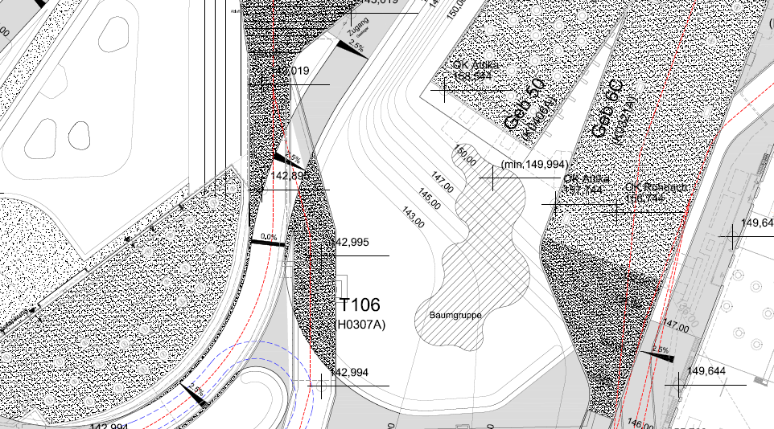
Site for the implementation of the Helmholtz Beamline at FAIR
High-Energy
Cave
HESR
laser beamline APPA
laser beamline
HESR
1500 m²

Slide 19
FAIR is a very attractive driver for plasma physics
Summary
Plasma physics is pertinent to some outstanding planetary science questions but also it is a field that can be studied at FAIR on its own.
Compared to other drivers, FAIR offers many unique advantages: quasi-equilibrium and mesoscopic scales.
FAIR-generated plasma require power diagnostics.
pump-probe setups are standard in plasma physics
laser-generated sources of particles (ions, electrons) used to generate tertiary sources (neutrons, X-rays) offer the most promising solution for direct measurement of plasma parameters

Slide 20
Thank You!

