Slide 1
FP420/AFP Fast Timing
UT-Arlington (Brandt), Alberta (Pinfold), Fermilab (Albrow), Louvain (Piotrzkowski)
+UC-London, Prague, Saclay, Stoneybrook, Giessen, BNL, Kansas…
WHO?
WHY?
Pileup Background Rejection for Diffractive Higgs (pp→pHp)
Ex: Two protons from one interaction and two b-jets from another
How?
Compare z-vertex position measured with silicon tracking (δz=50μm) with vertex measured from time difference of protons (δz=2.1mm for δt=10 psec)
How Fast?
Stage I: LHC luminosity 2 x10³³ δt < 20 ps (<2 year )
Stage II: 10³⁴ δt < 10 ps (<4 years)

Slide 2
Outline
Introduction to FP420/AFP
AFP Cerenkov detectors and test beam results
Rate and lifetime issues
Laser tests

Slide 3
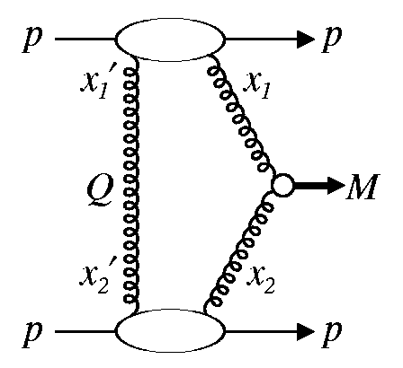
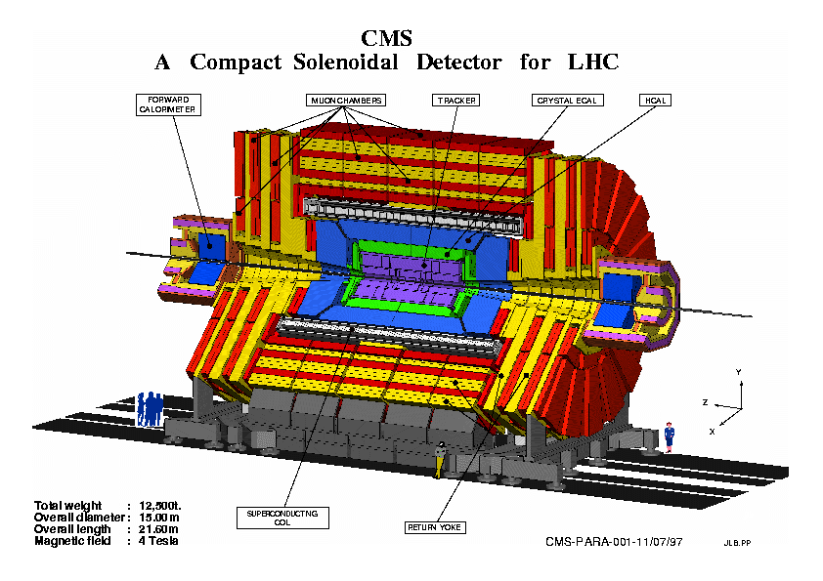
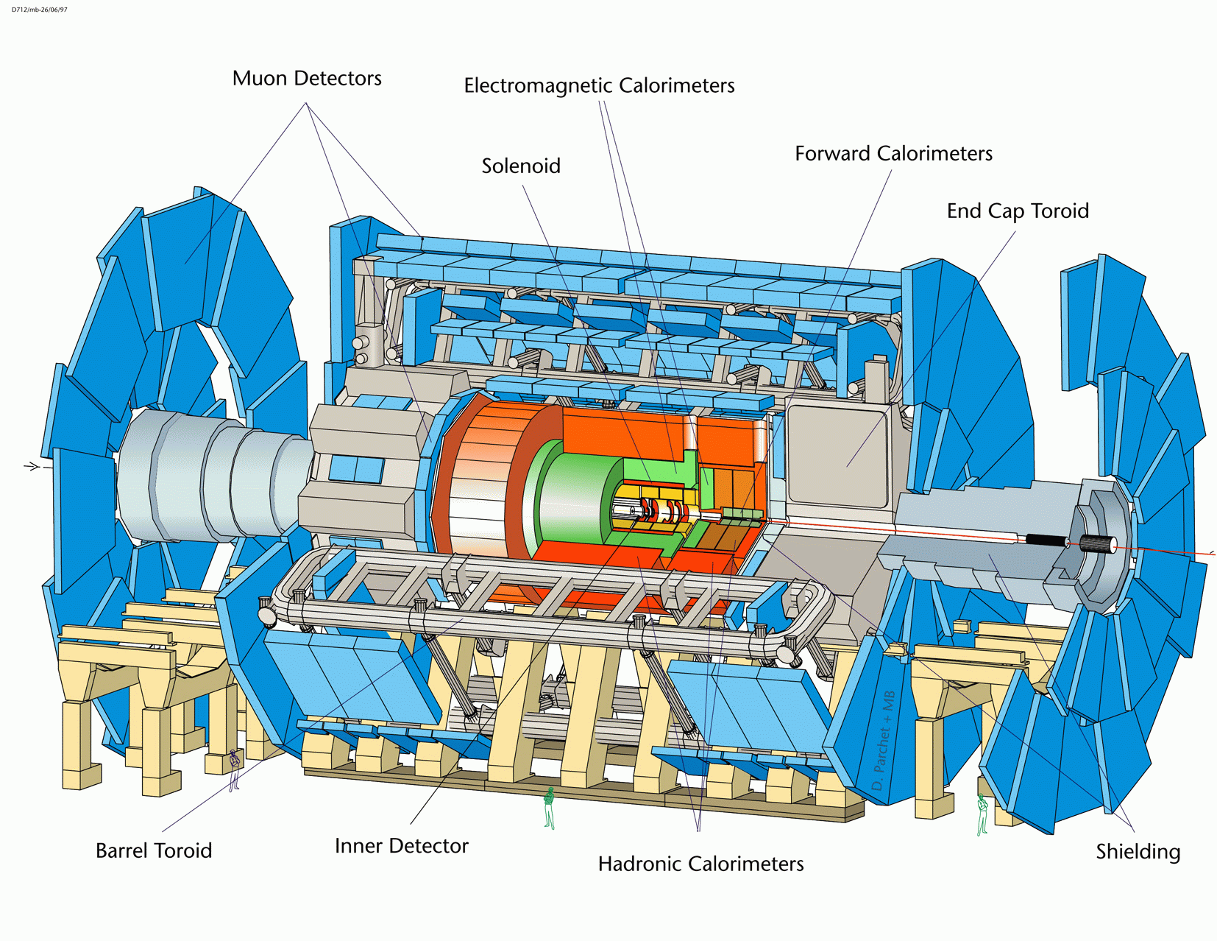
Forward Protons at LHC (FP420, AFP)
Central Exclusive Higgs production pp→ p H p : 3-10 fb
(used to be called double pomeron exchange)
-jet
gap
gap
H
η
p
p
-jet
beam
dipole
ΔM = O(2.0) GeV
dipole
p’
roman pots
p’
``The FP420 R&D Project: Higgs and New Physics with Forward Protons at the LHC,'' FP420, arXiv:0806.0302 [hep-ex].
``Letter of Intent for ATLAS FP: A Project to Install Forward Proton Detectors at 220 m and 420 m Upstream and Downstream of the ATLAS Detector,'' A. Brandt, B. Cox, C. Royon et al., AFP Collaboration.
NOTE AFP LOI under review by ATLAS management; seeking approval to proceed to TDR in July

Slide 4
Physics with Forward Protons
FP420 turns the LHC into a energy tunable glue-glue (and γγ) collider
At “low” to “intermediate” luminosity (30-100 fb-1) we can :
Establish the quantum numbers and measure the mass of a light SM Higgs OR be the discovery channel if there is an MSSM Higgs (or three) with favorable parameters
Perform a wide range of γγ physics including anomalous couplings
Perform interesting QCD measurements (0.002 < xIP < 0.01 )
In addition, at higher luminosity (> 100 fb-1) we can :
1) Search for exotic bound states such as gluinoballs
2) Make direct observation of CP violation in some SUSY Higgs
scenarios
3) Disentangle wide range of SUSY scenarios, including ~degenerate
Higgs

Slide 5
Better pileup rejection

Slide 6
Key Components of AFP
Space in tunnel: New Connection Cryostat (for 420m only)
“Hamburg Beam Pipe” to house detectors
3D silicon detectors for measuring proton postion
Trigger and Readout
Fast Timing Detector
UTA Focus

Slide 8
Fast Timing Is Hard!
ISSUES
Time resolution for the full detector system:
1. Intrinsec detector time resolution
2. Jitter in MCP-PMT's or other photosensor
3. Electronics (AMP/CFD/TDC)
4. Reference Timing
3 mm =10 ps
Rate and lifetime issues
Background in detector and MCP
Multiple proton timing
Rad Hardness of detector, phototube and electronics, where to put electronics in tunnel

Slide 9
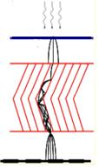
Micro-channel Plate Photomultiplier Tube (MCP-PMT)
photon
Faceplate
Photocathode
Photoelectron
ΔV ~ 200V
Dual MCP
ΔV ~ 2000V
Gain ~ 10⁶
ΔV ~ 200V
Anode
A photograph of an MCP showing an array of 12µm pores (holes)

Slide 10
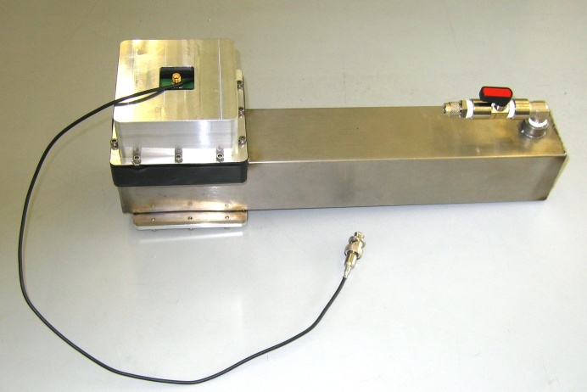
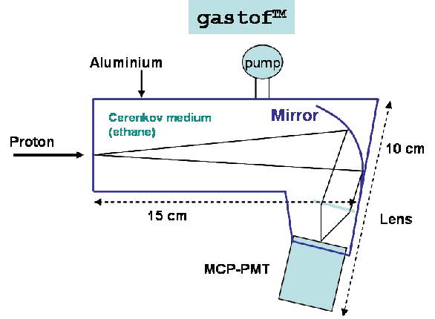
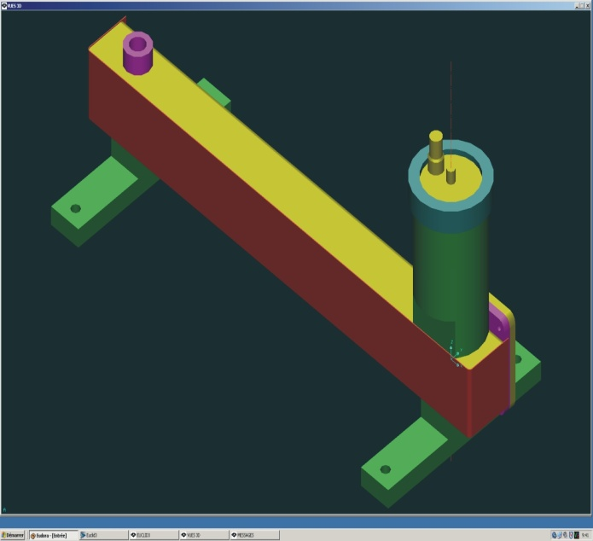
Fast Timing Detector: GASTOF
(Louvain)
Hamamatsu R3809U-50
6 μm pore tube with
Mini-circuits ZX-60 amplifier
Gas Cerenkov detector has low index of refraction, which limits total light, but full Cerenkov cone is captured. Simulations show yield of about 10 pe’s accepted within few ps! Have obtained 13 ps in TB (from fits to data).

Slide 11
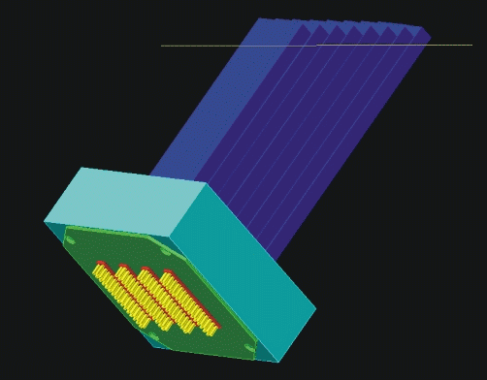
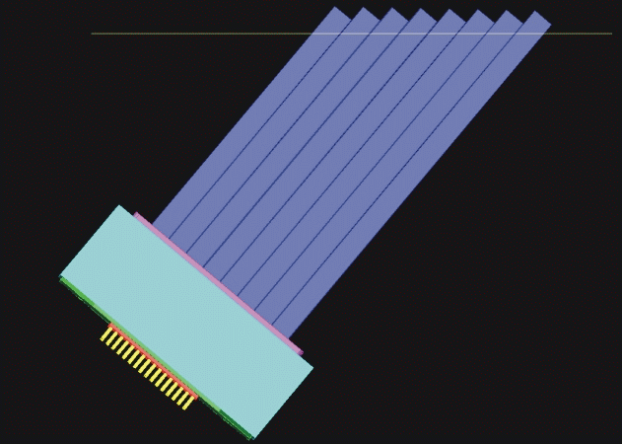
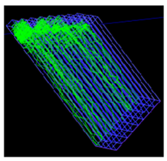
Fast Timing Detector : QUARTIC
4x8 array of 6 mm² fused silica bars
UTA, Alberta, FNAL
Only need 40 ps measurement if you can do it 16 times (2 detectors with 8 bars each)! Has advantage of x-segmentation
proton
photons

Slide 12
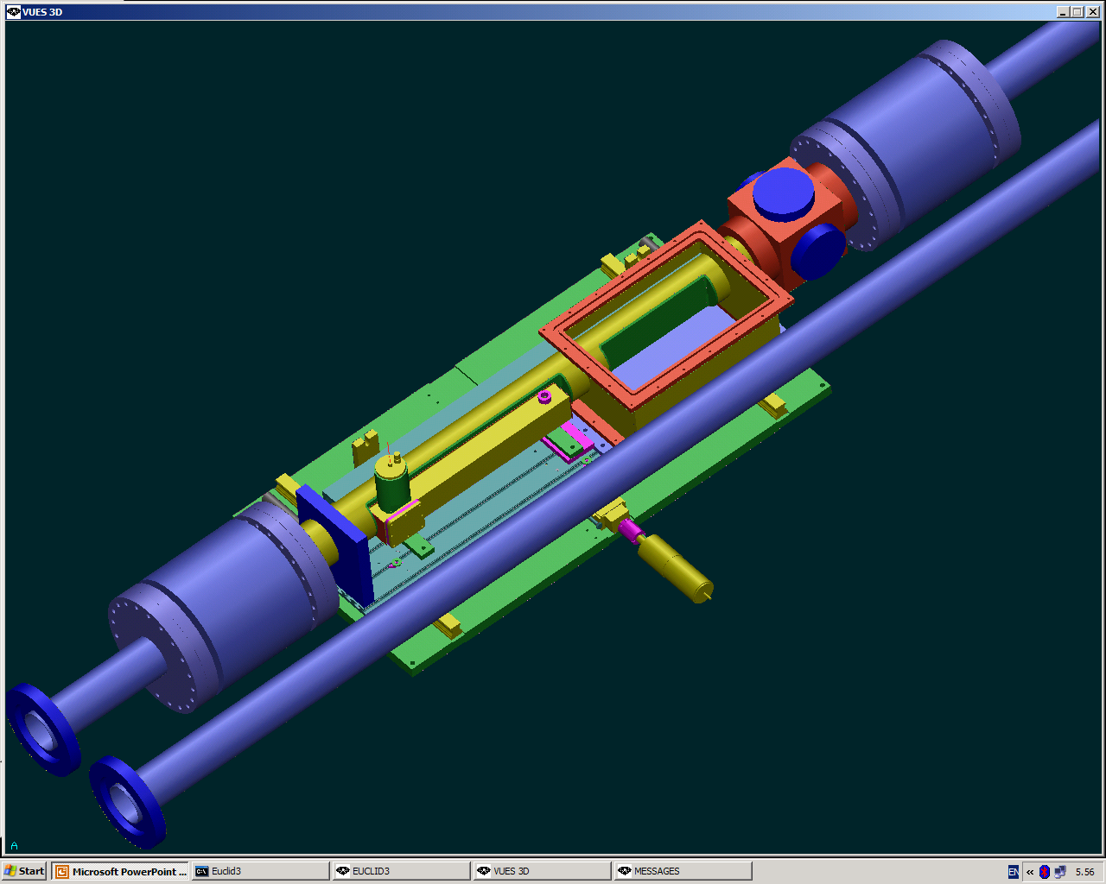
Section of Movable Beam Pipe showing 3D silicon box + GASTOF

Slide 13
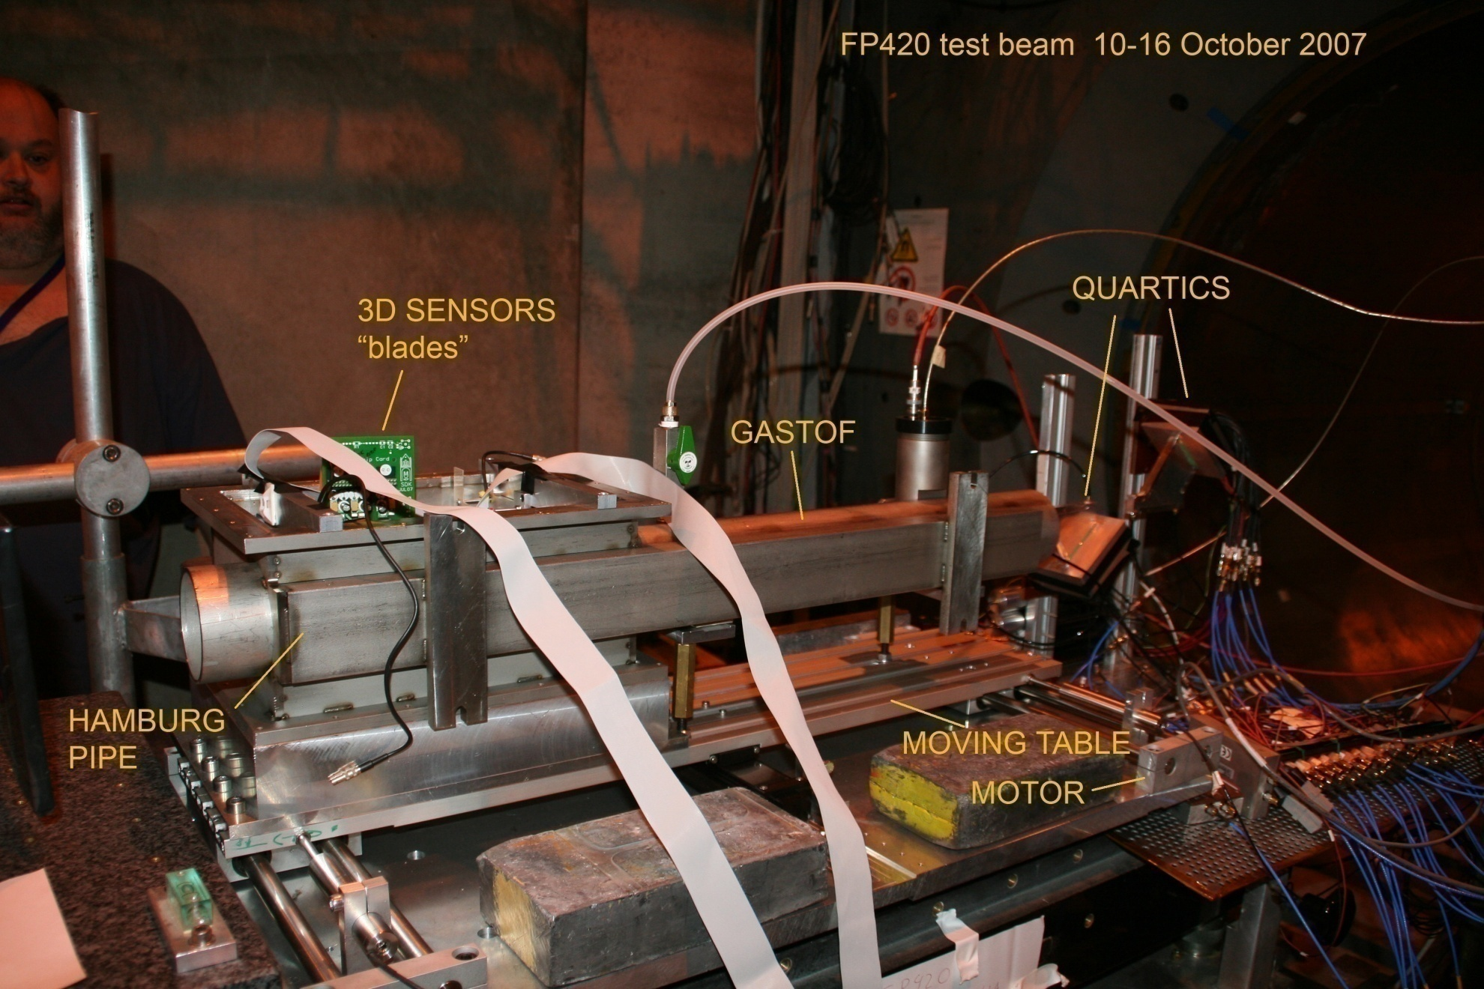
Test Beam Layout

Slide 14
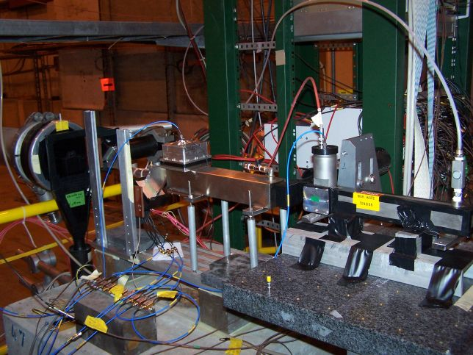
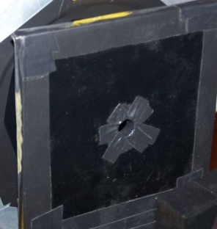
FP420 Timing Setup June 2008 CERN TB
veto
G2
G1
Q1
Amplifiers

Slide 15
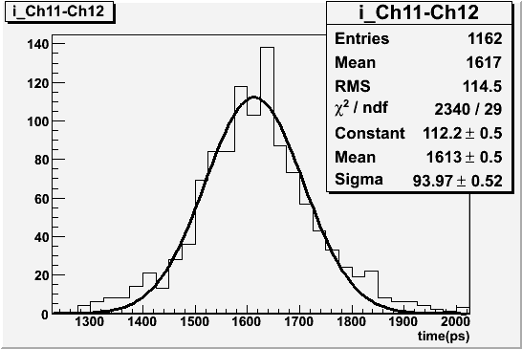
First TB Results ( Fall 2006)
G1-G2
For QUARTIC bar
110 psec
Efficiency 50-60%
For events with a few bars on see anticipated
√N dependence
<70 psec/Old style Gastof (Burle 25 um 8x8 tube, Σ4 pixels)
>90% efficiency, dominated by CFD resolution (used Ortec 934)

Slide 16
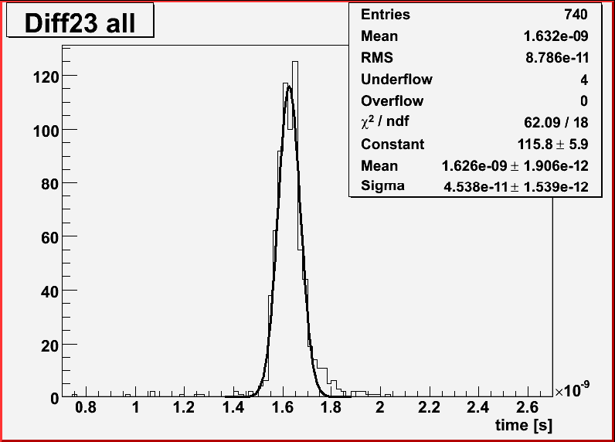
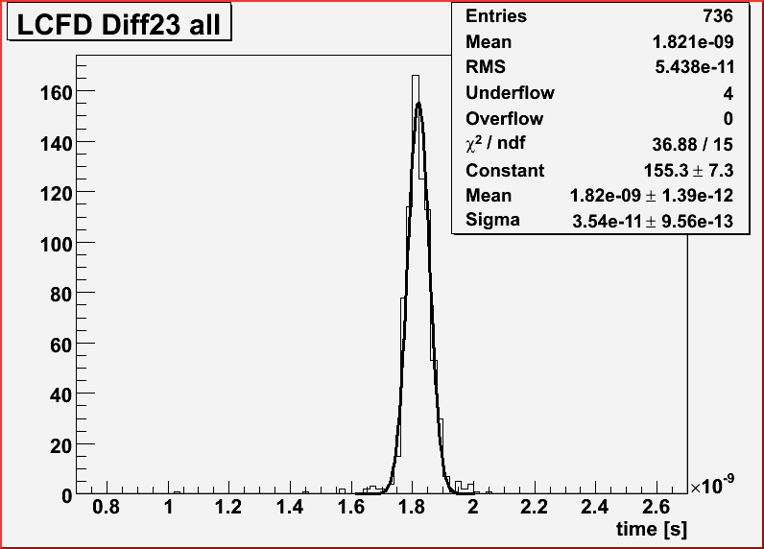
March 2007 Test Beam
σ(δt)=45 ps
σ(δt)=35 ps
Gastof new -
Gastof old
time difference
Threshhold discrimination
CFD algo simulated
If G1=G2 then δt=25 ps each, but G1 (Gastof new) has faster tube (Hamamatsu 6 μm pore vs 25 μm Burle) and better mirror then G2 (Gastof old); extract resolution G1=13 ps G2=32 ps, initial estimate 80% efficient
QUARTIC
80 ps/bar
(15 mm bar) 80% efficient

Slide 17
Test Beam Electronics
MCP-PMT
Preamplifier
LCFD
Fast
Scope
SMA
SMA
Lemo
QUARTIC:
Photonis Planacon 10 μm pore 8x8
Gastof:
Hamamatsu 6 μm pore single channel
SMA
Fast
Scope

Slide 18
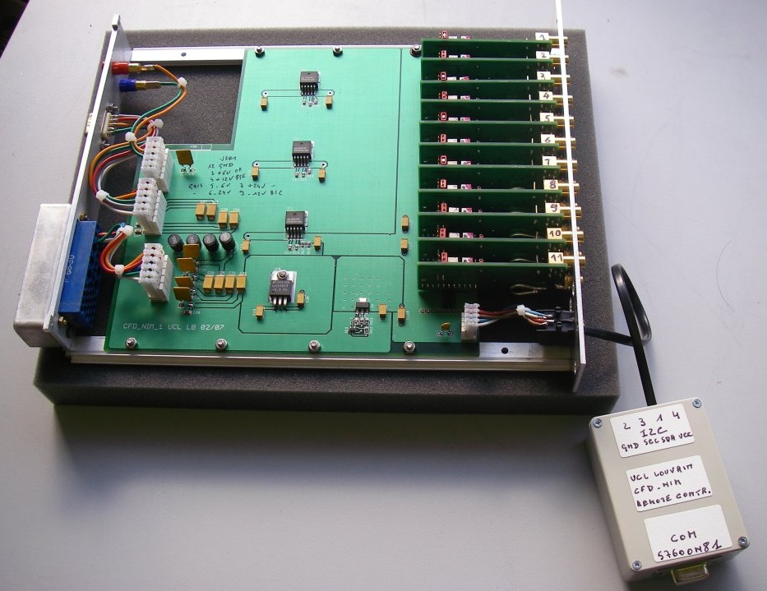
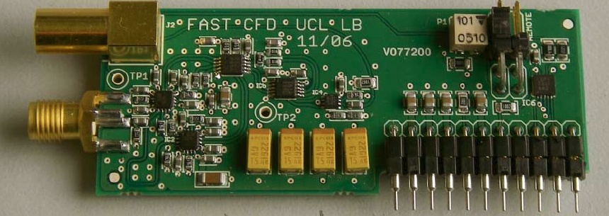
LCFD
Louvain (Luc Bonnet
engineer) developed
LCFD (Louvain Constant
Fraction Discriminator)
mini-module approach
tuned LCFD mini-module
to Burle and Hamamatsu rise
times; 12 channel NIM unit
Remote
control for
threshold

Slide 19

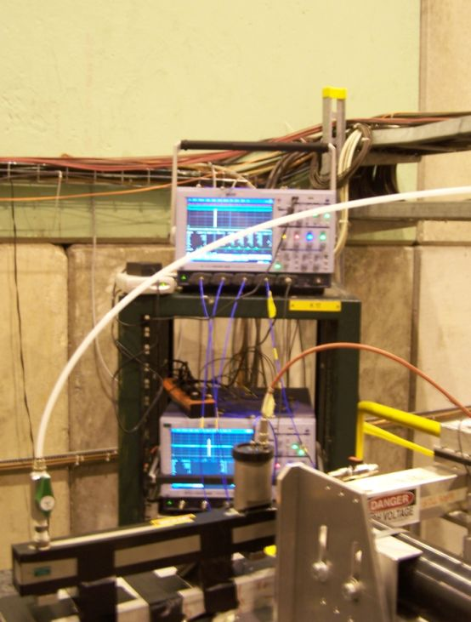
Data Acquisition
Lecroy 8620A 6 GHz 20 Gs (UTA)
Lecroy 7300A 3 GHz 10-20 GS (Louvain)
Remotely operated from control room using TightVNC
Transfer data periodically
with external USB drive

Slide 20
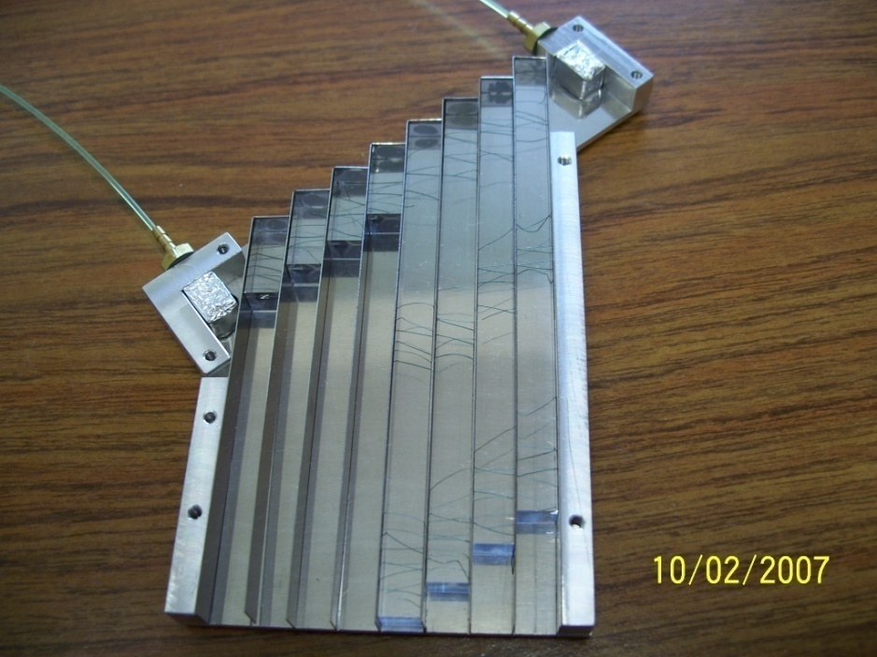
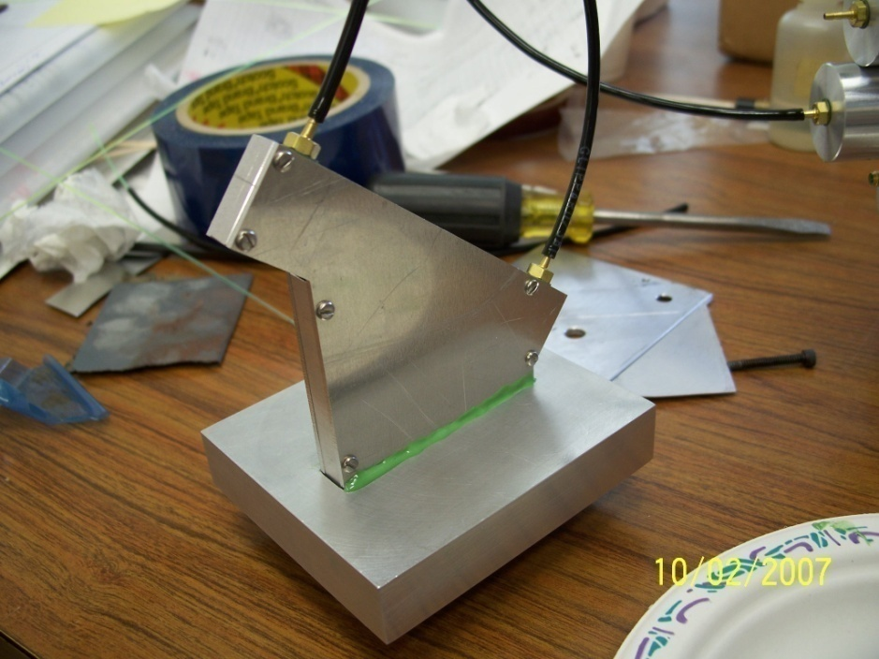
Latest QUARTIC Prototype
HC
HH
HE
Testing long bars 90 mm (HE to HH) and mini bars 15 mm (HA to HD).
Simulations show that long bars have more light from total internal reflection
vs. losses from reflection in air light guide, but more time dispersion due to n(λ)

Slide 21
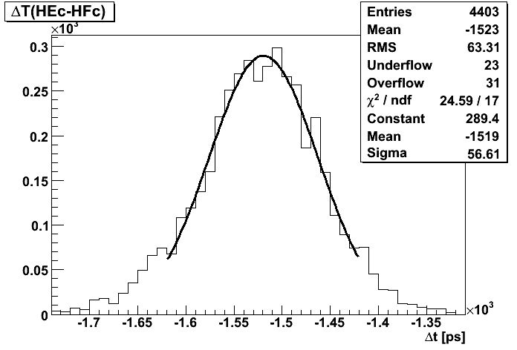
Dt
QUARTIC Timing 2008 CERN TB
56.6/1.4=40 ps/bar
including CFD!
CERN TB
June 2008
Time difference between two 9 cm quartz bars after Louvain
constant fraction discrimination is 56 ps, implies a single bar resolution of 40 ps

Slide 22
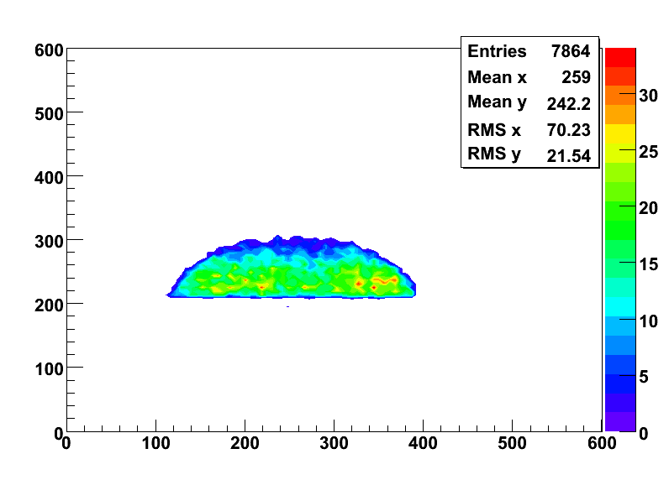
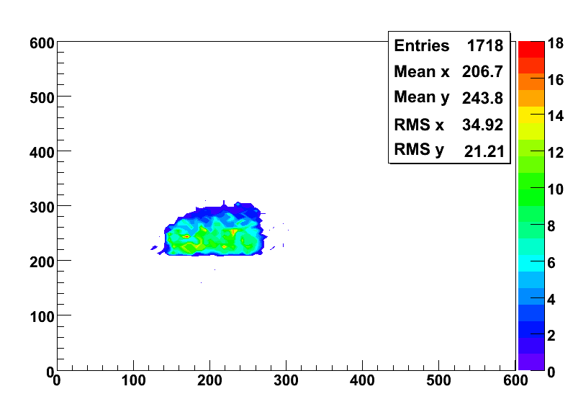
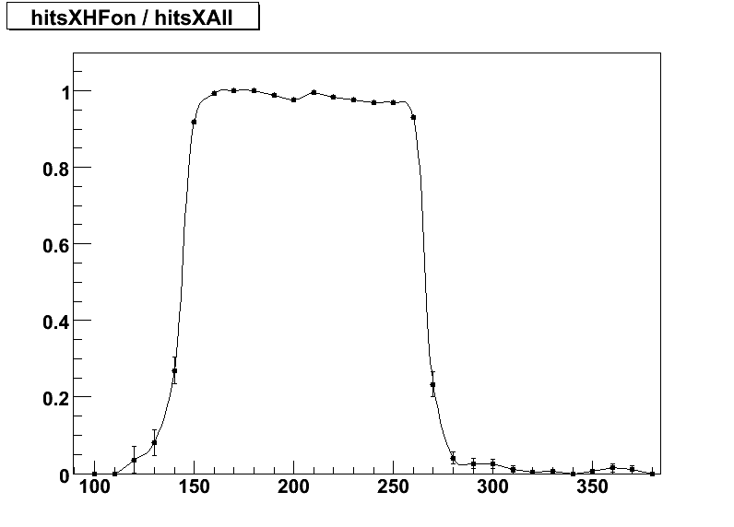
QUARTIC Efficiency Using Tracking
(a)
All tracks
(Bonn Silicon
Telescope)
(b)
Tracks with
a Quartz bar
on
Events
Shape
due to
veto
counter
with 15mm
diameter
hole
6mm
(c)
Use tracking
(b)/(a) to determine that QUARTIC bar efficiency is high and uniform
Efficiency
6 mm
Used scintillator trigger to synchronize silicon tracking
data sample and oscilloscope
data sample
Strip #

Slide 23
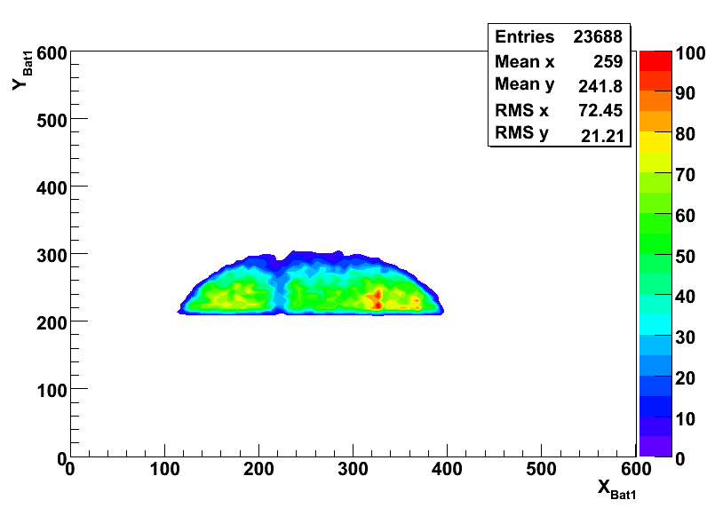
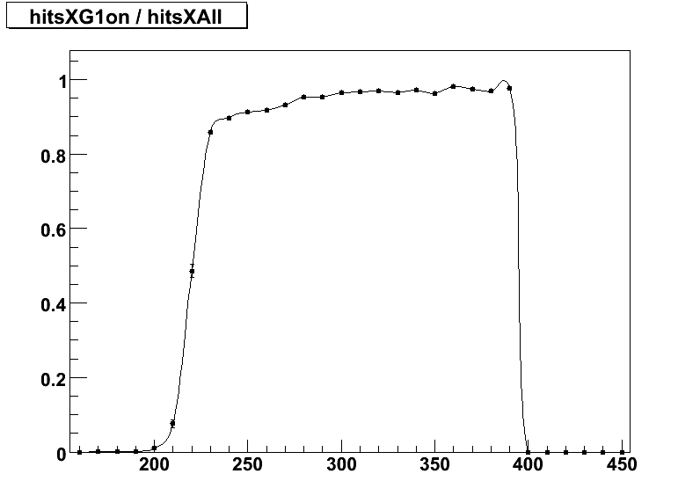
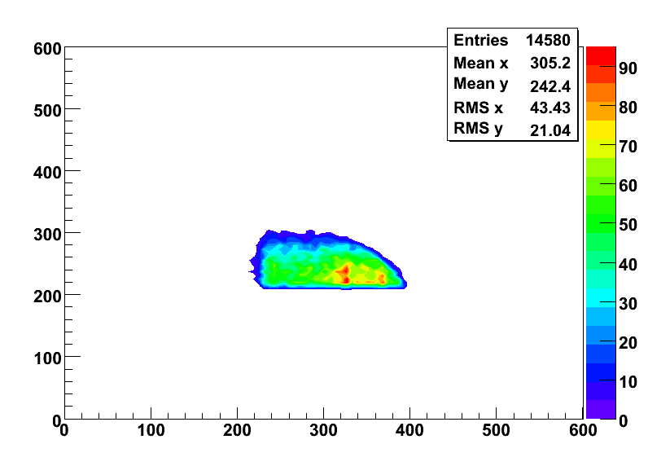
GASTOF Efficiency (Displaced 19 mm)
All tracks
2mm
Multiple scattering effects in 400 um wide, 30 cm long stainless steel edge of GASTOF cause veto
GASTOF On
Fraction of events with good track and G1 on as a function of track position 90 to 99%, loss at edge understood from simulation, can be improved with mirroring of inside of GASTOF
edge

Slide 24
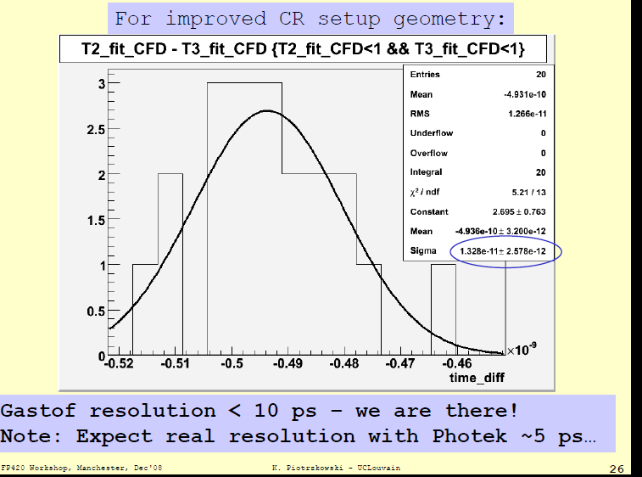
Gastof Cosmic Ray Results
Photek
PMT210
3 μm pore
<100 ps
rise time!

Slide 25
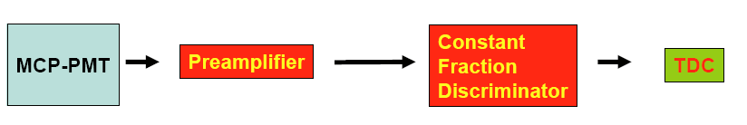
Components of Fast Timing System
Louvain Custom
CFD (LCFD)
HPTDC board
(Alberta)
Mini-circuits ZX60
4 GHZ or equivalent
QUARTIC:
Photonis planacon
10 μm pore 8x8 or
equivalent
GASTOF:
Hamamatsu 6 μm
pore single channel
or equivalent Photek
For GASTOF
replace CFD/TDC
with single photon
counter
Reference Timing
HV/LV
Opto-modules/
ROD
UTA/Alberta for QUARTIC, PMT, Amp;
barter with Louvain for GASTOF?
(PMT sold separately!)
Manchester/UCL

Slide 26
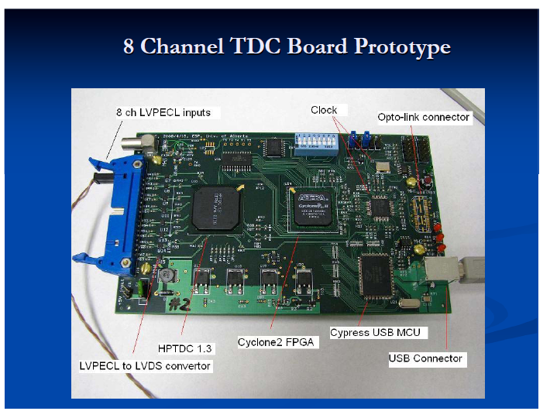
Alberta HPTDC board
12ps resolution with pulser;
Successfully tested last week with laser/10 μm tube/ZX60 amp/LCFD/
scope

Slide 27
Rate and Current Limits
The LHC is a high rate accelerator and we need to establish if the MCP-PMT’s are capable of coping with the large expected rates: from 1 MHz in a 6mm x 6mm pixel at 2x10³³ luminosity to up to 15 MHz at 10³⁴
The limiting quantity is not actually the rate, but the current in the tube:
Cathode Current = proton frequency x number of photo-electrons generated
by each proton x electron charge
Anode Current = Cathode Current x gain
In order to keep the Anode current at tolerable levels, lower gain is
preferable as well as less photoelectrons (but precise timing needs as many
pe’s as possible). In addition smaller pores improve timing and give more
pores/area reducing the current in any one pore.
When the current demanded of the tube is too high the tube does not give as big an output signal, we call this saturation.
Using 1 MHz/15 MHz and a gain of 10⁵ (!) and 10 pe’s expected for our detector, we require 1.6 to 24 pA (Cathode) or 0.16 μA/2.4 μA (Anode)
in a .36 cm² pixel

Slide 28
Lifetime Issues
Lifetime issues believed to be due to photocathode damage from +ions:
Q/year = I*10⁷ sec/year
Assuming Gain=10⁵ :
Q in Phase I =1.6 to 4.8 C/year (in a 0.36 cm² pixel!)
Q in Phase II 5x worse (up to 24 C/year or 72 C/ cm²/yr)

Slide 29
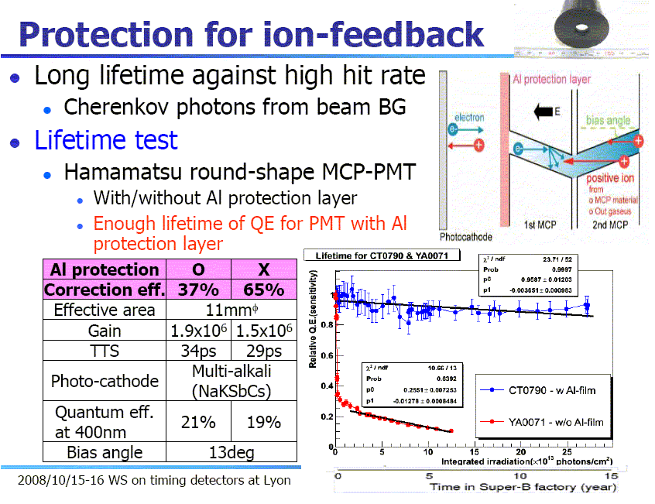
From Lyon picosecond workshop:

Slide 30
Resolving Rate and Lifetime Issues
I.) Measure using new UTA laser test stand
II.) Work with PMT companies to develop
solutions
III.) Look into alternative technology if
necessary

Slide 31
Initial Laser Test Goals
Develop useful flexible laser test facility
Study rate properties (gain, timing) of MCP-PMT’s
Some questions we are trying to answer:
How does timing depend on gain as f(#pe’s)
What is maximum rate? How does this depend on gain, number of pe’s, area, pore size, number of pixels hit?
3) Establish minimum gain to achieve timing goals of our detector given expected number of pe’s (~10). Evaluate different amp/cfd/tdc choices at the working point of our detector
4) Eventually lifetime tests
NOTE: All results are preliminary

Slide 32
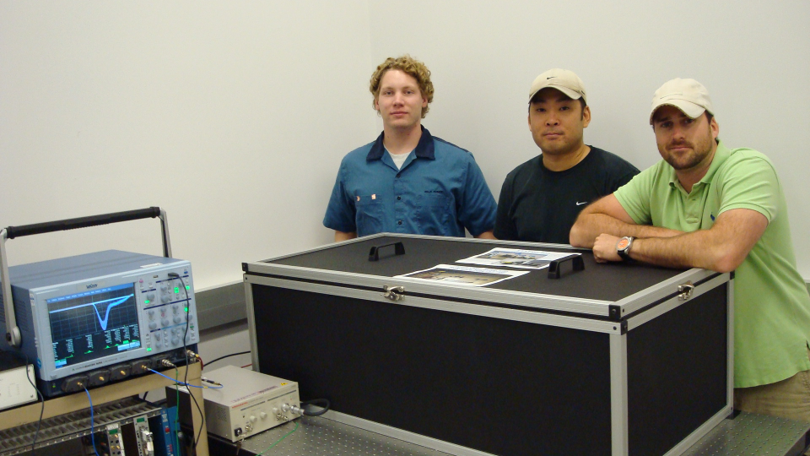
Laser Gang
¾ of laser gang: Ryan Hall, Larry Lim, Mason MacPhail (Ian Howley not shown)
LeCroy Wavemaster
6 GHz Oscilloscope
Hamamatsu
PLP-10 Laser Power Supply
Laser Box

Slide 33
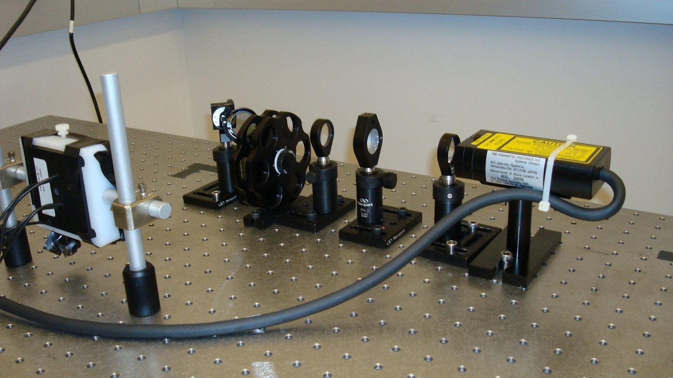
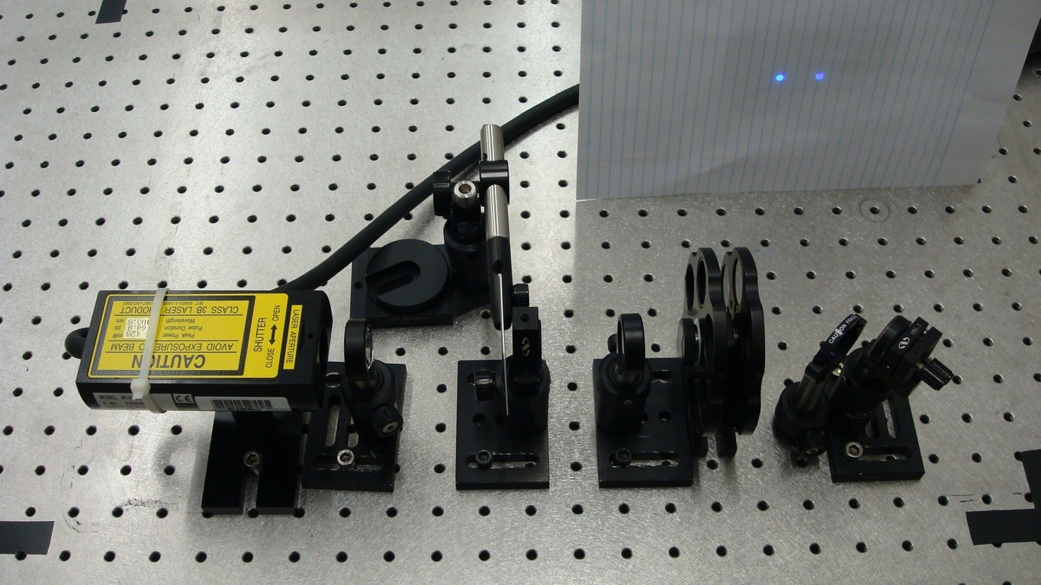
UTA Laser Tests
Support: Texas ARP,
DOE ADR, Burle/Photonis
beam splitter
mirror
mcp-pmt
filter
lenses
laser
Hamamatsu PLP-10 405 nm laser
Burle 85001 4 ch 25 μm
(initial studies with 25 μm tube) beam is about 5 mm diameter unless indicated otherwise

Slide 34
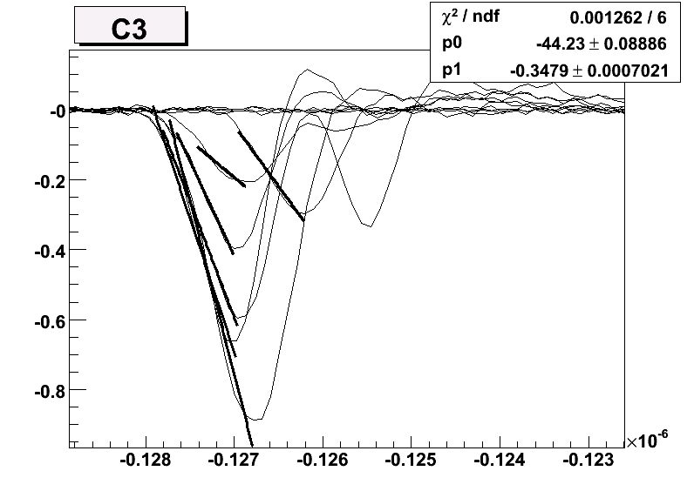
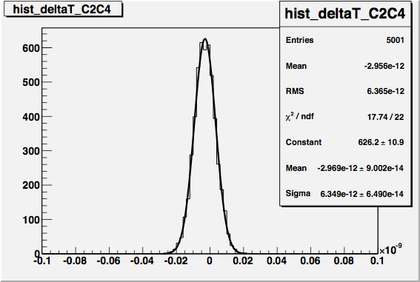
Measuring Time
Split signal
6.3 ps r.m.s
(scope measurement
uncertainty
using full
scale)
Linear fit to leading edge (20%to 80%), then use 50% time
More accurate measurements using LCFD (<4ps scope error)

Slide 35
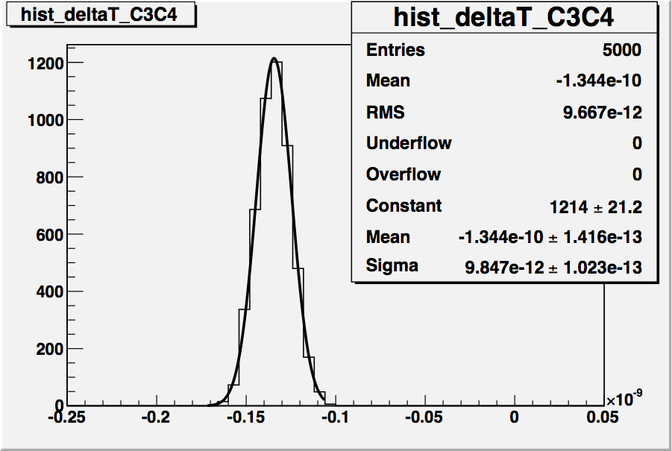
Best Time Measurement of (25μm) Microchannel Photomultiplier Tube
This is out best measurement of time difference between two channels using scope (~400 pe, ~1.4E4 Gain!)
9.8 ps, subtracting 6.3 measurement error gives 7.5 ps, divide by 1.4 gives
5.4 ps/pixel
Shows test stand performing at reasonable level

Slide 36
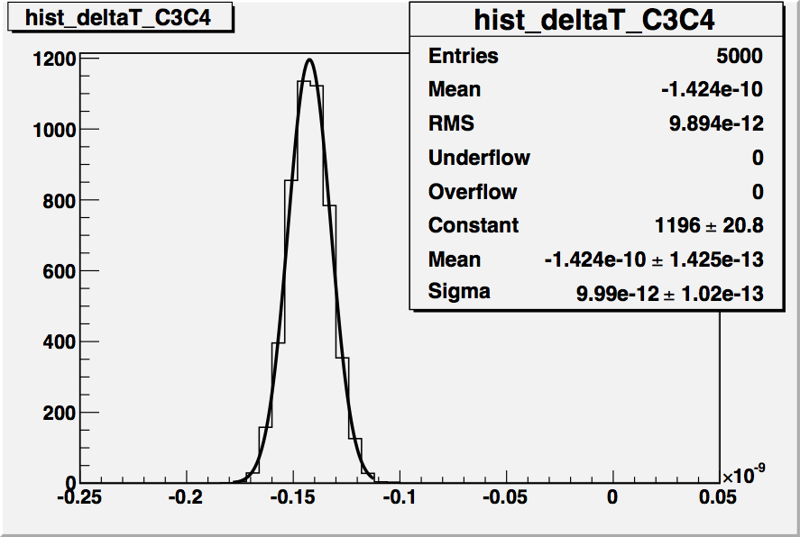
No Gain Dependence of Timing
Same time difference
for gain of 2E5
(no dependence
over more than
an order of magnitude, but
this is in large
light limit….)

Slide 37
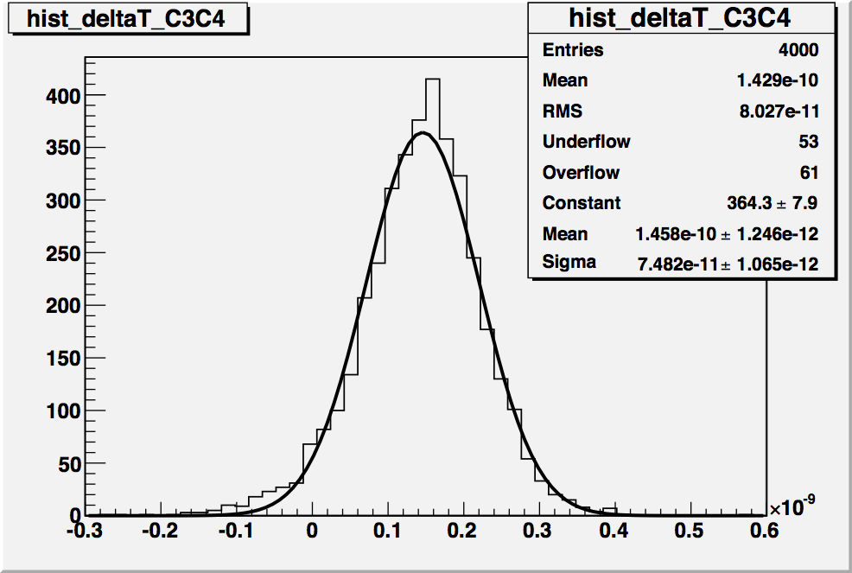
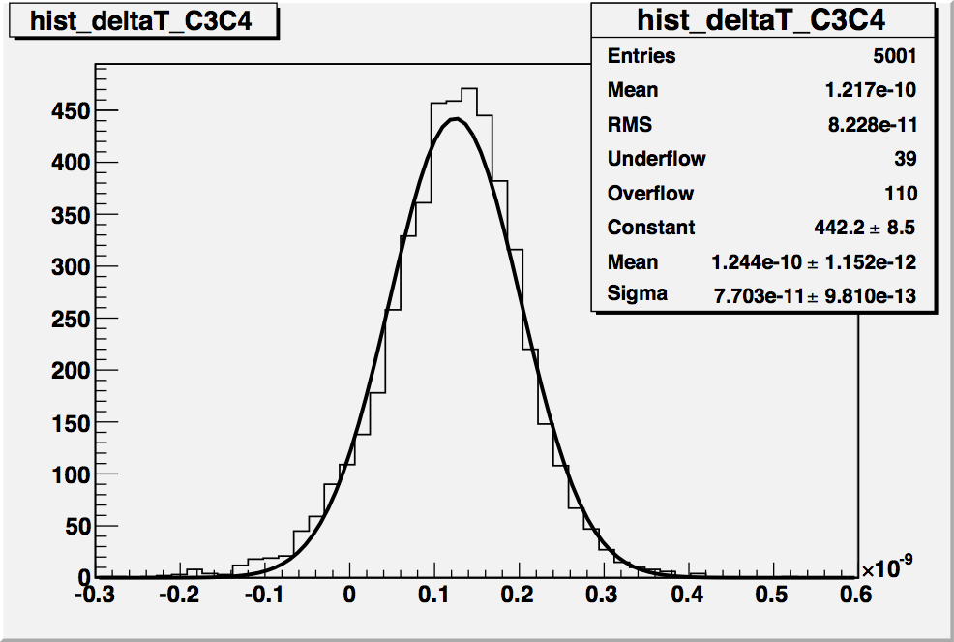
Timing Resolution vs. Gain (10 pe’s)
No gain dependence
on time measurement
for 10 pe’s over large
range in gain for 25 μm
tube!
75 +/-1ps
75/1.4
=54 ps
/channel
0.8x10⁵ Gains
x40 amp
77 +/-1ps
Conventional wisdom is that high
gain is important for timing—I believe
this is largely based on single pe work;
clearly there is a large gain plateau where timing does not depend on gain (more in 10 μm tube section)
1x10⁶ Gain
x16 amp

Slide 38
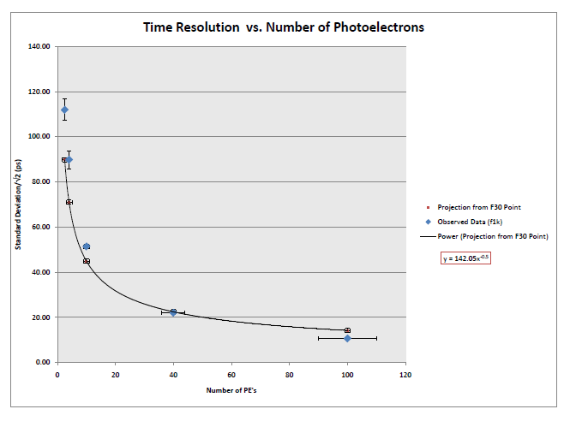
Timing vs. Number of PE’s
Measurement roughly shows expected √Npe behavior for 25 μm pore tube

Slide 39
Rate Dependence of
Amplitude/Timing
(~10 pe, gain ~0.8E5)
Pulse height decreases
to 60% of initial value,
timing 10% worse for
1MHz (~ equivalent to proton rate in max rate
pixel @2x10³³ at 420m)
54 ps 56ps 55ps
61ps
Blue squares: repeated
amplitude vs rate for one
channel only--no change in rate
behavior--implies that
limitation is local current (experts at ANL Workshop agreed—this implies that there is no penalty for hitting 8 pixels in same tube)

Slide 40
Rate/Current Limits as f(#pe’s)
For fixed gain, study how relative pulse height varies with rate/current for different numbers of photoelectrons
400 pe’s
4 pe’s
More pe’s implies higher current, so tube saturates at lower frequency
~1pA input current

Slide 41
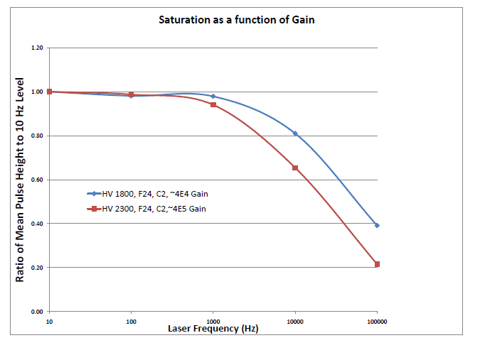
Rate Limits as f(gain)
For fixed number of photo-electrons (160) study how relative pulse height varies with rate for two different gain values
4x10⁴ Gain
4x10⁵ Gain
Saturation decreases with decreased gain, but not linear

Slide 42
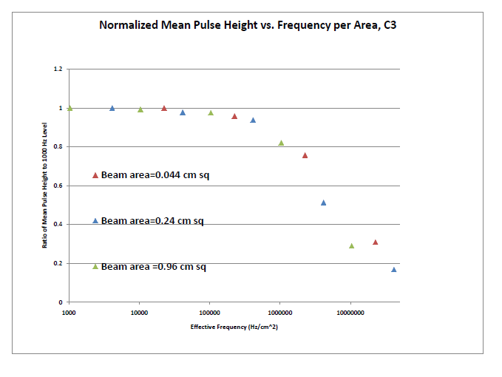
Rate Limits as f(beam area)
(~10 pe, gain ~0.8E5)
Note the last point is ~400 MHz/cm² pe rate!
10 pe’s at 10 MHz with 0.24 cm² area
at gain of 0.8x10⁵
2x10³³ at 420m
10³⁴ at 220m
about 450 MHz
pe/cm²
Scaling of saturation with beam area as expected

Slide 43
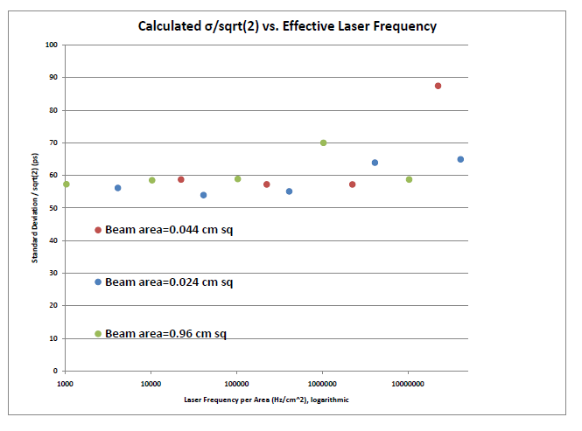
Timing vs Track Rate/cm²
(~10 pe, gain ~0.8E5)
0.24 cm sq
Timing degrades only slowly with rate, but up to 50% efficiency loss at high rate

Slide 44
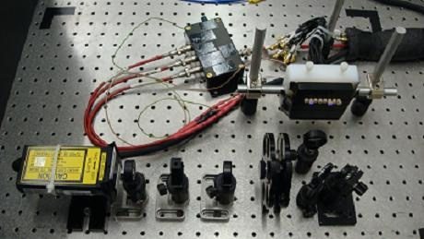
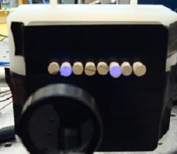
10 μm Laser Setup (2/20/09)
Allows us to study all channels ~easily
(manually)

Slide 45
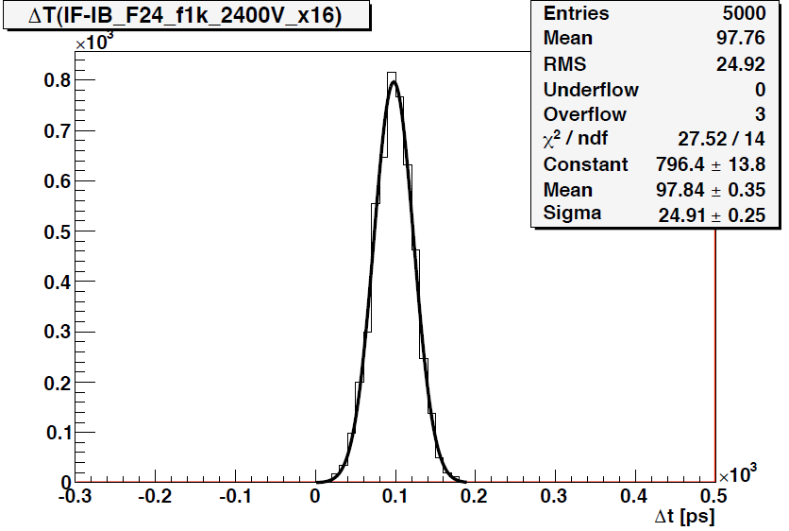
Timing vs Gain for 10 μm Tube
So at very low gain (<4E4) start to see timing dependence on gain! For many applications should be able to use tube with 20x reduction in gain
compared to canonical 1E6 (need good amplifier)
1.4E4
3E5

Slide 46
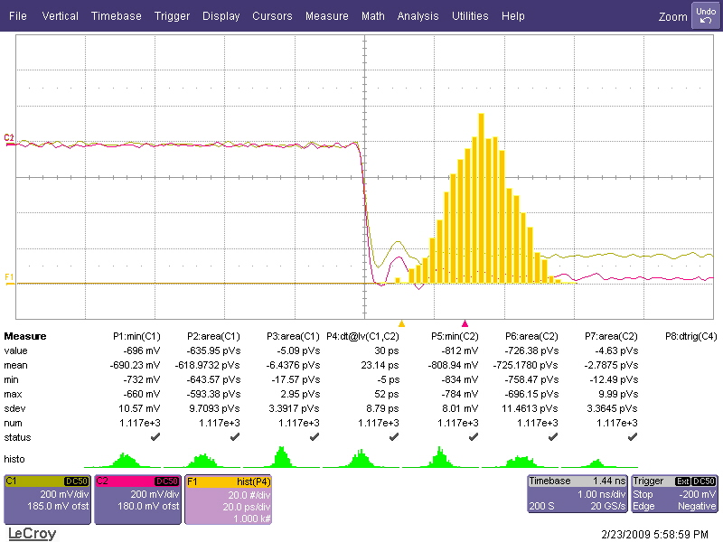
10 μm Timing
2ps/bin!
Large light limit with Louvain CFD’s show 8.8 ps time difference (including CFD)

Slide 47



Timing as Function of Position
78 ps
60 ps
Timing resolution varies with
position! Needs further study

Slide 48
Rate Limits as f(pore size)
Smaller pore size better for timing and also results in more pores/area reducing saturation

Slide 49

10 μm Laser Setup with Reference Tube (3/17/09)
Reference Tube (~6 ps)

Slide 50

Timing vs Gain for 10 μm Tube
Measured with reference tube using CFD’s and x100
mini-circuits amps (performed better than ORTEC VT120, 9306, homemade Phillips amps) ; with 10 pe’s can operate at ~5E4 Gain

Slide 51
Wait a Minute!
Jerry Va’vra and others have mentioned TTS
of 30-35 ps for single pe ⇒ we should have about 10 ps for 10 pe! Investigating! (of course that ~30 seems a bit suspect as it only applies to 70% of single pe events—first of two peaks)
Note Jerry grounded all channels except one, we don’t; could be impedance mismatch, noise from cables
Could be power supply noise or other noise in setup, just bought some low pass filters to test
Could be residual time walk, not corrected for by LCFD, studying timing as fct. of pulse height

Slide 52


Grounding Issues (25 μm Tube)
grounded channels
Voltage (50 mv bins)
(~400 pe, gain ~0.8E5)
Time (2 ns bins)
Ringing persists for >100 ns!
Voltage (50 mv bins)
Time (20 ns bins)

Slide 53

Aside: Measuring Speed of EM Waves
We noted that ground plane oscillations on reference tube were picked up by second tube
Used this to do a 3% measurement of speed of light
Moving 2nd tube 2 feet from reference tube shifts pick-up oscillation pattern by 2.05 ns

Slide 54

Grounding Issues (10 μm Tube)
Voltage (50 mv bins)
Time (10 ns bins)
New ground plane dramatically improved ringing both in magnitude and duration

Slide 55
Measuring Lifetime
We propose to measure lifetime in a controlled manner to establish a baseline of magnitude of lifetime problem (From Paul Hink 50% QE loss after 0.4 mC/cm² ; not sure about wavelength dependence)
Use 5 mm diameter 405 nm laser “beam” centered on a pixel and run at 100 MHz with 10 pe’s at 10⁶ gain to see how quickly a pixel deteriorates (monitoring neighboring pixels as well), then repeat for a few pixels. Then repeat with relaxed rate and gain to see if lifetime is linear with gain and rate. (eventually would want to test at operating conditions 10 MHz with 10 pe’s at 5E4 gain)

Slide 56
Improving Lifetime
Photonis has new electron scrubbing machines: may get x5 to x10 lifetime improvement.
Ion barrier certainly would help (at cost of x2 in collection efficiency)—used routinely in night vision Gen 3 tubes, and may be a solution on its own, or when coupled with better scrubbing. Would like to test this with Photonis tube.
Pursuing small business proposal with Arradiance, which has new coatings that have shown promise in extending lifetime. If development promising would like to test in photonis/photek tubes.
Other ideas more problematic (require more development), using lower gain on first MCP, Z stack, etc.

Slide 57

MCP Development (Arradiance)
Exploring collaboration with Arradiance; looking into adding thin film to protect MCP and also improve photocathode lifetime

Slide 58
Conclusions
Our fast timing R&D has come a long way in 3 years, but still a ways to go
Rate and lifetime issues are challenging, but likely solvable, given, time, will, and money
We are willing/eager to collaborate with any and everybody interested in longer life, fast MCP-PMT ( brandta@uta.edu !!!!)
Laser test stand working well, but still room for improvement
Working toward ATLAS approval to proceed to TDR, funding for
continued R&D
Next test beam late May at Fermilab

Slide 59
BACKUP SLIDES

Slide 60


New Multi-Channel Laser Setup

Slide 61
S. White has specified system (presented at Oct. 17 fast timing meeting), I’m sure it
will work, but would like to see it tested anyway
Optical CFD dominates performance (< 5 ps)
Provides average time as well for central event comparison

Slide 62
Final QUARTIC Design Considerations
Multiple proton tracking: 2nd detector could start with 3mm width and be offset by ½ pixel?
Could use Detector 1 to measure yellow and earlier of pink or red
Detector 2 to measure red and earlier of pink or yellow (so if pink earlier than
red or yellow, measure all 3). For 2 track event would measure both tracks in
at least one detector if tracks separated by more than 3 mm, and sometimes if < 3 mm)

Slide 63

Jim Pinfold
Fiber timing?
Advantages, can avoid cracks, use larger region of pmt

