Slide 1
Planning of the PANDA DIRC Test Experiments
Avetik Hayrapetyan
on behalf of PANDA Cherenkov Group
Workshop on Fast Cherenkov Detectors, DIRC Design
May 11-13 2009 Gießen
Barrel DIRC plans
fDISC_DIRC plans
TOP_DISK DIRC plans
Conclusions

Slide 2
Barrel DIRC Prototype
See C. Schwartz Talk for update

Slide 3
Barrel DIRC Prototype

Slide 4
BARREL DIRC Plans
In September a proton test beam GSI as parasitic user
“Either we are two weeks in the same cave with the main user having all the time beam.
Then however we cannot enter the cave as we would like and depend on the (too) high
beam rate of the main user.
Or we are in another cave and get 10% of the beam in block mode: 2.4 hours per day
for 5 days. CBM plans the same.
If we merge we could have 8 days.”
Other PANDA-Cherenkies participate.
For the moment the situation is however not fixed.
It might be beginning of September and I try to get this Cave with 2.4h per day.
Carsten

Slide 5
Glasgow Prototype Design
Light Guide
LiF
PMTs
Radiator

Slide 6
Prototype
Two Fused Silica Bars
500mm x 70mm x 20mm
Contact on lengthwise side
4 plates of Lithium Fluoride – 2 at each end
50mm x 50mm x 15mm
Contacting with 70mm side of Silica
Photomultipliers in contact with focal plane
Use Commercial Electronics

Slide 7
Test Beam
Study multiple Polar and Azimuthal angles for Pions, Kaons & Protons.
Test will allow us to study:
Photon transport properties
Dispersion correction
Pattern recognition & reconstruction
Mechanical design issues
Unforeseen challenges

Slide 8
Unsere Pläne, Our Prototype

Slide 9
Our first Results with this Prototype
With this spectra we got
190ps Resolution

Slide 10
Current status of our Prototype

Slide 11
With two UP/DOWN Trigger counters

Slide 12
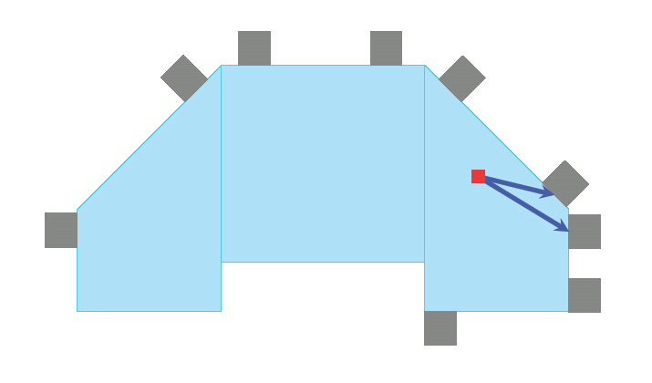
The Best Result we got from Cosmics
This Measurement
yields ~90ps
Resolution
We are in Right
Direction

Slide 13
Unsere Pläne!
-Test the Hamamatsu MPPC Photon detectors(in Lab, with Laser and Cosmics)
-Measure the time resolution we get in parallel with BINP MCPs
(in Lab with Laser/Cosmics)
-In parallel with radial readout try side readout too(in Lab with Cosmics)
-Check two wavelength measurements via dichroic mirrors
(we need second type Photon detectors peaking ~500-700nm range)
-Test a possibility that we can cool Glas and detectors together, i.e. Prototype
and simultaneously do a measurement using Cosmics
-building a prototype(on basis of ours) with so many channels plus FEE prototype and
DAQ that we could see the Parabola in xt space will be good proof of principle
-as soon as our Prototype+FEE+DAQ will be equiped with enough Channels go for
Test Experiment, we promised do the first one in 02/2010 it can be any beam(e,π,P)
But with enough Beamtime to have accumulate good Statistic
-Second Test Experiment we promise to do in 08/2010, hopefully, with design
as close as possible to the final design of DIRC we want to put in TDR

Slide 14
