Slide 1

Glasgow update
Euan Niall Cowie – NPE, University of Glasgow

Slide 2
Outline
Brief Outline of Technique
Look at ‘Superglue’
  Transmission properties
  Time evolution of Transmission
  Issues arising during curing
Prototype tests
  Planned tests prior to beam time.

Slide 3
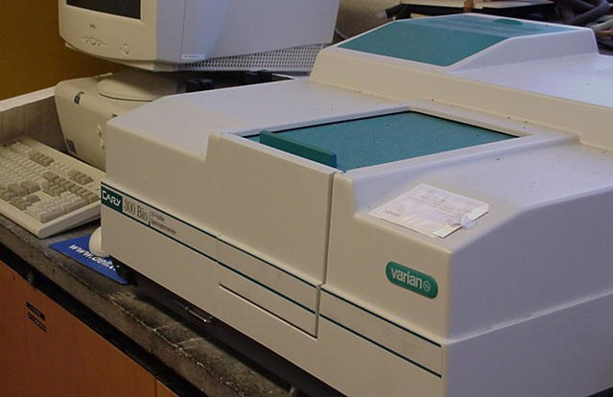
Technique
Varian Cary-300 UV-Vis-NIR Spectrophotometer used
Beam shone through sample and compared with reference beam
Estimation of systematic errors allows for parameter optimisation

Slide 4
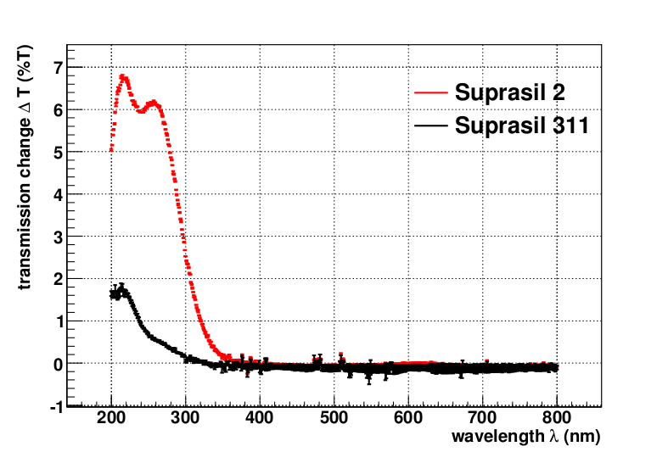
Past results
100krad dose on Suprasil 2 & Suprasil 311
Transmission measured
Direct comparison between the 2 and 311 shows different behaviour

Slide 5
Unglued Samples
Two small windows of Fused Silica were tested prior to being glued
Comparison made between the two unclean samples
  Gives indication of fluctuations between samples

Slide 6
“Super” Glued Samples
First readings were taken immediately
Second readings were taken after ~3 hours
Third readings were 3 days later

Slide 7
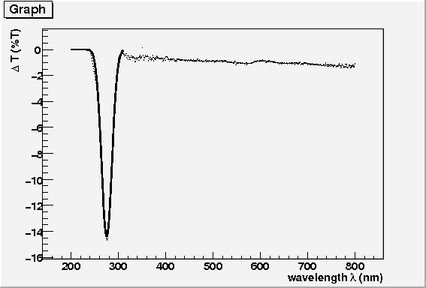
“Super” Glued Samples
By comparing the 1st and 2nd readings we see little change in transmission properties
If one compares the 1st and 3rd or the 2nd and 3rd readings we see a dramatic drop in transmission over time

Slide 8
“Not-So-Super” Glue?
After leaving the sample for a few days a noticeable “bubble” appeared
Compared transmission through bubble to that through glue
Bubble is an air bubble

Slide 9
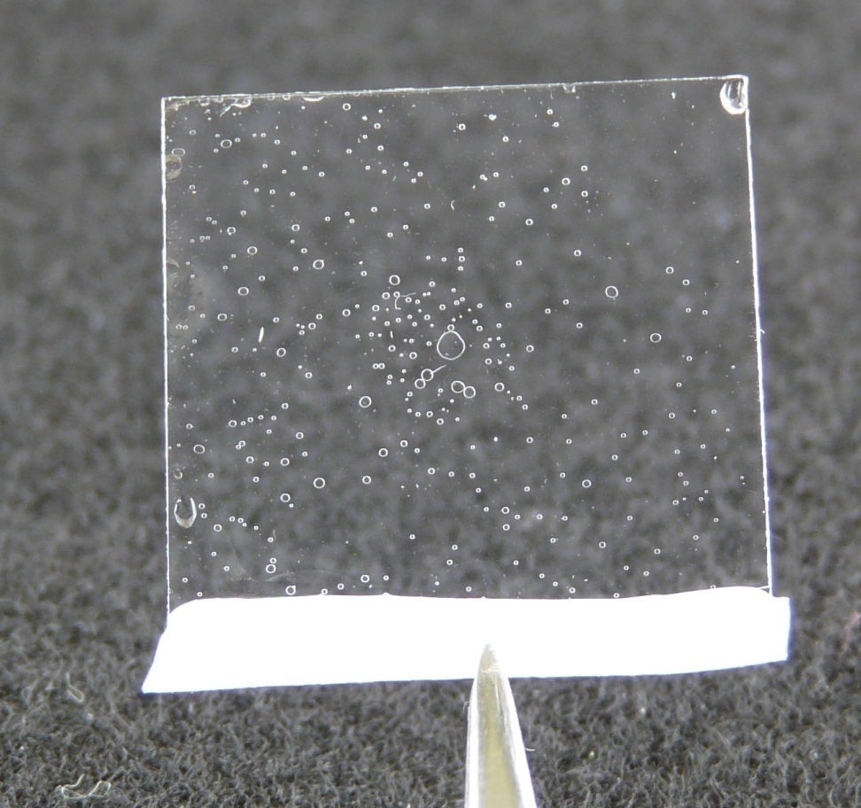
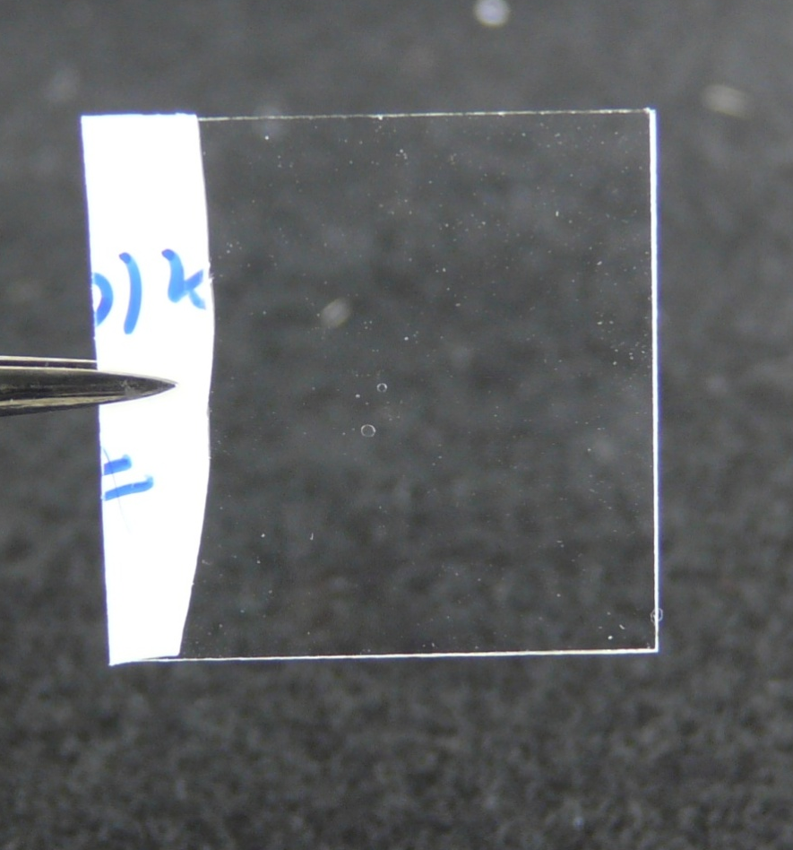
Importance of Gluing Method
Non-Evacuated
Evacuated

Slide 10
Reflectivity of Epotek 301-2

Slide 11
Prototype Design
No Longer Used
Light Guide
LiF
PMTs
Radiator

Slide 12
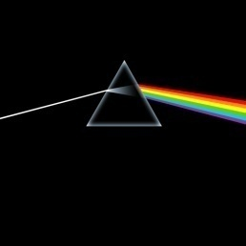
Future work
Light yield measurements
Prediction of chromatic correction
Assembly and testing using full prototype
  Photon transport
  “Real” data
  Pattern Recognition
  Unforeseen Challenges

