Slide 1
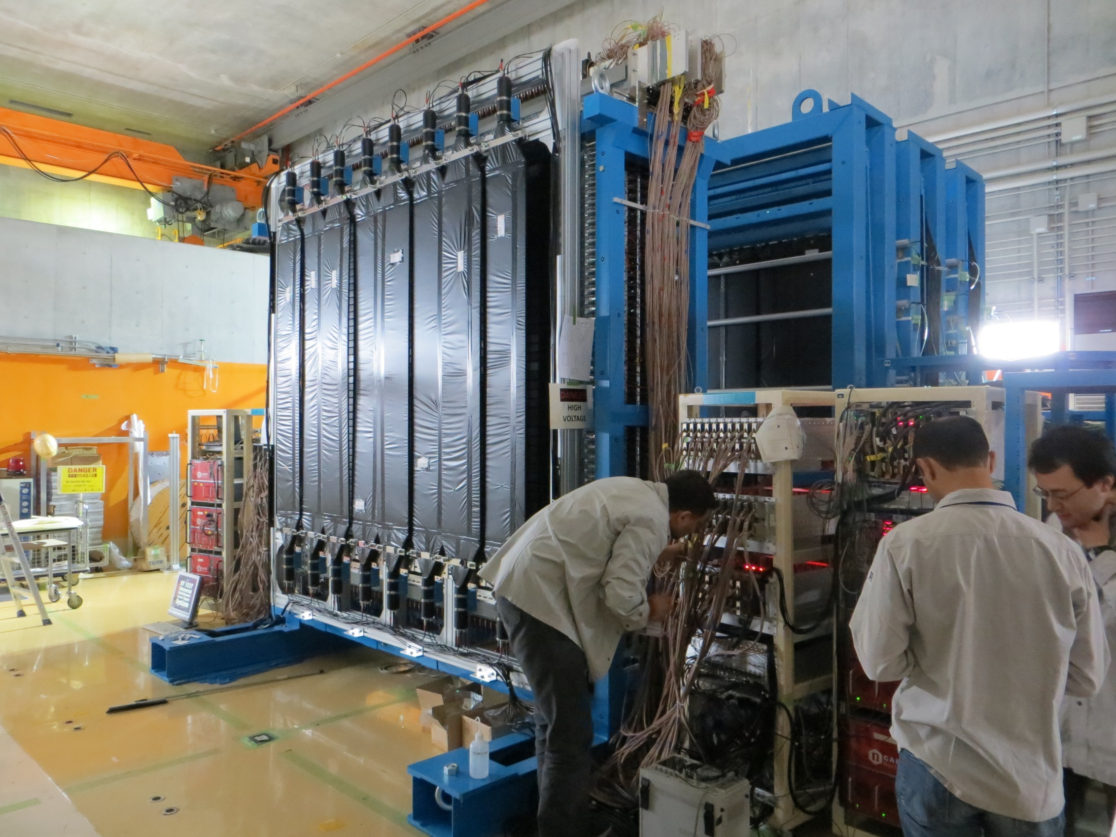
1/21
Design of the NeuLAND VETO Detector
K. Boretzky², C. A. Douma¹, I. Gasparic³, N. Kalantar-
Nayestanaki¹, D. Kresan², J. Mayer⁴, C. Rigollet¹
¹KVI-CART, University of Groningen, The Netherlands
²GSI Helmholtzzentrum für Schwerionenforschung, Germany
³Ruer Bošković Institute, Zagreb, Croatia
⁴Universität at Köln, Germany
1 June 2017

Slide 2
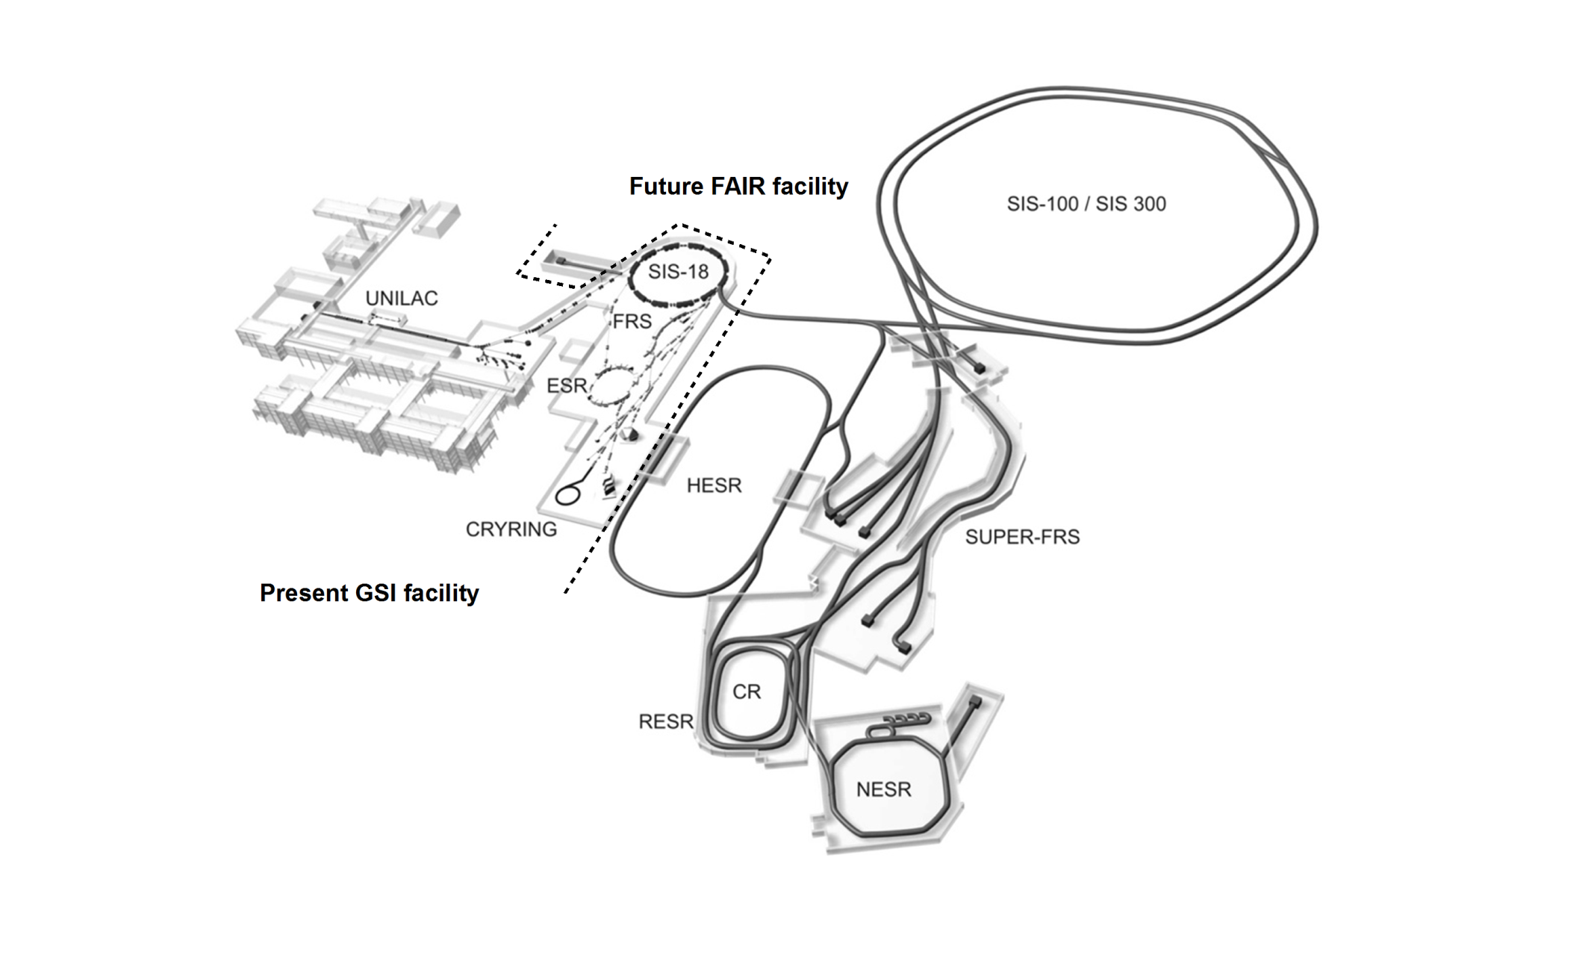
2/21
FAIR facility
Primary accelerator
Pre-acceleration
Fixed primary target
Selection of exotic fragments
➔ Radioactive Beam
R3B experiment
➔ Measure nuclear structure of the beam

Slide 3
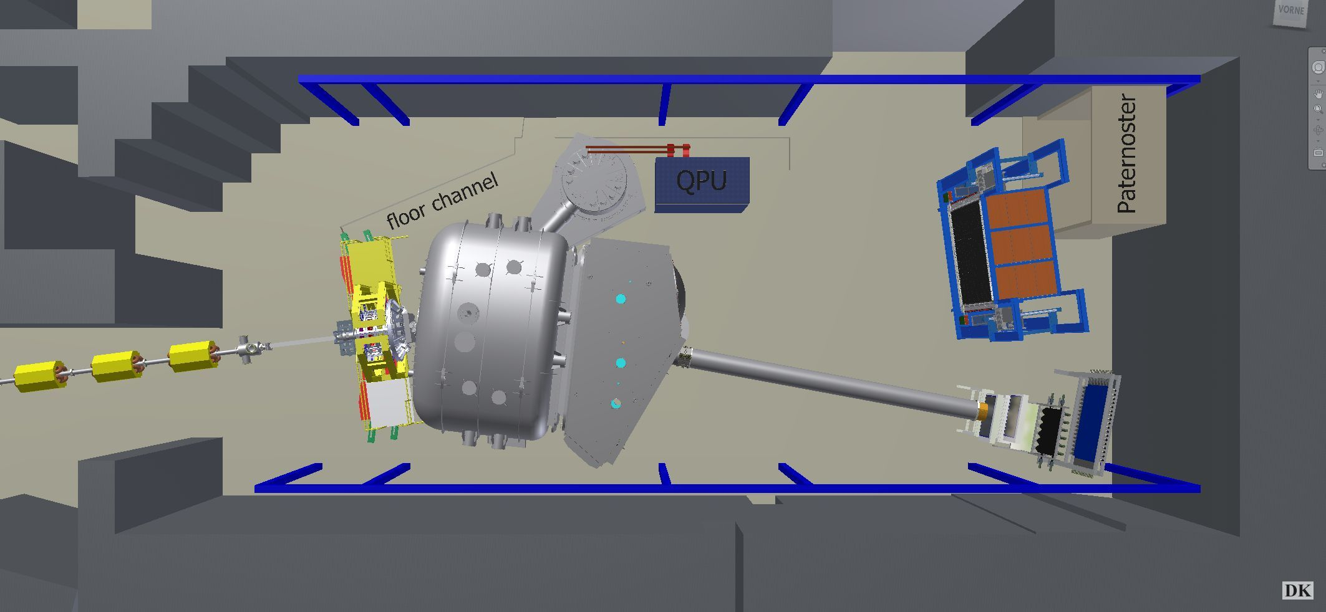
3/21
FAIR facility
R³B Experiment
Primary accelerator
Full kinematic reconstruction of nuclear Reactions with Radioactive Relativistic Beams
Pre-acceleration
Neutrons are detected by NeuLAND ➔ Neu(=new) Large Area Neutron Detector)
➔ We designed a VETO detector for NeuLAND
In-beam detector for diagnostics
GLAD (bending magnet)
Vacuum chamber
Fixed primary target
Selection of exotic fragments
➔ Radioactive Beam
neutrons
Outgoing fragment
➔ Detected by TOF wall & wire chambers
R3B experiment
Incoming radioactive
beam
Protons (detected inside chamber)
Fixed target + gamma spectrometer & proton tracker

Slide 4
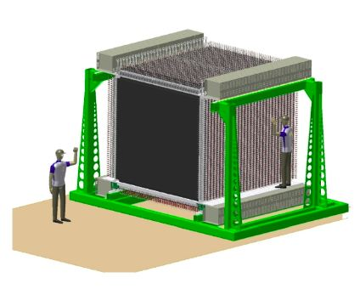
4/21
NeuLAND ➔ Why a VETO detector?
n
Scintillation light
p
How to distinguish?
VETO
p
Background
hit
p
NeuLAND ➔
3000 stacked bars of organic scintillators
n
No hit
Thin Scintillator
VETO design:
Ideal distance?
Scintillator thickness?
# scintillator bars?
Effectiveness?
Use R3BRoot simulations
Geant4 Monte Carlo transport
ROOT geometry builder
ROOT based analysis tools specifically for R³B

Slide 5
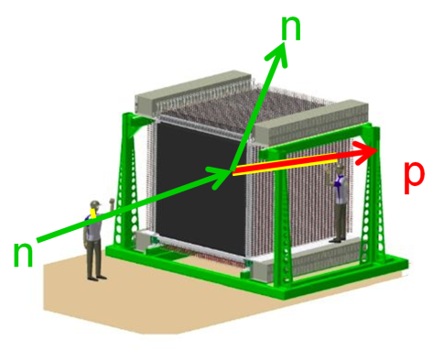
5/21
Simulation procedure
G3/4 Monte Carlo
Digitizer
Rec. first hits
VETO
Analysis
TDC, QDC data
Clusters
Measurements
Unpacker
NeuLAND Clusterfinder
R3B Neutron Tracker
My own
software
Monte Carlo transport:
Well established Geant3 Phys. List:
T. Blaich et al, A large area detector for
high-energy neutrons, (Nucl. Instr. Meth.
Phys. Res. A. 314 (1992).
NeuLAND Clusterfinder:
Group digitzer hitpoints into clusters.
Neutron Tracker:
Reconstruct first hits from clusters
Digitizer:
Calculates PMT pulses from
MC data.
➔ Output is TDC and QDC data.
VETO Analysis:
➔ Explore different VETO conditions

Slide 6
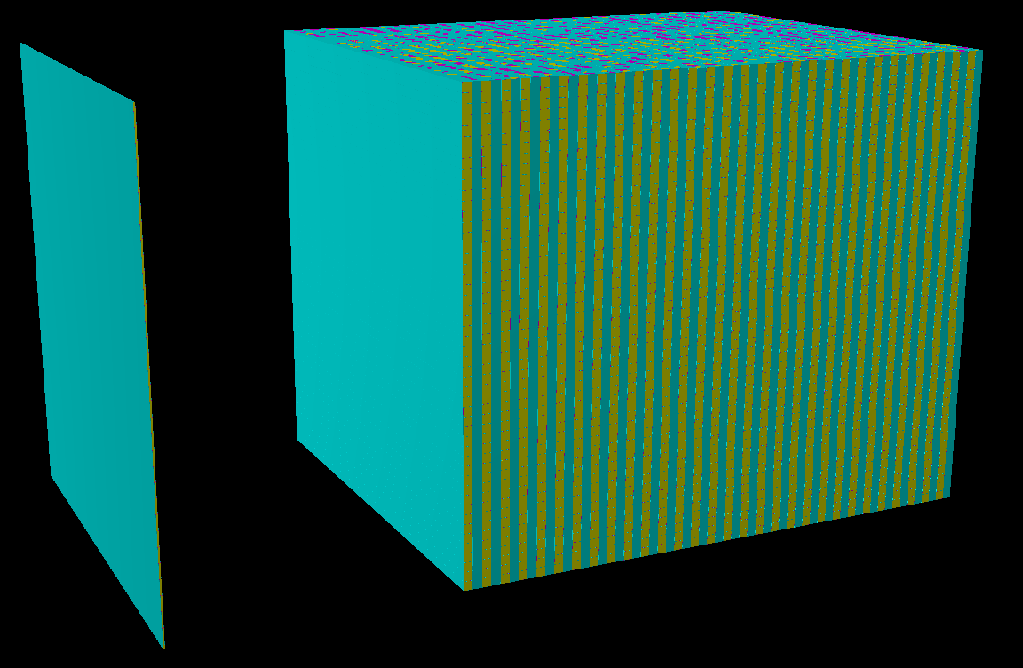
6/21
VETO Design
Keep optimization procedures as simple and clear as possible!
Geometry:
Full NeuLAND geometry at 0 deg
and 14 m distance
VETO: Use RIKEN ¹ as Anzatz and optimize!
Shoot 1 particle per event.
➔ 80 mrad spread from 14 m distance (GLAD acceptance)
VETO condition: only VETO full events (1 event = 1 particle) and refine later!
Optimization:
VETO distance to NeuLAND
Scintillator thickness
Number of bars (segmentation level)
¹ K. Boretzky et al, NeuLAND - from double-planes to the demonstrator, vol. 2015-1 of GSI Annual Report 2015.

Slide 7
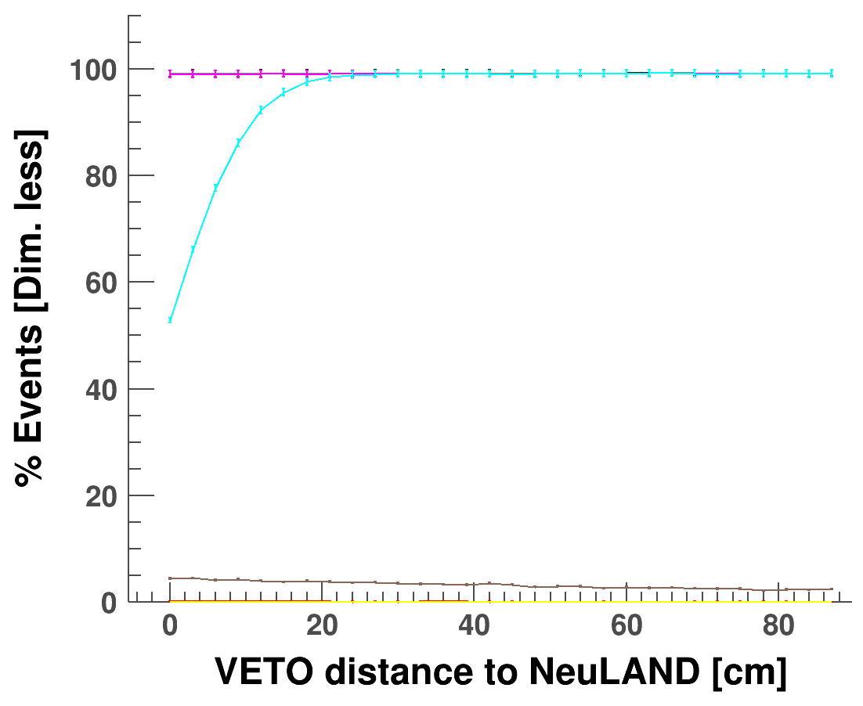
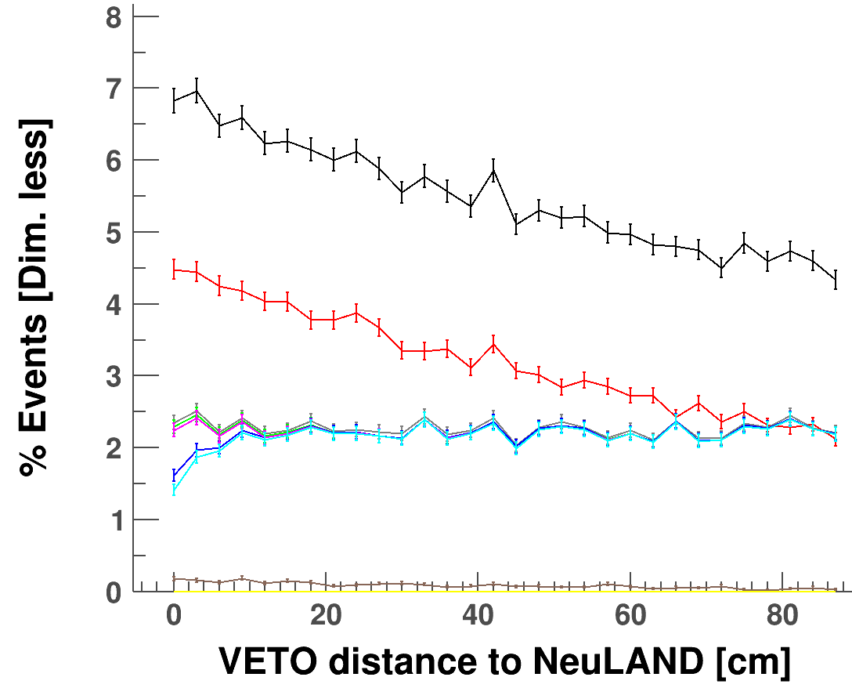
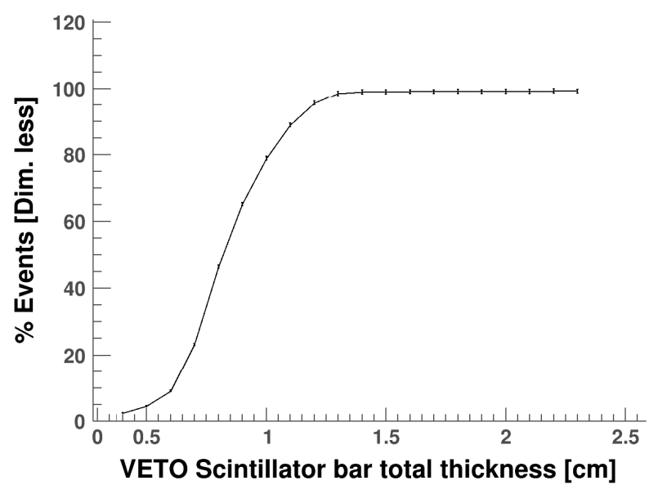
7/21
VETO Design
1 GeV neutrons
1 GeV protons
Position:
No need to simulate particles below 1 GeV. TOF works here, so it will work for slower partciles.
➔ Distance = 30 cm.
All %VETO fired
All %VETO fired
TOF filtered protons
Backscattering
Threshold:
30 cm
TOF filtered neutrons
Threshold:
12 cm
1 GeV protons
Thickness:
➔ Smallest thickness that detects all charged particles.
ΔE ~ Z² and ΔE ~ 1/β² ➔ Only simulate 1 GeV & Z = 1.
➔ Total thickness = 1.3 cm ➔ 1.1 cm active crystal.
%VETO fired
Threshold:
1.3 cm
TOF selects particles perfectly, irrespective of number of bars. ➔ need >1 particles per event to decide that.

Slide 8
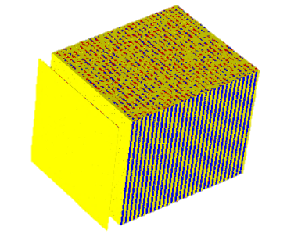
8/21
Advanced VETO condition
Use this!
G3/4 Monte Carlo
Rec. first hits
VETO
Analysis
TDC, QDC data
Clusters
Measurements
VETO bars
VETO clusters
VETO first hits
VETO bars:
Protons: 84.8% VETOed
Neutrons: 31.2% VETOed
➔ 10615 events reconstructed OK.
VETO clusters:
Protons: 83.7% VETOed
Neutrons: 20.3% VETOed
➔ 12688 events reconstructed OK.
25000 events,
E = 1 GeV,
16 bars VETO.
Shoot p & n
in coincidence.
➔ VETO part of event & solve the neutron
VETO First Hits:
Protons: 88.2% VETOed
Neutrons: 5.7% VETOed
➔ 16960 events reconstructed OK.
n
p

Slide 9
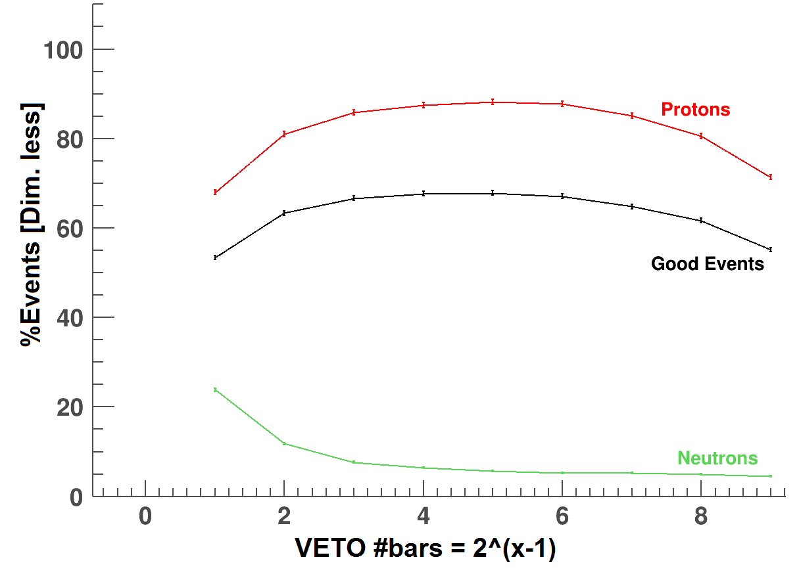
9/21
VETO Geometry
Too few bars to know proton position
Too many gaps
between VETO Crystals
≈ same for
600 MeV & 200 MeV
Optimal software: VETO First Hits.
Optimal geometry: 16 bars
Optimum = 16 bars
1000 MeV p/n coincidence, 25000 events/run

Slide 10
10/21
VETO Efficiency
Best design: 30 cm distance, 1.1 cm crystal thickness, 16 bars
➔ But how effective is this during an experiment?
Obviously:
Event with only neutrons ➔ It is better to have No VETO (no neutron conversion).
Event with p & n ➔ With a VETO we resolve 68% of all events.
Without a VETO we resolve nothing!
➔ The p/n production rates during experiment determine
how many pure n events & how many p&n events you get.
➔ p/n production rates determine which effect is dominant.
➔ p/n production ratio determines whether a VETO is effective!
How to solve?
Need to simulate full R3B setup with a realistic physics case.
Geant3 is not equipped for that.
Need Geant4 with a realistic physics list:
➔ realistic p/n ratio required.
➔ Verify with S438 experiment.

Slide 11
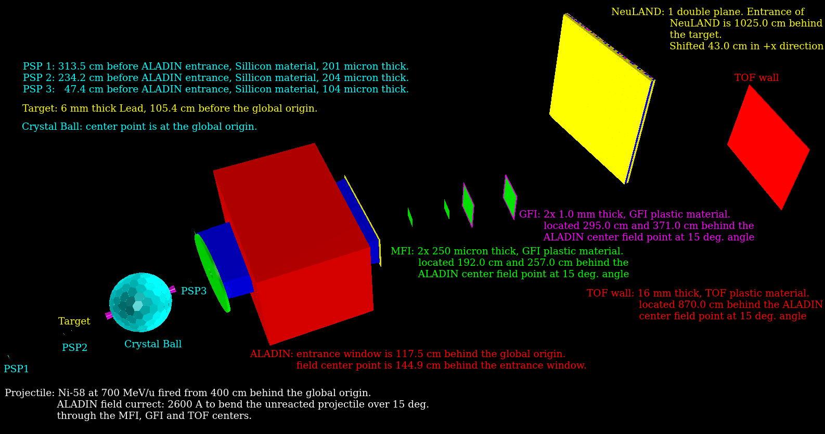
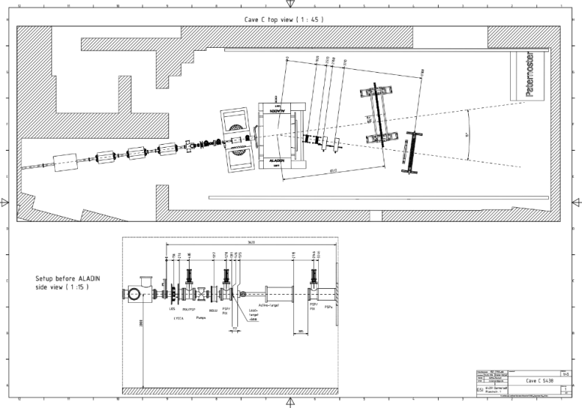
11/21
S438 Monte Carlo Simulation
Use Technical drawings to rebuild the exact geometry:
Use Dima his physics list:
From R3B Physics list builder:
/R3B/phys/addPhysics lowenergy /R3B/phys/addPhysics decay /R3B/phys/addPhysics elastic /R3B/phys/addPhysics ion_inclxx /R3B/phys/addPhysics qgsp_bert /R3B/phys/addPhysics gamma_nuc /mcPhysics/rangeCutForElectron 1000000. mm
Ni58 at 700 MeV/u + Pb target (6 mm): S438a
Same for Ca48 at 550 MeV/u + Pb (2.2 g/cm2) & C (4.4 mm): S438b (adapt the geometry).
Run 3*10⁶ events in simulation.
Process MC data with Jans digitizer.
Compare to 10⁶ events from experimental data.

Slide 12
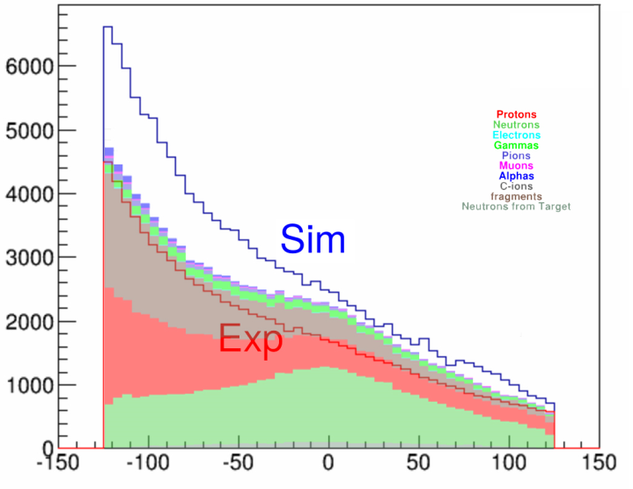
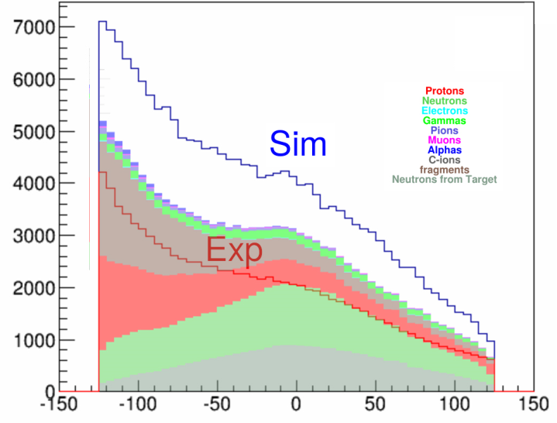
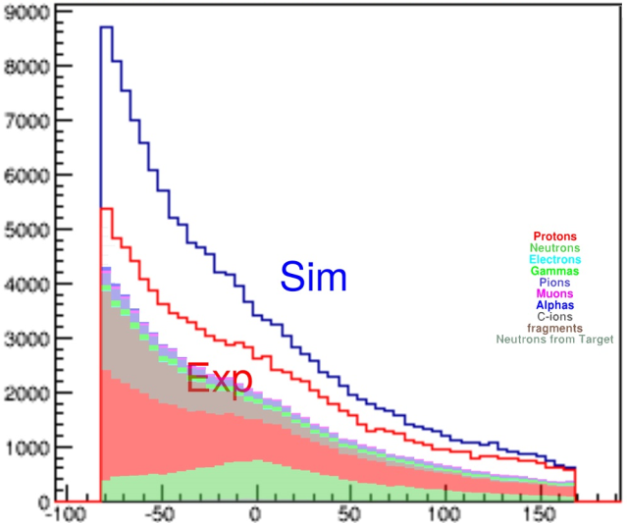
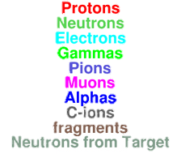
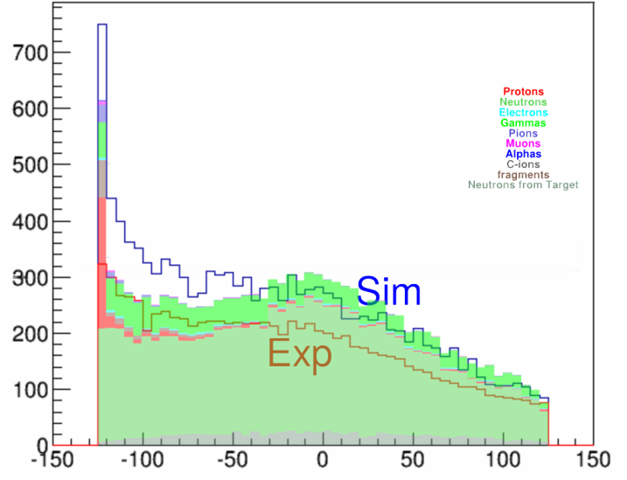
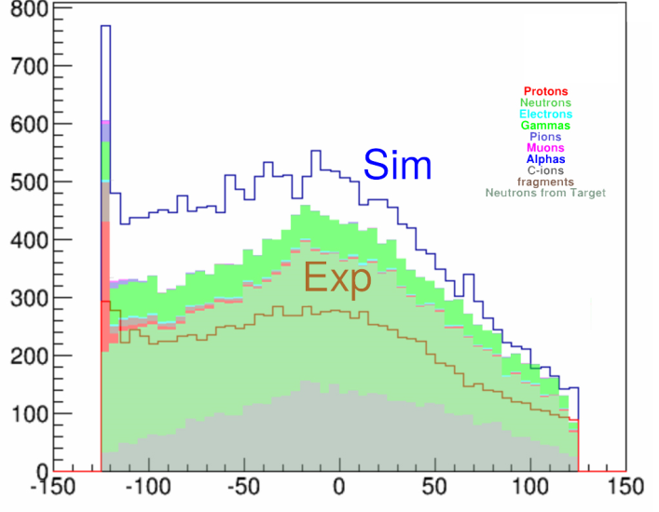
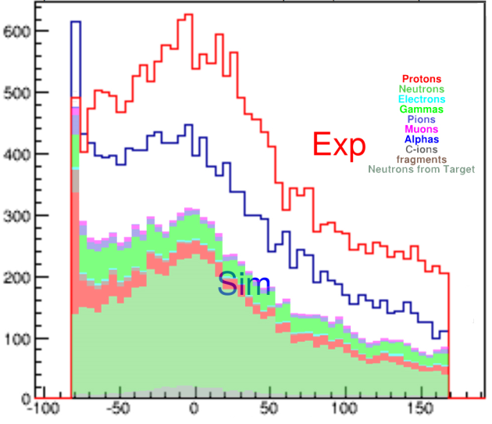
12/21
S438 Comparison
Normalized to nr. of beam particles
S438b: Ca48 + Pb, 4th plane
S438b: Ca48 + C, 4th plane
S438a: Ni58 + Pb, 2nd plane
Ken Miki his sim
(other Phys. List)
Plot: total nr. of times a bar fired
Measured Data
My sim
+ 3rd plane naive VETO condition
+ 3rd plane naive VETO condition
+ 1st plane naive VETO condition

Slide 13
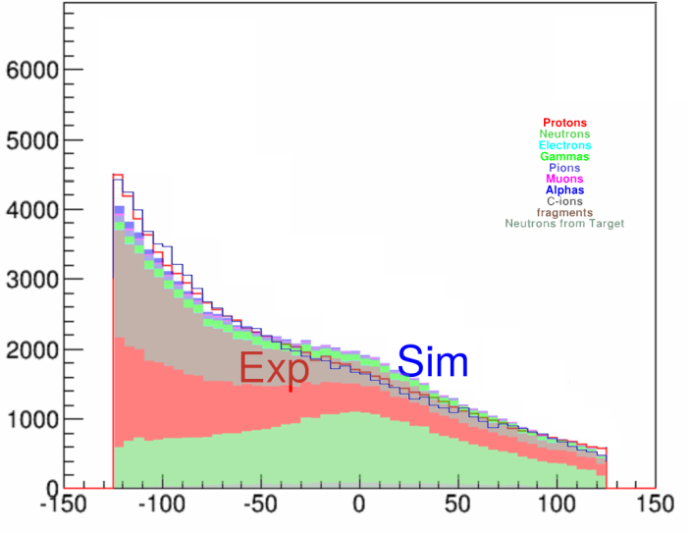
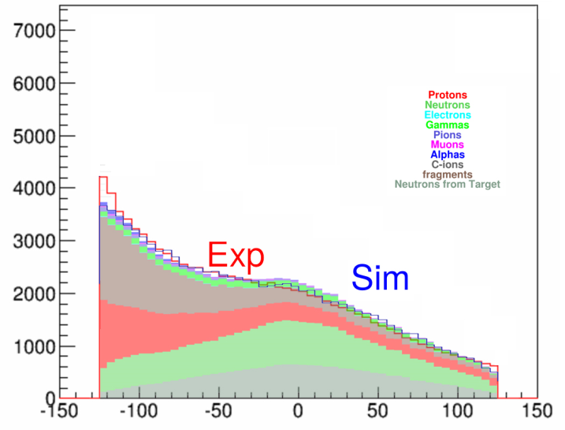
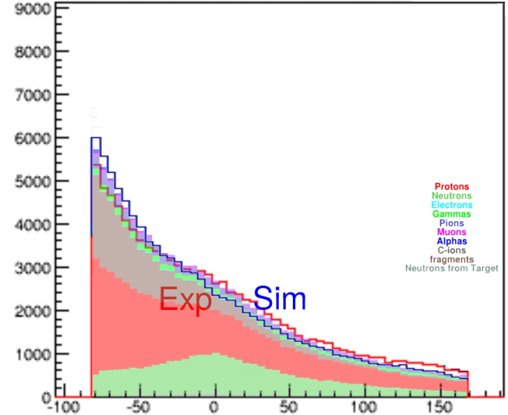
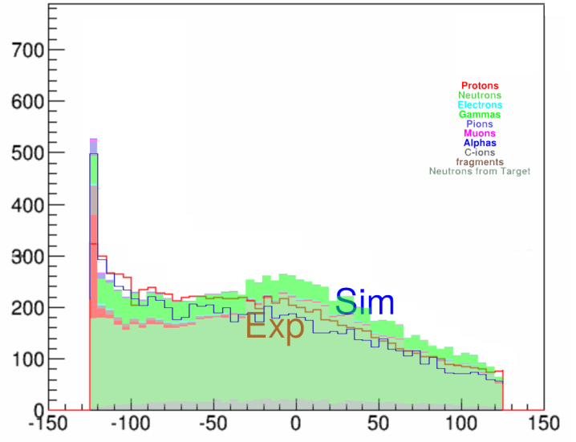
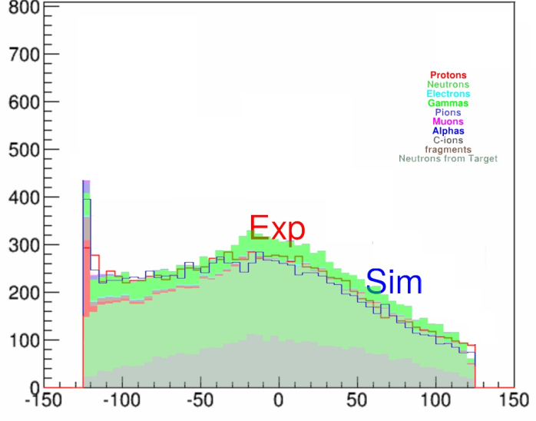
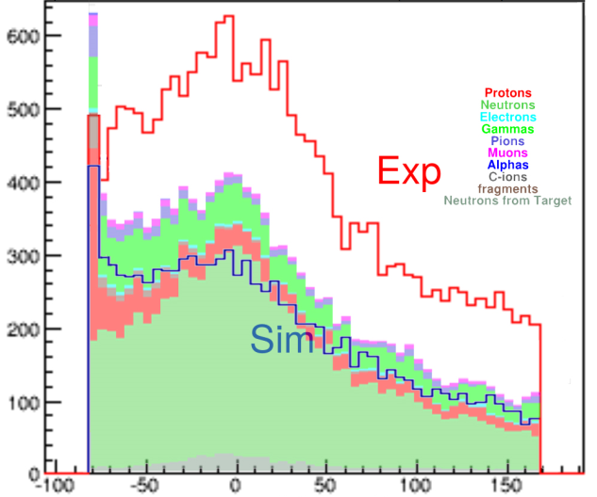
13/21
S438 Comparison
Normalized to UnVETOed data
S438b: Ca48 + Pb, 4th plane
S438b: Ca48 + C, 4th plane
S438a: Ni58 + Pb, 2nd plane
Ken Miki his sim
(other Phys. List)
Plot: total nr. of times a bar fired
Measured Data
My sim
+ 3rd plane naive VETO condition
+ 3rd plane naive VETO condition
+ 1st plane naive VETO condition

Slide 14
14/21
Intermediate conclusion
Simulation produces too much particles for Ca48 (both Pb and C).
Simulation produces too few particles for Ni58 + Pb.
➔ Change normalization to fit the UnVETOed data.
For Ca48 (both Pb and C) we get nearly perfect agreement for VETOed data as well!
For Ni58 we still have too few particles in the VETOed case.
➔ Changing the normalization is just a change in overall production rate.
➔ The p/n production rate is OK for Ca48 (Pb and C).
➔ p/n production rate is what we needed to be OK.
➔ We can use this physics list!
➔ Take the Ca48 + C physics case (reasonable amount of target neutrons).
➔ Go to the new R³B geometry and see the VETO effects…

Slide 15
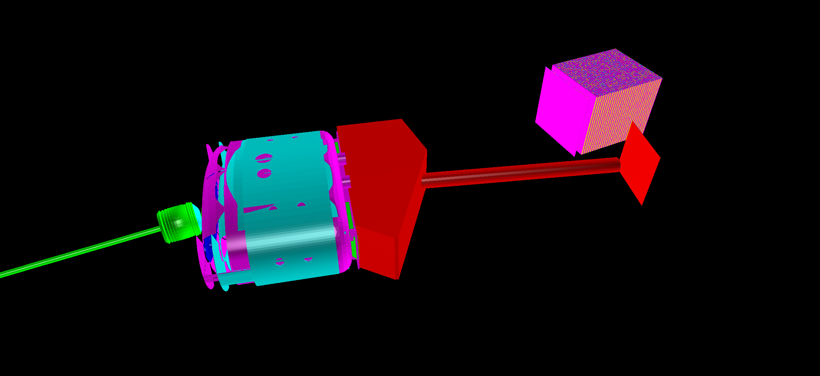
15/21
Full R³B Geometry
Tune GLAD field: beam passes through pipe without hitting it.
Use optimized VETO geometry.
Used VETO condition: VETO Rec. First Hits.
VETO: 16 bars,
dist = 30 cm,
1.1 cm crystal
NeuLAND: 0 deg,
dist = 14 m
GLAD bending magnet
Target, gamma spectrometer & proton tracker
TOF wall for fragment detection
Vacuum chamber
Vacuum beamline
Ca-48, 600 MeV/u
Standard Carbon target,
1000000 events, shoot beam from z = -400 cm

Slide 16
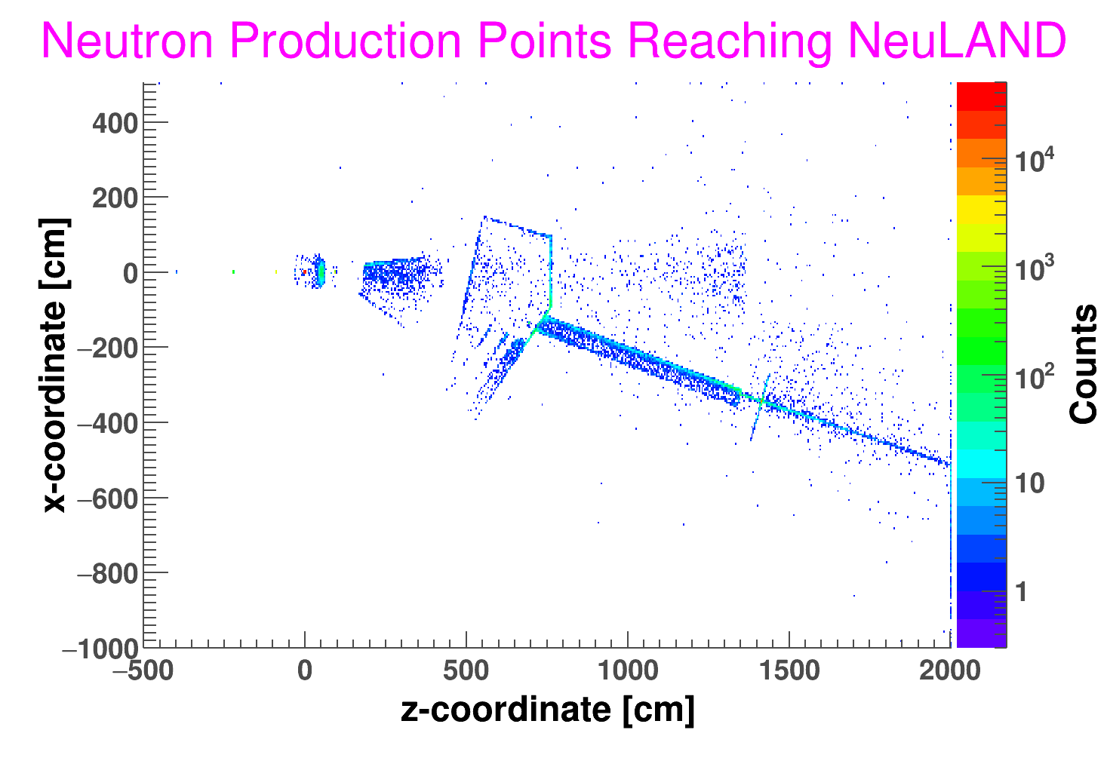
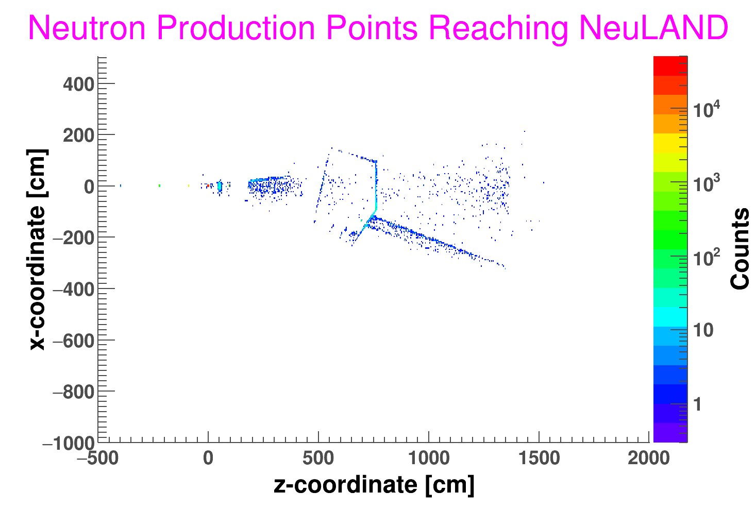
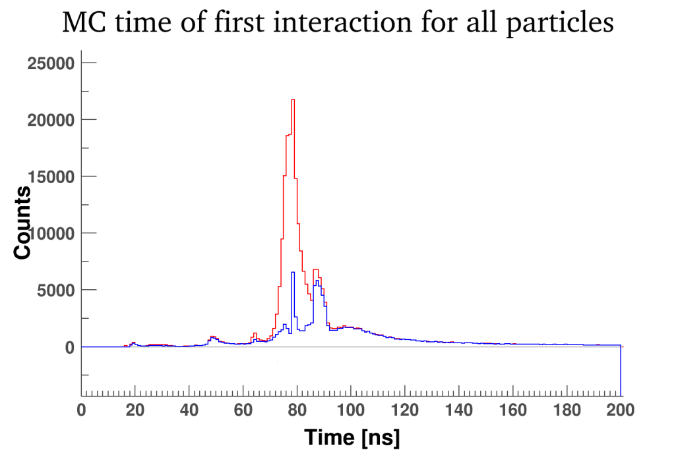
16/21
Neutron Background
Only process Raw data with TDC inside this window.
600 MeV: 52-72 ns.
GLAD
Scattering Chamber
Target
VETO
NeuLAND
Beam
Target neutron peak
Pipe
TOF wall
Particles not from the Target

Slide 17
17/21
Results
Ca48 (600 MeV/u) + C (4.4 mm)
10⁶ beam particles
43151 trigger signals
Neutron multiplicity:
Observed: MC confirmed:
Total: Cont. fraction Total: Cont. Fraction
1n 13779 2091 3097 0
2n 9167 483 2848 0
3n 8253 552 2226 0
4n 5932 490 1500 0
1n 13939 2167 3126 66
2n 9316 542 2850 50
3n 8234 520 2176 33
4n 5955 512 1463 23
1n 13841 2153 3187 90
2n 9248 564 2944 96
3n 8230 529 2297 71
4n 5943 500 1549 49
No VETO condition
VETO Rec. First Hits
VETO based on MC PDG code
(veto everything with charge)
Our VETO condition saves 47%-73% of what we max. can save!
We lose 1.0%-4.0% of clean events (1% of all neutrons hits the VETO).
At this p/n production ratio, this is good for 1n and bad for 3n & 4n.
➔ VETO does what it should do, but there is just so little
charged background that this makes no difference!

Slide 18
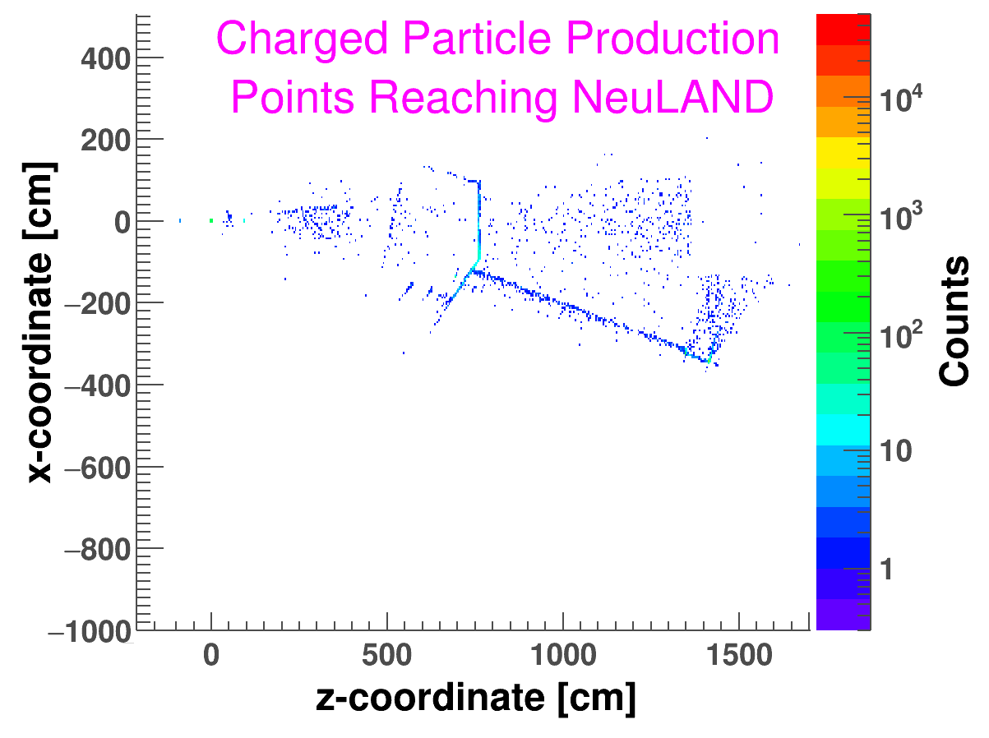
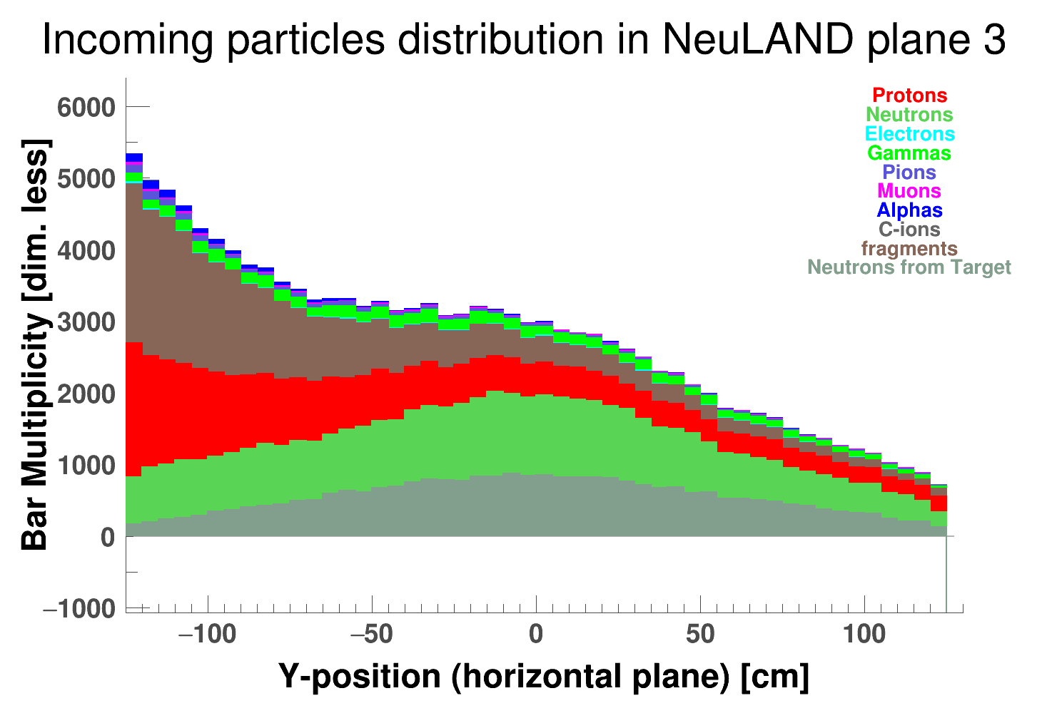
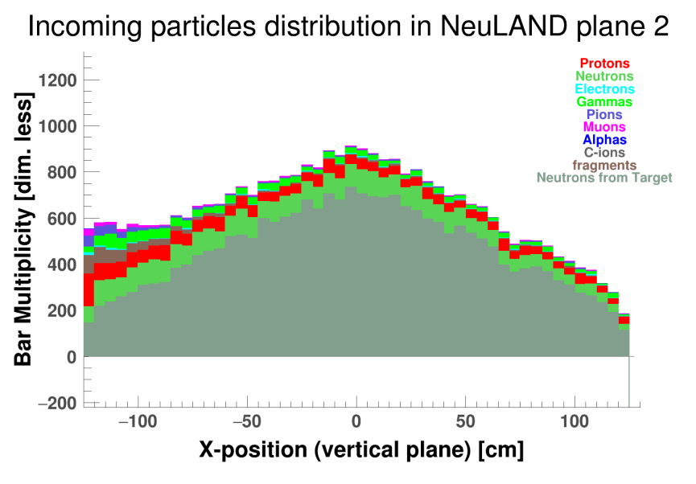
18/21
Charged background
10⁶ beam particles! Only 0/1 counts, except for the neutron window and the TOF wall
With S438b geometry…
NeuLAND bars hit by these particles
Rest of the new setup is so good, VETO has no job left…

Slide 19
19/21
Other Physics Cases
Observed: MC confirmed:
Total: Cont. fraction Total: Cont. Fraction
1n 8139 2755 52 0
2n 323 167 44 0
3n 175 63 30 0
4n 128 27 22 0
1n 8105 2730 53 0
2n 264 111 41 1
3n 327 159 29 0
4n 1103 549 20 0
1n 13463 3361 660 0
2n 1714 248 285 0
3n 998 164 127 0
4n 491 125 32 0
1n 13362 3268 630 0
2n 1668 202 268 0
3n 958 141 118 0
4n 468 115 29 0
Pb208 1 GeV/u at Pb (500 mg/cm²), 250.000 beam particles.
A case with a lot of background
No VETO
VETO Rec.
First Hits
No VETO
VETO Rec.
First Hits
Ni58 700 MeV/u at Pb
(6 mm), 1.000.000 beam particles
A case with few target neutrons.
Pb208 ➔ VETO makes signal/noise much worse.
Ni58 ➔ Looks similar to Ca48, but we do not see it because there are few target neutrons.

Slide 20
20/21
Conclusion
Best VETO geometry: 1.1 cm crystal, 30 cm distance, 16 bars.
Best VETO condition: VETO Rec. First Hits.
This saves 47%-73% of all contaminated events.
This is less then the 1% neutrons that get VETOed.
This p/n production ratio has been verified with S438
One does require time cuts to eliminate the neutron background! They give a 10% - 450%
improvement in signal-to-noise ratio! A follow-up project could be to optimize this even
further in the form of velocity cuts (watch calorimetry!)
➔ For the cases we investigated, a VETO seems NOT necessary.
➔ The rest of the R3B setup produces so little background that is is not worth it.
NB: The situation is quite different when you break the vacuum in the scattering chamber!
A 1.0 GeV Pb208 simulation at Pb target (500 mg/cm²) in air shows 30% - 500%
improvement in signal-to-noise ratio due to the VETO (naive condition!)

Slide 21
21/21
Thank you!

Slide 22
B1/3
Backup: when do we apply the timecuts?
G3/4 Monte Carlo
Rec. first hits
VETO
Analysis
TDC, QDC data
Clusters
Measurements
Raw Data TimeCut
First Hit TimeCut
Ca48 (600 MeV/u) + C (4.4 mm)
10⁶ beam particles
No VETO condition
Observed: MC confirmed:
Total: Cont. fraction Total: Cont. Fraction
1n 13779 2091 3097 0
2n 9167 483 2848 0
3n 8253 552 2226 0
4n 5932 490 1500 0
1n 11844 2250 2336 0
2n 7950 694 2220 0
3n 7037 673 1776 0
4n 6189 685 1374 0
NB: Both ways provide exactly the same Rec. Firts Hits!
Same experimental data!
But when comparing with orginal MC data, Raw TimeCut offers less detected particles ➔ less way to screw up the comparison!

Slide 23
B2/3
Backup: what happens without the timecuts?
Ca48 (600 MeV/u) + C (4.4 mm)
10⁶ beam particles
No VETO condition
Observed: MC confirmed:
Total: Cont. fraction Total: Cont. Fraction
1n 13779 2091 3097 0
2n 9167 483 2848 0
3n 8253 552 2226 0
4n 5932 490 1500 0
1n 50148 20430 2476 0
2n 8387 887 2313 0
3n 7164 701 1869 0
4n 6169 676 1424 0
With Raw data TimeCut
Without Raw data TimeCut

Slide 24
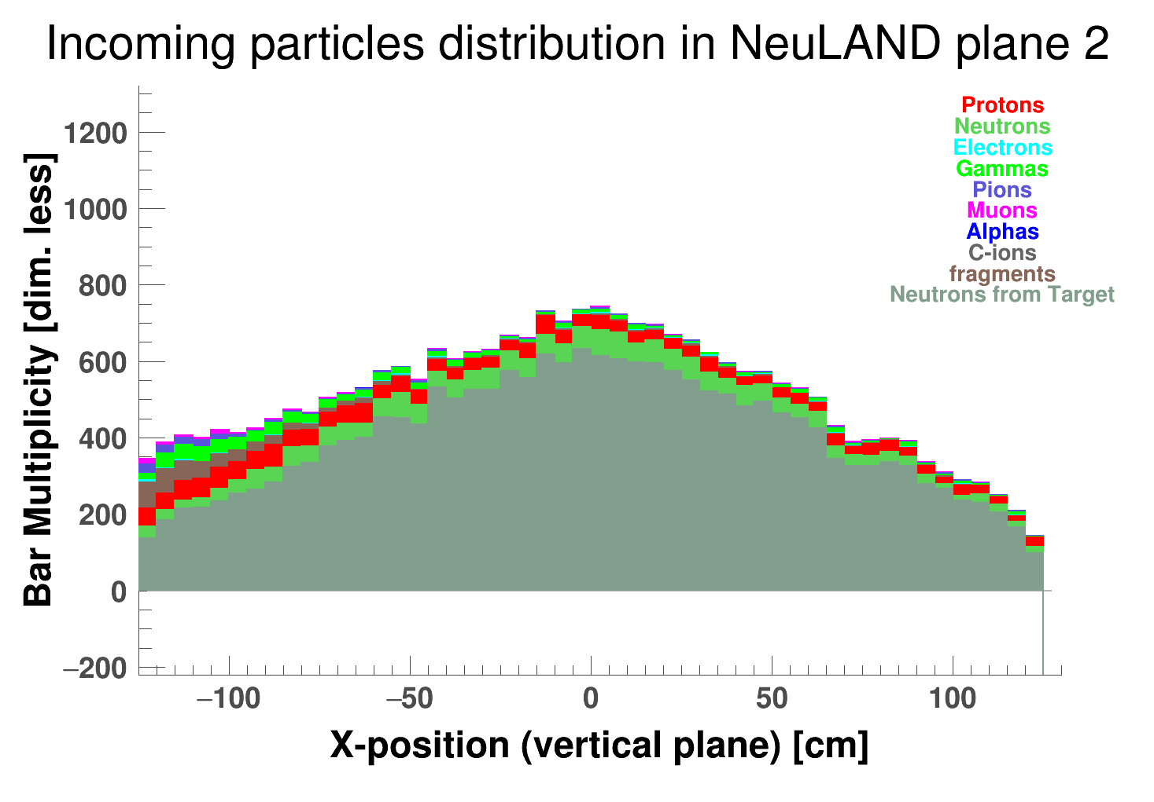
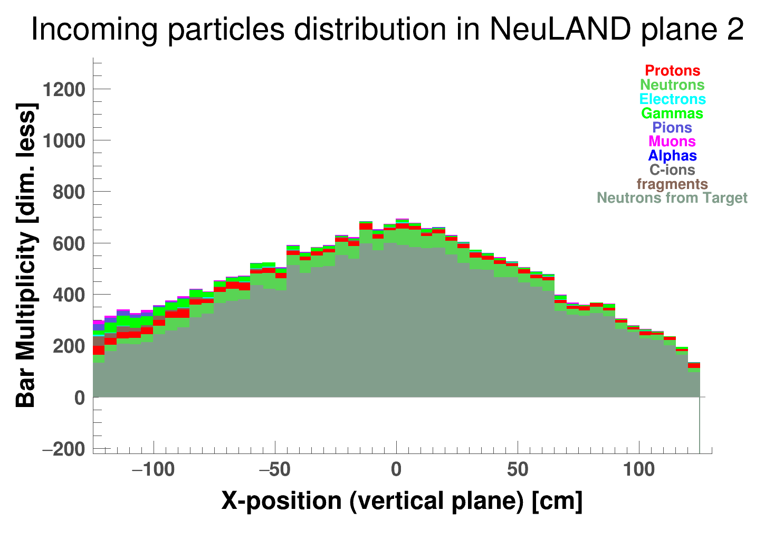
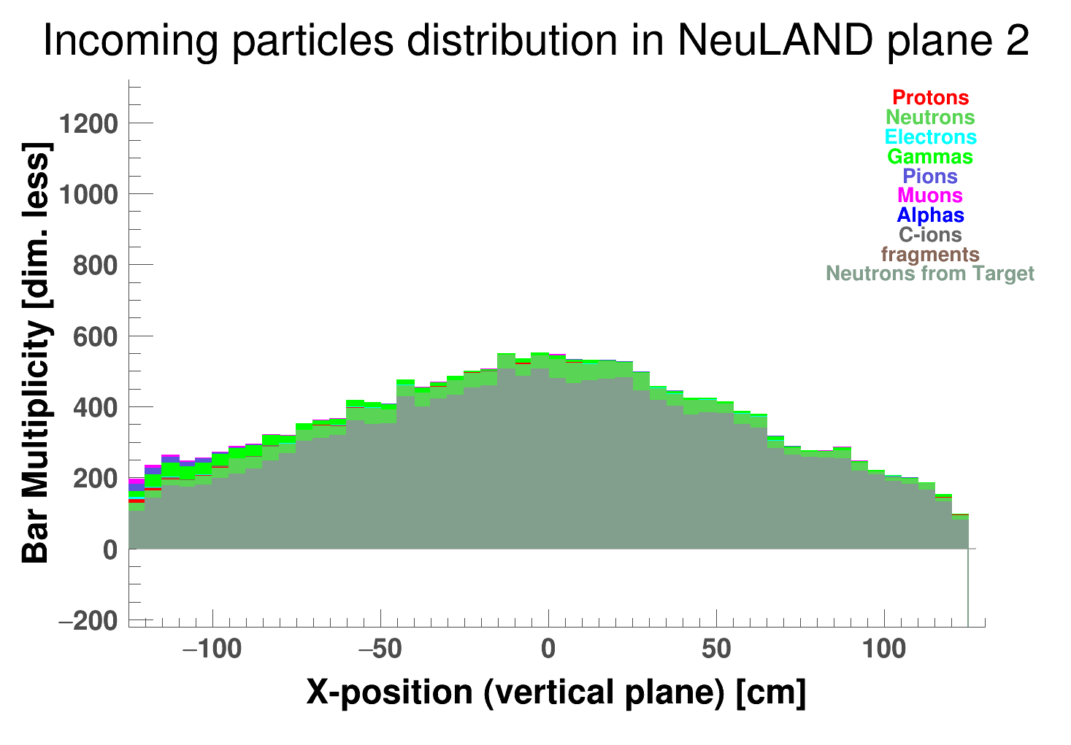
B3/3
Backup: NeuLAND hit patterns
No VETO condition
No TimeCut
No VETO condition
Raw data TimeCut
Advanced VETO condition
Raw data TimeCut
Naive VETO condition
Raw data TimeCut

