Slide 1
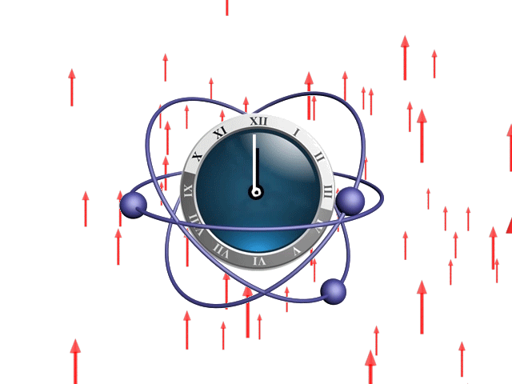
CPT Violation, Lorentz Violation, and Exotic Atoms
Arnaldo Vargas

Slide 2
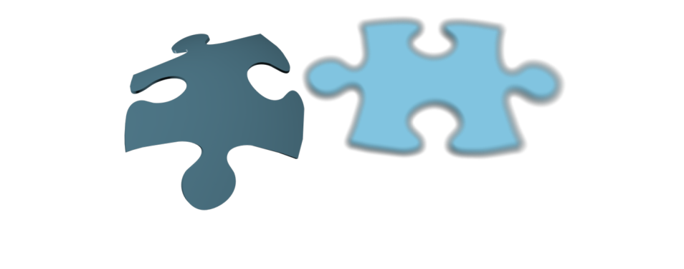
Why Lorentz violation?
Possible low-energy signature for theories beyond the Standard Model and General Relativity
General
Relativity
Quantum
Physics
Examples
String theory
Permits mechanisms for spontaneous Lorentz breaking compatible with gauge symmetries
Kostelecký and Samuel, PRD 39, 683 (1989)
Non-commutative field theory
Different directions do not commute
Carroll et al., PRL 87,141601 (2001)
Loop quantum gravity
The volume of a hypersurface is a field operator with a discrete spectrum
Florian et al., SIGMA 8, 098 (2012)

Slide 3
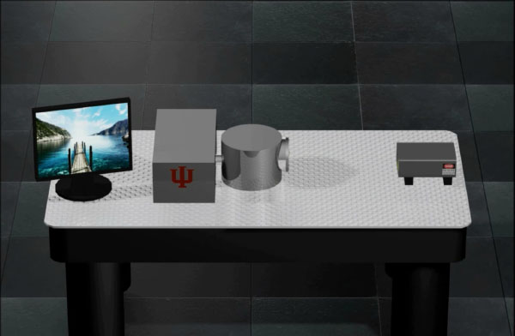
Lorentz symmetry
Experimental results are independent of the overall orientation and velocity of the experiment
Notes:
With the intention of illustrating the idea of Lorentz symmetry suppose that we do an experiment and obtain some results.

Slide 4
Lorentz symmetry
Experimental results are independent of the overall orientation and velocity of the experiment
Original inertial reference frame
Notes:
With the intention of illustrating the idea of Lorentz symmetry suppose that we do an experiment and obtain some results.

Slide 5
Lorentz symmetry
Experimental results are independent of the overall orientation and velocity of the experiment
Original inertial reference frame
Notes:
With the intention of illustrating the idea of Lorentz symmetry suppose that we do an experiment and obtain some results.

Slide 6
Lorentz symmetry
Experimental results are independent of the overall orientation and velocity of the experiment
Original inertial reference frame
Notes:
With the intention of illustrating the idea of Lorentz symmetry suppose that we do an experiment and obtain some results.

Slide 7
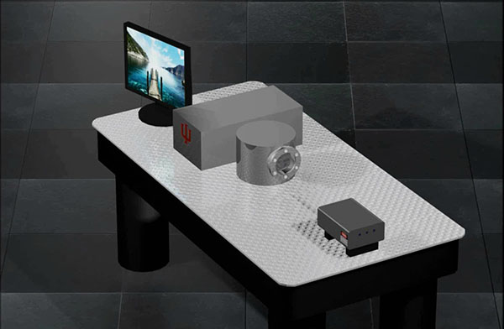
Lorentz symmetry
Experimental results are independent of the overall orientation and velocity of the experiment
Original inertial reference frame
Rotated reference frame
$$=$$
Notes:
With the intention of illustrating the idea of Lorentz symmetry suppose that we do an experiment and obtain some results.

Slide 8
Lorentz symmetry
Experimental results are independent of the overall orientation and velocity of the experiment
Original inertial reference frame
Rotated reference frame
Boosted reference frame
$$=$$
$$=$$
How can we represent violations of Lorentz symmetry?
Notes:
With the intention of illustrating the idea of Lorentz symmetry suppose that we do an experiment and obtain some results.

Slide 9
Representing Broken symmetries
Symmetry: relative orientation of the magnetic dipoles
Notes:
With the intention of illustrating the idea of Lorentz symmetry suppose that we do an experiment and obtain some results.

Slide 10
Representing Broken symmetries
Symmetry: relative orientation of the magnetic dipoles
Explicit symmetry breaking
$$H=…+c_{i} \vec{B}∙{\vec{μ}}_{i}+…$$
The magnetic field explicitly selects a preferred orientation
Applied magnetic field
Notes:
With the intention of illustrating the idea of Lorentz symmetry suppose that we do an experiment and obtain some results.

Slide 11
Representing Broken symmetries
Symmetry: relative orientation of the magnetic dipoles
Explicit symmetry breaking
$$H=…+c_{i} \vec{B}∙{\vec{μ}}_{i}+…$$
The magnetic field explicitly selects a preferred orientation
Applied magnetic field
$$μ_{i}=\vec{M}+δμ_{i}$$
Spontaneous symmetry breaking
$$H≃…+c_{i}\vec{M}∙{\vec{μ}}_{i}+…$$
The magnetization is a preferred orientation
$$T→0$$
Magnetization
Notes:
With the intention of illustrating the idea of Lorentz symmetry suppose that we do an experiment and obtain some results.

Slide 12
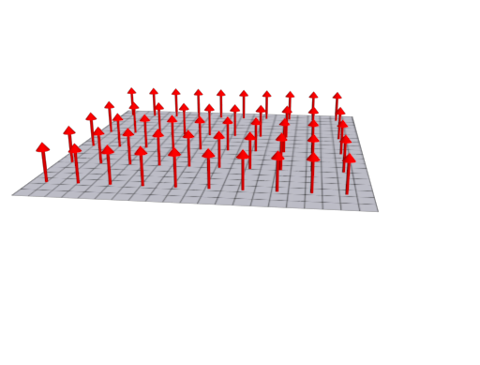
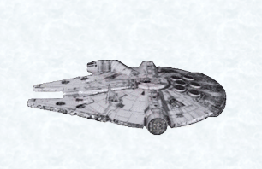
Lorentz violation as background fields
Lorentz-violation controlling coefficients Field operator
$$ℒ=…+e^{μ}\overline{ψ}i∂_{μ}ψ+…$$
Lorentz-violation controlling coefficients can be understood as the components of constant uniform background fields that permeate Minkowski spacetime
Representation of $〈\overline{ψ}i∂_{μ}ψ 〉$
Representation of $e^{μ}$
Lab frame
Fixed inertial reference frame

Slide 13
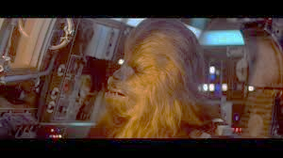
Fixed inertial frame
$$〈e^{μ}\overline{ψ}i∂_{μ}ψ〉$$
$$t$$
Expectation value
$$x$$
$$t$$
Relative velocity between lab frame and fixed frame
$$x$$
Lab frame
Chewie’s

Slide 14
Yoda’s
Fixed inertial frame
$$〈e^{μ}\overline{ψ}i∂_{μ}ψ〉$$
$$t$$
Expectation value
$$x$$
$$t$$
Relative velocity between lab frame and fixed frame
$$x$$
Lab frame
Chewie’s

Slide 15
Yoda’s
Fixed inertial frame
$$〈e^{μ}\overline{ψ}i∂_{μ}ψ〉$$
$$t$$
Expectation value
$$x$$
$$t$$
Relative velocity between lab frame and fixed frame
$$x$$
Lab frame
Chewie’s
Yoda and Chewie agree about $〈e^{μ}\overline{ψ}i∂_{μ}ψ〉$ (observer independent)
The result depends on the velocity of the experiment (Lorentz violation)

Slide 16
Lorentz violation as background fields
The SME Lagrangian
Colladay and Kostelecký, PRD 55, 6760 (1997)
Colladay and Kostelecký, PRD 58, 116002 (1998) Kostelecký, PRD 69, 105009 (2004)
$$ℒ_{SME}=ℒ_{SM}+ℒ_{GR}+ℒ_{LV}$$
Conventional physics
Lorentz violation
Facilitates the systematic test of Lorentz and CPT symmetry
Models for Lorentz violation applicable to diverse physical scenarios
Compare and classify tests of Lorentz symmetry
Predicts signals for Lorentz and CPT violation

Slide 17
Systems used in Lorentz symmetry tests
Atomic experiments
Clock comparison
Atomic spectroscopy
Ion spectroscopy
Masers
Atom interferometry
Doppler-shift experiment
Polarized matter
Torsion pendulums
Magnetometer
Collider experiments
Scattering cross-sections
Baryon decays
Meson decays
Quark pair production
Meson oscillations
Astrophysical observations
Astrophysical dispersion
Astrophysical birefringence
Lunar laser ranging
Gravitational waves
Pulsars
CMB polarization
Cosmic particles
Light experiments
Rotating resonators
Cavity oscillators
Light Interferometry
Spin-precession experiments
Penning traps
Ultra-cold neutrons
g-2 experiments
Gravity tests
Free-fall WEP tests
Force-comparison WEP tests
Space-based WEP tests
Short-range gravity
Neutrino experiments
Neutrinos oscillations
Neutrinos time of ﬂight
Neutrino-antineutrino comparison
Atmospheric neutrinos
Data Tables for Lorentz and CPT Violation
arXiv:0801.0287 [hep-ph]
(update annually)

Slide 18
Systems used in Lorentz symmetry tests
Atomic experiments
Clock comparison
Atomic spectroscopy
Ion spectroscopy
Masers
Atom interferometry
Doppler-shift experiment
Polarized matter
Torsion pendulums
Magnetometer
Collider experiments
Scattering cross-sections
Baryon decays
Meson decays
Quark pair production
Meson oscillations
Astrophysical observations
Astrophysical dispersion
Astrophysical birefringence
Lunar laser ranging
Gravitational waves
Pulsars
CMB polarization
Cosmic particles
Light experiments
Rotating resonators
Cavity oscillators
Light Interferometry
Spin-precession experiments
Penning traps
Ultra-cold neutrons
g-2 experiments
Gravity tests
Free-fall WEP tests
Force-comparison WEP tests
Space-based WEP tests
Short-range gravity
Neutrino experiments
Neutrinos oscillations
Neutrinos time of ﬂight
Neutrino-antineutrino comparison
Atmospheric neutrinos
Data Tables for Lorentz and CPT Violation
arXiv:0801.0287 [hep-ph]
(update annually)

Slide 19
Systems used in Lorentz symmetry tests
Atomic experiments
Clock comparison
Atomic spectroscopy
Ion spectroscopy
Masers
Atom interferometry
Doppler-shift experiment
Polarized matter
Torsion pendulums
Magnetometer
Collider experiments
Scattering cross-sections
Baryon decays
Meson decays
Quark pair production
Meson oscillations
Astrophysical observations
Astrophysical dispersion
Astrophysical birefringence
Lunar laser ranging
Gravitational waves
Pulsars
CMB polarization
Cosmic particles
Light experiments
Rotating resonators
Cavity oscillators
Light Interferometry
Spin-precession experiments
Penning traps
Ultra-cold neutrons
g-2 experiments
Gravity tests
Free-fall WEP tests
Force-comparison WEP tests
Space-based WEP tests
Short-range gravity
Neutrino experiments
Neutrinos oscillations
Neutrinos time of ﬂight
Neutrino-antineutrino comparison
Atmospheric neutrinos
Data Tables for Lorentz and CPT Violation
arXiv:0801.0287 [hep-ph]
(update annually)

Slide 20
Relation between CPT symmetry and Lorentz symmetry
Field operator
Even # indexes $⇒$ CPT even
CPT
$$A^{μ_{1}…μ_{n}} ⇒ {\left(−1\right)}^{n}A^{μ_{1}…μ_{n}}$$
Odd # indexes $⇒$ CPT odd
Lorentz-invariant field theory
CPT
$$A^{μ_{1}…μ_{n}} B_{μ_{1}…μ_{n}} ⇒ {\left(−1\right)}^{2n}A^{μ_{1}…μ_{n}} B_{μ_{1}…μ_{n}}=A^{μ_{1}…μ_{n}}B_{μ_{1}…μ_{n}}$$
Lorentz-violating field theory
CPT
$$k_{μ_{1}…μ_{n}}A^{μ_{1}…μ_{n}} ⇒{\left(−1\right)}^{n}k_{μ_{1}…μ_{n}}A^{μ_{1}…μ_{n}}$$
In an interacting quantum field theory CPT violation implies Lorentz violation
Greenberg, PRL 89, 231602 (2002)

Slide 21
$$e^{α}\overline{ψ}i∂_{α}ψ$$
$$e_{f}^{α}{\overline{ψ}}_{f}i∂_{α}ψ_{f}$$
What kind of particle it is?
In principle Lorentz violation could affect particles with different flavors in different ways

Slide 22
Atomic spectroscopy
$nS_{1/2}$ atomic state of hydrogen in the hyperfine-Zeeman regime
conventional case
$$ε=ε_{0}+δε$$
Lorentz-violating contribution
energy of the atomic state
$$δε≃S+\vec{β}∙\vec{V}+\frac{m_{F}}{B}\left( \vec{B}∙\vec{A}+B^{I}T_{IK}β^{K}\right)$$
$\vec{β}$ velocity of the laboratory
$\vec{B}$ applied magnetic field
Conventional case
$$m_{F}=1$$
$$\left|↑↑\right\rangle$$
$$F=1$$
$$m_{F}=0$$
$$\frac{1}{\sqrt{2}}\left(\left|↑↓\right\rangle +\left|↓↑\right\rangle \right)$$
$$nS_{1/2}$$
$$m_{F}=−1$$
$$\left|↓↓\right\rangle$$
$$F=0$$
$$\frac{1}{\sqrt{2}}\left(\left|↑↓\right\rangle −\left|↓↑\right\rangle \right)$$
Notes:
Increase and decrease and stuff

Slide 23
Atomic spectroscopy
$nS_{1/2}$ atomic state of hydrogen in the hyperfine-Zeeman regime
conventional case
$$ε=ε_{0}+δε$$
Lorentz-violating contribution
energy of the atomic state
$$δε≃S+\vec{β}∙\vec{V}+\frac{m_{F}}{B}\left( \vec{B}∙\vec{A}+B^{I}T_{IK}β^{K}\right)$$
$\vec{β}$ velocity of the laboratory
$\vec{B}$ applied magnetic field
Conventional case
Lorentz-violating case
$$m_{F}=1$$
$$F=1$$
$$m_{F}=0$$
$$nS_{1/2}$$
$$m_{F}=−1$$
$$F=0$$
Notes:
Increase and decrease and stuff

Slide 24
Atomic spectroscopy
$nS_{1/2}$ atomic state of hydrogen in the hyperfine-Zeeman regime
conventional case
$$ε=ε_{0}+δε$$
Lorentz-violating contribution
energy of the atomic state
$$δε≃S+\vec{β}∙\vec{V}+\frac{m_{F}}{B}\left( \vec{B}∙\vec{A}+B^{I}T_{IK}β^{K}\right)$$
$\vec{β}$ velocity of the laboratory
$\vec{B}$ applied magnetic field
Conventional case
Lorentz-violating case
$$m_{F}=1$$
$$nS_{1/2}$$
$$m_{F}=0$$
$$F=1$$
$$m_{F}=−1$$
$$F=0$$
Notes:
Increase and decrease and stuff

Slide 25
Atomic spectroscopy
$nS_{1/2}$ atomic state of hydrogen in the hyperfine-Zeeman regime
conventional case
$$ε=ε_{0}+δε$$
Lorentz-violating contribution
energy of the atomic state
$$δε≃S+\vec{β}∙\vec{V}+\frac{m_{F}}{B}\left( \vec{B}∙\vec{A}+B^{I}T_{IK}β^{K}\right)$$
$\vec{β}$ velocity of the laboratory
$\vec{B}$ applied magnetic field
Conventional case
Lorentz-violating case
$$m_{F}=1$$
$$F=1$$
$$m_{F}=0$$
$$nS_{1/2}$$
$$F=0$$
$$m_{F}=−1$$
Notes:
Increase and decrease and stuff

Slide 26
Atomic spectroscopy
$nS_{1/2}$ atomic state of hydrogen in the hyperfine-Zeeman regime
conventional case
$$ε=ε_{0}+δε$$
Lorentz-violating contribution
energy of the atomic state
$$δε≃S+\vec{β}∙\vec{V}+\frac{m_{F}}{B}\left( \vec{B}∙\vec{A}+B^{I}T_{IK}β^{K}\right)$$
$\vec{β}$ velocity of the laboratory
$\vec{B}$ applied magnetic field
Conventional case
Lorentz-violating case
$$F=1$$
$$m_{F}=1$$
$$m_{F}=0$$
$$nS_{1/2}$$
$$m_{F}=−1$$
$$F=0$$
Notes:
Increase and decrease and stuff

Slide 27
Atomic spectroscopy
$nS_{1/2}$ atomic state of hydrogen in the hyperfine-Zeeman regime
conventional case
$$ε=ε_{0}+δε$$
Lorentz-violating contribution
energy of the atomic state
$$δε≃S+\vec{β}∙\vec{V}+\frac{m_{F}}{B}\left( \vec{B}∙\vec{A}+B^{I}T_{IK}β^{K}\right)$$
$\vec{β}$ velocity of the laboratory
$\vec{B}$ applied magnetic field
$$S\left(n\right)=…{\left(\frac{αm_{r}}{n}\right)}^{2}\left(c_{200}^{NR}−a_{200}^{NR}\right)…$$
$α$ fine-structure constant
$m_{r}$ reduced mass of hydrogen
$n$ principal quantum number
$c_{200}^{NR}$ and $a_{200}^{NR}$ are the coefficients to be measured

Slide 28
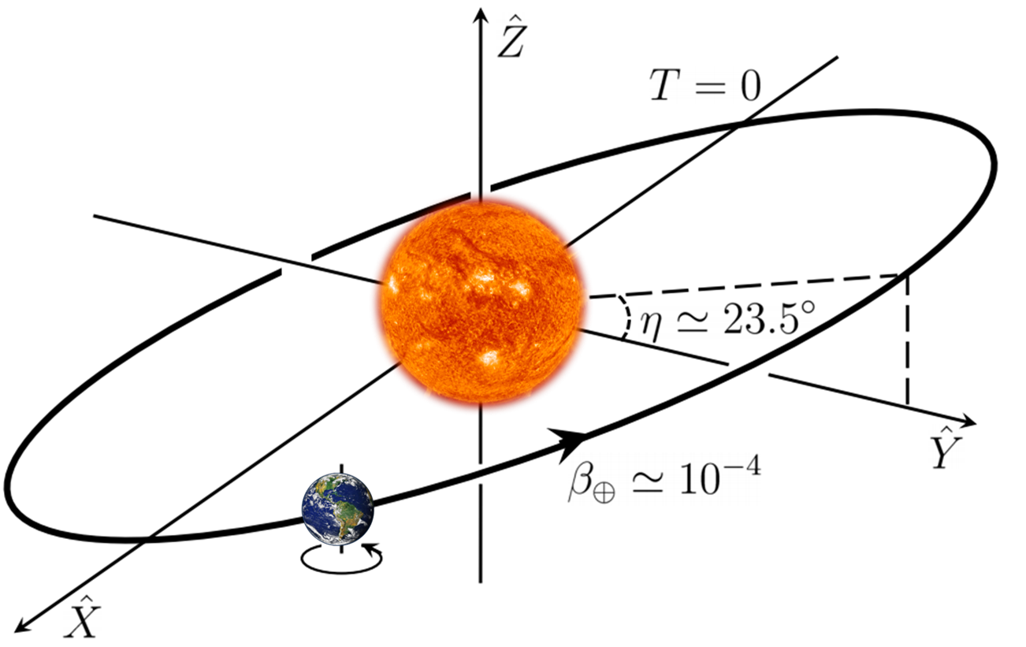
Atomic spectroscopy
$nS_{1/2}$ atomic state of hydrogen in the hyperfine-Zeeman regime
conventional case
$$ε=ε_{0}+δε$$
Lorentz-violating contribution
energy of the atomic state
$$δε≃S+\vec{β}∙\vec{V}+\frac{m_{F}}{B}\left( \vec{B}∙\vec{A}+B^{I}T_{IK}β^{K}\right)$$
$\vec{β}$ velocity of the laboratory
$\vec{B}$ applied magnetic field

Slide 29
Atomic spectroscopy
$nS_{1/2}$ atomic state of hydrogen in the hyperfine-Zeeman regime
conventional case
$$ε=ε_{0}+δε$$
Lorentz-violating contribution
energy of the atomic state
$$δε≃S+\vec{β}∙\vec{V}+\frac{m_{F}}{B}\left( \vec{B}∙\vec{A}+B^{I}T_{IK}β^{K}\right)$$
$\vec{β}$ velocity of the laboratory
$\vec{B}$ applied magnetic field

Slide 30
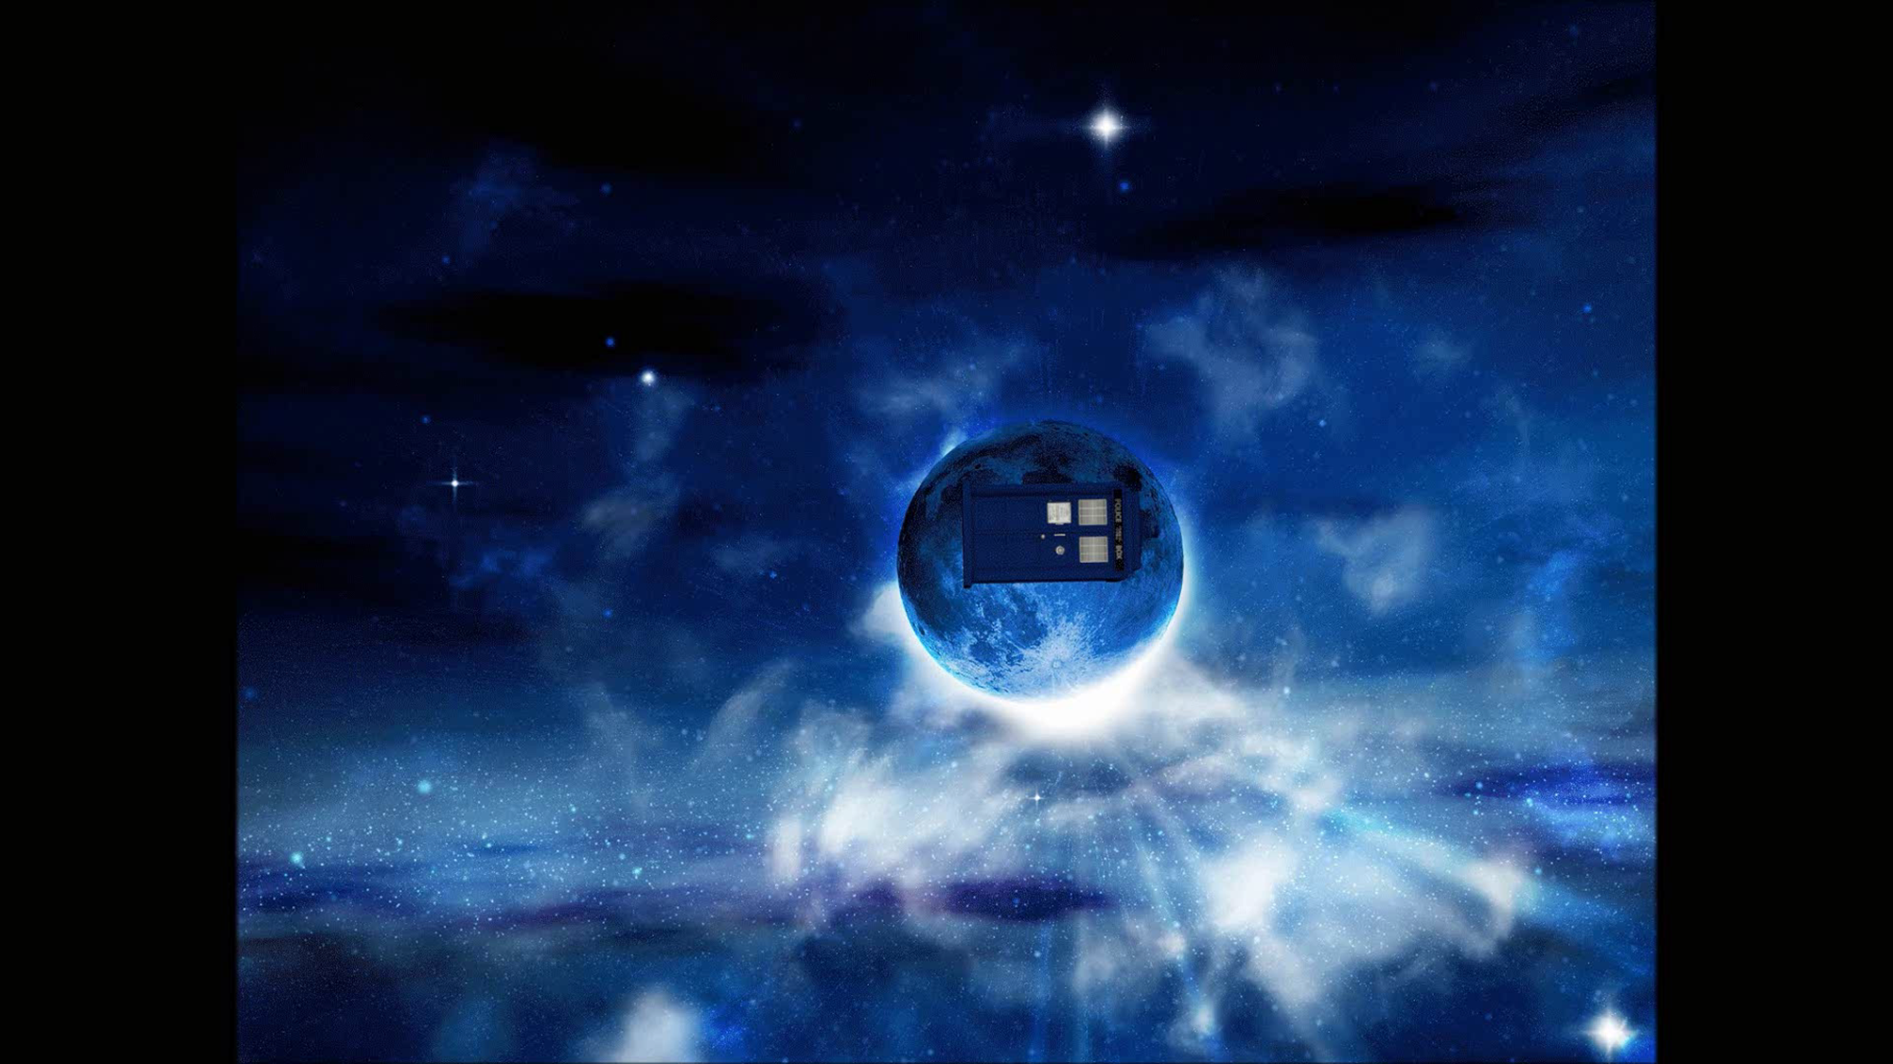
T.A.R.D.I.S.

Slide 32
Lab Frame
$$ν$$
B field
Orientation
Lorentz invariance
The frequency $ν$ is independent of the orientation
Fixed frame

Slide 33
Lab Frame
$$ν$$
B field
Orientation
$$δν=\frac{{∆m}_{F}}{B}\vec{A}∙\vec{B}$$
Fixed frame

Slide 34
$$δν=\frac{{∆m}_{F}}{B}\vec{A}∙\vec{B}$$

Slide 35
Atomic spectroscopy
$nS_{1/2}$ atomic state of hydrogen in the hyperfine-Zeeman regime
conventional case
$$ε=ε_{0}+δε$$
Lorentz-violating contribution
energy of the atomic state
$$δε≃S+\vec{β}∙\vec{V}+\frac{m_{F}}{B}\left( \vec{B}∙\vec{A}+B^{I}T_{IK}β^{K}\right)$$
$\vec{β}$ velocity of the laboratory
$\vec{B}$ applied magnetic field

Slide 36
Orbital velocity of the Earth
Lorentz-violating field
frequency
Annual variation
of the frequency
time

Slide 37
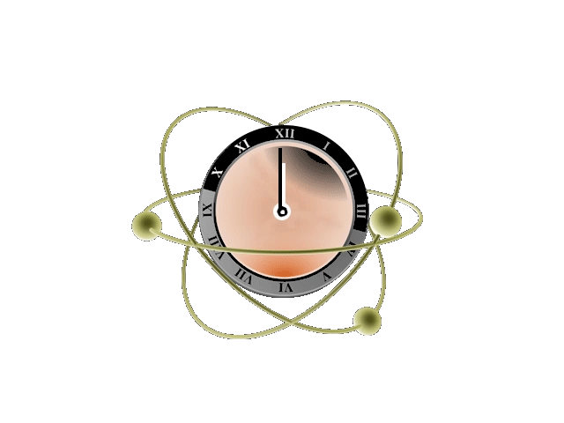
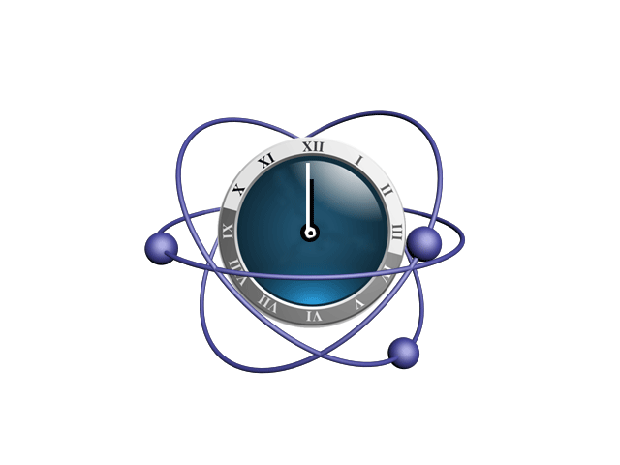
The SME allows clocks and anti-clocks to tick at different rates
Lorentz-violating energy shift for hydrogen
$$δε≃S+\vec{β}∙\vec{V}+\frac{m_{F}}{B}\left( \vec{B}∙\vec{A}+B^{I}T_{IK}β^{K}\right)$$
$$S\left(n\right)=…{\left(\frac{αm_{r}}{n}\right)}^{2}\left(c_{200}^{NR}−a_{200}^{NR}\right)…$$
Coefficients for CPT violation
Coefficients of CPT invariant operators
Lorentz-violating energy shift for antihydrogen
overbars
$$δε≃\overline{S}+\vec{β}∙\vec{\overline{V}}+\frac{m_{F}}{B}\left( \vec{B}∙\vec{\overline{A}}+B^{I}{\overline{T}}_{IK}β^{K}\right)$$
overbars
$$\overline{S}\left(n\right)=…{\left(\frac{αm_{r}}{n}\right)}^{2}\left(c_{200}^{NR}+a_{200}^{NR}\right)…$$

Slide 38
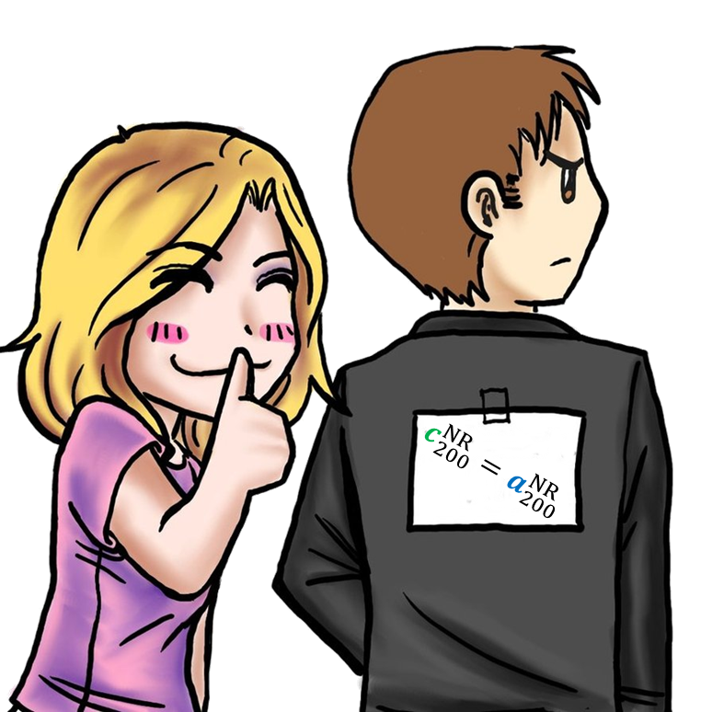
The SME allows clocks and anti-clocks to tick at different rates
Lorentz-violating energy shift for hydrogen
$$δε≃S+\vec{β}∙\vec{V}+\frac{m_{F}}{B}\left( \vec{B}∙\vec{A}+B^{I}T_{IK}β^{K}\right)$$
$$S\left(n\right)=…{\left(\frac{αm_{r}}{n}\right)}^{2}\left(c_{200}^{NR}−a_{200}^{NR}\right)…$$
Coefficients for CPT violation
Coefficients of CPT invariant operators
Lorentz-violating energy shift for antihydrogen
overbars
$$δε≃\overline{S}+\vec{β}∙\vec{\overline{V}}+\frac{m_{F}}{B}\left( \vec{B}∙\vec{\overline{A}}+B^{I}{\overline{T}}_{IK}β^{K}\right)$$
overbars
$$\overline{S}\left(n\right)=…{\left(\frac{αm_{r}}{n}\right)}^{2}\left(c_{200}^{NR}+a_{200}^{NR}\right)…$$

Slide 39
The SME allows ordinary clocks and muonic clocks to tick at different rates
Lorentz-violating energy shift for hydrogen
$$δε≃S+\vec{β}∙\vec{V}+\frac{m_{F}}{B}\left( \vec{B}∙\vec{A}+B^{I}T_{IK}β^{K}\right)$$
$$S\left(n\right)=…{\left(\frac{αm_{r}}{n}\right)}^{2}\left({c_{e}}_{200}^{NR}−{a_{e}}_{200}^{NR}+{c_{p}}_{200}^{NR}−{a_{p}}_{200}^{NR}\right)…$$
Coefficients for CPT violation
Coefficients of CPT invariant operators
Lorentz-violating energy shift for muonium
overbars
$$δε≃S_{μ}+\vec{β}∙{\vec{\overline{V}}}_{μ}+\frac{m_{F}}{B}\left( \vec{B}∙{\vec{\overline{A}}}_{μ}+B^{I}{{\overline{T}}_{μ}}_{IK}β^{K}\right)$$
overbars
$$S_{μ}\left(n\right)=…{\left(\frac{αm_{r}}{n}\right)}^{2}\left({c_{e}}_{200}^{NR}−{a_{e}}_{200}^{NR}+{c_{μ}}_{200}^{NR}+{a_{μ}}_{200}^{NR}\right)…$$

Slide 40
Coefficients affecting the atomic spectrum in the laboratory frame
$$H_{010}^{NR(0B)}$$ | $$H_{010}^{NR(1B)}$$ | $$g_{010}^{NR(0B)}$$ | $$g_{010}^{NR(1B)}$$ | $$a_{000}^{NR}$$ | $$c_{000}^{NR}$$ | $$H_{450}^{NR(0B)}$$ | $$H_{450}^{NR(1B)}$$ | $$g_{450}^{NR(0B)}$$ | $$g_{450}^{NR(1B)}$$
$$H_{011}^{NR(0B)}$$ | $$H_{011}^{NR(1B)}$$ | $$g_{011}^{NR(0B)}$$ | $$g_{011}^{NR(1B)}$$ | $$a_{200}^{NR}$$ | $$c_{200}^{NR}$$ | $$H_{451}^{NR(0B)}$$ | $$H_{451}^{NR(1B)}$$ | $$g_{451}^{NR(0B)}$$ | $$g_{451}^{NR(1B)}$$
$$H_{210}^{NR(0B)}$$ | $$H_{210}^{NR(1B)}$$ | $$g_{210}^{NR(0B)}$$ | $$g_{210}^{NR(1B)}$$ | $$a_{400}^{NR}$$ | $$c_{400}^{NR}$$ | $$H_{452}^{NR(0B)}$$ | $$H_{452}^{NR(1B)}$$ | $$g_{452}^{NR(0B)}$$ | $$g_{452}^{NR(1B)}$$
$$H_{211}^{NR(0B)}$$ | $$H_{211}^{NR(1B)}$$ | $$g_{211}^{NR(0B)}$$ | $$g_{211}^{NR(1B)}$$ | $$a_{220}^{NR}$$ | $$c_{220}^{NR}$$ | $$H_{453}^{NR(0B)}$$ | $$H_{453}^{NR(1B)}$$ | $$g_{453}^{NR(0B)}$$ | $$g_{453}^{NR(1B)}$$
$$H_{410}^{NR(0B)}$$ | $$H_{410}^{NR(1B)}$$ | $$g_{410}^{NR(0B)}$$ | $$g_{410}^{NR(1B)}$$ | $$a_{221}^{NR}$$ | $$c_{221}^{NR}$$ | $$H_{454}^{NR(0B)}$$ | $$H_{454}^{NR(1B)}$$ | $$g_{454}^{NR(0B)}$$ | $$g_{454}^{NR(1B)}$$
$$H_{411}^{NR(0B)}$$ | $$H_{411}^{NR(1B)}$$ | $$g_{411}^{NR(0B)}$$ | $$g_{411}^{NR(1B)}$$ | $$a_{222}^{NR}$$ | $$c_{222}^{NR}$$ | $$H_{455}^{NR(0B)}$$ | $$H_{455}^{NR(1B)}$$ | $$g_{455}^{NR(0B)}$$ | $$g_{455}^{NR(1B)}$$
$$H_{230}^{NR(0B)}$$ | $$H_{230}^{NR(1B)}$$ | $$g_{230}^{NR(0B)}$$ | $$g_{230}^{NR(1B)}$$ | $$a_{420}^{NR}$$ | $$c_{420}^{NR}$$
$$H_{231}^{NR(0B)}$$ | $$H_{231}^{NR(1B)}$$ | $$g_{231}^{NR(0B)}$$ | $$g_{231}^{NR(1B)}$$ | $$a_{421}^{NR}$$ | $$c_{421}^{NR}$$
$$H_{232}^{NR(0B)}$$ | $$H_{232}^{NR(1B)}$$ | $$g_{232}^{NR(0B)}$$ | $$g_{232}^{NR(1B)}$$ | $$a_{422}^{NR}$$ | $$c_{422}^{NR}$$
$$H_{233}^{NR(0B)}$$ | $$H_{233}^{NR(1B)}$$ | $$g_{232}^{NR(0B)}$$ | $$g_{233}^{NR(1B)}$$ | $$a_{440}^{NR}$$ | $$c_{440}^{NR}$$
$$H_{430}^{NR(0B)}$$ | $$H_{430}^{NR(1B)}$$ | $$g_{430}^{NR(0B)}$$ | $$g_{430}^{NR(1B)}$$ | $$a_{441}^{NR}$$ | $$c_{441}^{NR}$$
$$H_{431}^{NR(0B)}$$ | $$H_{431}^{NR(1B)}$$ | $$g_{431}^{NR(0B)}$$ | $$g_{431}^{NR(1B)}$$ | $$a_{442}^{NR}$$ | $$c_{442}^{NR}$$
$$H_{432}^{NR(0B)}$$ | $$H_{432}^{NR(1B)}$$ | $$g_{432}^{NR(0B)}$$ | $$g_{432}^{NR(1B)}$$ | $$a_{443}^{NR}$$ | $$c_{443}^{NR}$$
$$H_{433}^{NR(0B)}$$ | $$H_{433}^{NR(1B)}$$ | $$g_{433}^{NR(0B)}$$ | $$g_{433}^{NR(1B)}$$ | $$a_{444}^{NR}$$ | $$c_{444}^{NR}$$
Notes:
Block coeff cases

Slide 41
Coefficients affecting the atomic spectrum in the laboratory frame
$$H_{010}^{NR(0B)}$$ | $$H_{010}^{NR(1B)}$$ | $$g_{010}^{NR(0B)}$$ | $$g_{010}^{NR(1B)}$$ | $$a_{000}^{NR}$$ | $$c_{000}^{NR}$$ | $$H_{450}^{NR(0B)}$$ | $$H_{450}^{NR(1B)}$$ | $$g_{450}^{NR(0B)}$$ | $$g_{450}^{NR(1B)}$$
$$H_{011}^{NR(0B)}$$ | $$H_{011}^{NR(1B)}$$ | $$g_{011}^{NR(0B)}$$ | $$g_{011}^{NR(1B)}$$ | $$a_{200}^{NR}$$ | $$c_{200}^{NR}$$ | $$H_{451}^{NR(0B)}$$ | $$H_{451}^{NR(1B)}$$ | $$g_{451}^{NR(0B)}$$ | $$g_{451}^{NR(1B)}$$
$$H_{210}^{NR(0B)}$$ | $$H_{210}^{NR(1B)}$$ | $$g_{210}^{NR(0B)}$$ | $$g_{210}^{NR(1B)}$$ | $$a_{400}^{NR}$$ | $$c_{400}^{NR}$$ | $$H_{452}^{NR(0B)}$$ | $$H_{452}^{NR(1B)}$$ | $$g_{452}^{NR(0B)}$$ | $$g_{452}^{NR(1B)}$$
$$H_{211}^{NR(0B)}$$ | $$H_{211}^{NR(1B)}$$ | $$g_{211}^{NR(0B)}$$ | $$g_{211}^{NR(1B)}$$ | $$a_{220}^{NR}$$ | $$c_{220}^{NR}$$ | $$H_{453}^{NR(0B)}$$ | $$H_{453}^{NR(1B)}$$ | $$g_{453}^{NR(0B)}$$ | $$g_{453}^{NR(1B)}$$
$$H_{410}^{NR(0B)}$$ | $$H_{410}^{NR(1B)}$$ | $$g_{410}^{NR(0B)}$$ | $$g_{410}^{NR(1B)}$$ | $$a_{221}^{NR}$$ | $$c_{221}^{NR}$$ | $$H_{454}^{NR(0B)}$$ | $$H_{454}^{NR(1B)}$$ | $$g_{454}^{NR(0B)}$$ | $$g_{454}^{NR(1B)}$$
$$H_{411}^{NR(0B)}$$ | $$H_{411}^{NR(1B)}$$ | $$g_{411}^{NR(0B)}$$ | $$g_{411}^{NR(1B)}$$ | $$a_{222}^{NR}$$ | $$c_{222}^{NR}$$ | $$H_{455}^{NR(0B)}$$ | $$H_{455}^{NR(1B)}$$ | $$g_{455}^{NR(0B)}$$ | $$g_{455}^{NR(1B)}$$
$$H_{230}^{NR(0B)}$$ | $$H_{230}^{NR(1B)}$$ | $$g_{230}^{NR(0B)}$$ | $$g_{230}^{NR(1B)}$$ | $$a_{420}^{NR}$$ | $$c_{420}^{NR}$$
$$H_{231}^{NR(0B)}$$ | $$H_{231}^{NR(1B)}$$ | $$g_{231}^{NR(0B)}$$ | $$g_{231}^{NR(1B)}$$ | $$a_{421}^{NR}$$ | $$c_{421}^{NR}$$
$$H_{232}^{NR(0B)}$$ | $$H_{232}^{NR(1B)}$$ | $$g_{232}^{NR(0B)}$$ | $$g_{232}^{NR(1B)}$$ | $$a_{422}^{NR}$$ | $$c_{422}^{NR}$$
$$H_{233}^{NR(0B)}$$ | $$H_{233}^{NR(1B)}$$ | $$g_{232}^{NR(0B)}$$ | $$g_{233}^{NR(1B)}$$ | $$a_{440}^{NR}$$ | $$c_{440}^{NR}$$
$$H_{430}^{NR(0B)}$$ | $$H_{430}^{NR(1B)}$$ | $$g_{430}^{NR(0B)}$$ | $$g_{430}^{NR(1B)}$$ | $$a_{441}^{NR}$$ | $$c_{441}^{NR}$$
$$H_{431}^{NR(0B)}$$ | $$H_{431}^{NR(1B)}$$ | $$g_{431}^{NR(0B)}$$ | $$g_{431}^{NR(1B)}$$ | $$a_{442}^{NR}$$ | $$c_{442}^{NR}$$
$$H_{432}^{NR(0B)}$$ | $$H_{432}^{NR(1B)}$$ | $$g_{432}^{NR(0B)}$$ | $$g_{432}^{NR(1B)}$$ | $$a_{443}^{NR}$$ | $$c_{443}^{NR}$$
$$H_{433}^{NR(0B)}$$ | $$H_{433}^{NR(1B)}$$ | $$g_{433}^{NR(0B)}$$ | $$g_{433}^{NR(1B)}$$ | $$a_{444}^{NR}$$ | $$c_{444}^{NR}$$
Hyperfine trans. of the ground state
Notes:
Block coeff cases

Slide 42
Coefficients affecting the atomic spectrum in the laboratory frame
$$H_{010}^{NR(0B)}$$ | $$H_{010}^{NR(1B)}$$ | $$g_{010}^{NR(0B)}$$ | $$g_{010}^{NR(1B)}$$
$$H_{011}^{NR(0B)}$$ | $$H_{011}^{NR(1B)}$$ | $$g_{011}^{NR(0B)}$$ | $$g_{011}^{NR(1B)}$$
$$H_{210}^{NR(0B)}$$ | $$H_{210}^{NR(1B)}$$ | $$g_{210}^{NR(0B)}$$ | $$g_{210}^{NR(1B)}$$
$$H_{211}^{NR(0B)}$$ | $$H_{211}^{NR(1B)}$$ | $$g_{211}^{NR(0B)}$$ | $$g_{211}^{NR(1B)}$$
$$H_{410}^{NR(0B)}$$ | $$H_{410}^{NR(1B)}$$ | $$g_{410}^{NR(0B)}$$ | $$g_{410}^{NR(1B)}$$
$$H_{411}^{NR(0B)}$$ | $$H_{411}^{NR(1B)}$$ | $$g_{411}^{NR(0B)}$$ | $$g_{411}^{NR(1B)}$$
Hyperfine trans. of the ground state
Theory vs. experiment
1st harmonic sidereal frequency
$$δν≃\frac{Δm_{F}}{B}\left( \vec{B}∙\vec{A}+B^{I}T_{IK}β^{K}\right)$$
1st & 2nd harmonic sidereal frequency
Annual variation
Notes:
Block coeff cases

Slide 43
Coefficients affecting the atomic spectrum in the laboratory frame
$$H_{010}^{NR(0B)}$$ | $$H_{010}^{NR(1B)}$$ | $$g_{010}^{NR(0B)}$$ | $$g_{010}^{NR(1B)}$$
$$H_{011}^{NR(0B)}$$ | $$H_{011}^{NR(1B)}$$ | $$g_{011}^{NR(0B)}$$ | $$g_{011}^{NR(1B)}$$
$$H_{210}^{NR(0B)}$$ | $$H_{210}^{NR(1B)}$$ | $$g_{210}^{NR(0B)}$$ | $$g_{210}^{NR(1B)}$$
$$H_{211}^{NR(0B)}$$ | $$H_{211}^{NR(1B)}$$ | $$g_{211}^{NR(0B)}$$ | $$g_{211}^{NR(1B)}$$
$$H_{410}^{NR(0B)}$$ | $$H_{410}^{NR(1B)}$$ | $$g_{410}^{NR(0B)}$$ | $$g_{410}^{NR(1B)}$$
$$H_{411}^{NR(0B)}$$ | $$H_{411}^{NR(1B)}$$ | $$g_{411}^{NR(0B)}$$ | $$g_{411}^{NR(1B)}$$
Hyperfine trans. of the ground state
Theory vs. experiment
1st harmonic sidereal frequency
$$δν≃\frac{Δm_{F}}{B}\left( \vec{B}∙{\vec{A}}_{μ}+B^{I}{T_{μ}}_{IK}β^{K}\right)$$
Hughes et al., PRL 87, 111804 (2001)
Sideral variation study with muonium
Muonic Lorentz violation
1st & 2nd harmonic sidereal frequency
Annual variation
MuSEUM (Ueno, Today) could improve bounds and new signals
Notes:
Block coeff cases

Slide 44
Coefficients affecting the atomic spectrum in the laboratory frame
 |  | $$g_{010}^{NR(0B)}$$ | $$g_{010}^{NR(1B)}$$
 |  | $$g_{011}^{NR(0B)}$$ | $$g_{011}^{NR(1B)}$$
 |  | $$g_{210}^{NR(0B)}$$ | $$g_{210}^{NR(1B)}$$
 |  | $$g_{211}^{NR(0B)}$$ | $$g_{211}^{NR(1B)}$$
 |  | $$g_{410}^{NR(0B)}$$ | $$g_{410}^{NR(1B)}$$
 |  | $$g_{411}^{NR(0B)}$$ | $$g_{411}^{NR(1B)}$$
Hyperfine trans. of the ground state
Coefficients for CPT violation
1st harmonic sidereal frequency
$H$ vs. $\overline{H}$
$$δν≃\frac{Δm_{F}}{B}\left( \vec{B}∙\vec{\overline{A}}+B^{I}{\overline{T}}_{IK}β^{K}\right)$$
ASACUSA (Kuroda, Today) and ALPHA (Friesen, Tue.) can search for these signals in the future
1st & 2nd harmonic sidereal frequency
Annual variation
Testing CPT symmetry is more than comparing hydrogen with antihydrogen
Notes:
Block coeff cases

Slide 45
Coefficients affecting the atomic spectrum in the laboratory frame
$$H_{010}^{NR(0B)}$$ | $$H_{010}^{NR(1B)}$$ | $$g_{010}^{NR(0B)}$$ | $$g_{010}^{NR(1B)}$$ | $$a_{000}^{NR}$$ | $$c_{000}^{NR}$$ | $$H_{450}^{NR(0B)}$$ | $$H_{450}^{NR(1B)}$$ | $$g_{450}^{NR(0B)}$$ | $$g_{450}^{NR(1B)}$$
$$H_{011}^{NR(0B)}$$ | $$H_{011}^{NR(1B)}$$ | $$g_{011}^{NR(0B)}$$ | $$g_{011}^{NR(1B)}$$ | $$a_{200}^{NR}$$ | $$c_{200}^{NR}$$ | $$H_{451}^{NR(0B)}$$ | $$H_{451}^{NR(1B)}$$ | $$g_{451}^{NR(0B)}$$ | $$g_{451}^{NR(1B)}$$
$$H_{210}^{NR(0B)}$$ | $$H_{210}^{NR(1B)}$$ | $$g_{210}^{NR(0B)}$$ | $$g_{210}^{NR(1B)}$$ | $$a_{400}^{NR}$$ | $$c_{400}^{NR}$$ | $$H_{452}^{NR(0B)}$$ | $$H_{452}^{NR(1B)}$$ | $$g_{452}^{NR(0B)}$$ | $$g_{452}^{NR(1B)}$$
$$H_{211}^{NR(0B)}$$ | $$H_{211}^{NR(1B)}$$ | $$g_{211}^{NR(0B)}$$ | $$g_{211}^{NR(1B)}$$ | $$a_{220}^{NR}$$ | $$c_{220}^{NR}$$ | $$H_{453}^{NR(0B)}$$ | $$H_{453}^{NR(1B)}$$ | $$g_{453}^{NR(0B)}$$ | $$g_{453}^{NR(1B)}$$
$$H_{410}^{NR(0B)}$$ | $$H_{410}^{NR(1B)}$$ | $$g_{410}^{NR(0B)}$$ | $$g_{410}^{NR(1B)}$$ | $$a_{221}^{NR}$$ | $$c_{221}^{NR}$$ | $$H_{454}^{NR(0B)}$$ | $$H_{454}^{NR(1B)}$$ | $$g_{454}^{NR(0B)}$$ | $$g_{454}^{NR(1B)}$$
$$H_{411}^{NR(0B)}$$ | $$H_{411}^{NR(1B)}$$ | $$g_{411}^{NR(0B)}$$ | $$g_{411}^{NR(1B)}$$ | $$a_{222}^{NR}$$ | $$c_{222}^{NR}$$ | $$H_{455}^{NR(0B)}$$ | $$H_{455}^{NR(1B)}$$ | $$g_{455}^{NR(0B)}$$ | $$g_{455}^{NR(1B)}$$
$$H_{230}^{NR(0B)}$$ | $$H_{230}^{NR(1B)}$$ | $$g_{230}^{NR(0B)}$$ | $$g_{230}^{NR(1B)}$$ | $$a_{420}^{NR}$$ | $$c_{420}^{NR}$$
$$H_{231}^{NR(0B)}$$ | $$H_{231}^{NR(1B)}$$ | $$g_{231}^{NR(0B)}$$ | $$g_{231}^{NR(1B)}$$ | $$a_{421}^{NR}$$ | $$c_{421}^{NR}$$
$$H_{232}^{NR(0B)}$$ | $$H_{232}^{NR(1B)}$$ | $$g_{232}^{NR(0B)}$$ | $$g_{232}^{NR(1B)}$$ | $$a_{422}^{NR}$$ | $$c_{422}^{NR}$$
$$H_{233}^{NR(0B)}$$ | $$H_{233}^{NR(1B)}$$ | $$g_{232}^{NR(0B)}$$ | $$g_{233}^{NR(1B)}$$ | $$a_{440}^{NR}$$ | $$c_{440}^{NR}$$
$$H_{430}^{NR(0B)}$$ | $$H_{430}^{NR(1B)}$$ | $$g_{430}^{NR(0B)}$$ | $$g_{430}^{NR(1B)}$$ | $$a_{441}^{NR}$$ | $$c_{441}^{NR}$$
$$H_{431}^{NR(0B)}$$ | $$H_{431}^{NR(1B)}$$ | $$g_{431}^{NR(0B)}$$ | $$g_{431}^{NR(1B)}$$ | $$a_{442}^{NR}$$ | $$c_{442}^{NR}$$
$$H_{432}^{NR(0B)}$$ | $$H_{432}^{NR(1B)}$$ | $$g_{432}^{NR(0B)}$$ | $$g_{432}^{NR(1B)}$$ | $$a_{443}^{NR}$$ | $$c_{443}^{NR}$$
$$H_{433}^{NR(0B)}$$ | $$H_{433}^{NR(1B)}$$ | $$g_{433}^{NR(0B)}$$ | $$g_{433}^{NR(1B)}$$ | $$a_{444}^{NR}$$ | $$c_{444}^{NR}$$
Hyperfine trans. of the ground state
1S-2S transition
Notes:
Block coeff cases

Slide 46
Coefficients affecting the atomic spectrum in the laboratory frame
 |  |  |  | $$a_{200}^{NR}$$ | $$c_{200}^{NR}$$
 |  |  |  | $$a_{400}^{NR}$$ | $$c_{400}^{NR}$$
1S-2S transition
Theory vs. experiment comparison
$$δν≃∆S+\vec{β}∙∆\vec{V}$$
1st harmonic sidereal frequency
Annual variation
Notes:
Block coeff cases

Slide 47
Coefficients affecting the atomic spectrum in the laboratory frame
 |  |  |  | $$a_{200}^{NR}$$ | $$c_{200}^{NR}$$
 |  |  |  | $$a_{400}^{NR}$$ | $$c_{400}^{NR}$$
1S-2S transition
Theory vs. experiment comparison
$$δν≃∆S_{μ}+\vec{β}∙∆{\vec{V}}_{μ}$$
1st harmonic sidereal frequency
Annual variation
Muon coefficients
$$c_{220}^{NR}+a_{220}^{NR}∼{10}^{−7} {GeV}^{−1}$$
Gomes, Kostelecký and AJV, PRD 90, 076009 (2014)
Annual variation study of 1S-2S muonium (proposed as a gravity antimatter test)
Kirch et. al., IJMPCS 30, 1460258 (2014)
Notes:
Block coeff cases

Slide 48
Coefficients affecting the atomic spectrum in the laboratory frame
 |  |  |  | $$a_{200}^{NR}$$ | $$c_{200}^{NR}$$
 |  |  |  | $$a_{400}^{NR}$$ | $$c_{400}^{NR}$$
1S-2S transition
$H$ vs. $\overline{H}$
$$δν≃∆\overline{S}+\vec{β}∙∆\vec{\overline{V}}$$
1st harmonic sidereal frequency
Annual variation
Theory vs. experiment
Antihydrogen ( $∼$100 $kHz$)
Positronium
$$a_{220}^{NR}∼{10}^{−7} {GeV}^{−1}$$
$c_{220}^{NR}∼{10}^{−6} {GeV}^{−1}$
Ahmadi et. al., nature 541, 506 (2017)
Kostelecký and AJV, PRD 92, 056002 (2015).
Annual variation study of 1S-2S positronium¹ (proposed as a gravity antimatter test)
Crivelli et. al., IJMPCS 30, 1460257 (2014)
Notes:
Block coeff cases

Slide 49
Coefficients affecting the atomic spectrum in the laboratory frame
$$H_{010}^{NR(0B)}$$ | $$H_{010}^{NR(1B)}$$ | $$g_{010}^{NR(0B)}$$ | $$g_{010}^{NR(1B)}$$ | $$a_{000}^{NR}$$ | $$c_{000}^{NR}$$ | $$H_{450}^{NR(0B)}$$ | $$H_{450}^{NR(1B)}$$ | $$g_{450}^{NR(0B)}$$ | $$g_{450}^{NR(1B)}$$
$$H_{011}^{NR(0B)}$$ | $$H_{011}^{NR(1B)}$$ | $$g_{011}^{NR(0B)}$$ | $$g_{011}^{NR(1B)}$$ | $$a_{200}^{NR}$$ | $$c_{200}^{NR}$$ | $$H_{451}^{NR(0B)}$$ | $$H_{451}^{NR(1B)}$$ | $$g_{451}^{NR(0B)}$$ | $$g_{451}^{NR(1B)}$$
$$H_{210}^{NR(0B)}$$ | $$H_{210}^{NR(1B)}$$ | $$g_{210}^{NR(0B)}$$ | $$g_{210}^{NR(1B)}$$ | $$a_{400}^{NR}$$ | $$c_{400}^{NR}$$ | $$H_{452}^{NR(0B)}$$ | $$H_{452}^{NR(1B)}$$ | $$g_{452}^{NR(0B)}$$ | $$g_{452}^{NR(1B)}$$
$$H_{211}^{NR(0B)}$$ | $$H_{211}^{NR(1B)}$$ | $$g_{211}^{NR(0B)}$$ | $$g_{211}^{NR(1B)}$$ | $$a_{220}^{NR}$$ | $$c_{220}^{NR}$$ | $$H_{453}^{NR(0B)}$$ | $$H_{453}^{NR(1B)}$$ | $$g_{453}^{NR(0B)}$$ | $$g_{453}^{NR(1B)}$$
$$H_{410}^{NR(0B)}$$ | $$H_{410}^{NR(1B)}$$ | $$g_{410}^{NR(0B)}$$ | $$g_{410}^{NR(1B)}$$ | $$a_{221}^{NR}$$ | $$c_{221}^{NR}$$ | $$H_{454}^{NR(0B)}$$ | $$H_{454}^{NR(1B)}$$ | $$g_{454}^{NR(0B)}$$ | $$g_{454}^{NR(1B)}$$
$$H_{411}^{NR(0B)}$$ | $$H_{411}^{NR(1B)}$$ | $$g_{411}^{NR(0B)}$$ | $$g_{411}^{NR(1B)}$$ | $$a_{222}^{NR}$$ | $$c_{222}^{NR}$$ | $$H_{455}^{NR(0B)}$$ | $$H_{455}^{NR(1B)}$$ | $$g_{455}^{NR(0B)}$$ | $$g_{455}^{NR(1B)}$$
$$H_{230}^{NR(0B)}$$ | $$H_{230}^{NR(1B)}$$ | $$g_{230}^{NR(0B)}$$ | $$g_{230}^{NR(1B)}$$ | $$a_{420}^{NR}$$ | $$c_{420}^{NR}$$
$$H_{231}^{NR(0B)}$$ | $$H_{231}^{NR(1B)}$$ | $$g_{231}^{NR(0B)}$$ | $$g_{231}^{NR(1B)}$$ | $$a_{421}^{NR}$$ | $$c_{421}^{NR}$$
$$H_{232}^{NR(0B)}$$ | $$H_{232}^{NR(1B)}$$ | $$g_{232}^{NR(0B)}$$ | $$g_{232}^{NR(1B)}$$ | $$a_{422}^{NR}$$ | $$c_{422}^{NR}$$
$$H_{233}^{NR(0B)}$$ | $$H_{233}^{NR(1B)}$$ | $$g_{232}^{NR(0B)}$$ | $$g_{233}^{NR(1B)}$$ | $$a_{440}^{NR}$$ | $$c_{440}^{NR}$$
$$H_{430}^{NR(0B)}$$ | $$H_{430}^{NR(1B)}$$ | $$g_{430}^{NR(0B)}$$ | $$g_{430}^{NR(1B)}$$ | $$a_{441}^{NR}$$ | $$c_{441}^{NR}$$
$$H_{431}^{NR(0B)}$$ | $$H_{431}^{NR(1B)}$$ | $$g_{431}^{NR(0B)}$$ | $$g_{431}^{NR(1B)}$$ | $$a_{442}^{NR}$$ | $$c_{442}^{NR}$$
$$H_{432}^{NR(0B)}$$ | $$H_{432}^{NR(1B)}$$ | $$g_{432}^{NR(0B)}$$ | $$g_{432}^{NR(1B)}$$ | $$a_{443}^{NR}$$ | $$c_{443}^{NR}$$
$$H_{433}^{NR(0B)}$$ | $$H_{433}^{NR(1B)}$$ | $$g_{433}^{NR(0B)}$$ | $$g_{433}^{NR(1B)}$$ | $$a_{444}^{NR}$$ | $$c_{444}^{NR}$$
Hyperfine trans. of the ground state
1S-2S transition
Notes:
Block coeff cases

Slide 50
Coefficients affecting the atomic spectrum in the laboratory frame
$$H_{010}^{NR(0B)}$$ | $$H_{010}^{NR(1B)}$$ | $$g_{010}^{NR(0B)}$$ | $$g_{010}^{NR(1B)}$$ | $$a_{000}^{NR}$$ | $$c_{000}^{NR}$$ | $$H_{450}^{NR(0B)}$$ | $$H_{450}^{NR(1B)}$$ | $$g_{450}^{NR(0B)}$$ | $$g_{450}^{NR(1B)}$$
$$H_{011}^{NR(0B)}$$ | $$H_{011}^{NR(1B)}$$ | $$g_{011}^{NR(0B)}$$ | $$g_{011}^{NR(1B)}$$ | $$a_{200}^{NR}$$ | $$c_{200}^{NR}$$ | $$H_{451}^{NR(0B)}$$ | $$H_{451}^{NR(1B)}$$ | $$g_{451}^{NR(0B)}$$ | $$g_{451}^{NR(1B)}$$
$$H_{210}^{NR(0B)}$$ | $$H_{210}^{NR(1B)}$$ | $$g_{210}^{NR(0B)}$$ | $$g_{210}^{NR(1B)}$$ | $$a_{400}^{NR}$$ | $$c_{400}^{NR}$$ | $$H_{452}^{NR(0B)}$$ | $$H_{452}^{NR(1B)}$$ | $$g_{452}^{NR(0B)}$$ | $$g_{452}^{NR(1B)}$$
$$H_{211}^{NR(0B)}$$ | $$H_{211}^{NR(1B)}$$ | $$g_{211}^{NR(0B)}$$ | $$g_{211}^{NR(1B)}$$ | $$a_{220}^{NR}$$ | $$c_{220}^{NR}$$ | $$H_{453}^{NR(0B)}$$ | $$H_{453}^{NR(1B)}$$ | $$g_{453}^{NR(0B)}$$ | $$g_{453}^{NR(1B)}$$
$$H_{410}^{NR(0B)}$$ | $$H_{410}^{NR(1B)}$$ | $$g_{410}^{NR(0B)}$$ | $$g_{410}^{NR(1B)}$$ | $$a_{221}^{NR}$$ | $$c_{221}^{NR}$$ | $$H_{454}^{NR(0B)}$$ | $$H_{454}^{NR(1B)}$$ | $$g_{454}^{NR(0B)}$$ | $$g_{454}^{NR(1B)}$$
$$H_{411}^{NR(0B)}$$ | $$H_{411}^{NR(1B)}$$ | $$g_{411}^{NR(0B)}$$ | $$g_{411}^{NR(1B)}$$ | $$a_{222}^{NR}$$ | $$c_{222}^{NR}$$ | $$H_{455}^{NR(0B)}$$ | $$H_{455}^{NR(1B)}$$ | $$g_{455}^{NR(0B)}$$ | $$g_{455}^{NR(1B)}$$
$$H_{230}^{NR(0B)}$$ | $$H_{230}^{NR(1B)}$$ | $$g_{230}^{NR(0B)}$$ | $$g_{230}^{NR(1B)}$$ | $$a_{420}^{NR}$$ | $$c_{420}^{NR}$$
$$H_{231}^{NR(0B)}$$ | $$H_{231}^{NR(1B)}$$ | $$g_{231}^{NR(0B)}$$ | $$g_{231}^{NR(1B)}$$ | $$a_{421}^{NR}$$ | $$c_{421}^{NR}$$
$$H_{232}^{NR(0B)}$$ | $$H_{232}^{NR(1B)}$$ | $$g_{232}^{NR(0B)}$$ | $$g_{232}^{NR(1B)}$$ | $$a_{422}^{NR}$$ | $$c_{422}^{NR}$$
$$H_{233}^{NR(0B)}$$ | $$H_{233}^{NR(1B)}$$ | $$g_{232}^{NR(0B)}$$ | $$g_{233}^{NR(1B)}$$ | $$a_{440}^{NR}$$ | $$c_{440}^{NR}$$
$$H_{430}^{NR(0B)}$$ | $$H_{430}^{NR(1B)}$$ | $$g_{430}^{NR(0B)}$$ | $$g_{430}^{NR(1B)}$$ | $$a_{441}^{NR}$$ | $$c_{441}^{NR}$$
$$H_{431}^{NR(0B)}$$ | $$H_{431}^{NR(1B)}$$ | $$g_{431}^{NR(0B)}$$ | $$g_{431}^{NR(1B)}$$ | $$a_{442}^{NR}$$ | $$c_{442}^{NR}$$
$$H_{432}^{NR(0B)}$$ | $$H_{432}^{NR(1B)}$$ | $$g_{432}^{NR(0B)}$$ | $$g_{432}^{NR(1B)}$$ | $$a_{443}^{NR}$$ | $$c_{443}^{NR}$$
$$H_{433}^{NR(0B)}$$ | $$H_{433}^{NR(1B)}$$ | $$g_{433}^{NR(0B)}$$ | $$g_{433}^{NR(1B)}$$ | $$a_{444}^{NR}$$ | $$c_{444}^{NR}$$
Hyperfine trans. of the ground state
1S-2S transition
$2S_{1/2}−nD_{5/2}^{}$ transition
Signals for Lorentz violation
Theo. vs. exp.
$H$ vs. $\overline{H}$
Sid. variations (1st - 6th harm.)
Annual variation
Notes:
Block coeff cases

Slide 51
Coefficients affecting the atomic spectrum in the laboratory frame
$$H_{010}^{NR(0B)}$$ | $$H_{010}^{NR(1B)}$$ | $$g_{010}^{NR(0B)}$$ | $$g_{010}^{NR(1B)}$$ | $$a_{000}^{NR}$$ | $$c_{000}^{NR}$$ | $$H_{450}^{NR(0B)}$$ | $$H_{450}^{NR(1B)}$$ | $$g_{450}^{NR(0B)}$$ | $$g_{450}^{NR(1B)}$$
$$H_{011}^{NR(0B)}$$ | $$H_{011}^{NR(1B)}$$ | $$g_{011}^{NR(0B)}$$ | $$g_{011}^{NR(1B)}$$ | $$a_{200}^{NR}$$ | $$c_{200}^{NR}$$ | $$H_{451}^{NR(0B)}$$ | $$H_{451}^{NR(1B)}$$ | $$g_{451}^{NR(0B)}$$ | $$g_{451}^{NR(1B)}$$
$$H_{210}^{NR(0B)}$$ | $$H_{210}^{NR(1B)}$$ | $$g_{210}^{NR(0B)}$$ | $$g_{210}^{NR(1B)}$$ | $$a_{400}^{NR}$$ | $$c_{400}^{NR}$$ | $$H_{452}^{NR(0B)}$$ | $$H_{452}^{NR(1B)}$$ | $$g_{452}^{NR(0B)}$$ | $$g_{452}^{NR(1B)}$$
$$H_{211}^{NR(0B)}$$ | $$H_{211}^{NR(1B)}$$ | $$g_{211}^{NR(0B)}$$ | $$g_{211}^{NR(1B)}$$ | $$a_{220}^{NR}$$ | $$c_{220}^{NR}$$ | $$H_{453}^{NR(0B)}$$ | $$H_{453}^{NR(1B)}$$ | $$g_{453}^{NR(0B)}$$ | $$g_{453}^{NR(1B)}$$
$$H_{410}^{NR(0B)}$$ | $$H_{410}^{NR(1B)}$$ | $$g_{410}^{NR(0B)}$$ | $$g_{410}^{NR(1B)}$$ | $$a_{221}^{NR}$$ | $$c_{221}^{NR}$$ | $$H_{454}^{NR(0B)}$$ | $$H_{454}^{NR(1B)}$$ | $$g_{454}^{NR(0B)}$$ | $$g_{454}^{NR(1B)}$$
$$H_{411}^{NR(0B)}$$ | $$H_{411}^{NR(1B)}$$ | $$g_{411}^{NR(0B)}$$ | $$g_{411}^{NR(1B)}$$ | $$a_{222}^{NR}$$ | $$c_{222}^{NR}$$ | $$H_{455}^{NR(0B)}$$ | $$H_{455}^{NR(1B)}$$ | $$g_{455}^{NR(0B)}$$ | $$g_{455}^{NR(1B)}$$
$$H_{230}^{NR(0B)}$$ | $$H_{230}^{NR(1B)}$$ | $$g_{230}^{NR(0B)}$$ | $$g_{230}^{NR(1B)}$$ | $$a_{420}^{NR}$$ | $$c_{420}^{NR}$$
$$H_{231}^{NR(0B)}$$ | $$H_{231}^{NR(1B)}$$ | $$g_{231}^{NR(0B)}$$ | $$g_{231}^{NR(1B)}$$ | $$a_{421}^{NR}$$ | $$c_{421}^{NR}$$
$$H_{232}^{NR(0B)}$$ | $$H_{232}^{NR(1B)}$$ | $$g_{232}^{NR(0B)}$$ | $$g_{232}^{NR(1B)}$$ | $$a_{422}^{NR}$$ | $$c_{422}^{NR}$$
$$H_{233}^{NR(0B)}$$ | $$H_{233}^{NR(1B)}$$ | $$g_{232}^{NR(0B)}$$ | $$g_{233}^{NR(1B)}$$ | $$a_{440}^{NR}$$ | $$c_{440}^{NR}$$
$$H_{430}^{NR(0B)}$$ | $$H_{430}^{NR(1B)}$$ | $$g_{430}^{NR(0B)}$$ | $$g_{430}^{NR(1B)}$$ | $$a_{441}^{NR}$$ | $$c_{441}^{NR}$$
$$H_{431}^{NR(0B)}$$ | $$H_{431}^{NR(1B)}$$ | $$g_{431}^{NR(0B)}$$ | $$g_{431}^{NR(1B)}$$ | $$a_{442}^{NR}$$ | $$c_{442}^{NR}$$
$$H_{432}^{NR(0B)}$$ | $$H_{432}^{NR(1B)}$$ | $$g_{432}^{NR(0B)}$$ | $$g_{432}^{NR(1B)}$$ | $$a_{443}^{NR}$$ | $$c_{443}^{NR}$$
$$H_{433}^{NR(0B)}$$ | $$H_{433}^{NR(1B)}$$ | $$g_{433}^{NR(0B)}$$ | $$g_{433}^{NR(1B)}$$ | $$a_{444}^{NR}$$ | $$c_{444}^{NR}$$
Heavier antiatoms such as antideuterium and antihelium are significantly more sensitive to some proton coefficients.
Notes:
Block coeff cases

Slide 52
Coefficients affecting the atomic spectrum in the laboratory frame
$$H_{010}^{NR(0B)}$$ | $$H_{010}^{NR(1B)}$$ | $$g_{010}^{NR(0B)}$$ | $$g_{010}^{NR(1B)}$$ | $$a_{000}^{NR}$$ | $$c_{000}^{NR}$$ | $$H_{450}^{NR(0B)}$$ | $$H_{450}^{NR(1B)}$$ | $$g_{450}^{NR(0B)}$$ | $$g_{450}^{NR(1B)}$$
$$H_{011}^{NR(0B)}$$ | $$H_{011}^{NR(1B)}$$ | $$g_{011}^{NR(0B)}$$ | $$g_{011}^{NR(1B)}$$ | $$a_{200}^{NR}$$ | $$c_{200}^{NR}$$ | $$H_{451}^{NR(0B)}$$ | $$H_{451}^{NR(1B)}$$ | $$g_{451}^{NR(0B)}$$ | $$g_{451}^{NR(1B)}$$
$$H_{210}^{NR(0B)}$$ | $$H_{210}^{NR(1B)}$$ | $$g_{210}^{NR(0B)}$$ | $$g_{210}^{NR(1B)}$$ | $$a_{400}^{NR}$$ | $$c_{400}^{NR}$$ | $$H_{452}^{NR(0B)}$$ | $$H_{452}^{NR(1B)}$$ | $$g_{452}^{NR(0B)}$$ | $$g_{452}^{NR(1B)}$$
$$H_{211}^{NR(0B)}$$ | $$H_{211}^{NR(1B)}$$ | $$g_{211}^{NR(0B)}$$ | $$g_{211}^{NR(1B)}$$ | $$a_{220}^{NR}$$ | $$c_{220}^{NR}$$ | $$H_{453}^{NR(0B)}$$ | $$H_{453}^{NR(1B)}$$ | $$g_{453}^{NR(0B)}$$ | $$g_{453}^{NR(1B)}$$
$$H_{410}^{NR(0B)}$$ | $$H_{410}^{NR(1B)}$$ | $$g_{410}^{NR(0B)}$$ | $$g_{410}^{NR(1B)}$$ | $$a_{221}^{NR}$$ | $$c_{221}^{NR}$$ | $$H_{454}^{NR(0B)}$$ | $$H_{454}^{NR(1B)}$$ | $$g_{454}^{NR(0B)}$$ | $$g_{454}^{NR(1B)}$$
$$H_{411}^{NR(0B)}$$ | $$H_{411}^{NR(1B)}$$ | $$g_{411}^{NR(0B)}$$ | $$g_{411}^{NR(1B)}$$ | $$a_{222}^{NR}$$ | $$c_{222}^{NR}$$ | $$H_{455}^{NR(0B)}$$ | $$H_{455}^{NR(1B)}$$ | $$g_{455}^{NR(0B)}$$ | $$g_{455}^{NR(1B)}$$
$$H_{230}^{NR(0B)}$$ | $$H_{230}^{NR(1B)}$$ | $$g_{230}^{NR(0B)}$$ | $$g_{230}^{NR(1B)}$$ | $$a_{420}^{NR}$$ | $$c_{420}^{NR}$$
$$H_{231}^{NR(0B)}$$ | $$H_{231}^{NR(1B)}$$ | $$g_{231}^{NR(0B)}$$ | $$g_{231}^{NR(1B)}$$ | $$a_{421}^{NR}$$ | $$c_{421}^{NR}$$
$$H_{232}^{NR(0B)}$$ | $$H_{232}^{NR(1B)}$$ | $$g_{232}^{NR(0B)}$$ | $$g_{232}^{NR(1B)}$$ | $$a_{422}^{NR}$$ | $$c_{422}^{NR}$$
$$H_{233}^{NR(0B)}$$ | $$H_{233}^{NR(1B)}$$ | $$g_{232}^{NR(0B)}$$ | $$g_{233}^{NR(1B)}$$ | $$a_{440}^{NR}$$ | $$c_{440}^{NR}$$
$$H_{430}^{NR(0B)}$$ | $$H_{430}^{NR(1B)}$$ | $$g_{430}^{NR(0B)}$$ | $$g_{430}^{NR(1B)}$$ | $$a_{441}^{NR}$$ | $$c_{441}^{NR}$$
$$H_{431}^{NR(0B)}$$ | $$H_{431}^{NR(1B)}$$ | $$g_{431}^{NR(0B)}$$ | $$g_{431}^{NR(1B)}$$ | $$a_{442}^{NR}$$ | $$c_{442}^{NR}$$
$$H_{432}^{NR(0B)}$$ | $$H_{432}^{NR(1B)}$$ | $$g_{432}^{NR(0B)}$$ | $$g_{432}^{NR(1B)}$$ | $$a_{443}^{NR}$$ | $$c_{443}^{NR}$$
$$H_{433}^{NR(0B)}$$ | $$H_{433}^{NR(1B)}$$ | $$g_{433}^{NR(0B)}$$ | $$g_{433}^{NR(1B)}$$ | $$a_{444}^{NR}$$ | $$c_{444}^{NR}$$
Muonic hydrogen is more sensitive to some of the coefficients than muonium
CREMA (Pohl, Today)
FAMU (Bakalov, Tue., Poster)
Notes:
Block coeff cases

Slide 53
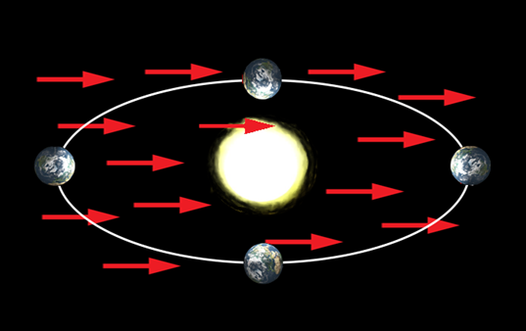
The free-falling acceleration of an object might depend on the relative orientation between orbital velocity of the Earth and the LV background field
Kostelecký and Tasson, PRD 83, 016013 (2011)

Slide 54
The free-falling acceleration of an object might depend on the relative orientation between orbital velocity of the Earth and the LV background field
Kostelecký and Tasson, PRD 83, 016013 (2011)

Slide 55
The free-falling acceleration of an object might depend on the composition of the object.
Kostelecký and Tasson, PRD 83, 016013 (2011)
Muonic apple (bigger)
Ordinary apple (smaller)
MAGE (Phillips, Wed.)

Slide 56
The free-falling acceleration of an object might depend on the composition of the object.
Kostelecký and Tasson, PRD 83, 016013 (2011)
Muonic apple (bigger)
Ordinary apple (smaller)
MAGE (Phillips, Wed.)

Slide 57
The free-falling acceleration of an object might depend on the composition of the object.
Kostelecký and Tasson, PRD 83, 016013 (2011)
Muonic apple
Neutrino apples
Ordinary apple
$$+$$
$$+$$

Slide 58
The free-falling acceleration of an object might depend on the composition of the object.
Kostelecký and Tasson, PRD 83, 016013 (2011)
Muonic apple
Neutrino apples
Ordinary apple
$$+$$
$$+$$

Slide 59
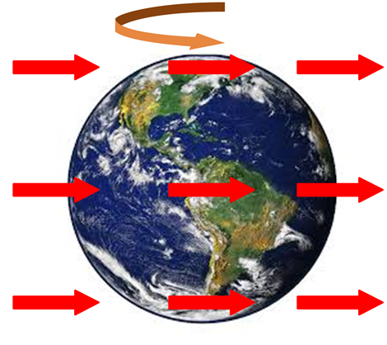
Who much antimatter weights?
The effective weight of matter and antimatter might differ at different times of the day
Kostelecký and Tasson, PRD 83, 016013 (2011)
Gbar (Crivelli, Today)
AEgIS (Guatieri, Today)

Slide 60
Final Comments
The Standard-Model Extension is a natural test framework for testing CPT symmetry
Tests of Lorentz and CPT symmetry with antimatter are sensitive to unique combinations of coefficients for Lorentz violation
Tests of Lorentz symmetry with second generation particles and other exotic particles are fundamental in a systematic search for Lorentz violation
Matter vs antimatter comparison is important, but it is not enough.
It might be possible that antimatter experiments are more sensitive to Lorentz violation than matter experiments. Looking for sidereal and annual variations is crucial.

