Slide 1









High-precision measurements of the antiproton's fundamental properties
Christian Smorra
RIKEN, Ulmer Fundamental Symmetries Laboratory
former: CERN, Research Fellow
on behalf of the BASE collaboration
International Conference on Exotic Atoms and Related Topics, EXA 2017, Vienna – 11.09.2017

Slide 2
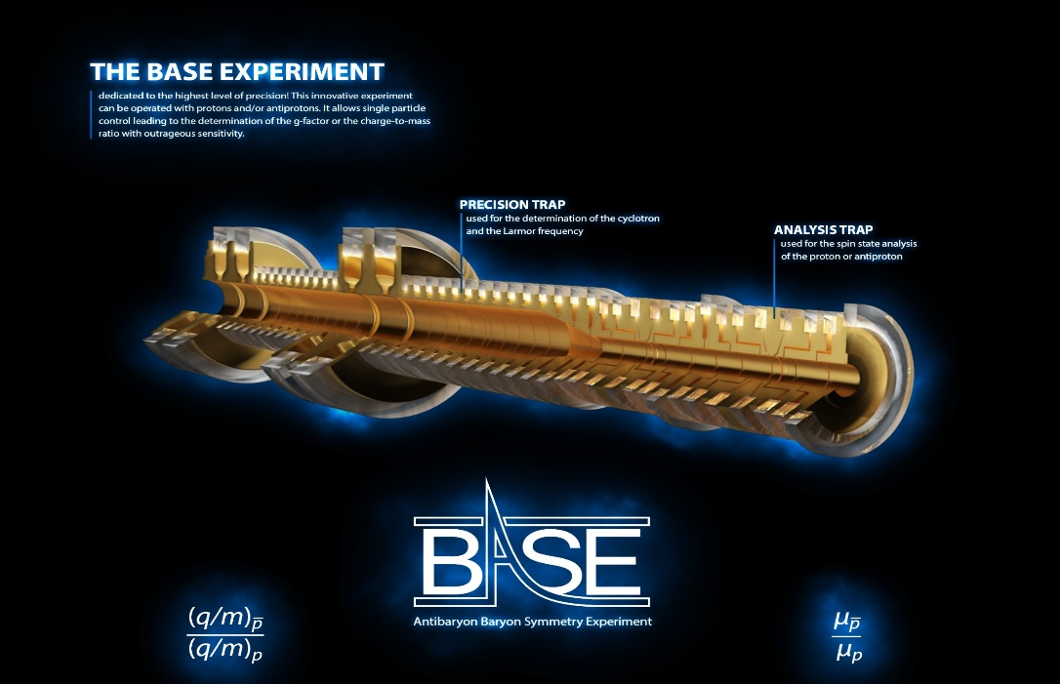
Outline
Motivation: CPT invariance
Antiproton Decelerator
CPT Tests in Penning traps
BASE - Experimental Setup
Antiproton Lifetime
Antiproton Magnetic Moment

Slide 3
CPT INVARIANCe

Slide 4




CPT Invariance
What are the discrete symmetries of the fundamental interactions?
fundamental interactions and their symmetries,
fundamental constants
particle
antiparticle
P
C
T
Adapted from H. Wilschut
CPT Theorem: Quantum-field theories are CPT invariant given a few assumptions:
locality, unitarity, spin statistics and Lorentz-invariance of the interactions
CPT invariance is an important symmetry in the Standard Model of particle physics
Fundamental properties of matter and antimatter conjugates are identical
Stringent tests of CPT symmetry by high-precision comparison of these quantities

Slide 5
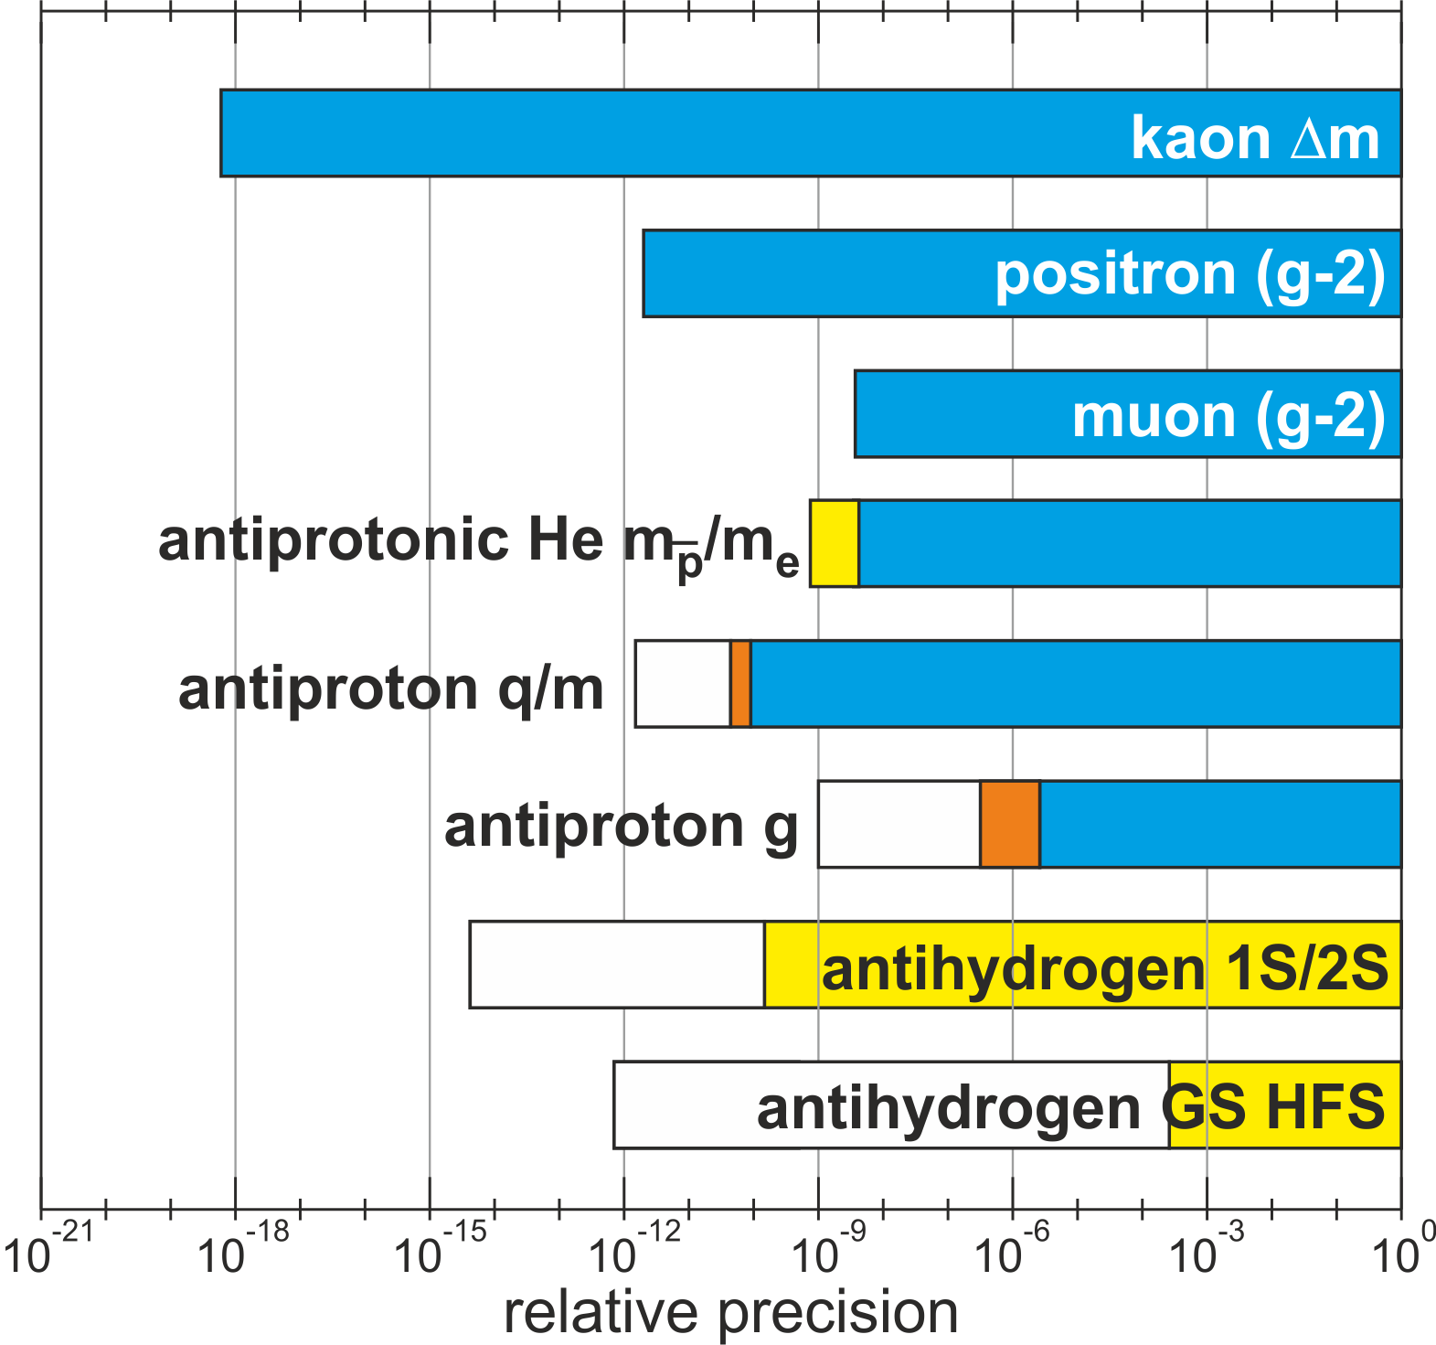

Some CPT tests based on particle/antiparticle comparisons
Recent
Past
Planned
R.S. Van Dyck et al., Phys. Rev. Lett. 59, 26 (1987).
B. Schwingenheuer, et al., Phys. Rev. Lett. 74, 4376 (1995).
H. Dehmelt et al., Phys. Rev. Lett. 83, 4694 (1999).
G. W. Bennett et al., Phys. Rev. D 73, 072003 (2006).
M. Hori et al., Nature 475, 485 (2011).
G. Gabriesle et al., PRL 82, 3199(1999).
J. DiSciacca et al., PRL 110, 130801 (2013).
S. Ulmer, C. Smorra, et al., Nature 524, 196-200 (2015).
ALICE Collaboration, Nature Physics 11, 811–814 (2015).
M. Hori et al., Science 354, 610 (2016).
H. Nagahama, C. Smorra, et al., Nat. Comm. 8, 14084 (2017).
M. Ahmadi et al., Nature 541, 506 (2017).
M. Ahmadi et al., Nature 548, 66–69 (2017).
CERN
AD
The work on CPT invariance tests
in general has been summarized in:
V. A. Kostelecky, N. Russell, 0801.0287v10 (2017).

Slide 6
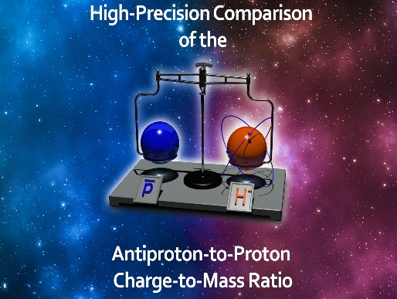
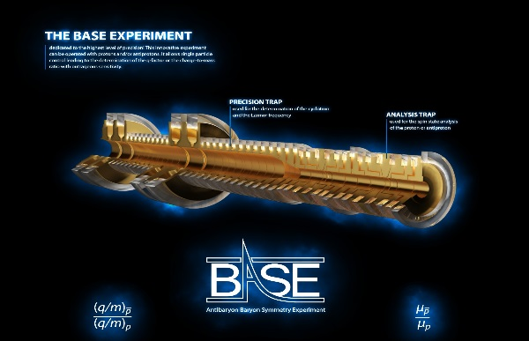
Recent work of the BASE collaboration
Physics:
  Antiproton-to-proton charge-to-mass ratio comparison with 69 ppt relative precision [1]
  Antiproton magnetic moment measurement with 0.8 ppm relative precision [2]
  Observation of individual spin transitions of a single antiproton [3]
  Antiproton lifetime limit of 10.2 years [4]
  Overview: Technical and Physical Aspects of the BASE experiment [5]
Technical papers:
  Antiproton reservoir trap [6]
  Highly-sensitive image-current detection systems for single particles [7]
[1] S. Ulmer, C. Smorra, et al., Nature 524, 196-200 (2015).
[2] H. Nagahama, C. Smorra, et al., Nat. Comm. 8, 14084 (2017).
[3] C. Smorra et al., Phys. Lett. B 769, 1-6 (2017).
[4] S. Sellner et al., New J. Phys. 19, 083023 (2017).
[5] C. Smorra et al., Eur. Phys. J. ST 224, 3055-3108 (2015).
[6] C. Smorra et al., Int. J. Mass Spectr. 389, 10 (2015).
[7] H. Nagahama et al., Rev. Sci. Instr. 87, 113305, (2016).

Slide 7
ANTIPROTON DECELERATOR

Slide 8
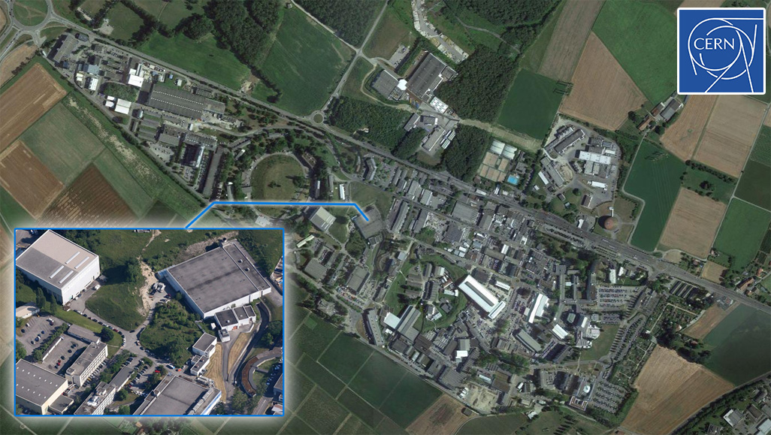
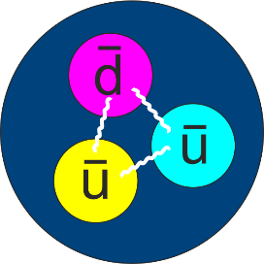


Antiproton Decelerator of CERN
CERN – Meyrin Site
Antiproton Decelerator (AD)
Only source of slow antiprotons
35 million antiprotons
5.3 MeV kinetic energy
150 ns pulse length
2 min cycle time
AD
The world’s only laboratory to study antimatter at rest (so far)

Slide 9
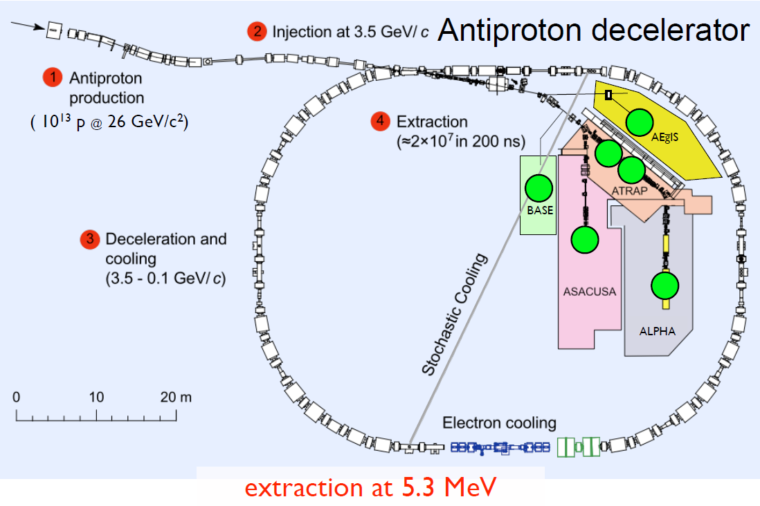
Antiproton decelerator in 2015
Proton Synchrotron beam on irdium
target: Pair production of antiprotons
Focusing and separation of antiprotons
Antiproton decelerator:
Synchrotron for antiprotons
Decelerates from 3.6 GeV to 5.3 MeV by
1.) Rf-deceleration
2.) Stochastic cooling
3.) Electron cooling
Ejection to experiments:
30 million antiprotons in 200 ns
every 110 s
figure from M. Doser

Slide 10
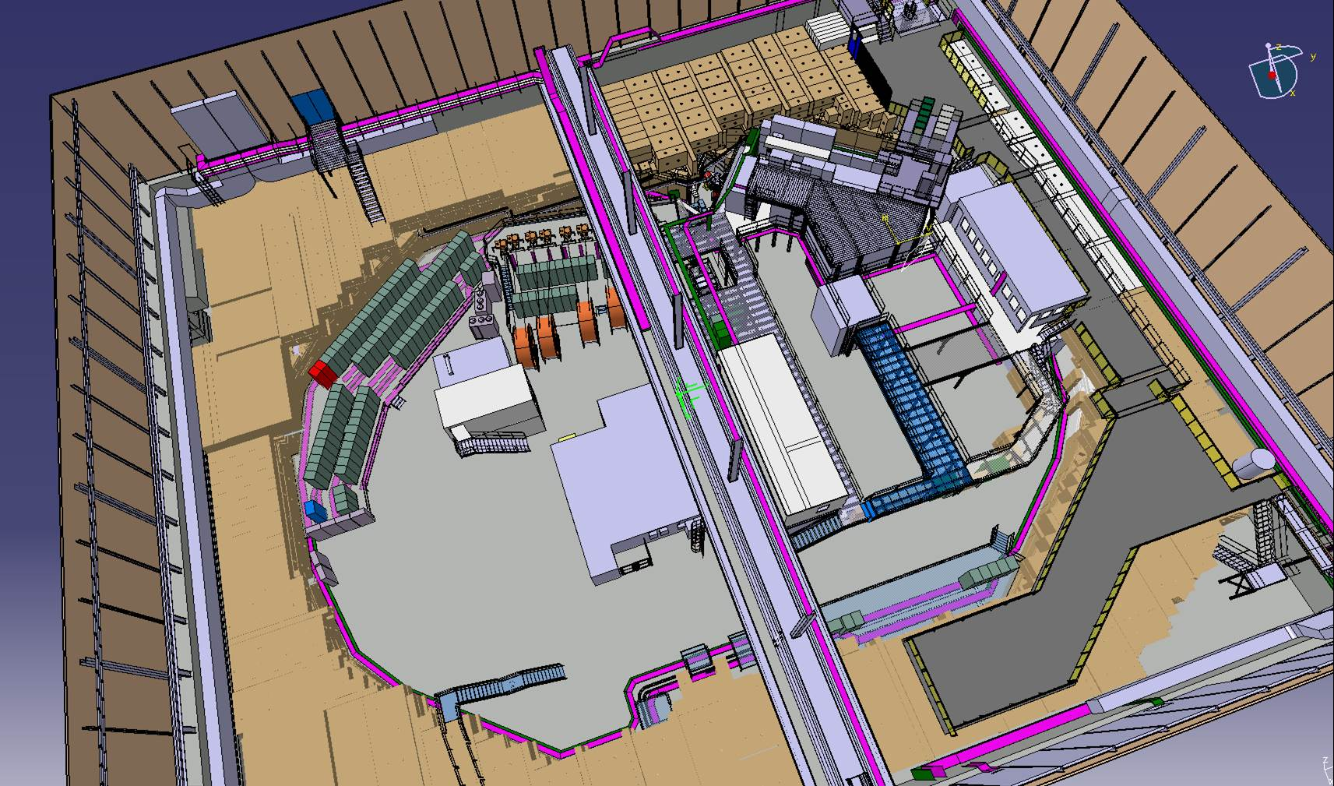
BASE in the AD/ELENA-facility
40 m
BASE, ATRAP,
Fundamental properties
of the antiproton
ALPHA, ATRAP,
Spectroscopy of 1S-2S
in antihydrogen
ASACUSA, ALPHA
Spectroscopy of GS-HFS
in antihydrogen
ASACUSA
Antiprotonic helium spectroscopy
ALPHA, AEgIS, GBAR
Test free fall/equivalence principle with antihydrogen
AEGIS
ATRAP
BASE
ALPHA
ELENA - 100 keV
ASACUSA
AD - 5.3 MeV
GBAR
M. Hori, J. Walz, Prog. Part. Nucl. Phys. 72, 206-253 (2013).

Slide 11
CPT Tests in penning traps

Slide 12
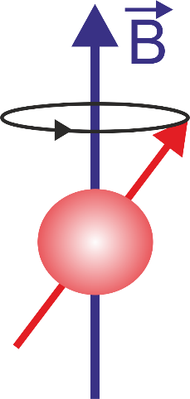
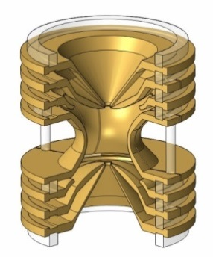
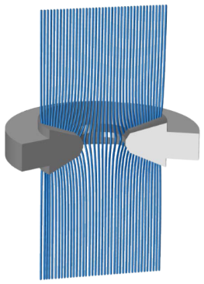


High-precision measurements in Penning traps
Cyclotron Frequency
Larmor Frequency
$$\frac{ω_{c,\overline{p}}}{ω_{c,p}}=\frac{q_{\overline{p}}/m_{\overline{p}} }{q_{p}/m_{p} }$$
$$\frac{ω_{L}}{ω_{c}}=\frac{g}{2}=\frac{μ}{μ_{N}}$$
H. G. Dehmelt and P. Ekström, Bull. Am. Phys. Soc. 18, 72 (1973).
D. J. Wineland and H. G. Dehmelt, J. Appl. Phys. 46, 919 (1975).

Slide 13
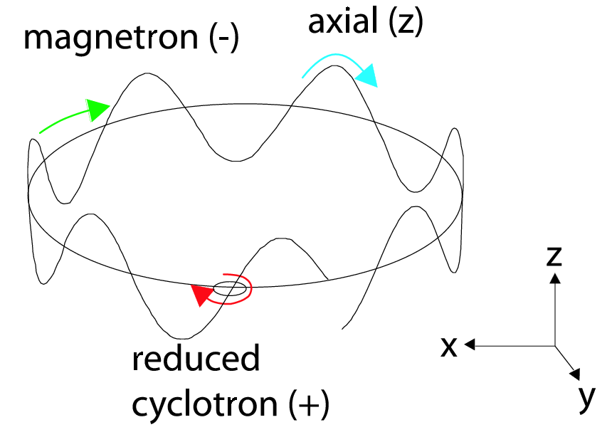
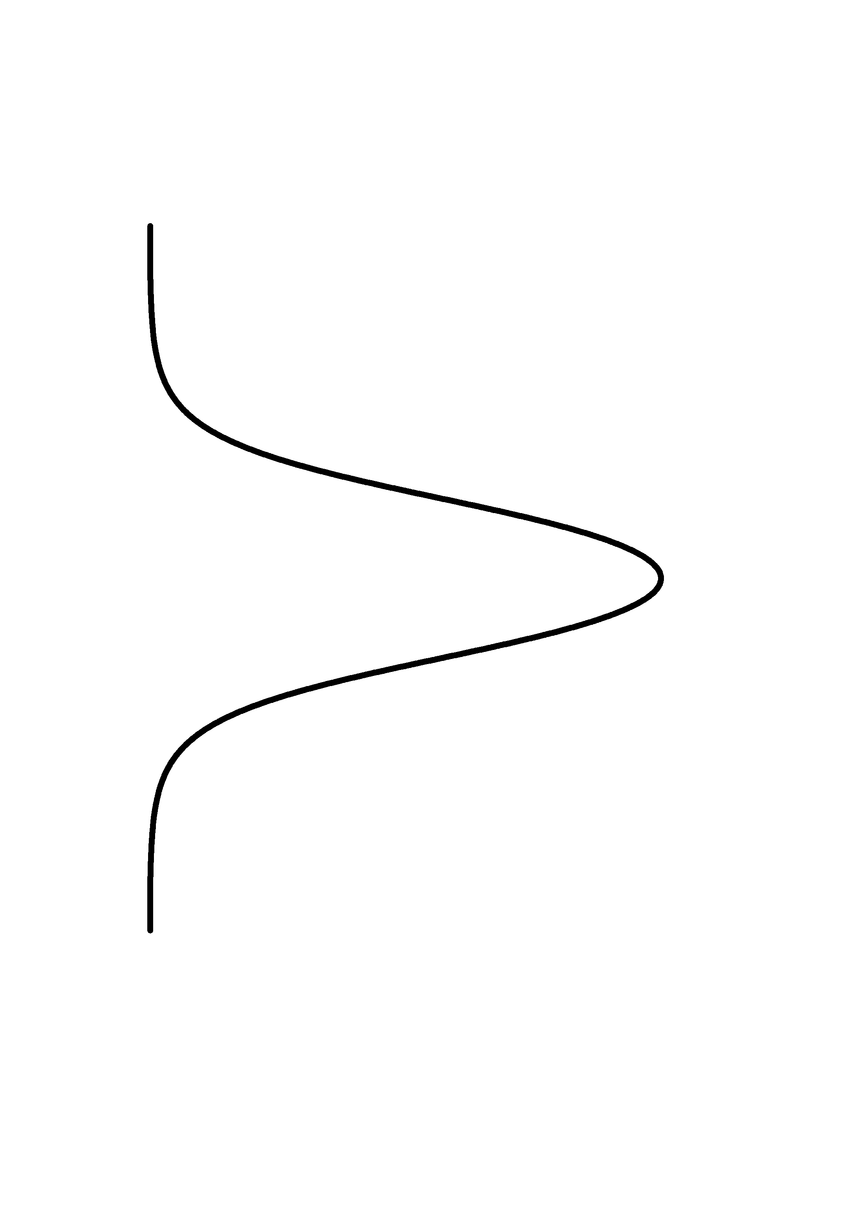
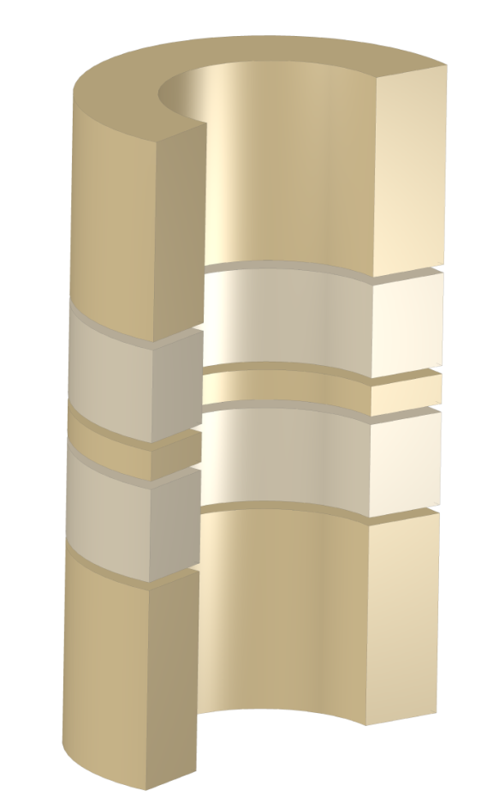

The Penning trap
B
Motion of the confined particle:
Cyclotron frequency:
q/m
Invariance Theorem:
The cyclotron frequency can be determined by measuring the three particle eigenfrequencies

Slide 14
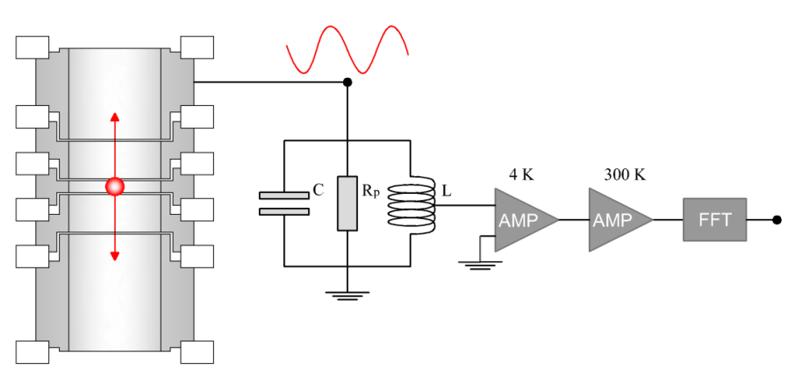
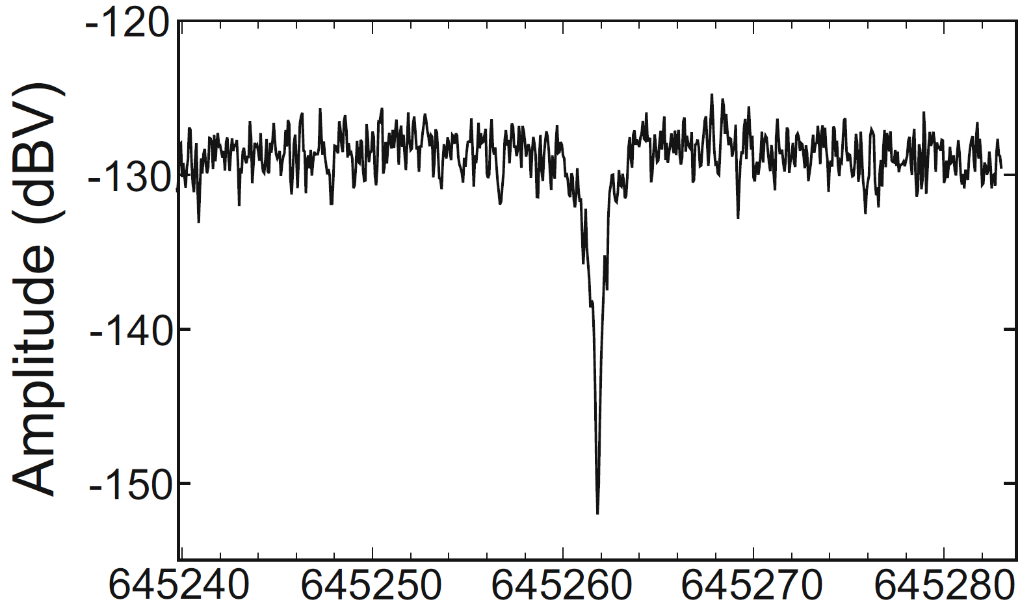



Image-current detection
$I_{p}=ω q \frac{r}{D}≈$ 1 to 10 fA
Image current:
$ω_{res}=\frac{1}{\sqrt{L C}}≈2π 670$ kHz
Resonance frequency:
Effective resistance:
$R_{p}=ω L Q≈800$ MΩ
Axial frequency dip of a single antiproton
Consequences:
A signal at the eigenfrequency of the particle can be detected
The particle dissipates energy and is resitively cooled
D.J. Wineland, H.G Dehmelt, J. Appl. Phys. 46, 919 (1975).
C. Smorra et al., Eur. Phys. J. ST 224, 3055 (2015).
Notes:
Motional frequencies are measured via image-current detection

Slide 15
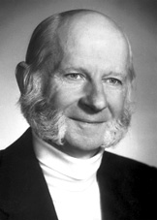
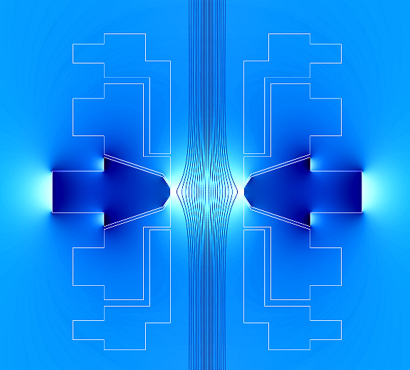
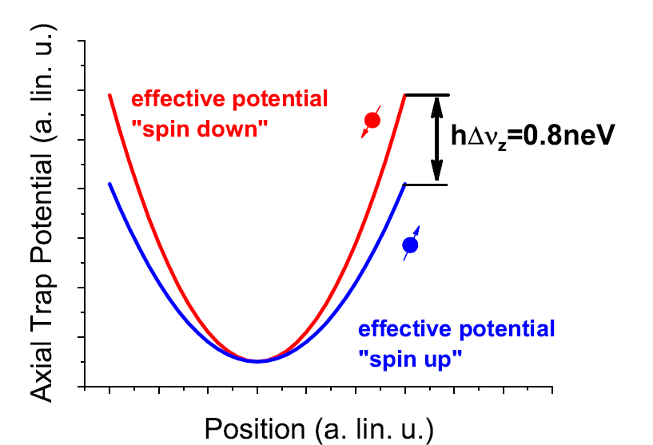
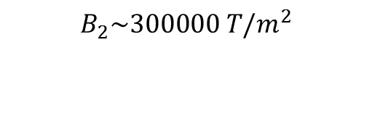
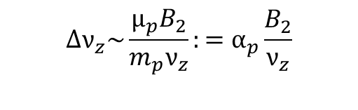
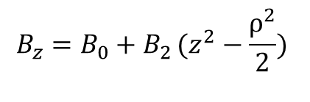

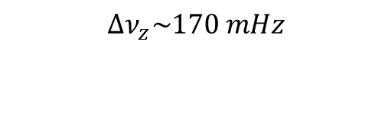
Larmor Frequency measurement
Measurement based on continuous Stern Gerlach effect.
Magnetic potential:
$$Φ_{M}=−\left.(\vec{μ_{p}}⋅\vec{B})\right.$$
$$B_{z}=B_{0}+B_{2}\left.(z^{2}−\frac{ρ^{2}}{2}) \right.$$
Harmonic force generated by a magnetic bottle:
B₂=300000 T/m²
Axial frequency becomes function of spin state
$$Δν_{z}\sim \frac{μ_{p}B_{2}}{m_{p}ν_{z}}:=α_{p}\frac{B_{2}}{ν_{z}}$$
- Very difficult for the proton/antiproton system.
$$B_{2}\sim 300000 T/m^{2}$$
- Most extreme magnetic conditions ever applied to single particle.
$${∆ν}_{z}\sim 170 mHz$$
Observe driven spin transitions -> Measurement of Larmor resonance

Slide 16
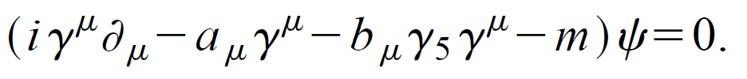
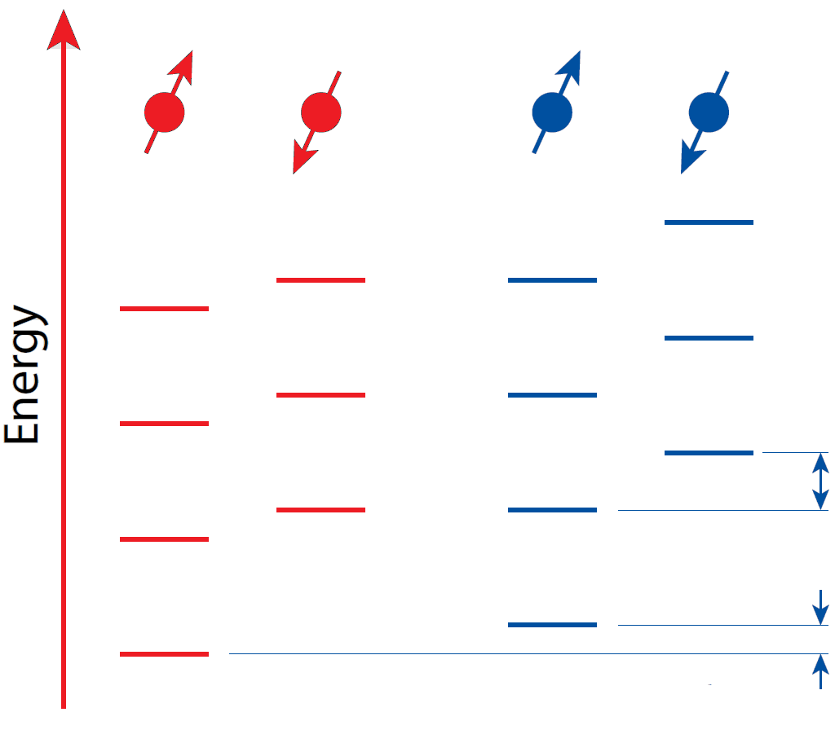
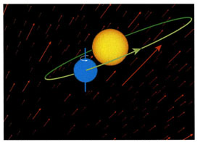



Standard Model Extension in Penning traps
$$δω_{L}^{p}−δω_{L}^{\overline{p}}∝b$$
$$δω_{a}^{\overline{p}}$$
b
$$δω_{a}^{p}$$
a
Proton
Antiproton
Figure from V.A. Kostelecky
D. Colladay and V.A. Kostelecky, Phys. Rev. D 55, 6760 (1997).
Y. Ding and V.A. Kostelecky, Phys. Rev. D 94, 056008 (2016).

Slide 17
CPT violation in the SME framework
Effective field theory to include Lorentz-violation
into the Standard Model
CPT violation is mediated through Lorentz violation
in the Standard Model Extension (SME)
Dirac’s Equation is modified
(lowest order CPT-odd contributions):
Figure from V.A. Kostelecky
D. Colladay and V.A. Kostelecky, Phys. Rev. D 55, 6760 (1997).
P.A. Bolokhov, S.G. Nibbelink, and M. Pospelov, Phys. Rev. D 015013 (2005).
Y. Ding and V.A. Kostelecky, Phys. Rev. D 94, 056008 (2016).

Slide 18
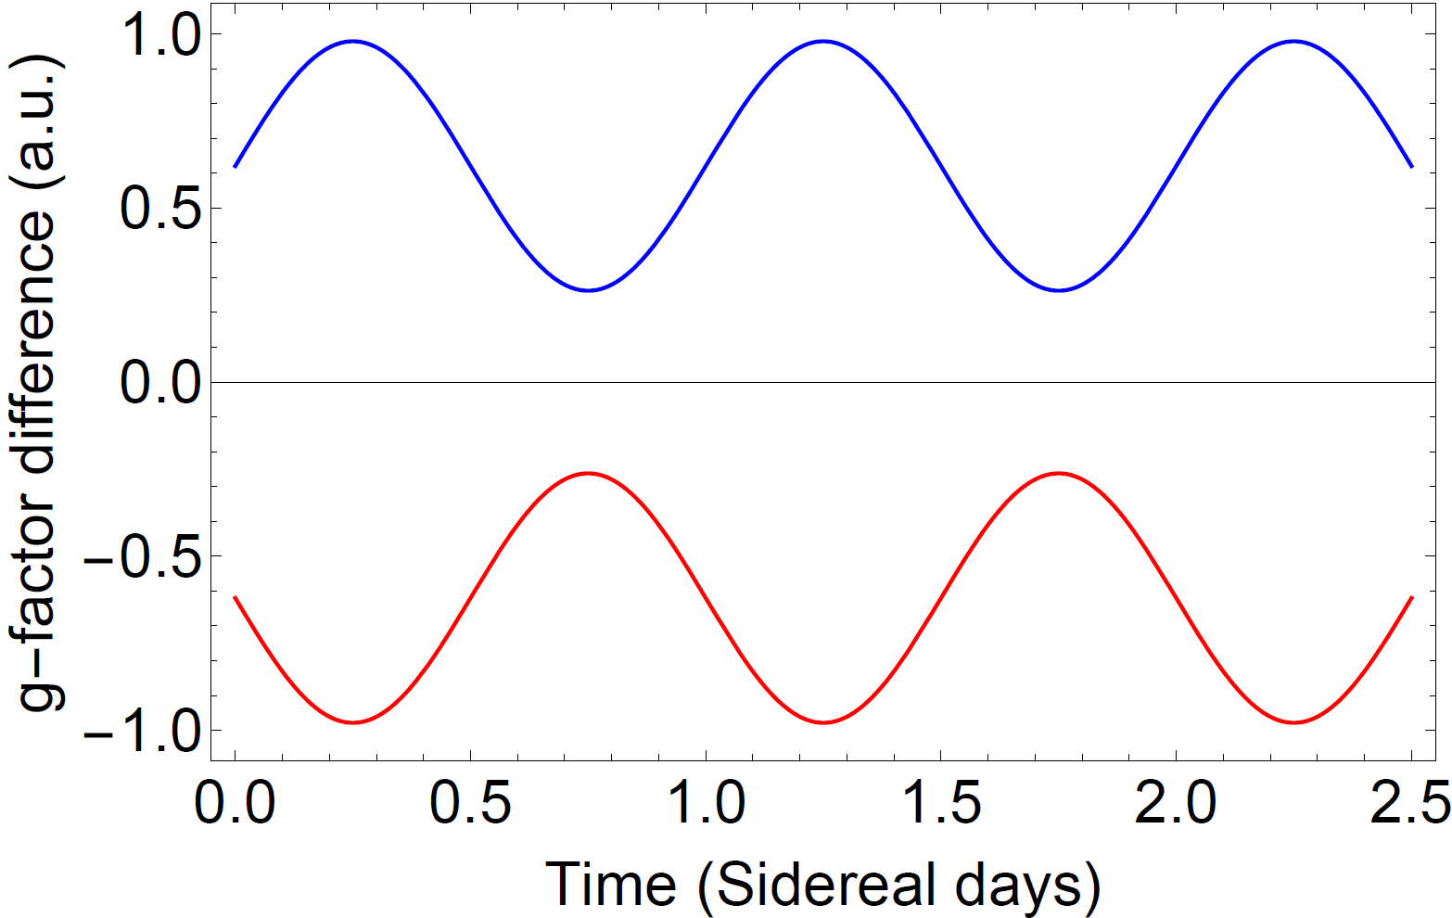

Experimental consequences of the SME
$$δω_{L}^{p}−δω_{L}^{\overline{p}}∝b$$
Frequencies become dependent on the experiment orientation relative to the SME fields
Sidereal variation of the measured frequencies occur
Hypothetical signature of CPT violation:
$$δω_{a}^{\overline{p}}$$
$$δω_{a}^{p}$$
a
Proton
Antiproton

Slide 19
Experimental setup

Slide 20
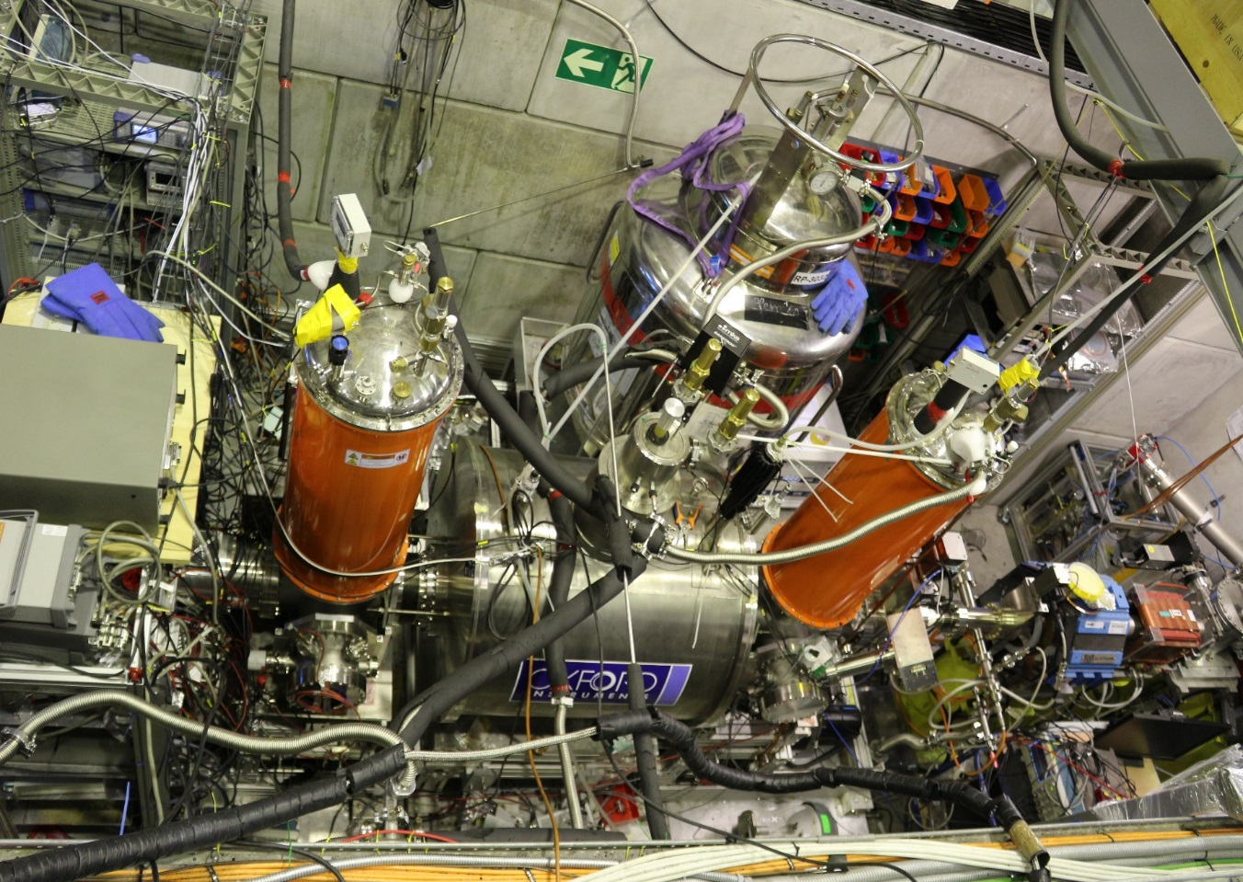
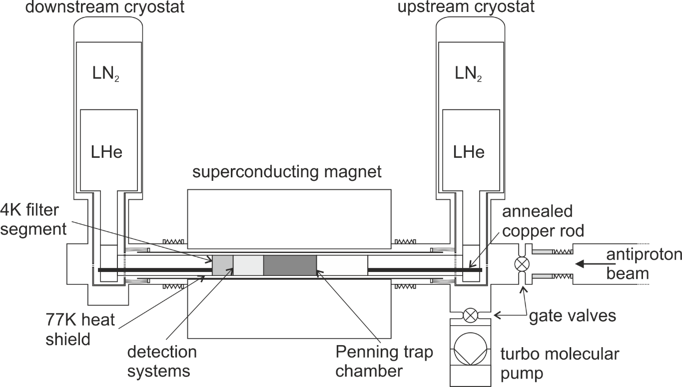
The BASE Apparatus at CERN

Slide 21
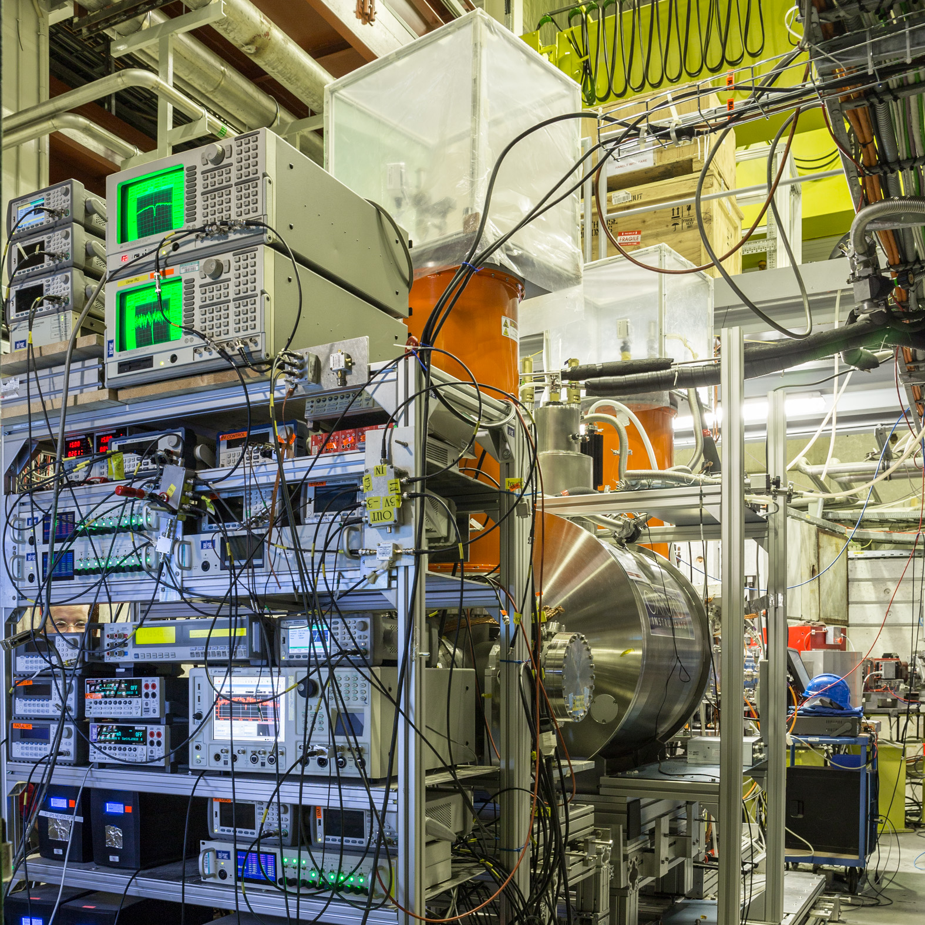
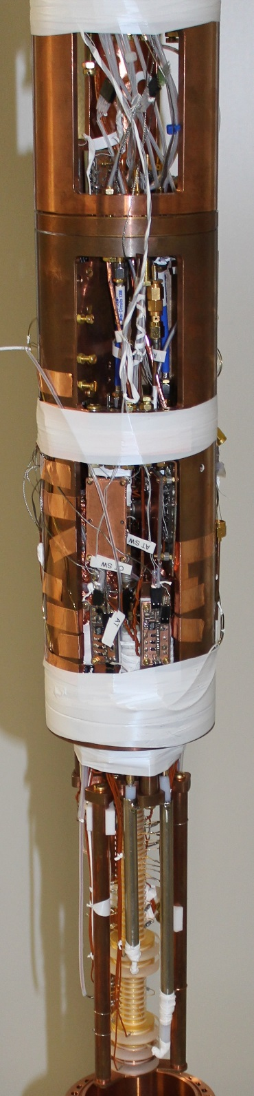
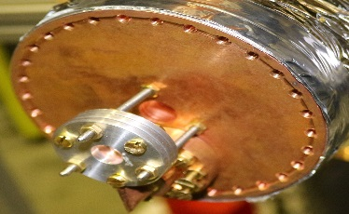
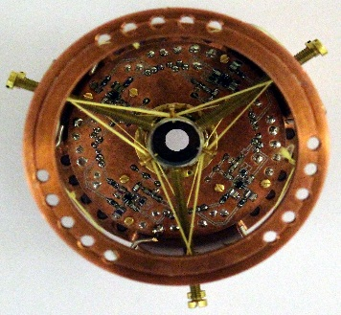
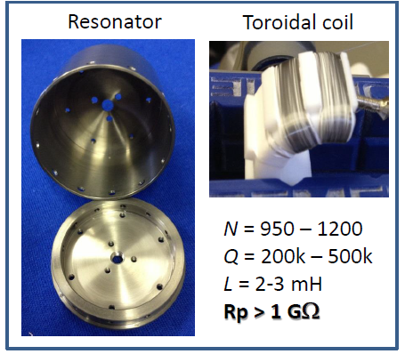
The BASE experiment
H. Nagahama et al., Rev. Sci. Instr. 87, 113305, (2016).

Slide 22
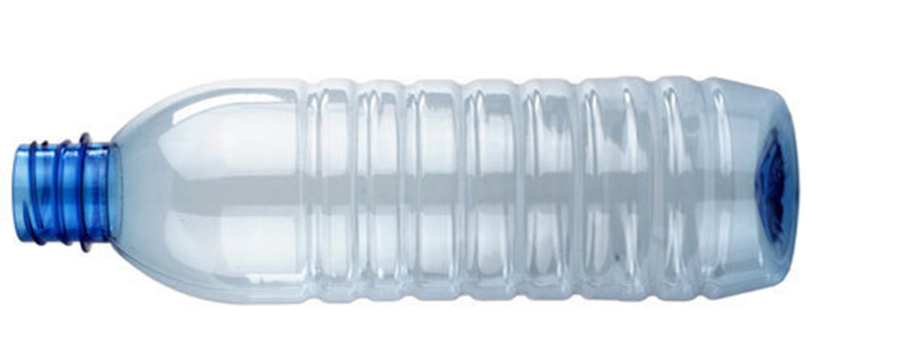
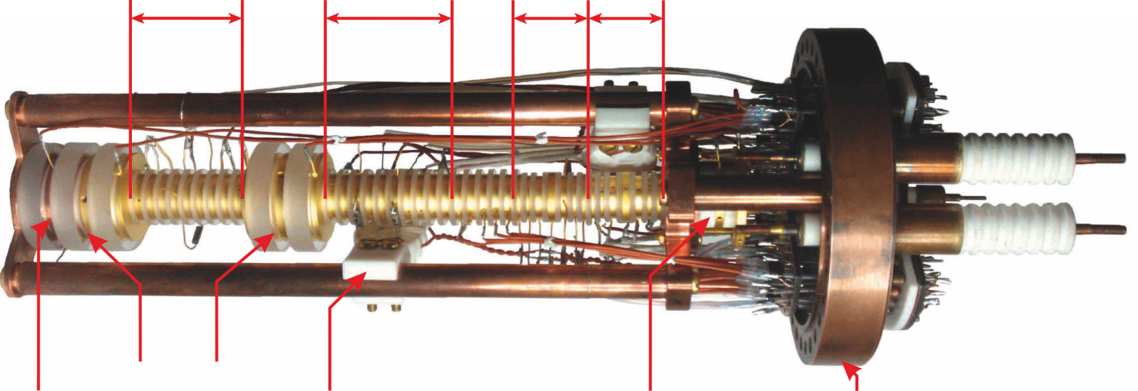
The BASE four Penning-trap system
New trap system dedicated to measure the antiproton magnetic moment with 10⁻⁹ uncertainty
RT
PT
CT
AT
HV Electrodes
Degrader
Spin flip coil
Electron gun
Pinbase
Catching / Reservoir Trap: Catching, cooling and storing of antiprotons
Precision Trap: Homogeneous field for frequency measurements
Cooling Trap: Fast cooling of the cyclotron motion
Analysis Trap: Inhomogeneous field for the detection of antiproton spin flips, B₂ = 30 T / cm²

Slide 23
Antiproton decelerator in 2015
Proton beam on Ir target:
Pair production of antiprotons
Focusing and separation of
antiprotons
Antiproton decelerator:
Synchrotron for antiprotons
Decelerates from 3.6 GeV to 5.3 MeV by
1.) Stochastic cooling
2.) Rf-deceleration
3.) Electron cooling
4.) Ejection to experiments
30 million antiprotons in 200 ns
every 110 s
figure from M. Doser

Slide 24


C. Smorra et al., Eur. Phys. J. ST
224, 3055-3108 (2015).

Slide 25
Reservoir Trap

Slide 26
Antiproton Lifetime Limit
~10 years

Slide 27
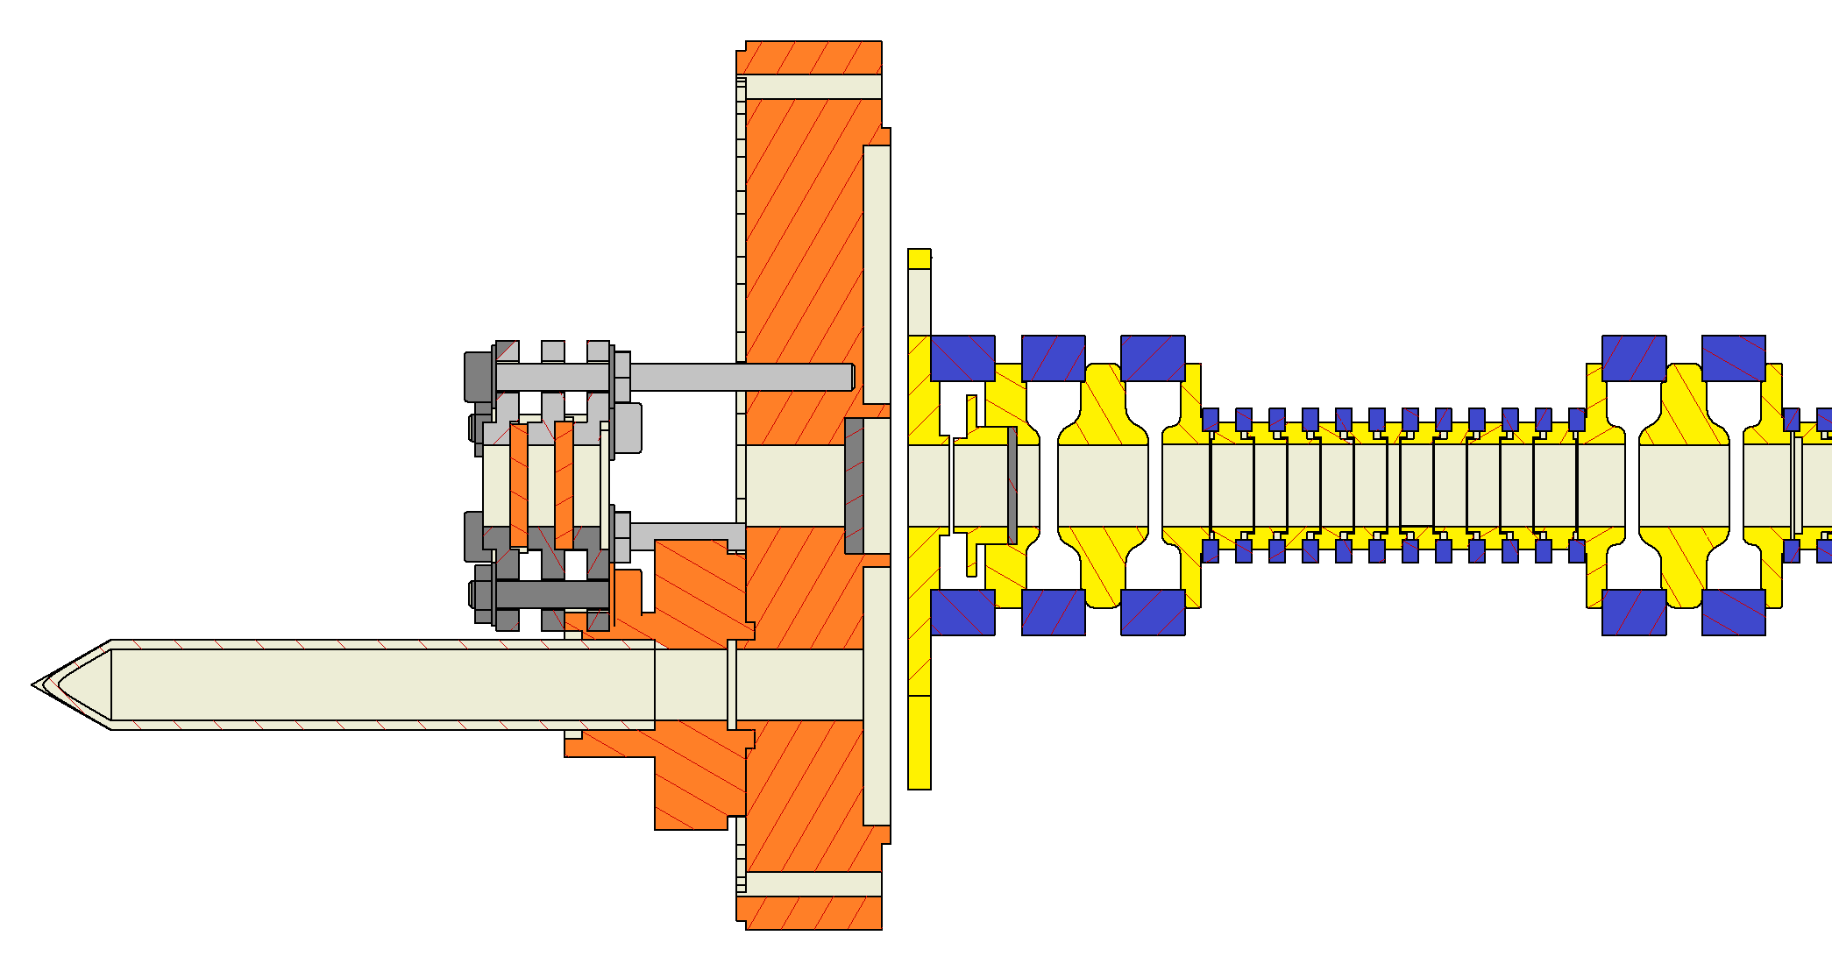
Deceleration from 5.3 MeV to 0.5 meV
Isolation vacuum: ~ 10⁻⁸ mbar
Trap can vacuum: < 10⁻¹⁸ mbar
Mesh degrader
Al degrader
HV pulsed
HV static
Ring electrode
Antiprotons
1 – 5 x 10⁻⁴
Pinch off tube
Stainless steel
Vacuum window
20 um

Slide 28
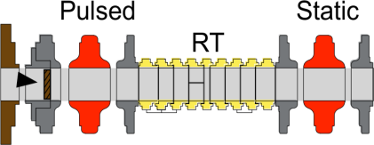
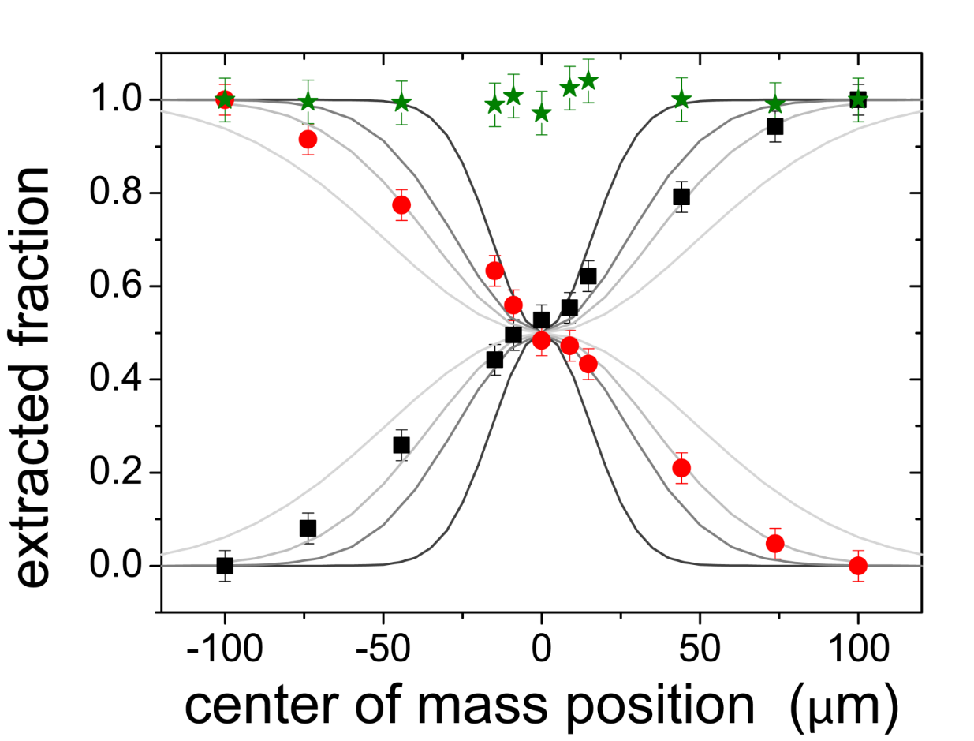
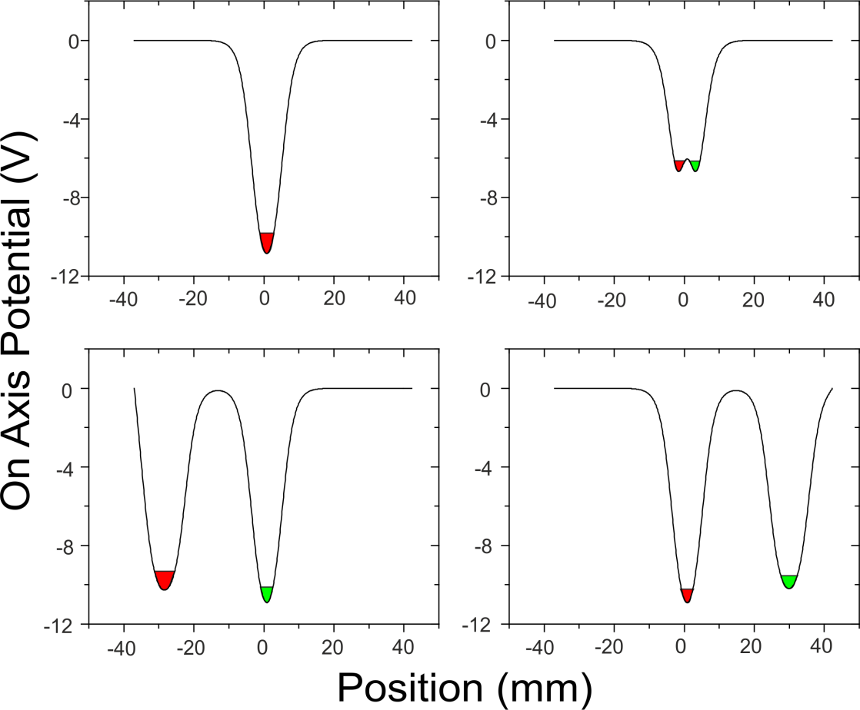
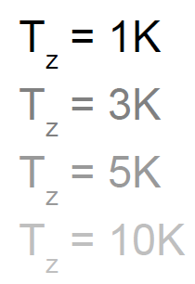
Non-destructive extraction: Separate and Merge

Slide 29
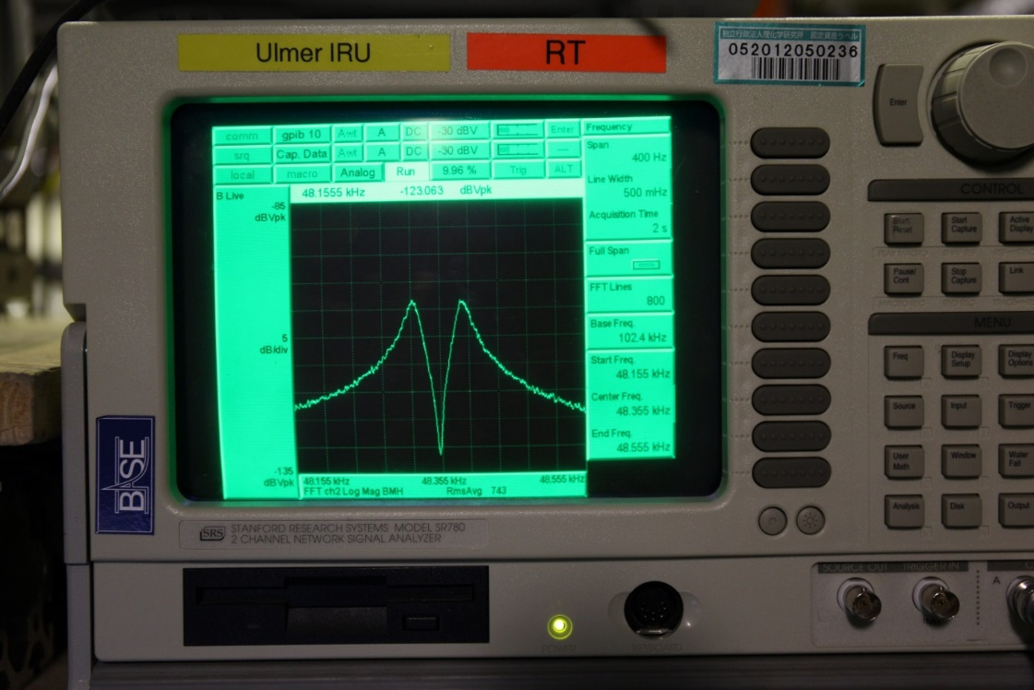
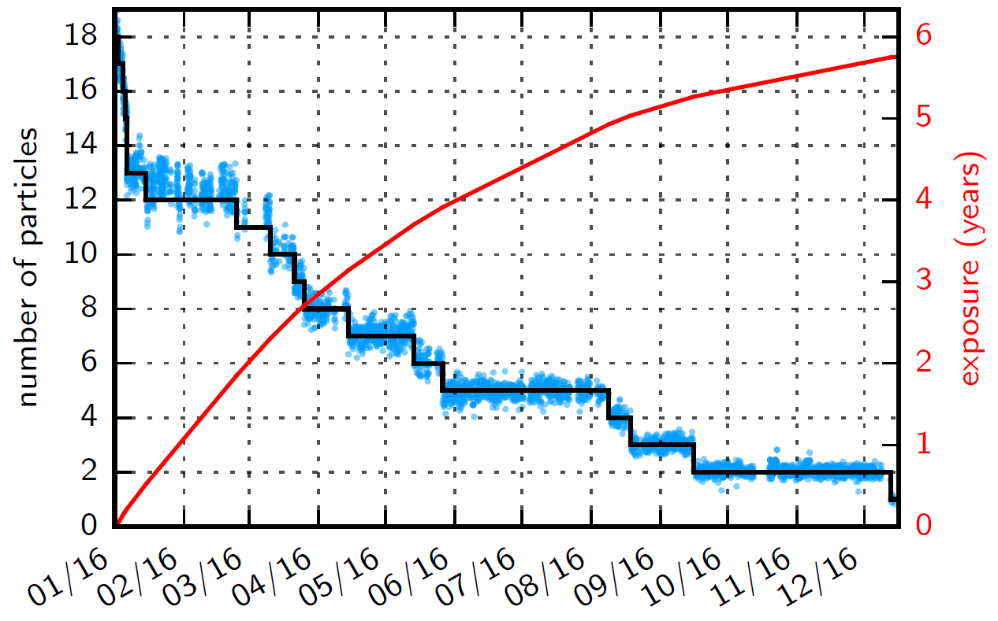
Reservoir trap
Antiprotons stored from 03.11.2015 – 22.12.2016
Storage of antiprotons for more than one year: 405.5 days
Extraction of single particles by a potential tweezer scheme
Inversion of the baryon asymmetry:
Antibaryon density: ~ 10⁸/cm³
V < (50 μm)³
Baryon density: ~ 1 / cm³
p < 10⁻¹⁶ Pa
C. Smorra et al., Int. J. Mass Spectr. 389, 10 (2015).
S. Sellner et al., New J. Phys. 19, 083023 (2017).

Slide 30
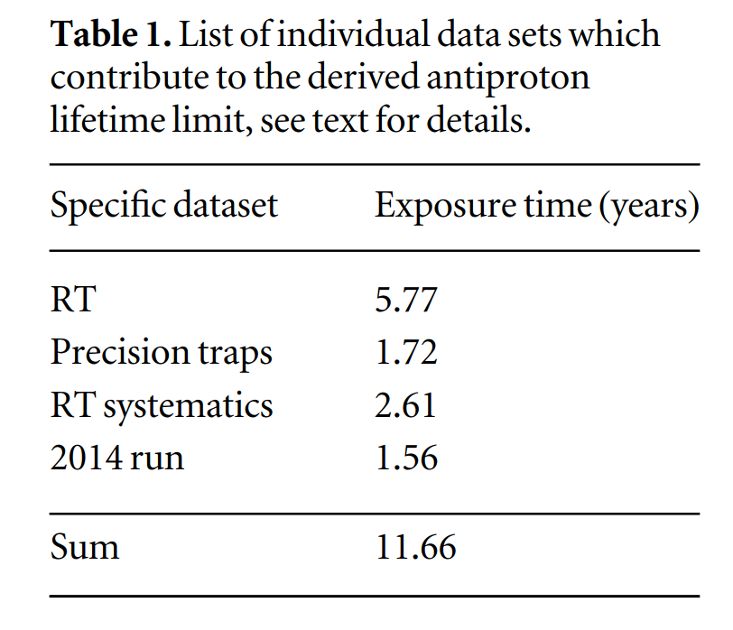


Antiproton Lifetime Limits
$τ_{\overline{p}}>10.2$ y (68% C.L.)
Antiproton lifetime limits:
$τ_{\overline{p}}>5.0$ y (90% C.L.)
S. Sellner et al., New J. Phys. 19, 083023 (2017).

Slide 31
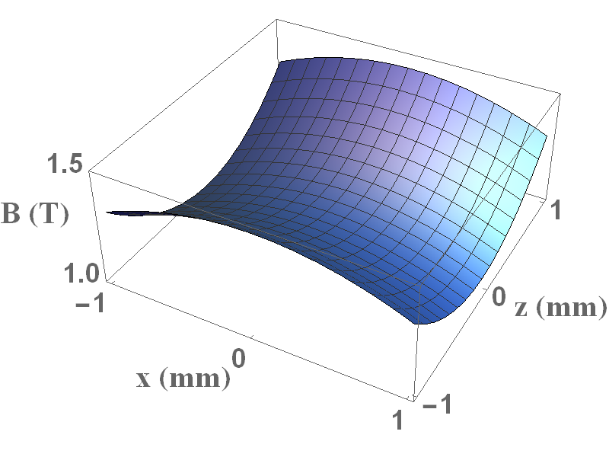
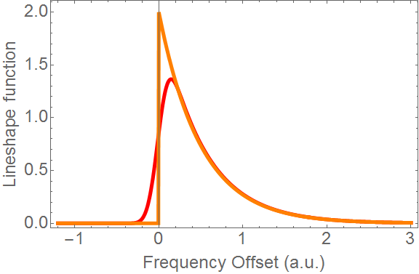
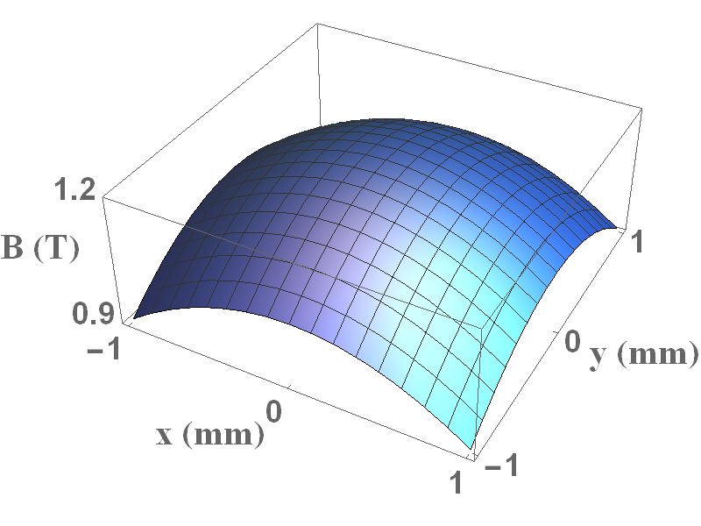
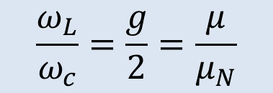
Measurements in the magnetic bottle
$$\frac{ω_{L}}{ω_{c}}=\frac{g}{2}=\frac{μ}{μ_{N}}$$

Slide 32



Spin-state readout in a magnetic bottle
Axial frequency shift due to
orbital and spin angular momentum!
$$Φ_{M}=−\left.(\vec{μ_{p}}⋅\vec{B})\right.$$
$$B_{z}=B_{0}+B_{2}\left.(z^{2}−\frac{ρ^{2}}{2}) \right.$$
Measurement principle: induce changes in the quantum numbers
μ_{s} and n₊ by excitation/spin-flip drives.
Measure the increase of the axial frequency fluctuation
A. Mooser et al., Phys. Rev. Lett. 110, 140405 (2013).

Slide 33


Resonance curves
H. Nagahama et al., Nat. Comm. 8, 14084 (2017).

Slide 34


Lineshape in the magnetic bottle
The frequencies of interest depend strongly on the particle amplitudes
The axial detector acts as a thermal bath (correlation time 33 ms).
To obtain the g-factor we need to extract the frequencies
at zero axial amplitude and identical magnetron radius
$$\frac{g}{2}=\frac{ω_{L}(E_{z}=0, ρ_{−}=r)}{ω_{c}(E_{z}=0, ρ_{−}=r)}$$
No concern for 10⁻⁶
precision
Energy fluctuation smears out
the “cut” E_{z} = 0.
Stability requirement 5 mK / 12 h.
Lineshape reflects the Boltzmann
distribution of axial energy

Slide 35

Cyclotron cut frequency
Record frequency fluctuations for drive frequencies close to the cut frequency
The time fraction the drive frequency is above the cut frequency increases the fluctuation
Analytical reconstruction of the line-shape based on the magnitude of the fluctuations
or
Monte-Carlo simulation to extract the confidence interval for the cyclotron frequency
Cyclotron frequency measurements up to
0.6 ppm precision
H. Nagahama et al., Nat. Comm. 8, 14084 (2017).

Slide 36


Larmor cut frequency
Monte-Carlo simulation using the magnetron heating rate information to extract the confidence interval
Larmor cut frequency was measured with up to 0.6 ppm precision

Slide 37




Spin-state readout in a magnetic bottle
The magnetic bottle couples also the magnetic moment to the radial motion to the axial frequency!
$$Φ_{M}=−\left.(\vec{μ_{p}}⋅\vec{B})\right.$$
$$B_{z}=B_{0}+B_{2}\left.(z^{2}−\frac{ρ^{2}}{2}) \right.$$
Measurement needs to be done at constant n₊, n₋!
A. Mooser et al., Phys. Rev. Lett. 110, 140405 (2013).

Slide 38



Antiproton g-factor results
Six fold improved uncertainty of the
antiproton magnetic moment
Respective limits on SME coefficients for CPT violation improved up to a factor 20
$$g_{\overline{p}}/2=2.7928465(23)$$
H. Nagahama et al., Nat. Comm. 8, 14084 (2017).

Slide 39


SME Figures of Merit
vector
vector
vector
$$\frac{δE}{E}=\frac{h Δυ}{m c^{2}}$$
vector
scalar
scalar
V. A. Kostelecky, N. Russell, 0801.0287v10 (2017).

Slide 40
(Anti)proton g-factor
WiTH 10⁻⁹ Precision

Slide 41




Divide and Conquer - Double Trap Method
Idea: Separate spin state analysis and precision frequency measurements.
B₂ = 300000 T/m²
T₊ < 0.2 K
Analysis
Trap
44 mm
B₂ = 3.5 T/m²
T₊ = 300 K
Δν_{z}/ν_{c} = 5 x 10⁻⁹
Precision Trap
Requires clear identification of the spin state
19 mm
H. Häffner, Phys. Rev. Lett.85, 5308 (2000)

Slide 42
The Magnetic Moment of the Proton
A. Mooser, S. Ulmer, K. Blaum, K. Franke, H. Kracke, C. Leiteritz, W. Quint, C. Smorra, J.Walz, Nature 509, 596 (2014)
Line width:
Saturation,
Residual B₂
Magnetic field fluctuations
g/2 = 2.792847350 (7) (6) (3.3 ppb)
First direct high precision measurement of the proton magnetic moment.
Improves 42 year old MASER value by factor of 2.5
Value in agreement with accepted CODATA value, but 2.5 times more precise
A. Mooser et al., Nature 509, 596 (2014).

Slide 43



Single antiproton spin-transitions
Single spin transitions can be identified with a high fidelity
(Average spin-state fidelity > 92 %)
Enables an antiproton g-factor measurement with the double-trap method
C. Smorra et al., Phys. Lett. B 769, 1-6 (2017).

Slide 44



Conclusion and Outlook
$\frac{{(q/m)}_{\overline{p}}}{{(q/m)}_{p}}$ $+1=1\left(69\right)×{10}^{−12}$
Proton-antiproton charge-to-mass
ratios compared with highest precision
6-fold improved antiproton g-factor
High precision measurement of the proton
g-factor using the double-trap technique:
Outlook: Antiproton g-factor measurement
with the double trap method
$$\frac{g_{\overline{p}}}{2}=2.7928465\left(23\right)$$
$$\frac{g_{p}}{2}=2.792847350\left(9\right)$$

Slide 45





Thank you for your attention!
Thanks to the BASE team
BASE@CERN: M. Borchert, J. Harrington, T. Higuchi, A. Mooser, H. Nagahama, S. Sellner, T. Tanaka, S. Ulmer
BASE@Hannover: M. Niemann, C. Ospelkaus, A. Paschke
BASE@Mainz: M. Bohman, A. Mooser, G. Schneider, N. Schoen, J. Walz
BASE collaborators: K. Blaum, Y. Matsuda, W. Quint, Y. Yamazaki
Thank you for the funding:

Slide 46
ANTIPROTON Q/m

Slide 47

S. Ulmer, C. Smorra, A. Mooser et al.,
Nature 524, 196-200 (2015).

Slide 48

Measurement configuration
Based on reservoir extraction technique and developed methods to prepare negative hydrogen ions we prepared an interesting set of initial conditions
antiproton
H⁻ ion
Comparison of H-/antiproton cyclotron frequencies:
One frequency ratio per 4 minutes with ~ 5 ppb uncertainty

Slide 49


Data analysis and result
Line-width limitation:
Random-walk noise
of the magnetic field: 5.5 ppb
Major systematic limitation:
A displacement of 29 nm in the gradient of B₁ = 7.6 mT / m requires a correction of : 114(26) p.p.t.
6521 frequency ratios
  Final experimental result:
Rexp,c = 1.001 089 218 755 (64) (26)
$\frac{{(q/m)}_{\overline{p}}}{{(q/m)}_{p}}$ $+1=1\left(69\right)×{10}^{−12}$
In agreement with CPT conservation
Exceeds the energy resolution of
previous result by a factor of 4.

Slide 50

Data analysis and result
Width limited by random-walk noise
of the magnetic field (~ 5.5 ppb)
6521 frequency ratios
Experimental result:
Rexp = 1.001 089 218 872 (64)
Cyclotron frequency ratios for $\overline{p}$-to-$\overline{p}$ and $H^{−}$-to-$H^{−}$ $R_{id}$ are also evaluated
$$R_{id}−1=−3\left(79\right)×{10}^{−12}$$
Consistent with 1

Slide 51
Systematic Corrections
Major systematic correction due to the residual magnetic B1 gradient.
  A displacement of 29 nm in the gradient of B1 = 7.6 mT / m causes a correction of
  dR_{B1} = -114(26) p.p.t.
  Slight re-adjustment of the trapping potential: dR_{C4} = -3(1) p.p.t.
  Final experimental result:
Rexp,c = 1.001 089 218 755 (64) (26)
$\frac{{(q/m)}_{\overline{p}}}{{(q/m)}_{p}}$ $+1=1\left(69\right)×{10}^{−12}$
In agreement with CPT conservation
Exceeds the energy resolution of
previous result by a factor of 4.

Slide 52
Sidereal Variations (Lorentz violation)
Constrains in first order CPT-even parameters of the Standard Model Extension
Limit of sidereal variations in proton/antiproton charge-to-mass ratios to < 0.72 ppb
Amplitude
Oscillation Period (s)

Slide 53







Antiproton gravitational redshift
Cyclotron Frequency reflects the gravitational binding energy of the antiproton
Gravitational anomaly can be constrained
$$r→∞$$
$$ω_{c,p}=ω_{c\overline{,p}}$$
$r=$ R
$$ω_{c,p} ? ω_{c\overline{,p}}$$
$$\frac{ω_{c,p}−ω_{c,\overline{p}}}{ω_{c,p}}=−3(α_{g}−1) U/c^{2}$$
Our 69ppt result sets
a new upper limit of
$\left|α_{g}−1 \right|$ $<$ 8.7$×{10}^{−7}$
S. Ulmer et al., Nature 524 196 (2015)
Cyclotron frequency ratio depends on (q/m)-difference, SME-coefficients, and the gravitational anomaly
Limits on the gravitational anomaly depend on assumptions on the gravitation potential U
R. J. Hughes, & M. H. Holzscheiter, Phys. Rev. Lett. 66, 854-857 (1991).
R. J. Hughes, Contemporary Physics, 34:4, 177-191 (1993).

Slide 54


Conclusions to antiproton Q/M
Most precise comparison of a fundamental quantity of baryons and antibaryons.
Test of the standard model with $hΔυ_{c}=8 {10}^{−18}$eV energy resolution. Factor 4 improvement due to lower cyclotron frequency
Constrain on the gravitational anomaly of antiprotons by arguing via the gravitational redshift
No diurnal variation in cyclotron frequency ratio observed in 35 days
TRAP (1999/2006) 68% C.L.
BASE (2015) 68% C.L.
5.5 ppb
1.25 ppb
Limitations due to the magnetic field fluctuations have been improved
A more precise measurement seems feasible

Slide 55
Antiproton g-factor
WiTH 10⁻⁶ Precision

Slide 56

Challenge: Resolve individual spin-flips
Status after the 0.8 ppm
antiproton g-factor measurement
Axial frequency stability: 101 mHz
Spin flip frequency shift: 170 mHz
Suppression of voltage noise densities of order
10 – 100 pV / SQRT(Hz) is challenging!
This noise can be measured only by a
single antiproton in a strong magnetic bottle
Axial frequency stability after optimization: 48 mHz

Slide 57













Why not to use protons
$$B_{0}+B_{1} z$$
Systematic uncertainties due to the particle position are large (~10⁻⁹)
No significant uncertainties in converting the mass ratio
CPT test by a measurement of the cyclotron frequency ratio of antiproton and H⁻ ion
$$H^{−}$$
$$U_{H^{−}}$$
$$\overline{p}$$
$$U_{\overline{p}}$$
$$U_{p}$$
$$p$$
$$\frac{m_{H^{−}}}{m_{p}}= (1+2\frac{m_{e}}{m_{p}}−\frac{E_{b}}{m_{p}}−\frac{E_{a}}{m_{p}}+\frac{α_{pol,H^{−} }B_{0}^{2}}{m_{p}})$$
R_{theo} = 1.0010892187542(2)
(0.2 ppt)
$$U_{c}$$
$$U_{0}$$
$$U_{c}$$
$$+U_{offset}$$
G. Gabriesle et al., PRL 82, 3199(1999).
S. Ulmer, C. Smorra, A. Mooser et al., Nature 524, 196-200 (2015).

Slide 58


g-factor measurements of protons/antiprotons
Antiproton g-factor:
J. DiSciacca et al.,
Phys. Rev. Lett. 110,
130801 (2013).
Proton g-factor:
A. Mooser et al.,
Nature 509, 596 (2014).

Slide 59








Antiproton gravitational redshift
$$r→∞$$
$$ω_{c,p}=ω_{c\overline{,p}}$$
Constrain of the gravitation anomaly for antiprotons:
$$\frac{ω_{c,p}−ω_{c,\overline{p}}}{ω_{c,p}}=−3(α_{g}−1) U/c^{2}$$
$r=$ R
$$ω_{c,p} ? ω_{c\overline{,p}}$$
$\frac{{(q/m)}_{\overline{p}}}{{(q/m)}_{p}}$ $+1=1\left(69\right)×{10}^{−12}$
$$\left|α_{g}−1 \right|$$
constrained to 10⁻⁶
Assuming CPT Invariance, we can compare the proton/antiproton gravitational redshift.
R. J. Hughes, & M. H. Holzscheiter, Phys. Rev. Lett. 66, 854-857 (1991).
R. J. Hughes, Contemporary Physics, 34:4, 177-191 (1993).

Slide 60


Double Trap System in Mainz
High precision due to spatially separated spin state analysis and precision frequency measurements.
Proton trap system (Mainz University)
$$Φ_{M}=−\left.(\vec{μ_{p}}⋅\vec{B})\right.$$
Analysis
Trap
44 mm
Precision Trap
H. Dehmelt and P. Ekström, Bull. Am. Phys. Soc. 18, 72 (1973).
E. A. Cornell et al., Phys. Rev. A 41, 312 (1990).
H. Häffner, Phys. Rev. Lett.85, 5308 (2000).
A. Mooser, K. Franke et al. Phys. Lett. B 723, 78 (2013).
19 mm

Slide 61



Detection of the radial frequencies
Sideband method:
A radiofrequency drive at ν₊ - ν_{z} or ν_{z} + ν₋ couples two eigenmotions.
The amplitudes of the two states are periodically exchanged.
The magnetron frequency and the reduced cyclotron frequency can be measured by detecting ν_{l}, ν_{r} and ν_{z}
Using the invariance theorem
the free cyclotron frequency is derived.
Amplitude (dBm)
ν-ν_{z} (Hz)

Slide 62
The Magnetic Moment of the Proton
Sweeping excitation frequency -> g factor resonance
A. Mooser, S. Ulmer, K. Blaum, K. Franke, H. Kracke, C. Leiteritz, W. Quint, C. Smorra, J.Walz, Nature 509, 596 (2014)
Line width:
due to saturation and residual B₂
In precision trap.
g/2 = 2.792847350 (7) (6)
First direct high precision measurement of the proton magnetic moment.
Improves 42 year old MASER value by factor of 2.5
Value in agreement with accepted CODATA value, but 2.5 times more precise
A. Mooser et al., Nature 509, 596 (2014).

Slide 63

Antiproton charge-to-mass ratio
TRAP I: 100 protons vs. 100 antiprotons (40 ppb)
Limit: Coulomb interaction
TRAP II: 1 proton vs. 1 antiproton (1.1 ppb)
Limit: Magnetic field gradient
“Trap Asymmetry”
TRAP III: Co-trapped negative hydrogen ion (H⁻) and antiproton (90 ppt)
Limit: Magnetic field stability,
extrapolation to zero energy
BASE I: Fast exchange of 1 H⁻ ion and 1 antiproton (69 ppt)
Limit: Magnetic field stability, trap asymmetry
G. Gabrielse et al., Phys. Rev. Lett. 82, 3198 (1999).
G. Gabrielse, Int. J. Mass Spectr. 251, 273-280 (2006).
S. Ulmer, C. Smorra et al., Nature 524, 196 (2015).

Slide 64




Limitations of the state-of-art method
Transition amplitude for electric dipole transitions in the cyclotron mode:
$$\frac{{dn}_{+}}{dt}∝Γ_{i→f}^{2}$$
1 K
Resistive cooling to prepare particles with high spin-flip fidelity is inefficient!
3 hours for each Larmor resonance data point are required
400 data points in 4 month measurement time for 3.3 ppb
A. Mooser et al., Phys. Rev. Lett. 110, 140405 (2013).
A. Mooser, K. Franke et al. Phys. Lett. B 723, 78 (2013).

Slide 65


Cooling (anti-)protons with laser cooled ions
Laser-cooling provides a deterministic cooling scheme to cool to the ground-state of motion
(Anti-)Protons have no optical transitions
Use the methods proposed by Wineland/Heinzen to form a coupled harmonic quantum oscillator
Direct coupling by coulomb interaction in a microtrap
(2d = 200 μm)
Cooling times of 1 ms can be achieved
Increases data collection rate of the state-of-art method
by a factor of ~ 50
$$Ω_{ex}=\frac{e^{2}}{4πε_{0}{s_{0}}^{3}\sqrt{{m_{Be}m}_{p}}ω_{z}}$$
C. Ospelkaus, M. Niemann, A. Paschke et al.
M. Niemann, Master Thesis, Leibniz Universität Hannover (2013).

Slide 66
Systematic Studies
AD – Magnetic Noise
100 ppb fluctuation by the AD
Reduced by self-shielding factor of 10
High sampling rate enables us to perform detailed systematic studies
Magnetic field fluctuations are the most significant uncertainty contribution

Slide 67




Future prospects
Phase methods allow to achieve higher precision
in shorter measurement time.
Applications:
Detection of the axial frequency jump due to a spin flip
Fast and direct measurement of the cyclotron frequency
g-factor line width can be reduced to about 0.5 ppb limited by magnetic field inhomogeneity
Proof of principle from the proton precision trap
$$\frac{{δω}_{dip}}{ω}∝\sqrt{\frac{∆ω}{T_{avg}\sqrt{SNR}}}$$
$$\frac{{δω}_{phase}}{ω}∝\frac{A_{0}}{A_{exc}}\frac{1}{T_{evol}}$$
E. A. Cornell et al., Phys. Rev. Lett. 63, 1674 (1989).
S. Sturm et al., Phys. Rev. Lett. 107, 143003 (2011).
S. Ulmer, Ruprecht-Karls University Heidelberg, PhD Thesis (2011).

Slide 68




Measurement cycle
AD cycle
$$ν_{l}=ν_{z}−\frac{δ}{2}−\frac{Ω}{4π}$$
$$ν_{r}=ν_{z}−\frac{δ}{2}+\frac{Ω}{4π}$$
ν𝑙+ν𝑟=ν𝑧+ν𝑟𝑓−ν±𝑎
Measurement cycle is triggered by the antiproton injection into the AD
One BASE charge-to-mass ratio measurement is by 50 times faster than
achieved in previous proton/antiproton measurements.
First high-precision mass spectrometer which applies fast shuttling technique

Slide 69


Axial frequency drifts/fluctuations
The magnetic bottle couples also the magnetic moment to the radial motion to the axial frequency!
$$μ_{p}=μ_{\text{Spin}}+μ_{\text{Motion}}$$
Transition | Shift / mHz
Spin | 180
Cyclotron | 65
Magnetron | 0.05
Noise on the trap electrodes drives cyclotron and magnetron transitions!
S. Ulmer, PhD thesis, Heidelberg University (2011).

Slide 70


Single spin-flip resolution 1/2
A spurious external noise source with noise density E₀ in V/m Hz^{-1/2} drives dipol transitions of a harmonic oscillator.
According to Fermi`s golden rule:
E₊ < 150 μeV, n₊ < 1300
A. Mooser et al., Phys. Rev. Lett. 110, 140405 (2013).

Slide 71

Single spin-flip resolution 2/2
Spin-state fidelity and cyclotron cooling:
Preparation of a particle below
150 μeV cyclotron energy is necessary for a reliable spin-state detection!
75 % fidelity
Current energy
threshold with 2 hour preparation time
A. Mooser et al., Phys. Rev. Lett. 110, 140405 (2013).

Slide 72
Progress – Beamtime 2015
Implementation of a self-shielded solenoid and increase of homogeneity in the measurement trap
12ppb
5.5 ppb
1.25 ppb
RMS fluctuation of magnetic field improved by factor of 4.
With conditions of beamtime 2014 Q/M comparison with 15 ppt possible.

Slide 73


Catching / Reservoir Trap
Al degrader
Mesh degrader
HV pulsed
HV static
Trap Center
1 – 5 x 10⁻⁴
20 um
Antiprotons
100 trapped antiprotons
at 5.3 (1.1) K temperature
Pinch off tube
Stainless steel
Vacuum window
Image-current detection system
G. Gabrielse et al., Phys. Rev. Lett. 57, 2504 (1986).
G. Gabrielse et al., Phys. Rev. Lett. 63, 1360 (1989).

Slide 74
Non-destructive extraction: Separate and Merge
No particle loss in > 40 separate and merge cycles
Single particle preparation time of minutes instead of hours
Efficient use of antiprotons compared to single-particle preparation by evaporation

Slide 75
Loading antiprotons and H⁻ ions (2014 run)
Frequency (kHz)
details of H⁻ trapping have yet to be understood.
typical yield H⁻ /pbar = 1/3.
managed to prepare a clean composite cloud of H⁻ and antiprotons.

Slide 76
Antiproton storage (12.11.2015-10.03.2016)
Long storage time of antiprotons (> 1 year)
Independent operation of BASE from the accelerator run-time cycle
Enables precision measurements during AD shut-down periods
BASE is the only AD experiment still running with antiprotons from 2015!

Slide 77


Antimatter Asymmetry in the Universe
After Big Bang
Now
?
Equivalent in theory, but in contradiction: Our universe consists only out of matter!
Cosmic rays show no evidence of primary antiprotons / antinuclei
No baryon number violating process is known
Particles and antiparticles are created in pair production and annihilate exactly in collisions
What caused this asymmetry in the universe?
Is the CPT invariance violated?
D. N. Spergel et al., (WMAP Collaboration), Astrophys. J. Suppl. Ser. 148, 175 (2003).
G. Steigman, Ann. Rev. Astr. Astrophys. 12, 339 (1976).

