Slide 1
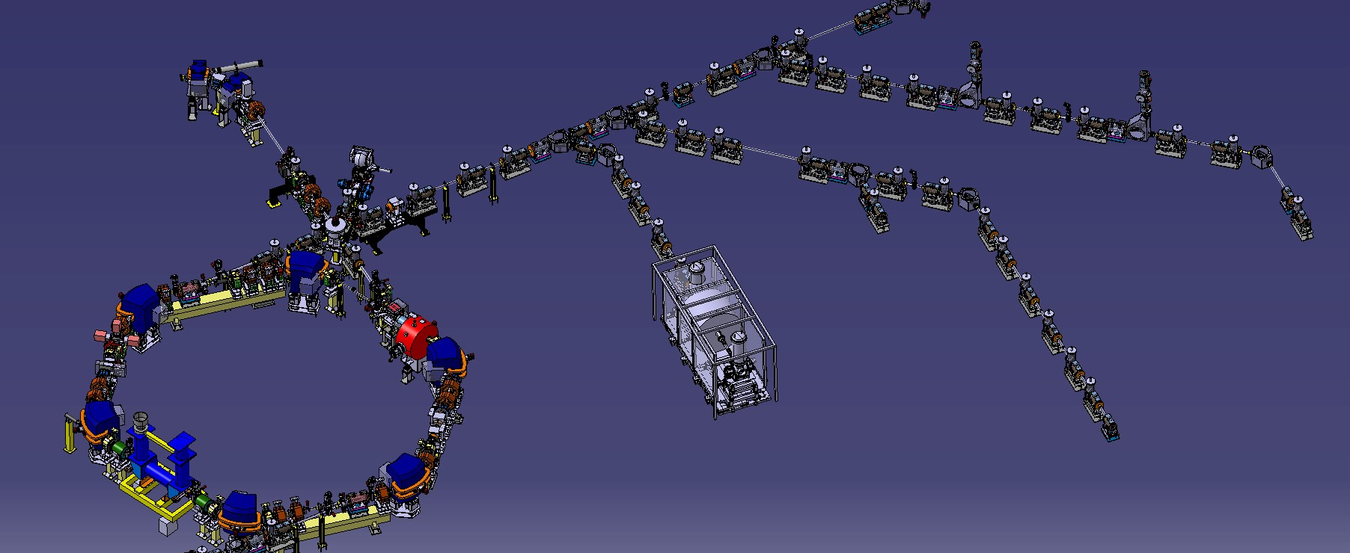
The ELENA Decelerator at CERN
C. Carli on behalf of the AD/ELENA team(s) EXA 2017, 5th September 2017
Introduction
Overview and Layout
Selected Features and Challenges
Status of Electron Cooler
ELENA Commissioning
Summary and Outlook

Slide 2
Introduction: Antiproton Decelerator AD – a unique facility providing 5.3 MeV antiprotons
(3 10⁷ in <300 ns)
~1.5 10¹³ protons
(26 GeV) on target
~3.5 10⁷ antiprotons captured in AD
  Acceptances 200 μm and ±30 10⁻³
Deceleration to the lowest energy 5.3 MeV reachable “safely” (limited by mag. Fields?)
Stochastic and electron cooling at four different energies
~3 10⁷ antiprotons extracted per cycle
  Dense core containing ~70% within <1 μm, often tails up to 10 μm
  Longitudinal before bunch rotation
  95% within 10⁻⁴ and 400 ns
Cycle length about 100 s
Location of
ELENA
Sketch of the present AD – circumference 182 m
- In addition experiments AEGIS and BASE
- Experiment Gbar being installed in new
experimental area

Slide 3
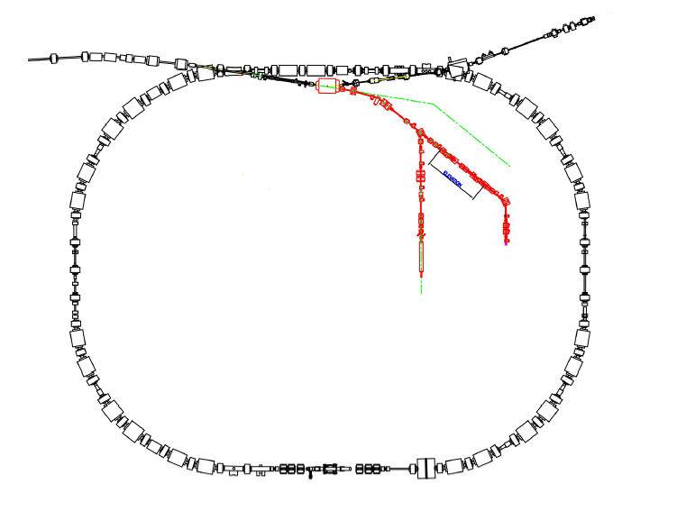

Introduction: Efficiency for capturing antiprotons in traps without and with ELENA
5.3 MeV antiprotons
a shot every ~ 100 sec
to one experiment
~4 keV
antiprotons/
~ 100 sec
~ 3 x 10⁷
Present situation with AD alone:
- Most experiments slow antiprotons down by “degrader”
=> very inefficient – most (>99%) antiprotons lost
(one experiment uses an RFQ for deceleration with higher efficiency)
100 keV antiprotons
a shot every ~100 sec
shared by ~4 experiments
ELENA
~ .45 x 10⁷
Future situation with AD and ELENA decelerating to 100 keV:
- thinner “degrader” and increased trapping efficiency
(some experiments use other means to decelerate the beam)
- Intensity shared by four exp’s allows longer periods with beam

Slide 4
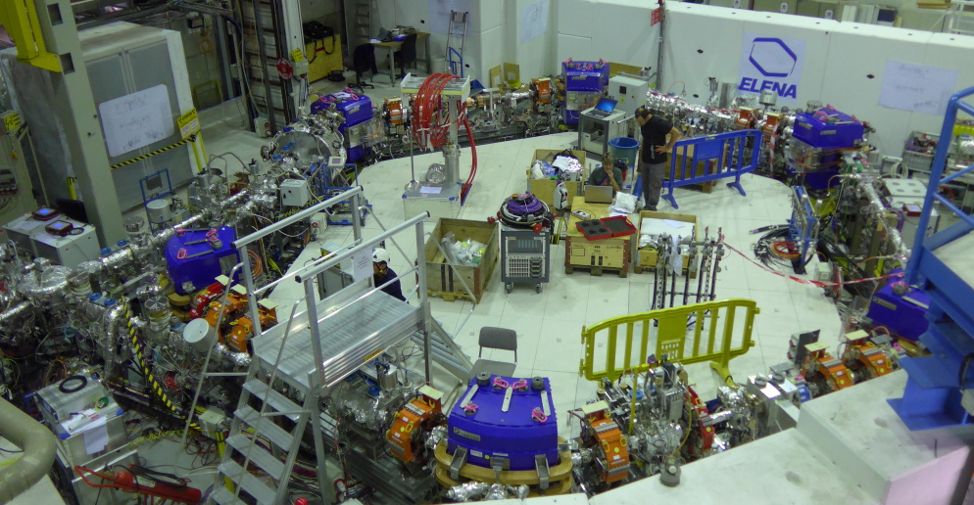
ELENA Overview and Layout
High sensitivity
magnetic Pick-up
(Schottky diagnostics
for intensity, LLRF..)
Extraction towards
new experimental zone (fast deflector)
followed by el.-static transfer lines
Injection with magnetic
septum and kicker
Compensation
solenoids
for (not yet
Installed) cooler
Wideband RF cavities
(very similar to new
PSB cavities)
Line
From AD
Extraction towards
existing experiments
Scraper to measure
emittance
Deceleration of antiprotons from 5.3 MeV to 100 keV to improve efficiency of experiments
Circumference 30.4 m (1/6 the size of the AD), magnetic ring and electrostatic extraction lines
Challenges related to low energy as field quality of magnets operated with very low fields

Slide 5
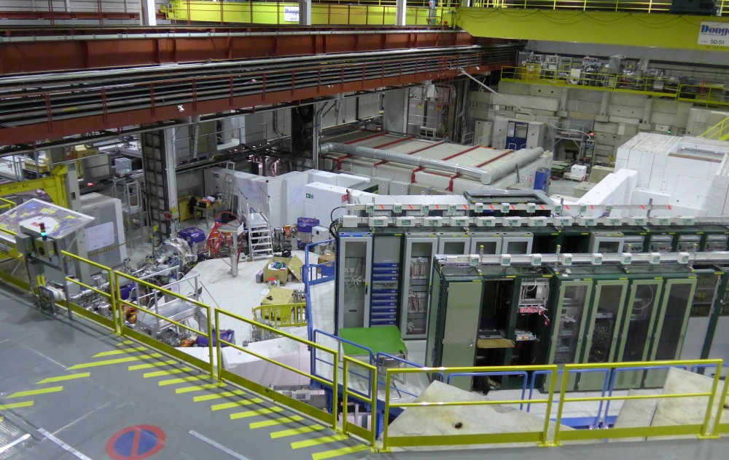
ELENA Overview and Layout
Towards existing experiments in other half of hall
AD Tunnel
New area with
One approved
experiment
ELENA
ring
ELENA in AD hall with existing (AD experiments) and new experimental area
  Seen from the door to the new small annex building (for kicker generators and storage)
  Cost effective with short transfer line from AD and no relocation of existing experiments

Slide 6
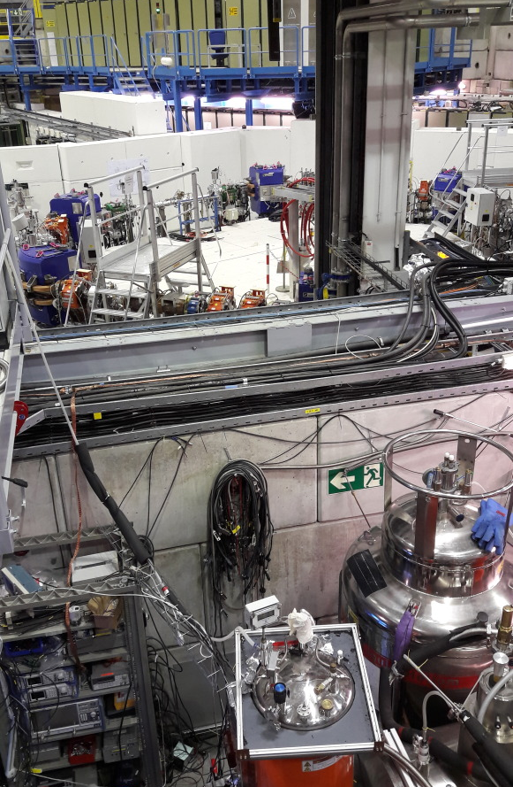
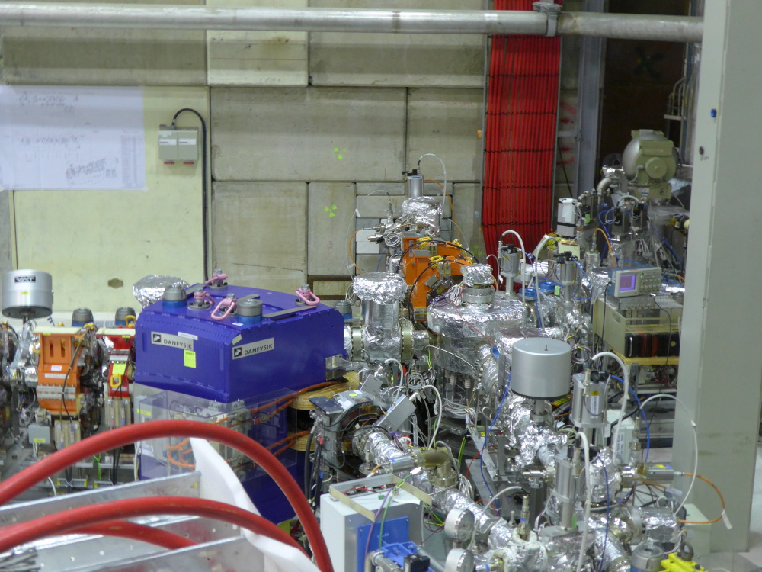
ELENA Overview and Layout

Slide 7
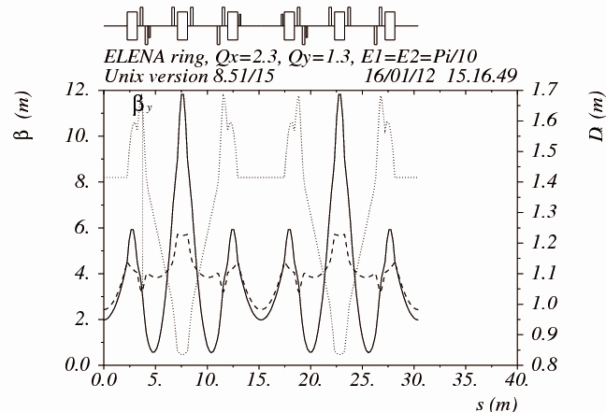
Selected Features and Challenges
Energy Range
  Machine operated at an unusually low energy for a synchrotron (down to 100 keV!)
  Challenges mainly a consequence of the low energy
Lattice
  Geometry of ring with position and strength of magnets
  Constraints
    Long straight section with small dispersion for electron cooling
    Geometry in AD hall (location
    of injection and two extractions)
    Acceptances, working point …
  Many geometries and quadrupole
  locations investigated
  Hexagonal shape and optics
  with periodicity two
  Tunes : Q_{X} ≈ 2.3, Q_{Y} ≈ 1.3
  (e.g. Q_{X} = 2.23, Q_{Y} = 1.23)
  Acceptances: about 75 μm
  (depends on working point)

Slide 8
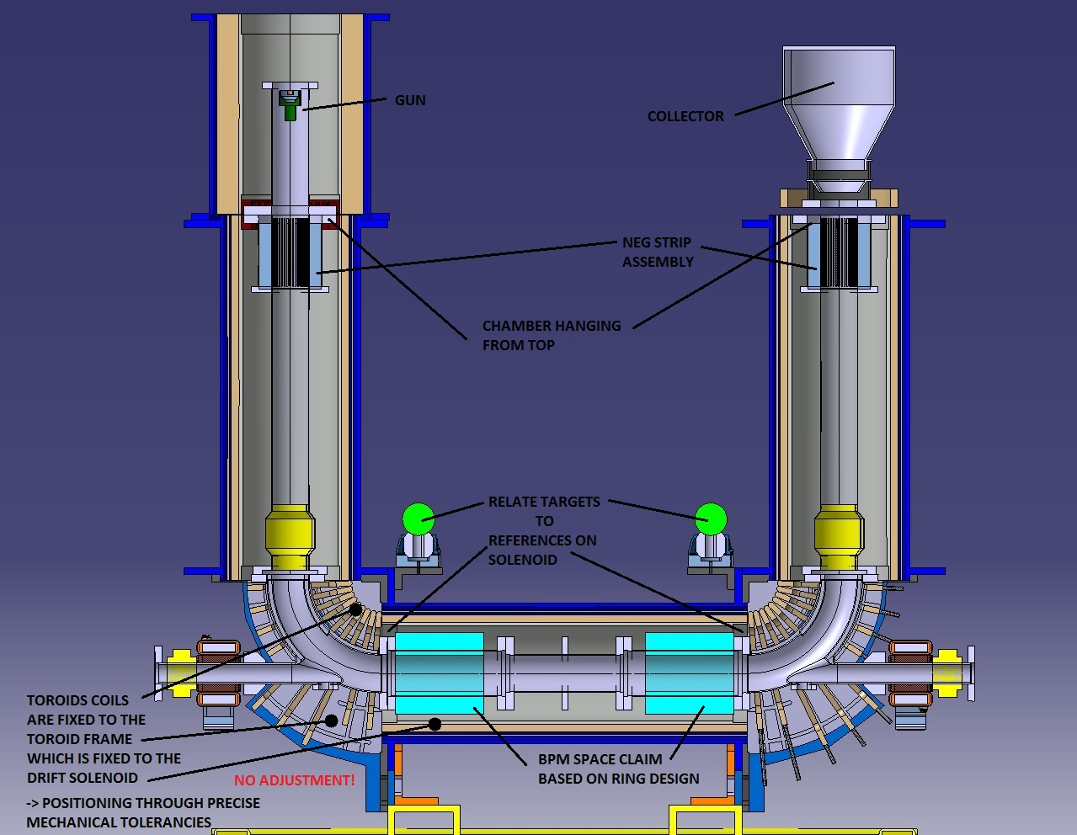
Selected Features and Challenges
Electron cooling
  Essential ingredient of concept
  Cooling at intermediate plateau to reduce losses and
  the final energy 100 keV to provide dense bunches
  Bunched beam cooling at 100 keV to
  reduce momentum spread of short bunches
  Perturbations of magnetic system on circulating
  beam difficult to assess and under discussion
  Mounting within the next weeks
Intra Beam Scattering IBS
  Coulomb scattering between beam particles
  Transfer of heat (unordered motion)
  between phase spaces (long. & transverse)
  Emittance blow-up – determines together
  with cooling emittances of available beams
Equilibrium between Cooling and IBS
determines properties of beams for
experiments
x (trans. position)
s
(long.
position)
Intra Beam Scattering IBS – co-moving coord. system

Slide 9
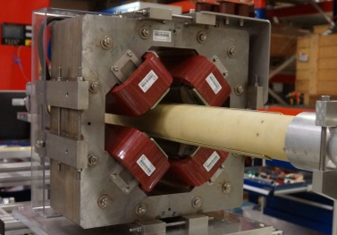
Selected Features and Challenges
Direct space charge effect
  Coulomb force between beam particles generate non-linear defocusing force
  Initial reason to split available intensity into 4 bunches
Magnets with very low fields
  Low energy beam sensitive stray fields and
  magnet imperfections due to hysteresis &
  remanence
  “Thinning” (mixing of stainless steel and
  magnetic laminations) had been foreseen
  initially to improve
  Careful magnetic measurement with pre-series
  quadrupoles showed smallest remanence with
  conventional yoke (no thinning)
  Observation confirmed with bending magnet
  prototype and understood now
  Magnet thinning does NOT improve field
  quality at low fields, but rather increases remanence effects
  ELENA bending magnets, quadrupoles and sextupoles made with conventional yokes
  (Corrector magnets without yokes)
Prototype quadrupole to investigate magnet
“thinning” on the measurement bench

Slide 10
Selected Features and Challenges
Rest gas interactions and vacuum system
  3 10⁻¹² Torr nominal pressure - fully baked machine with NEGs wherever possible
  Interactions of beam with rest gas to be evaluated with care, not the dominant limitation
Beam diagnostics with very low intensities and energy
  E.g.: Beam currents down to well below 1 μA far beyond reach standard slow BCTs
  Intensity of coasting beam measured with Schottky diagnostics (observing noise generated by coasting beam on a pick-up, special pick-ups design to limit background noise)
Electrostatic transfer lines to experiments
  Cost effective at very low energies,
  Many quadrupoles allow a design with small “betatron functions” and large “betatron phase advance” (small beam sizes) limiting impact from stray fields
  Easier for shielding against magnetic stray fields
RF system with modest voltages, but very large dynamic range
H⁻ and proton source (and electrostatic acceleration to 100 keV) for commissioning as much as possible
  Higher repetition rate but start commissioning at the difficult low energy part of the cycle
  Antiprotons needed to complete ELENA ring commissioning … and already taken during the last weeks

Slide 11
ELENA Beam Parameters
Present best guess combining different Sources
Step in cycle | ε_{L} (meVs) | σ_{p}/p (10⁻³ ) | σ_{E} (keV) | σ_{Τ} (ns) | ε_{H,rms} (μm) | ε_{V,rms} (μm)
Injection^{+,a)} | 3.5 | 0.25 | 2.8 | 98 | 0.5 | 0.3
Start 1st ramp^{+,b)} | 3.5 | 0.49 | 5 | 53 | 0.5 | 0.3
End 1st ramp^{c)} | 3.5 | 1.4 | 1.8 | 150 | 1.8 | 1.1
Start plateau 35 MeV/c^{d)} | 5.2 | 0.46 | 0.6 | coasting | 1.8 | 1.1
End plateau 35 MeV/c^{e)} | 1.7 | 0.15 | 0.20 | coasting | 0.45 | 0.42
Start 2nd ramp^{d)} | 2.5 | 0.84 | 1.1 | 180 | 0.45 | 0.42
End 2nd ramp^{c)} | 2.4 | 2.1 | 0.42 | 455 | 2.2 | 2.5
Start plateau 100 keV^{d)} | 3.6 | 0.81 | .16 | coasting | 2.2 | 2.5
Cooled coasting 100 keV^{e)} | 1.1 | 0.25 | .050 | coasting | 0.3 | 0.2
Cooled bunched 100 keV^{f)} | 4 x 0.12 | 0.60 | .120 | 75 | 1.2 | 0.75
ε_{rms} = σ_{β}²/β_{T} with σ_{β} the rms betatron beam size and β_{T} the Twiss betatron function
+) difficult to determine due to (i) dense core and long tails, (ii) variations with time
a) Typical values measured with AD – some reduction of long. Emittance with bunched beam cooling
b) Increase of voltage from 16 V at transfer to 100 V on ramp
c) Simulations of IBS on ramp
d) Debunching/bunching with 50% blow-up (bunched with LHC def. ε_{L} = 4π σ_{E} σ_{Τ}, coasting ε_{L} = 4 (2/π)^{1/2} σ_{E} Τ_{rev})
e) From ELENA technical meetings with presentations by G.Tranquille and P. Beloshitsky

Slide 12
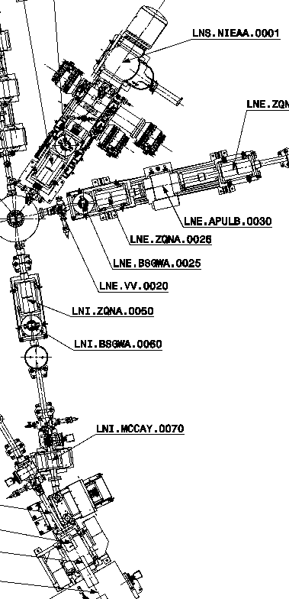
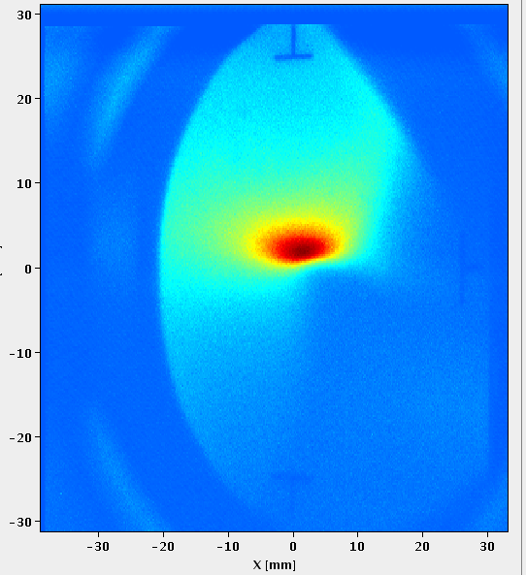
ELENA Commissioning –
Ion Source and Line from Source to Ring
Aim: progress as much as possible without taking precious antiprotons
Source available and tested well in advance
  100 keV (post-acceleration), source a few meters from Faraday cage with HV cables in between
  First tests with source mounted in Faraday cage
Technical issues despite serious preparations
  => Now running with fixed isolation transformer at 85 keV
Empirical adjustments led to unexpected settings
Limited beam diagnostics
  Only one profile monitors with temporary electronics available
Source
Profile monitor
prototype
Source and profile monitors
are in-kind contributions to ELENA
Thanks a lot to all teams contributing!
TV station
almost only
instrumentation
available
One of the first acquisitions
from November 2016

Slide 13
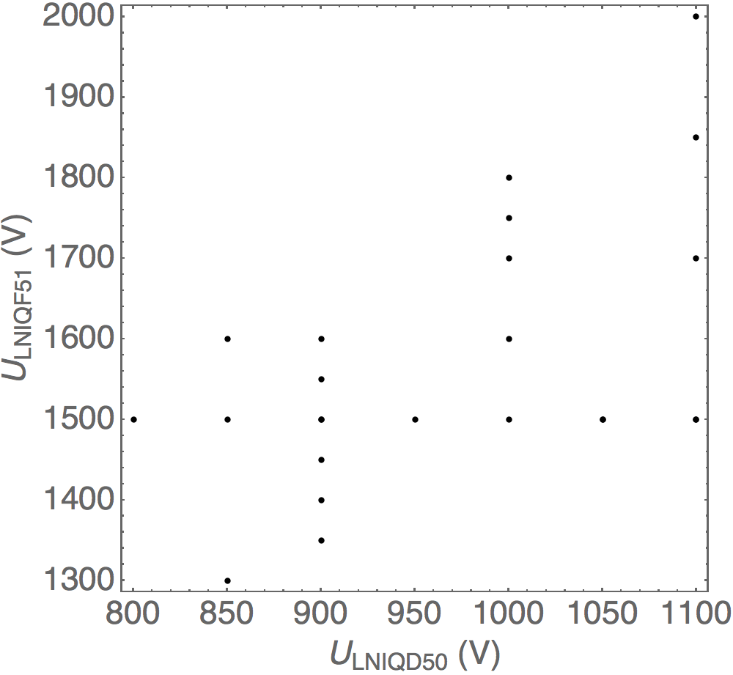
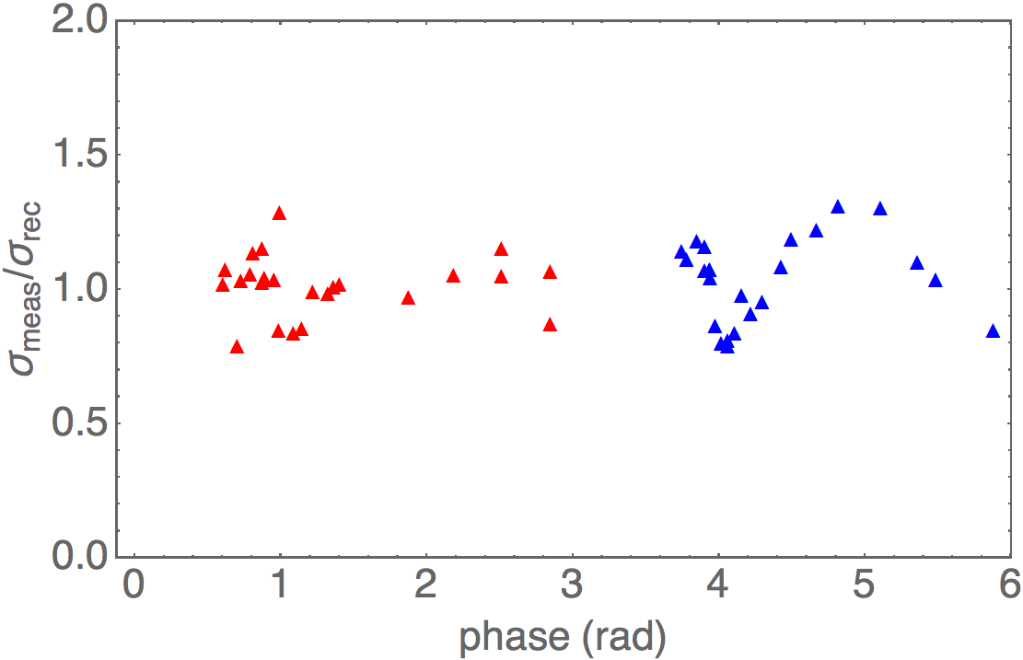
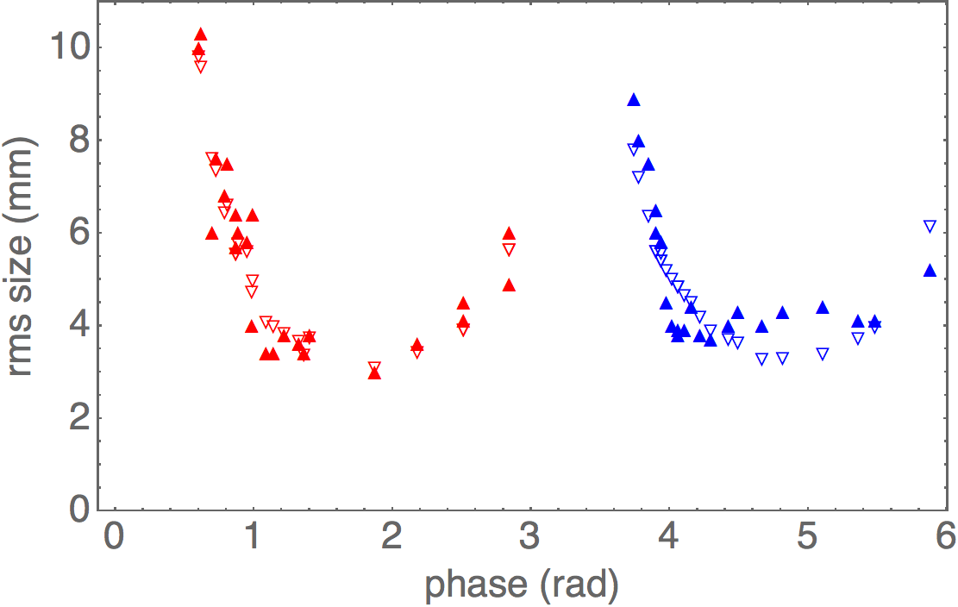
ELENA Commissioning –
Ion Source and Line from Source to Ring
LNS quads U_{LNSQF20} = 1855 V and U_{LNSQD21} = 1220 V
Reconstructed characteristics at the reference
  Hor.: ε_{x,rms} = 4.71 μm, β_{x} = 1.4151 m and α_{x} = -3.0061
  Vert.: ε_{y,rms} = 5.08 μm, β_{y} = 0.8381 m and α_{y} = -2.6142
Comparison of measured beam sizes and reconstructed ones
  Vertical phase space in red, horizontal in blue
  Right image: Filled (empty) triangles for measured (reconstructed beam sizes)sizes
LNI Quad settings used
Indication for possible
systematic errors?

Slide 14
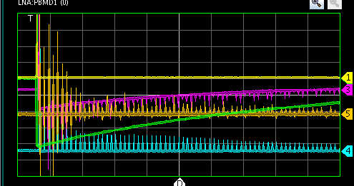
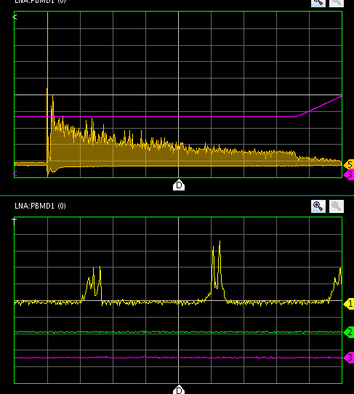
Start of ELENA Commissioning –
Ring
Beam observed over several 10s of turns
(probably a few ms) in November ‘16
after less than 2 weeks
  Beam lost quickly or just not visible
  any more due to debunching?
  Commissioning of RF system as next
  under preparation, when source broke
  (insulation transformer)
With 85 keV H⁻ after commissioning of RF system
  Beam shown to survive at least until start of ramp
  Only very basic RF functionalities, no phase loop
  Poor reproducibility a serious issue
    Slow drifts and shot-to-shot
    Difficult to work on setting-up systems as RF
Synchrotron oscillation, debunching seen
with OASIS
Position pick-up sum signals
50 μs/div
50 ms/div
1 μs/div
About 150 ms after injection
~1.5 10⁶ H⁻ ???

Slide 15
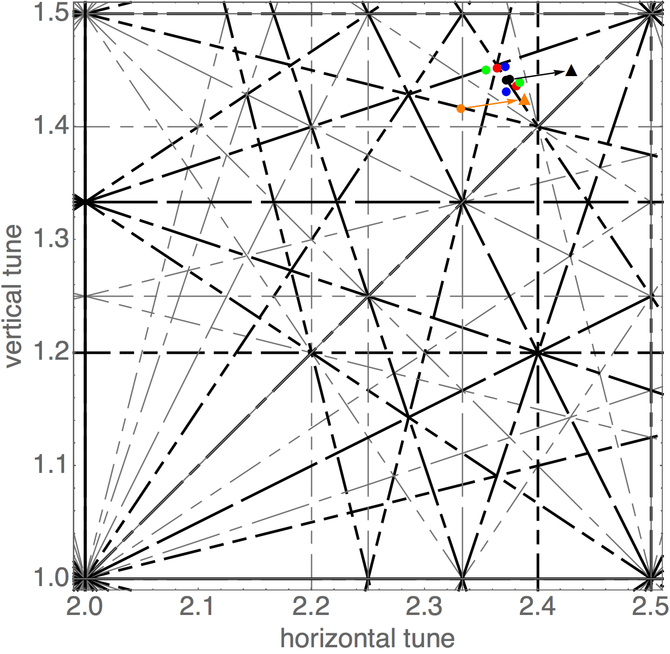
Working points
Tune: number (average) of transverse oscillations per revolution (two tunes for the horizontal and vertical plane)
Working point is the combination of the two tunes – must avoid “resonances”
Black: measured working point with
initial quadrupole currents
Red, blue and green: current of one of the three quadrupole circuits changed by ±0.05 A
(Orange: working point from model with programmed quad currents)
Reassuring that behavior about as expected
Resonance diagram with working point(s)
close to 5th order resonance

Slide 16
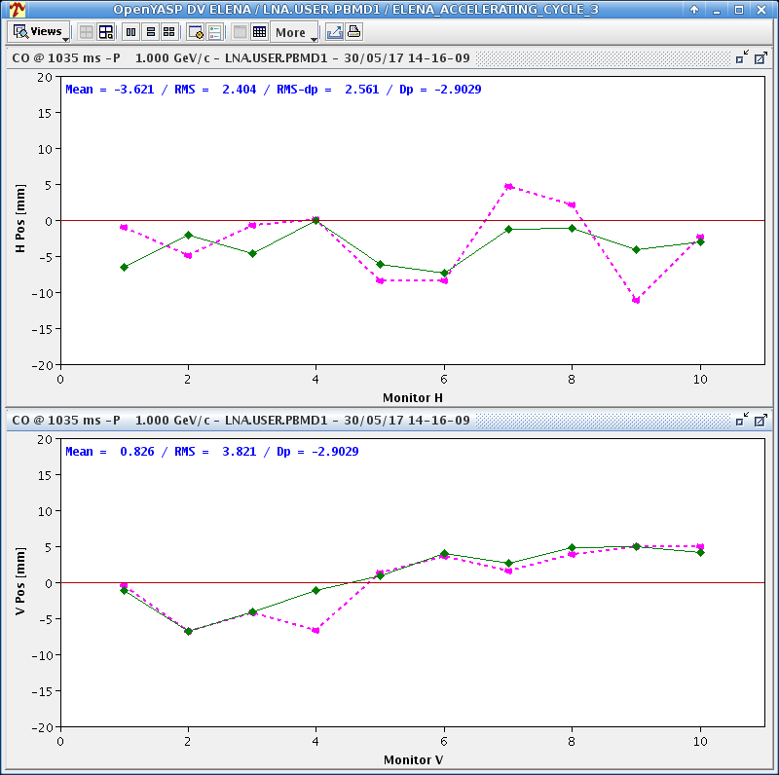
First orbit corrections
Orbit is the transverse position of the beam as a function of the longitudinal position
  Measured at some locations with “pick-ups”
  Beam not at center of chamber due to perturbations (stray fields magnet mis-alignment ..)
  Corrector dipoles to improve
  Confidence in basic machine optics

Slide 17
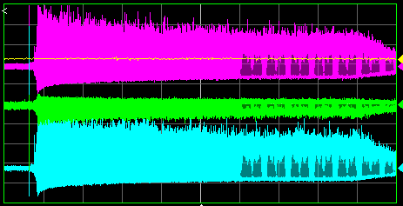
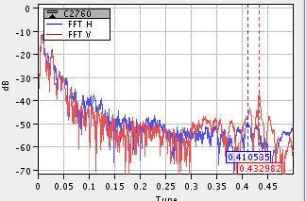
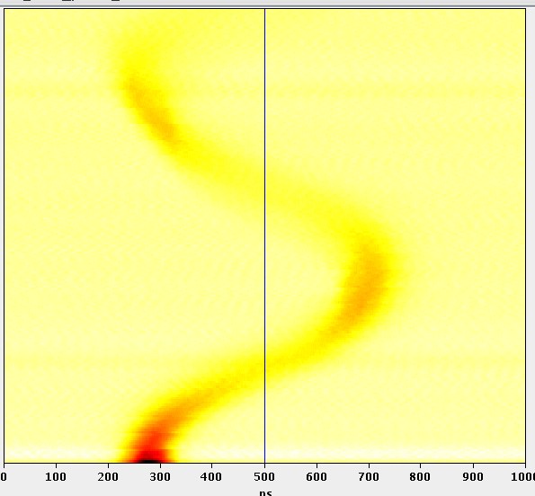
ELENA Commissioning
Progress with Antiprotons
Antiprotons injected followed by bunching
  Phase and radial loops and “Bunch to Bucket”
  transfer to be set-up
  Large transverse missteering (leading to
  emittance blow-up) to be corrected
  Good life-time
Commissioning of the scraper
  Emittance measurement by observing
  losses, when a scraper is moved into the beam
Tune measurement with the system
  So far “only” using the coherent oscillations from injection
Synchrotron oscillation
with RF on at injection
Injection followed
by bunching
Start of
ramp down
Pick-up signals (200 ms/div.)
≈1.5 ms
Time
≈ 1 us
Time

Slide 18
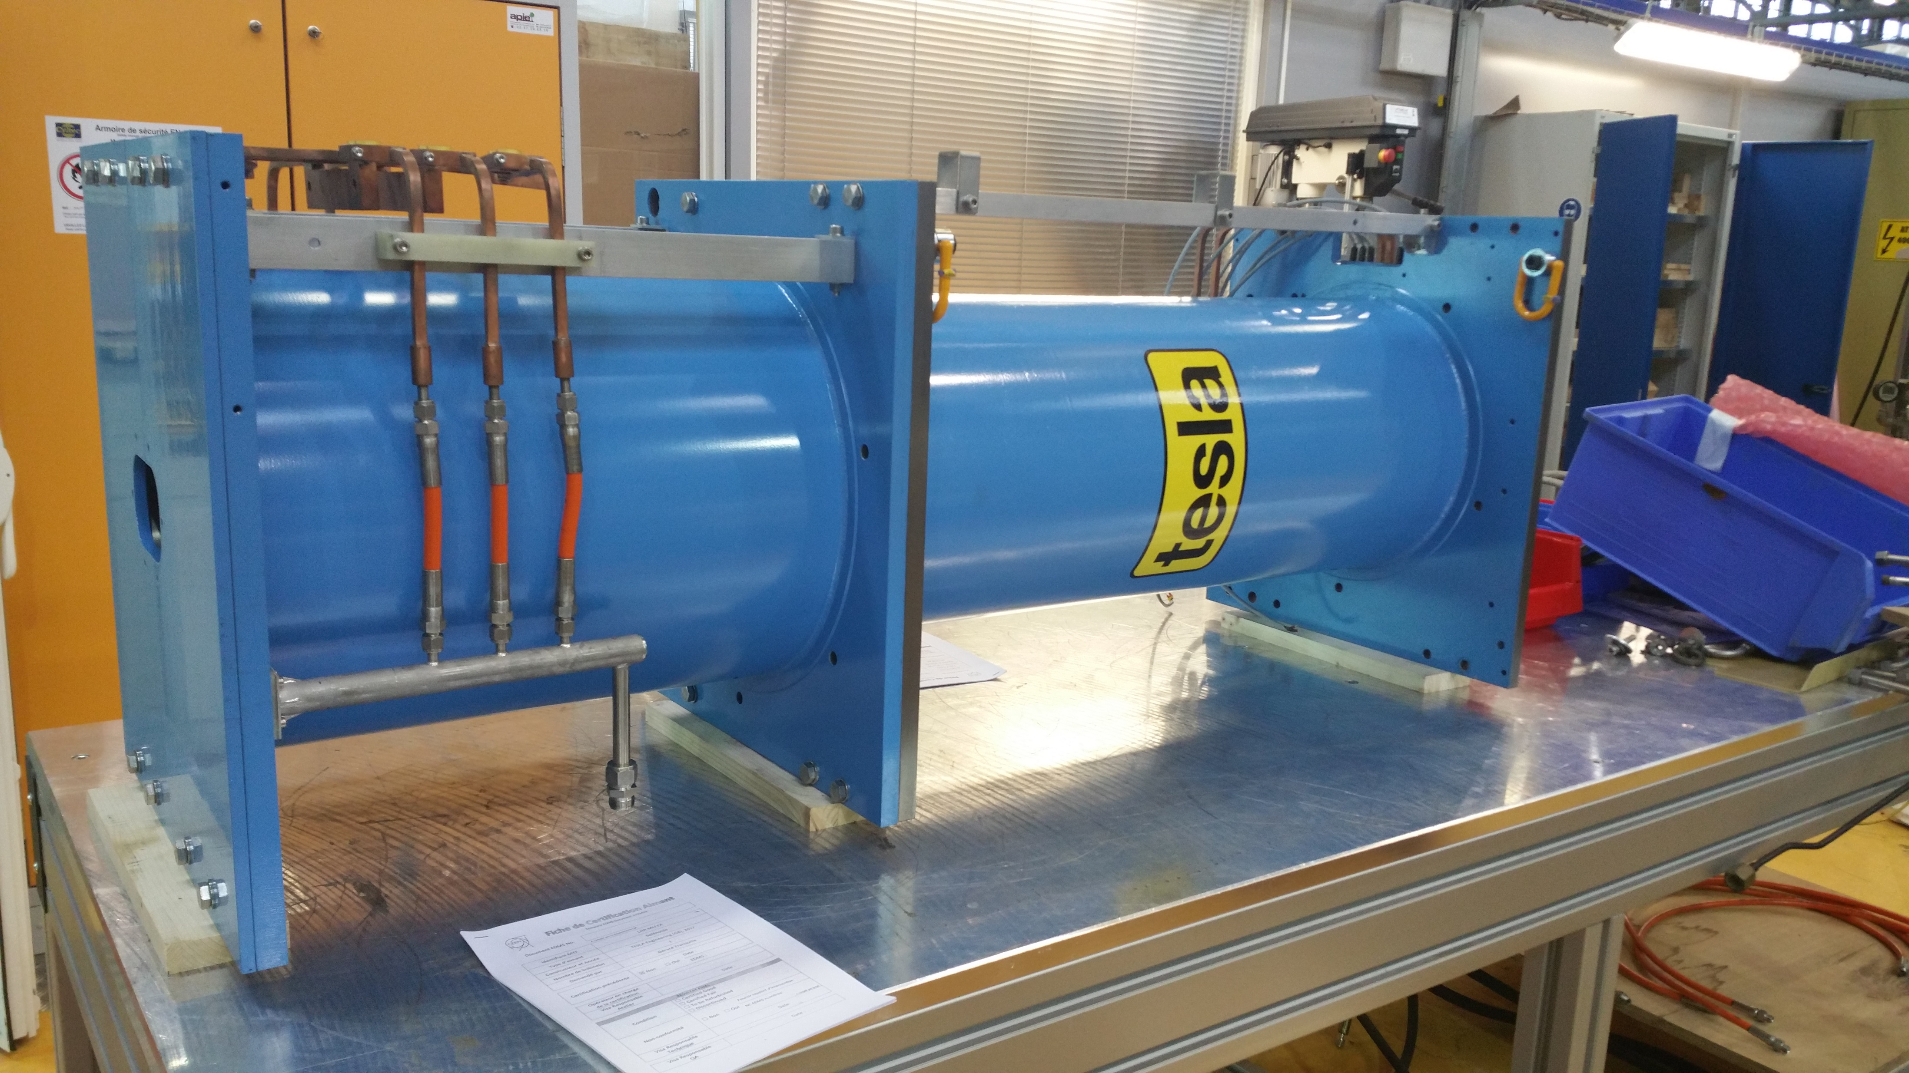
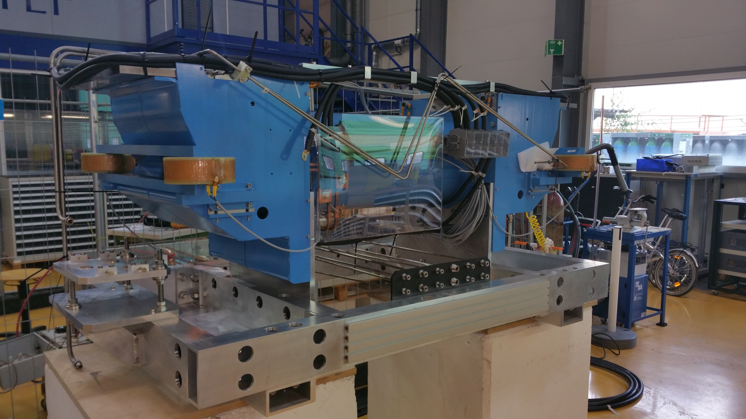
Status of the Electron Cooler
Magnetic system at CERN since about three weeks
  Now with Magnet Group for “Certification” (standard tests done with magnets)
  Some issues with magnetic measurements done by company
    Compensation scheme combining info. from measurements of single solenoids and full system
    Try to understand (simulations and/or measurements?) unexpected field and possible impact
Issues with NEG coating of Vacuum System (recurrent problems for several ELENA Chambers)
  All chambers (and electrodes) coated, acceptance tests still to be completed
  Depending on progress this autumn or during CERN YETS (end-of year shutdown)
Installation to be coordinated with other activities and in particular, first beam for GBAR

Slide 19
Summary and Outlook
ELENA Ring installed and Commissioning started
  Circulating H⁻ beam from source for several 100 ms at 85 keV (limited by flat bottom)
  Commissioning of system (RF, instrumentations, …) slowed down by poor reproducibility of injection of 85 keV H⁻ beam
  Commissioning with antiprotons started (circulating beam with decent life-time …)
Short Transfer Line Towards GBAR installed recently
Next Steps
  Continuation of ELENA Commissioning with H⁻ (protons?) and antiprotons
    Further setting up of RF and other systems, acceleration/deceleration
    Completion of commissioning of orbit system and correction, tune measurements,
    scraper …
    Quantification and correction of antiproton injection oscillations
    Efforts to understand and cure poor reproducibility of H⁻ injection (transfer line?)
  First beam (probably H⁻ or protons) to GBAR this year
  Installation of cooler in autumn or during YETS (end-of-year shutdown)
  Completion of ELENA ring commissioning (electron cooling and finally
  setting-up of operational antiproton cycle)
  Until CERN Long Shutdown 2 (LS2) GBAR will be the only user with the connection of old experimental area to ELENA during LS2 only

Slide 20
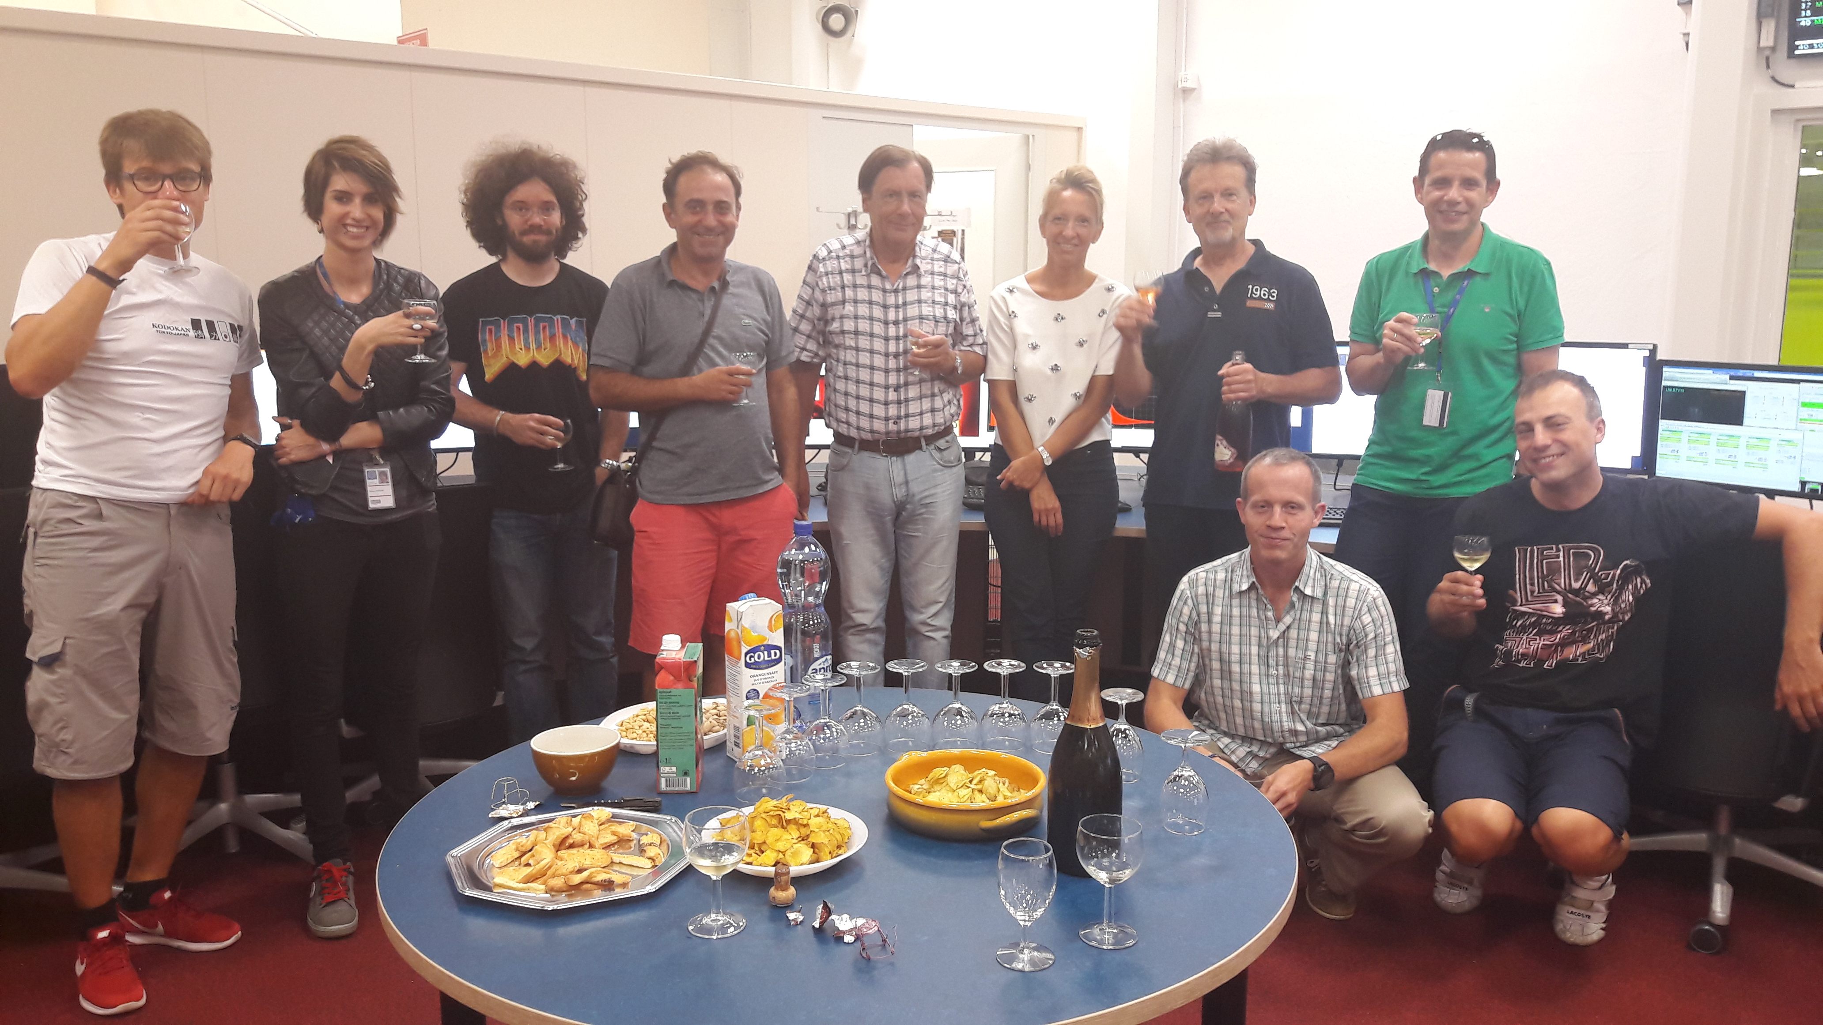
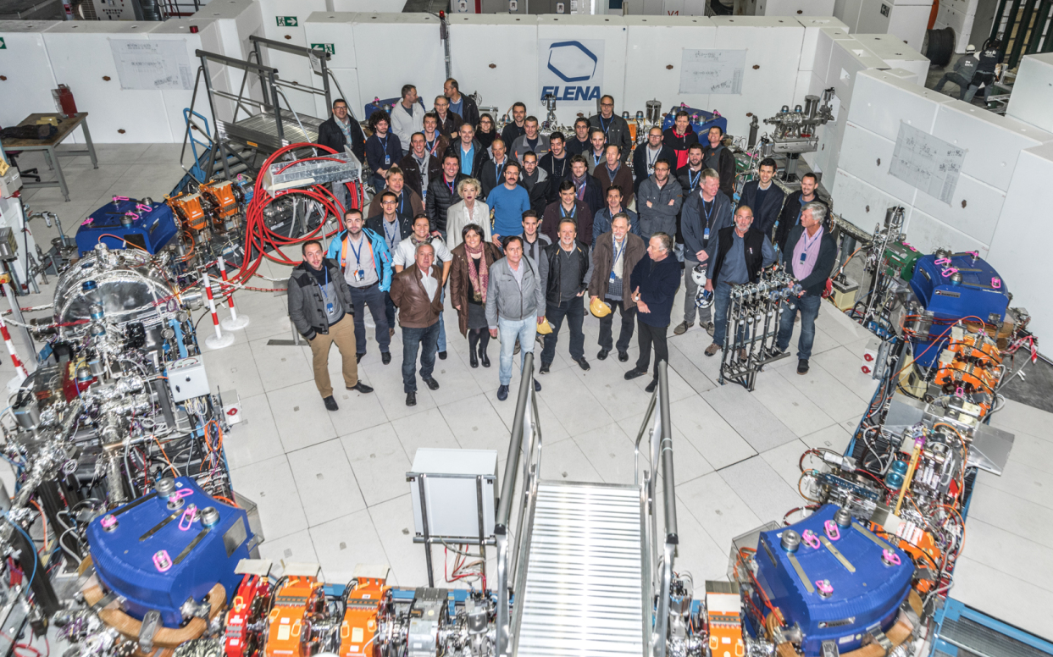
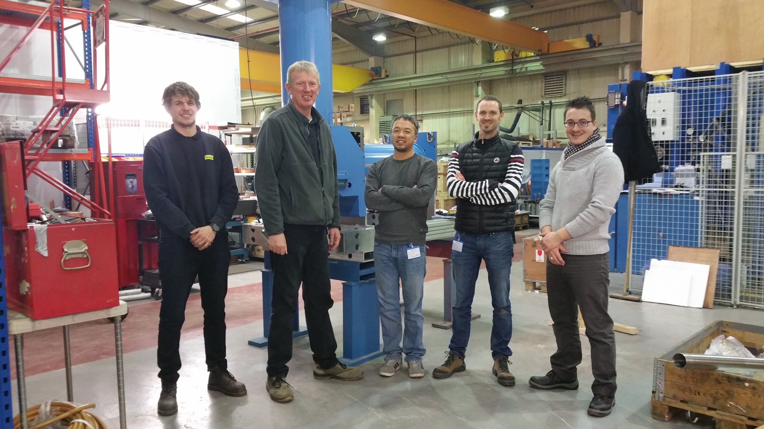
Contributors to the ELENA Project

