Slide 1
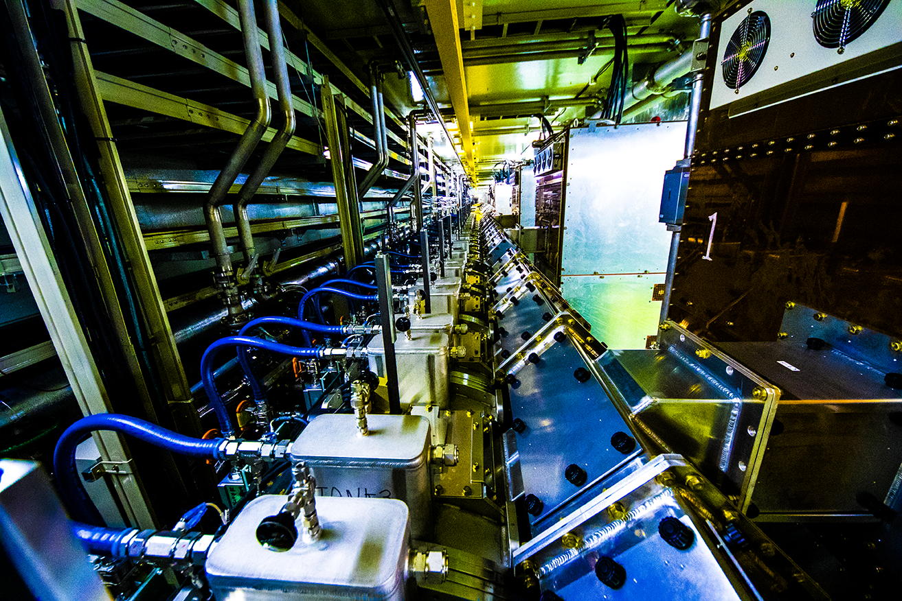

J-PARC Overview
The current status of fundamental physic s at J-PARC including hadron physics and future plans with upgrades
EXA2017
September 11-16, 2017. Wien, Austria
Naohito SAITO
J-PARC
High Energy Accelerator Research Organization (KEK)
Japan Atomic Energy Agency (JAEA)

Slide 2
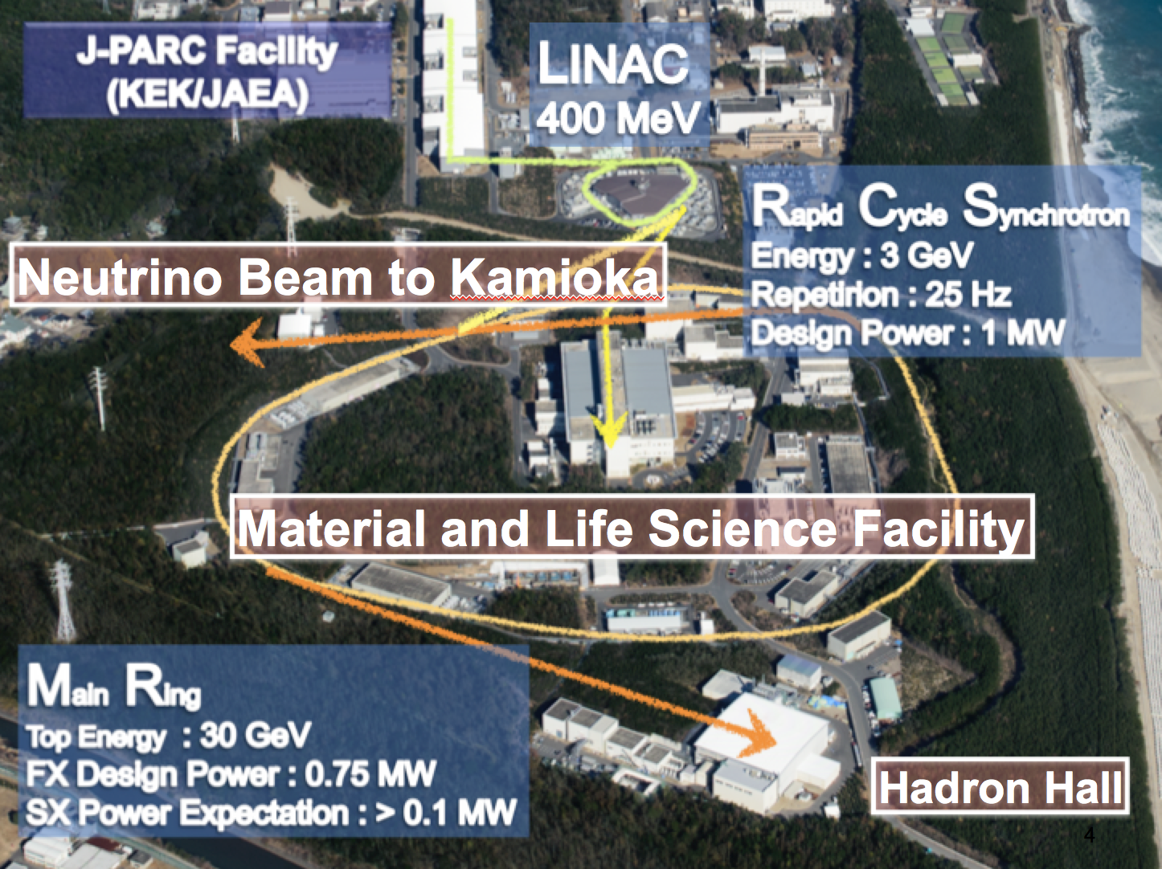


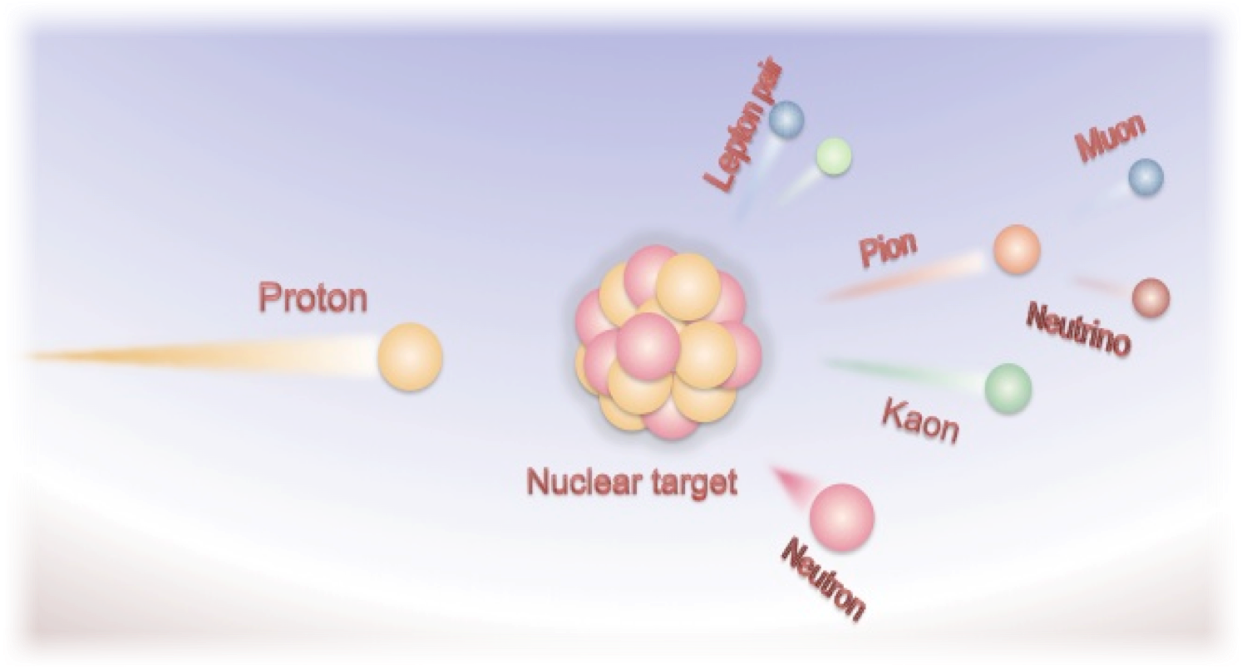
J-PARC Overview
Multi-purpose research facility with hi-intensity proton driver:
  Material and Life Science
  Particle and Nuclear Physics
  ADS R&D
Jointly operated by two organizations:
  KEK, and
  JAEA
For origin of
  Matter and Universe
  Diversity of Material and Life
  R&D of ADS of Nuclear Transmutation

Slide 3
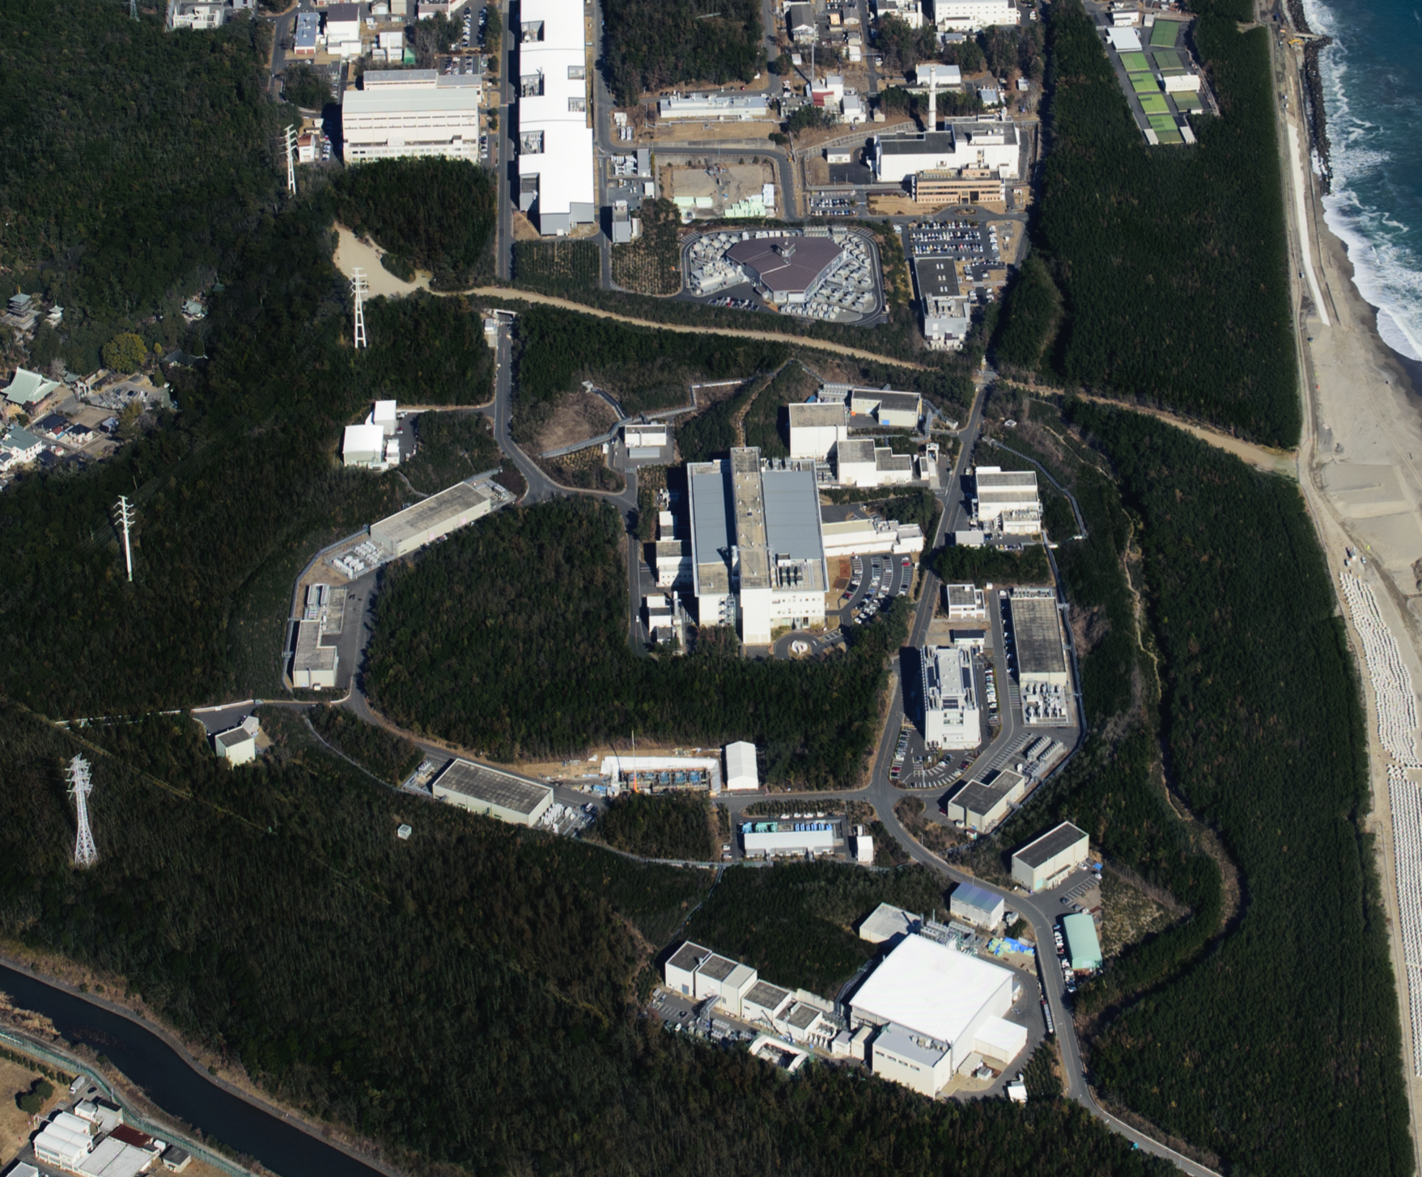


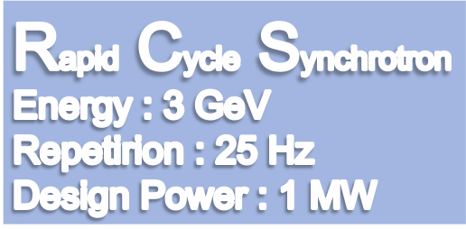




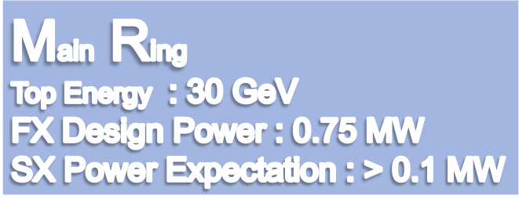
LINAC
400 MeV
Neutrino Beam to Kamioka
Material and Life Science Facility
Hadron Hall
Notes:
まず、こちらが、J-PARCの加速器複合施設です。陽子ビームを１８１MeVまで加速する（来年度以降４００ MeVになる）線形加速器ライナックがあり、その後、ビームは、40 msという短い時間の間に3 GeVまで加速されます。そのビームのほとんどは、この物質生命科学実験施設で中性子やミュオンを使った実験の為に使われています。

Slide 4

D'où venons-nous ? Que sommes-nous ?
Où allons-nous ?
Where did we come from? What are we? Where do we go?
P. Gauguin 1897, Boston Museum

Slide 5
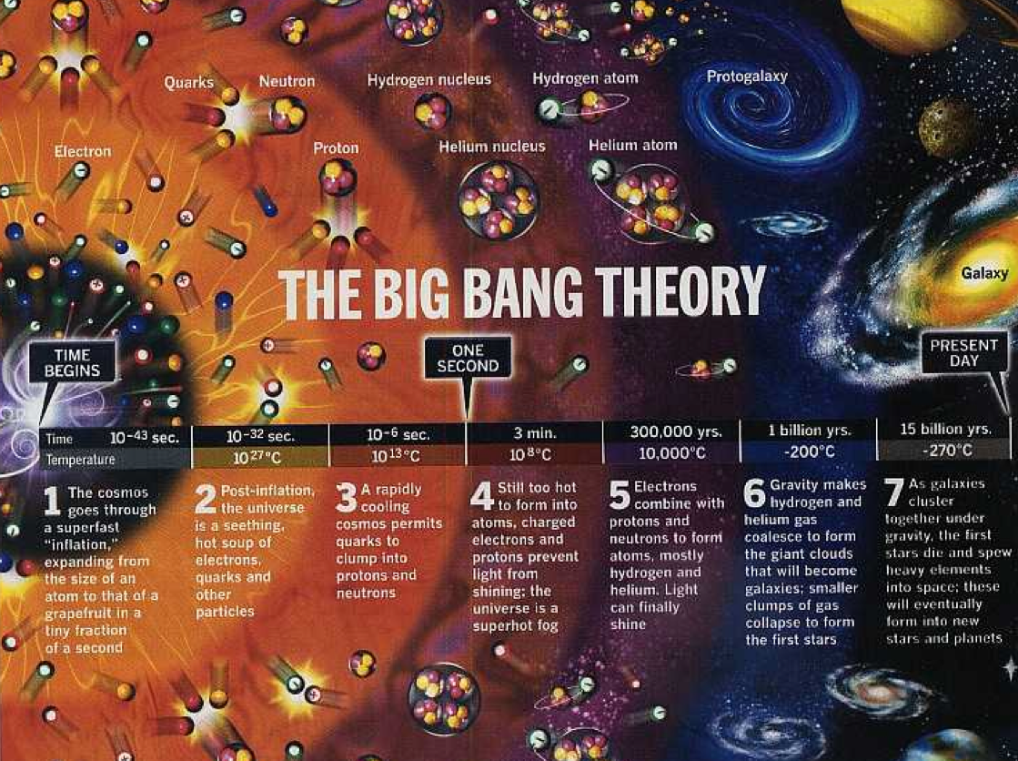


Slide 6
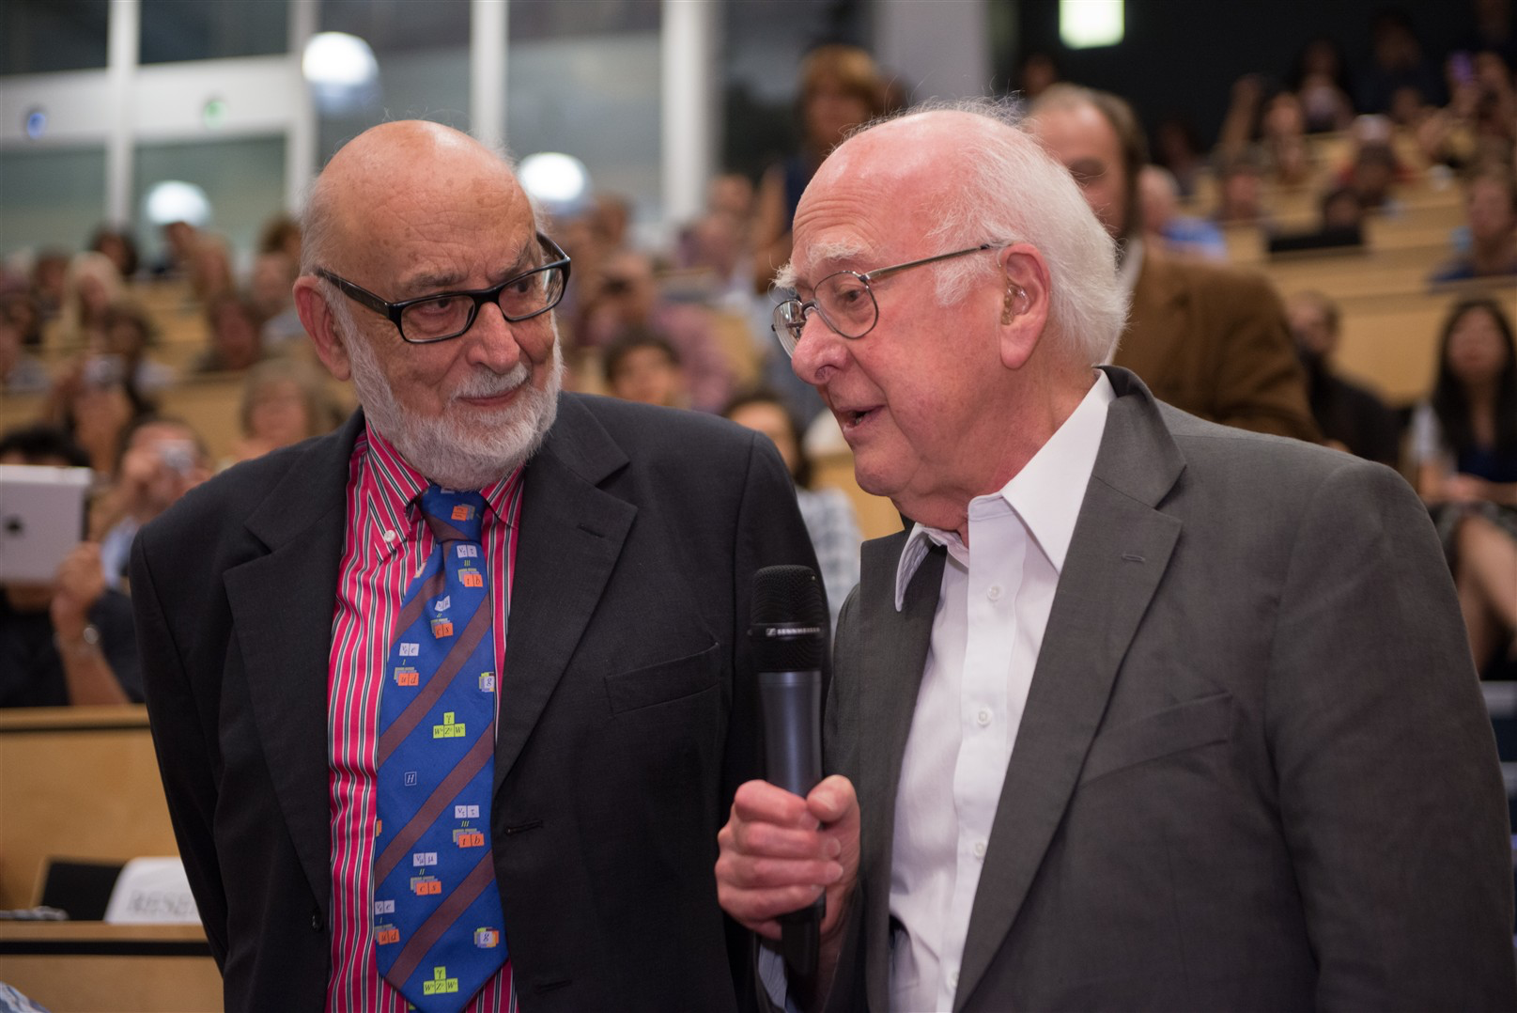

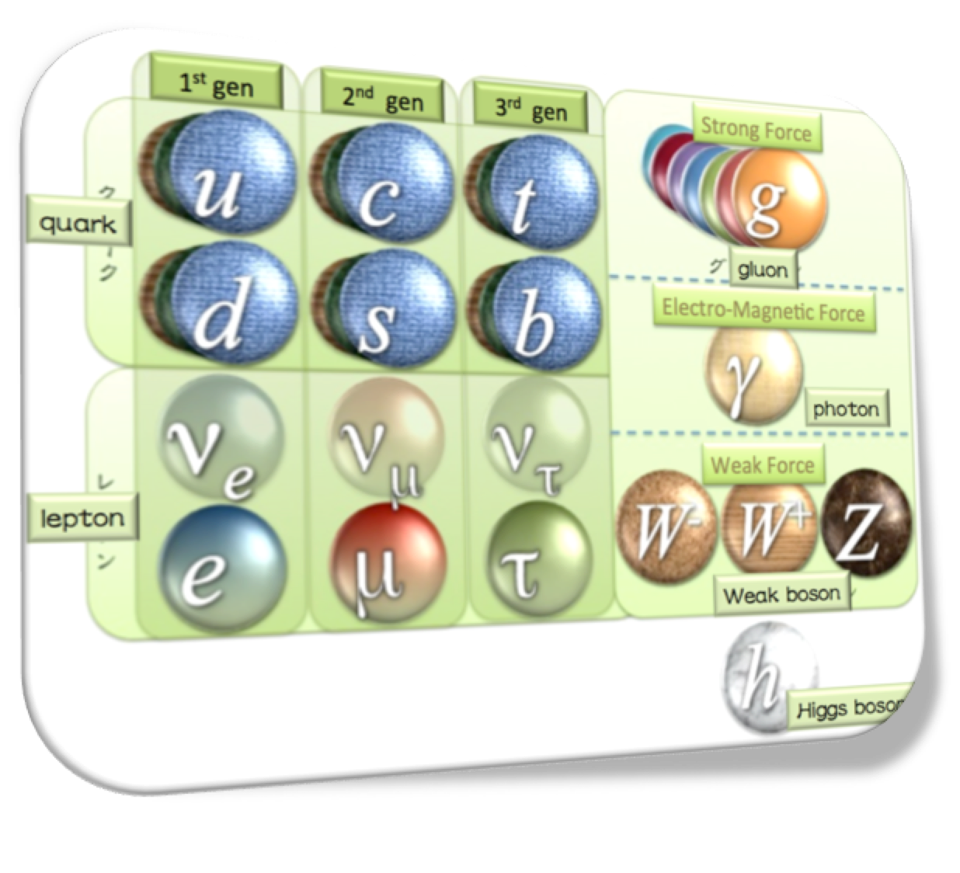


Many Remaining Questions
Completion of the Standard Model
Why 3 generations?
Why CP violates? (particle-anti-particle asymmetry)
Why mass distributed this way?
Baryon number, Lepton number, Lepton flavor violated?
What is Dark Matter, Dark Energy?
Why our Universe is matter-dominant?
Is super-symmetry real?
x~100 heavier

Slide 7
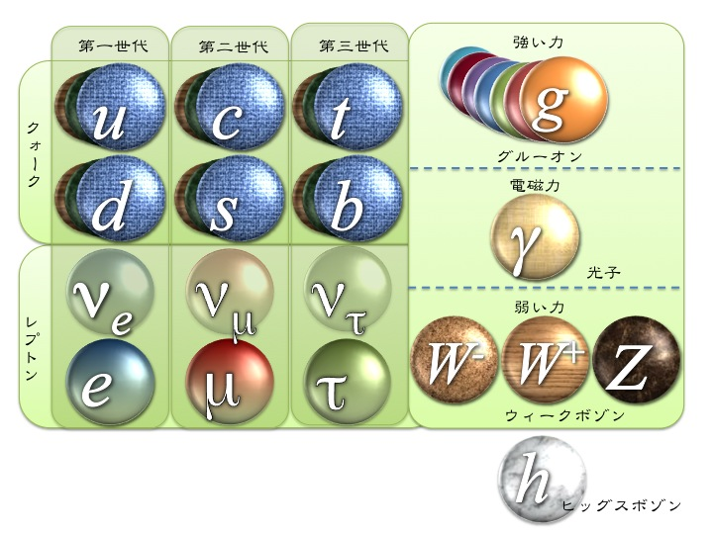
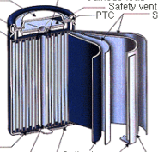
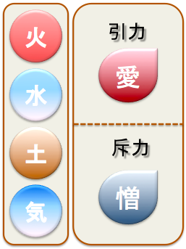
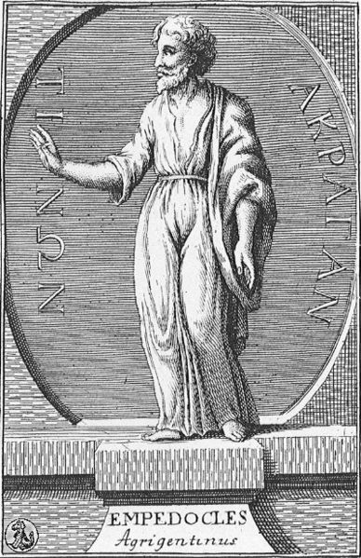
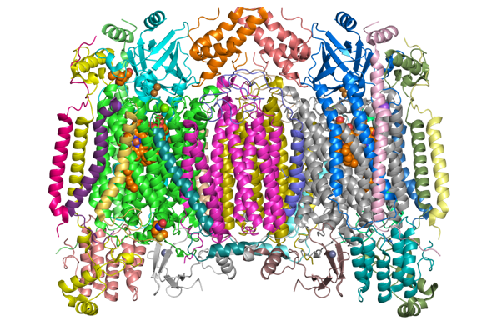
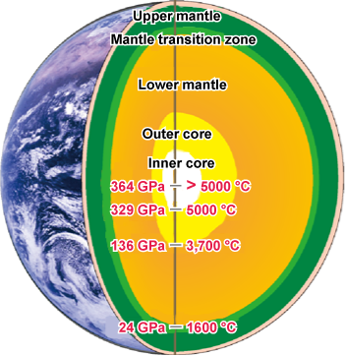
Hi-power Beams for the Next Stage of Our Life
Why no anti-matter?
（matter and “anti-matter” are twin）
How a life emerged on the earth ?
（Anthropology）
How the diversity of the matter and life emerged?
（What a beautiful world!）
Our view is limited by
  “what we can feel and touch”
To elucidate the truth in the nature, we need
  ”better eyes to investigate more fine structure more precisely with more sensitivity”

Slide 8
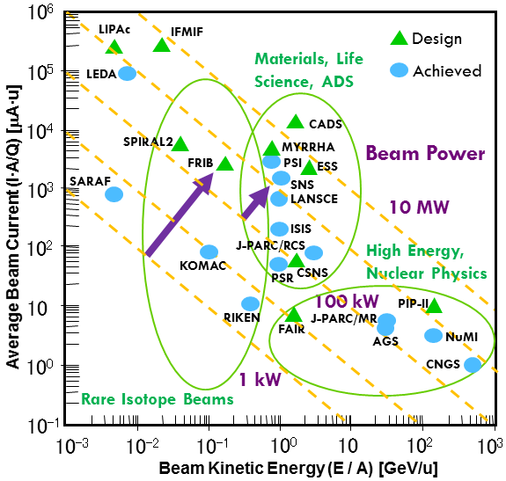
A Quest for High Intensity
High Intensity
High Statistics
1 MW
More Precision
More Rare Searches
More Materials
Discovery!
Jie Wei / Y. Yamazaki

Slide 9
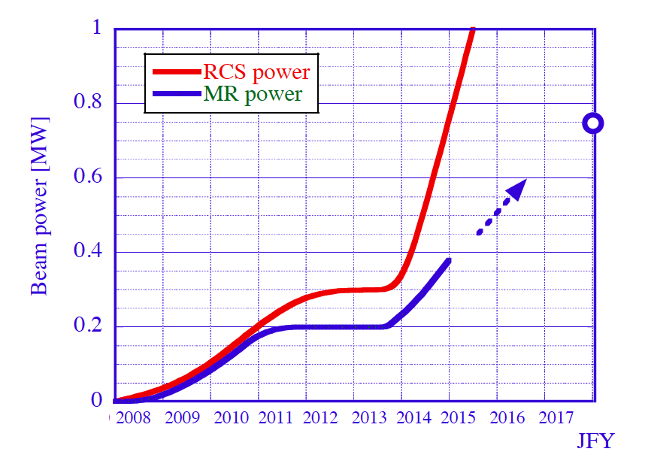

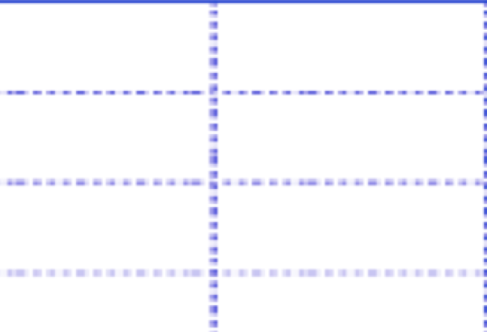
Beam Power : Plan vs Reality
RCS ::1 MW achieved in Jan, 2015
Thanks to new working point!
MR::so far 0.38 MW for FX ; ０.9 MW reachable with new PS
LINAC Upgrade
MR PS renew
MLF one shot
750 kW
MLF achieved
（user operation）
FX achieved
（user operation）

Slide 10
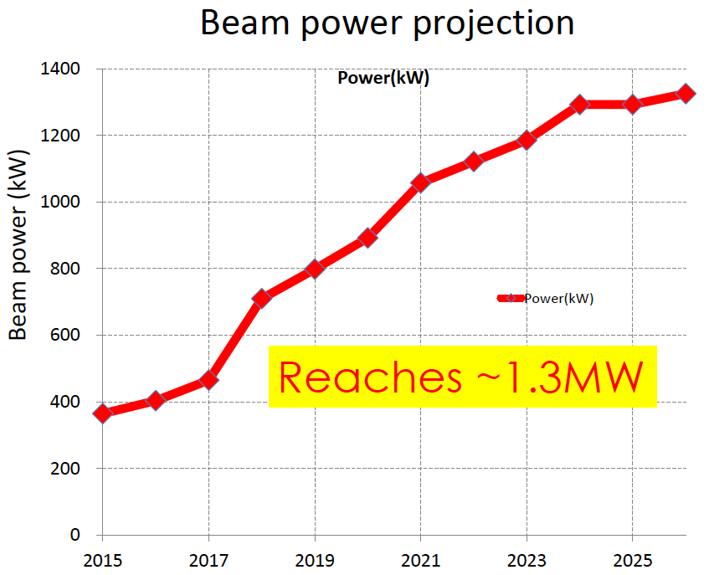
J-PARC Main Ring (30 GeV) operates beyond 1 MW
RF anode power supply upgrade
Air-cooled 2nd RF
1.16 s cycle
10th RF system
1.20 s cycle
1.25 s cycle
Magnet PS upgrade
2.48 → 1.3 s cycle
JFY
Notes:
This picture shows expected power.
Horizontaｌ is JFY and vertical is beam power.
Now we are here.
Here , we have magnet PS upgrade and after that cycle time is gradually shortened.
And we plan to upgrade RF anode power supply here. And we reach 1.3 MW in 2023, if budget is approved as the plan.

Slide 11

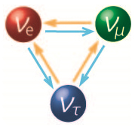
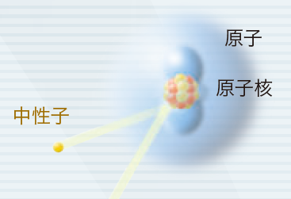
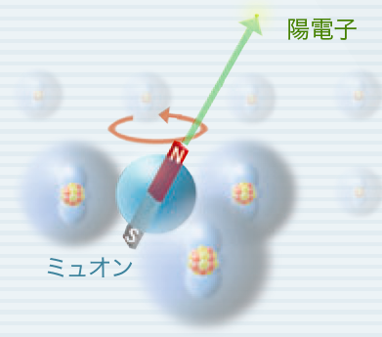
Science at J-PARC
Elucidate Origin of Matter and Universe
  Neutrino Oscillation and its CPV search
  Charged Lepton and Quark Flavor studies and CPV search
  Strong Interaction studies
Explore Origin of Diversity in Matter and Life
  Neutron as penetrating and hydrogen sensitive probe
    Energy materials (e.g.bettery), Life and soft matter (e.g. proteins, polymer), Hard matter (e.g. super conductor)
  Muon as a micro magnetic probe
    μSR, X-ray from muonic atom, muon microscope
    Fundamental physics
  Industrial Application
    Synergetic use of SPring-8/PF and J-PARC, Super Computer “Kei”
R&D for Nuclear Transmutation
atom
nuclei
neutron
positron
muon

Slide 12


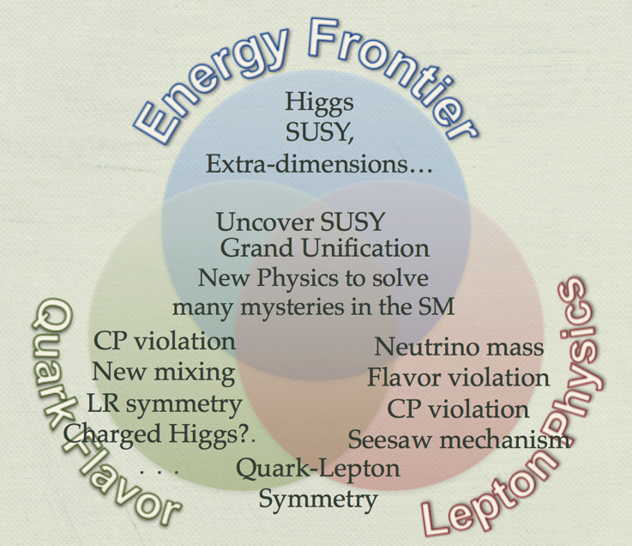
Hi-Energy Frontier
New phenomena may exist in the unprecedented energy region
→LHC, ILC and future colliders
Astrophysics
Hi-Intensity Frontier
Ultra-precision measurements may provide a hint for New Physics!
→Hi-Luminosity lepton colliders, Hi-Intensity Proton Drivers

Slide 13
Matter = Remnant of 1/10⁹ Asymmetry
Origin of Matter
＝
Matter-Antimatter Asym.
CPV and Flavor Mixing
CPV beyond CKM
Role of muon as a charged Lepton
＋
Role of Strong Interaction
Strangeness and Charm
Explored with SuberKEKB and LHCb
Explored with J-PARC/PSI/Fermilab Intense Beams
Our Stable World

Slide 14
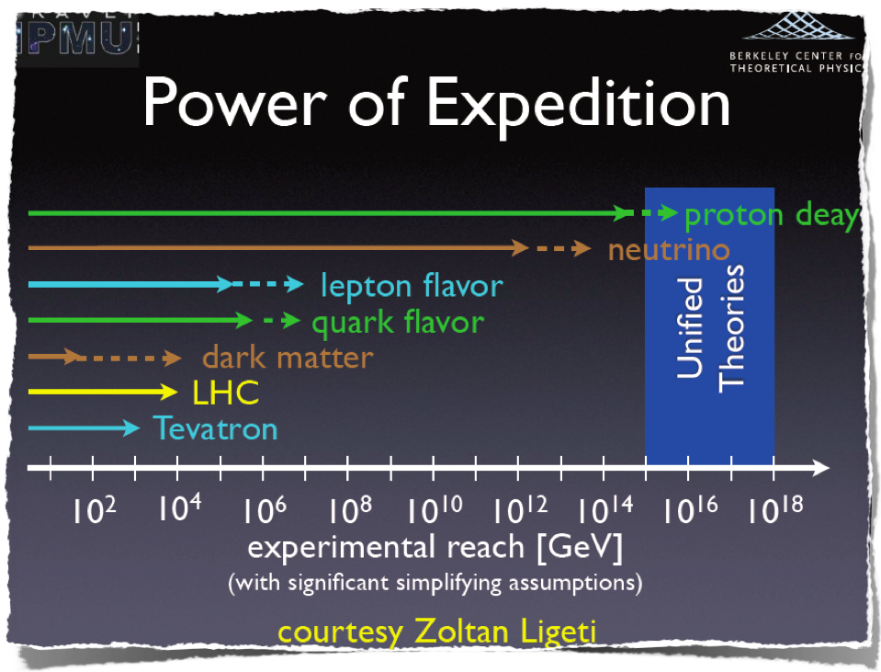
a slide by Hitoshi Murayama

Slide 15
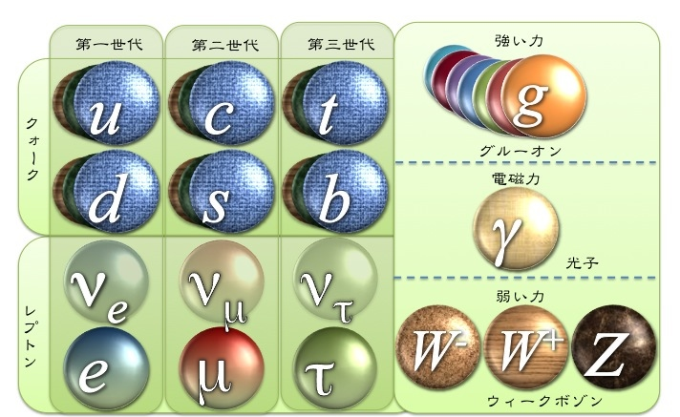
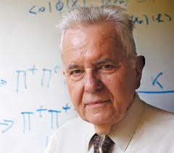

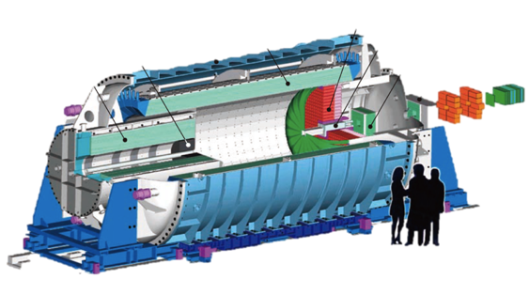

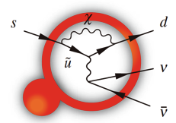

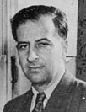
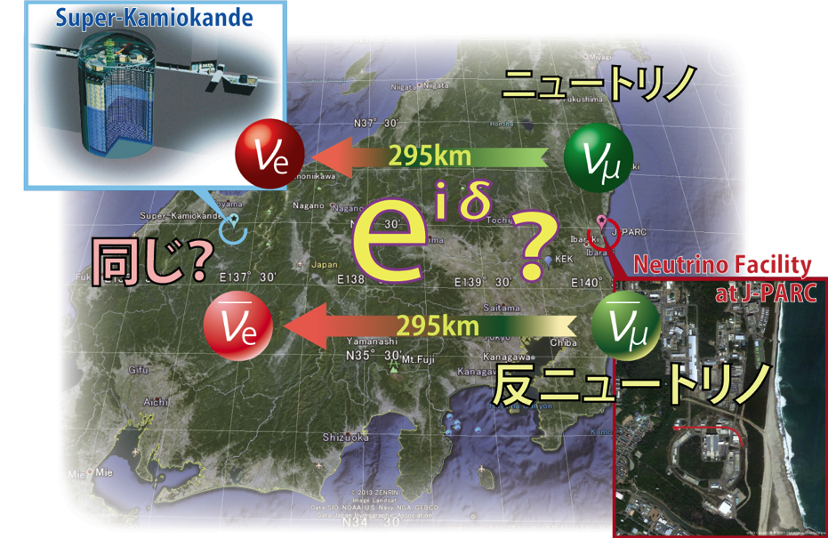



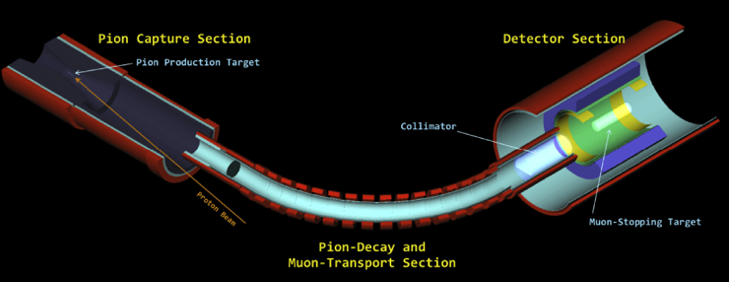

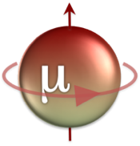
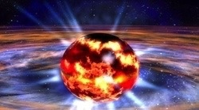
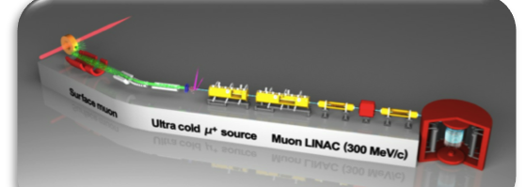
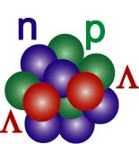

Particle-Nuclear Physics explored at J-PARC
Search for CPV beyond CKM theory
KOTO@Hadron Hall
Neutrino Mixing thru PMNS matrix
Charged Lepton Flavor violated?
T2K Exp.
COMET
CPV in neutrino sector?
Explore role of strangeness in neutron stars
CPV in Charged Lepton?
Strange quark may play an important roles in an extreme high density matter, aka neutron star.
g_{μ}-2/μEDM
ΛΛ-Hyper Nuclei

Slide 16
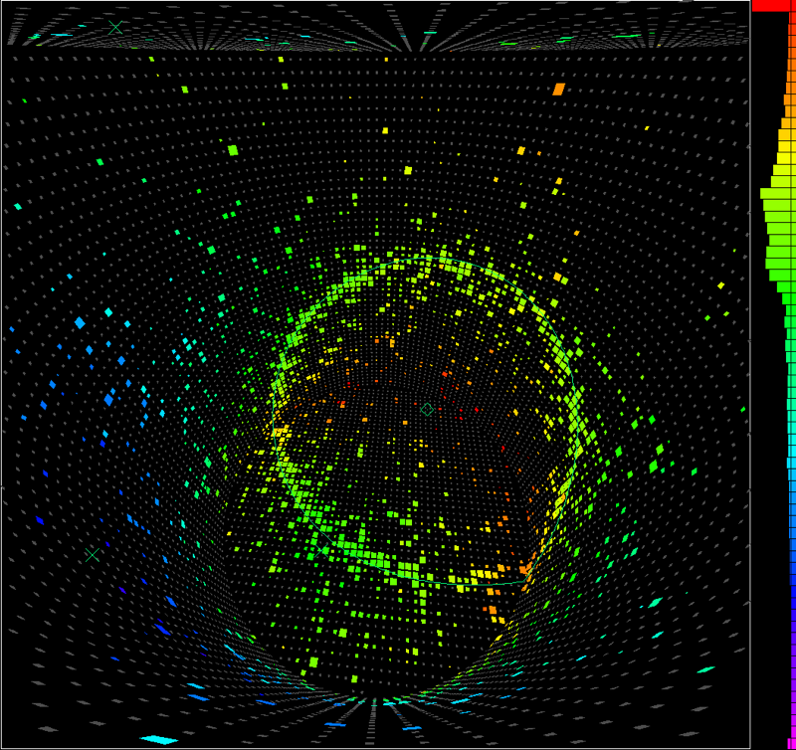
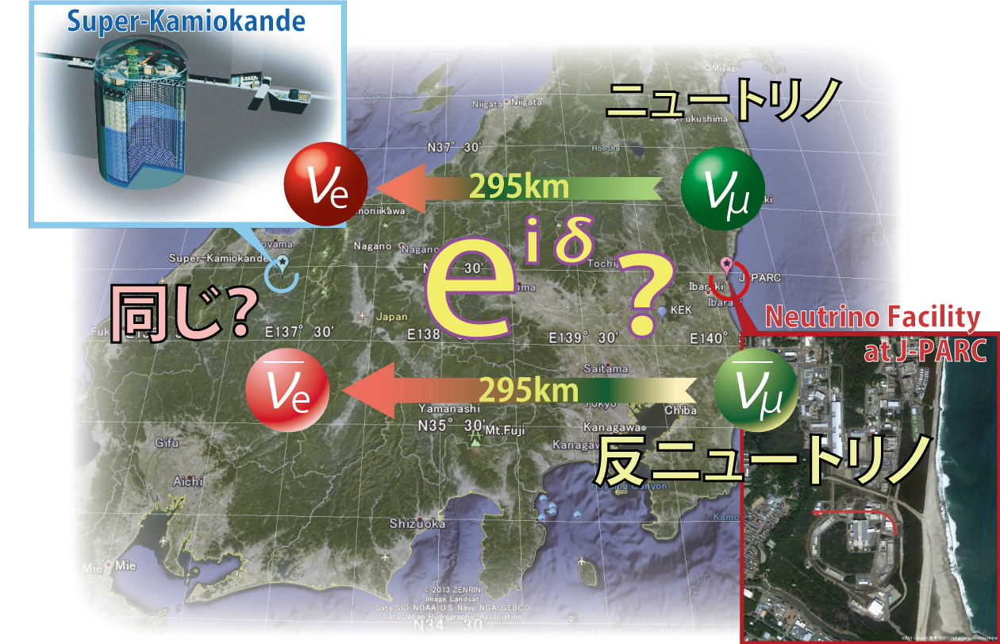
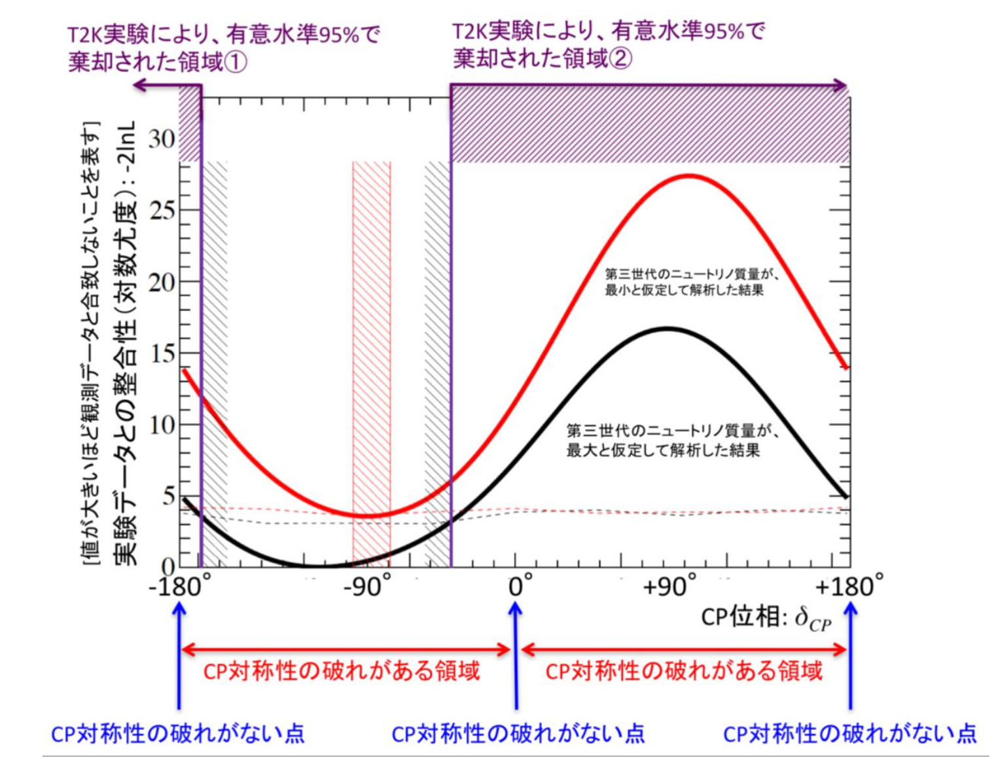
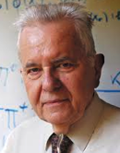
Goal of T2K
Neutrino and anti-neutrino behave same?
Search for CP Violation beyond CKM
Origin of Matter

Slide 17
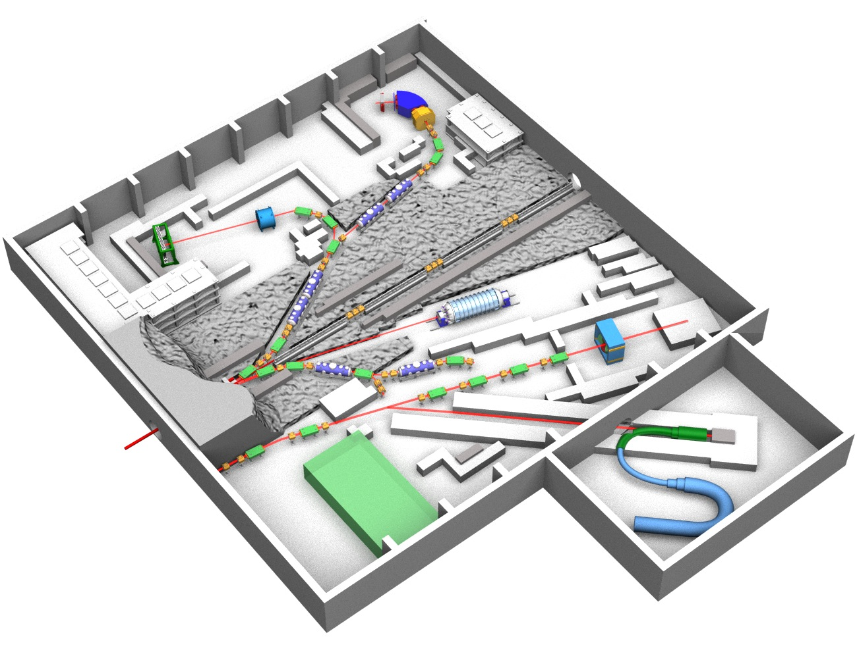
Hadron Hall in 2016
K1.8
Strangeness Nuclear Physics
K1.8BR
Hadron Physics
K Rare Decay (CP violation）
KL
High Momentum Beamline
Hadron Mass Shift
COMET Beamline
mu-e Conversion Search

Slide 18
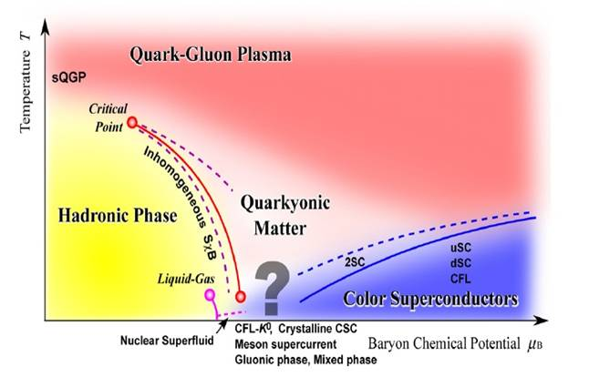
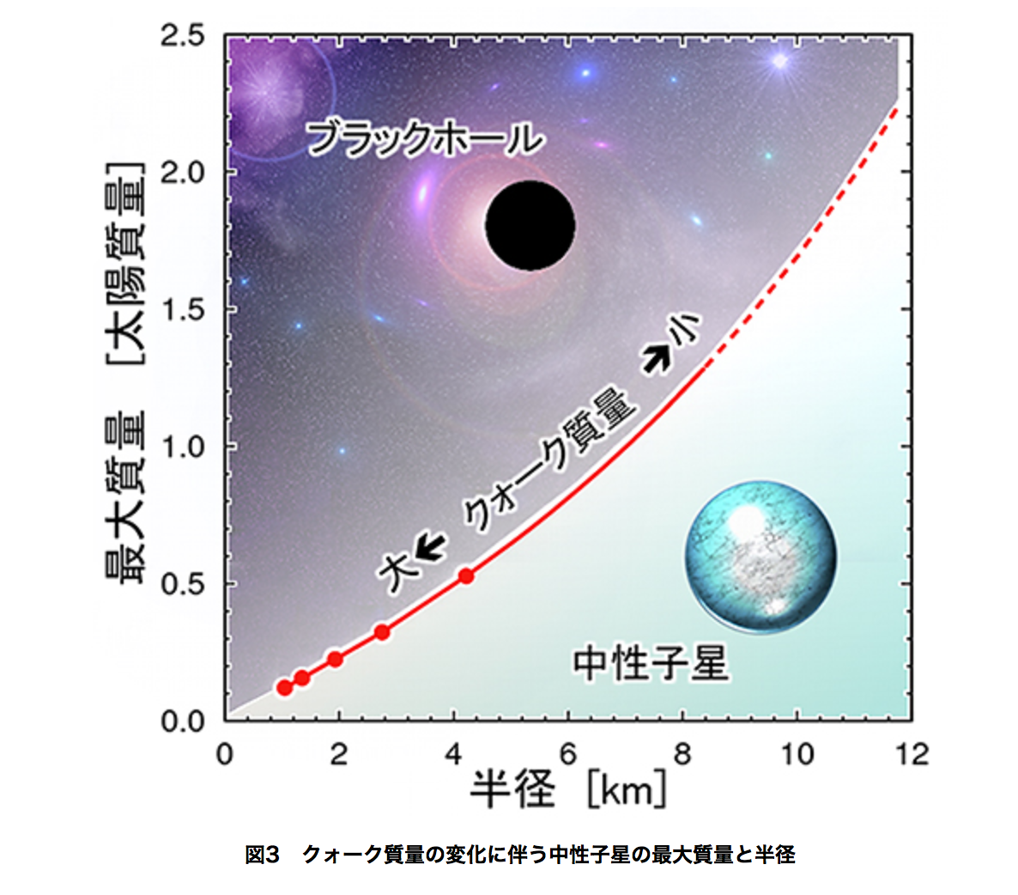
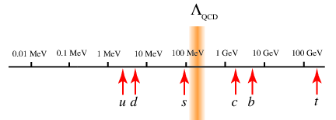
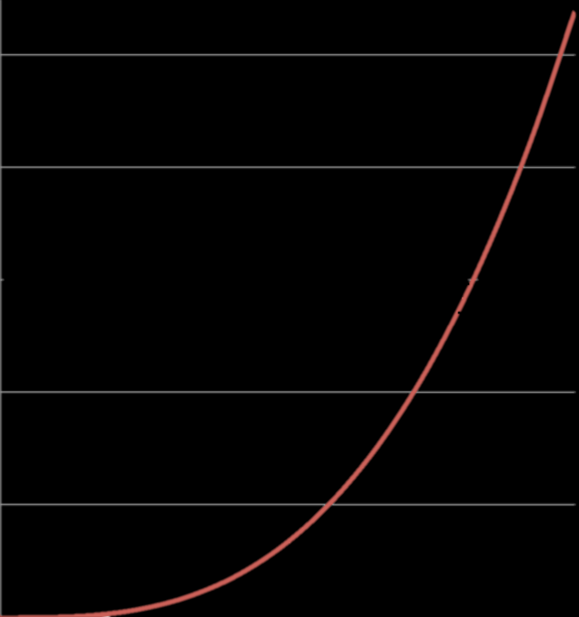
QCD Phase, Neutron Star, Quark Mass
Exploring Hi-density matters
Neutron Star > 2 Solar Mass observed.
Threshold of Gravitational Decay depends on Baryon-Baryon Interaction, Quark Mass
Blackhole
Large < -- Quark Mass --> Small
Mass (Solar mass)
neutron star
Radius (km)
From Jaffe et al., PRD79 (2009) 065014
Courtesy of Hatsuda-san

Slide 19
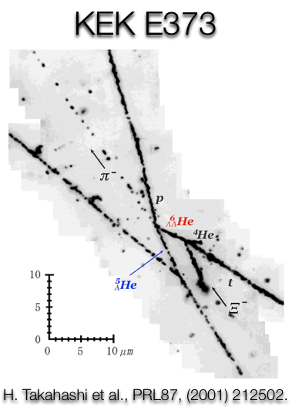
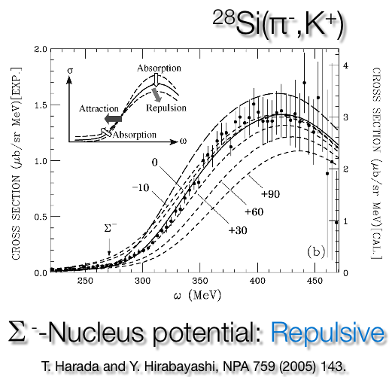
Baryon-Baryon Interactions
Based on a slide by S. Sawada
Hypernuclear Spectroscopy :
Excitation-energy spectra
→Potential depth V_{Y} ~YN force in medium-long range
  S=-1: V_{Λ}= -28±1 MeV (Attractive), V_{Σ}= +30 MeV (Repulsive)
    KEK PS, BNL AGS
  S=-2: ∆B _{ΛΛ} = -0.67±0.17 MeV, KEK PS E373,
  V_{Ξ} ~ -14 MeV ??, BNL AGS E885
    →E05, E07, E03 @J-PARC
 | Medium-Long range 1-2 fm | Short range <1 fm
NN | ○ | Phenome.
NNN | ○ | △
YN | ○ | ×
YNN | × | ×

Slide 20
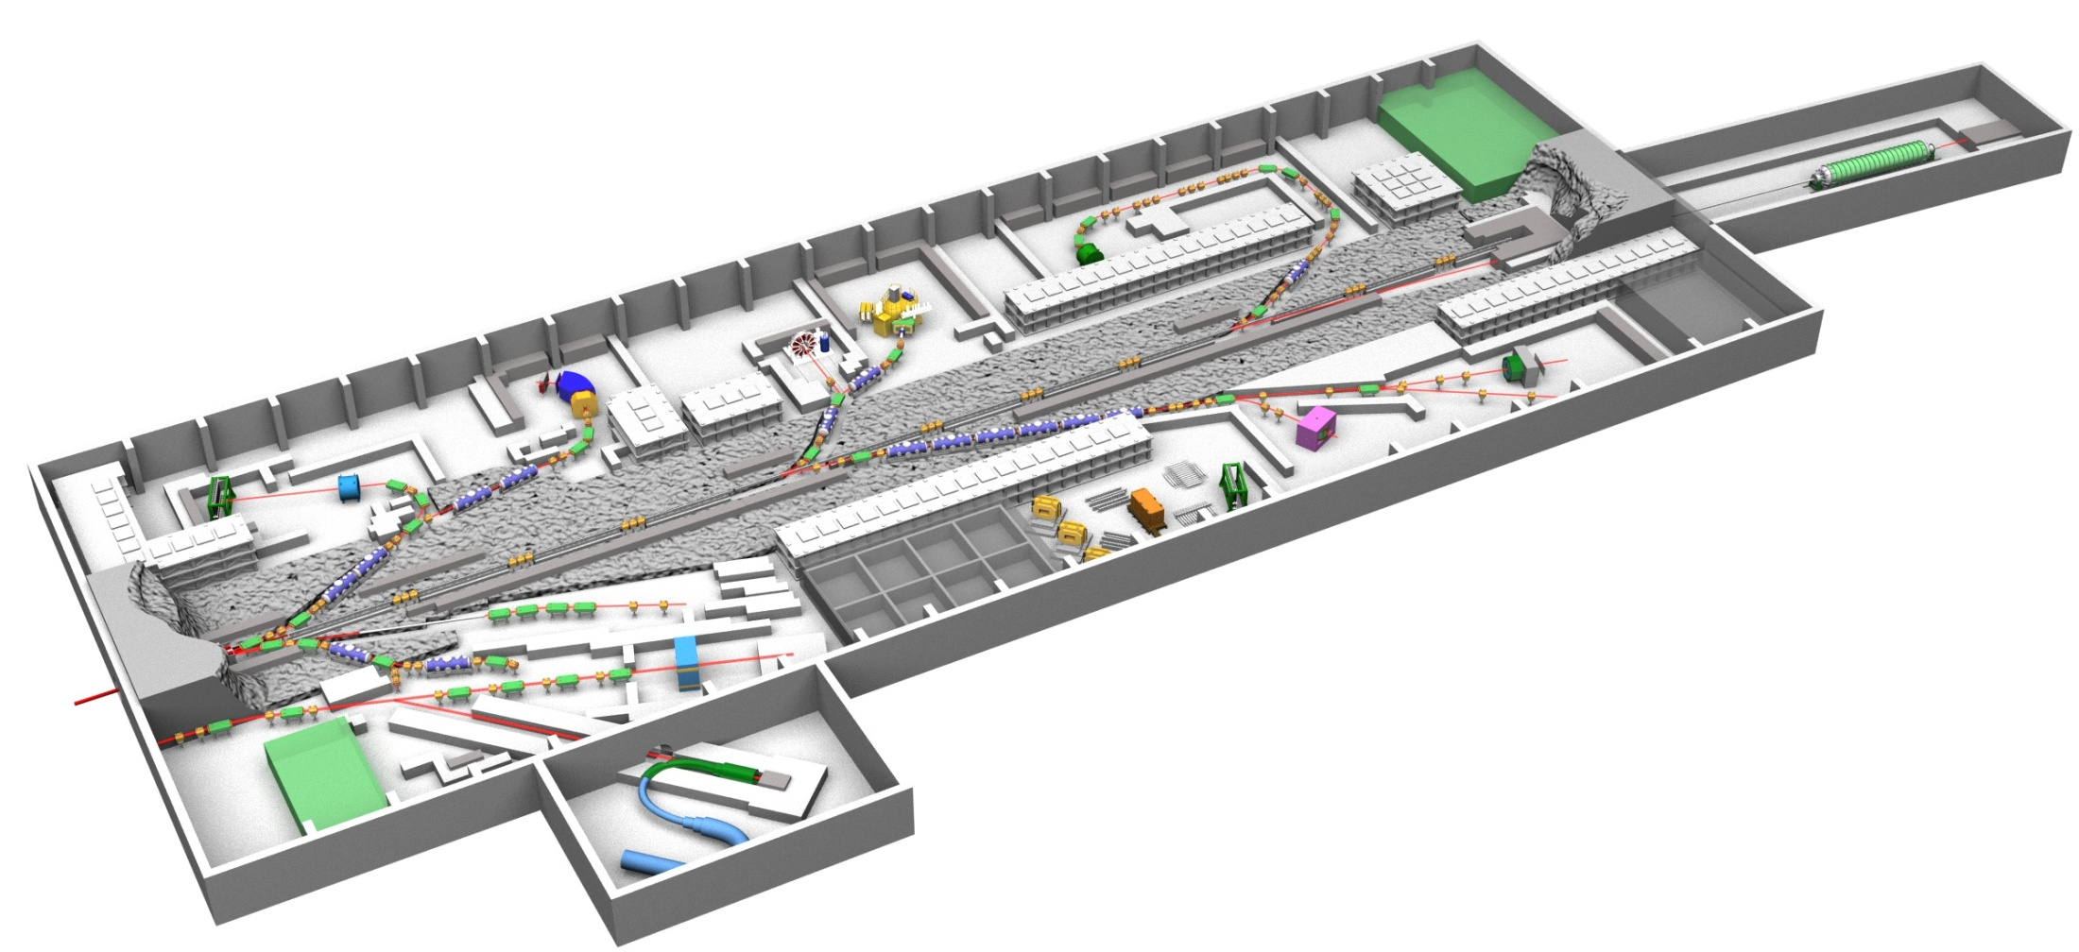
Upgrade Plan of Hadron Experimental Facility
3 body BB interaction
< 2.0 GeV/c
1.8x10⁸ pion/spill
x10 better Δp/p
CPV beyond CKM
2 body BB interaction
5 deg extraction
~5.2 GeV/c K⁰
Good n/K
< 1.2 GeV/c
~10⁶ K⁻/spill
HIHR
< 2.0 GeV/c
~10⁶ K⁻/spill
K1.1
KL
< 1.1 GeV/c
~10⁵ K⁻/spill
K1.8
105 m
K1.8BR
K10
TEST BL
<10 GeV/c separated pion, kaon, pbar
~10⁷/spill K⁻, pbar
High-p
Highly-excited hadrons
Mesons in nuclear medium
COMET
30 GeV proton
<31 GeV/c unseparated 2ndary beams (mostly pions), ~10⁷/spill
Muon

Slide 21
Short Range parts of BB interaction : Repulsive Core and LS force
Slide by S. Sawada
Large repulsive core due to quark Pauli effect in the ΣN (I=3/2, S=1) channel
Anti-symmetric LS force originated by the one gluon exchange between quarks should appear in YN interaction
  Forbidden in NN channel from isospin symmetry
  Large Anti-symmetric LS force in quark model
  Very small in meson exch.
1.0
0.7
0.5
P_{Σ} [ GeV/c ]
Total spin = 1
p
Σ⁺
u
Hall extension
u
u
d
u
Existing facility
s
: isospin 1
spin of u (d) quark is same
0.5 1.0 1.5 2.0
r [fm]
Derive phase shift up to 1 GeV/c region to obtain radial dependence of potential
Measure the spin observables
in YN channels
21

Slide 22
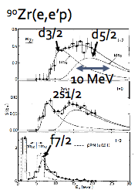
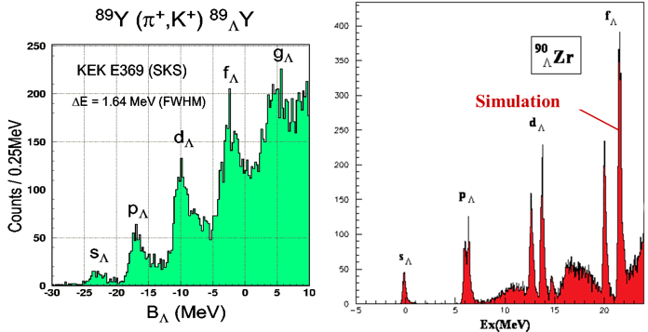
High Density Hadronic Matter through high precision (π,K⁺) spectroscopy
Slide by S. Sawada
Existing facility: ∆E~2 MeV (SKS)
Deeply-bound single-particle orbits down to s-orbit should be studied.
  Impossible for normal nuclei due to nuclear Auger effect (large width)
  Systematic measurements in wide A is required
∆E~0.1 MeV measurement with (π,K+) at High-Intensity High-Resolution BL
KEK-PS E369 with SKS
Expected at HIHR beam line
HIHR
~60 days @ 3M π⁺/spill
~30 days @ 180M π⁺/spill

Slide 23
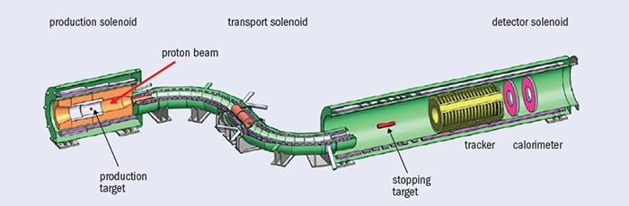





muon-to-electron conversion search
FNAL mu2e
J-PARC COMET
E_{proton}=8GeV 8 kW beam
  Sensitivity < 10⁻¹⁶ @ 90% C.L.
S-shape solenoid to transport and momentum-separate muons
Ground-breaking in Apr.2015
Detector & beamline commissioning scheduled in 2020
E_{proton} = 8GeV, 3.2-56kW beam
  Sensitivity @ 90 % C.L
  Phase I: < 10-¹⁴ (3.2kW)
  Phase II: <10⁻¹⁶ (56kW)
U-shape solenoid to transport and momentum-separate muons in Phase I
  Additional U-shape solenoid in Phase II
Building const. completed in 2015
Data taking (Phase-I) expected in 2018-2019
Slide by Satoshi MIHARA
curved solenoid installation
CERN Courier & mu2e homepage

Slide 24



















Search for Lepton Flavor Violation using
J-PARC high-intensity pulsed muon beam the COMET Experiment
International collaboration composed of 175 researchers of 33 institutes (including JINR) from 15 countries
Search for the μ-e conversion process violating lepton flavor number conservation
  < 10⁻¹⁴ sensitivity in Phase I （2018-2021）
  < 10 ⁻¹⁶ sensitivity in Phase II ( 2022 - )
  Current upper limit: 7x10⁻¹³
  Georgian contribution in Calorimeter, Cosmic-ray veto, tracking
  Tbilisi State University
  Georgian Technical University
A muon in a muonic atom converts to an electron w/o emitting neutrino
e⁻
Muonic Atom
CM 14 hosted by Tbilisi State University

Slide 25



Multi-Probe Platform for
Material and Life Science
With Synergetic Use of Neutron, Muon, Photon and Positron
Neutron
Positron
Muon
Photon
Neutron・Muon
（J-PARC）
Photon・Positron
（KEK, Spring-8）

Slide 26






Accelerator Based Neutron Source in the World
5MW
ESS
(Sweden)
2019~
ISIS, RAL
(UK)
2nd target station
2008~
IPNS, ANL
@Illinois, USA
0.01MW
MLF, J-PARC
(Japan)
2008~
SNS, ORNL
(USA)
2006~
CSNS
(China),500kW
2019~
0.16MW
0.3MW
1MW
1.4MW
LANSCE, LANL
@Los Alamos, USA
0.06MW
Notes:
In the world, there are several pallation neutron sorces.
In UK, ISIS is running at 200 kW, and in USA SNS working at 1.4 MW. In Japan you know J-PARC is now operating at 500kW, and soon become 1MW.
In Europe, ESS (Europian Spallation Neutron Source) is under construction, and first beam is expected at 2019.
In China also CSNS is under constraction.

Slide 27






World Highest Intensity of Neutron Pulse Beam!
Material and Life Science Facility （MLF）
J-PARC
18
Advanced Mercury Target
(8.5)
SNS, US
(6.8)
ISIS – TS2, UK
Hi-performance Moderator
5.9
5.1
4.2
4.0
５00 kW
(2015.４)
1,000 kW (Design)
400 kW
(2015.3)
300 kW
(2012.11)
1,000 kW
(2009.12)
1,400 kW
(Design)
48kW
J-PARC SNS ISIS
Unit： 10¹² n/(sr・pulse)

Slide 28

Hg-Target for
J-PARC MLF
(3 GeV – 1 MW)
W
W/O
W
W/O
Preparing the Hg-Target system for 1MW operation
Higher freq. components, related with cavitation phenomena, were sufficiently mitigated.
Notes:
This is a picture of neutron target, which is a Hg target.

Slide 29





















Neutron Instruments at MLF
Operation
Operation
Operation
Construction
The first neutron in May, 2008
23 Neutron Beam Ports
From Fundamental Physics to Industrial Uses
Operation: 19 (Apr., 2015)
Construction/Commissioning:2
Constructed by
・KEK
・JAEA
・Ibaraki Prefecture
・Universities, Institutes &
Government organizations...
Yearly Operation Days
・~180
Yearly Guest Number
・731 (2014)
NOBORU (JAEA)
Operation
ANNRI
(Tokyo Tech. U., JAEA,,
Hokkaido U.)
SHRPD(KEK)
VIN_ROSE
(KEK, Kyoto Univ.)
Operation
SPICA
(NEDO, KEK)
Operation
Operation
NOP(KEK)
iBIX
(Ibraki Pref.)
PLANET (JAEA, U. of Tokyo)
HRC (KEK)
Operation
Operation
DNA (JAEA)
Operation
Operation
4SEASONS
(JAEA)
AMATERAS
(JAEA)
Construction
POLANO
(Tohoku Univ,, KEK)
Operation
RADEN
(JAEA)
Operation
TAIKAN
(JAEA)
Operation
NOVA
(NEDO, KEK)
Operation
Operation
Operation
Operation
Operation
SOFIA (KEK)
SHARAKU
(JAEA)
iMATERIA
(Ibraki Pref..)
SENJU (JAEA)
TAKUMI (JAEA)

Slide 30










Neutron Fundamental Physics @ J-PARC/MLF
Neutron Lifetime
BL05
Gravity
BL05
In-beam measurement
with pulsed neutrons
Gas scattering
Newtonian + α
in nm range
Xe
Gas
pulse shape can be defined by Spin Flip Chopper
θ
typical event of beta decay
Xe
p
n
p
2D neutron Detector
ν
e
e
Interference
ν
measure electrons only when the bunch is in TPC
incident flux is also measured in TPC with ³He capture
Newtonian + α
in μm range
Neutron Beam Splitter
CP Violation
UCN Optics
BL04
BL17
BL05
EDM with noncentrosymmetric crystal
for Neutron EDM with UCNs
T-violation in Neutron-induced Compound Nuclei
T-odd asymmetry <-> nEDM
10⁻²⁷ecm equiv. / yr (κ=1)
n, target polarization required
~10⁹ V/cm
BGO
UCN generator
UCN focusing
(n,γ) measurement in progress to quantify the enhanced sensitivity to discrete symmetry violations
measure spin precession using the high voltage in material
Development UCN devices for next generation UCN experiments
Slide by Hirohiko SHIMIZU

Slide 31



Geo-Science at J-PARC/MLF
Water in the inner-earth
Water in the inner-earth
Investigate the mystery of light elements in the early history of the earth – hydrogen in the ferroic materials probed by pulsed neutron beam at J-PARC
- U. Tokyo, U. Ehime, U. Okayama, JAEA, J-PARC
BL11 PLANET
温度圧力の変化とともに含水鉱物Mg (OD) ₂の脱水を経て、鉄がbcc相 (黒線：298-802K) からfcc相 (赤線：867-1000K) へ相転移する様子を示す回折パターンの時間変化。

Slide 32




Muon Facility MUSE @ MLF
H-Line
S-Line
Fundamental Science with a large scale international coll.
Accommodate many
μSR experiments
U-Line
D-Line
Very unique Ultra-Slow Muon Beam
Mid-intensity beam line
For general use
Notes:
Page 4; From the graphite target, we designed MUSE facility extracting four muon beam lines.
D-Line is a general use muon beam line where either surface muon or decay muon up to 120 MeV/c can be extracted. This D-line is only one muon beam line where User’s RUN has been in operation.
U-Line is a dedicated muon beam line for the Ultra Slow Muon, intended to generate 0.05 to 30 keV.
S-Line is a muon beam line to extract surface muons for the 4 experimental areas.
H-Line is a muon beam line mainly for the fundamental physics.

Slide 33








3 GeV proton beam
( 333 uA)
g-2
Silicon Tracker
Surface muon beam
(28 MeV/c, 4x10⁸/s)
66 cm diameter
Muonium Production
(300 K ~ 25 meV)
Super Precision Magnetic Field
(3T, ~1ppm local precision)
Resonant Laser Ionization of Muonium (~10⁶ μ⁺/s)
EDM
23

Slide 34




muon g-2/EDM
BNL E821 measured the muon g-2 with 0.54 ppm precision.
More than 3σ deviation from the SM.
FNAL E989
J-PARC E34
Photos from G. Venanzoni, EPS 2015
Higher precision with the magic momentum technique established by BNL E821
Muon storage magnet was moved from BNL.
Data taking started in 2017
Completely different technique with ultra-cold muon beam
(compact storage ring, spin flip)
Independent test of BNL E821
TDR under review
Also, prepares to measure Mu-HFS and μ_{μ}/μ_{p} (MuSEUM exp).
Slide by Tsutomu MIBE

Slide 35

J-PARC: Next 5 Years
・Achieve Design Intensity
・More Science Outputs
・Explore Intensity Frontier
Accelerator
・RCS:1 MW achieved
・MR 0.75 MW→ 1.3 MW
・Explore Multi-MW Possibility
Neutrino
・Established non-zero θ₁₃
・Constrain CPV. Hierachy?
・Prepare next gen. of Exp.
ADS (Acc. Driven System)
Staged R&D approach from ADS Target Test Facility to
Transmutation Exp. Facility
MLF
・Neutron and Muon: Diverse Material and Life Science
・Enhance Industrial Usage
・New beam lines to extend Science Frontier (g-2/EDM/HFS/DeeMe)
Hadron
・Physics Production
: Hyper-nucl/hadron physics,
K-rare decays
・Complete new beam line for
COMET/Hi-p BL and 1st results
Stability and Intensity

Slide 36
Fundamental Physics at J-PARC
There will be more excitements to come! With
More beam power
More robust targetry
with
More beamlines at Hadron Hall
Nicely “crafted” experiments/measurements
Enhanced support from theorists
… and
Ambitious YOUNG Scientists!
Any hint of
New Physics?
Including Young at Heart!

Slide 37
BACKUP

Slide 38






Collaboration with Academia & Industry
Domestic University
Oversea Institutions
Collaboration with TRIUMF
Experimental Collaboration and exchange program of researchers; share the know-how on facility and safety management
Collaboration with ANSTO
For improving user environment, sample environment, e.g. deuterization lab, and exchange program for researchers.
Collaboration with ESS
Contribute to the newly constructed major facility based on the experience of J-PARC construction.
New Graduate Course Established to include J-PARC science
Industrial Sector
Osaka University
京都大学
Univ. branch at J-PARC
Education and training of students and young researchers at the very front of J-PARC operation, especially to raise the next generation who can create a future cutting edge facilities
J-PARC/Sumitomo rubber Inc. Fellowship is established

Slide 39









RaDIATE
Radiation Damage In Accelerator Target Environments
radiate.fnal.gov
High Intensity Accelerator requires investigation of radiation damage of target and beam window
RaDIATE: an internat’l collab. of scientists and engineers from acc. and reactor facilities to solve the problems
J-PARC has joined the team since 2014. MOU is in preparation.
Neutrino Beam Window
Ti Alloy ~1x10²¹ pot
  ~1 Displacement Per Atom
  ( Existing data up to ~0.3DPA)
2016～ （予定）
NuMI graphite broken target
Post-Irradiation Examination (PIE)
at PNNL: Swelling effect observed
New Irradiation Run at BNL (2017 February ~)

Slide 40





Hi-Intensity P-driver
1 MW class
→ Multi-MW potential
SPS, CERN
450-GeV Synchrotron
Main Injector, FNAL
120-GeV Synchrotron, 700 kW
J-PARC, KEK&JAEA
3-GeV RCS, 1 MW
30-GeV MR , 750 kW
Spallation Neutron Source,
ORNL
1-GeV AR, 1.4 MW
HIPA, PSI
590 MeV/u cyclotron, 1.4 MW

Slide 41






Flavor and Space-Time
J.J. Heckman, C.Vafa, Phys.Lett. B694 (2011) 482-484
CPV and Flavor Structure can be explained from higher dimensions / higher energies?
F-Theory GUT

Slide 42


Just a Dream of an Experimentalist
Elucidate the relation btw flavour and space-time structure
  Particle, Force, and Space-time
Comments at the 2nd WS on Particle Physics of Dark Universe
http://kds.kek.jp/conferenceTimeTable.py?confId=11916#20130404.detailed
  “Certainly flavor physics could provide some constraints for compactification … but not enough”
  “Need to combine accelerator based results and gravity, cosmology”
The Standard Model

