Slide 1

The Kaonic Atoms research program at DAΦNE: from SIDDHARTA to SIDDHARTA-2
Alessandro Scordo
(on behalf of SIDDHARTA-2 collaboration)
International Conference on Exotic Atoms and Related Topics – EXA 2017 Vienna 10-15/09/2017

Slide 2
Summary
Physics case: why STRANGE exotic atoms
The DAΦNE Φ-factory @ LNF
The SIDDHARTA experiment:
  Basic concepts and setup
  K-He, KH results
SIDDHARTA-2 experiment: a quest for Kd
  New setup and detectors
  Expected improvements
Conclusions

Slide 3
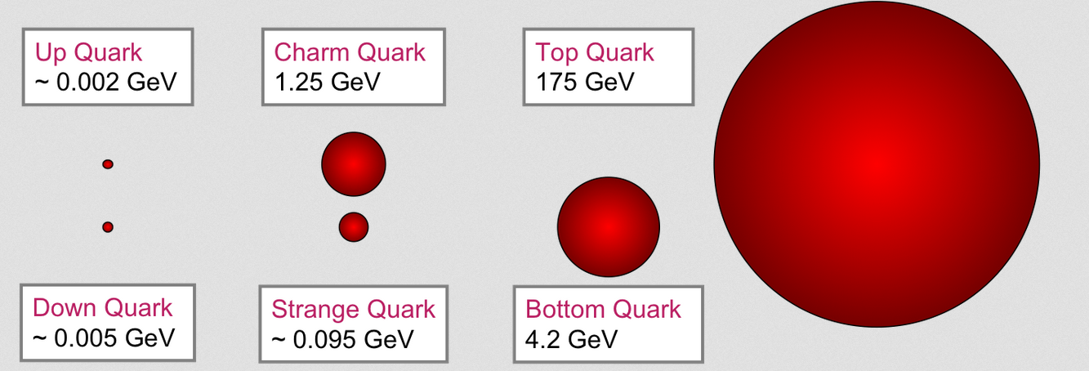
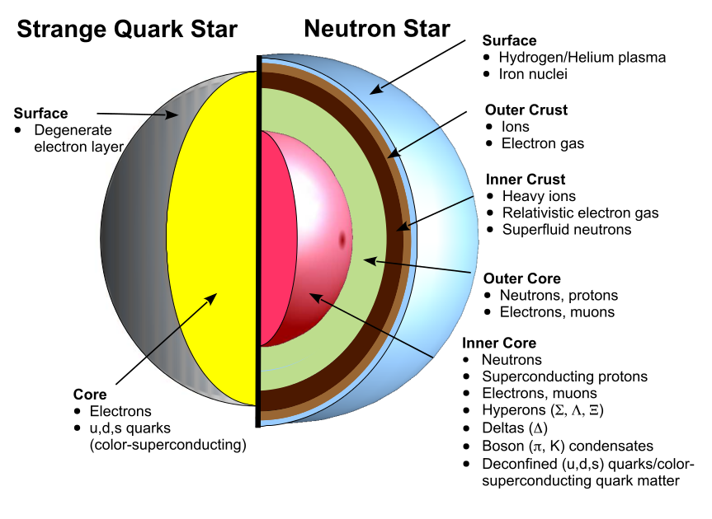
STRANGE exotic atoms
Strange quark mass is still, together with the u,d quark masses, lower than the Λ_{QCD} parameter (≈ 217 MeV)
How strong is the strange quark interaction with ‘standard’ matter?
Is there any place for strange matter?
At low energies, the (running) coupling constant of QCD becomes higher and color confinement is observed. A perturbative approach is not anymore possible!
Kaons are the lowest mass strange particles and their interaction with protons and neutrons at very low energy is fundamental to be investigated

Slide 4
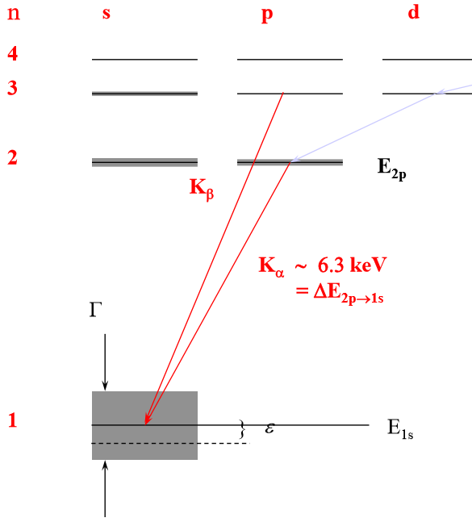
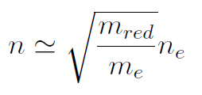
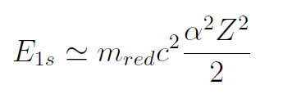
Kaonic atoms
n ~ 25
K⁻
3d
e⁻
1s
2p
1s
K⁻
K⁻
X- ray
emission
p
K⁻
Nuclear
absorption
Strong interaction causes a shifting of the energy of the lowest atomic level from its purely electromagnetic value
Absorption reduces the lifetime of the state, so Xray transitions to this final atomic level are broadened.

Slide 5
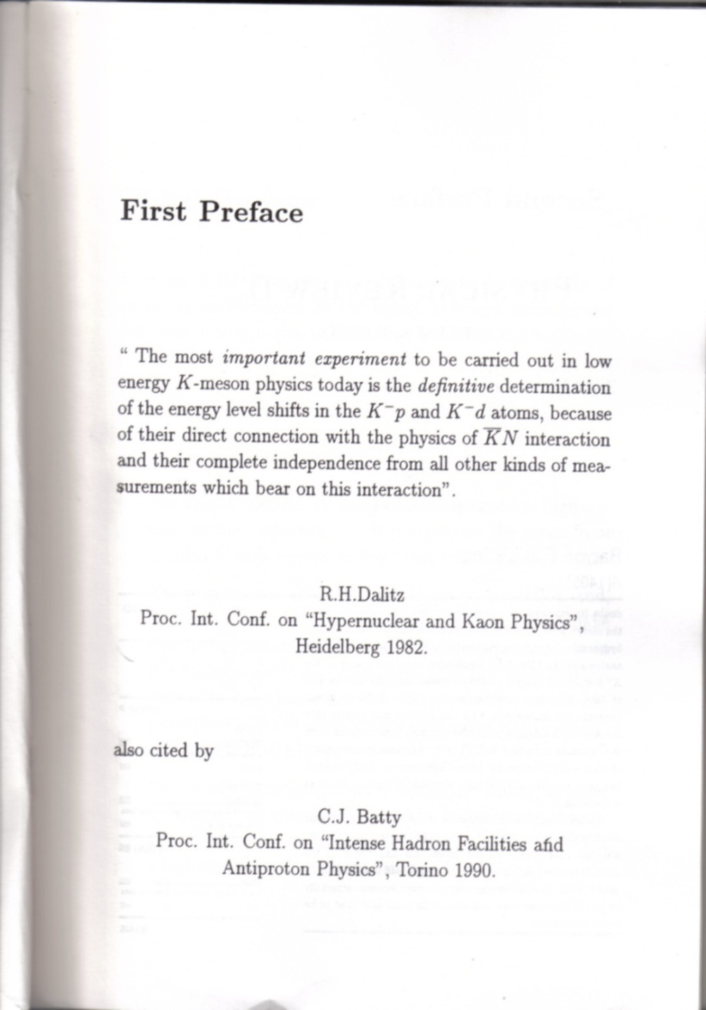
Kaonic atoms
Energy shift ε and line width Γ of 1s state are related to real and imaginary part of the S-wave scattering length (Deser-Trueman formula) :
Scattering lengths can be expressed in terms of antiK-N isospin dependent scattering lengths:

Slide 6
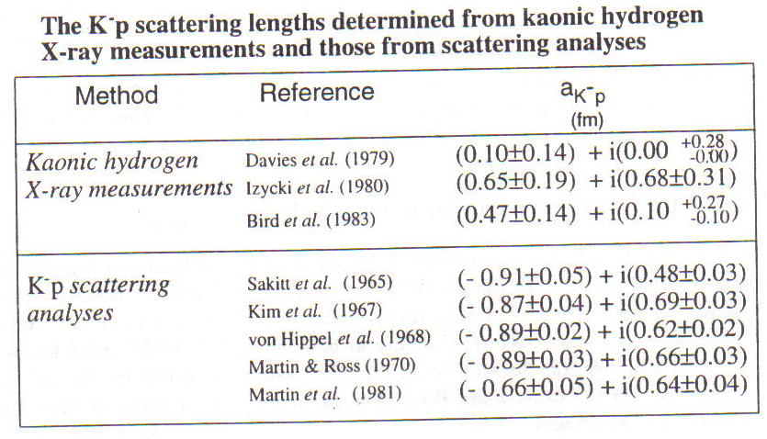
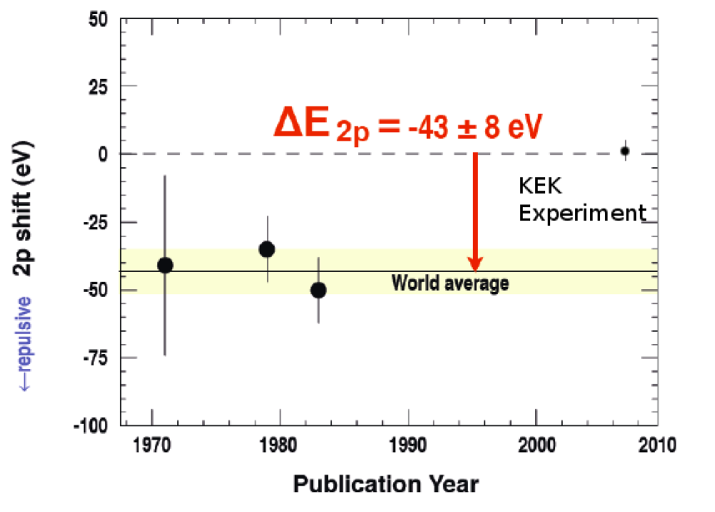
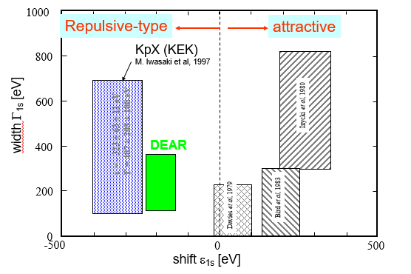
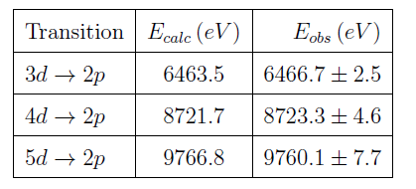
The KH & K⁴He ‘puzzles’
Both puzzles have been finally solved by the SIDDHARTA experiment

Slide 7
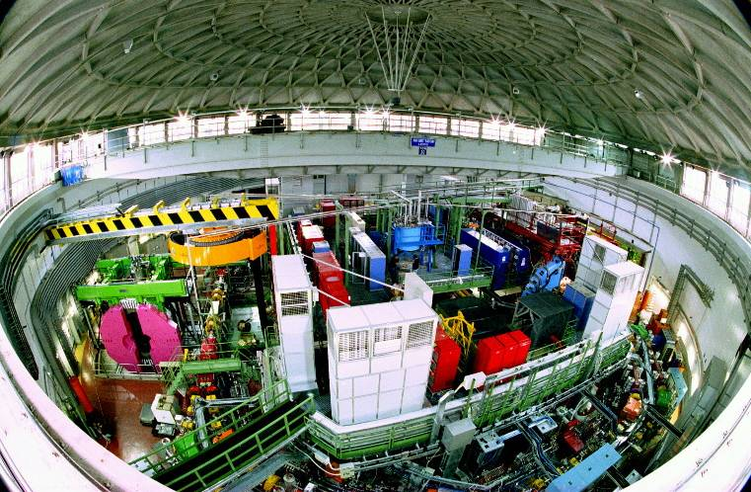
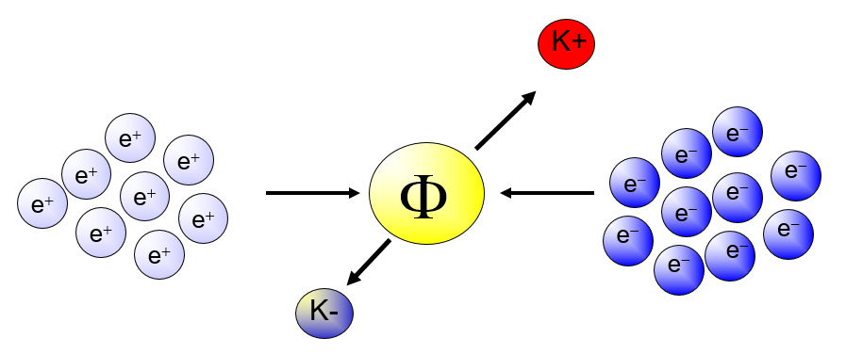
The DAΦNE Φ-factory @ LNF
e⁺ e⁻ at 510 MeV
resonance decays at 49.2 % in K⁺ K⁻ back to back pair
Very low momentum (≈ 127 MeV) K⁻ beam
Flux of produced kaons: about 1000/second
Best low momentum K⁻ factory in the world

Slide 8
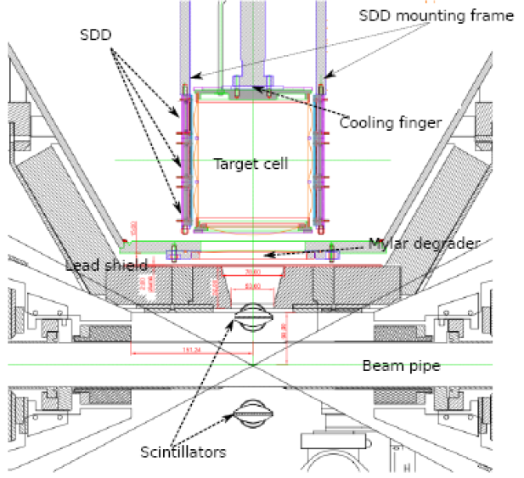
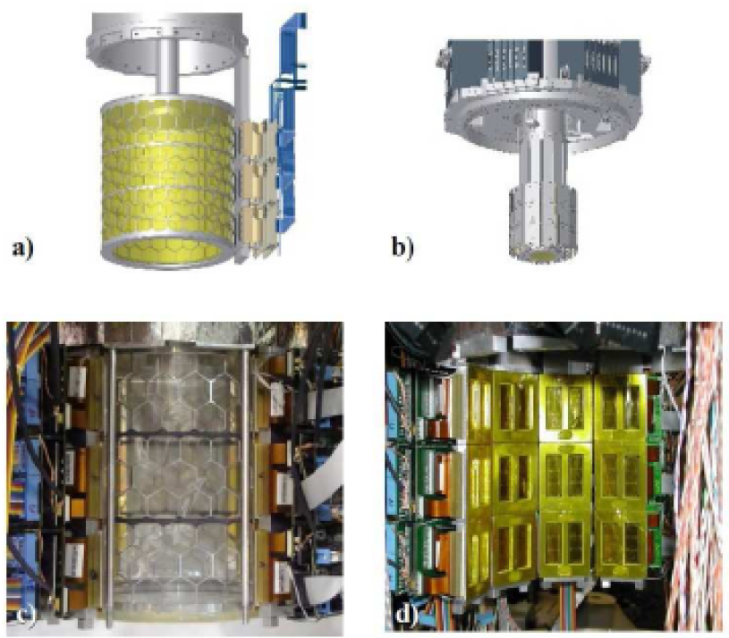
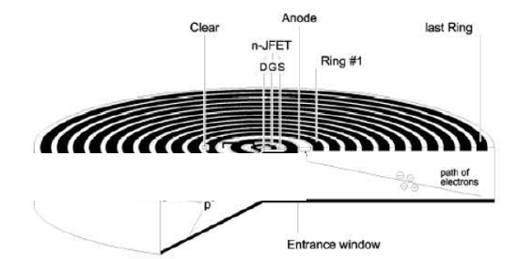
The SIDDHARTA setup
Gaseous target
T = 18 K
P = 1.2 bar
K⁻
Silicon Drift Detectors
e⁻
Φ
e⁺
K⁺
Very fast and triggerable
Used for the first time as energy detectors

Slide 9
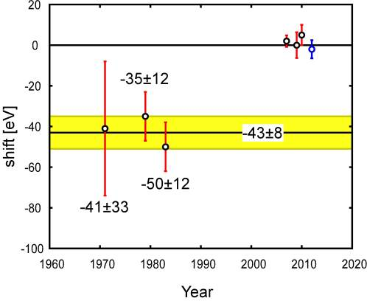
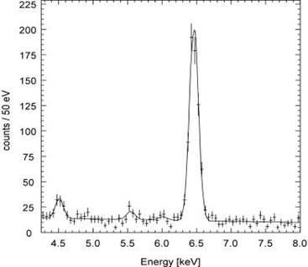
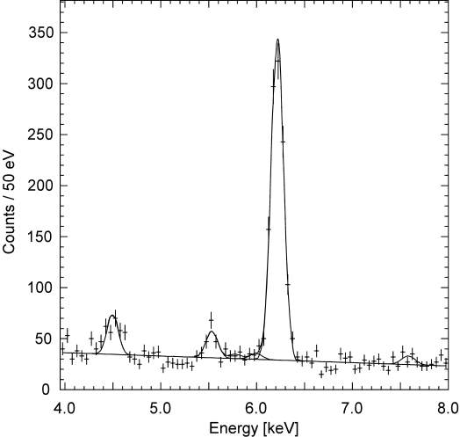
K-⁴He & K-³He results
K-4He (3d-2p)
PLB697(2011)199
 | Shift [eV] | Reference
KEK E570 | +2±2±2 | PLB653(07)387
SIDDHARTA (He4 with 55Fe) | +0±6±2 | PLB681(2009)310
SIDDHARTA (He4) | +5±3±4 | arXiv:1010.4631, PLB697(2011)199
SIDDHARTA (He3) | -2±2±4
K-3He (3d-2p)
First measurement with a gaseous target both on ³He and ⁴He

Slide 10
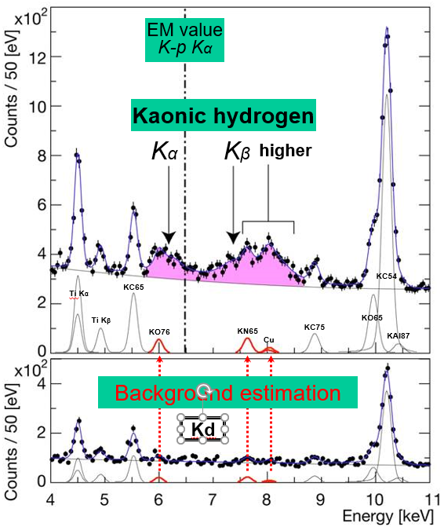
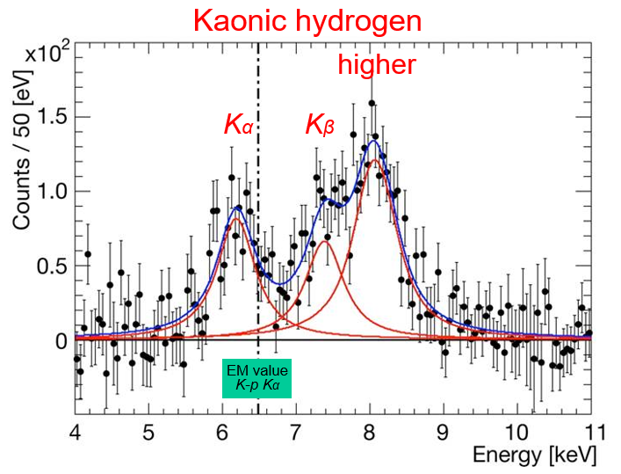
KH & Kd results
Residuals of K-p x-ray spectrum after subtraction of fitted background
ε_{1S}= −283 ± 36(stat) ± 6(syst) eV
Γ_{1S}= 541 ± 89(stat) ± 22(syst) eV
Only exploratory measurement for Kd, no measured ε,Γ values obtained
M. Bazzi et al.. 2011. (SIDDHARTA Coll.), Phys. Lett. B704, 113

Slide 11
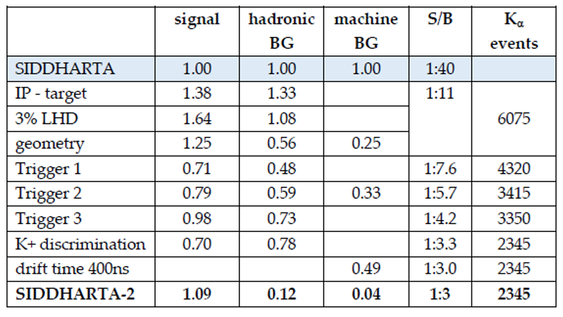
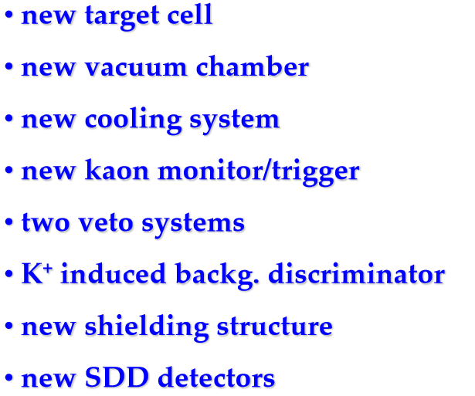
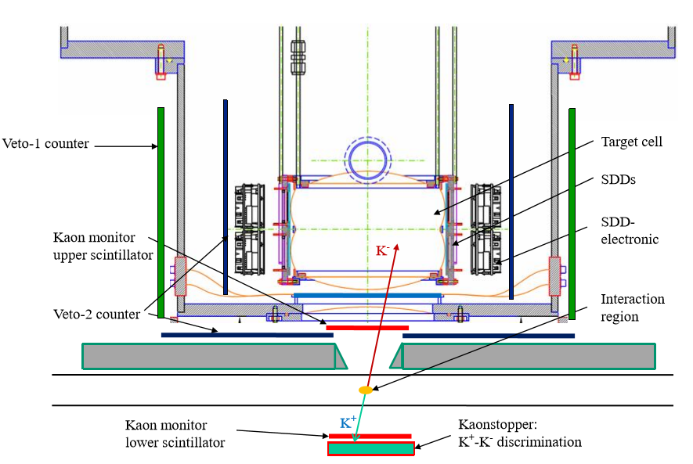
From SIDDHARTA to SIDDHARTA-2
With the new S/B, Kd measurement will be possible
(Y_{KH} / Y_{Kd} ≈ 10)

Slide 12
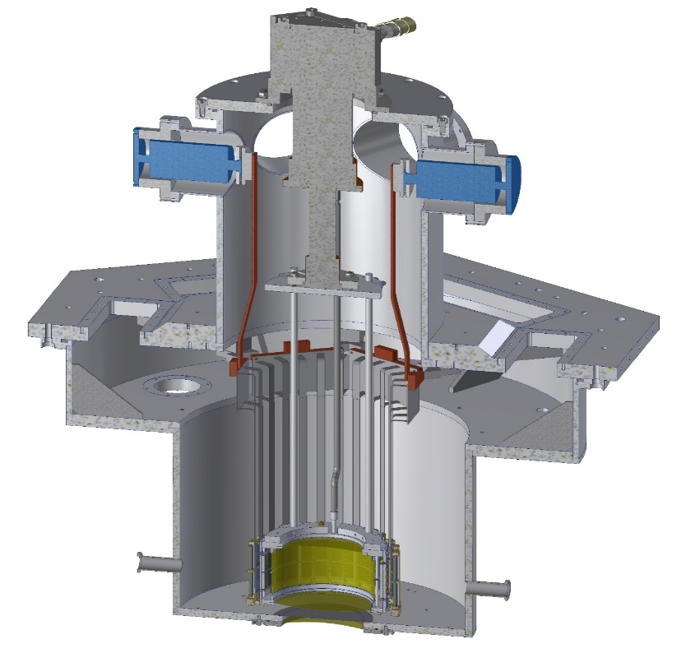
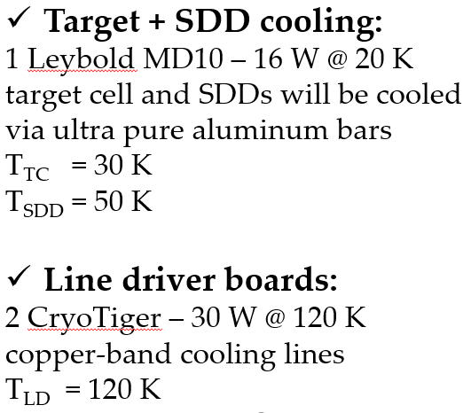
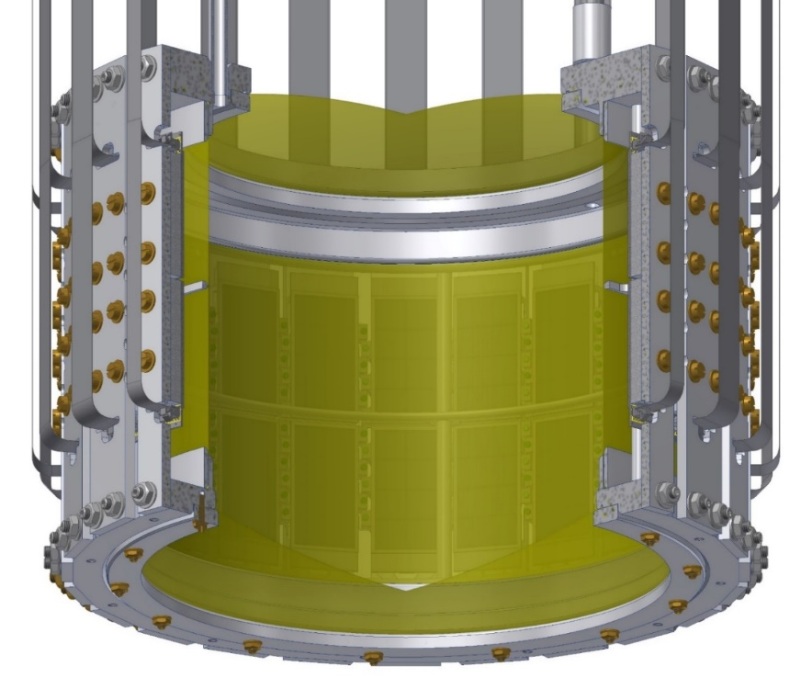
From SIDDHARTA to SIDDHARTA-2
copper-band
ultra pure
Al bars
Working temperature: 30 K
Working pressure : 0.3 MPa
Target cell wall is made of a
2-Kapton layer structure
(25µm+25µm+Araldit<100µm)
HPH Deuterium generator and heavy water

Slide 13
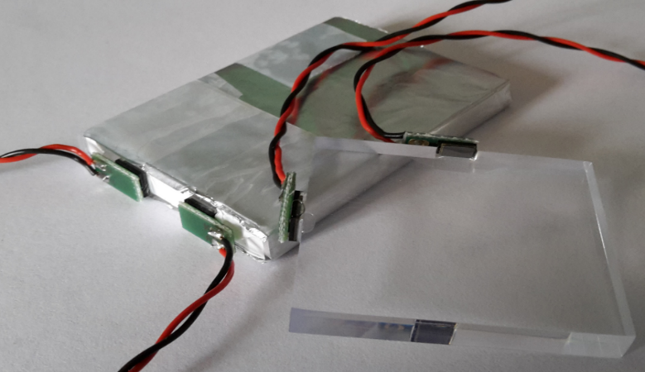
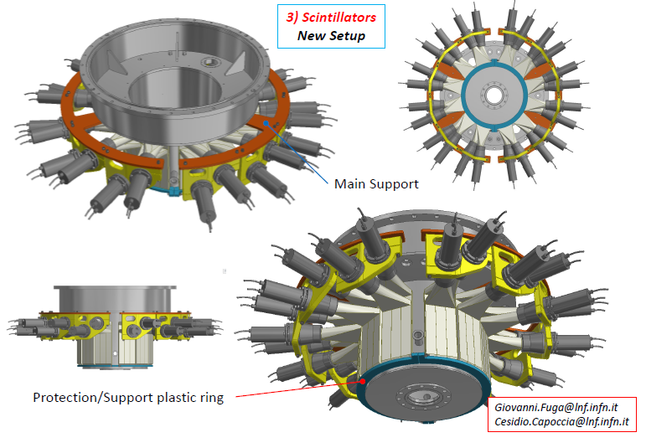
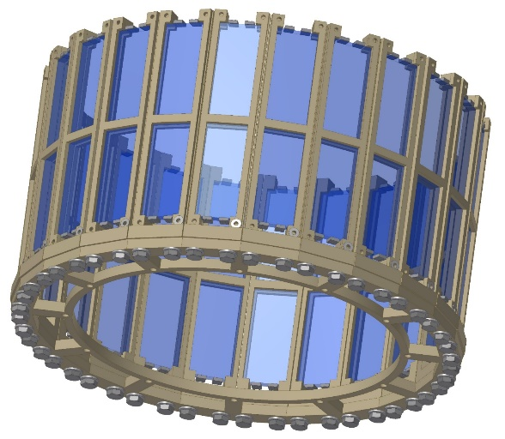
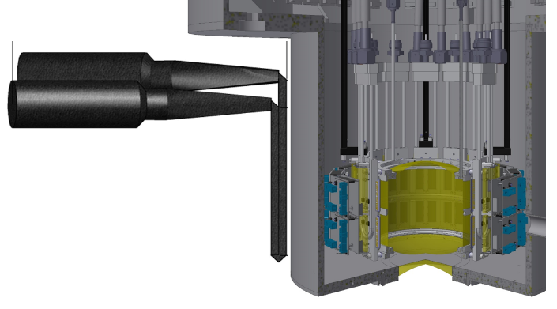
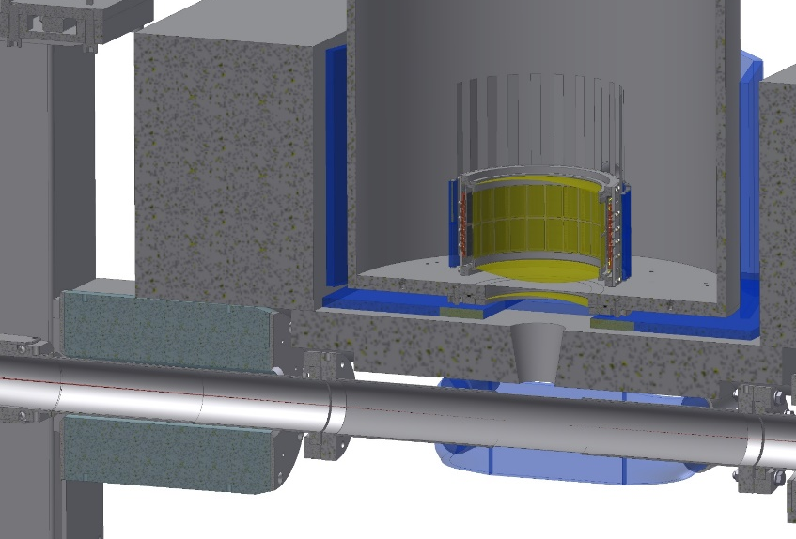
From SIDDHARTA to SIDDHARTA-2
The veto-2 system
BC-408 scintillator tile
SiPM –4x4 Trento (FBK)
The veto-1 system
After K⁻ absorption, a pion is always emitted

Slide 14
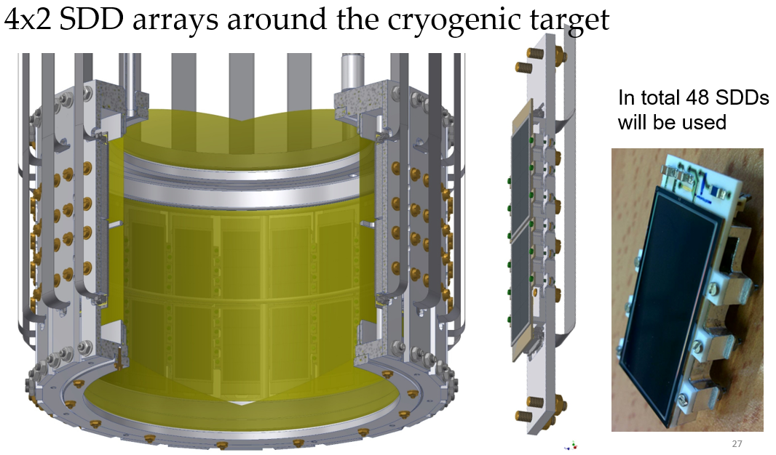
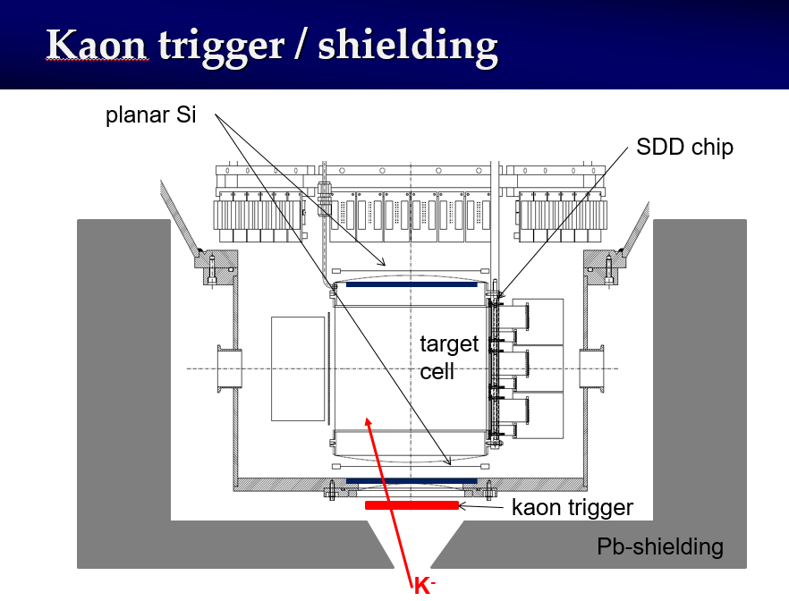
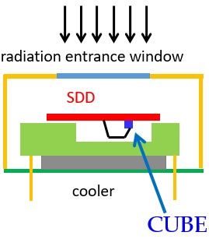
From SIDDHARTA to SIDDHARTA-2
4x2 SDD array - single unit
external CUBE preamplifier
(MOSFET input transistor)
larger total anode capacitance
better than FET performances
standard SDD technology
SDD produced @ FBK
Electronics developed by PoliMi

Slide 15
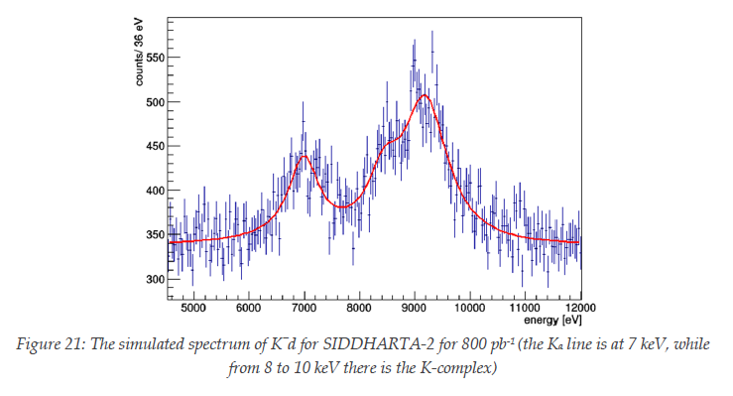
Expected Kd spectrum
Assumptions
signal: shift - 800 eV
width 750 eV
density: 5% (LHD)
detector area: 246 cm²
Kα yield: 0.1 %
yield ratio as in K⁻p
MC simulation for 800 pb⁻¹
Achievable precisions:
Δε(1s) = 30 eV and ΔΓ(1s) = 70 eV

Slide 16
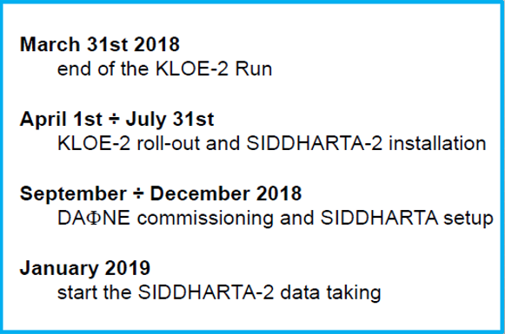
DAΦNE & SIDDHARTA Timeline

Slide 17
Conclusions
Kaons are the lowest mass strange particles and their interaction with protons and neutrons at very low energy is fundamental to be investigated
Kaonic atoms, in particular KH & Kd, represent a unique tool to investigate the KN low energy interaction,
The DAΦNE collider @ LNF is the best low momentum K- factory available and represents the only possibility to perform measurements leading to a better understanding of the low energy QCD in the strangeness sector
The SIDDHARTA experiment, with its data taking campaign in 2009, delivered fundamental results based on the KH, K⁴He and K³He shift and width measurements
The SIDDHARTA-2 experiment, in 2019, aims to deliver the first measurement ever of the Kd 1s level shift and width
SIDDHARTA-2 future program and perspectives involve also:
Other light kaonic atoms (K⁻O, K⁻C,…)
Heavier kaonic atoms (K⁻Si, K⁻Pb…)
Kaonic helium transitions to the 1s level
Kaon mass - precision measurement at a level < 7 keV
Radiative kaon capture – Λ(1405) study
Possible measurement of other types of hadronic exotic atoms (sigmonic hydrogen ?)

Slide 18


Thanks for your attention !

