Slide 1

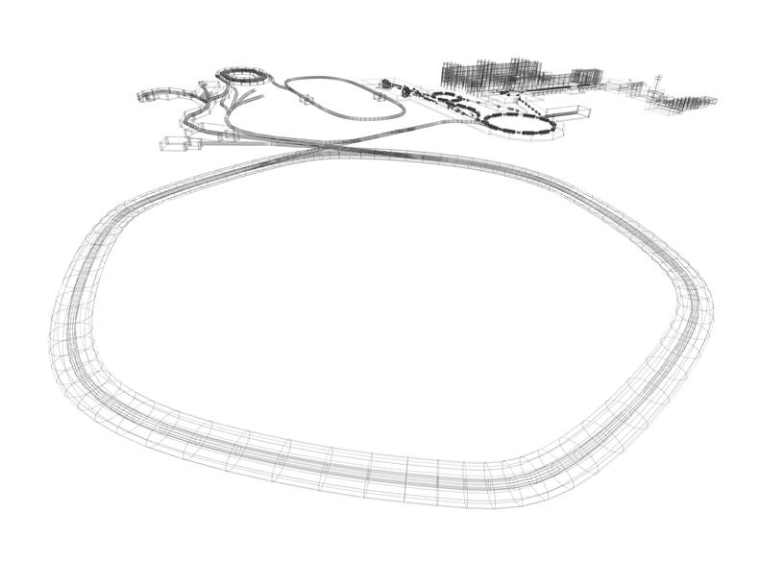
Physics at GSI / FAIR
- Status of the FAIR Project

Slide 2
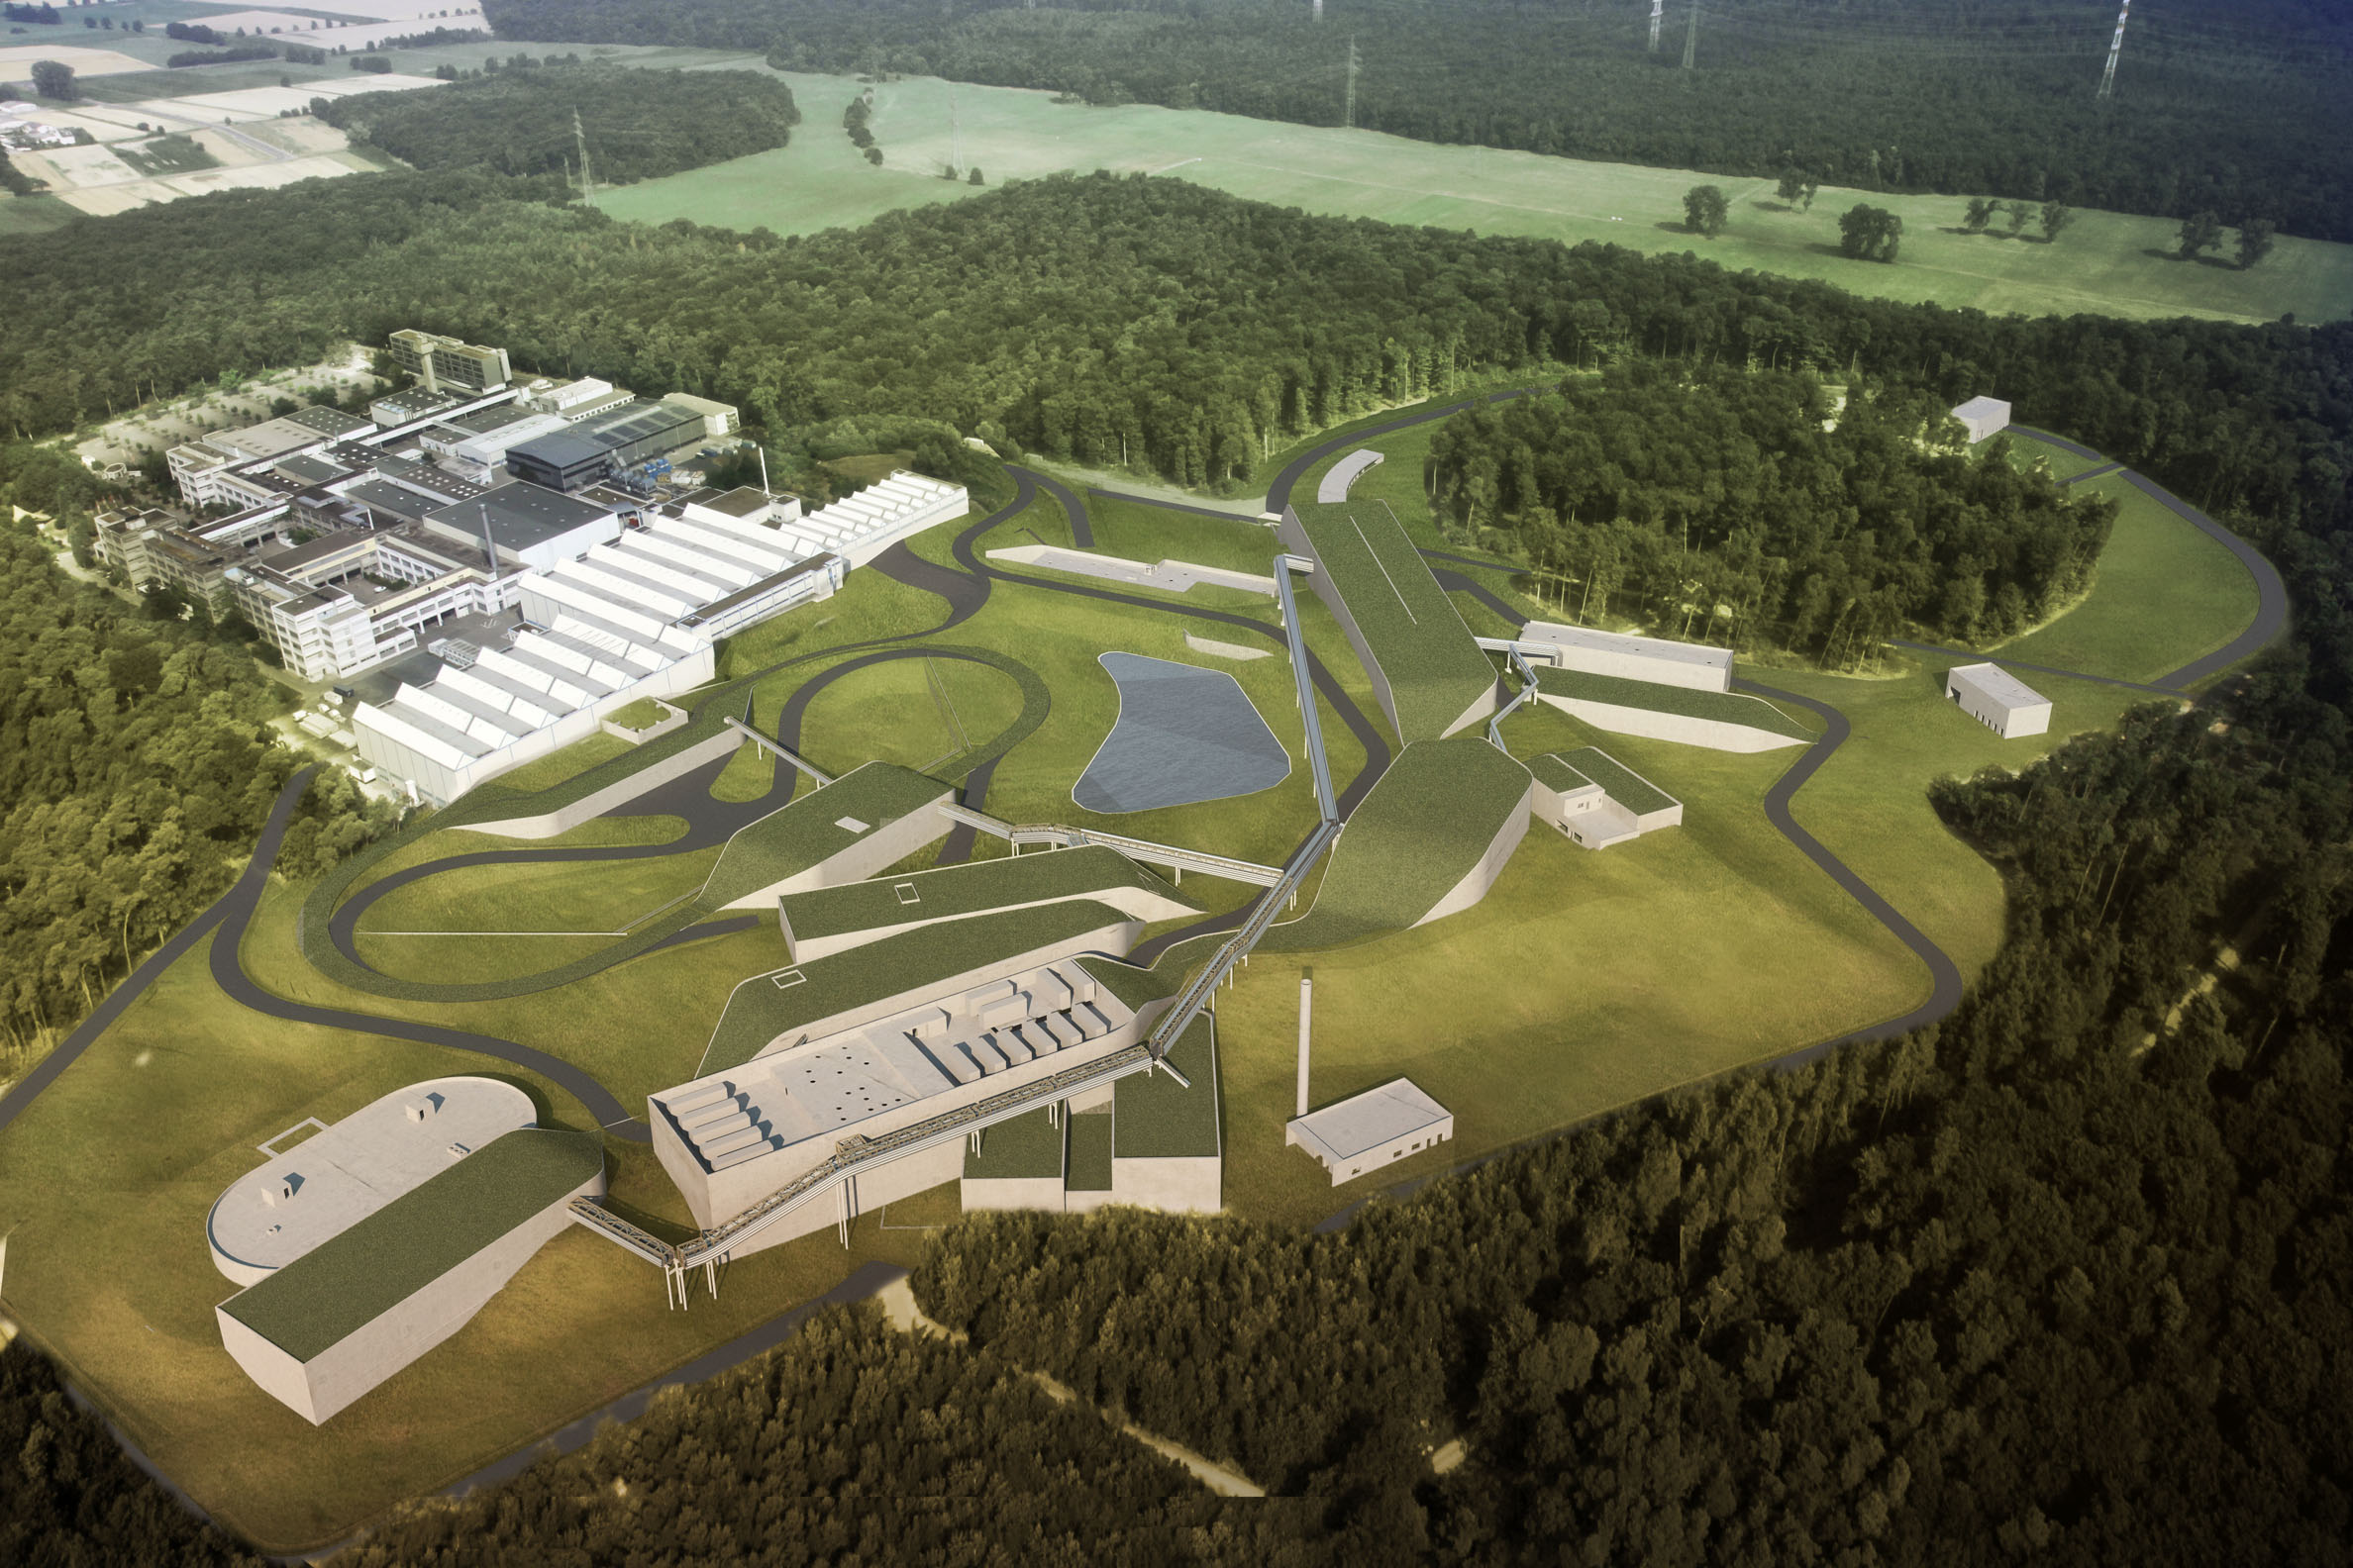
FAIR: Facility for Antiproton and Ion Research
– A World-Wide Unique Accelerator Facility
ESFRI Landmark
Top priority for European
Nuclear Physics Community
Driver for Innovation in Science and Technology

Slide 3
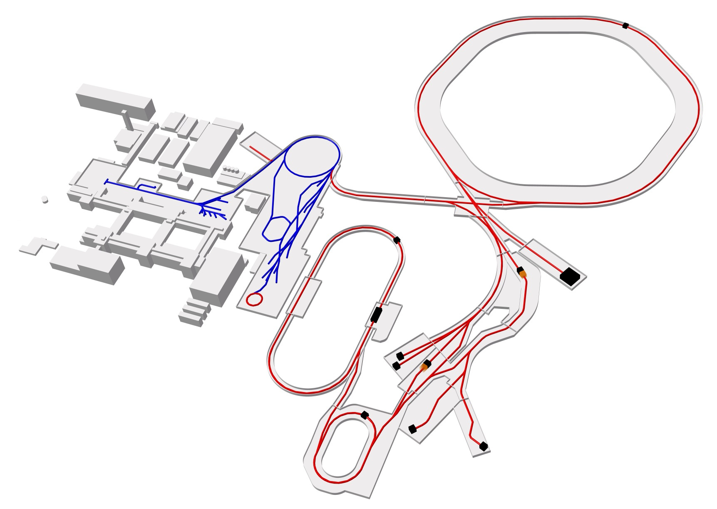
FAIR – The Facility
Ring
accelerator
SIS18
Ring accelerator SIS100
Linear
accelerator
UNILAC
ESR
Production of new exotic nuclei
Antiproton
ring
HESR
Production of antiprotons
CRYRING
100 meters
“Gain factors” rel. to GSI
100 – 10.000 x intensity
10 x energy
antiproton beams
Existing facility
Planned facility
Experiments
Collector
ring CR

Slide 4
FAIR – The Facility
FAIR
... accelerates particle beams from
(anti)protons up to uranium ions with
very high intensities
  up to a factor of ~100 increase for primary Uranium beams (~ 5 x 10¹¹ U²⁸⁺ ions /s),
  up to a factor of ~10.000 increase for secondary rare isotope beams
high pulse power (up to ~ 50 kJ / 50 ns)
suite of storage cooler rings equipped with stochastic and electron cooling for brilliant
beam quality
... develops and exploits innovative particle
separation and detection methods, as well as
novel computing techniques
... to perform forefront experiments
towards the production and
investigation of
New Extreme States of Matter.
Ring
accelerator
Ring accelerator SIS100
Linear
accelerator
Production of new atomic nuclei
Antiproton
ring
Production of antiprotons
100 meters
Existing facility
Planned facility
Experiments
Collector
ring

Slide 5
Four Scientific Collaborations
Atomic Physics and Fundamental Symmetries,
Plasma Physics,
Materials Research,
Radiation Biology,
Cancer Therapy with Ion Beams / Space Res.
Dense and Hot Nuclear Matter
Nuclear Structure far off stability,
Physics of Explosive Nucleosynthesis
(r process)
Hadron Structure & Dynamics with cooled antiproton beams
APPA
CBM
NUSTAR
PANDA

Slide 6
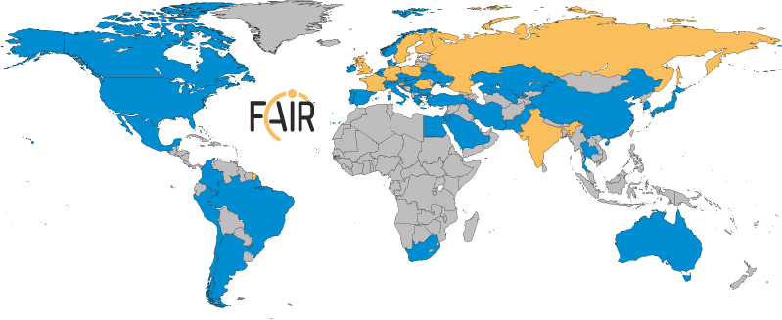
FAIR: International Cooperation
Realization and operation in international cooperation
Nine international shareholders
Participation of 3.000 scientists from all continents
Notes:
Message Internationalität-II, FÜR wen bauen wir. (Grafik muss aktualisiert werden)

Slide 7
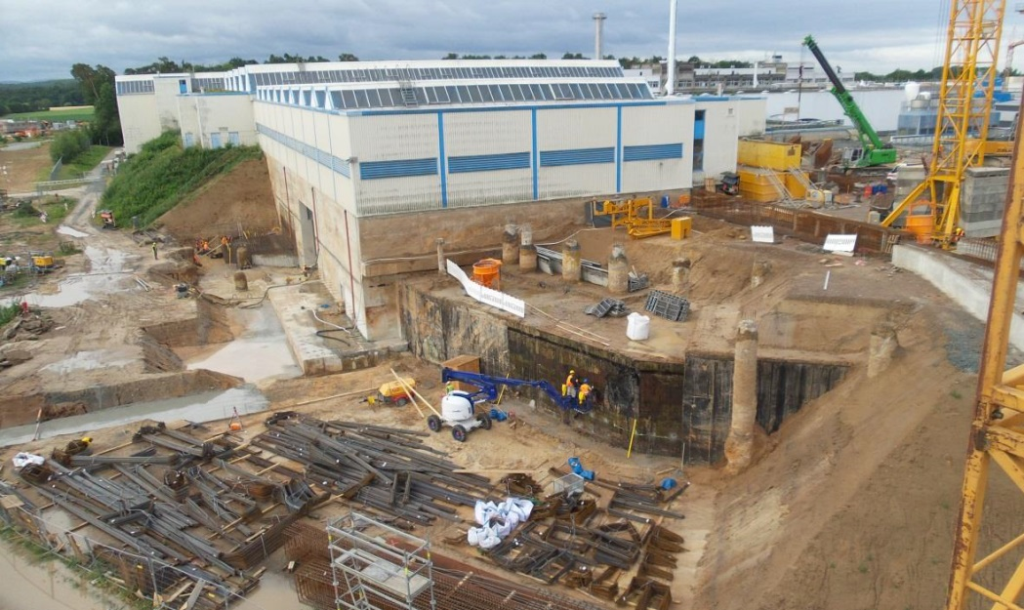
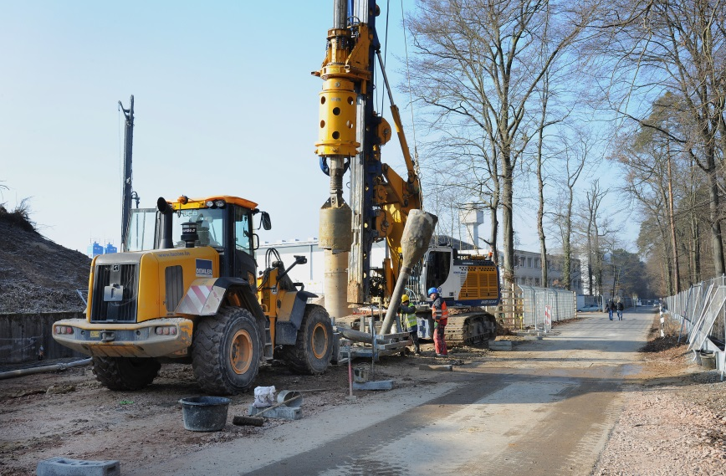
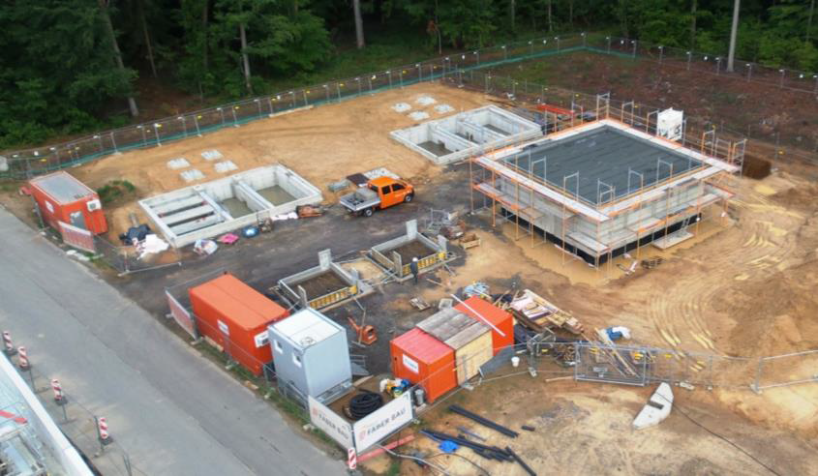
Important Recent Achievements
After critical project review successful restart in 2015 and 2016
Comprehensive civil construction plan:
- completion of all buildings by 2022
Full integrated planning for
the entire project:
- completion and commissioning
of the full FAIR facility by 2025.

Slide 8
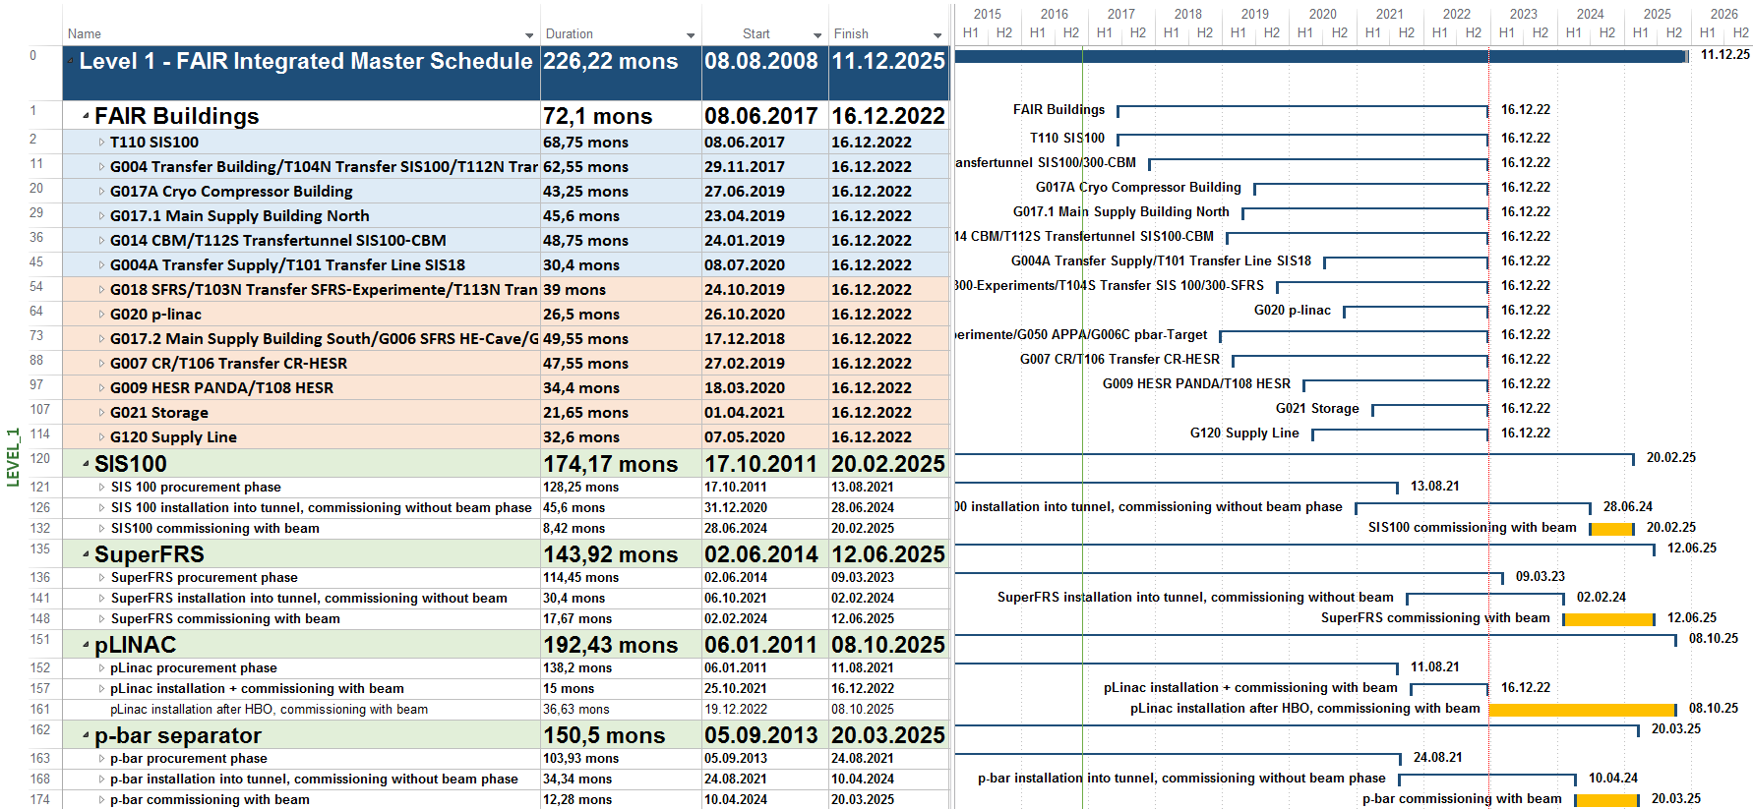
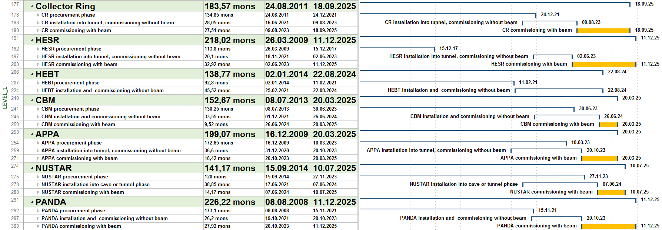
Integrated Project Time Schedule – Level 1:
FAIR Buildings, Accelerators & Experiments
FAIR
Buildings
7/2017 –
12/2022
FAIR
Acc. &
Exp. Install.
and
commiss.w/o
beam
1/2021
-
8/2024

Slide 9
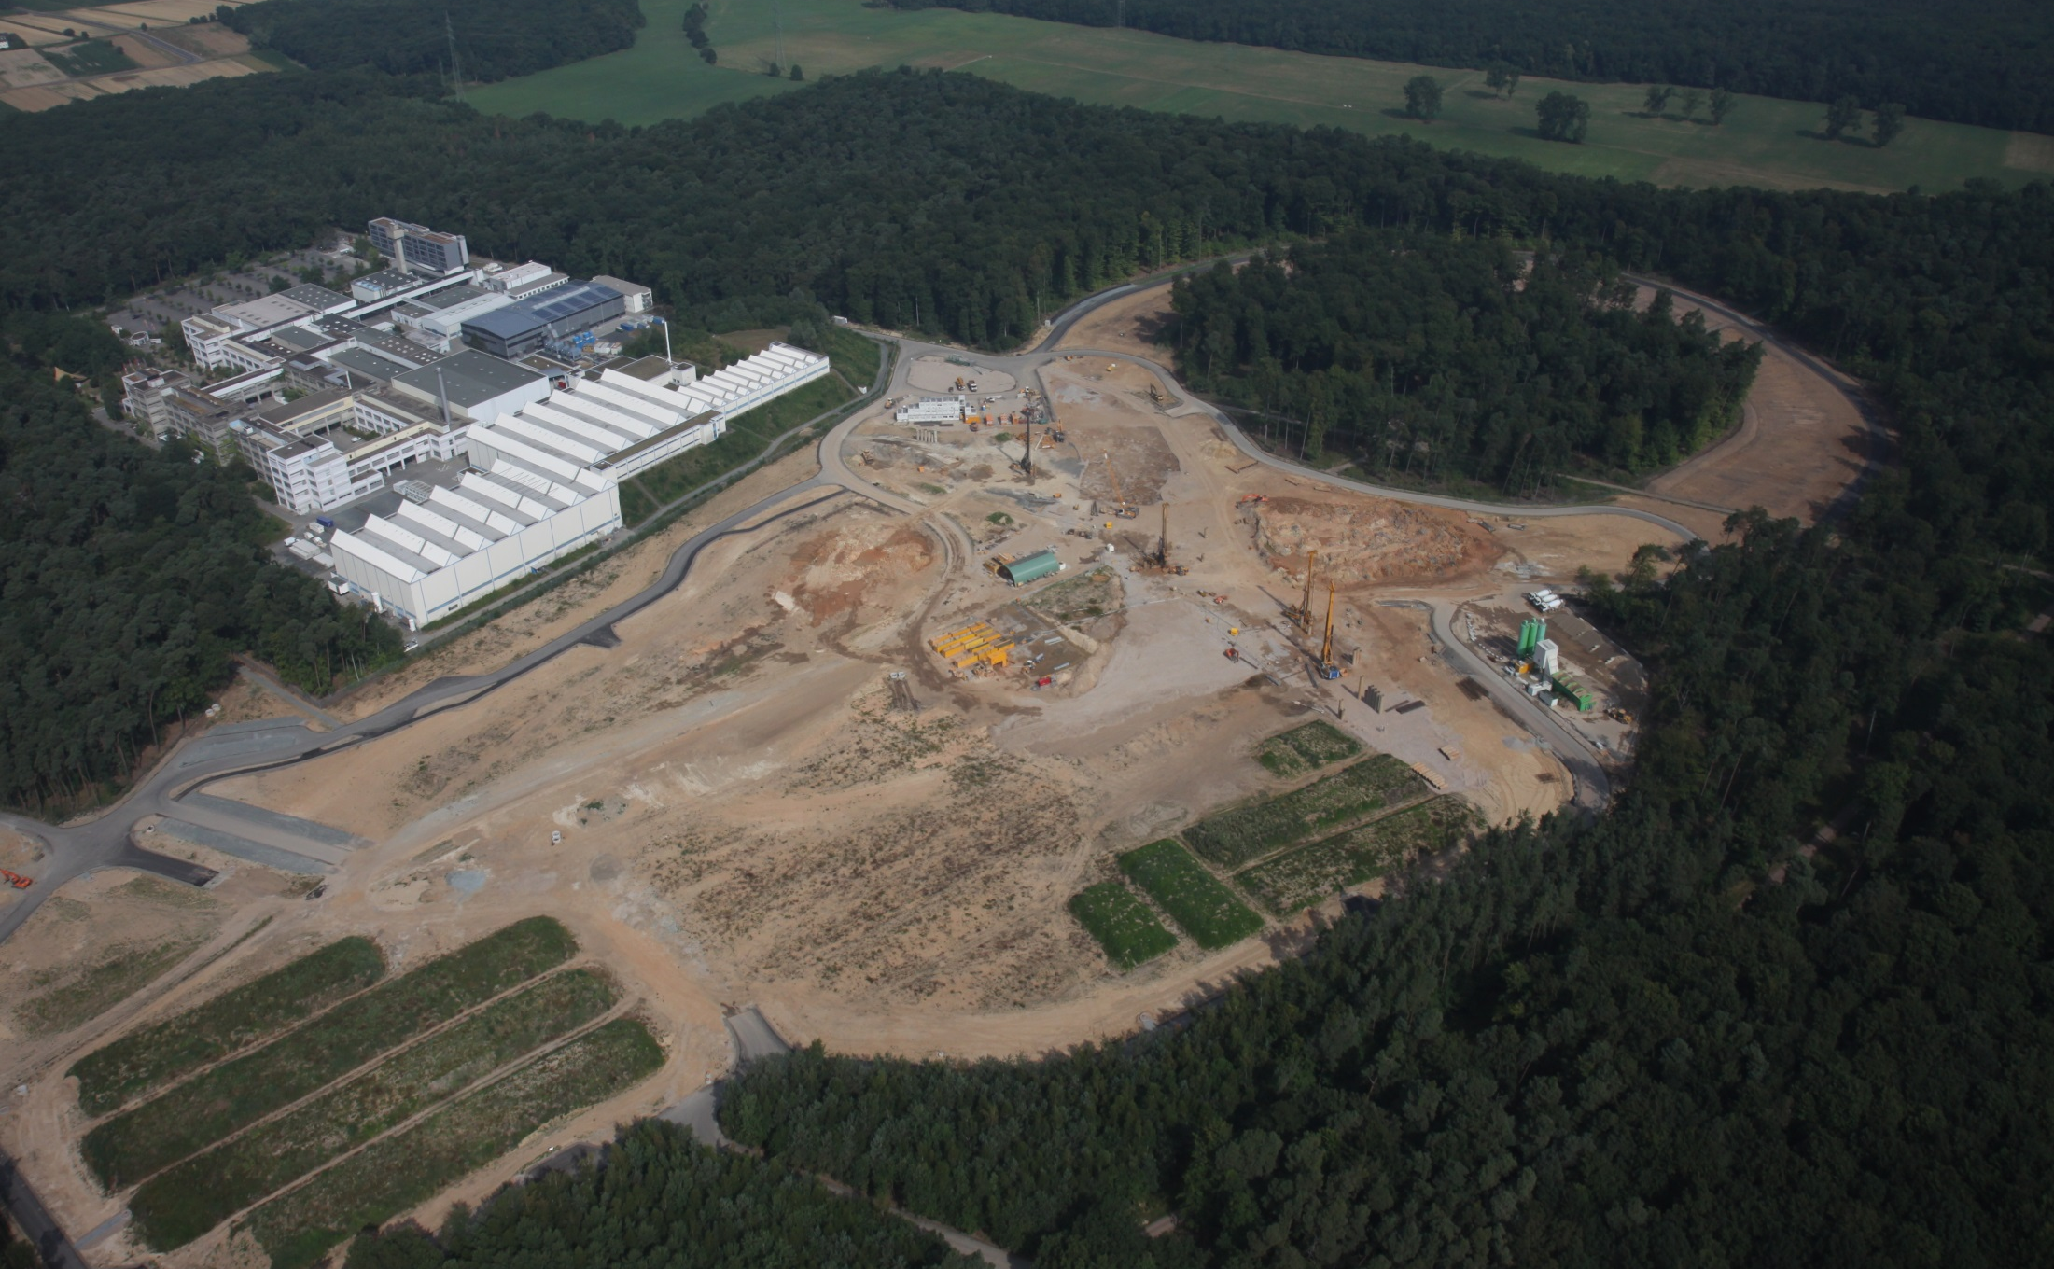
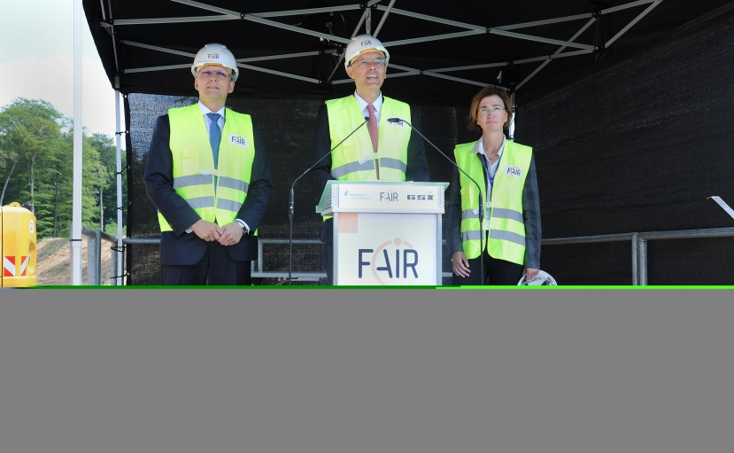
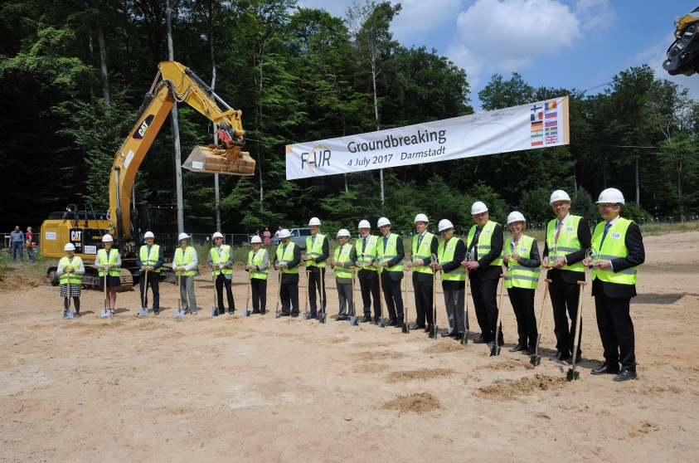
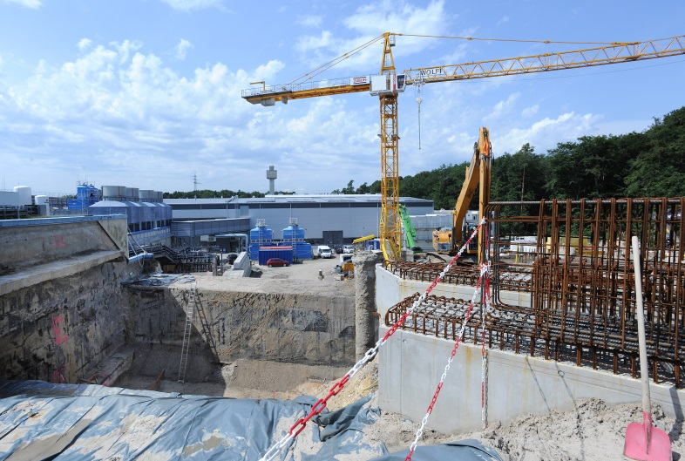
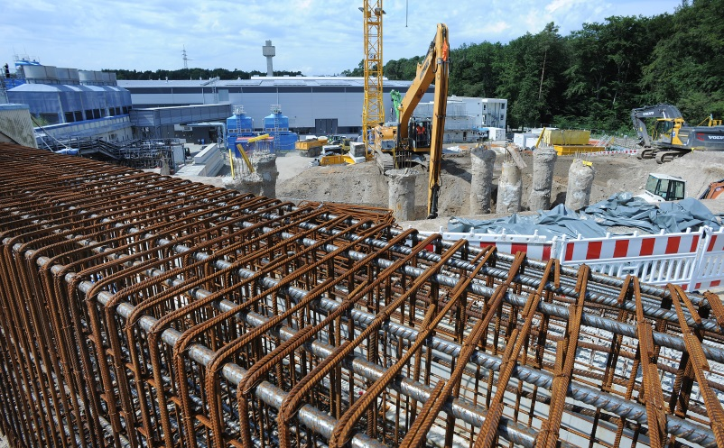
FAIR Civil Construction officially started on 4 July 2017
Notes:
Message: Und so sieht es „in echt“ aus. Links bestehende GSI und für den Bau von FAIR ist „schon alles vorbereitet“ (aktuelleres Bild einsetzen)

Slide 10
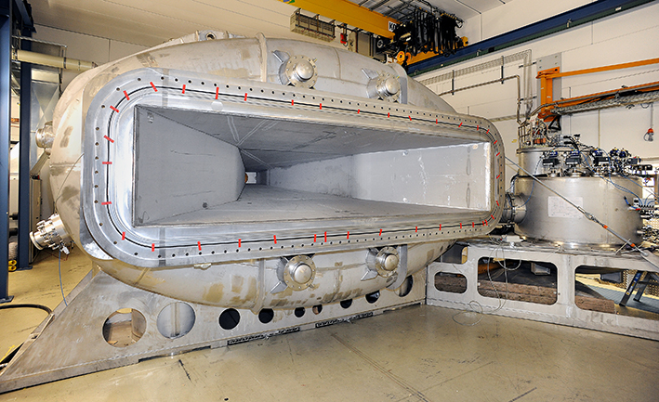
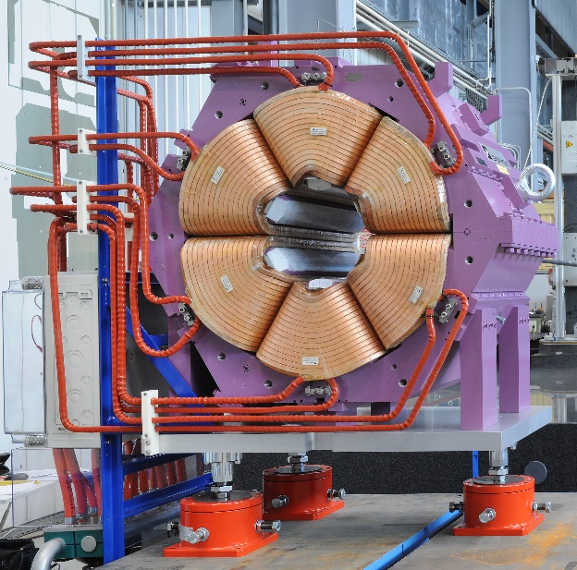
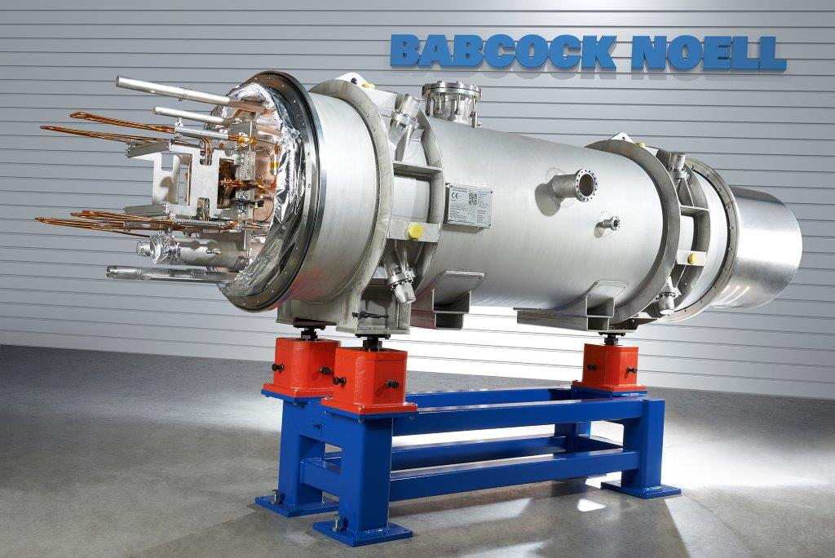
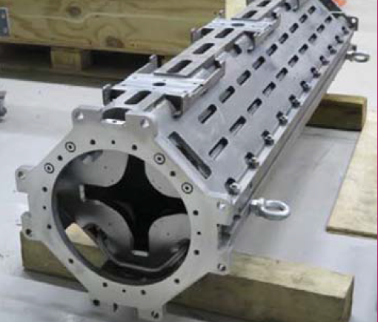
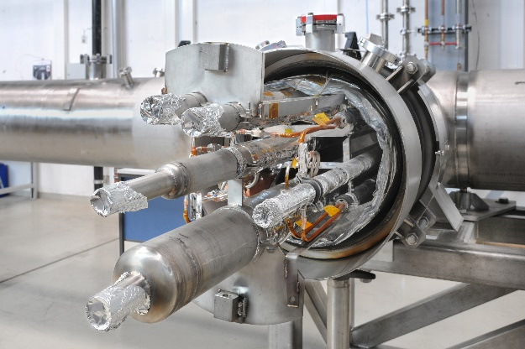
Production of accelerator components for FAIR is progressing
Germany
Poland
France
Denmark
Russia
Accelerator and detector contributions from many different partner institutions

Slide 11
The experiments advance!

Slide 12
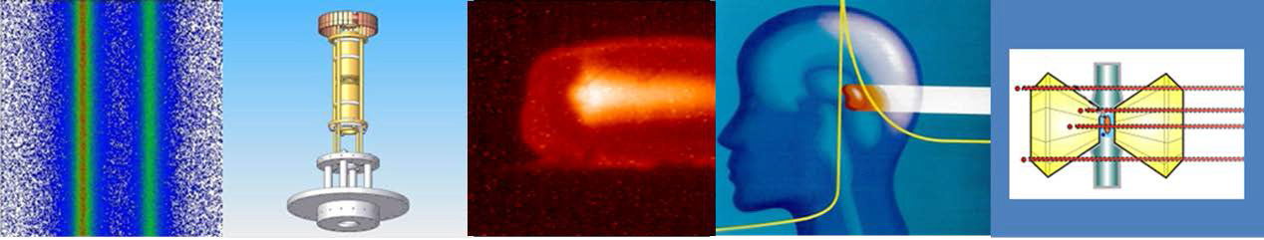
From fundamental to applied research –
Atomic physics, Plasma Physics, Application
APPA

Slide 13
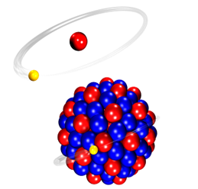
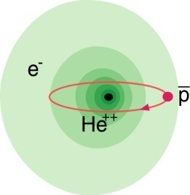
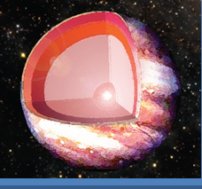

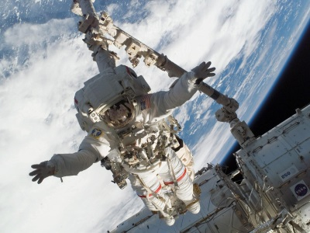
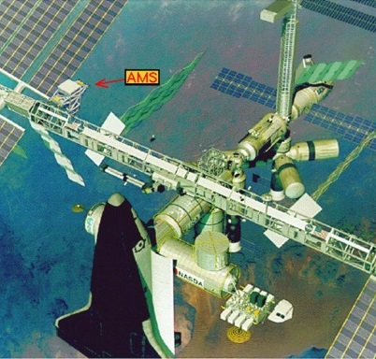
Atomic Physics, Plasma Physics, and Applied Sciences
FACILITY CAPABILITY
SCIENTIFIC CAPABILITY
Highest Charge States Extreme Static Fields
Relativistic Energies Extreme Dynamical Fields and Ultrashort Pulses
High Intensities Very High Energy Densities and Pressures
High Charge at Low Velocity Large Energy Deposition
Low-Energy Anti-Protons Antimatter Research
Atomic Physics
Plasma
Materials
Bio
SPARC
FLAIR
HEDgeHOB/WDM
MAT/BIOMAT
BIO/BIOMAT
strong field research
... probing of fundamental laws of physics
antimatter
... matter / anti-matter asymmetry
warm dense matter
... states of matter common in astrophysical objects
radiation hardness
... mechanical and electrical degradation of materials
space travel
... cosmic radiation risk and shielding

Slide 14
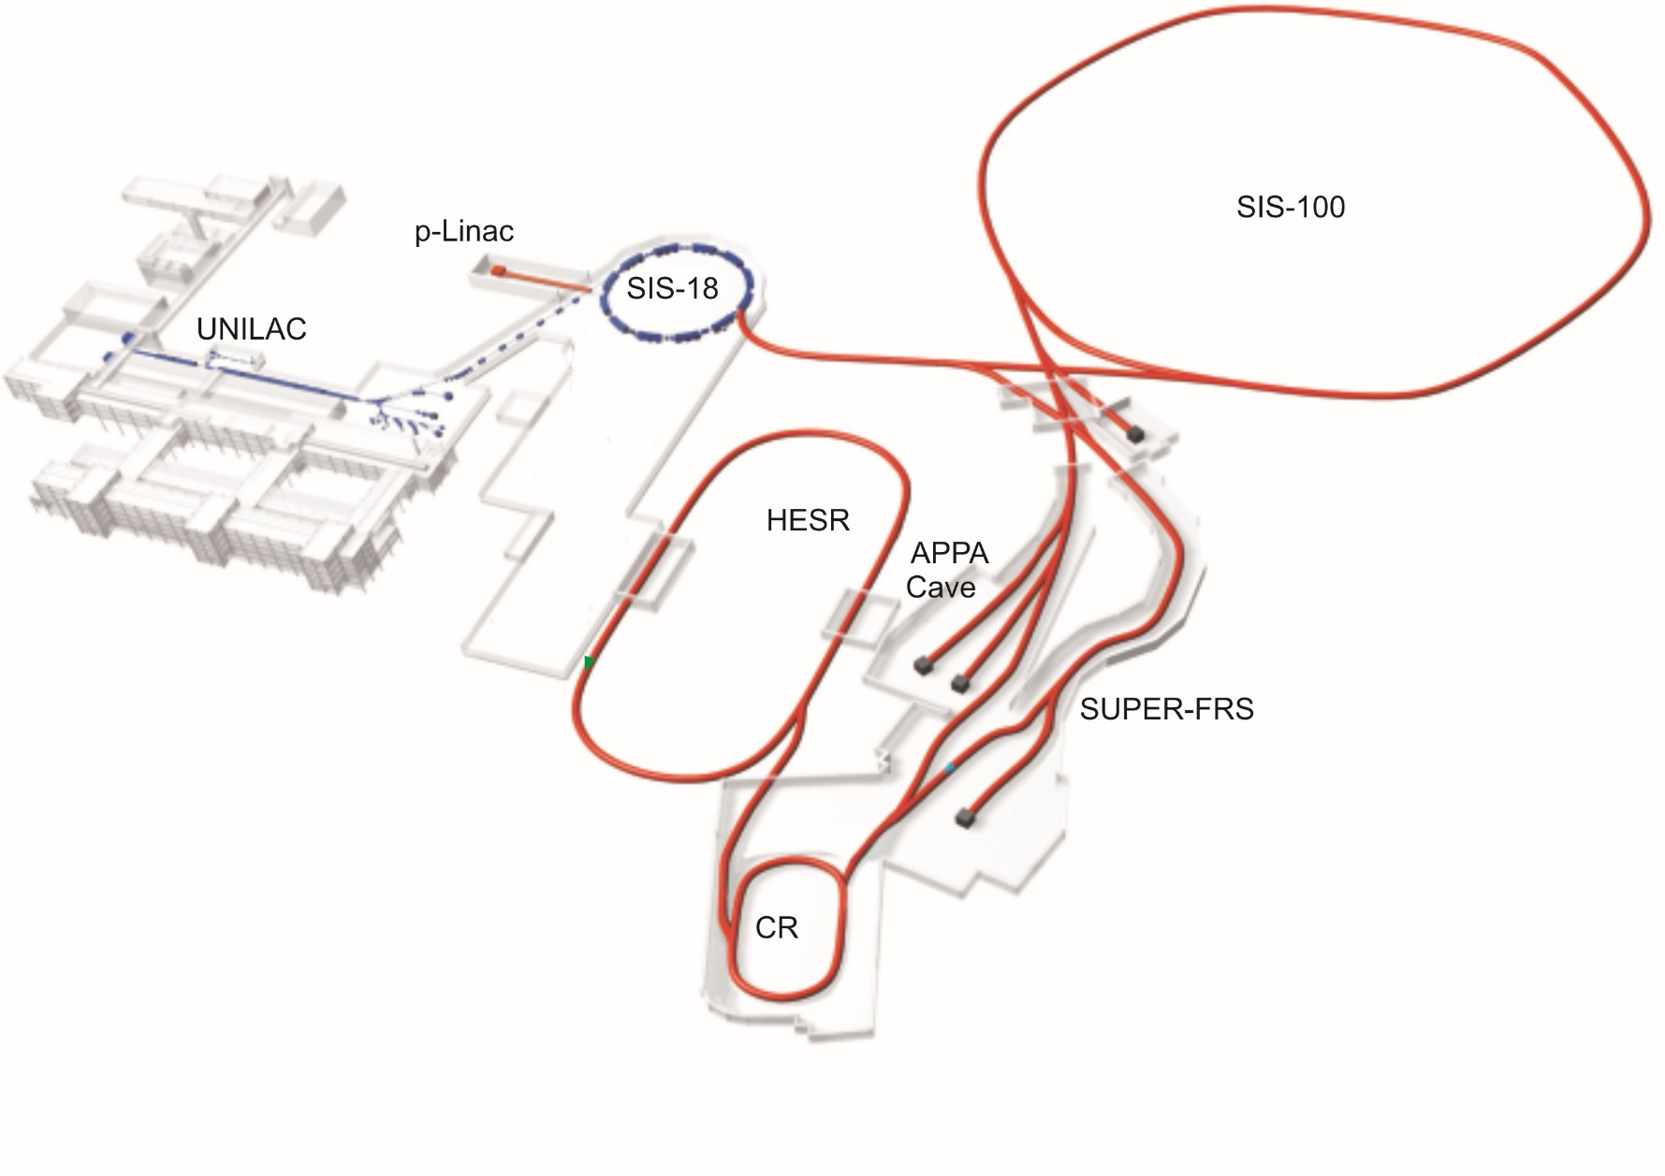
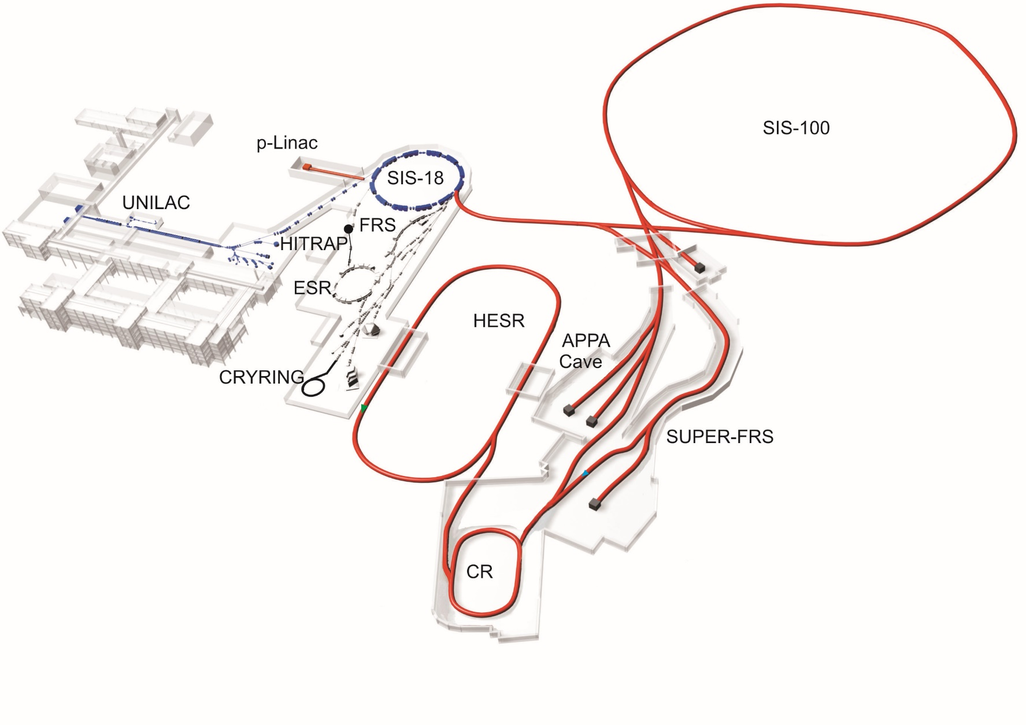
FAIR-MSV: APPA Facilities
PHELIX
FACILITIES
SIS100
HESR
APPA-Cave
ESR
CRYRING
HITRAP

Slide 15

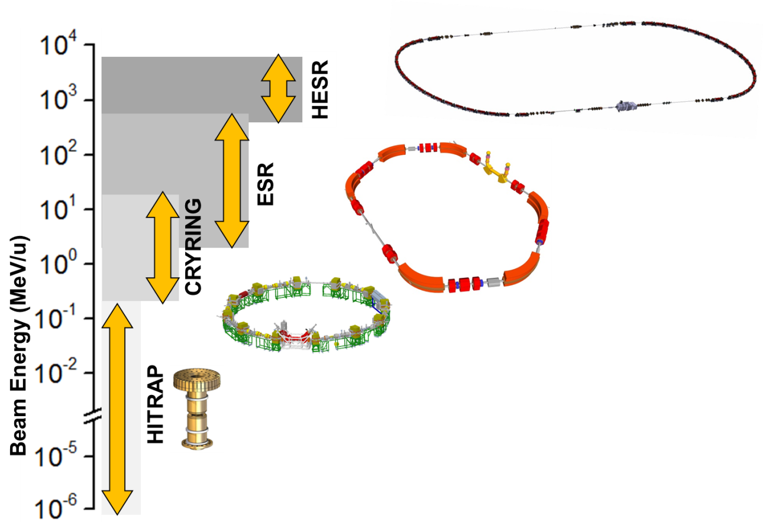
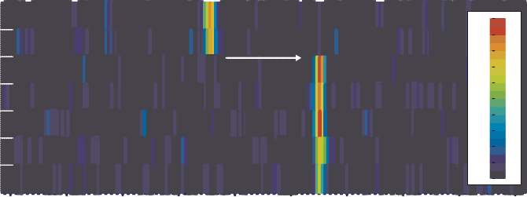
Ion Beam Facilities / Trapping & Storage
Stored and Cooled
Highly-Charged Ions (e.g. U⁹²⁺) and Exotic Nuclei
From Rest to Relativistic Energies (up to 4.9 GeV/u)
Worldwide Unique
Cooling: The Key for Precision
1,0
Δp/p ~ 10⁻⁵
uncooled beam electron cooled beam
beam intensity (arb. units)
0,8
0,6
0,4
0,2
0,0
0,88
0,91
0,94
0,97
1,00
f / f
1,03
1,06
1,09
1,12
0
From Single Ions to Highest Intensities
recording time / seconds
0
192 _{Pb} 81+
0.95
30
60
e⁻ capture
0.87
0.80
0.77
intensity / arb. units
90
120
150
180
Qec = 3.37MeV ¹⁹² _{Tl} ⁸¹⁺ |  |  |  | 0.67
 |  |  |  | 0.62
 |  |  |  | 0.57
 |  |  |  | 0.52
 |  |  |  | 0.48
 |  |  |  | 0.44
 |  |  |  | 0.40
127400 127500 127600 | 127700 | 127800 | 127900 128000 | 128100 128200
240
127300
frequency / Hz
15

Slide 16

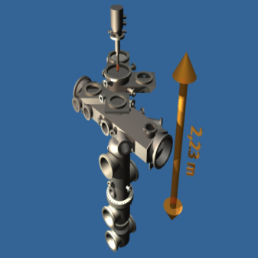
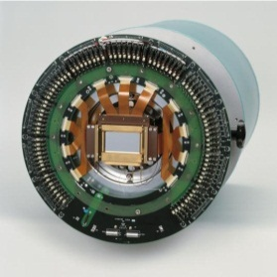
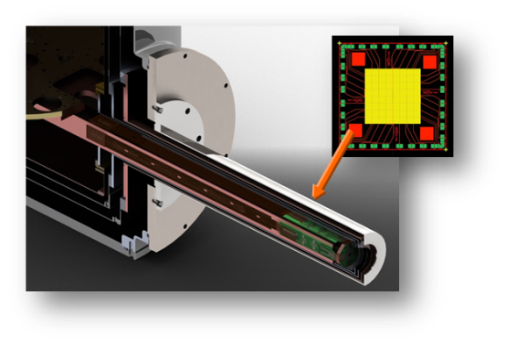
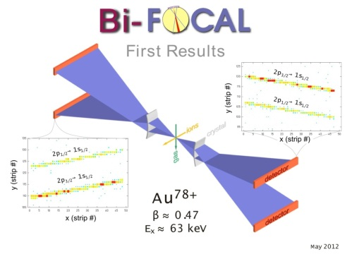
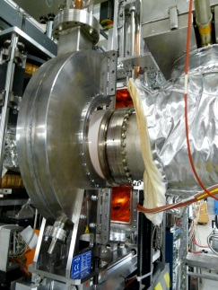
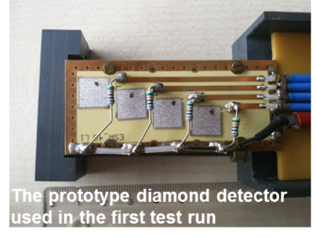
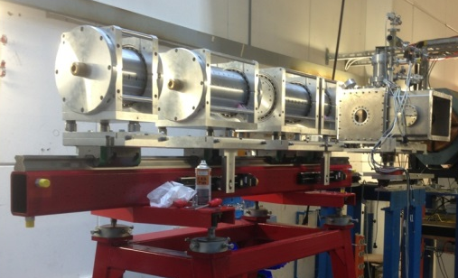
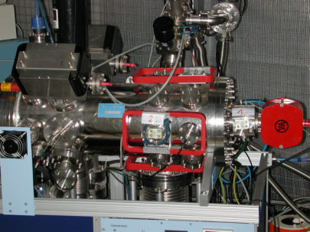
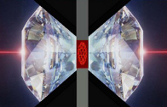
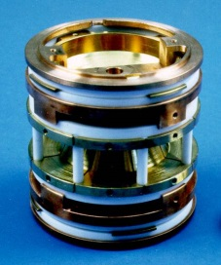
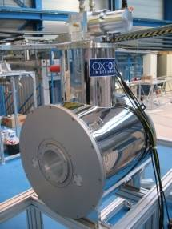
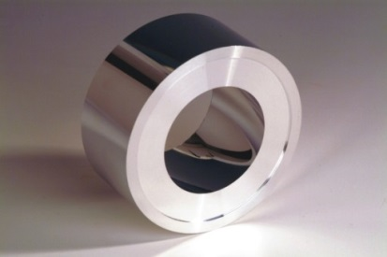
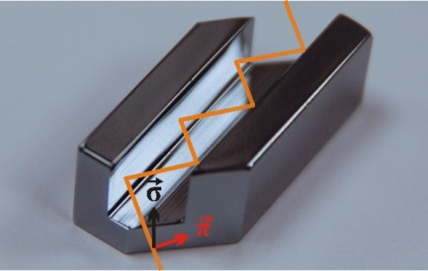
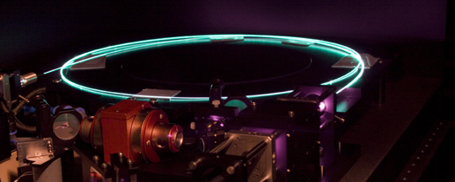
APPA
Sophisticated & Versatile Instrumentation
Observables: Photons, electrons, positrons, ions
Targets
Position-sensitive solid-state detectors
High-resolution spectrometers
Particle detectors
Particle spectrometers
High pressure cell
Traps
X-ray optics, channel-cut crystals
Laser systems

Slide 17


Slide 18
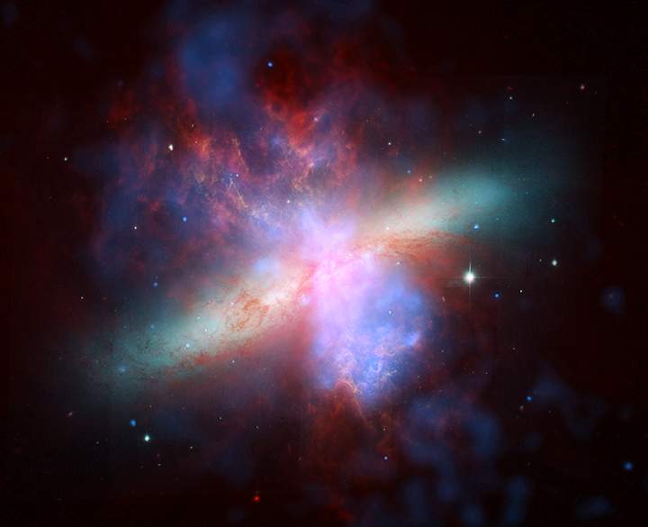
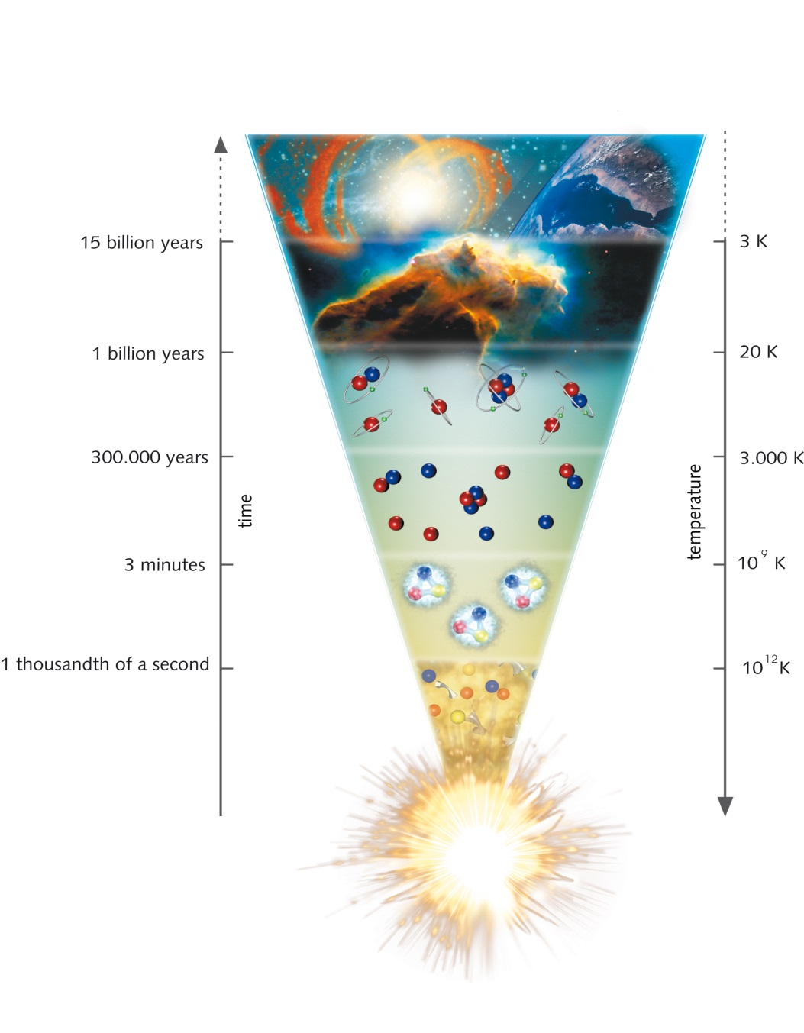
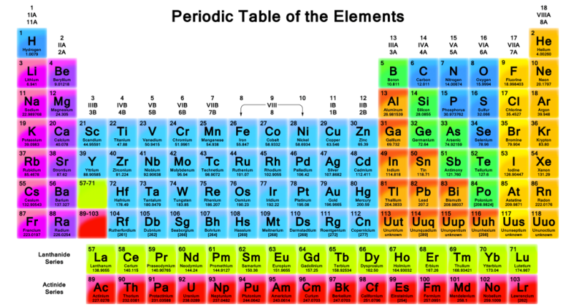

Synthesis of the chemical elements
Unique particle accelerator facility
Where and how were the heavy elements
made in the universe?

Slide 19
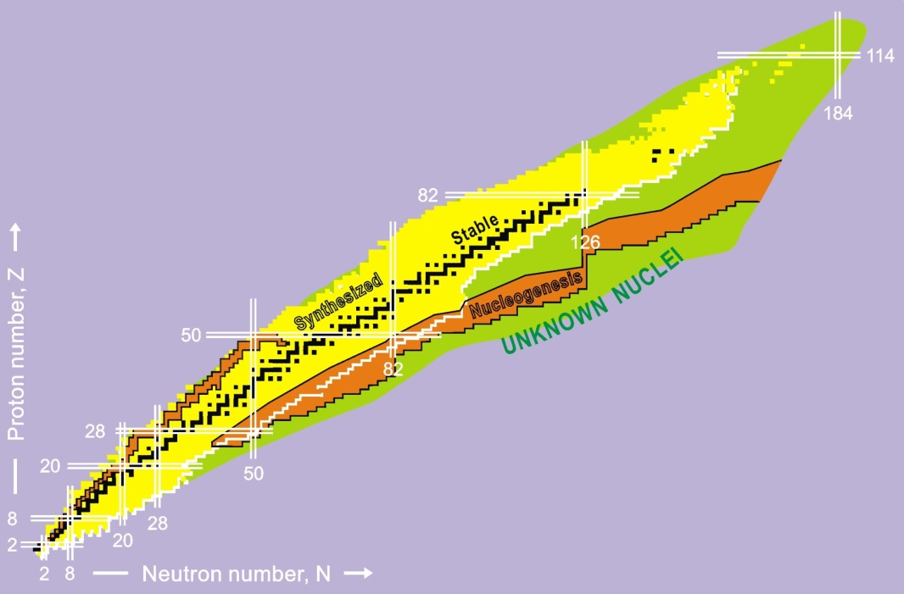
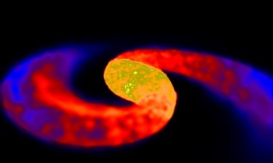

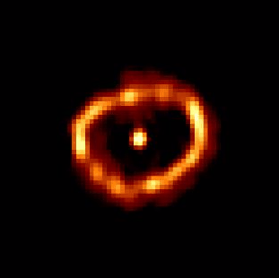

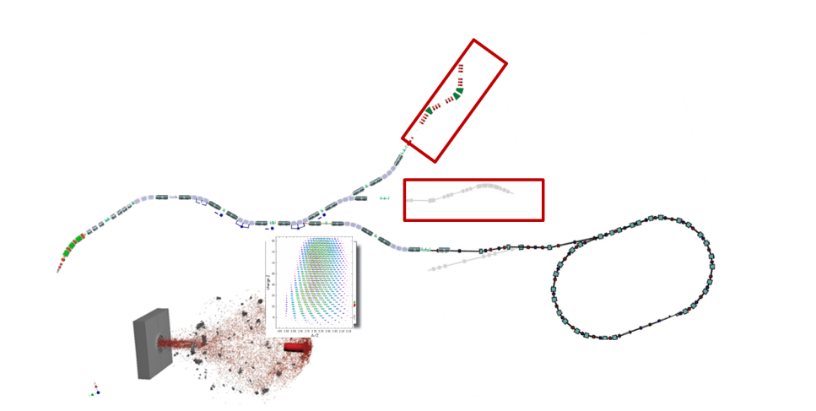

NUSTAR - Origin of elements in the universe
Neutron Star Merger
„Nucleosynthesis sites“ in the universe
Type I Supernova
Nova
Type II Supernova
„Nucleosynthesis sites” at FAIR
Sun
MATS & LaSpec
HISPEC/DESPEC
R³B
SFRS
SIS
100
production
target
ILIMA, EXL at CR
and at ESR, HESR, Cryring
19

Slide 20

NUSTAR - Origin of elements in the universe
Neutron Star Merger
„Nucleosynthesis sites“ in the universe
High SIS100 energies + SFRS: superior charge separation
and beam quality
Type I Supernova
Nova
Type II Supernova
Sun
MATS & LaSpec
HISPEC/DESPEC
R³B
SFRS
SIS
100
ILIMA
production
target
SPES-LNL
20

Slide 21
Physics goals/ highlights of the NUSTAR program
  Understanding the 3rd r-process peak by means of comprehensive measurements of masses, lifetimes, neutron branchings, dipole strength, and level structure along the N=126 isotones;
  Equation of State (EoS) of asymmetric matter by means of measuring the dipole polarizability and neutron-skin thicknesses of tin isotopes with N larger than 82 (in combination with the results of the first highlight);
  Exotic hypernuclei with very large N/Z asymmetry.
Notes:
The third r process peak is responsible for the production and abundances of the very heavy elements Pt, Au, Pb and beyond (around N = 126) .
it is and will remain the only) peak which, regarding isotopically clean separation of the involved exotic nuclei, can only be studied at GSI/FAIR due to the high energies available.

Slide 22
SC R³B Dipole GLAD installed at GSI
for first experiments in 2018/19
GLAD magnet (French in-kind contribution)
In 2018, start of physics program with GLAD
using beams from SIS18 and FRS at 1 GeV/u

Slide 23







Novel detectors developed for NUSTAR
Backward-angle neutron detector for tensor-force
experiments
Ion Catcher → LEB-MATS/LASPEC
O-TPC: discovered β-delayed
3p-emission of ³¹Ar
GADAST prototype measurements at S2
Full integrated S2 fiber tracker
Simulations for a
pion detector
integrated at S2

Slide 24

CBM

Slide 25


Exploring the phase diagram of „nuclear“ matter
Courtesy of K. Fukushima & T. Hatsuda
Search for answers to fundamental questions:
What are the properties of nuclear matter at high densities?
What is the structure of neutron stars?
➢ What is the origin of the mass of the universe?
Do exotic formes of (strange) matter exist?

Slide 26


CBM: Focus on SIS100 beam energies
Physics program: Exploring QCD matter at neutron star core densities (> 5 ρ₀)
nuclear matter equation of state
search for phase transition,
phase coexistence, exotic phases
onset of Chiral symmetry restoration
hypernuclei, strange matter
New physics insights by “pushing” interactions rates up to 10 MHz
optimized for precision measurements of rare probes (hyperons, hypernuclei, dileptons, charm)

Slide 27






CBM detector and DAQ tests at CERN SPS
➢ Successfull operation of detectors and of the DAQ system
➢ Events successfully reconstructed from free-streaming data
➢ Data quality allows for investigation of detector performance
TRD
MUCH
TOF
DAQ
Diamond

Slide 28



HADES Preparation for FAIR
Detector upgrades
  ECAL
  RICH-700 (synergy with CBM – UV detector)
  MDC-FEE
  FW-Tracker (synergy with PANDA – straws)
  FW-RPC
  FW-Wall (synergy with CBM – PSD)
  START (synergy with CBM – t₀ detector)
  Up to 50 kHz interaction rate, improved electron-id, detection of photons, large acceptance for exclusive processes.
sc-CVD diamond start detector
ECAL based on OPAL
lead glass
MAPMT based RICH UV detector

Slide 29


Slide 30

Science Case
  PANDA physics program focused on:
  Strangeness: High statistics sample of unexplored territory
  hyperon (Λ∗, Σ∗, Ξ∗, Ω∗) spectroscopy
  Charm(-like):
  X,Y,Z-factory, high statistics allow new approach to lineshapes, transitions, nature of the states
  Heavy-light mesons unexplored high spin states, lineshape
  Nucleon Structure:
  highest rates at lower q² for G_{E}, G_{M}, TDA, WACS, TMD
  Hypernuclei and nuclear targets:
  Hyperon-potential in nuclei, excited states of ΛΛ-hypernuclei
30

Slide 31


FAIR Facility Darmstadt

Slide 32
Strategy of PANDA
After intense discussion with the scientific community, there is – a focusing of the first key experiments
– a definition of the start setup
– a proposal for intermediate experiments/activities
And in addition:
  Development of dedicated analysis methods at ELSA, MAMI, BESIII, Jlab, COMPASS to ensure a quick start of PANDA.
  Application of modern PANDA technologies at present and future facilities, e.g. Trackers, Cherenkov (DIRC), EMC, Photon readout, Readout electronics
NUPECC LRP:
  The combination of PANDA’s discovery potential for new states, coupled with the ability to perform high-precision systematic measurements is not realised at any other facility or experiment in the world.
32

Slide 33







Straw Tube Tracker
Detector Layout
4600 straws in 21-27 layers,
of which 8 layers skewed at ~3°
Tube made of 27 µm thin Al-mylar, Ø=1cm
R_{in}= 150 mm, R_{out}= 420 mm, l=1500 mm
Self-supporting straw double layers
at ~1 bar overpressure (Ar/CO₂)
Readout with ASIC+TDC or FADC
Material Budget
Max. 26 layers,
0.05 % X/X₀ per layer
Total 1.3% X/X₀
Project Status
3000 Straws produced
Readout prototypes and beam tests
Ageing tests: up to 1.2 C/cm²

Slide 34
research already starts now ...

Slide 35

Intermediate Research Program FAIR Phase 0
Goals
  Forefront research by employing and testing new FAIR detectors
  Exploiting upgraded GSI accelerator facilities
    ongoing upgrade of SIS18 completed by mid 2018
    Make use of Cryring
  Education of young scientists
  Maintain and extend skills and expertise
  Serve national and international user community

Slide 36
Intermediate Research Program FAIR Phase-0
Scientific programme and beam parameters defined taking into account scientific and technical priorities of the FAIR Collaborations
110 days of beam time in 2018 scheduled
Similar amount of beam time envisaged for 2019
High-profile international Program Advisory Committee, chaired by Prof. Sydney Gales
Call for proposals closed on June 19, for decision by end of September
Over 130 submitted experiment proposals “overbook” available beam time by a factor of 2-3
  Overwhelming response from the scientific communities of all partner countries
  Confirms the importance of the experimental program

Slide 37

  NUPECC Long Range Plan 2017
  Key Summary Recommendation of the LRP:
Complete urgently the construction of the ESFRI flagship FAIR and develop and bring into operation the experimental program of its four scientific pillars APPA, CBM, NUSTAR and PANDA.
FAIR is a European flagship facility for the coming decades. Worldwide unique it will allow for a large variety of unprecedented fore-front research in physics and applied science. It focuses on the structure and evolution of matter. Its multi- faceted research opens a new era in our understanding of the fundamental building blocks of matter and the forces as well as of the evolution of our Universe: the new possibilities for research in Darmstadt are unique and are expected to produce ground breaking new insights for nuclear research.

Slide 38
Summary and Outlook
GSI/FAIR progress:
Civil construction progresses rapidly, while accelerator components continue to be delivered
R&D for and construction of the FAIR experiments advance
FAIR phase 0 – intermediate research program bridging the construction phase from 2018 until commissioning of the FAIR accelerators and experiments.
Call for 2018/2019 Beam time very successful: Physics to start next year
Growing involvement of groups from all over the world
and
Many opportunities to enhance our
well-established scientific-technological cooperation !
Exciting years to come!

Slide 39

FAIR 2025
Thank You!

Slide 40



CRYRING at GSI/FAIR

Slide 41

FLAIR Layout
HITRAP
CRYRING

Slide 42




CRYRING at GSI/FAIR
hydrogen
CRYRING: Swedish in-kind contribution to FAIR
Z=1
E_{b} = 13.6 eV
Z·α « 1
STORAGE RING
CRYRING
uranium ion
Z=92
E_{b} = 132 keV
Z·α ≈ 1
ions at rest in the laboratory

Slide 43










CRYRING: Transfer of ions from ESR to CRYRING
Scintillating screen in the first section of CRYRING:
C⁶⁺ @ 6 MeV/u
CRYRING team
supported by:
FAIR
GSI
HI-Jena
KVI Groningen
Univ Cracow
Univ. Stockholm
July 2016

Slide 44


Status CRYRING@ESR project
View from local injector to the ring
Milestones in 2016/17
ring installation completed
ions transfered from ESR to CRYRING@ESR
local ion source and injector operational
first turn achieved
(Nov. 2016)
current activities:
  bakeout to reach UHV
  Electron cooler commissioning
  commissioning of Accel/Decel
Signal from pick up electrodes
first pass
(after injection)
second pass = first turn!
Successful testbed for FAIR control system stack
injected beam shape
Notes:
Machine point of view

Slide 45







Nucleosynthesis
Proton Capture Reactions of Astrophysical Relevance
^{N}A^{Z+} (p, γ) in-flight studies
at low-energies
Precursor Experiment for CRYRING at the ESR (June/July 2016)
¹²⁴Xe⁵⁴⁺ + p → ¹²⁵Cs⁵⁵⁺ + γ
(charge transfer process)
Preconditions for such studies
Low collision energies → deceleration
Inverse kinematics → proton target (dense hydrogen target)
J. Glorius, Y. Litvinov, R. Reifarth et al.
Astrum

Slide 46


Proof of principle at the ESR (June 2016)
Preliminary data: ¹²⁴Xe @ 7 MeV/u
Target „off“
Target „on“
Gaussian +
Rutherford background fit
8, 6.7, 6, 5.5 MeV/u
Threshold for (p,n) is at 6.75 MeV/u
Data for 6.7 AMeV point to very small (p,n) at 7 MeV/u
Data for 8 MeV/u are (p,n) dominated
position
J. Glorius et al.

Slide 47

  Additional Beamline to Exploit the Physics Potential of FAIR
stable and exotic ions and antiprotons from HESR to ESR (not MSV)
SIS18
HESR
Early realization of pbar @ FLAIR
Exotic nuclei in storage rings
Protons from SIS18 to APPA Cave

