Slide 1
Distribution of MC Information
PANDA Computings Workshop - SUT
| Tobias Stockmanns

Slide 2
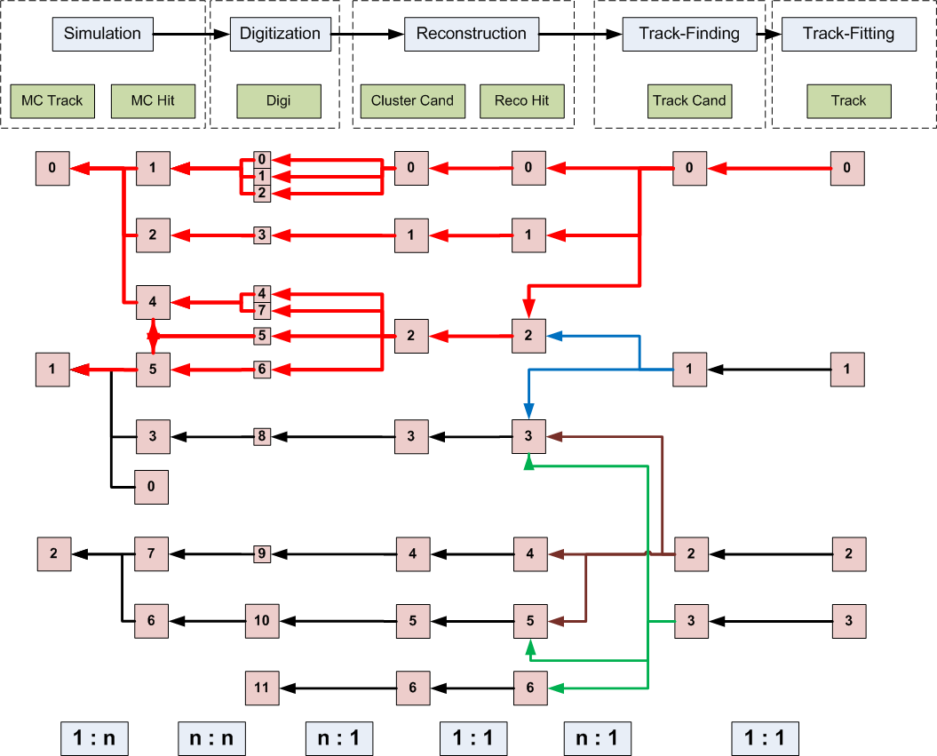
Motivation

Slide 3
Motivation
How to transport MC information through simulation stages?
What type of questions to answer?
What is the MC Track of a Reco Track?
What is the correct position of a Reco Hit?

Slide 4
Motivation

Slide 5
Data treatment
Each simulation stage stores its outcome in a root file
Inside the root file the data is organized in a TTree of TBranches
Each TBranch contains one type of information object
Each entry in a TBranch consist of a TClonesArray which holds the data
In event-based simulation each entry inside the tree contains all data of one event
This is not true for time-based simulation
How to connect data over branch boundaries and file boundaries?

Slide 6
FairLink
Type: Unique identifier of each branch.
Index: Position in TClonesArray
Weight: Counts how often a Link was used
(File / Entry / Type / Index / Weight)
File: Identifies different simulation files for signal and background
Entry: Identifies entry in TTree
FairLink is a unique identifier for each data object stored in a tree

Slide 7
FairLink
File
Branch
Tree
Branch 1
Entry 1
Entry 2
Branch 2
Entry 1
Entry 2
Entry 3
Entry 3
Entry 1
Branch 3
Entry 2
Entry 3
Entry
Index

Slide 8
FairMultiLinkedData
Two important Methods:
SetLink(FairLink link)): Clears the existing list of links and sets link as first entry
AddLink(FairLink link, bool multi): Adds link to the vector of links. If multi is false it checks first if this link already exists and increases the weight factor for this link. In all other cases the link is added to the vector.
If you want to use MC Propagation you have to:
derive your classes from FairMultiLinkedData_Interface or FairHit/FairMCPoint
set/add the links to the data you have used to generate your actual data set

Slide 9
Example SttHit
/** Standard constructor **/
PndSttHit::PndSttHit (Int_t detID, TVector3& pos, TVector3& dpos,
Int_t index, Int_t flag, Double_t isochrone,
Double_t isochroneError, TVector3 wireDir)
: FairHit(detID, pos, dpos, index)
{
fIsochrone = isochrone;
fIsochroneError = isochroneError;
fRadial = TMath::Sqrt(pos.X() * pos.X() + pos.Y() * pos.Y());
fWireDirection = wireDir;
fAssigned = kFALSE;
// stt1
fXint = fX;
fYint = fY;
fZint = fZ;
SetLink(FairLink(“STTPoint”, index)); //short version
SetLink(FairLink(-1, FairRootManager::Instance()->GerEntryNr(), “SttPoint”, index));
}

Slide 10
Example PndTrack – Full Information
[(-1/9/MCTrack/2/154)
(-1/9/STTPoint/55/3) (-1/9/STTPoint/56/3)
(-1/9/MVDPoint/5/15) (-1/9/MVDPoint/6/20) (-1/9/MVDPoint/7/20)
(-1/9/STTHit/55/2) (-1/9/STTHit/56/2)
(-1/9/MVDPixelDigi/6/4) (-1/9/MVDPixelDigi/7/4) (-1/9/MVDPixelDigi/8/4)
(-1/9/MVDStripDigi/2/4) (-1/9/MVDStripDigi/3/4) (-1/9/MVDStirpDigi/4/4)
(-1/9/MVDStripDigi/5/4) (-1/9/MVDStripDigi/6/4) (-1/9/MVDStripDigi/7/4)
(-1/9/MVDStripDigi/8/4) (-1/9/MVDStripDigi/9/4)
(-1/9/MVDPixelCluster/4/3)
(-1/9/MVDPixelHit/6/2)
(-1/9/MVDStripCluster/0/3) (-1/9/MVDStripCluster/1/3)
(-1/9/MVDStripCluster/2/3) (-1/9/MVDStripCluster/3/3)
(-1/9/MVDStripHit/1/2) (-1/9/MVDStripHit/2/2)]
* Type number replaced by branch name – Reduced Number of STTHits

Slide 11
FairLinks in Data Classes
class FairMultiLinkedData_Interface:
TObject
FairMultiLinkedData* fLink;
class FairMultiLinkedData: TObject
set<FairLink> fLinks;
FairLink fEntryNr;
class FairTimeStamp
Double_t fTimeStamp, fTimeStampError
Data Classes

Slide 12
FairLinkManager
Often not the complete history data is wanted
Mostly MCTrack, sometimes MCPoint
FairLinkManager controls what is stored as a FairLink
FairLinkManager is an instanton created in FairRun
Access via FairLinkManager::Instance()
Two ways how to control what is stored:
AddIncludeType(Int_t type);
This branch type is stored
AddIgnoreType(Int_t type);
This branch type is not stored
Cannot be mixed!
Example in macro
FairLinkManager::Instance()->AddIncludeType(0);
only stores MCTracks

Slide 13
What to do with the FairLinks?
You can ask each object with FairLinks where it was coming from:
vector<FairLink> GetSortedMCTracks();
returns all MCTracks sorted by their weight
FairMultiLinkedData GetLinksWithType(FairRootManager::Instance() ->GetBranchId(“MyType”));
returns all FairLinks with the given type
You can even get the object the FairLink is pointing to:
TObject* FairRootManager::Instance() ->GetCloneOfLinkData(FairLink);
You have to cast it to its original data type
You have to destroy it at the end (it is a clone!)
Have a look at class PndMCTruthMatch

Slide 14
What to do with FairLinks?
Ideal track finder PndIdealTrackFinder based on FairLinks
Tracking quality assurance based on FairLinks

Slide 15
Remarks
FairLinks can be switched on and off
Without FairLinks the data classes only contain an empty pointer
Level of detail for FairLinks can be set via FairLinkManager, everything from only MC Tracks to complete history possible
FairRootManager can return a clone of a data object for a FairLink
FairRootManager adds history data (optional)
Size increase strongly depends on settings:
No FairLinks | Full FairLinks | Only MCTrack
3,132,578 byte | 3,926,688 byte | 3,188,179 byte
 | + 25 % | + 2 %
Reconstructed Tracks for 1000 events DPM

Slide 16
EMC – a special case
Tracking Detectors
EMC
8
x
5
9
6
4
7
x
10
3
2
x
1
1

Slide 17
1st Implementation – Go back to primary
8
5
9
6
4
7
10
3
2
1
12
11
13
0

Slide 18
2nd Implementation – Go Back to first outside EMC
8
5
9
6
4
7
10
3
2
1
12
11
13
0

Slide 19
2nd Implementation – Go Back to first outside EMC
8
5
9
6
4
7
10
3
2
11
1
12
13
0

Slide 20
New Implementation – EMC Nomenclature
8
5
Emc Point
9
6
4
7
10
3
2
1

Slide 21
New Implementation – EMC Nomenclature
8
5
Emc Point
9
6
4
7
Emc Hit –
All points in one
crystal
10
3
2
1

Slide 22
New Implementation – EMC Nomenclature
8
5
Emc Point
9
6
4
7
Emc Hit –
All points in one
crystal
10
3
2
Emc Cluster –
All hits in neighboring
crystals
1

Slide 23
New Implementation – EMC Nomenclature
8
5
Emc Point
9
6
4
7
Emc Hit –
All points in one
crystal
10
3
2
x
x
Emc Cluster –
All hits in neighboring
crystals
1
11
x
Emc Bump –
Subdivision of Cluster for multiple particles

Slide 24
New Implementation
For each EmcPoint if track is entering / exiting the crystal is stored
8
5
EmcPoint: entering: 1, 11, 4, 6, 7, 9 ,10 exiting: 4, 5, 6, 7, 8, 9, 10
9
6
4
7
10
3
2
1
11

Slide 25
New Implementation
For each EmcPoint if track is entering / exiting the crystal is stored
Each EmcHit stores tracks entering and exiting
8
5
EmcHit 0: in: 9 ,10 out -
1: in: 1 out 4, 5, 9, 10
2: in: 4 out 6, 7
3: in 6, 7, 11 out 8
9
6
4
7
10
3
2
0
1
2
3
1
11

Slide 26
New Implementation
For each EmcPoint if track is entering / exiting the crystal is stored
Each EmcHit stores tracks entering and exiting
Each EmcCluster stores tracks entering and exiting
8
5
EmcHit 0: in: 9 ,10 out -
1: in: 1 out 4, 5, 9, 10
2: in: 4 out 6, 7
3: in 6, 7, 11 out 8
EmcCluster 0: in 1,11 out 5, 8
9
6
4
7
10
3
2
0
1
11

Slide 27
New Implementation
For each EmcPoint if track is entering / exiting the crystal is stored
Each EmcHit stores tracks entering and exiting
Each EmcCluster stores tracks entering and exiting
Each EmcBump stores nearest track entering (not implemented yet)
8
5
EmcBump 0: in: 1
1: in 11
9
6
4
7
10
3
2
x
x
0
1
1
11

Slide 28
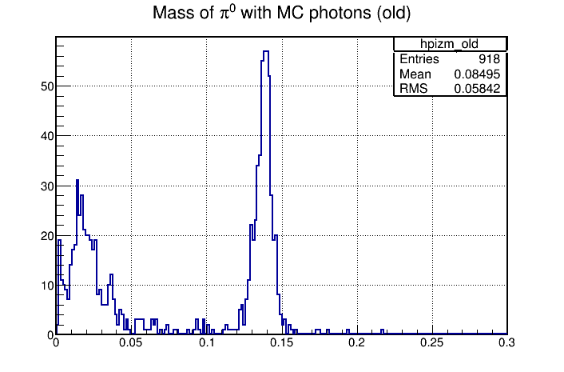
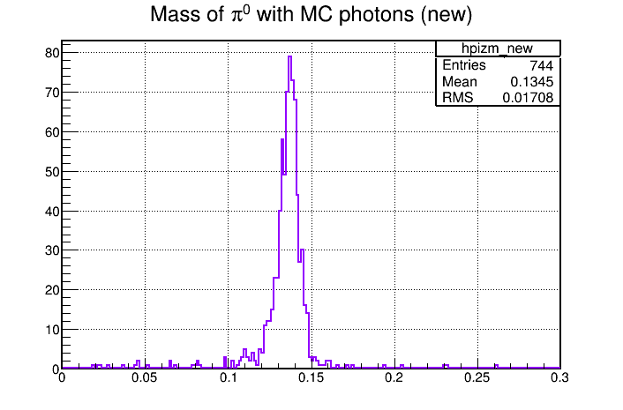
Result
Example from Lu: π⁰ reconstructed with MC matched photons

Slide 29
Summary
Monte Carlo truth propagation is a non-trivial task
FairLinks: unique pointer to all data objects inside FairRoot
MC information stored as collection of FairLinks pointing to (up to all) older data objects used to generate the current data object
What to store can be handled by FairLinkManager
EMC data needs special treatment

