Slide 1
Introduction

Slide 2
Some History
3rd generation PANDA framework
Born around 2005, official since 2006
Initiated by Giessen, Jülich, Pavia, and Torino
Derived from CBMroot, today FairRoot
Aims for full simulation and reconstruction, low-threshold usage, ROOT+VMC-based, modular and virtual design, platform independent, dynamic data structure, …

Slide 3
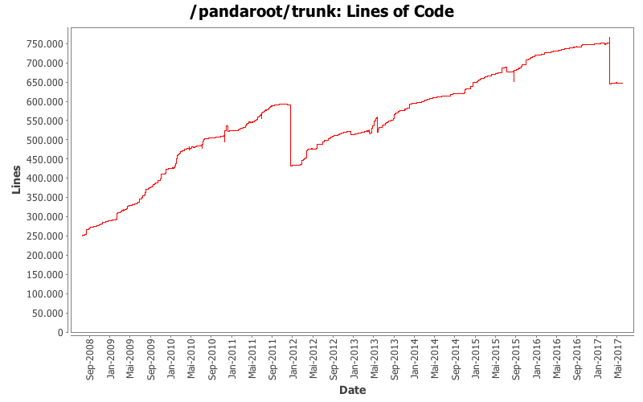
Development of Code

Slide 4
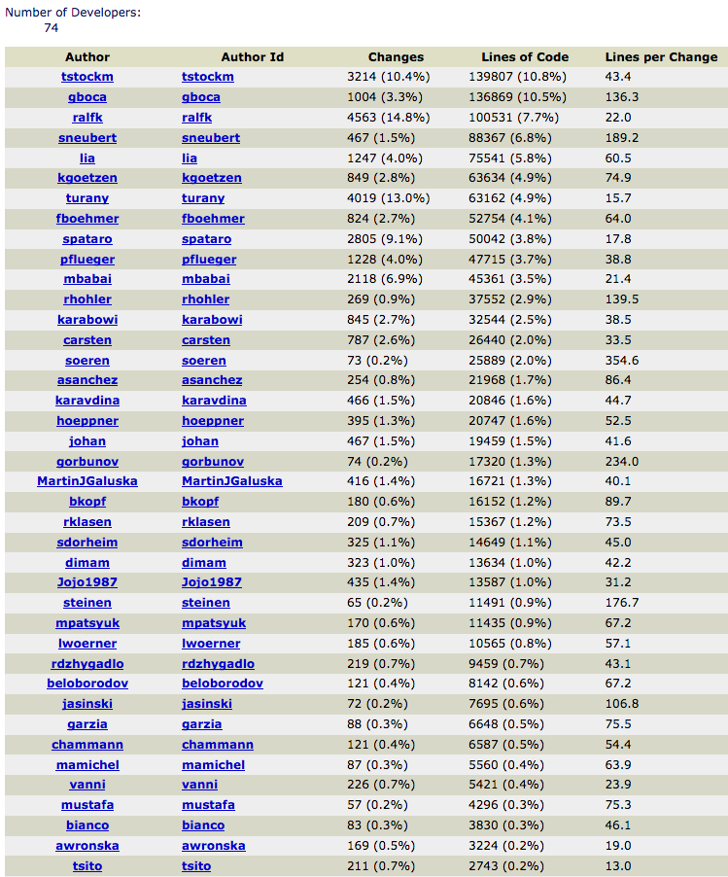
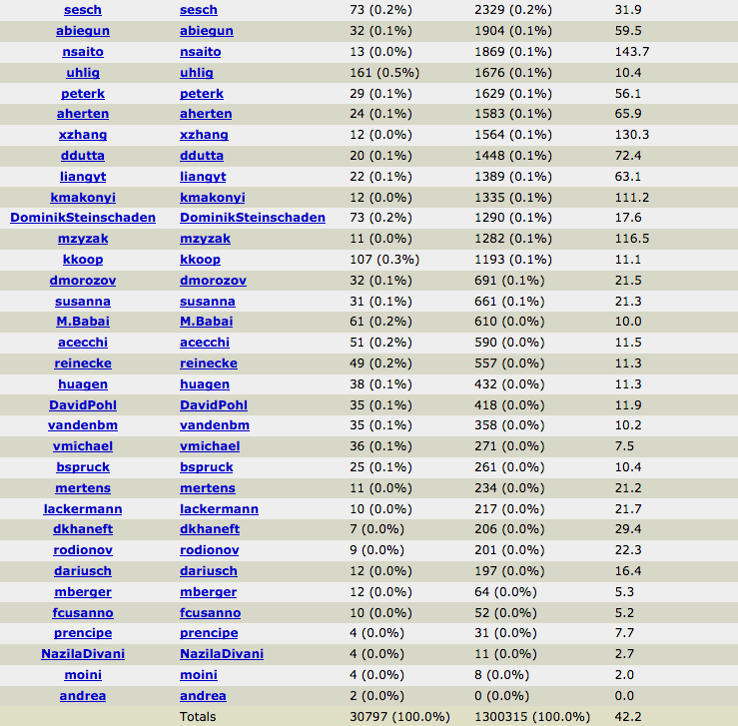
Developers

Slide 5
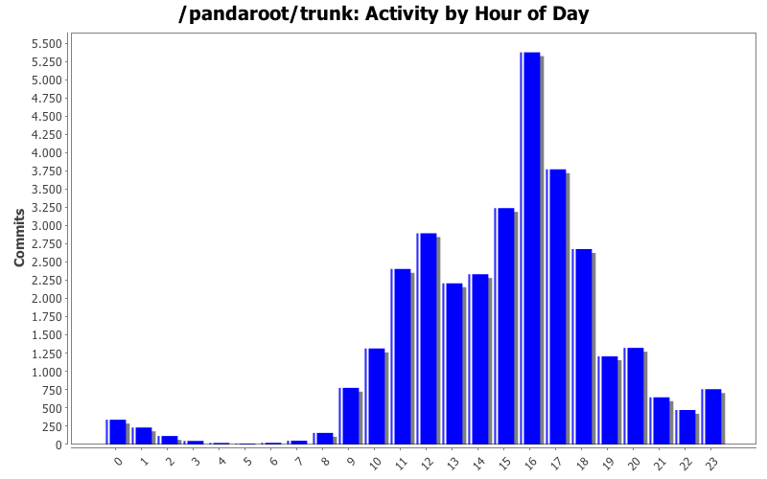
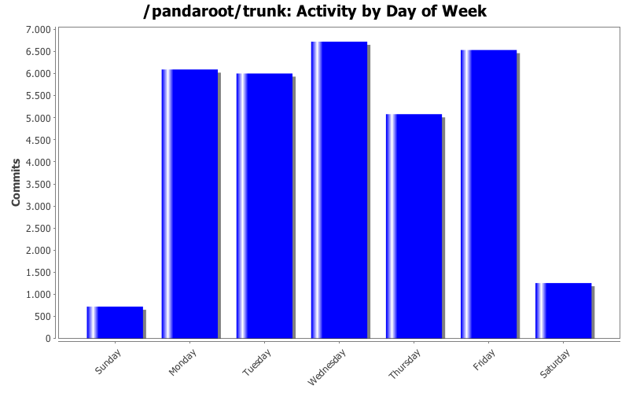
Updates

Slide 6
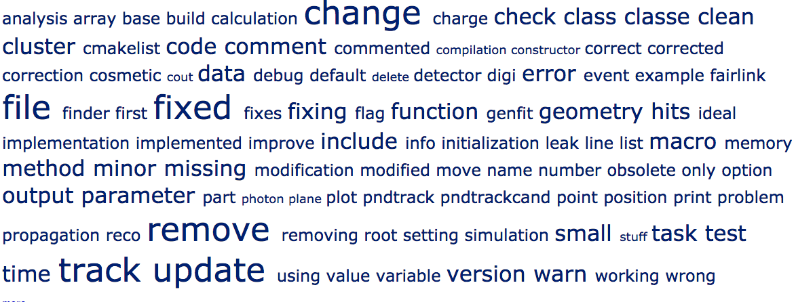
Commit Comments

Slide 7
Useful Tools

Slide 8
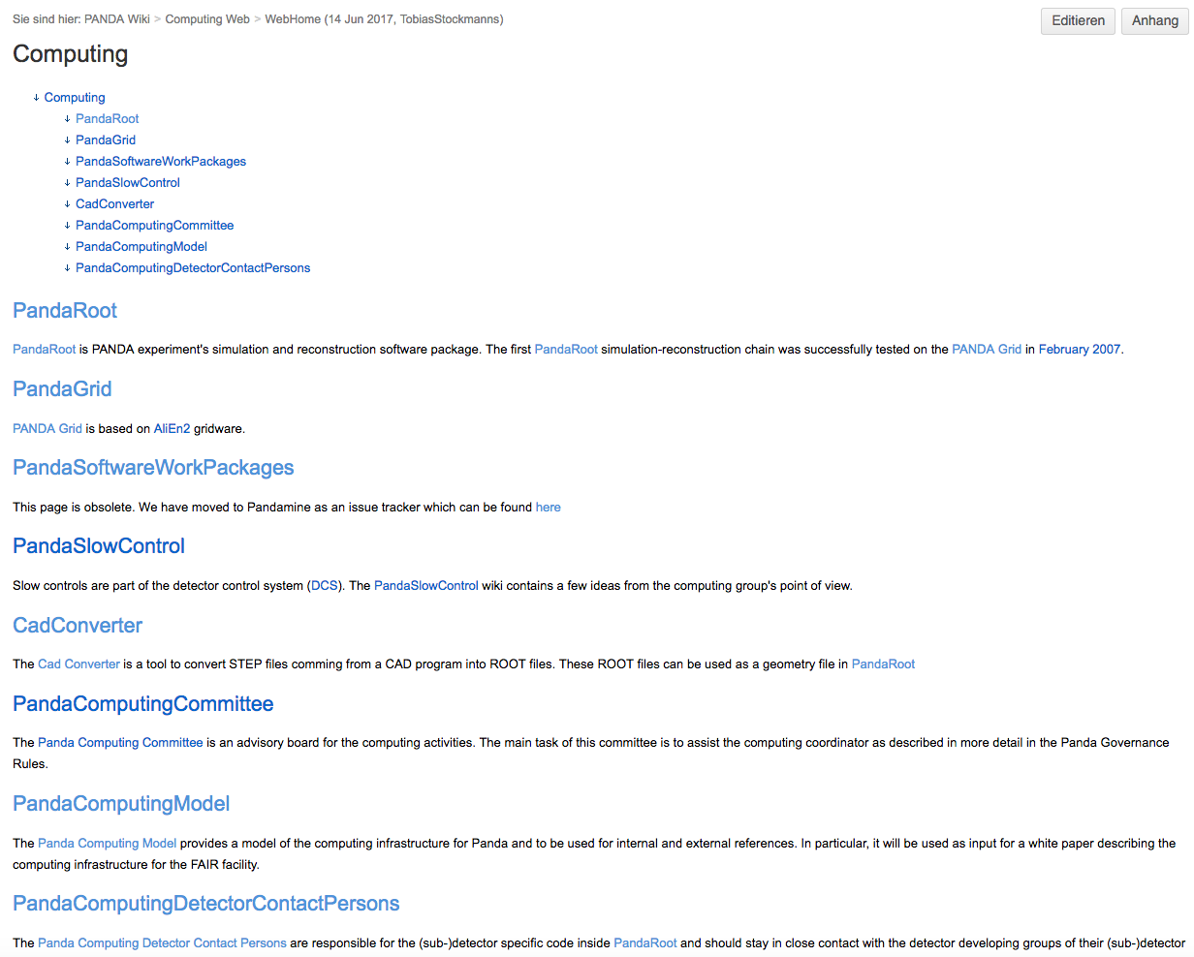
PANDA Computing Wiki
The place to find all different kind of information
https://panda-wiki.gsi.de/cgi-bin/view/Computing

Slide 9
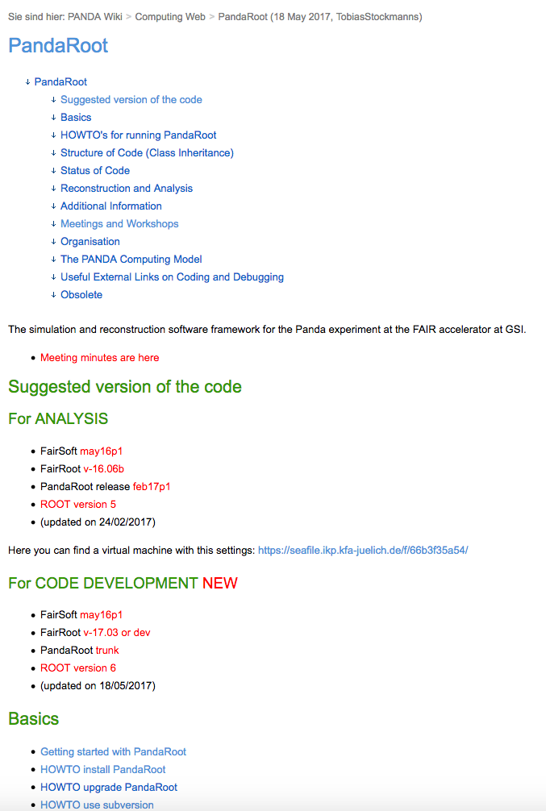
PANDA Computing Wiki

Slide 10
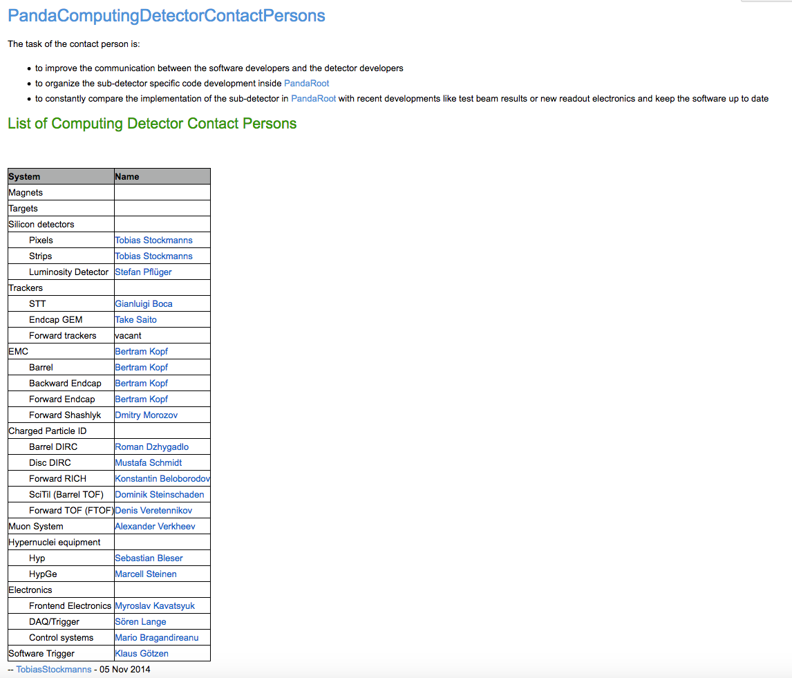
PANDA Computing Detector Contact Persons

Slide 11
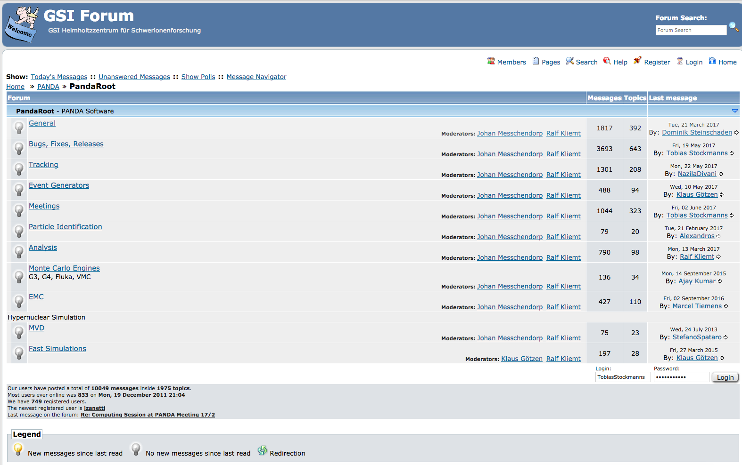
PandaRoot Forum
https://forum.gsi.de/index.php?t=index&cat=26&

Slide 12
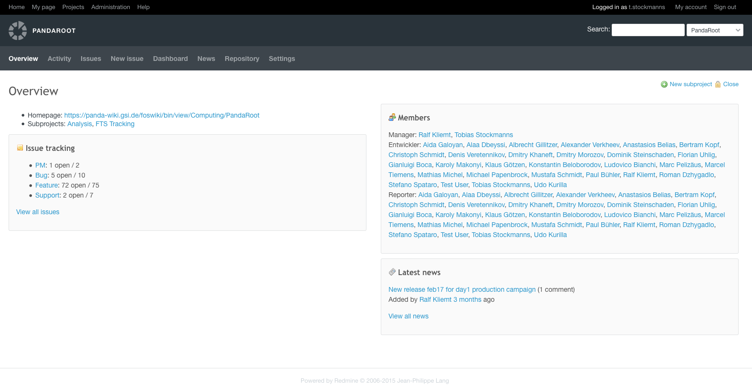
Pandamine – Issue Tracker
pandamine.gsi.de/projects/pandaroot

Slide 13
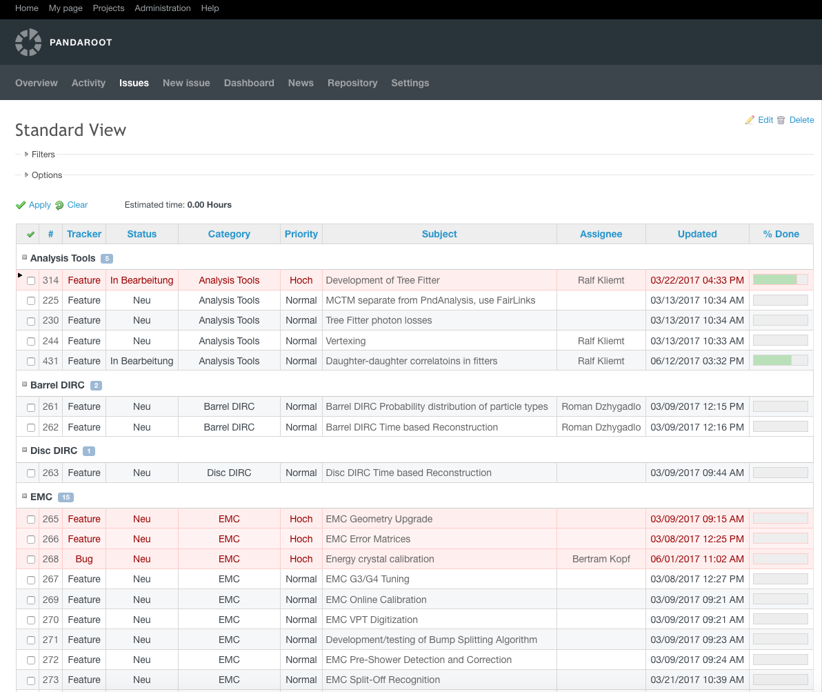
Pandamine – Issue Tracker

Slide 14
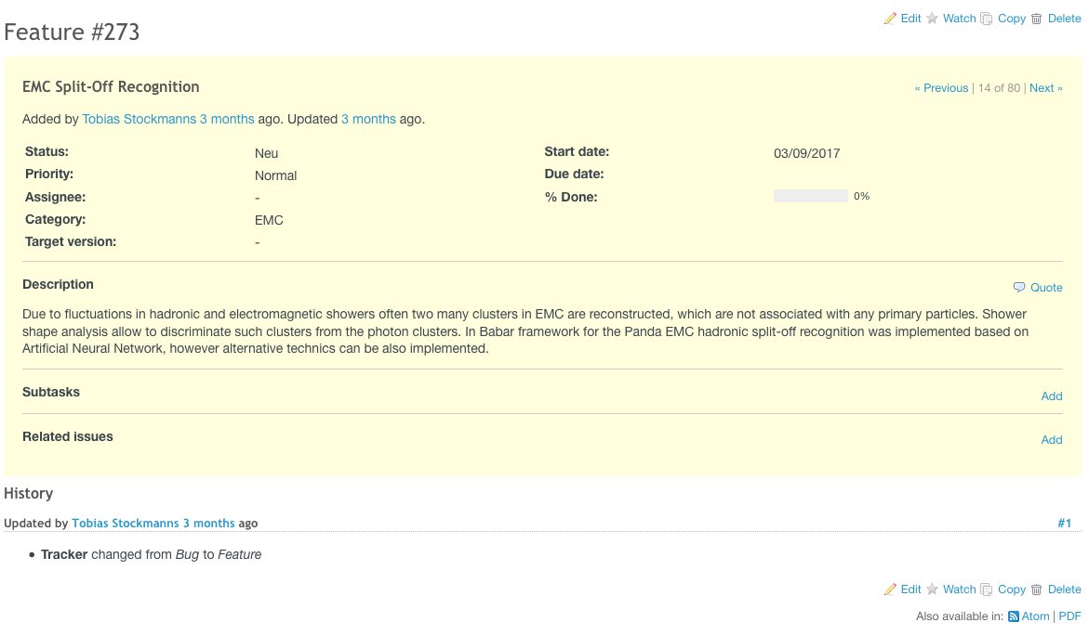
Pandamine – Issue Tracker

Slide 15
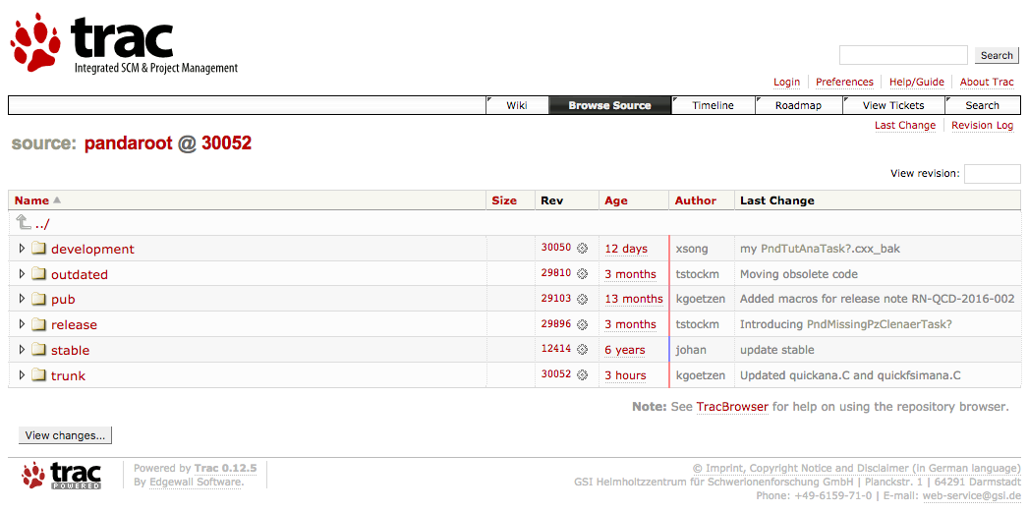
SVN Repository
https://subversion.gsi.de/trac/fairroot/browser/pandaroot

Slide 16
Future GitLab
https://pandaatfair.githost.io/users/sign_in

Slide 17
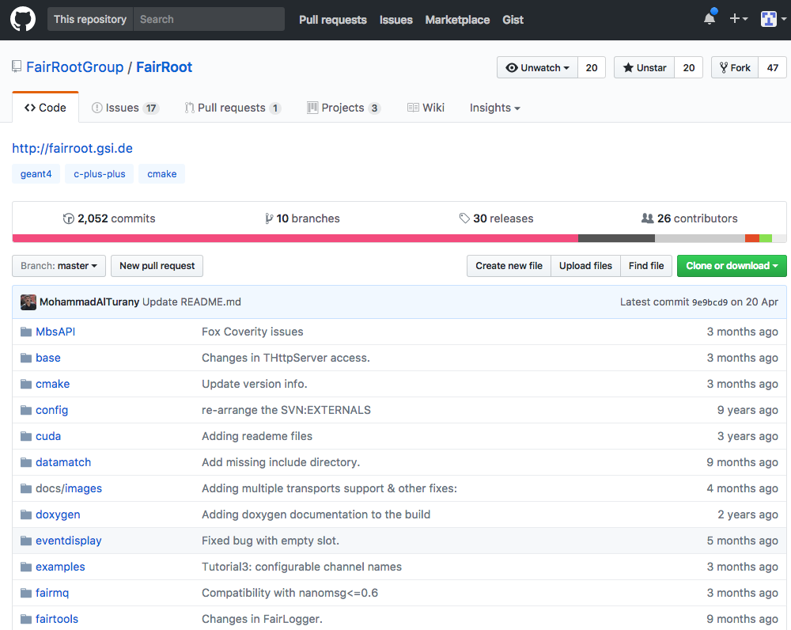
FairRoot - GitHub
https://github.com/FairRootGroup/FairRoot

Slide 18
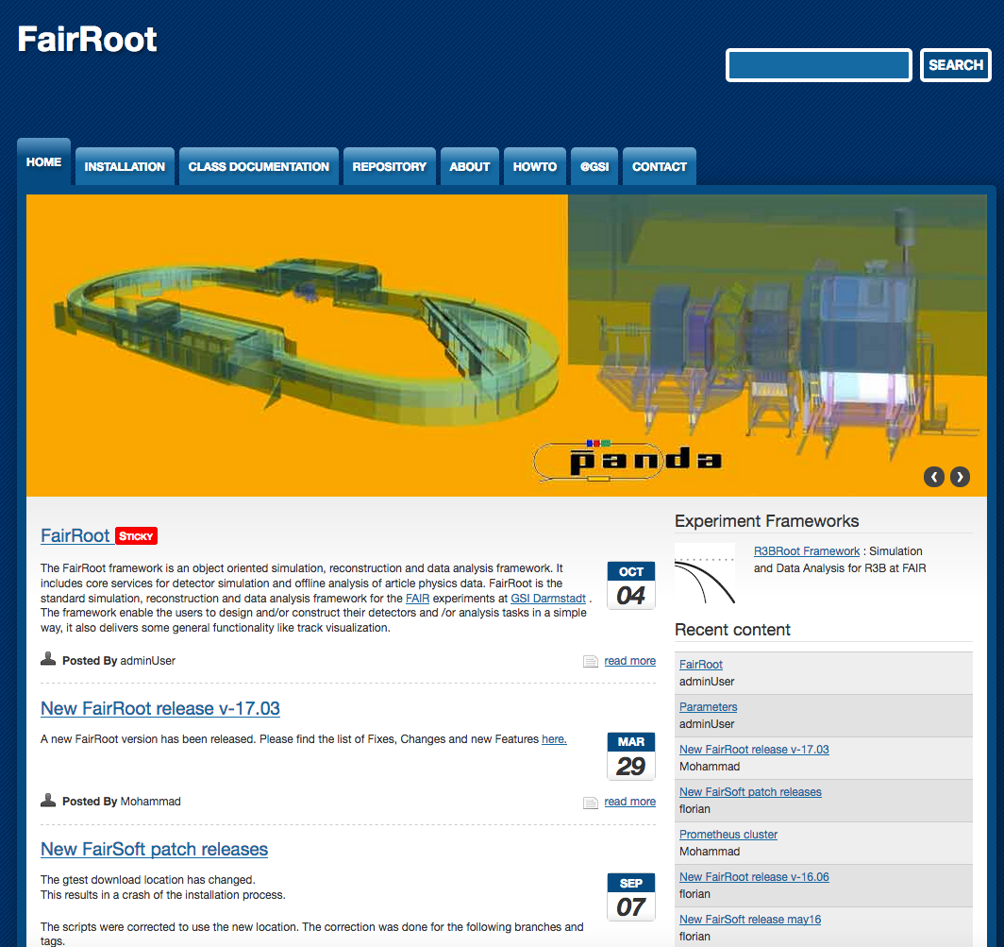
FairRoot Wiki
https://fairroot.gsi.de/

Slide 19
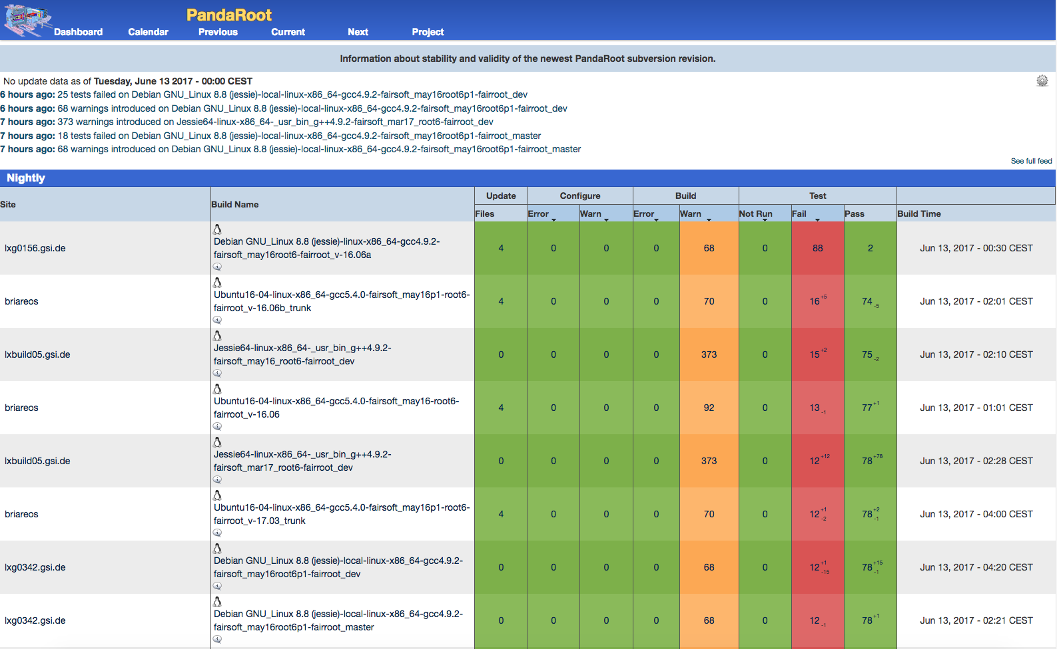
Dashboard
https://cdash.gsi.de/CDash/index.php?project=PandaRoot

Slide 20
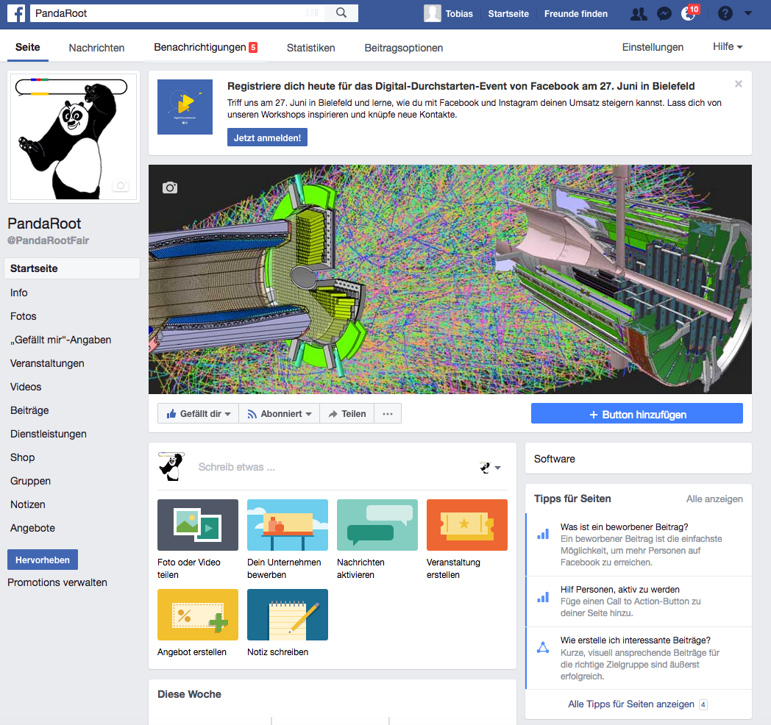
Facebook

Slide 21
pandaroot

Slide 22
FairRoot

Slide 23
FairRoot → ALFA
AliRoot6 (O²)
CbmRoot
R3BRoot
SofiaRoot
MPDRoot
ShipRoot
PandaRoot
AsyEosRoot
FopiRoot
EICRoot
ALFA
FairRoot
????
DDS
Building configuration
Testing
Fair MQ
MC Application
Module
Detector
Magnetic Field
Event
Generator
Runtime DB
Libraries and Tools
Protocol Buffers
BOOST
ROOT
ZeroMQ
CMake
Geant4
Genat4_VMC
Geant3
VGM
…

Slide 24
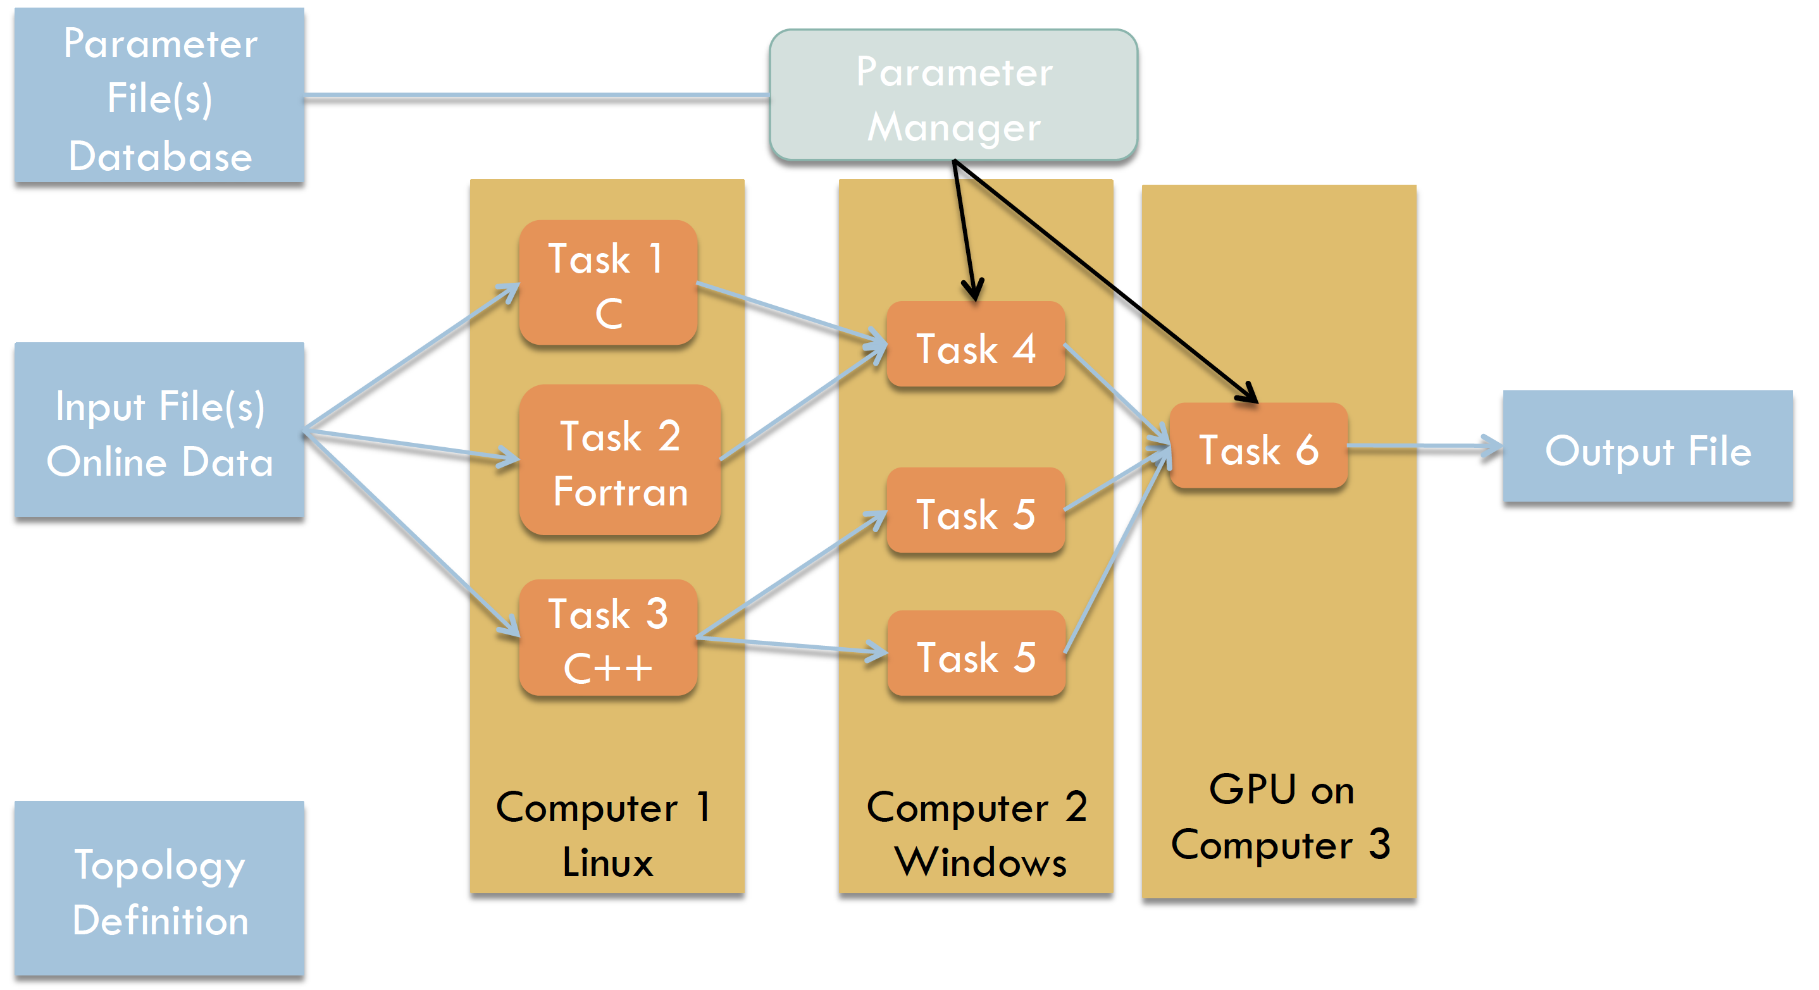
FairMQ
Message Queue

Slide 25
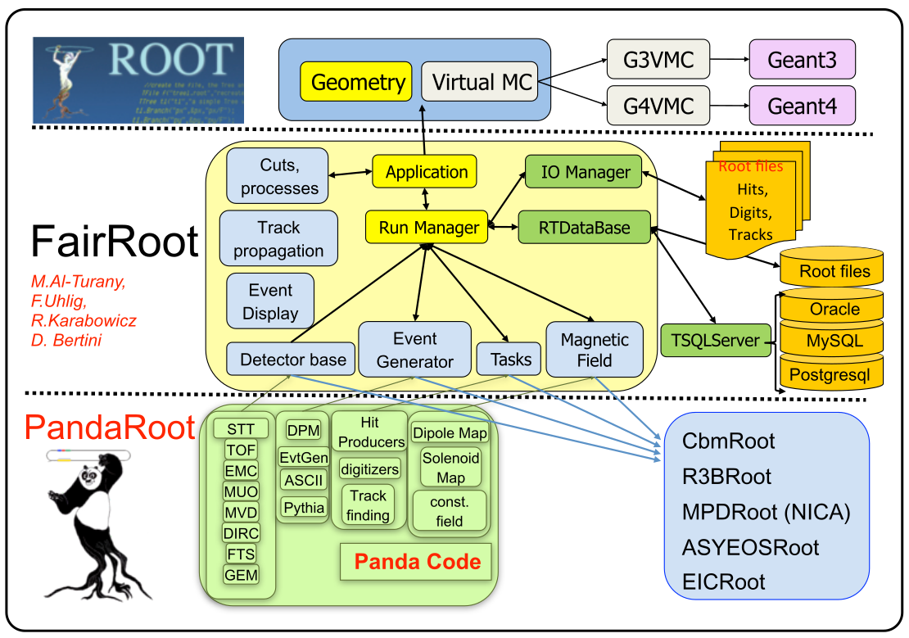
Structure of Code
FairSoft

Slide 26
The Mission
Event Generator
Determine properties of particles in primary interaction
Transport
Transport particles through the detector material
Full Simulation
SIM
Digitizer
Determine detector response
DIGI
Fast Simulation
Reconstruction local / global
local: sub-detector response global: track finding + fitting
RECO
Analysis
PID
Combine all detector data Calculate PID prob.
PID
storage levels
Physics Analysis
Extract signal from background

Slide 27
PANDA Data Flow
* Dual parton Model
** Ultra Relativistic Quantum
Molecular Dynamics
Event Generator
EvtGen
DPM*
Pythia6/8
UrQMD **
FTF
Transport
GEANT3/GEANT4
Digitizer
MVD
STT
FTS
GEM
TOF
DIRC
MUON
EMC
Tracking
Charged Track
Charged Candidate
Neutral Candidate
Particle
Identification
PID Probability
Analysis
Analysis

Slide 28
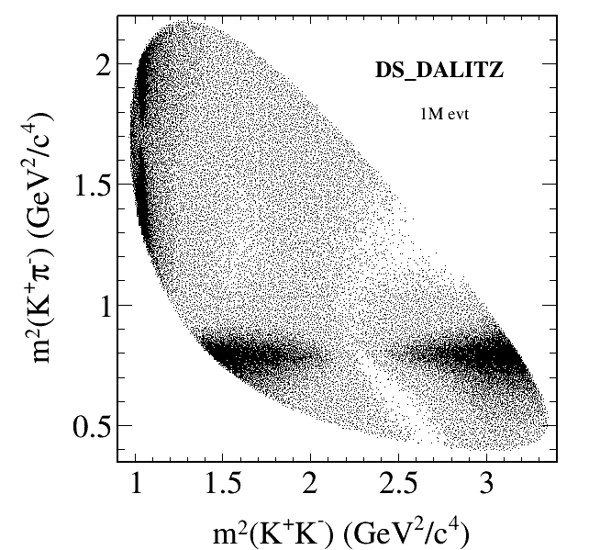
Event Generation
Many different event generators available
EvtGen:
Simulation of dedicated physics channels
Can be extended by individual decay models
Dual-Parton-Model (DPM):
Background generator for anti-proton – proton interactions
UrQMD:
Background generator for anti-proton – nucleus interactions
FTF generator:
New development of a combined background generator by Vladimir Uzhinsky and Aida Galoyan
Box generator:
Particle gun

Slide 29
Particle Propagator
Usage of Virtual Monte Carlo allows seamless change of propagation engine
Available:
Geant3
Geant4
(Fluka)
Same geometry description in propagation and reconstruction of events by using the same geometry engine from root

Slide 30
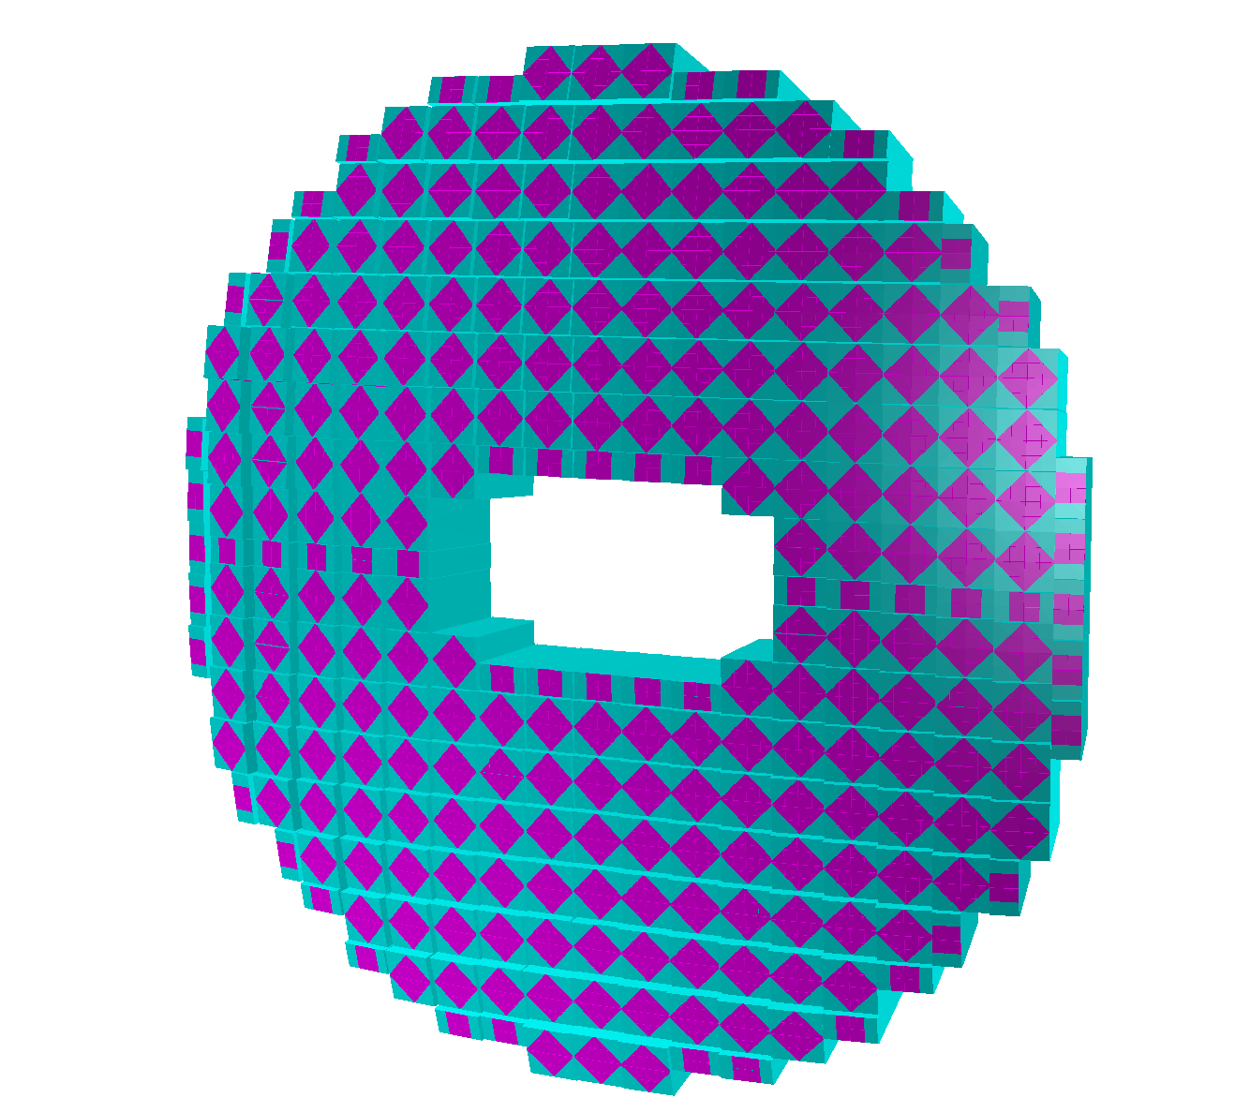
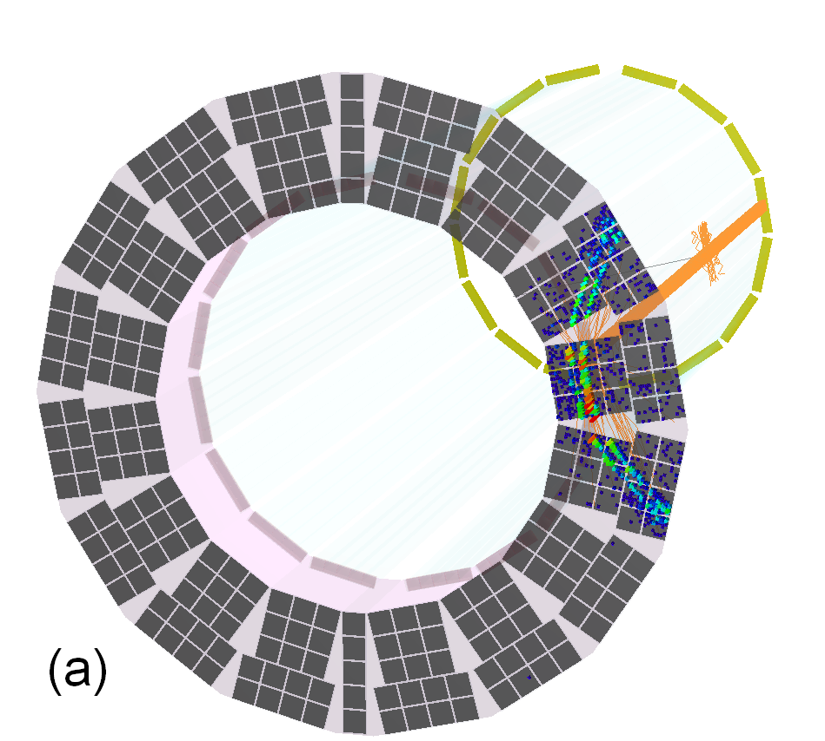
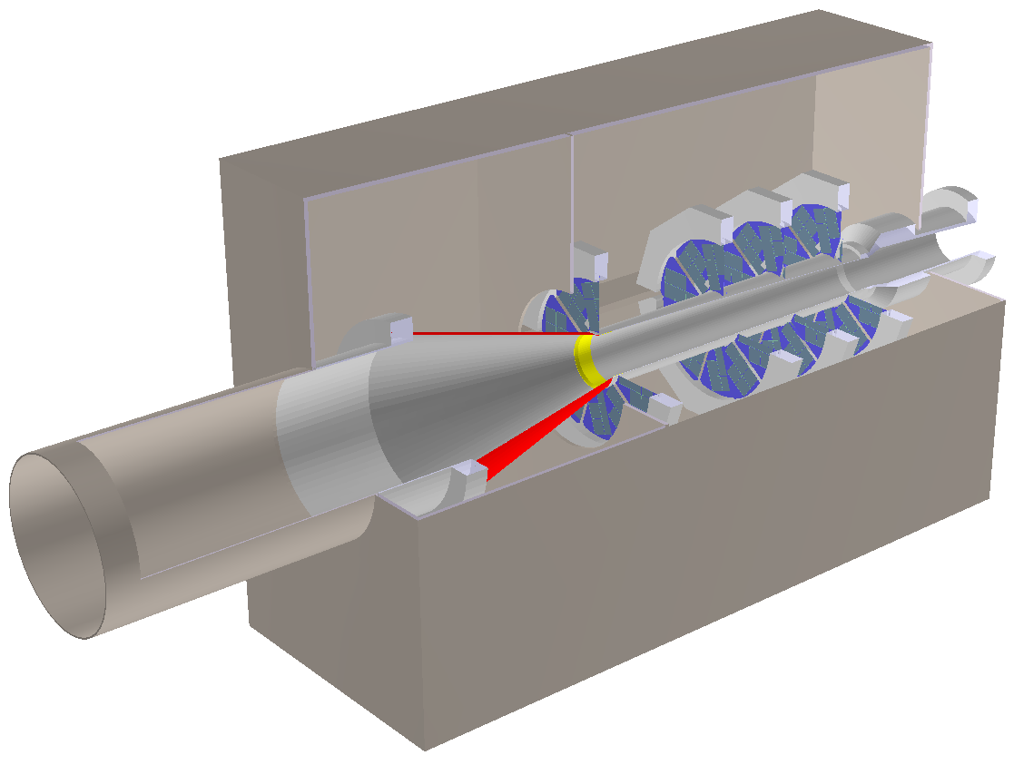
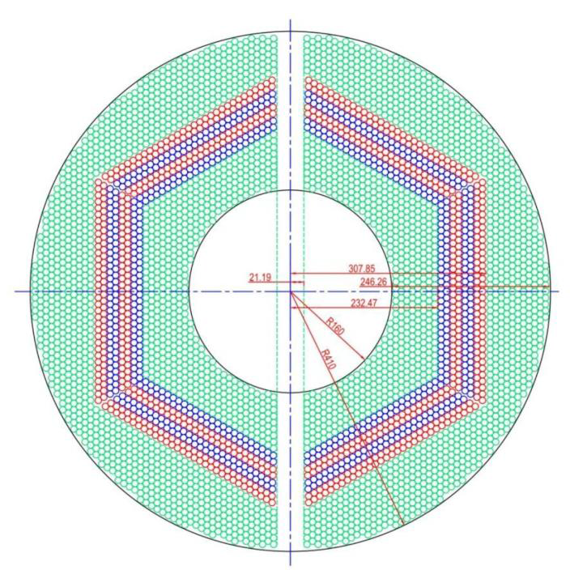
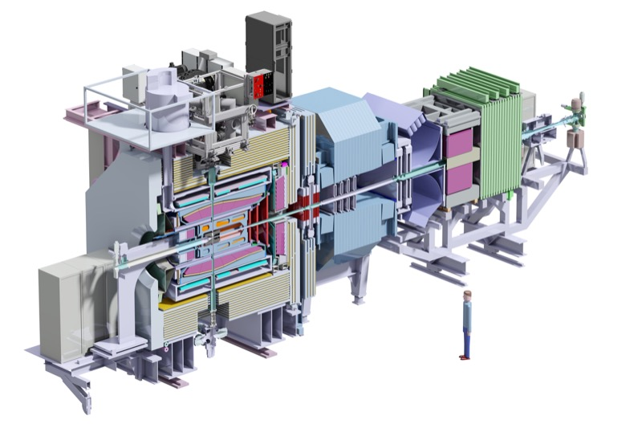
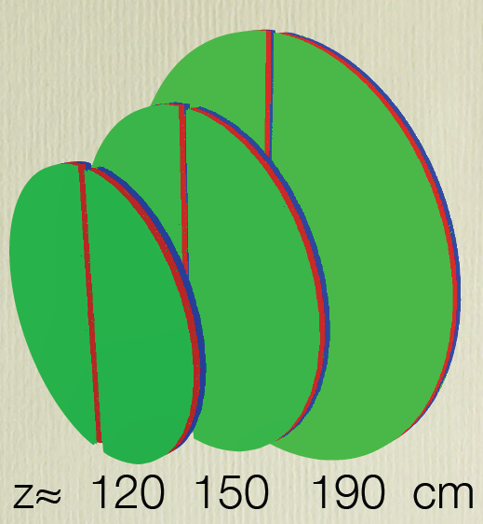
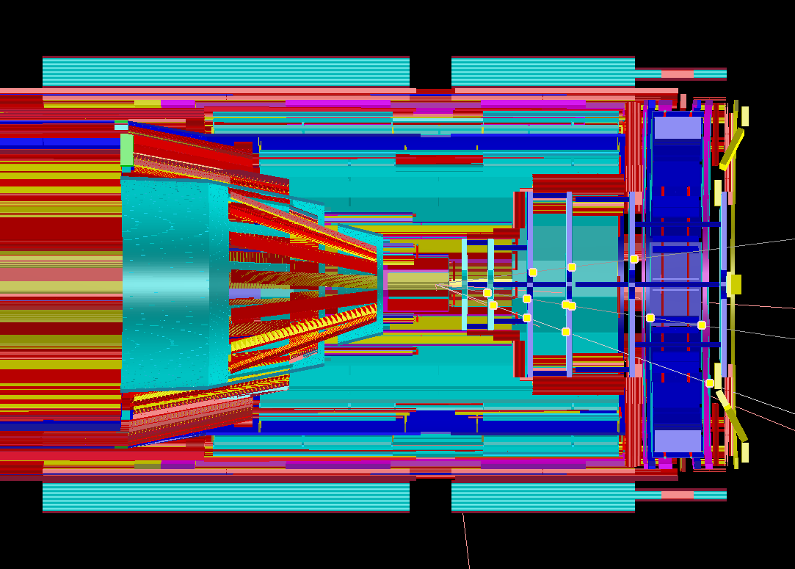
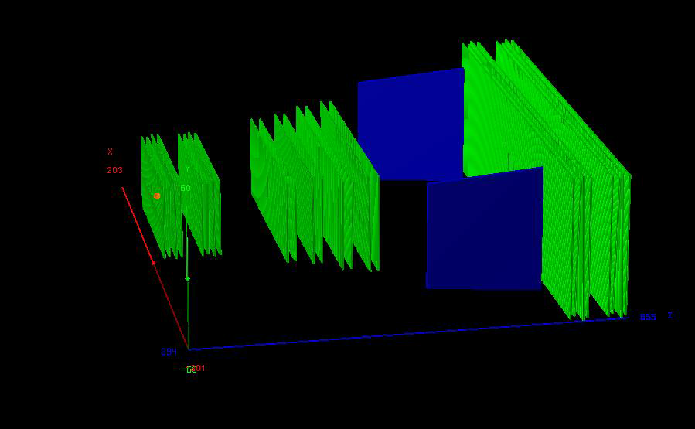
Geometry description

Slide 31
Geometry description
All detectors in simulation
Strongly varying level of detail, e.g.
MVD: All materials including support structures, cooling, active and passive electronic
EMC: only crystals

Slide 32
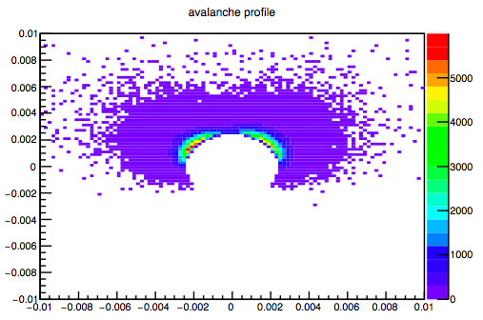
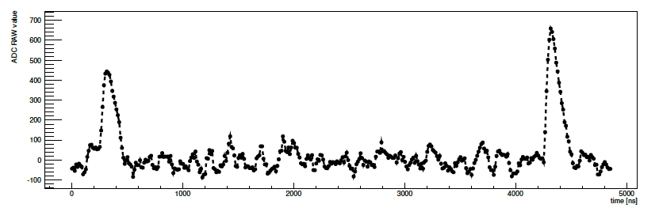
Digitization
Avalanche Simulation in MDT
Translates ideal detector data into realistic data stream
3D space points into channel number
Deposited energy into ADC values
Adding noise and inefficiencies
Charge sharing between neighboring detector elements
Dead times and electronics properties
Data should look like as coming from the final experiment
Simulated EMC waveform

Slide 33
Reconstruction - I
Local reconstruction for each sub-detector
Translation from detector data into physical parameters (from channel number to space point, ADC to energy)
Calibration
Cluster formation
Reconstruction algorithms
Various different algorithms implemented for each sub-detectors
Compared with test beam data
PandaRoot used to reconstruct test beam data

Slide 34
Reconstruction - II
Global reconstruction
Combining different sub-detectors
Tracking
PID
Event building

Slide 35
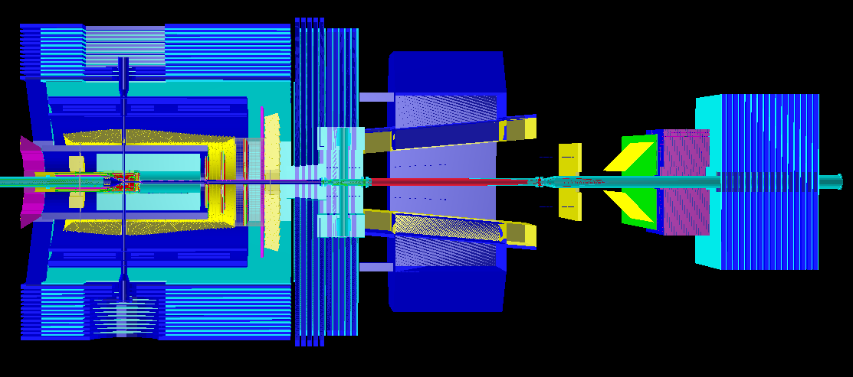
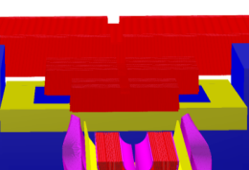
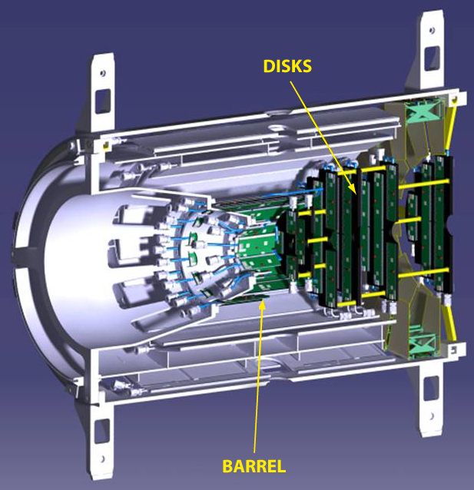
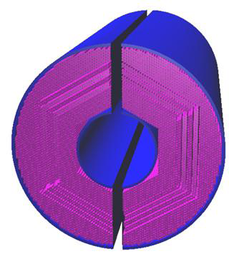
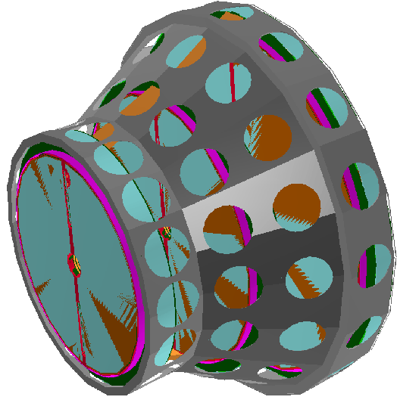
Global Tracking
FTS
p
MVD
STT
GEM

Slide 36
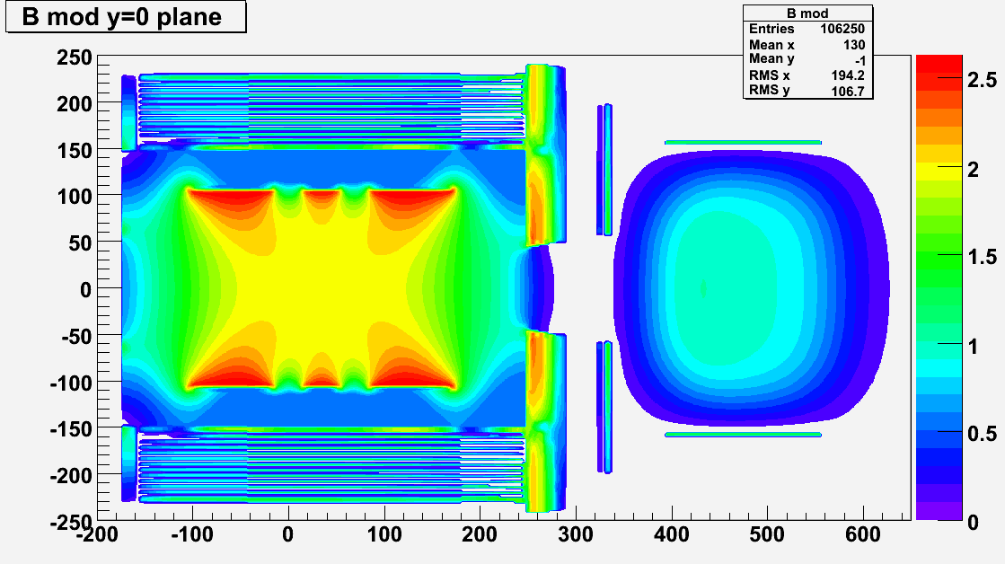
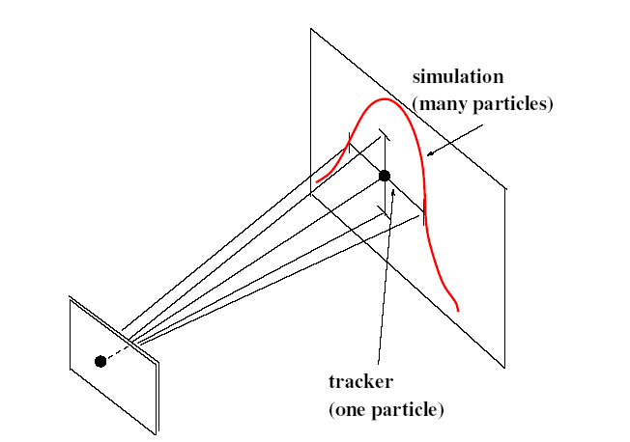
Tracking: Global Fit
Energy loss
Not homogeneous magnetic field
Different detector hits
planar hits – MVD/GEM
tube + drift time – STT/FTS
barrel
forward
Prefit Track
Kalman Filter
(GENFIT)
Detector Hits
Track Follower
(GEANE)
same geometry for simulation and track following

Slide 37
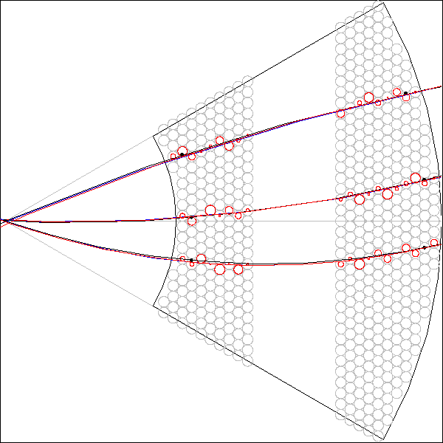
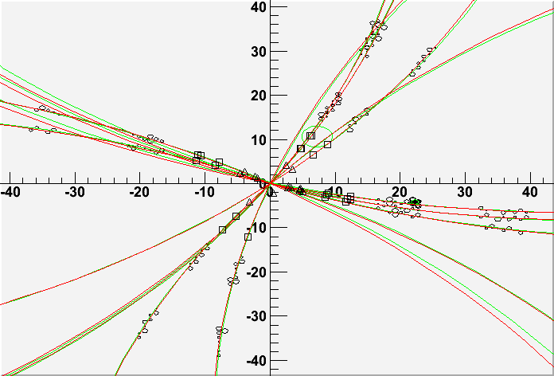
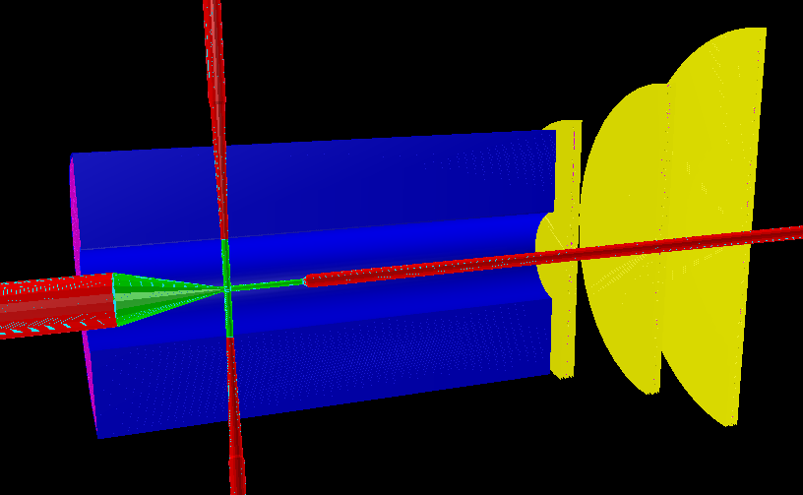
Barrel Tracking: Pattern Recognition
1° step – MVD/STT local pattern recognition
MVD
STT
2° step – Correlation of STT & MVD tracklets
- Correlation with STT/MVD spurious hits
3° step – Extrapolation to
GEM planes
4° step – Kalman Filter

Slide 38
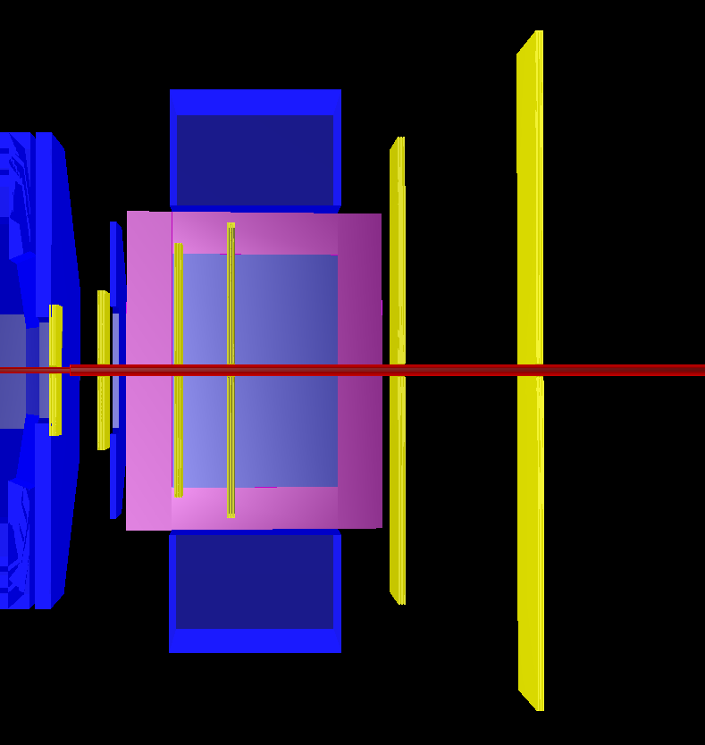
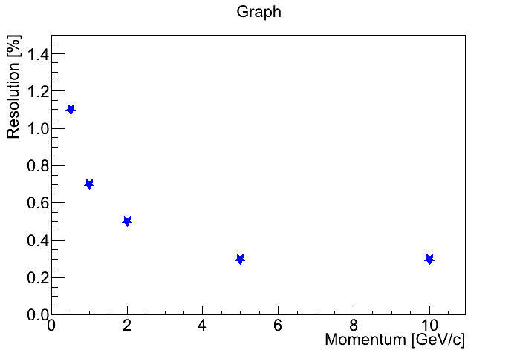
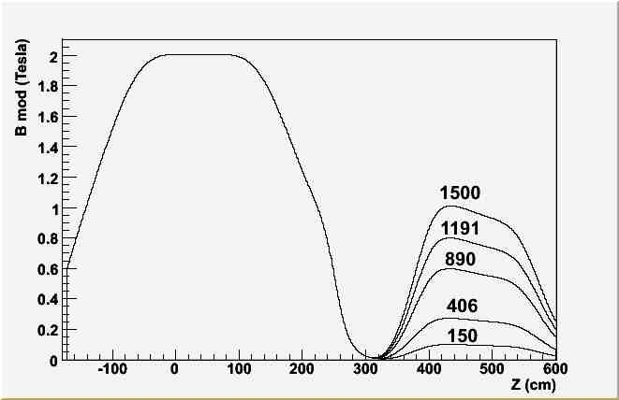
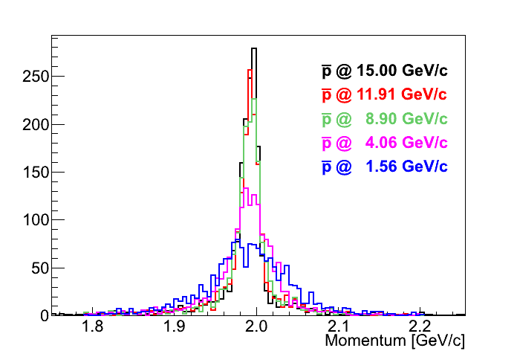
Forward Tracking
FTS
+
MVD
+
GEM
Ideal Pattern Recognition
Kalman Filter
muons
Various different forward track finders under development
|B| [T]
_
p @ [GeV/c]
15.00
11.91
8.90
4.06
1.50

Slide 39
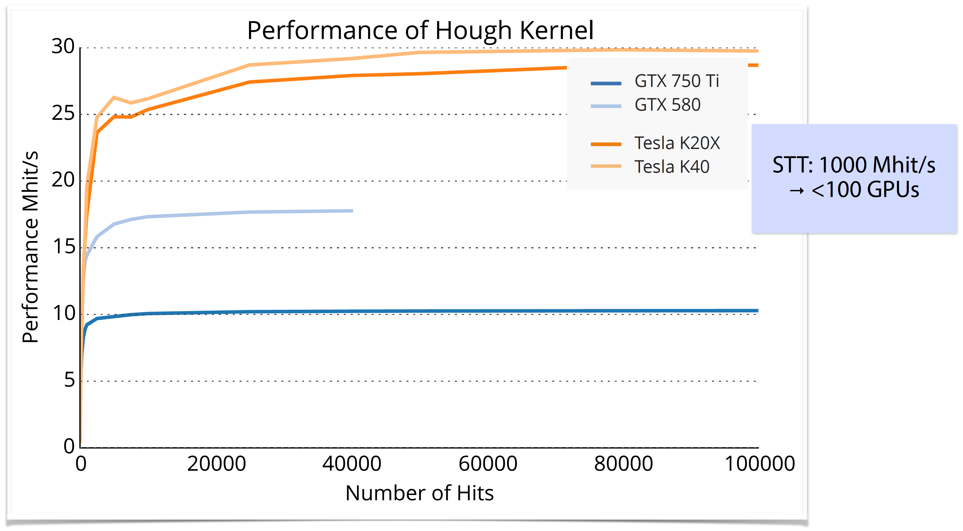
Tracking - online
Find and fit tracks with the production speed at Panda (10 - 20 MHz in high luminosity mode)
Alternative hardware:
FPGA:
Helix tracking algorithm
GPGPU:
Cellular automaton
Hough transformation
Triplet finder
Riemann transformation
Direct switch in PandaRoot between CPU and GPU

Slide 40
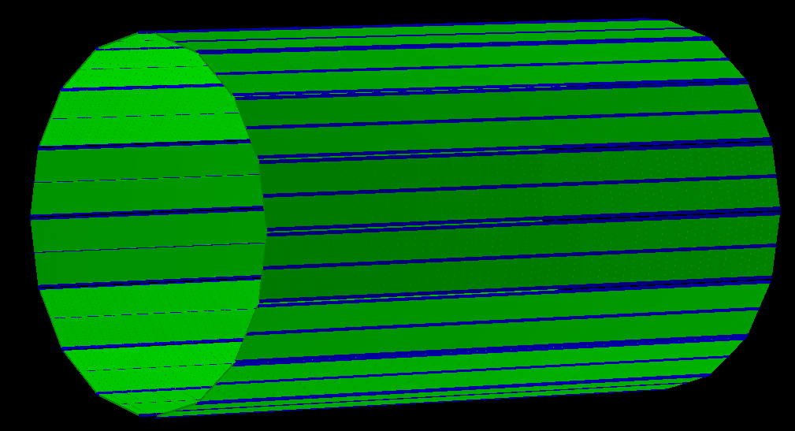
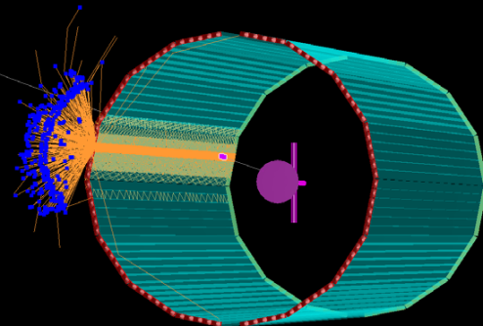
Particle Identification
Forward
EMC
EMC
p
TOF
DIRC
MDT
FTOF
FWDMDT

Slide 41
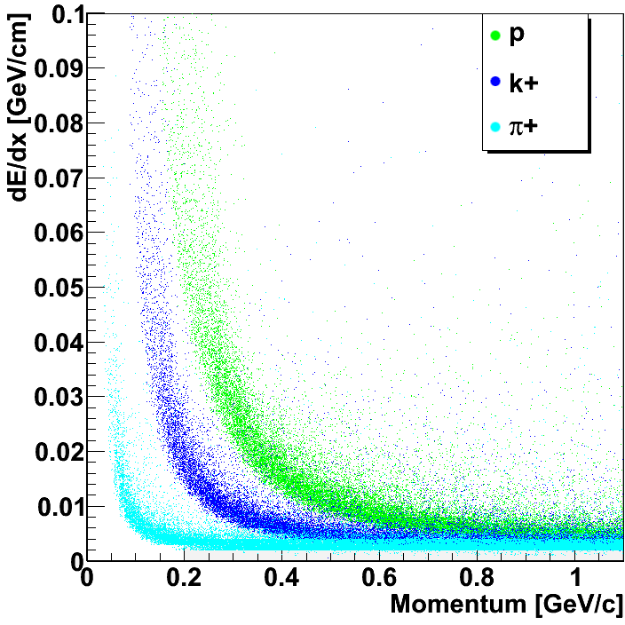
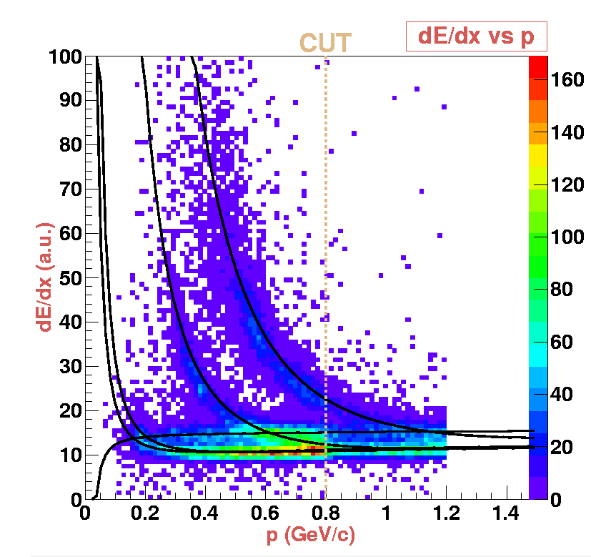
Particle Identification
Implemented PDFs for many detectors (Bayes)
EMC
STT
MVD
DIRC
DISC
MDT

Slide 42
MultiVariate Particle ID
implementation of TMVA methods
EMC shower shape analysis
e/π
separation in EMC
preliminary tests for muons (MDT)
← Correlation
Variables →

Slide 43
Time-based simulation
Signal and background-events very similar ➔ no hardware trigger possible
Quasi continuous beam with maximum interaction rate of 20 MHz ➔ Poisson distribution
Raw data rate of 200 GByte/s
Reduction of 1000 needed for permanent storage O(PByte/year) ➔ Online Event Filte

Slide 44
Time-Based Simulation
Single Event

Slide 45
Time-Based Simulation
20 MHz overlap

Slide 46
Time-Based Reconstruction
MVD
STT
Event 1
Event 2
Event 3
Activities on the central tracker MVD + STT + GEM + EMC
EMC

Slide 47
Analysis example
Rho package
Combine hits
Fit with constraints
Apply cuts

