Slide 1
Materials research applications with high intensity laser driven proton beams
M. Tomut
GSI Helmholtzzentrum für Schwerionenforschung

Slide 2
Materials research with laser driven proton beams:
response of accelerator target materials to short, intense particle beams pulses
ground testing of space materials and electronics in complex radiation environments
defect dynamics studies in irradiated materials
proton beam radiography of transient phenomena

Slide 3
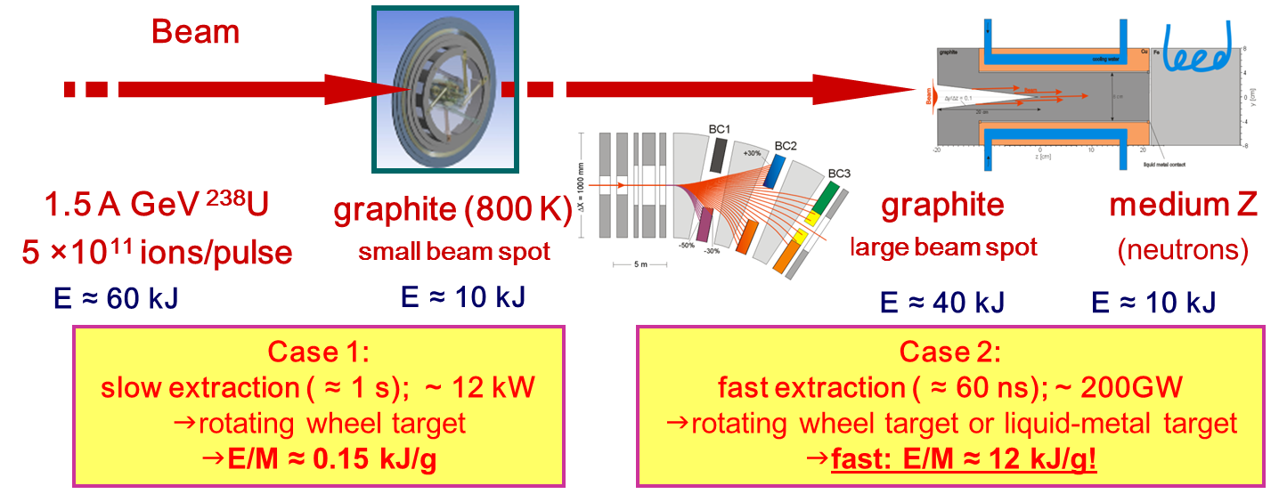
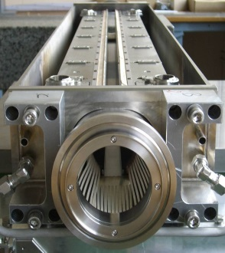
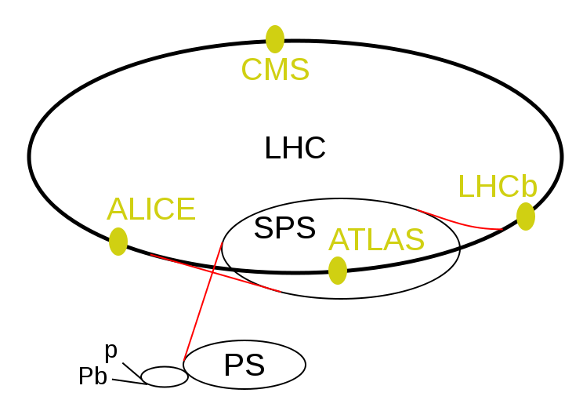
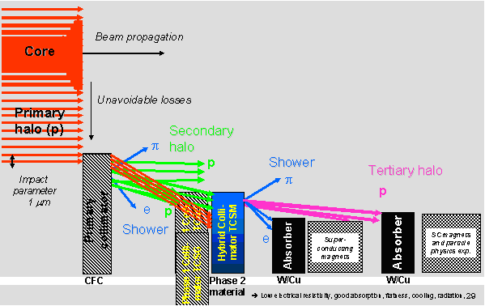
Accelerator components exposed to high intensity ion beams
LHC
Collimators
1.2 m
slow beam loss at 7 TeV:
1% of beam over 10 s –
500 kW
Accidental beam impact:
2 MJ/mm2 in 200 ns (0.5 kg TNT)
360 MJ proton beam

Slide 4
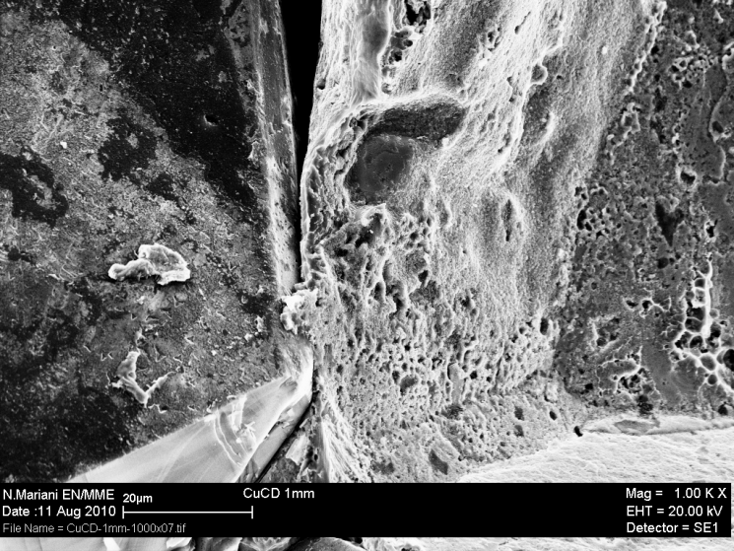
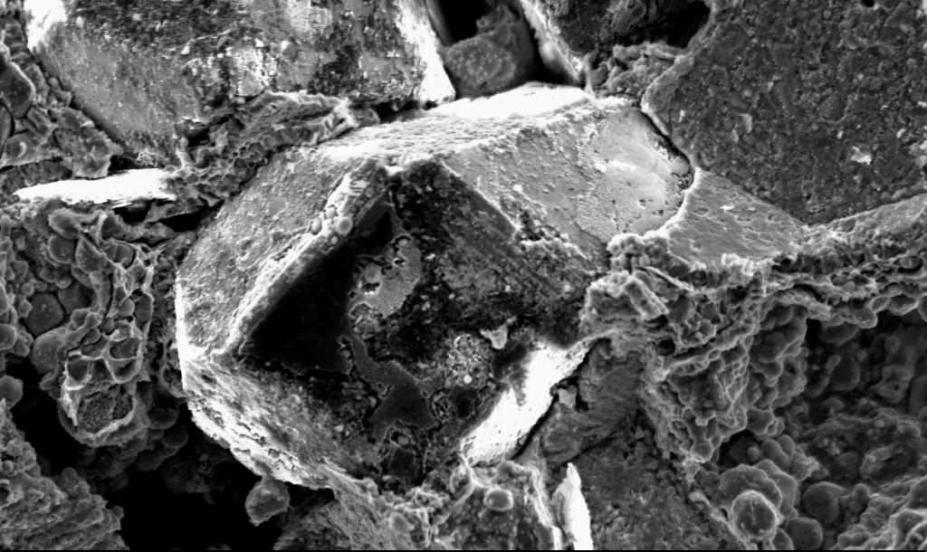
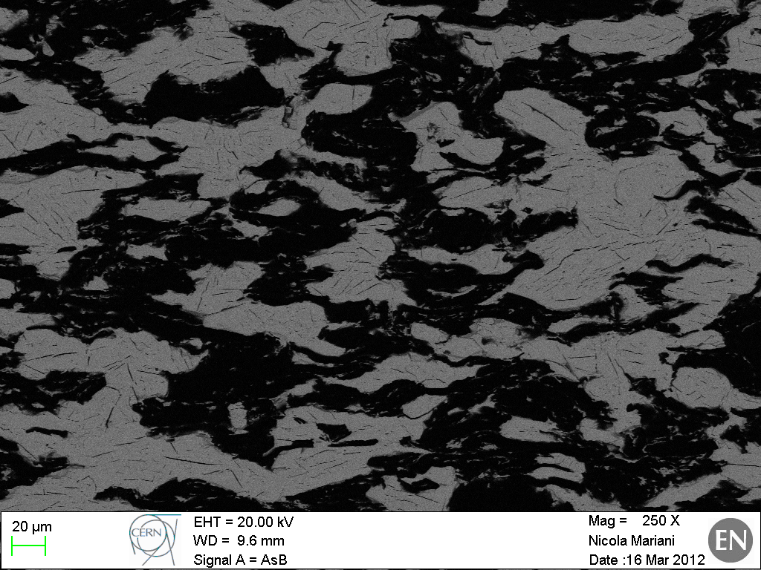
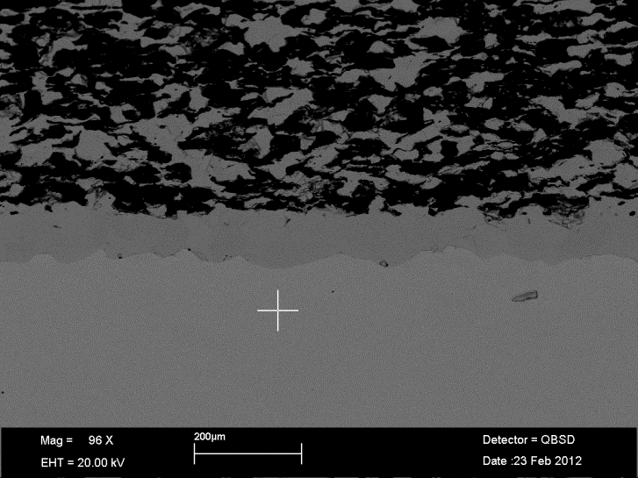
Novel composite materials solution with improved thermal conductivity and mechanical robustness
Cu-CD composite
Mo-CD composite
Mo-Gr/Mo sandwich
Mo-Gr composite
Courtesy of A. Bertarelli
Notes:
Mo-Gr with c oating C (per ridurre impedenza)

Slide 5
Designing and testing new materials for high power targetry applications
Materials ranking by Figure of Merit
calculated based on material properties at room temperature, low strain rates, non-irradiated
experimental validation required

Slide 6
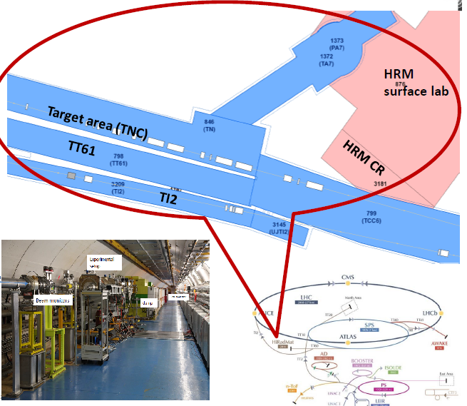
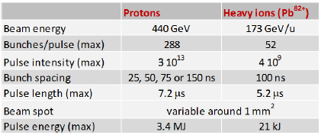
Existing facilities
HighRadMat - High Radiation to Materials
Maximum specific energy deposition
in tungsten:
~ 7 KJ/g
(FLUKA calculation- source N. Tahir)

Slide 7
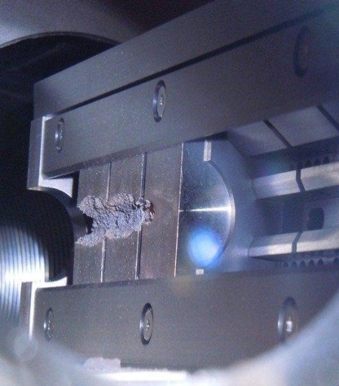
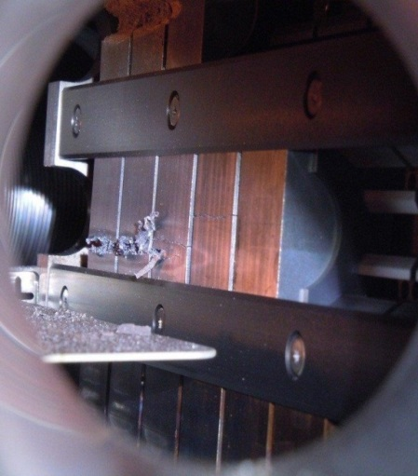
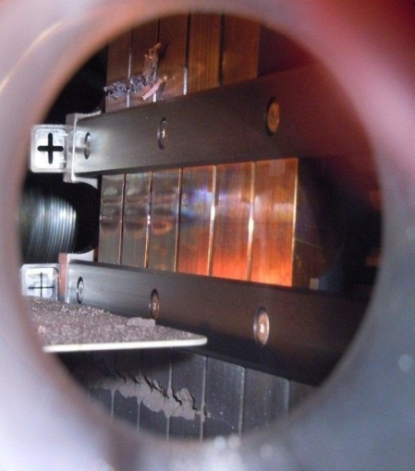
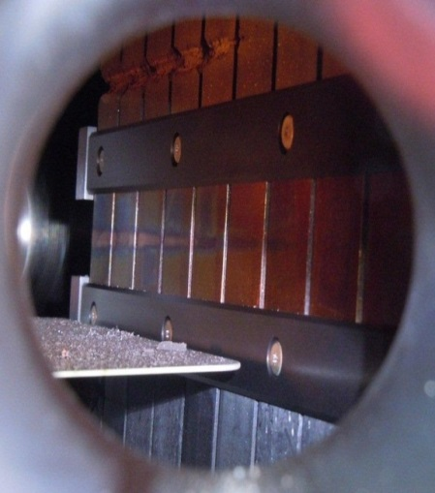
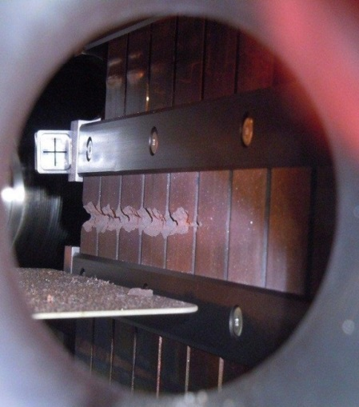
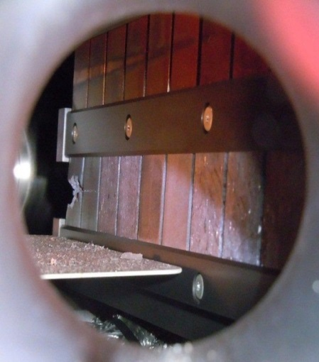
HiRadMat- CERN: High Intensity Tests
Experiments:
Thermal management
Pressure waves
Radiation damage
Designed for single-pulse experiments
long irradiation –excluded due to beam sharing & activation
Application :
•machine components
protection devices
targets
material studies
detector testing
electronics
Inermet 180, 72 bunches
Molybdenum, 72 & 144 bunches
Glidcop, 72 bunches (2 x)
Copper-Diamond
144 bunches
Molybdenum-Copper-Diamond 144 bunches
Molybdenum-Graphite (3 grades)
144 bunches

Slide 8
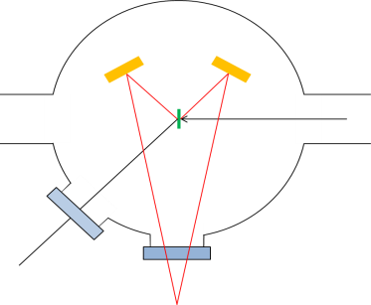
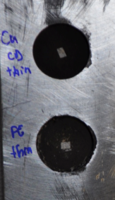
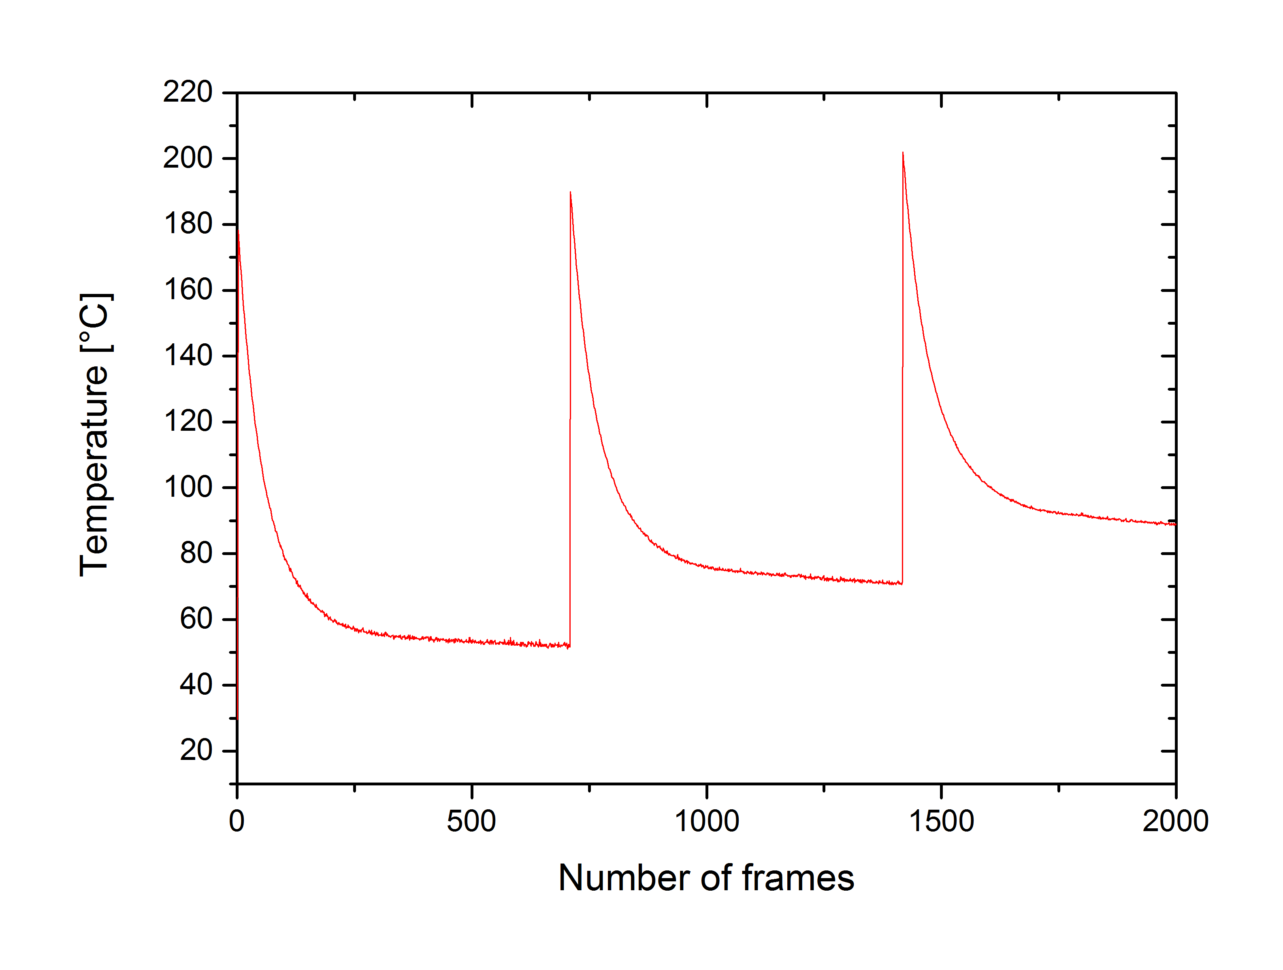
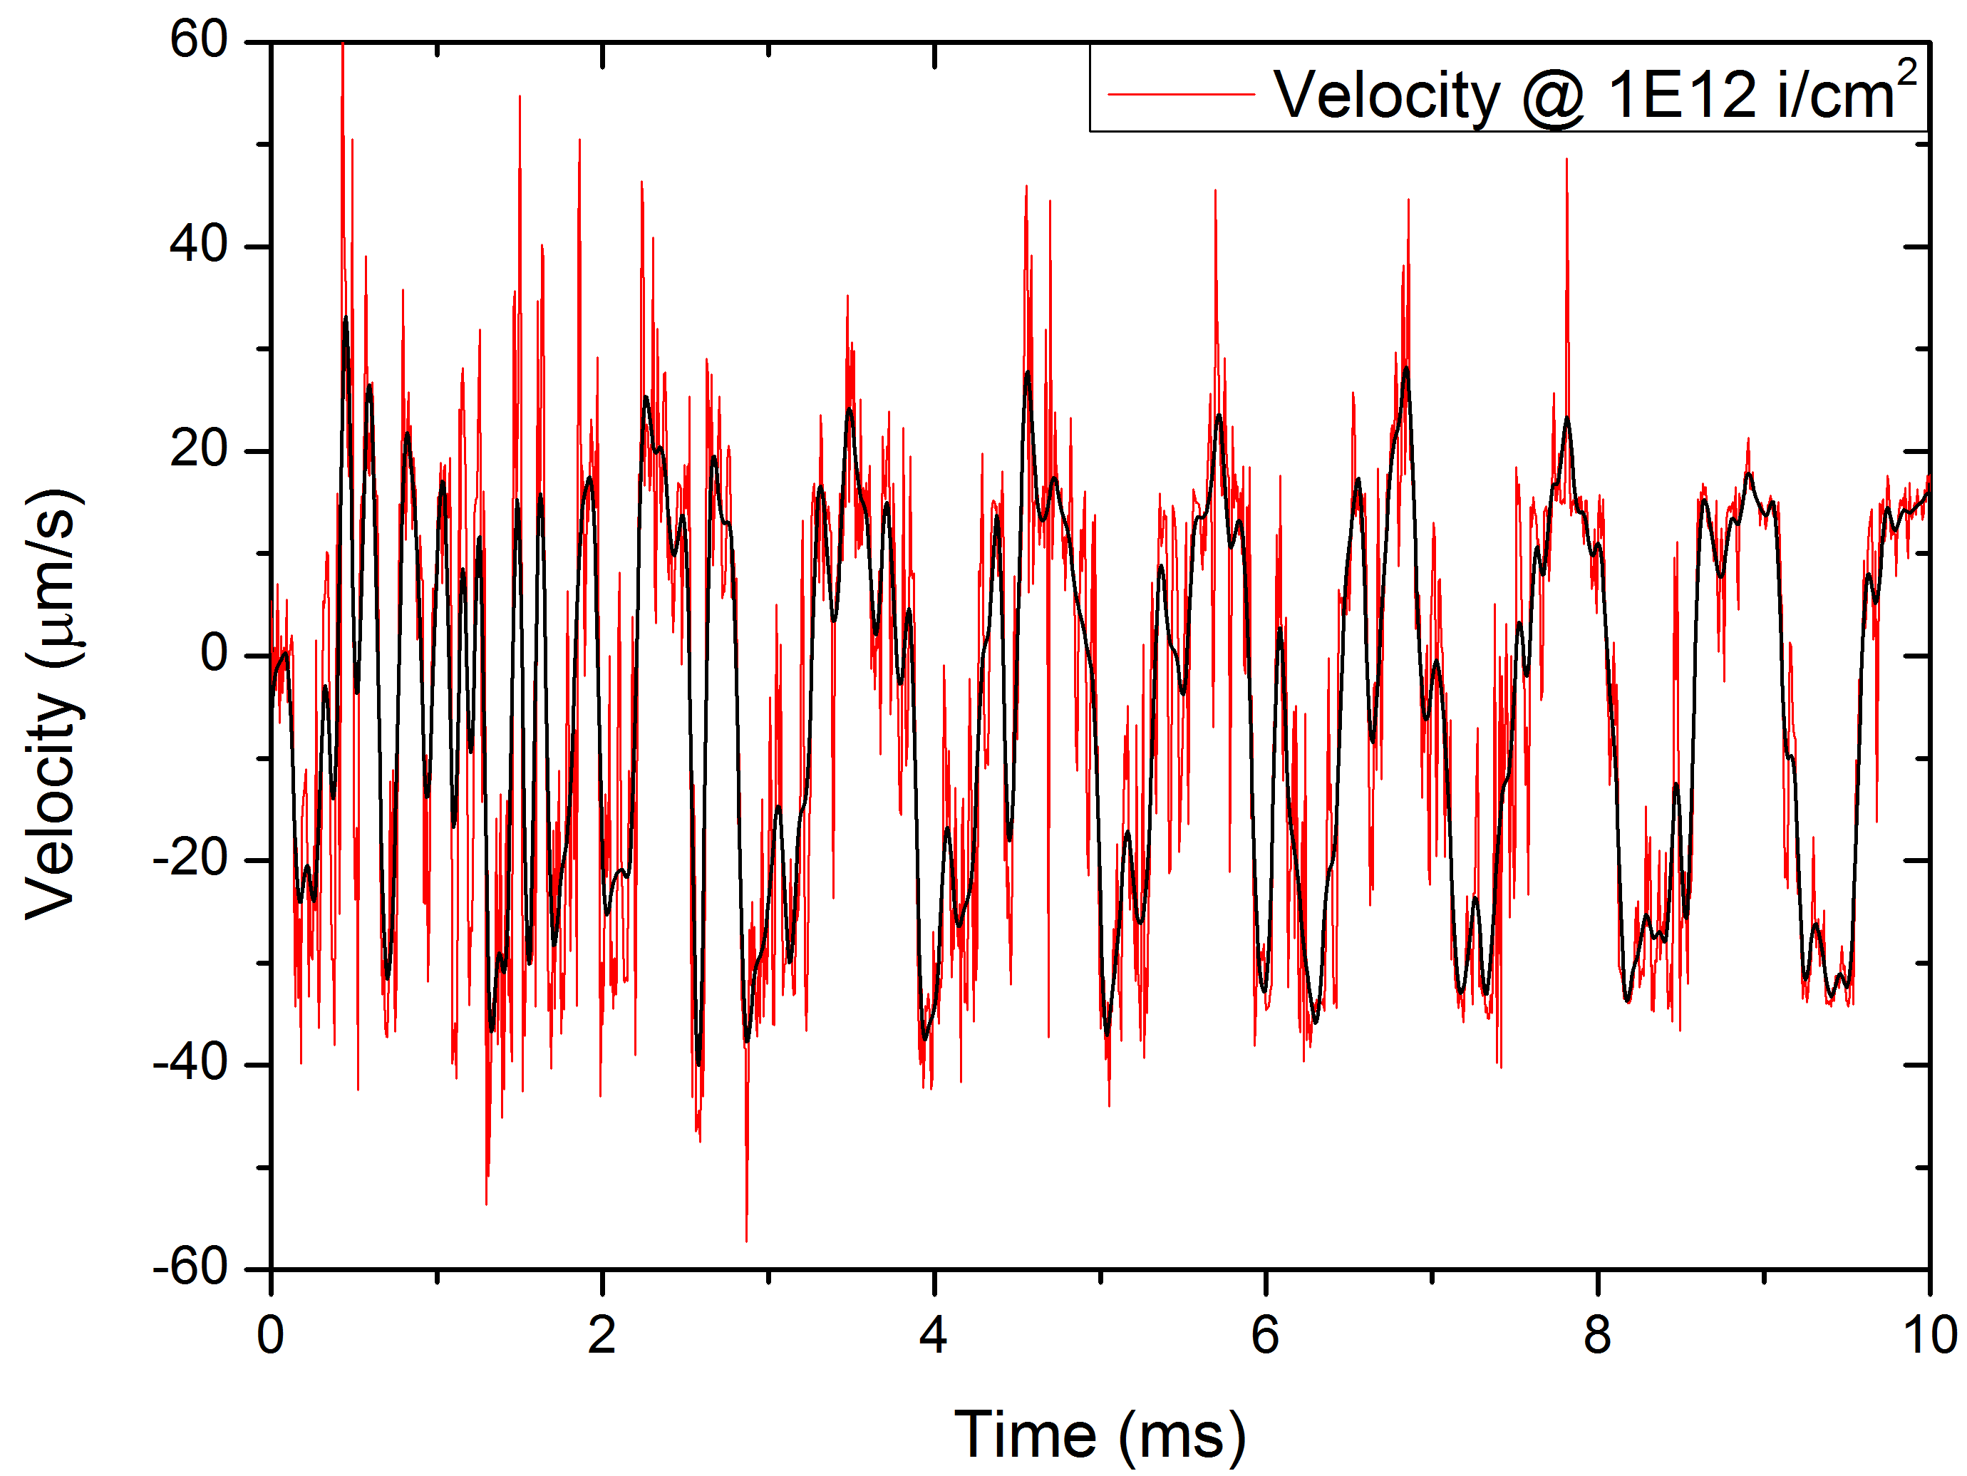
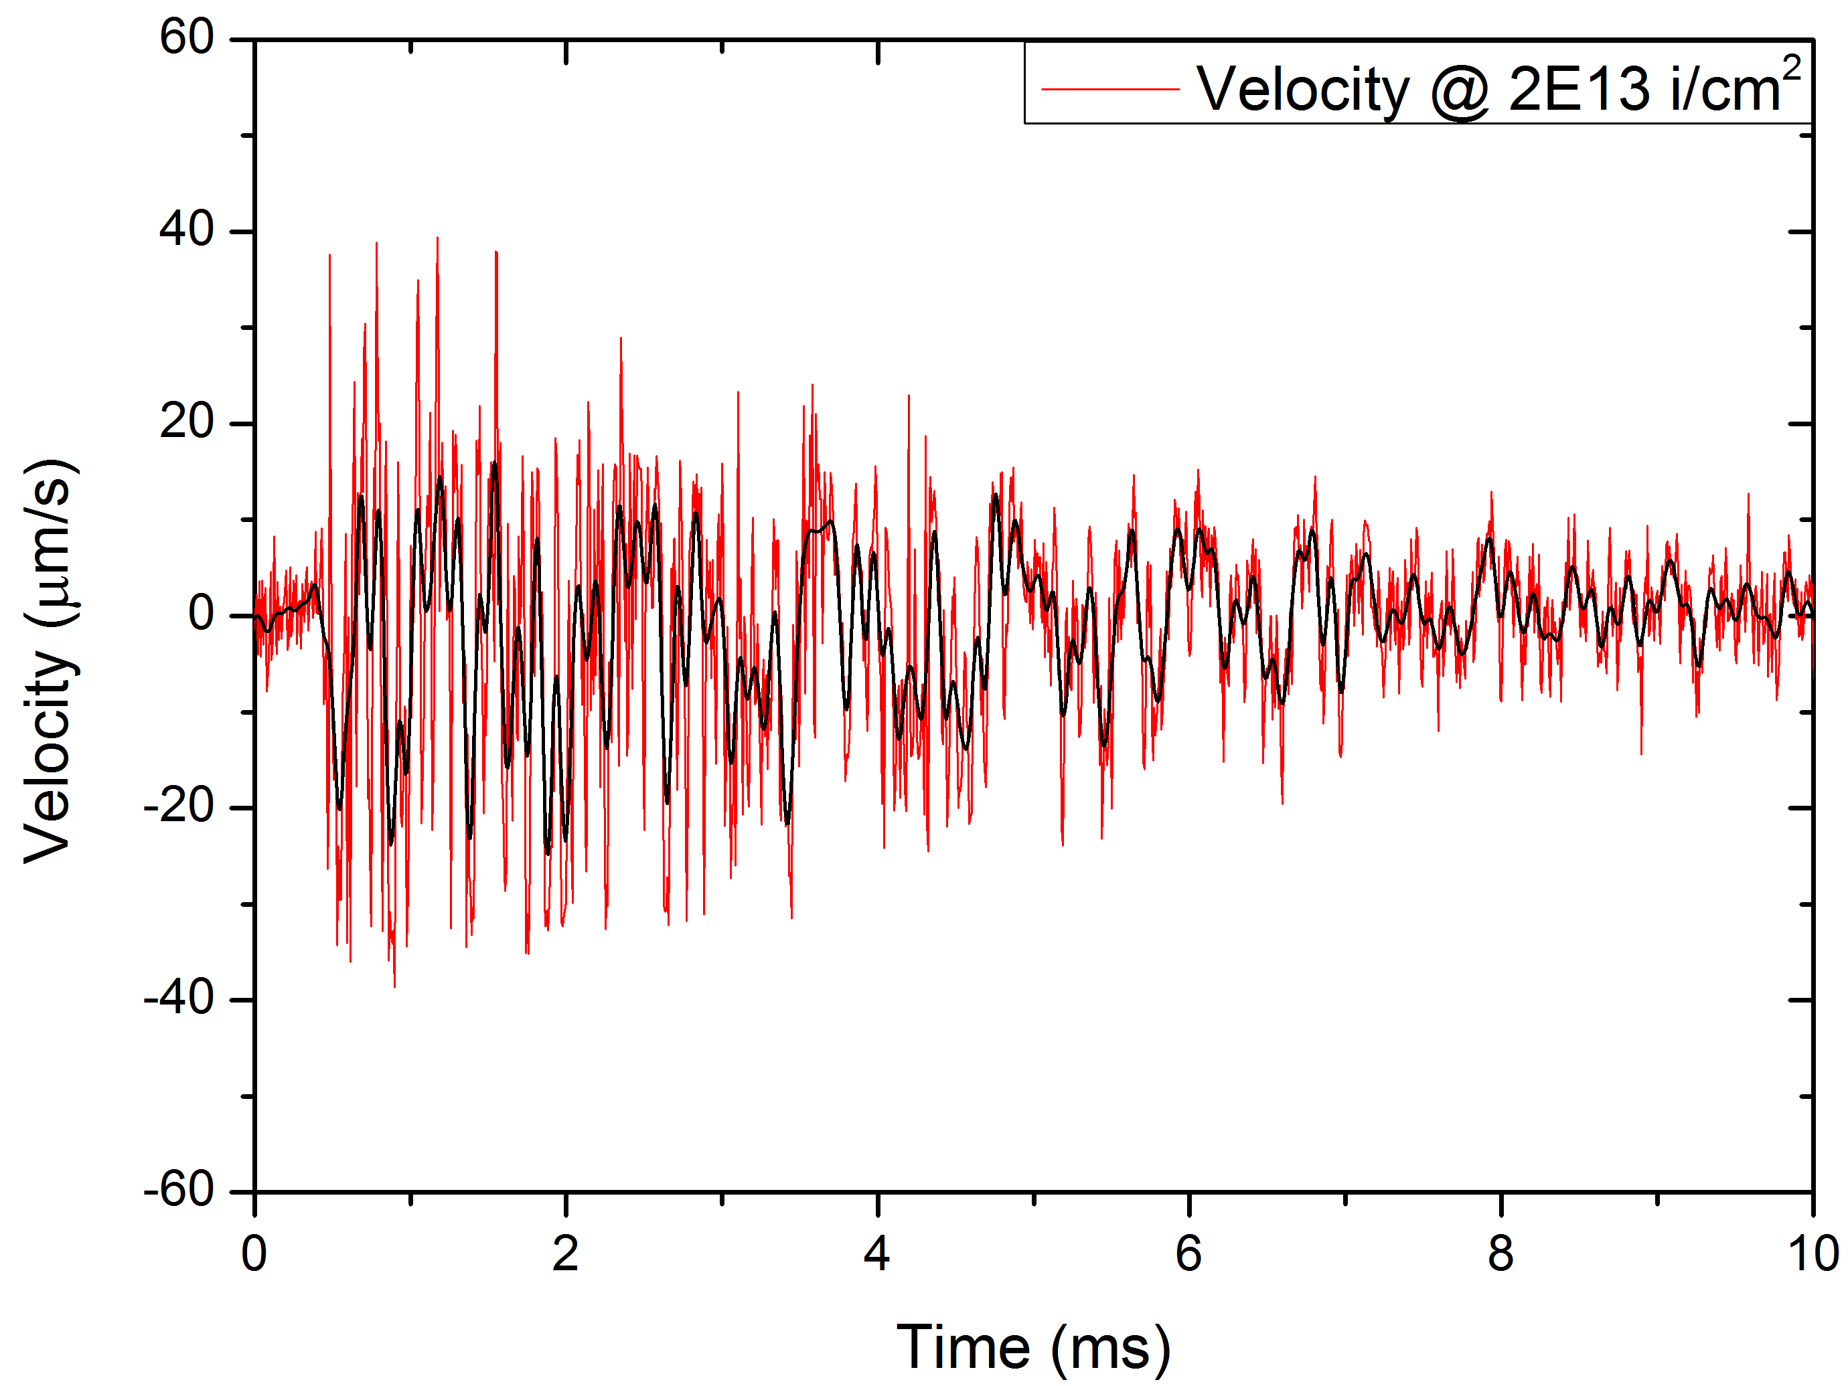
UNILAC, GSI- short pulse 4.8 MeV/u U beams
Existing facilities
Beam parameters
4.8 MeV/u U^{28+;;} 0.15 ms pulse length; 1 Hz
Up to 1.5×10¹⁰ i/cm² per pulse
Up to fluences of 1×10¹⁴ i/cm²
LDV
IR camera
Material response to beam-induced stress waves with radiation damage accumulation
Temperature - beam spot
Polycrystalline isotropic graphite 140 μm

Slide 9
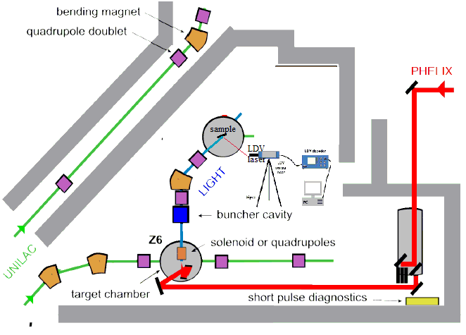
Experimental set-up for measuring proton beam induced stress waves

Slide 10
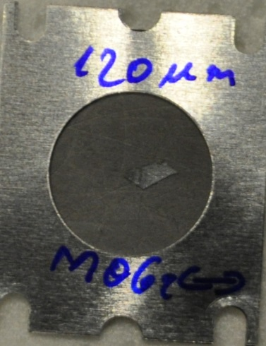
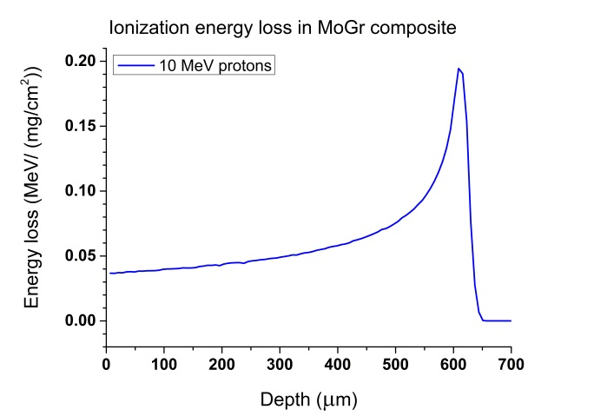
Response of accelerator target materials to short, intense proton beam pulses
velocity (m/s)
time (s)

Slide 11
Ground testing of space materials in conditions similar to natural environment probed by satellites
Cosmic radiation and solar particle events includes protons, helium and heavier ions, and also electrons, neutrons, and ultraviolet radiation
Complex radiation environment might have a synergistic effect on materials damage
The energy spectrum of laser accelerated particles is quite similar to the natural one - exponential energy distribution
This condition is difficult to achieve by traditional accelerator facilities
Vacuum and extreme temperatures as well as thermal cycling alter physical properties and lead to material fatigue.
Impacts of micro-meteoroids and orbiting man-made debris can damage spacecrafts and components.

Slide 12
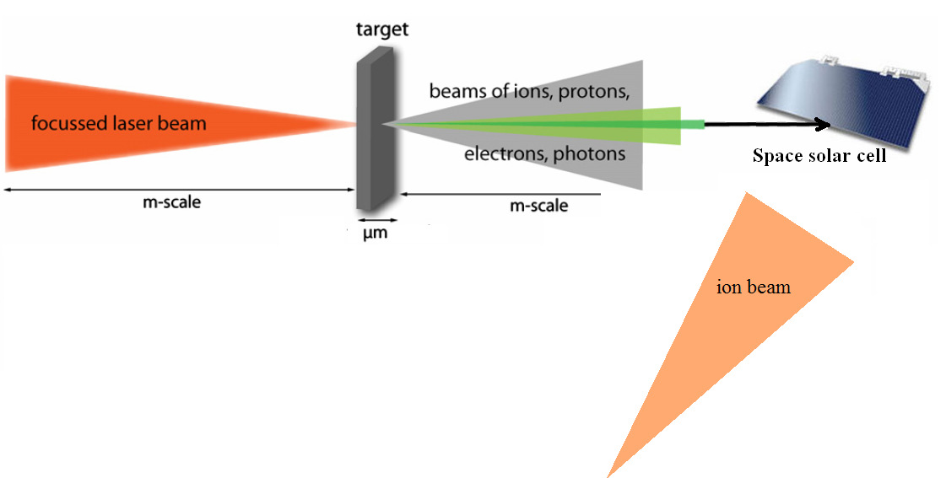
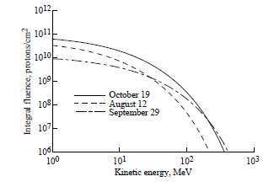
Ground testing of space components
cummulative effects of mixed proton and ion irradiation can be tested at Z6 at lower energies and in the future at the APPA-Helmholtz beamline at higher energies
Proton fluences on Mars for SPE‘s
(source NASA technical paper)

Slide 13
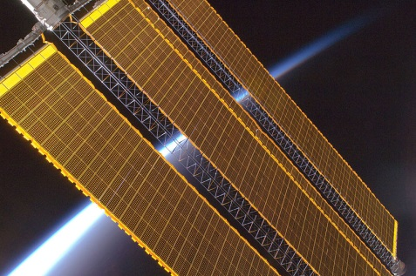
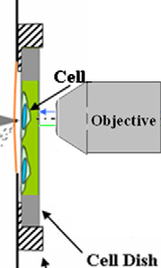
Ground testing of space components
optical crystals and solar cell materials
composite and polymeric materials for space technologies
electronic components for cummulative dose effects
cell cultures

Slide 14
Dynamics of radiation induced defects in materials
in situ study of :
-defect recovery and clustering, effect of dose rate
-phase transformation ,
-and ion track formation
ps - µs - h
^{~10 nm}
^{fs-ps}
Fast diagnostic:
time resolved laser transmission, reflection, absorption, X-ray spectroscopy, RBS, optical spectroscopy, resistometry

Slide 15
Conclusions and outlook
possible experiments are limited at the moment by the repetition rate - at the moment focus on single shot experiments
for studies on materials response to pressure waves –one could trade the narrow energy spread for intensity
need for fast probing beams: laser, VISAR, (laser driven) X-ray .. positron sources
.. if possible also with high repetition rate
heavier ions- Au, Pd?
LIGHT facility at Z6 can be a test bench for future experiments combining high energy ion beams and laser driven proton beams at APPA cave + Helmhotz beamline

