Slide 1
TPC FEE status and more
TUM Physics Department E18
I.Konorov

Slide 2
Overview
T2K chip FEE
Full system readout
Important questions
Plans

Slide 3
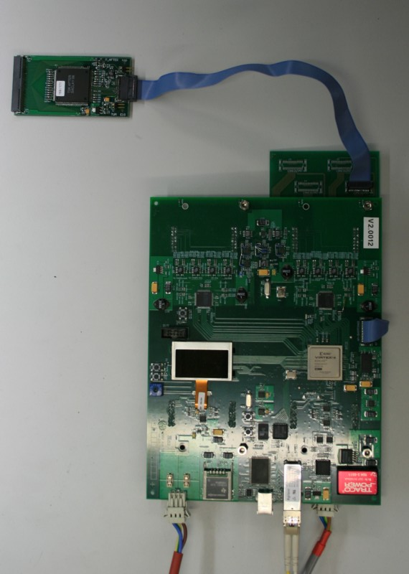
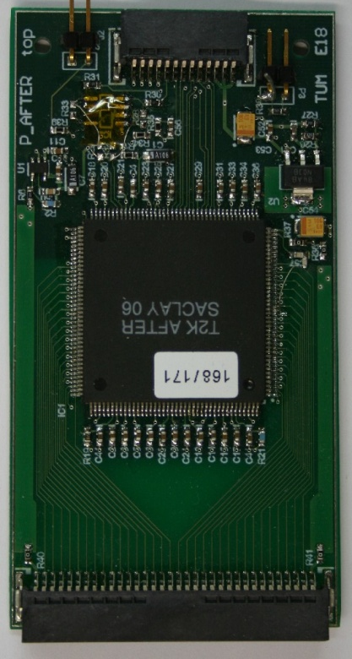
Front end card, first prototype

Slide 4
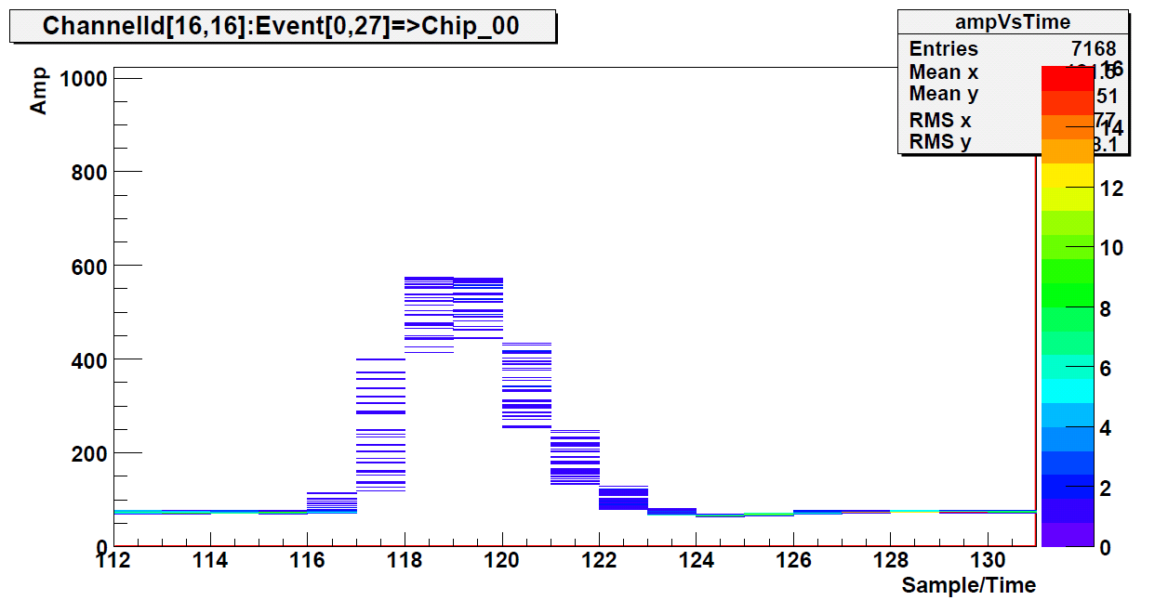
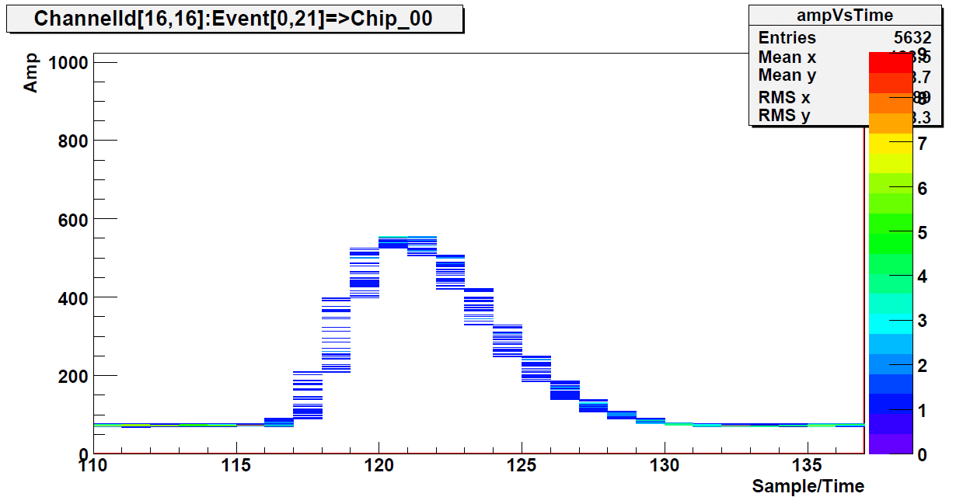
Calibration with pulse
Test pulse : 50 fC
Peaking time
116 ns
Peaking time
200 ns

Slide 5
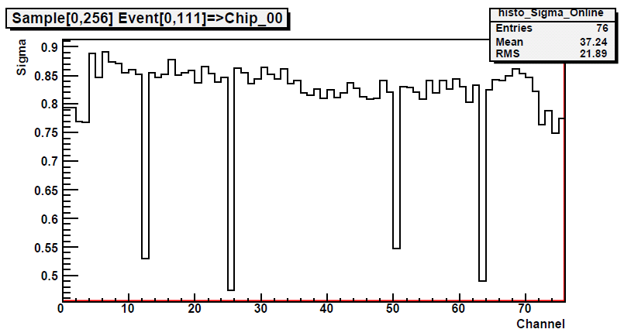
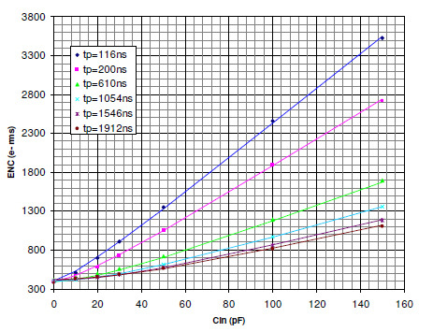
Measured chip performance
Noise performance
  Board is not connected to detector
  1 ADC unit = 0.12 fC or 700e-
  4+4 unconnected channels
  4 Fixed Pattern Noise channels
T2K noise measured @ Saclay
  Noise of connected channels: ~600 e-

Slide 6
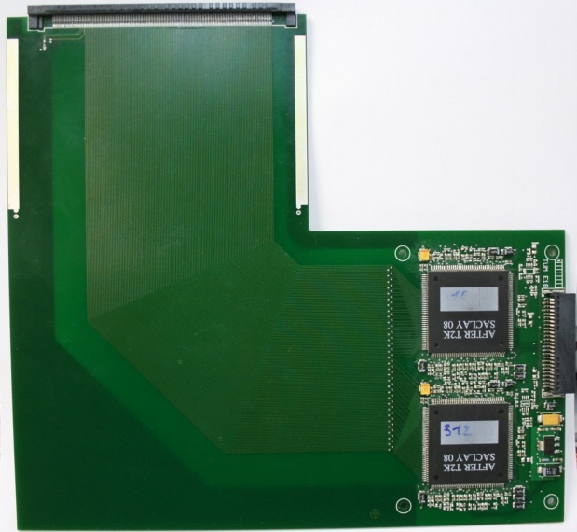
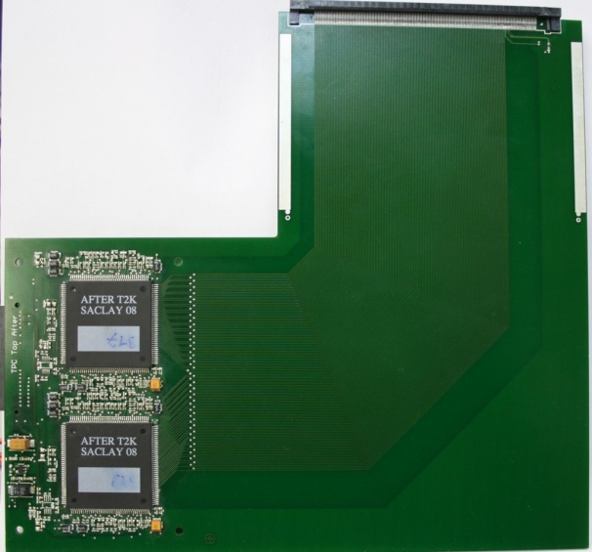
Test chamber front-end board
Front-end board:
  4xT2K chips
  256 channels
L-shaped to place chips outside
of beam
Top side
Bottom side
Noise performance: 850 e-

Slide 7
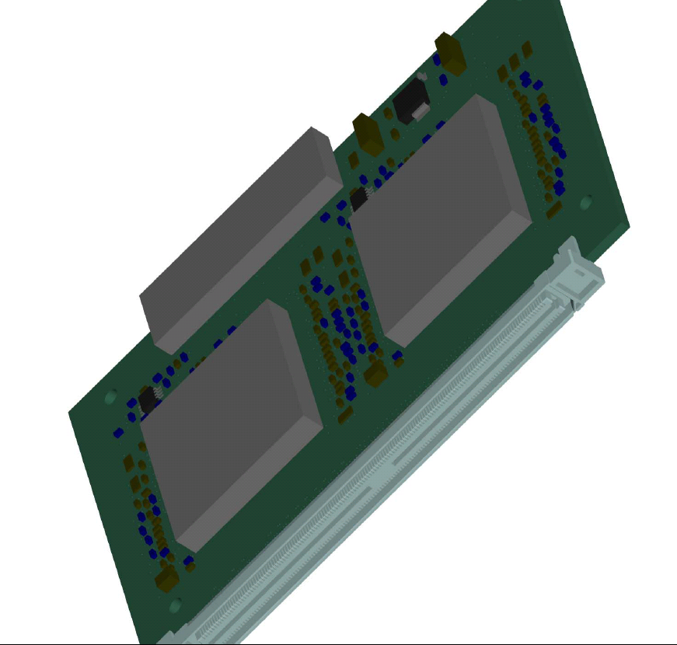
Final design of T2K FE card
CUT
4 T2K chips, 256 Channels
Power Supply +3.3V
Power consumption < 1.5W

Slide 8
Further step : cooling tests
Increase thickness or add two more Ground copper layers for cooling
Produce final FE card
Test temperature distribution on the card with side cooling
With and Without top copper plate
For test we need final design of grounding/cooling contacts
Peltier cooler
Peltier cooler

Slide 9

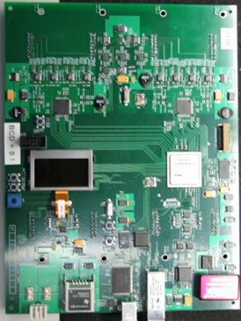
Complete Readout scheme
42 x T2K FEE
11 x ADC
2 x HGESICA
Fibers
Other modules:
  2 Spill Buffer PCI cards
  TCS controller
  TDC for TCS synchronization

Slide 10
To be done
Production
  50 T2K FEE cards
  12 ADC cards
  3 HGESICA
T2K chips availability:
  Saclay provides 320 chips(20k channels)
    20 chips this week
    300 during March

Slide 11
Conclusions and outlook
Performance of T2K chip fulfils TPC requirements
Complete readout tests till end of February (first week of March)
Complete cooling tests till April
Start production in April
Integrate HGESICA readout into FOPI asap

