Slide 1
Tracking TDR
Status of the whole document;
Simulation requirements;
Next steps.

Slide 2
Status of the whole document
In December 2008 the svn repository has been set up in Pavia:
svn+ssh://pndstt@lxfocus14.pv.infn.it/home/pndstt/PndTrkTdr
The editing rules are similar to the ones for the TPR and the PB.
Have a look to the editing rules of the Physics Book in the Panda PBook Wiki.
If you have not been contacted and want to be an author with svn access, please contact Paola Gianotti (paola.gianotti@lnf.infn.it)
The tracking group convene every 3 weeks on EVO on Thursday morning.

Slide 3
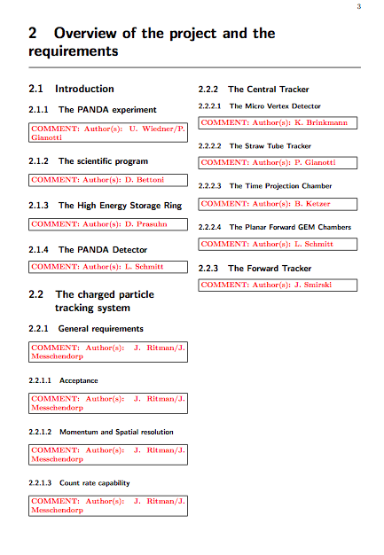
Status of the whole document
These sections are completely missing. Defined editors are kindly requested to start uploading some text to the repository.

Slide 4
Simulation requirements
In order to define the requirements for the whole tracking system a campaign of simulations are needed:
These are the channels that have been identified to evaluate the requirements and the performance of the tracking sytem.
Possibly with a realistic layout of the detector.

Slide 5
Simulation requirements
The listed channels reflect the main applications of the tracking detectors inside PANDA in terms of:
position measurements;
momentum evaluation.
For particles in an energy region from 100 MeV up to 15 GeV.
Secondary vertex capabilities for hadrons with c- and s-quark content:
The channels pp → D^{∗ +} D^{∗−} and D⁺D⁻ deﬁne the requirements for secondary vertices of the MVD;
The channel pp → ΛΛ has to be distinguished from the K₀ production: pp → K _{0S} K±π∓ with K_{0S} → π⁺ π⁻;
It is worth to evaluate CT capability to detect Λ decay vertices;
pp → J/ΨX serve as a benchmark channel for high p_{T} charged tracks in a multi-track environment.
pp → η_{c} → φφ is dedicated for the PID studies with respect to pionic final states;
pp-scattering serves as benchmark for tracking and momentum measurement in particular for the forward tracking detectors as well as background process for the CT because it produces a high particle ﬂux close to Θ = 90◦ .

