Slide 1
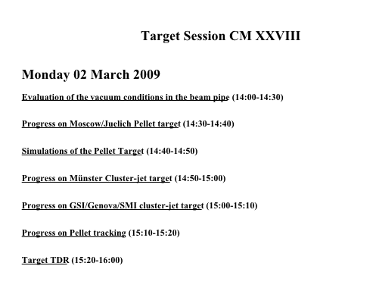
Target Working Group

Slide 2
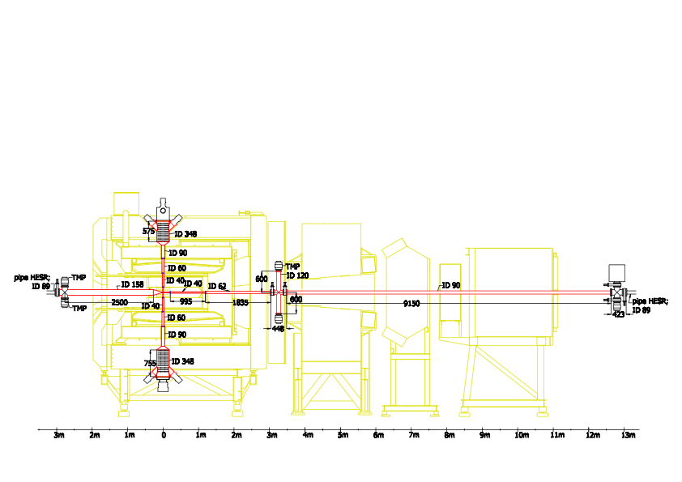
Vacuum in PANDA

Slide 3
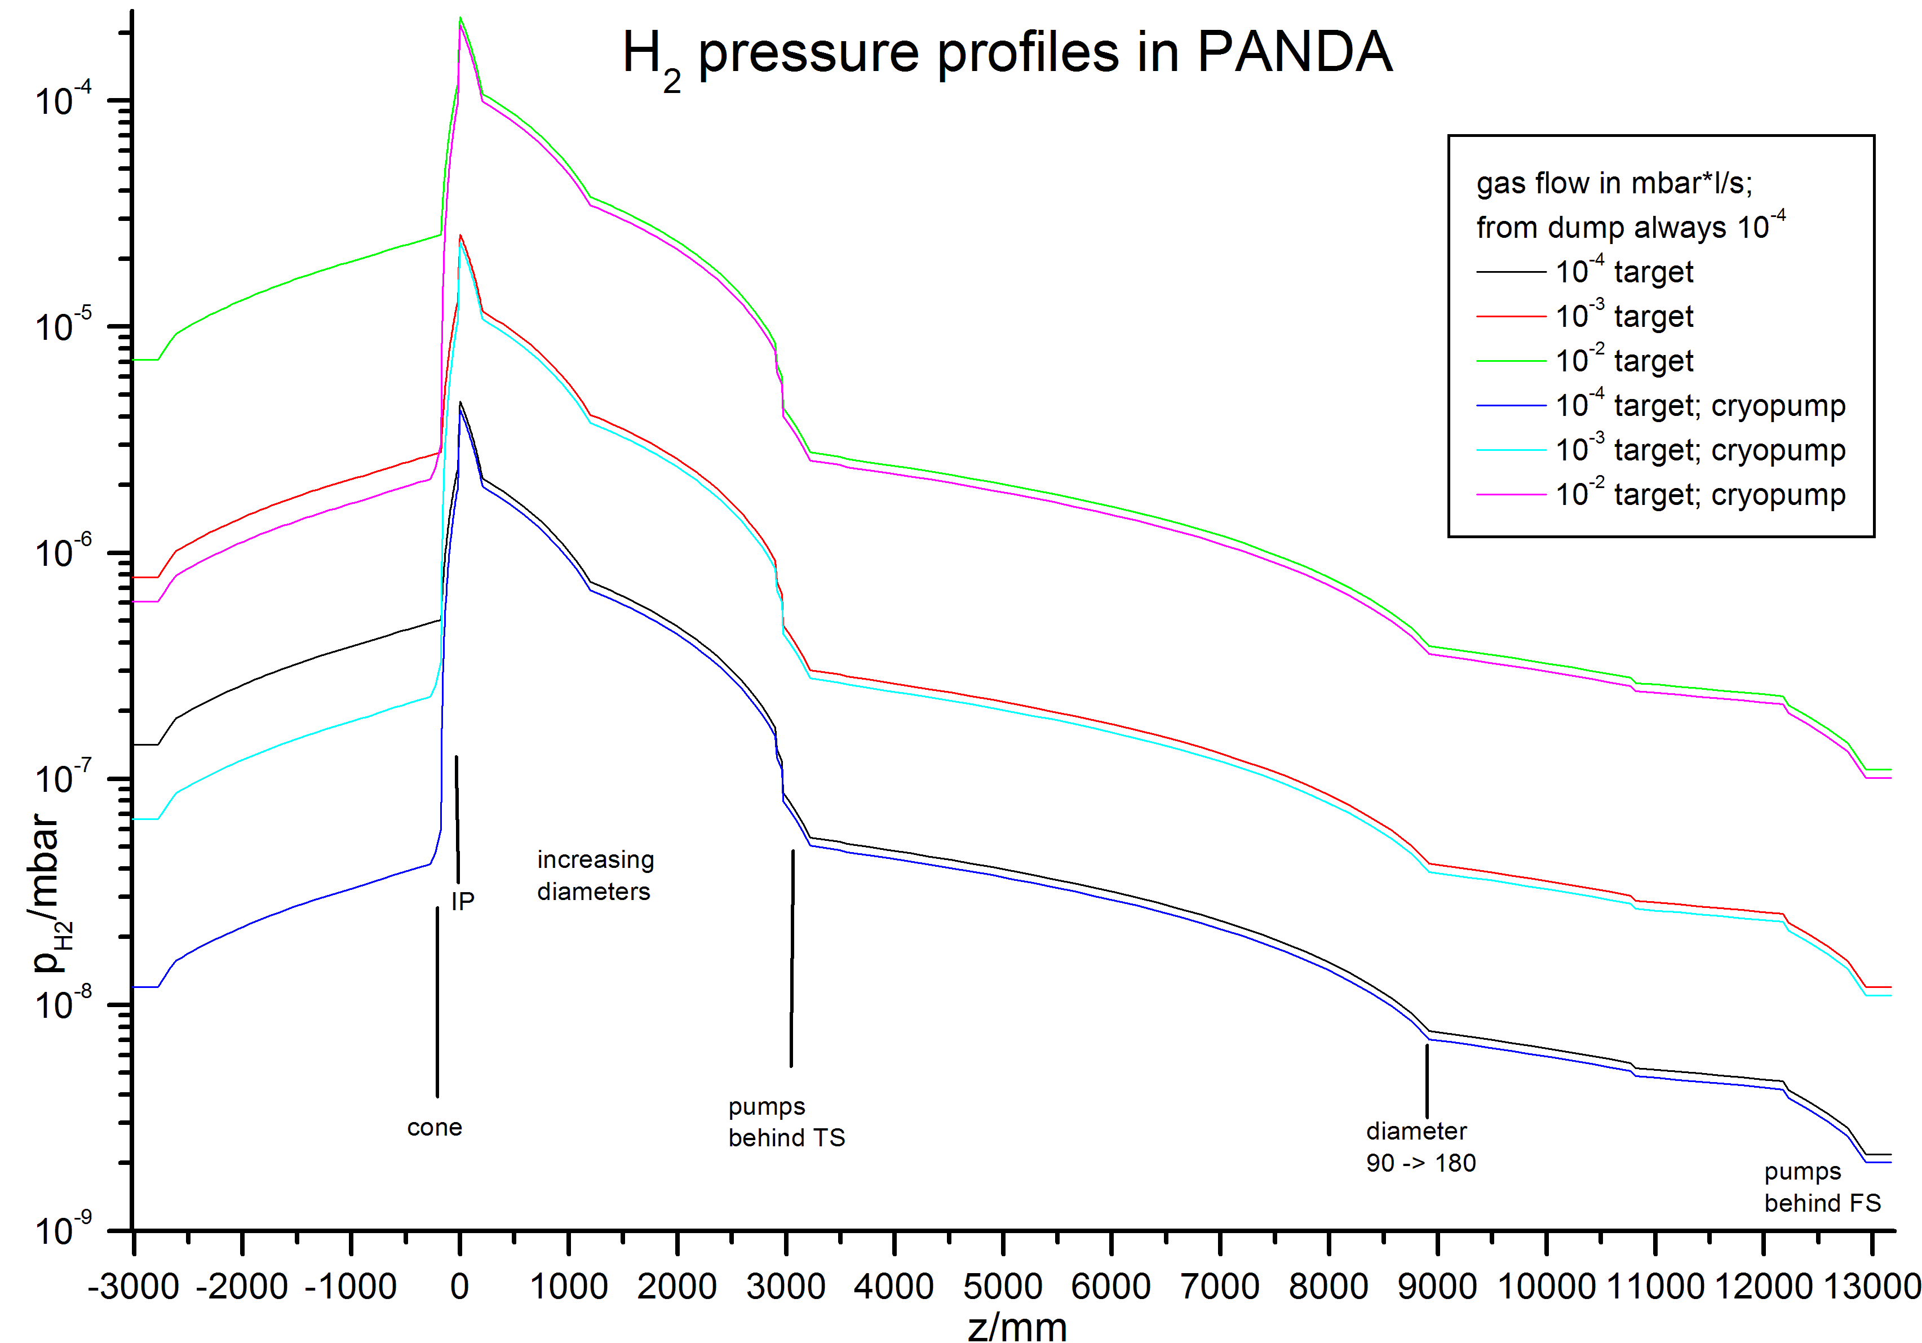
pressure along pbar-line

Slide 4
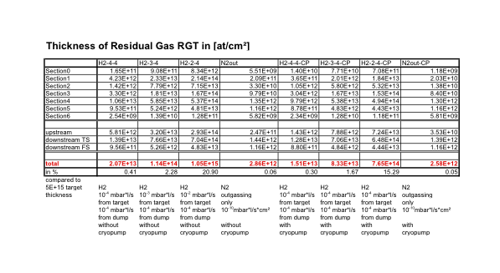
Residual Gas

Slide 5
Progress on Genvova-GSI-SMI
Cluster-Jet Target

Slide 6
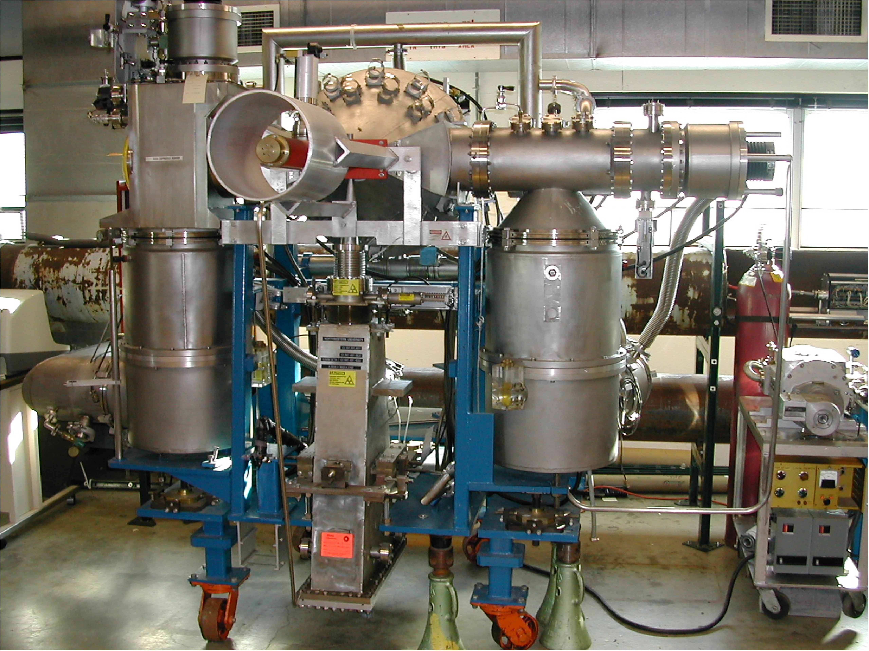
FNAL/Genova cluster-jet target picture taken at Fermilab

Slide 7
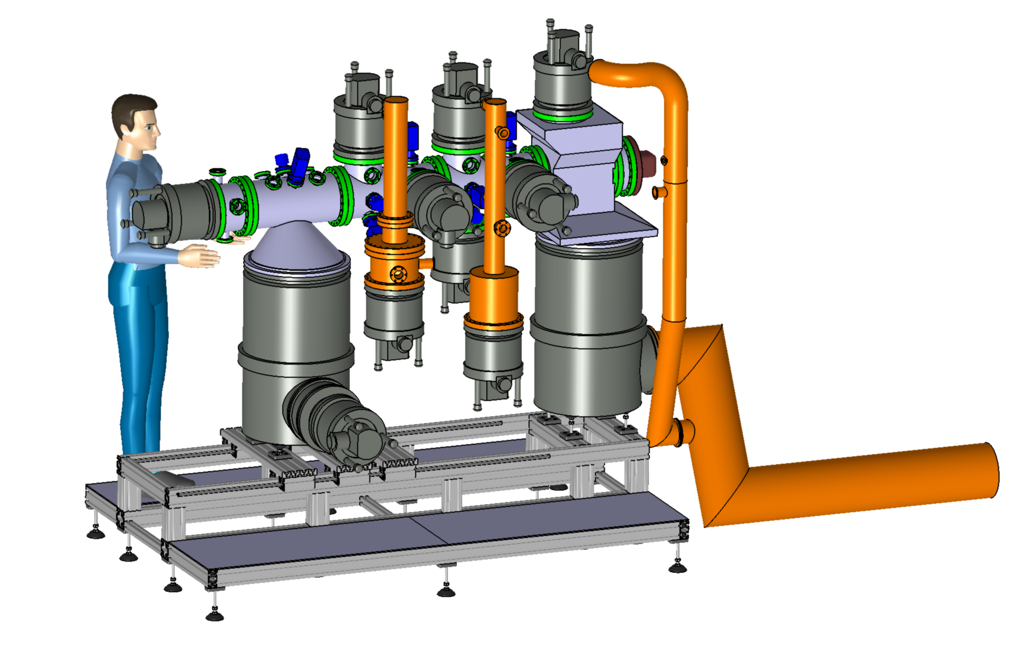
View on the drawing board with standardized european Man

Slide 8
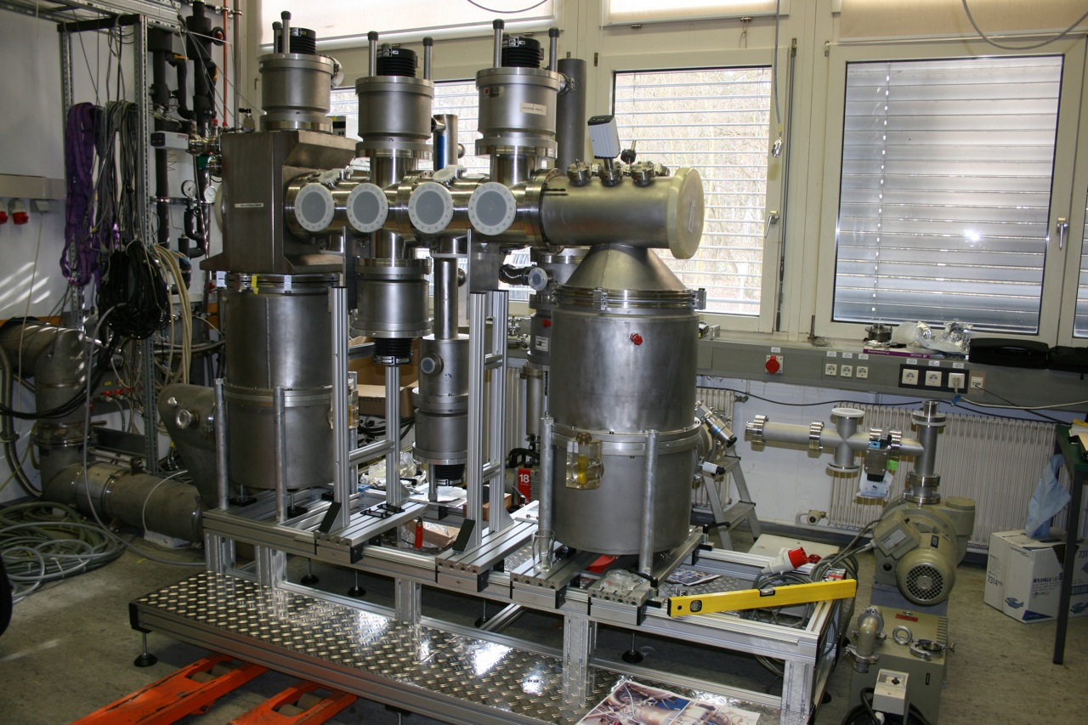
New Genova/GSI/SMI Cluster-Jet – Front View

Slide 9
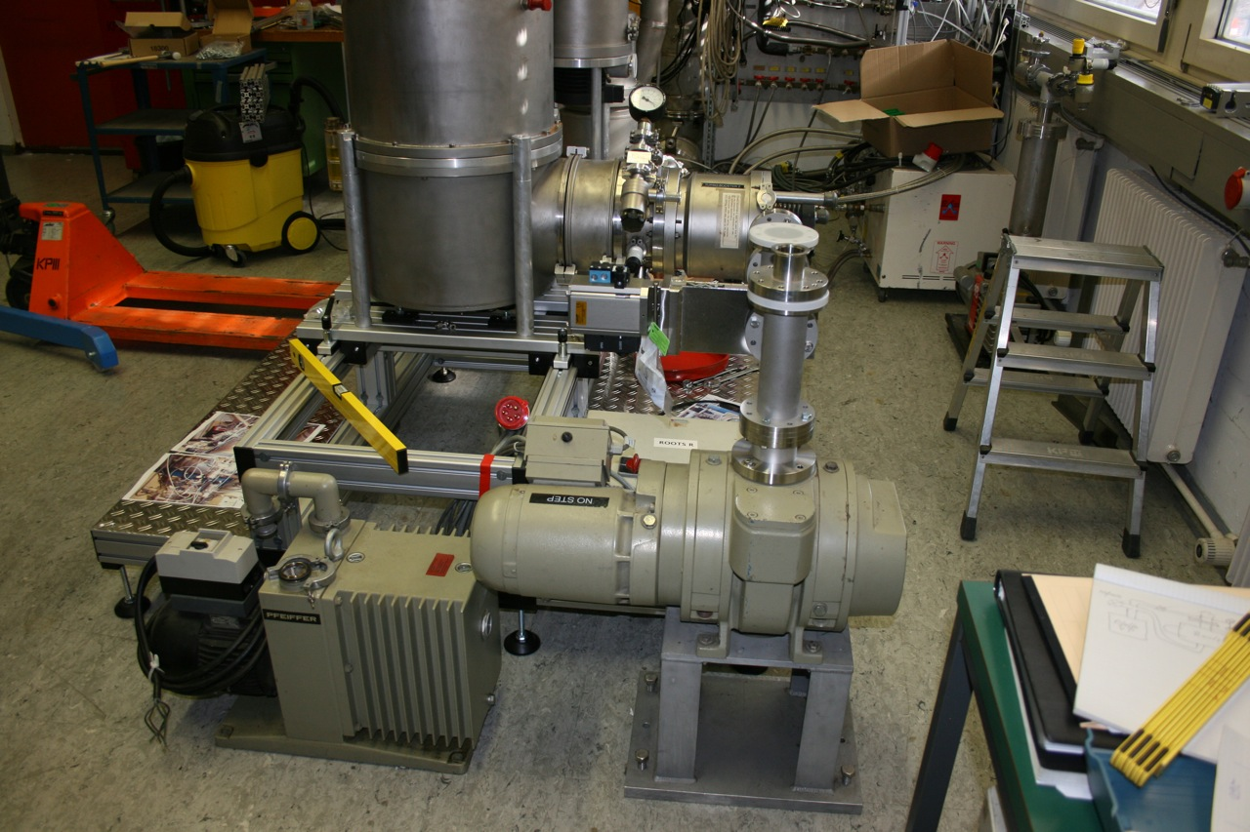
New Genova/GSI/SMI Cluster-Jet – Dump-Roots

Slide 10
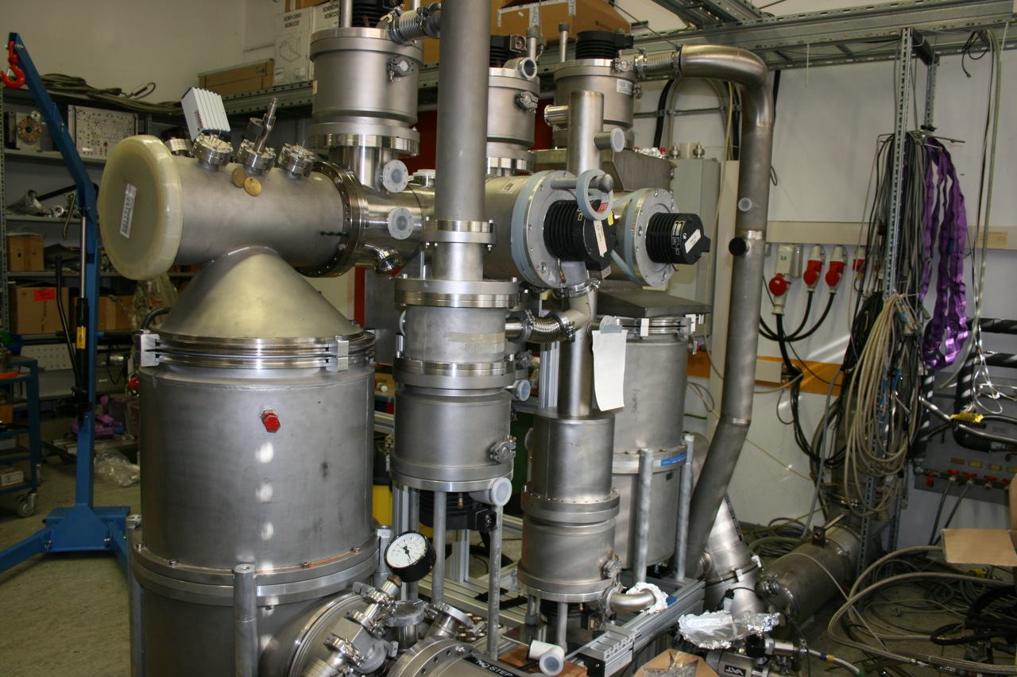
New Genova/GSI/SMI Cluster-Jet – Back View

Slide 11
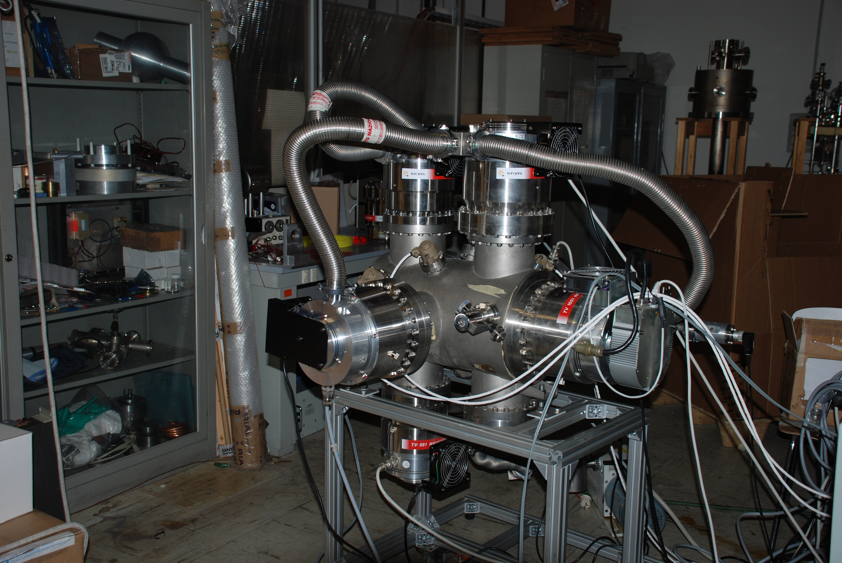
Genova Catcher

Slide 12
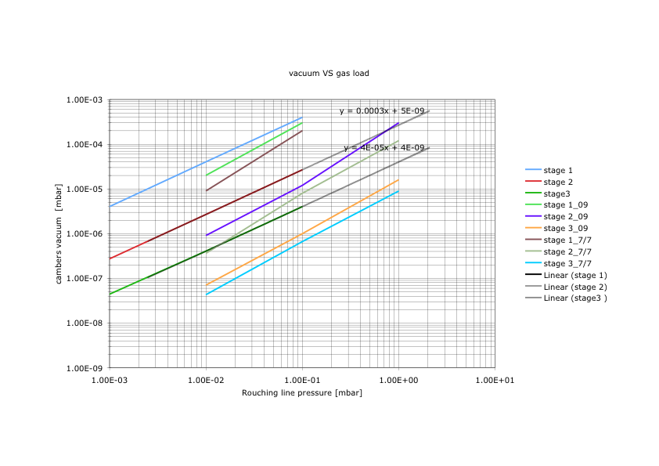
Vacuum VS gas load

Slide 13
New Genova/GSI/SMI Cluster-Jet time lines
Completion of mechanics for vacuum chamber 4/09
Pumping with roughing and roots (10⁻⁵ mbar) 4-5/09
Pumping with all turbos down to 10⁻⁸ mbar 5/09
Setting up hardware for control and interlock 5/09
Jet-head and hydrogen system hook-up 6/09
LabView (CompctRio) slow controle 6/09
Stepping motors and general data acquisition 7/09
Start producing cluster-jet beam 7/09
Experiments beginning in August 09

