Slide 1
OECD Science and Technology Scoreboard 2015 Japan and My View on Education, Univ/Lab Relation, and Jobs in Japan
Yong Ho Chin (KEK)
Universities Meet Laboratories Workshop
Orsay, 3-4 November, 2016
2016/11/4
1

Slide 2
Outline
OECD (Organization for Economic Co-operation and Development) Global View
OECD Science , Technology and Industry Scoreboard, Japan 2015
Low Investment in Higher Education and Training
Lagging Quality of Research
Low Level of International Collaboration
My View
Education
Jobs
Answers to the Questionnaire
Relationship between Universities and Laboratories

Slide 3
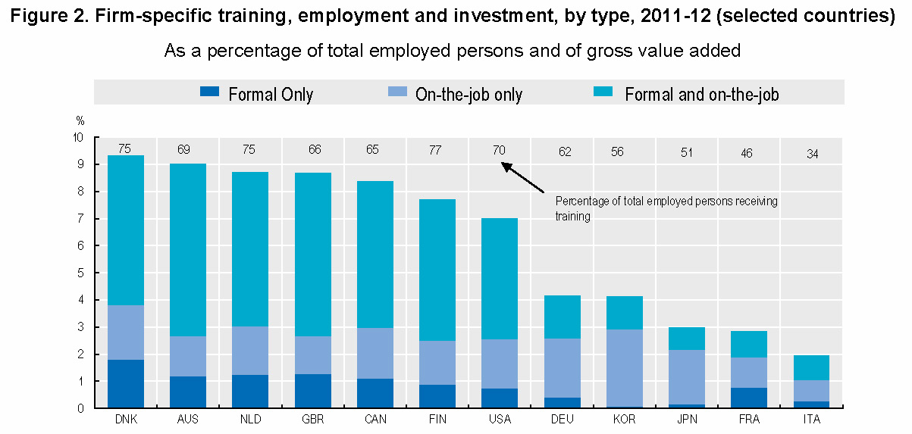
OECD Assessment on Japan 2015
OECD assesses every year the status of major countries regarding science, technology and industry.
Highlights from its Scoreboard for Japan 2015.
“Compared to buoyant investment in R&D and ICT (Information and Communication Technology), investment in other types of knowledge capital, including in higher education, firms' organizational capabilities, and firms' specific training, is relatively weak.”

Slide 4
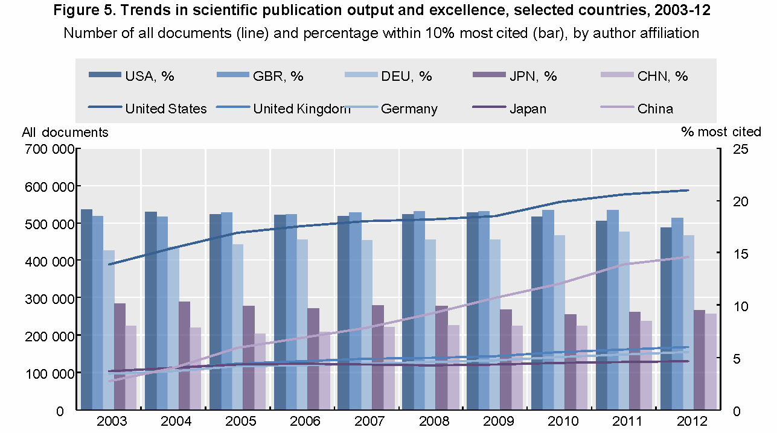
Quality of Research
“Despite a large, but declining, volume of scientific production, the “quality” of research in Japan is below most OECD countries as measured by top-cited publications.”

Slide 5
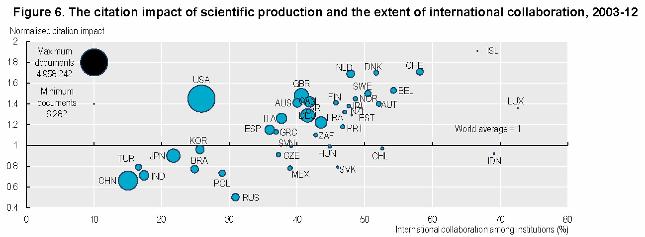
International Collaboration
“Japan has a low share of internationally mobile researchers and relatively low levels of international collaboration. These indicators point to Japan as being among the least connected economies in the OECD.”

Slide 6
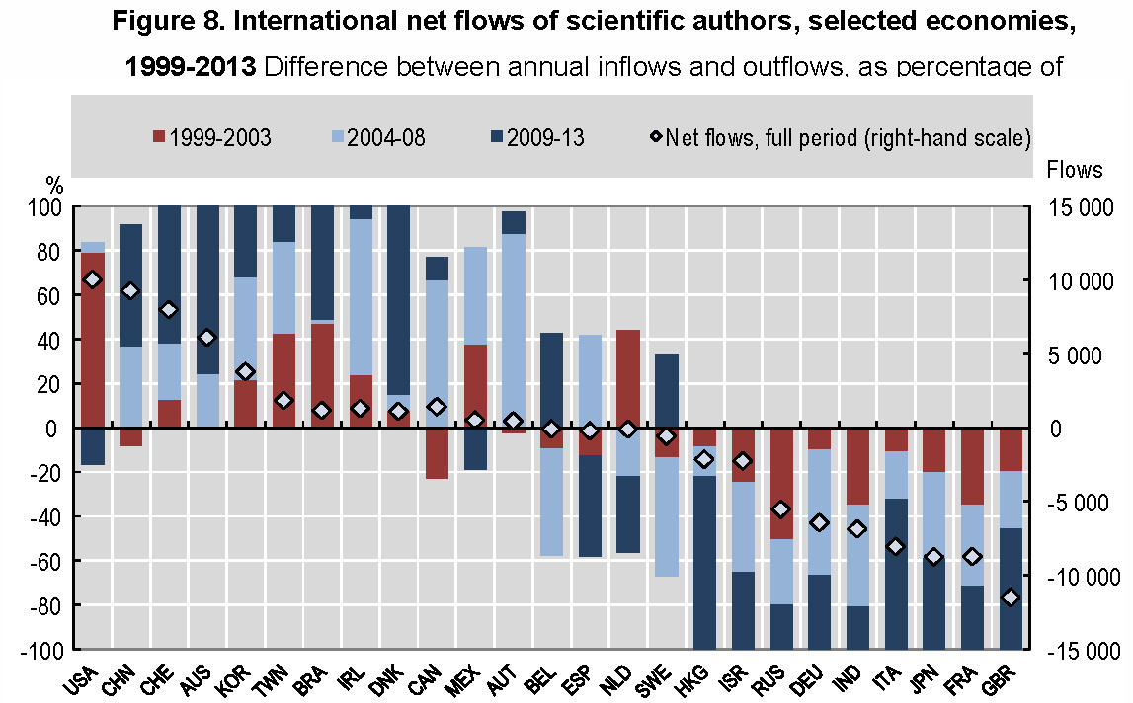
Research Capacity
“Track mobility of scientists who publish is to trace changes in institutional affiliation in their scholarly publications.” “In the case of Japan, there have been net outflows of researchers, in particular from Japan to the United States and to China over the last twenty years.”
Yamazaki-san
Oide-san
Saito-san
….

Slide 7
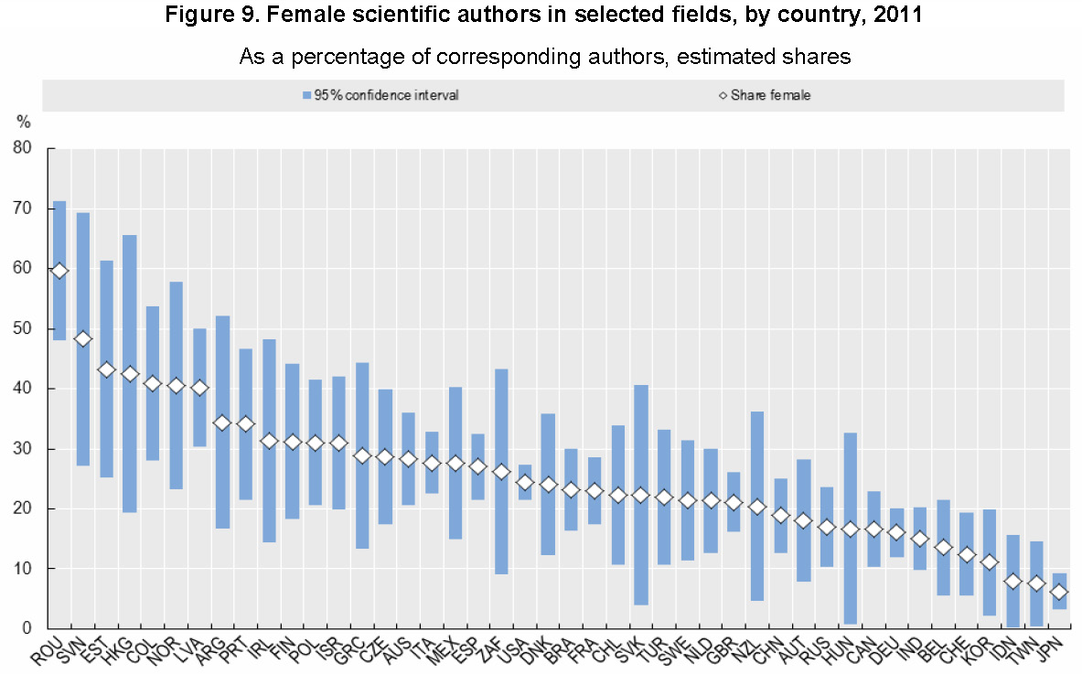
Women in Science
“Another key challenge for Japan is fostering participation rate of women in science.”
It tells about how the society is made up and bound.

Slide 8
Conclusions Part 1
In the era of the internet and advanced computer technologies, the labor productivity and international collaboration should grow.
In old days, we had to ask secretaries to type papers with typewriters, often equipped with no memory.
Now, we can type a paper by ourselves, with MS Word, etc.
We have international communication tools such Skype.
In this regard, the stagnation of the number of publications and the decline of “quality papers” indicate that the scientific activities in Japan are indeed declining.
This may be what happens when “the economy pie is shrinking”.
Low productivity, low levels of international collaboration, and low share of internationally mobile researchers are all correlated and rooted in the same fundamental reasons (I do not go to politics).

Slide 9
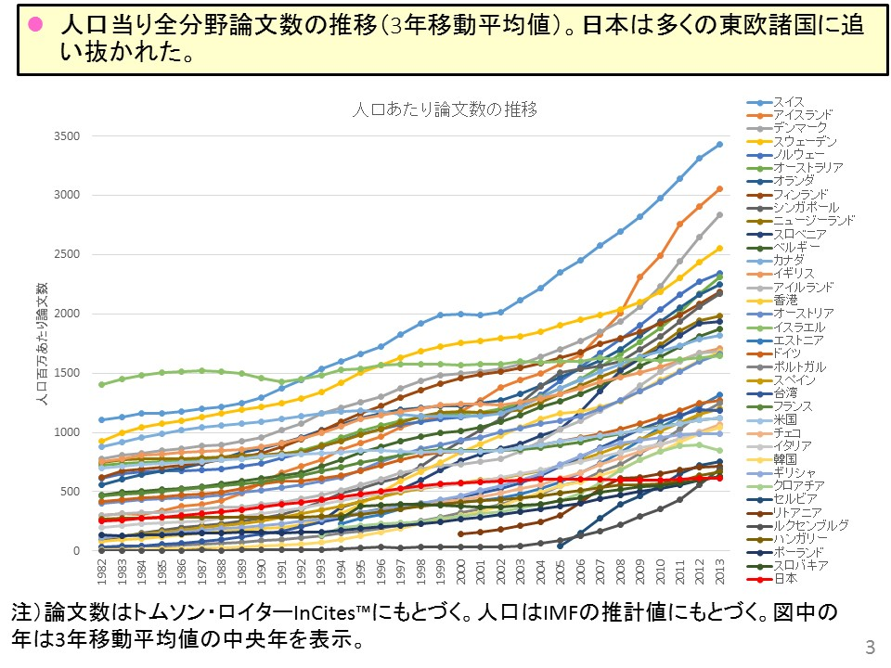
Number of Publications (in the Entire Scientific Fields) per Capita
8M
1. Switzerland
14. UK
4M
20. Germany
24. France
25. US
27. Italy
28. Korea
29. Greece
30. Croatia
31. Servia
32. Lithonia
33. Luxemburg
34. Hungary
35. Poland
36. Slovakia
37. Japan

Slide 10
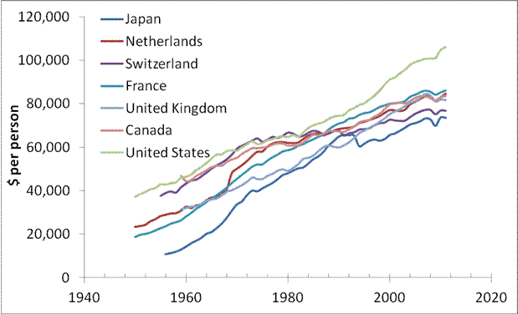
Labor Productivity per Capita
Labor productivity in dollars per hour
Labor productivity in dollars per employee
Japan
Japan

Slide 11
A Matter of Survival
The key words from OECD for understanding.
“Japan is the world’s third largest manufacturing economy and the world’s fourth largest exporter of manufacturing goods, although its share has sharply decreased over the past decade, as with other large OECD economies.”
More words from Brexit (David Stockman):
“A shrinking economic pie generates widespread insecurity that pressures every status quo arrangement as people circle the wagons in an attempt to protect their remaining slice of the pie from others' claims for a larger piece of the dwindling pie.”
In the shrinking economy and budget circumstance, each institute/university has to struggle for survival.

Slide 12
Education
In US and Europe, it is a common practice that accelerator scientists have posts also in universities and educate and recruit young students to their labs.
In Japan, it is very few nowadays in the accelerator community
Instead, the government created its own graduate school, called Sokendai, with no its own educational resource, but in association with national labs.
Each national lab accepts and educates students.
Essentially, it is “KEK graduate school” independently operated
Right now, we have 19 students (9 Japanese and 10 other Asians).
Asian students mostly go back to their countries after graduation to become pioneers in the accelerator science.
Roughly, 2 Ph.D. students graduate from Sokendai each year.

Slide 13
Merits and Demerits of Sokendai System
Merits
KEK can run the branch of Sokendai almost freely, unlike in the collaboration with universities where you have to negotiate and reconcile with them for many arrangements.
Students can concentrate their activities at KEK, while in case of Univ/KEK collaboration, they have to go back and forth physically between KEK and their universities.
Demerits
Difficult to collect students
Most of students prefer to proceed to graduate schools belonging to the same undergraduate schools. Change the course is not an attractive option for many students.
Many KEK staffs are simply too busy with their own business to fully commit to education and training of students.

Slide 14
Accelerator School (Oho School)
Every September, KEK organizes one 3.5-day accelerator course for Sokendai and outside students.
But it is not affiliated with universities.
Thus, students cannot earn their university credit for their Oho accelerator course.
At USPAS (United States Particle Accelerator School), there are some USPAS-affiliated universities and students enrolled at these universities may earn university credit for their two-week USPAS course.
Indiana Univ, MIT, MSU…
In Japan, a student has to take 1.5-hour course for 15 weeks to receive 2 semester credits in his/her university.
3.5 days are too short to meet this requirement.

Slide 15
Work Style
I have been always told during my stay at CERN, DESY and LBL that we, scientists, should work as scientists, and explore the unknown.
We should leave engineering works to engineers.
In most of accelerator labs in Japan, we have practically no engineer.
Many of us work like engineers in the way engineers work.
Depend on established knowledge and technology.
This may explain why the number of papers published in PRAB from Japan is stagnated.
“Get it done” by any means than new inventions/findings.
Interestingly, we have some engineers working at KEK, but they prefer to work like scientists.

Slide 17
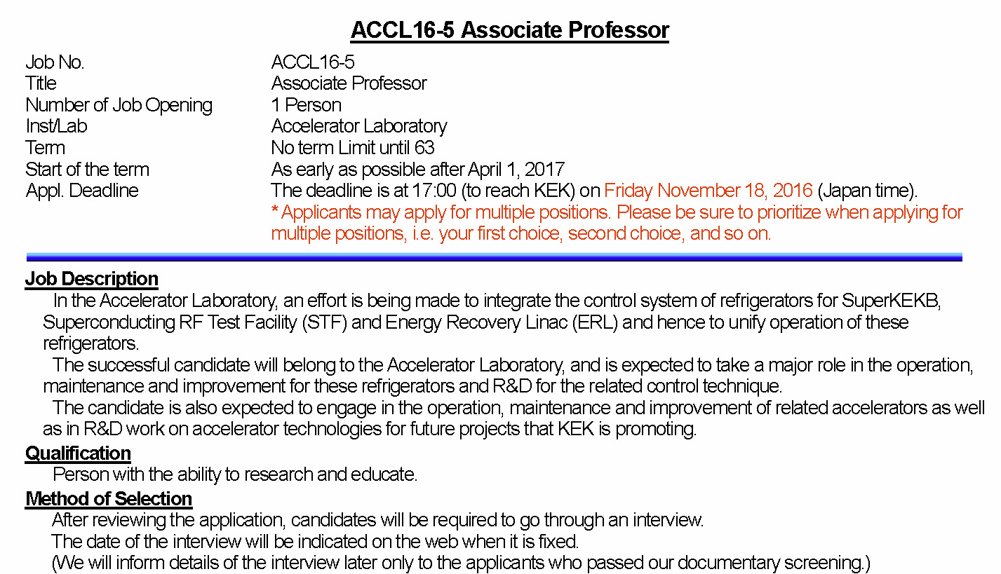
Job Opening at KEK
The job description is very specific and pinpoint.

Slide 18
My Answers to the Questionnaire
Do formal collaborations and joint ventures exist between universities and national laboratories?
Yes, but not so many. Only on a small scale.
The government tried it and allocated some budgets, but the collaboration motivation and mood faded away quickly.
Does the university-laboratory collaboration/synergy work well?
Maybe, in some cases. But, not on a grand scale.
When the pie is growing, collaborations may work as synergy effects to improve their productivity.
In the shrinking pie situation, universities and laboratories have to compete for survival, budget-wise and resource-wise.
Universities do not favor joint appointments because they have to bear a half salary and may lose precious students to labs.

Slide 19
Cont.
How important are publications and impact factor for the academic university career? If impact factor or other indices are important, are the relevant evaluations based on Thomson-Reuters/Web-of-Science or on Elsevier Scopus (or both, or others)? Is the impact factor and number of publications the only criterion for promotion?
Not so important (in accordance with the official answer).
There is very little job mobility at KEK (in Japan as a whole).
Thus little motivation to appeal to the outside community to improve career or resume (unless looking for a job somewhere).
Promotion (mostly internal) is determined mainly by intra-lab contributions to lab’s projects (e.g., improvement of machine performance), little by the number of publications in peer-reviewed journals.

Slide 20
Conclusions Part 2
The collaboration between universities and labs in Japan is “sluggish”.
There is little motivation for or gain from a collaboration when the budget is shrinking and the human resource is limited.
“It is every man for himself” situation.
To achieve a meaningful synergy effect, a collaboration has to be well coordinated, organized and well staffed.
Lack of human resources for this kind of jobs in labs/univ.
Good professional advices and coordination are costly.
In my view, this is a challenge for Japan to move on from the “it is every man for himself” to the “earth, we are one”.
For improvement of publications and quality papers, our work conditions and promotion system need to be overhauled by employing more world standards.

Slide 21
Cont.
In my view, EU tries to establish new standards or common rules that rule EU beyond the border of each country.
In Asia, this seems to be difficult, since Asia is so diversified historically and geographically that I am not sure if Asians really think that they are “Asians”.
I was amazed at a TV program on Brexit from UK that a British young man says that he is more European than British!
In the era of globalization, “Japan remains stuck in a mindset that is fundamentally provincial” or domestic.
New “getting to global” mindset is needed beyond the tired “nation-state” national model in which Japan has been so successful with the “clear border” till recently.

Slide 22
Charles Darwin Once Said
"It is not the strongest of the species that survives, nor the most intelligent, but the one most responsive to change.“
How responsive are we?

