Slide 1
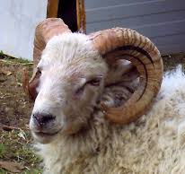
The new ARIES project:
Accelerator Integrating Activities strengthening the synergies between Universities and Laboratories
Maurizio Vretenar
Un.meetLab. Workshop
Orsay, 03-11-16

Slide 2
What is ARIES
ARIES
Accelerator
Research and
Innovation for
European
Science and Society
New Integrating Activity (IA) on R&D for European Particle Accelerators in Horizon 2020, approved in August 2016 (H2020-INFRAIA-2016-2017, Integrating and opening Research Infrastructures of European interest) and presently in the Grant Agreement preparation phase.
Proposed start date May 1st, 2017.
EC funding 10 M€, total budget 24 M€ (42% rate).
Duration of 4 years (May 2017-April 2021), starting at the end of EuCARD-2.
41 participants from 18 EU countries; coordination by CERN.
Evaluated at 14.5/15: number 3 out of 28 projects presented at this call for different branches of science: a great success for particle accelerators!
ARIES is the 4th IA for particle accelerators, after CARE, EuCARD, EuCARD-2

Slide 3




The 4 ARIES Pillars
excellence
access
innovation
sustainability
Develop key accelerator technologies to make more performant, affordable, reliable and sustainable the present and future accelerators
Improve the European accelerator infrastructure
New scheme of Transnational Access opening 14 accelerator test facilities
Enlarged consortium with 20 new partners in accelerator projects and 6 new countries in the East and South of Europe
Enhanced industrial participation (7 industries and 1 association)
3 new co-innovation programmes with industry
Development of societal applications (medicine, industry, environment)
Joint programme with TIARA to develop a model for sustainable accelerator science in Europe
Training programme for the new generations of accelerator scientists and engineers

Slide 4
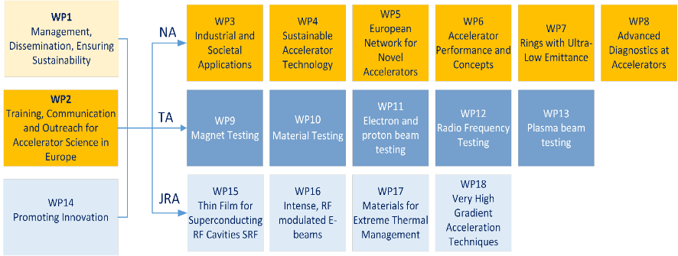
The structure
18 Workpackages:
8 Networks 5 Transnational Access, 5 Joint Research Activities.

Slide 5
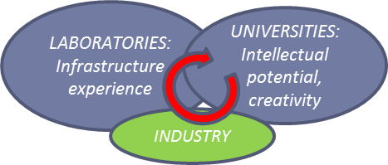
ARIES objectives
To develop novel concepts and technologies with the aim of increasing performance, affordability, reliability and sustainability of next generation accelerators.
To further the integration of the particle accelerator community, by establishing new geographical and interdisciplinary connections between accelerator laboratories, universities and industries.
To promote innovation, by setting up co-innovation programmes with industry, feeding back from industry to the accelerator field, and promoting societal applications of accelerators.
To ensure the long term sustainability of particle accelerator research by defining scenarios and strategic roadmaps and by enhancing the scientific and technical training for young European researchers.

Slide 6

Ingredients of the magic potion
 | Strong points | Weak points
Universities | Intellectual potential Multidisciplinarity Human resources (students) More time to think… | Dispersion (weak hierarchical structure)
Laboratories | Long-term focused expertise Infrastructure (accelerators, laboratories, workshops) Specialisation Technical expertise and support | Lack of global picture Lack of flexibility

Slide 7
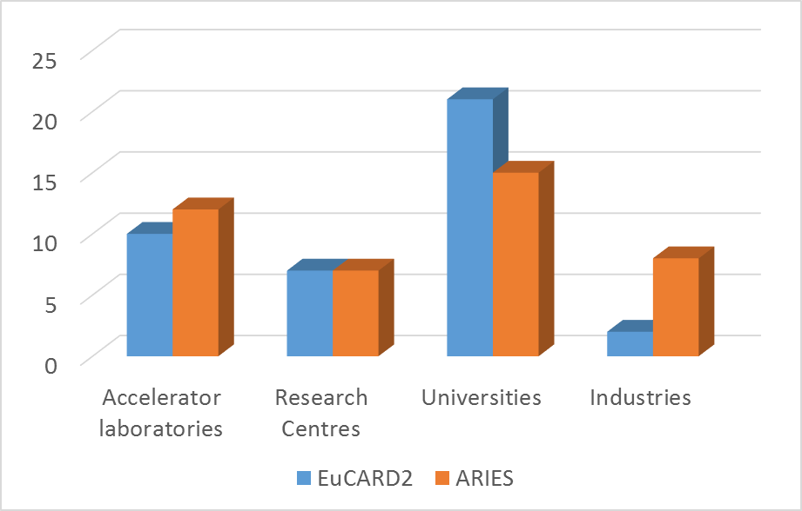
ARIES: where Universities and Laboratories meet
We are convinced that Universities are an essential ingredient for the magic mixture of accelerator R&D. Nevertheless, the number of Universities went down from EuCARD2 to ARIES, because:
EuCARD2 was more exploratory while ARIES is more technology oriented
To make space for industries we had to reduce universities.
We had to exclude partners with too low funding level, to reduce the administrative burden (Universities are not very expensive…)
Consortia of Universities would be a good way to improve University participation to large EU projects.
In spite of the reduction in number, Universities remain the largest component of ARIES.
 | EuCARD2 | ARIES
Accelerator laboratories | 10 | 12
Research Centres | 7 | 7
Universities | 21 | 15
Industries | 2 | 8
TOTAL | 40 | 42

Slide 8
ARIES participants
 | Laboratories and research institutions hosting large accelerator infrastructures | Universities and research centres | Industries and industrial associations | Total
Based in the high-technology European hub: DE, UK, FR, IT, CH | PSI, DESY, GSI, KIT, CEA, CNRS, SOLEIL, CERN, INFN, STFC | UNIGE, JGU, SIEGEN, HZB, IAP, FAU, POLITO, POLIMI, UOXF, HUD | FEP, HIT, BRUKER, CNI, BREVETTI | 25
Based in other EU-15 countries: BE, NL, PT, ES, AT, SE | ESS, ALBA | CIEMAT, UT, UU, UL, IST | RHP, IBA | 9
Based in other EU countries: HU, LT, MT, PL, RO, SI, SK |  | WIGNER RCP, RTU, UM, WUT, INCT, ELI-NP, IEE/SAS | COSYLAB | 8
Total | 12 | 22 | 8 | 42
Universities:
UNIGE (Switzerland), JGU, Siegen, IAP, FAU (Germany), UOXF, HUD (UK), POLITO, POLIMI (I), UU, UL (Sweden), UT (NL), RTU (Latvia), UM (Malta), WUT (Poland).
With respect to EuCARD2, we have lost TUT (Finland), Grenoble INP (France), KUG (Austria), UDUS, UROS (Germany), RHUL, SOTON, STRATH, UCL, ULANC, UNIMAN (UK).
The UK University participation was unbalanced in EuCARd2, and is now more balanced.
Large University participation comes mainly from UK and Germany.
Almost no participation from France (because of CNRS acting as a consortium of research centres related to Universities). Similar role for INFN in Italy.
Could we imagine in future the participation of a UK or German consortium (Helmholtz?)

Slide 9
Participant table
Participant number | Participant short name | Participant name | Country | WP
1 | CERN | European Organization for Nuclear Research | IEIO | 1,2,3,4,5,6,7,8,9,10,12,14,15,16,17
2 | ESS | European Spallation Source ESS AB | ERIC | 2, 4
3 | RHP | RHP - Technology GmbH & CO KG | Austria | 14
4 | IBA | IBA Proton Therapy | Belgium | 3
5 | CEA | Commissariat A L’Energie Atomique Et Aux Energies Alternatives | France | 1, 4, 5, 11, 14,15,18
6 | CNRS | Centre National De La Recherche Scientifique | France | 2, 3, 5, 13, 18
7 | SOLEIL | Societe Civile Synchrotron SOLEIL | France | 7
8 | BHTS | Bruker HTS GmbH | Germany | 14
9 | DESY | Stiftung Deutsches Elektronen-Synchrotron DESY | Germany | 5,8, 11, 18
10 | FAU | Friedrich-Alexander-Universität Erlangen-Nürnberg | Germany | 18 - PLASMA
11 | FEP |  | Germany | 3
12 | GSI | GSI Helmholtzzentrum fuer Schwerioneforschung GmbH | Germany | 4,6,8,10,16,17
13 | HIT | Heidelberg Ion-Beam Therapy Center | Germany | 6
14 | HZB | Helmholtz-Zentrum Berlin für Materialien und Energie | Germany | 15
15 | IAP | Frankfurt University of Applied Sciences | Germany | 16 - ELENS
16 | JGU | Johannes Gutenberg-Universität Mainz | Germany | 6
17 | KIT | Karlsruher Institut fuer Technologie | Germany | 7,11
18 | SIEGEN | Universitaet Siegen | Germany | 15 – THIN FILMS
19 | WIGNER RCP | WIGNER Research Centre for Physics | Hungary | 14
20 | BREVETTI | Brevetti Bizz Srl | Italy | 14
21 | CNI |  | Italy | 14
22 | INFN | Istituto Nazionale di Fisica Nucleare | Italy | 5, 6, 7, 15
23 | POLIMI | Politecnico di Milano | Italy | 17 - MAtERIALS
24 | POLITO | Politecnico di Torino | Italy | 17 - MATERIALS
25 | RTU | Riga Technical University | Latvia | 15, 16 - ELENS
26 | UM | Universita ta Malta | Malta | 17 - MATERIALS
27 | UT | Universiteit Twente | Netherlands | 14 - HTS
28 | INCT |  | Poland | 3
29 | WUT | Politechnika Warszawska | Poland | 1
30 | IST LISBON | Instituto Superior Técnico Lisbon | Portugal | 18
31 | ELI-NP | Extreme Light Infrastructure - Nuclear Physics | Romania | 17
32 | IEE | Institute of Electrical Engineering | Slovakia | 15
33 | COSYLAB | COSYLAB, Laboratorij za Kontrolne Sisteme, d.d. | Slovenia | 14
34 | ALBA | ALBA Synchrotron | Spain | 8
35 | CIEMAT | Centro de Investigaciones Energéticas,Medioambientales y Tecnológicas | Spain | 3
36 | UL | Lunds Universitet | Sweden | 13, 18 - PLASMA
37 | UU | Uppsala Universitet | Sweden | 9, 12
38 | PSI | Paul Scherrer Institut | Switzerland | 4, 7
39 | UNIGE | Université de Genève | Switzerland | 14 - HTS
40 | HUD | The University of Huddersfield | United Kingdom | 3
41 | STFC | Science And Technology Facilities Council | United Kingdom | 11, 14, 15
42 | UOXF | The Chancellor, Masters and Scholars of The University of Oxford | United Kingdom | 2, 7
Out of the 15 Universities, as many as 12 contribute to Joint Research Activities = experimental work, construction of hardware.

Slide 10
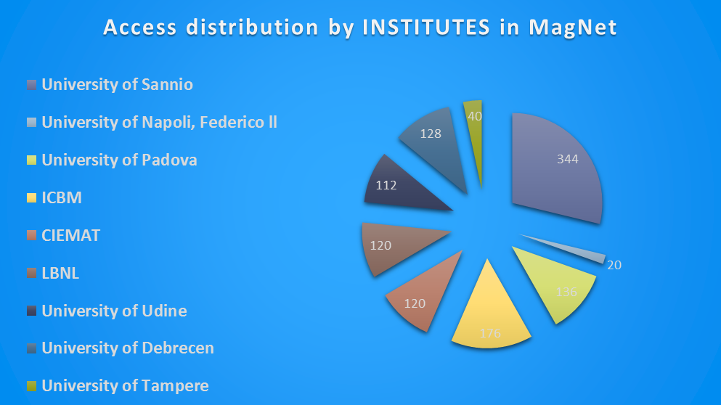
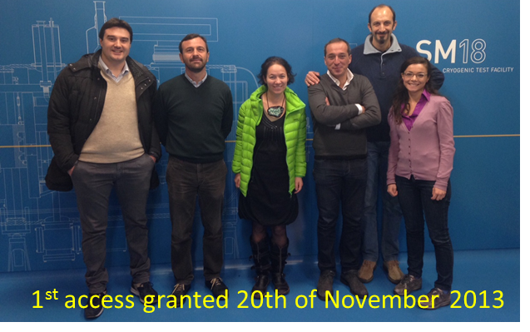
Ways to improve synergies
Importance of Joint Research Activities: the case of Electron lenses, a JRA that joins CERN and GSI with Riga TU and Frankfurt IAP.
Importance of Transnational Access. In EuCARD2, an excellent way to open laboratories to universities that come to test equipment (and are exposed to the lab environment, make connections, etc.). The case of MagNet at CERN (6 universities out of 9 users). More TA now in ARIES!

Slide 11
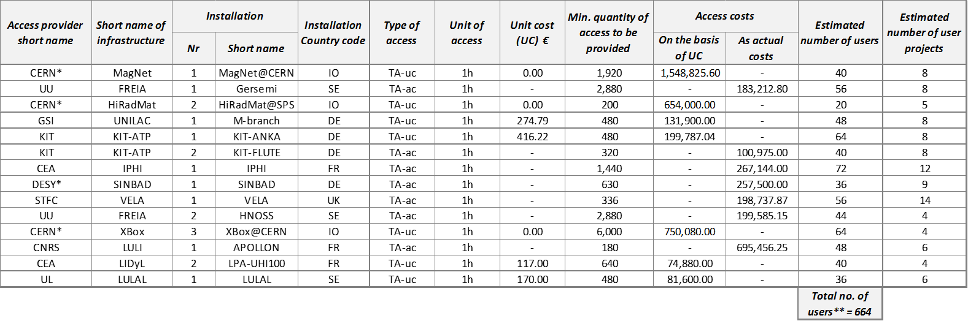
Transnational Access
Magnet testing: CERN SM18 and FREIA at Uppsala.
Material testing: HiRadMat at CERN and M-branch at GSI.
Beam testing: protons and RF at IPHI (CEA), high current electrons in ANKA (KIT), variable electron beams at VELA (CI), short electron bunches at FLUTE (KIT) and when operational at SINBAD (DESY).
RF testing at FREIA (Uppsala) and at the XBOX at CERN.
Plasma acceleration testing at the Apollon laser (CNRS), UHI100 laser (CEA-CNRS) and Lund Laser Centre.
Flagships: IPHI, VELA, ANKA, Apollon.
14 facilites in 5 WPs
664 estimated users
About 18’000 access hours

Slide 12
Training in ARIES
Another new and important way to improve collaboration between Universities and Labs.
Is an important new component (Network) in ARIES.

Slide 13
WP2: Training, communication and outreach for accelerator science in Europe
WP | Type | Proposed name | Acronym | Coordinator | Tasks | # of tasks | Requested EC Contribution (€) | Funding Rate (%) | Total Budget (€) | Beneficiaries
2 | NA | Training, Communication and Outreach for Accelerator Science in Europe | ETCO | P. Burrows (UOXF) | communications/outreach activities - training activities - e-learning course | 4 | 395,400 | 55.3% | 715,500 | UOXF, CERN, ESS, CNRS
Merging of Education and Training as in TIARA with Communication and outreach from the Management WP.
Contents: support ongoing accelerator training in Europe, e-learning course, support outreach actions.
Support ongoing training, not substitute!
E-learning course.

Slide 14
First ideas for the future of Integrating Activities
The European Commission is preparing FP9 (the programme that will follow H2020).
There will be no more Integrating Activities for Super-Advanced Communities (3 or more projects).
We are discussing with DG-R a scheme that could replace the IA and possibly integrate the other instruments used by our community (DS, etc.).
Keywords are co-funding (share of funding between the EC and the partners), innovation programs with industry, training. Common governance between partners and the EC.
It is important to find ways to keep Universities in the new scheme. They should be ready to provide co-funding (mainly personnel, as now) and could profit of industrial programmes similar to the present JRAs. Training schemes can be very profitable for Universities.
The fragmentation of Universities can make the governance more difficult (consortia of Universities could be the only way out…).

Slide 15

Conclusions
We match… and we are bound to work together!

