Slide 1
Towards the future of JUAS, the Joint Universities Accelerator School
Philippe Lebrun
“Universities meet Laboratories” Workshop
LAL Orsay, 3-4 November 2016

Slide 2
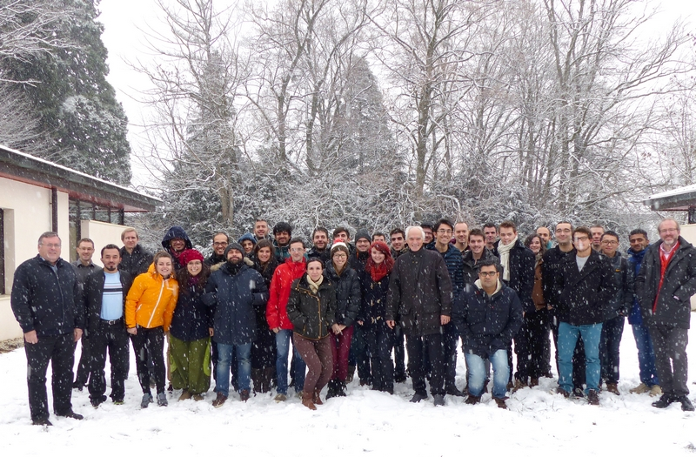





Scientific Schools at ESI Archamps Technopole
Accelerators
Detectors
Scientific Computing
Accélérateurs
Détecteurs
Calcul scientifqiue
Philippe LEBRUN
CERN
Johann COLLOT
UGA
Philippe SABATIER
UGA
International Collaboration
Collaboration internationale

Slide 3
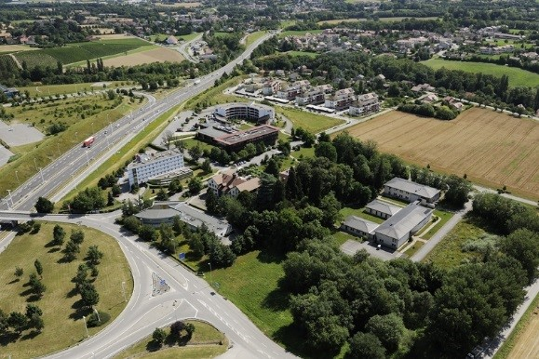
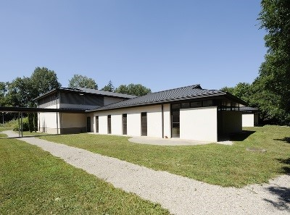
ESI Archamps Technopole
Host of JUAS
Chamonix
Geneva
«Mont Blanc I» building
Paris

Slide 4
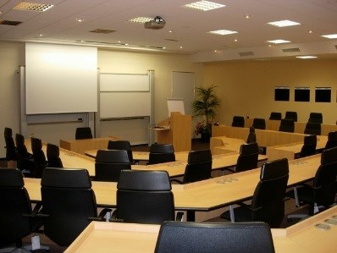
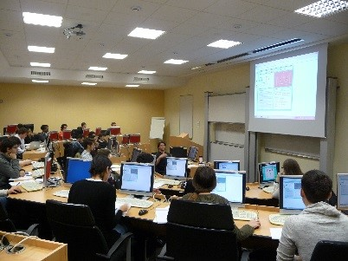
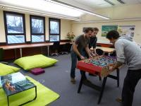
ESI Archamps Technopole
Host of JUAS
Lecture hall
Computer room
Student foyer

Slide 5
JUAS mission
Invented a century ago as instruments of basic science, particle accelerators have also become essential tools of applied science, engineering and medicine. There are today more than 30’000 particle accelerators in operation worldwide. Their design, construction and operation have developed into a specific domain of science and technology, resulting in a growing demand for training
The mission of the Joint Universities Accelerator School (JUAS) is primarily to train graduate students from its Partner Universities in the science, technology and applications of particle accelerators
For this purpose, JUAS holds two five-week courses yearly at the European Scientific Institute (ESI) in Archamps, taught by renowned experts from universities and laboratories and accredited by the Partner Universities:
  A course on the Science of Particle Accelerators
  A course on the Technology and Applications of Particle Accelerators
Depending on the availability of places, JUAS also welcomes graduate students from other universities as well as professionals
Additionally, JUAS contributes to knowledge dissemination and outreach in the field of particle accelerators

Slide 6
















16 Partner Universities

Slide 7

















22 Sponsor Institutes and European Programs
Europe
Germany
France
Spain
Italy
United Kingdom
Switzerland

Slide 8
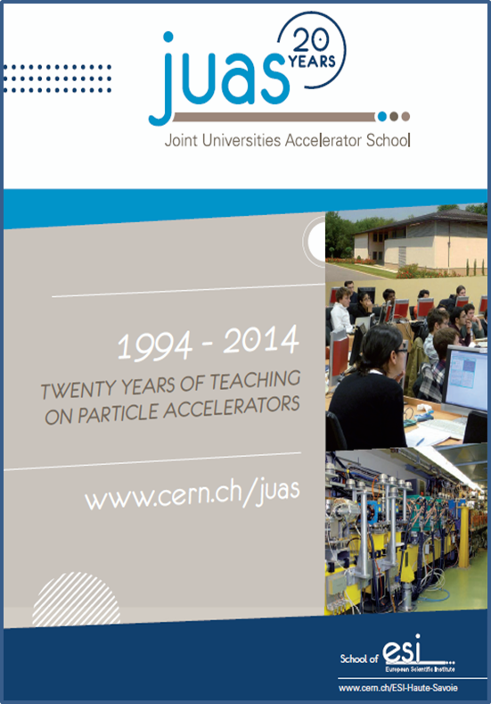
JUAS is 22 years old
Origins
  Accelerator courses given by CERN staff at Université Joseph Fourier in Grenoble
  Creation of ESI by Département de la Haute-Savoie
Previous directors
  M. Rey-Campagnolle (founder)
  J. Le Duff
  F. Méot
  L. Rinolfi
Disclaimer
  In my first year as JUAS Director, it is a bit early for me to commit on the future of this mature organization
  Still, I have identified a number of constraints, trends and actions which could contribute to shape JUAS’ future

Slide 9
JUAS pedagogy
Two courses, each 5 weeks + 1 week exams
  The science of particle accelerators
  The technology and applications of particle accelerators
Expert lecturers from universities, national labs and CERN
Lectures + tutorials + seminars + workshops + practical work + lab visits
Syllabus and appointment of lecturers submitted to Advisory Board
Lecture notes available
  On INDICO at beginning of course
  On paper (color printing) for the lectures
«Refresher» lecture and tutorial documents (E-M and Relativity) available to students well before the course for personal work
Written exams
  Paper documents and pocket calculator available to students
  No connected device allowed
Oral presentations by students on design workshops and practical work

Slide 10
JUAS Student Certification
JUAS and home institutions of students
  Master Students: for each course, the Partner University can give ECTS credits (usually 6 to 8 per Course) to its students who have passed the examination
  Doctoral Students: credits may be given by the doctoral schools according to their policy
  Professionals: JUAS Course may be considered part of professional training («Formation Continue» in France)
Certification
  JUAS issues a Certificate for each Course containing all information
    Lecture topics and numbers of hours
    Exam taken or not
    Marks obtained in relation to Pass/Fail levels

Slide 11
JUAS 2016 in a nutshell
10 weeks (incl. exams) from January to March 2016
  Two courses of 126 h each: Accelerator science (Course 1), Accelerator technology and applications (Course 2)
  Course 1: 65 h lectures, 46 h tutorials, 7 h seminars, 8 h visits (CERN, EPFL Plasma Center)
  Course 2: 63 h lectures, 19 h tutorials, 6 h seminars, 17 h visits (CERN, PSI, HUG), 14 h practical work at CERN, 7 h practical work at BERGOZ
49 lecturers (lectures, tutorials, seminars), of which 23 from CERN
71 students from 18 countries
  Course 1: 40 students (12 Master, 22 Doctoral, 6 Professional), 25 took the exam, 24 passed
  Course 2: 48 students (22 Master, 9 Doctoral, 17 Professional), 32 took the exam, 26 passed

Slide 12
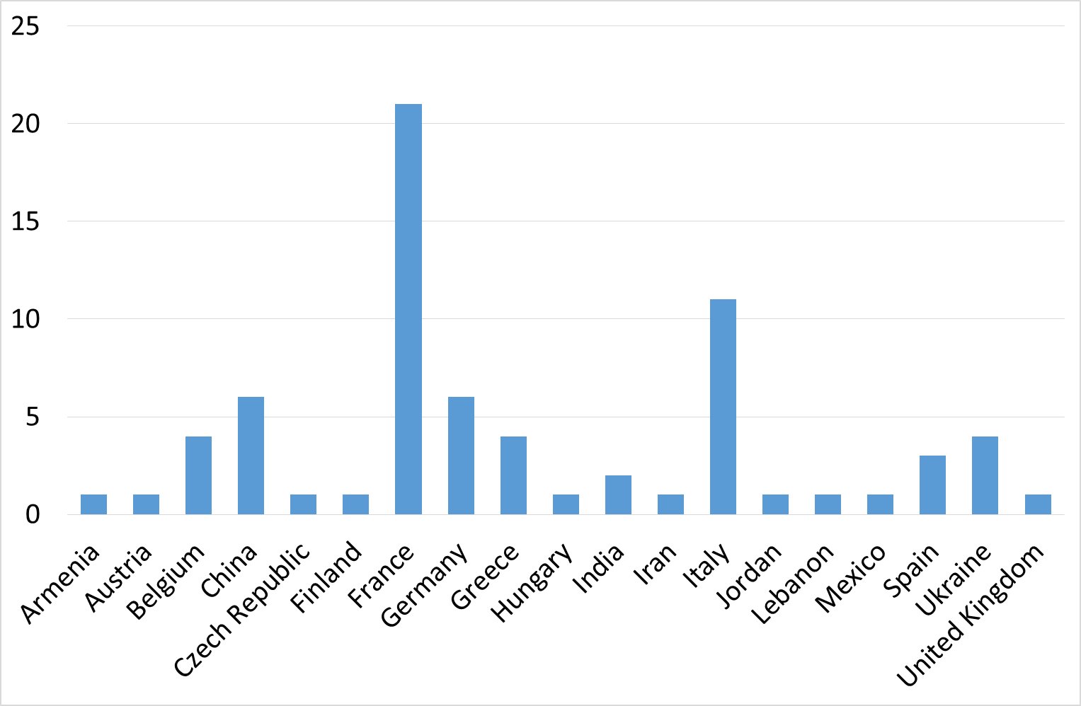
Origin of JUAS 2016 students

Slide 13
JUAS 2016 Visits
CERN CMS
CERN LEIR
CERN CTF3
EPFL Plasma Center
PSI Swiss FEL
HUG Radiotherapy Center

Slide 14
JUAS 2016 Practical Work
CERN Magnets
CERN RF
CERN Vacuum
CERN Beam measurements
BERGOZ Instrumentation

Slide 15
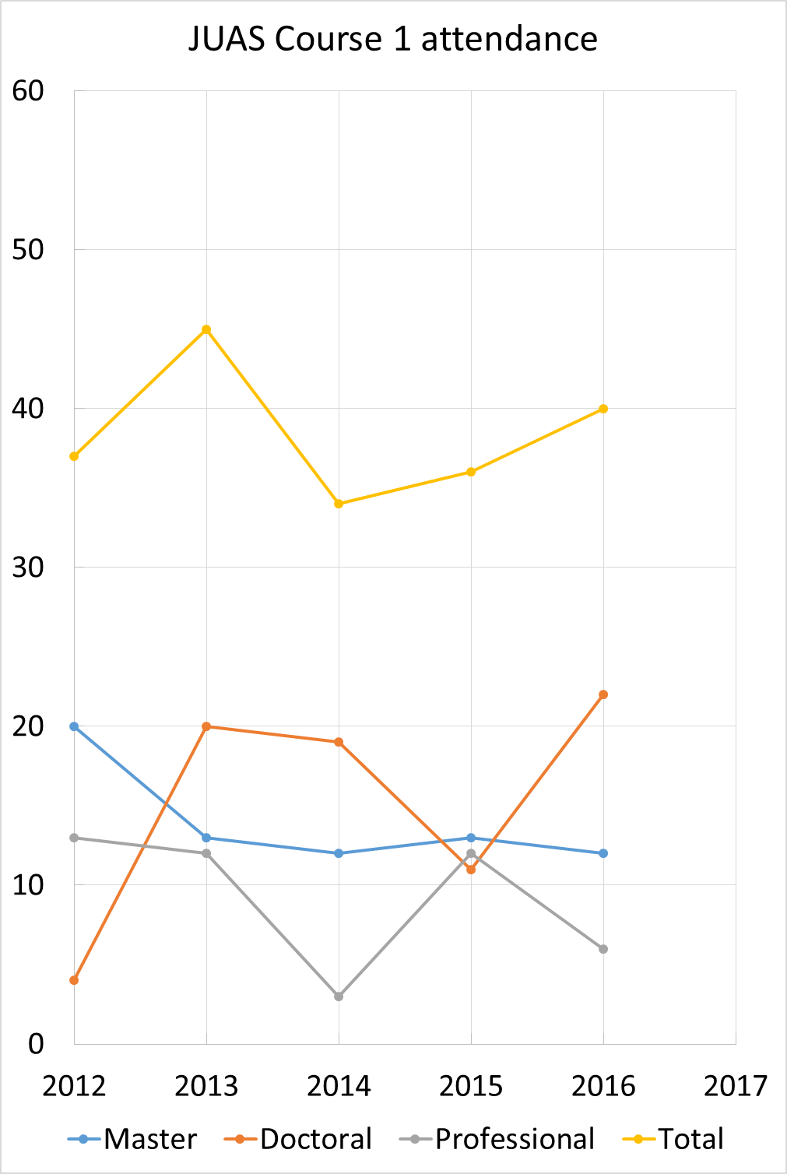
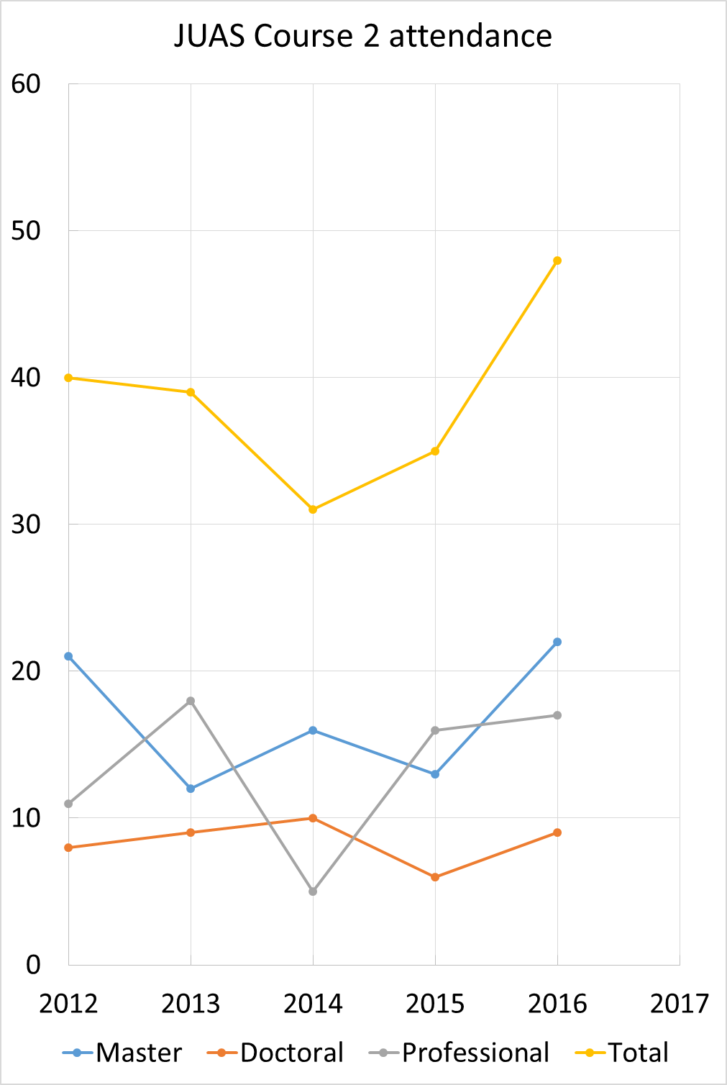
Attendance at JUAS Courses

Slide 16
Towards the future: students
Reaffirm priority given to Partner Universities
  Selection of students
  Preferential fees
Continue developing Partner University network
Maintain mix of Master students, Doctoral students and Professionals
Consider MOOC for undergraduates as «feeder» course (ARIES EU project)
Develop alumni network

Slide 17
Towards the future: pedagogy
Maintain format and mixed curriculum of lectures, tutorials, mini-workshops, practical work, visits as well as topical seminars
Maintain rigorous student assessment
  Written exams by lecturers
  Oral presentations on lab work
Optimize (costly) residential period at ESI
  Non-residential «refresher» courses in general physics?
  MOOCs?
Unique «hands-on» experience on operating accelerators
  Very successful at CTF3 (6 students) and SOLEIL (2 students) in 2016
  Proposal to use CALIFES electron accelerator at CERN for R&D and training
  Still, will only concern limited number of students
Explore synergy with other schools
  At ESI: shared topical seminars with ESIPAP
  Other: CAS, NPAS, USPAS, «feeder» schools

Slide 18
Towards the future: logistics
Attendance technically limited by ESI infrastructure, matching current demand
  Lecture hall 60
  Computer room 29
  Travel logistics for lab visits
New student residence project

Slide 19
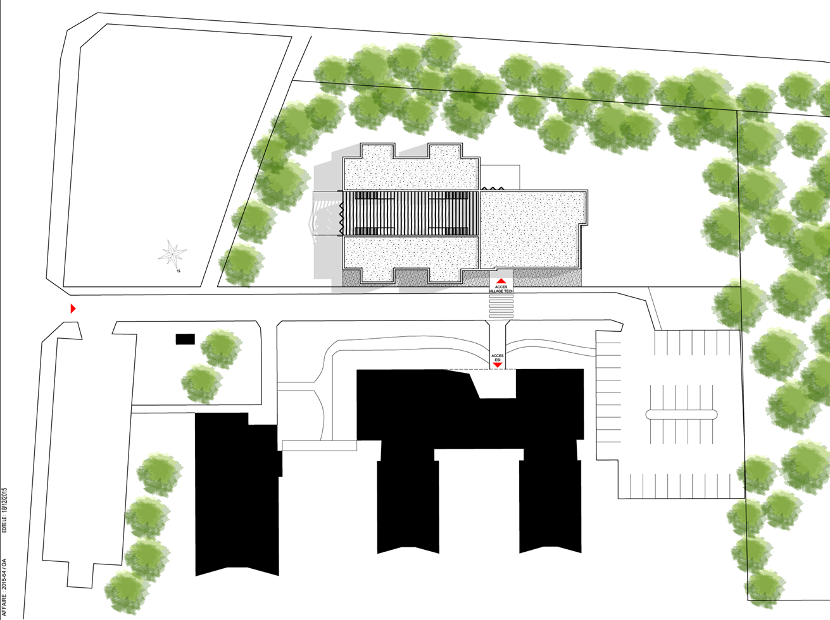
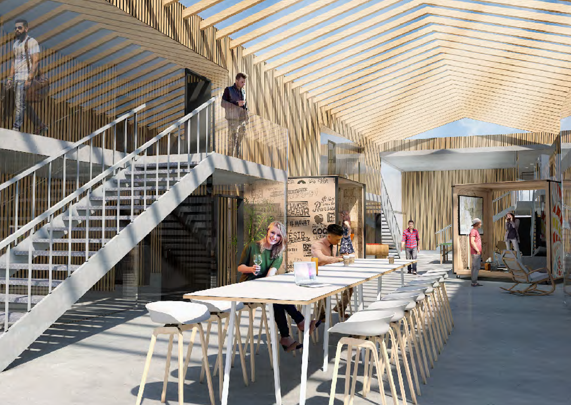
New student residence project
On Archamps Technopole campus opposite the existing ESI building
Mix of 4-room units and self-contained studios
Shared, open-space, multipurpose area
Expected delivery 2018

Slide 20
Towards the future: business model
JUAS specificities
  Two 5-week courses at graduate level
  Top-class expert lecturers from Partner Universities and CERN
  Thorough assessment of students (exams), possible ECTS credits
  Proximity of CERN for visits and practical work
  Operation under scrutiny of Advisory Board representing Partner Universities
Average present cost of JUAS student (5 week course, accommodation included)
  Total cost ~ 1500 EURO
  Marginal cost ~ 890 EURO
Very moderate tuition fees, may need to be adapted
Subvention from Département de la Haute-Savoie to ESI reduced
Financial support from sponsoring institutes remains essential
Try to develop sponsorship from industrial companies

Slide 21
Summary
JUAS is a well-established, top-level organization performing efficiently its mandate
It exists through a unique model of voluntary work and secondment of lecturers from its Partner Universities and CERN, as well as sponsorship from universities, research institutes and european programs
JUAS is the flagship school of ESI which hosts it and provides administrative support and logistics
Recognized well beyond its Partner Universities, JUAS attracts students – in growing numbers – from many regions of the world
Pedagogical diversity characterized by a mix of theoretical and practical teaching, collective and individual work, as well as visits and hands-on activities in advanced laboratories
Networking with other teaching initiatives is essential («feeder» schools)
With reduction of public subventions, JUAS’ business model may have to be adapted
  Optimization of residential activities and use of distance learning (MOOCs)
  Revision of tuition fees
  Increased support from industrial companies

Slide 22
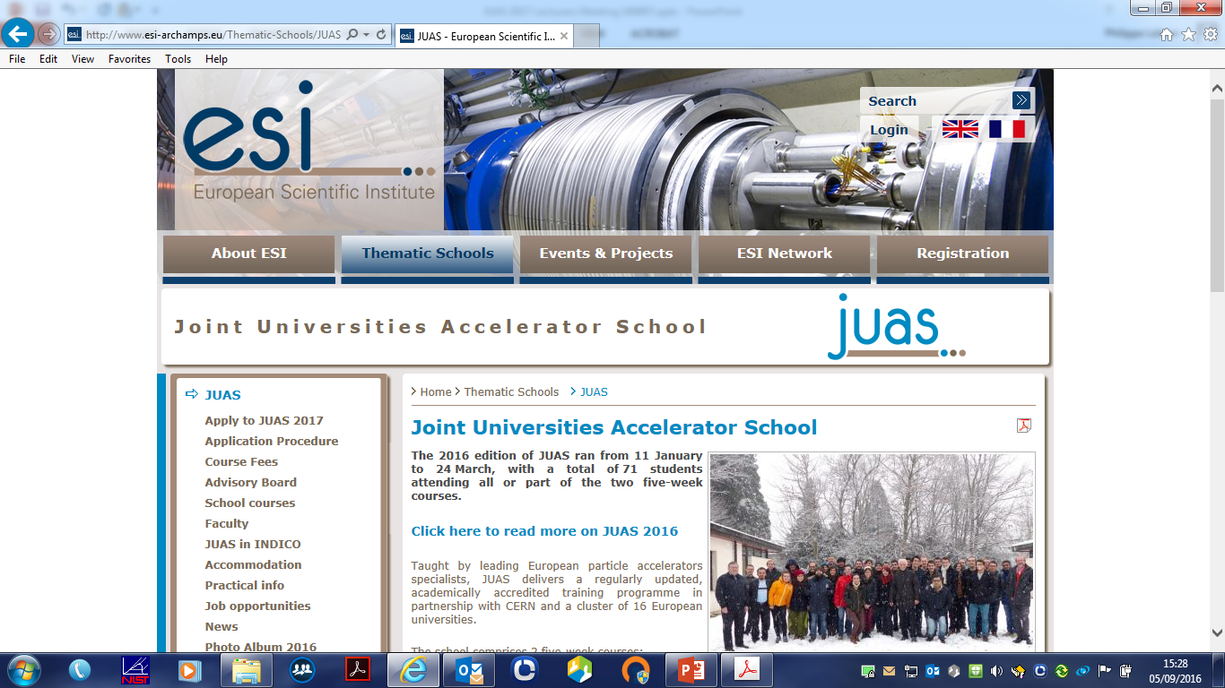
ESI-JUAS web site http://www.esi-archamps.eu/Thematic-Schools/JUAS

