Slide 1
Forming an University Accelerator Center
Stern-Gerlach-Center
Goethe-Universität Frankfurt
Oliver Meusel
Universities Meel Laboratories Workshop
Orsay 2016

Slide 2
Outline
Why do we need a center?
Who is interrested in an accelerator center?
What is already there?
How is the exchange between Goethe-University and Labs organized?
What about the formats of teaching students?

Slide 3
Why do we need a center ?
As we learned from ULA One in Frankfurt 2014
accelertor physics lives in two different worlds:
Accademics
Application
Research on
Beam dynamics
Collective behaviour
Interaction between beam, accelerator & operator
Request of operation:
Relaiability
Maintanance
Investment & operational costs

Slide 4
Why do we need a center ?
Accademics
Application
R&D for Labs
Recruiting young investigators and researcher for Labs
Research on demand
Providing startups
Knowledge transfer to companies

Slide 5

Who is interested in an accelerator center?
Universities
(Mainz, RTU Riga, Bologna)
Laboratories
(GSI/FAIR, CERN, FNAL)
SGC
@
Companies
(NTG, Bruker, Resaerch Instruments)
Non-profit Org.
(ESA, OECD, IAEA)
Gradiuate Schools
(HGS-Hire, CAS ?, JUAS ?)

Slide 6
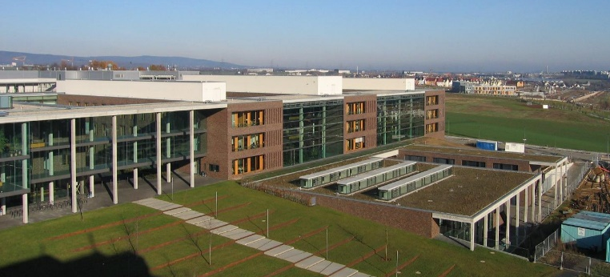
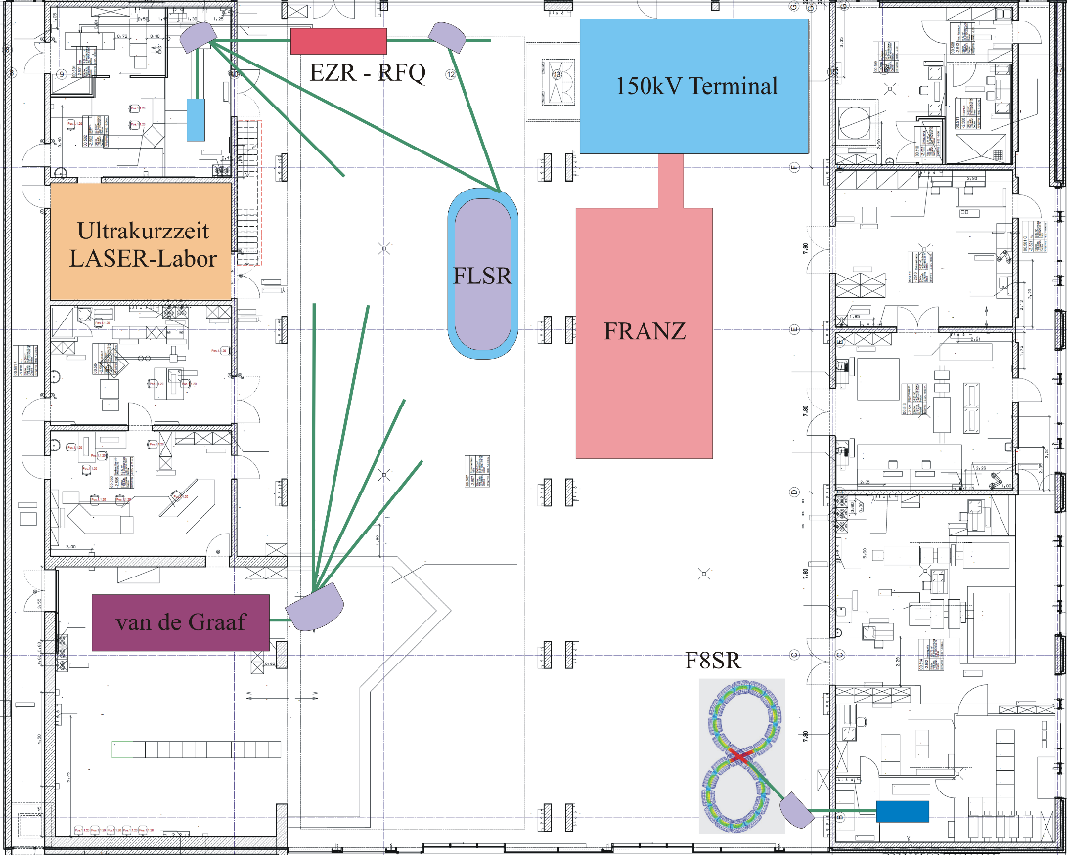
The center is a separat experimental hall, but it is attached to the building of the physics department of the university.
What is already there?
Kryo-Labor & Reinraum
Neutron Source
2 Storage Rings
2 Accelerators
LASER-Laboratory
Liquid Target-Laboratory
Kryo-Laboratory
Liquid Target-Labor

Slide 7
Member of the SGC
What is already there?
Proposed or requested research topics are connected to a professor or associate professor
Prof. R. Dörner – Atomic Physics
PD R. Grisenti – Cryogenic Liquid Targets
Prof. R. Reifarth – Nnuclear Astrophysic
Prof. H. Podlech – Superconducting RF-Cavities
PD. G. Franchetti – Electrostatic Storage Ring
Prof. U. Ratzinger – Hadron Accelerator
Prof. H. Marschall – Geology of deap Erth

Slide 8
Example FLSR
Frankfurt Low-Energy Storage Ring
Designed for FLAIR @ FAIR
Accumulator for HI and p [bar]
Development of in-ring electron/positron target
Beam dynamic and stability
W_{b} = 50keV
circumference u = 14,7m

Slide 9
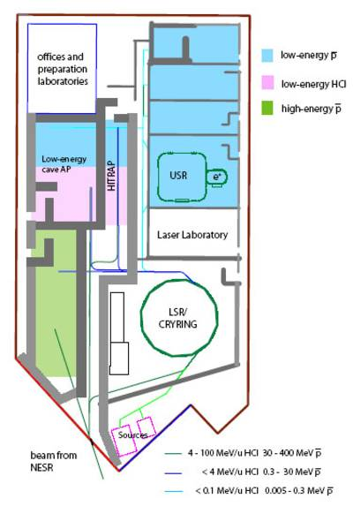
How is the exchange between
Goethe-University and Labs organized?
Goethe-University
SGC
Forming a research group
Giving lectures
Active in the board of SGC
GSI/FAIR

Slide 10
Van de Graaf Accelerator
E_{Acc} = 2,5 MeV
I_{Max} = 30 – 40µA
ΔE = ± 2keV
HF- Ionenquelle

Slide 11
How is the exchange between
Goethe-University and Companies organized?
E_{Acc} = 2,5 MeV
I_{Max} = 30 – 40µA
ΔE = ± 2keV
HF- Ionenquelle
Goethe-University
SGC
Get connected with Professor / PD
Involve students (seminars/assistence)
Cash flow
Company

Slide 12
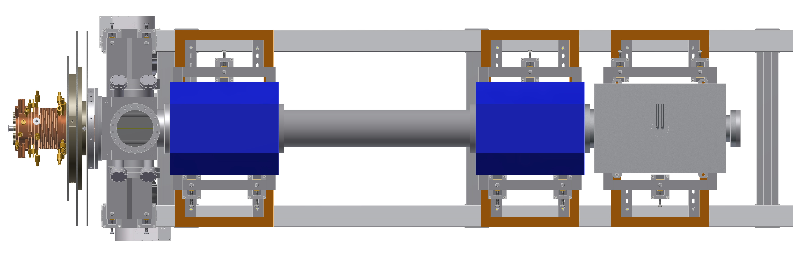
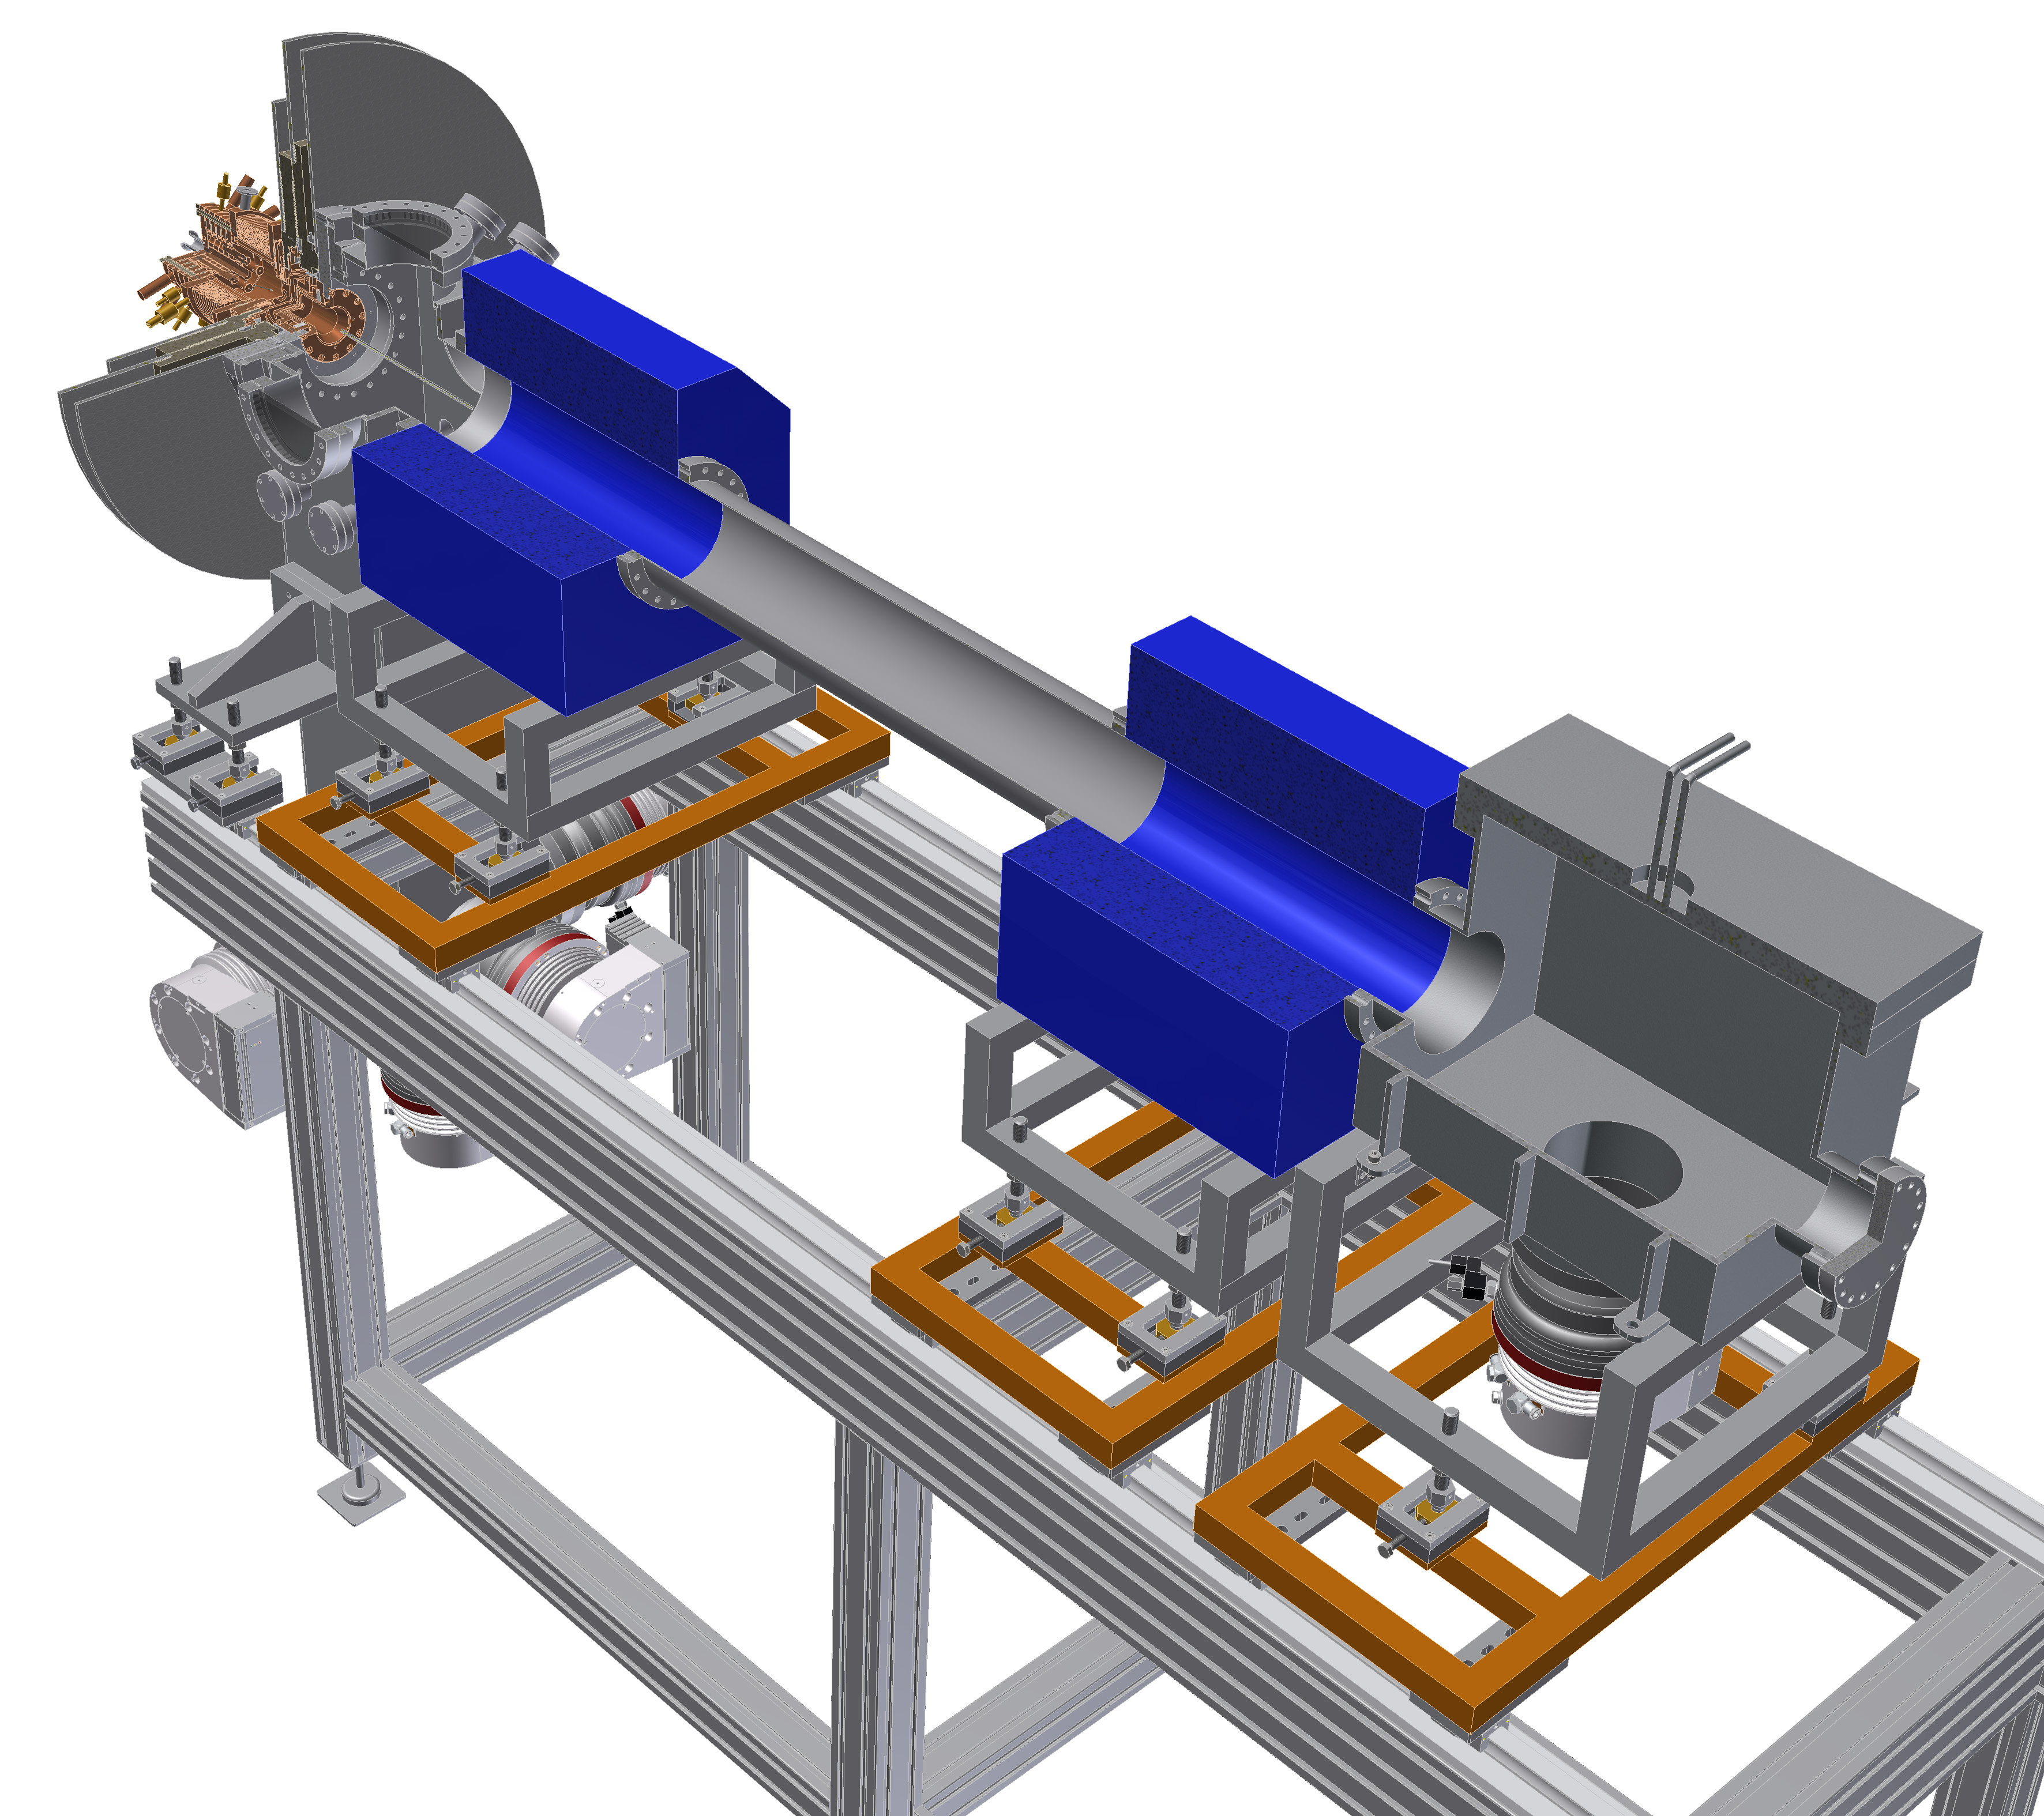
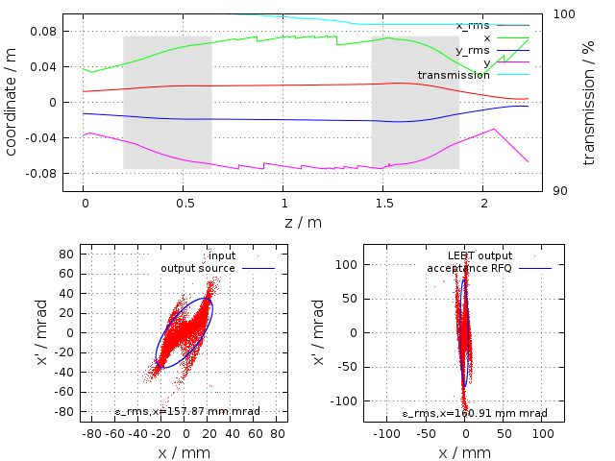
Compact Heavy Ion LINAC Front End
Development of compact transport channel for intense U⁴⁺ beam based on space charge lenses.
GL 1
GL 2
Ion Source
Beam Transport Simulation of U⁴⁺, 2.2 keV/u
Gabor Lens 1
Gabor Lens 2
GL 1
GL 2
Beam Dump

Slide 13
How is the exchange between
Goethe-University and Labs organized?
Goethe-University
SGC
Forming young investigator group
Giving lectures
Connected to a provider (Prof.//PD) of the board
GSI/FAIR

Slide 14
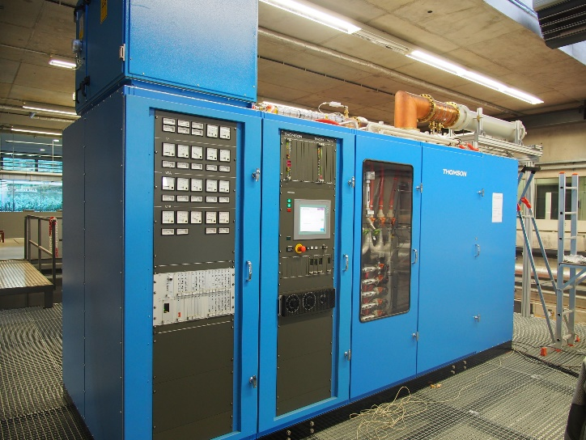
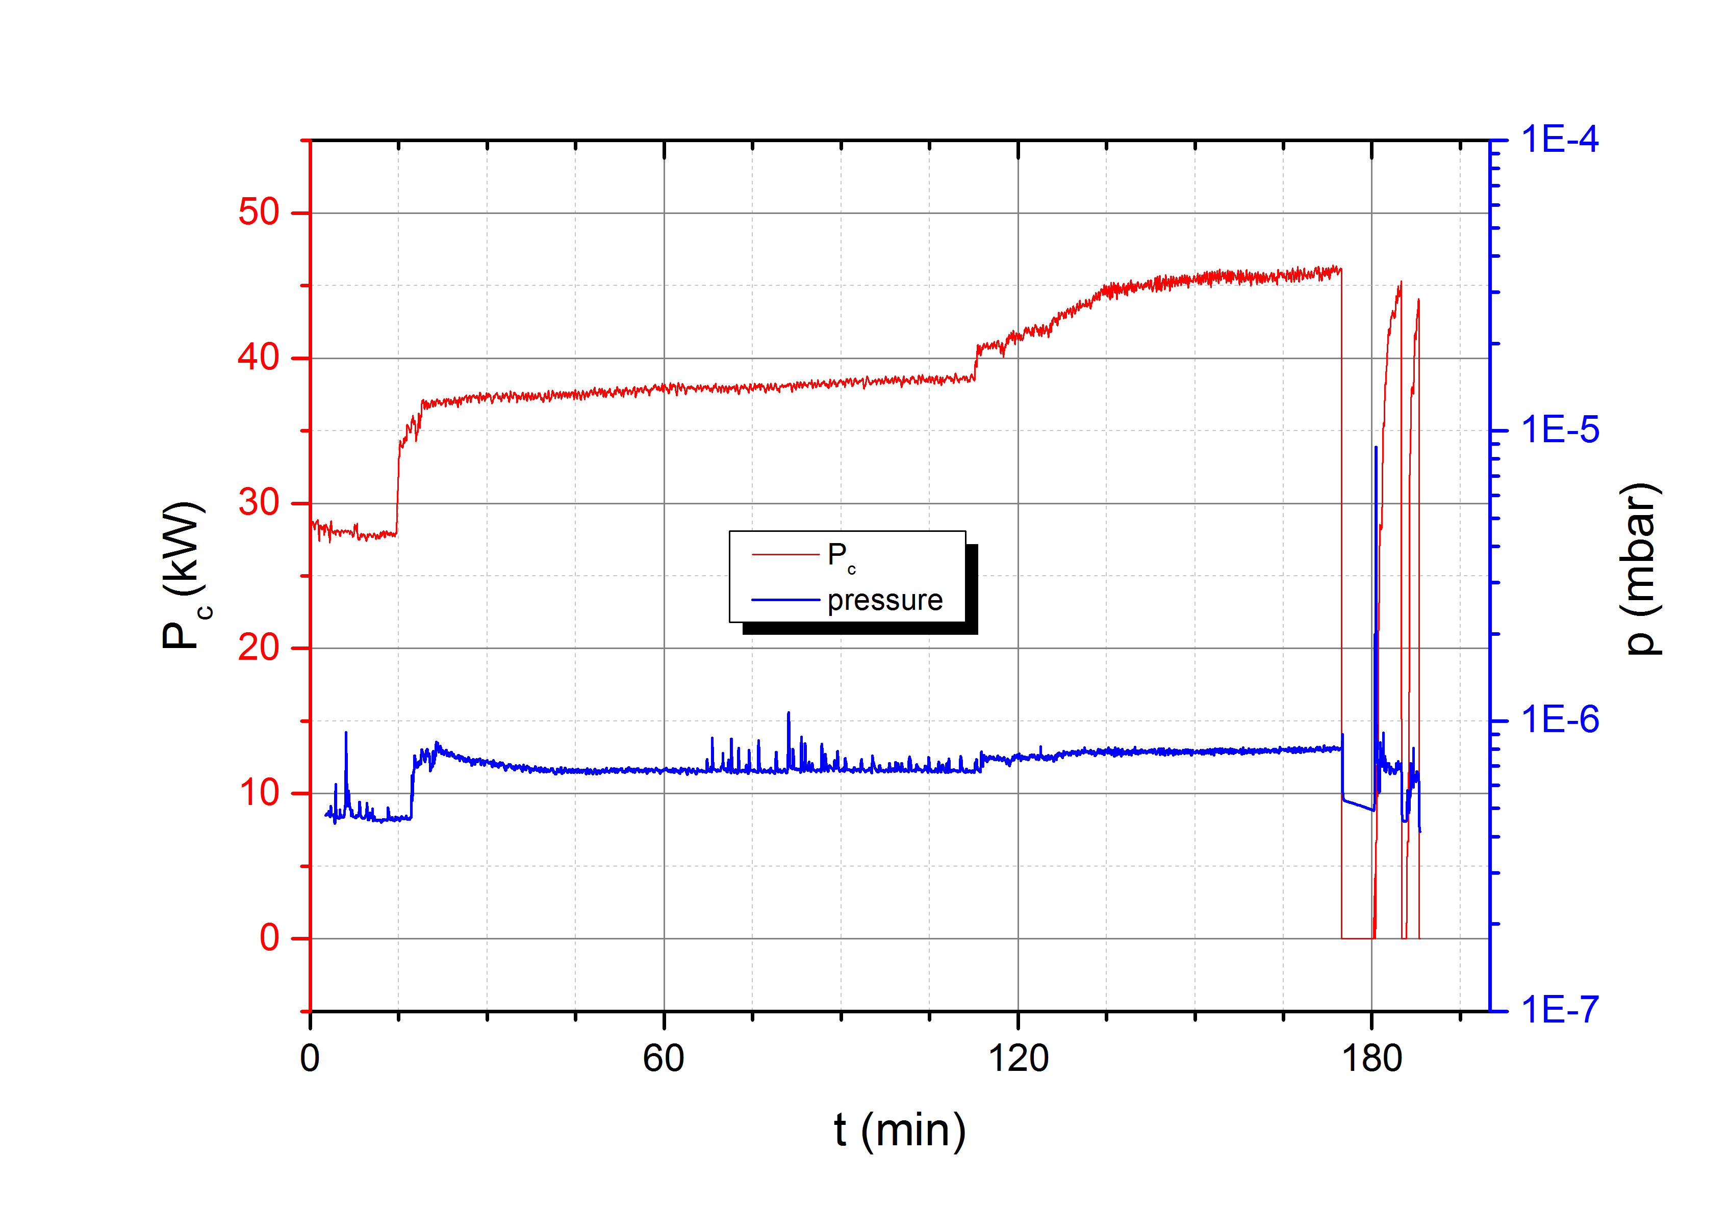
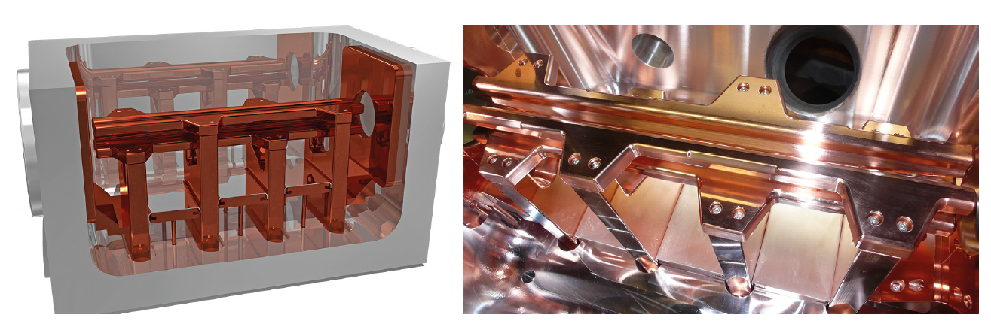
RF High Power Accelerator Technology
RF-Power Test Bench (175 MHz, 250kW, cw)

Slide 15

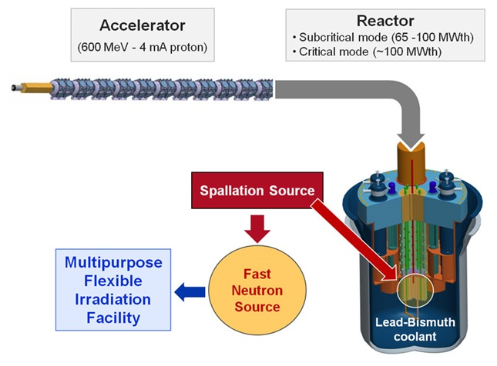
How is the exchange between
University and Collaborations organized?
WP2: Accelerator R&D for ADS/MYRRHA
Participants: SCK•CEN, ACS, ADEX, CERN, CNRS, EA, IAP, IBA, U. Darmstadt, COSYLAB, TED, CEA, NTG

Slide 16
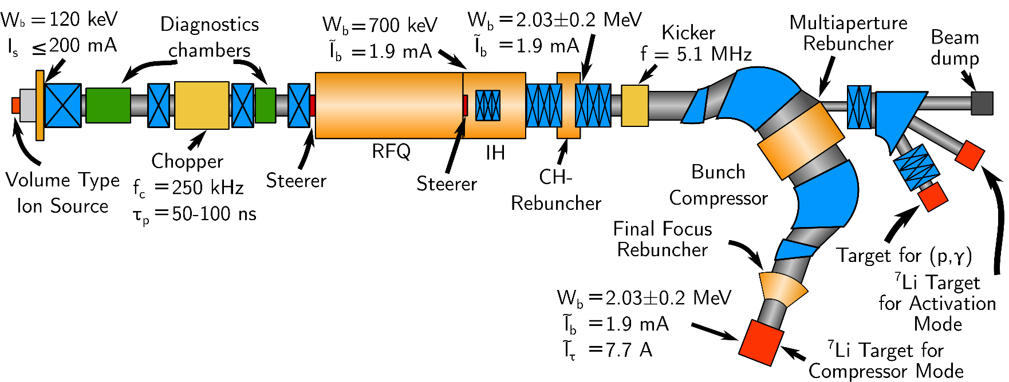
Accelerator Based neutron Source
Possibility to bring different resaerch fields together
Test bench for new concepts
Testing connection/interface of different groups at accelerator science

Slide 17
What about the formats of teaching students?
Graduate ScHools (Myrte School HGS-HIRE, CAS?, JUAS?)
Lectures within the university
Laboratory courses
Contact with Labs and companies via practical courses

Slide 18
Summery
Stern-Gerlach-Center acts as an exchange platform, where Goethe-University meets Laboratories.
R&D for Labs
Recruiting young investigators and researcher for Labs
Research on demand
Providing startups
Knowledge transfer to companies

Slide 19
Thank you for your attention.

