Slide 1
Online Event Selection
| Tobias Stockmanns

Slide 2
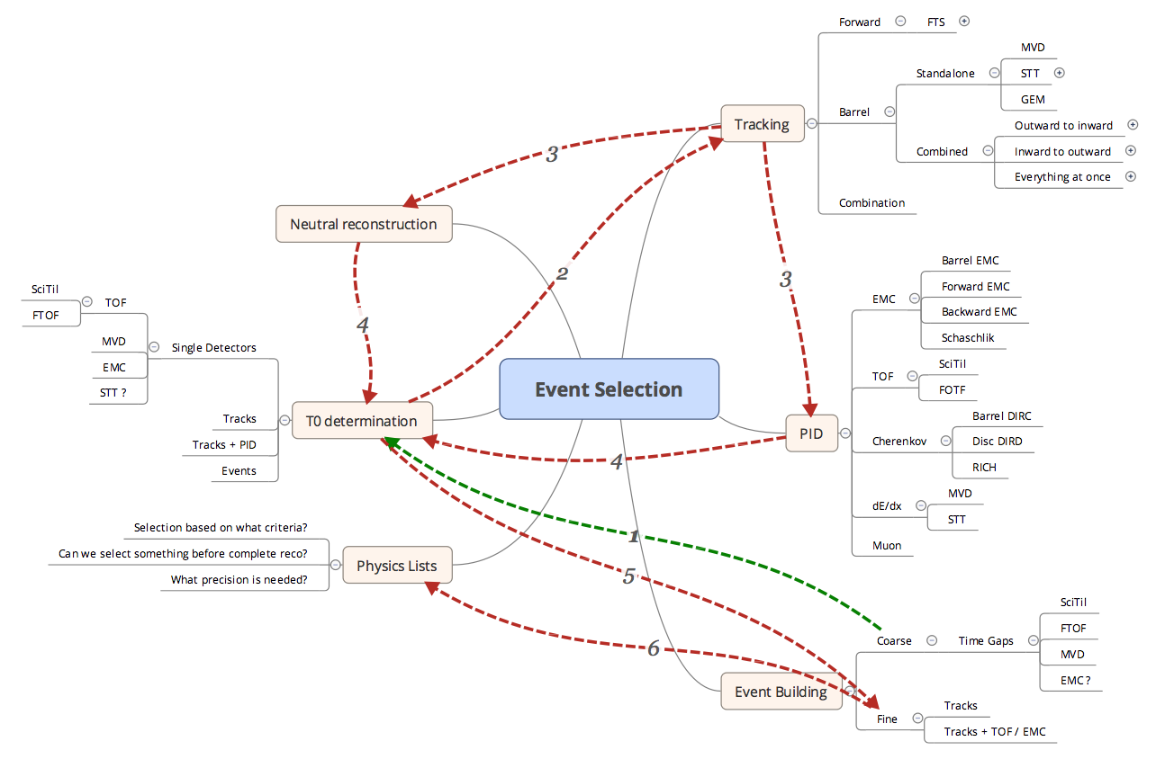
Online Event Selection

Slide 3
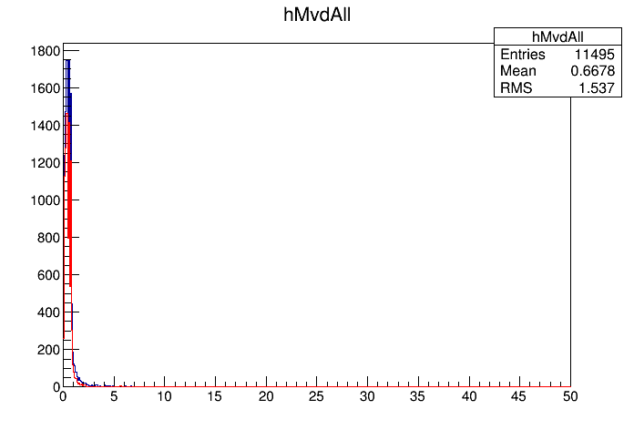
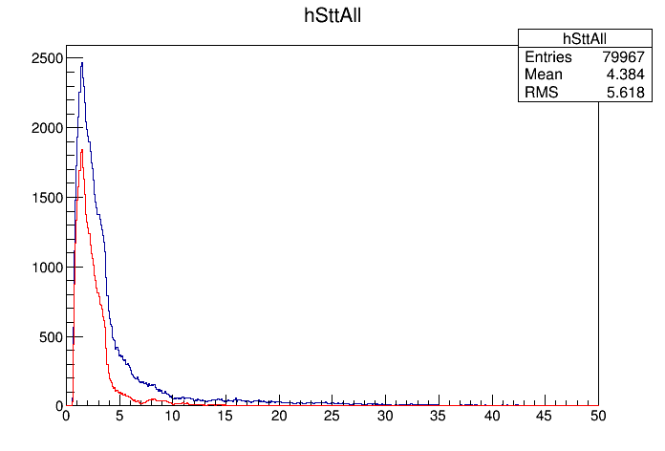
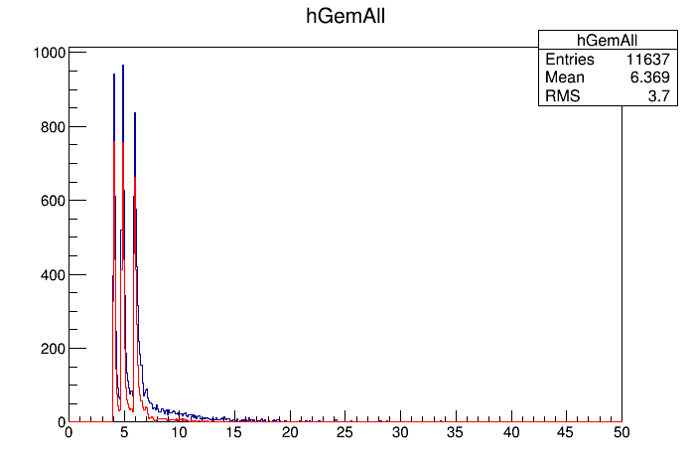
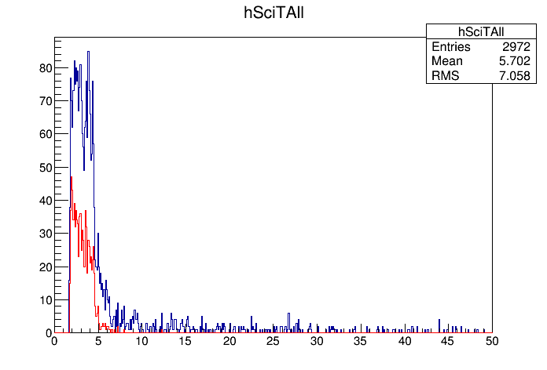
TOF - Barrel

Slide 4
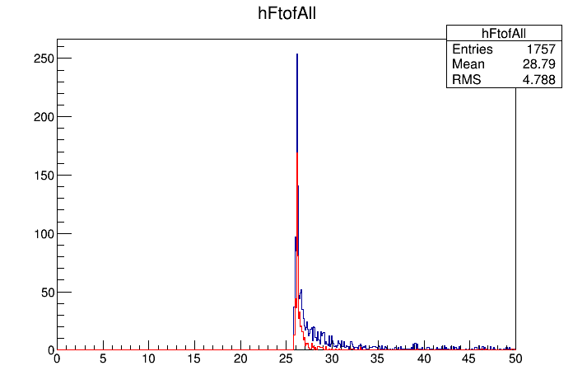
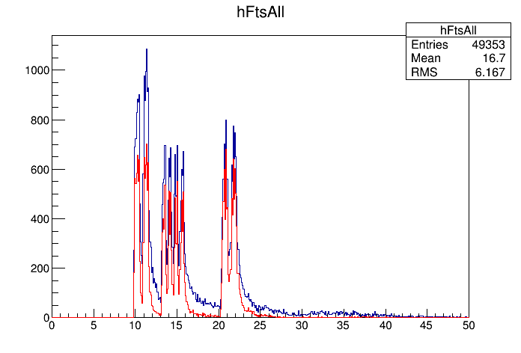
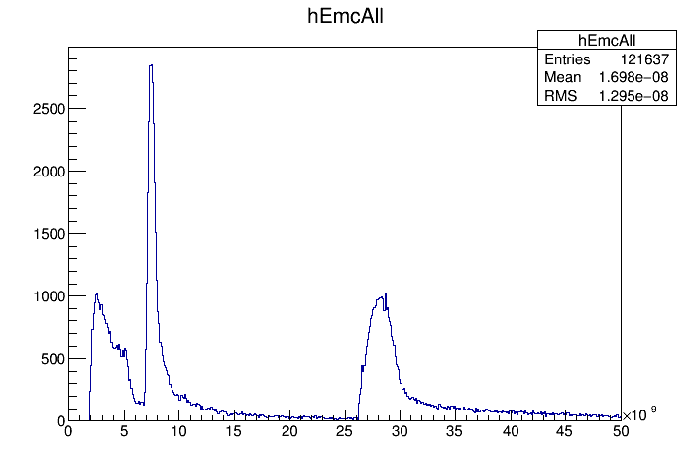
TOF – Forward (+ EMC)

Slide 5
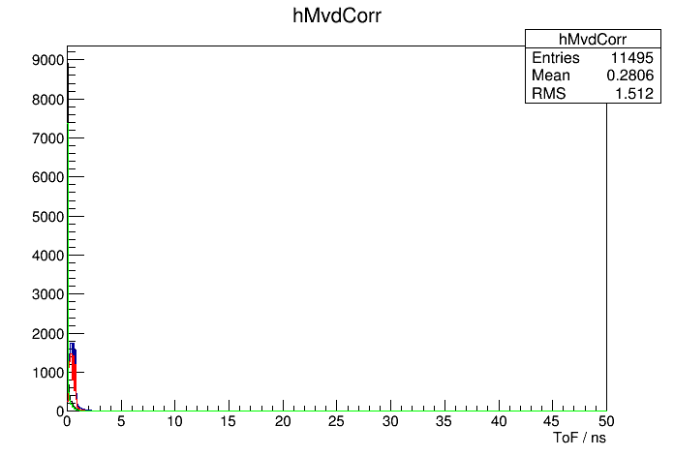
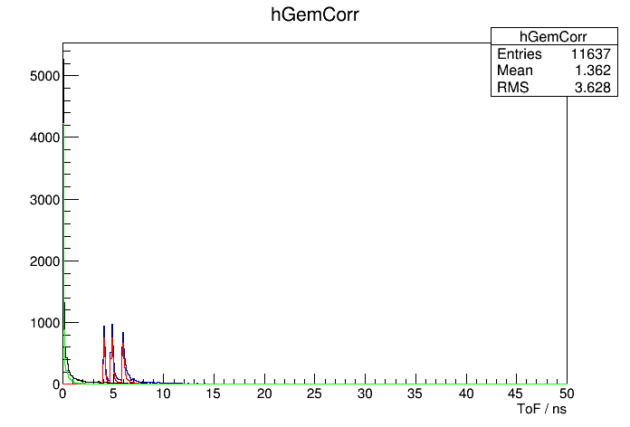
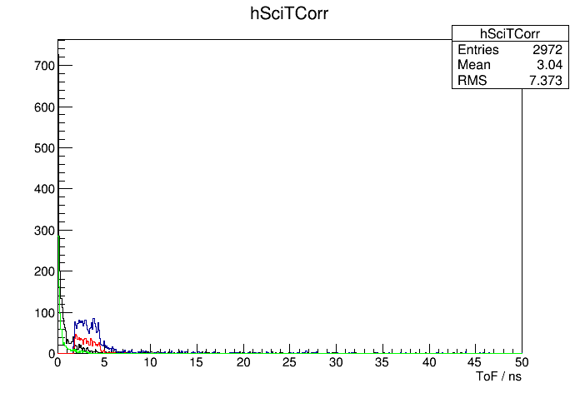
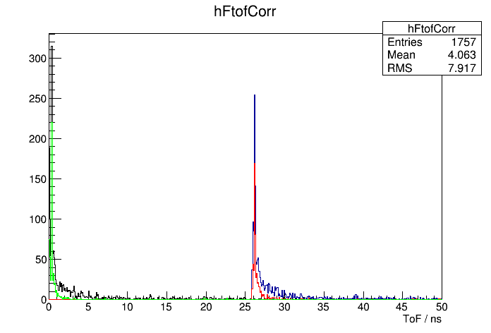
TOF Correction

Slide 6
Data Flow
Tracking
Charged Cand.
Barrel
Calor.
Neutral Cand.
Cher.
Burst
Events
Tracking
Charged Cand.
Forward
Calor.
Neutral Cand.
Cher.

