Slide 1
Introduction to Accelerator Physics
D. Ondreka, GSI
Operator Training 2016

Slide 2
Outline
Introduction
Particles and units
Relativity
Charged particles in fields
Magnets
Charged particle dynamics
Emittance and acceptance

Slide 3

Experimenters wishes
What are these fancy symbols here about: p, Au, N, Ni ?
What do these funny numbers mean: 3.6MeV/u, 300-1000MeV/u, 1e8/spill ?
What do our accelerators have to do with all this?

Slide 4
Elements and Isotopes
Elements
  atomic building blocks of matter
  characterized by atomic number Z
    number of protons in nucleus and electrons in neutral atom
    one-to-one correspondence to chemical symbol X
Isotopes
  variants of the same element with different number N of neutrons
  identified by mass number A = Z + N
  same electron configuration, hence same chemical properties
  only few isotopes stable
Notation
^{A}X
 | Z | A | N | Abundance
⁴⁰Ca | 20 | 40 | 20 | 96.9%
⁴⁸Ca | 20 | 48 | 28 | 0.2%
neutron-rich nucleus, often used for SHE experiments

Slide 5
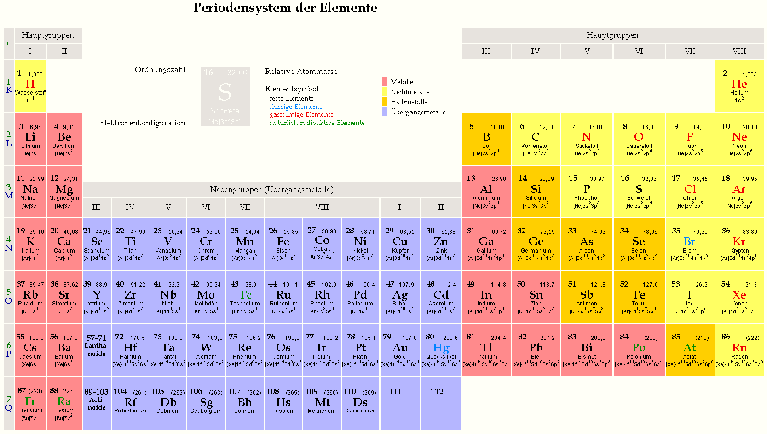
Elements
(Source: http://www.pctheory.uni-ulm.de/didactics/quantenchemie/html/PSE-F.html)
Ordering of elements according to atomic number Z and electron configuration

Slide 6
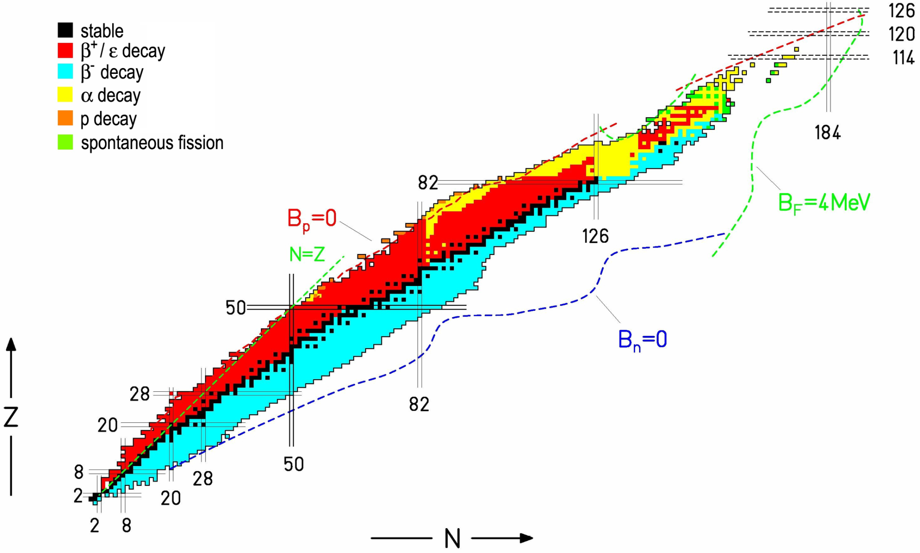
Isotopes
Source: http://moriond.in2p3.fr/radio/moriond-huyse.ppt
Ordering of elements according to proton number Z and neutron number N

Slide 7
Ions
Acceleration requires charged particles
(we’ll come to that...)
Ions
  created by removing electrons from atoms (or molecules)
  characterized by their charge state Q
  notation for ions of atoms (i.e. isotopes)
  notation for molecules similar
    examples: H₂⁺, H₃⁺, CH₃⁺
  creation of ions from neutral particles in ion sources
  increasing of charge state by stripping in gas or foils
^{A}X^{Q}
 | Z | Q | #electrons
⁴⁸Ca | 20 | 0 | 20
⁴⁸Ca¹⁰⁺ | 20 | 10 | 10

Slide 8
Ion Masses
Acceleration of ions depends on mass of ion
  Need to know the masses of ions
SI units impractical:
  m_{p} ≈ m_{n} ≈ 1.7·10⁻²⁷ kg
Atomic mass units (AMU)
  definition of atomic mass unit:
  for general isotopes we define a mass number M:
  small difference between A and M:
    mass excess ME:
    missing electrons for ions:
    significant for high precision exp. (e.g. mass measurements in storage rings)
 | SI units | AMU | ME
u | 1.661·10⁻²⁷ kg | 1u | 0
m_{p} | 1.672·10⁻²⁷ kg | 1.007u | 0.007
m_{n} | 1.675·10⁻²⁷ kg | 1.009u | 0.009
m(¹²C) | 1.993·10⁻²⁶ kg | 12u | 0
m(⁴⁸Ca) | 7.965·10⁻²⁶ kg | 47.953u | -0.047
m_{e} | 9.109·10⁻³¹ kg | 5.5·10⁻⁴u | n.d.
m(¹²C) = 12u = A·u
m(^{A}X) = M·u ≈ A·u
M = A + ME
ME/M < 0,1% (except e.g. p, d)
but this is the origin of nuclear power...
m(^{A}X^{Q}) = (M - Q·A_{e})·u
Z·A_{e} /M < 0,05%

Slide 9
Ion Energies
Experimentalists require ions with a certain kinetic energy
  usually specified as kinetic energy per atomic mass unit
  example: ²³⁸U⁷³⁺, E=1GeV/u, N_{ions}=10⁹ particles
  what’s this mysterious ‘GeV’?
    elementary charge:
    when pushed by a voltage of 1V, a particle with charge e gains energy 1eV
    in SI units:
    prefixes for saving digits: 1000eV=1keV, 1000keV=1MeV, 1000MeV=1GeV
  what’s the kinetic energy of the beam in the example?
    A = 238, ME = 0.05u, Q = 73 → M = 238.01, m = M·u
    E_{ion} = M·u·E = 238.01GeV
    E_{beam} = N_{ions}· E_{ion} = 10⁹·238.01GeV = 238.01·10¹⁸eV ≈ 40J
      kinetic energy of a walking man: E = 1/2·m·v² = 1/2·80kg·1(m/s)² = 40J
      if deposited in 1ml of water: heating by 10 degrees, dose 40000Gy
e = 1.602·10⁻¹⁹C
      charge of proton and electron (up to sign)
1eV = 1.602·10⁻¹⁹J

Slide 10
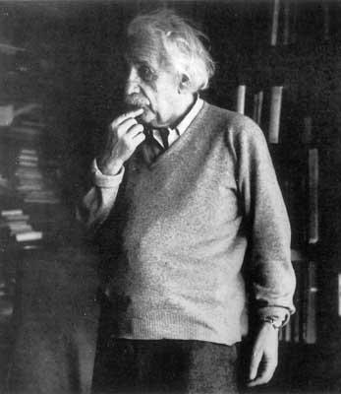
Relativity: Mass and Energy
Mass and energy are equivalent
What’s the energy of a mass unit?
  speed of light (constant of nature):
  energy of 1u:
    u·c² ≈ 1.661·10⁻²⁷kg·(2.998·10⁸m/s)² ≈ 1.4925·10⁻⁸J
    1eV ≈ 1.602·10⁻¹⁹J
    u·c² ≈ 931.6·10⁶eV
    precise value:
Expression of masses as energies in convenient units
  consider ²³⁸U⁷³⁺: m·c² = M·u·c² = 238.01·u·c² = 221.7GeV
  also written as: m = 221.7GeV/c²
E = mc²
c = 299792458 m/s
u·c² = 931.494 MeV

Slide 11
Relativity: Energy
Energy equivalent to mass is referred to as rest energy
  will use symbol E₀ from now on:
  use special symbol E_{u} for amu:
Kinetic energy of ion always proportional to mass
  write kinetic energy as:
  E is referred to as kinetic energy per nucleon (or per atomic mass unit)
Total energy is the sum of rest and kinetic energy
  again proportional to mass:
Comparison of total energy to rest energy
  defines the relativistic gamma:
  examples:
    injection into SIS18: E = 11.4MeV/u → γ = 1 + 11.4/931.5 = 1.01
    extraction from SIS18: E = 1GeV/u → γ = 1 + 1000/931.5 = 2.07
E₀ = mc² = M·uc²
E_{u} = uc²
E_{ion} = M·E
M·E_{tot} = M·(E + E_{u})
γ = E_{tot}/E_{u} = 1 + E/E_{u}

Slide 12
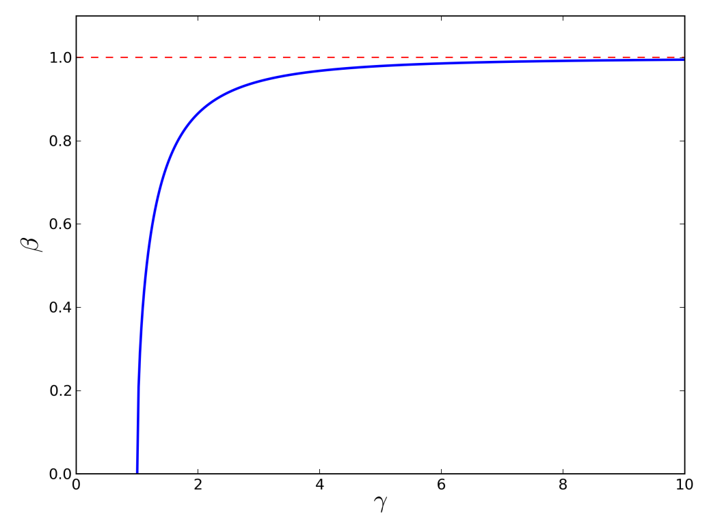
Relativity: Velocity
Velocity expressed in units of the speed of light
  defines relativistic beta:
Gamma and beta are related
  Lorentz factor:
  can be inverted:
Velocity bound by speed of light
  Look again at γ = 1 + E/E_{u}
    E=0 → γ = 1 → β = 0
    E ->∞ → γ ->∞ → β -> 1
    range of beta:
  Ions never reach the speed of light
    but they can come quite close:
    (e.g. p@LHC: E=7TeV, γ≈7500, 1-β≈10⁻⁸)
v = β·c
γ = 1/√(1 - β²)
β = √(1 - 1/γ²)
0 ≤ β < 1

Slide 13
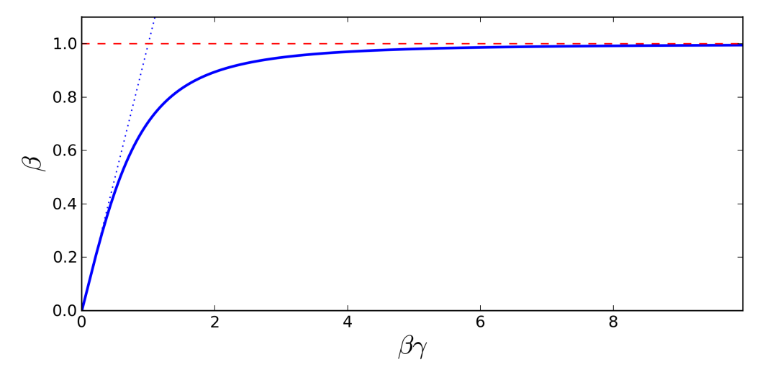
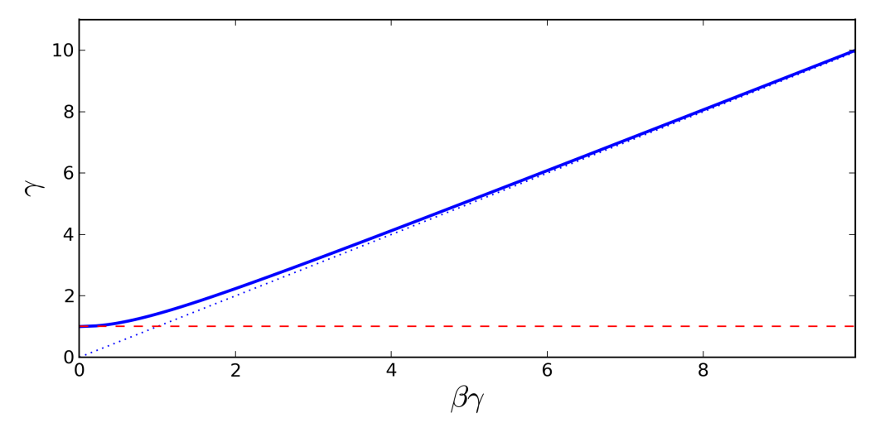
Relativity: Momentum
Momentum is an important kinematical quantity
  conserved if no forces act on the particle
  deflection in a magnet is proportional to momentum (we’ll come to that...)
Related to the other relativistic parameters
  proportional to mass:
  non-linear relation to velocity:
  non-linear relation to energy:
  example: E = 1GeV → pc = 1692GeV or p = 1692GeV/c
p_{ion} = M·p
pc = γ·β·E_{u} = β/√(1 - β²)·E_{u}
pc = √(E·(E + 2·E_{u}))
here we’ve omitted the /u for convenience...

Slide 14
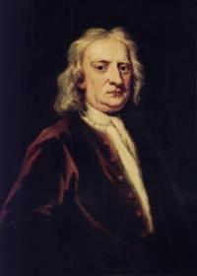
Relativity: Non-Relativistic Limit
Newton’s physics recovered for small energies
  Newton’s relations for momentum:
  check of velocity relation:
    let β -> 0 → pc = β/√(1 - β²)·E_{u} -> β·E_{u} = c·u·βc = c·u·v
  check of energy relation:
    let E -> 0 → pc = √(E·(E + 2·E_{u})) ->√(2·E_{u}·E) = c√(2·u·E)
How far does Newton’s arm reach?
  depends on required precision
    consider relation between momentum and velocity
    define deviation from Newton’s relation by:
    below this β, deviation from linearity smaller than ε
p = u·v
p = √(2·u·E)
ε | γ | β | E
0.1 | 1.11111 | 0.436 | 103MeV/u
0.01 | 1.01010 | 0.141 | 9.4MeV/u
0.001 | 1.00100 | 0.045 | 932keV/u
0.0001 | 1.00010 | 0.014 | 93.2keV/u
0.00001 | 1.00001 | 0.004 | 9.32keV/u
β/(βγ) = 1 - ε with 0 < ε < 1
last line still corresponds to 1300km/s = 1.3m/μs!

Slide 15
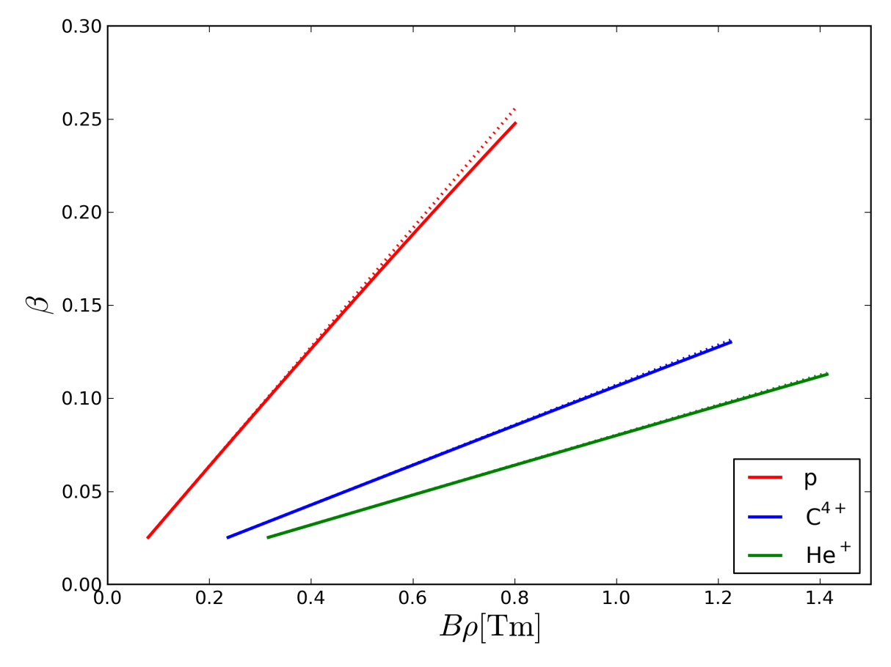
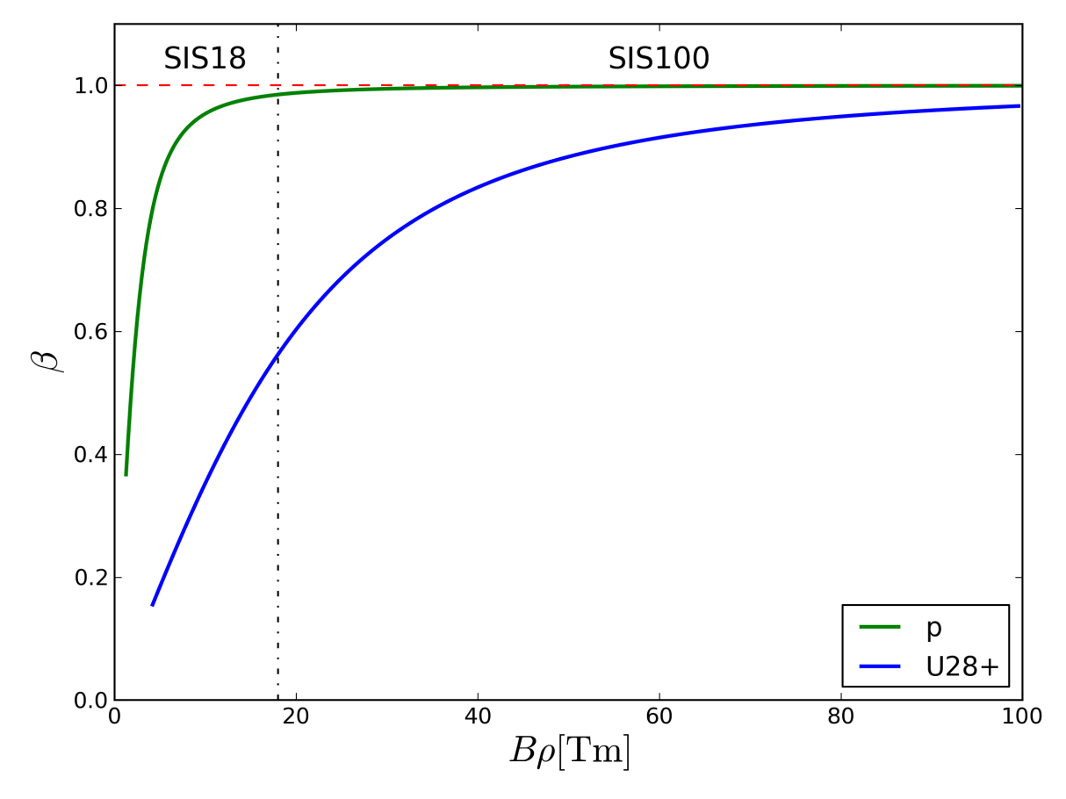
How Relativistic are GSI and FAIR?
CRYRING
UNILAC (β < 0.15) and CRYRING (β < 0.25) close to non-relativistic
SIS18 and SIS100 practically always relativistic
SIS100 for protons at extraction pretty relativistic (γ ≈ 30)
For comparison: LHC @ 7 TeV → γ ≈ 7500 (now this is ultra-relativistic...)

Slide 16
Lorentz Force and Magnetic Rigidity
Lorentz force on charged particles in electromagnetic fields
  general equation involving 3D vector quantities (F, E, v, B, p)
  electric field E will accelerate particle if aligned with v
  force by magnetic field B always perpendicular to v -> no acceleration
  change of momentum per nucleon proportional to Q/M
Particle in homogenous magnetic field B
  energy remains constant
  trajectory is circle with radius ρ satisfying:
  fundamental relation for accelerator physics
  quantity Bρ denoted magnetic rigidity
  the larger Bρ, the harder it is to deflect the particle by a magnetic field
  for fixed p rigidity determined by mass-to-charge ratio M/Q
F = Q·e ( E + v x B) = M·dp/dt
B·ρ = M/Q·p

Slide 17
Manetic Rigidity: Examples
Ions |  | SIS18 Inj. | SIS18 Ext. | SIS100 Ext.
 |  | E=11.4MeV/u | E=1GeV/u | E=1.5GeV/u
Ion | M/Q | Bρ [Tm] | Bρ [Tm] | Bρ [Tm]
⁴⁰Ar¹⁸⁺ | 2.22 | 1.08 | 12.5 | 16.6
⁴⁰Ar¹⁰⁺ | 4.00 | 1.95 | n.a. | 30.0
⁸⁶Kr³³⁺ | 2.61 | 1.27 | 14.7 | 19.5
⁸⁶Kr¹⁶⁺ | 5.38 | 2.62 | n.a. | 40.3
²³⁸U⁷³⁺ | 3.26 | 1.59 | 18.4 | 24.4
²³⁸U²⁸⁺ | 8.50 | 4.14 | n.a. | 63.7
Protons | SIS18 Inj. (UNILAC) | SIS18 Inj. (p-Linac) | SIS18 Ext. | SIS100 Ext.
 | E=11.4MeV/u | E=70.0MeV/u | E=4GeV/u | E=29GeV/u
M/Q | Bρ [Tm] | Bρ [Tm] | Bρ [Tm] | Bρ [Tm]
1.007 | 0.49 | 1.26 | 16.3 | 100

Slide 18
Deflection in Dipoles
Dipole with a uniform field deflects a charged particle by an angle θ
θ depends on arc length L and magnetic field B
L depends on θ and radius ρ
Particle with magnetic rigidity Bρ
Quantity B·L is referred to as
integral magnetic field
Deflection angle given by
L
L = θ·ρ
ρ
θ
B·L = θ·Bρ
Macroscopic angles to bend transfer lines or create circular accelerators
→ bending magnets
Microscopic angles to correct beam trajectory or closed orbit
→ steering magnets
θ = B·L/Bρ

Slide 19
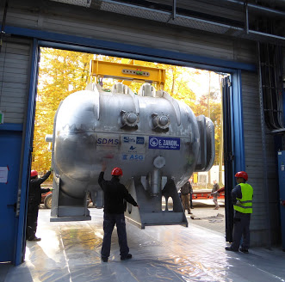
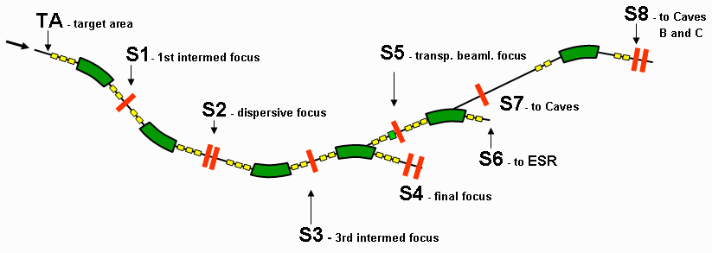
Dipoles as Separators
Consider particles with fixed p but different M and Q in a dipole field B
  assume B·L same for all M, Q
  deflection angle given by
Charge separation
  assume same M, but different Q
  let only one angle θ pass and vary B, then Q proportional to 1/B
Mass separation
  assume same Q, but different M
  let only one angle θ pass and vary B, then M proportional to B
θ = Q/M · B·L/p
Some separator magnets are rather large...
...and one can build separators with more dipoles.

Slide 20
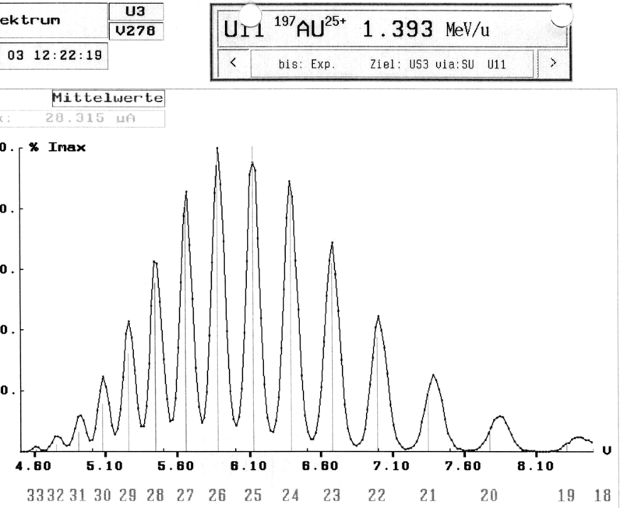
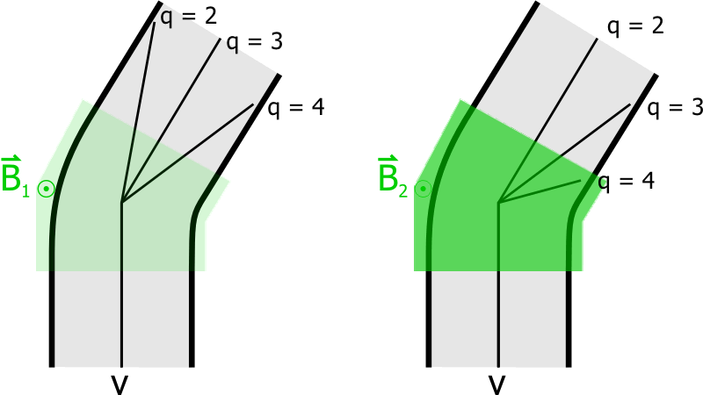
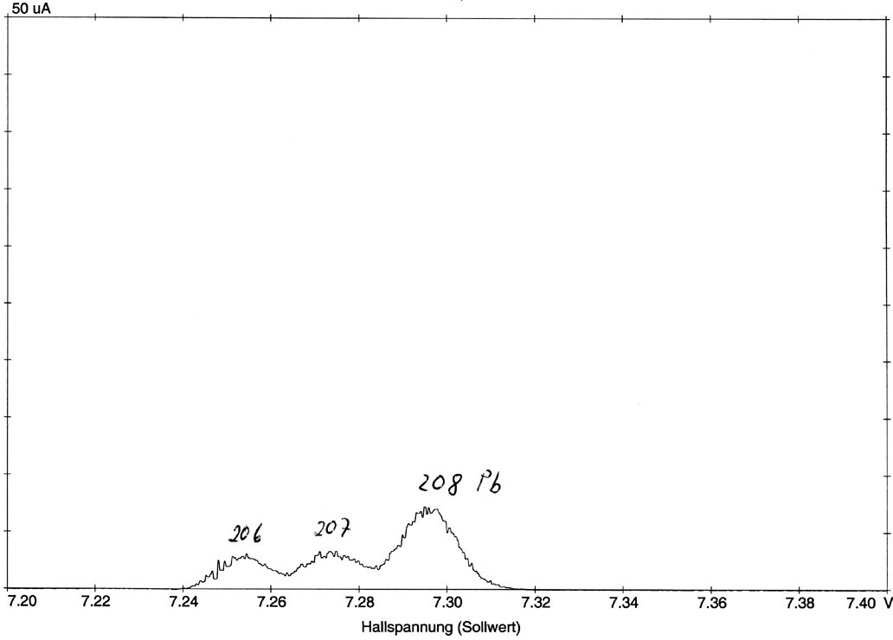
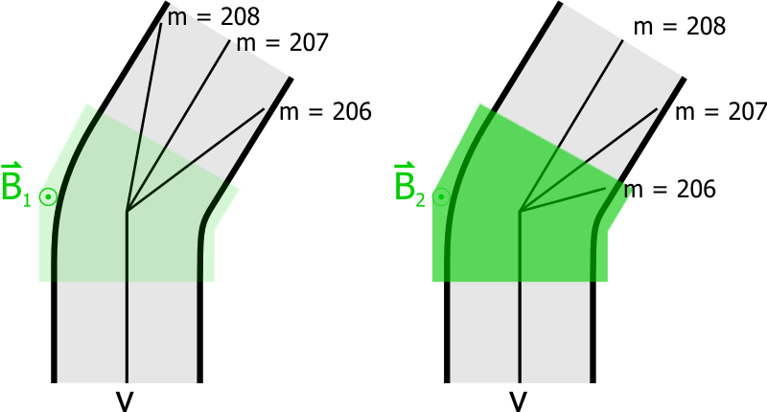
Example: Spectrometer
Charge separation behind gas stripper
Mass (isotope) separation

Slide 21
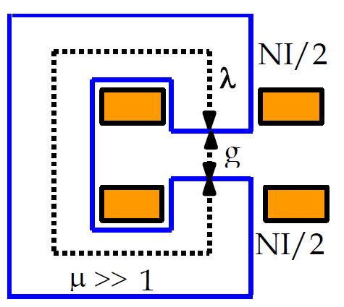
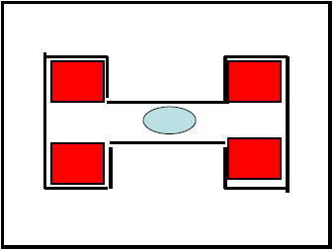
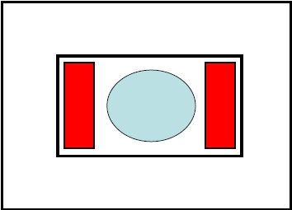
Dipole Magnets
Homogeneous field desired
At GSI and FAIR electromagnets with and iron core are used
B field created in gap g between two parallel iron poles N and S
B field excited by current in
coil with N windings
B field can be calculated
Choice of coils
  Normal conducting (water cooled)
    e.g. SIS18, ESR, FRS
  Super-conducting (liquid He cooled)
    e.g. SIS100, Super-FRS
N
B
g
C core dipole
S
e.g. ESR, CRYRING
N
B = μ₀·N·I/g
H core dipole
S
e.g. SIS18, SIS100
μ₀ = 4π·10⁻⁷Tm/A (constant of nature)
N
Window frame
dipole
S

Slide 22
Bending Magnets @ GSI and FAIR
Machine | Type | N | θ [deg] | ρ [m] | L [m] | B_{max} [T] | BL_{max} [Tm] | Bρ_{max} [Tm]
SIS18 | H | 24 | 15 | 10.4 | 2.7 | 1.8 | 4.9 | 18.7
ESR | C | 6 | 60 | 6.25 | 6.5 | 1.6 | 10.5 | 10.0
CRYRING | C | 12 | 30 | 1.20 | 0.63 | 1.2 | 0.75 | 1.44
SIS100 | H | 108 | 3.33 | 52.6 | 3.1 | 1.9 | 5.8 | 100.0
CR | H | 24 | 15 | 8.13 | 2.1 | 1.6 | 3.4 | 13.0
HESR | H | 44 | 8.18 | 29.4 | 4.2 | 1.7 | 7.1 | 50.0
And a large variety of bending magnets in the transfer lines and at the experiments...

Slide 23
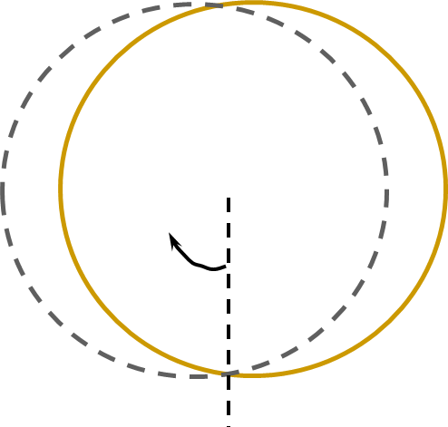
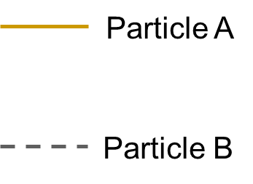
Particle Motion in Dipole Magnets
Can we build circular accelerators from dipoles only?
Start two particles in same field
  same momentum, same position
  different angle
Use particle A’s trajectory as reference and measure deviation of B’s trajectory along the circle
  particle B oscillates around particle A
  such oscillations characterize transverse motion in accelerators
  referred to as betatron oscillations
  more about that later...
  (see talk on ‘Transverse Dynamics’)
Particle B
deviation
Particle A
0
2π

Slide 24
Stable or Unstable Motion
In the previous example, horizontal trajectories close on themselves
  could be repeated infinitely
  motion considered to be stable
  focusing effect of the dipole field
What about the vertical motion?
  particle A at zero position and angle
  particle B with same position but small angle at start
  the dipole field has no influence on the vertical motion of both particles
  position of particle B grows without bounds over many turns
  motion considered to be unstable
Need focusing in the vertical direction
Horizontal relative motion
horizontal dev.
0
2π
4π
Vertical relative motion
vertical dev.
0
2π
4π

Slide 25
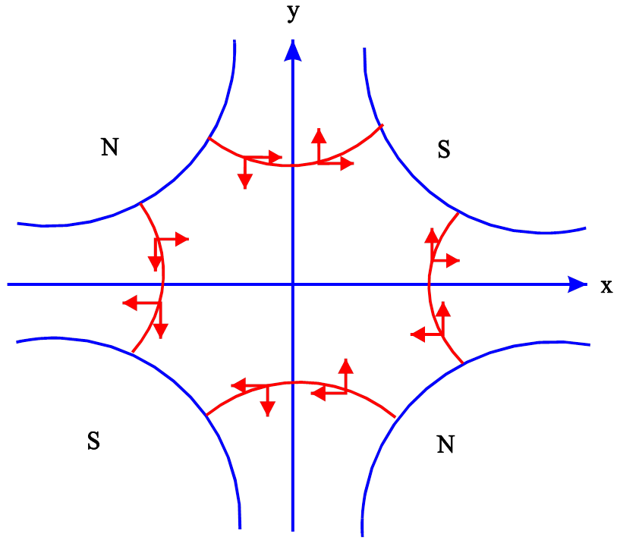
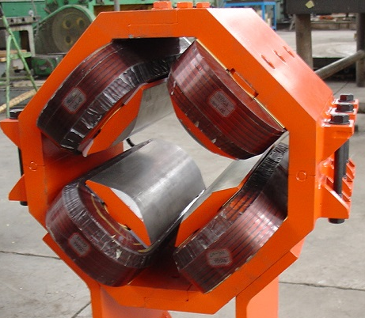
Quadrupole Magnets
Quadrupole magnet has 4 poles symmetric about the center
By symmetry the B field on the longitudinal axis is zero
  particle passes straight through the center with no deflection
  quadrupole magnet is straight
B field depends linearly on position
  horizontal direction:
  vertical direction:
  B’ referred to as field gradient
Integral quadrupole strength
  focusing power for particles with Bρ
  analogous to angle of a dipole
Magnetic field
B_{y} = B’·x
B_{x} = -B’·y
Hyperbolic contour
x · y = constant
k·L = B’·L/Bρ

Slide 26
Effect of Quadrupole Magnets
Focusing quadrupole (QF)
Forces on particles determined by arrangement of poles
  arrangement
    focusing in horizontal plane
    defocusing in vertical plane
    denoted focusing quadrupole (QF)
  arrangement
    defocusing in horizontal plane
    focusing in vertical plane
    denoted defocusing quadrupole (QD)
Forces linear in transverse position
  particles receive deflection proportional to their position
  similar to lenses in optics except that
  lenses (de)focus in both planes
Force on particles
N | S
S | N
S | N
N | S
x
QF
s
y
QF
s

Slide 27
Focusing with Quadrupole Magnets
Neither QF nor QD can focus in both x and y simultaneously, but...
Combinations of QF and QD with overall focusing in x and y possible
Idea:
  put QD in place where horizontal offsets are small
  put QF in place where vertical offsets are small
  then effect of QD on x respectively
  QF on y should be small
Different arrangements possible
  FODO: smallest field gradients
  Doublet: long free section
  Triplet: symmetric beams
x
QD
QF
QD
y
QD
QF
QD
FODO
Doublet
Triplet

Slide 28
Transverse Phase Space
Consider again focusing by QF in the horizontal plane
  parallel input trajectories
  → particles characterized by position x
  at focal point, all particles have x = 0
  → particles characterized by angle x’
In general, position x and angle x’ needed to fully describe particle
  aggregated into vector
  can be depicted in 2D coordinate system called phase space
  convergent trajectories have negative x’ for positive x and vice versa
  opposite sign for divergent trajectories
Vertical plane completely analoguos
focal point
x
QF
s
x’
x

Slide 29
Quadrupole Effect Quantitatively
Consider thin quadrupole at s = 0
Input vector (just in front of quad)
Output vector (just behind quad)
  same position x₁ (thin quad)
  angle of trajectory: -x₁/f (x₁<< f)
Vector downstream of quad at s
  angle fixed in drift space
  position change linear in s
x
s
f

Slide 30
Matrix Formalism
Matrices and vectors
  mathematical structures with a very powerful calculus (linear algebra)
  easily implemented in computer programs
  very convenient for representing particle transport through accelerators with linear forces
  takes some time getting used to it...
Multiplication rules for matrices and vectors
Matrix · Vector = Vector
Matrix · Matrix = Matrix
Multiplication not commutative...
..but associative

Slide 31
Quadrupoles and Drifts as Matrices
Effect of thin quadrupole with focal length f described by matrix
  first row: position x is unchanged and does not depend on angle x’
  second row: quad changes angle x’ by amount proportional to position x
Effect of drift space of length L
  first row: position x changes by amount proportional to angle x’
  second row: angle unchanged
Can be visualized in phase space
x’
x
x’
x

Slide 32
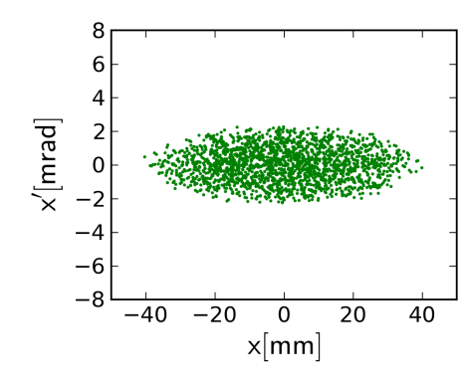
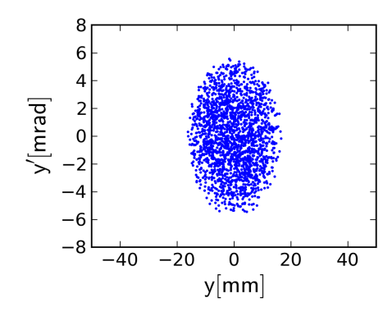
FODO Focusing
QF
QD
QF
Alternating focusing and defocusing quadrupoles separated by drift spaces
FODO cell can be repeated many times (periodic FODO channel)
Dipole magnets installed between quadrupoles for curved accelerators
  approximately like drift spaces
Efficient focusing structure regarding necessary fields for given aperture
Periodic solution exists
  output beam same as input beam
  ellipses in phase space
  other beam shapes may lead to troubles (mismatch)
L
L
FODO cell
Matrix formalism allows to split quads easily...
Matrix of FODO cell
Just for the curious and brave...

Slide 33
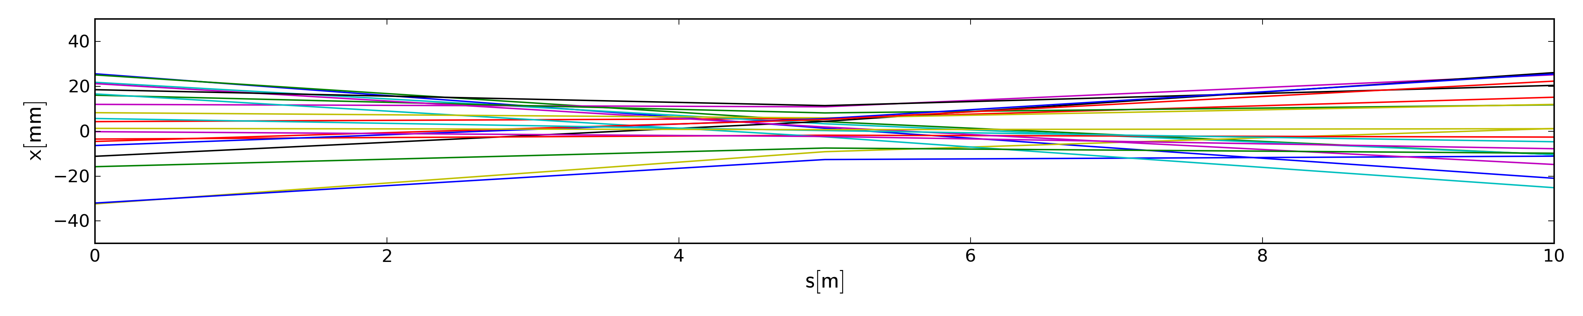
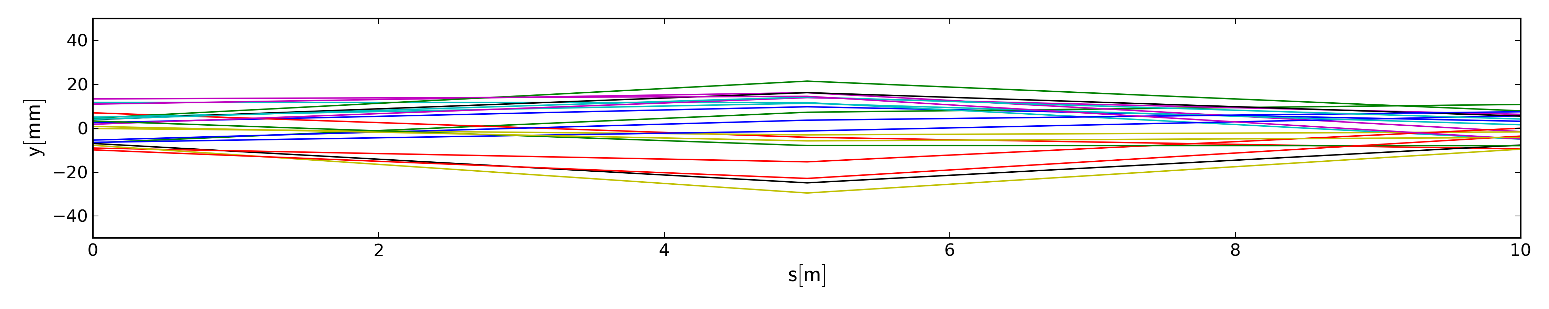
FODO Tracking: Trajectories
QF
QD
QF
L
L
Trajectories in horizontal plane
Trajectories in vertical plane
Tracks obtained by tracking 20 particles
Particle tracks obtained by tracking random sample of particles
General properties of FODO structure visible, but where are the limits?

Slide 34
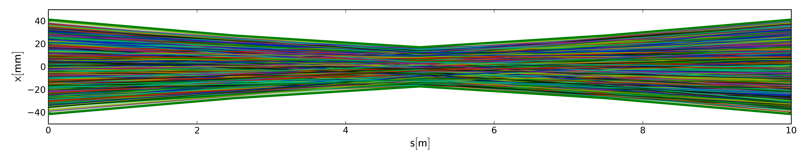
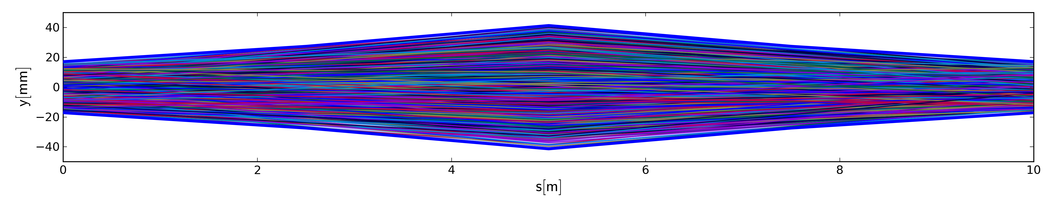
FODO Tracking: Envelopes
QF
QD
QF
L
L
Envelopes in horizontal plane
Envelopes in vertical plane
Tracks obtained by tracking 2000 particles
Shape of beam emerges when tracking lots of particles
Envelope can actually be calculated from L and f (→ talk on transverse optics)

Slide 35
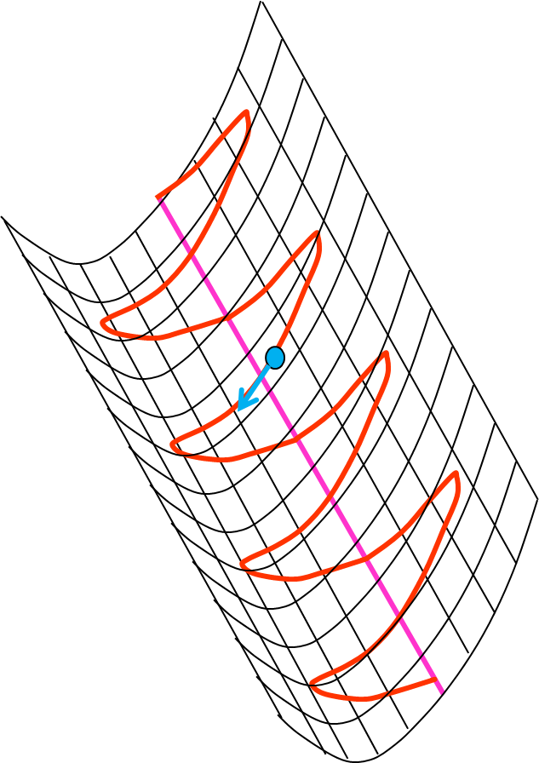
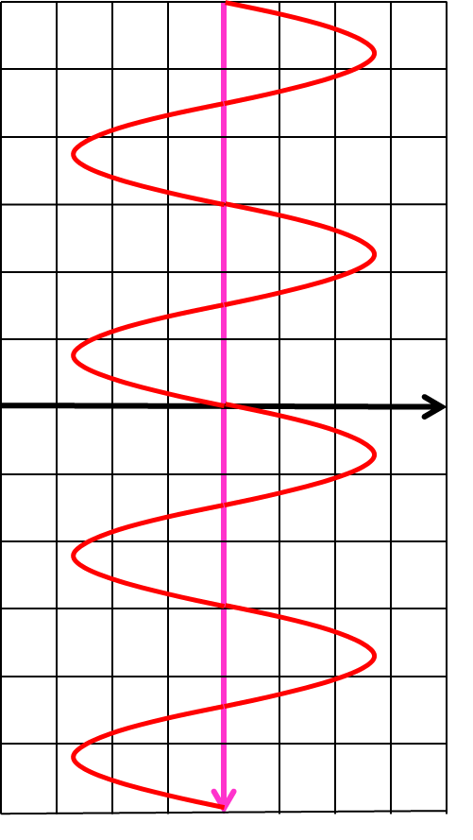
FODO Focusing: Mechanical Analogue
Ball rolling without friction in a gutter can’t escape due to force of gravity
Particles diverging from nominal orbit focused back by quadrupoles

Slide 36
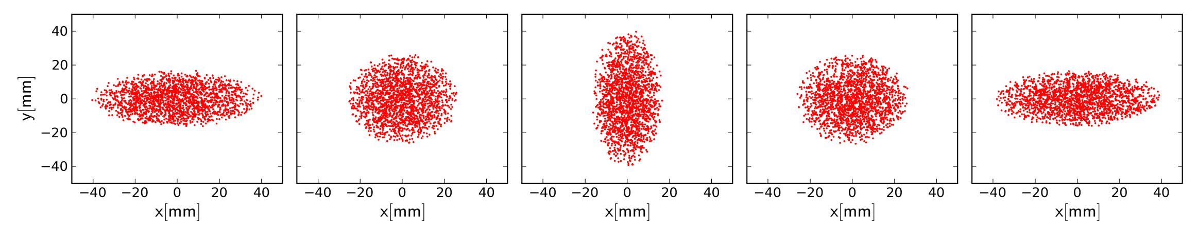
FODO Tracking: Cross section
QF
QD
QF
L
L
Beam cross sections in x-y
Cross sections reflect the change of beam size through FODO cell
In real accelerator observable using scintillating screens
  not possible for beam in a circular accelerator
  typically not inside of quadrupoles, of course...

Slide 37


FODO Tracking: Phase Space
QF
QD
QF
L
L
Horizontal phase space
Vertical phase space
Important property of beam, but not directly observable in a real accelerator
  how would you measure the angle of a trajectory simultaneously with position?

Slide 38
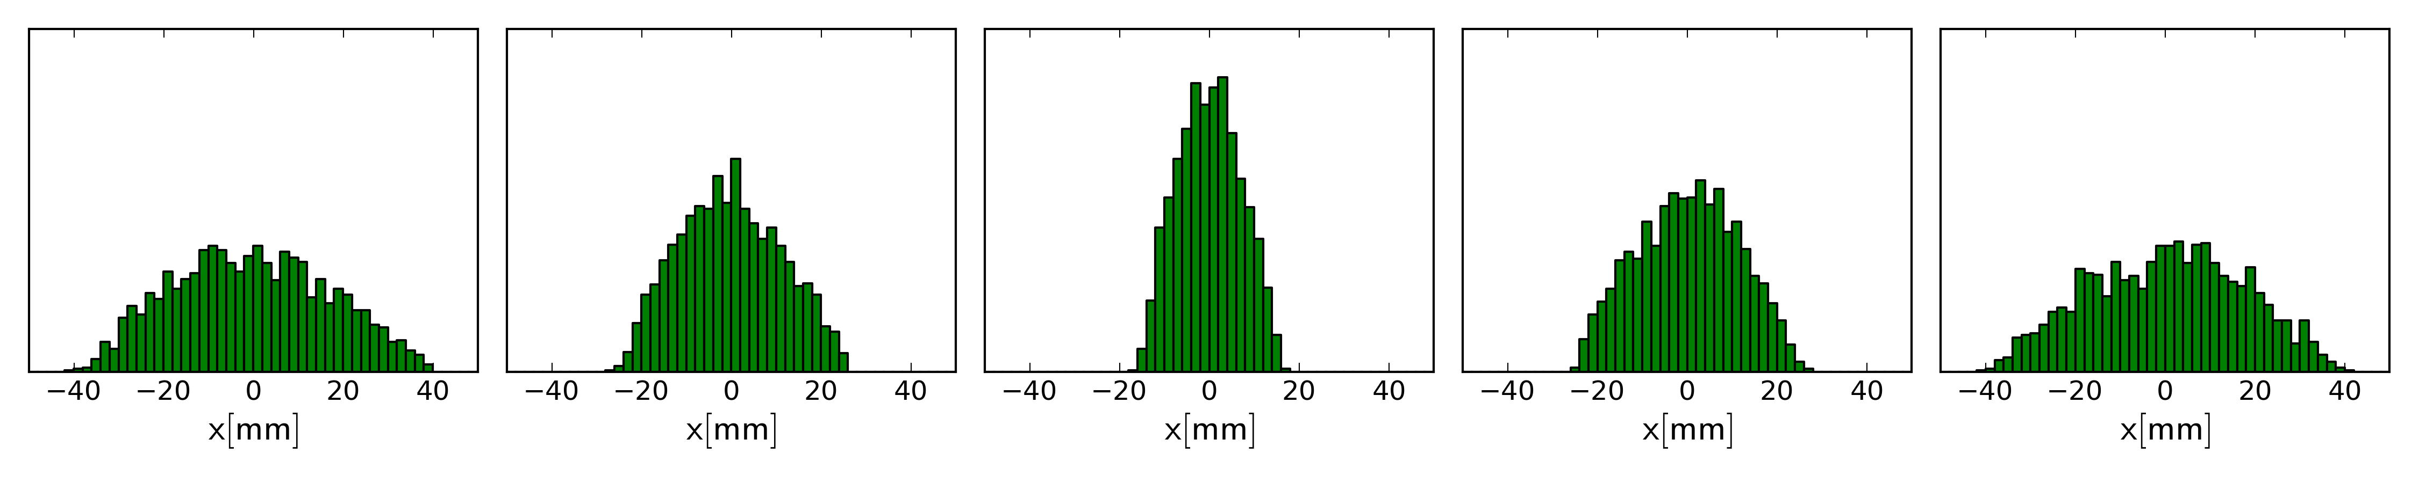
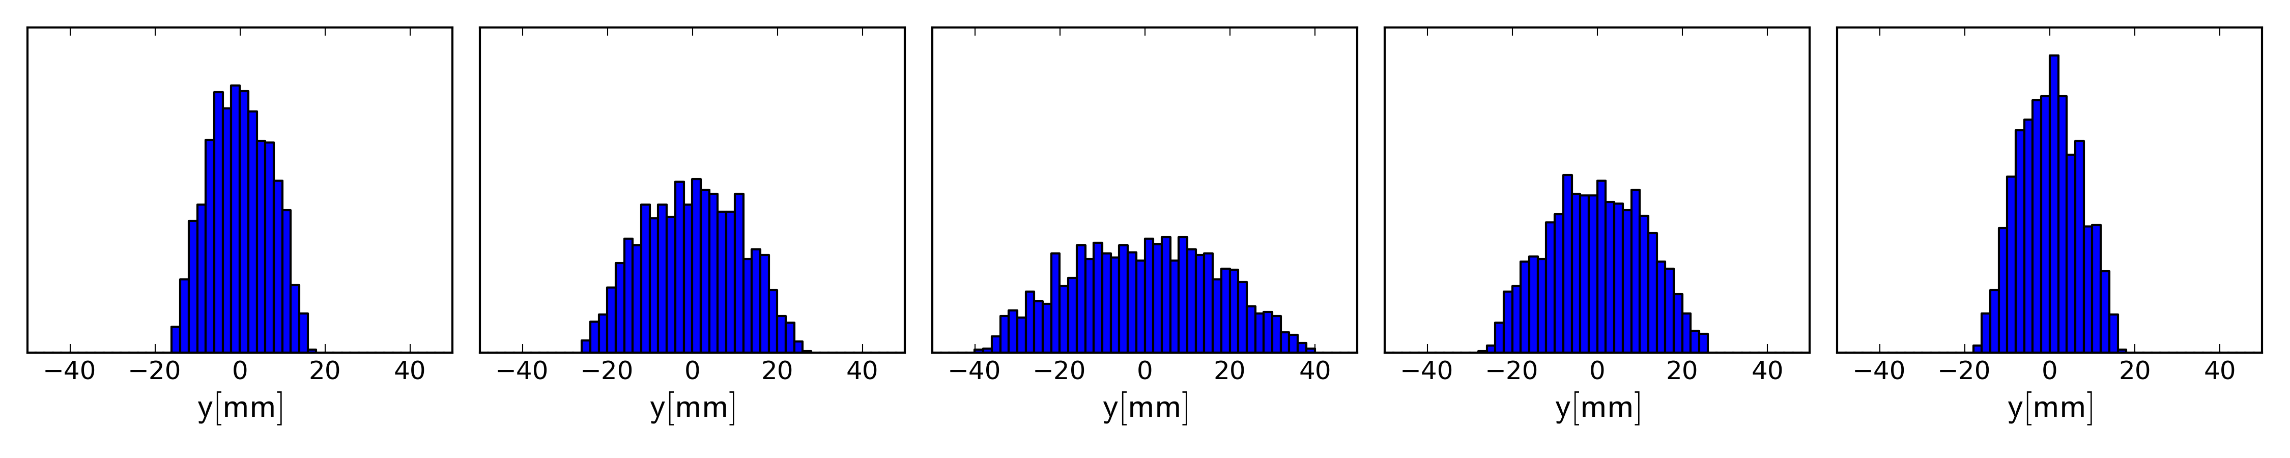
FODO Tracking: Beam Profiles
QF
QD
QF
L
L
Horizontal beam profiles
Vertical beam profiles
Projections of phase space onto position can be observed
  beam profiles measured by SEM-grids, MWPCs, BIFs, IPMs
  very important information for set-up of accelerators and beamlines

Slide 39
FODO Tracking: Mismatch
QF
QD
QF
L
L
Horizontal phase space
Vertical phase space
Important property of beam, but not directly observable in a real accelerator
  how would you measure the angle of a trajectory simultaneously with position?

Slide 40
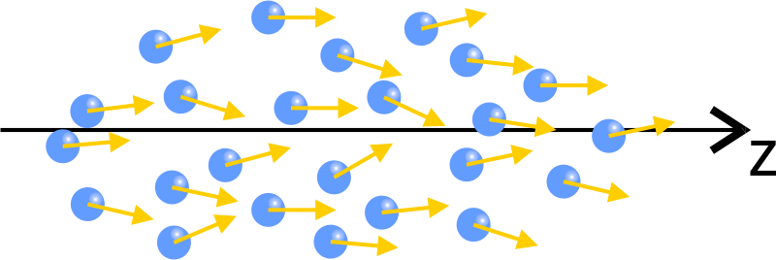
Emittance
Oscillation amplitude of single particles normally conserved
  remember the frictionless gutter:
  ball will oscillate forever
  measure of transverse energy
Transverse energy referred to as single particle emittance
  transverse energy created by random motion in the source
  conserved (at best) until final target
  measure of disorder of particles in the beam
  impossible to create truly parallel beam (would be completely ordered)

Slide 41
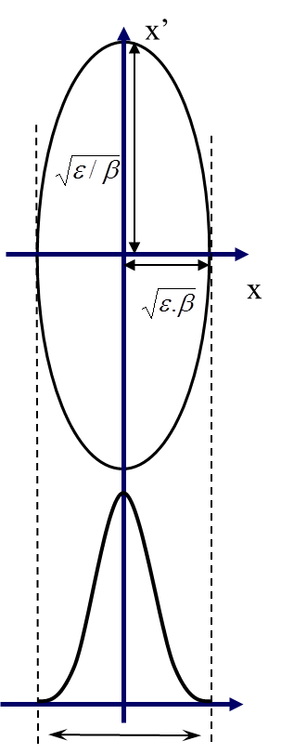
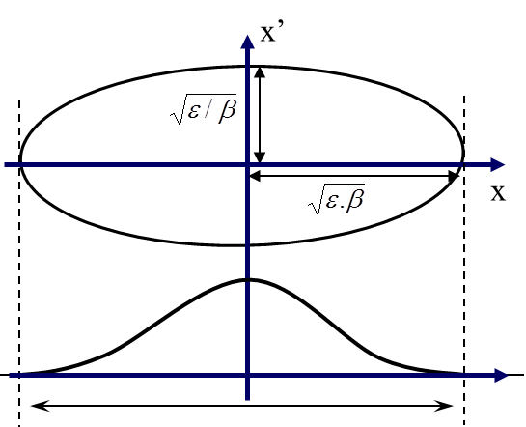
Beam Size and Emittance
Periodic solution of FODO cell characterized by ellipses
  aspect ratio defined by quadrupoles
  for upright ellipses, aspect ratio described by beta functions β_{x/y}
  area of ellipse written as
  emittance ε_{x/y} measure for beam size
Emittance is constant in FODO cell
  small width implies large angle spread
  limits the beam spot size at a target
  impossible to create parallel beam
Skew ellipses → talk on Transverse Optics

Slide 42
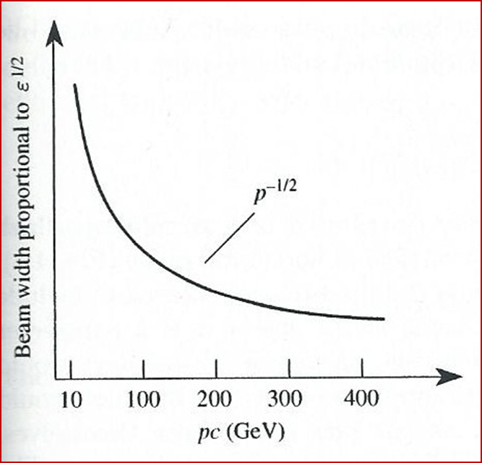
Emittance Change
Sources of emittance growth
  scattering in stripping foil or targets
  ellipse mismatch
  non-linear fields
Ways to shrink emittance
  acceleration shrinks emittance according to ε ~ 1/p ~ 1/Bρ
  (adiabatic damping)
  electron cooling (SIS, ESR) and stochastic cooling (ESR) available to create very small emittances
Unnecessary emittance growth can limit performance
  beam losses due to beam size growth
  larger beam spot size at targets

Slide 43
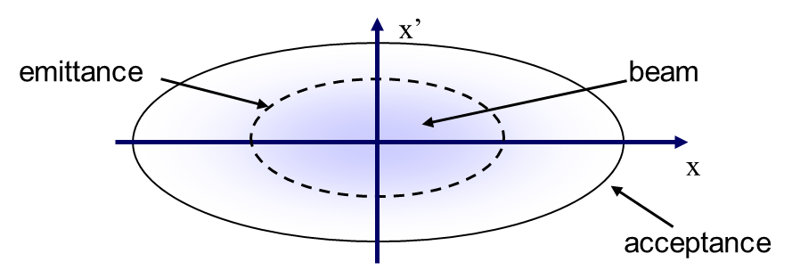
Emittance and Acceptance
Emittance:
area of phase space ellipse containing a fraction of particles (e.g. 95%)
  may grow due to mismatch, non-linear fields, beam interaction with pipe, etc.
  does not take into account deviations of beam center from ideal orbit
Acceptance:
maximum area of the ellipse possible without ever losing particles (by hitting beam pipe)
  acceptance in general smaller than physical aperture of beam pipe
  need some margin for deviations of beam center and emittance growth

Slide 44
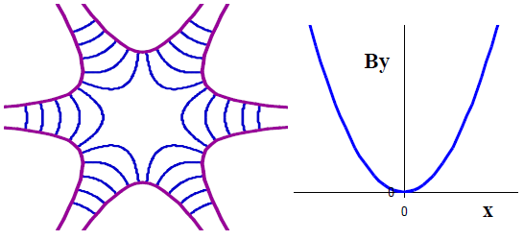
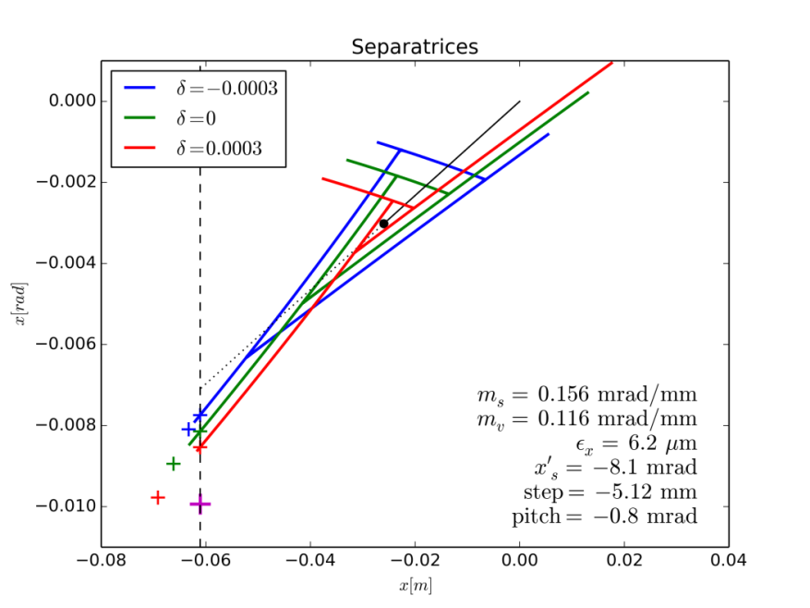
Non-Linear Magnets: Sextupoles
Magnet with six poles
Field depends quadratic on position
  forces on particles non-linear
  in general no analytic solutions
  can even lead to chaotic motion
Frequently used in accelerators
  correction of momentum dependent effects on betatron oscillations
  (e.g. SIS18, ESR, FRS)
  essential for slow extraction (SIS18)
  compensation of unavoidable field errors in main magnets (dipoles)
N
S
S
B_{y} ~ x² for y=0
N
N
S
Particle motion during slow extraction (SIS18)

Slide 45
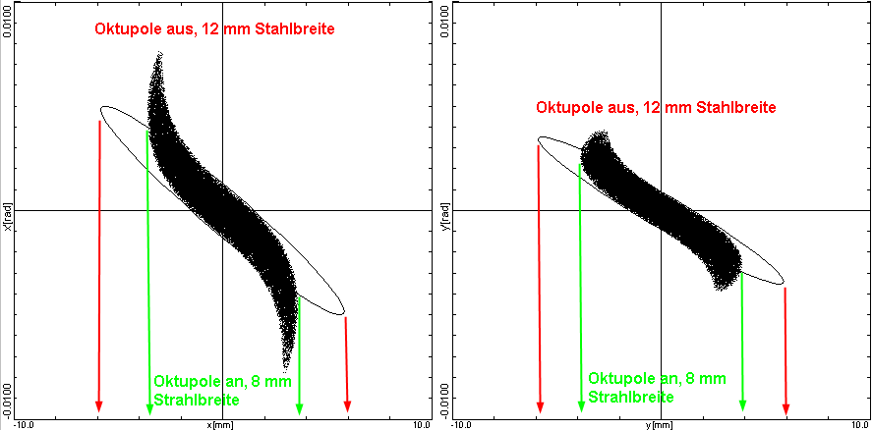
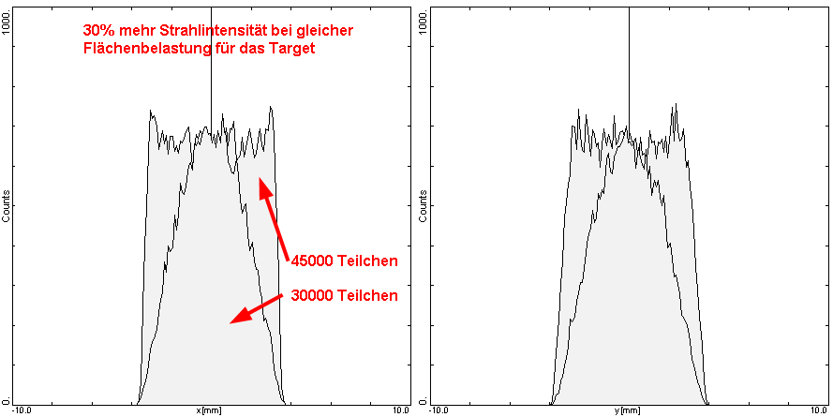
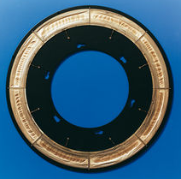
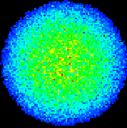
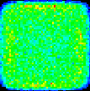
Non-Linear Magnets: Octupoles
Octupoles for SHIP beamline
  deformation of ellipse by non-linear field of octupoles
  uniform distribution in cross section
  higher beam intensity at equal maximum particle density on target

Slide 46
Summary
Definition of elements and isotopes
Special relativity and electro-dynamics
  masses, energies and mass-energy relation
  Relativistic particle motion and non-relativistic limit
  Lorentz force and magnetic rigidity
Motion of charged particles in magnetic fields
  dipoles as bending magnets and separators
  quadrupoles as focusing magnets
  non-linear magnets for more sophisticated purposes
Particle tracking and transverse phase space
  vectors for description of particles and matrix formalism
  FODO focusing structure
  emittance and acceptance

Slide 47
Thank you for your attention!
These slides contain material I found in talks of the following colleagues:
W. Bayer and M. Maier (GSI), R. Steerenberg (CERN), K. Peach (Oxford University)
I’m very grateful for the possibility of profiting from their excellent material.

