Slide 1
SPARC Topical Workshop 2016
Conversion e-spectrometer for CRYRING
Xinwen Ma
Institute of Modern Physics, Chinese Academy of Sciences
20 Sept 2016, Krakow, Poland

Slide 2
Electron Spectrometer at Internal Target
Atomic physics at Future Facility HIAF

Slide 3
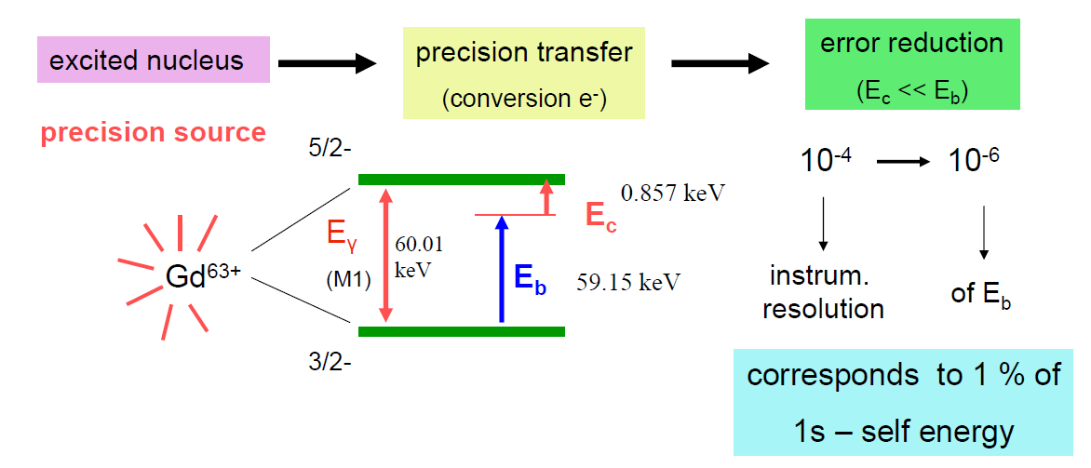
Electron Spectrometer @ Internal Target
precision measurement of E_{b} (1s) – QED test ~ 2 x 10⁻³
Branching ratio IC
High resolution electron spectrometer is desirable (∆p/p<10⁻⁴ )
Ajay Kumar, High Resolution Electron Spectrometry at the NESR, SPARC TALK

Slide 4
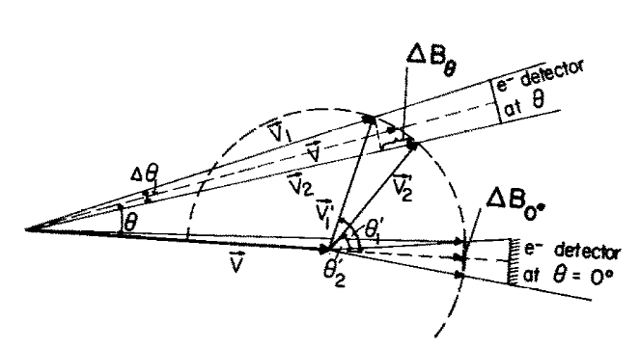
Electron Spectrometer @ Internal Target
Uncertainty sources
Kinematic line broadening (finite acceptance angle)
Line broadening due to momentum spread of the projectile
Momentum resolution of the spectrometer
Other small effects
T. J. M. Zouros et al., Nuclear Instruments and Methods in Physics Research B31 (1988) 349-358

Slide 5
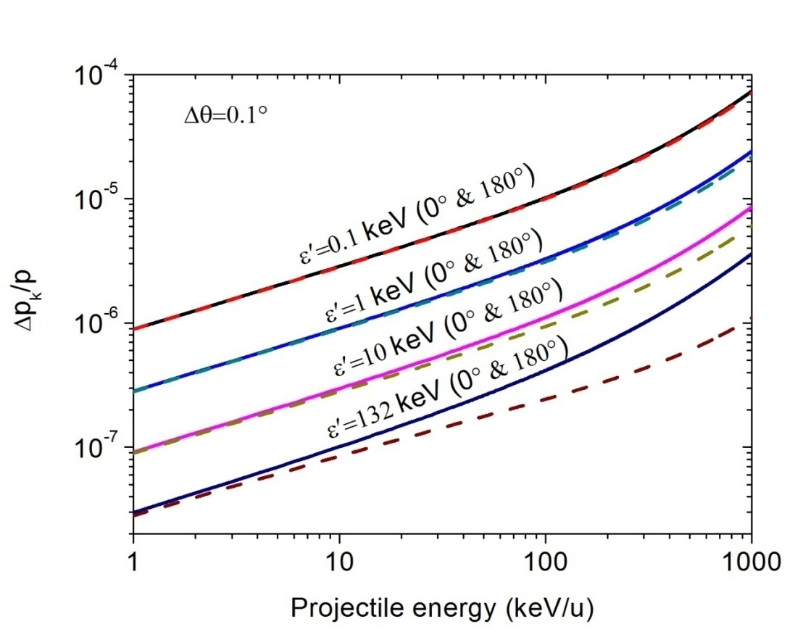
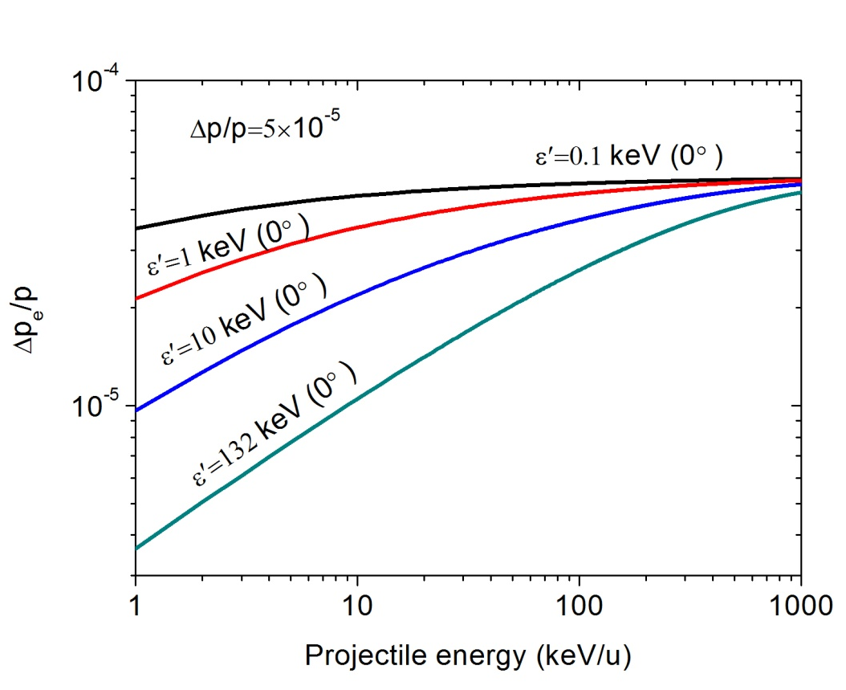
Electron Spectrometer @ Internal Target
Line broadening due to
momentum spread of the projectile
Kinematic line broadening
- increases with projectile energy
decreases with electron energy in the projectile rest frame

Slide 6
Electron Spectrometer @ Internal Target
Resolution contributions
E_{p} | 1 MeV | 10 MeV | 100 MeV | 1000 MeV
∆E_{k} | 0.0020 eV | 0.040 eV | 1.15 eV | 60.99 eV
∆E_{e} | 0.078 eV | 0.62 eV | 5.47 eV | 41.66 eV
∆E_{s} | 0.22 eV | 1.4 eV | 11.26 eV | 83.04 eV
E_{p} | 1 MeV | 10 MeV | 100 MeV | 1000 MeV
∆E_{k} | 0.0017 eV | 0.02 eV | 0.44 eV | 21.24 eV
∆E_{e} | 0.13 eV | 0.78 eV | 6.00 eV | 43.73 eV
∆E_{s} | 0.60 eV | 2.20 eV | 13.29 eV | 88.09 eV
∆E_{k} - Kinematic broadening
∆E_{e} - Broadening due to momentum spread of emitter
∆E_{s}- Broadening due to spectrometer momentum resolution (∆p/p=5*10⁻⁵)

Slide 7
Electron Spectrometer @ Internal Target
Resolution contributions
E_{p} | 1 MeV | 10 MeV | 100 MeV | 1000 MeV
∆E_{k} | 0.0027 eV | 0.018 eV | 0.23 eV | 9.03 eV
∆E_{e} | 0.29 eV | 1.31 eV | 7.76 eV | 50.80 eV
∆E_{s} | 3.01 eV | 5.91 eV | 20.66 eV | 105.22 eV
E_{p} | 1 MeV | 10 MeV | 100 MeV | 1000 MeV
∆E_{k} | 0.0080 eV | 0.034 eV | 0.25 eV | 6.88 eV
∆E_{e} | 0.98 eV | 3.57 eV | 15.92 eV | 86.96 eV
∆E_{s} | 26.69 eV | 33.75 eV | 60.49 eV | 190.63 eV
∆E_{k} - Kinematic broadening
∆E_{e} - Broadening due to momentum spread of emitter
∆E_{s} - Broadening due to spectrometer momentum resolution (∆p/p=5*10⁻⁵)

Slide 8
Electron Spectrometer @ Internal Target
Preliminary simulation (Transfer matrix method)
Parameter | 1 magnet | 2 magnet
Mean radius | 50 cm | 100 cm
Distance of object | 500 cm | 205 cm
Entrance angle | 0 | 5.5º
1st homogeneous field | 45º | 30º
1/r field | 45º | 216º
2nd homogeneous field | none | 30º
Exit angle | 4 | 5.5º
Focal length | 65.76 cm | 210 cm
Radial scaling factor | -0.158 | -1
Axial scaling factor | -0.152 | 1
Dispersion coefficient | 126.9 cm | 1146.7 cm
Two Stage Spectrometer
transport magnet
high resolution double focusing spectrometer
Ultimate resolution - ∆p/p<10⁻⁴

Slide 9
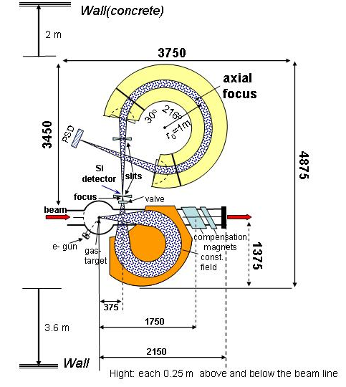
Electron Spectrometer @ Internal Target
The 270º dipole transport magnet, the high resolution double focusing spectrometer, beam compensating magnets, gas jet target position, electron gun for calibration and alternative solid detector (the numbers are given in mm)

Slide 10
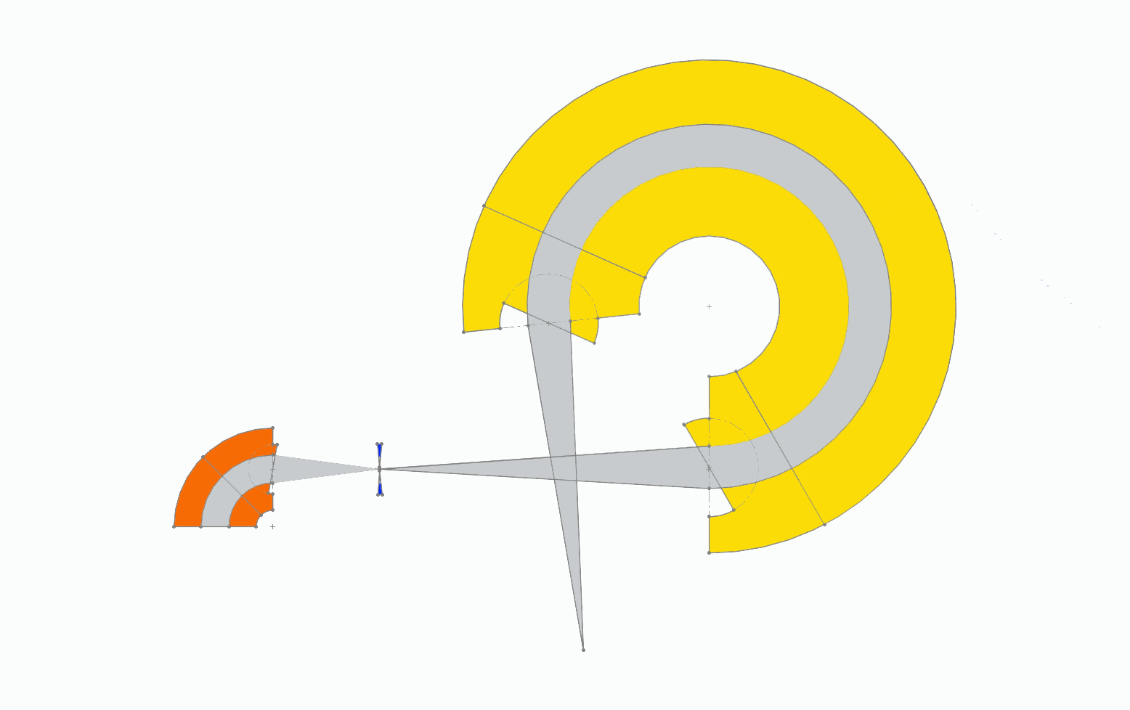
Electron Spectrometer @ Internal Target
1/r field
homogeneous field
1/r field
slit
Si detector
axial focus
homogeneous field
homogeneous field
beam
PSD
Two Stage Spectrometer System

Slide 11
Electron Spectrometer @ Internal Target
Schedule related to the Electron Spectrometer
Detailed simulation of the electron optical properties, Geometrical construction and design (end of 2016)
Construction of Transport Magnet and Chamber (2017.6)
Development of Detectors, Purchase of Power Supplies, Electronics and Parts, Mounting and Testing at Laboratory (2018.6)
Design and Construction of High Resolution magnet, Mounting and Test (2018-2019)

Slide 12
Atomic Physics plans at future facility HIAF
Ultra-cold electron target

Slide 13
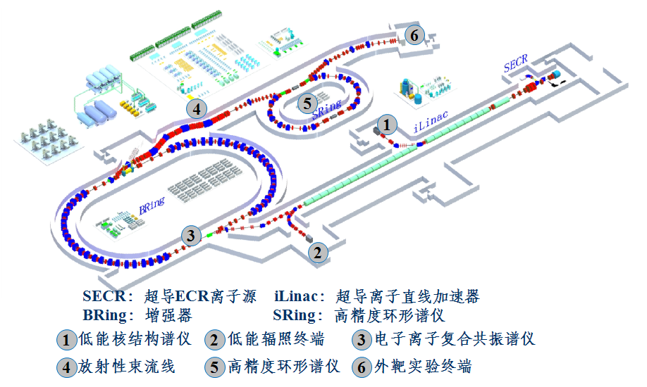
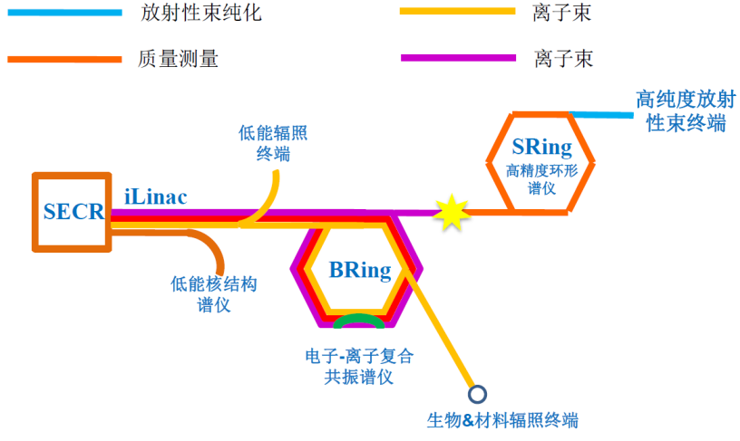
High intensity heavy ion accelerator Facility
provide unprecedented experimental conditions for nuclear physics, atomic physics with HCIs, and nuclear-astrophysics, excellent platform for heavy ion applications

Slide 14
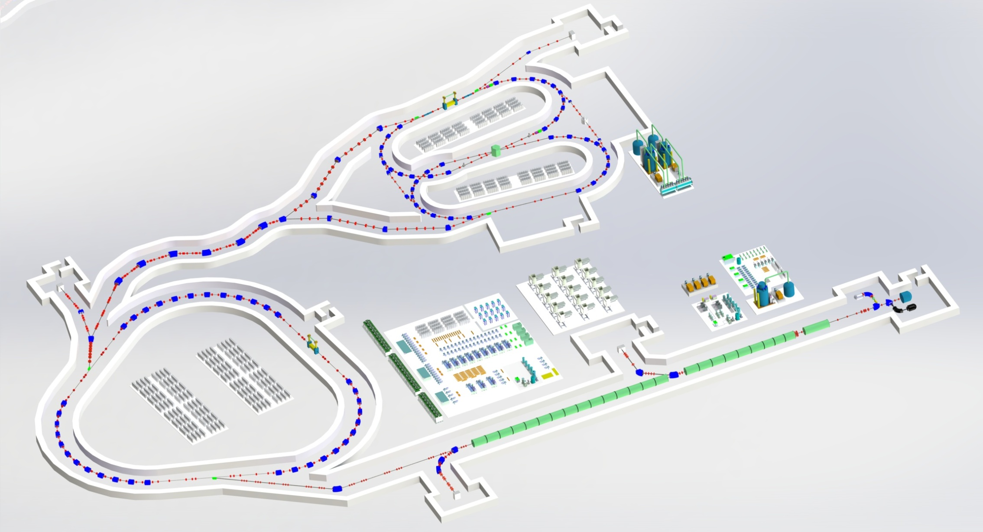
HIAF Overview
 | Ions | Energy | Intensity
SECR | U³⁴⁺ | 14 keV/u | 0.05 pmA
iLinac | U³⁴⁺ | 17 MeV/u | 0.028 pmA
BRing | U³⁴⁺ | 0.8 GeV/u | ~1.0×10¹¹ ppp
SRing-A
BRing: Booster ring
Circumstance: 500 m
Magnetic Rigidity: 34 Tm
SRing-B
BRing
iLinac: Spectrometer linac
Length:180 m
Final energy: 17MeV/u(U³⁴⁺)

Slide 15
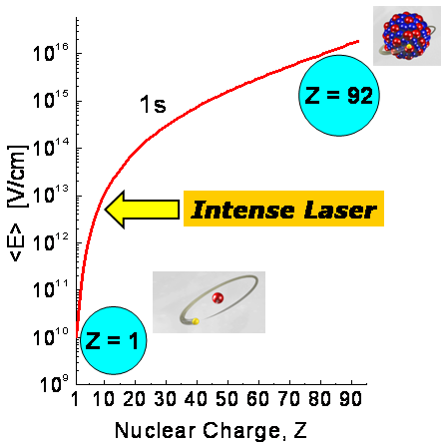
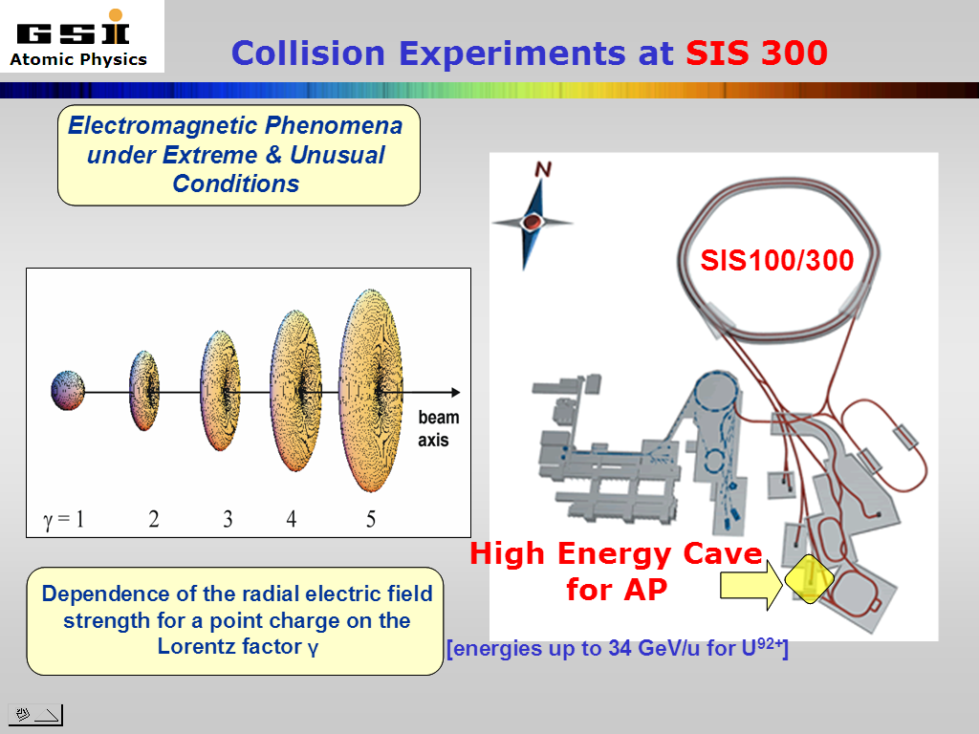
Atomic & Fundamental Physics
Interplay between Relativity, Correlation, and QED in the Non-Perturbative Regime
αZ ≈1
Radiative corrections in the non-perturbative regime
Correlated multi-body dynamics for atoms and ions
Precision determination of fundamental constants
Influence of atomic structure on nuclear decay properties
Critical Fields
Ultrashort Pulses
“sub-attosecond”
Borrowed from Thomas Stoehlker

Slide 16
Critical- and Super-Critical Fields
Critical field strength
The 1s level dives into the negative-energy continuum at Z_{crit} ≈ 173
S.S. Gershtein, Ya.B. Zel’dovich, 1969; W. Pieper, W. Greiner, 1969
Physics Today 35(8), 24 (1982)

Slide 17
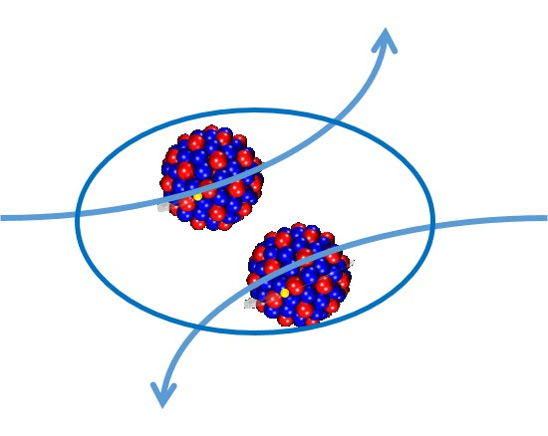
Pair production with slow-collision of bare U+U
²³⁸U⁹²⁺
²³⁸U⁹²⁺
Physics Today 35(8), 24 (1982)

Slide 18
QED in Strong Field—Pair Production @ HIAF
²³⁸U⁹²⁺, ²³⁸U⁹¹⁺
ion beam
ion beam
x-ray Detector array
e⁺ Detector
²³⁸U⁹¹⁺, ²³⁸U⁹⁰⁺
Ion Detector
e Detector
ion beam
x-ray Detector
Low background signals
Super critical Stronger EM fields;
Enhanced cross section;

Slide 19
The prospective electron target performance

Slide 20
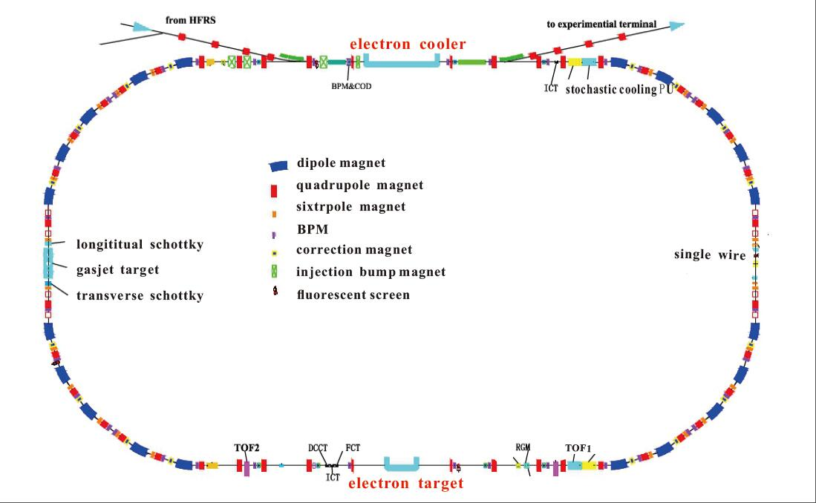
Experimental installation at SRing of HIAF
DR experimental region
Laser cooling of relativistic ion beams
Laser spectroscopy
Collision dynamics
Precision x-ray Spec
Cold e-target
DR experimental region
Notes:
The sketch view of the HIAF-SRing , high light the electron target!

Slide 21
Atomic Physics Program at HIAF
QED in super critical field at MRing
QED in strong fields, higher order effects
Radioactive Nuclear properties @ DR spectroscopy
Collision dynamics in Zepto-second scale @ reaction Microscope
Laser cooling of relativistic heavy ion beams and
laser spectroscopy of HCIs

Slide 22










DR collaboration
IMP, CAS, China | X. Ma, Z K Huang, W Q Wen, H B Wang, X Y Chuai, L J Dou, X L Zhu, D M Zhao, L J Mao, Y J Yuan, J C Yang, J Li, X M Ma, T L Yan, J W Xia, H S Hu, G Q Xiao, W L Zhan
USTC, China | L F Zhu, X Xu, S X Wang
GSI, Darmstadt, Germany | Th. Stöhlker, C. Brandau, A. Gumberidze, Yu. Litvinov, M. Steck
Uni. Giessen, Ger | A. Müller, S. Schippers
BINP, Novosibirsk, Russia | V. V. Parkhomchuk, V. B. Reva,
IAPCM, China | Y C Li, X y Hand, J G Li, J G Wang
NWNU, China | C Z Dong, L Y Xie
Uni. Strathclyde | N. R. Badnell
Fudan Univ. China | B R Wei, K Yao, R. Hutton, Y M Zou
Benbu Colleague, CN | W Q Xu
Tianshui Colleague, CN | Shi Yinglong

Slide 23




Laser Cooling collaboration
IMP: X. Ma, W Q Wen, H B Wang, Z K Huang, D M Zhao, L J Mao, Y J Yuan, J C Yang, J W Xia
HZDR: M. Bussmann, M. Loeser
GSI: D. Winters, Th. Stöhlker
TU-Darmstadt: Thomas Walther, Gerhard Birkl

Slide 24
e-spec collaboration
IMP: X. Ma, Dalong Guo, Xiaolong Zhu, Shaofeng Zhang, D M Zhao
GSI: S. Haggmann, P. M. Hillenbrand, Y. Litvinov, A. Bräuning-Demian, Th. Stöhlker
UOC, Greece: Theo Zouros
… …
Collaboration: Heraklion (Uni of Creete) // IMP-Lanzhou (China) // CSIC (Madrid)
Atomki Debrecen (Hungary) // MPI-K (Uni Heidelberg) // IKF (Uni
Frankfurt) // MSI (Uni Stockholm) // GSI (Darmstadt)
Under construction … …

Slide 25
Thank you for your attention!

Slide 27
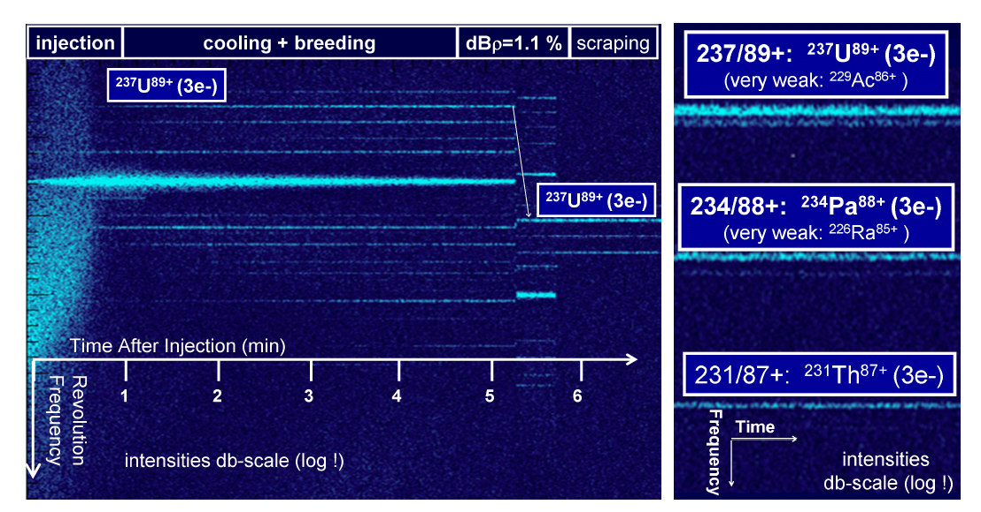
DR pilot experiment with the radioisotopes ²³⁴Pa⁸⁸⁺ and ²³⁷U⁸⁹⁺

Slide 28
Projections for NESR electron target performance
Energy Spread Due to the Electron Temperature

Slide 29
Sensititivity to higher-order QED effects
M. Lestinsky et al.,PRL 100 (2008) 033001

Slide 30
Main parameters of Li-like argon ions experiment
Table 1: main parameters of the DR experiment of Li-like Argon ions at CSRm
Parameters（unit） | value
Circumstance of CSRm (m) Ions injection energy (MeV/u) Maximum ion beam current (μA) life time of the ion beam (s) Momentum spread of the ion beam | 161.00 8.37 200 120 ~2×10⁻⁴
Radius of the electron beam (cm) Cooling point (kV) Electron beam current (mA) Density of the electron (cm⁻³) | 2.61 -4.581 112.90 1.1×10⁶
Length of the cooling section (m) Magnet field at cooling section (Gs) Magnet field at gun section(Gs) | 3.40 390 1250

Slide 31
Expected DR experimental condition
Beam condition:
Momentum spread of the ion beam Δp/p~ 10⁻⁵
Lifetime of the measured ions ≥ 20 s
The number of stored ion in the ring 10⁵~10⁸
The accuracy of the ions energy 10⁻⁴
The beam size 1 mm
Electron target:
The stability of the main -HV PS 10⁻⁵
The stability of the detuning PS 10⁻⁵
The electron beam size ~5 mm
The lifetime of the target ------(10 h)
Temperature of the target kT// ~ 0.1 meV kT⊥~ 1 meV
The space angle between two beams ≤ 1 mrad

Slide 32
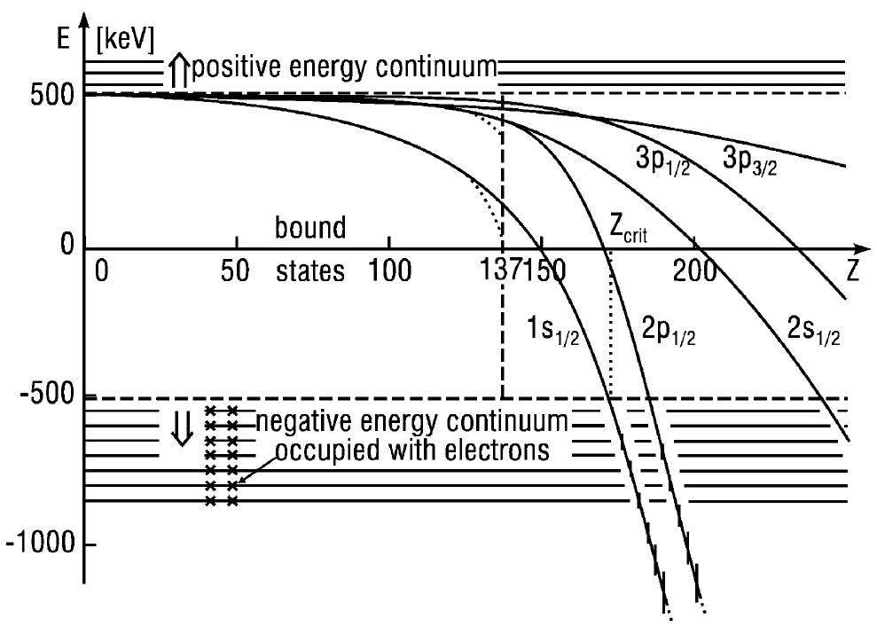
Atomic Physics at Extreme Fields
Critical- and Super-Critical Fields
1s
Electric Field Strength [V/cm]
2s
2p_{1/2}
173
Explore the Super-Critical Field Regime
- decay of the vacuum
- break down of QED ?
What happens if we increase the nuclear charge Z?
If nuclear charge of the ion is greater than Z_{crit} the ionic levels can “dive” into Dirac’s negative continuum.
Physical vacuum becomes unstable: creation of pairs may take place!

Slide 33
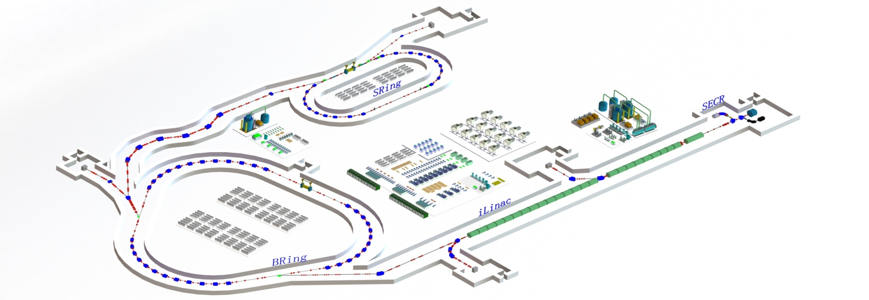
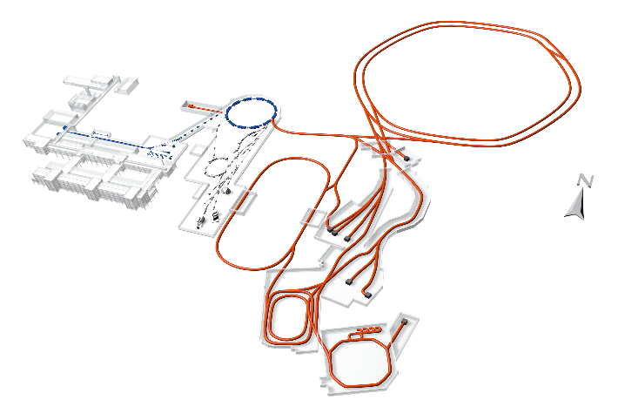
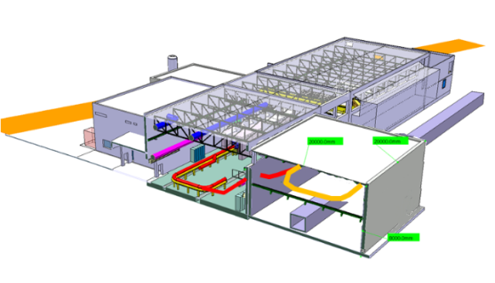
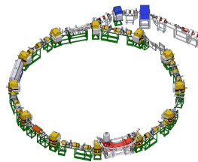
New/update Storage rings @ DR
HIAF
FAIR
TSR@ISOLDE
CRYRING@FAIR

Slide 34
Results of Li-like argon ions
Notes:
The total recombined rate coefficients including RR and DR for Ar15+ ions for c.m. energy up to about 40 eV. The DR resonances involve Δn = 0 transition of the 2s core electron. The energies of Rydberg states with configurations 1s22p1/2nl and 1s22p3/2nl, populated during recombination process are indicated by vertical lines.

