Slide 1



Accelerators
Validating
Antimatter
physics
Dr. Lee Devlin
University of Liverpool
Cockcroft Institute, UK

Slide 2

Overview
Background
Research
AVA Events

Slide 3
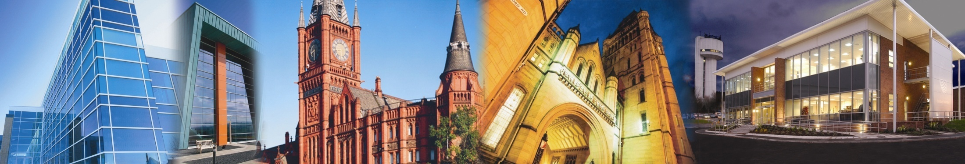




Accelerator Physics Group
2 academics
+30 members
Mostly at CI
But also:
  CERN
  RIKEN
  SOLEIL

Slide 4
The Cockcroft Model
(Universities) + (STFC: ASTeC and elements at DL)
+
Integration of all the above

Slide 5




Marie Curie Networks
  (Beam Diagnostics, Physics)
  4.2 M€, 32 partners
  (Laser Applications, Engineering)
  4.6 M€, 38 partners
  (Accelerator Optimization, Physics)
  6 M€, 35 partners
  (Medical Accelerators R&D, Life Sciences)
  4.0 M€, 24 partners
Largest portfolio of Marie Curie networks
in any scientific area.

Slide 6
The 2016 MSCA ITN Call
One of the most competitive (EU) funding schemes.
1,367 proposals were received in ETN scheme
Proposals were evaluated within 8 “Panels”
  CHE
  LIF
  ENV
  ECO
  SSH
  ENG
  MAT
  PHY
This is an excellent quality indicator for attractiveness
of antimatter research !
< 100 selected.
7 % !!

Slide 7
What is AVA ?
Funding for 15 Fellows
One of the largest Marie Curie networks in this call with a budget of around 4 M€
Gives industry an important role in training the next generation of scientists !
Allows for organizing (large) number of events.
Recognized importance of R&D into fundamental physics and accelerator
sciences at European level !

Slide 8












Beneficiaries

Slide 9














Partner Organizations

Slide 10
Accelerators
Validating
Antimatter
physics
Research and Training

Slide 11

Antimatter Facilities
Better facility design
New beam handling techniques
Online diagnostics
Improved detectors
Experiments: Novel cooling schemes
Spectroscopy on antihydrogen.

Slide 12
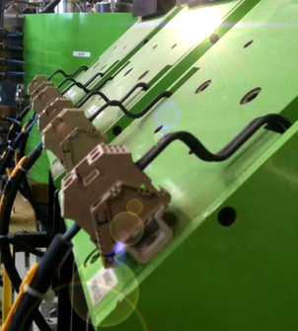
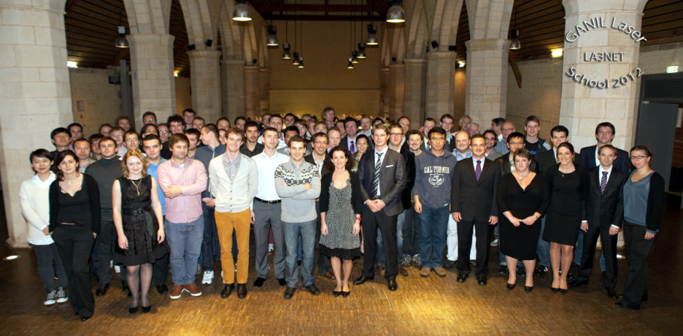
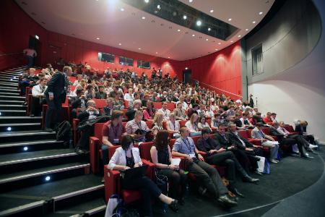
AVA Events
International Schools on Antimatter Physics and Fundamental Symmetries;
Topical Workshops on focused research topics – always across the different project Work Packages;
Final Conference and Outreach Symposium to present project results.
Events are open to all Fellows and wider community !

Slide 13
AVA Events - Details
 | Main Training Events & Conferences
1 | Complementary skills and media school
2 | HPC Training Week
3 | 1st AVA school on Antimatter physics
4 | Detector hands-on training
5 | Hands on beam diagnostics training
6 | TW: Optimization via diagnostics
7 | TW: Diagnostics in acclerators and experiments
8 | TW: Machine-Experiment interface
9 | 2nd AVA school on precision studies
10 | Advanced researcher skills school
11 | Workshop "Techology transfer
12 | Workshop "Researcher Careers"
13 | Final conference
Symposium will be held in June 2019 together with the OMA Project to maximize impact;
Final conference location will be decided in due time.

Slide 14
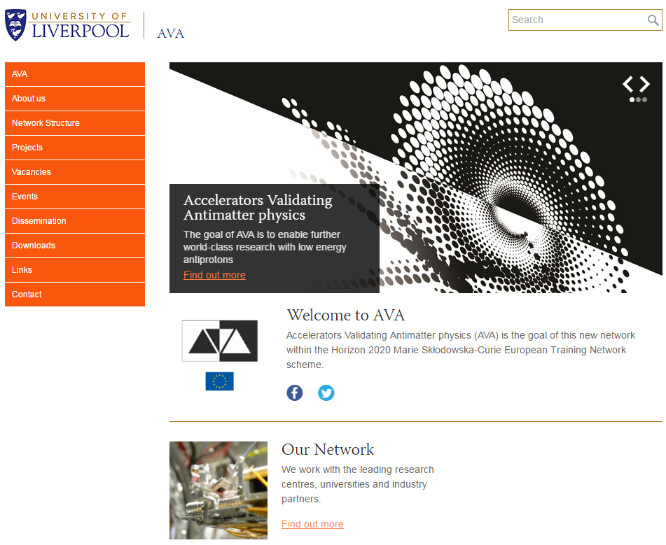

Project Web Site
URL: (http://www.)ava-project.eu
QUASAR Group + CI

Slide 15

MIRROR Newsletter
Main communication channel of the FLAIR collaboration
Quarterly newsletter for the antimatter research community
www.flairatfair.eu

Slide 16

Position Vacancies
15 Fellowships on offer for start spring / summer 2017;
R&D projects across the 3 AVA Work Packages;
International training program
Excellent salaries will be offered.
www.ava-project.eu

Slide 17
Summary
A major European initiative in antimatter research and accelerator science will start in January 2017;
Three work packages address many of the most important open challenges;
There are many opportunities for getting involved.
  Spread the word – participate – benefit

Slide 18
Contact and Further Details
Prof. Dr. Carsten P. Welsch
AVA Coordinator
Department of Physics
University of Liverpool
www.liverpool.ac.uk/physics
c.p.Welsch@liverpool.ac.uk

