Slide 1
X-RAY SPECTROSCOPY EXPERIMENTS AT EBIS FACILLITY IN KIELCE
Ł. Jabłońskiª, D. Banaśª, J. Braziewiczª, J. Czubª, P. Jagodziński^{b}, A. Kubala-Kukuśª, U. Majewskaª, D. Sobotaª, I. Stabrawaª, J. Szlachetkoª and M. Pajekª
ªInstitute of Physics, Jan Kochanowski University, Kielce, Poland
^{b}Department of Mathematics and Physics, Kielce University of Technology, Kielce, Poland

Slide 2
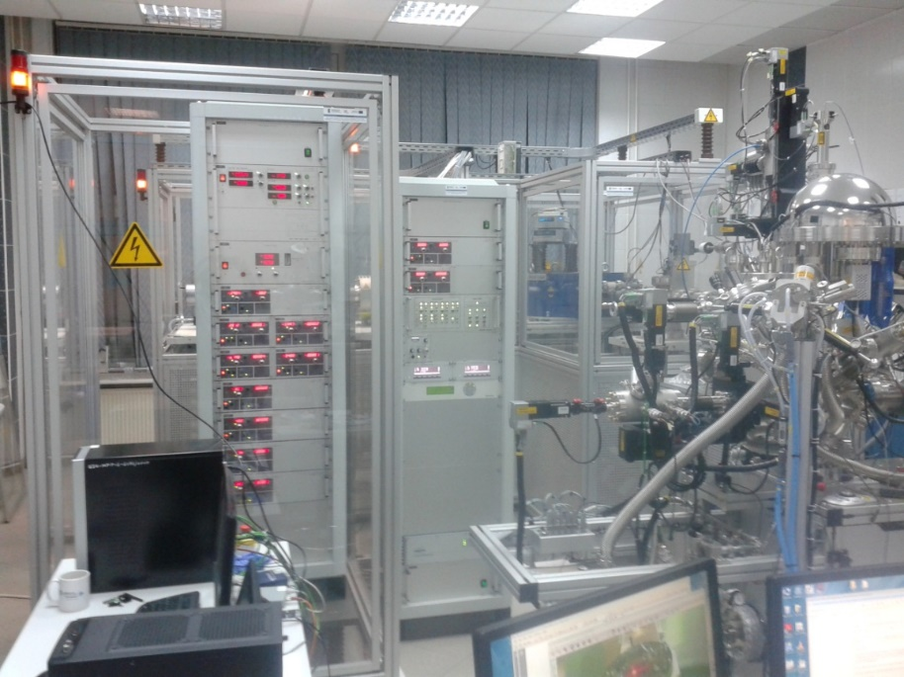
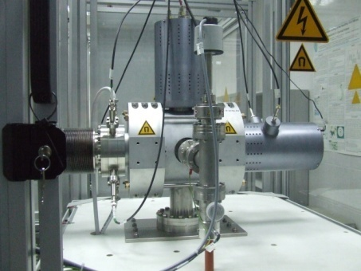
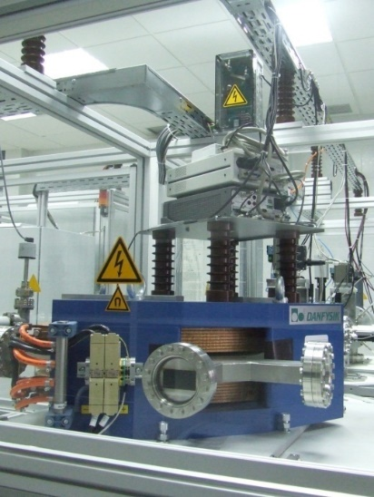
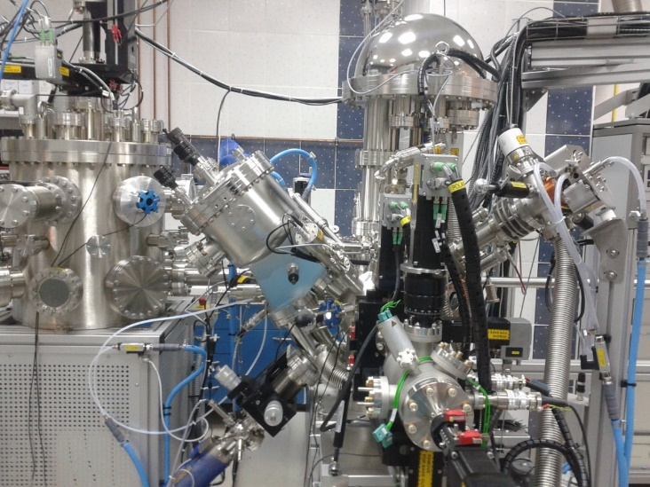
Kielce EBIS facility (Dreebit)
Dresden EBIT ion source
beam guiding components (Einzel lens, deflectors)
beam diagnostics (Faraday cups)
Charge state separation (double focusing analyzing magnet)
multipurpose target chamber
UHV system (10⁻¹⁰ mbar)
HV supplies & controls
DC and pulsed beams (10ns to 100 μs per pulse)
Typical ions energy 1 - 20 keV x q
EBIT source
dipole magnet
Experimental chamber (+XPS system)

Slide 3
charge states distribution
Xe^{q+} (q = 10 - 44) and Ar ⁺ (q = up to 18) ion beams
DC mode:
Xe⁴⁴⁺: ~ 4⋅10⁴ ions/s
AC mode:
Xe⁴⁴⁺ : ~ 7⋅10⁵ ions/s
Measurement of Xe^{q+} and Ar^{q+} beams charge states for different confinement times in the EBIS-A ion source.

Slide 4
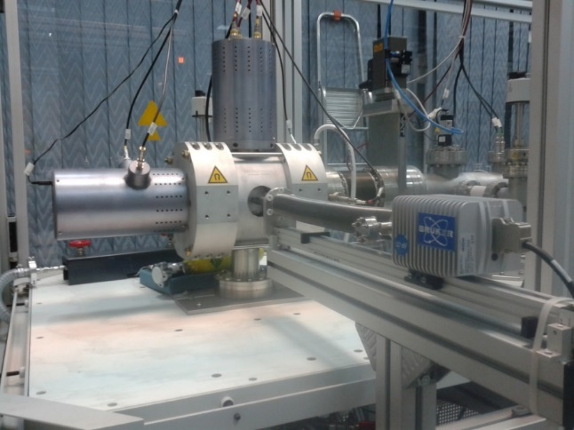
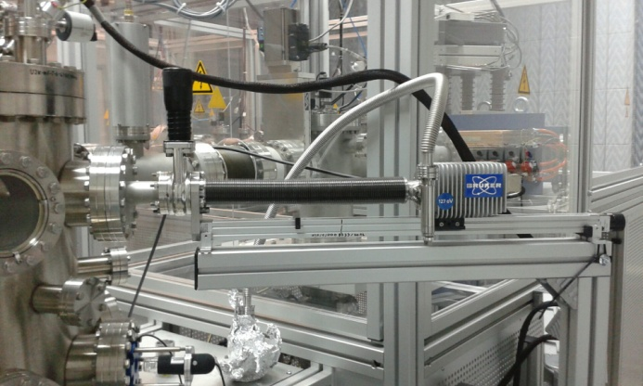
X-ray spectroscopy
Experimentsts in the EBIT:
Measurements of X-rays emitted in various atomic processes (electron excitation/ deexcitation, radiative recombination, X-ray fluorescence) in the EBIT plasma
Experiments in the chamber:
Measurements of X-rays emitted in interaction of highly charged ions with surfaces (formation of „hollow atoms”)

Slide 5
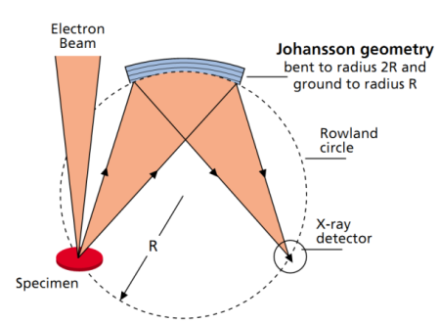
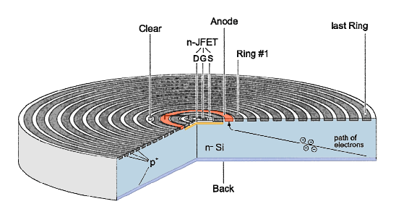
X-ray spectrometers
X-ray INCAWave (Oxford Instruments)
X-ray XFlash (Bruker GmbH)
Resolution = 1-20 eV
6-crystals diffraction spectrometer
Silicon Drift Detector (30 mm² active area)
Energy resolution - 127 eV (Mn Kα)
Be window - 12.5 μm
X-ray/ EUV energy range: 70 eV–15 keV
UHV compatibile via differential pumping

Slide 6
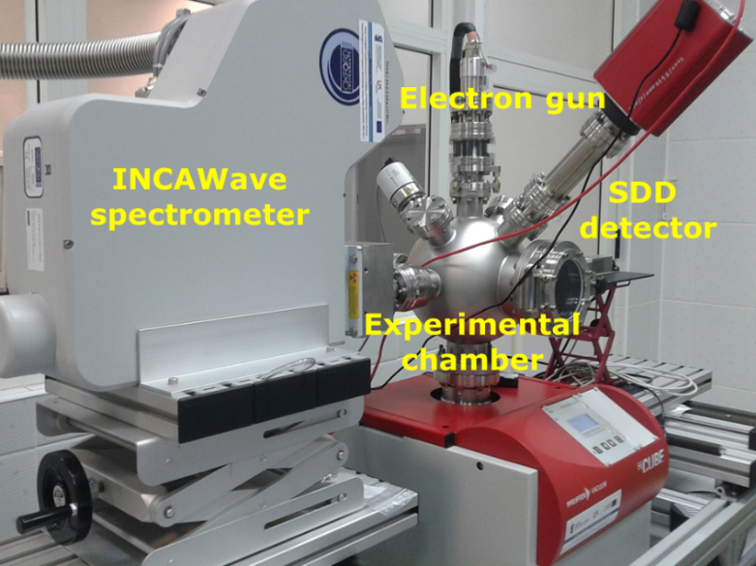
INCA Wave X-ray spectrometer
The INCAWave X-ray spectrometer will be used in the "out-of-focus" geometry, which needs additional investigations to determine its energy resolution and acceptance of lateral extensions of x-ray source.
Declared resolution confirmed!

Slide 7
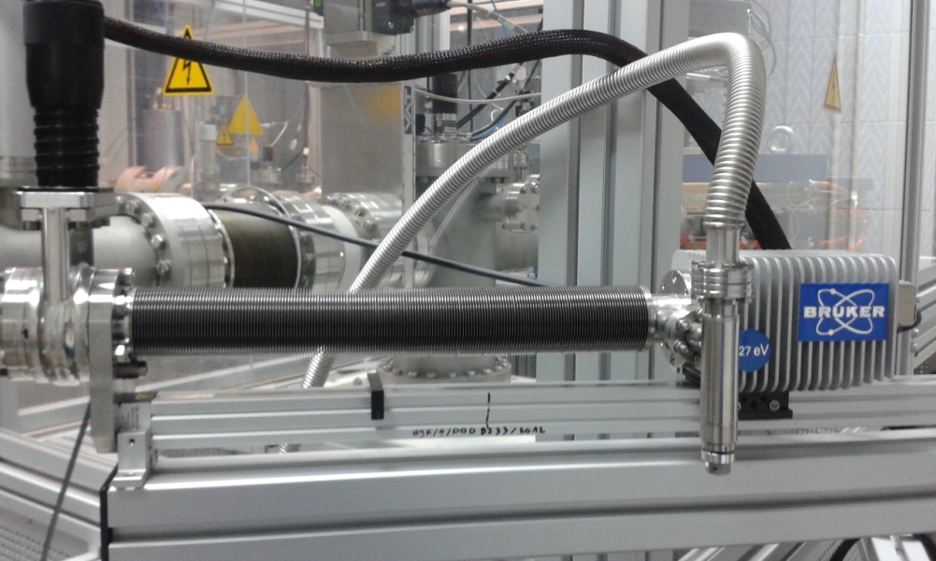
XFlash SDD X-ray detector
Thin beryllium window (12.5 μm) gives the opportunity to measure X-rays in low energy region (above 600 eV)
The detector energy resolution –
down to ~60 eV

Slide 8
EBIT ion source: X-ray spectrum of Xe^{q+} ions
X-rays emitted in EBIT carry information about various atomic processes such as:
Radiative recombination
X-ray fluorescence
Direct excitation/deexcitation to L-shell
Deexcitation to M-shell
Notes:
The low-resolution x-ray measurements deliver information important for understanding the dynamics and equilibration of the atomic processes occurring in the EBIT plasmas.
In turn, the high resolution studies of EUV/x-ray from the EBITs yield precise characteristics of a structure of few-electron ions and thus are important for testing the atomic structure calculations, in particular, using the relativistic multiconfiguration Dirac-Fock (MCDF) approach including QED corrections.

Slide 9
EBIT ion source: X-ray spectrum of Xe^{q+}
Radiative recombination to L-shell wasn’t observed (no holes in the L-shell)

Slide 10
EBIT ion source: X-ray spectrum of Xe^{q+}
Transitions to L-shell was observed (indication of direct electron impact excitation process)

Slide 11
EBIT ion source: X-ray spectrum of Xe^{q+}
Transitions to M-shell was observed (deexcitation to the holes in M-shell or direct electron impact excitation/deexcitation)

Slide 12
X-rays emitted in interaction of HCI with surface
X-rays emitted in interaction of Xe^{q+} ions with beryllium foil
Kinetic energy of ions: ~3 keV×q
Ion charge states: Xe²⁶⁺, Xe²⁷⁺, Xe³⁵⁺, Xe⁴⁰⁺
X-ray measured by SDD XFlash detector

Slide 13
X-rays emitted in interaction of HCI with surface
Measurements of xenon M-X-rays emitted from the interaction of Xe^{q+} ions with Be foil.

Slide 14
Interaction of HCI with surface
Auger Cascade
Resonat capture
X-rays
Ion
Solid
J. Burgdörfer, F. Meyer 1993 Phys. Scripta T46 225

Slide 15
Xe³⁵⁺ electron configuration
Satellite
4f
N
4d
4p
4s
Hypersatellite
3d
B. Rudek et al. 2012 Nature Photonics 6 858
M
3p
3s

Slide 16
X-ray spectrum of Xe³⁵⁺
Transitions from high Rydberg states up to n=20 (consistent with COB model)
Relative intensity of hypersatellites:
I_{h}~1/(m-1)^{α}
m=2÷10 α=0÷1.1
experimental broadering and broadering caused by satellite structure

Slide 17
Satellite structure of M-X-rays
Relative intensity of satellites:
I_{s}~1/(n-1)
n=1÷14

Slide 18
Relative population of electrons in high n-states
Increase of relative population of electrons in high n-states („hollow atoms”)
I~N_{k}

Slide 19
Summary
X-rays emitted from EBIT ion source carry information about atomic processes which occur in the cold, magnetized plasma
Analysis of M-X-ray spectra from interaction of higly charged ions with surface indicate formation of „hollow atoms”
Satellite and hypersatellite structure should be taken into acount to corectly interpret the spectra in both experiments
More complex MCDF calculation of electron binding energies are needed

Slide 20
Thank you for your attention!

Slide 21
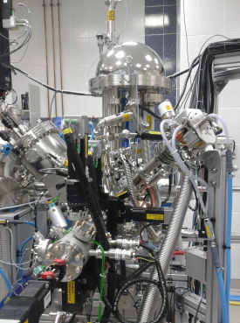
XPS system: multiprobe surface analysis
PHOIBOS 100 electron/ion energy analyser with 1D-DLD
X-ray source (Al/Ag) with quartz monochromator (160 meV)
X-ray source (Mg/Cr)
Ultraviolet source (HeI, HeII)
Scanning e-beam (4 μm)
Scanning ion-beam (100 μm)
Flood e-gun
Cleaning/sputtering ion source
Electron beam evaporator
5-axis VT (100-1000 K) sample manipulator
XPS/UPS, SEM/SAM, AES, ISS, GEXRF (planned)

Slide 22
Internal dielectronic excitation?

