Slide 1
Status of the ESR and Future Upgrades
M. Steck, Storage Rings
GSI Darmstadt

Slide 2
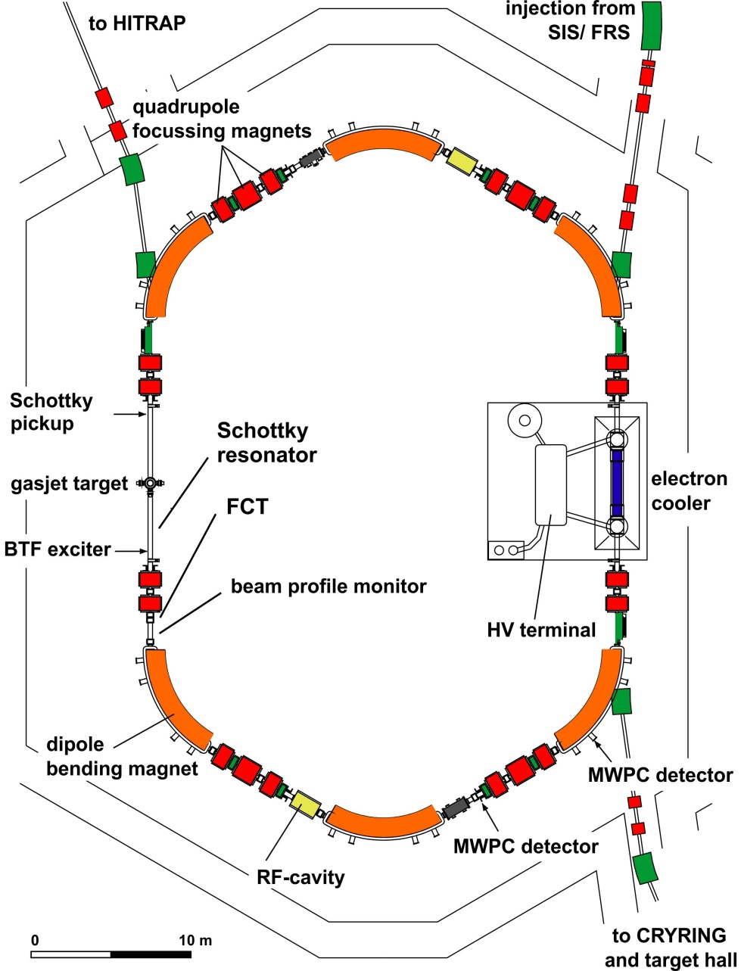
ESR Operation Modes
Fast injection (stable ions / RIBs)
Stochastic cooling ( ≥ 400 MeV/u)
Electron cooling ( 3 - 430 MeV/u)
Laser cooling (C³⁺ 120 MeV/u)
Internal gas jet target
Laser experiments
Acceleration/deceleration (down to 3 MeV/u)
Fast extraction to HITRAP (CRYRING)
Slow (resonant) extraction
Ultraslow extraction (charge change)
Beam accumulation
Multi charge state/multi component operation
Schottky mass spectrometry
Isochronous mode (TOF detector)
All these modes were established with the old accelerator control system

Slide 3
ESR Control System
all ESR components were controlled by a VMS based control system
i.e. not only accelerator components (magnets, rf, beam cooling)
but also experimental devices, e.g. beam diagnostics, detector pockets
and the timing system
all VMS systems were stopped in July 2016 and will not be continued
the entire control of the ESR has to be migrated to FAIR standards, i.e. LSA = LHC Software Architecture
LSA has been tested in SIS18 and will be used for CRYRING,
but there is no experience concerning ESR operations.
It is still under discussion to what extent hardware (interfaces, control units) will be modified for the new control system. Most likely only control computers will be replaced.

Slide 4
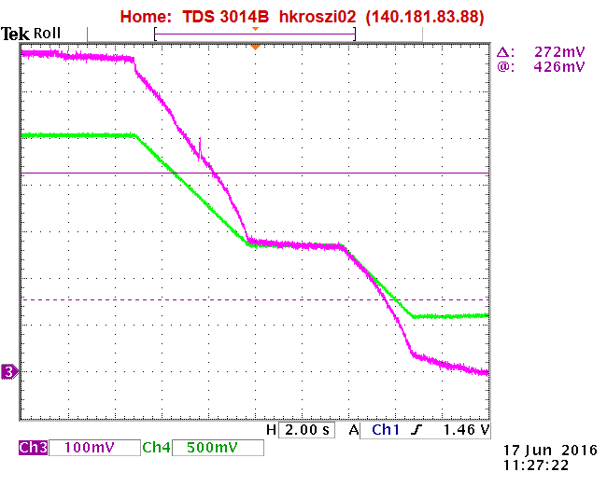
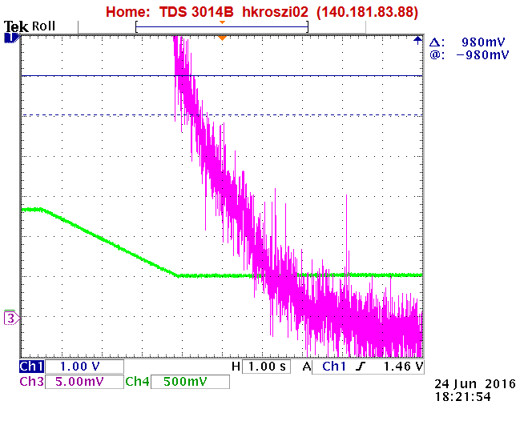
Recent Achievements: Deceleration
Lowest energy of 5.5 MeV/u of the stored decelerated beam for an internal experiment with very reliable machine performance,
deceleration of 2×10⁷ bare xenon ions (efficiency ≈ 30%).
Beam lifetime was limited by the detector set-up (T_{1/2} ≈ 1 s at 5.5 MeV/u).
Stable operation of the internal target with a hydrogen density of up to 1×10¹⁴ cm⁻² over days.
ion current
ion current at 5.5 MeV/u
magnetic
field
deceleration 100 – 30 – 5.5 MeV/u

Slide 5
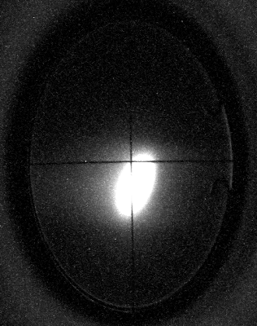
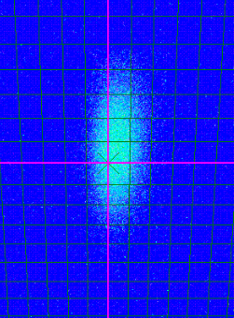
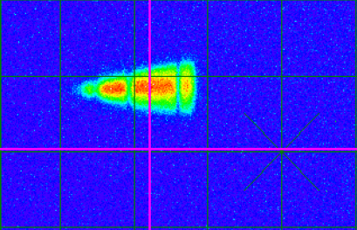
Fast Beam Extraction towards CRYRING
C.M. Kleffner & CRYRING team
5 August 2014
at exit ESR
p 200 MeV
26 August 2014
at intersection
N⁷⁺ 4 MeV/u
10 July 2016 (after 18 months shutdown)
transport of a 6 MeV/u C⁶⁺ beam
with a rigidity of 0.7 Tm along the beam line originally designed for 18 Tm and through
the CRYRING injection septum

Slide 6
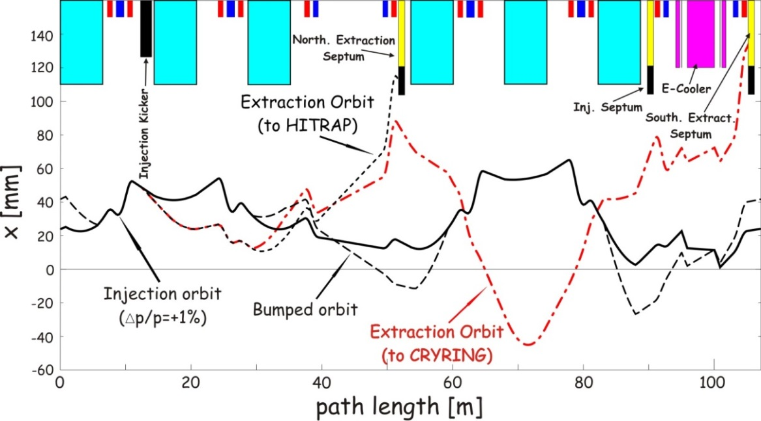
Fast Beam Extraction towards CRYRING
fast beam extraction from ESR to CRYRING is employing a sophisticated scheme
with a distorted closed orbit for the circulating beam before extraction to CRYRING consequence: no cooling during extraction, risk of unacceptable heating and emittance growth, particularly for highly charged ions
(expensive remedy: additional kicker in the northern arc)
S. Litvinov

Slide 7
Remarks on Deceleration in the ESR
cycle time
for full cycle presently > 40 seconds
limited by cooling time and hardware (electron cooling system)
faster ramping might come with the new control system
cycle time < 30 seconds requires considerable machine development
vacuum
for highly charged ions low 10⁻¹¹ mbar range is indispensable
conflicts with some internal experiments
⇒ coordination effort, complex beam time scheduling
efficiency
significant particle loss, but:
the new control system should provide more flexibility for tuning
low intensity beams (RIBs)
present beam diagnostics inadequate for < 10⁵ ions
⇒ lack of means for machine setting and tuning

Slide 8
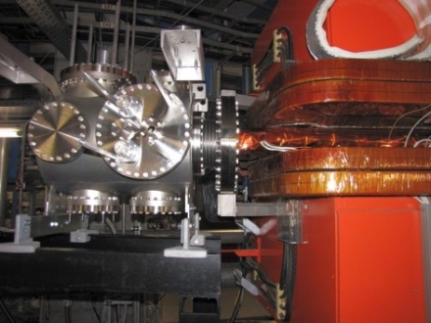
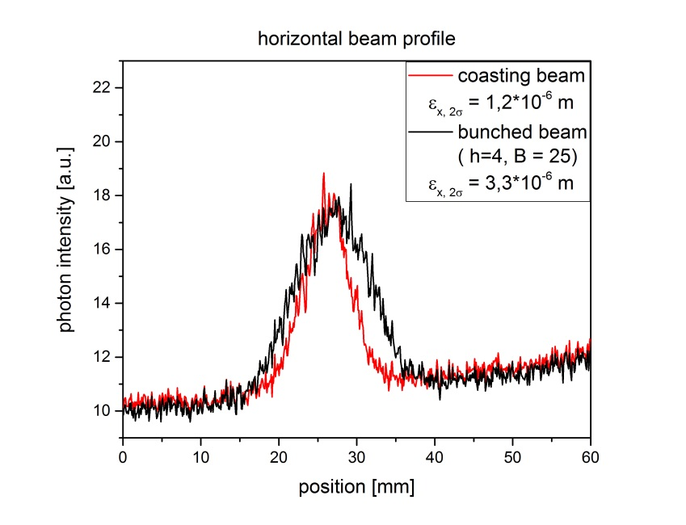
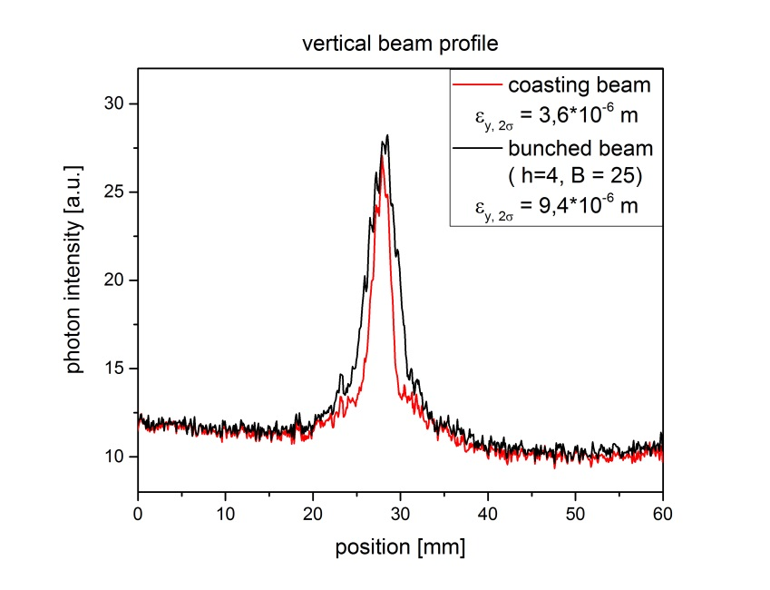
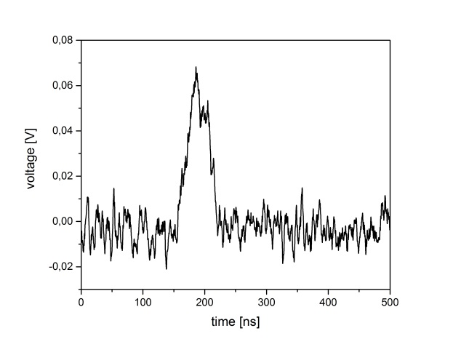
Recent Achievements: Beam Profiles
new beam profile monitor is commissioned, new software allows
more flexibility in measuring profiles
issue: lifetime of channel plate
C⁶⁺ 6 MeV/u
horizontal profile
vertical profile
1 bunch of 4
I_{i}=8 μA
N=2.6×10⁷
β_{x}=27.8 m
β_{y}=1.62 m
U_{rf}=100 V, h=4
40 ns (FWHM)
I_{e}= 60mA
T. Giacomini, R. Heß

Slide 9
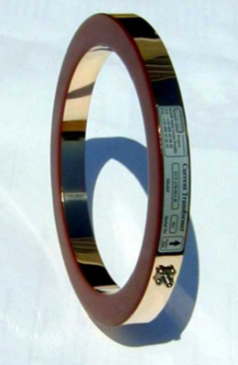
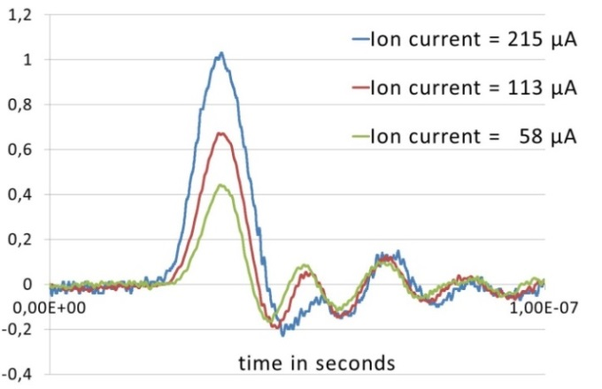
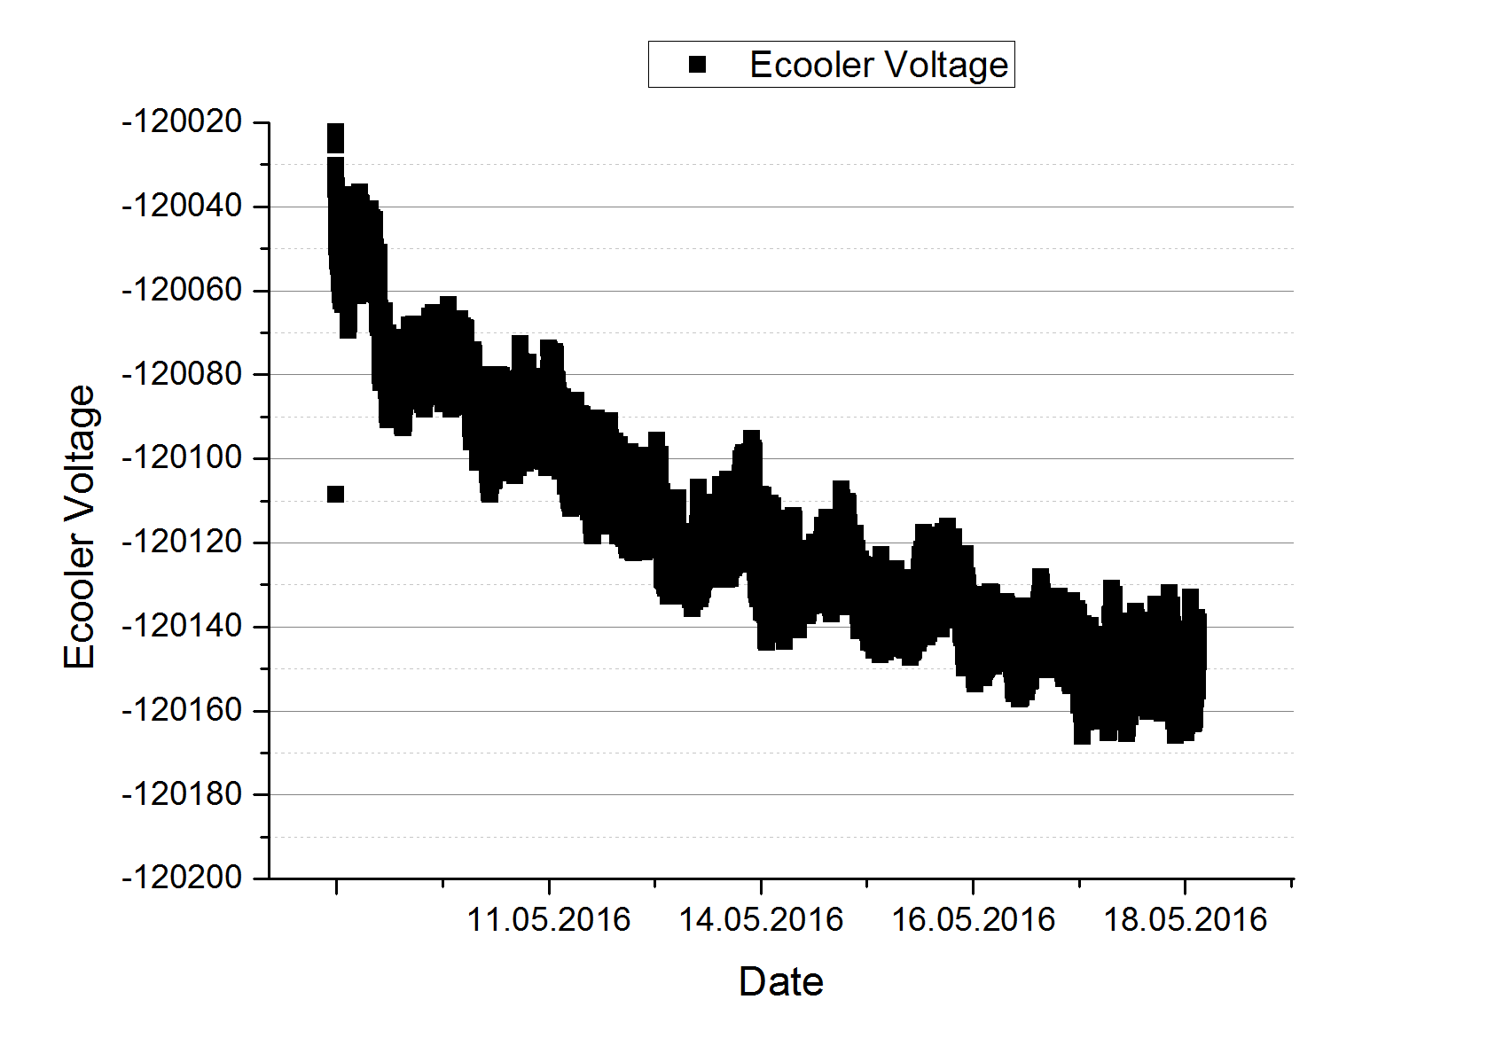
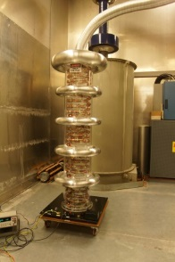
More Recent Achievements
the new fast current monitor was installed and employed in systematic measurements of bunched beams.
⇒ better understanding of limitations during deceleration
measurements of the accelerating voltage of the electron cooler with a commercial divider are not yet satisfactory.
ion bunch
H. Reeg, R. Heß
over one week
4×10⁻⁴ drift
(divider problem)
J. Ullmann, W. Nörtershäuser et al.

Slide 10
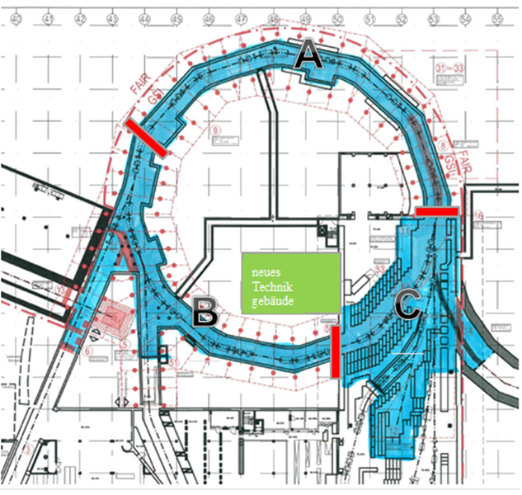
Shutdown 2016 - 2018
main task: civil construction work connecting SIS18 and SIS100 improvement of shielding
improvement of infrastructure
at ESR:
installation of a new barrier bucket cavity with space for an additional Schottky resonator (replacement of the second acceleration cavity)
repair of dipole vacuum chamber in northern arc
repair of electron cooler drift tube
refurbishment of beam diagnostics (funding?)
all activities for experiments should be listed and included in the overall shutdown schedule

Slide 11
Time Schedule for Shutdown and Operation
2016 – 2023
2016
2019
upgrade A2 und A3
2019
2023
Alvarez substitution
11/21 – 06/23
SIS18 operation for experiments:
08/18 - 11/18 (3 months)
07/19 - 11/19 (4 months)
07/20 - 11/20 (4 months)
07/21 – 11/21 (4 months)
Recommissioning of the ESR with the new control system requires largely SIS18 operation.

Slide 12
ESR Operation Beginning in 2018
recommissioning
extended ‘dry runs’ in the first half of 2018
machine operation interleaved with software implementation
operator training
importance of decelerated beams (HITRAP, CRYRING) ⇒ excellent vacuum conditions required
time estimate (based on previous commissioning)
basic operation (beam storage and cooling): 1 month
commissioning of all features: 2-3 months
(i.e. orbit control, deceleration, extraction fast/slow, all diagnostics)
not including the implementation of new features

Slide 13
ESR Operation Beginning 2018
what are the priorities for ESR experiments?
SPARC, NUSTAR
target developments
beam cooling developments
vacuum issues
new detection systems (e.g. detector drives)
what additional new features are requested?
operating modes
special ion optics (e.g. orbit control, dispersion control, isochronous mode)
new beam diagnostics
this is also important for upgrade measures which have to be defined for the shutdown period and need to be discussed with the GSI management with respect to money and human resources

