Slide 1
APPA R&D – BMBF Collaborative Research in Germany
Atomic and Plasma Physics and Applied Sciences
Stefan Schippers
APPA R&D coordinator
Justus-Liebig-Universität Gießen, Germany
SPARC Topical Workshop, Krakow, Poland 16-20 September 2016

Slide 2
APPA
Collaborations
international group of more than 600 scientists from 30 countries
SPARC
Spokesperson: R. Schuch,
Stockholm University
Coordinator: A. Bräuning-Demian, FAIR
BIOMAT
Spokespersons: M. Durante, C. Trautmann,
GSI and TU Darmstadt
Coordinator: R. Pleskac, FAIR
Atomic Physics
Biophysics &
Materials Research
HEDgeHOB
WDM
Spokespersons: D. H. H. Hoffmann,
TU Darmstadt
F. Rosmej,
Sorbonne University Paris
Coordinator: S. Neff, FAIR
FLAIR
Spokesperson: C. Welsch,
University of Liverpool
Physics with
Low-energy Antiprotons
Plasma Physics

Slide 3
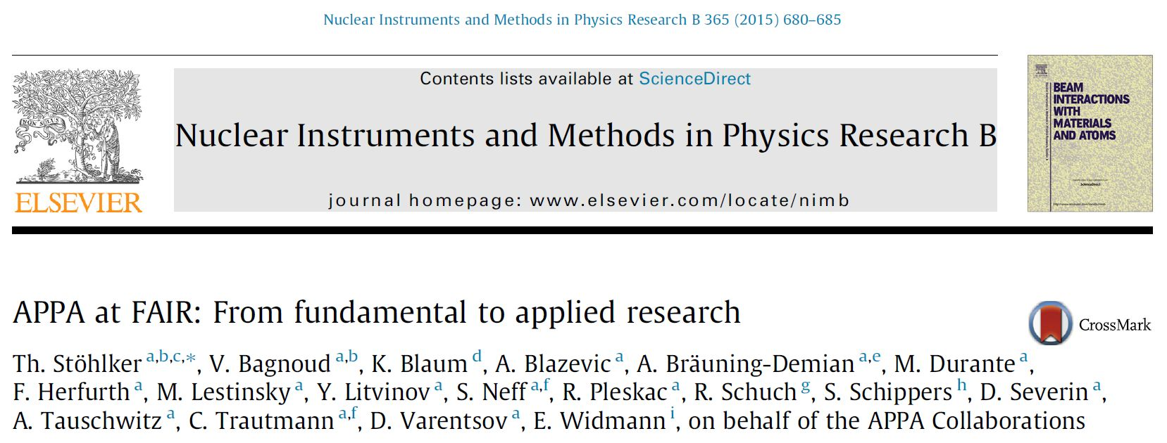
Atomic and Plasma Physics and Applied Sciences
NIM B 365 (2015) 680
APPA white paper

Slide 4
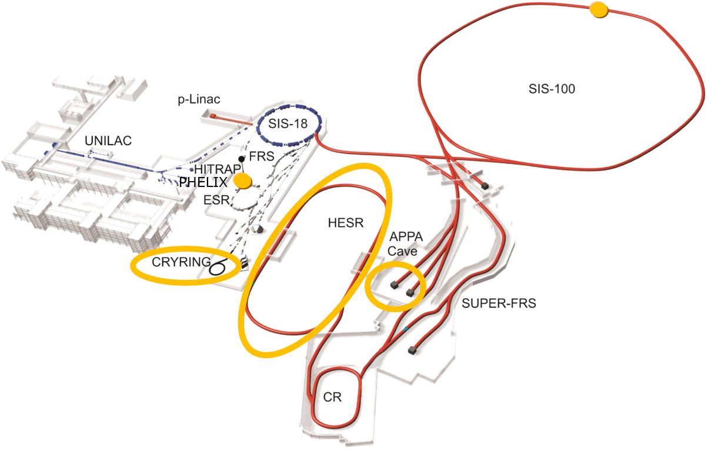
FAIR MSV
APPA Facilities
SIS-100
HESR
APPA-Cave
ESR
HITRAP
CRYRING

Slide 5
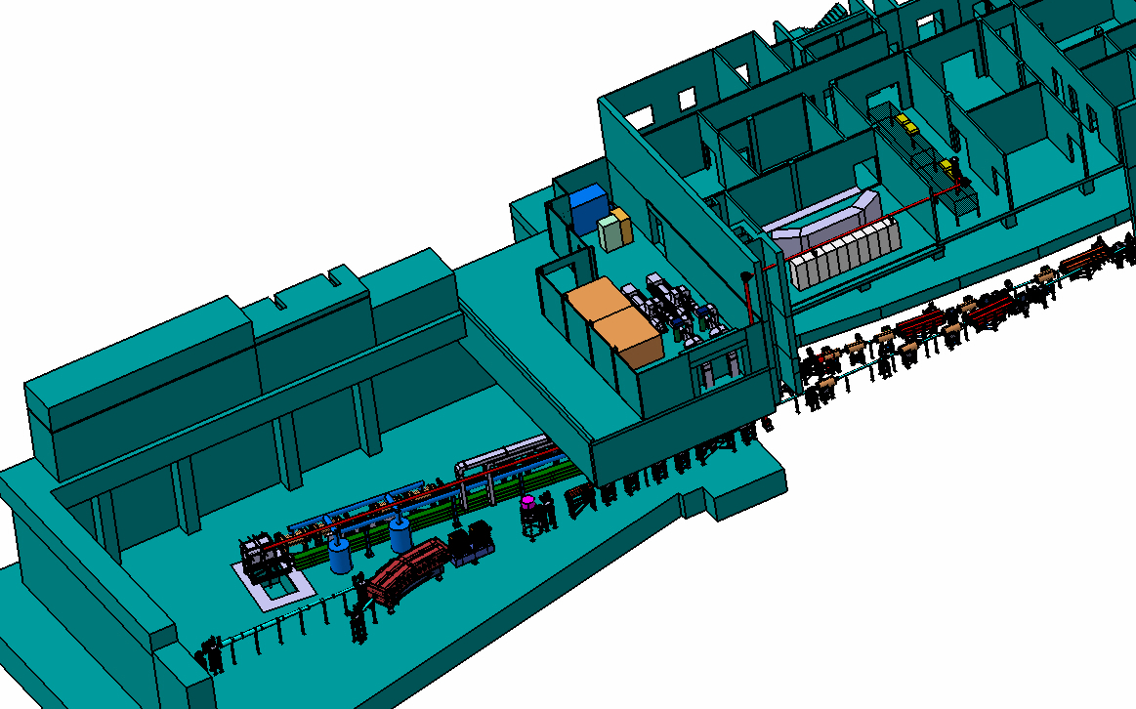
FAIR MSV
APPA Cave
protons (10 GeV): 2 x 10¹³ p/bunch
U²⁸⁺ (2 GeV/u): 5 × 10¹¹ ions/bunch
U⁹²⁺ (10 GeV/u): 10⁸ ions/s
user facility
several target stations
flexible detector settings
flexible beam shaping
external drivers
SPARC/BIOMAT
beamline
HEDgeHOB/WDM
beamline

Slide 6
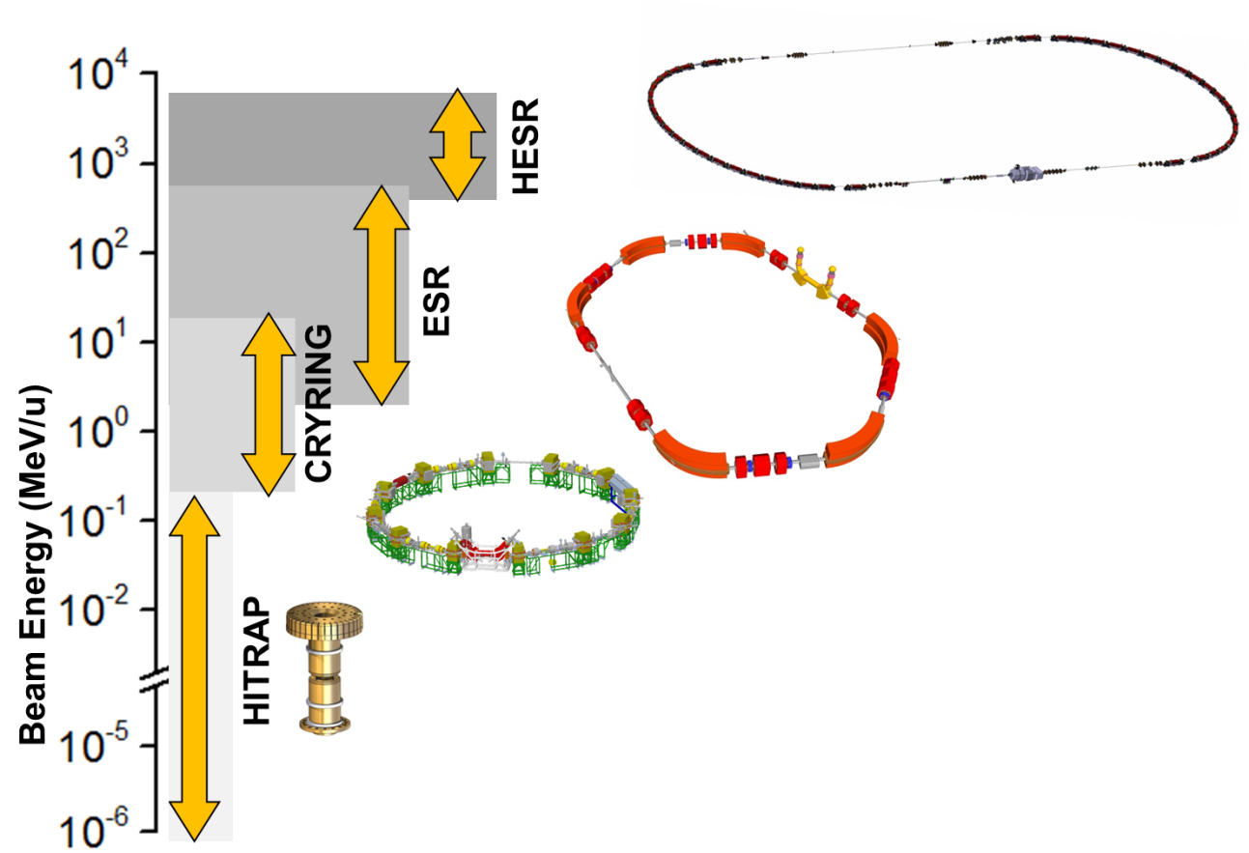
FAIR MSV
Trapping and Storage Facilities
highly charged ions (e.g. U⁹²⁺) and exotic nuclei
from rest to relativistic energies (up to 6 GeV/u)
cooling: The key for precision
from single ions to highest intensities
worldwide
unique

Slide 7
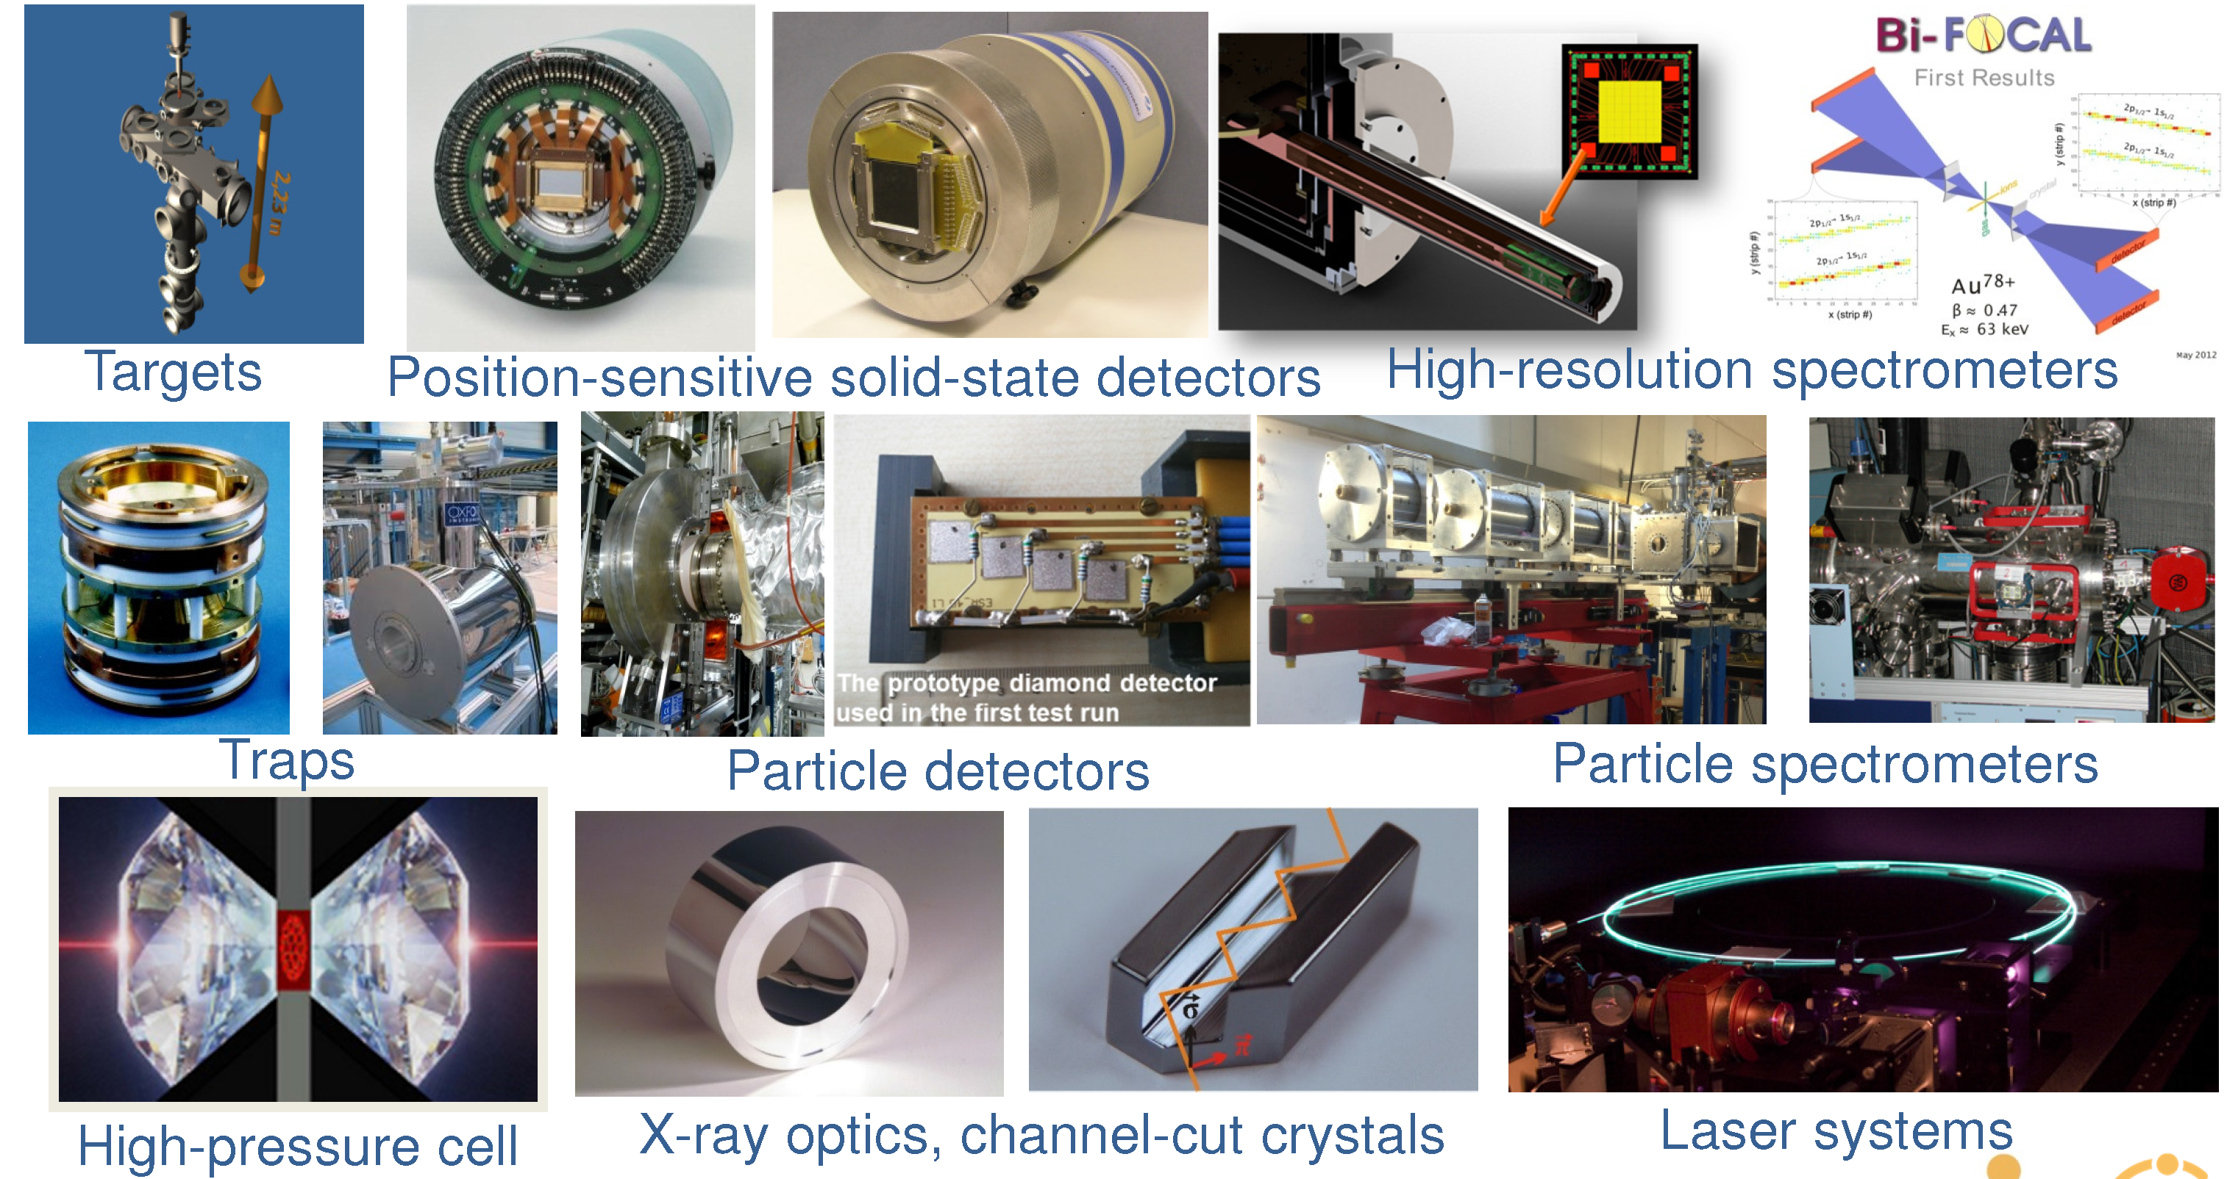
Instrumentation granular, versatile, state-of-the-art
detection systems for photons, electrons, positrons, and ions

Slide 8
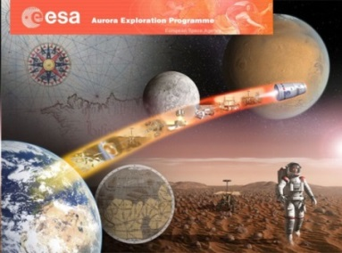
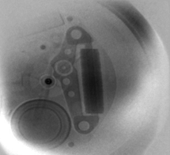
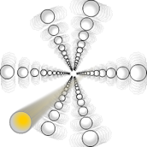
APPA Day-1 2021/2022
(prominent examples)
BIOMAT (Biophysics and Materials Research)
materials under extreme conditions (pressure, heat, irradiation)
radiation shielding of cosmic radiation
Day-1 experiments (TDRs: 1 in preparation)
  sample irradiation at APPA cave using high pressure cells
  irradiation of biological samples at APPA cave
HEDgeHOB/WDM (Plasma Physics)
phase transitions shocked/compressed matter
opacity measurements of warm dense matter
Day-1 experiments (TDRs: 5 approved, 1 submitted, 4 in preparation)
  proton microscopy of shocked/compressed materials at APPA cave
  opacity changes from cold- to warm dense matter at APPA cave
SPARC (Atomic Physics)
precision test of QED in the strong field domain (αZ≈1)
model independent determination of nuclear parameters
  Day-1 experiments (TDRs: 7 approved, 2 in preparation)
  ion channeling at APPA cave
  laser spectroscopy at HESR (fine-structure) and at CRYRING (hyperfine)
Notes:
SPARC TDRs
approved: Gastarget Grisenti, APPA@HESR, CRYRING
submitted: Experiments@CRYRING, Eperiments @HESR, Spectrap, 2xMicrocalorimeters
in preparation: Instrumentation APPA Cave, …
Hallo Stefan,
ich habe mir die Folie von Thomas angeschaut. Was da steht, ist O.K. Das ist tatsächlich die Statistik der TDRs. Allerdings die Darstellung könnte irreführend sein. Die Folie beschäftig sich mit dem Day-one Experiments, aber die Liste beinhaltet ALLE mögliche APPA TDRs. Die day-one Experiments werden nicht automatische ALLE dies items ( TDRs) brauchen.
Die TDRs von SPARC sind:
HESR jet target und CRYRING (approved)
Cryring Instrumentation, HERS Instrumentation, SPECTRAP; Microcallorimetrs 1 and Mircocalorimeter 2 , submitted und under evaluation
APPA cave setup for SPARC und BioMAt ( ein gemeinsamen TDR), CRYRING Instrumetation_2, Laser cooling in SIS 100, CRYRING jet Target) sind in preparation. Ob diese 4 oder 5 werden ist abhängig wie wir die Geräte gruppieren und wie die Kollegen fertig sind.
Grüsse,
Angela

Slide 9
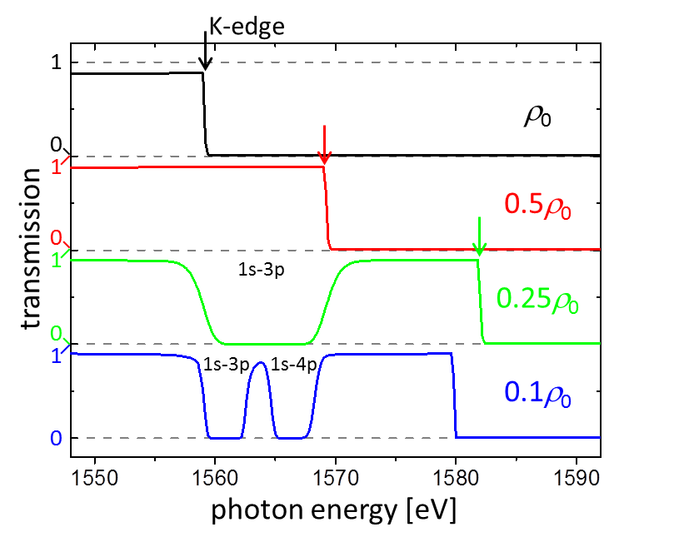
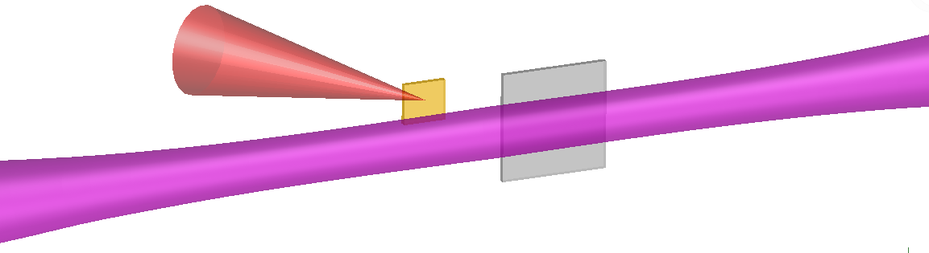
APPA Science at Day-1 another example
  K-shell absorption spectroscopy in dense plasmas
continuum lowering: fundamental phenomenon in plasma physics
recent experiments in dense plasmas show significant discrepancies
in contrast: FEL- and HP-laser produced plasmas: hot, highly non-equilibrium
high-power laser drives x-ray source for probing
Aluminium
laser beam
(100 J, 0.5 ns)
Al-foil
(5 μm)
Δt=22 ns
ion beam
FAIR
K-edge shift
M-shell rebinding
rapid heating by intense heavy-ion pulse
hydro-expansion to ρ = 10%...50% ρ₀
Experiment at FAIR will access transition from dense gas to metal.

Slide 10
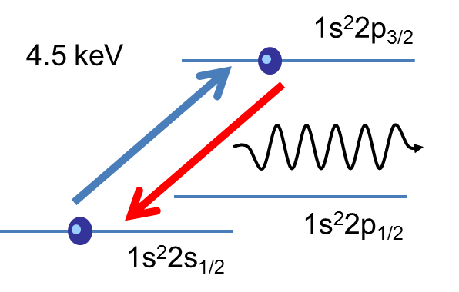
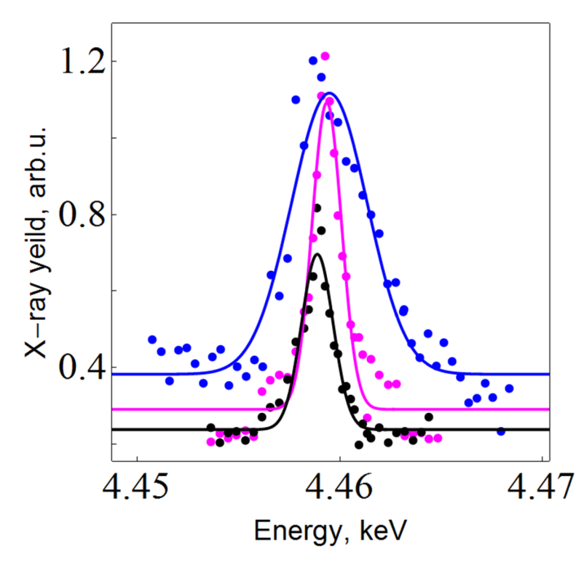
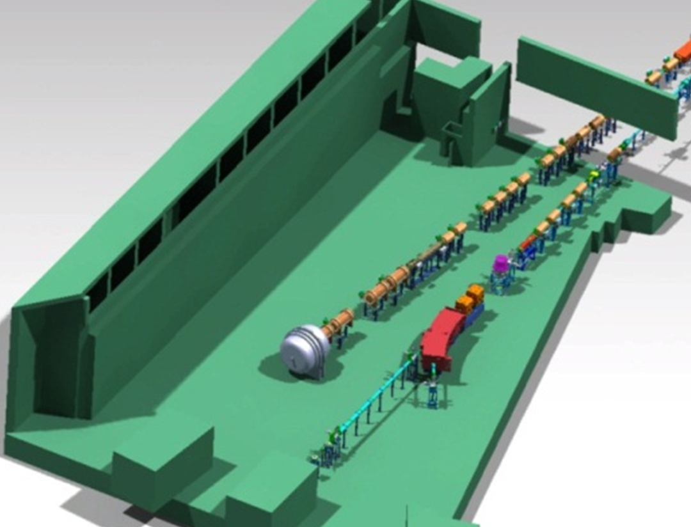
APPA Science at Day-1 one example
Resonant Coherent Excitation at relativistic energies (test@SIS18/ESR: 2014)
U⁸⁹⁺
Ion Channeling
7.0 mm
2.5 mm
1.0 mm
FWHM = 4.4 eV
FWHM = 1.6 eV
FWHM = 1.3 eV
Y. Nakano et al., PRA 86, 060501 (R) (2013)
Only moderate beam intensities are required !
Y. Nakano et al., PRA 87, 060501 (R) (2013)
FAIR SIS100: Excitation of 1s-2p in U⁹¹⁺ via RCE possible for the first time.

Slide 11
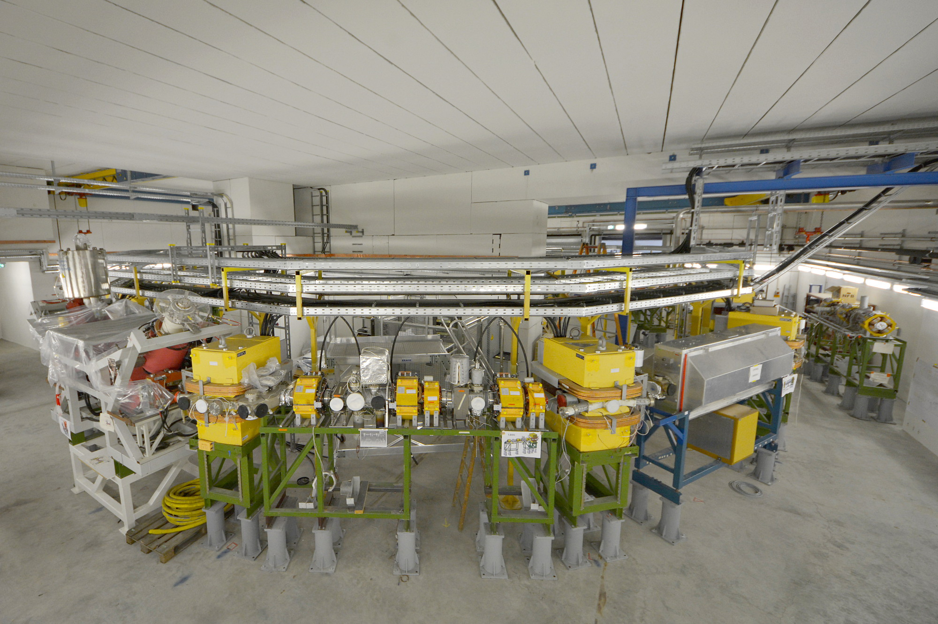
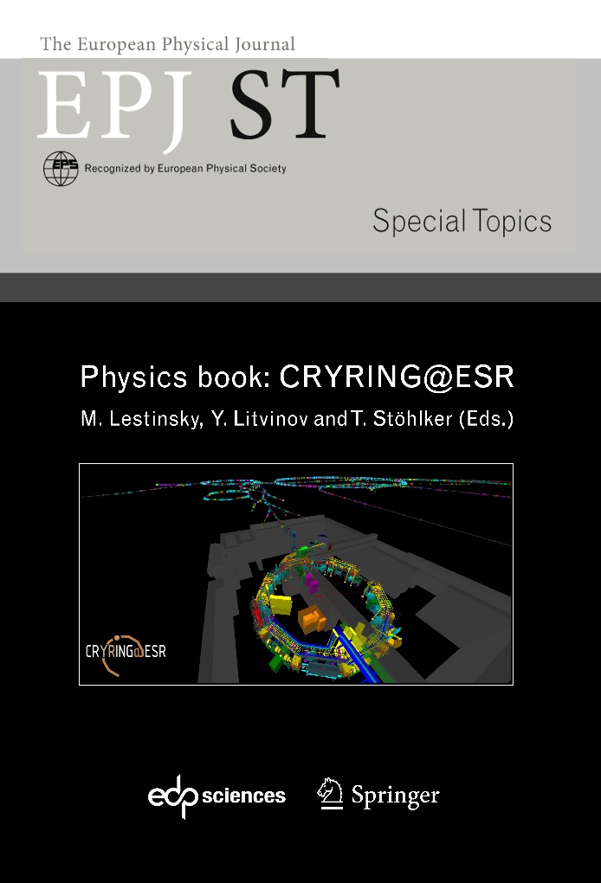
CRYRING@ESR
bei FAIR
Collaboration
AP/GSI-Darmstadt
HI-Jena
KVI Groningen
Univ. Cracow
Univ. Jena
Univ. Stockholm
in print
Ion sources already in operation.
Commissioning 2016

Slide 12
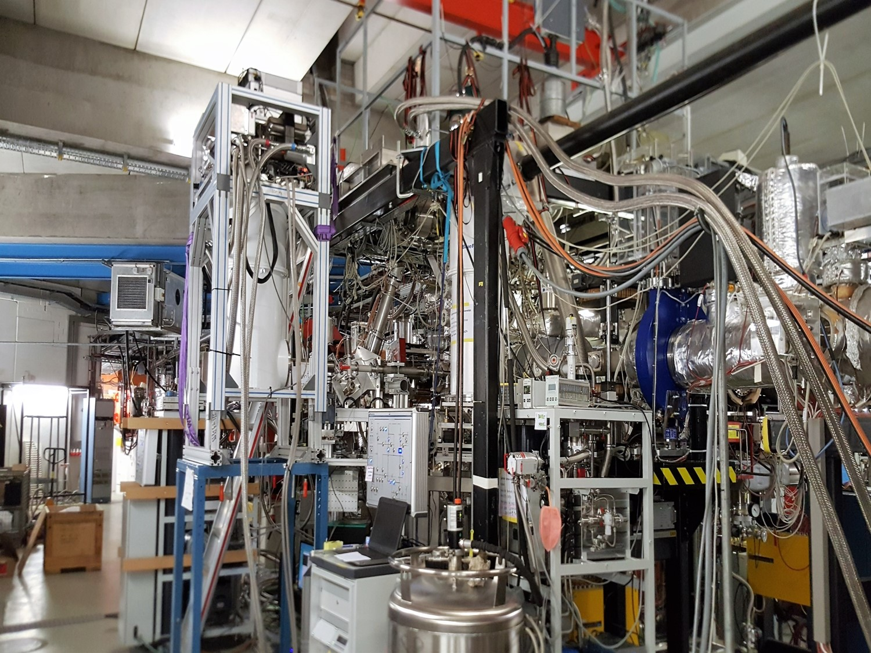


Heidelberg/HI-Jena
Micro-Cal
GSI/Frankfurt
Internal-Target
Gießen
Micro-Cal
Kassel
UV-XUV
GSI
Schottky
SPARC phase 0
ESR
Mai-Juli 2016
Verbundforschung

Slide 13
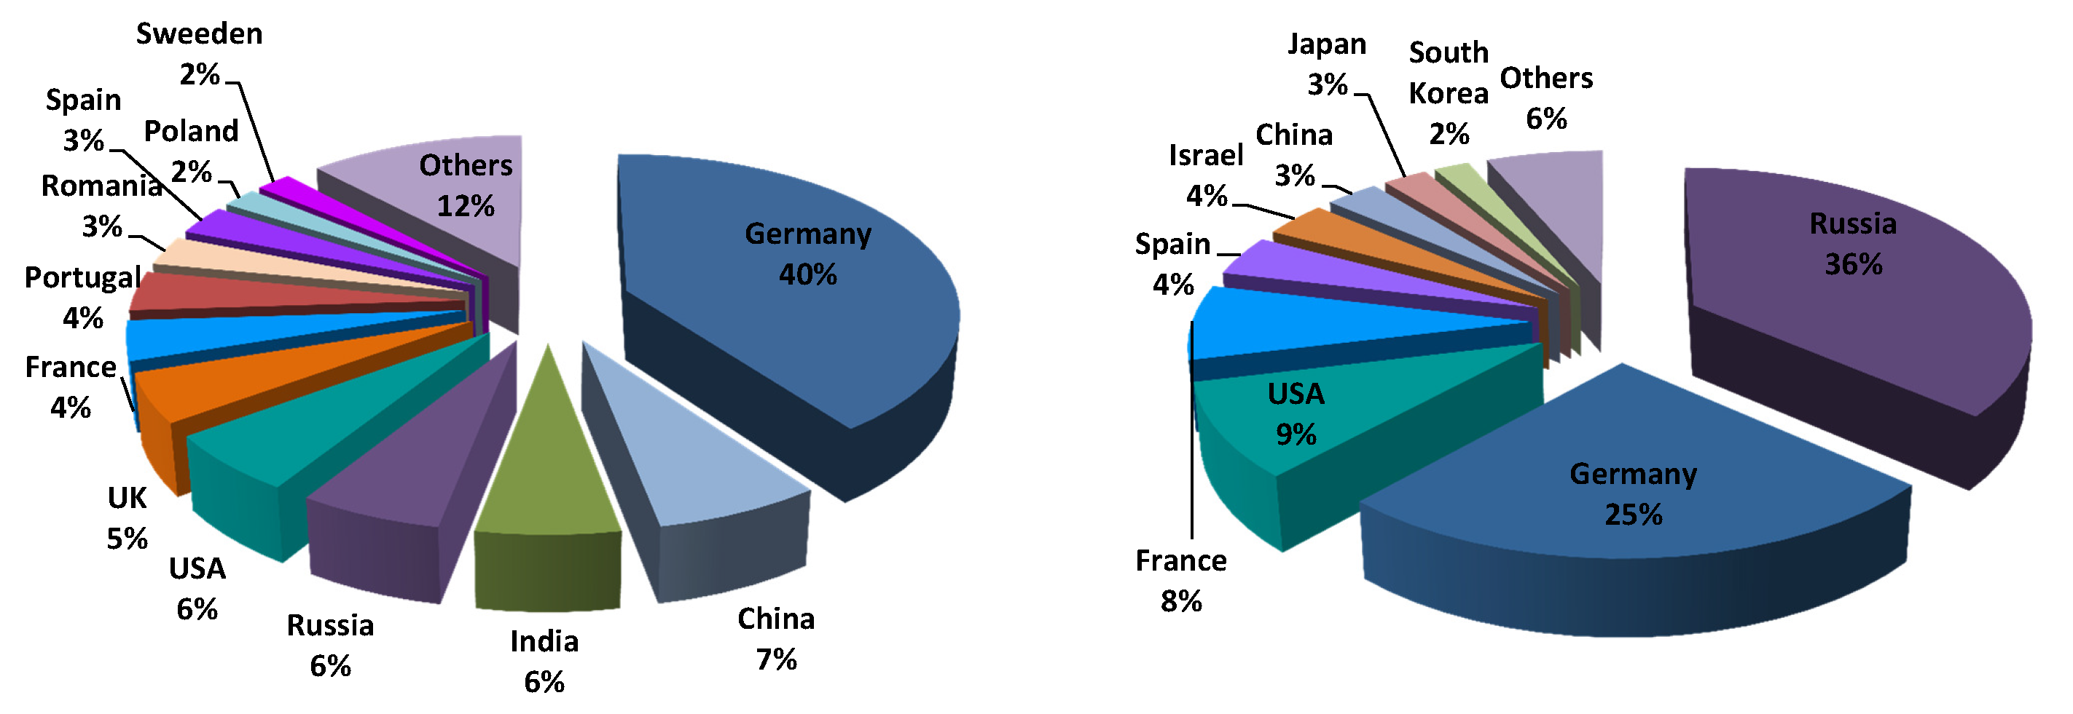
APPA
International
HEDgeHOB / WDM:
240 members
SPARC: 413 members
BIOMAT: 180 members

Slide 14
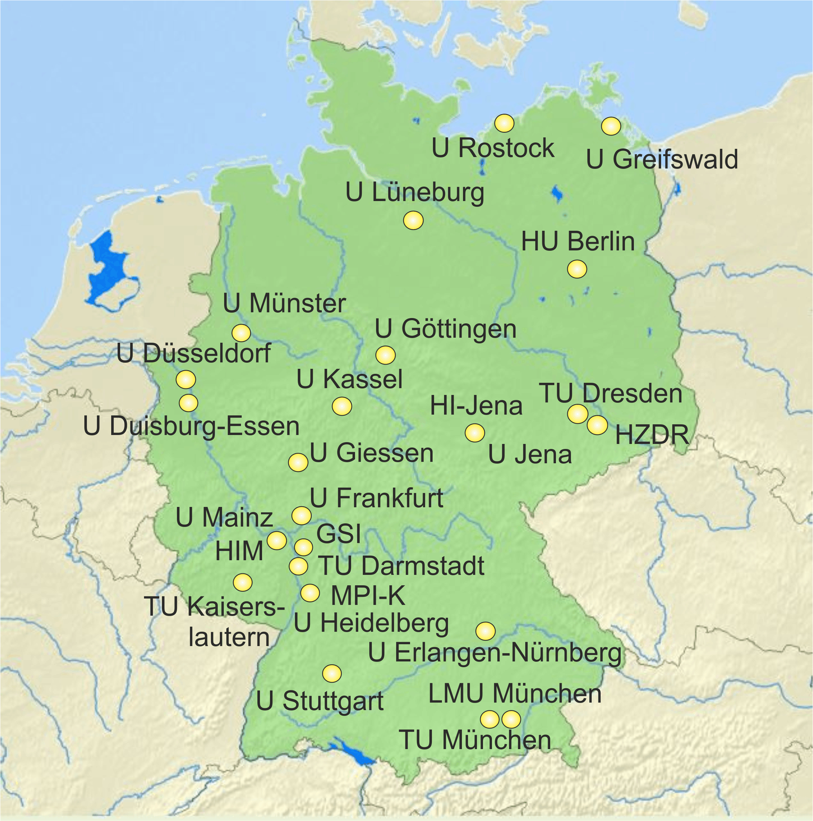

APPA R&D
German University Groups
BMBF-Verbundforschung
SPARC, PLASMA
31 applications, 22 funded by the
program “Physics of the Smallest
Particles”
coordinated by S. Schippers (Giessen)
BIOMAT
8 applications, 4 funded by the
program “Condensed Matter”
coordinated by
M. Schleberger (Duisburg/Essen)
HS Rhein-Main

Slide 15
Mission of APPA R&D
The APPA R&D research collaboration pursues coordinated research projects in the area of accelerator based experiments with heavy ions at the future FAIR-installation. Central issues are:
Further development of the experimental infrastructure, in particular, research,
Development for enhancing the scientific capabilities of the existing installations and of the future accelerator and detector systems including the respective base technologies,
Set-up of the APPA experiments of the modules 0-3 of the modularized start version of FAIR,
Providing a contact point between BMBF and APPA.

Slide 16
APPA R&D funded projects (6.8 M€)
Funded projects 2015-2018 (Physics of the Smallest Particles)
Solution of the time-dependent Dirac equation for highly charged ions in laser pulses of highest intensities, Humboldt-Universität zu Berlin
Development of a precision high-voltage divider and of fluorescence detectors for the storage ring CRYRING / Further development and deployment of
single-photon detectors for laser spectroscopy at ESR and at SPECTRAP, Westfälische Wilhelms-Universität Münster
Research for the implementation of laser cooling and interaction with matter at FAIR, Technische Universität Darmstadt
Laser spectroscopy at CRYRING and HITRAP — New techniques for laser spectroscopy at GSI, Technische Universität Darmstadt
Development of diagnostics and simulations for plasma physics experiments at FAIR, Johann Wolfgang Goethe-Universität Frankfurt am Main
Detectors for charge-changed ions at CRYRING: Detector manipulators and UHV-compatible Si-detectors, Johann Wolfgang Goethe-Universität Frankfurt am Main

Slide 17
APPA R&D funded projects (6.8 M€)
Funded projects 2015-2018 (Physics of the Smallest Particles)
Construction and tests of experimental installations for electron-collision spectroscopy and for x-ray spectroscopy, Justus-Liebig-Universität Gießen
High-resolution Seya-Namioka-fluorescence spectrometer for the spectral band 35–700 nm for experiments at heavy-ion storage rings, Universität Kassel
Spectroscopy of plasmas at FAIR, Friedrich-Schiller-Universität Jena
Light-matter interaction with highly charged ions, Friedrich-Schiller-Universität Jena
Micro-calorimeter-arrays und quantum-gas target for experiments at GSI/FAIR, Ruprecht-Karls-Universität Heidelberg
Optical beam diagnostics for intense ion beams, Technische Universität München
Cooling of beams of highly-charged ions at highly relativistic energies with pulsed-laser systems, Technische Universität Dresden
lasers & x-rays: spectroscopy, diagnostics
targets & traps
particle detection and identification
theory: time-dependent phenomena, simulations

Slide 18
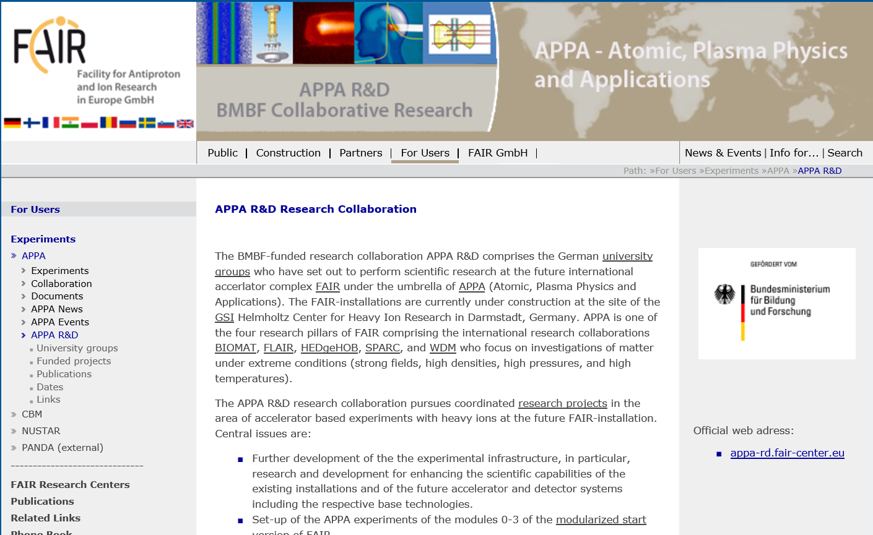
APPA R&D web pages
http://appa-rd.fair-center.eu/

Slide 19
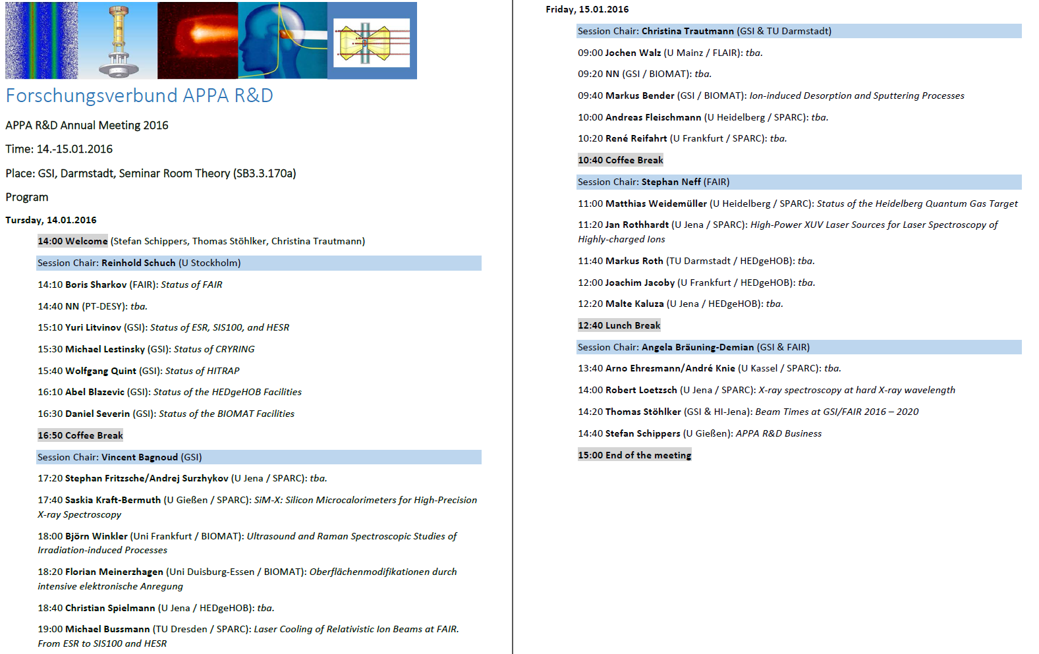
APPA R&D meeting 14./15.01.2016

Slide 20
APPA R&D upcoming events
15 September – 15 October 2016
election of new members of KHuK (Representation of German Nuclear and Atomic Physicists at large-scale
research facilities)
candidates from SPARC: Y. Litvinov and A. Surzhykov
12 – 13 January 2017
APPA R&D collaboration meeting at GSI

Slide 21
The End
Thank you for your attention!

