Slide 1
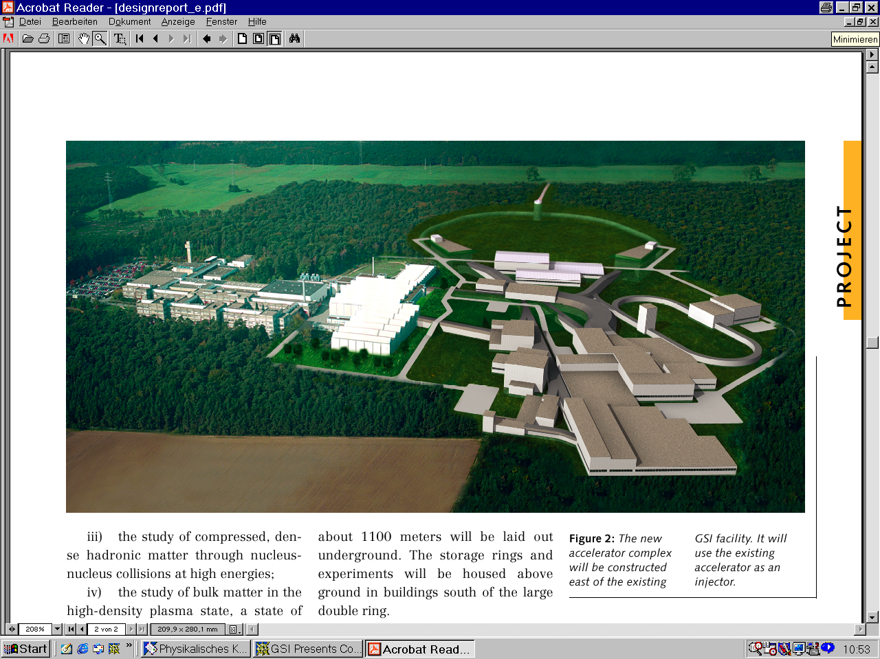

Welcome to the SPARC Collaboration Meeting, Krakow, Sept. 16, 2016
Krakow, Sept. 16, 2016
AUSTRIA
Vienna University of Technolgy
CANADA
University of Manitoba
York University
CHINA
China Institute of Atomic Energy, Beijing
Institute of Applied Physics and Computational Mathematics, Beijing
Institute of Modern Physics, Fudan University, Shanghai
Institute of Modern Physics, Chinese Academy of Sciences, Lanzhou
Institute of Atomic and Molecular Physics, Jilin University, Jilin
Lanzhou University, Lanzhou
University of Science and Technology of China, Hefei
Wuhan Institute of Physics and Mathematics, Wuhan
Physics Department, Northwest Normal University
Department of Physics and Astronomy, University of Aarhus
DENMARK
Department of Physics and Astronomy, University of Aarhus
EGYPT
Physics Department, Beni-Suef Faculty of Science
FRANCE
Laboratoire kastler-Brossel, Ecole Normale Sup. Paris
INSP, Univ. Pierre et Marie Curie
CIRIL Ganil
Ecole Normale Superieure – Lyon
Institut de Physique Nucléaire de Lyon
GERMANY
Ernst Moritz Arndt Universität Greifswald
Forschungszentrum Jülich
Freiburg University
GSI, Darmstadt
Institut für Kernphysik, Justus-Liebig-Universität Gießen
Institut für Atom- und Molekülphysik, Justus-Liebig-Universität Gießen
Sektion Physik, LMU Munich
Max-Planck-Institut für Kernphysik, Heidelberg
Institut für Theoretische Physik, TU Dresden
Tübingen University
IKF, J.W.v.Goethe Universität Frankfurt am Main
Institut für Physik, Universität Mainz
Institut für Physik, Universität Kassel
Institut für Theoretische Physik, TU Clausthal
Kirchhoff-Institut für Physik, Universität Heidelberg
TU Darmstadt
Physikalisch-technische Bundesanstalt
Mathematics Institute, University of Munich, 80333 Munich
HUNGARY
Inst. of Nuclear Research (ATOMKI), Debrecen
INDIA
Tata Institute of Fundamental Research
Vaish College, Rohtak
Nuclear Science Centre, New Delhi
Bhabha Atomic Research Centre
ITALY
Inst. Naz. Fisica Nucleare, Dip. di Fisica, Catania
JAPAN
University of Tokyo & Atomic Physics Laboratory RIKEN, Wako
JORDAN
Hashemite University
POLAND
Institute of Physics, Swietokrzyska Academy
Institute of Physics, Jagiellonian University
Institute of Theoretical Physics, Warsaw University
Institute of Nuclear Physics of Polish Academy of Sciences
The Soltan Institute For Nuclear Studies
ROMANIA
NIPNE National Institute for Physics and Nuclear Engineering
RUSSIA
Lebedev Physical Institute, Moscow
Institute of Physics, St. Petersburg State University
Institute of Metrology for Time and Space at VNIIFTRI
Institute of Spectroscopy of the RAS
V.G.Khlopin Radium Institute, St.Petersburg
SERBIA AND MONTENEGRO
Institute of Physics, Belgrade
SWEDEN
Chalmers University of Technology and Goteborg University
Stockholm University
Mid-Sweden University
Lund University
SWITZERLAND
CERN
Department of Physics, University Fribourg
Institut für Physik, Universität Basel
UNITED KINGDOM
Department of Physics, The University of Durham
Queen's University, Belfast
UNITED STATES
Lawrence Berkeley National Laboratory
Georgia State University
University of Missouri Rolla
Oak Ridge National Laboratory
Western Michigan University
Harvard-Smithsonian Center for Astrophysics
Brown University, Physics Department
Univeristy of Texas at Austin
Kansas State University
Columbia Astrophysics Laboratory, Columbia University
SPARC: Stored Particles Atomic physics Research Collaboration
Overview of Facilities at FAIR for SPARC
Accelerator and Storage Ring Units: SIS100, HESR, ESR, CRYRING status,
A few days ago green light to start construction of FAIR
Financial Situation of SPARC
TDRs and working groups

Slide 2
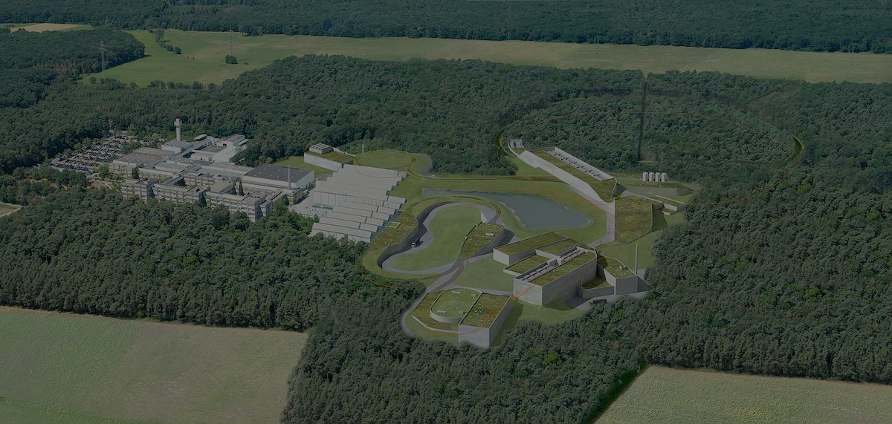

SPARC in APPA Collaborations at
APPA
SPARC
> 600 scientists
> 90 institutions
> 30 countries
FLAIR
338 scientists
83 institutions
26 countries
144 scientists
49 institutions
15 countries
BIOMAT
Plasma
136 scientists
70 institutions
20 countries
215 scientists
43 institutions
14 countries
Notes:
2

Slide 3

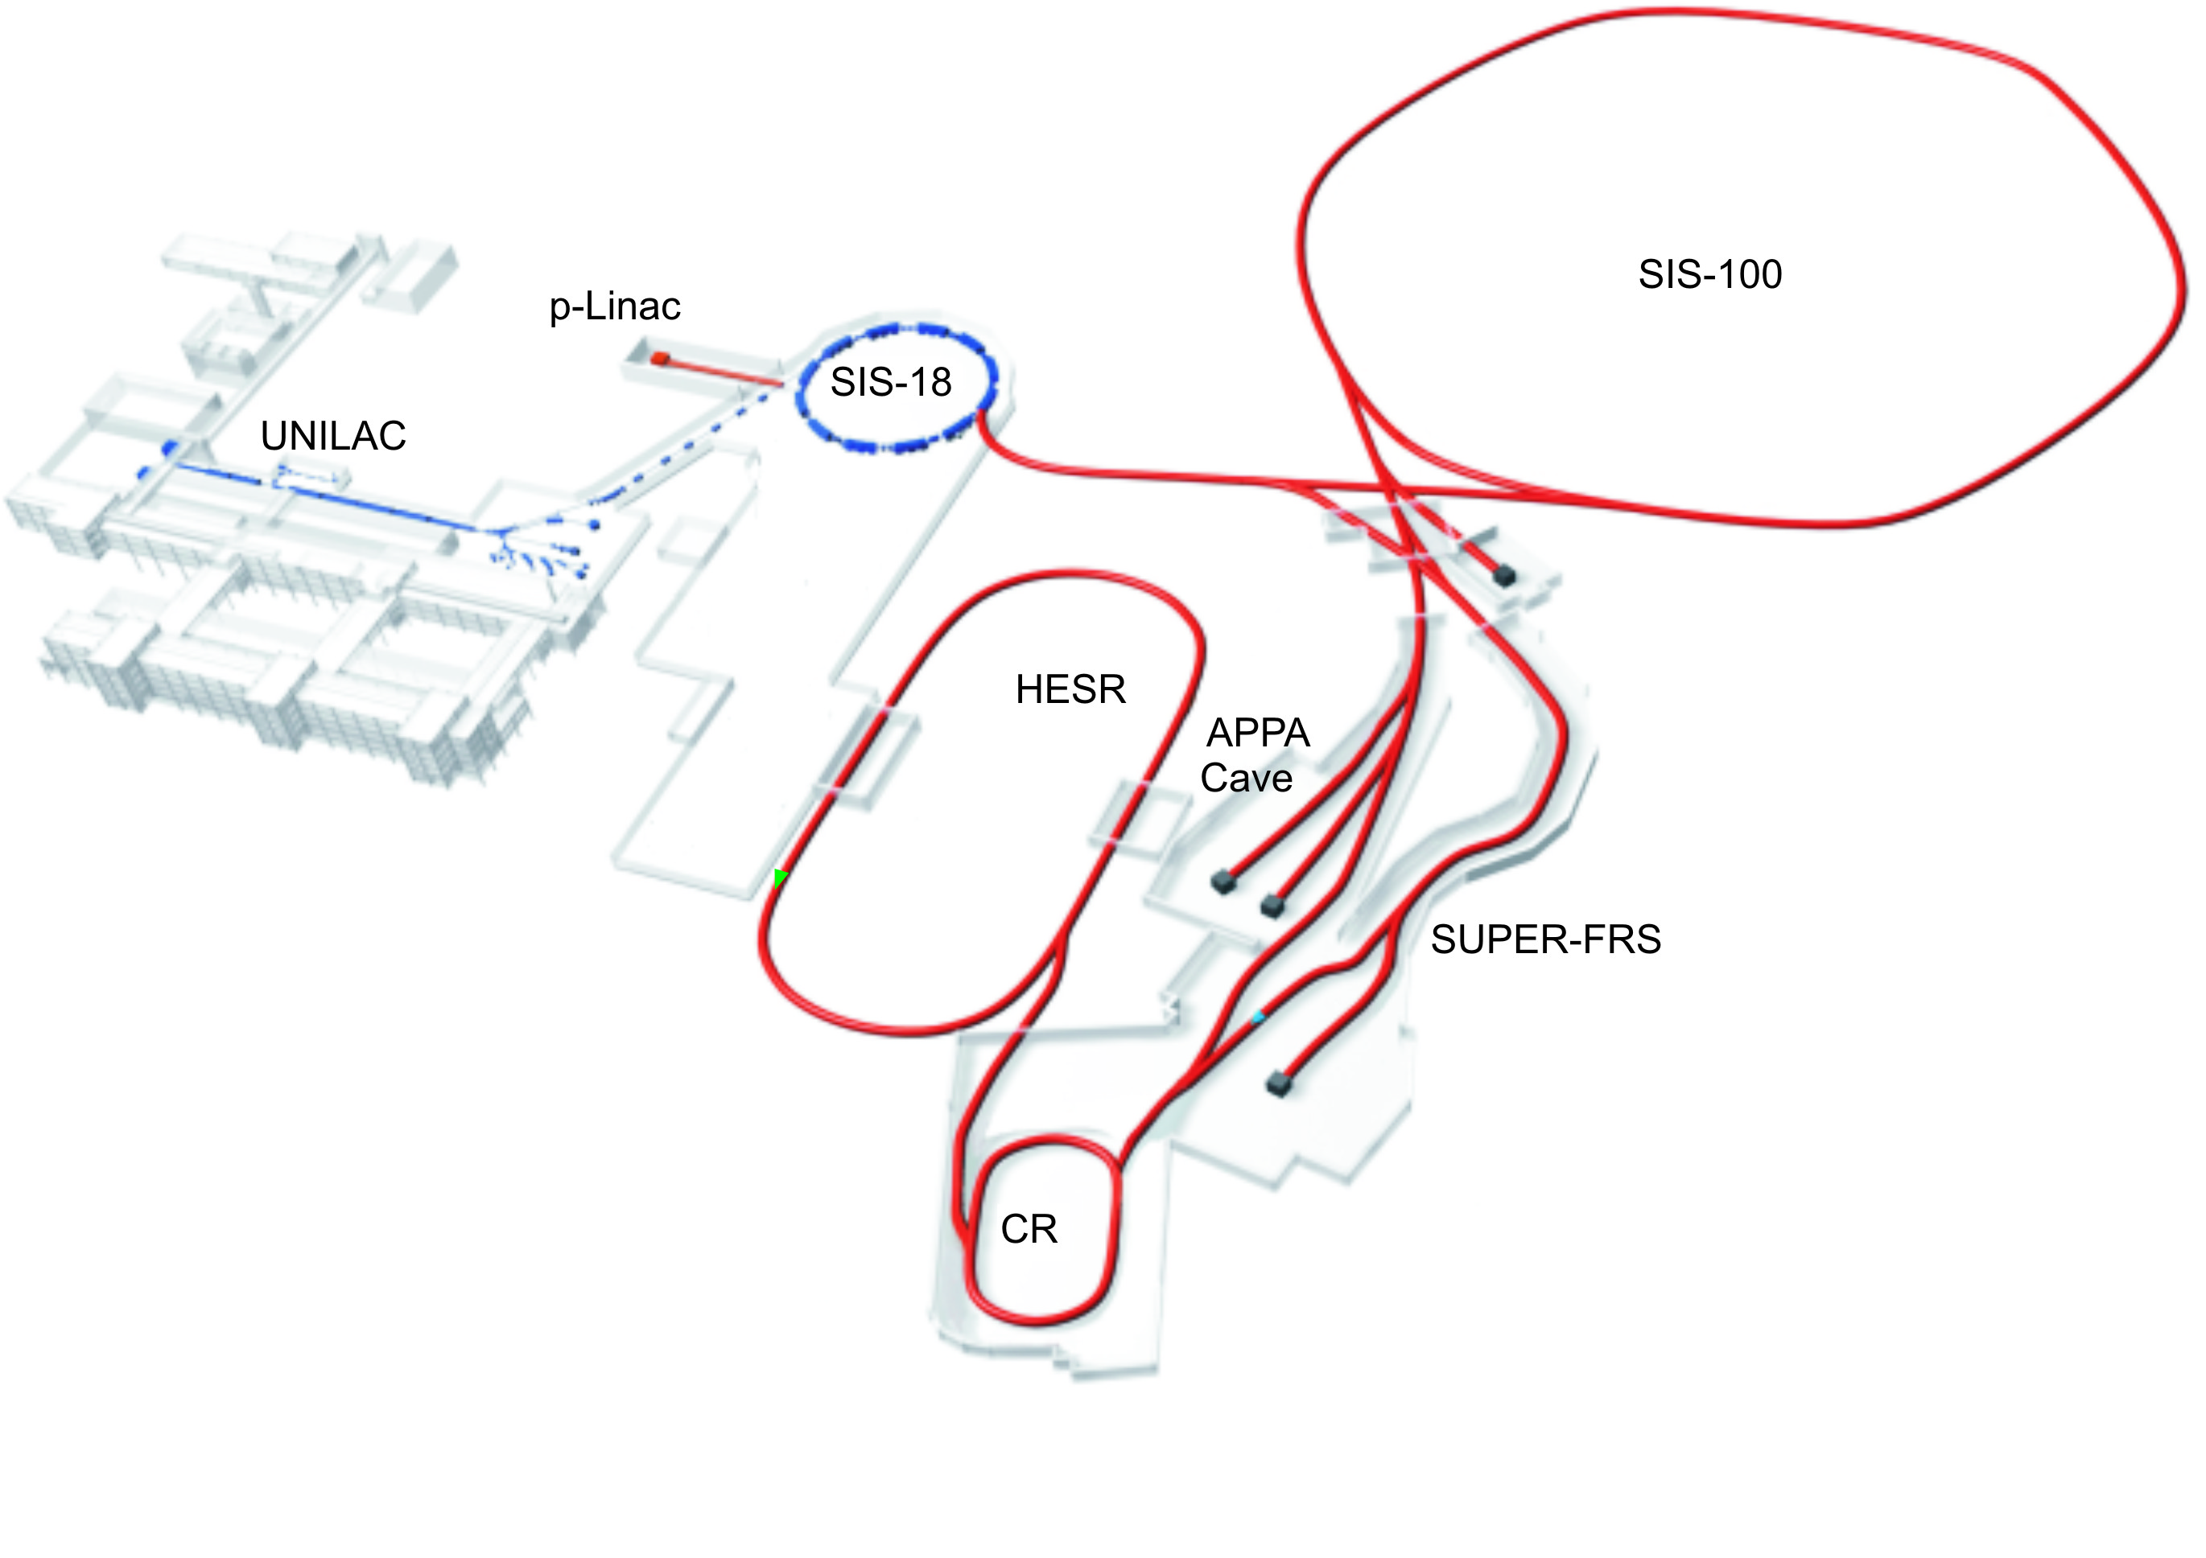
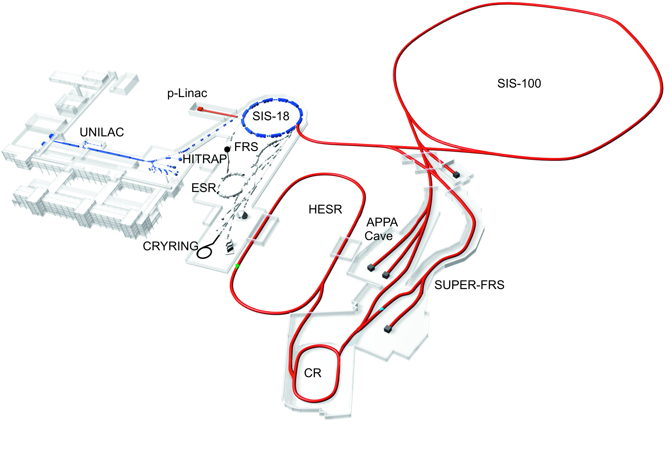

SPARC Experimental Faciliities@
PHELIX
ESR
CRYRING
HITRAP
HESR
APPA-Cave
SIS100

Slide 4

SPARC Collaboration
Over 400 members
135 institutions
26 countries:
Austria, Brazil, Canada, China, Egypt, France, Germany, Greece, Hungary, India, Italy, Japan, Jordan, Netherlands, Pakistan, Poland, Portugal, Romania, Russia, Serbia, Spain, UK, Ukraine, Sweden, Switzerland, USA

Slide 5
Status TDRs
Approved : 6
Under evaluation : none
To be submitted: maybe 4
APPA cave 1 TDR to be submitted 20167/2017
CRYRING Installation 1 TDR Approved 2012
SPARC at HESR 3 TDRs Approved 2016
SPARC at CRYRING 1 TDR Approved 2016
at least 2 more TDRs to be submitted
CRYRING Installation 1 TDR Approved 2012

Slide 6
SPARC Funding
FAIR Council in-kind assignments 2016
Romania: 200 k€ for National Institute for Physics of Lasers and Plasma Radiation (INFLPR) (PSP 1.3.1.1.2.1) and (PSP 1.3.1.3.11.1)
Sweden: 138.5 k€ for the Laser spectroscopy experiments (ion setup at HITRAP and CRYRING), Uppsala University (PSP 1.3.1.5.8.2.1)
Germany:
  550 k€ for CRYRING installation, GSI (PSP 1.3.4.2.11.1)
  460 k€ for HESR Jet target, GSI (PSP 1.3.1.3.2)
The corresponding In-Kind Contracts are planned to be
ready for signing during the fourth quarter of 2016.

Slide 7
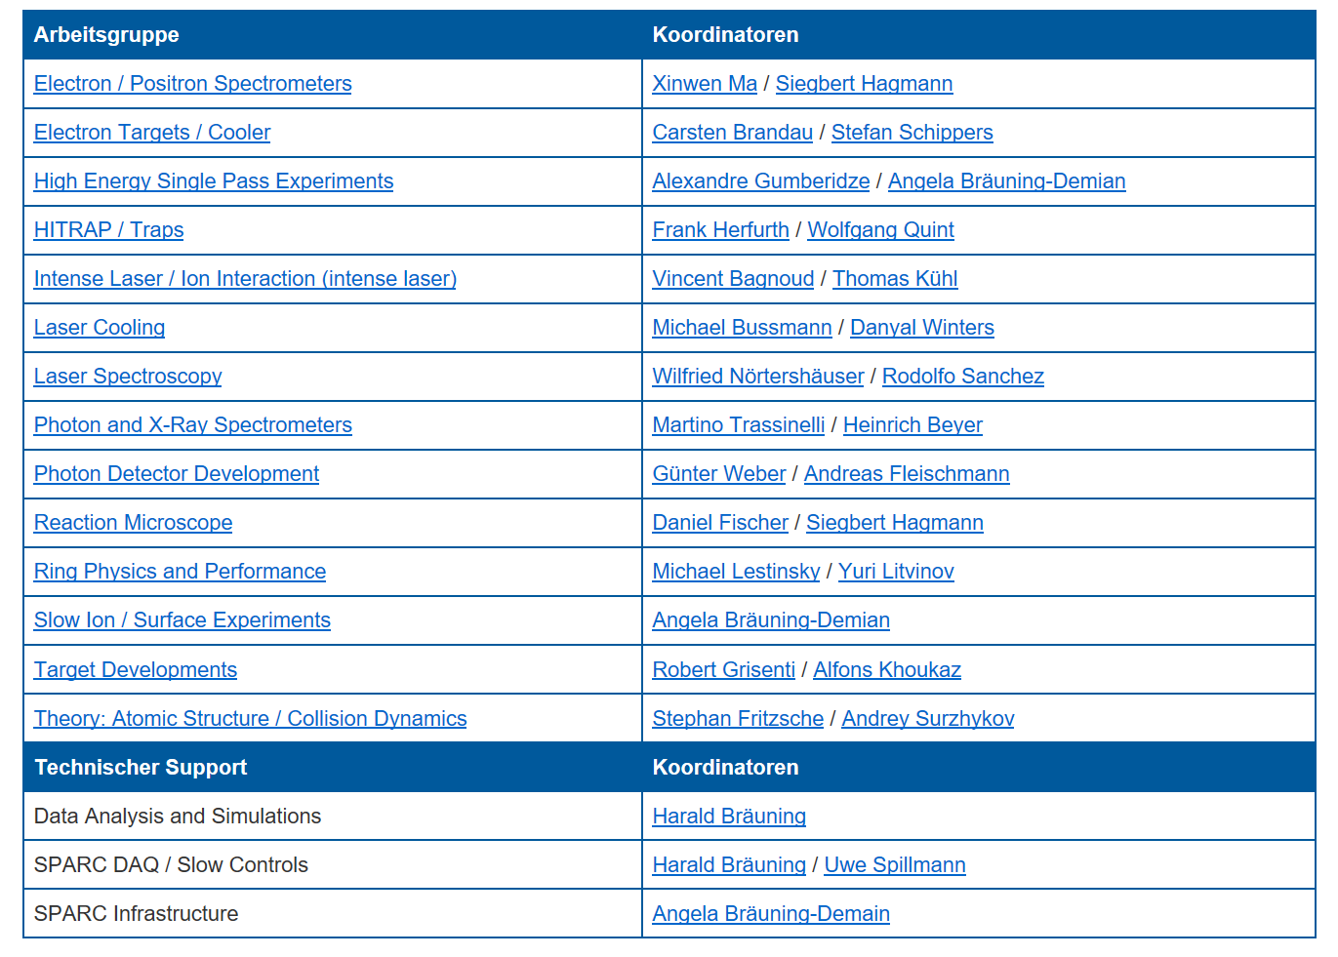
SPARC Working Groups

Slide 8
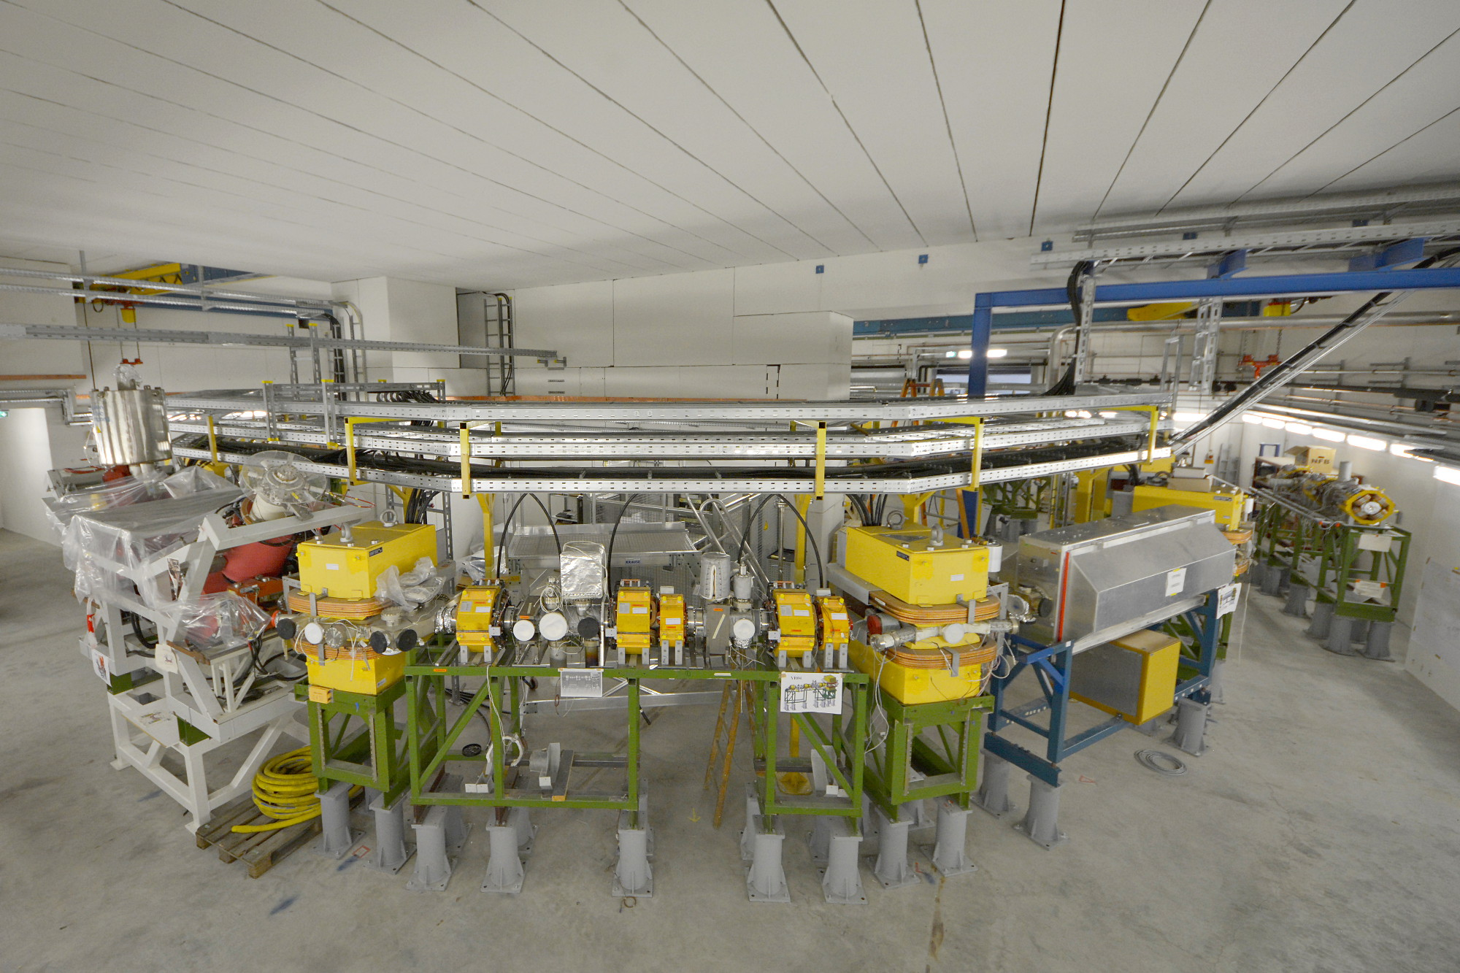
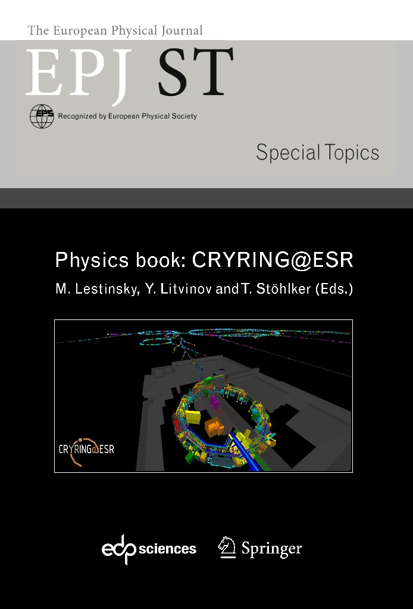
CRYRING / FAIR
Scientific goal:
  atomic and nuclear physics of exotic systems al low energy
circumference: 54 m
decelerate ions down to 7‰ c
UHV: p < 10⁻¹¹ mbar
gas and electron targets
e-cooler
several experiment stations
in print
CRYRING in the SIS18 target hall @ GSI/FAIR

Slide 9







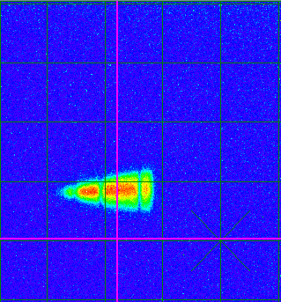
CRYRING: First transfer of ions from ESR to CYRING
Scintillating screen in the first section of CRYRING:
C⁶⁺ @ 6 MeV/u
CRYRING team
supported by:
FAIR
GSI
HI-Jena
KVI Groningen
Univ Cracow
Univ. Stockholm
A. Bräuning-Deminan,F. Herfurth, M. Lestinsky et al.

