Slide 1

CRYRING @ ESR
Slow highly charged ions and antiprotons
  Overview, Motivation, Physics Program
  Status of Installation
Project Team
F. Herfurth, M. Lestinsky, Z. Andelkovic, N. Bauer, A. Bräuning-Demian, R. Bär, H. Danared, C. Dimopoulou, O. Dolinskyy, W. Enders, M. Engström, S. Fedotova, B. Franzke, M. Frey, W. Geithner, O. Gorda, R. Hettinger, L. Heyl, P. Hülsmann, A. Källberg, Th. Köhler, S. Litvinov, Y. Litvinov, J. Mohr, I. Pschorn, A. Reiter, J. Roßbach, A. Simonsson, T. Sieber, J. Sjöholm, M. Steck, Th. Stöhlker, G. Vorobjev, ...
GSI/FAIR + Stockholm University, + KVI Groningen
SPARC + HI Jena, + Krakow University

Slide 2
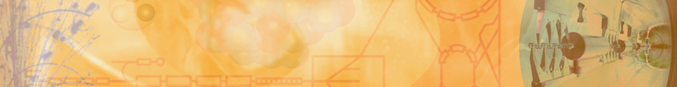
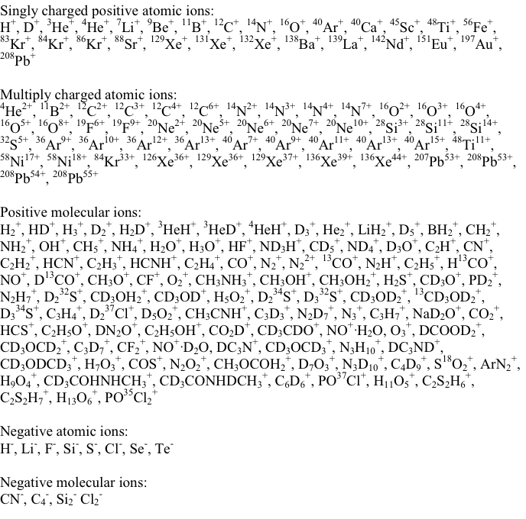
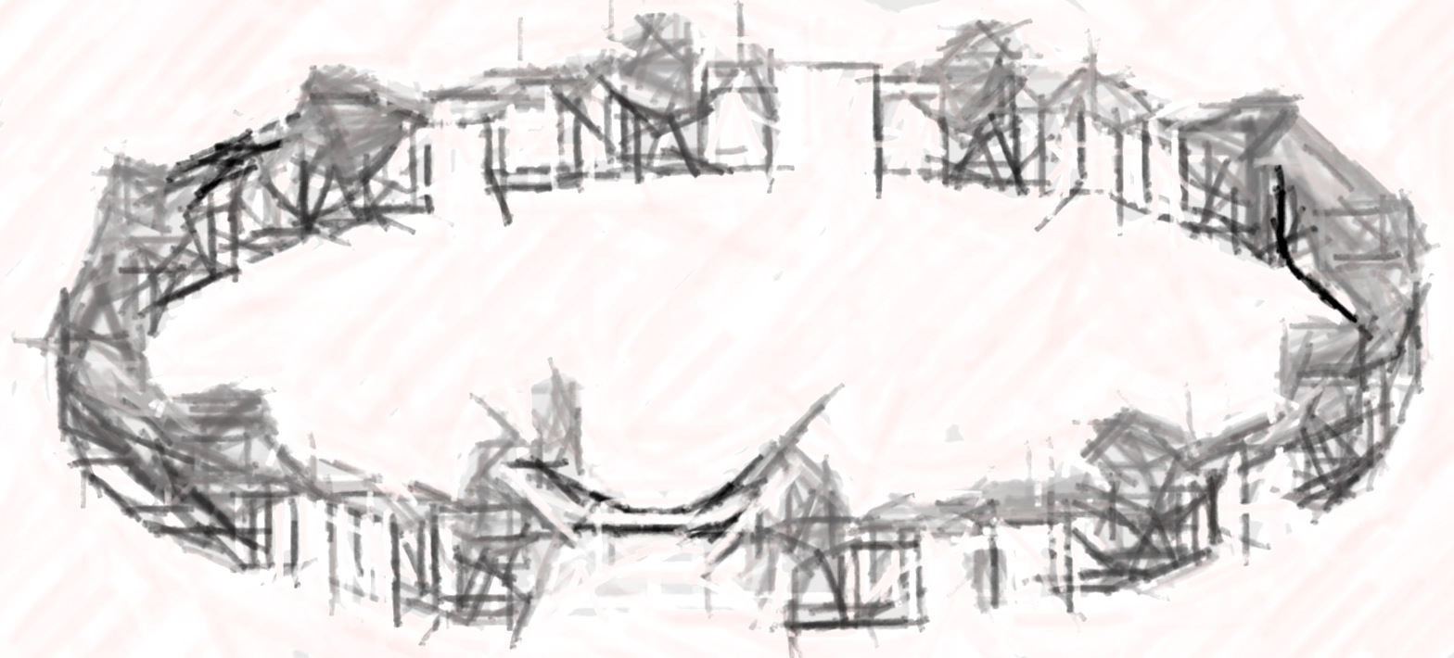

CRYRING in Stockholm (MSL)
~200 different ion species
singly charged (pos. & neg.)
multiply charged
molecular (pos. & neg.)
Successfully operated from 1992 to 2010
Dismantled and shipped to FAIR/GSI in 2012/13
GSI(FAIR): + heavy, highly charged ions!

Slide 3
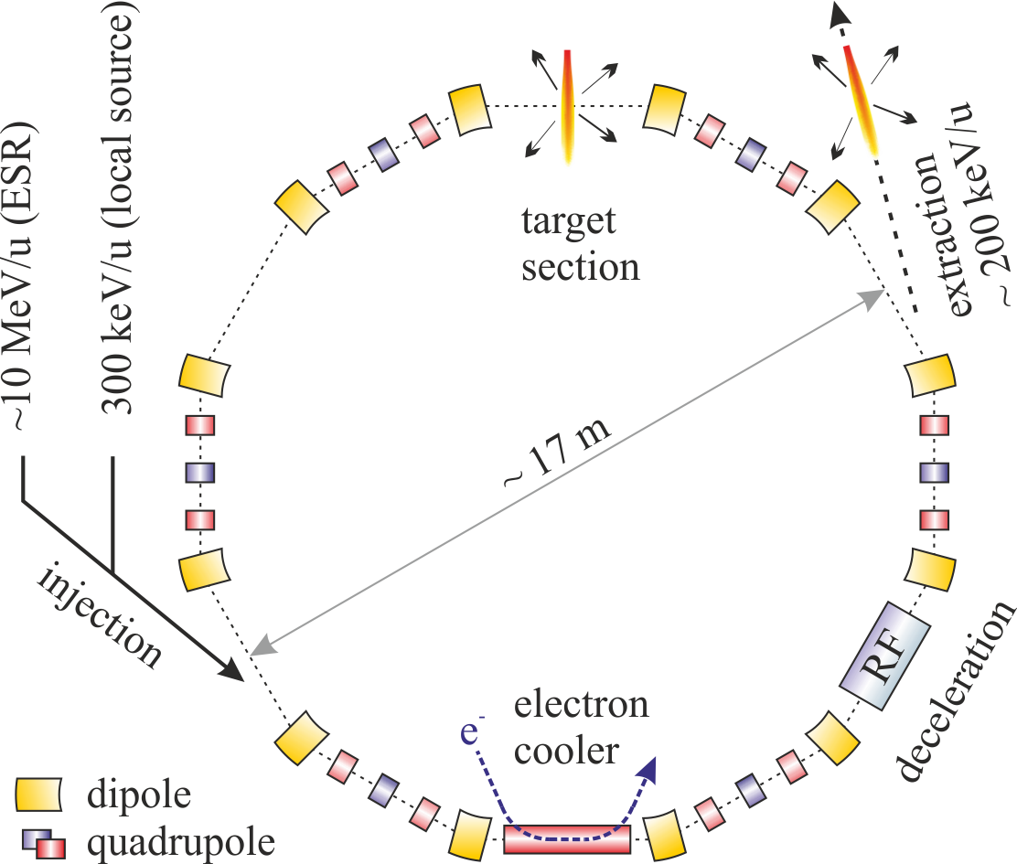
CRYRING@ESR
Max. rigidity 1.44 Tm
  15 MeV/u U⁹²⁺
  96 MeV/u protons
Min. rigidity ~ 0.054 Tm
  Actual limit given by beam life time
UHV … 10⁻¹¹ mbar

Slide 4
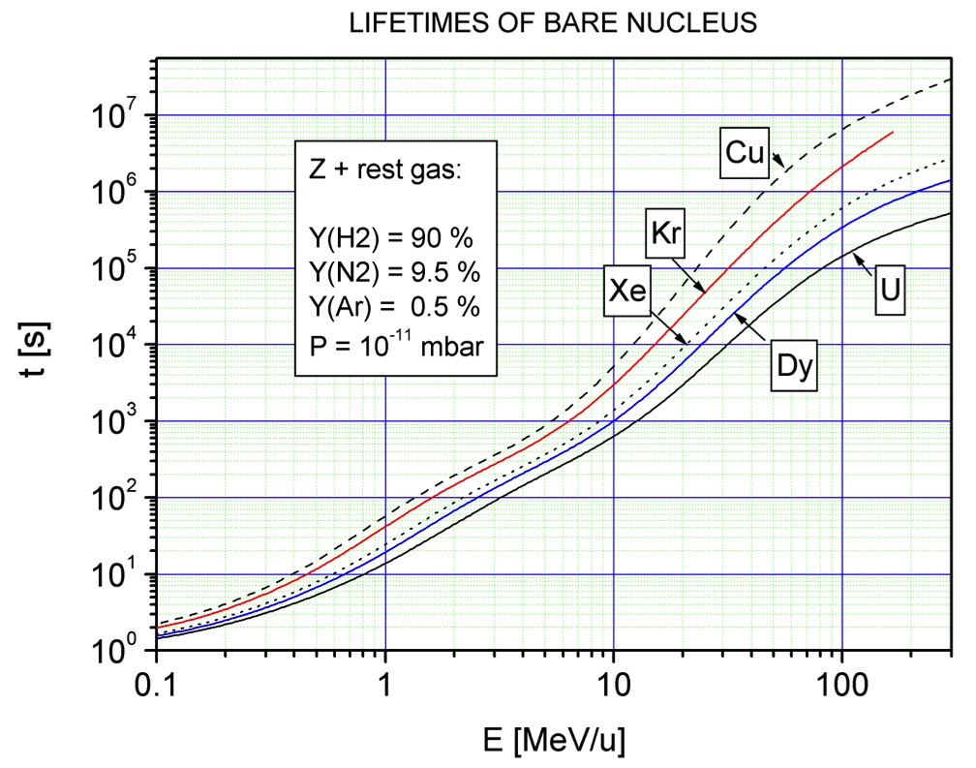
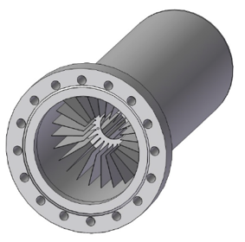
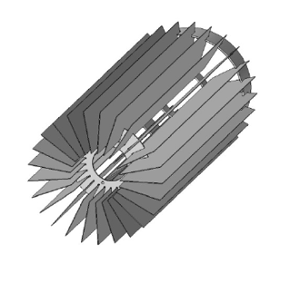
Vacuum & Beam Life Time
Ion pumps
  ~ 10
Cryopumps
NEG pumps
  ~ 100
15 min
V. Shevelko, priv. comm.
3 s
0.3
15

Slide 5
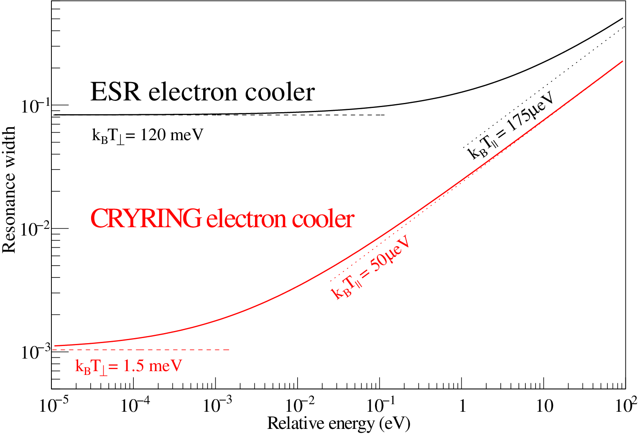
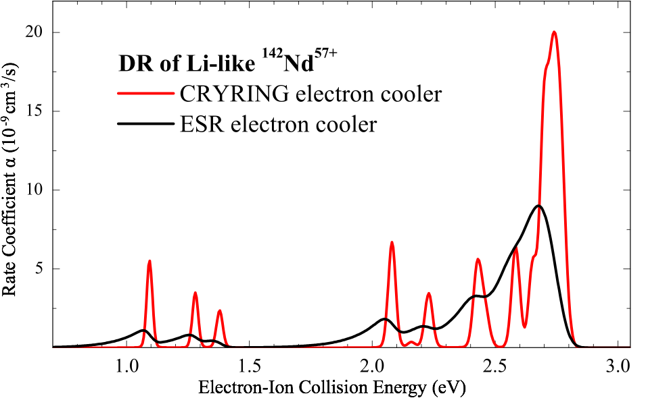
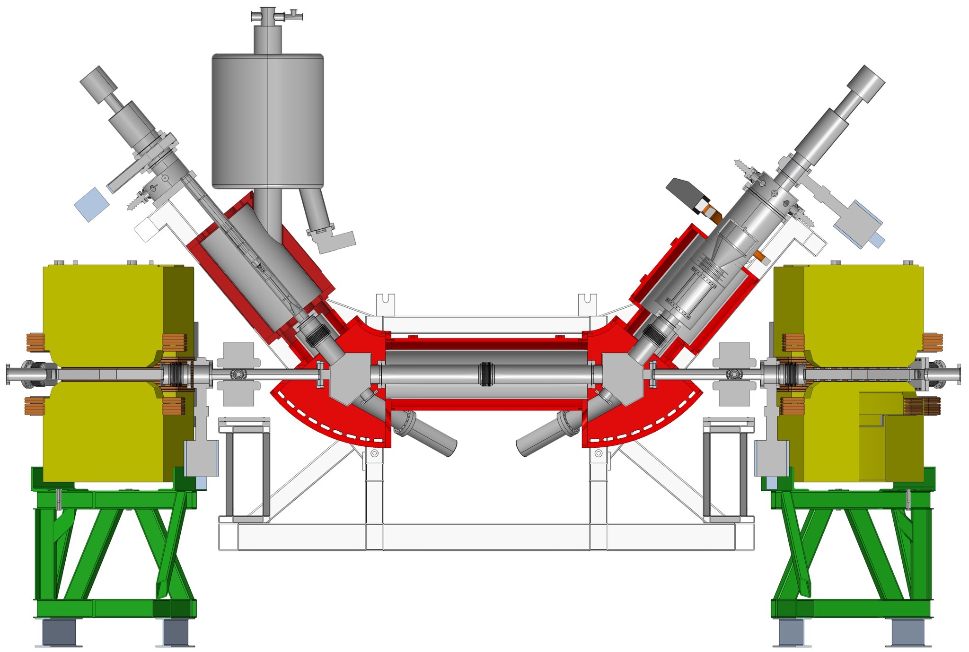
Electron Cooling ESR - CRYRING

Slide 6
CRYRING @ ESR
Max. rigidity 1.44 Tm
  15 MeV/u U⁹²⁺
  96 MeV/u protons
Min. rigidity ~ 0.054 Tm
  150 keV/u protons
CRYRING@ESR is
a prototype for FAIR + Detector tests (e.g. CCC)
Research opportunities
  Slow, highly charged ions: every ion species available at GSI can be transported to CRYRING: SPARC, NUSTAR, BioMat, (FLAIR?)
  Shortlived nuclei: fast ramping.
  “Double ring configuration”: accumulation, breeding, purification of quantum states in ESR, precision analysis in CRYRING
  Local injector: research may continue even during major shutdowns (at limited ion ranges)

Slide 7
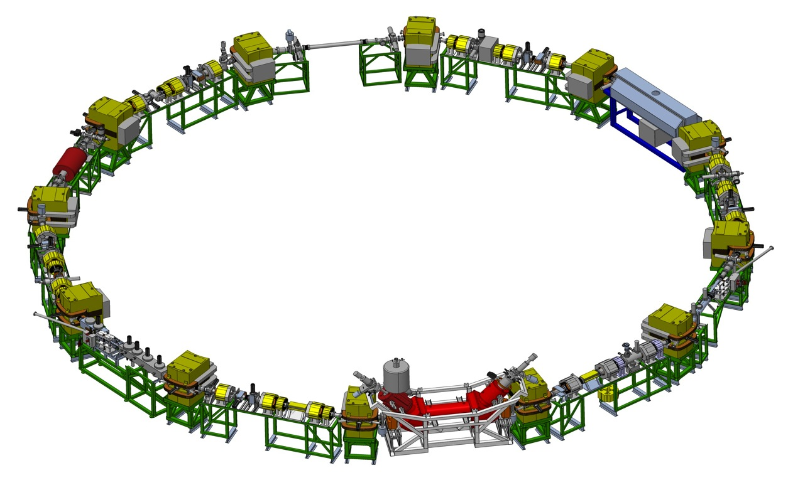
Equipment to be installed
Max. rigidity 1.44 Tm
  15 MeV/u U⁹²⁺
  96 MeV/u protons
Min. rigidity ~ 0.054 Tm
  150 keV/u protons
Particle detectors
Gas jet,
MOTReMi,
EXL ...
Extraction
Injection
Particle detectors
0° port
Microcalorimeter
180° port
Microcalorimeter
Electron cooler

Slide 8
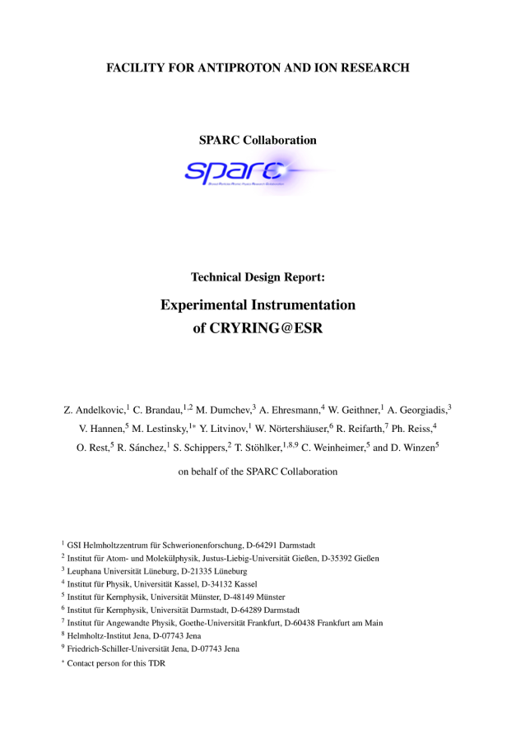
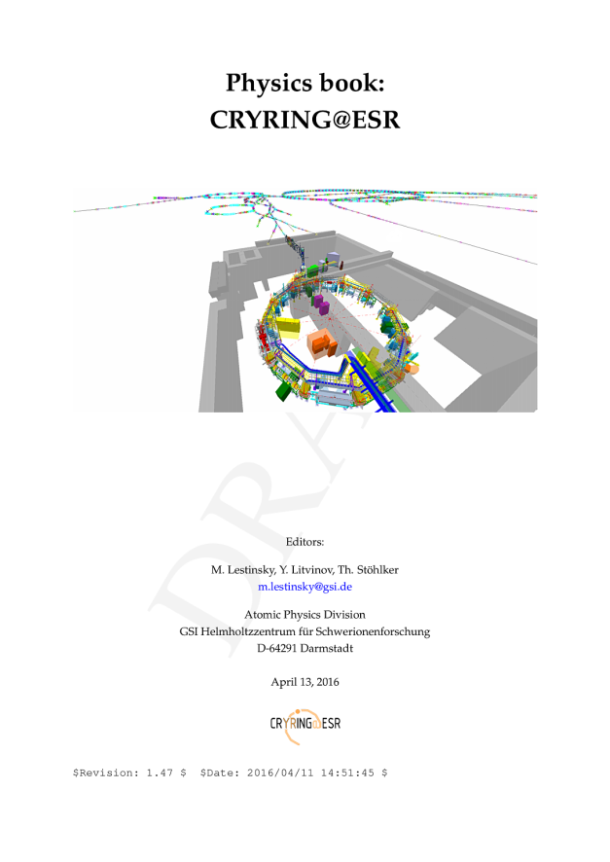
Documents
Max. rigidity 1.44 Tm
  15 MeV/u U⁹²⁺
  96 MeV/u protons
Min. rigidity ~ 0.054 Tm
  150 keV/u protons
Accepted
SPARC TDR
In print
EPJ-ST
Contact: Michael Lestinsky

Slide 9
TDR items
ECOOL
  HV-amplifier and DAQ electronics (→ Schippers/Gießen)
  precision HV-divider (→ Weinheimer/Münster)
Probes
  laser lab (→ Nörtershäuser/Darmstadt)
  transverse electron target (→ Schippers/Gießen and Kester/Frankfurt)
Detectors
  particle detector mount mounts (→ Reifarth/Frankfurt)
  Seya-Namioka VUV-VIS spectrometer (→ Ehresmann/Kassel)
  MWPC/MTPC counters for Xrays (→ Georgiadis/Lüneburg)
Related TDRs: maXs, SimX, gasjet target (TBD)
http://appa-rd.fair-center.eu

Slide 10
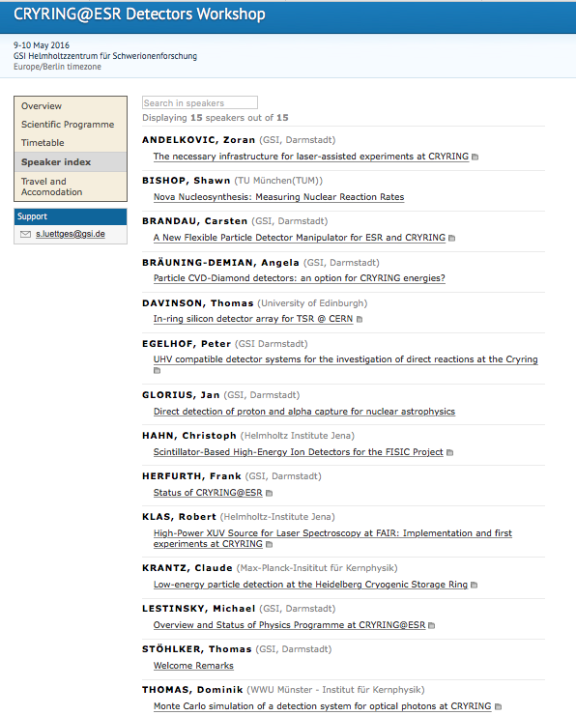
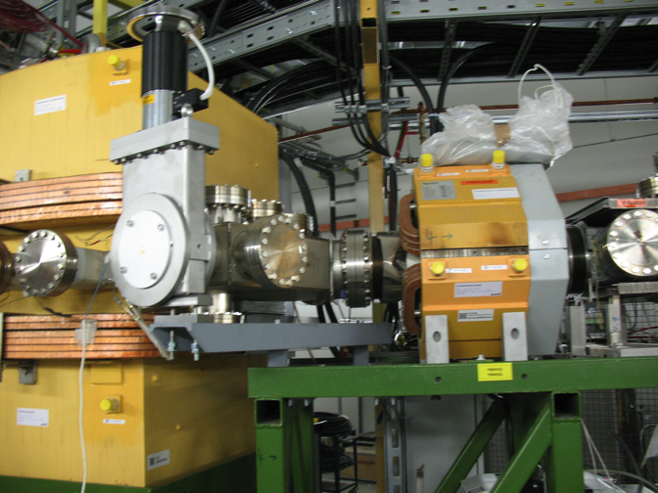
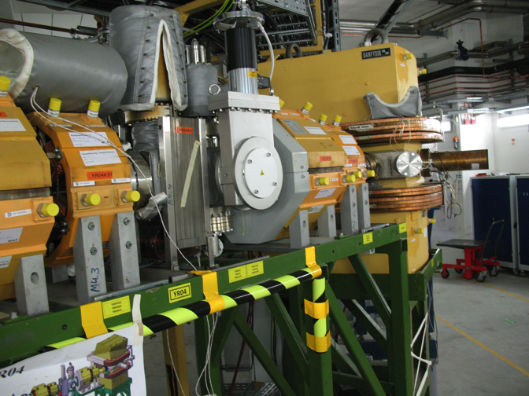
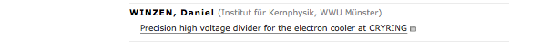
Detector
Workshop
May / 2016

Slide 11
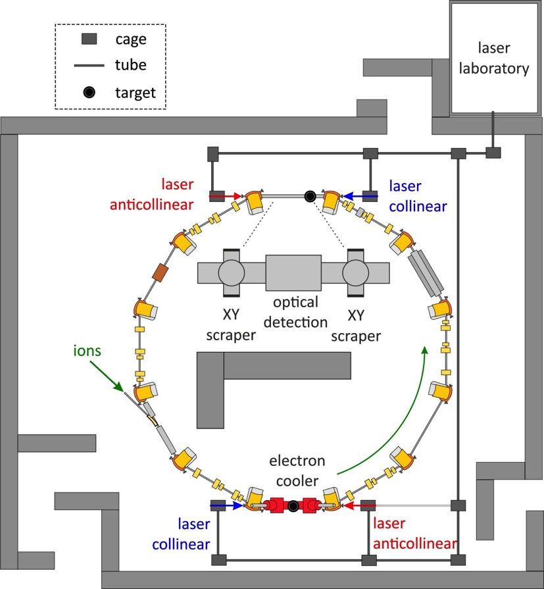
Laser Experiments
Installed 2017
Dielectronic recombination assisted laser spectroscopy
Preparation of polarized ion beams in a storage ring
…
Start with
  ^{24,25}Mg⁺
  ⁹Be⁺
  …
  H and Li like Pr, Pb, and Bi
x-ray cell?
x-ray cell?

Slide 12
Research Summary
We can do lots of science with CRYRING@ESR:
  Atomic structure and slow collision dynamics
  Nuclear structure, astrophysically relevant rates in the Gamov window of p-process, (p,γ), nuclear collisions at the Coulomb barrier
  Intersections of atomic and nuclear physics (nuclear magnetic moments, isotope shifts and charge radii, NEEC...)
  Biology, biophysics?
  HCI and surfaces/bulk material?
  pbar, rare isotopes, FLAIR
with present GSI accelerator chain
with FAIR
First experimental setups are being prepared. ETA ~2017/18

Slide 13
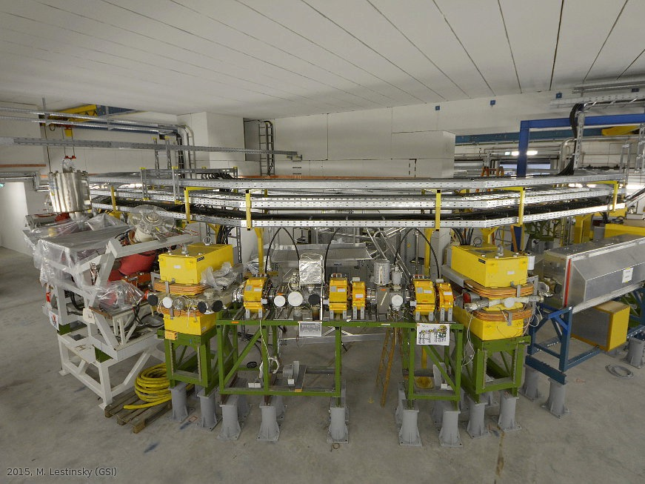
12/2015

Slide 14
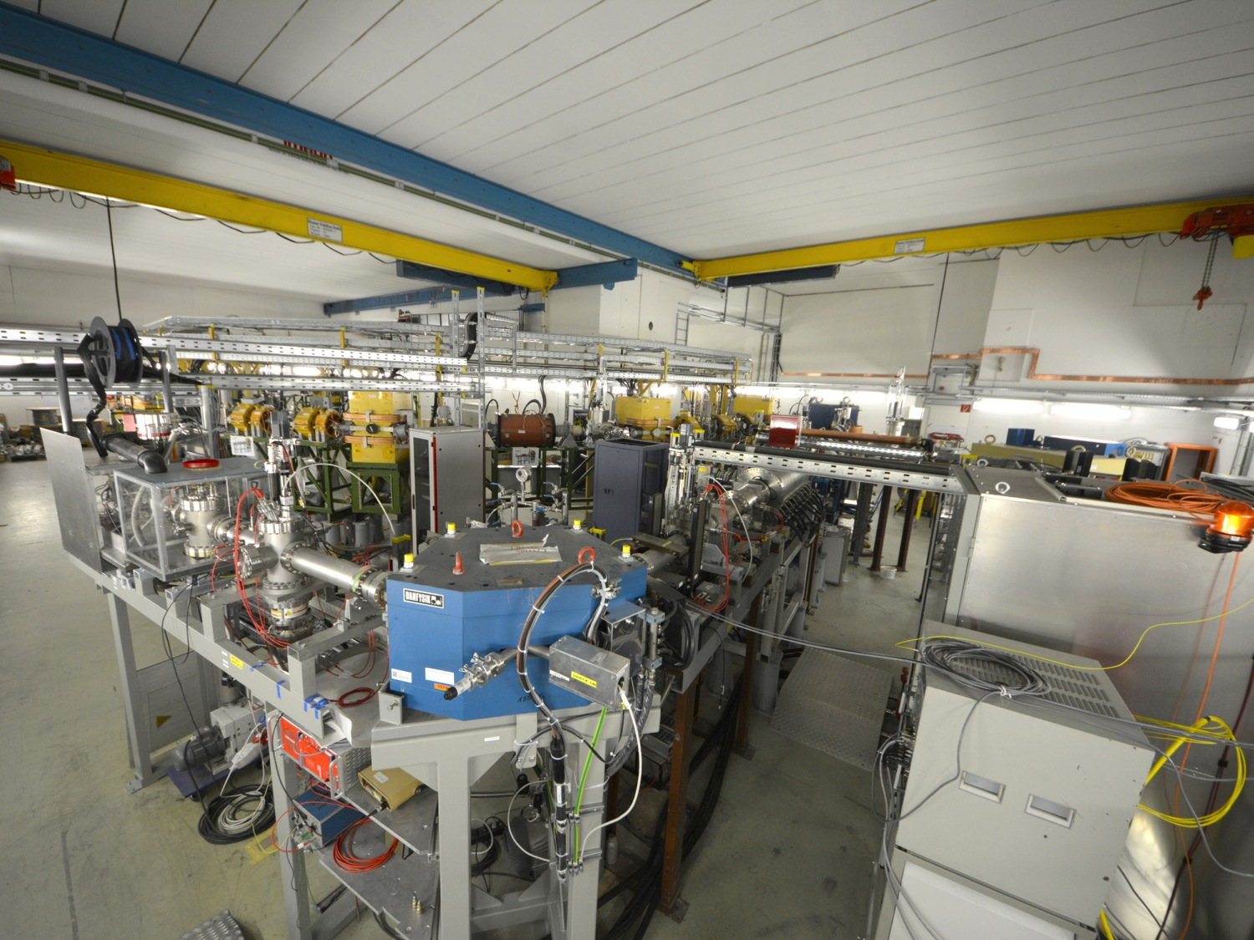
12/2015

Slide 15
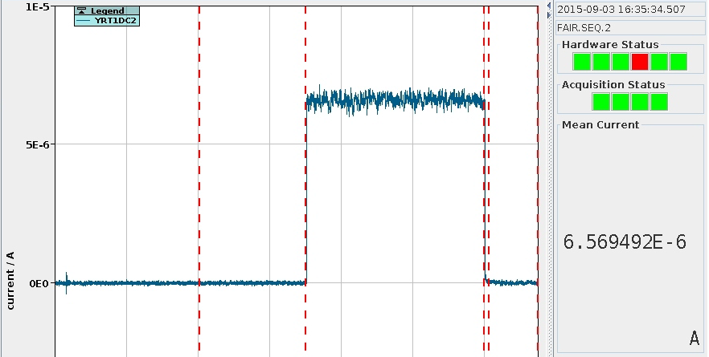
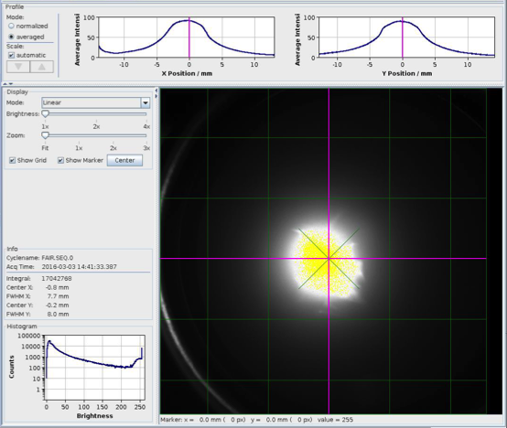
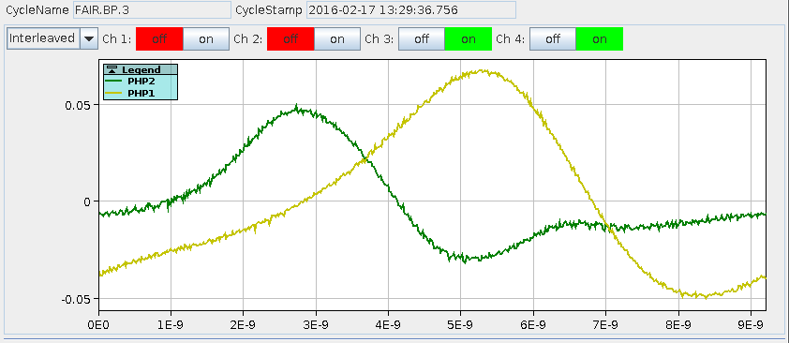
Local Injector Operational
Faraday Cup
- intensity
Fluorescent Screen
- beam shape
Local Ion source - μAs of H₂⁺
Accelerated to ~300 keV/nucleon
Ready to be injected into ring
Capacitive Pickup
- bunches, ToF, energy
03/2016

Slide 16
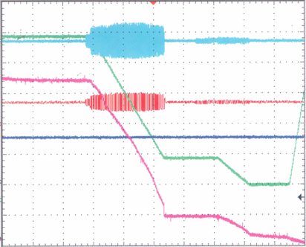
ESR – From 400 to 4 MeV/u
ESR – Experimental Storage Ring at GSI with stochastic and electron cooling
Ni²⁸⁺ 400 → 30 → 4 MeV/u
ESR cycle during recent experiment
signal:
time (s)
RF amplitude
5..20
injection, stoch. cooling
3..10
deceleration 400 – 30 MeV/u
2..6
e⁻ cooling, rebunching
2..5
deceleration 30 – 4 MeV/u
magn.dipole
field
2..5
e⁻ cooling, ejection
3
reset magnets
2 × 10⁷
ion current
40 s
1100 μA → 180 μA → 25 μA

Slide 17
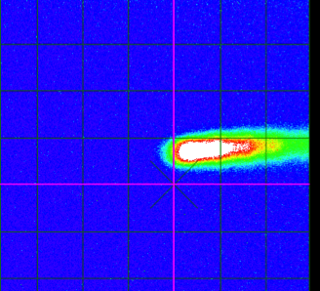
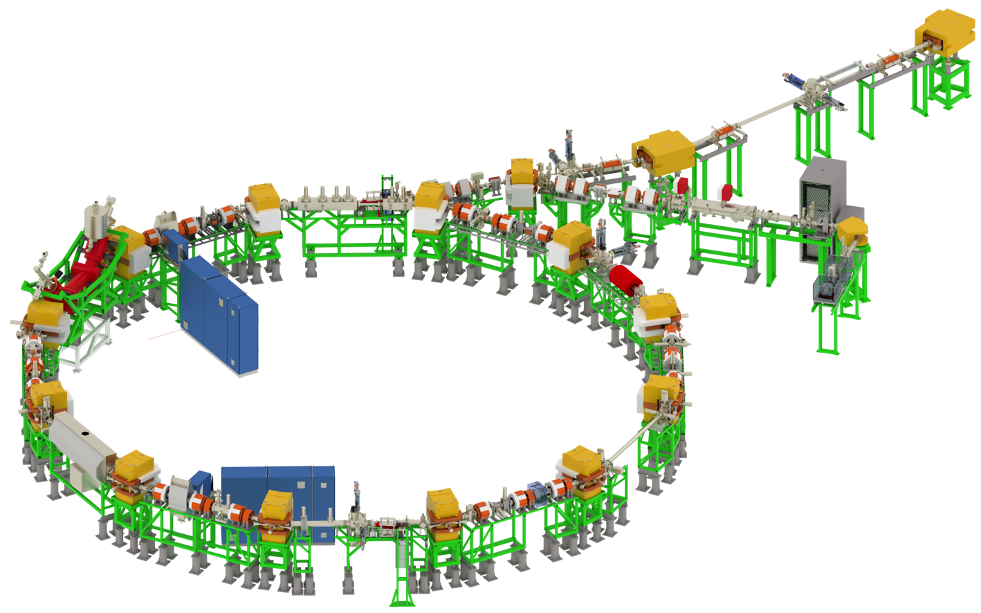
Beam transport ESR – CRYRING
from ESR @ 0.7 Tm
07/2016

Slide 18
Timeline CRYRING@ESR
We are here
Idea, Study Group Report
Restart of SIS/ESR
2012
2013
2014
2015
2016
2017
2018
Nov 7
Transport
to GSI
Dec 20
First ions from source
commissioning
Reconstruction Cave B
First ions @ 300 keV/u
New Cave Topping Out
Infrastructure, Setup, cables etc.
Transport test with ESR beam
First ions stored in ring
UHV, bake out, e-Cooler
Installation
and Test of 1st
Experiments

