Slide 1
Cold nuclear matter effects in J/ψ production in p-nucleus collisions‏
Energy dependence of the J/ψ “absorption cross section”
J/ψ feed-down fractions from χ_{c} and ψ’
Hermine K. Wöhri (LIP, Lisbon)
Charm 2009 Heidelberg, Germany, May 2009
In collaboration with Carlos Lourenço, Ramona Vogt, Pietro Faccioli and João Seixas
Notes:
1
1

Slide 2
Cold nuclear effects in quarkonium production in p-A collisions
Several “normal nuclear matter effects” can modify the production of quarkonia in p-nucleus collisions with respect to pp collisions. In particular, we can expect:
initial-state effects:
nuclear modifications to the PDFs
- initial-state energy loss of incident partons
final-state effects:
- formation time effects
Glauber-like charmonium absorption
absorption
~ exp{- σ_{abs} ρ L}
J/ψ
p-beam
L
To learn about these mechanisms we need to look at different data sets, collected in different kinematical domains, at different energies, with several nuclear targets, etc.
We also need to analyze in a global way the J/ψ, ψ’ and χ_{c} data.
What are the feed-down fractions of ψ’ and χ_{c} to the J/ψ ?

Slide 3
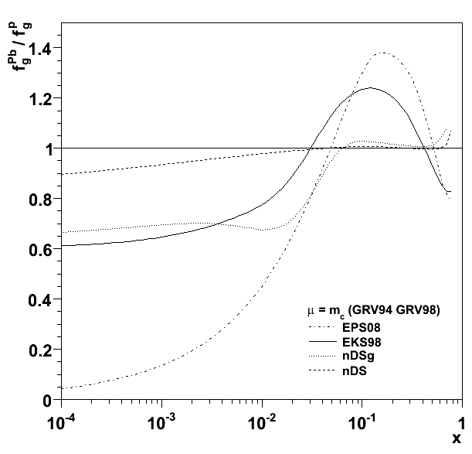
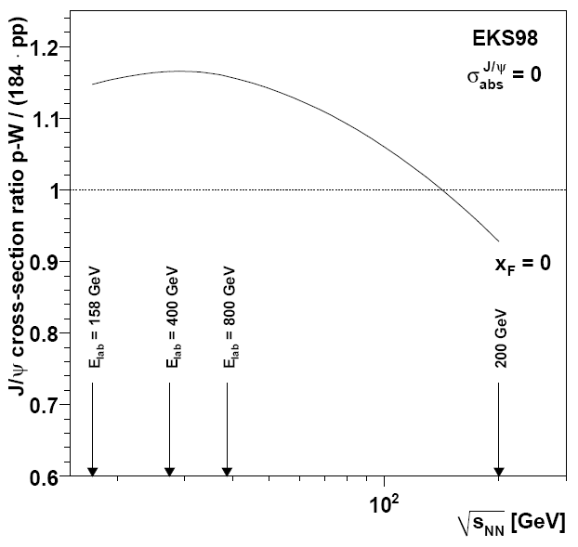
Nuclear effects on the Parton Distribution Functions
The probability of finding a gluon with a momentum fraction x is not the same in a free proton as in a proton inside a nucleus; this “detail” has significant consequences.
gluon density function in Pb gluon density function in p
gluon density function in Pb gluon density function in p
EKS 98
The existence of nuclear effects on the PDFs is well established but their level is not accurately known ⇒ calculations done with several models (EKS98, nDS, EPS08, etc).

Slide 4
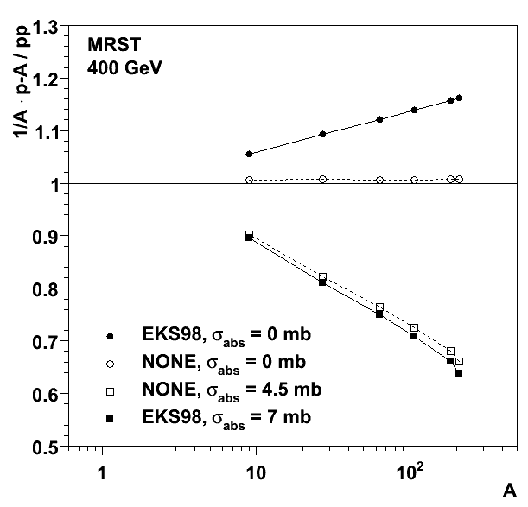
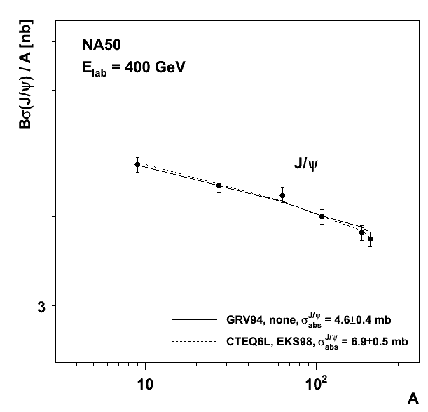
Nuclear effects on the PDFs vs. final state absorption
At x values ~ 0.1–0.4 (SPS energies), there is gluon anti-shadowing (EKS98); the J/ψ prod. cross section per nucleon increases from pp to p-Pb (before final state absorption)
⇒ The NA50 measurements are equally well described using σ_{abs} = 6.9 mb (with EKS98) or σ_{abs} = 4.6 mb (with “free protons”)
Be Al Cu Ag W Pb

Slide 5
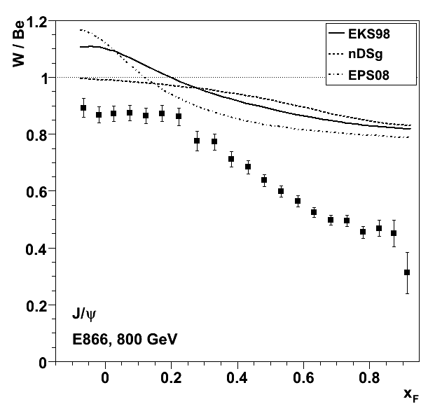
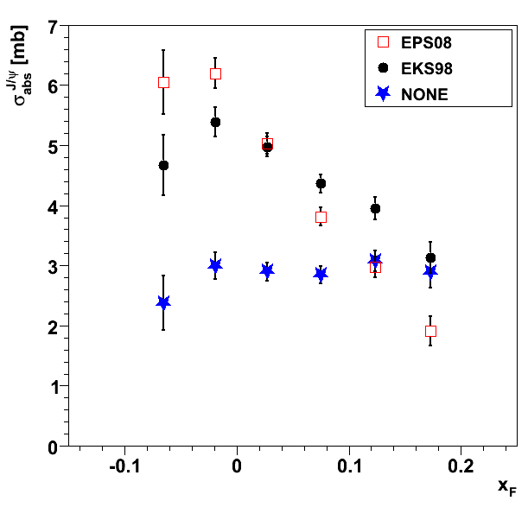
J/ψ σ_{abs} versus x_{F} : the importance of the N-PDFs
E866
The nuclear effects on the PDFs are a function of Bjorken-x ⇒ they are energy and x_{F} (or rapidity) dependent
At x_{F} < 0.2 : strong anti-shadowing in EKS98 and EPS08 : ⇒ In the absence of other effects, the E866 W/Be ratio should be higher than unity
The nuclear modifications of the PDFs significantly change the x_{F} dependence of σ_{abs}

Slide 6
J/ψ nuclear dependence measurements: a global summary
The nuclear dependence of the J/ψ production cross section was studied by several experiments, probing different collision energies and J/ψ kinematics

Slide 7
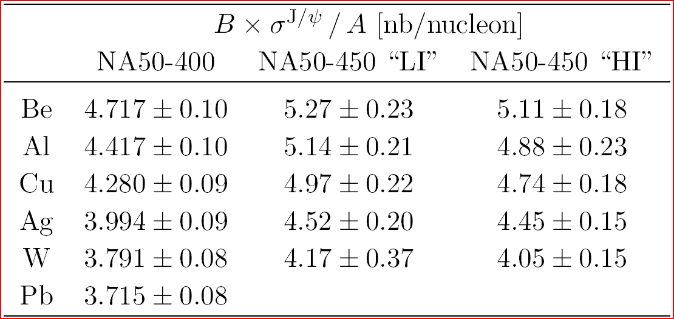
Some J/ψ data we have considered

Slide 8
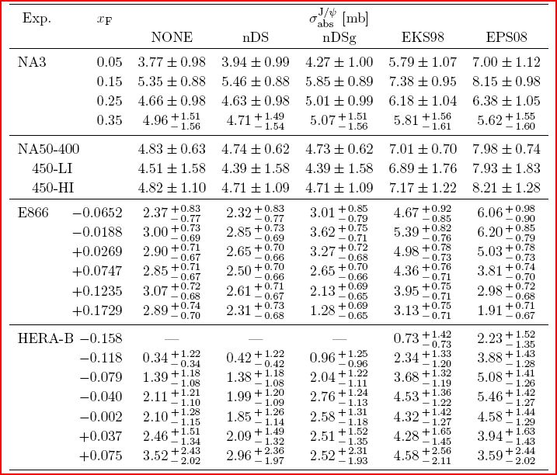
J/ψ σ_{abs} for each kinematical window and N-PDF set
Errors include the global systematic uncertainties of the ratios:
3% in NA3 3% in E866
4% in HERA-B
[ C. Lourenço et al., JHEP 2 (09) 14 ]

Slide 9
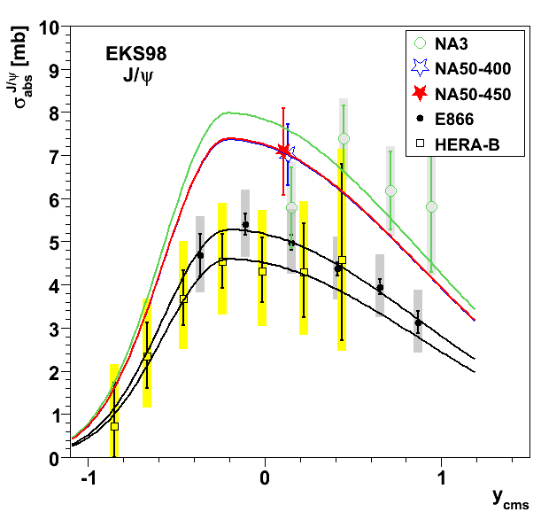
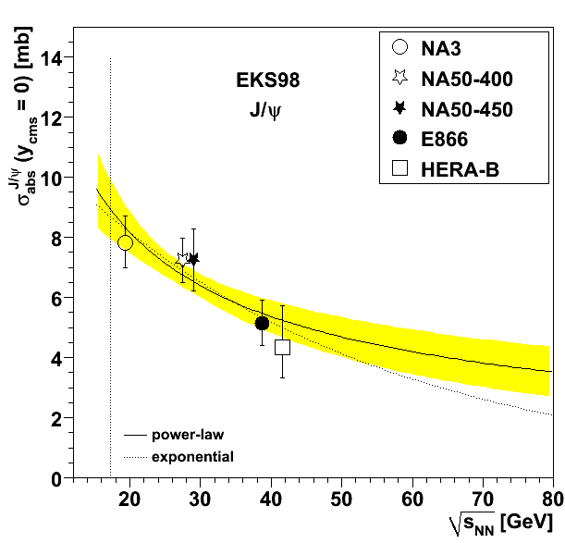
J/ψ σ_{abs} versus rapidity and collision energy
The E866 and HERA-B patterns define the shape of the rapidity dependence of σ_{abs}
σ_{abs} at y_{cms}=0 decreases with NN collision energy
EKS98
EKS98

Slide 10
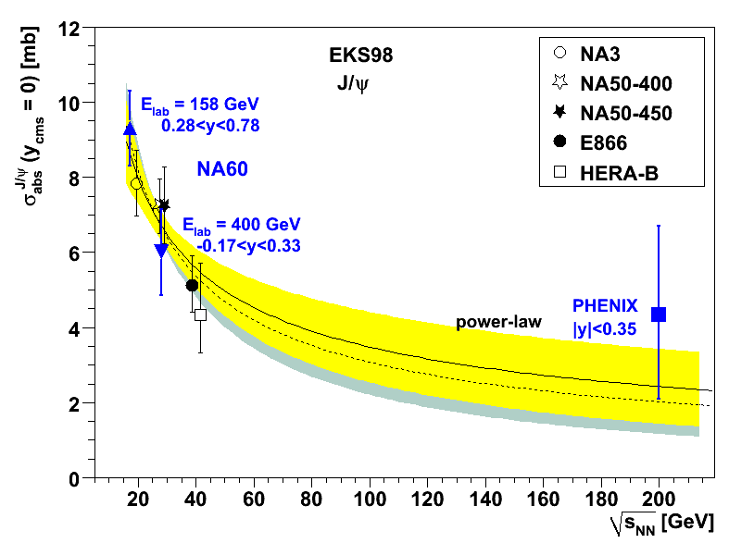
New (preliminary) results from NA60 and PHENIX
NA60 measured the J/ψ absorption cross section at 400 and 158 GeV, the energy of the SPS heavy-ion data. Both values follow the previously established trend (but are not obtained at exactly y_{cms}=0).

Slide 11
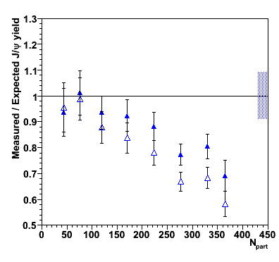
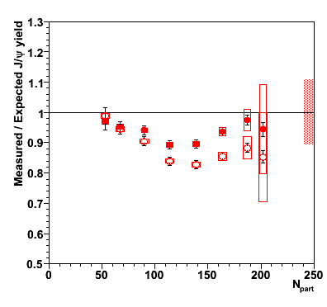
Anomalous J/ψ suppression revisited
The 158 GeV σ_{abs} value is larger than previously assumed and decreases the “anomalous suppression” remaining in the heavy-ion data:
Pb-Pb
published data
In-In
published data
new reference
new reference
E. Scomparin (NA60), QM09

Slide 12
J/ψ feed-down contributions
So far, only an “effective” absorption cross-section was extracted from the data, being a “weighted” sum of directly produced J/ψ’s and J/ψ’s from ψ’ and χ_{c} decays
From NA50 we know that σ_{abs}(J/ψ) is different from σ_{abs}(ψ’)
To interpret the J/ψ suppression seen in heavy-ion collisions, the J/ψ feed-down fractions from χ_{c} and ψ’ decays cannot be neglected
It is often assumed that 60% of the prompt J/ψ mesons are directly produced, 10% result from ψ’ decays and 30% from χ_{c} decays, without mentioning uncertainties, measurement conditions, kinematical windows, etc
Let’s have a more detailed look at these values

Slide 13
J/ψ feed-down contributions: from ψ’ decays
J/ψ’s from ψ’
R(ψ’) =
The fraction of J/ψ events resulting from ψ’ decays
is obtained from the measurements of
The “pp” value R⁰(ψ’) is obtained from the p-nucleus data assuming an exponential absorption model:
We define the difference of absorptions cross sections as Δσ_{abs} = σ_{abs}(ψ’) − σ_{abs}(J/ψ)
where the J/ψ term does not include the ψ’ contribution
We extract R⁰(ψ’) and Δσ_{abs} from a global fit of two data sets:
NA50: production cross sections in 6 target nuclei, at 400 and 450 GeV
E866: comparing p-W to p-Be, at 800 GeV
ALL J/ψ’s
σ(ψ’) B(ψ’→ℓℓ)
ρ(ψ’) =
σ_{incl}(J/ψ) B(J/ψ → ℓℓ)
[ P. Faccioli et al., JHEP 10 (08) 4 ]

Slide 14
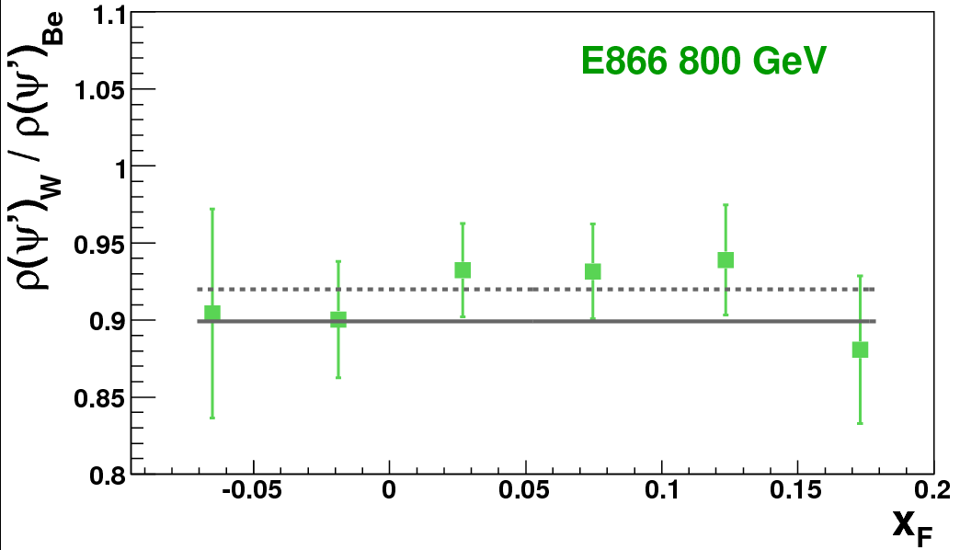
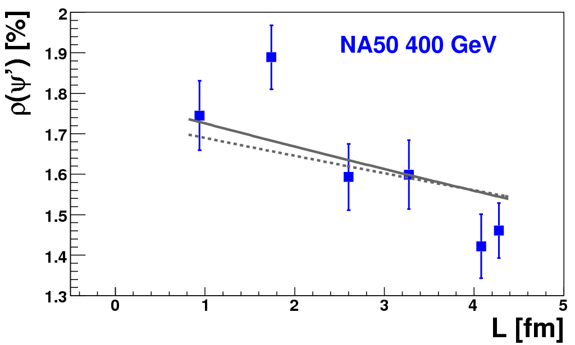
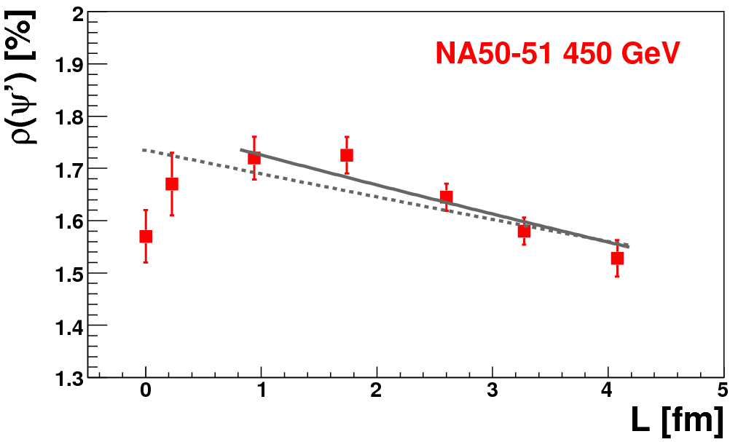
J/ψ feed-down contributions: from ψ’ decays
(only x_{F} < 0.2)
|x_{F}| < 0.1
Pb
The simple model used does not account for the H and D data points
Are H and D nuclei not large enough to be traversed by fully formed states?
|x_{F}| < 0.1
All data: P(χ²) = 1%
p d Be Al Cu Ag W
Without H and D data: P(χ²) = 27%

Slide 15
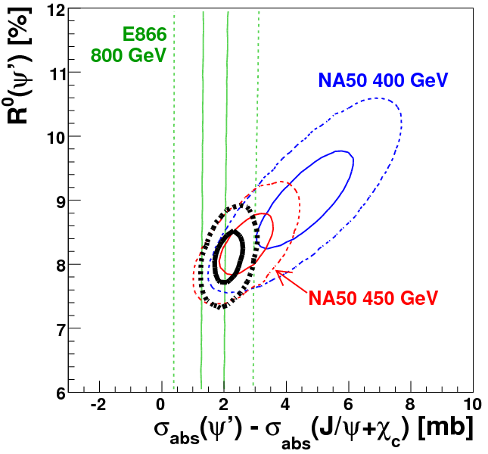
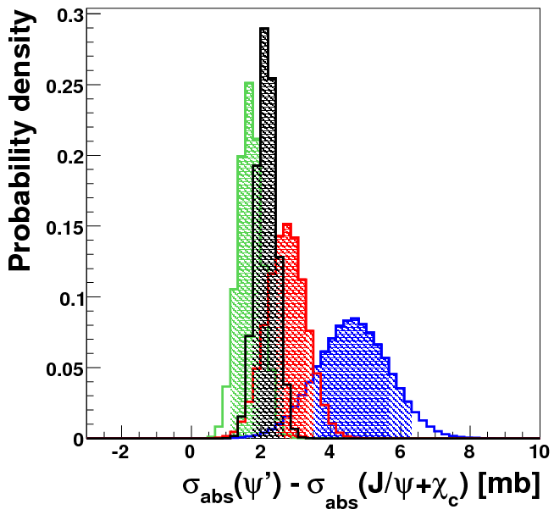
NA50 400 GeV
black: all combined
(→ global fits shown in the previous slide)
NA50 450 GeV
E866 800 GeV
68 and 99% c.l.’s
R⁰(ψ’) = 8.1 ± 0.3 %
Δσ_{abs} = 2.2 ± 0.3 mb
The error of R⁰(ψ’) is dominated by uncertainties of branching fractions
400 GeV
450 GeV
800 GeV
Even if the three values are compatible… it seems that Δσ_{abs} decreases with energy

Slide 16
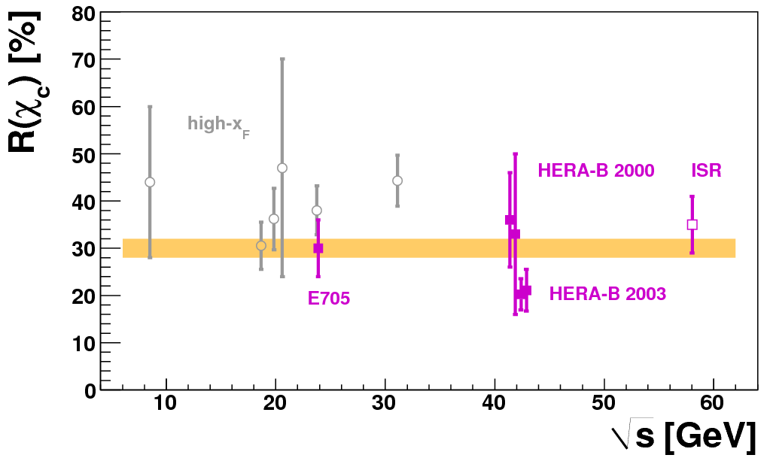
J/ψ feed-down contributions: from χ_{c} decays
CDF
E_{lab} : 38 → 920 GeV
A : 1 → 184
x_{F} : −0.35 → 0.9
A simple global average of all data points gives a very bad fit quality: P(χ²) < 1%
What if we concentrate on the mid-rapidity region and allow the J/ψ and χ_{c} to have different absorption cross sections?

Slide 17
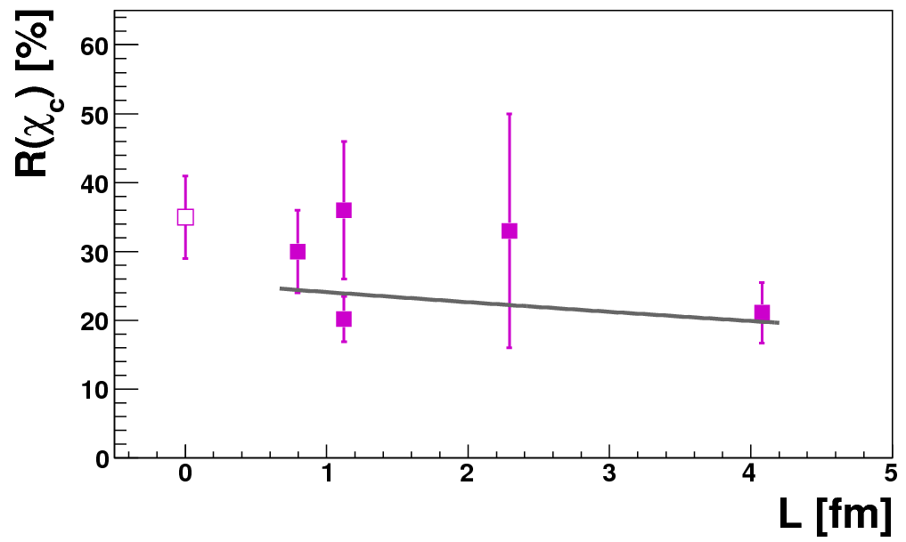
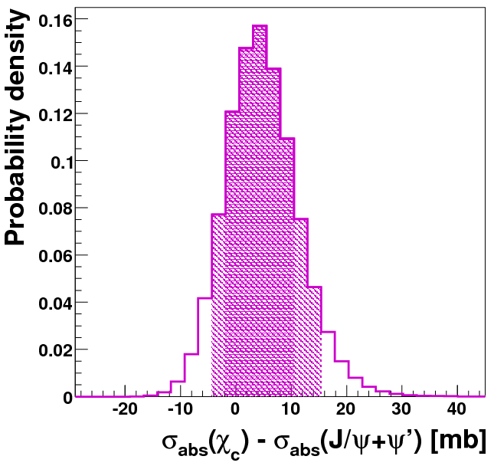
only p-A data with x_{F} ~ 0 and A > 1
The quality of the data description improves very much: P(χ²) = 25%
The “pp” feed-down fraction becomes
R⁰(χ_{c}) = 25 ± 5 %
Δσ_{abs} > 0 at 75% c.l.
nuclear matter breaks the χ_{c} more easily than the J/ψ

Slide 18
Summary
The detailed interpretation of the J/ψ suppression patterns seen in heavy-ion collisions crucially relies on a robust understanding of the nuclear effects already present in proton-nucleus data
The J/ψ absorption cross section, σ_{abs}, depends on rapidity and collision energy, being larger at 158 GeV than previously assumed
The J/ψ feed-down fractions from ψ’ and χ_{c} decays and their different nuclear dependences must be accounted for in the analysis of the heavy-ion results

