Slide 1
Status of FOPI data
Strangeness production in HICs
in the SIS energy regime
Yvonne Leifels , GSI

Slide 2
Outline
Experiment
  FOPI Detector
Motivation and Experimental program
Spectra and rapidity distributions
Pion induced reactions
Directed flow
Conclusions and Summary

Slide 3
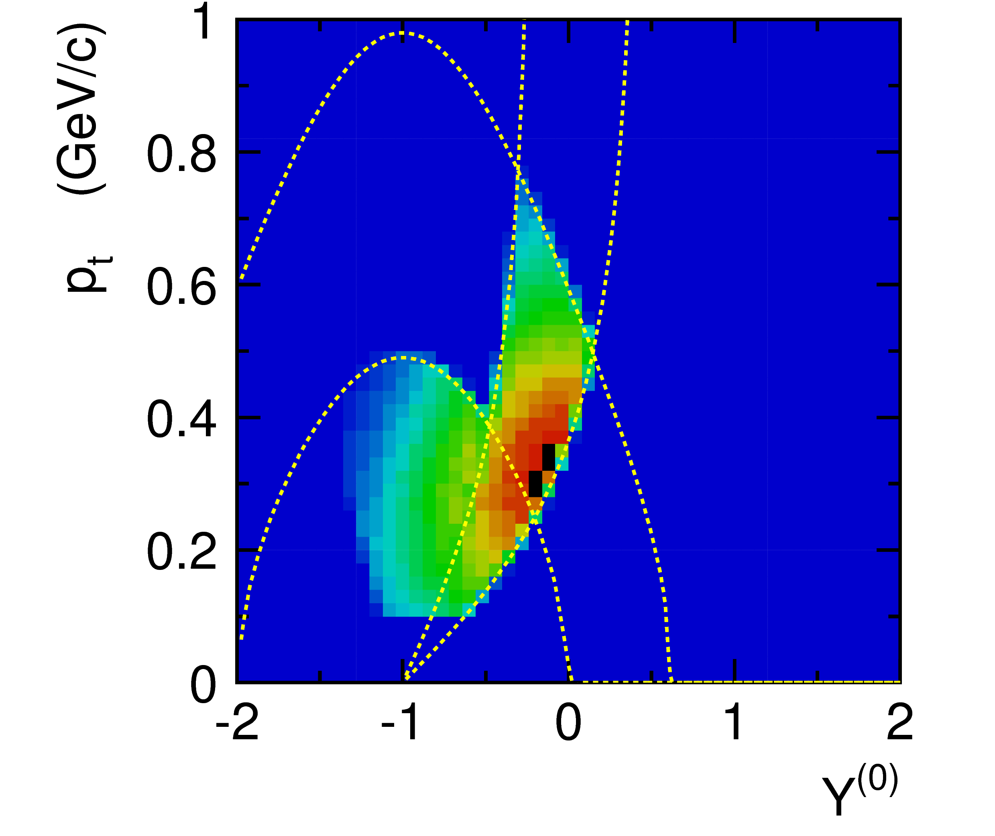
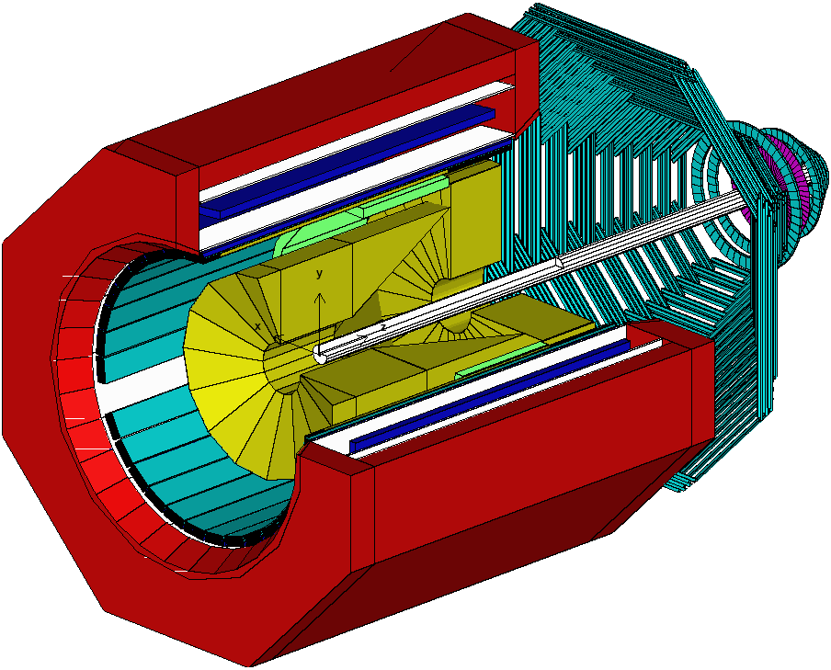
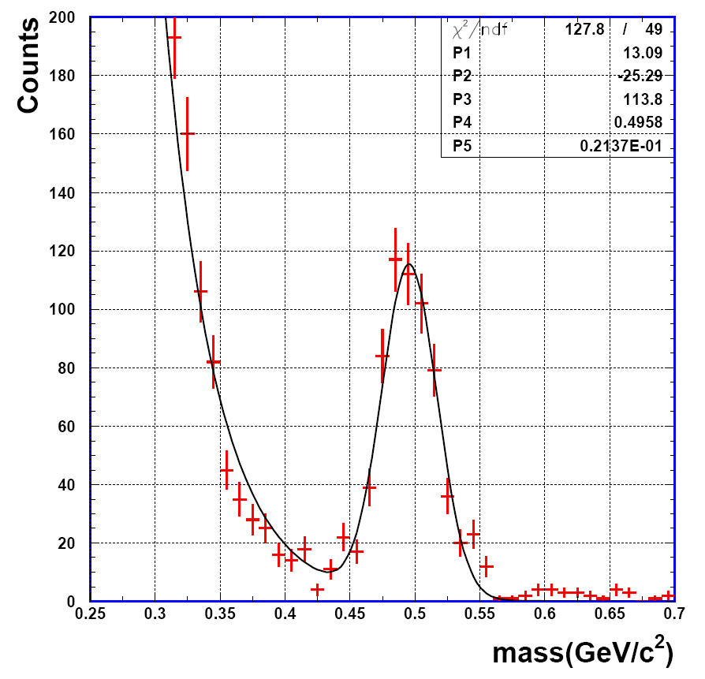
FOPI Detector
RPC ToF detectors
Θ _{Lab}
RPC : 30-52
Barrel : 52-120
Drift chambers
Plastic ToF detectors
Charged particle detector, large acceptance (EOS studies)
Charged kaon identification with RPC Tof barrel (σ_{tof} < 80 ps)
Reconstruction of strange resonances and other rare probes

Slide 4
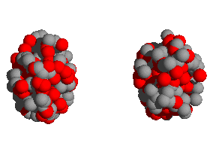
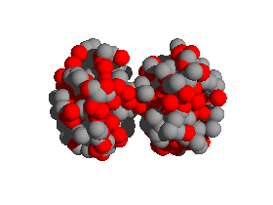
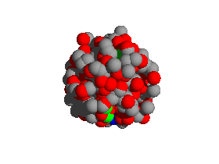
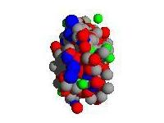
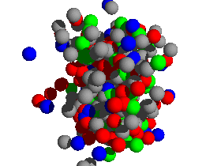
Experimental program
Symmetric Heavy ion collisions
Ca+Ca → Au + Au
90...2000A MeV
Mass asymmetric reactions
Ni+Pb, Ca+Au
400...1.9 AGeV
Isospin asymmetric reactions
⁹⁶Ru + ⁹⁶Zr
400, 1000, 1500 AMeV
Elementary reactions
p+p 3.1 GeV
Pion induced reactions
π⁻ + C...Pb 1.1 and 1.7 GeV/c
C. Hartnack

Slide 5
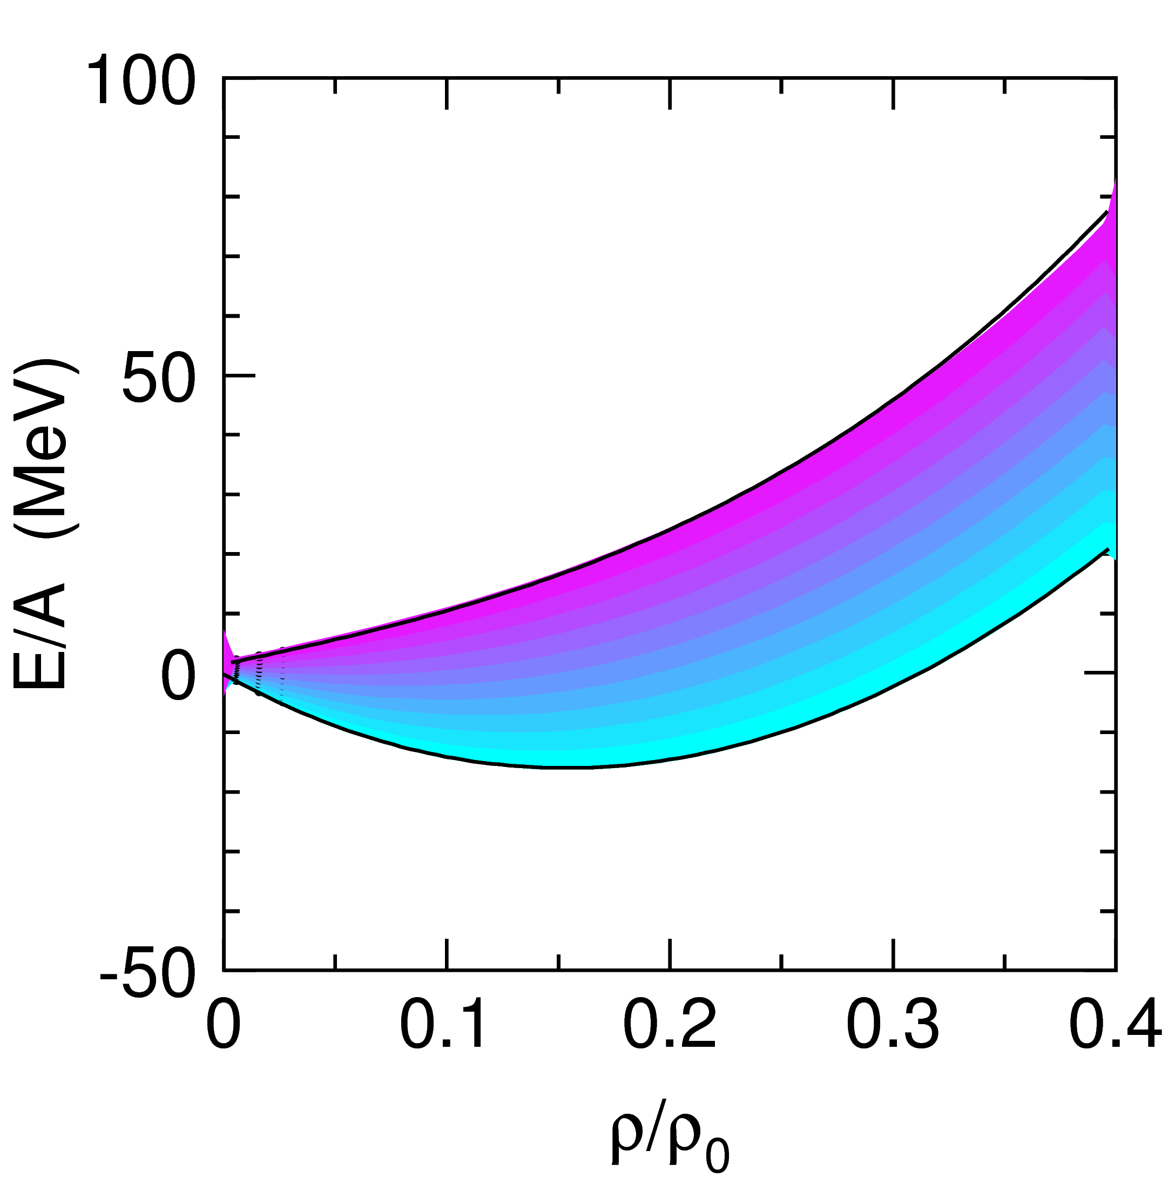
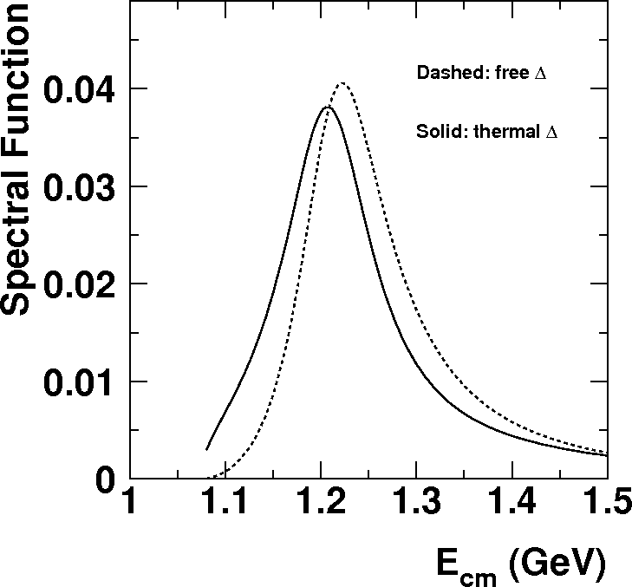
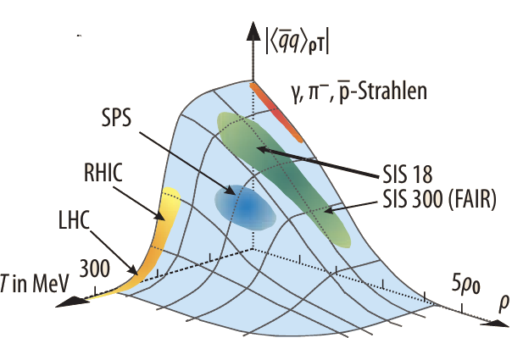
Motivation
properties of hot and dense matter
  EOS
  symmetry energy
  in – medium properties (cross sections)
  particle production
  ∆’s in dense matter
Strangeness in dense matter
  Kaon Nucleon potential
  interaction of Λ‘s in nuclear matter
exotic states
  hypernuclei
  .... states
M. Kotulla et al, Phys. Jou. 8 (2009) 3
nach W. Weise (2007)

Slide 6
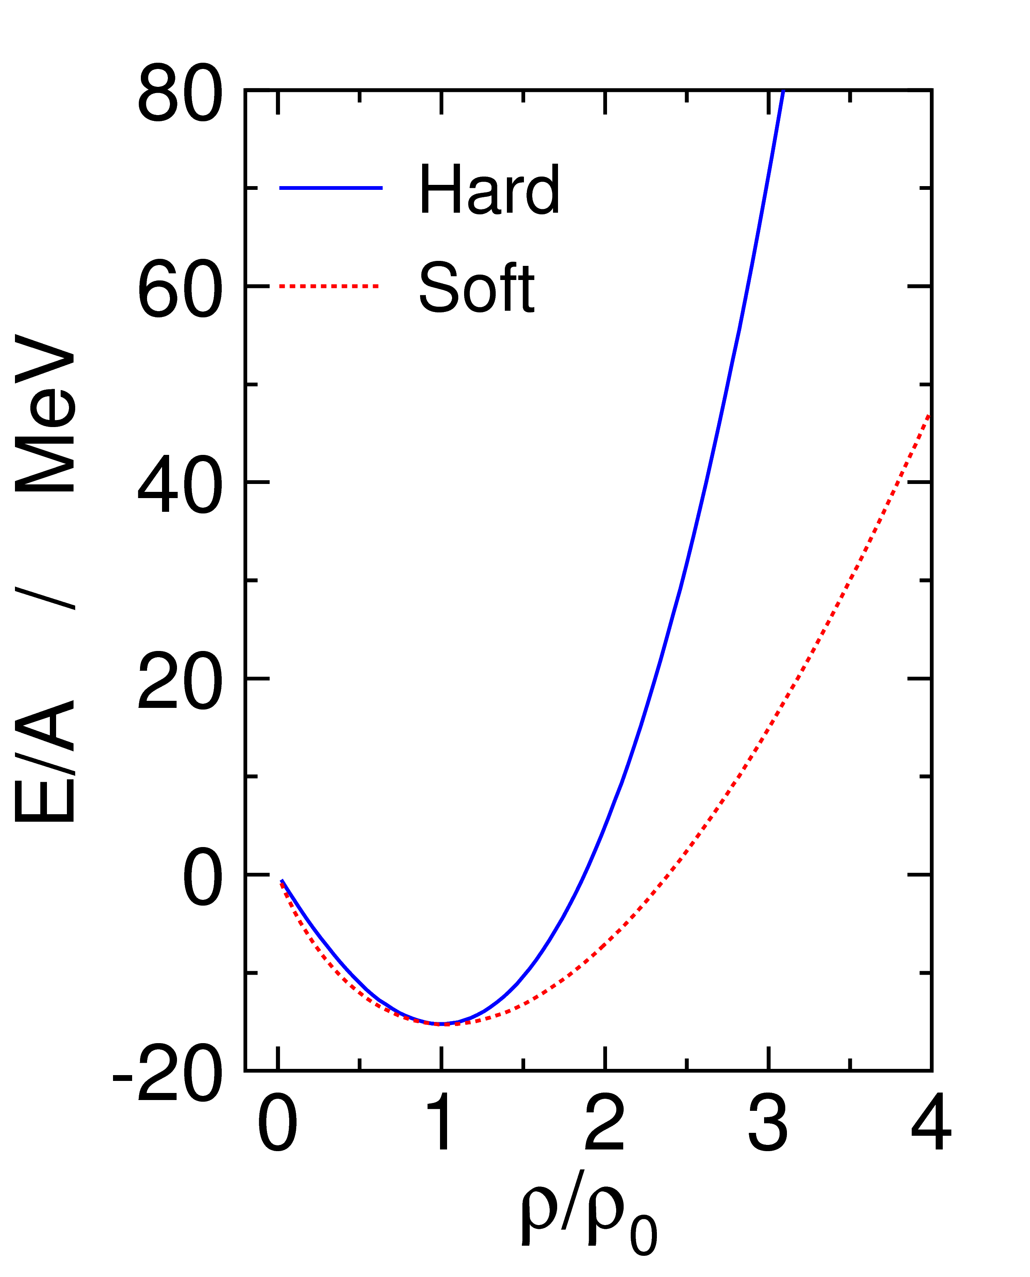
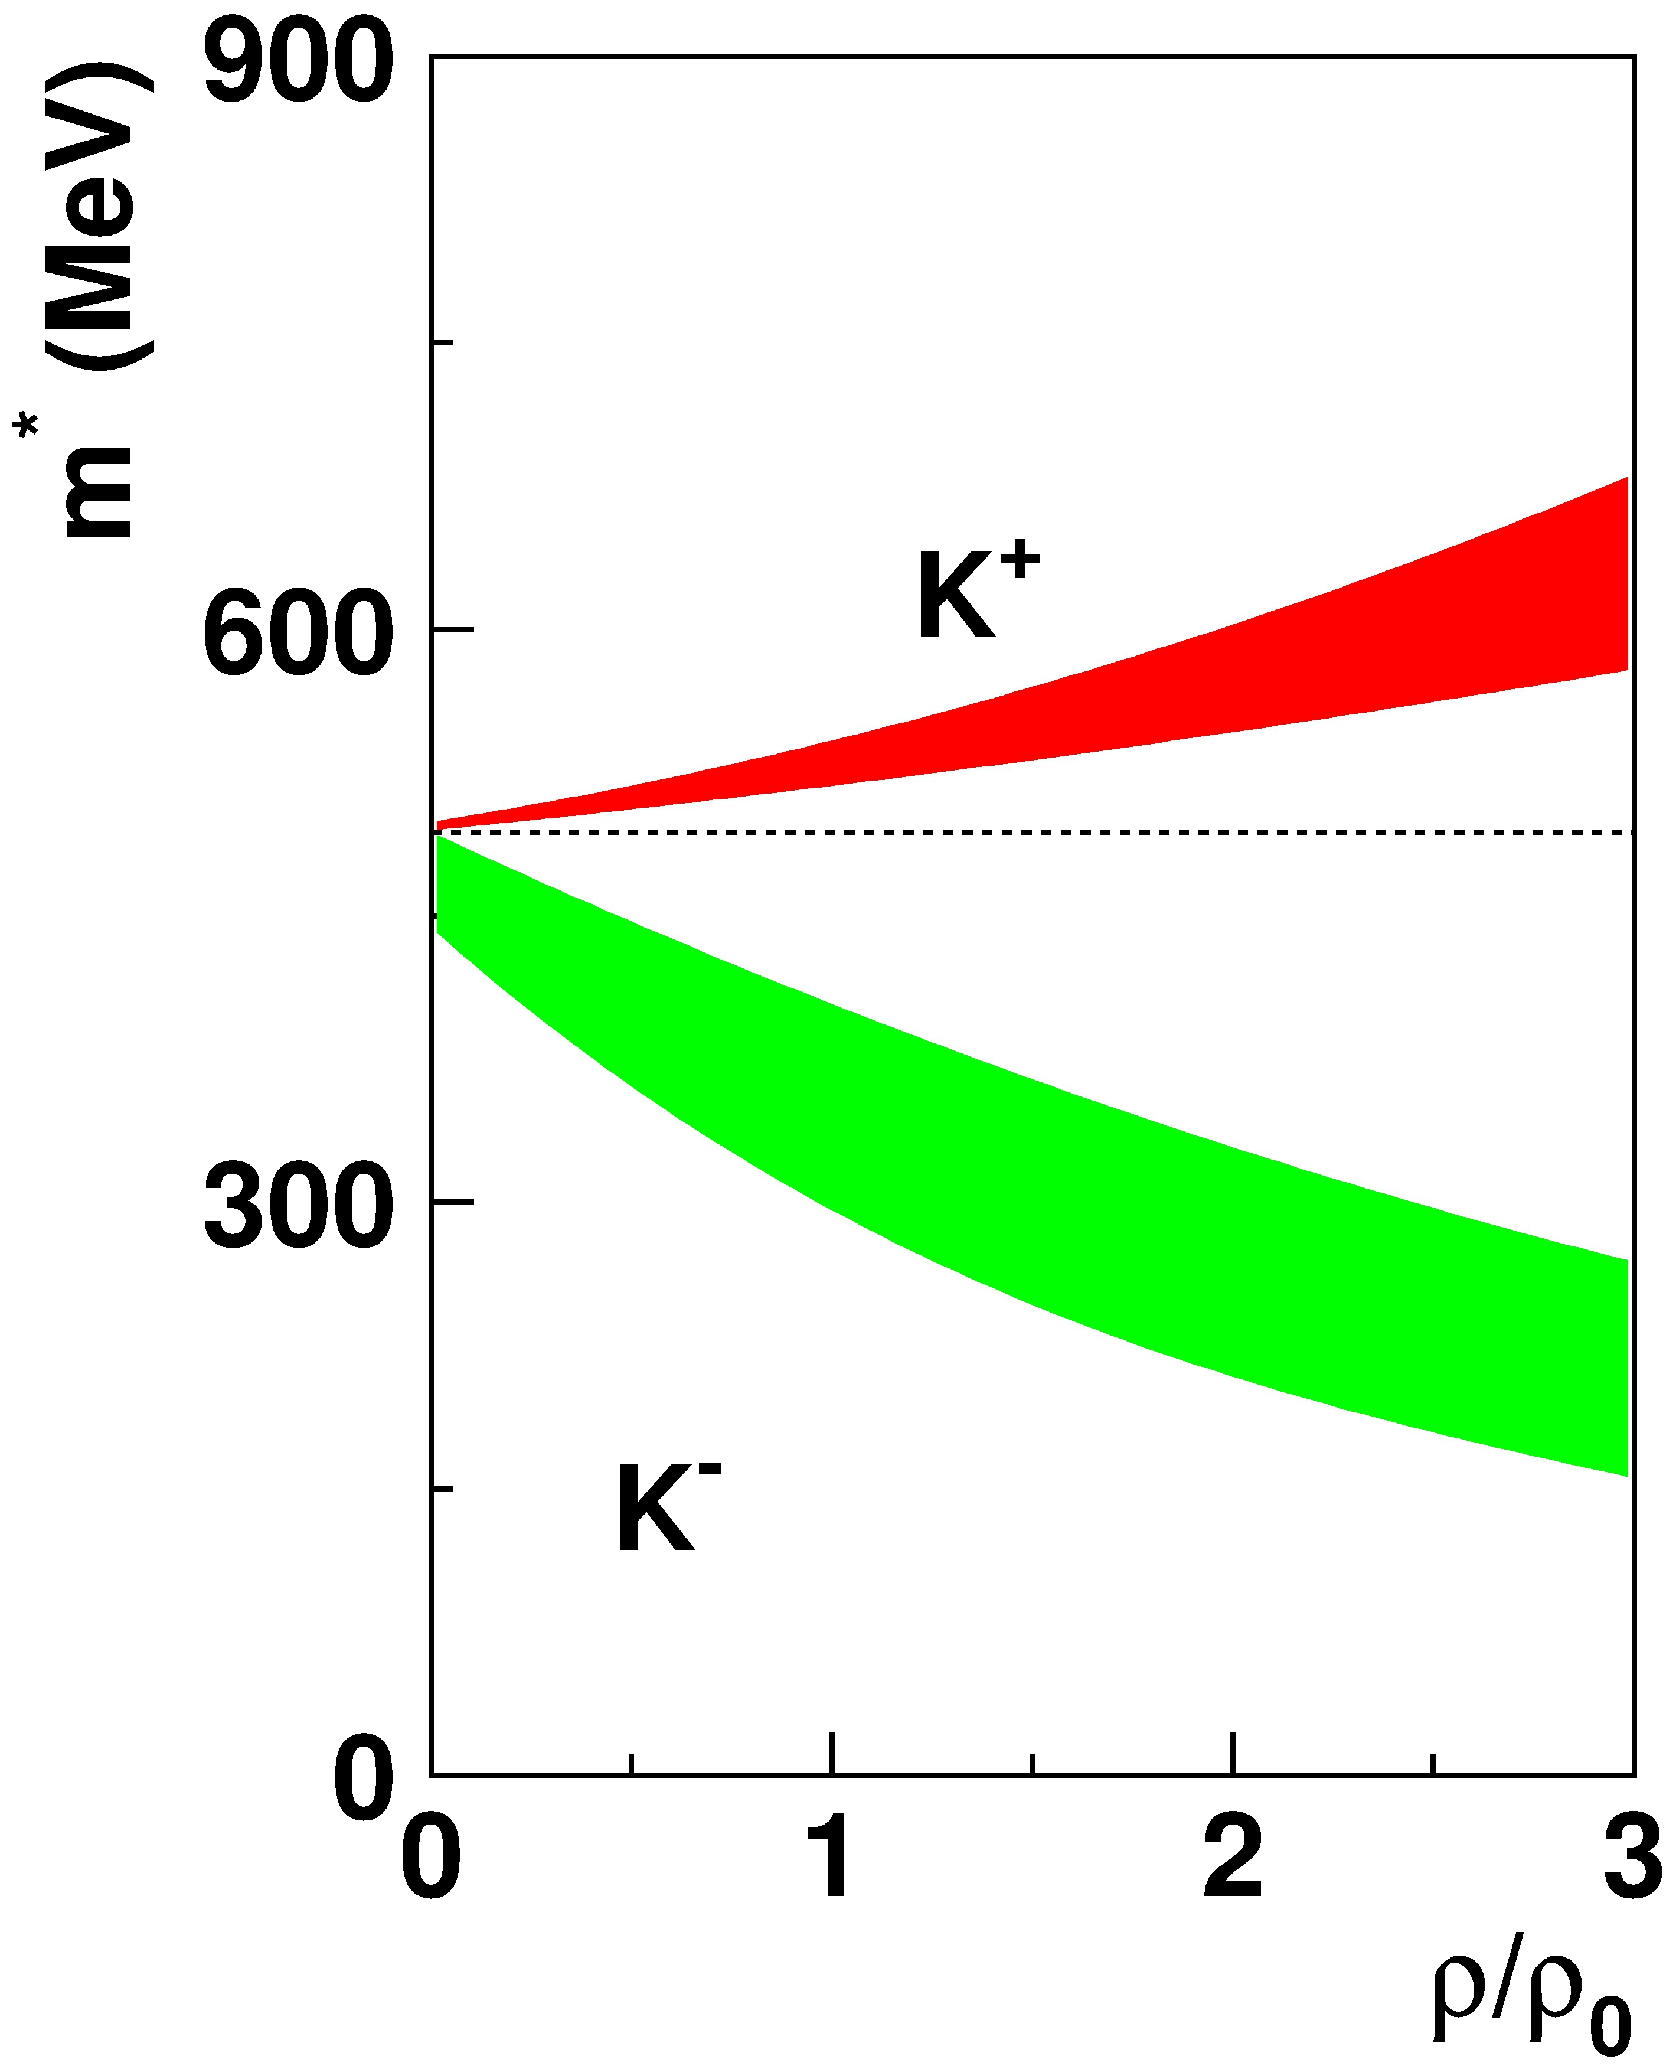
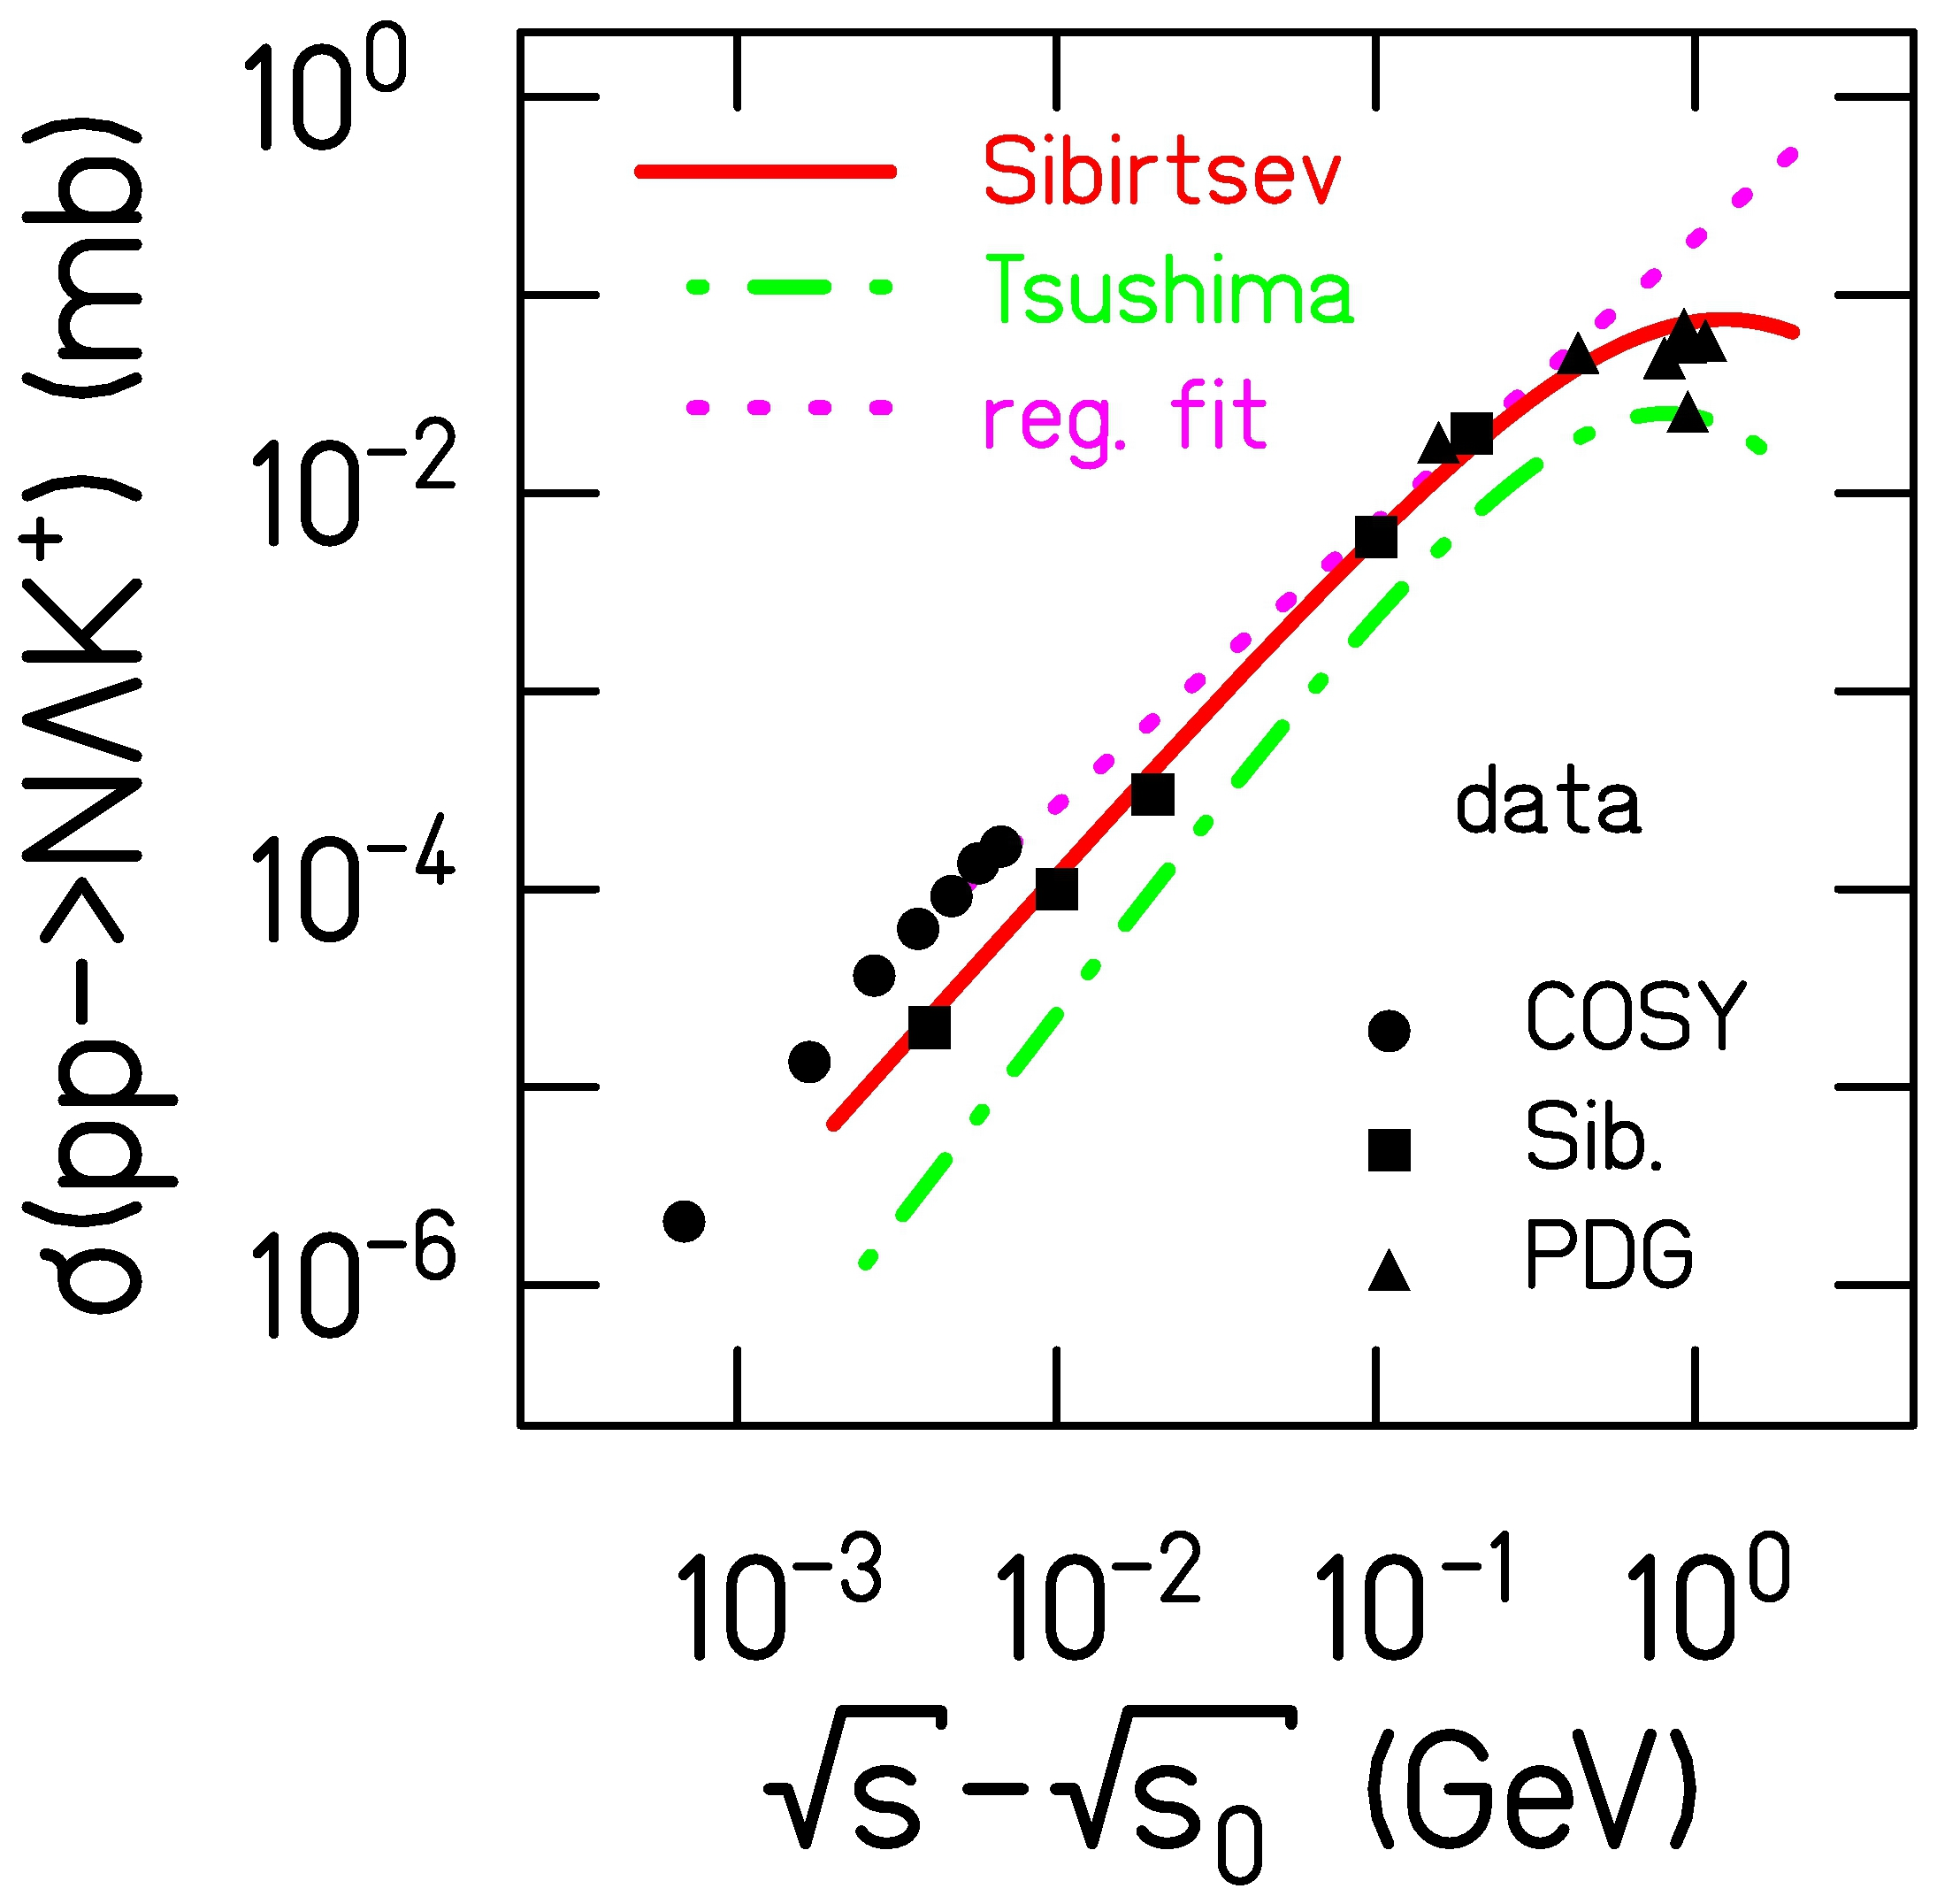
Model dependence of results
HSD (V1.5, BUU – Bratkovskaya)
IQMD (KQMD.V0711 – Hartnack)
→ EOS (soft, κ = 200-230 MeV)
→ Kaon production and propagation
→ equal cross sections
(production/re-scattering)
→ potential
U_{pot,K+N,HSD}(ρ₀,p=0) = +20 MeV mass shift
U_{pot,K+N,IQMD}(ρ₀,p=0) = +40 MeV RMF param.
→ BUU vs QMD code
→ Treatment of anti-kaons
→ IQMD quasi particles
(U(ρ=ρ₀, p=0 = -90 MeV)
→ HSD G-Matrix formalism
(U(ρ=ρ₀, p=0)= - 50 MeV)
→ C. Hartnack et al. Phys. Rep. 510, 119 (2012)
380 MeV
200 MeV

Slide 7
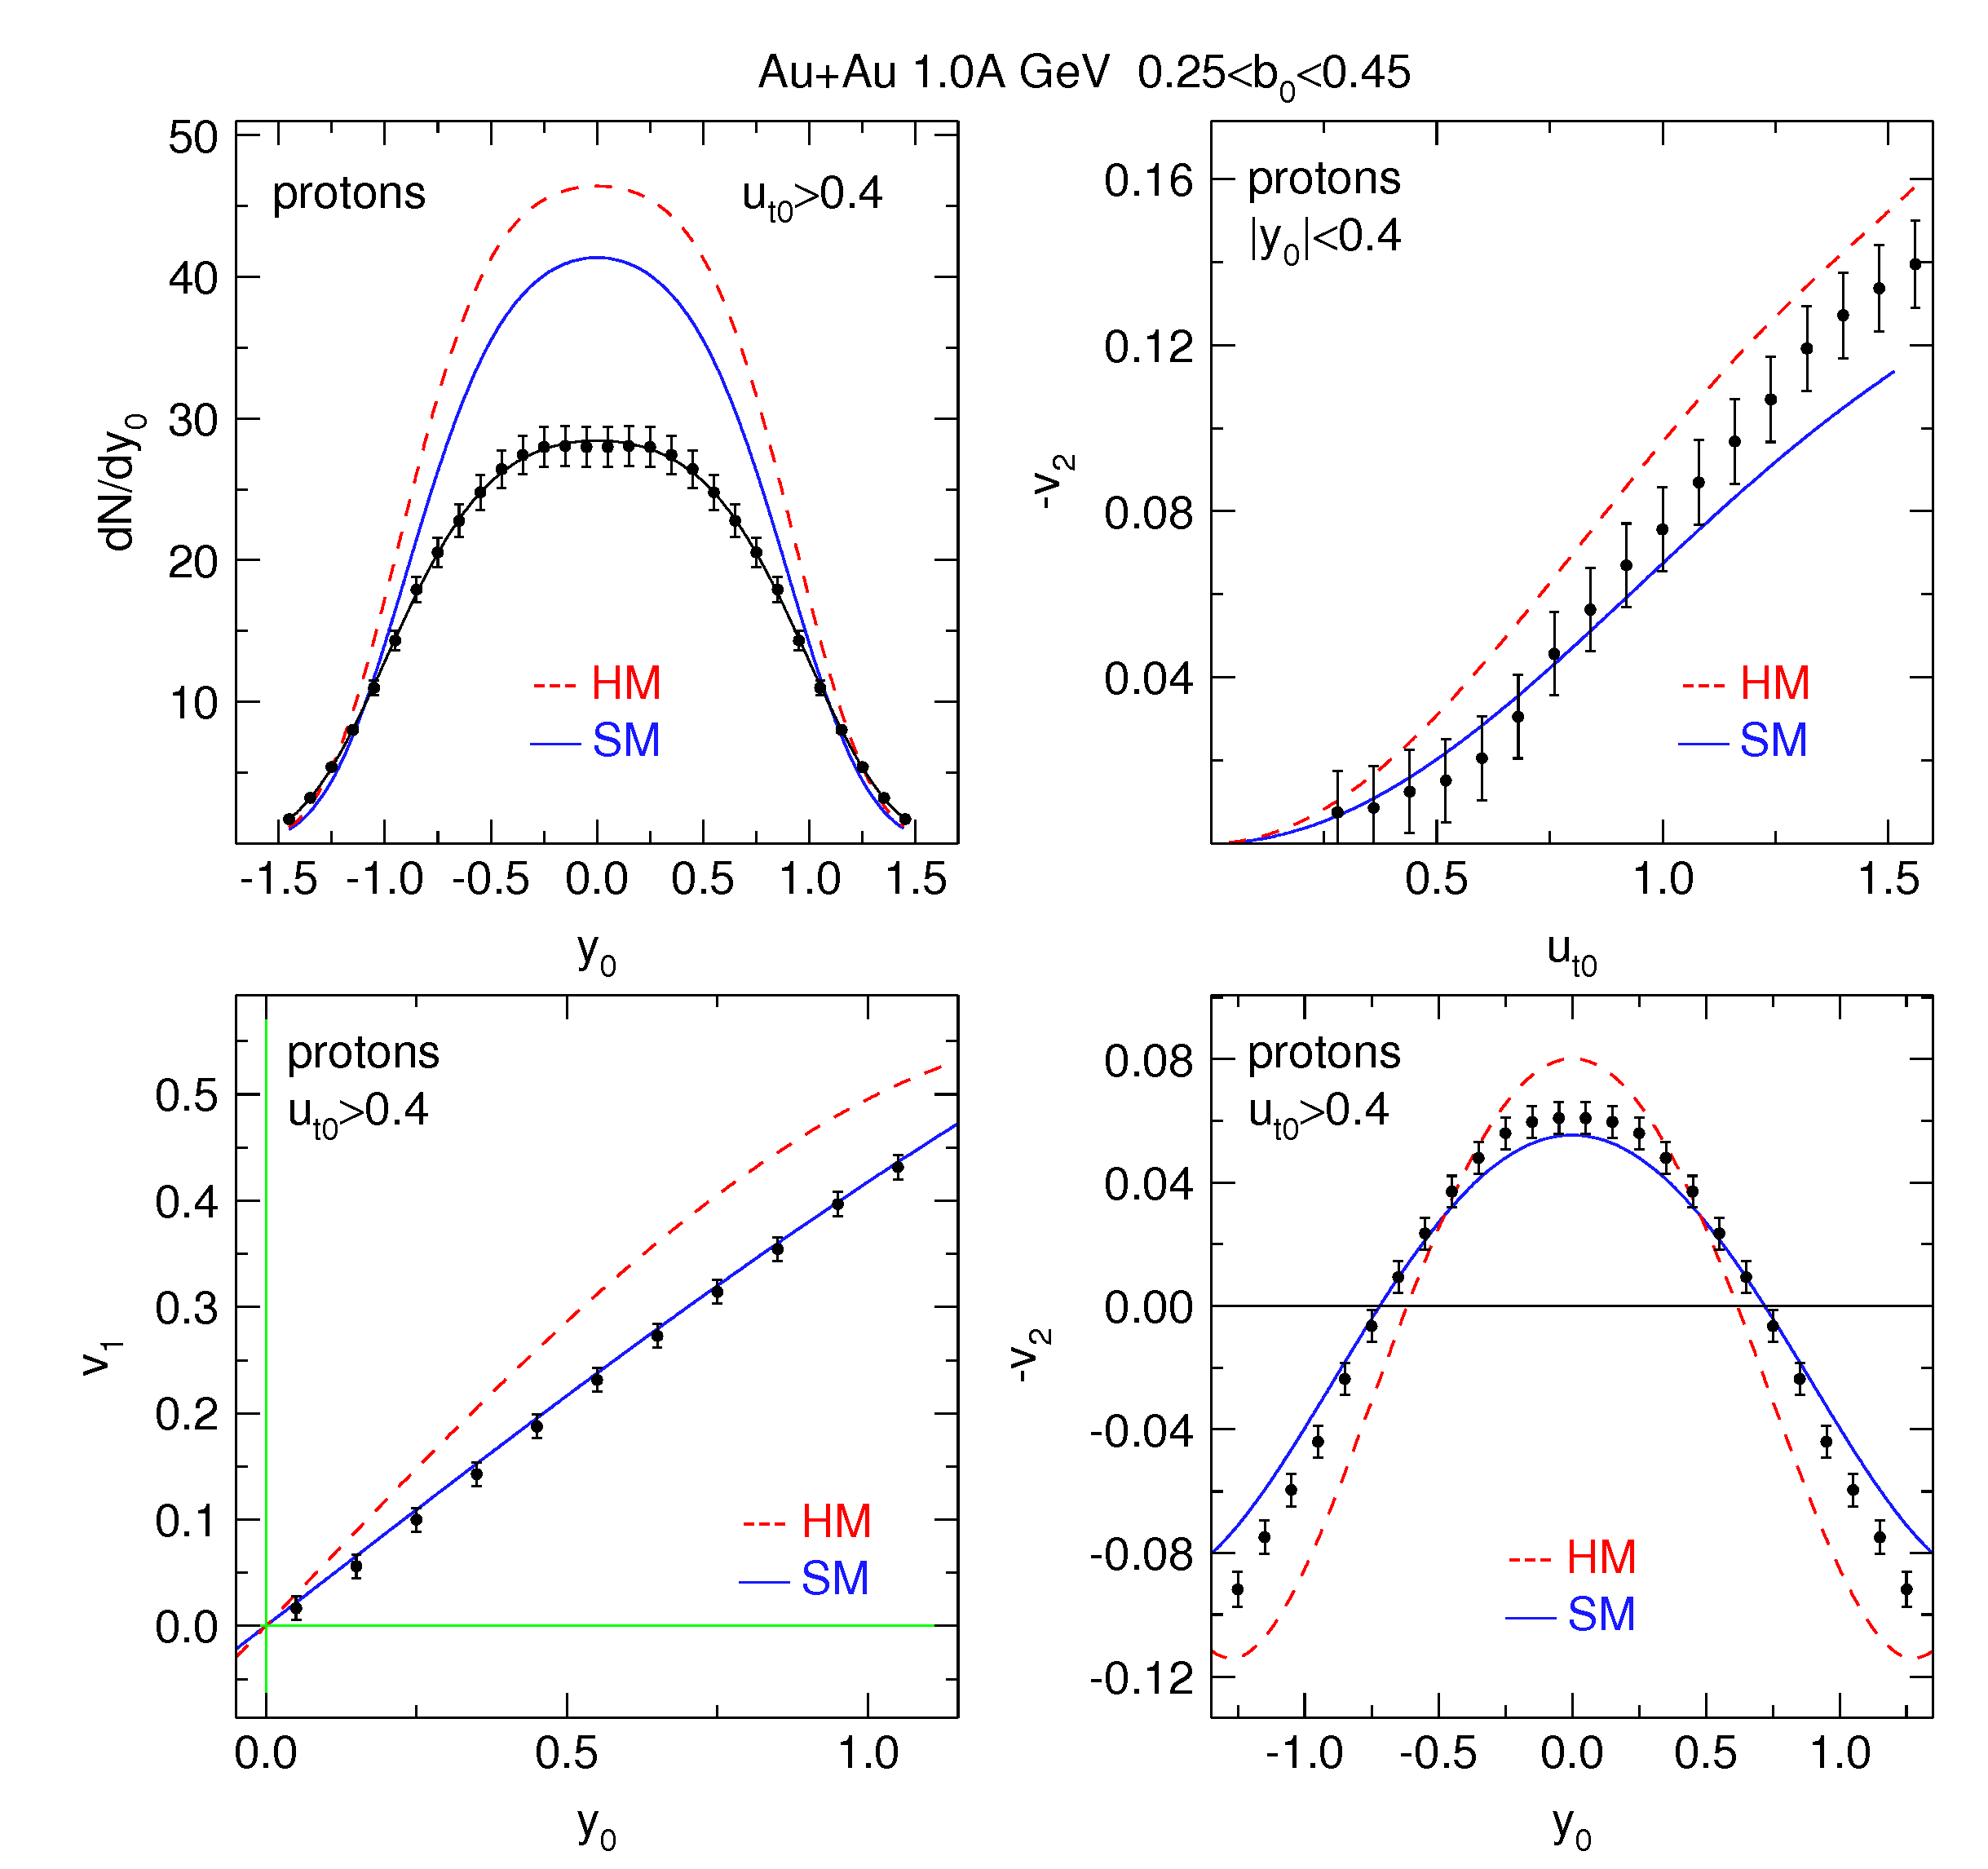
Description of “bulk” properties by the models
reaction dynamics described
pion production reproduced~10%
Proton yield overestimated
  yields depending on EOS (cluster production)
flows described by SM
HSD and IQMD describe experimental equally well (if clusters are omitted)

Slide 8
Spectra and Yields

Slide 9
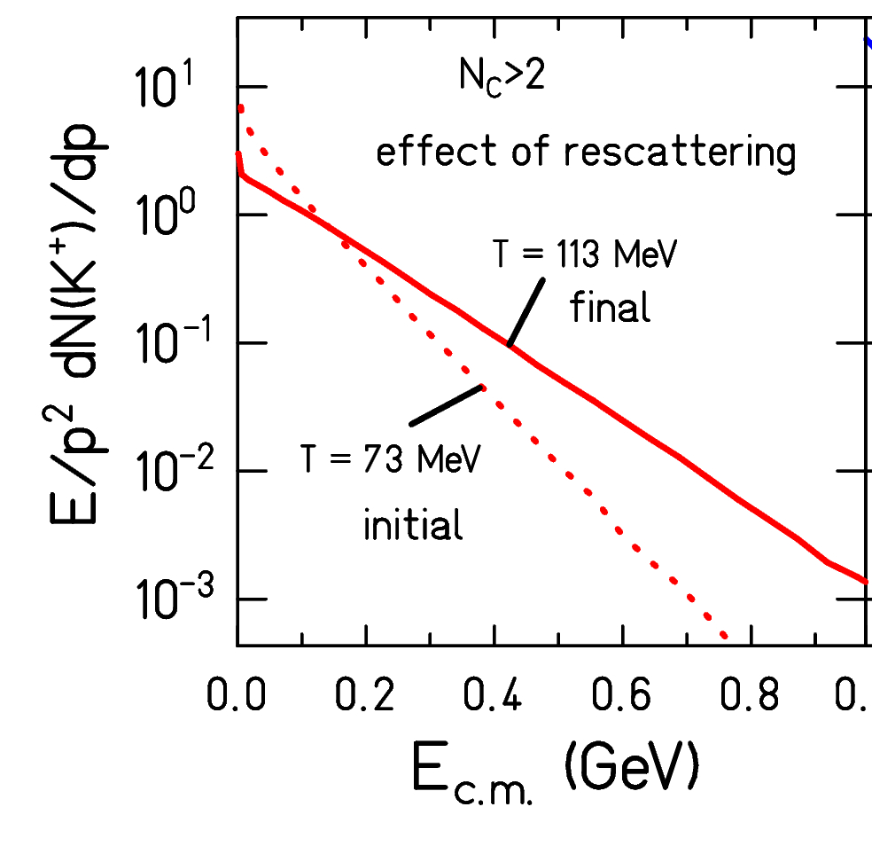
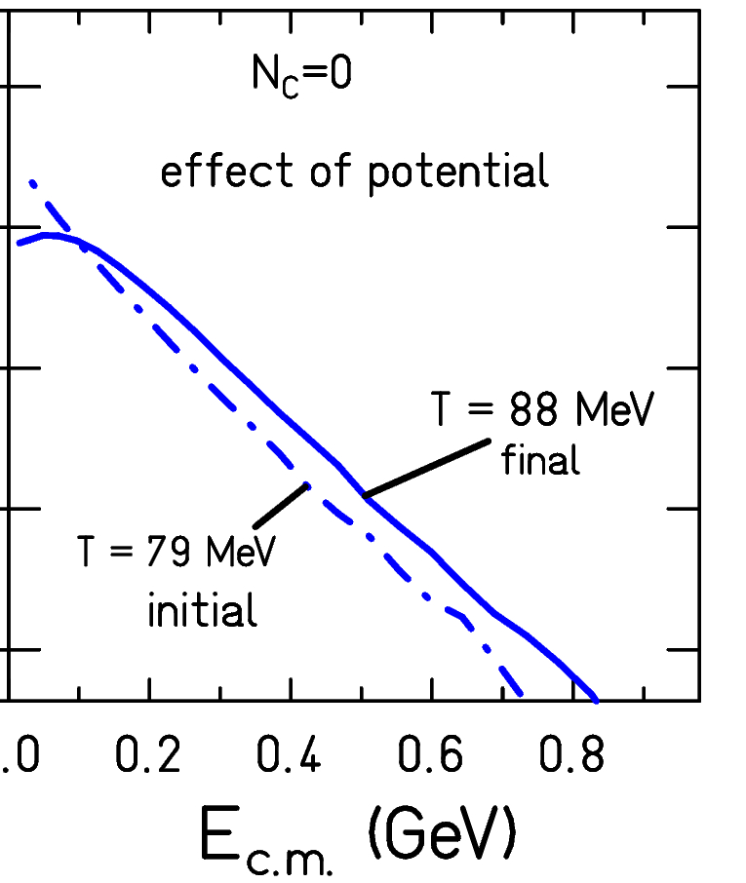
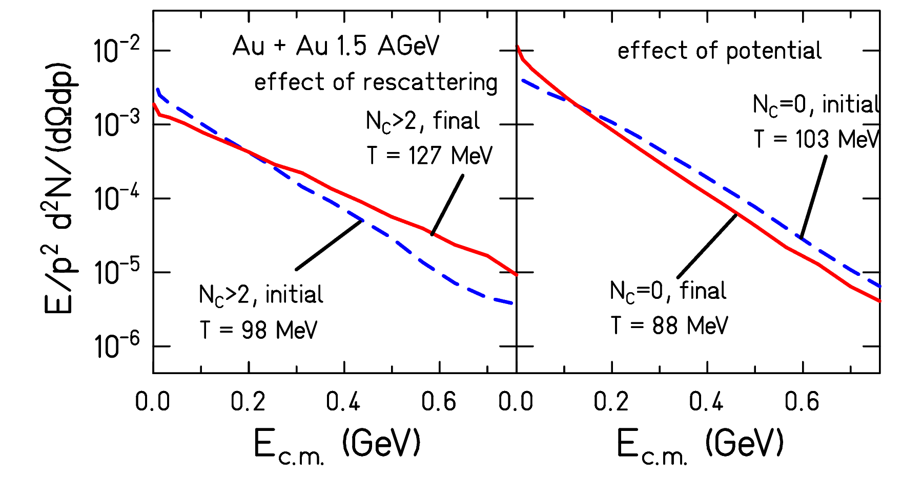
Spectra
C. Hartnack et al.
PR 510, 119 (2012)
rescattering potential
K⁺
K⁻
Strong enhancement of the slope from initial to final momentum
Small enhancement (K⁺) or reduction (K⁻)

Slide 10
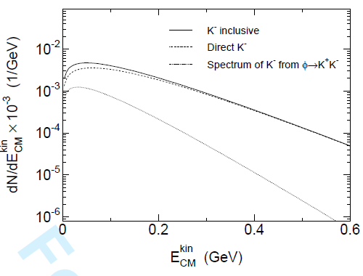
Spectra
C. Hartnack et al.
PR 510, 119 (2012)
rescattering potential
Influence of the ϕ decay on the K- spectra
K⁺
K⁻
Strong enhancement of the slope from initial to final momentum
Small enhancement (K⁺) or reduction (K⁻)

Slide 11
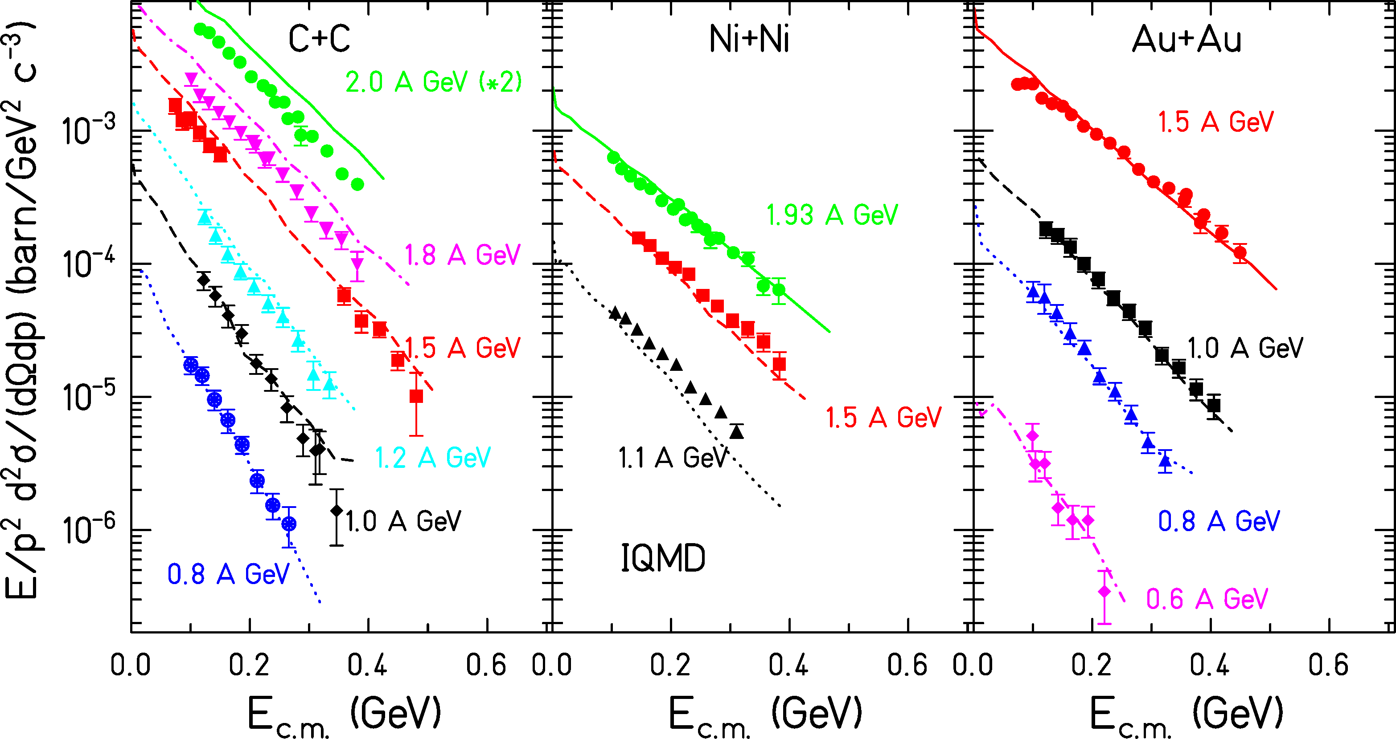
Kaos spectra
K⁺
Inclusive data, at mid-rapidity
model: IQMD C. Hartnack
PR 510 (2012)119

Slide 12
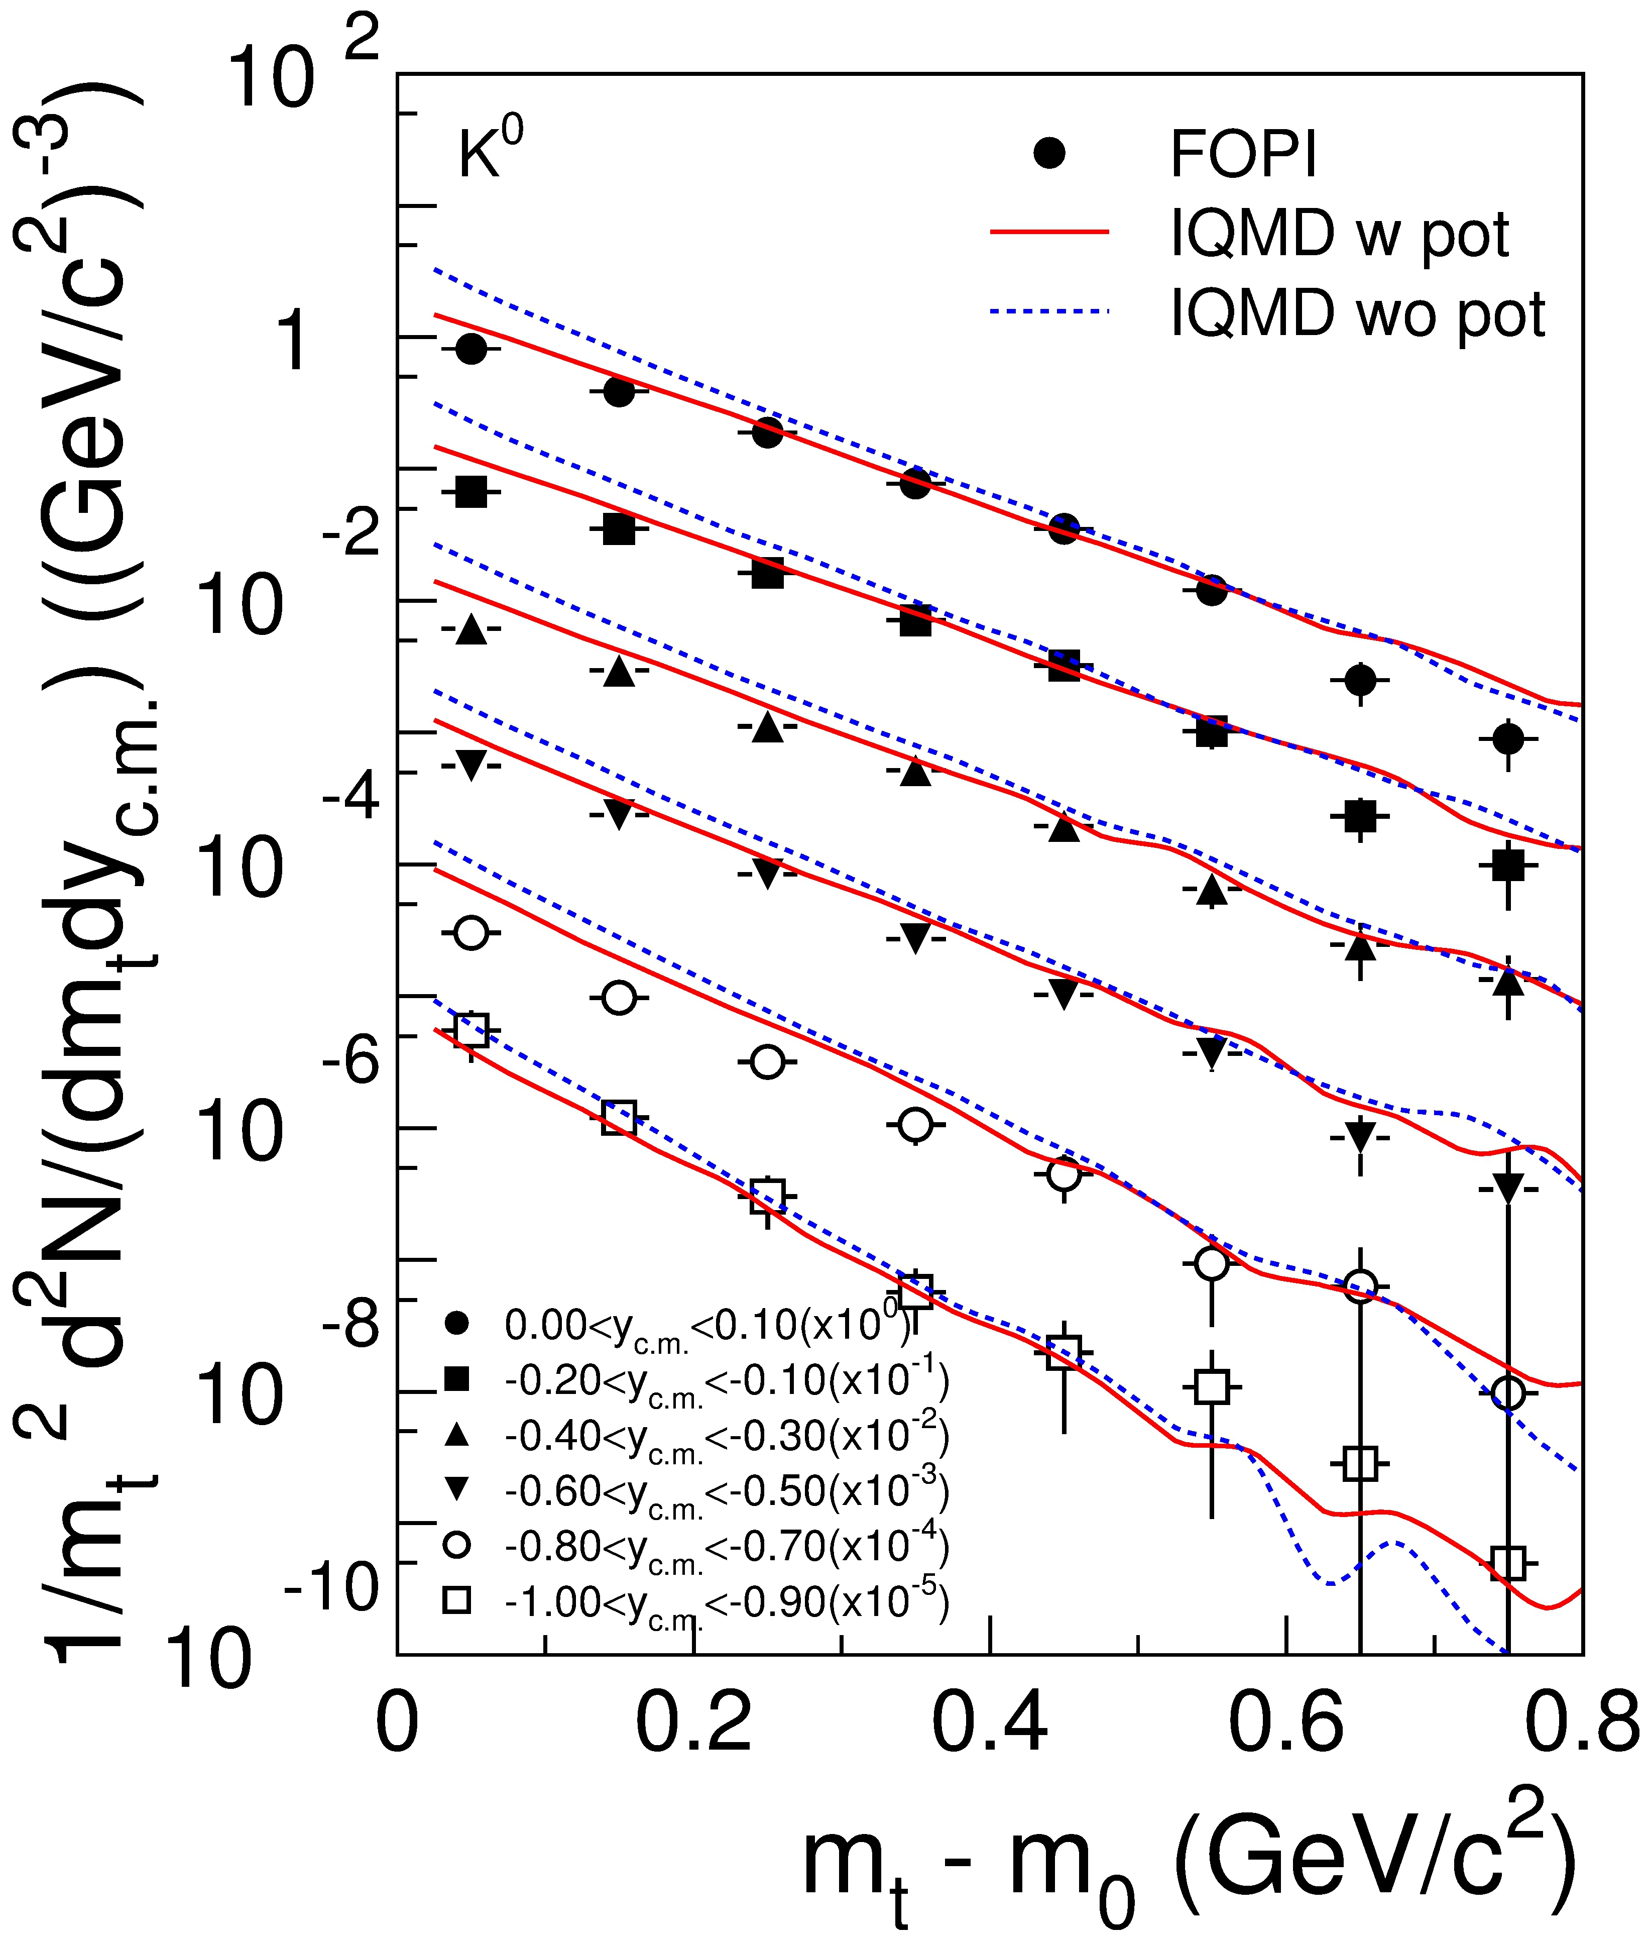
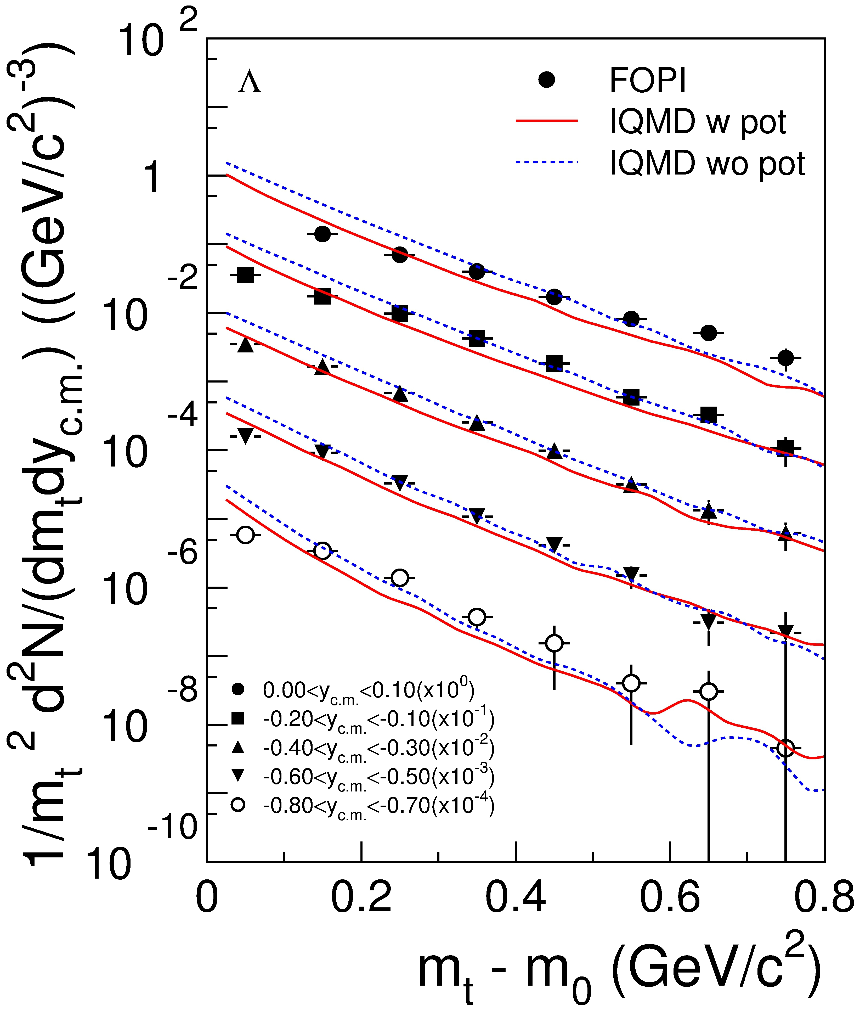
Fopi Ni+Ni data
X. Lopez
M. Merschmeyer
Phys. Rev. C 76 (2007) 024906

Slide 13
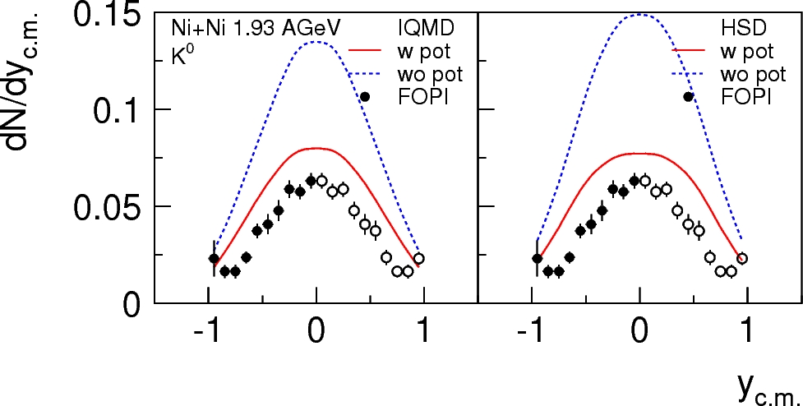
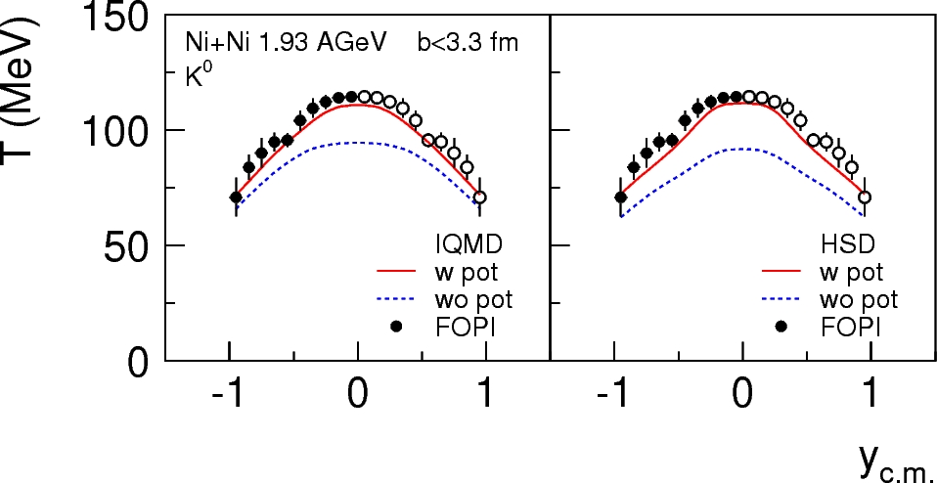
FOPI Ni+Ni data
KN U_{pot} = 40 MeV both IQMD and HSD
X. Lopez
M. Merschmeyer
All spectra, yields reasonably well described by HSD and IQMD

Slide 14
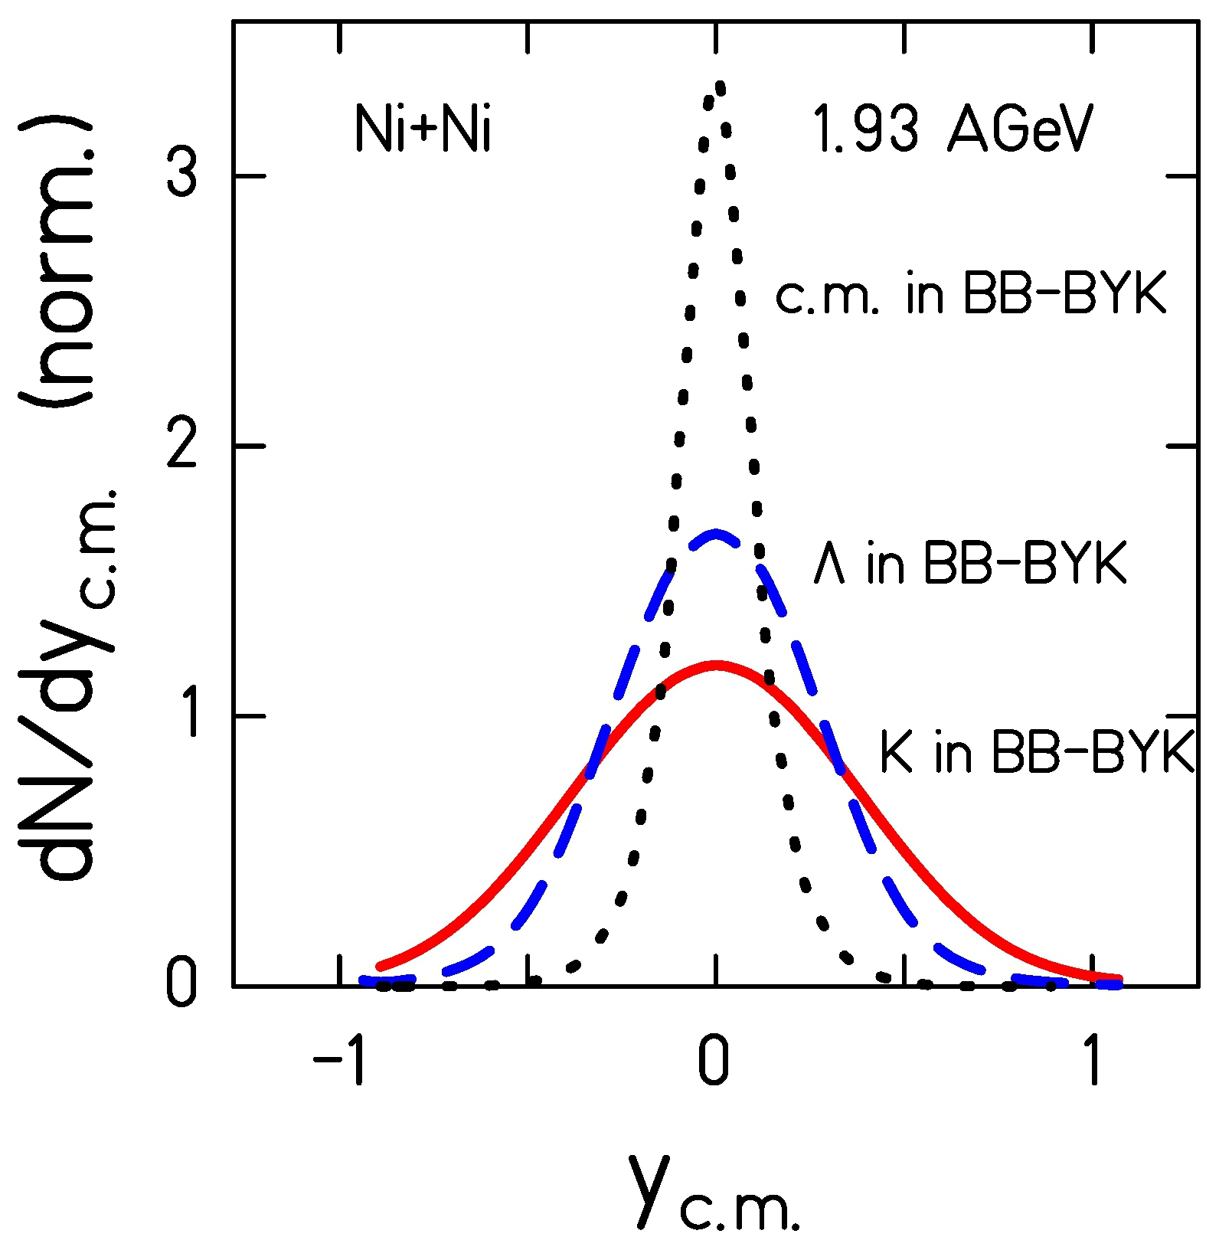
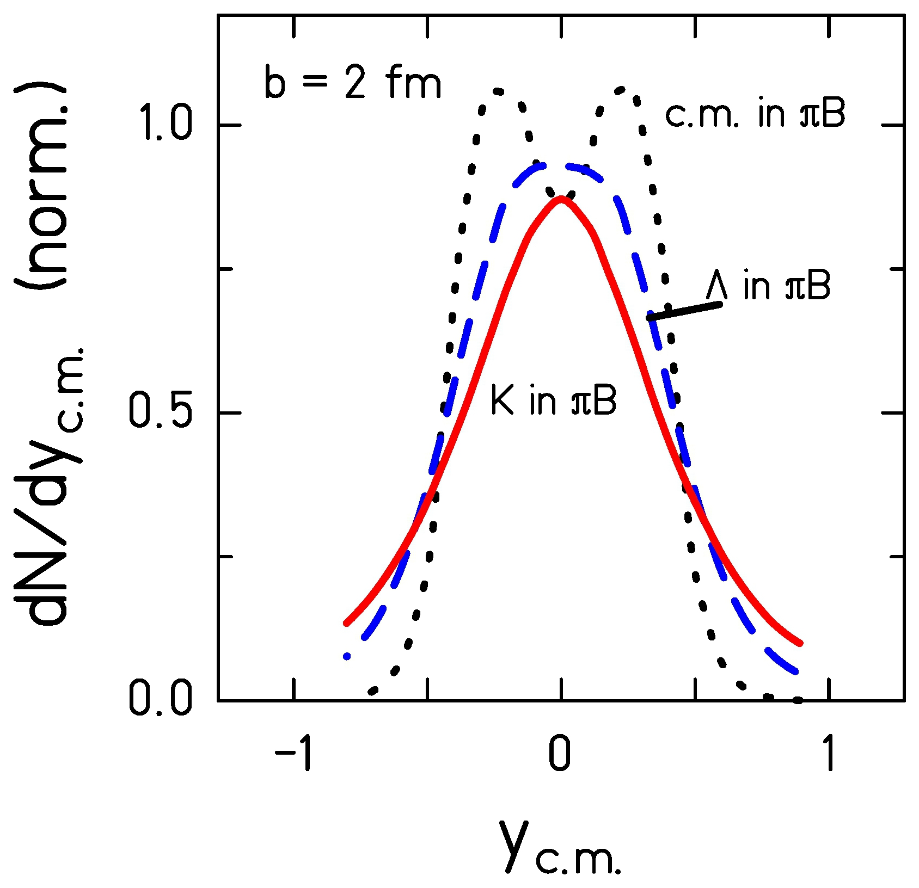
Origin of shape of the rapidity distribution
BB collisions vs
πB collisions
Notes:
rapidity of the center of mass of the two baryons which create a K+ is centered at mid-rap. Wenn K+ or Lambdas are created both shapes are broader than that of the sources and K+ will become quite wide. K+ mesons exhibit a similar width when they are produced in a pion induced reaction as if in BB collisions. Pions are coming from decays of Deltas hence, the sources do not have a maximum in the distribution at midrap.

Slide 15
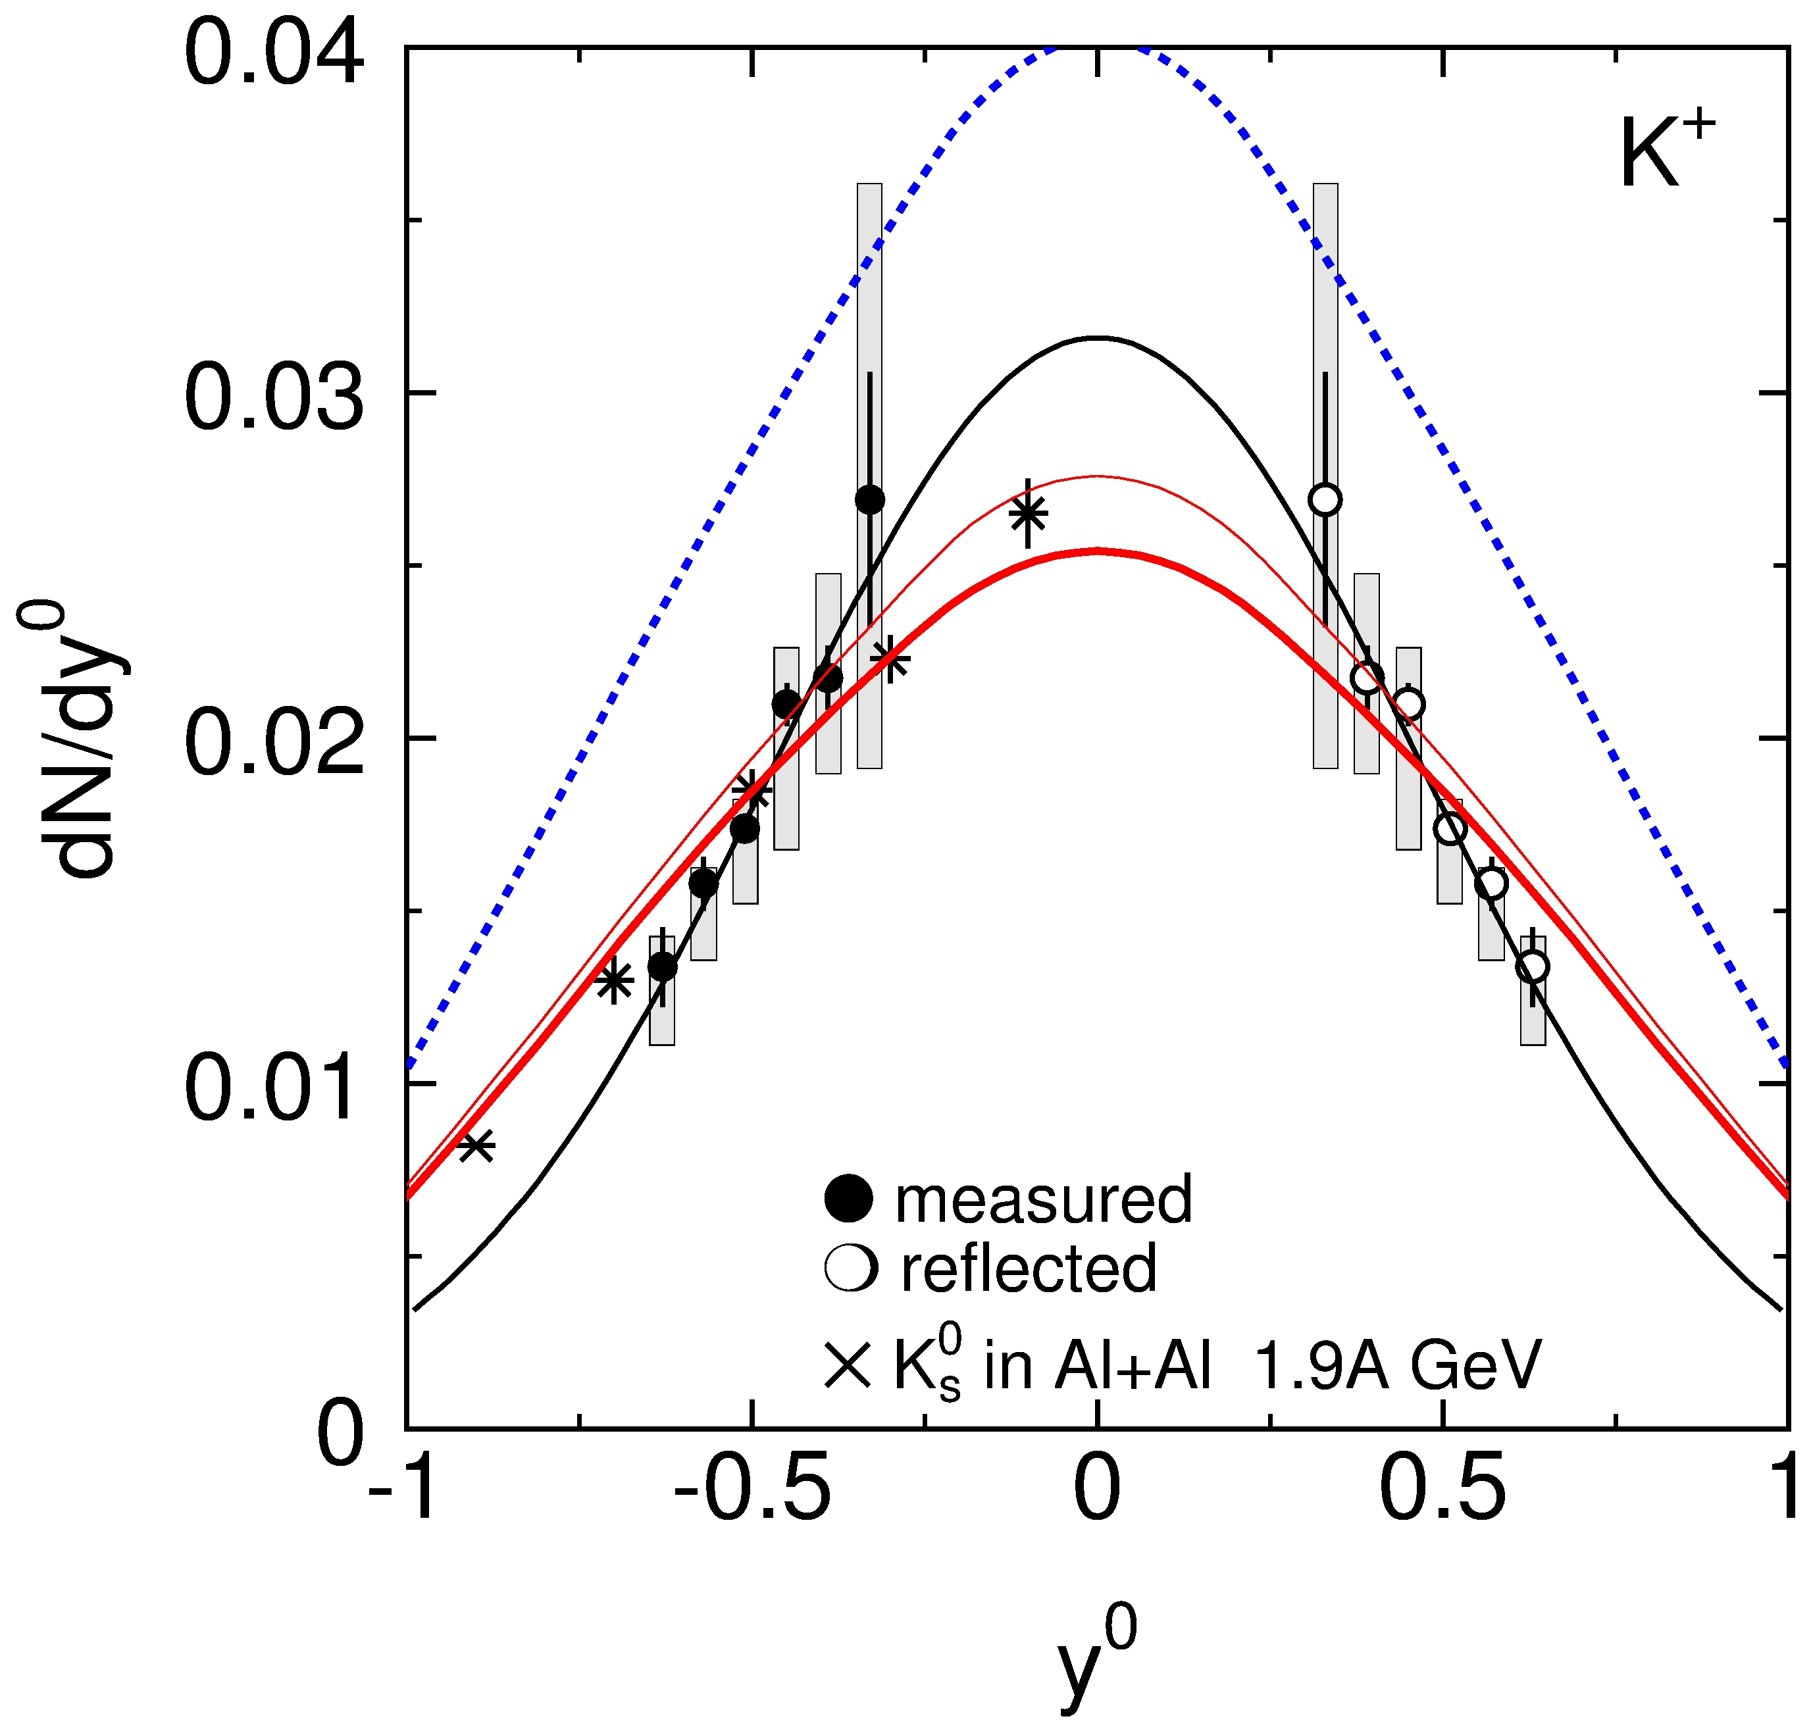
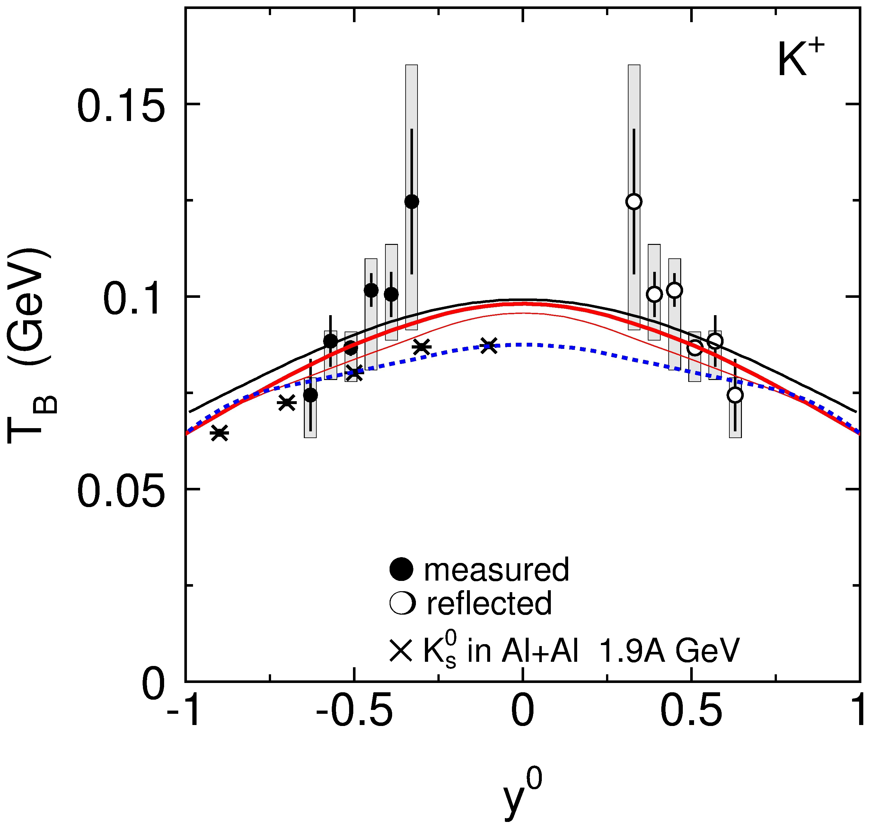
FOPI Al+Al data
P. Gasik
IQMD
K⁺ w pot
K⁰ w pot
K⁺ wo pot
KN U_{pot} = 40 MeV

Slide 16
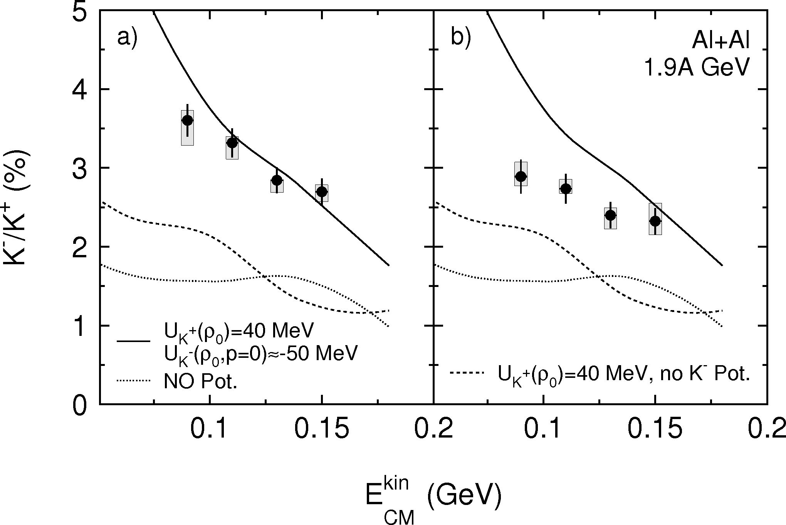
FOPI Al+Al data: K⁺/K⁻ ratio
HSD
K⁻ corrected for ϕ decays

Slide 17
Spectra in πA reactions

Slide 18
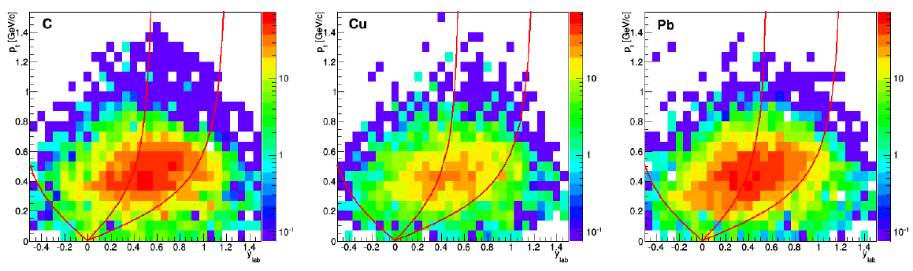
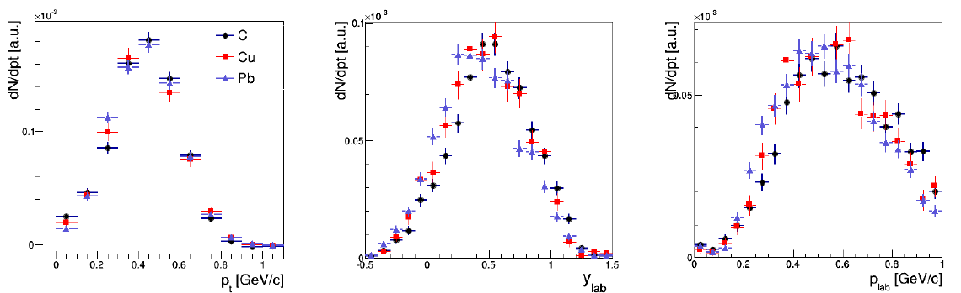
Phase space distributions of K⁰ in pion-induced reactions at 1.7 GeV/c

Slide 19
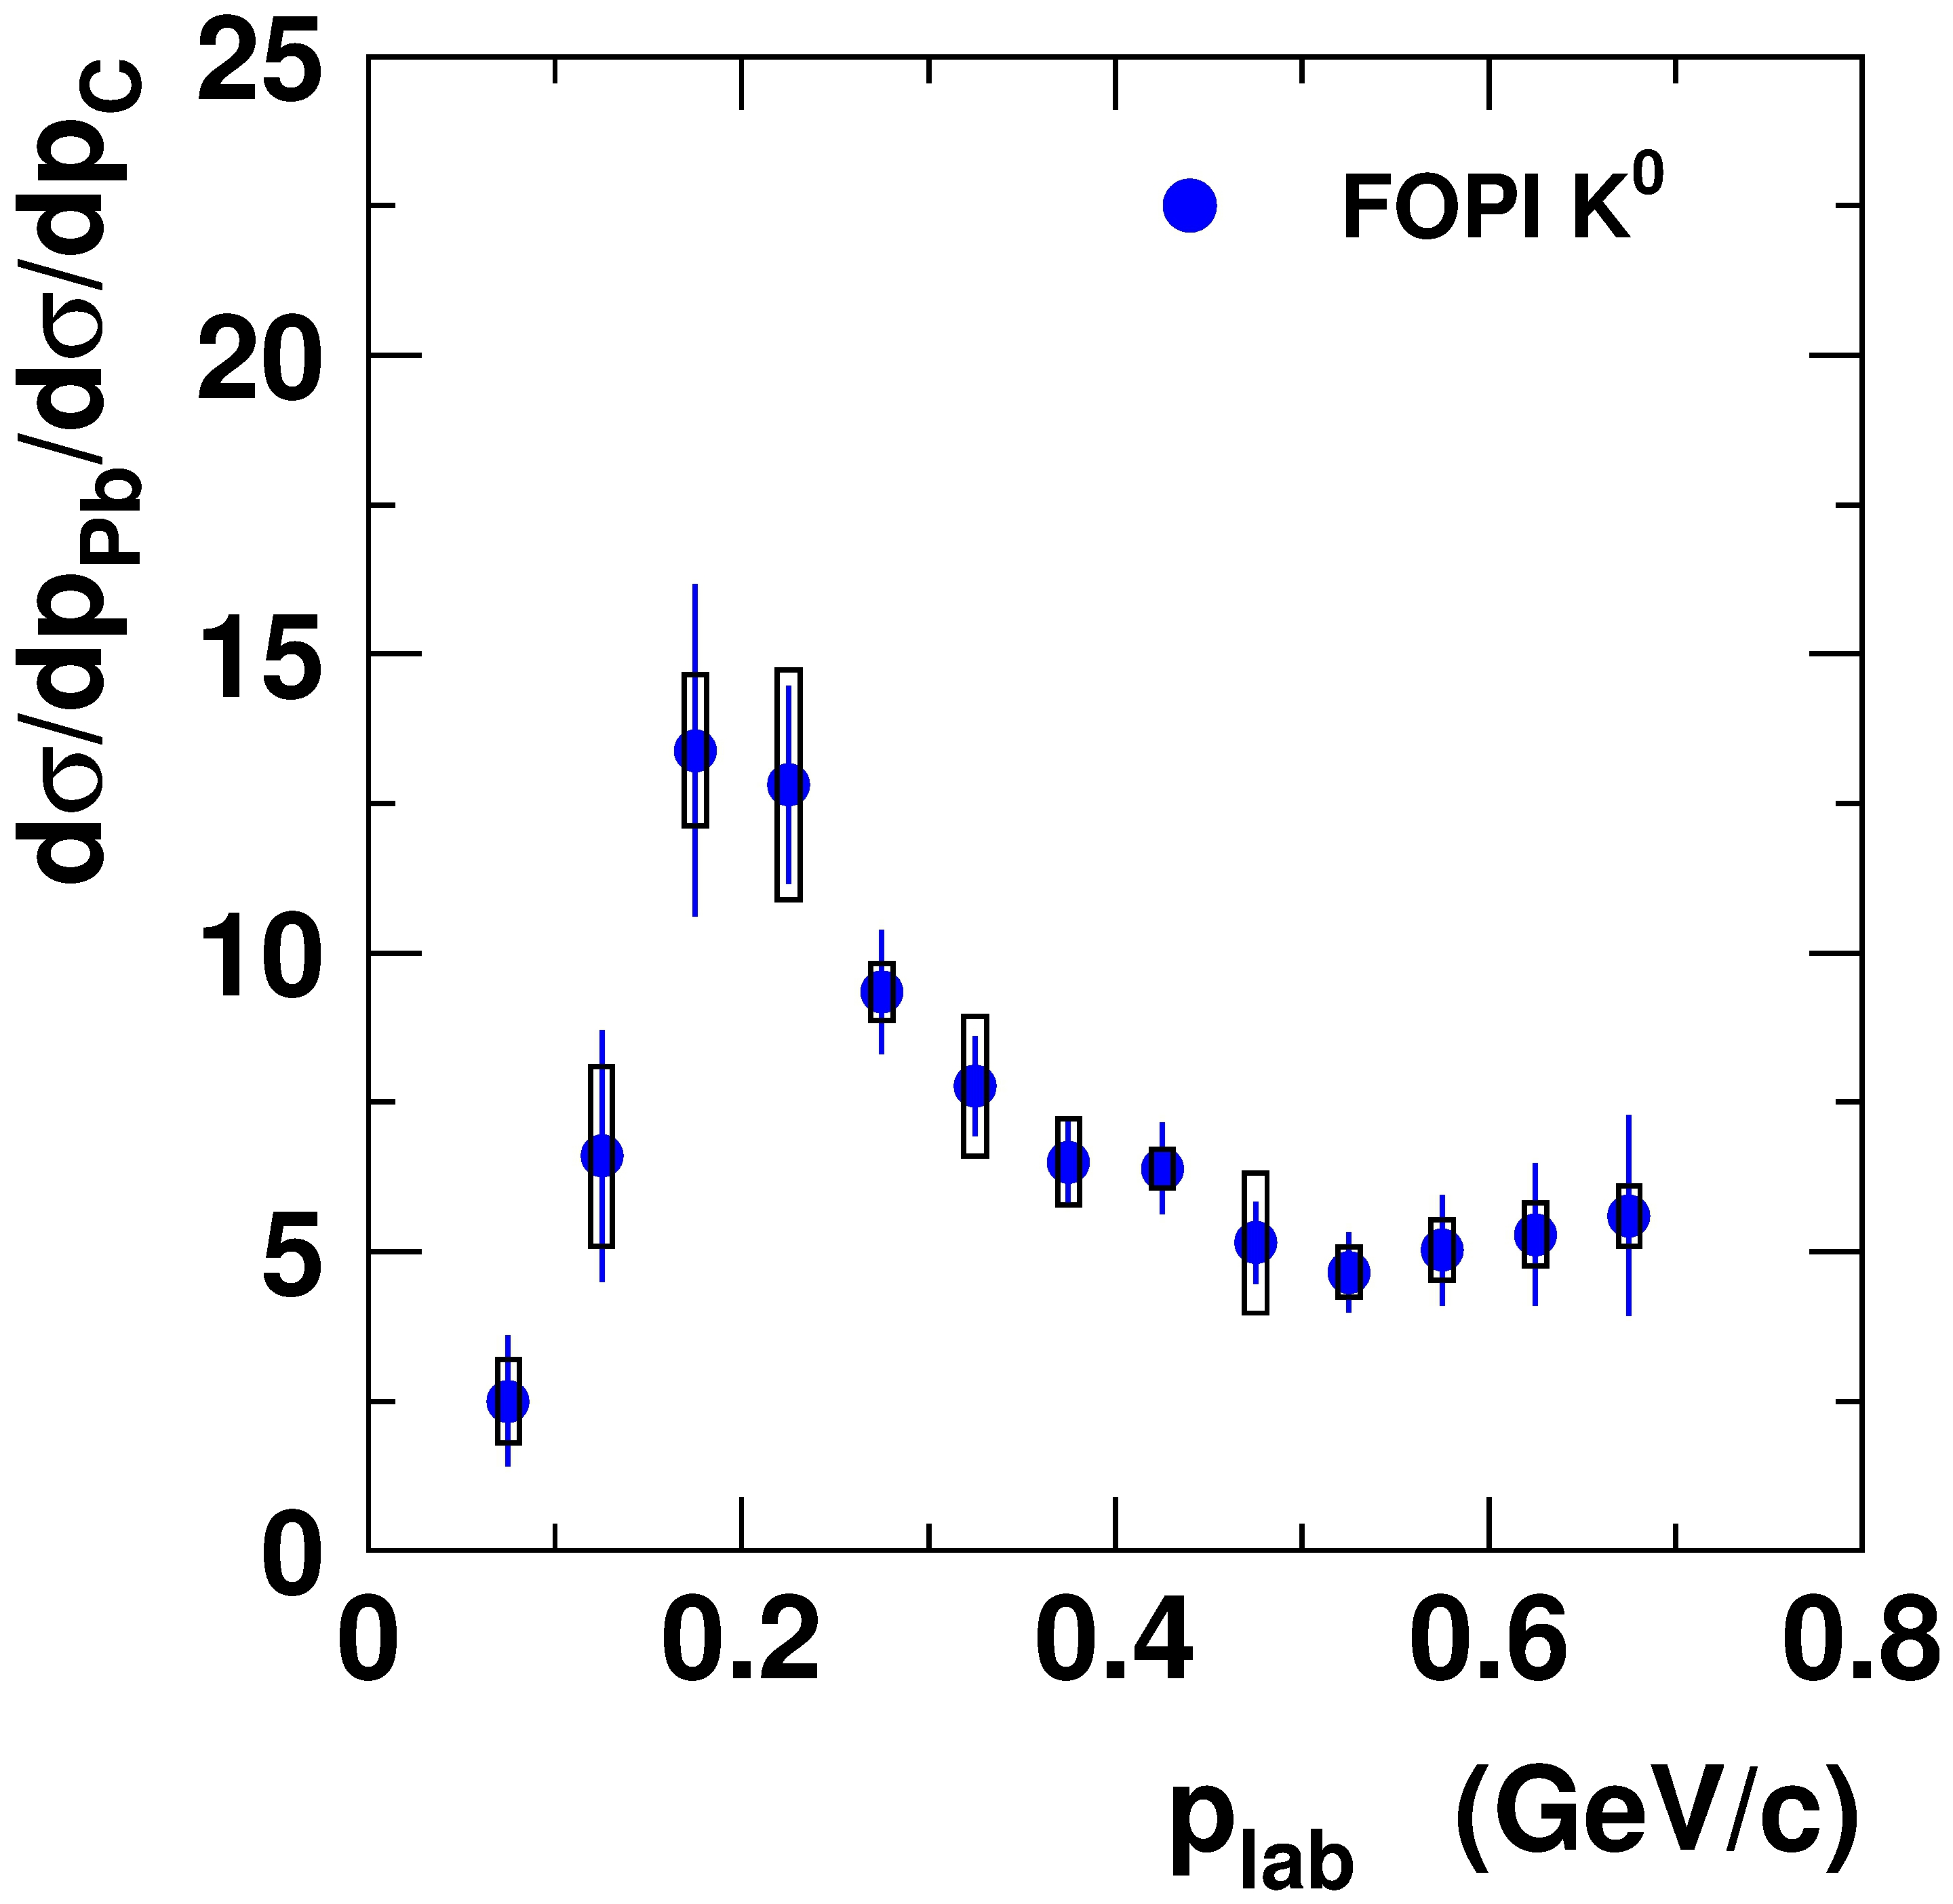
Investigating the KN potential with pion-induced reactions
FOPI data @ SIS
M.L. Benabderramahne et al., PRL (2009)
π + A → K⁰ + X at 1.15 GeV/c

Slide 20
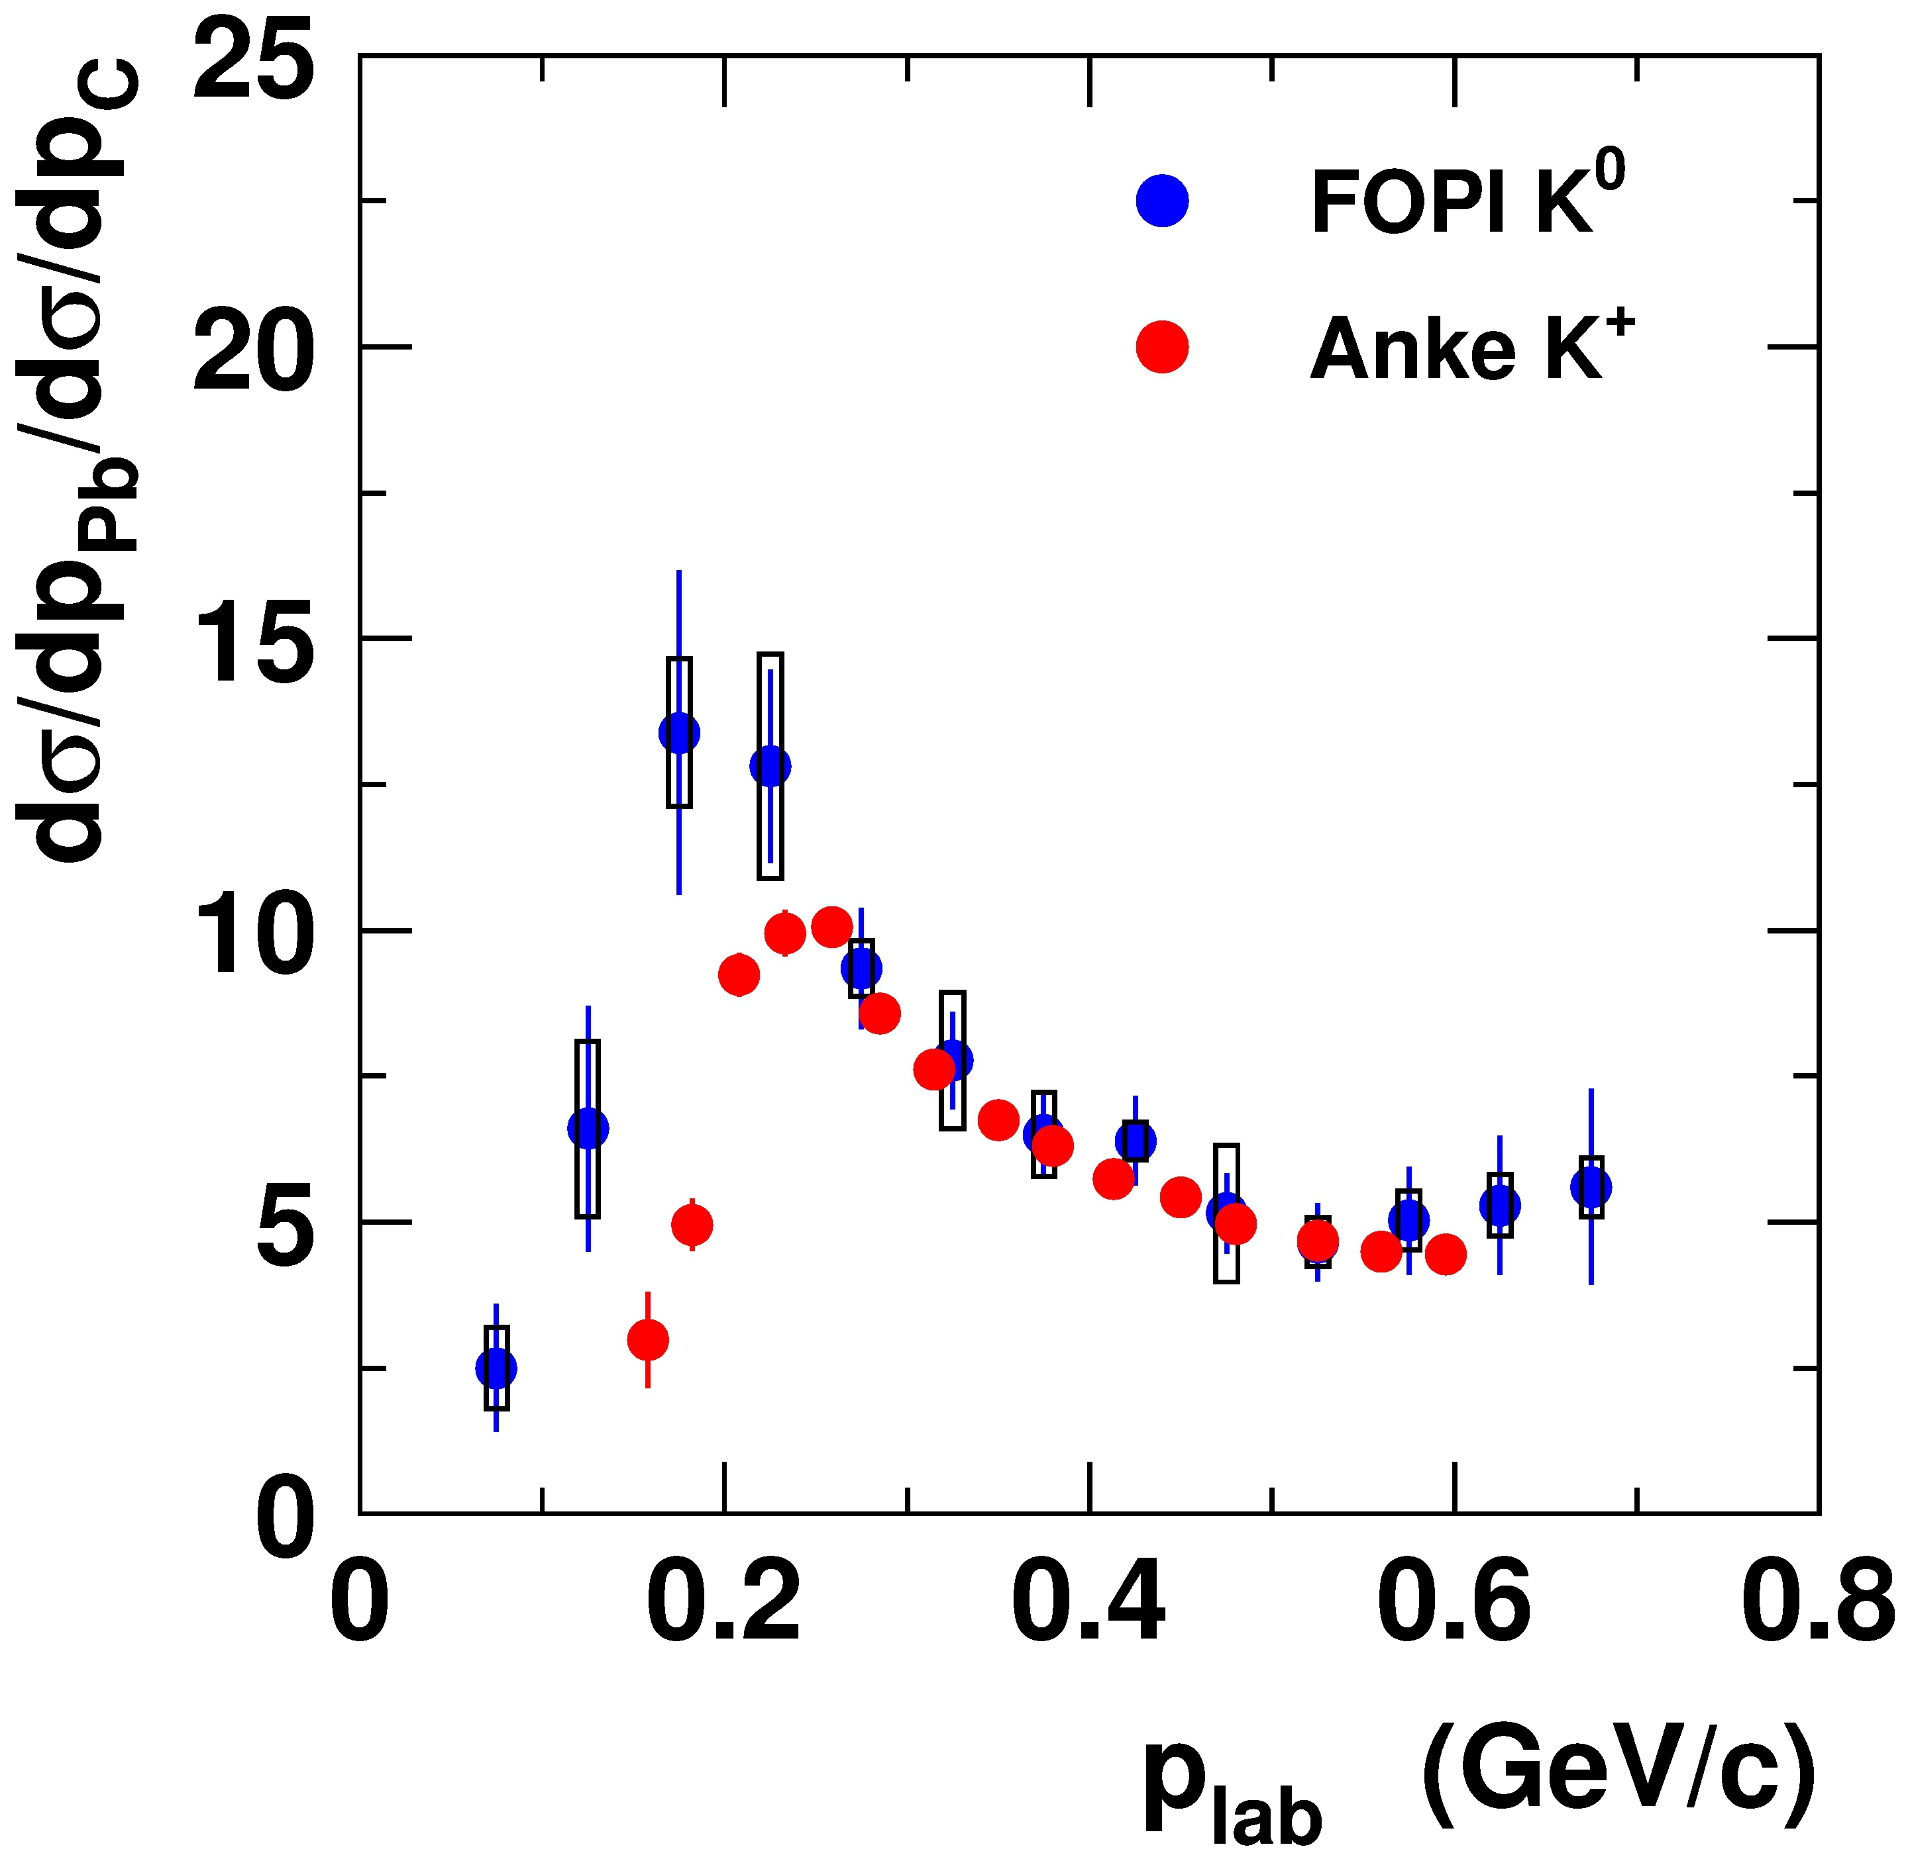
Investigating the KN potential with pion-induced reactions
FOPI data @ SIS
M.L. Benabderramahne et al., PRL (2009)
π + A → K⁰ + X at 1.15 GeV/c
Anke data @ COSY
M. Büscher et al., EPJ, A22, 301 (2004)
p + A → K⁺ + X at 2.5 GeV

Slide 21
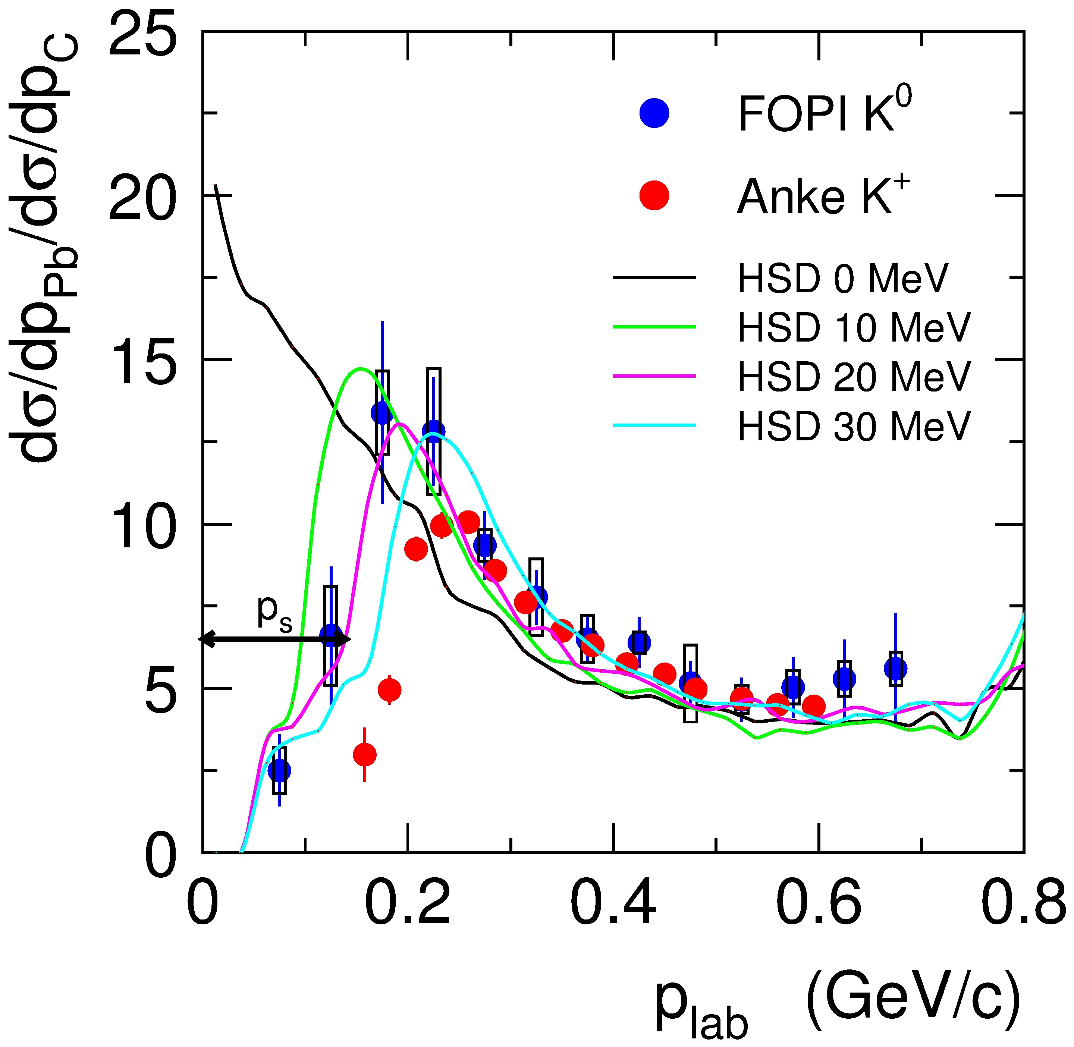
Investigating the KN potential with pion-induced reactions
FOPI data @ SIS
M.L. Benabderramahne et al., PRL (2009)
π + A → K⁰ + X at 1.15 GeV/c
Model interpretation with HSD:
U(K⁰) = + 20 MeV
Potential depth: U(K⁰) = + 20 (+/- 5) MeV consistent with heavy-ion data on K, flow
Accuracy (only) statistics limited

Slide 22
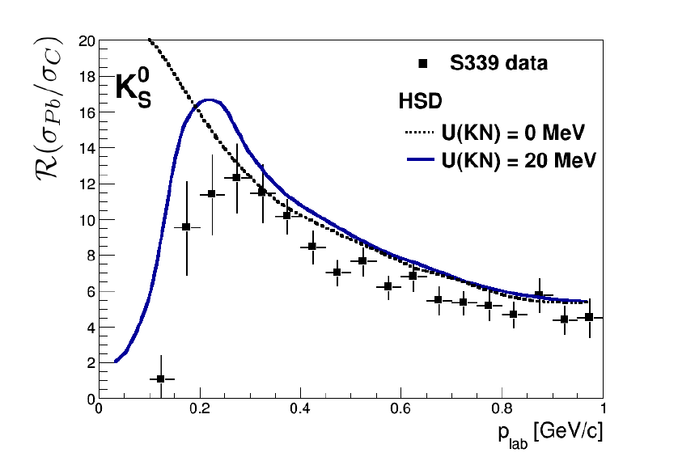
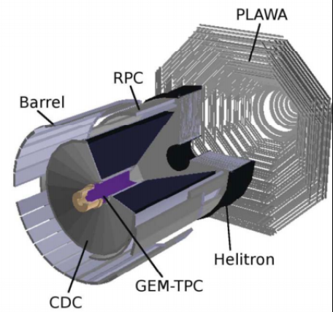
Pion induced reactions at 1.7 GeV/c
Data normalization preliminary
including low momentum Kaons reconstructed with inner GEM-TPC
preliminary
V. Zinyuk/F. Böhmer

Slide 23
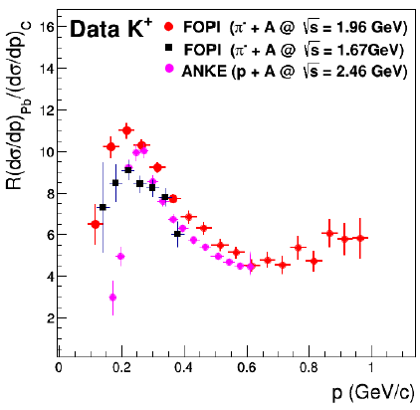
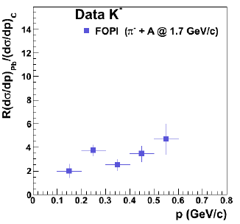
Pion induced reactions at 1.7 GeV/c
Comparison of K⁺ ratios
for π- + A at 1.17 GeV/c and 1.7 GeV/c
(J. Kecskemeti and V. Zinyuk)
K⁻ ratio
for π- + A at 1.17 GeV/c and 1.7 GeV/c
(V. Zinyuk)

Slide 24
Directed flow

Slide 25
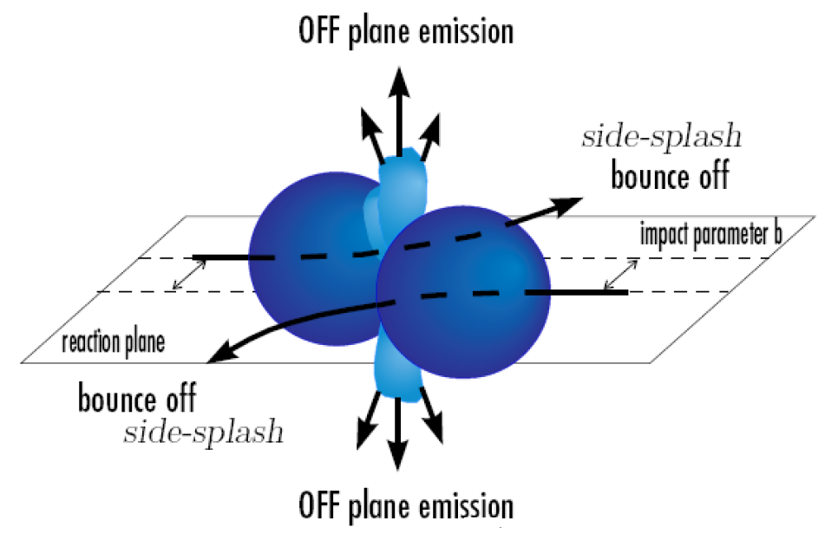
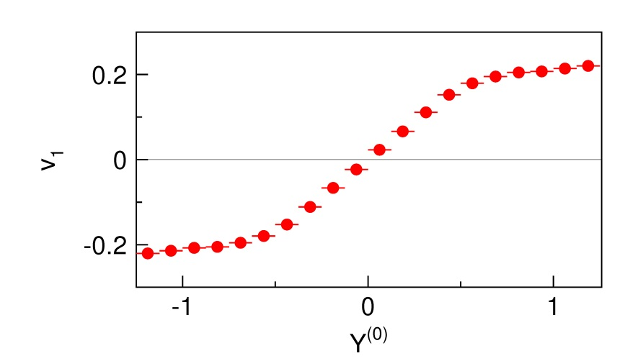
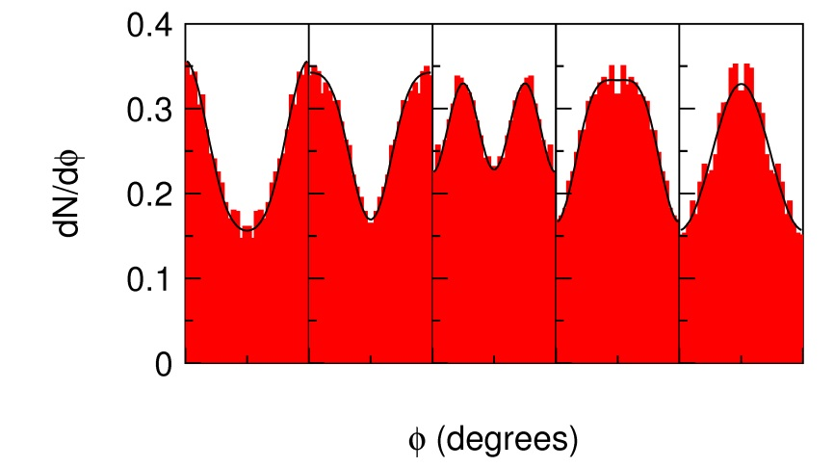
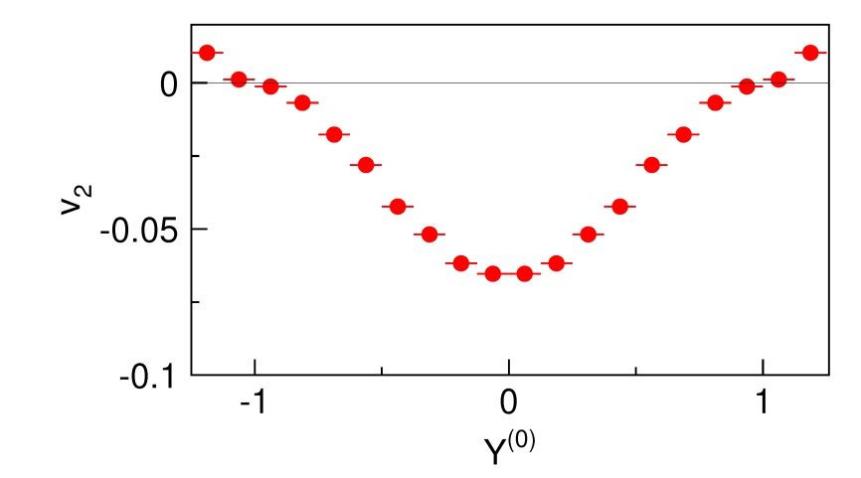
Systematic studies on flow data
Elliptic flow v₂
Side flow v₁
side flow
0°
0°
0°
0°
0°
elliptic flow

Slide 26
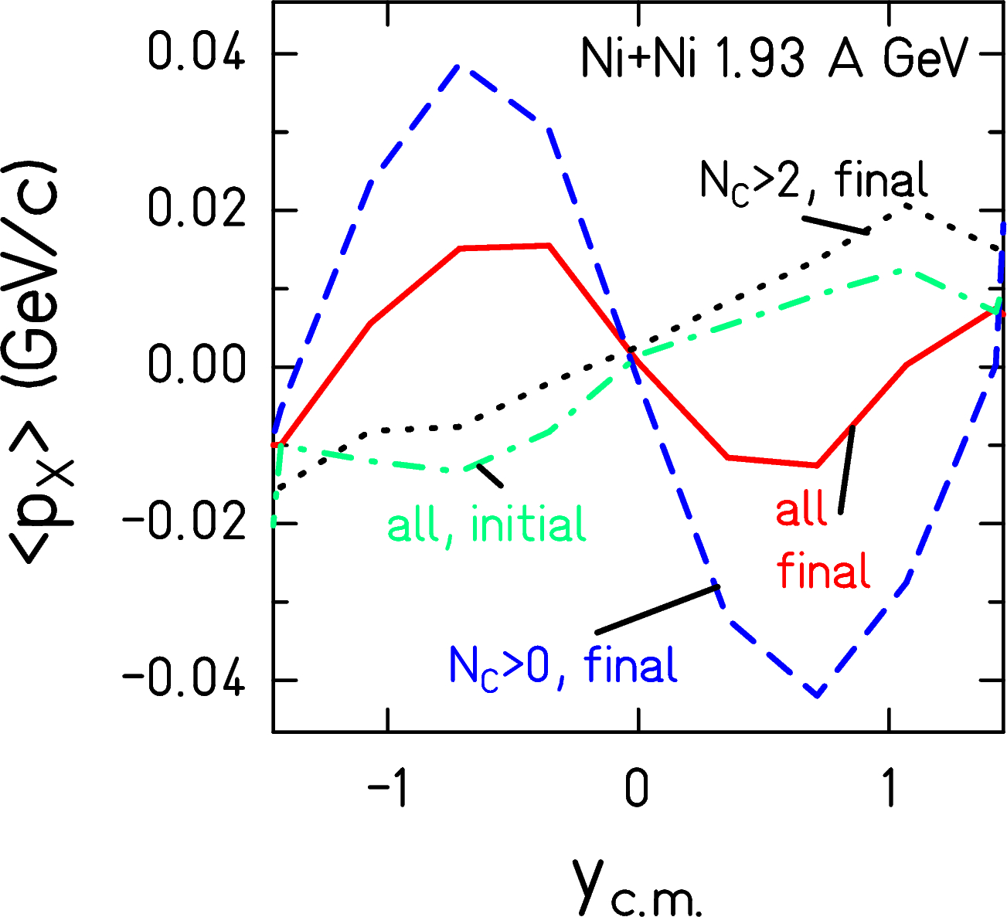
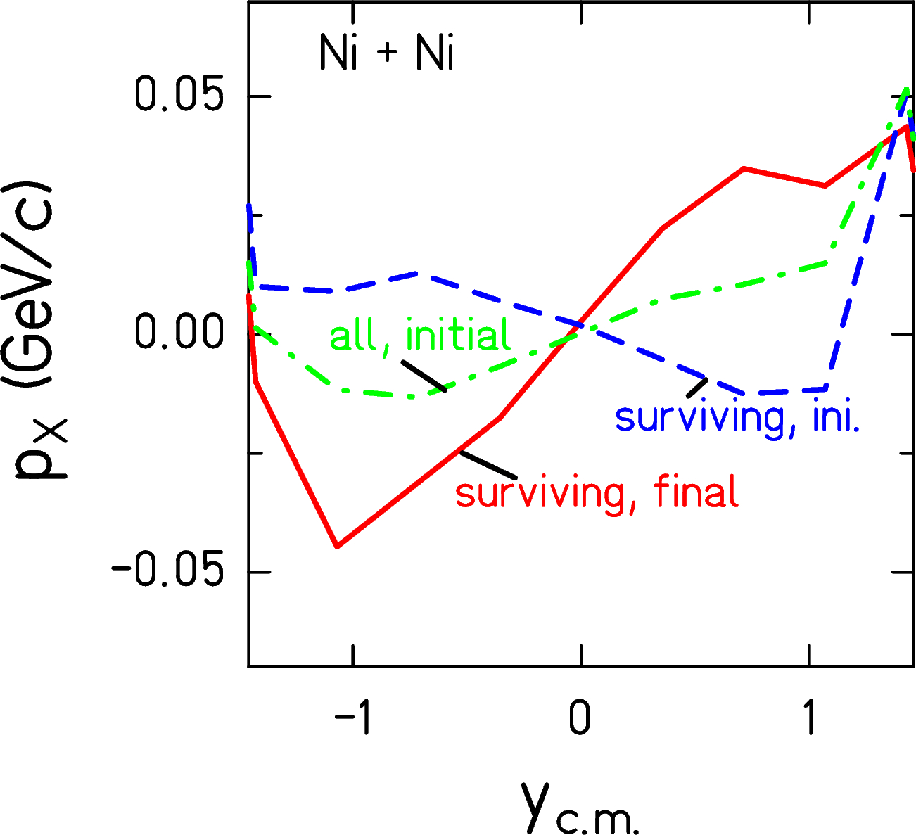
Systematic studies needed – Directed flow
IQMD (C. Hartnack):
at production same flow for
K⁺ and K⁻
K⁺ opposite to nucleon flow
  potential
+ scattering aligns them to nucleons
K⁻ similar to nucleon flow
  strong potential effect
  + absorption
K⁺
N_{c}=0
K⁻

Slide 27
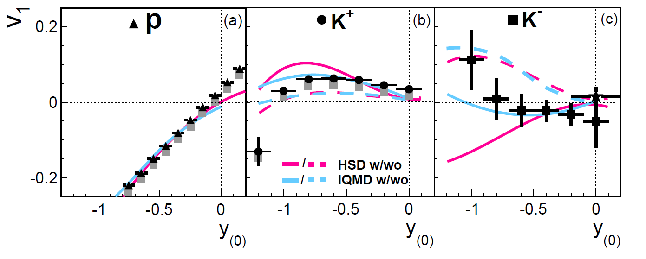
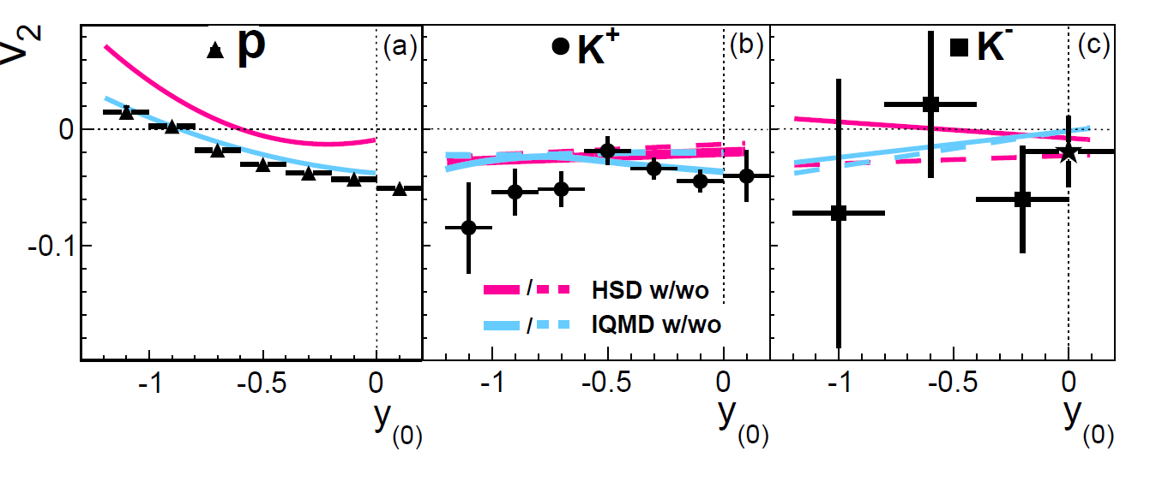
Flow in Ni+Ni collisions
Data for K- inconclusive
K- flow data from KaoS
more data is needed in heavier systems
system size dependence
energy dependence
  disentangle different contributions (potential, absorption, re-scattering)
FOPI measured
  Ru+Ru at 1.7A GeV
  Ni+Pb at 1.9 AGeV
V. Zinyuk et al. Ni+Ni b< 6 fm

Slide 28
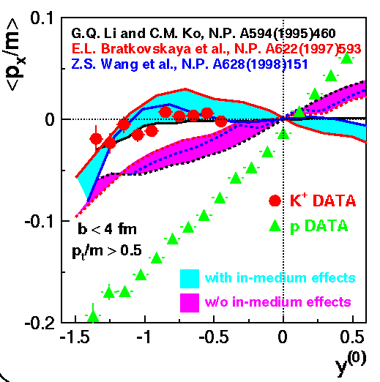
Comparison experimental to models
FOPI Ni+Ni 1.93A GeV b<3.3 fm

Slide 29
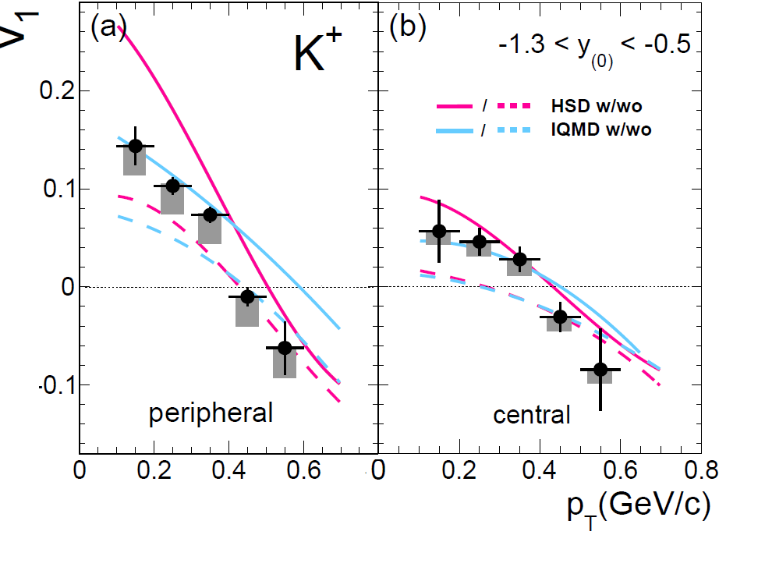
Systematic studies on flow – Ni+Ni
V. Zinyuk et al.
Side flow best described with repulsive KN potential U_{pot} <~20 MeV
V. Zinyuk et al.

Slide 30
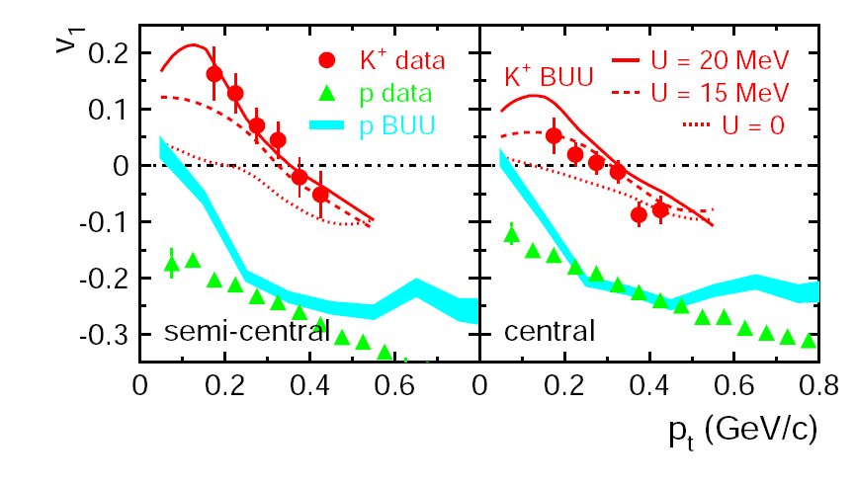
Systematic studies on flow – Ru+Ru
Ru+Ru @ 1.69A GeV
RBUU/Giessen
Need more data
on heavier systems
FOPI measured:
Ru+Ru @ 1.69AGeV
Ni+Pb @ 1.9A GeV
P. Crochet et al.

Slide 31
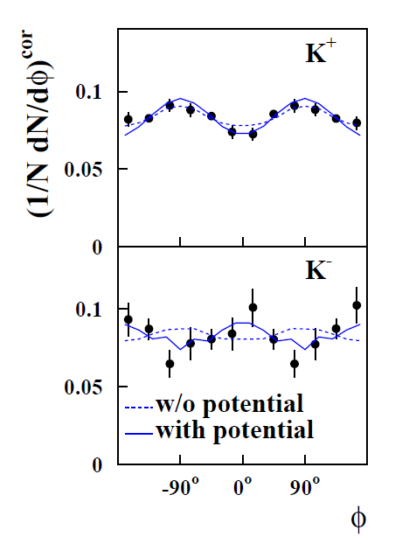
Systematics on flow - Ni+Ni
Ni+Ni 1.93A GeV
3.8 <b < 6.5 fm
0.3 < y/y_{beam}<0.7
0.2 < p_{t} < 0.8 GeV/c
Data Kaos:
F. Uhlig et al.
Model IQMD:
C. Hartnack

Slide 32
Directed flow of Hyperons

Slide 33


Hypernuclei production
Ni+Ni 1.93AGeV
Lambda interaction
potential
re-scattering cross section
constrained by
    flow
    spectra, rapidity distributions
Production of Hyper nuclei
Lambdas are preferentially at mid-rapidity but Hypernuclei production will take place more easily in the presence of spectator matter
→ Crucial to get Lambdas in the region of the spectator matter
IQMD
Data: M. Merschmeyer phd thesis
IQMD: C. Hartnack
preliminary
protons
Λ

Slide 34
Outlook

Slide 35

Outlook
1.9A GeV
Ongoing FOPI analyses
π+A at 1.15 and 1.7 GeV/c
phase space distributions
momentum ratios
Ru + Ru 1.7A GeV
yields
spectra
hypertritons
Ni + Pb 1.9A GeV
flow
phase space distributions
hypertritons

Slide 36
Unresolved
Slope of spectra
re-scattering vs potential
equilibration vs dynamics
Phi yields
origin
multiplicity dependence
consequences
Hyper nuclei
yields
production mechanism
Exotics
yields
properties

Slide 37

The FOPI collaboration
THU Beijing – NIPNE Bucharest – KFKI RMKI Budapest – LPC Clermont-Ferrand – GSI Darmstadt – Helmholtzzentrum Rossendorf – Universität Heidelberg – IMP Lanzhou – ITEP Moscow – KI Moscow – TU München – Korea University Seoul – University of Split - IPHC Strasbourg – SMI Vienna – University of Warsaw – RBI Zagreb

Slide 38
Strangeness 2016
Aim discussing
        experimental data
        models and new approaches
Heavy ion experiments
  yields, phase space distributions: high intensity beams and high quality data and rare probes
  systematic measurements to disentangle different processes
Investigation of “exotic” systems
  kaonic atoms, bound states, hyper nuclei
Elementary reactions
  disentangle reactions channels for strangeness production at threshold energies, PWA analysis
Models
  high mass resonances to describe yields of strange particles
  advances in statistical models
  self-consistent and unitary coupled-channel approach (pHSD)

Slide 39
Thank you to Chris, all contributors, all participants and the organizers

Slide 40



Advancing HSD
K/KN in hot/dense matter: self-consistent and unitary coupled-channel approach
Binary reactions:
cross sections/transition rates
Propagation:
K, K and Y optical potentials
Production:
K, K (off-shell) spectral functions
ϕ and Ξ production in the hadronic phase
ηN channel small
strangeness exchange
Daniel Cabrera
K spectral function

Slide 41
Yields and statistical model

Slide 42

Strange particle production yields and Thermal models
Particle yields are described by Thermal models with reasonable parameters consistent over the complete energy range upto LHC
  Al+Al collisions are most probably not equilibrated
  Phase space distributions are generally elongated beyond 400AMeV even in Au+Au
  Systems are not completely mixed
  No equilibration within microscopic models
  Microscopic models are able to account for particles ratios for which production cross sections are ‘’known’’
FOPI data for Al+Al at 1.91 AGeV
Statistical model analysis with THERMUS code (K. Piasecki)
M. Bleicher

Slide 43


Symmetry energy – why Kaons?
Kaons are produced much earlier
do not interact with matter
Au+Au, b < 1 fm
stiff
G. Ferrini et al. PRL 97 (2006)
soft
pion ratio determined

Slide 44

Symmetry energy – Kaons as a probe
X.Lopez, PRC (2007)
Ru+Ru, Zr+Zr, b < 5 fm
static calc.
for infinite
nucl. matter
HIC scenario:
fast neutron emission (mean field)
NN=>NΔ threshold effects
nn=>pΔ⁻ (no chemical equilibrium)
see, e.g., di Toro et al.,
J.Phys.G (2010)
HIC szenario

Slide 45


Symmetry energy – Pions as benchmark
Au + Au central
Data described by various models with stiff (or soft) density dependences of the symmetry energy
Ferini et al. RMF stiffer for ratio up
Xiao et al. IBUU softer “
Feng & Jin ImIQMD stiffer “
Xie et al. ImIBL softer “
Hong et al pBUU no
Ko et al. RBUU moderate
Data: W. Reisdorf et al., NPA 781 (2007)
Calculations: Z. Xiao et al, PRL 102, 062502 (2009)

Slide 46


Symmetry energy – n/p flows, the alternative
P. Russotto 2014
n/p elliptic flow favors an intermediate symmetry energy
preliminary result γ~0.7-0.8 at 400A MeV Au+Au collisions
test higher densities?

