Slide 1
Radiation damage analysis
for the MVD on the pandaGRID
| Tobias Stockmanns

Slide 2
Analysis done on the PANDA GRID
Data Challenge 02 (17.-21. November 2008)
Simulation of anti-proton on ¹³²Xe with different beam momenta of 2.0 – 6.2 – 15.0 GeV/c
Full Panda detector geometry to include backscattered particles
Modification of MVD code to “see” neutral particles
Beam momentum [GeV/c] | Simulated events
2.0 | 645,000
6.2 | 627.900
15.0 | 487,000

Slide 3
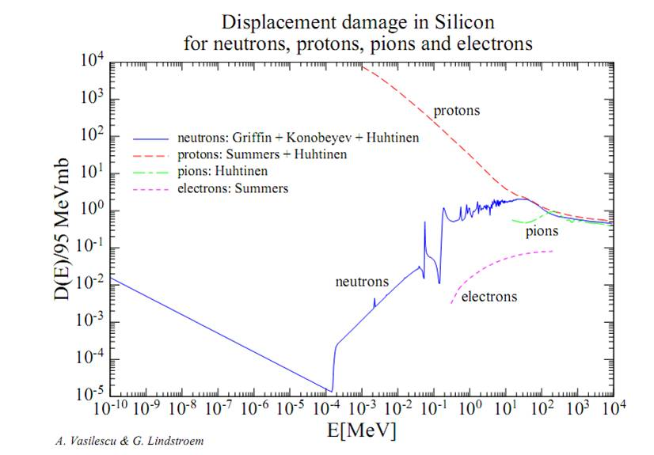
Analysis done on the PANDA GRID
Analysis of the simulated data:
translate the flux of the different particle types into a normalized flux of 1 MeV neutrons
➔ Installation of a new package radDamAna::v1.2
this package is an updated version of pandaROOT
better would be to use a patch because the modifications on pandaRoot are very small
Problems:
Package does not compile/run on all sites
Errors: SE full / no cmake installed / wrong path variable
Additional problem: no error treatment

Slide 4
Analysis done on the PANDA GRID
The analysis is done with collections:
find -c <collectionName> <folder> <fileName> puts all files belonging to a simulation run into one collection
The files are still stored on the initial storage elements but the collection can be used as an input into a masterJob
The subJobs are distributed to the compute elements where the simulated file is stored
Advantage: No need to copy the large simulation files from one compute node to another
Problem: Two conditions for a subJob to run:
The necessary package has to be installed
The file to analyze has to be on the storage element close to the compute node
If one of them fails the data is not processed

Slide 5
Analysis done on the PANDA GRID
Problems:
The installation of the package failed in Dubna (at the beginning) but it reported that the installation was successful ➔ Dubna took many subJobs but was not able to process them and they were lost for others
At GSI jobs start delayed (up to days) or sometimes not at all even if they meet all requirements
Once GSI is running it covers 90 % of the analyzed files (Dubna 7 %, Jülich 2.5 %)
Beam momentum [GeV/c] | Simulated events | Analyzed events on the GRID | Events analyzed at desktop
2.0 | 645,000 | 594,500 | 0
6.2 | 627.900 | 564,200 | 0
15.0 | 487,000 | 390,700 | 215,700

Slide 6
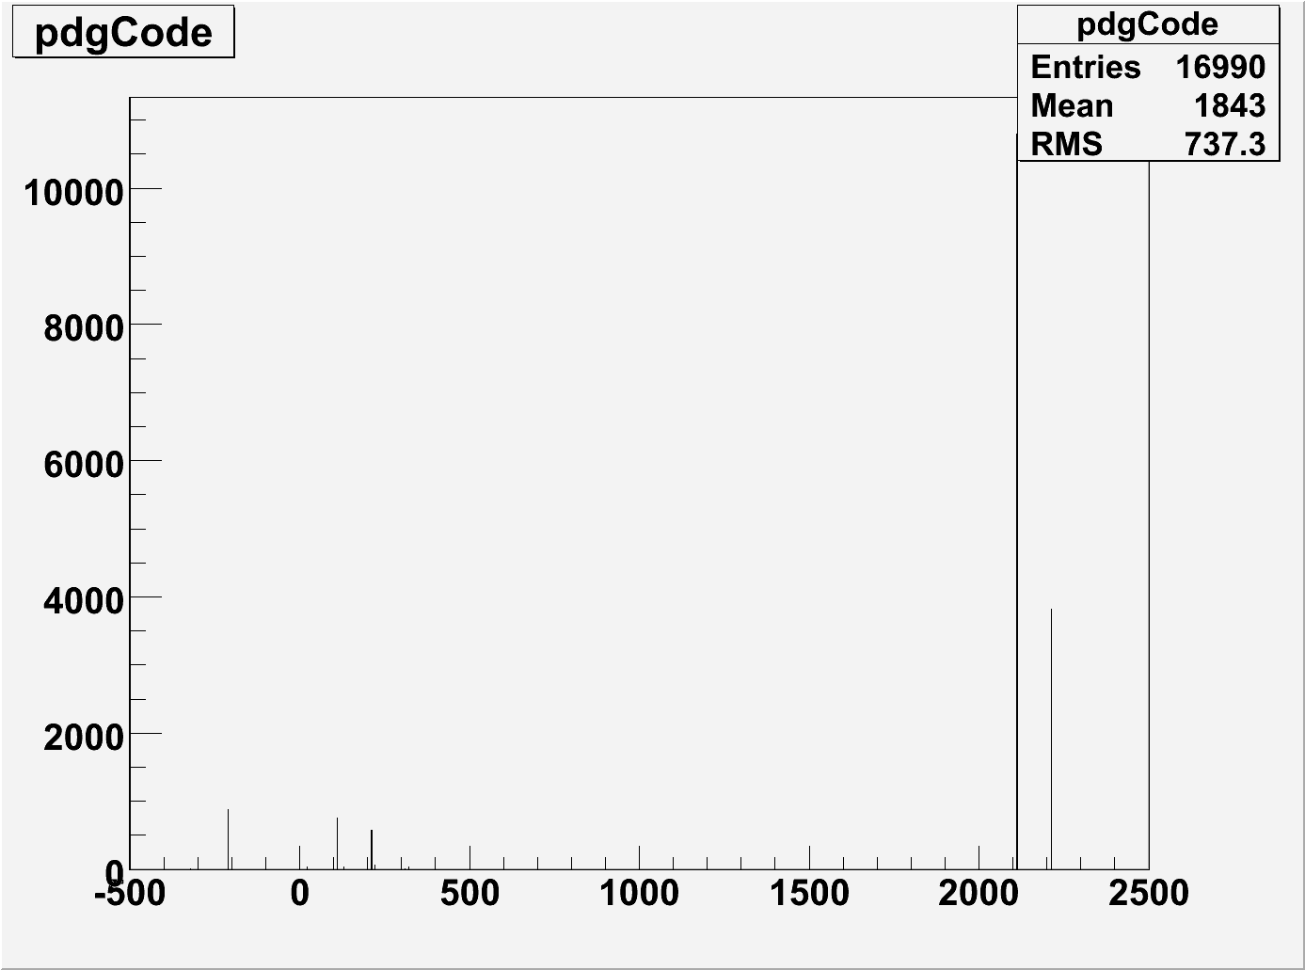
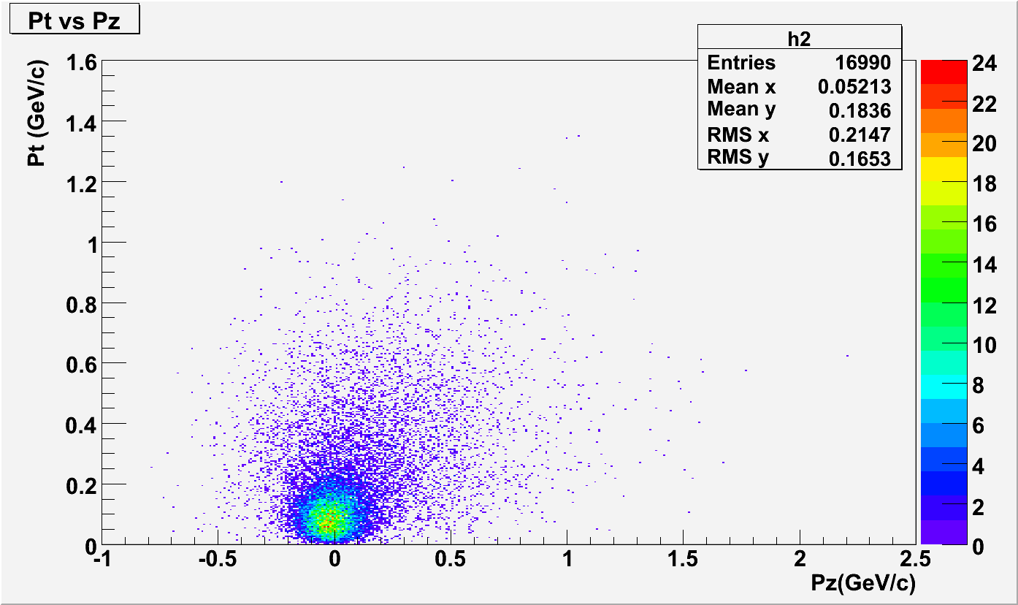
Primary Particles
15 GeV/c antiprotons on Xe
primary particles:
neutrons, protons and pions
≈ 33 primaries per event
almost spherical distribution of momentum

Slide 7
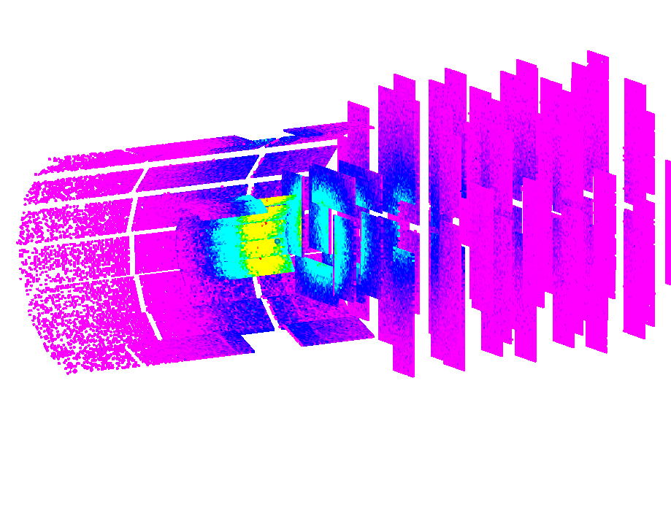
Overview of the flux distribution
new Class DrawEveHisto to plot histograms in EVE
Assumptions:
Interaction rate of 1x10⁶
Operation time: one year with 50% duty cycle

Slide 8
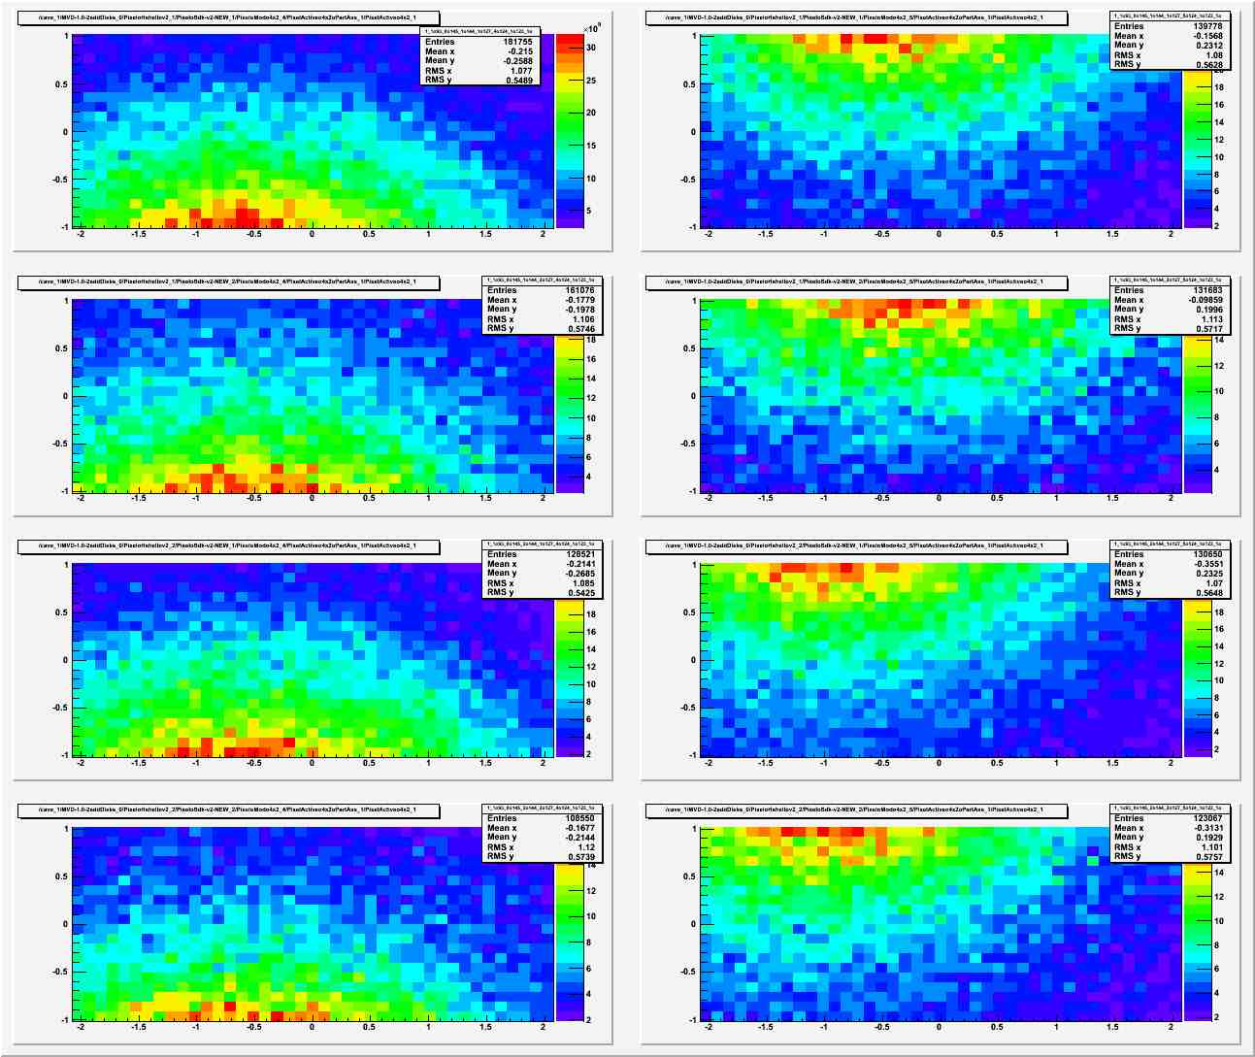
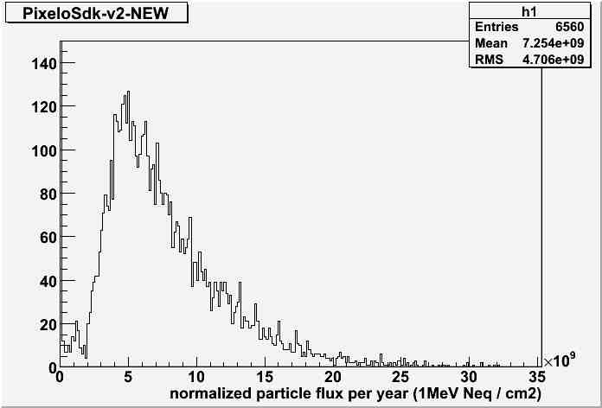
Pixel SDK
Small disks:
maximum flux for disks
3 x 10¹⁰ n_{eq}[1MeV]/cm²
strong asymmetry

Slide 9
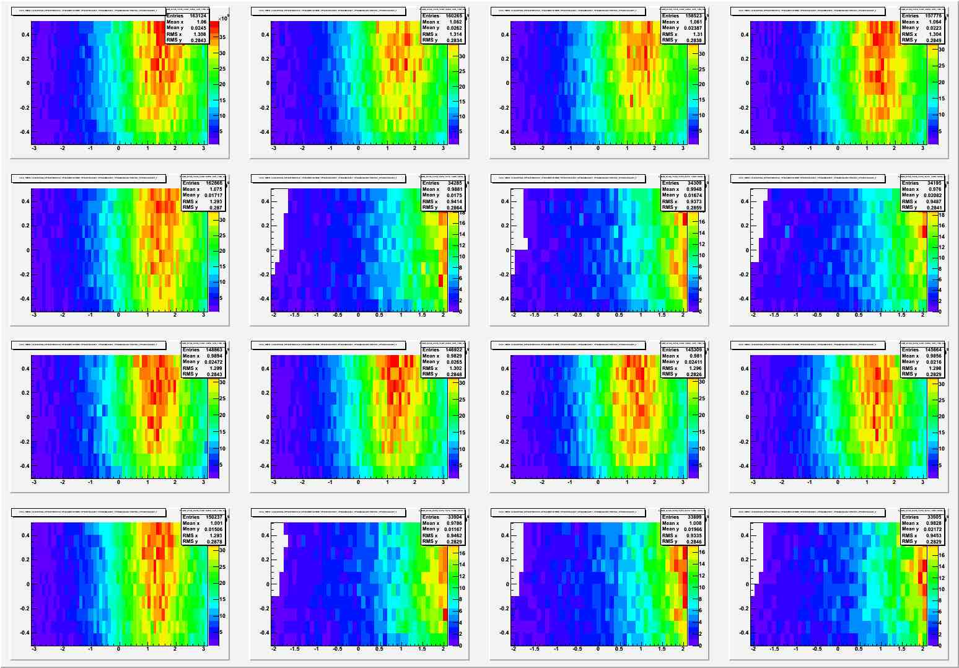
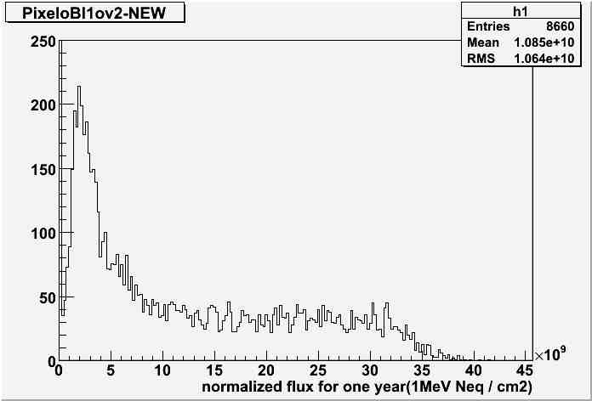
Pixel BL1
Pixel Barrel Layer 1:
highest particle flux
4 x 10¹⁰ n_{eq}[1MeV]/cm²
strong asymmetry

Slide 10
Summary
First real test of a data analysis running on pandaGRID was successful ➔ Thank you Dan, Kilian and Rene
Still a couple of problems have to be solved:
Availability of sites
Improvement of error tolerance
Improvement of documentation
Simplification/Improvement of tools on the GRID
Suggestions:
Automatic installation of pandaRoot every week/month
Use the GRID! It is very powerful and easier than it seems

