Slide 1
UPDAte on C-RORC FOR PANDA
Common Read-Out Receiver Card

Slide 2
Introduction
Less optical cables
Higher bandwidth to storage
Possible processing on GPU
Used by ALICE DAQ & HLT

Slide 3
C-RORC Board
Performance
Xilinx Virtex-6 FPGA
12 optical links
Gen2 x8 PCI Express
2 DDR3 SO-DIMMs
Total Bandwidth up to 4000MB/s

Slide 4
Possible Read-Out Chain
FEE
DC
CN
CN
CN
CN
ComputeNodes borrowed
From Belle II
3x Quad SFP
CRORC
CN
CN
CN
CN
CN
CN
CN
CN
PCIe
PC
Maybe instead of CN?

Slide 5
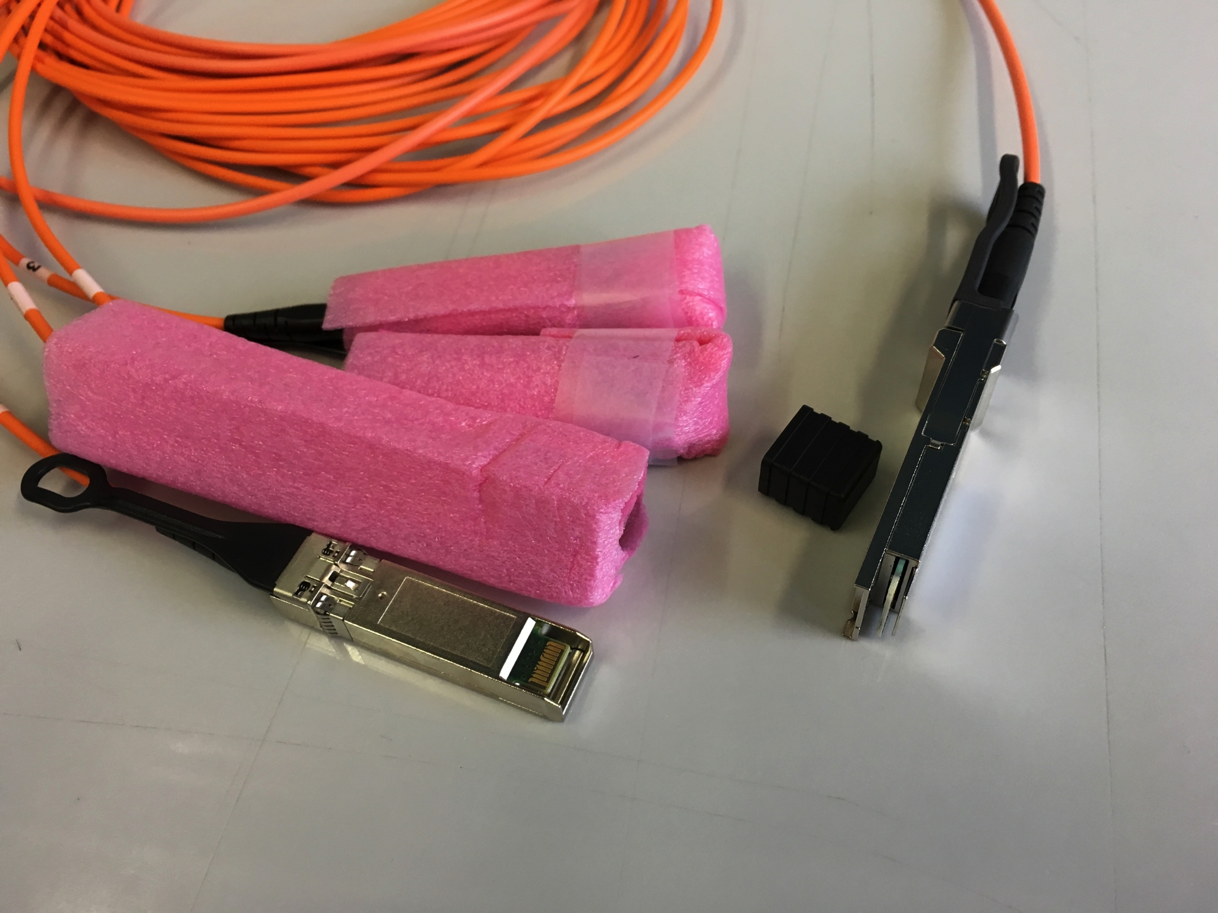
Development Status
Drivers installed and self test passed
Core and drivers provided by H. Engel
Implemented to existing core:
Pattern generator
Output send via PCIe to HDD
Reached up to 400 MB/s on one channel limited by SSD write speed

Slide 6
Outlook
Implementation of usability of SFP lanes
Adapting clocks, Line Rate,
Possible protocol between CNs and CRORC:
Aurora
Same like Data Concentrators (push forward)
Connection test
Beam test in Mainz 10.-14. December

