Slide 1


Vienna, PANDA meeting, December 1st, 2015
Universita’
di Pavia
Italy
Track efficiency and
contamination
in Road Finding Pattern Recognition
when the interaction rate is 2 MHz
Gianluigi Boca
Universita’ di Pavia and INFN, Italy

Slide 2
Outlook of the talk
Recently the hypothesis of an initial run in PANDA at 2 MHz interaction rate has been suggested.
In this talk I show the performance (efficiency in track reconstruction, contamination of spurious hits, CPU time consumption) when the pattern recognition I wrote is used at such interaction rate. These results
were obtained with MUON tracks.
I show results obtained with the two ‘cleanup procedures’ I wrote :
Mvd only cleanup
Mvd + Stt cleanup procedure

Slide 3
Obviously the pileup at 2 MHz
interaction rate is much less than
the pileup at 20 MHz
20 MHz
2 MHz

Slide 4
Performance :
Track Reconstruction
Efficiency
G.Boca U. Pavia & INFN, Italy

Slide 5
MC Box Generator; % of reconstructed tracks (‘reconstructed track’ means tracks
found associated to a MC truth track);
Comparison events with interaction rate at 2 MHz, 20 MHz or no pileup
P GeV/c | tracks per event | # good gen. tracks | % rec. Tracks 20 MHz 2 MHz noMix
0.3 | 1 | 3987 | 98.0 | 98.8 | 98.9
0.3 | 4 | 3982 | 95.8 | 96.5 | 96.5
0.3 | 8 | 3992 | 92.2 | 92.7 | 92.9
1.0 | 1 | 3883 | 98.5 | 98.9 | 98.9
1.0 | 4 | 3882 | 95.4 | 95.9 | 95.9
1.0 | 8 | 3869 | 93.4 | 92.9 | 92.9
2.0 | 1 | 3846 | 98.4 | 98.7 | 98.8
2.0 | 4 | 3860 | 96.2 | 96.4 | 96.4
2.0 | 8 | 3864 | 92.6 | 92.6 | 92.5
5.0 | 1 | 3860 | 98.2 | 98.3 | 98.4
5.0 | 4 | 3860 | 95.9 | 96.0 | 96.0
10 | 1 | 3864 | 98.0 | 98.5 | 98.4
Mvd only
cleanup
procedure !
2 MHz : max 98.9; min 92.6
20 MHz : max 98.5; min 92.2

Slide 6
MC Box Generator; % of reconstructed tracks (‘reconstructed track’ means tracks
found associated to a MC truth track);
Events with Background ( == pileup) at 2 MHz interaction rate
P GeV/c | tracks per event | # good gen. tracks | % rec. Tracks 20 MHz 2 MHz noMix
0.3 | 1 | 3987 | 77.5 | 93.0 | 95.6
0.3 | 4 | 3982 | 74.5 | 88.3 | 90.3
0.3 | 8 | 3992 | 67.1 | 80.2 | 82.2
1.0 | 1 | 3883 | 76.2 | 93.8 | 95.9
1.0 | 4 | 3882 | 72.2 | 88.5 | 90.3
1.0 | 8 | 3869 | 67.0 | 82.1 | 84.3
2.0 | 1 | 3846 | 75.3 | 92.5 | 94.8
2.0 | 4 | 3860 | 70.8 | 87.4 | 89.5
2.0 | 8 | 3864 | 66.7 | 81.4 | 83.3
5.0 | 1 | 3860 | 74.0 | 92.1 | 94.5
5.0 | 4 | 3860 | 70.8 | 87.0 | 89.3
10 | 1 | 3864 | 75.5 | 92.0 | 94.6
Mvd + Stt
cleanup
procedure !
2 MHz : max 93.8; min 80.2
20 MHz : max 77.5; min 66.7

Slide 7
Performance :
Reconstructed Track
Hit Purity

Slide 8
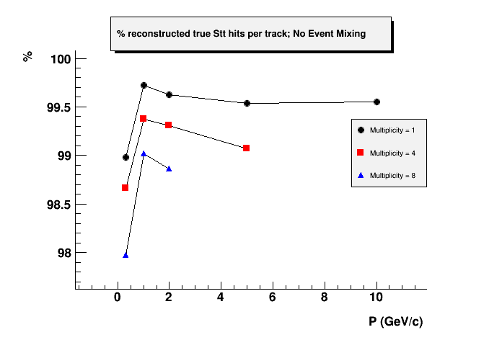
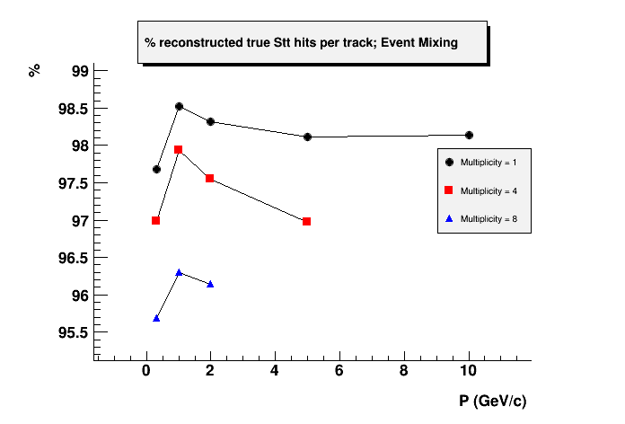
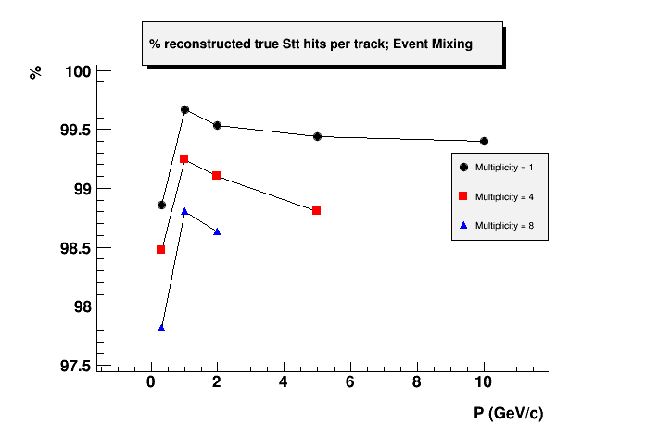
Mvd only
cleanup
procedure !
% of true Stt hits in found tracks
No Mix
20 MHz
interaction
rate
2 MHz
interaction
rate

Slide 9
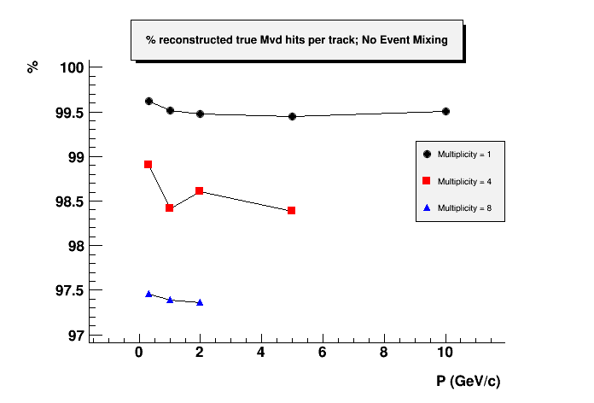
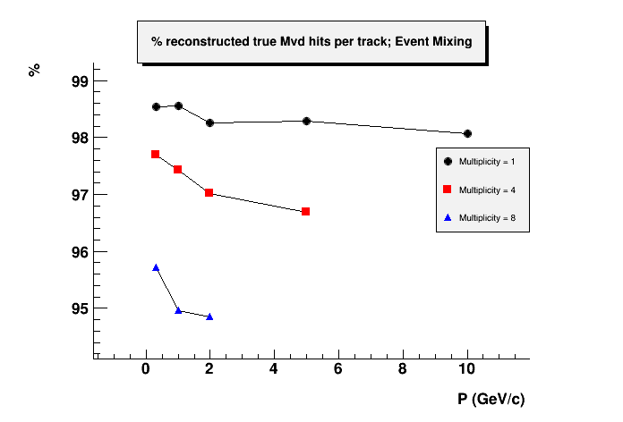
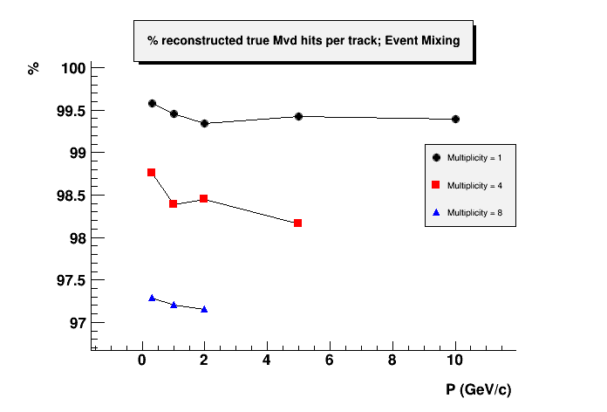
Mvd only
cleanup
procedure !
% of true Mvd hits in found tracks
No Mix
20 MHz
interaction
rate
2 MHz
interaction
rate

Slide 10
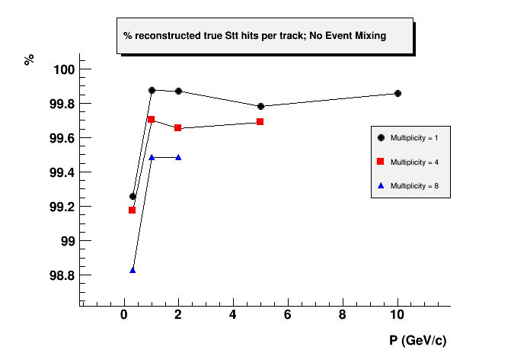
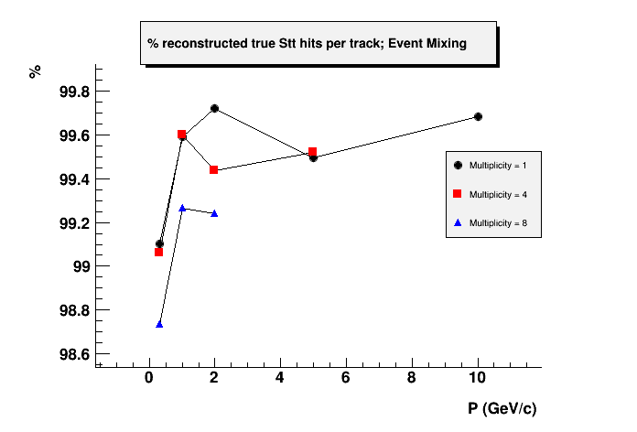
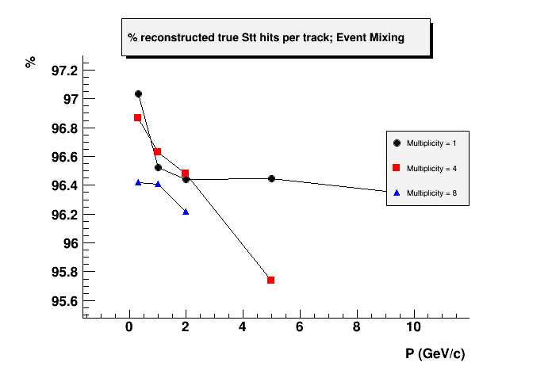
Mvd + Stt
cleanup
procedure !
% of true Stt hits in found tracks
No Mix
Purity seems too low
something unclear !
20 MHz
interaction
rate
2 MHz
interaction
rate

Slide 11
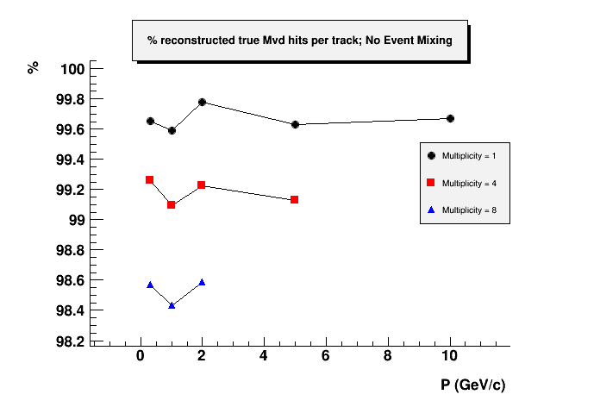
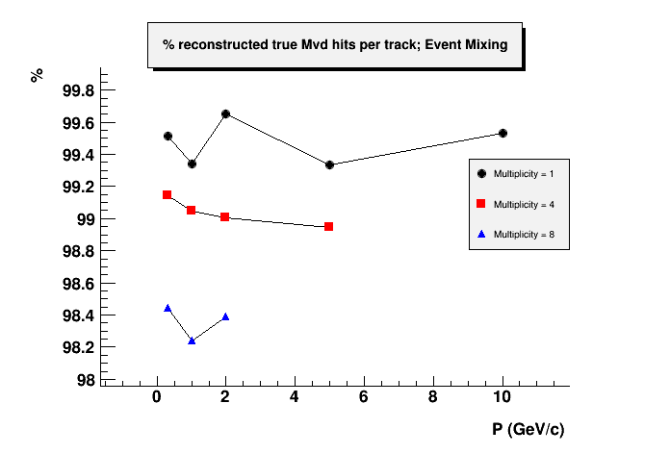
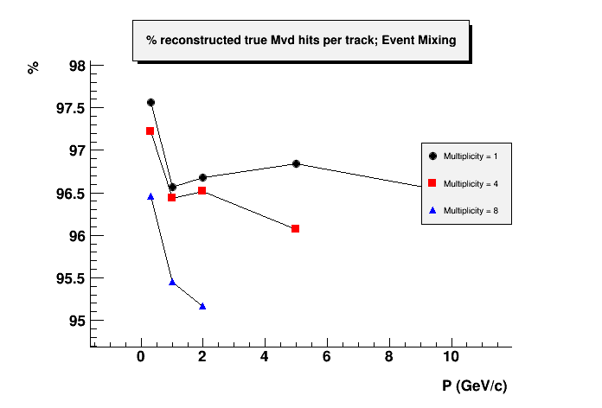
Mvd + Stt
cleanup
procedure !
% of true Mvd hits in found tracks
No Mix
Purity seems too low
something unclear !
20 MHz
interaction
rate
2 MHz
interaction
rate

Slide 12
Performance :
Ghost Tracks

Slide 13
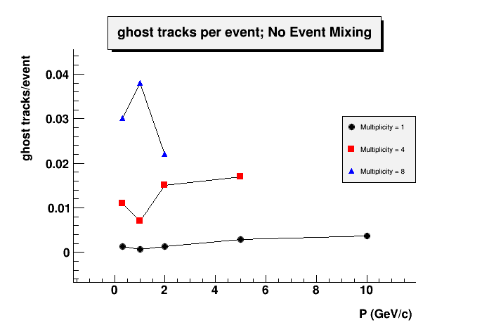
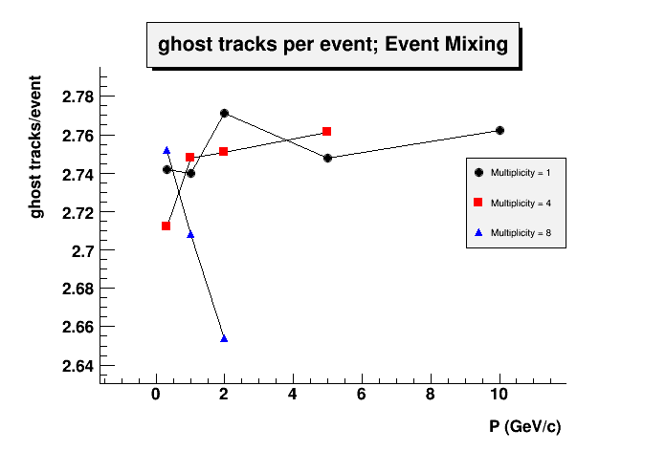
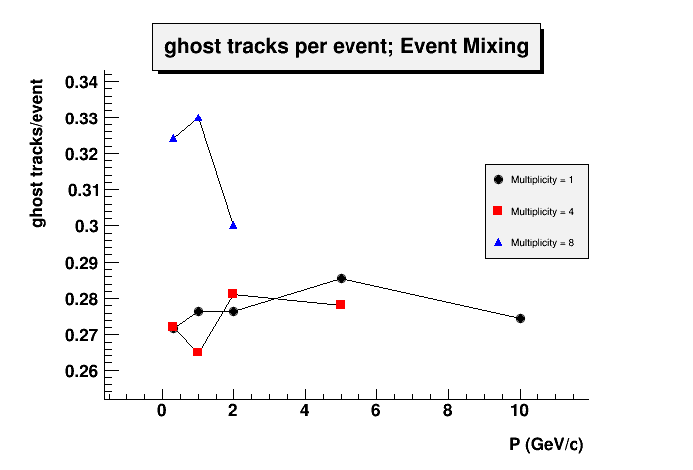
Mvd only
cleanup
procedure !
No Mix
GHOST tracks per
event
¿¿some bug??
2 MHz
interaction
rate
20 MHz
interaction
rate

Slide 14
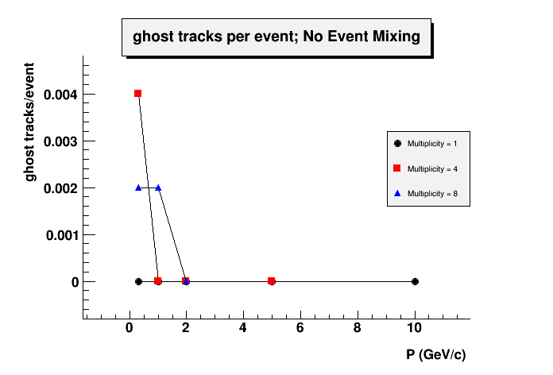
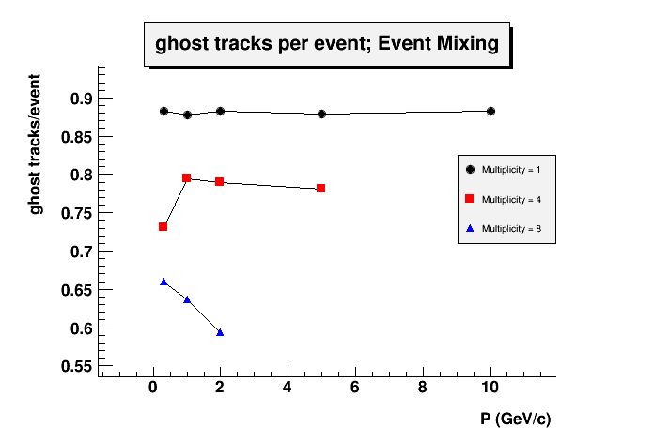
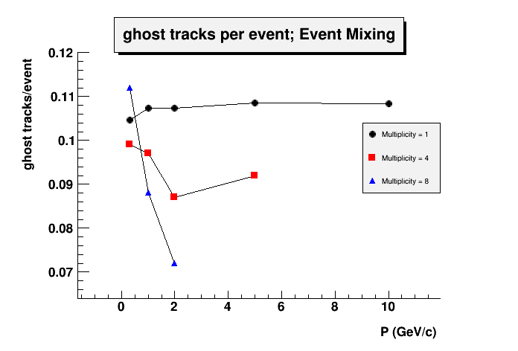
Mvd + Stt
cleanup
procedure !
No Mix
GHOST tracks per
event
20 MHz
interaction
rate
2 MHz
interaction
rate

Slide 15
Performance :
Cpu time/track

Slide 16
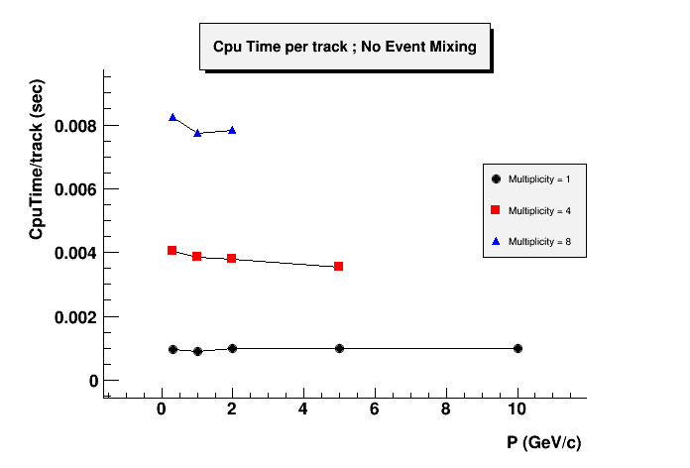
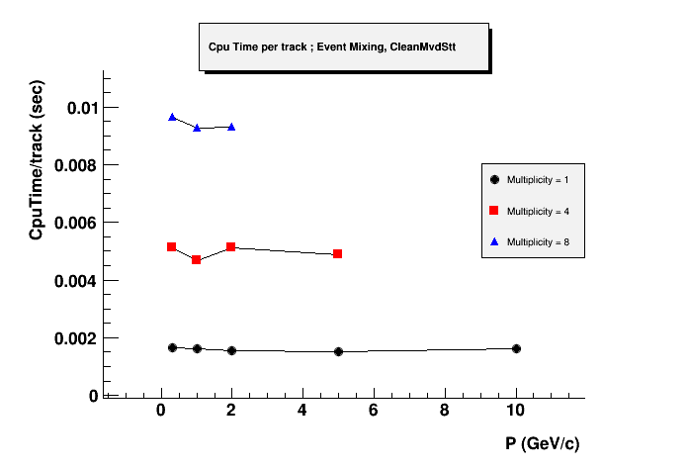
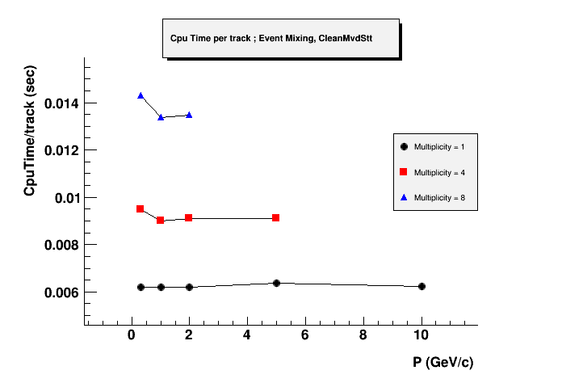
Mvd + Stt
cleanup
procedure !
No Mix
No Cleanup
procedure
Cpu time per track
NO PARALLELIZATION YET!
Cpu times measured on an
Intel i7-2600K CPU @ 3.4 GHz 64 bit
20 MHz
interaction
rate
2 MHz
interaction
rate

Slide 17
Conclusions

Slide 18
At 2 MHz interaction rate the code has been tested with
topologies from 1 track up to 8 tracks.
The code with the Mvd only cleanup procedure finds
tracks with efficiency ranging from 92.6 % to 98.9 %;
the % of Stt true hits per track ranges from 97.8 to 99.7 ;
the % of Mvd true hits per track ranges from 98.2 to 99.7 ;
the # of ghost tracks per event ranges from 0.26 to 0.33 ;
The code with the Mvd + Stt cleanup procedure finds
tracks with efficiency ranging from 92.2 % to 98.5 %;
the % of Stt true hits per track ranges from 98.7 to 99.7 ;
the % of Mvd true hits per track ranges from 98.2 to 99.7 ;
the # of ghost tracks per event ranges from 0.07 to 0.11 ;

Slide 19
At 20 MHz interaction rate the code has been tested with
topologies from 1 track up to 8 tracks.
The code with the Mvd only cleanup procedure finds
tracks with efficiency ranging from 92.2 % to 98.5 %;
the % of Stt true hits per track ranges from 95.6 to 98.5 ;
the % of Mvd true hits per track ranges from 94.8 to 98.6 ;
the # of ghost tracks per event ranges from 2.65 to 2.77 ;
a bug ?
The code with the Mvd + Stt cleanup procedure finds
tracks with efficiency ranging from 66.7 % to 77.5 %;
the % of Stt true hits per track ranges from 95.7 to 97.2 ;
the % of Mvd true hits per track ranges from 95.1 to 97.6 ;
the # of ghost tracks per event ranges from 0.58 to 0.89 ;
I think the Cleanup with Mvd + Stt need some refinement especially
(performance at 20 MHz not so exciting)

Slide 20
Finally, as far as the Cput time consumption is concerned,
there is still great room for improvement since the code
is not parallelized yet.
thank you for your attention !

