Slide 1
Parallel Processing of MVD Test Beam Data

Slide 2
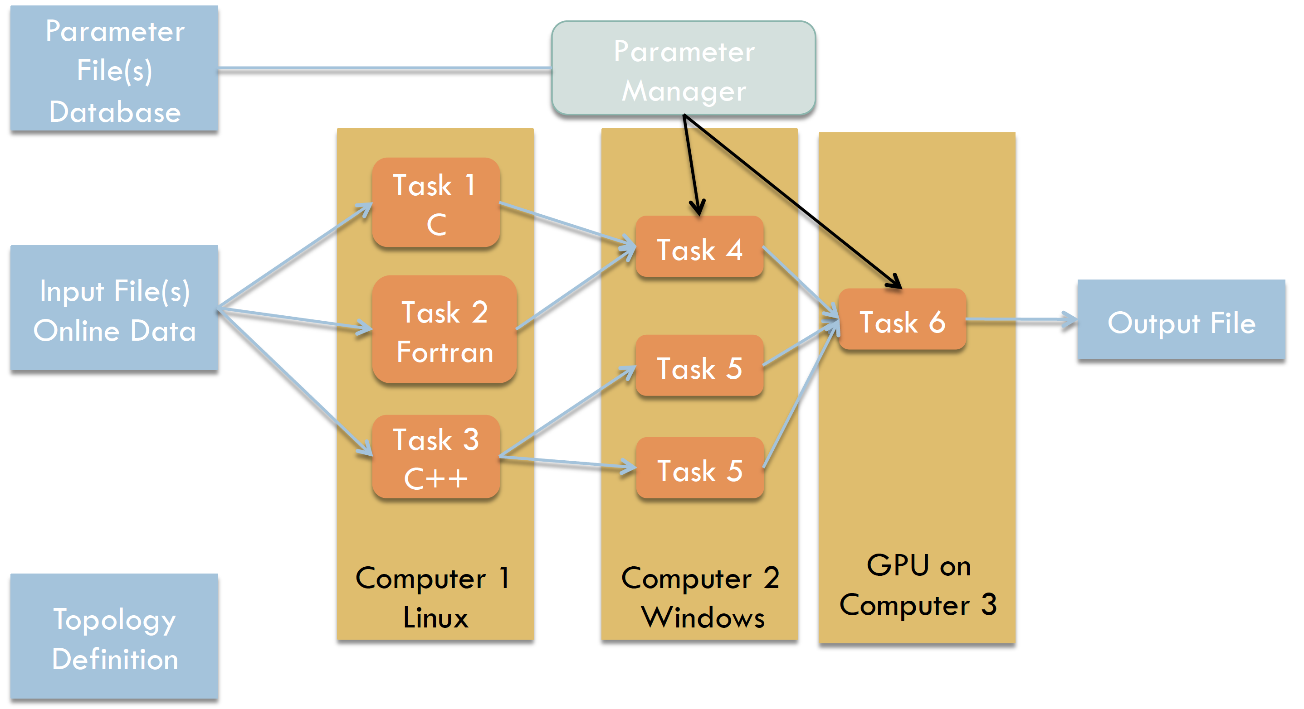
FairMQ
Message Queue

Slide 3
Setup
Parallel readout of 4 Topix4 front-end ASICs
Readout done by 4 FPGA boards sending their data to two PCs
On the PC bitstream converted into raw data
Raw data send via FairMQ to a FileSink
| Tobias Stockmanns

Slide 4
Idea
Use MQ to completely process TB data online
Processing steps:
Convert raw data into PndSdsDigi
Sort by time stamp
Build “event”
Find cluster
Convert Digis into Hits
Combine data stream of all four Topix4 ASICs
Build global event
Find Tracks
Fit Tracks
4 x Single FE

Slide 5
Single Front-End
Online
Sorter
Raw Data Sampler
Raw to Digi
Dupli-cator
Distri-butor
Sorter
Merger
Digi to Hit
TB Data
File Sink
Sorter

Slide 6
Distributor

Slide 7
Distributor
threshold

Slide 8
Distributor
offset
threshold

Slide 9
Distributor
offset
threshold

Slide 10
Data after sorting

Slide 11
Multiple Front-Ends v1
Digi to Hit FE 1
Digi to Hit FE 2
Event Builder
Track Finder
Track Fitter
File
Sink
Digi to Hit FE 3
Digi to Hit FE 3

Slide 12
Event Builder
Time Stamps
FE 1
FE 2
FE 3
FE 4
Data of each FE sorted in time

Slide 13
Event Builder
FE 1
FE 2
FE 3
FE 4
Take first in stack

Slide 14
Event Builder
FE 1
x
FE 2
FE 3
FE 4
Take first in stack
Take earliest

Slide 15
Event Builder
FE 1
x
FE 2
FE 3
x
FE 4
Take first in stack
Take earliest
Search for matching hits

Slide 16
Event Builder
FE 1
x
FE 2
FE 3
x
FE 4
Take first in stack
Take earliest
Search for matching hits
Write out those in one event

Slide 17
Event Builder
FE 1
FE 2
FE 3
FE 4
Fill empty positions with next hits

Slide 18
Event Builder
FE 1
FE 2
FE 3
FE 4
Fill empty positions with next hits
Repeat selection

Slide 19
Event Builder
FE 1
FE 2
FE 3
FE 4
Fill empty positions with next hits
Repeat selection

Slide 20
Multiple Front-Ends v1
Digi to Hit FE 1
Digi to Hit FE 2
Event Builder
Track Finder
Track Fitter
File
Sink
Digi to Hit FE 3
Digi to Hit FE 3

Slide 21
Multiple Front-Ends v2
Sorter / Digi to Hit
Event Builder Timeslot 1
Track Finder
Track Fitter
Distri-butor
Sorter / Digi to Hit
Sorter / Digi to Hit
Event Builder
Timeslot 2
Track Finder
Track Fitter
Merger
File Sink
Sorter / Digi to Hit
Distri-butor
Sorter / Digi to Hit
Event Builder
Timeslot 3
Track Finder
Track Fitter
Sorter / Digi to Hit

Slide 22
Memory Leaks
To empty a TClonesArray with Clear() is a memory leak in most PandaRoot cases. → Use Delete() instead
TObject* myObject = new TObject(); myObject = GetObjectFromSomewhereElse();
TCloneArray* myTCA(“MyObject”); TObject* myObject = new TObject(); new (*(myTCA)[myTCA->GetEntries()) TObject(myObject);
Whenever you have a new in your code you need to have a delete somewhere
If you do not need to use pointers avoid them
Most severe leak in PndStt/FTSStrawMap
Use tools like Valgrind or Instruments to find them

Slide 23
Summary
Message Queues offer an easy way to parallelize data processing
Enables online data processing for MVD TB data
Preparations for next TB ongoing
Test of future DAQ for PANDA

