Slide 1
FAIR magnets fiducialisation WP 7.5
Dominique Missiaen

Slide 2
Agenda
Introduction to Fiducialisation
Status

Slide 3
Fiducialisation
In order to align a magnet in a tunnel, some external references called «fiducials»
Have to be measured w.r.t a reference axis
Magnetic axis for the 33 cold multiplets
Magnetic axis/yoke for the 24 warm dipoles
The magnetic axis and roll angle is measured by the Magnet group and transfered on some «references»

Slide 4
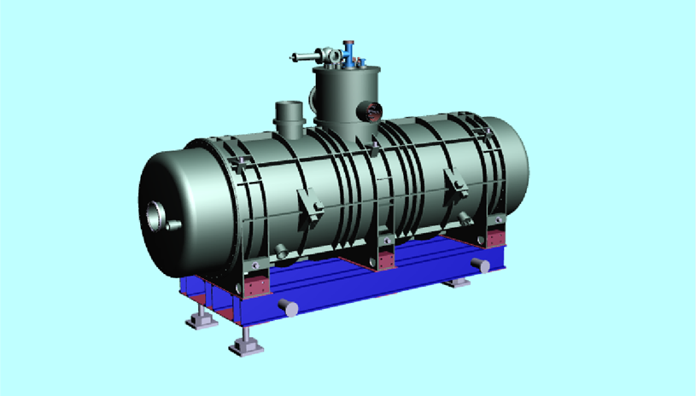
Fiducialisation set up

Slide 5
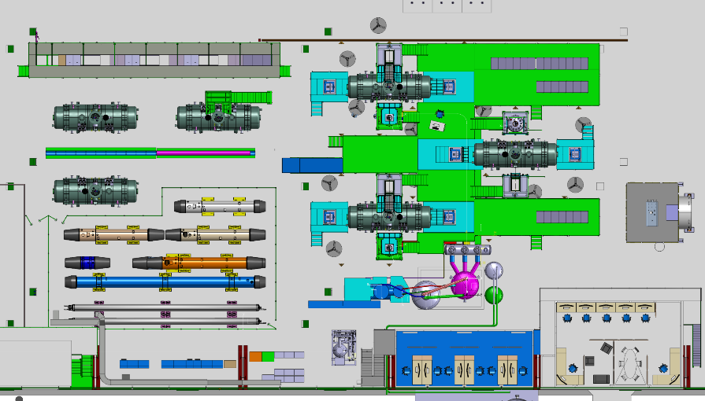
Fiducialisation Layout
Courtesy Antoine Kosmicki

Slide 6
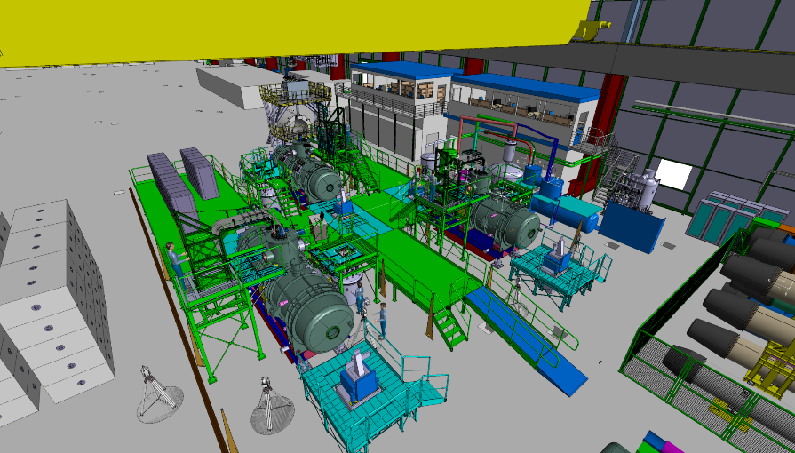
Courtesy Antoine Kosmicki

Slide 7
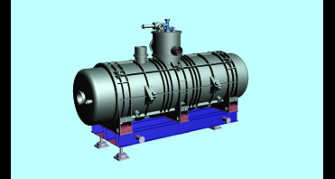
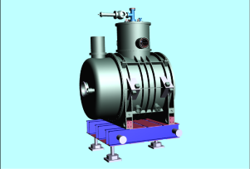
Fiducialisation
 | Number offiducials | Requested number (GSI) | CERN | Requested accuracy (mm at 1s) | CERN Accuracy (mm at 1 s) | Roll angle (mrad)
Long Multiplets | 12 | 4 (not on the same side) | As much as possible | 0.2 | 0.08
Small multiplets | 8 | 4 (not on the same side) | As much as possible | 0.2 | 0.08
dipoles |  |  | As much as possible | 0.5 | 0.08 | 0.5

Slide 8
Requirements
4 positions per bench on a stable floor
At least 6 network points per bench on a stable floor
The supporting has to be realised exactly the same way for the fiducialisation as for the tunnel !!
Supporting system is done by GSI ?

Slide 9
Co-ordinates system
Y
Optics Exit point
Beam trajectory
Z
Fid1 (x1,y1,z1)
Optics Entry point
Mean plane
X
Y axis is the magnetic axis
XY plane given by the roll angle

Slide 10
Questions
Do you prefer the origin to be the magnetic center ?
longitudinal reference is measured on the cryostat ?
Y
Z
Optics Exit point
Beam trajectory
X
Fid1 (x1,y1,z1)
Optics Entry point
Mean plane

Slide 11
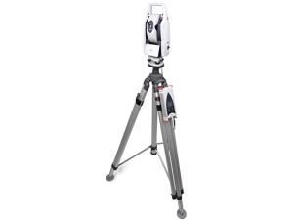
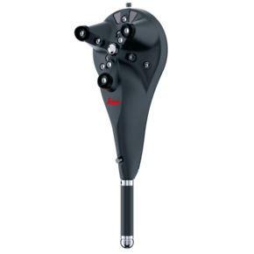
Status of the Wp
Acquisition of an instrument
AT402
Reception At CERN 2 days ago
Together with a BProbe

Slide 12
Fiducials
CCR1.5
Diameter ?
Offset ?
Magnetic or not ?

Slide 13
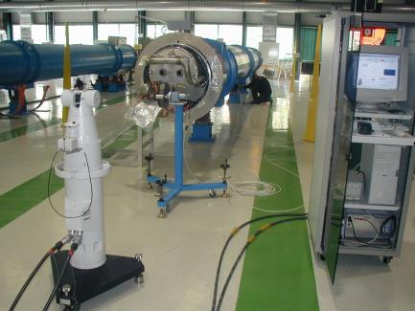
Status of the WP
Infrastructure
Most of Network points available from LHC cryo-magnets fiducialisation
Software
Automatisation of the measurement/data processing could be done using «Measurement Plan» from Spatial Analyzer

Slide 14
Thank you for your attention
Questions ?

