Slide 1
Magnetic measurements of the Super-FRS magnets
Overview:
Measurement systems for dipoles
  requirements
  Measurement systems review
  Open points
Measurement systems for Multiplets
  requirements
  Measurement systems review
  Open points
Magnetic measurement requests
1

Slide 2
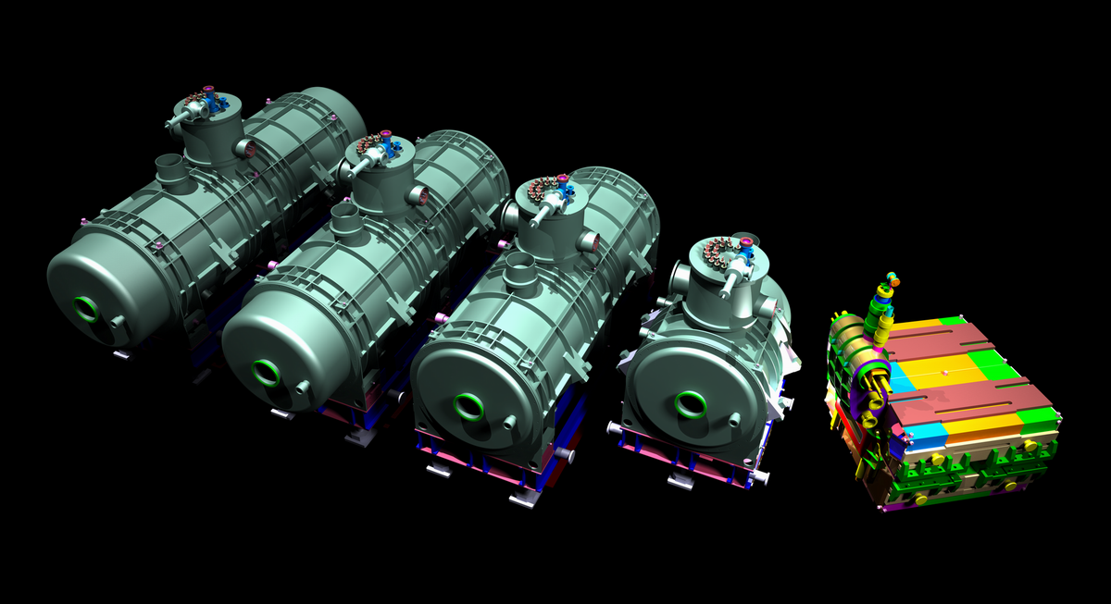
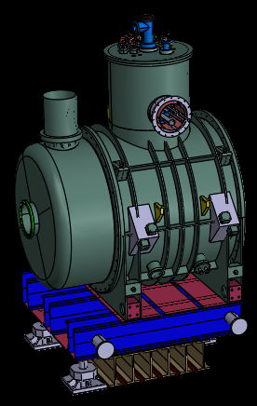
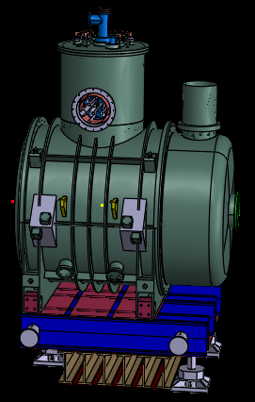
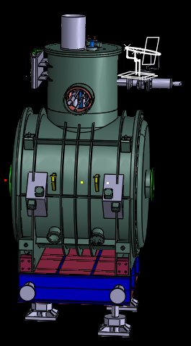
The Super-FRS: magnets overview
Latest update
2000mm
7000mm
6500mm
6000mm
2600mm
2400mm

Slide 3
MM requirements summary
Dipoles: series tests
Magnets | Dipole 2 (2.127 m length) | 21
 | Dipole 1 (2.4 m length) | 3
 | Dipole straight section | [2]+1
Measurement time |  | 10 days
Field Quality | Current levels | 5 (DC)
 | Absolute integral field accuracy | + 5*10⁻⁴
 | Integral field homogeneity | + 5*10⁻⁵
 | Measurement planes | 3
 | Measurement longitudinal parts | 3

Slide 4
MM requirements summary
Extended pre-series
- Full map with hall probe at 3 currents and 3 planes of:
One dipole unit per type
All dipoles with (straight) exit for beam
- Map reference accuracy + 2 mm
Integral field, integral transfer function, hysteresis and Homogeneity at 16 current levels
Testing of the vacuum chamber
Magnet optimization (shimming)
Assembly and reassembly of half yoke

Slide 5
Measuring systems for dipoles
Translating Fluxmeter:
Reasons:
Allows longitudinal profile of homogeneity
Possible configuration on a “box” on the GFR boundary
Possible to use an array of coils on standard pcb size (620 x 200 mm)
15 coils enough to cover the 40 mm spatial resolution required
Possibility to reconstruct the pseudo-multipoles (S. Russenschuck talk)
ΔB
Δs
ξ
5

Slide 6
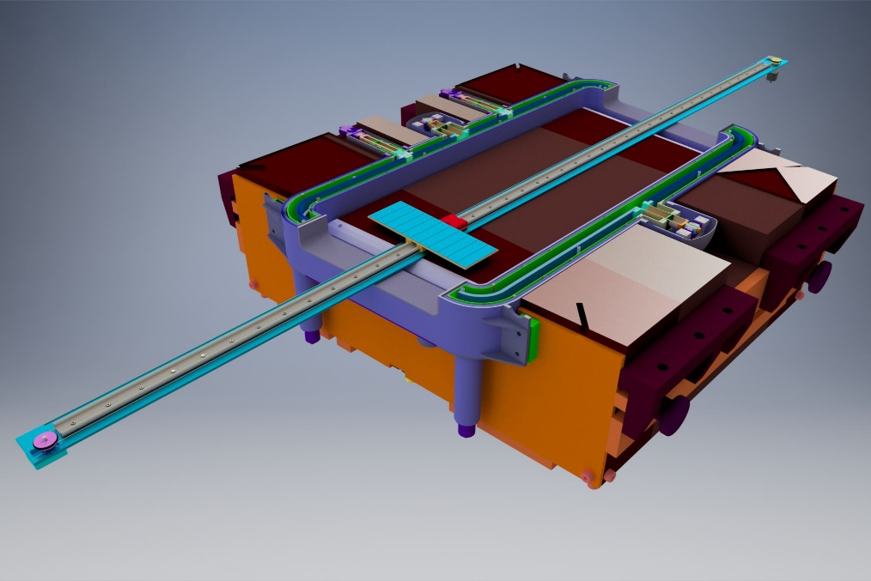
Measuring systems for dipoles
Translating Fluxmeter:
5000 mm length/ 4000 mm measurement path
Measuring on a straight path:
Reduces mechanical complexity of the system
Possible in-situ calibration of the absolute integral field and homogeneity measurement (comparing with SSW)
Enough space in the magnet to cover the whole GFR
6

Slide 7
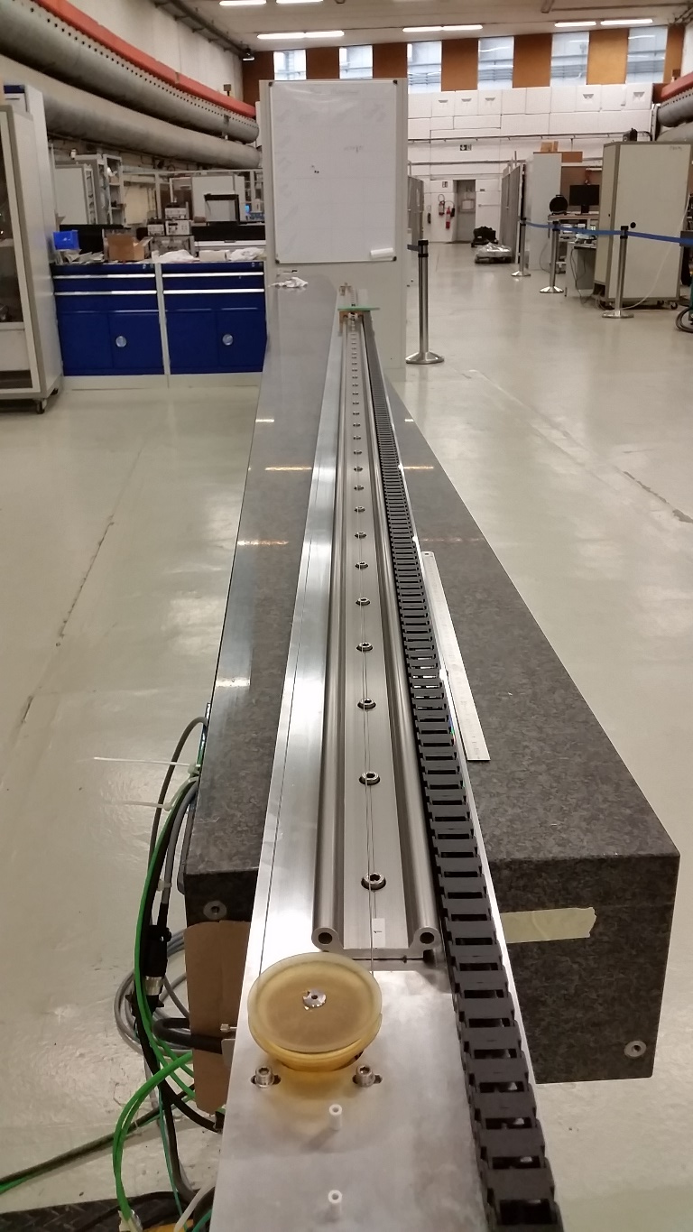
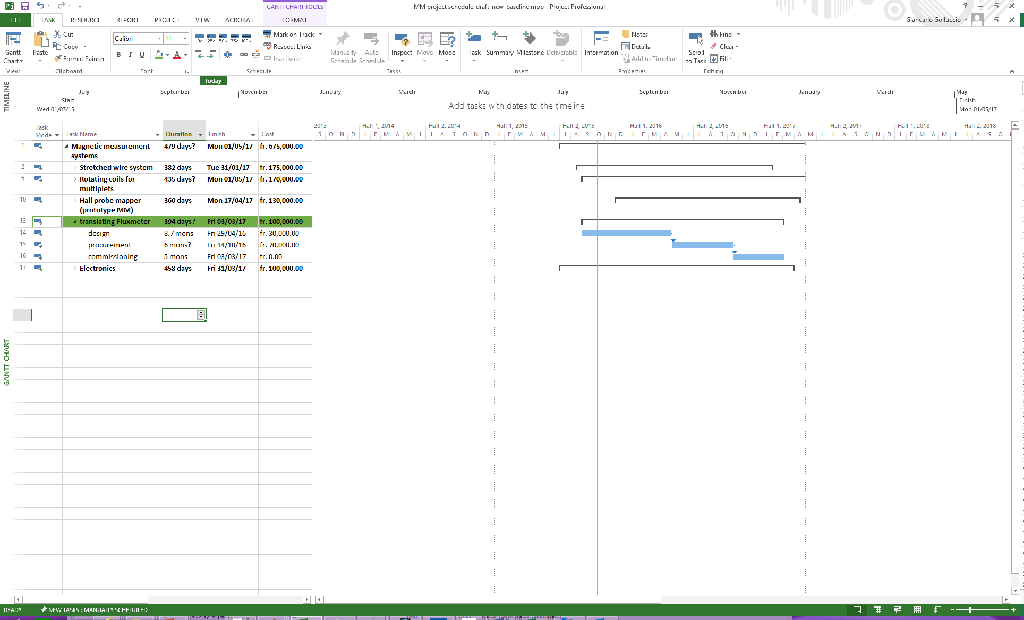
Measuring systems for dipoles
Status:
  Prototype needed to test:
    Linear encoder (installation and accuracy)
    Measurement principle
    Mechanics
    Accuracy estimation
  Design of prototype ready
  Final scale prototype in the assembly phase
7

Slide 8
Measuring systems for dipoles
3D Mapper for Pre-series
  Cost 200 kchf (synergy with MM section)
  3 x 1 x 1 m scanning volume
  Overall accuracy + 0.1 mm
Status
Stages procurement under tendering

Slide 9
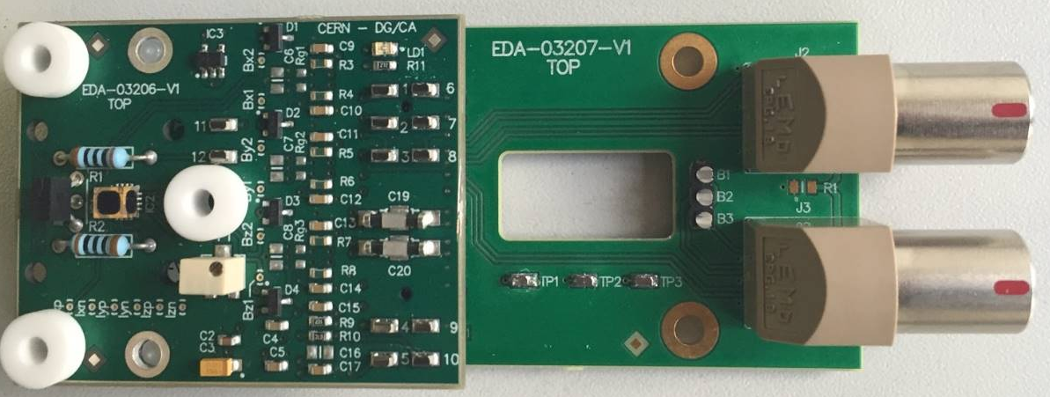
Measuring systems for dipoles
3D Mapper
  3D hall probe head under development at CERN
Commercial available 3D hall probe Hoeben HE-444
Temperature sensor, resistors and probe encapsulated in a thermic housing (not present)
Removable head for installation in the calibration magnet
Space for electrolytic inclinometer
Status
Electronic testing phase
Electronics for:
hall signals amplification
temperature reading
hall current input
Mother board on the carbon fibre shaft

Slide 10
Magnetic measurements proposal of the FAIR magnets
Open Questions:
The pre-series and series test time plan at the moment does not consider any characterization of an on line monitoring system for machine operation if there will be one
Yoke temperature measurements (sensors?)
Assembly and reassembly of half yoke ?
Magnet optimization
  It will be done?
  Is it foreseen only for the pre-series?
  Specification of the chamfers needed (weight, assembly procedure etc)
Magnet assembly and reassembly
10

Slide 11
MM requirements
Multipoles: series tests
Magnets | Short multiplet |  | 6 inter-distance fixed 2 inter-distance varying
 | Long multiplet |  | 22 inter-distance fixed 3 inter-distance varying
 | Quadrupoles | L 800 mm +octupole coils | 42
 |  | L 1200 mm | 24
 | Sextupoles | L 500 mm | 41
 | Steerers | L 500 mm | 13
Measurement time |  |  | 10 days (full multiplet)
Field Quality |  | Measurement radius | 170 mm
 | Quads | Current levels | 5
 |  | Integral field homogeneity | + 5*10⁻⁵
 | Multipoles | Absolute integral field accuracy | + 1*10⁻³
 |  | Integral field homogeneity | + 2*10⁻⁴
Fiducialization | Quads and multipoles | Angle (mrad) | <0.5
 |  | Axis (mm) except steerers | + 0.2

Slide 12
MM requirements
Multipoles: extended pre-series tests
* The longitudinal centre of the magnet in the assembly only needs to be known with an accuracy of + 2 mm. Their position will be derived by mechanical measurements at the manufacturer
- Full map with a short coil at 10 mm steps of:
1 quad 800 mm
1 short quad 1200 mm
1 sextupole
Integral field, integral transfer function, hysteresis and Homogeneity at 16 current levels.
Longitudinal center of the single magnet* within + 1 mm
Cross-talk between two adjacent magnets (2 magnets powered at the same time)
Measurement of octupole with the quad on/off.
Movement of the cold mass (optical test not under MM responsibilities)
Cross-check measurements of the axis measurement performed with the SSW with another system (vibrating wire)
Cross-check of the field homogeneity with another system (a standard shaft at a smaller radius).

Slide 13
MM requirements
Multipoles: Tests sequence
SSW measurements (quadrupoles)
Installation of wire
Quadrupoles precycling
Quadrupoles axis offset, angles (@ Inom/2) and main field integral strength (5 currents)
Fiducialization of axis (laser tracker)
Connection next quadrupole
Rotating coil measurements
Installation of shaft
Magnet precycling
Field homogeneity (5 currents) of quadrupoles
Field homogeneity and strength of sextupoles and steerers
Connection next magnet

Slide 14
Magnetic measurements proposal of the FAIR magnets
Rotating coil requirements:
170 mm radius
Total weight < 60 kg
Proposed measurement length 2700 mm (2 times the gap on each side to be cross-checked with simulation data)
Possibility of longitudinal harmonic distribution of pre-series
Measurement of quads and correctors
14

Slide 15
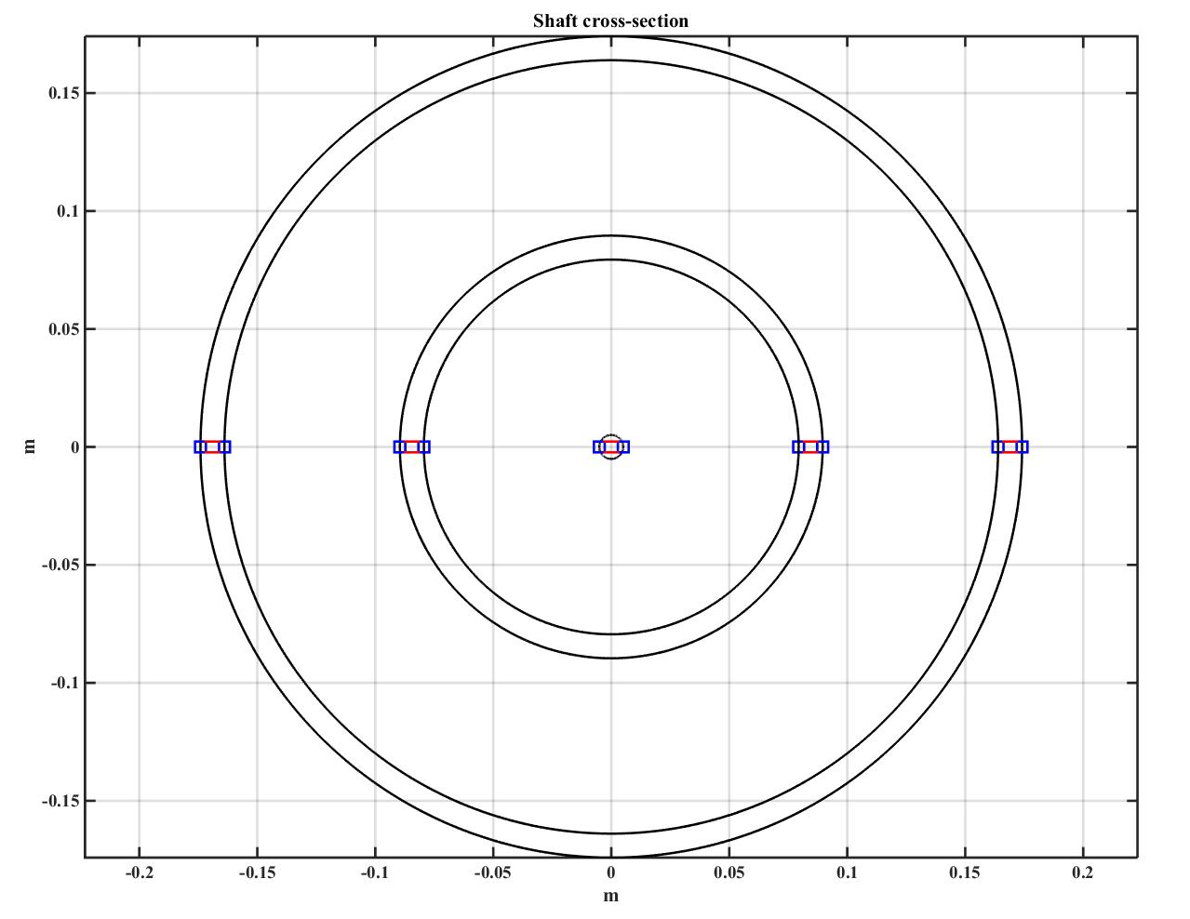
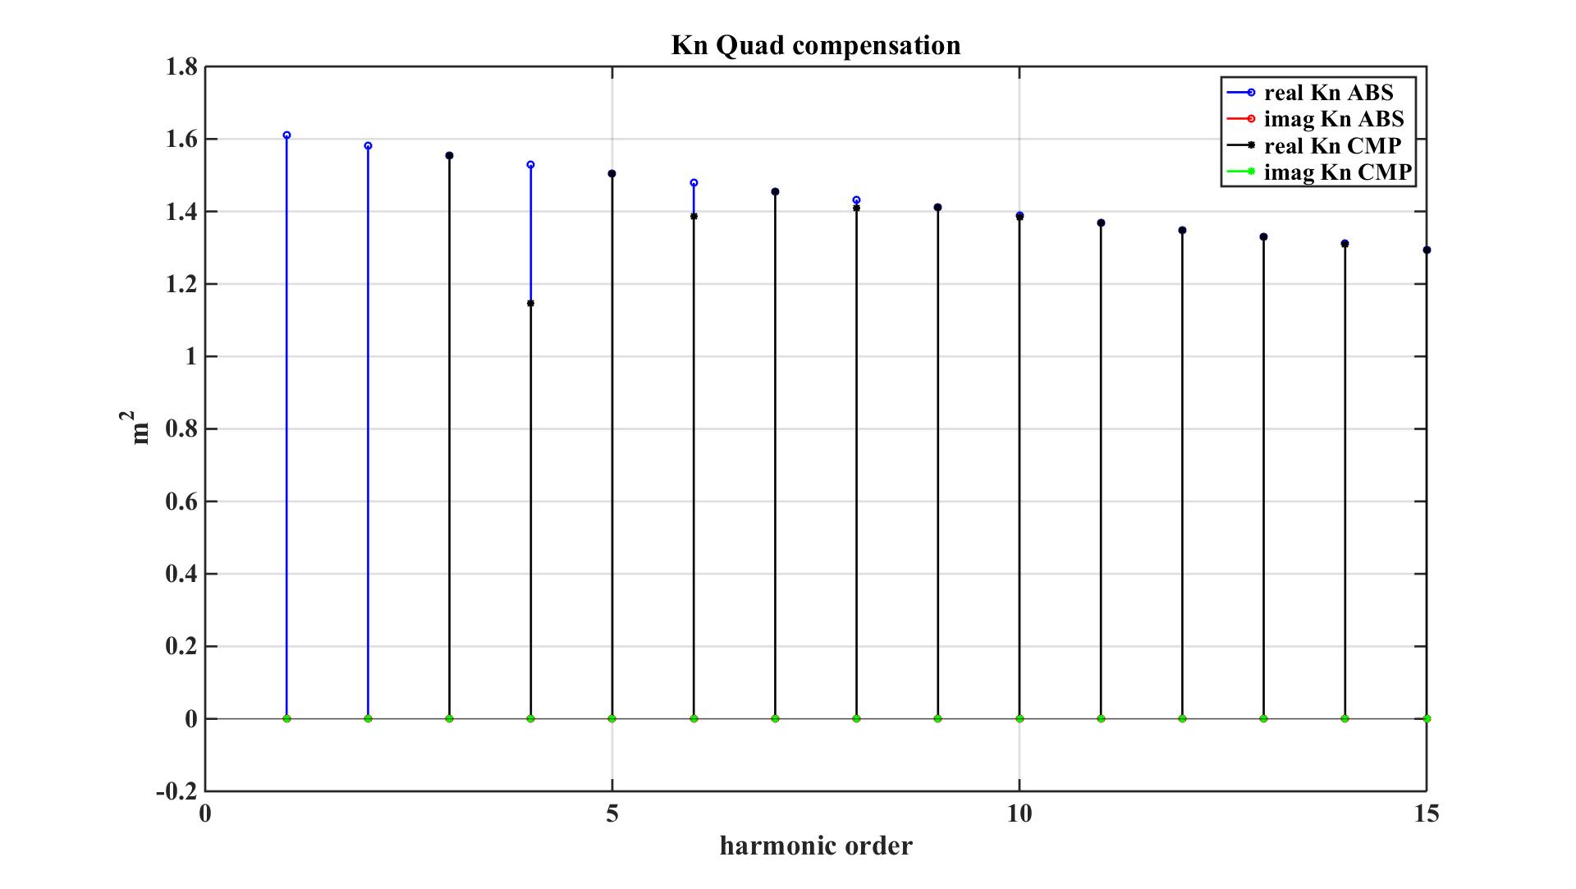
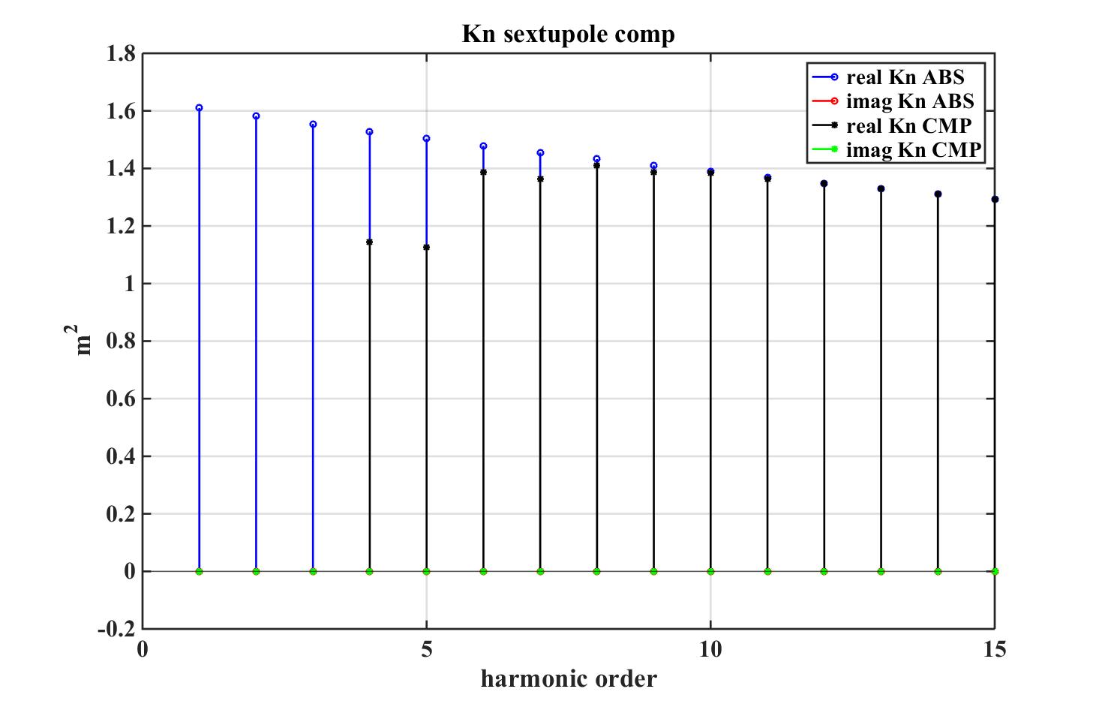
Magnetic measurements proposal of the FAIR magnets
Rotating coil solution:
2*PCB 1.35 m length coils
Carbon fiber shaft
MRU embedded in the shaft (reducing angular errors)
Longitudinal positioning for each inside the multiplet
Meas radius 172 mm
E
D
C
B
A
A-B-C+D
A-3B+3C-D
15

Slide 16
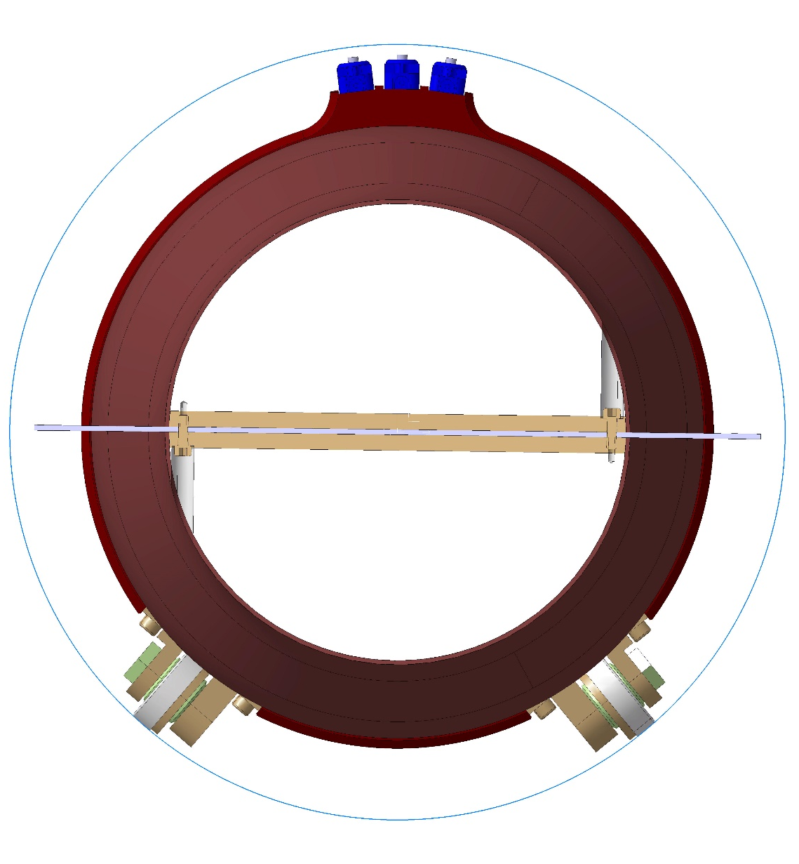
Magnetic measurements proposal of the FAIR magnets
Pneumatic brakes
(3 of 178 mm²)
Measurement radius
172 mm
Shaft weight (including motor) 46 Kg
Carbon fiber shaft
Nom force of brakes 80 N
Blocking spring 160 N
Multiplet vacuum chamber
PCB board:
5 Radial coils
2 x 1.35 m length
120 turns
10 layers
Sliding rollers
16

Slide 17
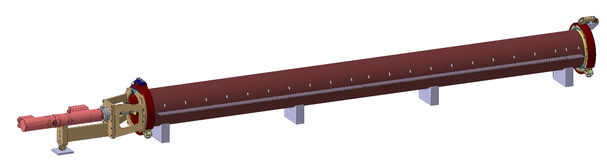
Magnetic measurements proposal of the FAIR magnets
Nom 320 N +10% max
Nom 380 N +10% max
inclinometer
2.8 m sag 0.06 mm
2 contact points
17

Slide 18
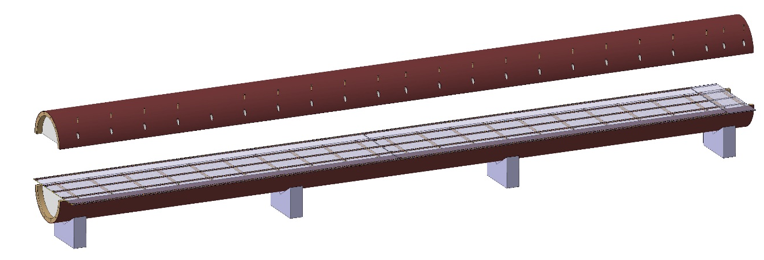
Magnetic measurements proposal of the FAIR magnets
4 mm thickness carbon fiber
Rohacell foam filling
Glass fiber supports
5.4 mm longitudinal nominal gap between coils (to be checked)
18

Slide 19
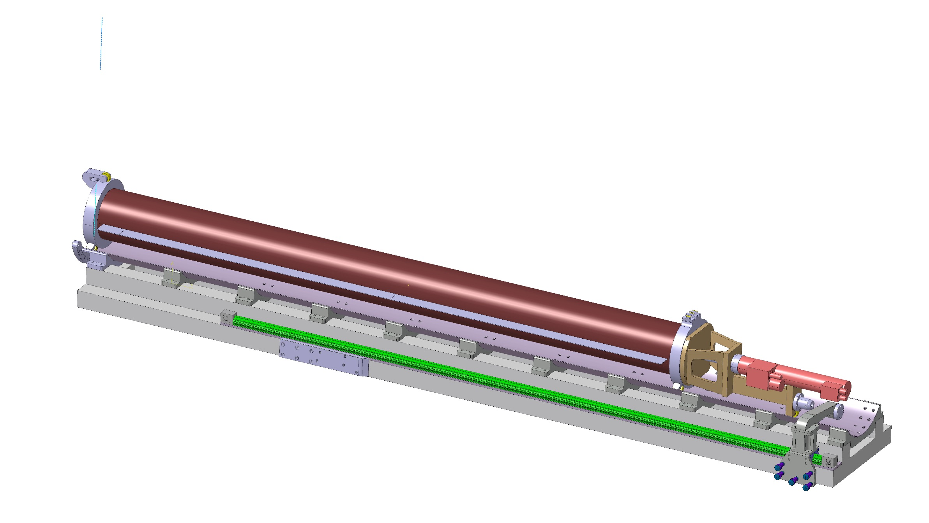
Magnetic measurements proposal of the FAIR magnets
FAIR MEASURING HEAD: DISPLACEMENT SEQUENCE
Overall dimensions: 3765 (L) x 560(l) x 545 (h)
19

Slide 20
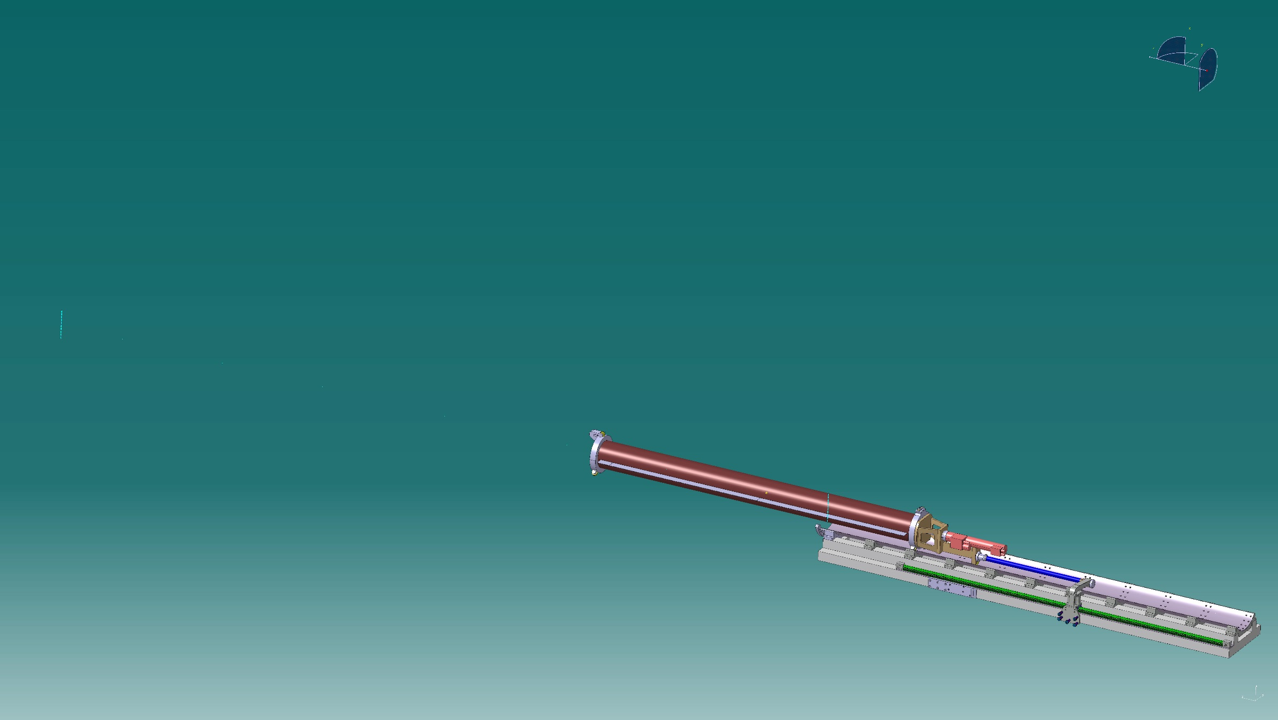

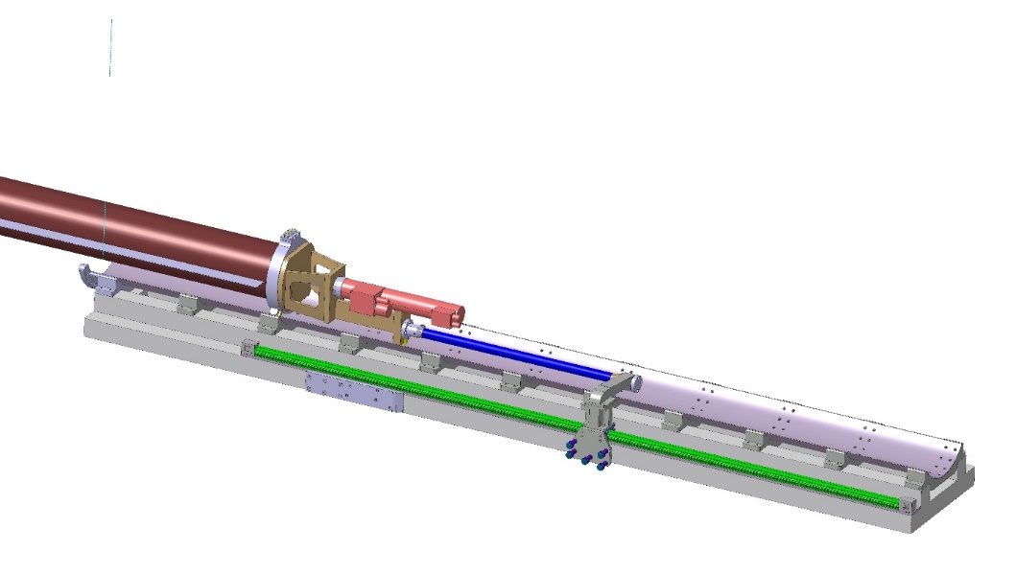
Magnetic measurements proposal of the FAIR magnets
20

Slide 21
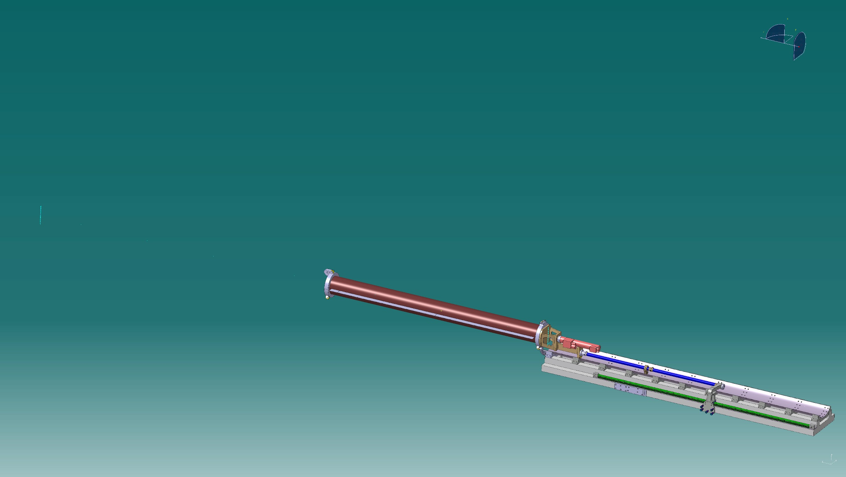
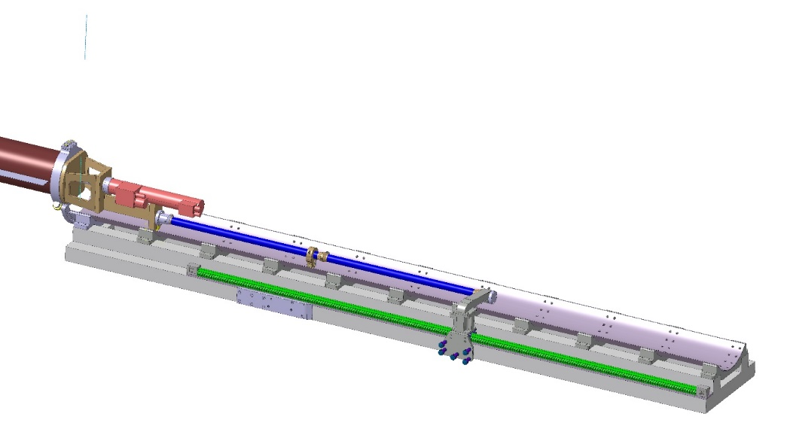
Magnetic measurements proposal of the FAIR magnets
21

Slide 22
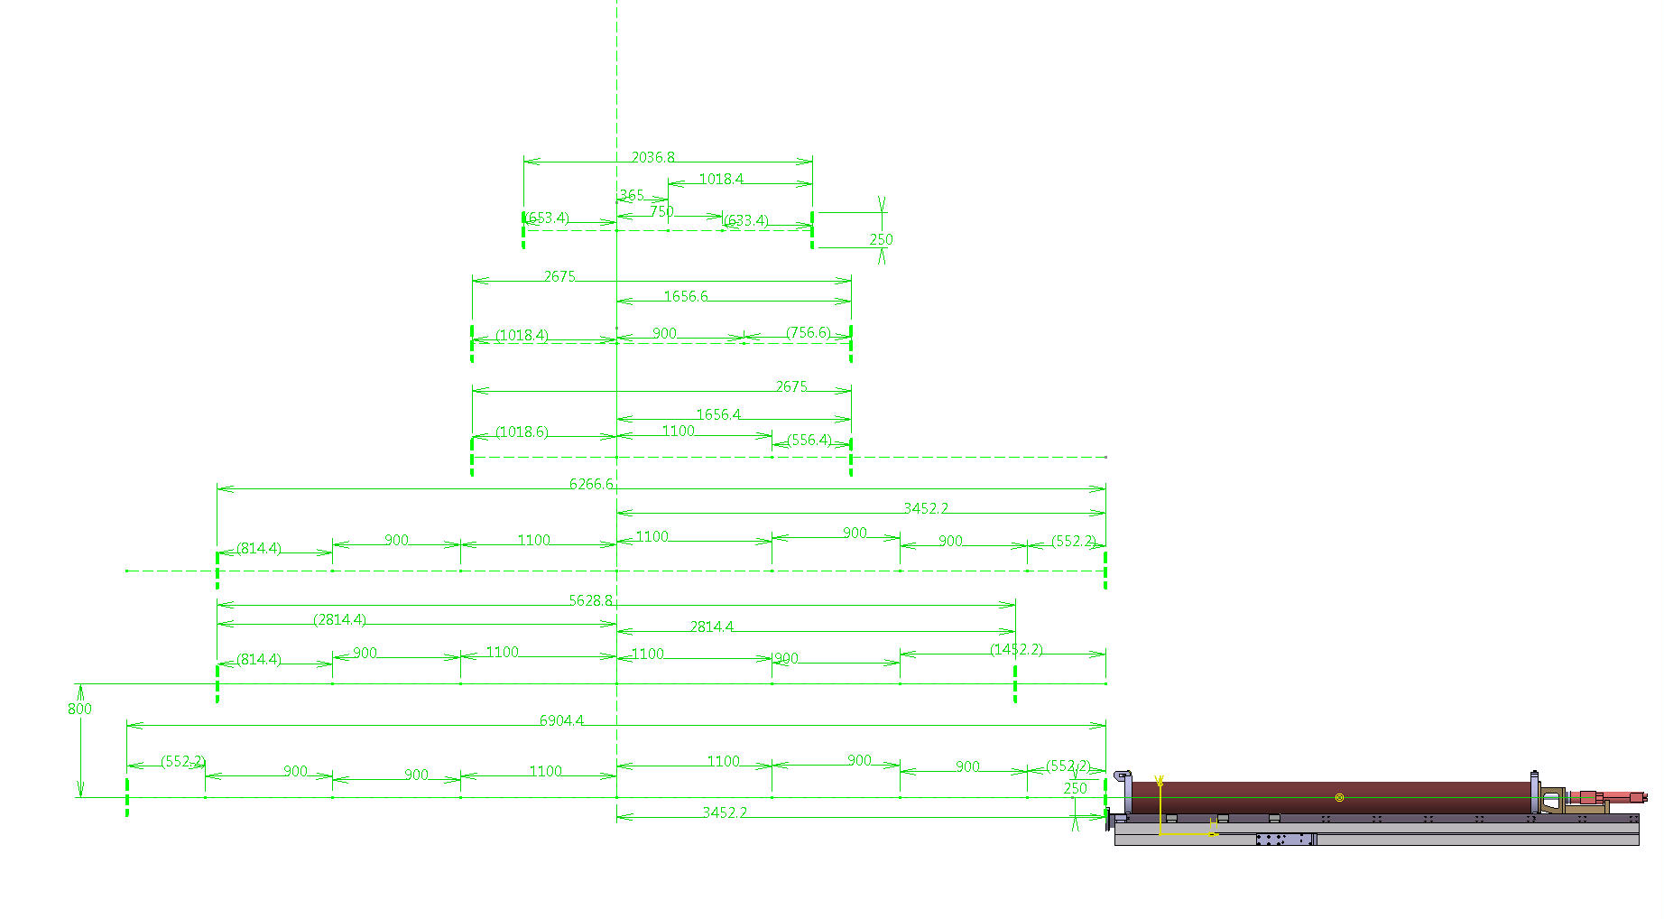
Magnetic measurements proposal of the FAIR magnets
22

Slide 23
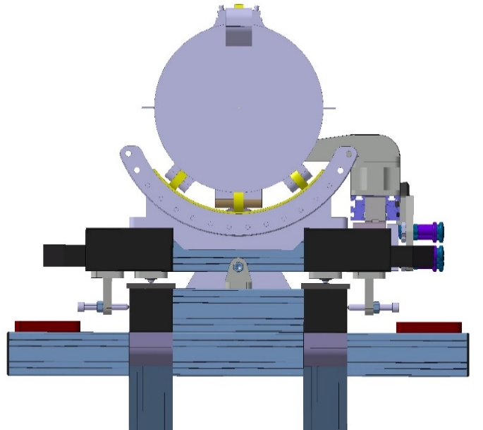
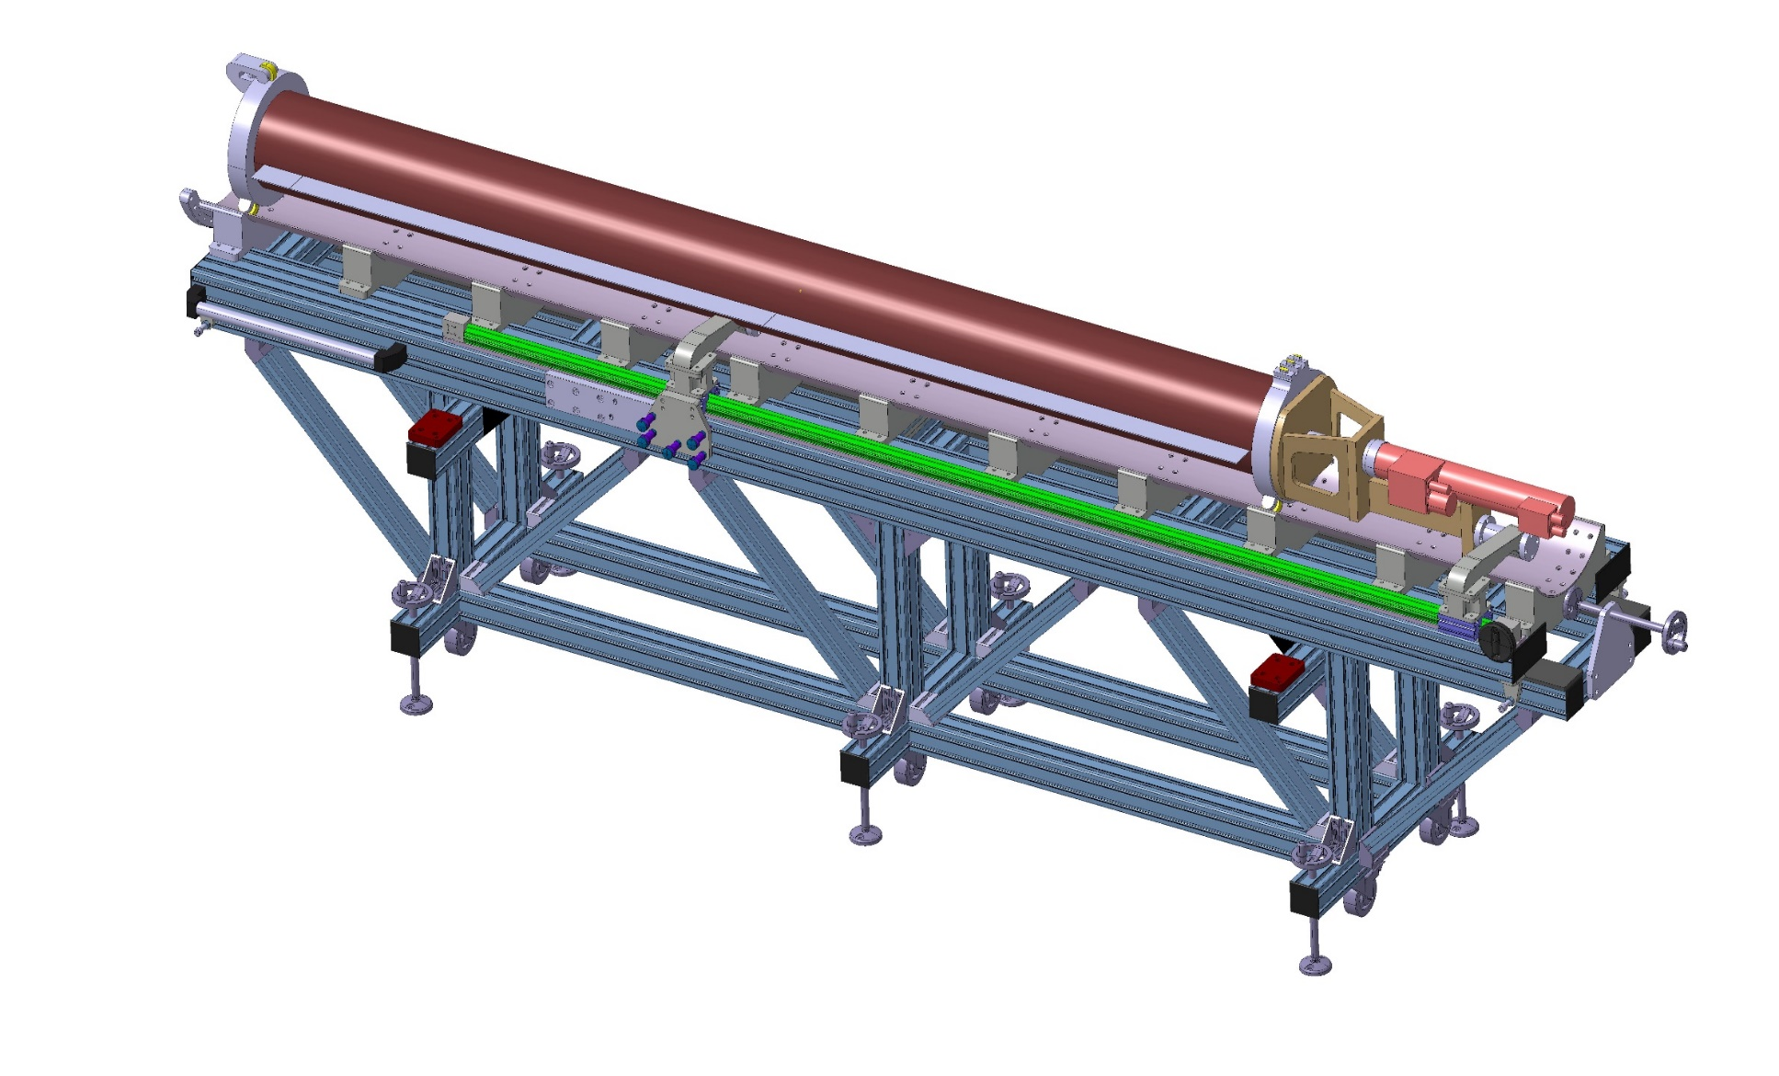
Magnetic measurements proposal of the FAIR magnets
1150
4000
850
Regulating of the height : +/- 25 mm
Longitudinally stroke: 100 mm
Transversal regulating: +/- 30 mm
23

Slide 24
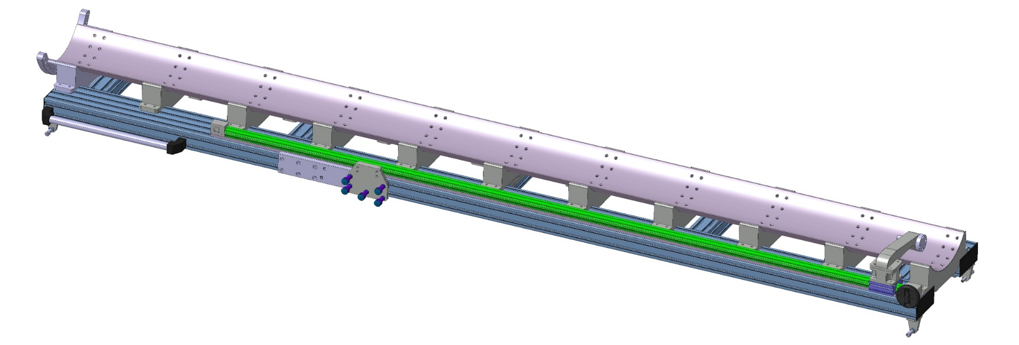
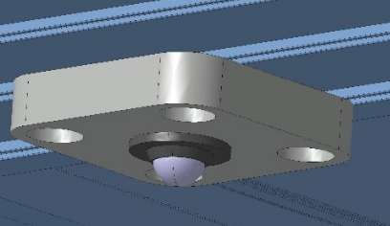
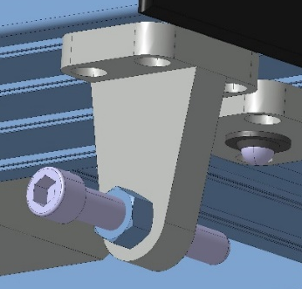
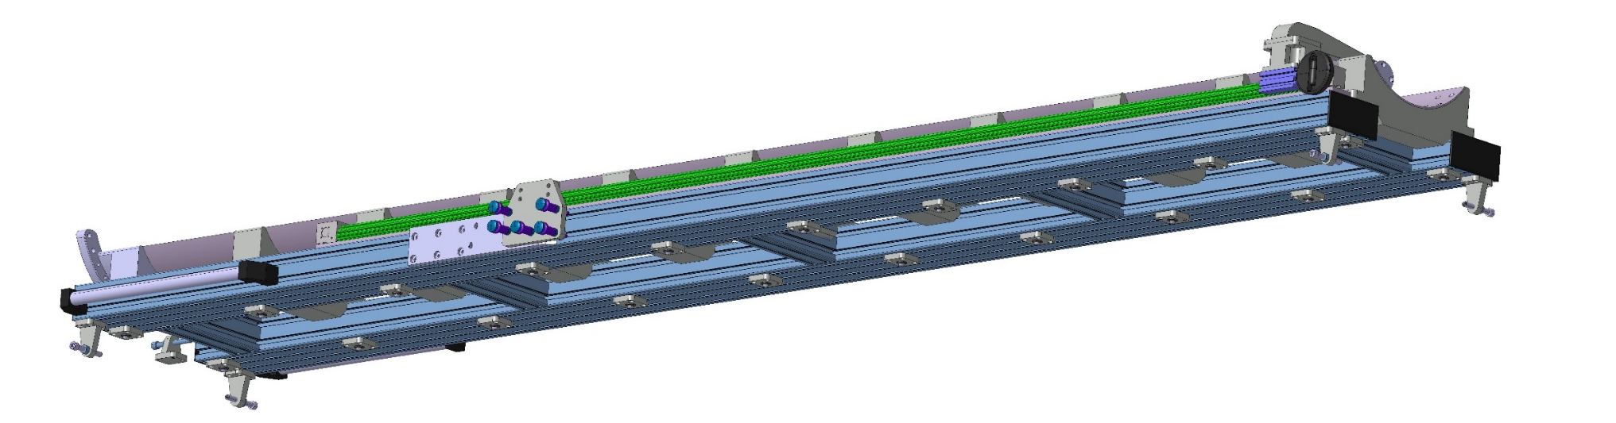
Magnetic measurements proposal of the FAIR magnets
REGULATING SCREW
(WITH BALL) (4X)
CARRIER BALL (20X)
24

Slide 25
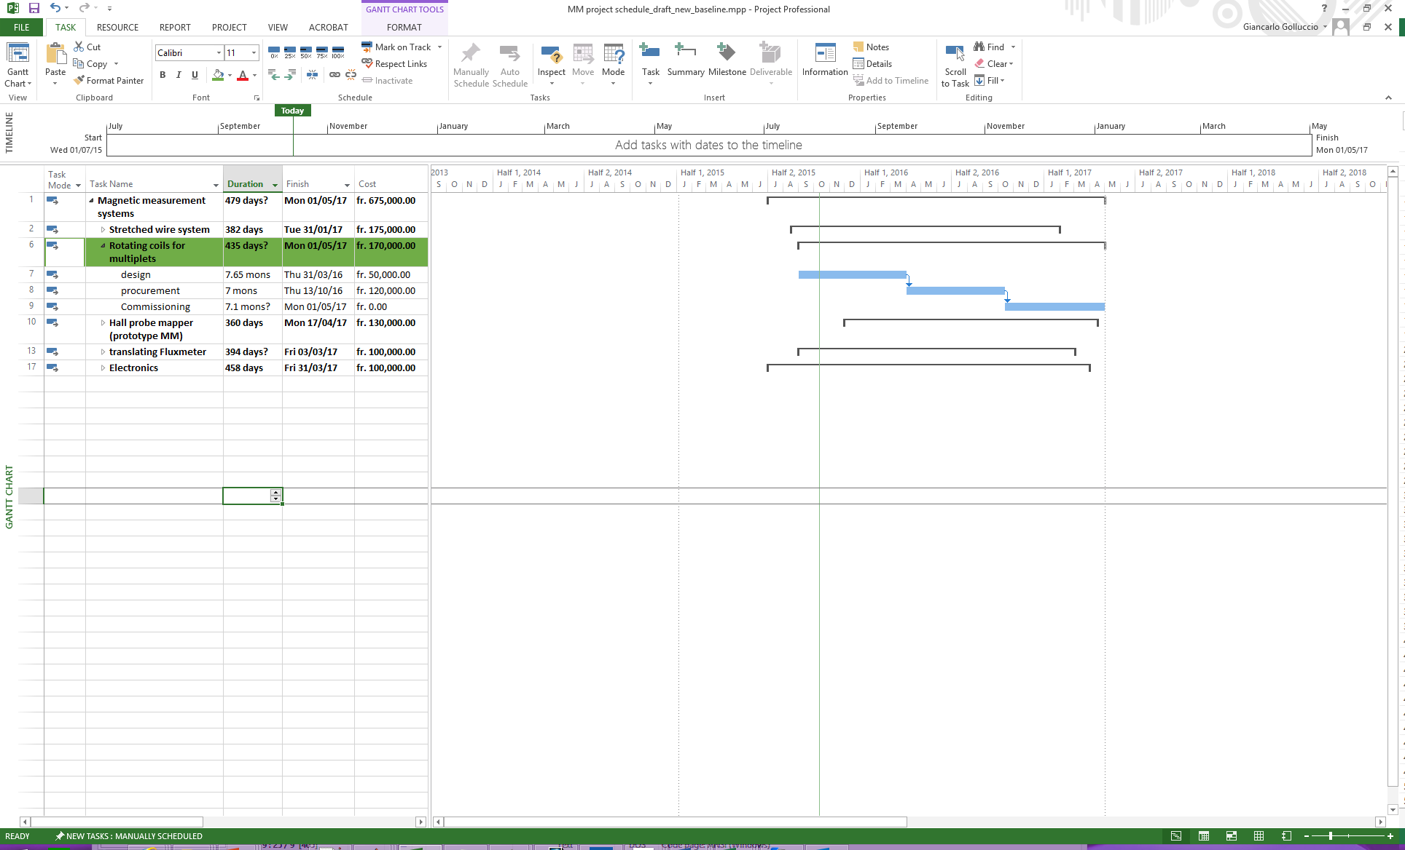
Magnetic measurements proposal of the FAIR magnets
Status:
  1st proto (synergy HI-Lumi) 45 mm radius 1.3 m length to:
    validate the use of carbon fiber and roachell
    To validate pcb production
    design finalized
    started procurement of parts
  2nd proto: full scale shaft (180 mm radius and 2.7 m length)
    To validate mechanics and assembly
    To be tested in a CERN resistive magnet
    Pre-designed studies to be finalized
- 1.6 m² surface coil
5 coils for dipole/quadrupole/sextupole compensation
10 single layers board
1st proto
2nd proto
final
25

Slide 26
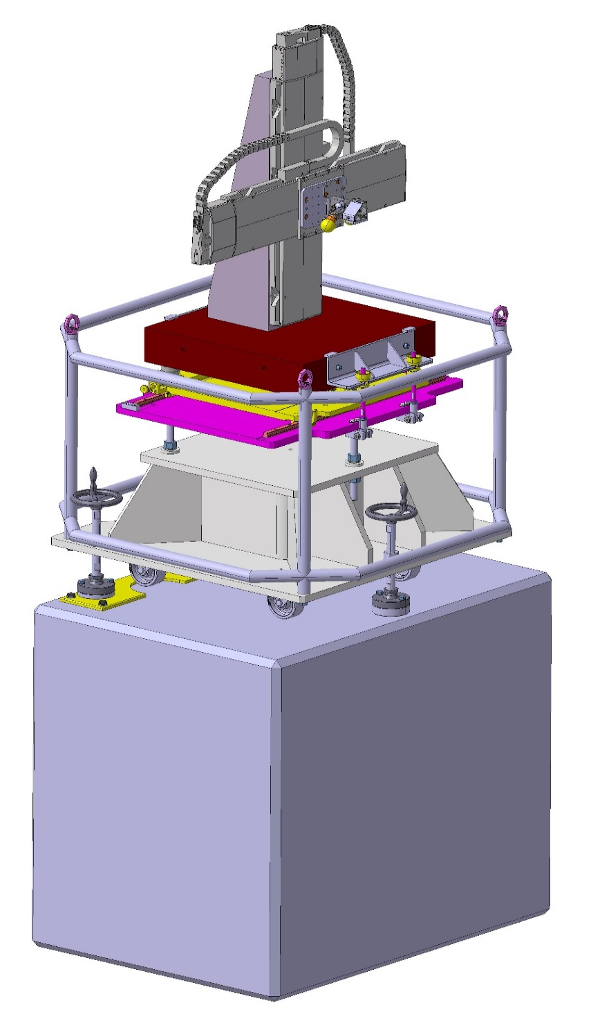
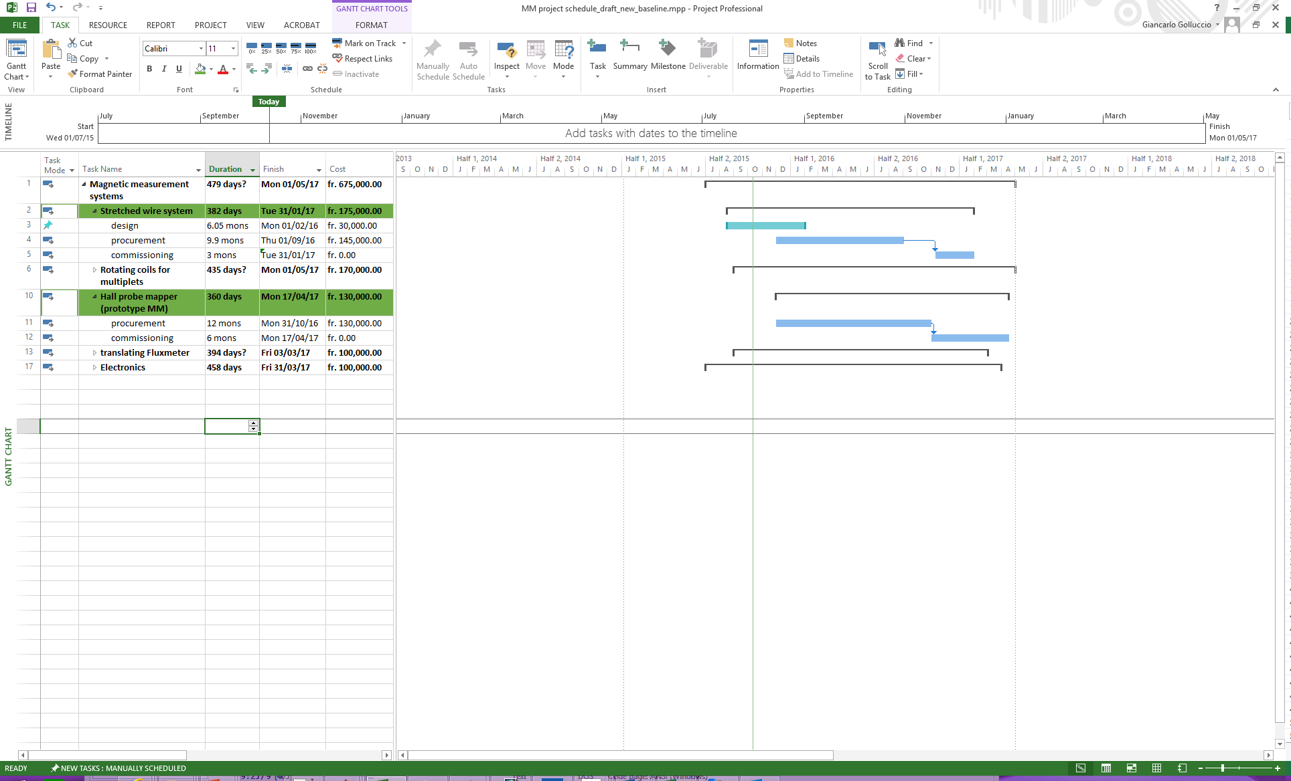
Magnetic measurements proposal of the FAIR magnets
Stretched wire system (400 mm stroke)
  Department request for the purchase accepted for the stages
  Integration on going
  Design of the wire support and other parts on going
Optical target repositioned in order to be visible from both side of magnet (survey request)
Redesign of support table for the 400 mm tables
26

Slide 27
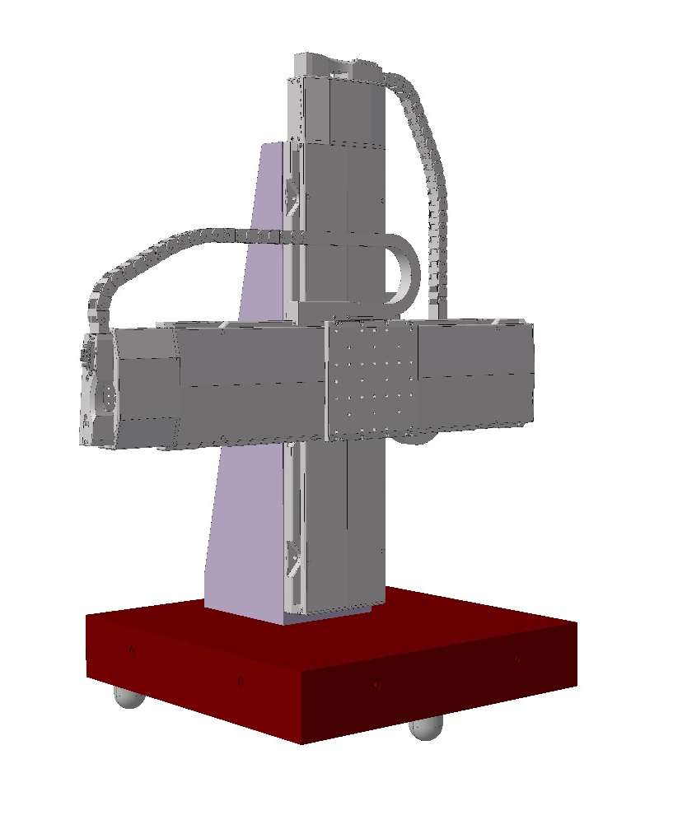
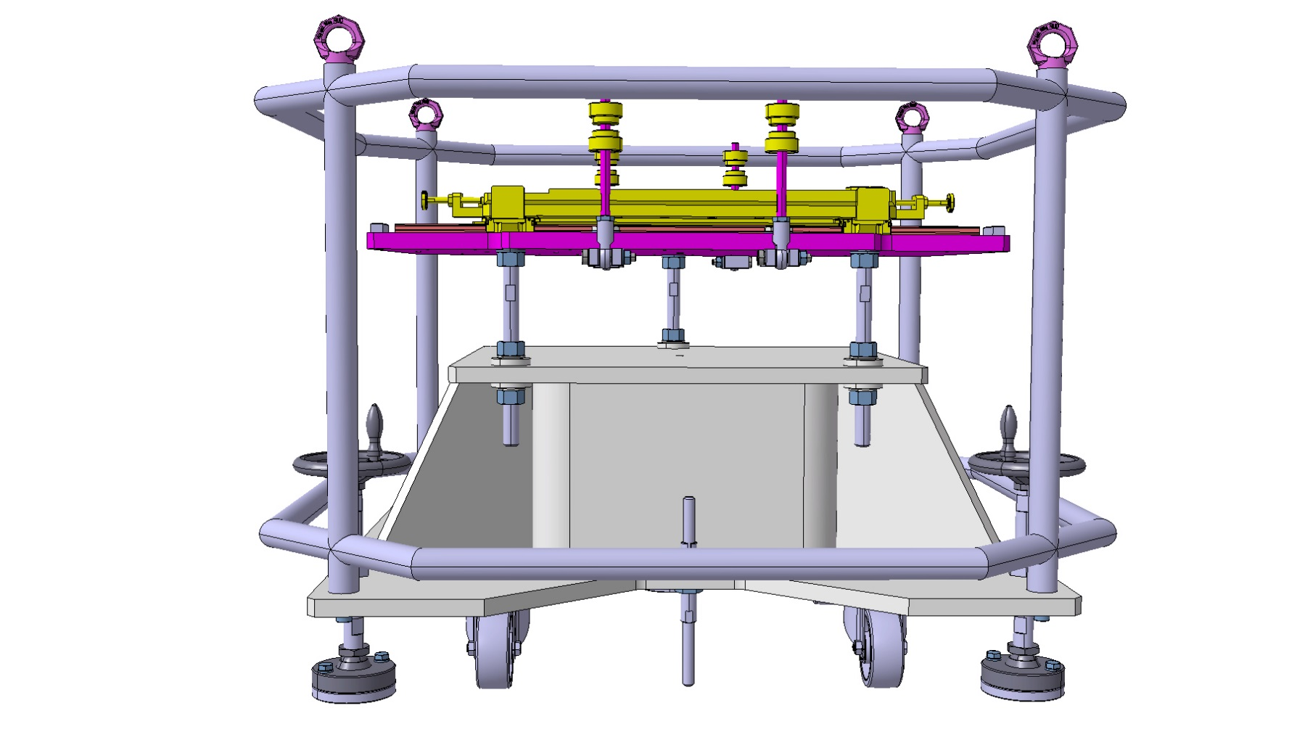
Magnetic measurements proposal of the FAIR magnets
1050 mm
Inox *
810 mm
Acier
Stage LS-180 (stroke 408) =10kg/stage )
Granite 550x550x100 mm
Distance feet: 450 mm
weight Catia : 140 kg
27

Slide 28
Magnetic measurements proposal of the FAIR magnets
Open points:
  Is the vacuum chamber diameter fixed (380 mm)?
  vacuum chamber tolerances on the diameter and straightness
  Can the maximum punctual weights be accepted?
  How the vacuum pipe is hold in the cryostat
  Continuity of the vacuum chamber internal surface (welding, chamfers, flanges etc..)
  Specification of the external interface of the vacuum chamber
  Magnets longitudinal location inside the cryostat for all the multiplet configurations (also not standard)
  Magnet naming convention
28

Slide 29
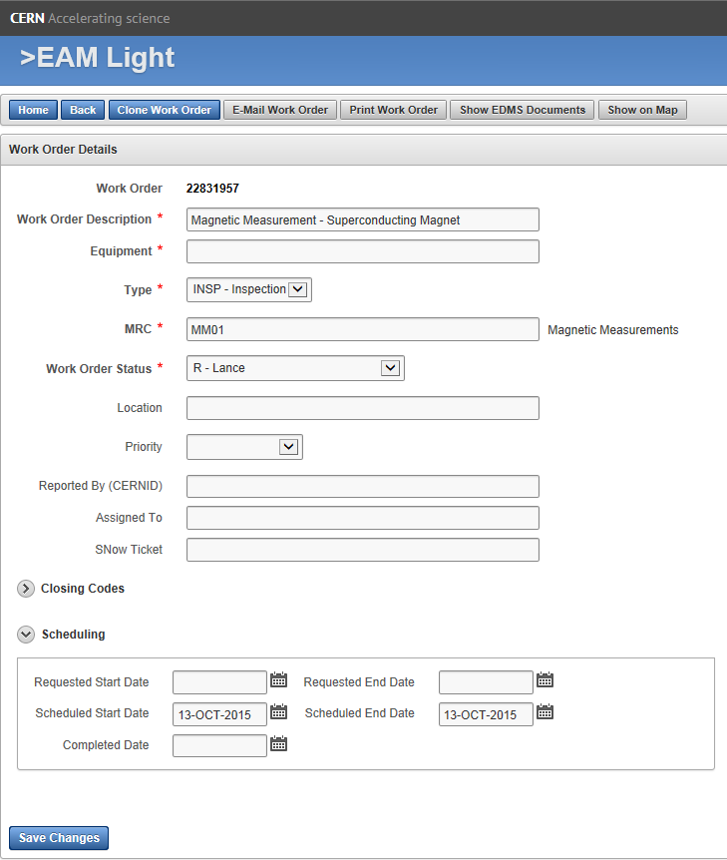
Magnetic measurements proposal of the FAIR magnets
New Magnetic Measurement request tool (EAM Light)
Provided by CERN one per magnet and one per multiplet
(the naming convention should be defined)
MM01 indicates the MM section
to be set to “RDT” before sending the request
Date of magnet availability for measurement
Date of end magnetic measurements
29

Slide 30
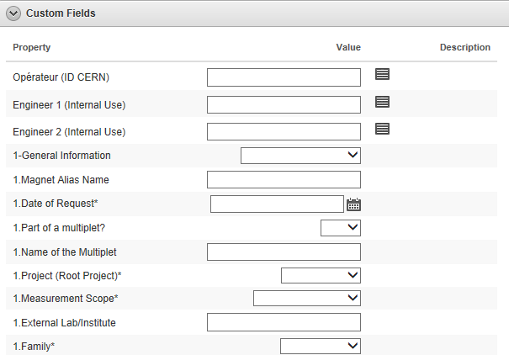
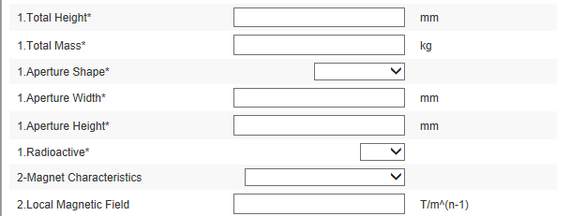
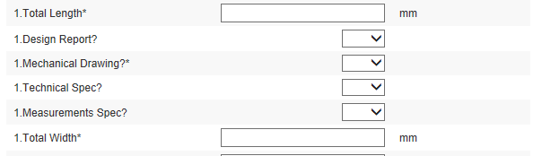
Magnetic measurements proposal of the FAIR magnets
New Magnetic Measurement request tool (EAM Light)
  Magnetic naming of EAM to be defined and agreed
  User manual will follow
30

