Slide 1
Survey and Alignment: Requests for fiducialisation and detection cold mass movements of Super-FRS Multiplets (and Dipoles)
Testing SuperFRS@CERN: Survey and MM measurement strategy review
19 November 2015
Ina Pschorn, Vasileios Velonas
FAIR@GSI Division
Engineering – NC Magnets and Alignment

Slide 2
Outline
Request to the survey and alignment department for the geometrical measurements on the S-FRS Multiplets and Dipoles
Overview of the existing measurement concept on the SIS100 Dipole
Needs for applying the existing concept on the S-FRS Multiplets
Diagram examples based on the results of SIS100 dipole

Slide 3
Request to the survey and alignment department for the geometrical measurements on the S-FRS Multiplets and Dipoles
Accuracy: magnetic axis to fiducials up to ± 0.2mm
Accuracy: axis between the components up to ± 0.1mm
  Fiducialisation of all Multiplets and Dipoles
  Behavior of the cold mass with respect to its surrounding cryostat (Fiducials) for two “first-of-series” Multiplets during:
  pumping processes
  thermal cycles (warm-cold-warm)
  after quenches
  after transport
  Detailed Analysis and documentation

Slide 4
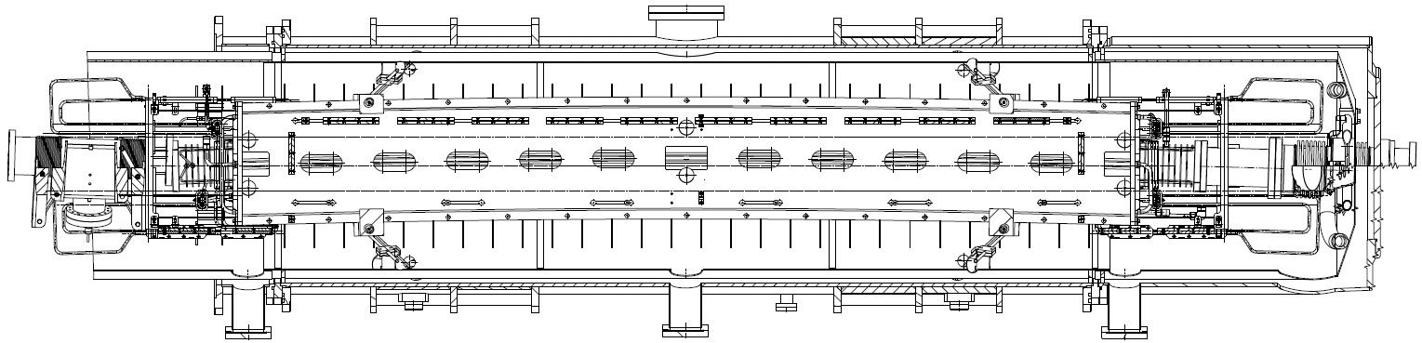
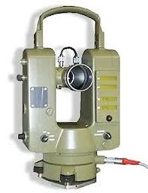
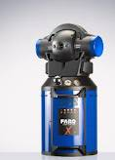
The existing measurement concept on the SIS100 Dipole
Measuring concept based on existing theodolite, laser tracker and suitable tools for lighting and sighting
Measurement setup in front of cryostat and enclosed SC dipole with fit bores (top view)
cryostat fiducials
magnets fit bore
theodolite position
Detailed information in: “Start of construction for the International Facility for Antiproton and Ion Research (FAIR) – Aspects of Survey and Alignment”
Ina Pschorn, Torsten Miertsch (GSI), IWAA 2012

Slide 5
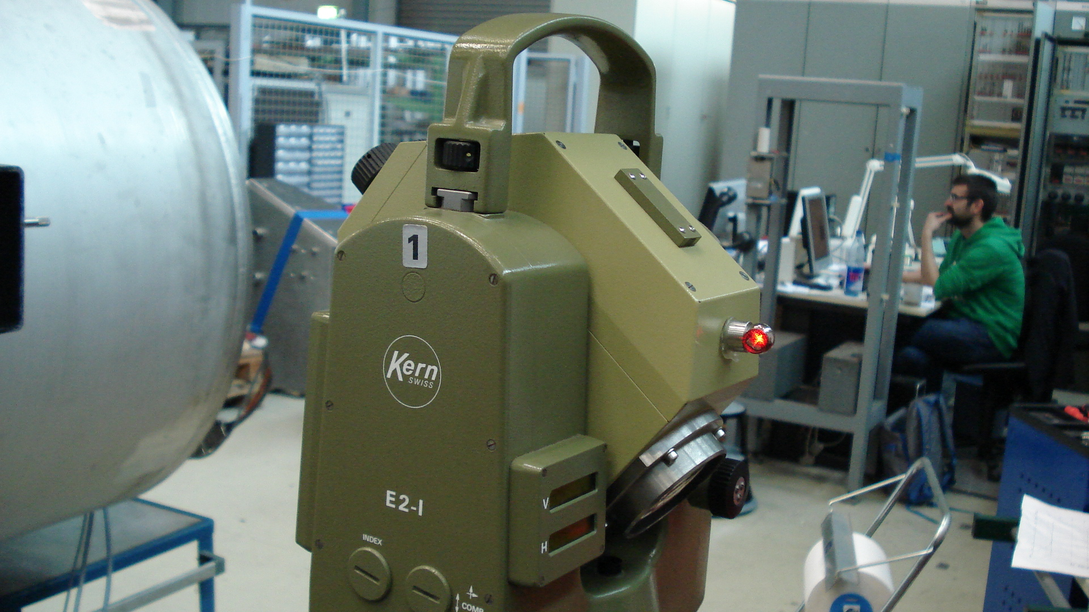
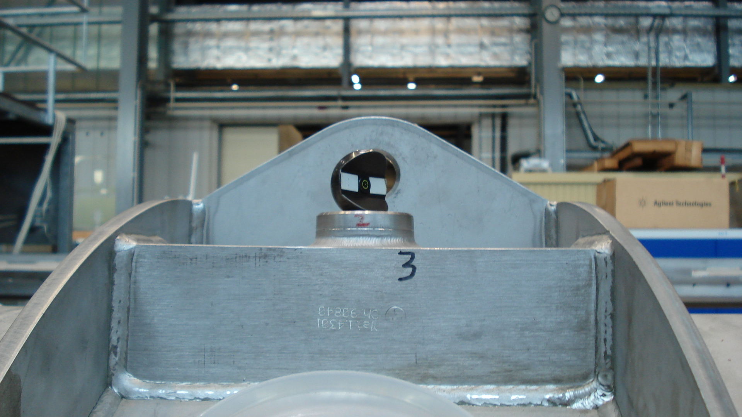
The existing measurement concept on the SIS100 Dipole
KERN E2 Theodolite with a fixed 0.5’’ SMR
Target sphere for the E2 Theodolite

Slide 6
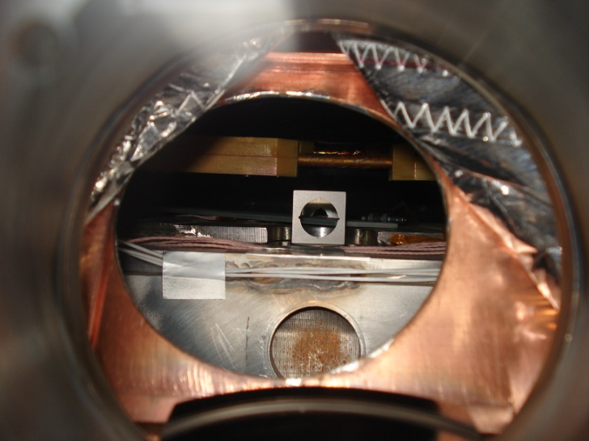
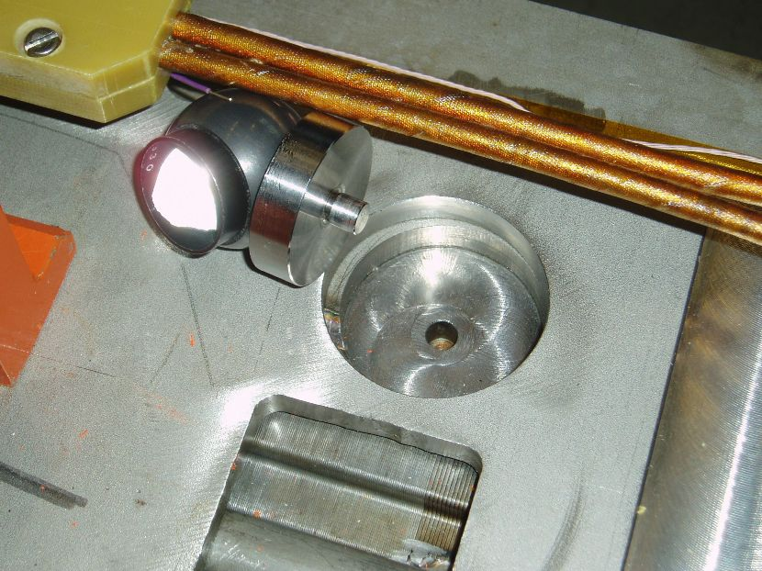
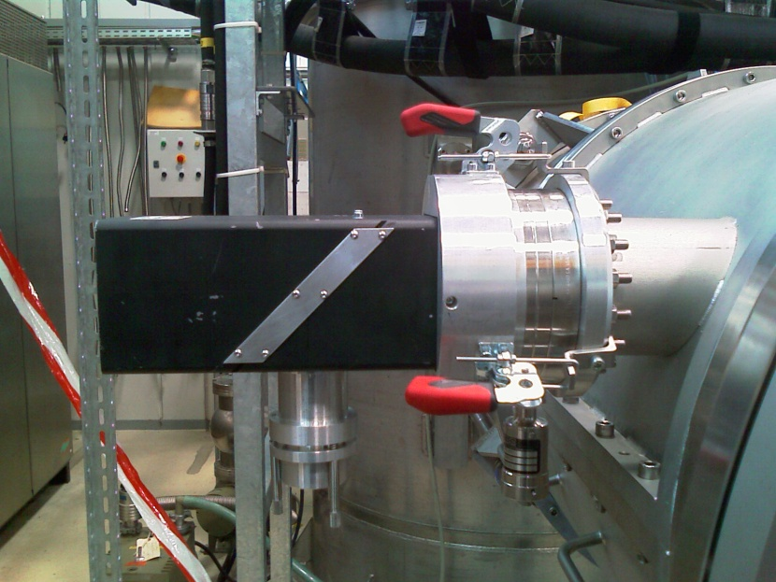
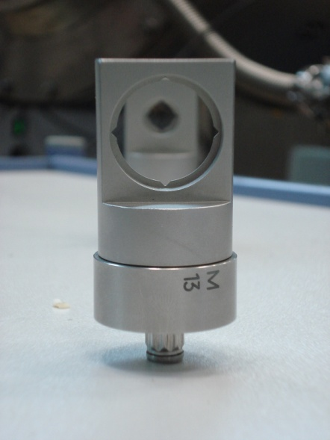
The existing measurement concept on the SIS100 Dipole
Suitable tools for lighting and sighting as well as a modified vacuum vessel and fit bores in the yoke
Fit bore in dipole yoke
View into cryostat
Lighting device at flange with glass window
Customized targets

Slide 7
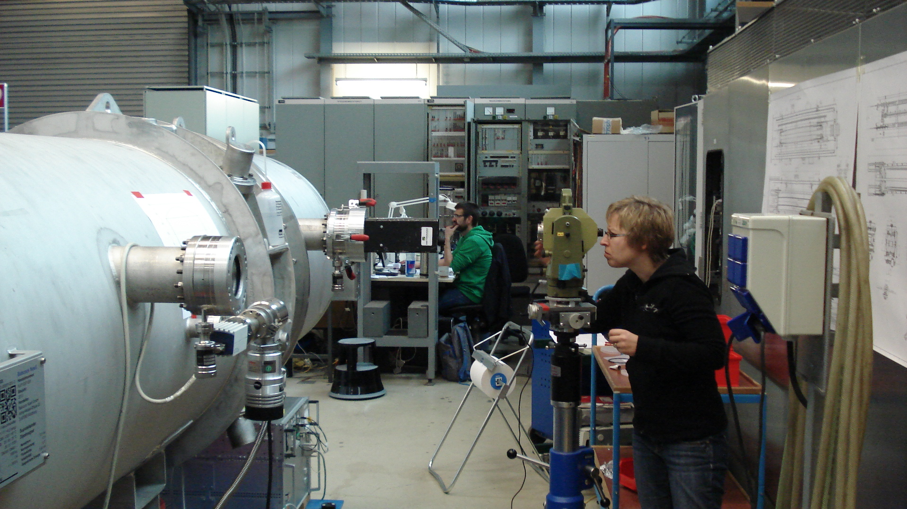
The existing measurement concept on the SIS100 Dipole
Line of sight between target on the cold mass and theodolite not less than 0.5m resp. 1.6m (depending on instrument focusing distance !)
Needed area for instrument and observer approx. 1.2m (diameter)
Defined precision of ±0.1 mm was confirmed by a large number of measurement runs

Slide 8
Needs for applying the existing concept on the S-FRS Multiplets
Different aspects of S-FRS Multiple
Liquid helium vessel
Target on the helium vessel

Slide 9
Needs for applying the existing concept on the S-FRS Multiplets
Possible conflicts between grid and line of sight of the instrument

Slide 10
Needs for applying the existing concept on the S-FRS Multiplets
Z
X
Movements and deformation of the helium vessel (cold mass) in vertical (Z) longitudinal (X) and lateral (Y) direction as well as its roll and tilt angle
Shrinking, stretching and possible sag or bulge of the cold mass
Accuracy: magnetic axis to Fiducials up to ± 0.2mm

Slide 11
Diagram examples based on the results of SIS100 dipole
Longitudinal distance between fiducials @ 297K: 2920 mm
0.41 mm
0.38 mm
0.24 mm
0.18 mm
0.03 mm
123.9 mm
4.00 mm
4.00 mm
3.66 mm
3.30 mm
2.32 mm
0.87 mm
Dipol @ 30K
@ 30K: bulge at yoke center (+0,25 mm compared to edges)
Dipol @ 115K
Dipol @ 145K
Dipol @ 195K
Dipol @ 265K
Dipol @ 297K
Schematic view of the shrinking values of the upper magnet yoke in longitudinal and vertical direction, determined at fit bores at decreasing temperatures (side view)

Slide 12
Diagram examples based on the results of SIS100 dipole
Repeatability of measured fit bores at the center in warm and cold condition
Comparison of averaged, uncorrected, measured shrinking values of the dipole half yoke at different temperatures and correspondent nominal data for vertical (Z) direction

