Slide 1

Meson Spectroscopy with COMPASS
-
Scientific Results and Future Prospects
Stephan Paul
TU München

Slide 2
Physics Goals with hadron beams
χPT related measurements with π,K, η in π(K)γ reactions
  Polarizabilities (electric, magnetic)
  Chiral anomaly
  Dynamics
Light and strange mesons:
Radiative width of excited hadrons in π(K)γ reactions
Spectroscopy in exclusive diffraction πp and Kp (iso-vectors)
Spectroscopy in pp central production (iso-scalars)

Slide 3
Process: Compton scattering
In π rest system:
  Incoming photon-field accelerates charge ➛ Bremsstrahlung
  For extended particle:
  Incoming photon-field deforms π ➛emission of dipole radiation

Slide 4
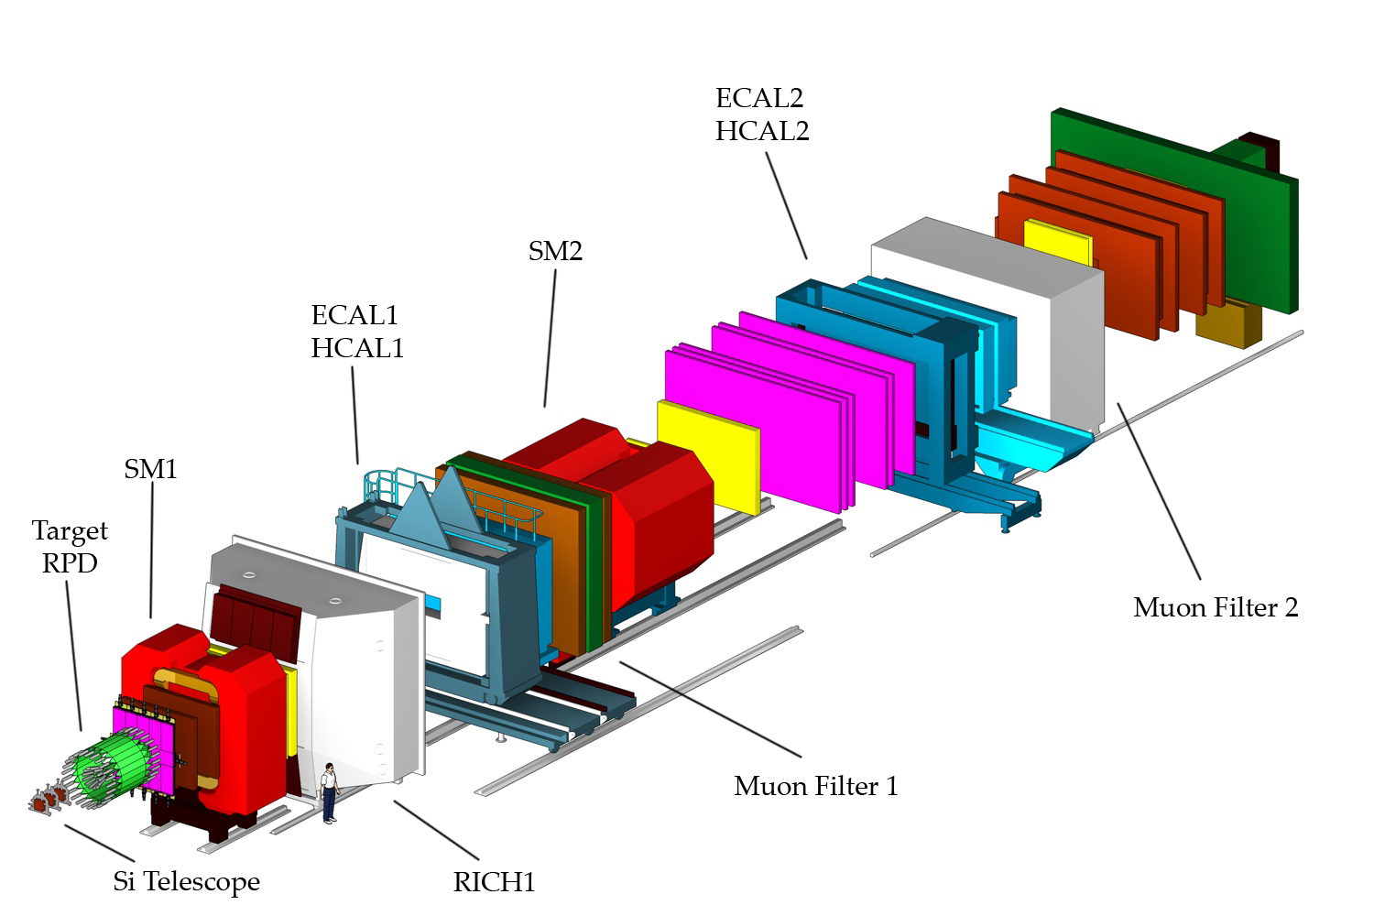
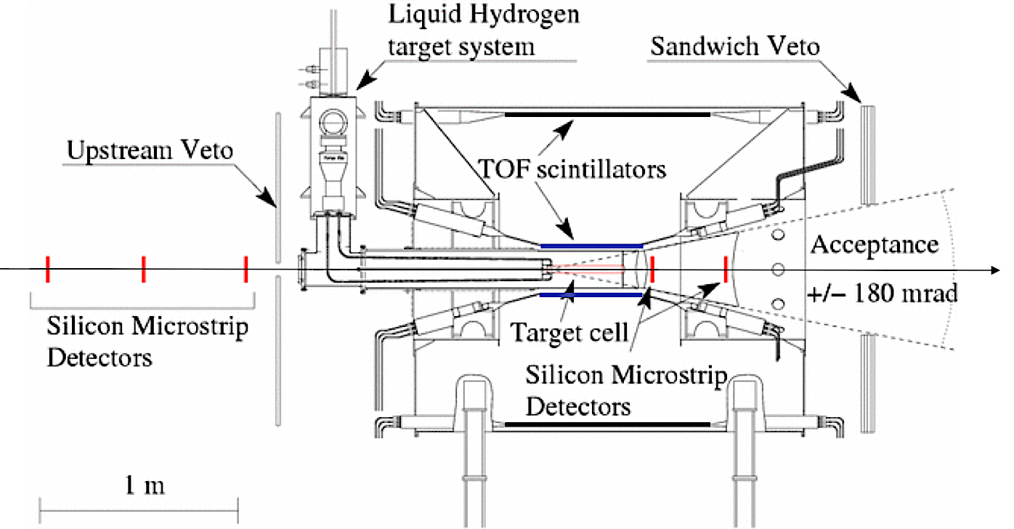
The COMPASS Experiment
CERN SPS
Hadron beam:
190 GeV/c π, K, p
5∙10⁷ particles/SPS-spill
60 days data taking 2008
Trigger: RPD hit, beam veto
50m

Slide 5
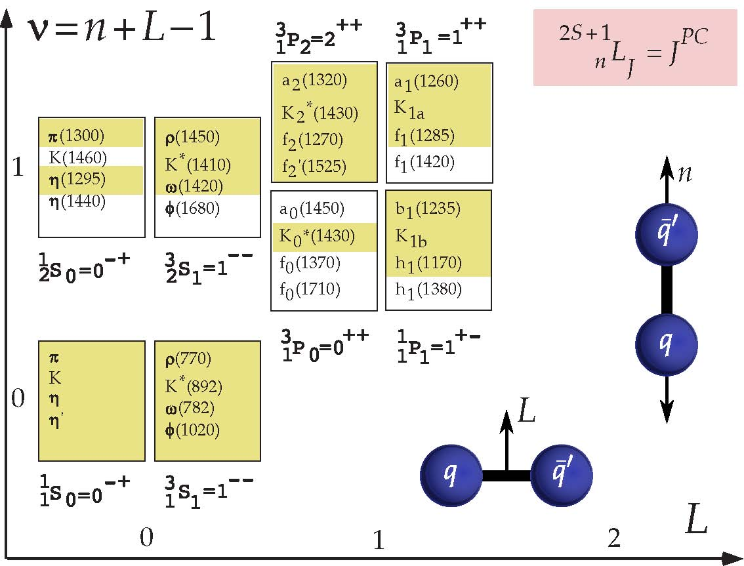
Constituent Quarks and Mesons
Spectrum of light mesons:

Slide 6
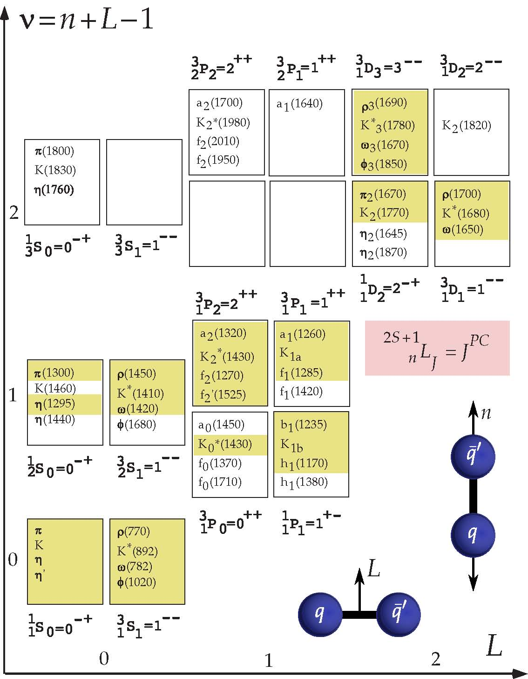
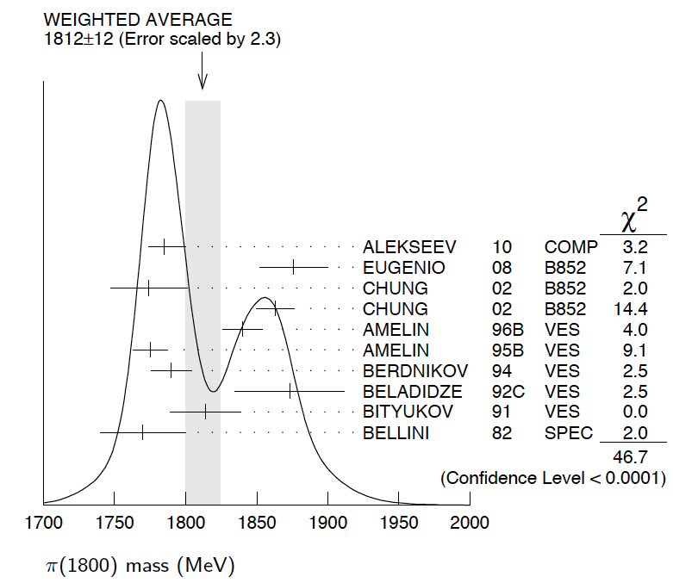

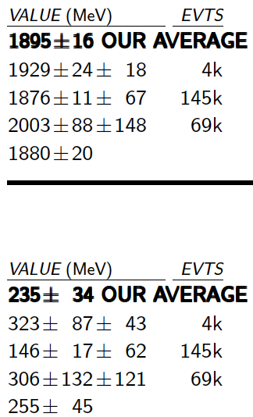

Constituent Quarks and Mesons
a₄(2040)
2
Limits for light mesons
many missing/disputed
states in mass region
m ~ 2 GeV/c²
Identification of heavy
states difficult
  broad states
  large number
  overlap + mixing
π₂(1880)
2
f₀(500)
f₀(980)
f₀(1500)

Slide 7
Constituent Quarks and Mesons
a₄(2040)
2
Limits for light mesons
many missing/disputed
states in mass region
m ~ 2 GeV/c²
Identification of heavy
states difficult
  broad states
  large number
  overlap + mixing
π₂(1880)
2
f₀(500)
f₀(980)
f₀(1500)

Slide 8
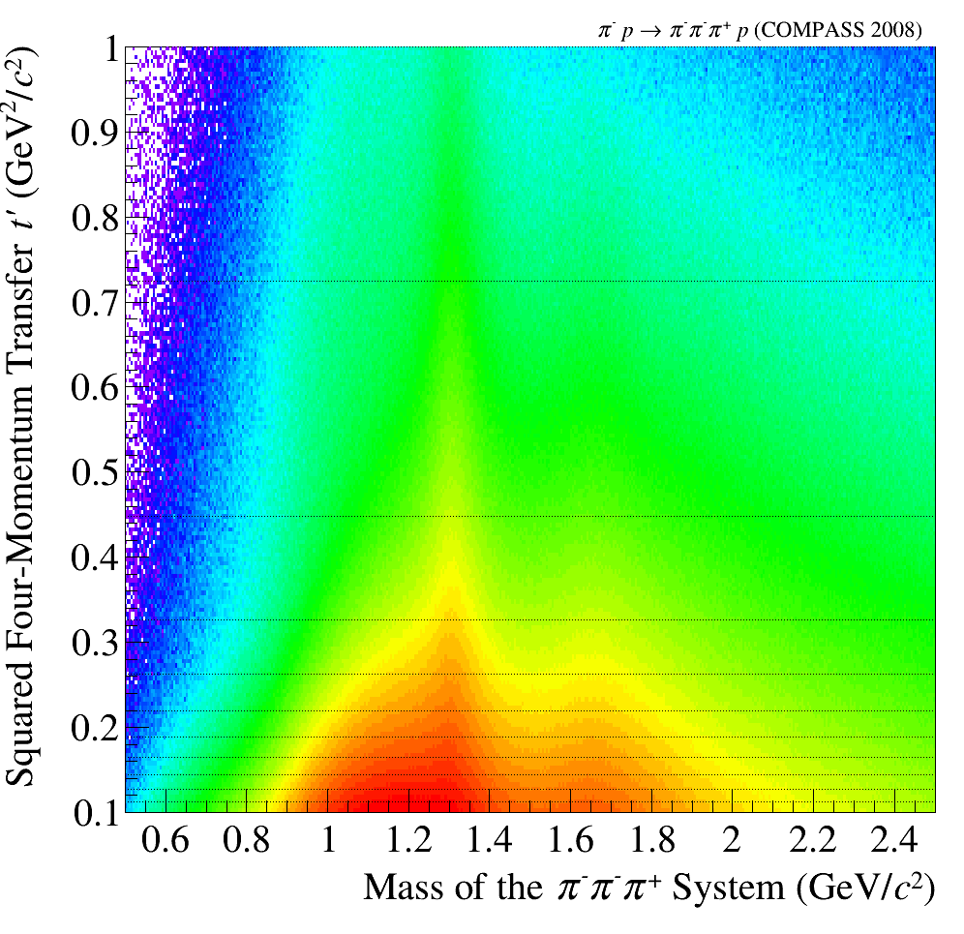
Kinematics
grid of t’ used
Δm: 20 MeV/c²

Slide 9
Kinematics and Isobars
isobar model
low t’
high t’
0.8< m_{3π}<0.85
1.6 < m_{3π}<1.65
grid of t’ used
Δm: 20 MeV/c²

Slide 10
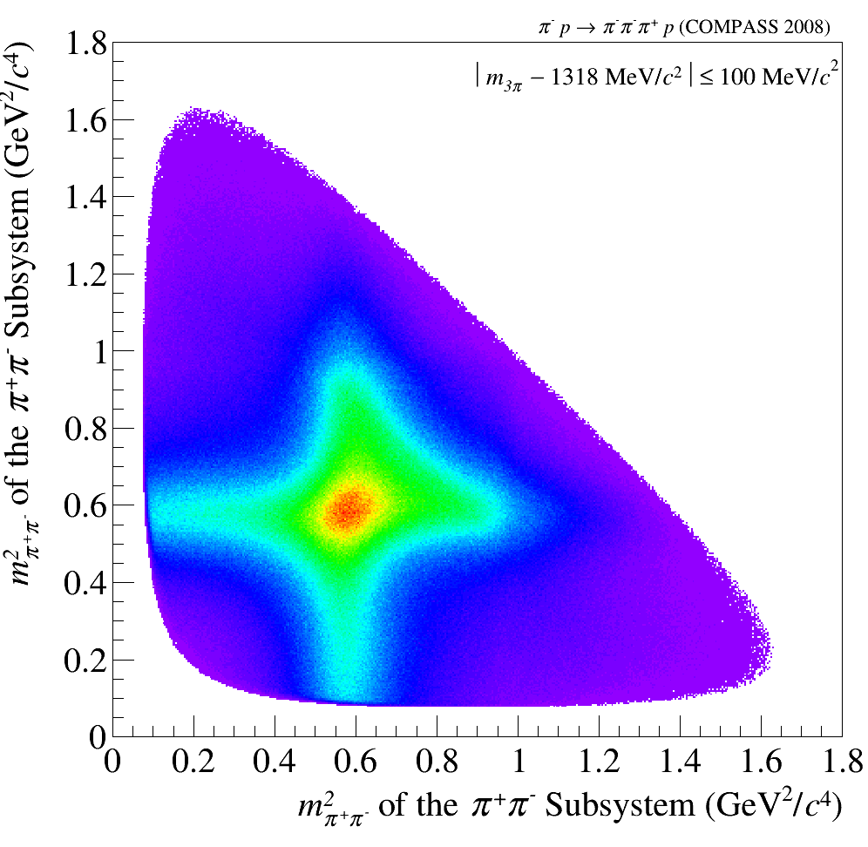
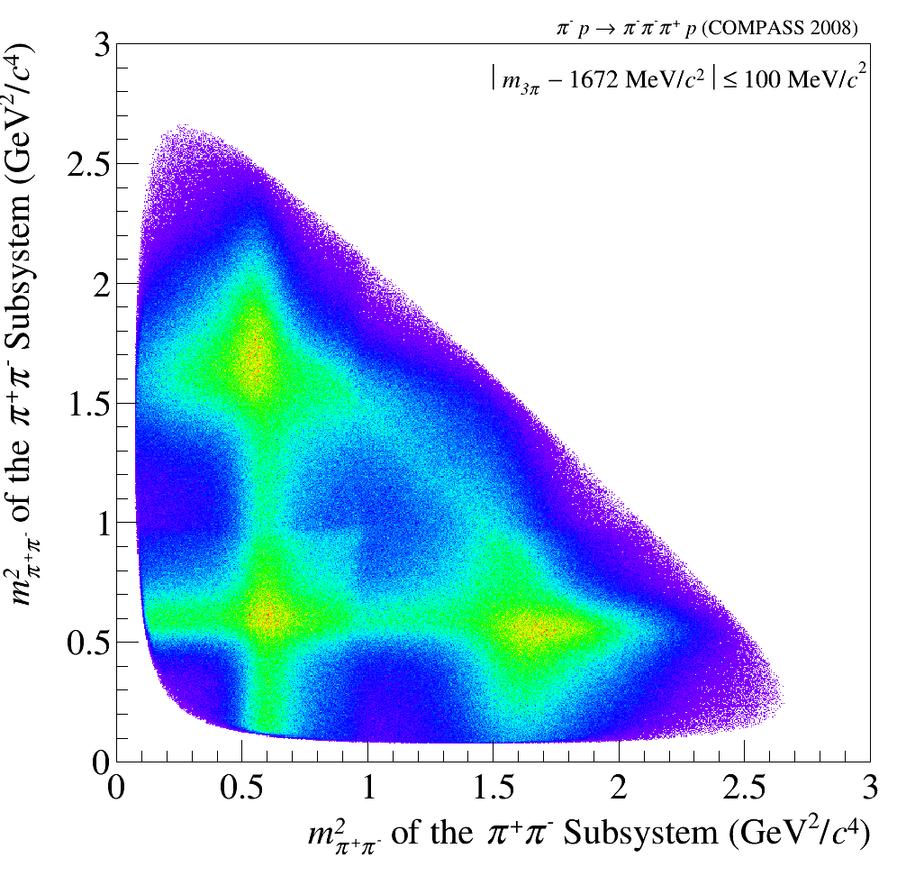
First Impressions
Motivation for Isobar Model
m²_{2π}
m²_{2π}
Preliminary
Preliminary
Preliminary
f_{f}(1270)
ρ
ρ
m²_{2π}
m²_{2π}
t’_{3π}
used in analysis
isobar model
isobar
Preliminary

Slide 11
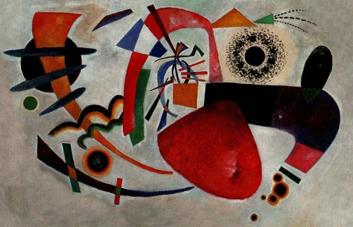
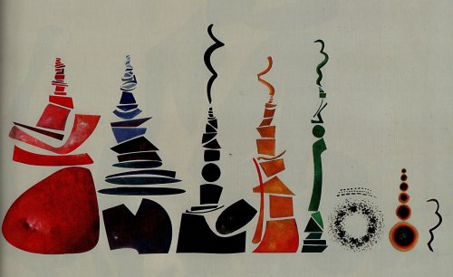
Partial wave analysis
inspired by M. Pennington
raw data
after PWA
πf₂
πf₀
Flat wave
(ππ)_{S} π
ρ(770)π
Art taken from Urs Wehrli: “Kunst aufgeräumt”

Slide 12
Partial wave analysis
What is ourPWA ?
Describe population in 5-dimensional phase space in πππ by model
Define a set of quantum numbers J^{PC}
Define a set of possible decay channels for each J^{PC}
(X⁻ → isobar + π; isobar→ππ ) : wave (88 waves used)
  each such “wave” has a pre-determined population in phase space
  each wave may have alignment of J described by quantum number M
For each bin of 20 MeV/c² mass of πππ: determine which coherent combination of waves fits distribution best
Obtain spin-density matrix (Dalitz-plot for every bin in m_{3π} and t’)
Describe spin density matrix (submatrix) by model containing resonances and non-resonant contributions connecting all mass bins
Determine resonance parameters
step 1
step 2

Slide 13
t dependence of mass distributions
low t
high t
1⁺⁺0⁺ρπ S
2⁺⁺1⁺ ρπ D
2⁻⁺0⁺ f₂ π S
4⁺⁺1⁺ ρπ G

Slide 14
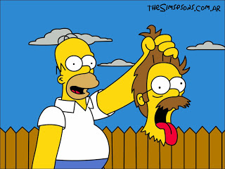
More exotic families
f₀(980)

Slide 15
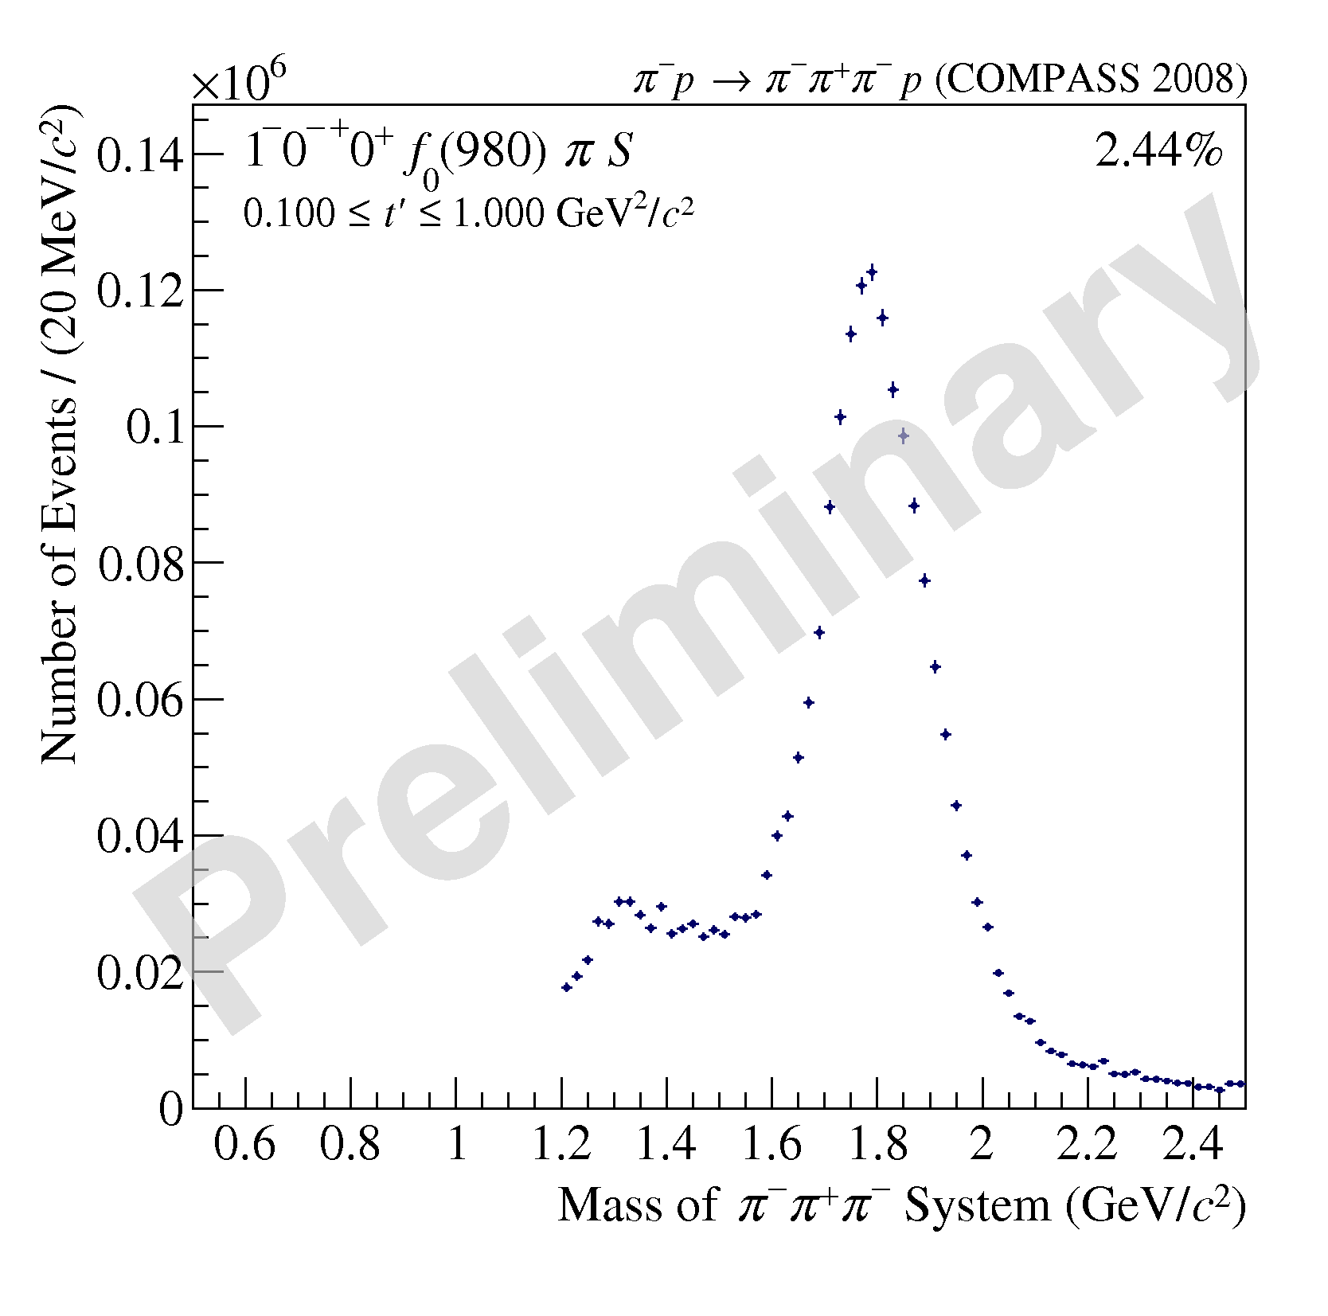
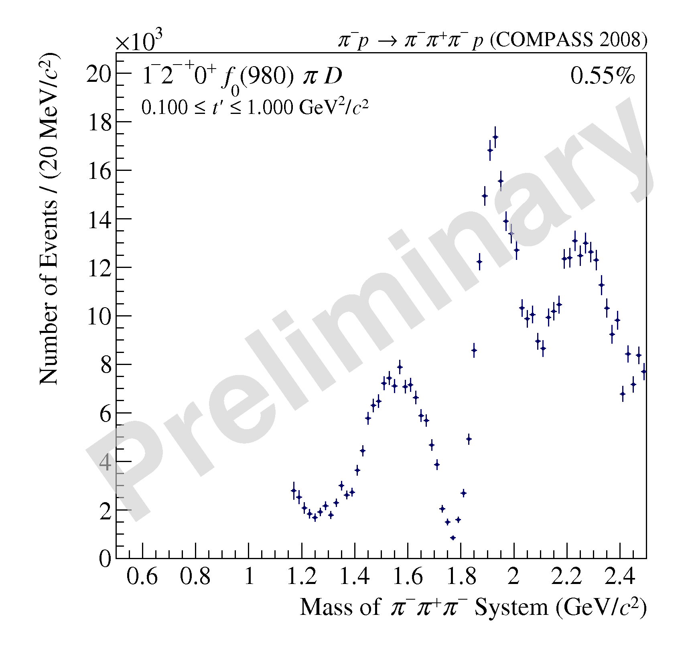
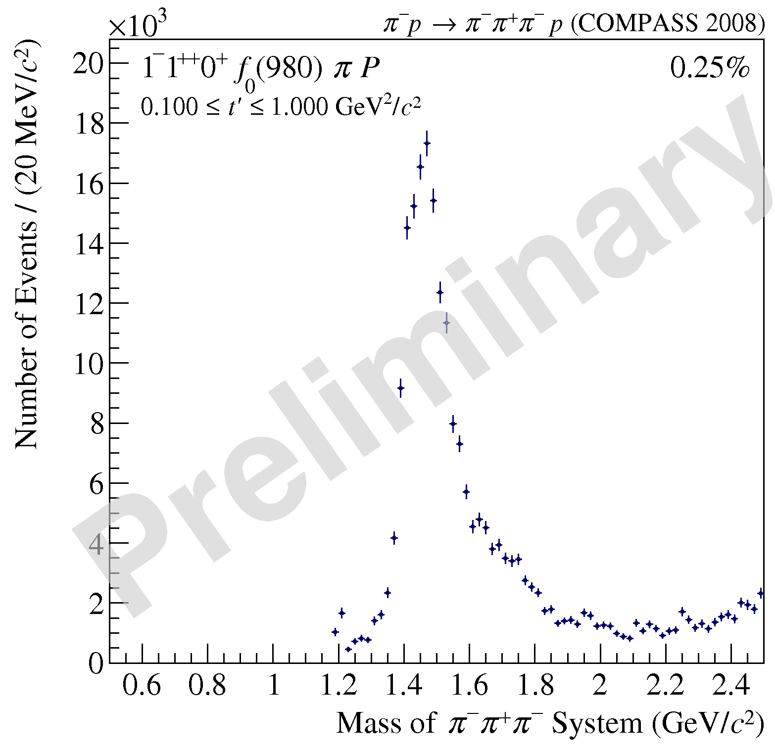
Waves involving f₀(980)
Waves involving [ππ]_{S}
1⁺⁺0⁺ f₀(980) π P
0⁻⁺0⁺ f₀(980) π S
2⁻⁺0⁺ f₀(980) π D
π⁻π⁺π⁻ and π⁻π⁰π⁰
experts only
1⁺⁺0⁺[ππ]_{S} π P
0⁻⁺0⁺[ππ]_{S} π S
2⁻⁺0⁺[ππ]_{S} π D

Slide 16

Model for Spin Density Matrix
Describe the results obtained independently in different mass bins by a model
select physics contributions
fit to spin density matrix (not only to simple mass spectra)
Resonance
Deck
π⁻
π⁺
π⁺
π⁺
π⁻
π⁻
π⁻
p
n
p
ρ, σ
π⁻
ρ, σ
𝑋
𝒫
𝒫
p
π⁻
p
π⁻
p
Two types of contributions

Slide 17

New Observation: a₁(1420)
Observation:
Decay only : [f₀(980)] π P
Mass : 1413 ± 15± 13 MeV/c²
Width: 157 ± 8 ± 23 MeV/c²

Slide 18
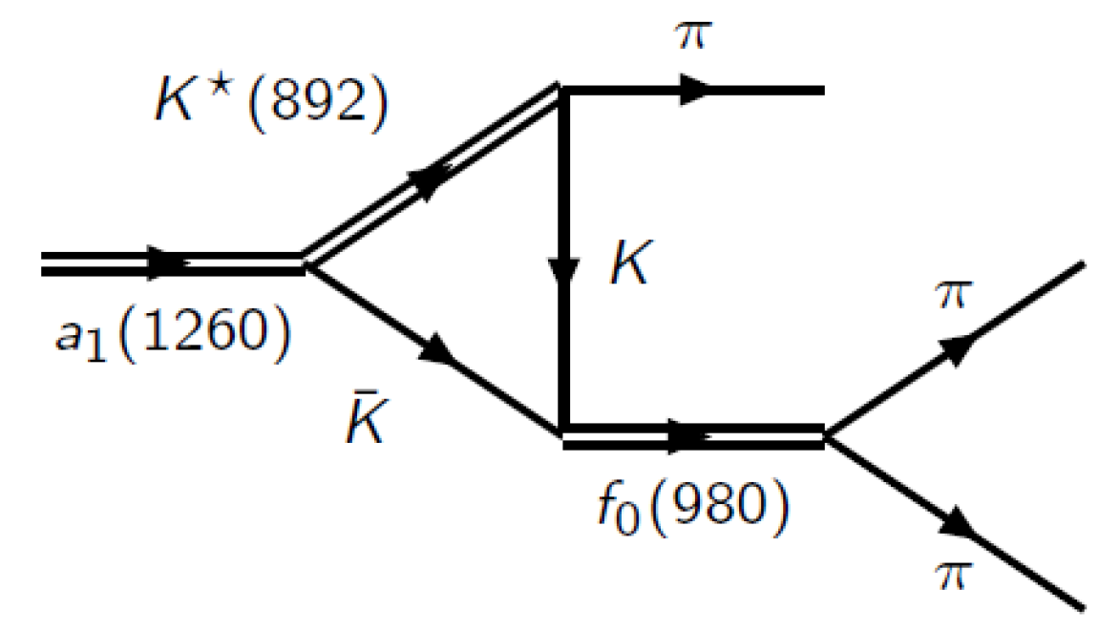
a₁(1420) and Production
Various explanations proposed for interpretation:
  Dynamics
    Interference of a₁(1260) with Deck amplitude (Δφ = 180⁰ shifted by 100 MeV)
    triangular anomaly coupling a₁(1260) → KK* → KKπ and KK⟷f₀(980) (Δφ = 90⁰) Requires same t´ dependence for a₁(1260) and a₁(1420)
  Molecular structure
    Partner of f₁(1420)
At present: slope difference Δb is 2 units
Uncertainty in extraction of resonance in 1⁺⁺ ρπ S-wave gives uncertainty for b_{a1(1260)}

Slide 19
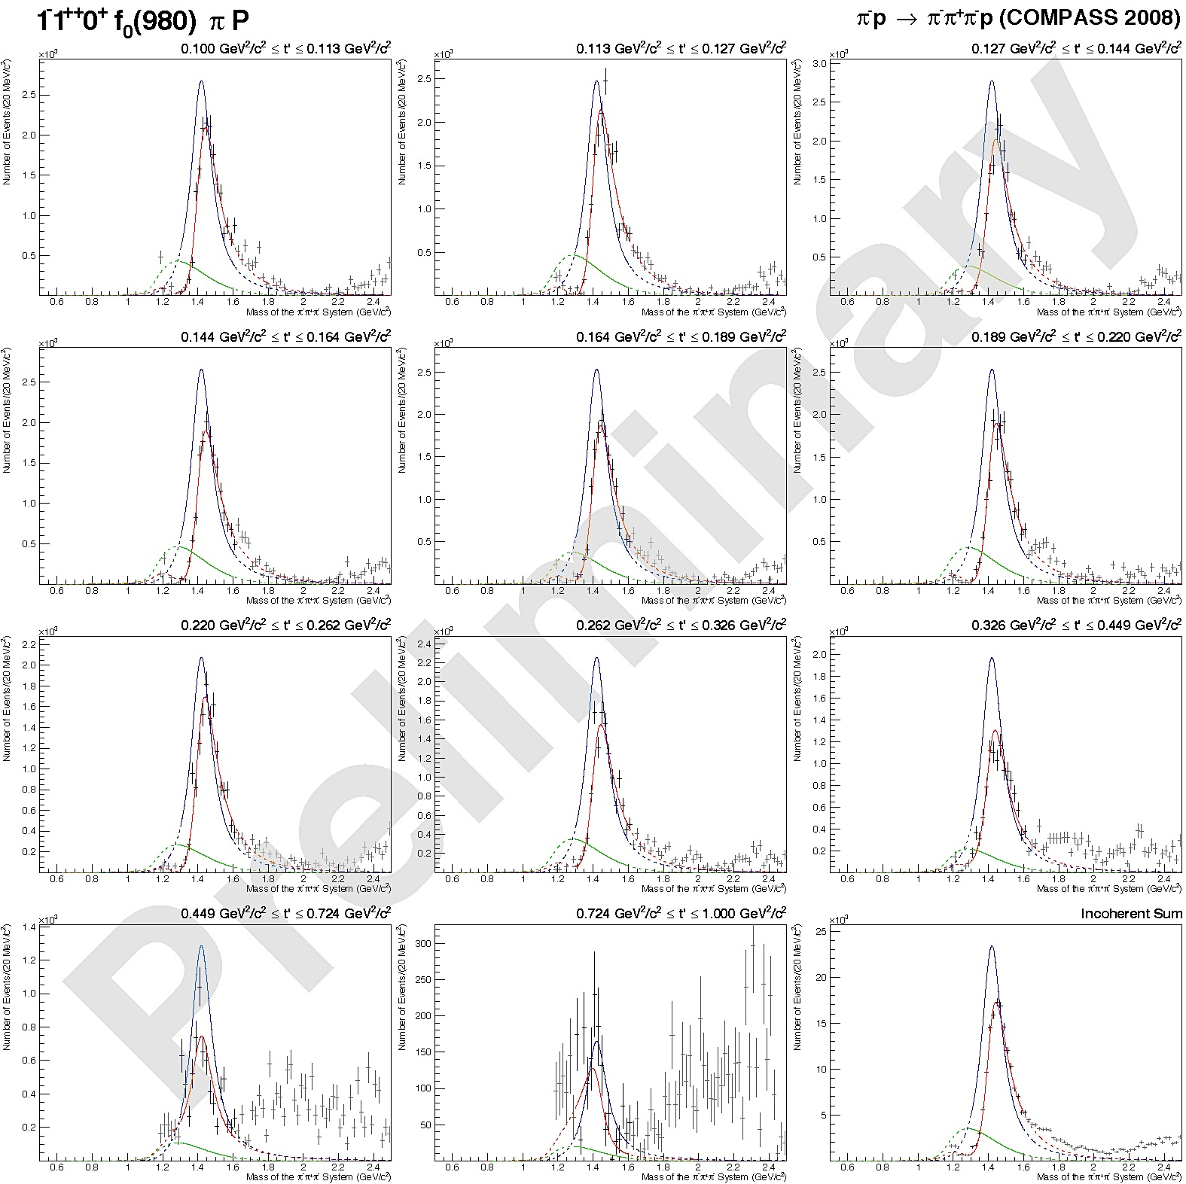

Mass dependent fits a₁(1420)
t
Fit in 11 t-bins
t
NEW
sum

Slide 20
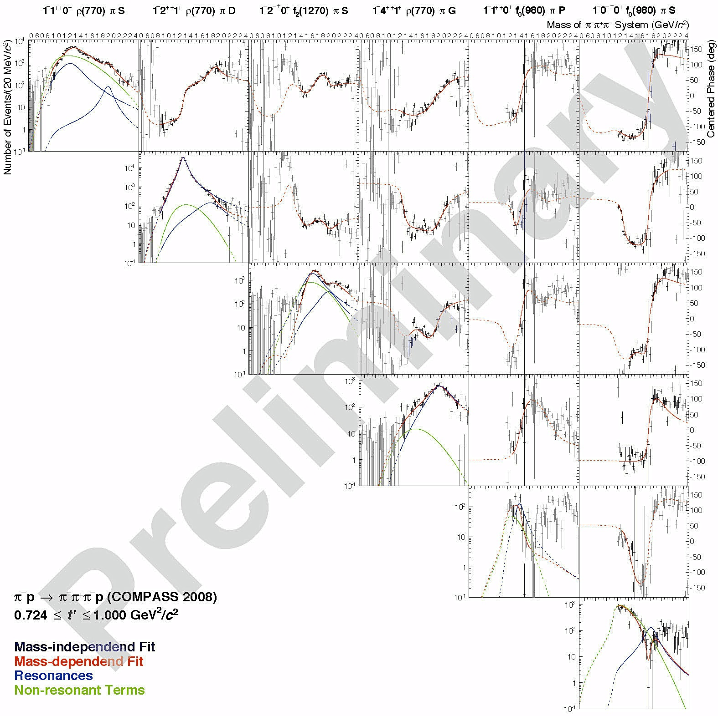
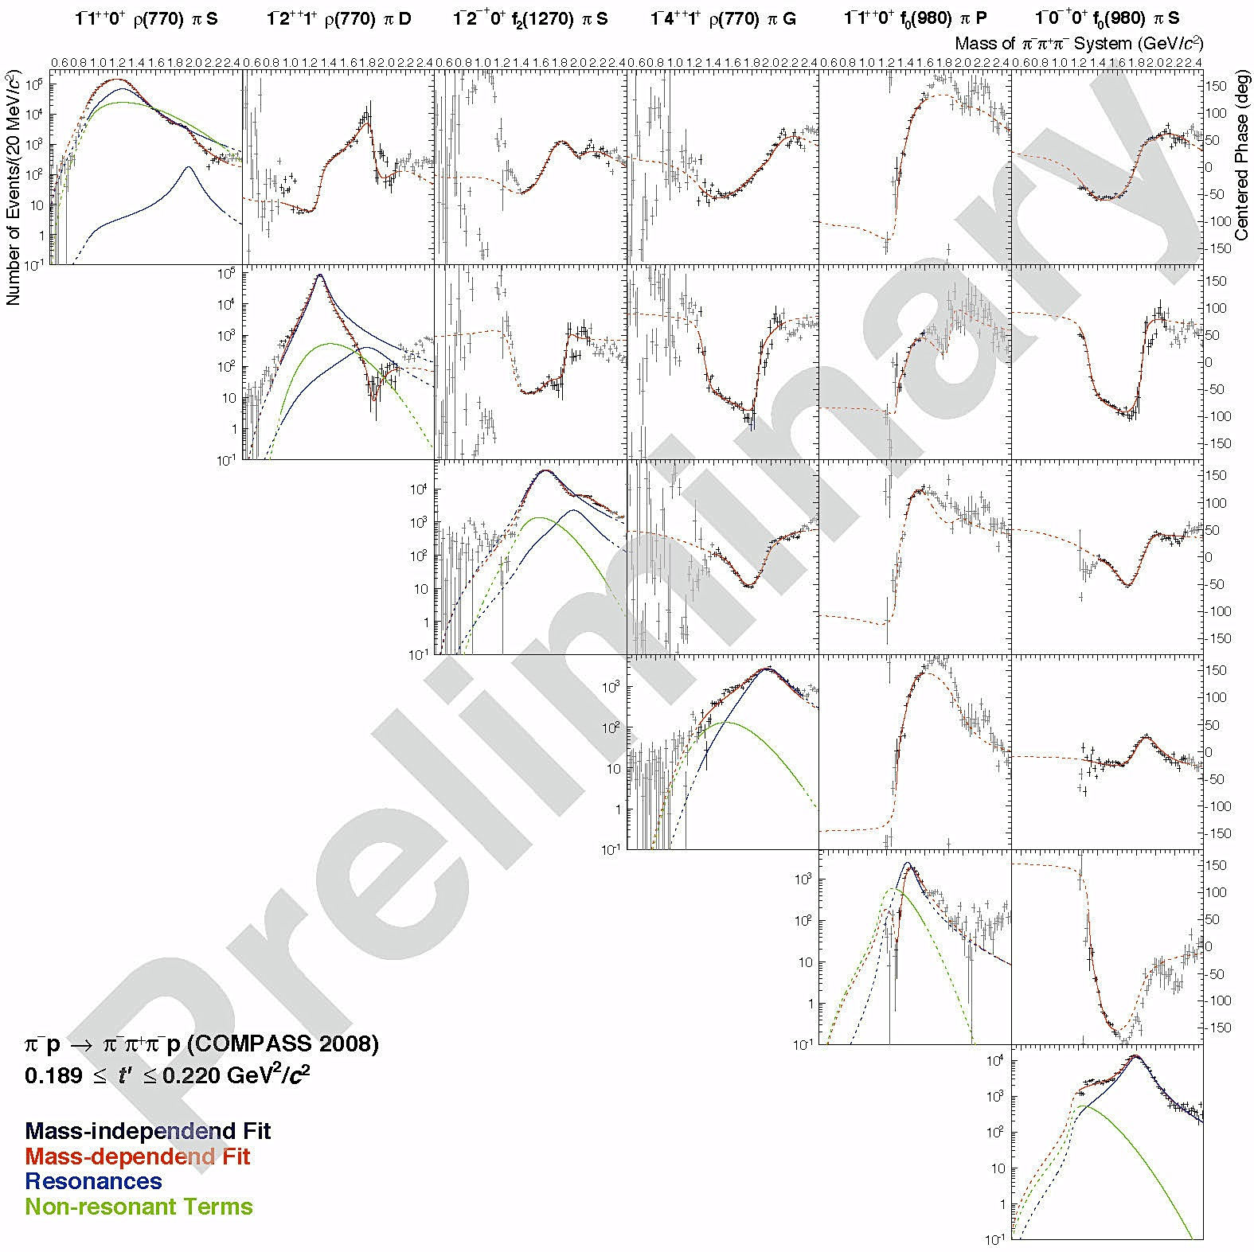
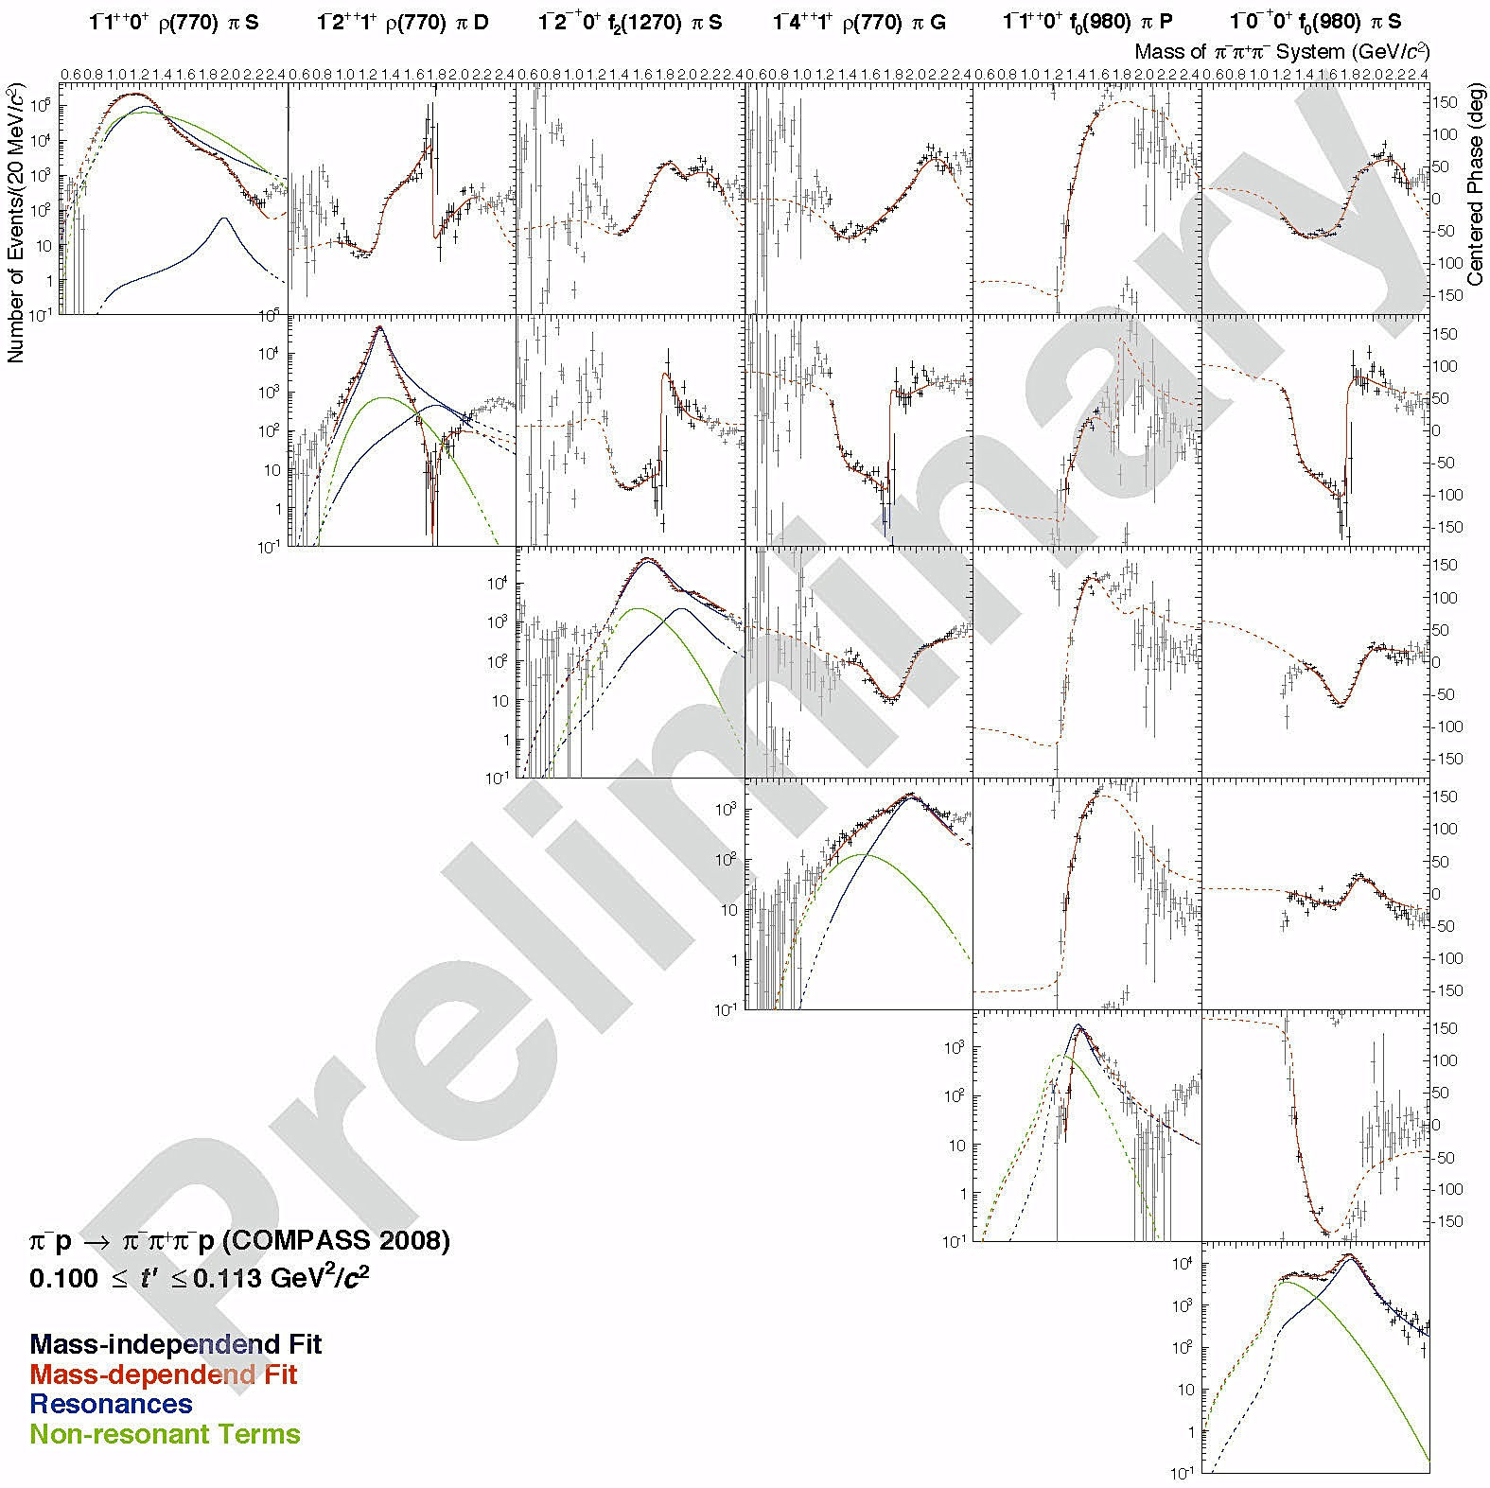
COMPASS “Holography”
Reference
waves
Interferometry
simultaneous fit in 11 t-bins
t
t

Slide 21
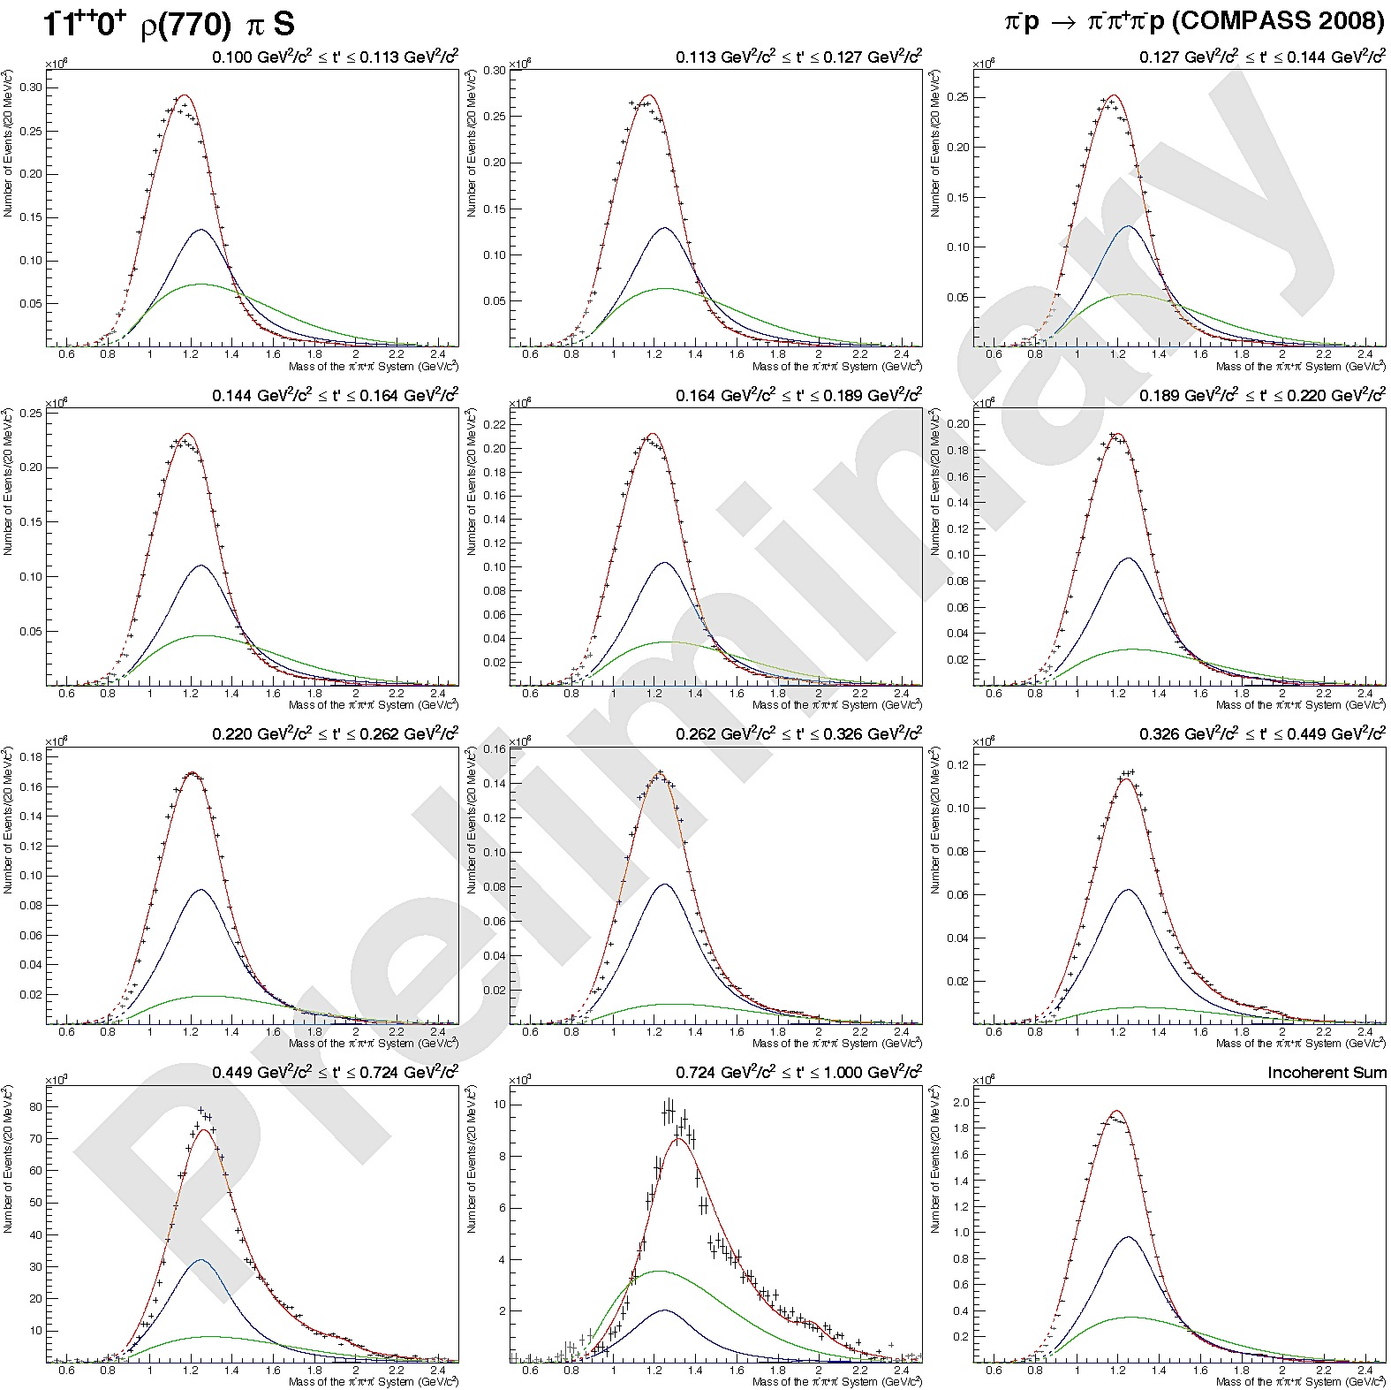

Mass dependent fits
Fit in 11 t-bins
t
Strongly t-dependent
spectral shape around
a₁(1260)
J^{PC}M^{ε}[isobar]πL
t
sum

Slide 22
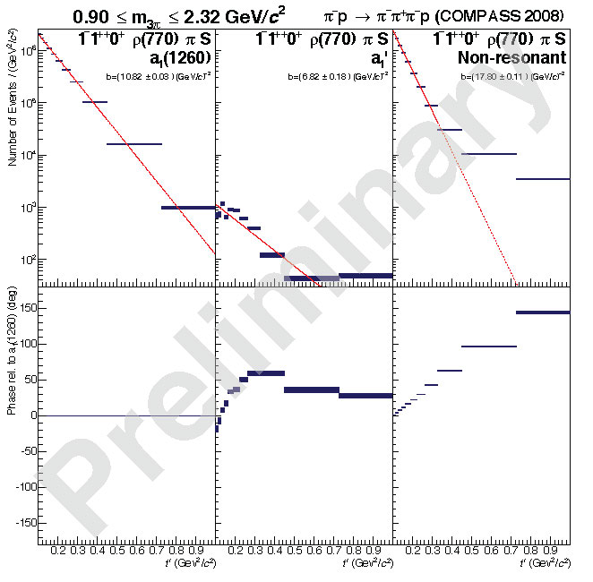
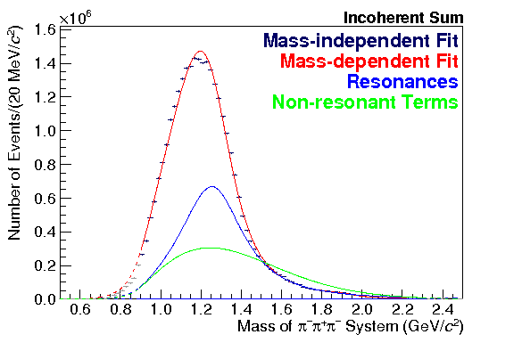
Example for t-dependence
πππ COMPASS 2008
a₁(1260)
non-resonant
Intensities
Phases
Reference wave
t
J^{PC}M^{ε}[isobar]πL

Slide 23
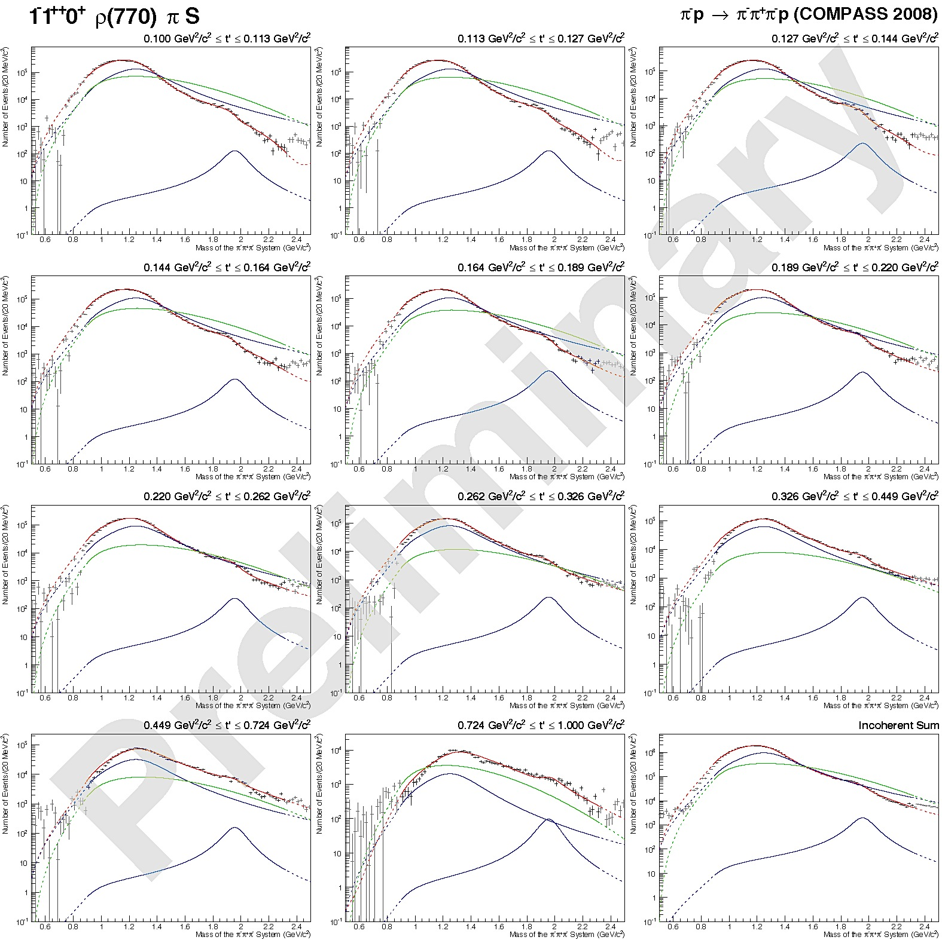
Mass dependent fits
Fit in 11 t-bins
t
Second high-mass a₁’ resonance visible
t
sum

Slide 24
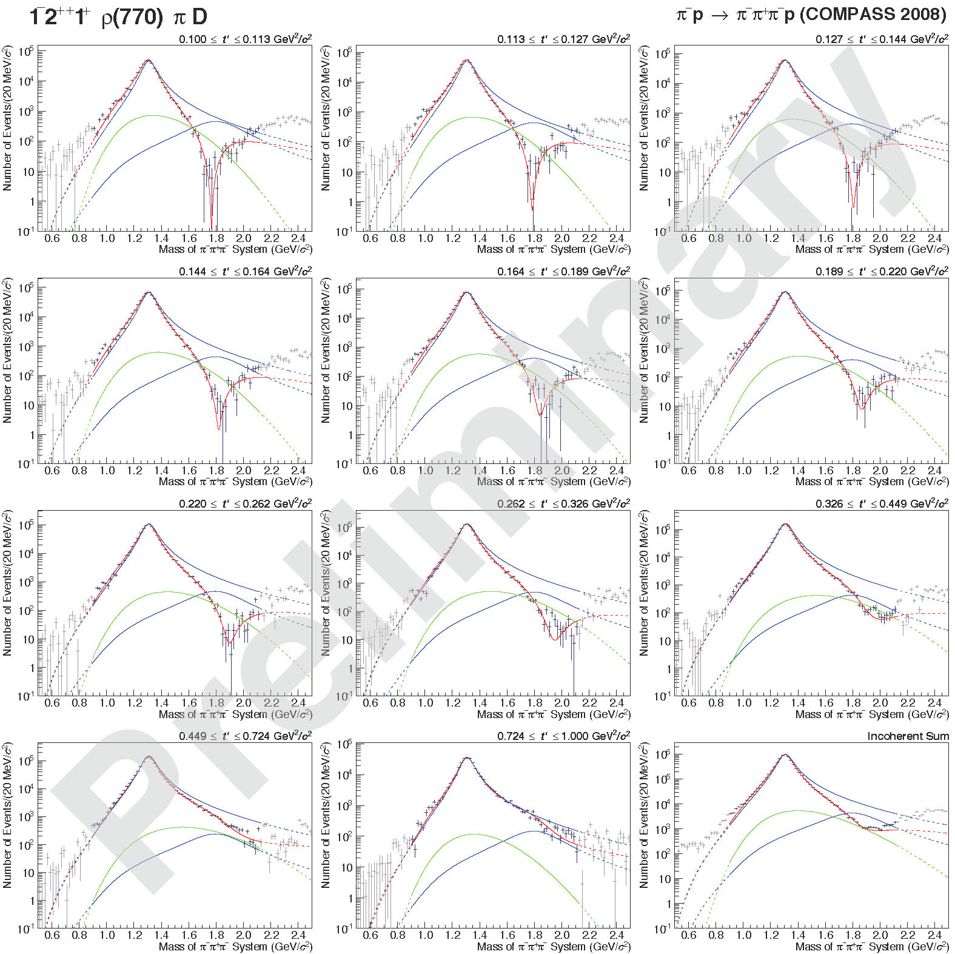
Mass dependent fits a₂(1320)
t
Strongly t-dependent
interference effects
high-mass a₂’
t
sum
a₂(1320)
a₂’

Slide 25



What about the building blocks
We have solved a puzzle – but were the building blocks correct ?
σ
ρ
Deck
σ
σ
Deck
?
ρ
ρ
Deck
f₀
f₂

Slide 26
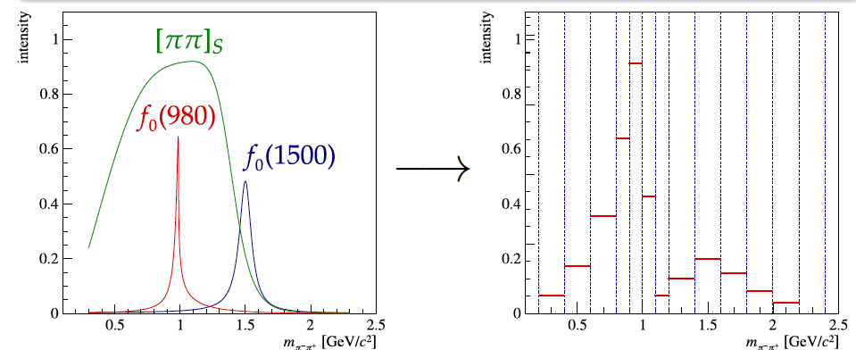
New Paths to Meson Decays
FSI
π⁻
π⁺
Deck
Resonances
π⁻
π⁻
π⁺
π⁺
π⁻
π⁻
ρ, σ
p
p
p
ρ, ρ₃ , f₀ , f₂
ρ, σ
π⁻
ρ, ρ₃ ,
f₀ , f₂
𝒫
𝒫
𝒫
π⁻
π⁻
p
π⁻
p
p
p
Select J^{PC} via PWA
For each J^{PC} and mass-bin in 3π :
  determine composition and shapes of 2π isobars
  complex couplings
  non-resonant contributions (via t-dependence)

Slide 27
Correlation:m_{2π}(0⁺⁺) vs m_{3π}(J^{PC})
3π: 0⁻⁺
3π: 2⁻⁺
3π: 1⁺⁺
low t
Tomography of the strong interaction
3π: 0⁻⁺
3π: 2⁻⁺
3π: 1⁺⁺
high t

Slide 28
Studying the Structure of Decays
Argand Diagram
(ππ)_{S-wave}
COMPASS
BaBar
(ππ)_{S-wave} Similar for weak and strong decays !!
Subtle differences will tell us more

Slide 29

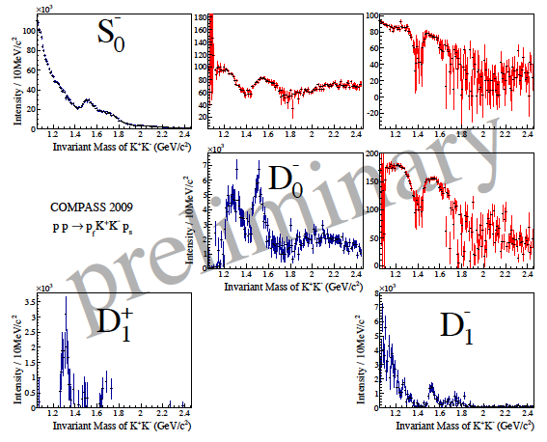
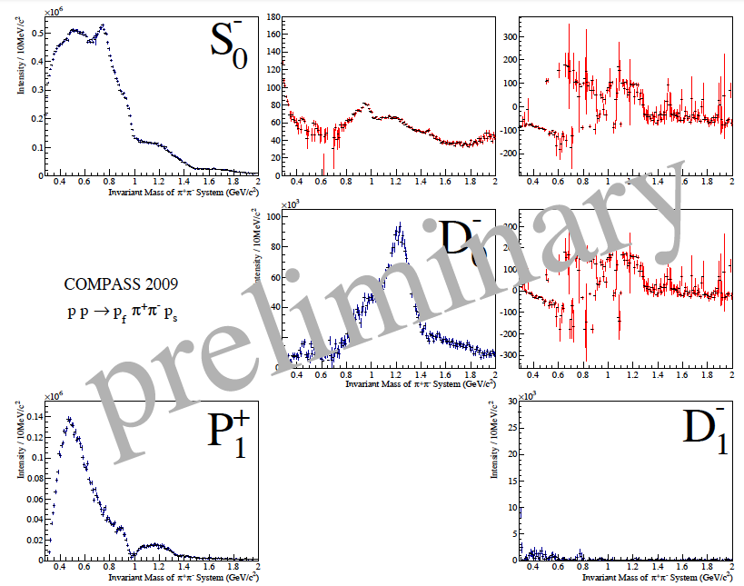
(hh)⁰ S-wave
π⁺π⁻
K⁻ K⁺
central production
central production

Slide 30
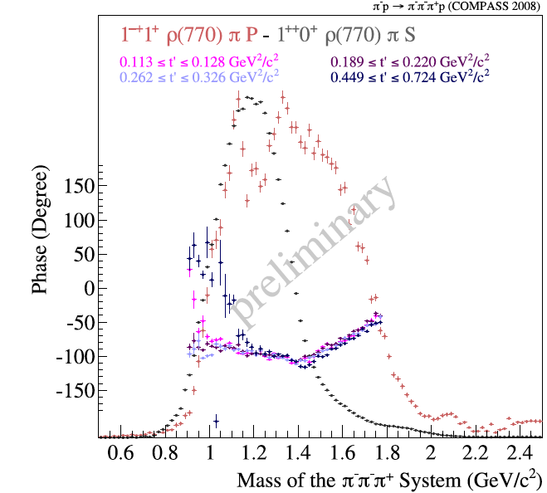
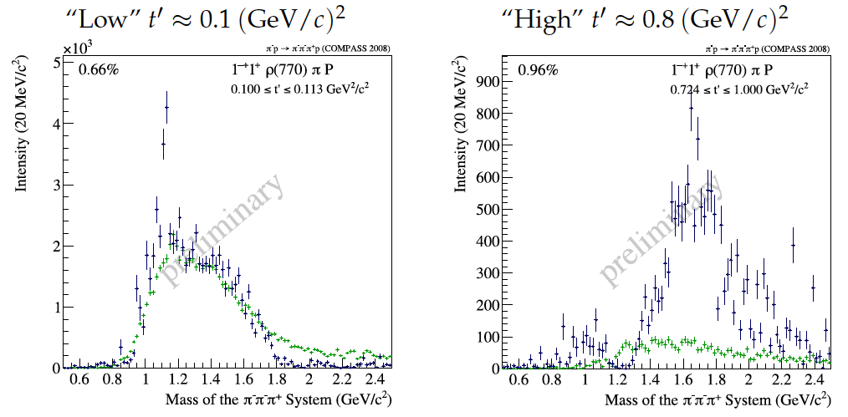
Exotic 1⁻⁺
Deck - simulated
Deck - simulated

Slide 31
And what about non-resonant backgrounds ?
Non-resonant contribution modeled in final fit (Deck)
Use analytic amplitude in first step
Example:
Extreme preliminary
0⁻⁺⁻
1⁺⁺⁻
4⁺⁺
6⁻⁺⁻
new: non-resonant partly taken out by Deck amplitude

Slide 32
What‘s next soon ?
Development of news tools to perform isobar-freed PWA simultaneously for many isobaric J^{PC}
Replace fit-function (BW+bckgrd) by polynomials and poles
  locking of pole parameters/branchings to be developed
Investigation of J^{PC} = 2⁻⁺ sector using 10 different waves
  Different isobars
  Different spin projections m
  VERY informative…. π₂(1670), π₂(1880), π₂(19xx), π₂(2xxx)… identify „objects“?
Include Deck modeling in PWA
True multibody final states (used 2000 waves in 5π)
  4 and 5-body decays e.g. f₁(1285) π, a₂(1320) ρ(770), a₂(1320) ρ₃(1690) and compare to η3π

Slide 33
Conclusion - Pion
First precise measurement of π polarizability
  Pion much stiffer than atom (strong interaction)
  Excellent agreement with theory (χPT)
  Future: separate magnetic and electric polarizabilities
New path to radiative meson excitations

Slide 34
Conclusion
  Establish new “2D” fit method to perform PWA in m_{3π} and t
Find new iso-vector state a₁(1420)
  M_{a1(1420)} = 1412-1422 MeV/c² , Γ_{a1(1420)} = 130-150 MeV/c²
  (exclusive) decay into f₀(980)π in relative P-wave
  Nature of a₁(1420) ?
  Isospin partner of f₁(1420) (considered to be exotic) ?
  Dynamically generated through a₁(1260) ⟷ KK* ⟷ f₀ (980)π channel ?
  Interference of a₁(1260) with non resonant amplitudes ?
Light component of the XYZ puzzle ?

Slide 35
Conclusion II
Developed new method to establish shape of isobar-spectrum
  first application: [ππ]_{S}*:
    Shows strong dependence on m_{3π} and on J^{PC} of mother wave
  Reveals information on scalar isobars (measure phases in decays)
  Open Path to Dalitz-plot analysis using PWA
  from PWA identified states
  Needs high statistics !!

Slide 36
Conclusion III
Study of a₁(1260)
  Observe “various components” of a₁(1260) with different t-dependencies:
Sort out higher excitations of a₁ , a₂ (broad states)
Radial excitation of π
  π(1800) well known: COMPASS observes decay into f₀(980)π and f₀(1500)
Orbital excitation of π
  π₂ (1670) well known: COMPASS observes decay into f₂(1270) π
  no evidence so far for strong coupling into [ππ]_{S}*π
  π₂ (1880) : Clear signal observed in f₂ π and f₀ π …. but
Radiative decays:
  First observation of a mesonic E2 transition : π₂(1670) → π γ
  Good / reasonable agreement with calculations

Slide 37
Hadron Physics and FAIR

Slide 38
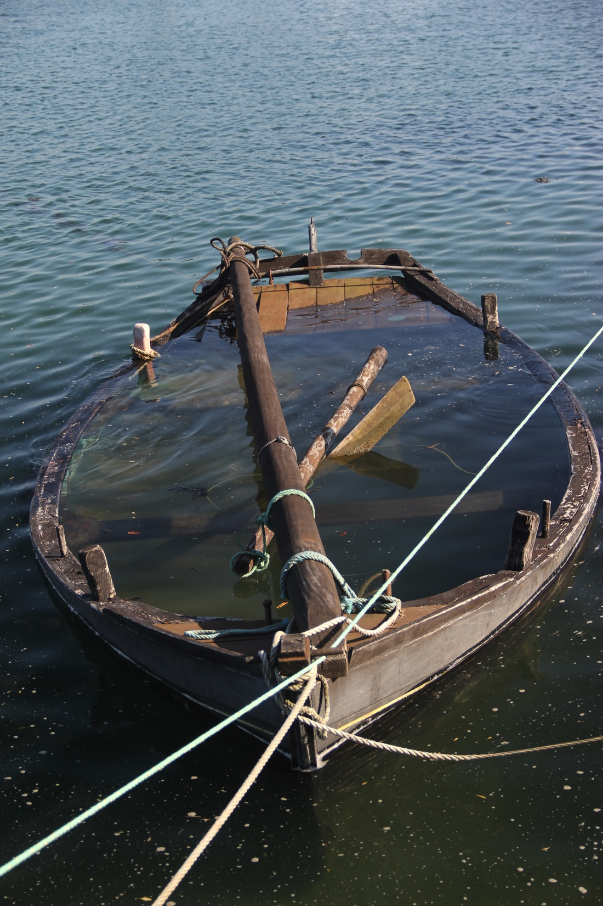
Past

Slide 39
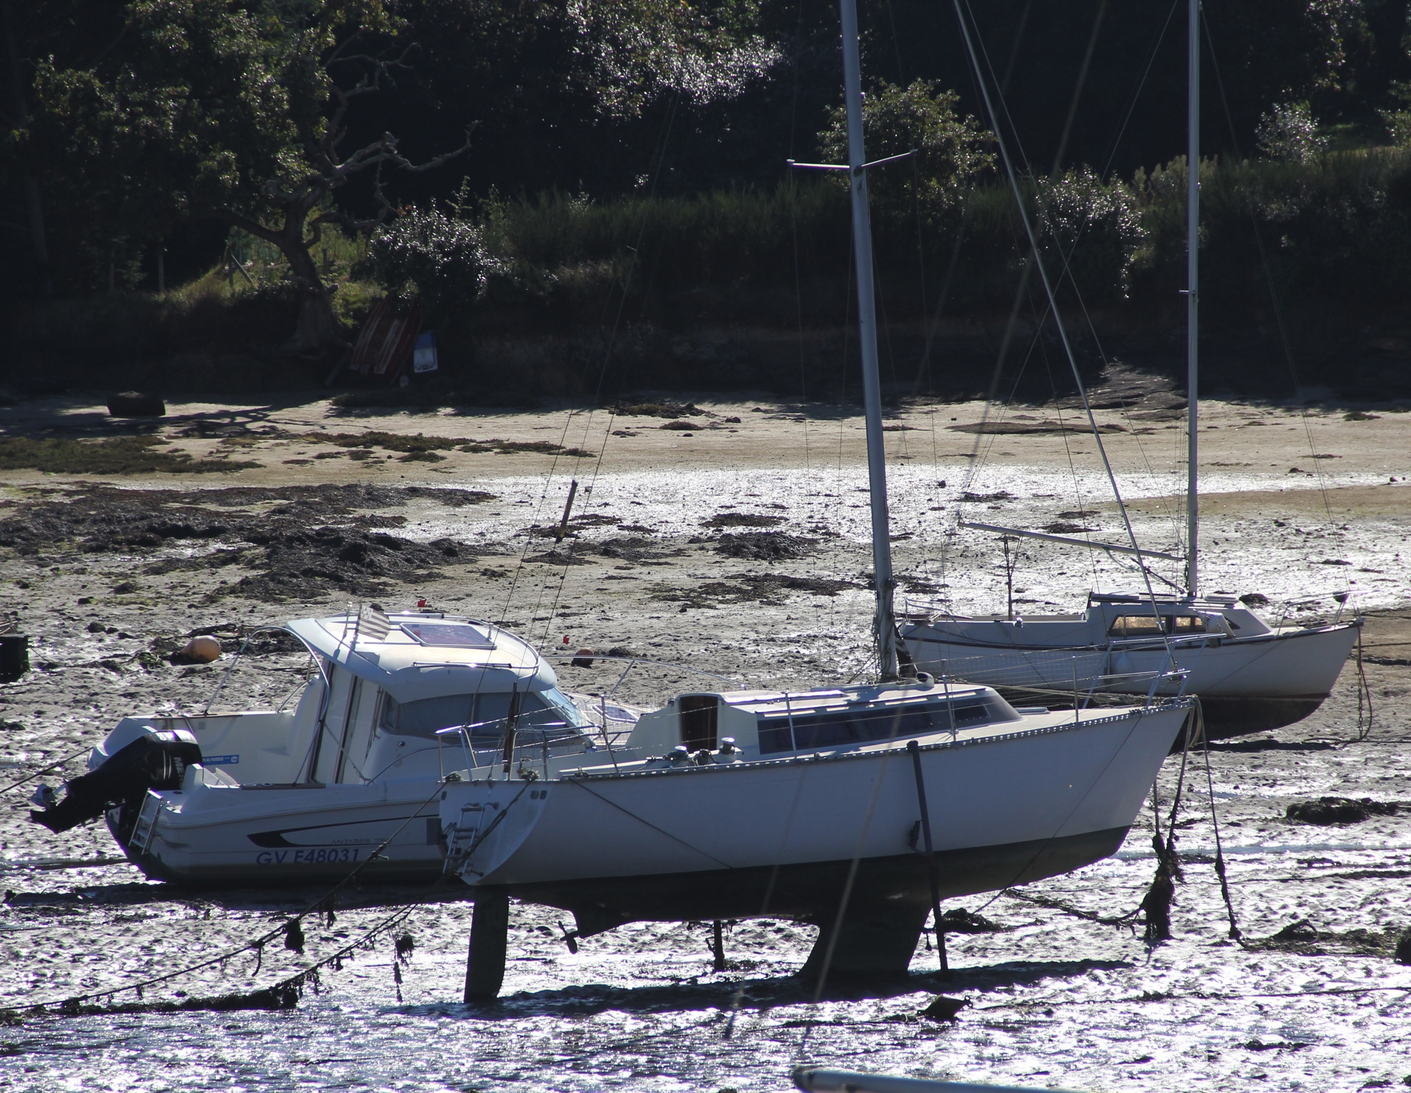
NOW

Slide 40
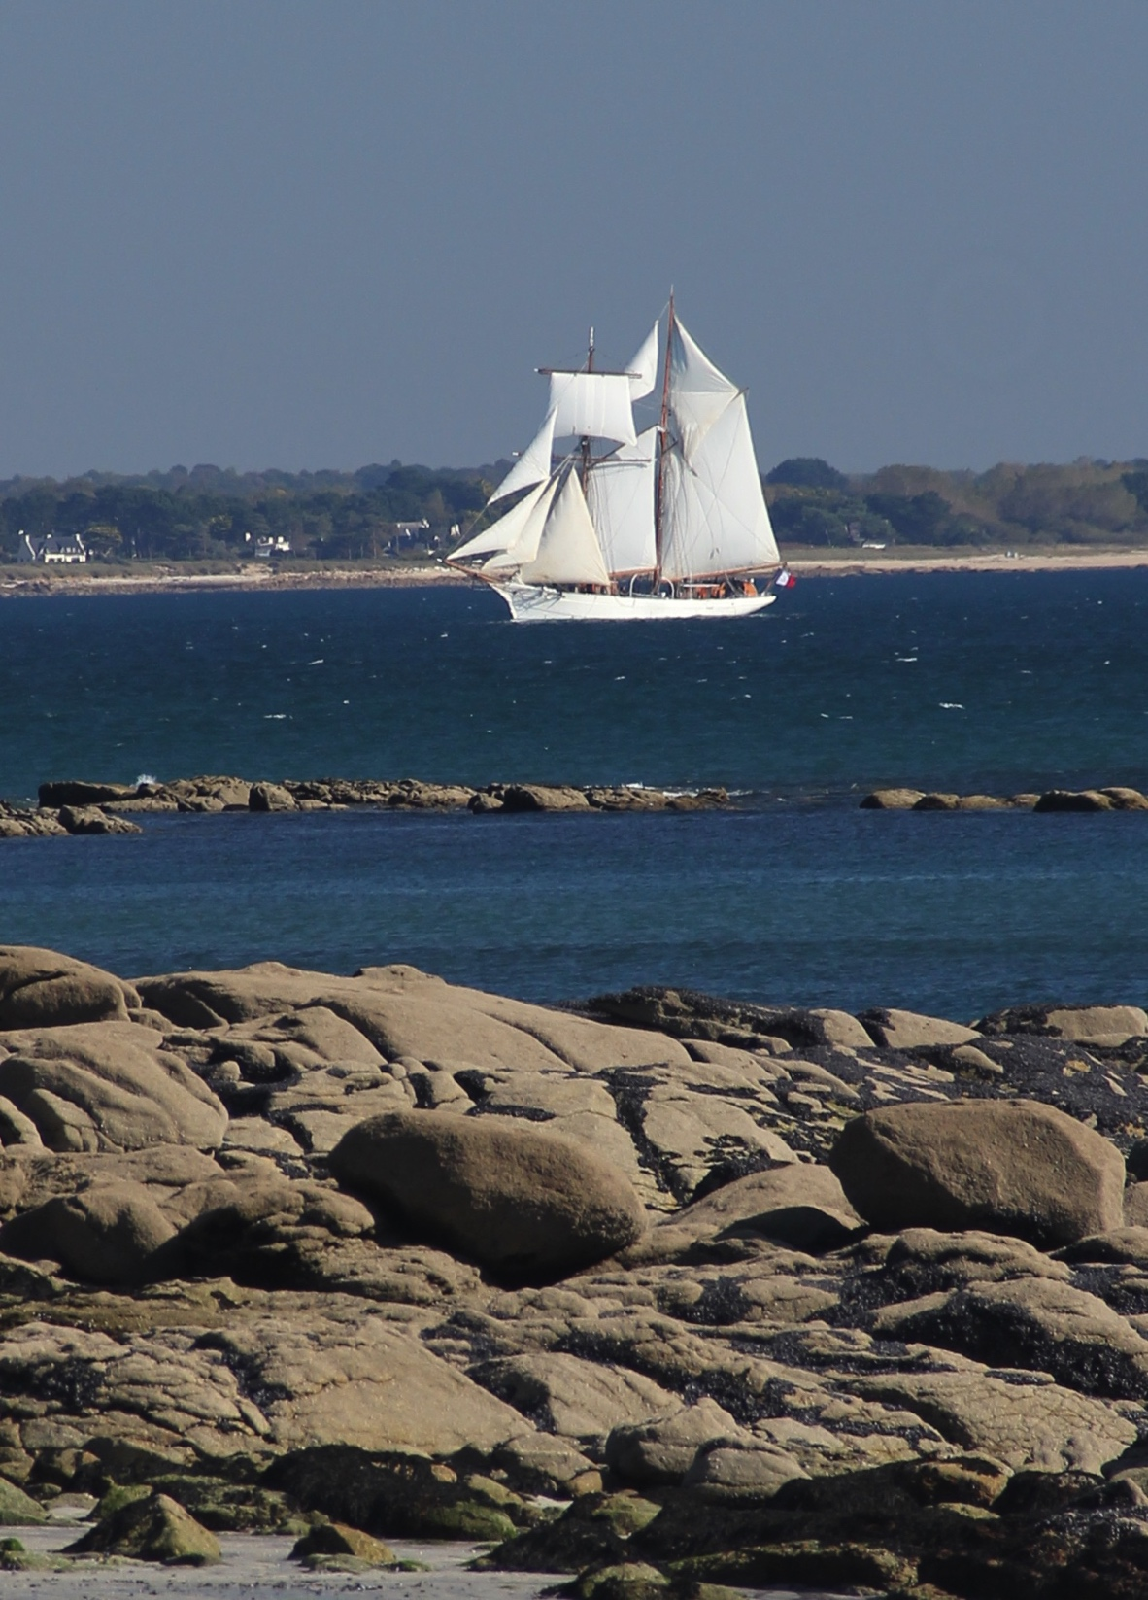
Future ?

Slide 41
Advantages of COMPASS
Large data sets (good acceptance, also for neutrals and many body)
Kaon beam allows access to strange sector (2% of π beam)
Spin alignment m and helicity reconstruction of X
Non-resonant waves as interferometer
Target mass A and kinematics (t‘ ) are variable
  Target-mass dependence varies m-production ratios and Deck-amplitudes
Supplementary information on specific states (poles)
  If caused by triangular diagrams involving „ground state“ it must follow production characteristics of ground state (m and t‘ dependence)
  If caused by interference with non-resonant components – relate to the proper production characteristics
Quasi-real in exclusive πZ-reaction
Quasi-real/virtual photo-production in exclusive μp-reaction (vary Q²)
Tools available to disentangle multi-body final states

Slide 42
Weaknesses of COMPASS
High-mass spectrum of light and strange mesons (m > 2.5-3 GeV/c²)
  Interesting for high spin waves
  States become very broad (phase information spread of wide mass range)
  Non-resonant production of high spin waves large (see 6⁻⁺ wave)
  No way to switch off Deck-like phenomena (target particle is always present)
  COMPASS energy too small for high mass central production
No cross section for hadronic charm production
Too few scientists in analysis !!

