Slide 1
Miscellaneous about Target Spectrometer PANDA Mechanics Meeting, September 2015 J. Lühning, GSI
Space around Barrel
Target Platform
Cable Routing and Cable Ducts on Downstream Side
Forward Endcap Mounting
Platform for Mounting Detectors from Upstream Side
3D-PDF files available here:
http://web-docs.gsi.de/~luehning/t/PP/

Slide 2
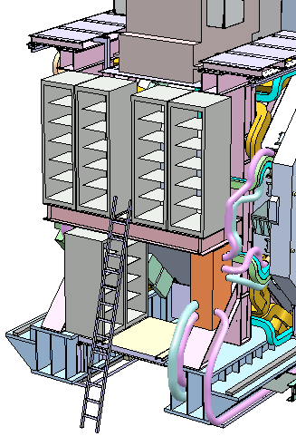
Space around Barrel
Space below barrel: target dump and supply festoon (cable chain)
Space on eastern and western side of barrel: available height ~4.6 m, sufficient for 1 storey of 42U-racks and 1 storey of 47U-racks
Space on top of barrel: target, pumping station, cryo-box, and maybe some racks.
4.6 m
space at 45° parts of barrel octagon reserved for muon crates

Slide 3
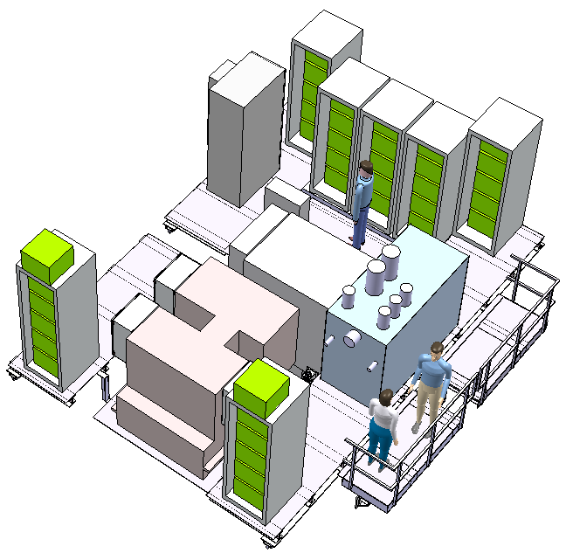
Target Platform
floor height above beam 2.8 m
available height limited by cave aperture
(5.1 m above beam)
target
cryo-box
gangway, fixed to upstream door
pumping station

Slide 4
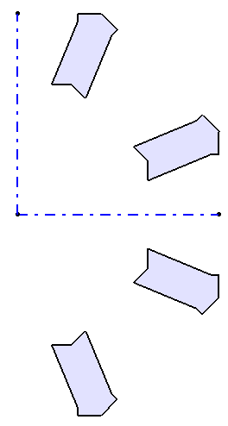
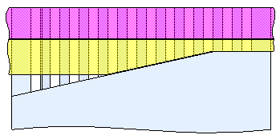
Cable Routing and Cable Ducts on Downstream Side
The width of each cable duct is 42 cm. If designed as proposed in the Muon TDR the depth increases from 14 cm to 28 cm (going outwards), so the “bottleneck” cross section of each duct is 42×14 cm².
Muon counters require 423 cm² in each duct, thereof 37% (158 cm²) in the “bottleneck” cross section?
NNE
ENE
muon supplies
The most critical space is in duct “ENE”. There the FE-EMC needs 477 cm². Expressing this value in duct depth (divided by duct width 42 cm) this is 11.4 cm.
This does probably not fit (if the depth needed by muon supplies in the bottleneck is 158 cm² / 42 cm = 3.8 cm)
ESE
SSE
denotation of cable duct positions
bottleneck depth 14 cm

Slide 5
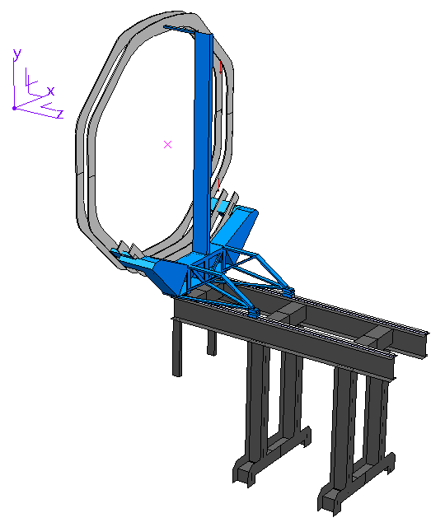
Forward endcap mounting
connection of FE-EMC to trolley ?
7.2 tons, c-o-g at z= 215 cm ?
trolley can be moved downstream by 1.6 m, strength was calculated with FEM
end of stage at 5.3 m, distance to Fw-Tr-5 when rolled out of cave is 0.8 m

Slide 6
Forward endcap mounting
The trolley rests on 4 rollers.
The z-coordinate of the centre-of-gravity of the FE-EMC is not between the 4 rollers, so two of the rollers have to bear a big pressure while the other two experience a moderate tension.
7.2 tons
3.1 tons
10.3 tons

Slide 7
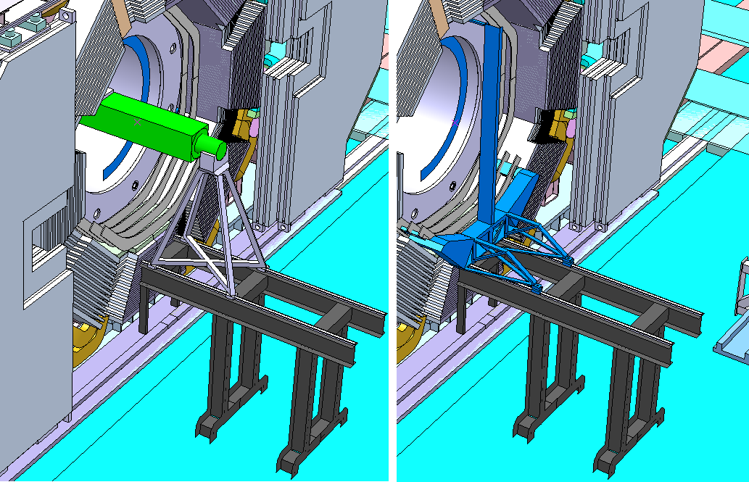
Forward endcap mounting
trestle for barrel-EMC mounting
trolley for FE-EMC
part of Fw-Tr-5
stage can be used both for barrel-EMC and for FE-EMC

Slide 8
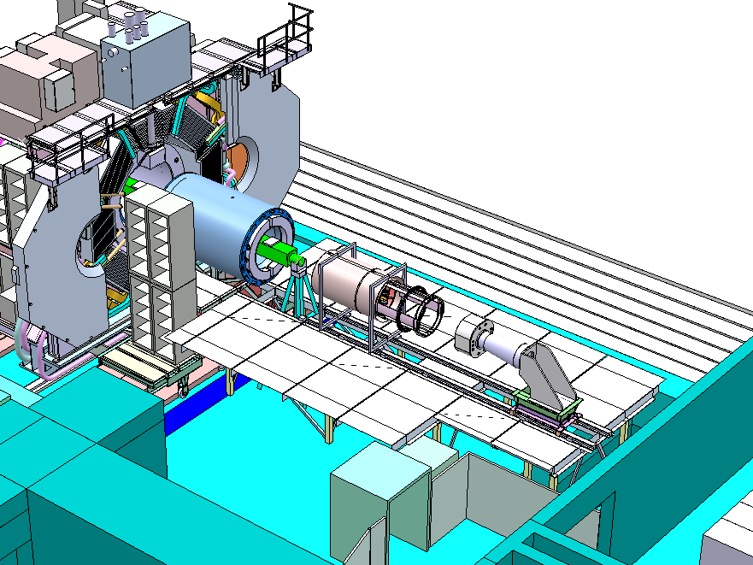
Platform for Mounting Detectors from Upstream Side
barrel-EMC
STT & MVD
BE-EMC
10 m
5.8 m
4.4 m

