Slide 1
Update of MVD services and requests
DCDC circuits
Optoelectronic (GBTx + VTRX) boards
Cooling plant
Services on platform in front of the magnet
Daniela Calvo
MVD group

Slide 2
MVD services - DCDC circuits

Slide 3
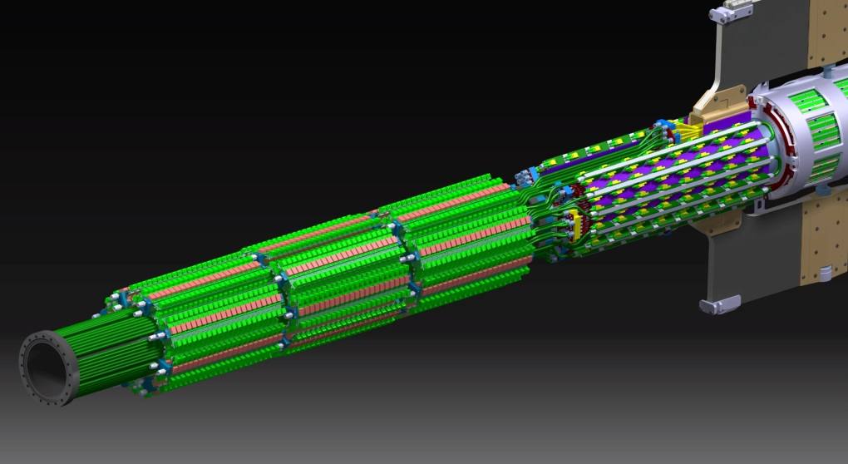
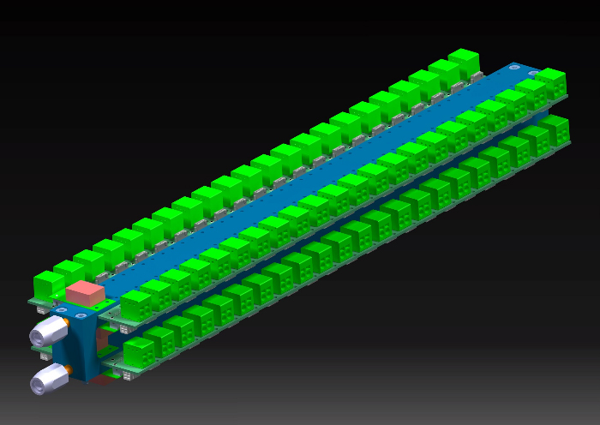
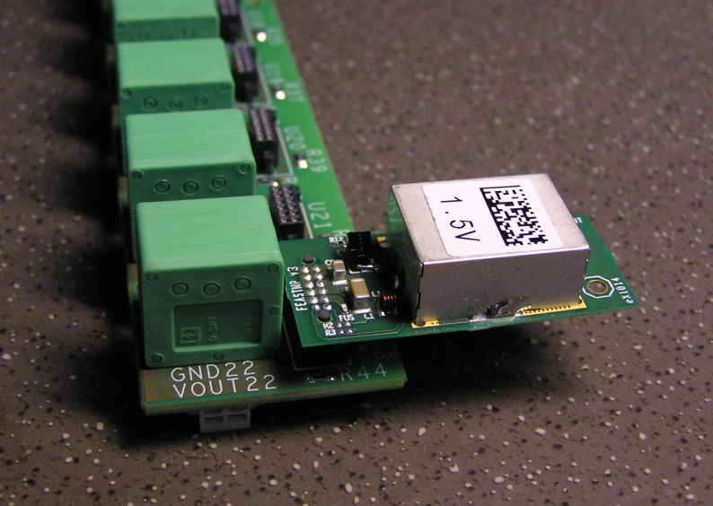
MVD service - DCDC circuits
24 blocks arranged in 3 sectors
(2112 DCDC circuits)
4 PCBs (left and right difference)
housing 22 DCDC circuits each

Slide 4
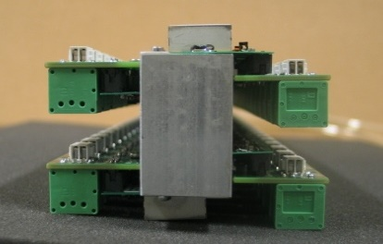
MVD services – first prototype
88 DCDC circuits (22 DCDC circuits each row)
Weight (without cables): ~ 1.3 Kg
Dimension (without cables):
455 mm (with cooling connectors) x 85 mm x 63 mm

Slide 5
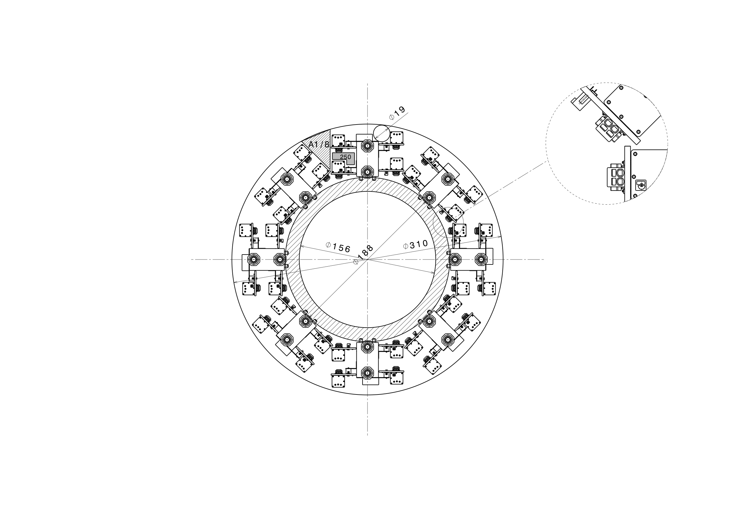
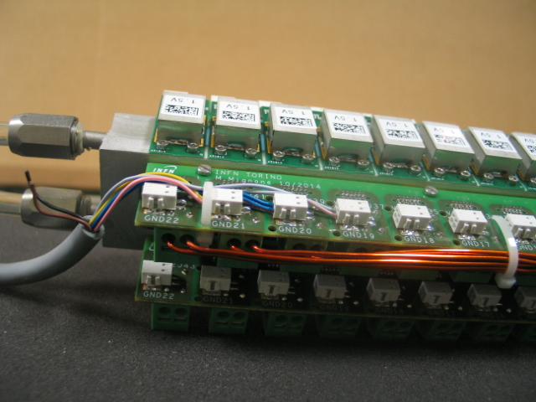
MVD services - Request
Available cross section: 56000 mm2
(between beam pipe and inner BEMC diameter)
Cooling pipes and supports: 9000 mm2
(dashed ring – challenge solution!)
DCDC circuits leave only ~ half of cross section for cables (needed cross section: 22300 mm2) and they will fill the empty parts between the circuits anyway.
(not reccommended!)
ONLY HALF of the needed CROSS SECTION is AVAILABLE for cables
IT IS NECESSARY MORE SPACE around the beam pipe for the MVD

Slide 6
MVD services – Optoelectronic boards

Slide 7
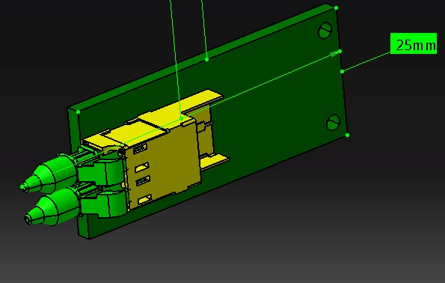
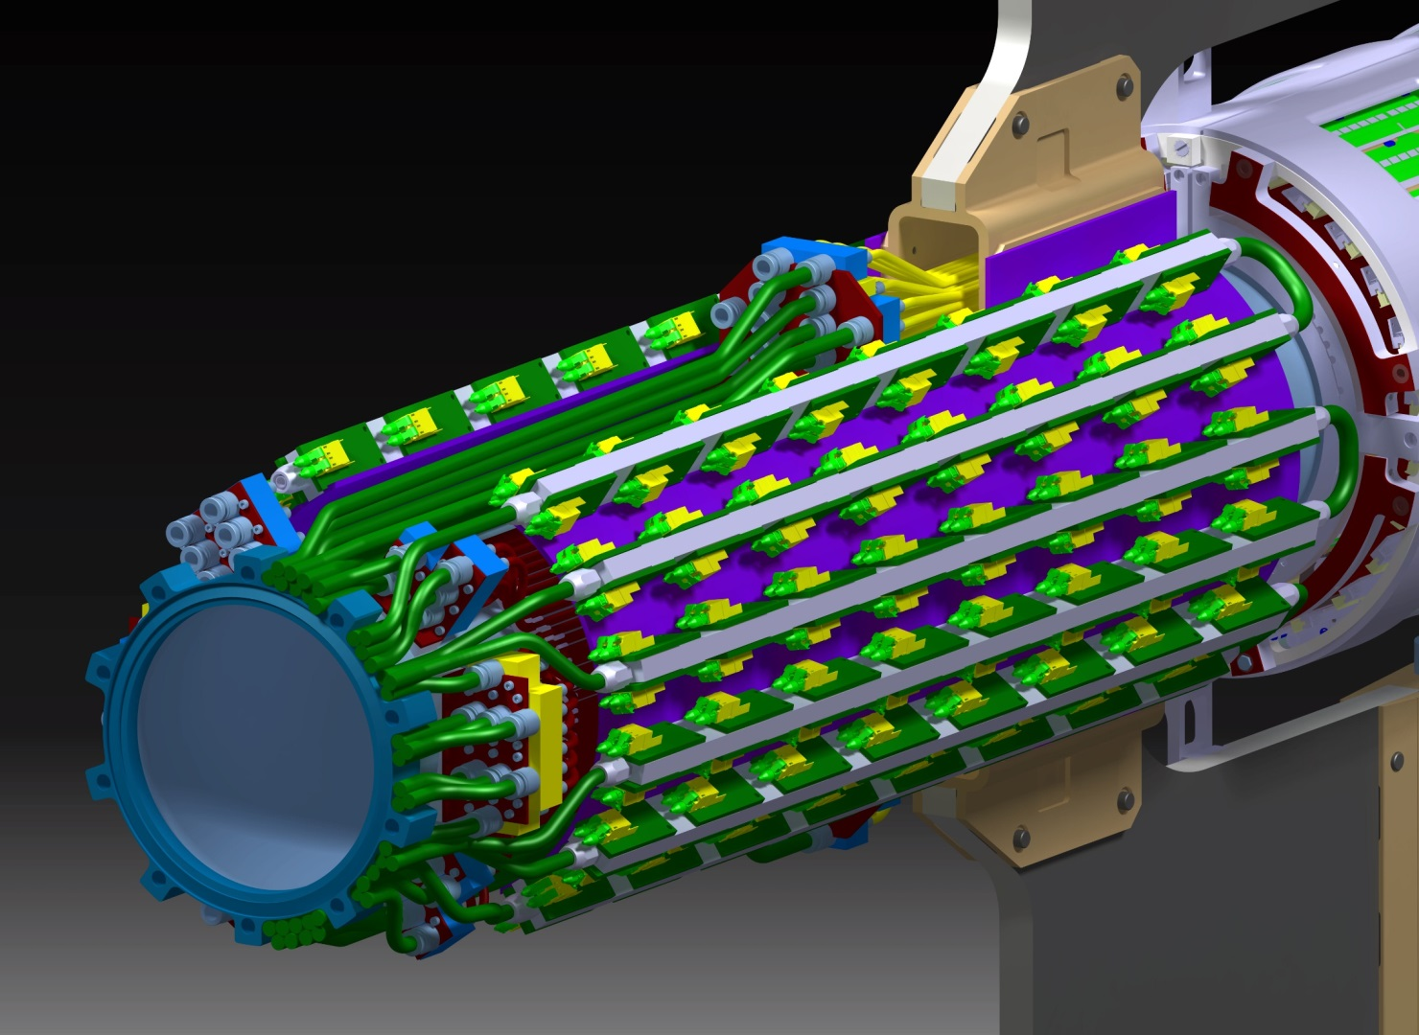
Optoelectronics board, old version
76 mm
60 mm
12 bars with 16 GBT boards each
(192 circuits)
Interspace between PCBs: 20 mm

Slide 8
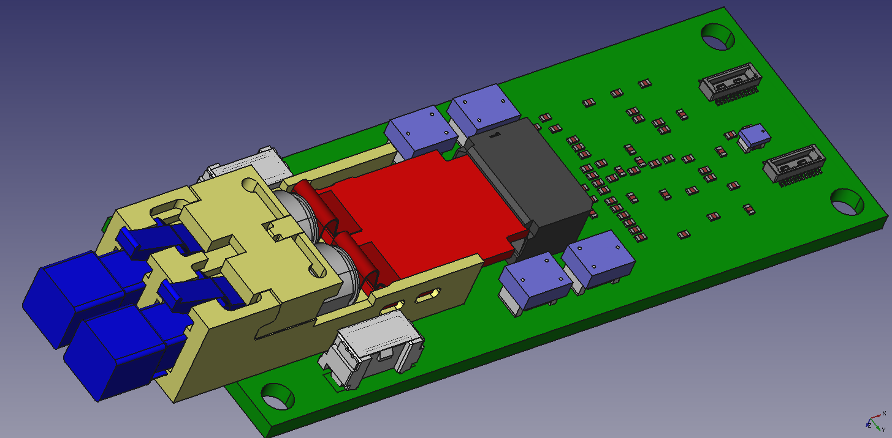
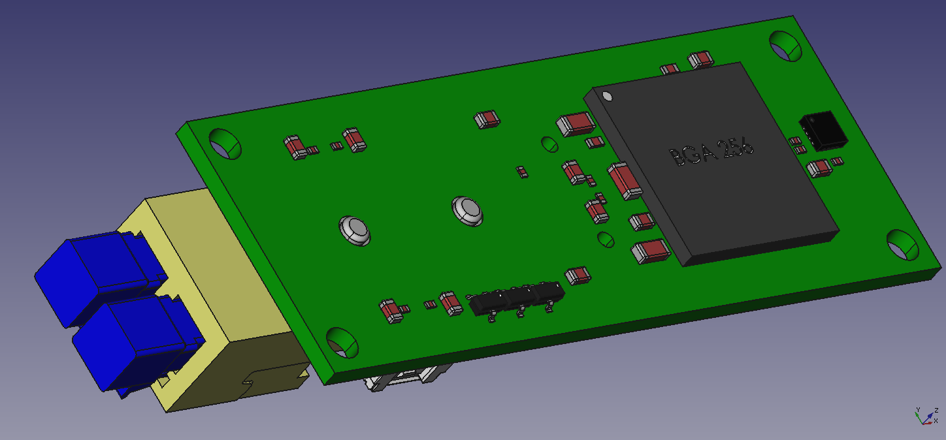
Optoelectronic board, new version – GBTx + VTRX
86 mm
25.4 mm
GBTx and VTRX on opposite sides, then 4.8 Gbit/s signals routed using vias
Two power supply connectors to fit the routing of the power supply cables, in fact two mounting configuration of the boards are foreseen.
Additional chip to distribute the SC out signal to the two connectors towards the FEE.
The cooling of the GBTx in this configuration should be easier (to be verified!).
The board dimension is larger than the estimated values ( 3 years ago) anyway.
15.5 mm

Slide 9
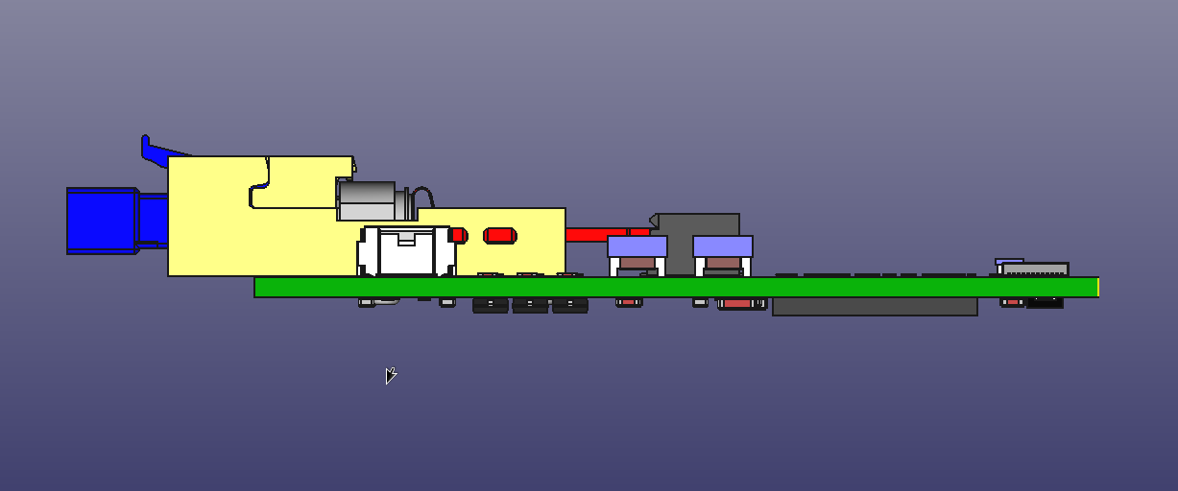
Opto. board, new version – board routing
Signal cable
16,5 mm
20 mm
Thermal bridge (copper)
Interference between optical fiber connectors and signal cables !!

Slide 10
Opto. board, new version – board number
86 mm
25.4 mm
Each connector includes : 5 e-links + SC signal
22 additional boards
to maintain the symmetry left– right during the routing of the semi disks and semi cylinders of the barrel part
to be able to send the SC signal to each pixel or strip module without connection between different modules
It is necessary to increase the GBT board number from 192 to 214.
It means 2 additional optoelectronic boards each bar, one each side

Slide 11
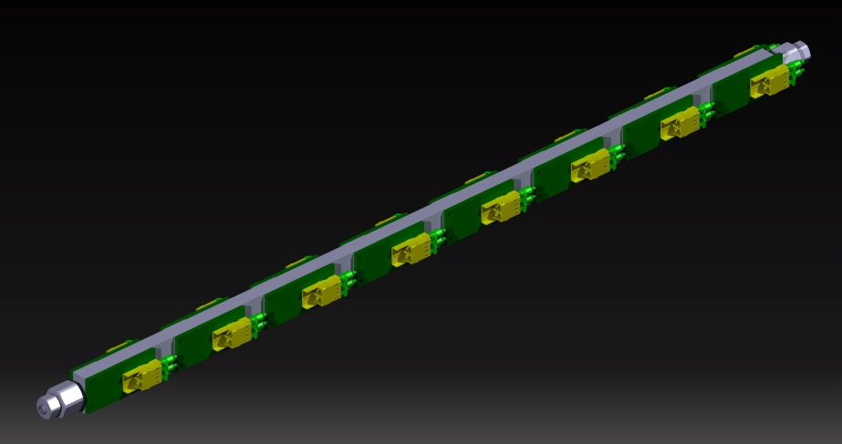
Requests
Additional 80 mm to arrange the 192 longer optoelectronics boards
Additional 86 mm to arrange an additional board along the rod
Additional 120 mm to avoid interference between optical fibers and signal cables
Interdistance:
15 mm longer
Possible solution ?: to shift upstream the beam pipe flange
A DCDC block (or partial block) has to be cut out, anyway!
IT IS NECESSARY MORE SPACE around the beam pipe for the MVD

Slide 12
MVD services – Cooling plant

Slide 13
Cooling plant ouside the pit
INLET RACKS (PIXEL, STRIP, SERVICES)
PLC

Slide 14
Cooling plant inside the pit
RETURN RACKS (PIXEL, STRIP, SERVICES)
INLET PUMP + WATER CLEANING UTIT
TANK+ VACUUM PUMP

Slide 15
Cooling plant - line paths inside PANDA Hall
RETURN LINES
INLET LINES

Slide 16
MVD services in front of the magnet

Slide 17
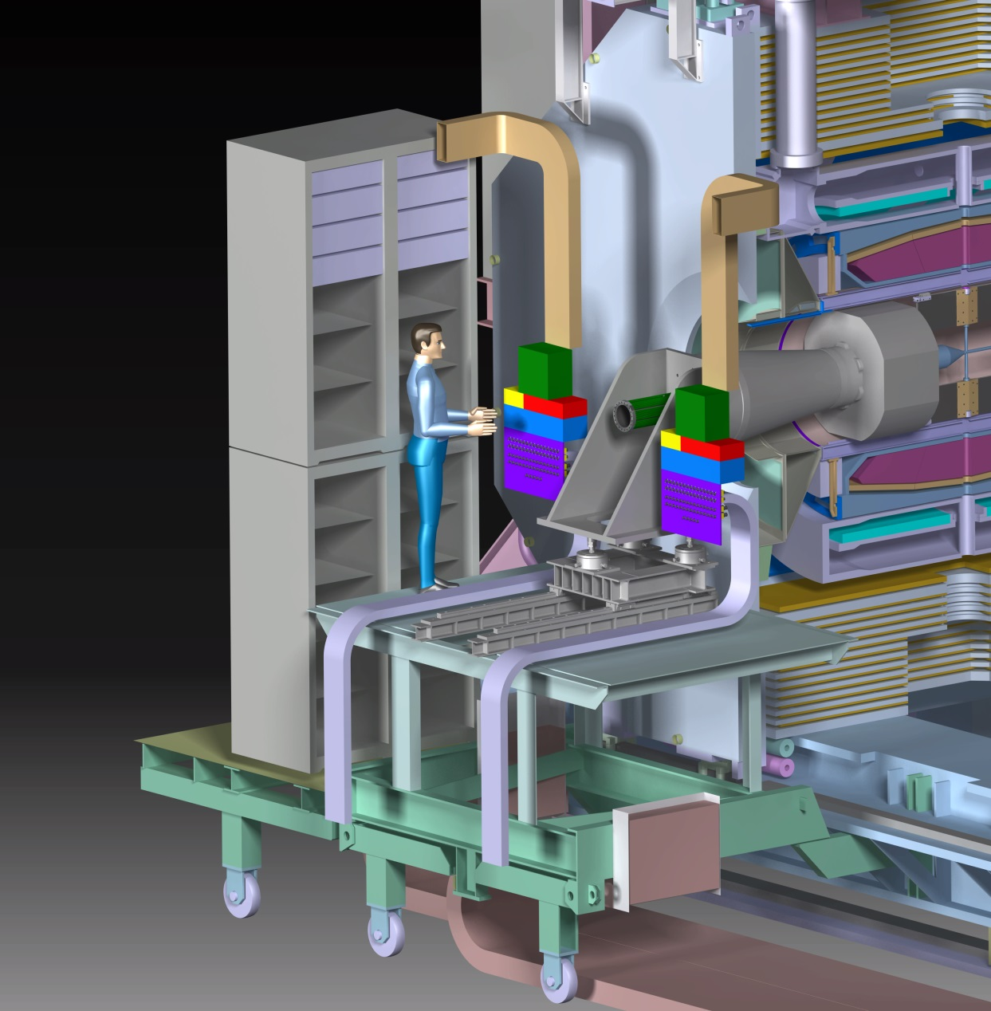
Racks - request
Use the racks starting from the top (222 U – 50% left and 50% right).
The reduction to 188 U is still under investigation.
MVD
MVD

Slide 18
Patch panels for cables - request
Patch panels
for MVD cables
Patch panels for MVD cables positioned close the BEMC support (left and right) with duct to route cables from racks.
A specific system could move and rotate the duct for positioning the patch panels at the external side of the racks, during the installation of detectors.
The system could be positioned on the top of the racks

Slide 19
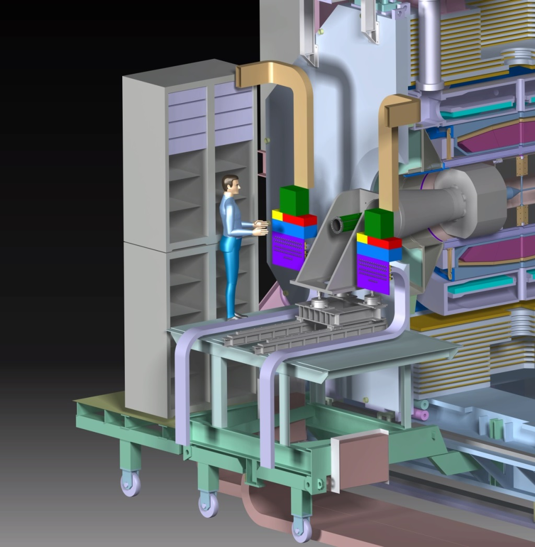
Routing of the cooling pipes and patch panel - request
The duct for the cooling pipes to the patch panels needs to be positioned under the platform floor
It should be a solution to foresee also the patch panel (for the cooling part) under the platform during the detectors installation. A system could move and rotate the patch panel to the final position, near the BEMC support. But it is necessary to go trough the platform floor.
Patch panel
Duct - cooling pipes
platform
Vertical section
platform

