Slide 1
Rare Isotopes and the SuperFRS
H. Simon
Notes:
In-Flight → energies as high as 1500 MeV/u

Slide 2
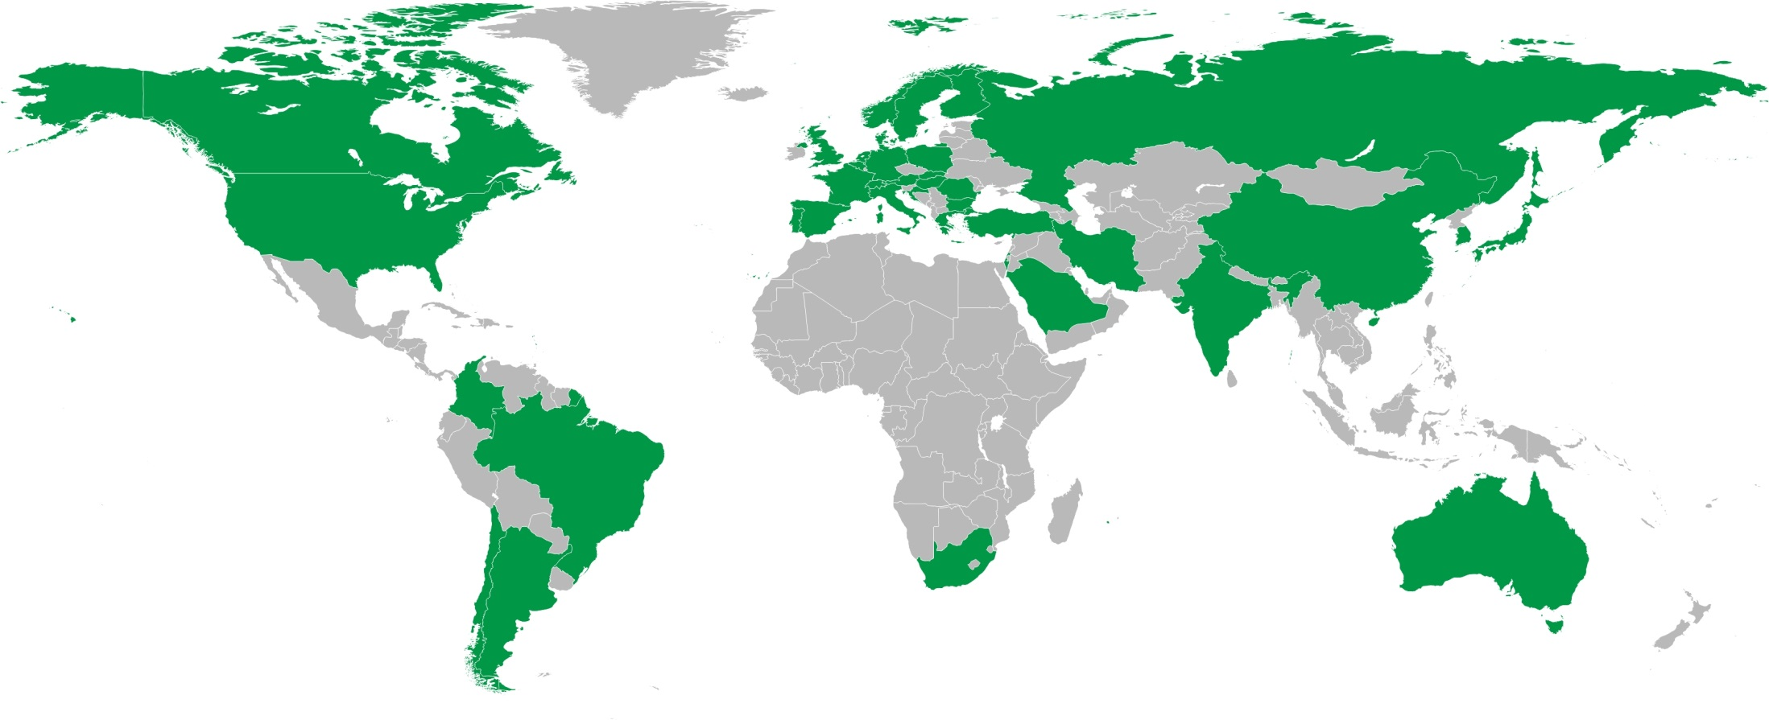
NUSTAR Collaboration
>800 registered NUSTAR members
39 countries
>180 institutes

Slide 3
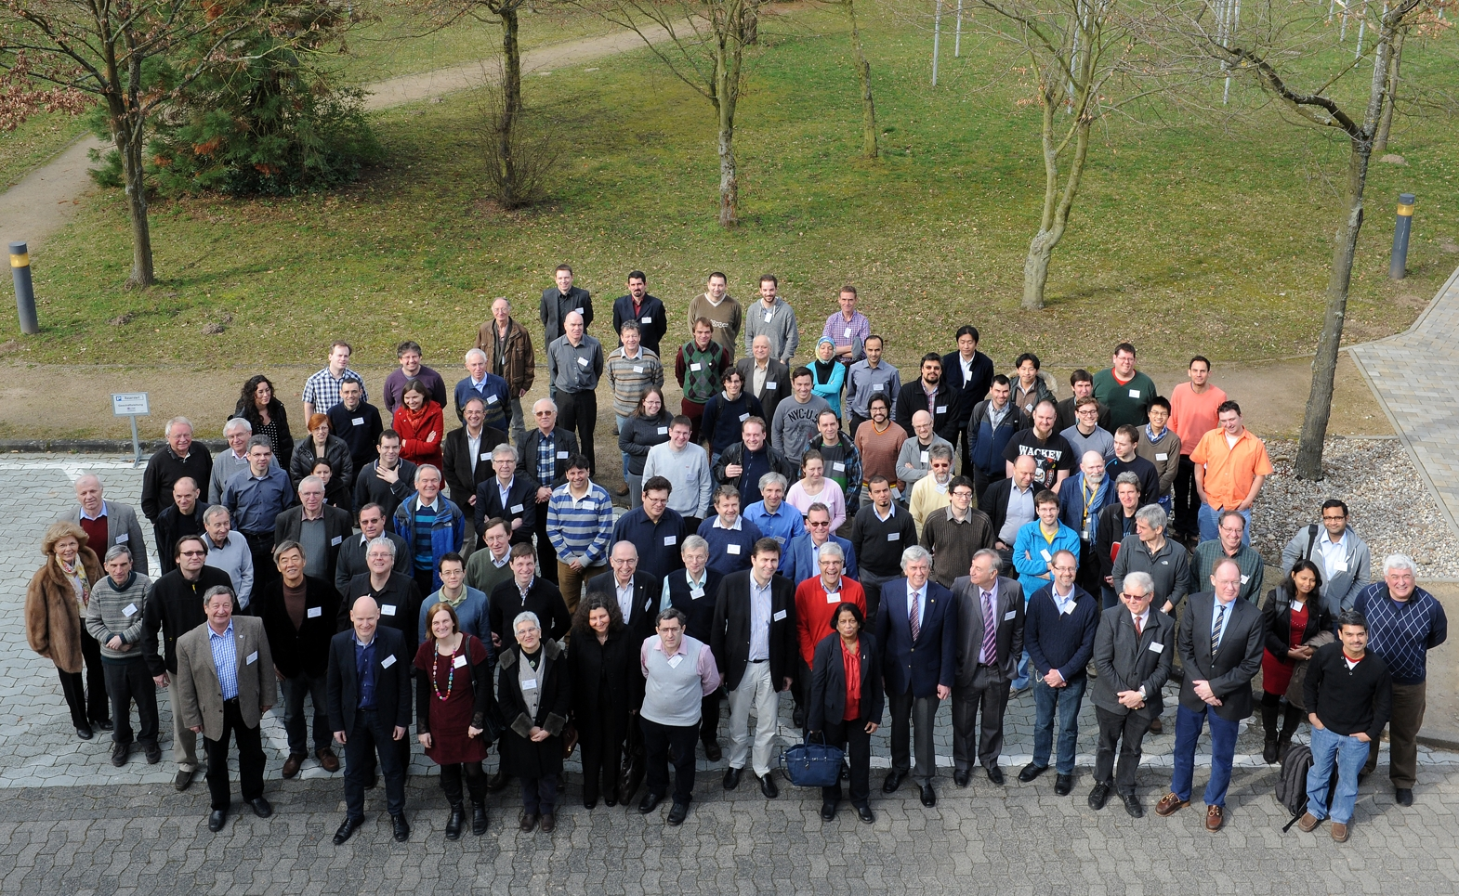
NUSTAR Week GSI March 2014
Notes:
3

Slide 4
Definition of NUSTAR experiment phases
Phase 0 ( 2017- )
  R&D and experiments to be carried out with present facilities and FAIR/NUSTAR equipment
Phase 1 ( 2022 - )
  Core detectors and subsystems completed
  First measurements with FAIR/Super-FRS beams
    Carry out experiments with highest visibility as part of the core program and within the FAIR MSV
Phase 2
  FAIR evolving towards full power
  Completion of experiments within MSV
    Essentially the full program of MSV can be performed
Phase 3
  Moderate projects, which have been initiated on the way (outside MSV) can be included (e.g. experiments related to return line for rings)
Phase 4
  Major new investments and upgrades for all experiments

Slide 5
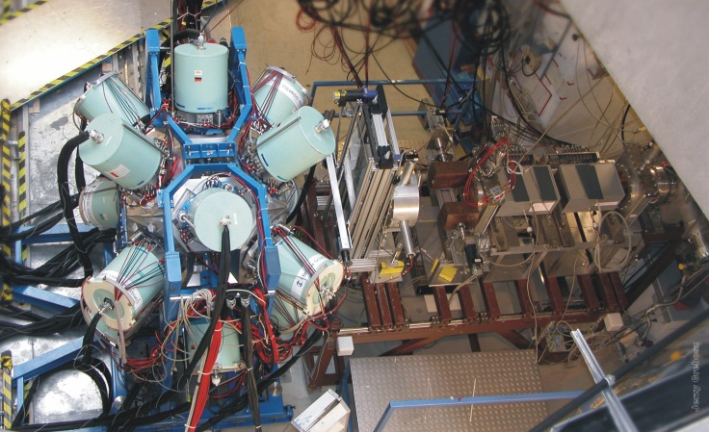
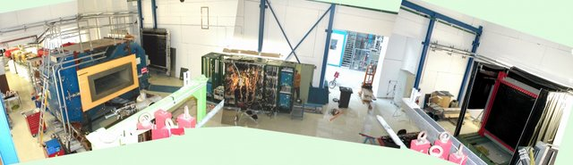
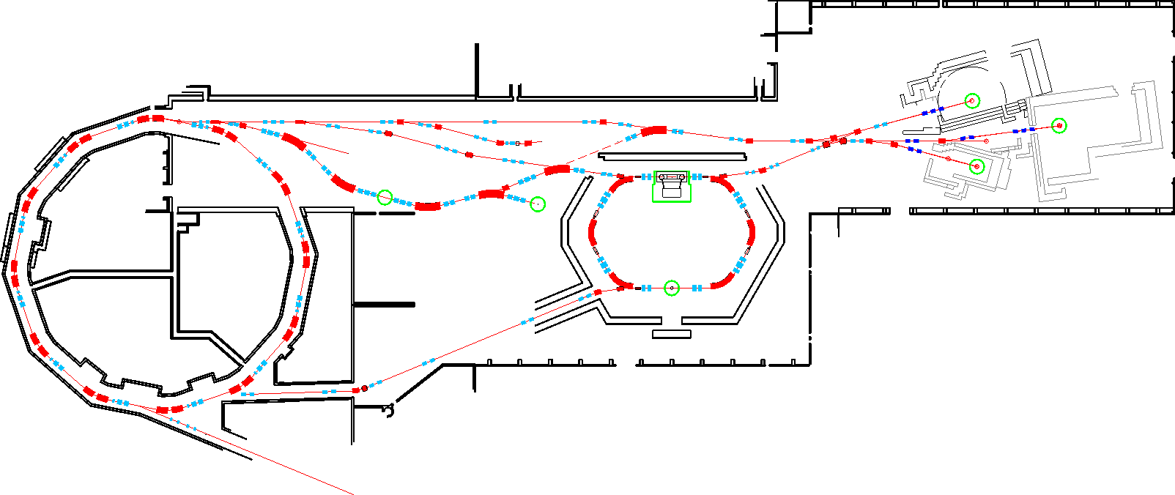
Current FRS and its 3 branches
Decay studies,
In-beam spectroscopy
Reaction studies
production and separation of exotic nuclei
LAND-R3B
FRS
RISING - PRESPEC
ESR
SIS
Ground state properties
inverse reactions

Slide 6
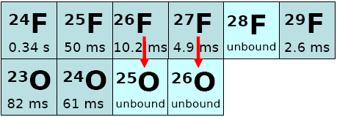
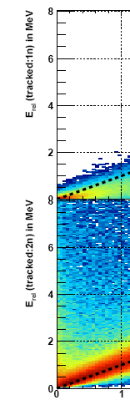

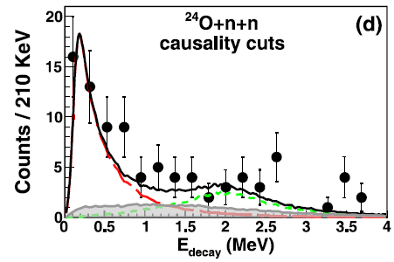
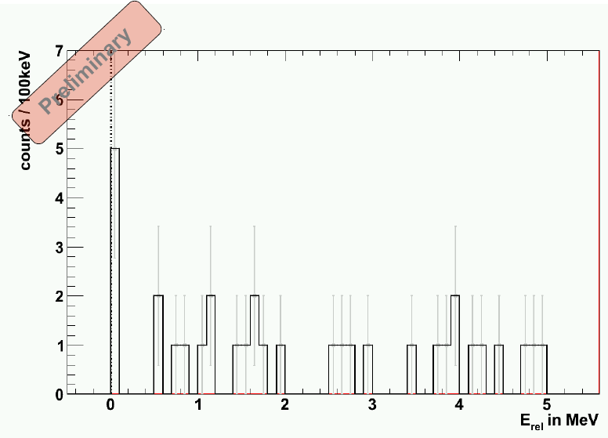
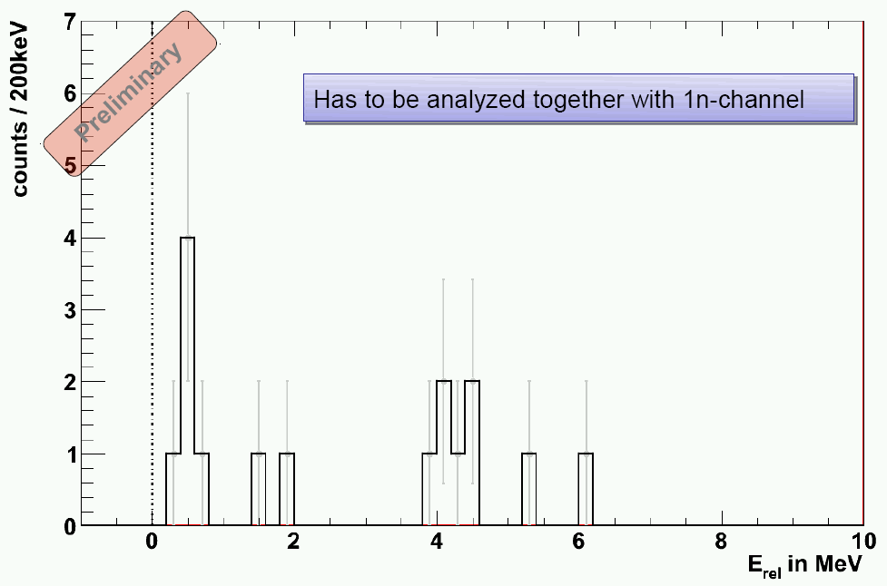
High intesities are of key importance! e.g. Current frontier: ²⁶O
Low energy
response
Beam intensity
3 ⋅10¹⁰ ⁴⁰Ar/spill
➔ ~ 0.1 ²⁷F/s
2) Multi neutron
detection and
acceptance.
MSU
E_{r}=150⁺⁵⁰₋₁₅₀keV
Γ= 5 keV
E. Lunderberg et al.
PRL108(2012)
142503
2n → 2n 2n→1n (MeV)
²⁷F→²⁴O+n+x
²⁷F→²⁴O+2n
E_{rel} (MeV)
Thesis: C.Cäsar 2012
TUDa/GSI

Slide 7
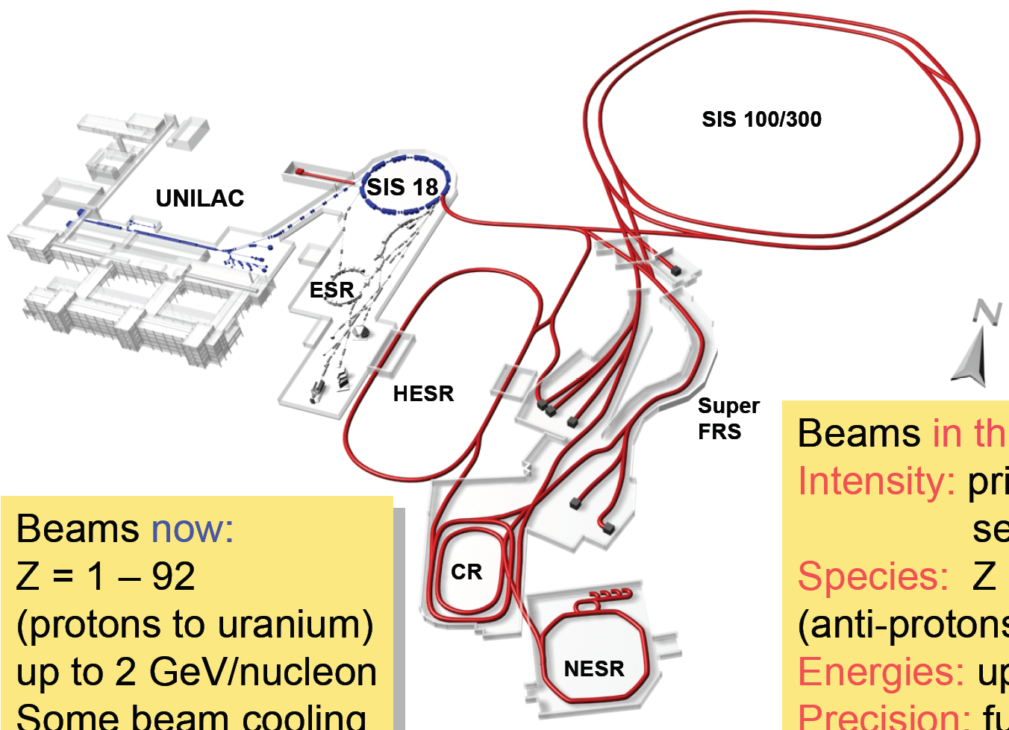

FAIR baseline: novel opportunities
Primary Beams
3 x10¹¹/s; 1.5-2 GeV/u; ²³⁸U²⁸⁺
Factor 100-1000
over present in intensity
Rare Isotope Beams
Broad range of
radioactive beams up to 1.5 - 2 GeV/u;
up to factor 10 000 in
intensity over present

Slide 8
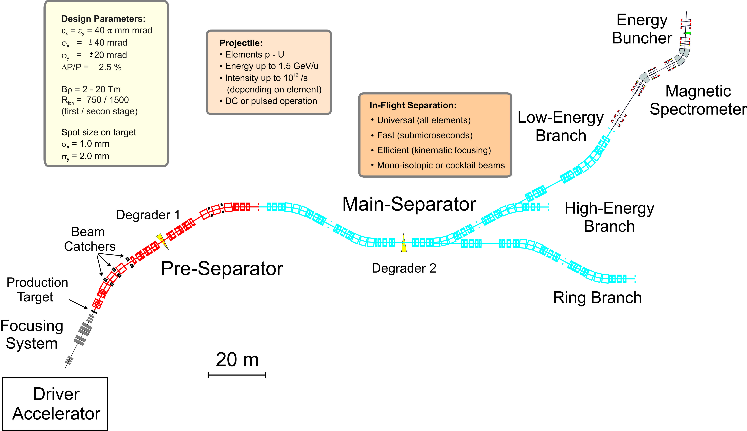
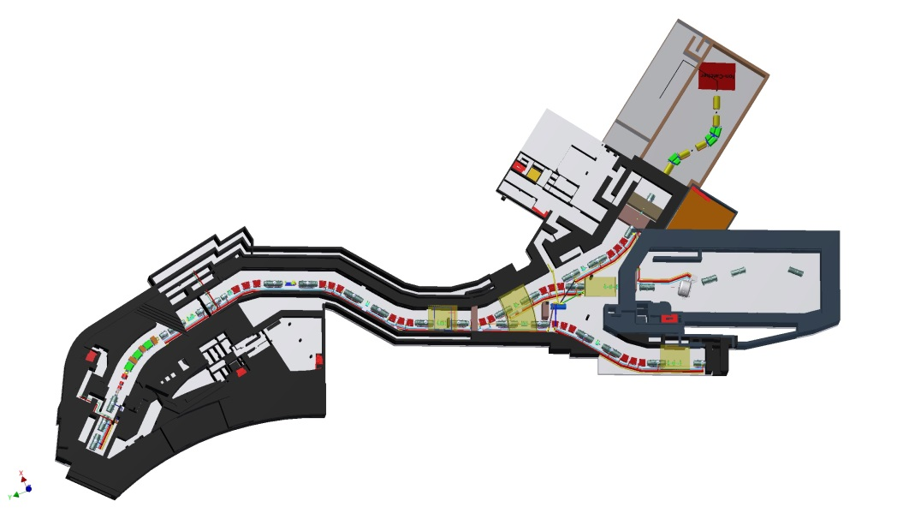
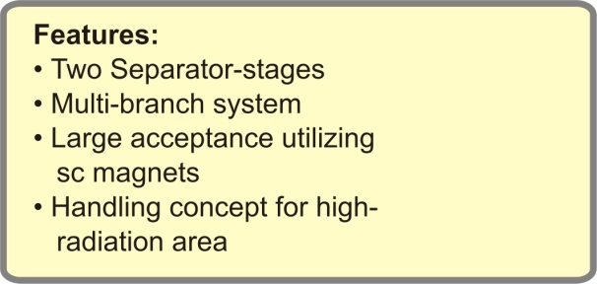
Layout of the Super-FRS (Full Version)
- again 3 branches
±

Slide 9
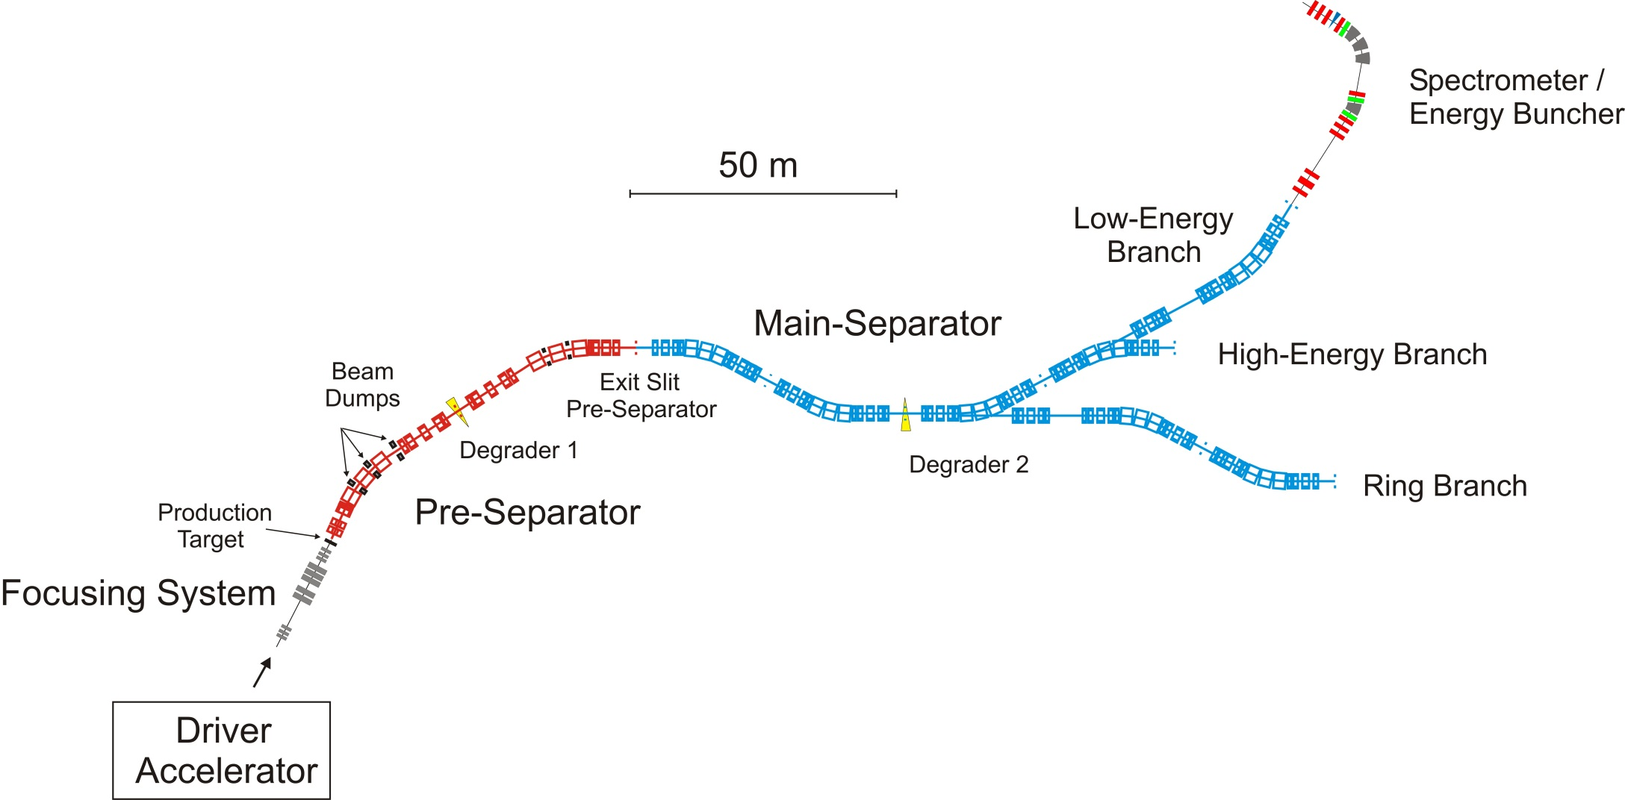
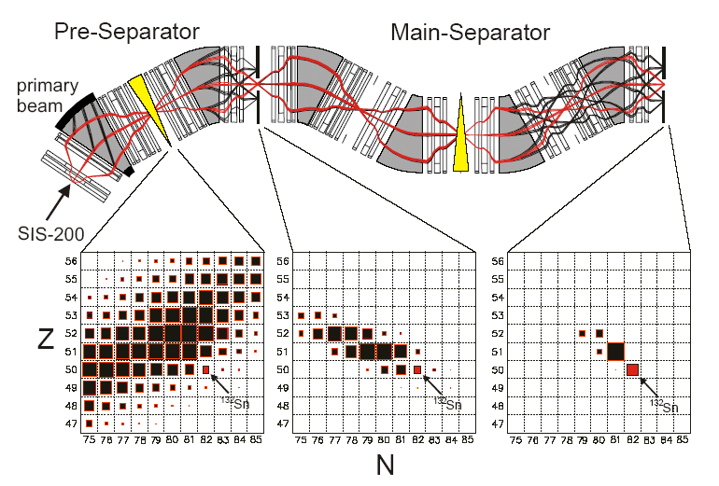
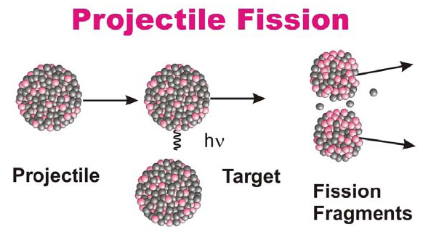
Superconducting FRagment Separator
Transmission
Apertures (~400mm) fully illuminated
Resolution requirement ~ 10⁻³
achromatic system limited by matter !
3 10¹¹/s
~50 kHz
9
Notes:
9

Slide 10

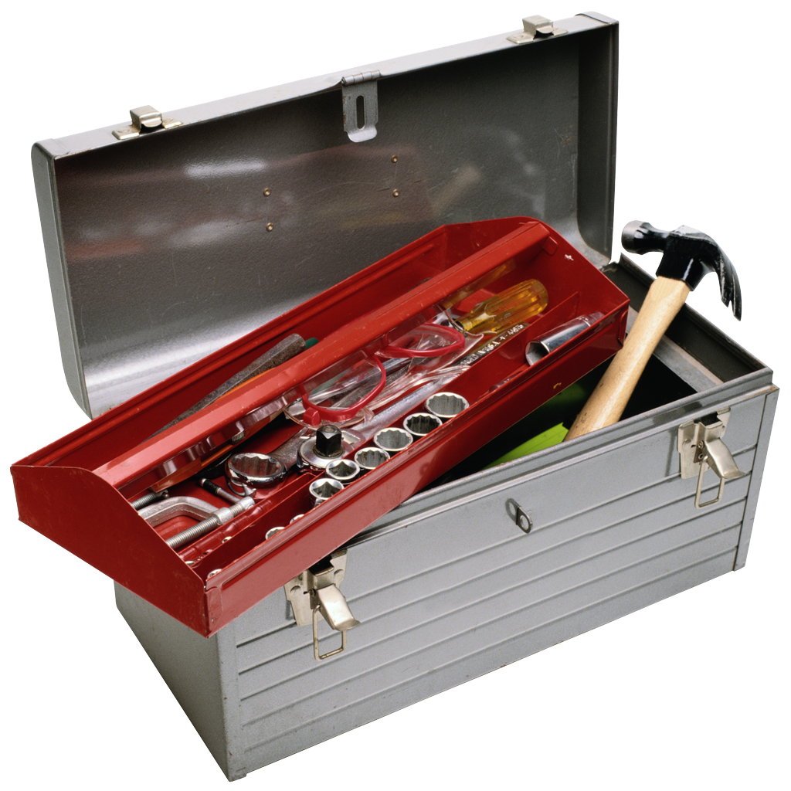
NUSTAR experiments
Super-FRS | RIB production and identification
DESPEC | γ-, β-, α-, p-, n-decay spectroscopy
HISPEC | in-beam γ spectroscopy at low/intermediate energy
ILIMA | masses and lifetimes of nuclei in ground and isomeric states
LASPEC | Laser spectroscopy
MATS | in-trap mass measurements and decay studies
R³B | kinematically complete reactions at high beam energy
ELISE | elastic, inelastic, and quasi-free e—A scattering
EXL | light-ion scattering reactions in inverse kinematics
Super-FRS physics | high-resolution spectrometer experiment
Superheavy elements | synthesis, nuclear structure, atomic physics, chemistry experiments with elements Z ≥ 104
The Approach
Complementary measurements leading to consistent answers
10
Notes:
10

Slide 11
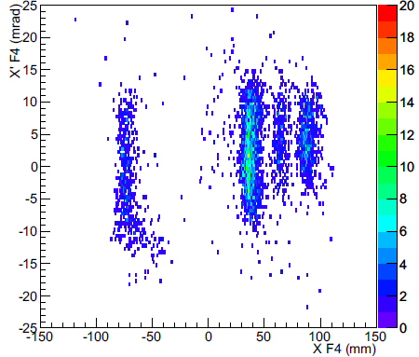
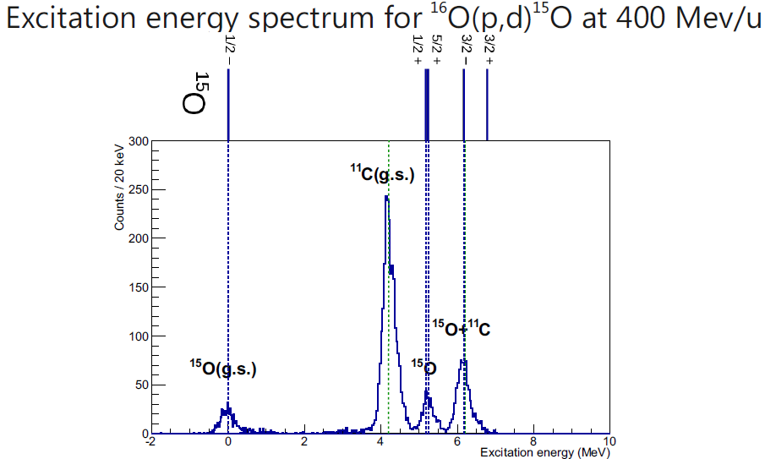
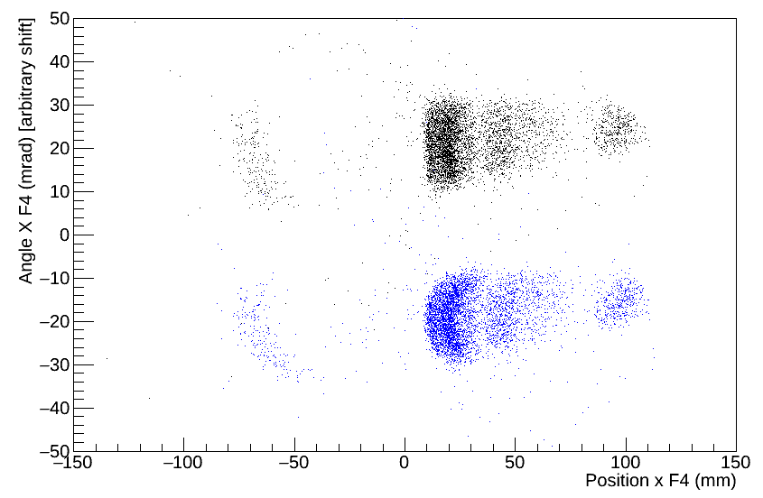
High Resolution Spectrometer
- recent example
Example from recent FRS experiment:
correct aberrations by sextupoles and tracking
σ_{Ε} = 200 keV @ 200 MeV/u
R ~ 2000 (via tracking)
Problems at higher energies (intensities)
and with heavier nuclei
track.
corr.
raw

Slide 12
The Super-FRS Experiments physics cases
Rare isotope search experiments (Pietri, Jokinen, Plaß et al.)
Atomic collision experiments (Purushothaman, Geissel et al.)
Mesonic atoms and in-medium effects (Itahashi, Weick et al.)
Exotic hypernuclei and their properties (Saito, Nociforo et al.)
Exploration of tensor force (Ong,Terashima, Toki, et al.)
Delta resonances probing nuclear structure (Benlliure, Lenske et al.)
Nuclear radii and momentum distributions (Kanungo, Prochazka et al.)
Exotic radioactivity modes (Fomichev, Pfützner, Mukha et al.)
Low-q experiments with Active Target (Egelhof et al.)
Low energy reactions (Heinz, Winfield et al.)

Slide 13
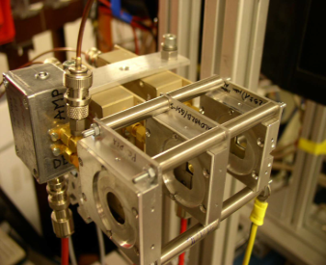
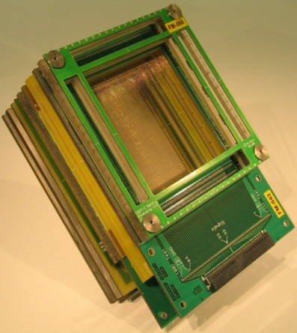
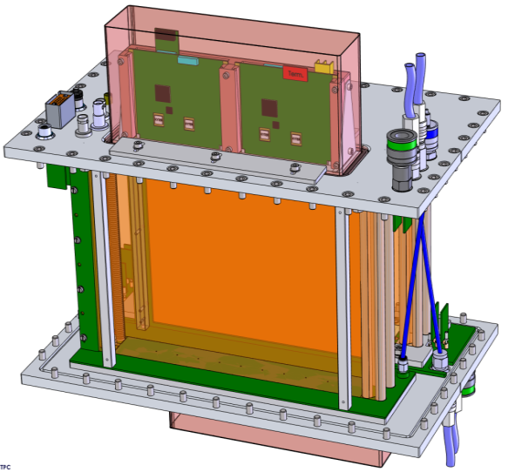
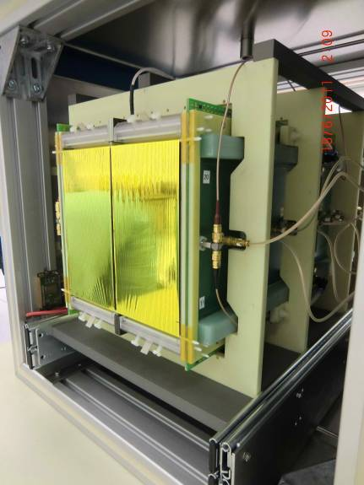
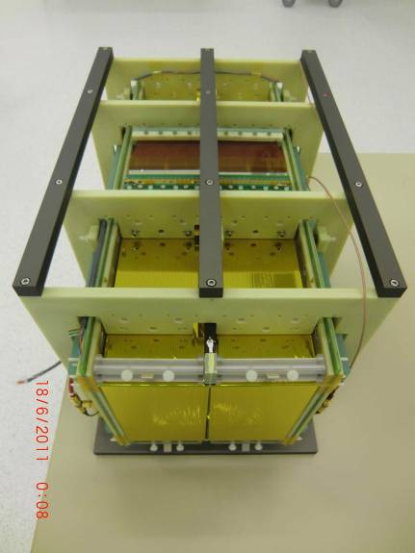
Tracking capabilities (possible corrections)
Detectors for
  beam diagnostics & particle identification
  fast & slow extracted beams
Resolutions required
  Position σ_{x,y}~ 1 mm
  Timing σ_{t} ~ 50 ps
  Energy loss σ_{ΔE}~ 1..2%
Major challenges
  Radiation hardness (diagnostics on target & machine safety)
  Particle rates 1/day ...10⁹/s (main-separator)
  Typ. 1-10 MHz
  Dynamic range H...U, 100...1500 MeV/u
So tracking needs to be optimized
vs. optical resolution

Slide 14
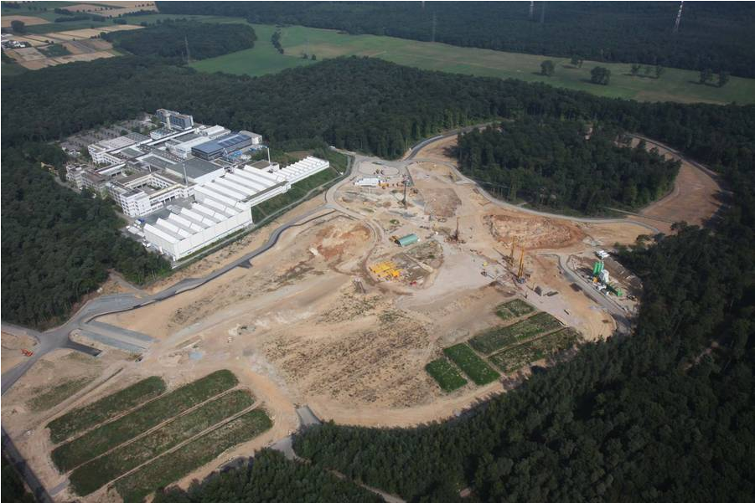
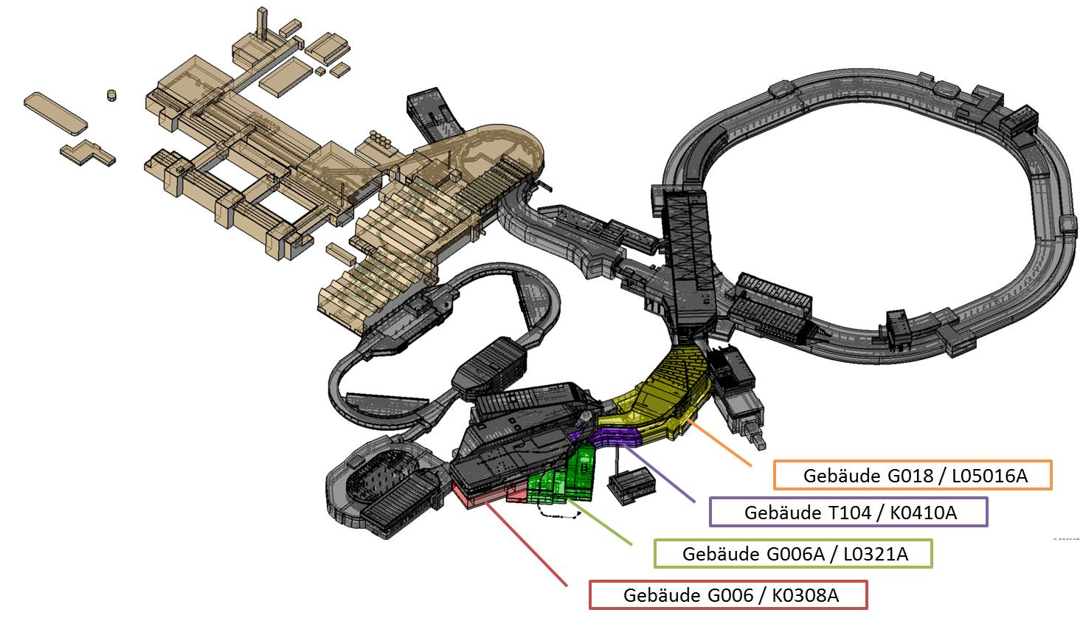
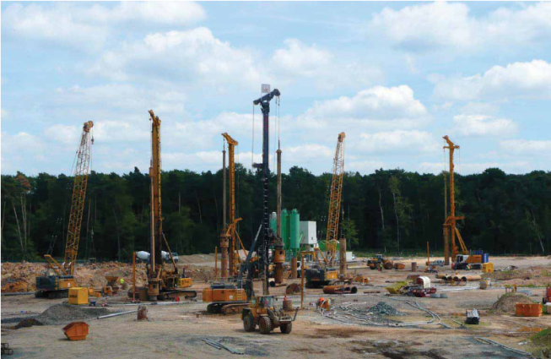
Stepping stone towards the facility
Super-FRS

